Slide 1
Section 2.R.1
The Real Number Line and Absolute Value

Slide 2
Objectives
Graph real numbers on a number line.
Identify types of numbers.
Recognize the inequality symbols and use them to
compare real numbers.
Find the absolute value of a real number.

Slide 3
Notes: Number Lines
The negative sign
indicates the opposite of a
number as well as a negative number. It is also used, as we will see in Section 8.3, to indicate subtraction. (Note on your calculator, the subtraction key on the right side and the negative key
at the bottom of the key pad.)

Slide 4
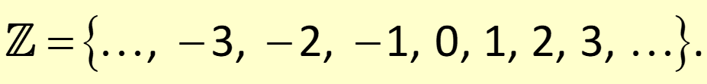
Definitions: Integers
The set of numbers consisting of the whole numbers and their opposites is called the set of integers:

Slide 5
Example 1: Finding the Opposite of an Integer
Find the opposite of each integer.
a. +7
b. −4
Solution
a. −7.
b. −(−4) or +4 in words, the opposite of −4 is +4.

Slide 6

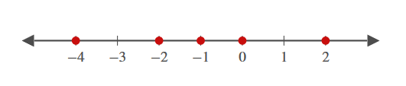
Example 2: Graphing Integers on a Number Line
Graph each set of integers.
Solution
a.
b.

Slide 7
Definitions: Variables
A variable is a symbol (generally a letter of the alphabet) that is used to represent an unknown number or any one of several numbers.

Slide 8
Definitions: Rational Numbers
A rational number is a number that can be written in the form of
where a and b are integers and b ≠ 0.
(≠ is read “is not equal to”).
OR
A rational number is a number that can be written in decimal form as a terminating decimal or as an infinite repeating decimal.

Slide 9
Example 3: Identifying Types of Numbers
List the numbers in the set
that are:
whole numbers
Integers
rational numbers
real numbers
Solution
0 and 17 are whole numbers.
−5, 0, and 17 are integers.
All numbers in S are real numbers.

Slide 10
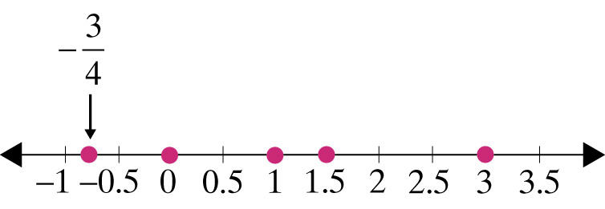
Example 4: Graphing Sets of Numbers
Graph the set of real numbers
Solution

Slide 11

Example 5: Graphing Sets of Numbers
Graph all natural numbers less than or equal to 3.
Solution
Remember that the natural numbers are

Slide 12
Notes: Inequality Symbols
Each symbol can be read from left to right as is indicated in “Symbols of Equality and Inequality.” However, each symbol can also be read from right to left. Thus, any inequality can be read in two ways. For example, 6 < 10 can be read from left to right as “6 is less than 10,” but also from right to left as “10 is greater than 6.”. We will see that this flexibility is particularly useful when reading expressions with variables in Section 9.7.

Slide 13
Symbols of Equality and Inequality
Reading from left to right:
= is equal to ≠ is not equal to
< is less than > is greater than
≤ is less than or equal to ≥ is greater than or equal to

Slide 14
Example 6: Verifying Inequalities₁
Determine whether each statement is true or false.
a. 7 < 15
b. 3 > −1
d. 2.7 ≥ 2.7
e. −5 > −6
Solution:
a. 7 < 15 is true, since 7 is less than 15. 7 is to the left
of 15 on the number line.

Slide 15
Example 6: Verifying Inequalities₂
b. 3 > −1 is true, since 3 is greater than −1. 3 is to the right of −1 on the number line.
is true, since
is less than
is to
on the number line. (Reminder, to
the left of
compare two fractions find equivalent fractions
using the LCD as the denominator. Then, compare
the numerators.)
d. 2.7 ≥ 2.7 is true, since 2.7 is equal to 2.7.
e. −5 > −6 is true, since −5 is greater than −6.

Slide 16
Notes: Inequality Symbols₂
7 < 15 can be read as “7 is less than 15” or as “15 is greater than 7.”
3 > −1 can be read as “3 is greater than −1” or as “−1 is less than 3.”

Slide 17
Properties: Absolute Value
The absolute value of a real number is its distance from 0 on a number line. Note that the absolute value of a real number is never negative.

Slide 18
Example 7: Finding Absolute Values₁
Simplify each absolute value expression.
Solution
The number 6.3 is 6.3 units from 0.
The number −5.1 is 5.1 units from 0.

Slide 19
Example 7: Finding Absolute Values₂
The opposite of the absolute value of −2.9.

Slide 20
Example 8: Verifying Absolute Value Inequalities
True or false:
Solution
True, since

Slide 21
Example 9: Solving Absolute Value Equations
If
what are the possible values for x?
Solution
x = 7 or x = −7

Slide 22
Example 10: Solving Absolute Value Equations
If
what are the possible values for x?
Solution
There are no values of x for which
The absolute value can never be negative. There is no solution.

Slide 23
Example 11: Application: Solving Absolute Value Equations₁
During the manufacturing of machine parts, certain measurements of the part must stay within a tolerance range or the part will be defective. The quality control manager determines that the maximum amount the length of a screw can vary from its targeted length of 12 millimeters and not be defective is 2 millimeters. If x represents the maximum acceptable difference in length from the target, either positive or negative, then
What are the maximum amounts that the screw
length can vary from its target?

Slide 24
Example 11: Application: Solving Absolute
Value Equations₂
Solution
To find the maximum the screw length can vary from
its target, solve the equation
millimeters. This gives the following two values for x: x = −2 millimeters and x = 2 millimeters.
Thus, the maximum amounts that the screw length can vary are −2 millimeters and 2 millimeters.

