Slide 1
Section 1.R.5
Decimals, Fractions, and Percents

Slide 2
Objectives
Understand percents.
Change decimal numbers to percents.
Change percents to decimal numbers.
Change fractions to percents.
Change percents to fractions.
Notes:
2

Slide 3
Example 1: Changing Fractions with Denominators of 100 to Percents₁
Change each fraction to a percent.

Slide 4
Example 1: Changing Fractions with Denominators of 100 to Percents₂

Slide 5
Procedure: To Change a Decimal Number to a Percent
Move the decimal point two places to the right.
Write the % sign.

Slide 6
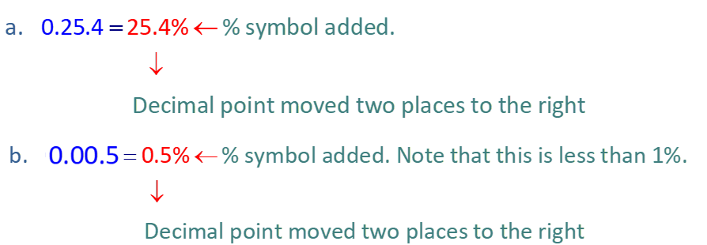
Example 2: Changing Decimal Numbers to Percents₁
Change each decimal number to percent.
Solution

Slide 7
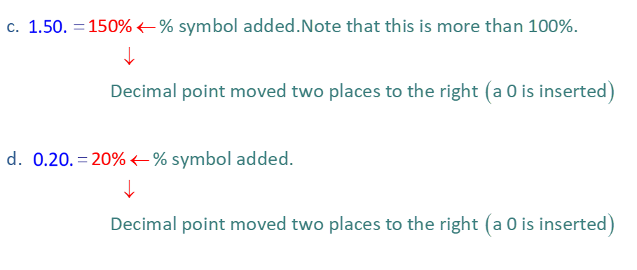
Example 2: Changing Decimal Numbers to Percents₂

Slide 8
Procedure: To Change a Percent to a Decimal Number
Move the decimal point two places to the left.
Delete the % sign.

Slide 9
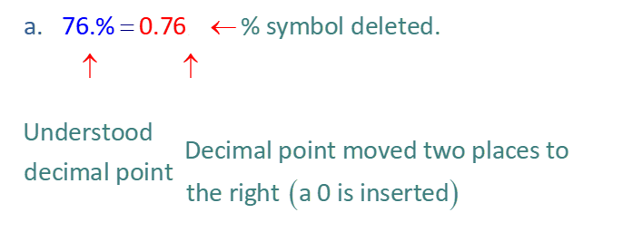
Example 3: Changing Percents to Decimal Numbers₁
Change each percent to a decimal number.

Slide 10
Example 3: Changing Percents to Decimal Numbers₂

Slide 11
Definition: Relationships Between Decimal Numbers and Percents
A decimal number that is
less than 0.01 is less than 1%.
between 0.01 and 0.10 is between 1% and 10%.
between 0.10 and 1.00 is between 10% and 100%.
more than 1 is more than 100%.

Slide 12
Procedure: To Change a Fraction to a Percent
Change the fraction to a decimal number.
(Divide the numerator by the denominator.)
Change the decimal number to a percent.

Slide 13
Example 4: Changing Fractions to Percents₁
to a percent.
Change
Solution
Note that 8 is not a factor of 100, so we divide using long division (or using a calculator).

Slide 14
Example 4: Changing Fractions to Percents₂
Now change 0.625 to a percent. Move the decimal point two places to the right
and write the % sign.

Slide 15
Example 5: Changing Fractions to Percents
Change
to a percent.
Solution
Divide:
Or, we can note that 20 is a factor of 100 and write

Slide 16
Example 6: Changing Mixed Numbers to Percents
Change
to a percent.
Solution
Change
to decimal form, then change the decimal
number to a percent as follows.

Slide 17
Example 7: Changing Mixed Numbers to Percents
Change
to a percent.
Solution
Since.
is larger than 1, the percent will be more than
100%.
Change
to decimal form, then change the decimal
number to a percent.

Slide 18
Example 8: Changing Fractions to Percents₁
Change
to a percent (rounded to the nearest tenth of
a percent).
Solution
Divide. To find the solution to the nearest tenth of a percent, we must round the decimal quotient to the nearest thousandth.

Slide 19
Example 8: Changing Fractions to Percents₂

Slide 20
Example 9: Application: Changing Fractions to Percents₁
During the years 1921 to 2012, the Los Angeles Dodgers baseball team played in 18 World Series Championships and won 6 of them. What percent of these championships did the Dodgers win (rounded to the nearest tenth of a percent)?
Solution
The percent won can be found by changing the fraction
to decimal form and then changing the
decimal number to a percent.

Slide 21
Example 9: Application: Changing Fractions to Percents₂
The Dodgers won 33.3% of these championships.

Slide 22
Procedure: To Change a Percent to a Fraction or a Mixed Number
Write the percent as a fraction with 100 as the denominator and delete the % sign.
Reduce the fraction, if possible.

Slide 23
Example 10: Changing Percents to Fractions
Change 60% to a fraction and reduce, if possible.
Solution

Slide 24
Example 11: Changing Percents to Mixed Numbers
Change 130% to a mixed number and reduce, if possible.
Solution

Slide 25
Caution: Common Misunderstanding Concerning Percents₁
The fractions
are often confused with the
percents
The differences can be clarified by using decimal numbers.

Slide 26
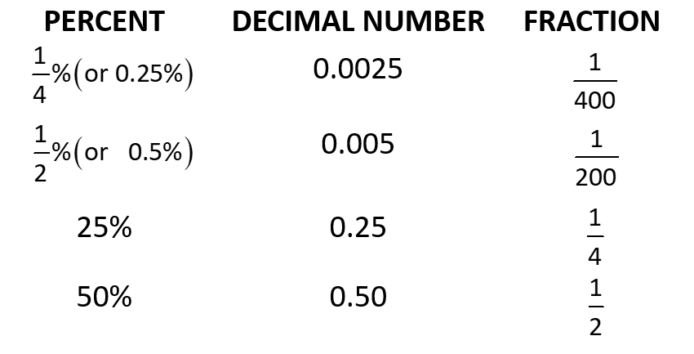
Caution: Common Misunderstanding Concerning Percents₂

Slide 27
Caution: Common Misunderstanding Concerning Percents₃
Thus
Similarly,

Slide 28
Caution : Common Misunderstanding Concerning Percents₄
You can think of
as being one-fourth of a dollar
(a quarter) and
as being one-fourth of a penny.
Similarly,
can be thought of as one-half of a dollar

Slide 29
Properties: Common Equivalent Percent, Decimal
Number, and Fraction Values₁

Slide 30
Properties: Changing Percents to Fractions₂

