Slide 1
Section 1.R.4
Preparing for a Final Math Exam

Slide 2
Objectives
Verify proportions.
Solve proportions.
Solve application problems using proportions.

Slide 3
Definition: Proportions
A proportion is a statement that two ratios are equal.
In symbols,
is a proportion.
A proportion is true if the cross products, a ⋅ d and
b ⋅ c, are equal.

Slide 4
Example 1: Verifying Proportions₁
Compare the cross products to determine whether each proportion is true or false.
Solution
Therefore the cross products are equal and the

Slide 5
Example 1: Verifying Proportions₂
Because the cross products are not equal (50 ≠ 56), the
proportion
is false.

Slide 6
Example 1: Verifying Proportions₃
c.
and
Because the cross products are equal, the proportion
is true.

Slide 7
Example 2: Verifying Proportions₁
Determine whether the given proportion is true or false. (Hint: Change each mixed number to an improper fraction.)

Slide 8
Example 2: Verifying Proportions₂
Solution
Because the cross products are equal, the proportion is true .

Slide 9
Procedure: To Solve a Proportion
Find the cross products (or cross multiply) and then set the cross products equal to each other.
Divide both sides of the equation by the number that multiplies the variable.
Simplify.

Slide 10
Example 3: Solving Proportions
Find the value of x if
Solution

Slide 11
Example 4: Solving Proportions₁
Find the value of y if
Solution

Slide 12
Example 4: Solving Proportions₂
Note that the variable may appear on the right side of the equation as well as on the left side of the equation. In either case, we divide both sides of the equation by the number that multiplies the variable.

Slide 13
Example 4: Solving Proportions₃
Alternative Solution
before solving the proportion to
Reduce the fraction
keep the numbers smaller and easier to work with.

Slide 14
Example 5: Solving Proportions
Find the value of y if
Solution

Slide 15
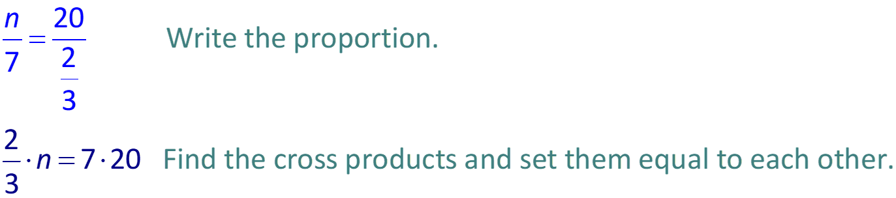
Example 6: Solving Proportions₁
Find the value of n if
Solution

Slide 16
Example 6: Solving Proportions₂

Slide 17
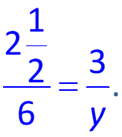


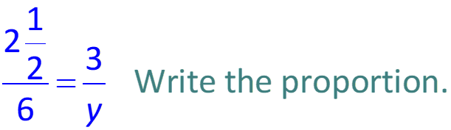
Example 7: Solving Proportions₁
Find the value of y if
Solution
First change the mixed number
to the improper
fraction

Slide 18
Example 7: Solving Proportions₂

Slide 19
Example 7: Solving Proportions₃

Slide 20
Procedure: To Solve an Application Using a Proportion
Identify the unknown quantity and use a variable to represent this quantity.
Set up a proportion in which the units are compared in the same order. (Make sure that the units are labeled so they can be seen to be in the right order.)
Solve the proportion.

Slide 21
Example 8: Application: Solving Proportions₁
A motorcycle will travel 352 miles on 11 gallons of gas. How many miles will this motorcycle travel on 15 gallons of gas?
Solution
Assign the variable: Let x = unknown number of miles.
Set up the proportion:
The units are in the same order (miles to gallons) in each ratio.

Slide 22
Example 8: Application: Solving Proportions₂
Solve the proportion:
The motorcycle will travel 480 miles on 15 gallons of gas.

Slide 23
Example 9: Application: Solving Proportions₁
An architect draws the plans for a building by using a scale of
inch to represent 10 feet. How many feet
are represented by 6 inches?
Solution
Assign the variable: Let y = unknown number of feet.
Set up the proportion:
For each ratio in the proportion, the units in the numerator and denominator are the same. Additionally, the numerators correspond and the denominators correspond.

Slide 24
Example 9: Application: Solving Proportions₂
Solve the proportion:
On these plans, 6 inches represents 120 feet.

Slide 25
Example 10: Application: Solving Proportions₁
A tire on a car makes 250 revolutions per minute. How many revolutions will the tire make in one hour?
Solution
Assign the variable: Let x = the number of revolutions made in one hour.
Set up the proportion:
Since 1 hr = 60 min, we have

Slide 26
Example 10: Application: Solving Proportions₂
Solve the proportion:
The tire will make 15,000 revolutions in one hour.

Slide 27
Example 11: Application: Solving Proportions₁
A recommended method of diluting weed killer is 3 capfuls of weed killer to 2 gallons of water. How many capfuls of weed killer should be mixed with 5 gallons of water?
Solution
Assign the variable: Let x = unknown number of capfuls of weed killer.
Set up the proportion:

Slide 28
Example 11: Application: Solving Proportions₂
Solve the proportion:
capfuls of weed killer should be mixed with 5 gallons of water.

Slide 29
Example 12: Application: Solving Proportions₁
A jelly manufacturer puts 2.5 ounces of sugar into every 6-ounce jar of jelly. How many ounces of jelly can be made with 300 ounces of sugar?
Solution
Assign the variable: Let x = unknown amount of jelly.
Set up the proportion:

Slide 30
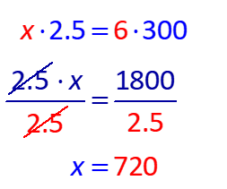
Example 12: Application: Solving Proportions₂
Solve the proportion:
300 ounces of sugar will make 720 ounces of jelly.

Slide 31
Example 13: Application: Solving Proportions Written in Medical Notation₁
A certain pain medicine is administered using a solution in the ratio of 2 grams of pain medicine to 32 ounces of solution. A nurse is told to give a patient 10 grams of the pain medicine. Given the following proportion, how many ounces of solution should the nurse give the patient?

Slide 32
Example 13: Application: Solving Proportions Written in Medical Notation₂
Solution
The nurse should give the patient 160 ounces of solution.

