Slide 1
Section 1.R.2
Multiplication with Fractions

Slide 2
Objectives
Multiply fractions.
Reduce fractions to lowest terms.
Multiply and reduce fractions to lowest terms.
Find the reciprocal of a fraction.
Divide fractions.

Slide 3
Procedure: To Multiply Fractions
Multiply the numerators.
Multiply the denominators.

Slide 4
Example 1: Multiplying Fractions₁
Find
Solution
Remember, to find a fraction of a number means to multiply the number by the fraction.

Slide 5
Example 2: Multiplying Fractions₂
Multiply.
Solution

Slide 6
Example 2: Multiplying Fractions₃

Slide 7
Example 3: Application: Multiplying Fractions₁
In a certain voting district,
of the eligible voters are
actually registered to vote. Of those registered voters,
are independents (have no party affiliation). What fraction of the eligible voters are registered independents?
Solution
Step 1: READ: Read the problem carefully. There are two types of voters to consider: registered voters and independent voters.

Slide 8
Example 3: Application: Multiplying Fractions₂
Step 2: SET UP: In looking for the fraction of registered
independent voters, we know that
eligible voters are registered independents, so
we will need to multiply
Step 3: SOLVE:
of the eligible voters are registered as
independents.

Slide 9
Example 3: Application: Multiplying Fractions₃
Step 4: CHECK:
which means that approximately
eligible voters are registered as independents.
reasonable answer as it is a little more than

Slide 10
Properties: Commutative Property of Multiplication
The order of the fractions being multiplied can be reversed without changing the product. Symbolically, if

Slide 11
Properties: Associative Property of Multiplication
The grouping of the fractions being multiplied can be changed without changing the product. Symbolically, if

Slide 12
Example 4: Recognizing the Properties of Multiplication
Each of the properties of multiplication is illustrated.
Commutative property of multiplication
Associative property of multiplication
As a check, we see that

Slide 13
Procedure: To Reduce a Fraction to Lowest Terms
Factor the numerator and denominator into prime factors.
Use the fact that
and “divide out” all common
factors.
Note: Reduced fractions may be improper fractions.

Slide 14
Example 5: Reducing Fractions to Lowest Terms
Reduce each fraction to lowest terms.
Solution
Note that the rules for divisibility quickly indicate that 5 is a factor of 15, 20, and 35, and 3 is a factor of 21.

Slide 15
Example 6: Reducing Fractions to Lowest Terms₁
Reduce
Solution
Remember that 1 is a factor of any whole number. So, if all of t he factors in the numerator or denominator are divided out, 1 must be used as a factor.
Using prime factors, we get the following.

Slide 16
Example 6: Reducing Fractions to Lowest Terms₂
Or, if you see that 8 is a common factor, divide it out. But remember that 1 is a factor.

Slide 17
Example 7: Reducing Fractions to Lowest Terms
Reduce
Solution
Finding a common factor could be difficult here. Prime factoring helps.

Slide 18
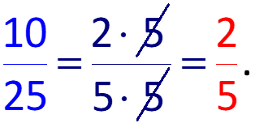
Example 8: Application: Reducing Fractions to Lowest Terms
Suppose you had $25 and you spent $15 to buy music.
What fraction of your money did you spend on music?
What fraction do you still have?
Solution
The fraction you spent is
b.
Since you still have $25 − $15 = $10, the fraction you still have is

Slide 19
Example 9: Multiplying and Reducing Using Prime Factors
Multiply and reduce to lowest terms:
Solution
Do not start by multiplying the numerators and denominators. The results would simply be large numbers that would then need to be factored. Using prime factors, we have the following.
Note that we did not find the product in the numerator or denominator before factoring.

Slide 20
Example 10: Multiplying and Reducing Using Prime Factors
Multiply and reduce to lowest terms:
Solution
Using prime factors, we have

Slide 21
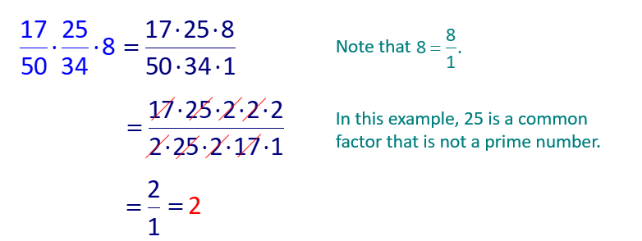
Example 11: Multiplying and Reducing Using Prime Factors
Multiply and reduce to lowest terms:
Solution
Solution

Slide 22
Example 12: Multiplying and Reducing Using Prime Factors
Multiply and reduce to lowest terms:
Solution
Solution

Slide 23
Example 13: Application: Multiplying and Reducing Fractions₁
A study showed that
of the members of a public
service organization were in favor of a new set of bylaws. If the organization had a membership of 200 people, how many were in favor of the changes in the bylaws?
Solution
Step 1: READ: Read the problem carefully. Note we need to find a fraction of the membership.
Step 2: SET UP:

Slide 24
Example 13: Application: Multiplying and Reducing Fractions₂
Step 3:
Step 4: CHECK:
which gives an approximation of 100 members in favor of the law. Therefore, the answer of 125 members is reasonable as it is a little more than 100.

Slide 25
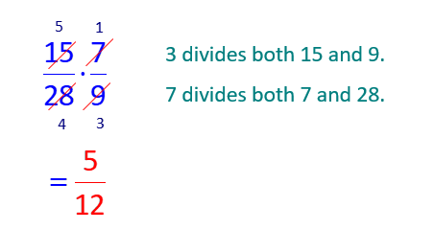
Example 14: Multiplying and Reducing Using the Division Method
Multiply and reduce to lowest terms:
Solution

Slide 26
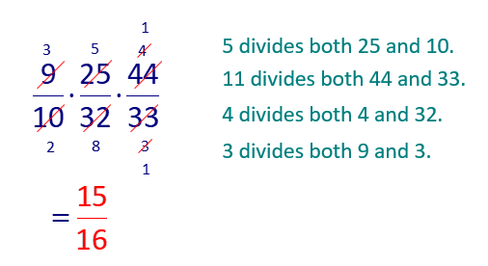
Example 15: Multiplying and Reducing Using the Division Method
Multiply and reduce to lowest terms:
Solution

Slide 27
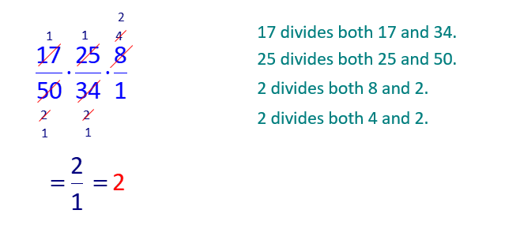
Example 16: Multiplying and Reducing Using the Division Method
Multiply and reduce to lowest terms:
Solution

Slide 28
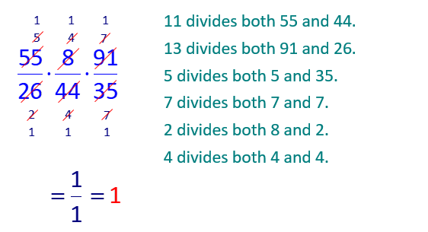
Example 17: Multiplying and Reducing Using the Division Method
Multiply and reduce to lowest terms:
Solution

Slide 29
Definition: Reciprocals
The reciprocal of
The product
of a nonzero number and its reciprocal is always 1.
Note:
That is, the number 0
has no reciprocal.

Slide 30
Example 18: Finding Reciprocals
Find the reciprocal of
Solution

Slide 31
Example 19: Finding Reciprocals
Find the reciprocal of 10.
Solution

Slide 32
Procedure: To Divide Fractions
To divide by any nonzero number, multiply by its reciprocal. In general,

Slide 33
Example 20: Dividing Fractions
Divide:
Solution

Slide 34
Example 21: Dividing Fractions
Divide:
Solution

Slide 35
Example 22: Dividing and Reducing Fractions
Divide and reduce to lowest terms:
Solution
by factoring.

Slide 36
Example 23: Dividing and Reducing Fractions
Divide and reduce to lowest terms:
Solution

Slide 37
Example 24: Dividing and Reducing Fractions
Divide and reduce to lowest terms:
Solution

Slide 38
Example 25: Dividing and Reducing Fractions
Divide and reduce to lowest terms:
Solution

Slide 39
Example 26: Finding a Missing Number₁
The result of multiplying two numbers is
If one of
Solution

Slide 40
Example 26: Finding a Missing Number₂
The other number is
Check by multiplying:

Slide 41
Example 27: Application: Dividing Fractions₁
A baker uses
cup of lemon juice for one apple pie in
her special apple pie recipe.
juice on hand, how many apple pies can she make using this amount of lemon juice?
Solution
Step 1: READ: Read the problem carefully. We know the total amount of lemon juice she has and how much is used in one pie.

Slide 42
Example 27: Application: Dividing Fractions₂
Step 2: SET UP: To find the number of pies she can bake, divide the amount of lemon juice on hand by the amount used in one pie.

Slide 43
Example 27: Application: Dividing Fractions₃
Step 4: CHECK: There are two eighths in one quarter, which means each quarter of a cup of lemon juice can make two pies. Since there are three quarters of a cup of lemon juice, 2 × 3 = 6, which means 6 pies can be made. So the answer is reasonable.

Slide 44
Example 28: Application: Multiplying and Dividing Fractions₁
A box contains 30 pieces of candy.
maximum amount of this candy the box can hold.
Is the maximum amount of candy the box can hold more or less than 30 pieces?
If you want to multiply
product be more or less than 30?
What is the maximum number of pieces of candy the box can hold?

Slide 45
Example 28: Application: Multiplying and Dividing Fractions₂
Solution
The maximum number of pieces of candy is more
Less than 30.
To find the maximum number of pieces, divide.
The maximum number of pieces the box will hold is 50.

