Slide 1
Section 1.R.1
Exponents and Order of Operations

Slide 2
Objectives₁
Identify the base and exponent in an exponential expression.
Evaluate expressions with exponents.
Evaluate expressions with 1 and 0 as exponents.
Use the order of operations to simplify expressions containing whole numbers.
Check for divisibility by using the tests for 2, 3, 4, 5, 6, 9, and 10.

Slide 3
Objectives₂
Understand the difference between prime and composite numbers.
Determine whether a number is prime or composite.
Find the prime factorization of a composite number.
Find all factors of a composite number.
      Find the LCM of a set of counting numbers using prime factorizations.
      Find equivalent fractions.
Notes:
3

Slide 4
Example 1: Identifying the Base and Exponent
Identify the base and exponent in each exponential expression.
a. 6² 6 is the base, and 2 is the exponent.
10 is the base, and 4 is the exponent.

Slide 5
Note₁
There is usually some confusion about the use of the word “power.”
it is natural to think of 5 as the power. This is not true. A power is not an exponent. A power is the product indicated by a base raised to an exponent. Thus, for the
think of the phrase “two to the fifth
power” in its entirety. The corresponding power is the product, 32.

Slide 6
Example 2: Writing Expressions
Using Exponents₁
In order to illustrate exponential notation, we show several products written with repeated multiplication and the equivalent exponential expressions.
With Repeated
Multiplication
With Exponents
7² is read “7 to the second power” or “7 squared.”
7² = 49
3² = 9
3² is read “3 to the second power” or “3 squared.”

Slide 7
Example 2: Writing Expressions
Using Exponents₂
With Repeated
Multiplication
With Exponents
2³ = 8
2³ is read “2 to the third power” or “2 cubed.”
is read “10 to
the fourth power.”

Slide 8
Example 3: Evaluating Exponential Expressions
Evaluate each exponential expression.
Solution

Slide 9
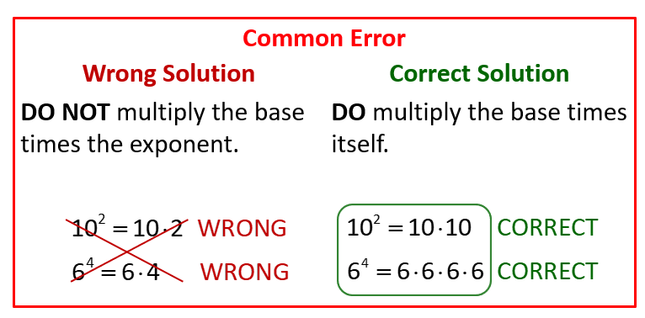
Evaluating Expressions with Exponents

Slide 10
Definition: The Exponent₁
Any number raised to the first power is equal to itself.
For example,

Slide 11
Definition: The Exponent₂
Any nonzero number raised to the 0 power equals 1.
For example,
Note:

Slide 12
Note₂
To help in understanding the exponent 0, note the pattern in the following powers with base 3.
Each value is the previous value divided by 3. In this way defining
makes sense. (Try this idea with
bases other than 3.)

Slide 13
Example 4: Evaluating Exponential Expressions
Evaluate each exponential expression.
Solution

Slide 14
Procedure: Rules for Order of Operations
1. Simplify within grouping symbols, such as parentheses ( ), brackets [ ], or braces { }. (If there are more than one pair of grouping symbols, start with the innermost grouping symbols.)
2. Evaluate any exponential expressions.
3. Moving from left to right, perform any multiplication or division in the order in which it appears.
4. Moving from left to right, perform any addition or subtraction in the order in which it appears.

Slide 15
Note₃
Note that in Rule 3 neither multiplication nor division has priority over the other. Whichever of these operations occurs first, moving left to right, is done first. In Rule 4, addition and subtraction are handled in the same way. Unless they occur within grouping symbols, addition and subtraction are the last operations to be performed.

Slide 16
Example 5: Using the Order of Operations with Whole Numbers₁
Simplify:
Solution
In this example there are no grouping symbols or exponents, so we begin with multiplication and division (left to right).

Slide 17
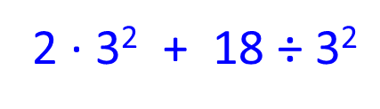
Example 6: Using the Order of Operations with Whole Numbers₂
Simplify:
Solution

Slide 18
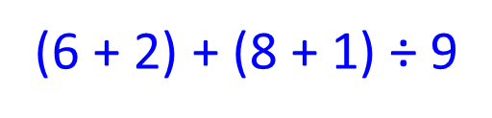
Example 7: Using the Order of Operations with Whole Numbers₃
Simplify:
Solution

Slide 19
Example 8: Using the Order of Operations with Whole Numbers₄
Simplify:
Solution

Slide 20
Example 9: Using the Order of Operations with Whole Numbers₅
Simplify:
Solution

Slide 21
Example 10: Using the Order of Operations
Simplify:
Solution

Slide 22
Example 11: Using the Order of Operations
Simplify:
Solution

Slide 23
Definition: Divisibility
If a number can be divided by another number so that the remainder is 0, then we say
1. the number is divisible by the divisor, or
2. the divisor divides the dividend.

Slide 24
Definition: Divisibility by 2
A number is divisible by 2 (is an even number) if the ones digit is 0, 2, 4, 6, or 8. (Note: A number is an odd number if it is not divisible by 2.)

Slide 25
Example 12: Determining Divisibility by 2
Determine whether each of the following numbers is divisible by 2.
a. 674
b. 357
Solution
a. 674 is divisible by 2 since the ones digit is 4 (an even digit).
b. 357 is not divisible by 2 since the ones digit is not 0, 2, 4, 6, or 8.

Slide 26
Definition: Divisibility by 3
A number is divisible by 3 if the sum of the digits is divisible by 3.

Slide 27
Example 13: Determining Divisibility by 3
Determine whether each of the following numbers is divisible by 3.
a. 6801
b. 356
Solution
a. 6801 is divisible by 3 since 6 + 8 + 0 + 1 = 15, and 15 is divisible by 3.
b. 356 is not divisible by 3 since 3 + 5 + 6 = 14, and 14 is not divisible by 3.

Slide 28
Definition: Divisibility by 4
A number is divisible by 4 if the number formed by the last two digits is divisible by 4. (00 is considered to be divisible by 4.)

Slide 29
Example 14: Determining Divisibility by 4₁
Determine whether each of the following numbers is divisible by 4.
a. 9036
b. 6700
c. 15,031
Solution
a. 9036 is divisible by 4 since 36 (the number formed by the last two digits) is divisible by 4.
b. 6700 is divisible by 4 since 00 is considered to be divisible by 4.

Slide 30
Example 14: Determining Divisibility by 4₂
c. 15,031 is not divisible by 4 since 31 is not divisible by 4.

Slide 31
Definition: Divisibility by 5
A number is divisible by 5 if the ones digit is 0 or 5.

Slide 32
Example 15: Determining Divisibility by 5
Determine whether each of the following numbers is divisible by 5.
a. 1365
b. 970
c. 1863
Solution
a. 1365 is divisible by 5 since the ones digit is 5.
b. 970 is divisible by 5 since the ones digit is 0.
c. 1863 is not divisible by 5 since the ones digit is not 0 or 5.

Slide 33
Definition: Divisibility by 6
A number is divisible by 6 if it is divisible by both 2 and 3.

Slide 34
Example 16: Determining Divisibility by 6₁
Determine whether each of the following numbers is divisible by 6.
a. 9054
b. 17,000
Solution
a. 9054 is divisible by 2 since the ones digit is 4. 9054 is divisible by 3 since 9 + 0 + 5 + 4 = 18, and 18 is divisible by 3. Therefore, 9054 is divisible by 6.

Slide 35
Example 16: Determining Divisibility by 6₂
b. 17,000 is divisible by 2 since the ones digit is 0. 17,000 is not divisible by 3 since 1 + 7 + 0 + 0 + 0 = 8, and 8 is not divisible by 3. Therefore, 17,000 is not divisible by 6.

Slide 36
Definition: Divisibility by 9
A number is divisible by 9 if the sum of the digits is divisible by 9.

Slide 37
Example 17: Determining Divisibility by 9
Determine whether each of the following numbers is divisible by 9.
a. 2530
b. 873
Solution
a. 2530 is not divisible by 9 since 2 + 5 + 3 + 0 = 10, and 10 is not divisible by 9.
b. 873 is divisible by 9 since 8 + 7 + 3 = 18, and 18 is divisible by 9.

Slide 38
Definition: Divisibility by 10
A number is divisible by 10 if the ones digit is 0.

Slide 39
Example 18: Determining Divisibility by 10
Determine whether each of the following numbers is divisible by 10.
a. 12,530
b. 841
Solution
a. 12,530 is divisible by 10 since the ones digit is 0.
b. 841 is not divisible by 10 since the ones digit is not 0.

Slide 40
Example 19: Using the Divisibility Rules₁
Complete each sentence.
a. 250 is divisible by 10 since the ones digit is 0.
b. 5712 is divisible by 4 since the number formed by
the last 2 digits (12) is divisible by 4.
c. 5402 is not divisible by 3 since 5 + 4 + 0 + 2 = 11,
and 11 is not divisible by 3.

Slide 41
Example 19: Using the Divisibility Rules₂
d. 6036 is divisible by 6 since 6036 is divisible by both 2 and 3. (It is divisible by 2 since the ones digit is 6 and it is divisible by 3 since 6 + 0 + 3 + 6 = 15, and 15 is divisible by 3.)

Slide 42
Definition: Prime Number
A prime number is a counting number greater than 1 that has exactly two different factors (or divisors)—itself and 1.

Slide 43
Definition: Composite Number
A composite number is a counting number with more than two different factors (or divisors).

Slide 44
Attention!
1 = 1⋅1, and 1 is the only factor of 1. 1 does not have exactly two different factors, and it does not have more than two different factors. Thus, 1 is neither a prime nor a composite number.

Slide 45
Example 20: Determining Prime Numbers
The following numbers are prime because each has exactly two different factors, 1 and itself.
2: 2 has exactly two different factors, 1 and 2.
7: 7 has exactly two different factors, 1 and 7.
11: 11 has exactly two different factors, 1 and 11.
29: 29 has exactly two different factors, 1 and 29.

Slide 46
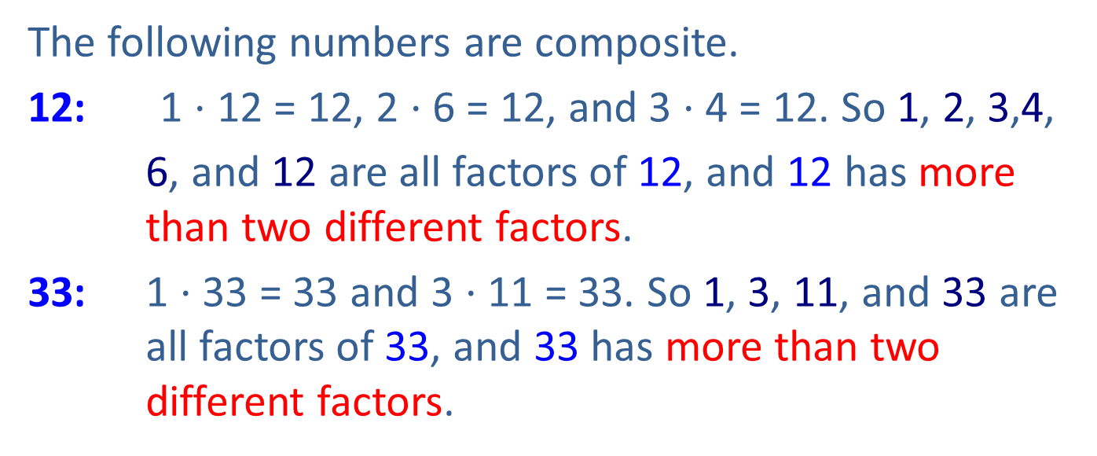
Example 21: Determining Composite Numbers
The following numbers are composite.
12: 1 ⋅ 12 = 12, 2 ⋅ 6 = 12, and 3 ⋅ 4 = 12. So 1, 2, 3,4,
6, and 12 are all factors of 12, and 12 has more than two different factors.
33: 1 ⋅ 33 = 33 and 3 ⋅ 11 = 33. So 1, 3, 11, and 33 are all factors of 33, and 33 has more than two different factors.

Slide 47
Procedure: To Determine Whether a Number is Prime
Divide the number by progressively larger prime numbers (2, 3, 5, 7, 11, and so forth) until one of the following is true.
1. The remainder is 0. This means that the prime number is a factor and the given number is composite.
2. You find a quotient smaller than the prime divisor. This means that the given number is prime because it has no smaller prime factors.

Slide 48
Note₄
We divide only by prime numbers. That is, there is no
need to divide by a composite number. (The reasoning is that if a composite number was a factor, then one of its prime factors would have been found in an earlier division.)

Slide 49
Example 22: Determining Whether a
Number is Prime₁
Is 605 a prime number?
Solution
The ones digit is 5. Therefore, 605 is divisible by 5 and is not prime. The number 605 is a composite number.
that is, 5, 11, and 121 are factors of 605.

Slide 50
Example 23: Determining Whether a
Number is Prime₂
Is 103 a prime number?
Solution
Tests for 2, 3, and 5 fail. (The number 103 is not even;
1 + 0 + 3 = 4 and 4 is not divisible by 3; and the ones digit is not 0 or 5.)

Slide 51
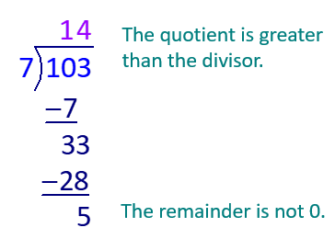
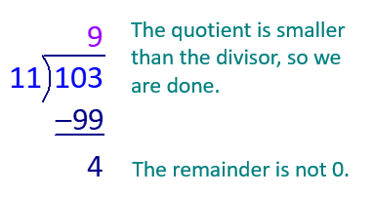
Example 23: Determining Whether a
Number is Prime₃
Divide by 7:
Divide by 11:
The number 103 is prime.

Slide 52
Example 23: Determining Whether a
Number is Prime₄
Note: There is no point in dividing by larger numbers such as 13 or 17 because the quotient would only get smaller, and if any of these larger numbers were a divisor, the smaller quotient would have been found to be a divisor earlier in the procedure.

Slide 53
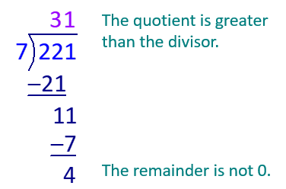
Example 24: Determining Whether a
Number is Prime₅
Is 221 a prime number?
Solution
Tests for 2, 3, and 5 fail. (The number 221 is not even; 2 + 2 + 1 = 5 and 5 is not divisible by 3; and the ones digit is not 0 or 5.)
Divide by 7:

Slide 54
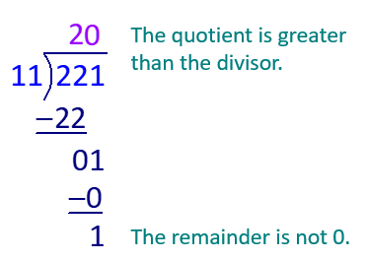
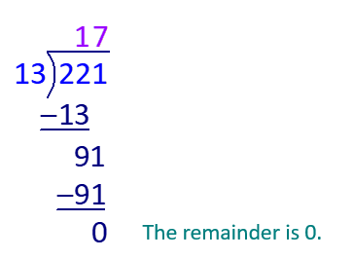
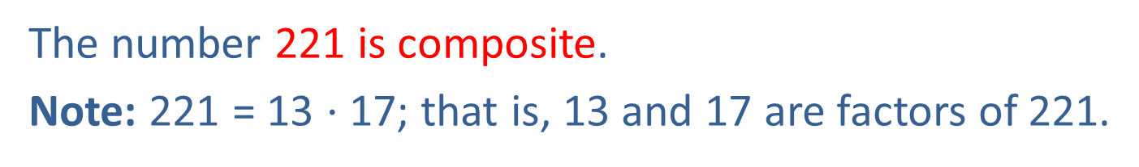
Example 24: Determining Whether a
Number is Prime₆
Divide by 11:
Divide by 13:
The number 221 is composite.
Note: 221 = 13 $⋅$ 17; that is, 13 and 17 are factors of 221.

Slide 55
Example 25: Determining Whether a Number is Prime₇
Is 199 a prime number?
Solution
Tests for 2, 3, and 5 fail. (The number 199 is not even;
1 + 9 + 9 = 19 which is not divisible by 3; and the ones digit is not 0 or 5.)
Divide 199 by 7: 28 R3
Divide 199 by 11: 18 R1
Divide 199 by 13: 15 R4
Divide 199 by 17 : 11 R12
199 is a prime number.

Slide 56
Definition: The Fundamental Theorem of Arithmetic
Every composite number has exactly one prime factorization.

Slide 57
Procedure: To Find the Prime Factorization of a Composite Number
1. Factor the composite number into any two factors.
2. Factor each factor that is not prime.
3. Continue this process until all factors are prime.

Slide 58
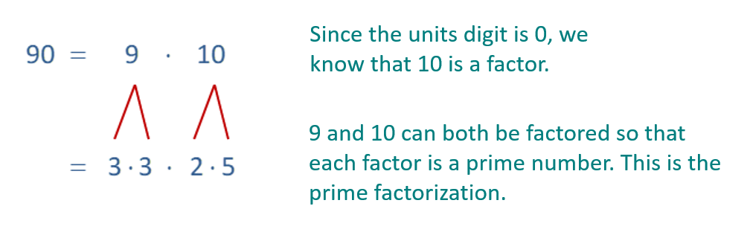
Example 26: Finding the Prime Factorization of a Number₁
Find the prime factorization of 90.
Solution
We can also start with a different set of factors.

Slide 59
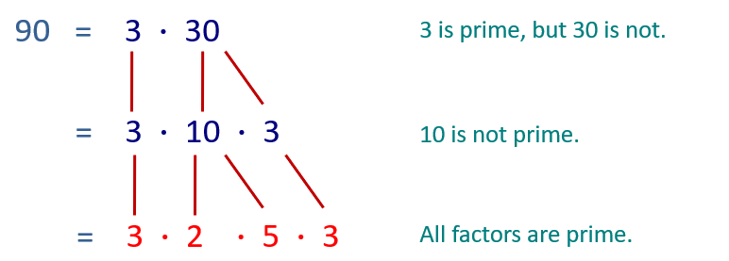
Example 26: Finding the Prime Factorization of a Number₂
Note: The final prime factorization was the same in both factor trees even though the first pair of factors was different.

Slide 60

Example 26: Finding the Prime Factorization of a Number₃
Since multiplication is commutative, the order of the factors is not important. What is important is that all the factors are prime. Writing the factors in ascending order, we can write 90 = 2 $⋅$ 3 $⋅$ 3$⋅$ 5 or, with exponents,
90 = 2$⋅$ 3²$⋅$ 5.

Slide 61

Example 27: Finding the Prime Factorization of a Number₄
Find the prime factorization of each number.
a. 65
b. 72
c. 294
Solution
a. 65 = 5 $⋅$ 13
5 is a factor because the units digit is 5. Since both
5 and 13 are prime, 5 ⋅ 13 is the prime factorization.

Slide 62
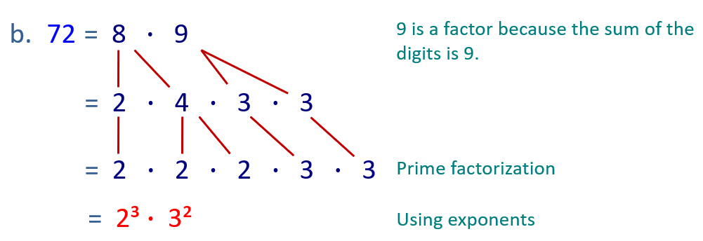
Example 27: Finding the Prime Factorization of a Number₅

Slide 63
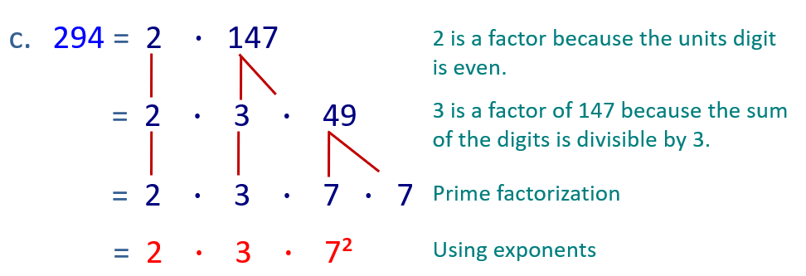
Example 27: Finding the Prime Factorization of a Number₆

Slide 64
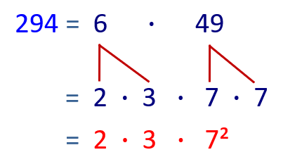

Example 27: Finding the Prime Factorization of a Number₇
If we begin with the product 294 = 6 $⋅$ 49, we see that the prime factorization is the same.

Slide 65
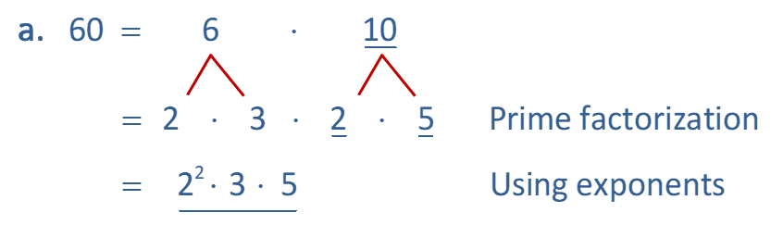
Example 28: Finding the Prime Factorization of a Number₈
Find the prime factorization of each number.
a. 60
b. 308
Solution
a.

Slide 66
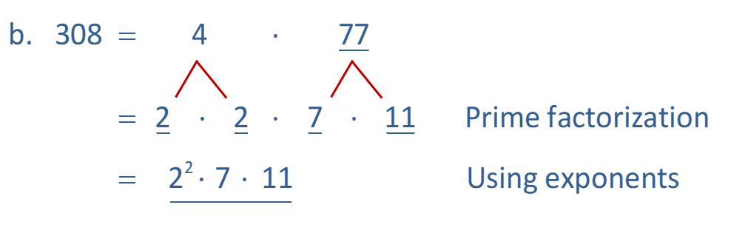
Example 28: Finding the Prime Factorization of a Number₉

Slide 67
Definition: Factors of a Composite Number
The only factors (or divisors) of a composite number are
1. 1 and the number itself,
2. each prime factor, and
3. products formed by all combinations of the prime factors (including repeated factors).

Slide 68
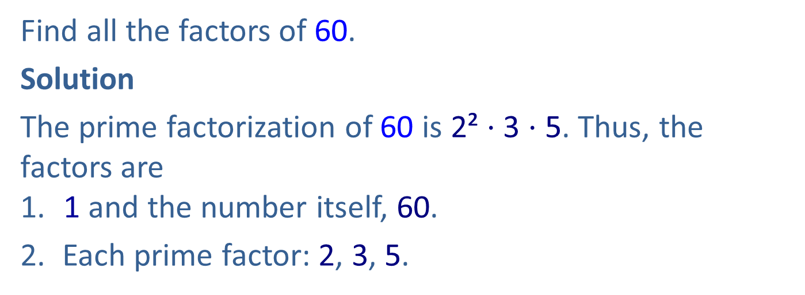
Example 29: Finding the Factors of a Composite Number₁
Find all the factors of 60.
Solution
The prime factorization of 60 is 2² $⋅$ 3 $⋅$ 5. Thus, the factors are
1. 1 and the number itself, 60.
2. Each prime factor: 2, 3, 5.

Slide 69
Example 29: Finding the Factors of a Composite Number₂
3. Products of all combinations of the prime factors:
The factors are 1, 2, 3, 4, 5, 6, 10, 12, 15, 20, 30, and 60.

Slide 70
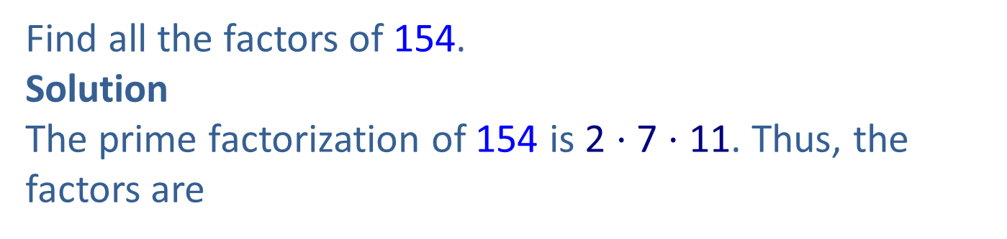
Example 30: Finding the Factors of a Composite Number₁
Find all the factors of 154.
Solution
The prime factorization of 154 is 2 $⋅$ 7 $⋅$ 11. Thus, the factors are
1. 1 and 154.
2. Each prime factor: 2, 7, and 11.

Slide 71
Example 30: Finding the Factors of a Composite Number₂
3. Products of all combinations of the prime factors:
The factors of 154 are1, 2, 7, 11, 14, 22, 77, and 154.

Slide 72
Example 31: Using Factors of Counting Numbers₁
Find two factors of 70 such that their product is 70 and their sum is 19.
Solution
Factors of 70 | Sum of Factors
1 ⋅ 70 = 70 | 1 + 70 = 71
2 ⋅ 35 = 70 | 2 + 35 = 37
5 ⋅ 14 = 70 | 5 + 14 = 19
7 ⋅ 10 = 70 | 7 + 10 = 17

Slide 73

Example 31: Using Factors of Counting Numbers₂
In the table, we have listed the pairs of factors and their sums in a table format. The pair we are looking for can be found by looking at the list of sums.
Thus, the numbers we are looking for are 5 and 14 because
5 $⋅$ 14 = 70 and 5 + 14 = 19.

Slide 74
Definition: Least Common Multiple (LCM)
The least common multiple (LCM) of two (or more) whole numbers is the smallest number that is a multiple of each of these numbers.

Slide 75
Procedure: To Find the LCM of a Set of Counting Numbers
1. Find the prime factorization of each number.
2. List the prime factors that appear in any one of the prime factorizations.
3. Find the product of these primes using each prime the most number of times it appears in any one of the prime factorizations.

Slide 76
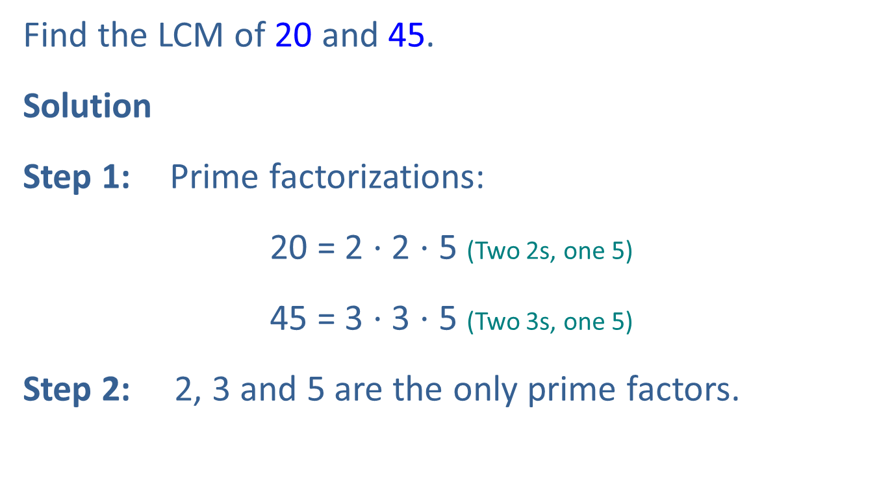
Example 32: Finding the Least
Common Multiple (LCM)₁
Find the LCM of 20 and 45.
Solution
Step 1: Prime factorizations:
20 = 2 $⋅$ 2 $⋅$ 5 (Two 2s, one 5)
45 = 3 $⋅$ 3 $⋅$ 5 (Two 3s, one 5)
Step 2: 2, 3 and 5 are the only prime factors.

Slide 77
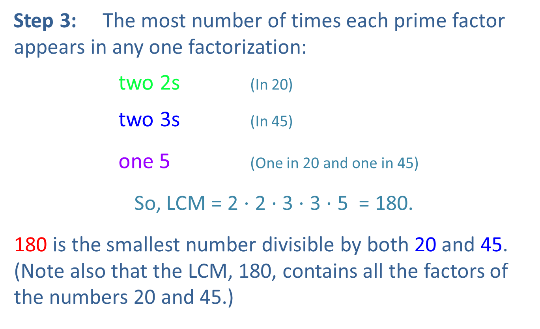
Example 32: Finding the Least Common
Multiple (LCM)₂
Step 3: The most number of times each prime factor appears in any one factorization:
two 2s (In 20)
two 3s (In 45)
one 5 (One in 20 and one in 45)
So, LCM = 2 $⋅$ 2 $⋅$3 $⋅$ 3 $⋅$ 5 = 180.
180 is the smallest number divisible by both 20 and 45. (Note also that the LCM, 180, contains all the factors of the numbers 20 and 45.)

Slide 78
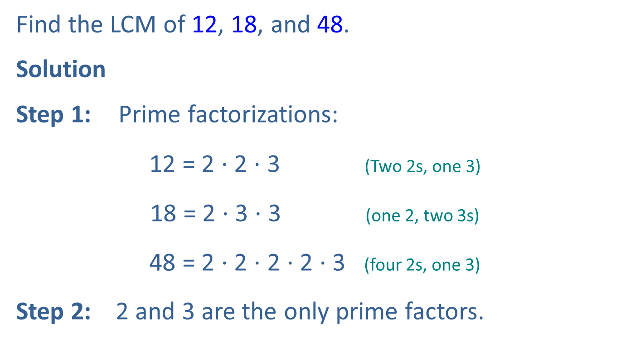
Example 33: Finding the Least
Common Multiple (LCM)₃
Find the LCM of 12, 18, and 48.
Solution
Step 1: Prime factorizations:
12 = 2 $⋅$ 2 $⋅$ 3 (Two 2s, one 3)
18 = 2 $⋅$ 3 $⋅$ 3 (one 2, two 3s)
48 = 2 $⋅$ 2 $⋅$ 2 $⋅$ 2 $⋅$ 3 (four 2s, one 3)
Step 2: 2 and 3 are the only prime factors.

Slide 79
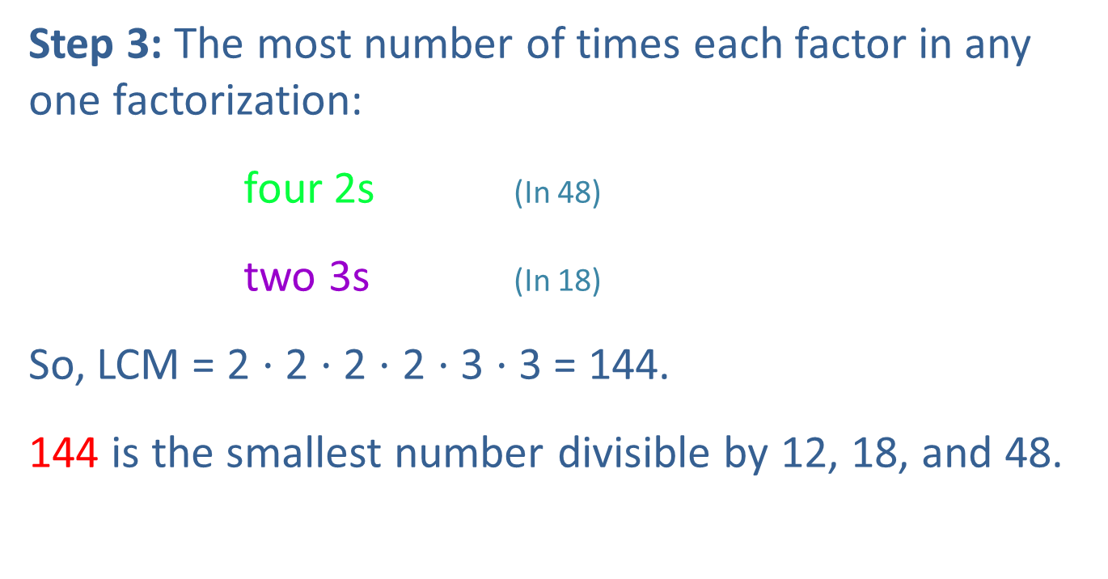
Example 33: Finding the Least Common
Multiple (LCM)₄
Step 3: The most number of times each factor in any one factorization:
four 2s (In 48)
two 3s (In 18)
So, LCM = 2 $⋅$ 2 $⋅$ 2 $⋅$ 2 $⋅$ 3 $⋅$ 3 = 144.
144 is the smallest number divisible by 12, 18, and 48.

Slide 80
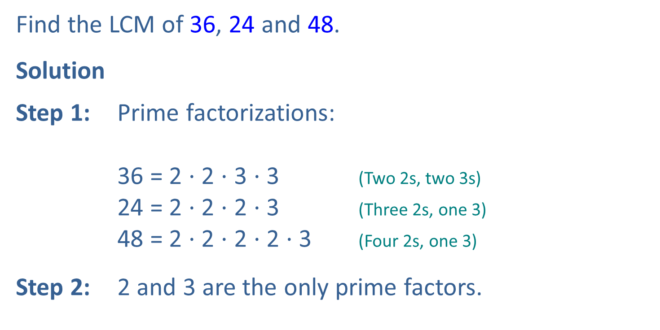
Example 34: Finding the Least Common Multiple (LCM)₅
Find the LCM of 36, 24 and 48.
Solution
Step 1: Prime factorizations:
36 = 2 $⋅$ 2 $⋅$ 3 $⋅$ 3 (Two 2s, two 3s)
24 = 2 $⋅$ 2 $⋅$ 2 $⋅$ 3 (Three 2s, one 3)
48 = 2 $⋅$ 2 $⋅$ 2 $⋅$ 2 $⋅$ 3 (Four 2s, one 3)
Step 2: 2 and 3 are the only prime factors.

Slide 81
Example 34: Finding the Least Common Multiple (LCM)₆
Step 3: The most number of times each prime factor appears in any one factorization:

Slide 82
Example 35: Finding the Least Common
Multiple (LCM)₇
Find the LCM of 27, 30, and 42.
Solution

Slide 83
Example 36: Finding the Least Common
Multiple (LCM)₈
Find the LCM of 8 and 25.
Solution
In this case, where the two numbers have no common prime factors, the LCM is the product of the two numbers.

Slide 84
Example 37: Finding the Least Common Multiple (LCM)₉
Find the LCM for 27, 30, and 42 and then state how many times each number divides into the LCM.
Solution
Now determine how many times each number divides into the LCM.

Slide 85
Example 37: Prime Factorizations and the
Least Common Multiple (LCM)₁₀
So, 27 divides into 1890 70 times;
30 divides into 1890 63 times;
42 divides into 1890 45 times.

Slide 86
Example 38: Finding the Least Common Multiple (LCM)₁₁
Find the LCM for 12, 18, and 66; and then state how many times each number divides into the LCM.
Solution
Begin by finding the LCM.

Slide 87
Example 38: Finding the Least Common Multiple (LCM)₁₂
Now determine how many times each number divides into the LCM.

Slide 88
Example 38: Finding the Least Common Multiple (LCM)₁₃
So, 12 divides into 396 33 times;
18 divides into 396 22 times;
66 divides into 396 6 times.

Slide 89
Example 39: Finding the Least Common Multiple (LCM)₁₄
Find the LCM of 30, 50, and 63; then state how many times each number divides into the LCM.
Solution
Begin by finding the LCM.

Slide 90
Example 39: Finding the Least Common Multiple (LCM)₁₅
Now determine how many times each number divides into the LCM:
So, 30 divides into 3150, 105 times.

Slide 91
Example 39: Finding the Least Common Multiple (LCM)₁₆
Now determine how many times each number divides into the LCM:

Slide 92
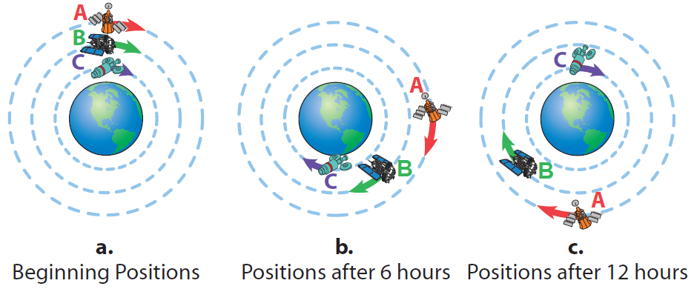
Example 40: Application: Finding the LCM₁
Suppose it takes three weather satellites—A, B, and C— different lengths of time to orbit the earth. Satellite A takes 24 hours, B takes 18 hours, and C takes 12 hours. If they are directly above each other now, as shown in part a. of the given figure, in how many hours will they again be directly above each other in the position shown in part a.? How many orbits will each satellite have made in that time?

Slide 93
Example 40: Application: Finding the LCM₂
Solution
Step 1: READ: Read the problem carefully and, in this situation, study the figures. Note that there are two questions to be answered. The answer to the number of orbits depends on the number of hours it takes for the satellites to align again.
Step 2: SET UP: Since A takes 24 hours to make one complete orbit, the solution must be a multiple of 24. Similarly, the solution must be a multiple of 18 and a multiple of 12 to allow for complete orbits of satellites B and C.

Slide 94
Example 40: Application: Finding the LCM₃
Step 3: SOLVE: The solution is the LCM of 24, 18, and 12.
Thus, the satellites will align again at the position shown in 72 hours (or 3 days).

Slide 95
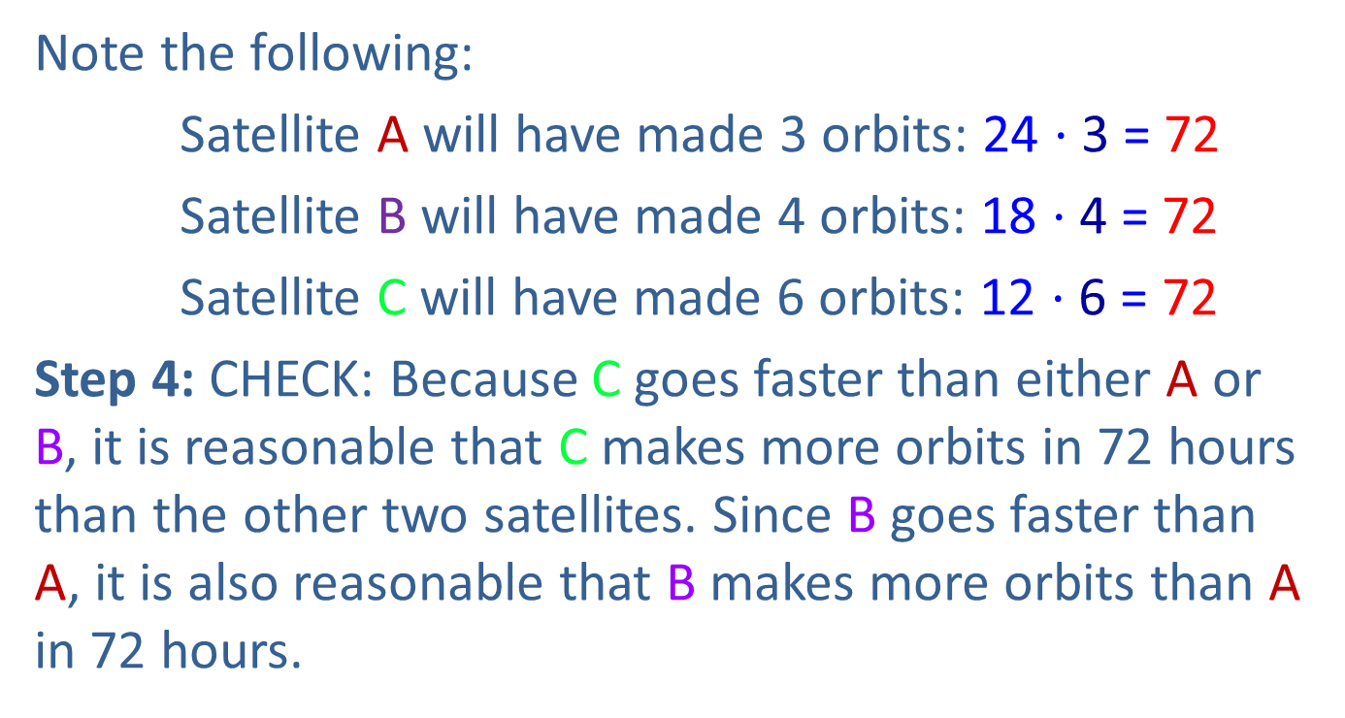
Example 40: Application: Finding the LCM₄
Note the following:
Satellite A will have made 3 orbits: 24 $⋅$ 3 = 72
Satellite B will have made 4 orbits: 18 $⋅$ 4 = 72
Satellite C will have made 6 orbits: 12 $⋅$ 6 = 72
Step 4: CHECK: Because C goes faster than either A or B, it is reasonable that C makes more orbits in 72 hours than the other two satellites. Since B goes faster than A, it is also reasonable that B makes more orbits than A in 72 hours.

Slide 96
Procedure: Finding Equivalent Fractions
To find a fraction equivalent to
numerator and denominator by the same nonzero whole number.
For example,

Slide 97
Example 41: Finding Equivalent Fractions
Find the missing numerator that will make the fractions equivalent.
Solution

Slide 98
Example 42: Finding Equivalent Fractions
Find the missing numerator that will make the fractions equivalent.
Solution

Slide 99
Example 43: Finding Equivalent Fractions
Find the missing numerator that will make the fractions equivalent.
Solution

