Slide 1
Section 8.4
Second-Order Linear Differential Equations

Slide 2
TOPICS
Solving homogeneous second-order linear differential equations
Initial value problems and boundary value problems

Slide 3
Solving Homogeneous Second-Order Linear Differential Equations
In full generality, a second-order linear differential equation is one that can be written in the standard form
where P, Q, R, and F are all continuous on some interval of interest. If F(x) = 0 for all x on the interval, the equation is said to be homogeneous; otherwise, F is not identically 0 and the equation is nonhomogeneous.

Slide 4
Solving Homogeneous Second-Order Linear Differential Equations
One step in solving nonhomogeneous equations is to first solve the associated homogeneous equation—the general solution of the homogeneous version is part of the solution of the nonhomogeneous equation. The techniques used to tackle nonhomogeneous equations are best left to a course on differential equations, so we concentrate here on cases where F(x) = 0.

Slide 5
Theorem: Linear Combinations of Solutions Are Solutions
Linear Combinations of Solutions Are Solutions
If y₁(x) and y₂(x) are both solutions of then so is
for any choice of real numbers c₁ and c₂.
(The expression is a linear combination of the two solutions.)

Slide 6
Theorem: Linear Combinations of Solutions Are Solutions
Proof
Since both y₁ and y₂ are solutions, we have the following.
The proof then follows immediately from properties of the derivative.

Slide 7
Theorem: Linear Combinations of Solutions Are Solutions
Proof (cont.)

Slide 8
Solving Homogeneous Second-Order Linear Differential Equations
The preceding theorem gives us a way to create new solutions out of existing solutions. A second important theorem tells us how to describe all of the possible solutions of a homogeneous second‑order linear equation. Its proof (which will be left to a course devoted to differential equations) uses the following idea from the study of vector spaces.

Slide 9
Definition: Linear Independence
Linear Independence
Two functions y₁(x) and y₂(x) are linearly independent on an interval if neither can be written as a constant multiple of the other. Another way of expressing linear independence is to say that the only way for a linear combination to equal the identically 0 function is when c₁ = c₂ = 0.

Slide 10
Theorem: Linearly Independent Solutions Span All Solutions
Linearly Independent Solutions Span All Solutions
If y₁(x) and y₂(x) are linearly independent solutions of the equation on an interval, and if P(x) is never 0 on the interval, then every solution of the equation can be written as for some choice of real numbers c₁ and c₂. We say that y₁(x) and y₂(x) span the space of solutions, and we can write the general solution of the equation as

Slide 11
Solving Homogeneous Second-Order Linear Differential Equations
Narrowing our focus one last time, we now devise a method for solving all homogeneous second‑order linear differential equations with constant coefficients. Such an equation can be written in the form ay″ + by′ + cy = 0, where a, b, and c are real numbers. The method originated with Euler, who realized that for y to satisfy the equation ay″ + by′ + cy = 0, y and its derivatives must be similar to one another.

Slide 12
Solving Homogeneous Second-Order Linear Differential Equations
For if the graphs of y, y′, and y″ had very different shapes, it would be impossible for some linear combination of them to equal the identically 0 function over some interval—while it is easy to solve the equation for any one point x₀, we need the equation to be true for all x in the interval of interest.

Slide 13
Solving Homogeneous Second-Order Linear Differential Equations
Exponential functions have exactly the property we desire: the derivative of any such function is a constant multiple of itself. So we start by letting y = e^{rx}, where r is a constant to be determined later (we could also use any other exponential base, but e is the easiest to work with).

Slide 14
Solving Homogeneous Second-Order Linear Differential Equations
Substituting y = e^{rx} into the equation ay″ + by′ + cy = 0, we get the following.
And since e^{rx} ≠ 0 for all x, we divide both sides by e^{rx} to obtain the following characteristic equation.

Slide 15
Solving Homogeneous Second-Order Linear Differential Equations
Now we determine the constant r by solving the characteristic equation of the given homogeneous second-order linear equation. There are three cases to consider.
Case 1: b² − 4ac > 0. In this case there are two distinct solutions of ar² + br + c = 0; call them r₁ and r₂. Since are linearly independent functions (neither is a constant multiple of the other), our general solution is as follows.

Slide 16
Example 1
Solve the equation y″ + 2y′ − 15y = 0.
Solution
Our characteristic equation is r² + 2r − 15 = 0, with solutions r = 3 and r = −5. So the general solution of the differential equation is as follows.

Slide 17
Solving Homogeneous Second-Order Linear Differential Equations
Case 2: b² − 4ac = 0. The quadratic formula tells us that r = −b/(2a) is a double root of ar² + br + c = 0 when b² − 4ac = 0. So while y = e^{rx} is one solution of the differential equation, we can’t generate a second linearly independent solution the same way we did in Case 1. But we can verify that y = xe^{rx} is a solution, and clearly e^{rx} and xe^{rx} are not constant multiples of one another on any interval.

Slide 18
Solving Homogeneous Second-Order Linear Differential Equations
So the general solution of such a differential equation is as follows.

Slide 19
Example 2
Solve the equation y″ − 4y′ + 4y = 0.
Solution
Our characteristic equation is r² − 4r + 4 = 0, with the double root r = 2. So the general solution of the differential equation is as follows.

Slide 20
Solving Homogeneous Second-Order Linear Differential Equations
Case 3: b² − 4ac < 0. There are two distinct roots again in this case, but they are complex numbers and conjugates of each other. We can write them as where
One way
to write the general solution is as follows.

Slide 21
Solving Homogeneous Second-Order Linear Differential Equations
But we can also use Euler’s Formula to express the general solution as follows.

Slide 22
Example 3
Solve the equation y″ − 6y′ + 10y = 0.
Solution
Our characteristic equation is r² − 6r + 10 = 0, with the following roots.
So α = 3, β = 1, and the general solution of the differential equation is as follows.

Slide 23
Second-Order Linear Differential Equations
We have already studied first-order initial value problems, and we will now see how IVPs appear in the context of second-order differential equations. We can also now discuss differential equations that must satisfy conditions referred to as boundary conditions.

Slide 24
Definition: Second-Order Initial Value and Boundary Value Problems
Second-Order Initial Value and Boundary Value Problems
An equation with the additional constraints that is called a second-order initial value problem (IVP), so named because y and y′ must satisfy the given initial conditions at the point x = x₀.

Slide 25
Definition: Second-Order Initial Value and Boundary Value Problems
Second-Order Initial Value and Boundary Value Problems (cont.)
An equation with the additional constraints that is called a second-order boundary value problem (BVP). The distinction is that we seek a solution y satisfying two boundary conditions at the points x = x₀ and x = x₁. Note that there is no additional constraint on y′.

Slide 26
Initial Value Problems and Boundary Value Problems
Another important distinction between the two types of second-order problems is that, under the assumptions that P, Q, R, and F are continuous on a given interval and that P is never 0 on the interval, an IVP is guaranteed to have a solution while a BVP is not. We conclude this section with examples of how we solve IVPs and BVPs.

Slide 27
Example 4
An object of mass m is suspended at one end of a spring with spring constant k while the other end of the spring is firmly fixed in place. If the object is then set in motion, its vertical displacement y at time t satisfies the equation
assuming friction and air resistance are negligible. (This follows from Newton’s Second Law of Motion and Hooke’s Spring Law.)

Slide 28
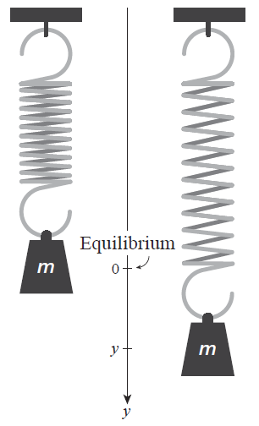
Example 4 (cont.)
Find the displacement y(t) of such an object if its mass is 2 kg, the spring constant k = 100 N/m, the spring is stretched 0.2 m beyond its natural length at time t = 0, and the object is released at time t = 0 with a velocity of 0 m/s.
Figure 1 Mass and Spring

Slide 29
Example 4 (cont.)
Solution
We first find the general solution of the equation my″ + ky = 0. The associated characteristic equation is mr² + k = 0, which has solutions If we let (a common choice of notation for this kind of problem), then r = ±iω and the general solution of our differential equation is as follows.
An object whose motion is described by such a function is said to exhibit simple harmonic motion.

Slide 30
Example 4 (cont.)
We can now solve for c₁ and c₂ by applying the initial conditions (corresponding to the spring being stretched 0.2 m at time 0 and the object having an initial velocity of 0 m/s).
Since ω ≠ 0 we have c₂ = 0.

Slide 31
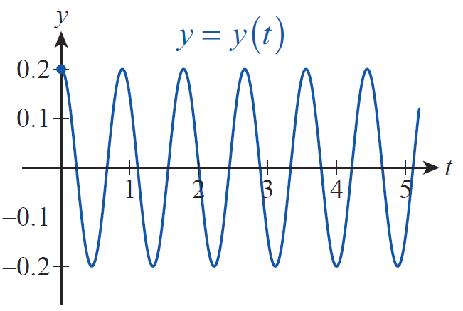
Example 4 (cont.)
So the particular solution of our IVP is as follows.
A graph of this vertical displacement over time is shown in Figure 2, where the vertical axis measures the distance below the resting position of the object.
Figure 2 Simple Harmonic Motion

Slide 32
Example 5
If frictional forces proportional to the velocity of the object are considered in the mass-spring model of Example 4, the displacement y(t) of the object satisfies the equation
where c is a positive constant called the damping constant. Find the displacement of such an object under the same conditions as Example 4, but with the damping constant c = 4 kg/s.

Slide 33
Example 5 (cont.)
Solution
In this model, the characteristic equation is mr² + cr + k = 0, with the following roots.
The three cases of c² − 4mk > 0, c² − 4mk = 0, and c² − 4mk < 0 are referred to as overdamped, critically damped, and underdamped, and correspond to the three cases we have outlined for solutions of a generic constant-coefficient homogeneous second-order equation.

Slide 34
Example 5 (cont.)
In this example, the model is underdamped (since c² − 4mk = 4² − 4 ⋅ 2 ⋅ 100 < 0), and the general solution of the equation is
with The initial condition y(0) = 0.2 again implies that c₁ = 0.2, but now

Slide 35
Example 5 (cont.)
So implies
or Using
we obtain

Slide 36
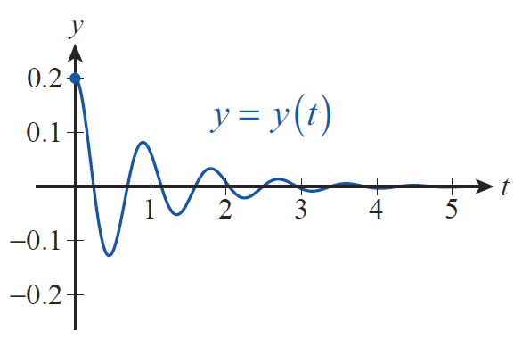
Example 5 (cont.)
Substituting values for c, m, c₁, c₂, and ω, we find the particular solution for this scenario.
The graph of this function appears in Figure 3.
Figure 3 Underdamped Mass-Spring Model

Slide 37
Example 6
Solve the equation y″ + y′ − 2y = 0 with the following boundary conditions.
Solution
The general solution of y″ + y′ − 2y = 0 is with the exponents determined by the characteristic equation r² + r − 2 = 0. We determine c₁ and c₂ from the two sets of boundary conditions.

Slide 38
Example 6 (cont.)
a. The conditions y(0) = 1 and y(2) = −1 imply
Solving the second equation for c₁ by substituting c₂ = 1 − c₁, and then using c₂ = 1 − c₁ to determine c₂, we get the following.

Slide 39
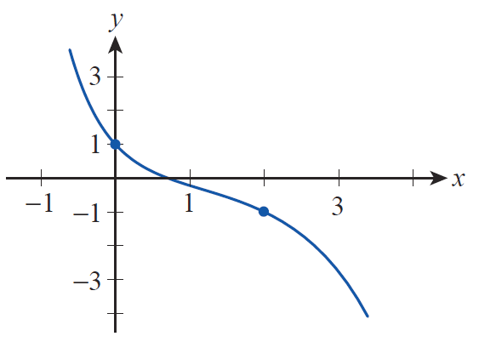
Example 6a (cont.)
The graph of for these particular choices of c₁ and c₂ is shown in Figure 4. Note that the graph does indeed satisfy the boundary conditions.
Figure 4
Boundary Value Problem Solution

Slide 40
Example 6 (cont.)
b. The boundary conditions y(0) = 0 and y(2) = 0 can only be imposed on the general solution by letting c₁ = 0 and c₂ = 0, resulting in the trivial solution y(x) = 0.

