Slide 1
Section 8.3
Autonomous Differential Equations and Slope Fields

Slide 2
TOPICS
Autonomous differential equations
Modeling with autonomous differential equations
Euler’s method

Slide 3
Definition: Autonomous Differential Equations
Autonomous Differential Equations
A first-order differential equation in the dependent variable y is autonomous if it can be written in the form
Those values of y for which f(y) = 0 are called equilibrium points or rest points.

Slide 4
Autonomous Differential Equations
At this point, it is useful to introduce a new way of visualizing the meaning of a differential equation and its solutions. Given a first-order equation
imagine drawing a small line segment at the point
whose slope is Since y′ is the rate of change of the function y with respect to x, each small segment indicates the behavior of the solution y that passes through the specific point In other words, the equation describes a picture of its own general solution from the outset, before we have even begun to solve it.

Slide 5
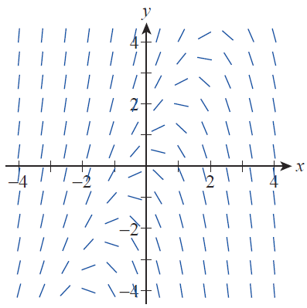
Autonomous Differential Equations
Such an image of segments is called a slope field (or direction field) corresponding to the equation. Figure 1 shows a slope field for the differential equation y′ = y − 2x; study this figure and verify that each small segment starting from a given point (x,y) appears to have slope roughly equal to y − 2x.
Figure 1
Slope Field for y’ = y − 2x

Slide 6
Autonomous Differential Equations
Now picture the slope field for a typical autonomous equation y′ = f (y). Since f (y) has the same value for all points in the plane that have the same y‑coordinate, we can use any one particular solution to generate another simply by shifting it horizontally to the left or right. This characteristic of autonomous differential equations is illustrated by our first example.

Slide 7
Example 1
Solve the autonomous equation
Then graph its slope field and several of its particular solutions.
Solution
This autonomous equation is also separable—it is not unusual to find that a given differential equation falls into several classifications. The fact that it is autonomous tells us something about the behavior of its solutions, while the fact that it is separable guides us toward a solution method.

Slide 8
Example 1 (cont.)
In separated form, the equation is
and we can integrate the left-hand side using the partial fractions method.

Slide 9
Example 1 (cont.)

Slide 10
Example 1 (cont.)
This family of equations implicitly defines the general solution of the differential equation, except for two important cases: y = −2 and y = 1. By definition, these two values are equilibrium points of the autonomous equation, but the equations y = −2 and y = 1 also qualify as solutions of the equation
(as you can check); they are graphed as black lines in Figure 3. But while these two values of y are both equilibrium values, y = −2 is classified as a stable equilibrium and y = 1 is an unstable equilibrium.

Slide 11
Example 1 (cont.)
The meaning of these terms is that solutions close (but not equal) to y = −2 tend to approach it as x → ∞ while solutions close (but not equal) to y = 1 move away from it as x → ∞. The different behavior of these two equilibria is actually apparent from the slope field, once we have sketched it (note how, scanning Figure 2 from left to right, the slopes tend toward the line y = −2 and away from the line y = 1).

Slide 12
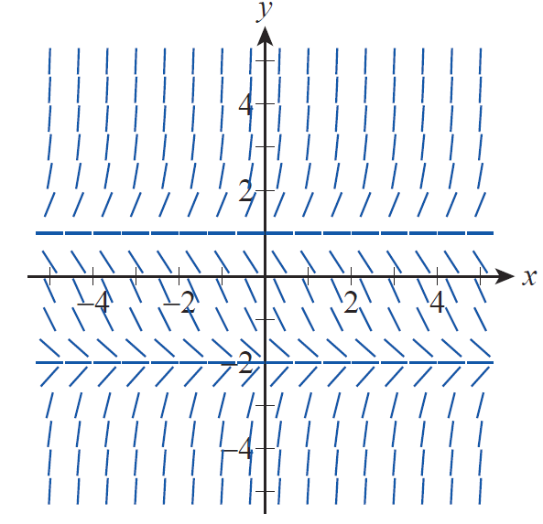
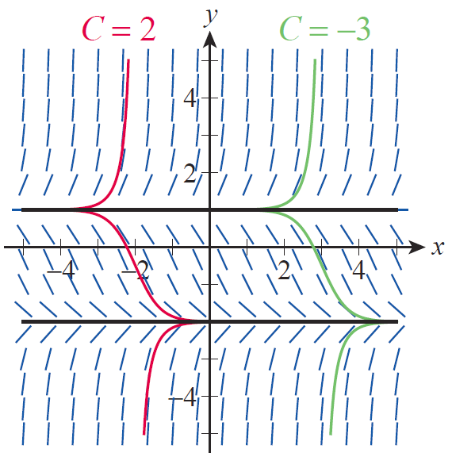
Example 1 (cont.)
Figure 2 Slope Field for
Figure 3 Slope Field and Representative Particular Solutions

Slide 13
Example 1 (cont.)
How do we efficiently and reasonably make a sketch such as the one shown in Figure 2? To begin with, we know that y′ = 0 when y = −2 and y = 1, meaning particular solutions passing through these two points on the y-axis have slope 0 everywhere. Therefore we draw there small horizontal segments. So the two black horizontal lines in Figure 3, representing two particular solutions, can be graphed immediately.

Slide 14
Example 1 (cont.)
Elsewhere in the plane, note that
at any point where y₀ > 1, meaning the line tangent to the particular solution through will have positive slope. Similarly,
at any point where −2 < y₀ < 1, so the short line segments in our slope field sketch should have negative slope. Finally, is positive again at any point where y₀ < −2, indicating positive‑slope trend lines again. Figure 2 summarizes these observations graphically.

Slide 15
Example 1 (cont.)
If desired, we can improve the accuracy of our slope field sketch if we include information about y ″.
This allows us to indicate the concavity (upward or downward) of the slope field trend lines in our sketch in the four horizontal bands defined by
and y = 1.

Slide 16
Example 1 (cont.)
Our last task is to graph several of the particular solutions of our autonomous equation. In Figure 3, the graph shown in green corresponds to C = −3 and the graph in red corresponds to C = 2. These particular solutions are discontinuous at y = −2 and y = 1; in fact, these two horizontal lines are asymptotes of every particular solution.
Figure 3 Slope Field and Representative Particular Solutions

Slide 17
Example 2
Newton’s Law of Cooling states that the rate of change of temperature of an object with temperature T(t) at time t is proportional to T − T_{s}, where T_{s} is the temperature of the object’s surroundings (we assume that T_{s} remains constant).

Slide 18
Example 2 (cont.)
One recipe for homemade yogurt calls for heating 2 quarts of milk to 180°F and then letting it cool to 115°F before adding the yogurt cultures. If it takes 5 minutes for 2 quarts of milk to cool from 180°F to 170°F in a room held at 75°F, how long will it take for the milk to cool to 115°F?

Slide 19
Example 2 (cont.)
Solution
We first solve the autonomous equation for temperature in full generality.

Slide 20
Example 2 (cont.)
If T_{s} = 75 and T(0) = 180, then A = 105 and the only remaining undetermined constant is k. We can solve for k by using the fact that T(5) = 170.

Slide 21
Example 2 (cont.)
Then and we solve the equation T(t) = 115 to find how long it will take for the milk to cool to 115°F.

Slide 22
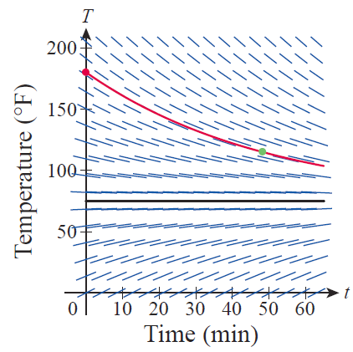
Example 2 (cont.)
Figure 4 illustrates the slope field for this equation and, in red, the particular solution
we have just found. The stable equilibrium solution of T = 75 is shown as a solid black line.
Figure 4 Newton’s Law of Cooling

Slide 23
Example 3
The simplest model of population growth is based on the equation where P(t) denotes the population of a group at time t and k is a proportionality constant dependent on the circumstances. This model leads to exponential growth where this is a formula that is usually only valid for short periods of time and when there are no significant environmental barriers to population growth.

Slide 24
Example 3 (cont.)
A more realistic model is based on the logistic differential equation
where K is called the population’s carrying capacity, which represents the maximum population size that the environment can support. Solve this autonomous equation to find the general formula for the logistic growth of a population.

Slide 25
Example 3 (cont.)
Solution
As in the last example, we can solve this autonomous equation by separating variables.

Slide 26
Example 3 (cont.)

Slide 27
Example 3 (cont.)
We will solve this equation for P, but first let’s determine the constant A that corresponds to an initial population of P₀. Note that when t = 0,
Now, we solve for P.

Slide 28
Example 3 (cont.)
It is customary to divide the top and bottom of this last fraction by Ae^{kt} so as to have only one term containing the independent variable. In the process of doing so, we will let

Slide 29
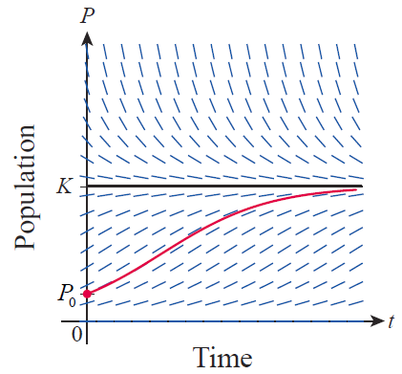
Example 3 (cont.)
The physical meaning of the carrying capacity is that it serves as an asymptotic limit to the population growth. It is also the case that P = K is a stable equilibrium solution of the equation, as indicated in Figure 5, and that P = 0 is an unstable equilibrium solution.
Figure 5 Logistic Growth
of a Population

Slide 30
Example 3 (cont.)
One particular solution is shown in red in this slope field illustration—such a curve is called a sigmoid curve because it is shaped like the letter S.

Slide 31
Example 4
Recall that the velocity v(t) of a body falling under the influence of gravity and encountering air resistance proportional to v² satisfies the following equation.
Use the methods of this section to find the terminal velocity of such a body, without actually solving the differential equation.

Slide 32
Example 4 (cont.)
Solution
Our equation is autonomous, and from the form
we know that it will have an equilibrium point when
or (we discard the negative root since it has no physical meaning in this problem). Further, we can determine that this equilibrium value is stable, since v′ is positive if v is less than and negative if v is greater than

Slide 33
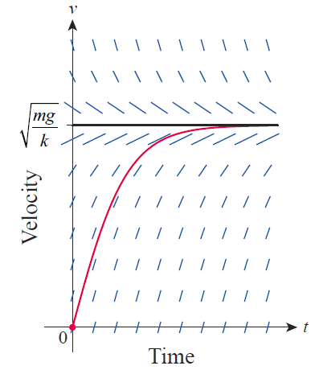
Example 4 (cont.)
A slope field sketch, with the stable equilibrium solution
shown in black and a typical nonequilibrium solution in red, is depicted in Figure 6.
Figure 6 Terminal Velocity

Slide 34
Euler’s Method
The basic idea behind sketching slope fields is also the key to a method of approximating solutions to first-order initial value problems; the method is named in honor of the great Swiss mathematician Leonhard Euler (1707–1783).

Slide 35
Euler’s Method
Suppose we want a solution y to with the condition that
Knowing that the tangent line to the solution curve has slope we can find a point
on the tangent line which will approximate a second point on the solution curve.

Slide 36
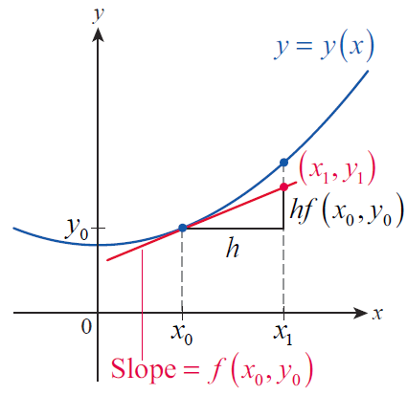
Euler’s Method
If we specify that x₁ − x₀ = h, then
so we define Iterating the process, we define the following:
Figure 7

Slide 37
Example 5
Use Euler’s method to approximate a solution to the IVP y′ = y − 2x with the condition y(0) = 1.
Solution
We have x₀ = 0, y₀ = 1, and f(x,y)= y − 2x. We need to choose a step size h in order to apply the iterative approximations x_{n} = x₀ + nh and
We will compare the results with h = 0.5 and h = 0.1.

Slide 38
Example 5 (cont.)
Table 1 h = 0.5
n | x_{n} | y_{n}
0 | 0 | 1
1 | 0.5 | 1.5
2 | 1.0 | 1.75
3 | 1.5 | 1.625
4 | 2 | 0.9375

Slide 39
Example 5 (cont.)
Table 2 h = 0.1
n | x_{n} | y_{n} | n | x_{n} | y_{n}
0 | 0 | 1 | 11 | 1.1 | 1.3470
1 | 0.1 | 1.1 | 12 | 1.2 | 1.2617
2 | 0.2 | 1.19 | 13 | 1.3 | 1.1479
3 | 0.3 | 1.269 | 14 | 1.4 | 1.0027
4 | 0.4 | 1.3359 | 15 | 1.5 | 0.8230
5 | 0.5 | 1.3895 | 16 | 1.6 | 0.6053
6 | 0.6 | 1.4285 | 17 | 1.7 | 0.3458
7 | 0.7 | 1.4514 | 18 | 1.8 | 0.0404
8 | 0.8 | 1.4565 | 19 | 1.9 | −0.3156
9 | 0.9 | 1.4422 | 20 | 2.0 | −0.7272
10 | 1.0 | 1.4064

Slide 40
Example 5 (cont.)
The tables show the results of calculating (x_{n}, y_{n}) up to
x = 2 with the two different step sizes, and Figures 8 and 9 compare the graphs of these estimated points (in red) with the exact solution y = 2x + 2 − e^{x}.

Slide 41
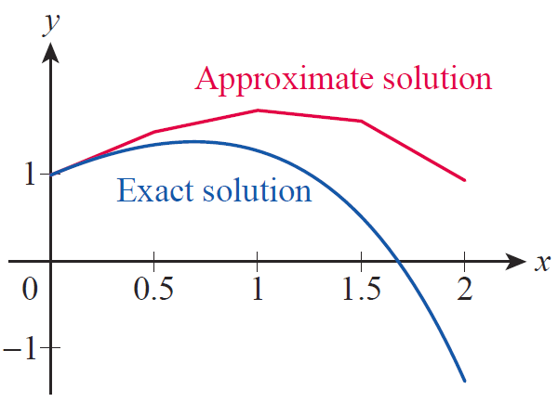
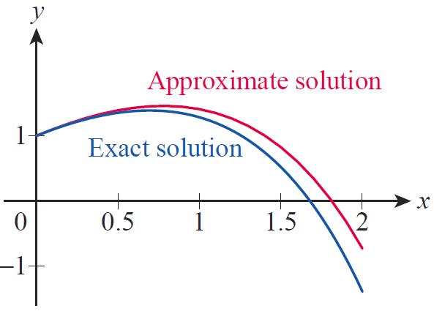
Example 5 (cont.)
Figure 8 h = 0.5
Figure 9 h = 0.1

