Slide 1
Section 8.1
Separable Differential Equations

Slide 2
TOPICS
Setting and terminology
Solving separable differential equations

Slide 3
Separable Differential Equations
In this chapter, we introduce techniques used to solve equations that are written in terms of a dependent variable and one or more of its derivatives—so-called differential equations. Such equations express relationships and principles that arise naturally in physics, biology, economics, geometry, chemistry, and many other disciplines.

Slide 4
Setting and Terminology
In a sense, we have already solved many differential equations: any equation of the form dy/dx = f(x), in which our goal is to determine y as a function of x, qualifies. But such equations are the very simplest examples, and the only solution technique we have used so far is integration; specifically, assuming f is integrable, is the answer.

Slide 5
Definition: First-Order Differential Equations
First-Order Differential Equations
A first-order differential equation is an equation of the form
in which f(x, y) is defined on a region in the xy-plane and it is understood that the unknown function y, which we seek to find, is a differentiable function of x.

Slide 6
Setting and Terminology
In general, the order of a differential equation is the order of the highest derivative of y in the equation. The objective is to determine a solution y as a function of x that satisfies the differential equation; a general solution is a description of all such possible functions y, and a particular solution is one that also satisfies an initial condition of the form y = y₀ when x = x₀ (that is, the graph of y passes through the point (x₀, y₀) in the xy-plane). A differential equation with an initial condition is often called an initial value problem (IVP).

Slide 7
Example 1
Solve the differential equation y′ = 2x − e^{x} with the initial condition y(0) = 3.
Solution
The absence of the dependent variable y on the right­hand side of this equation means we can solve it by simply integrating both sides:

Slide 8
Example 1 (cont.)
This solution is the general solution. To find the particular solution that also satisfies the initial condition y(0) = 3, we solve the following equation:
which gives C = 4. So y = x² − e^{x} + 4 is the particular solution of our given initial value problem.

Slide 9
Definition: Separable Differential Equations
Separable Differential Equations
A separable differential equation is a first-order differential equation that can be written in the following form.
The real significance of the right-hand side of this equation is that it is written as the product of a function of x and a function of y.

Slide 10
Definition: Separable Differential Equations
Separable Differential Equations (cont.)
It is convenient to express the function of y as 1/h(y) because the equation can then be rewritten in differential form as follows, in which all x’s appear on one side and all y’s on the other:

Slide 11
Solving Separable Differential Equations
After rewriting, a separable equation relates two differential expressions and can be integrated to result in a relationship between y and x.
This is the basic solution technique for such differential equations.

Slide 12
Example 2
Solve the equation
Solution
The question of whether a given first-order differential equation is separable can be answered by trying to rewrite it in the desired differential form.

Slide 13
Example 2 (cont.)
Now that the variables have been separated to opposite sides of the equal sign, we integrate both sides to obtain the relationship between y and x.
This last relation implicitly defines y as a function of x.

Slide 14
Example 2 (cont.)
We can make the functional relationship explicit under further conditions; for instance, if then we can write an equation for y as follows:

Slide 15
Example 3
Solve the initial value problem y ′ = x²y with the initial condition y(0) = −1.
Solution
Note that y = 0 is a valid, though trivial, solution of this differential equation. If we assume that y is not 0, we can again attempt to separate variables and, if successful, proceed to integrate.

Slide 16
Example 3 (cont.)

Slide 17
Example 3 (cont.)
Since y = 0 is also a solution of the original differential equation, we can simplify the last expression above to
write the general solution as where A can take on any real number value—in effect, we are allowing A to be e^{C}, −e^{C}, or 0. To find the particular solution that satisfies the initial condition, we solve for A as follows.
This gives us

Slide 18
Solving Separable Differential Equations
Mixture problems are a class of problems that can often be expressed as initial value problems. In general, such problems involve finding the quantity of some substance in a container, usually under dynamic conditions such as when a solution containing the substance is pumped into and/or out of the container.

Slide 19
Solving Separable Differential Equations
If the quantity of the substance as a function of time is denoted y(t), the IVP can be set up by determining the rate r_{in} at which the substance is entering the container, the rate r_{out} at which the substance is leaving the container, and the quantity y₀ of the substance at some time t = t₀. The IVP is then as follows.

Slide 20
Example 4
A 1000-gallon tank is filled with gasoline containing 15 pounds of a seasonal additive. A gasoline mixture containing 0.02 pounds of additive per gallon is added to the tank at the rate of 50 gallons per minute. The gasoline solution in the tank is continuously and thoroughly mixed and drained out at the same rate of 50 gallons per minute. How many pounds of additive are in the tank 30 minutes into the operation?

Slide 21
Example 4 (cont.)
Solution
If we let y(t) be the number of pounds of additive at time t, then we know that y(0) = 15 lb. The rate at which additive is being pumped into the tank is calculated as follows.

Slide 22
Example 4 (cont.)
Since the solution in the tank is continuously and thoroughly mixed, the concentration of additive in the tank at time t is y(t)/1000, measured in pounds per gallon, so the rate at which additive is leaving the tank is the concentration times the rate of outflow.

Slide 23
Example 4 (cont.)
So we are led to the following separable differential equation.

Slide 24
Example 4 (cont.)
Given the capacity of the tank and the additive’s concentration of 0.02 pounds per gallon, and given that y(0) = 15, we know that |20 – y| = 20 − y (in other words, y is less than or equal to 20 for all t), so And using the fact that y(0) = 15 again, it must be the case that A = 5, giving us So the amount of additive in the tank at the 30-minute mark is calculated as follows.

Slide 25
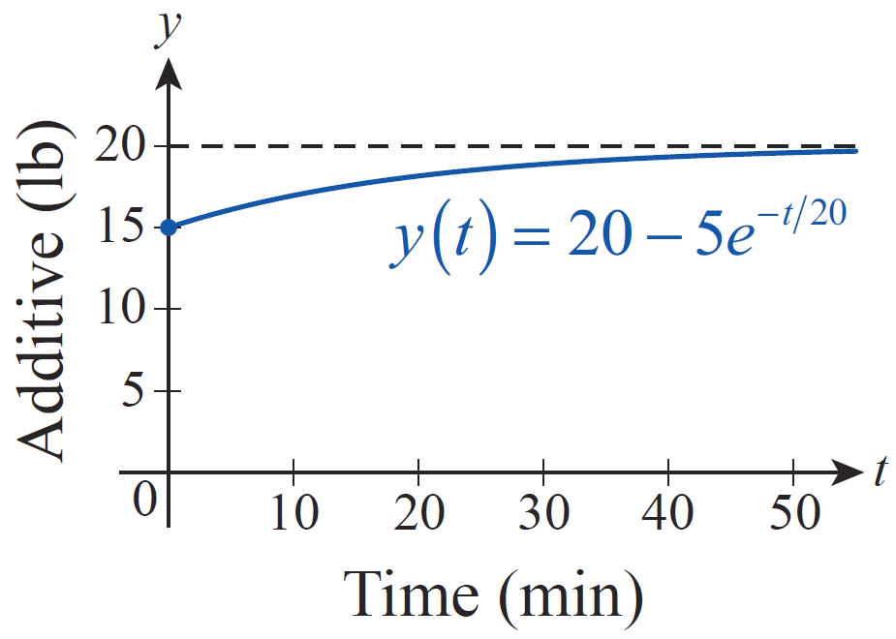
Example 4 (cont.)
Over time, the amount of additive in the tank will approach but never actually reach 20 pounds, as shown by the graph of y in Figure 1.
Figure 1

Slide 26
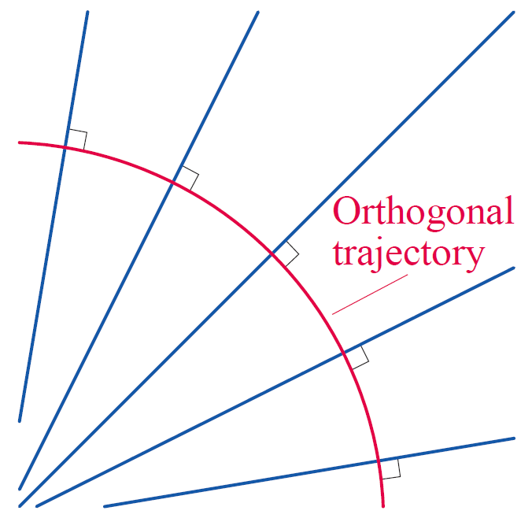
Solving Separable Differential Equations
Orthogonal trajectories of families of curves arise naturally in the study of magnetic, electrical, and gravitational fields. An orthogonal trajectory of a family of curves is a curve that intersects each member of the family at right angles (orthogonally)—in Figure 2, the red curve intersects the family of blue curves in just such a manner.
Figure 2

Slide 27
Solving Separable Differential Equations
And we can go further. Given a family of curves, we can determine another corresponding family of orthogonal trajectories, in which each curve in one family intersects each curve in the other family at right angles. We find the second family by solving a differential equation.

Slide 28
Example 5
Determine the orthogonal trajectories of the family of curves xy = a, where a is an arbitrary nonzero constant.
Solution
Each curve xy = a is a hyperbola with the coordinate axes as asymptotes. For a given constant a, we can determine the slope of the line tangent to the curve at a given point (x, y) by implicitly differentiating the equation xy = a and solving for dy/dx, as follows.

Slide 29
Example 5 (cont.)

Slide 30
Example 5 (cont.)
Recall that the slopes of orthogonal lines are negative reciprocals of each other, so the slope of the line that is perpendicular to the line tangent to the curve xy = a at the point (x, y) satisfies dy/dx = x/y. We can now solve this separable differential equation to find equations for the curves orthogonal to xy = a.

Slide 31
Example 5 (cont.)

Slide 32
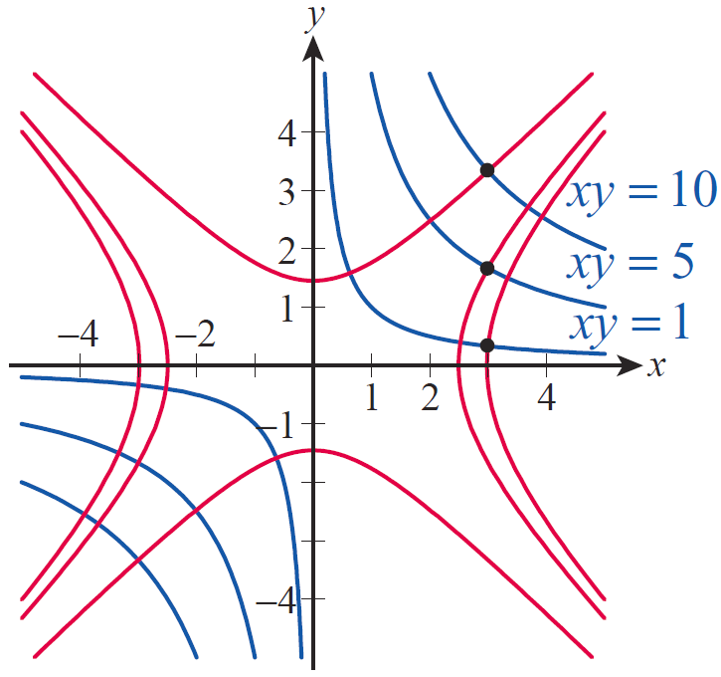
Example 5 (cont.)
Figure 3 illustrates how three curves of the first family (shown in blue) relate to three curves
of the second family
(shown in red).
Figure 3 Orthogonal Trajectories

Slide 33
Example 5 (cont.)
For each blue curve there are an infinite number of orthogonal curves from the second family that could be depicted—the three shown were chosen to each intersect a blue curve at a point with x-coordinate equal to 3.

Slide 34
Caution
Caution
It may be tempting to find the orthogonal trajectories of the family of curves xy = a by first solving for y, differentiating to get dy/dx = −a/x², and then integrating the negative reciprocal of this result. This will indeed give us one trajectory that is orthogonal to the curve xy = a for one fixed value of a, but not a family of trajectories orthogonal to the entire family of curves of the form xy = a. In order to find the complete family of orthogonal trajectories, we need a differential equation that is true for all values of a simultaneously.

Slide 35
Caution
Caution (cont.)
The method can be salvaged by recognizing the dependence of a on x and y, writing
and proceeding as in Example 5. Writing dy/dx in this fashion expresses the slope of the line tangent to the curve xy = a at a point (x, y) without reference to the value of a corresponding to that particular curve.

