Slide 1
Section F.6
Adding, Subtracting, and Multiplying Polynomials

Slide 2
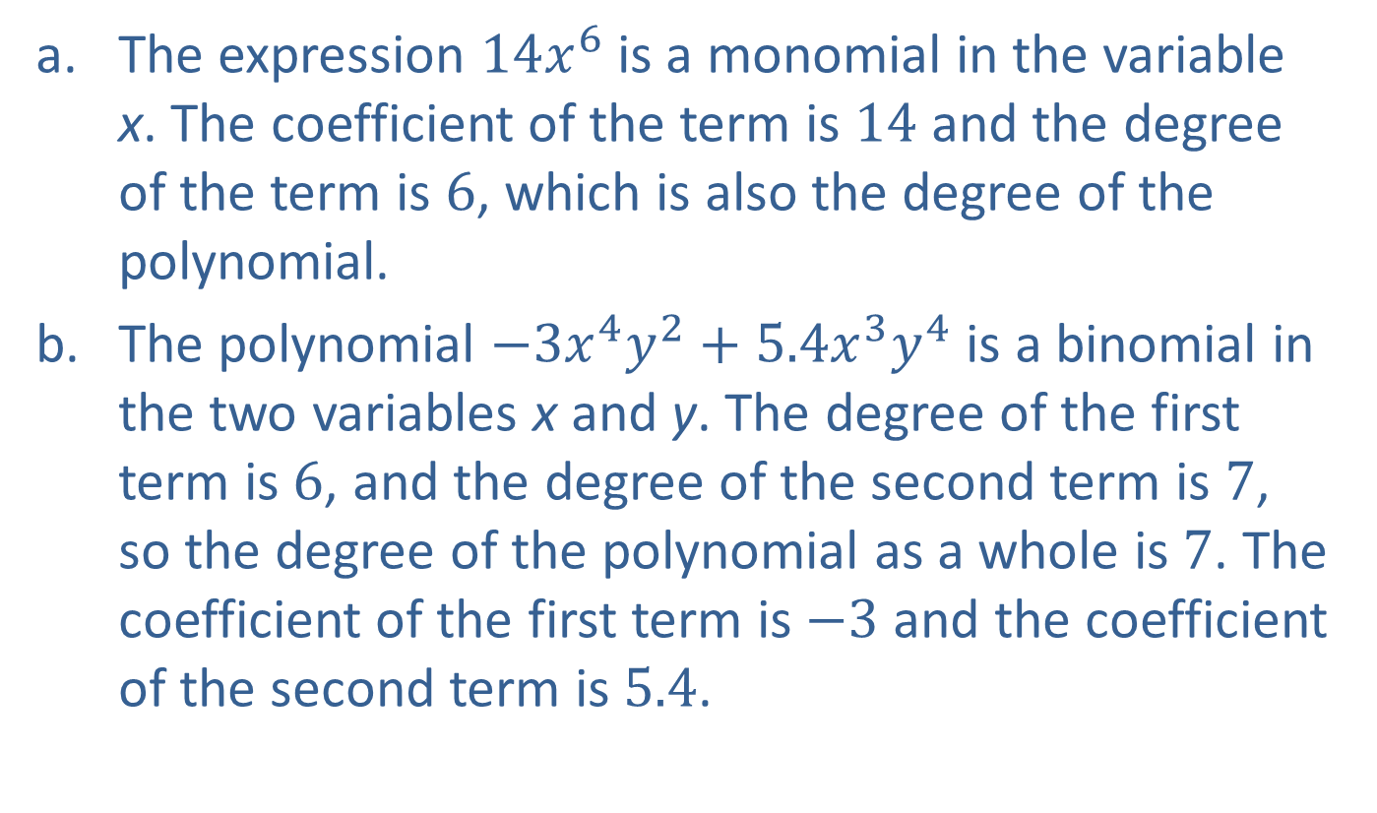
Example 1: Polynomial Expressions—Slide 1
​The expression $14x^{6}$ is a monomial in the variable x. The coefficient of the term is 14 and the degree of the term is 6, which is also the degree of the polynomial.
​The polynomial $−3x^{4}y^{2}+5.4x^{3}y^{4}$ is a binomial in the two variables x and y. The degree of the first term is 6, and the degree of the second term is 7, so the degree of the polynomial as a whole is 7. The coefficient of the first term is −3 and the coefficient of the second term is 5.4.

Slide 3
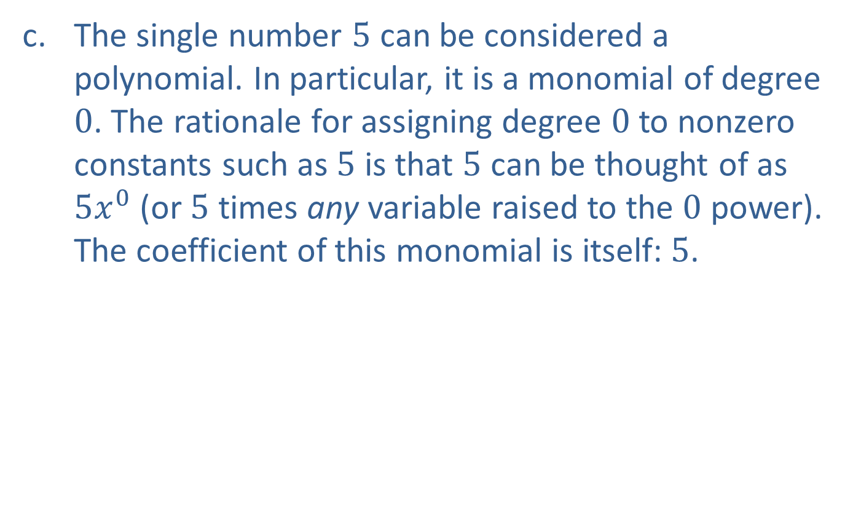
Example 1: Polynomial Expressions—Slide 2
​The single number 5 can be considered a polynomial. In particular, it is a monomial of degree 0. The rationale for assigning degree 0 to nonzero constants such as 5 is that 5 can be thought of as $5x^{0}$ (or 5 times any variable raised to the 0 power). The coefficient of this monomial is itself: 5.

Slide 4
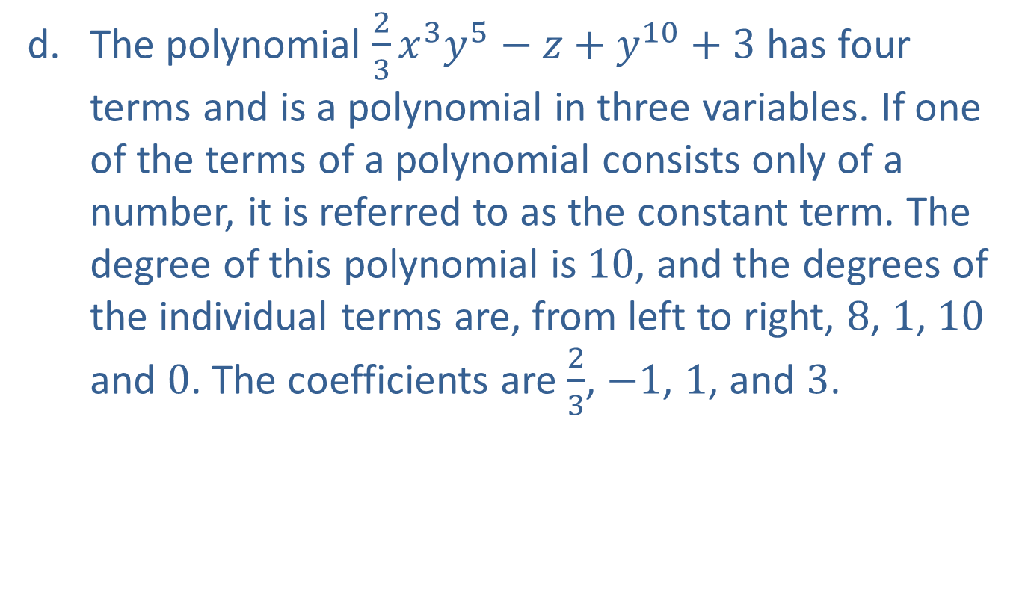
Example 1: Polynomial Expressions—Slide 3
​The polynomial $\frac{2}{3}x^{3}y^{5}−z+y^{10}+3$ has four terms and is a polynomial in three variables. If one of the terms of a polynomial consists only of a number, it is referred to as the constant term. The degree of this polynomial is 10, and the degrees of the individual terms are, from left to right, 8, 1, 10 and 0. The coefficients are $\frac{2}{3}$, −1, 1, and 3.

Slide 5
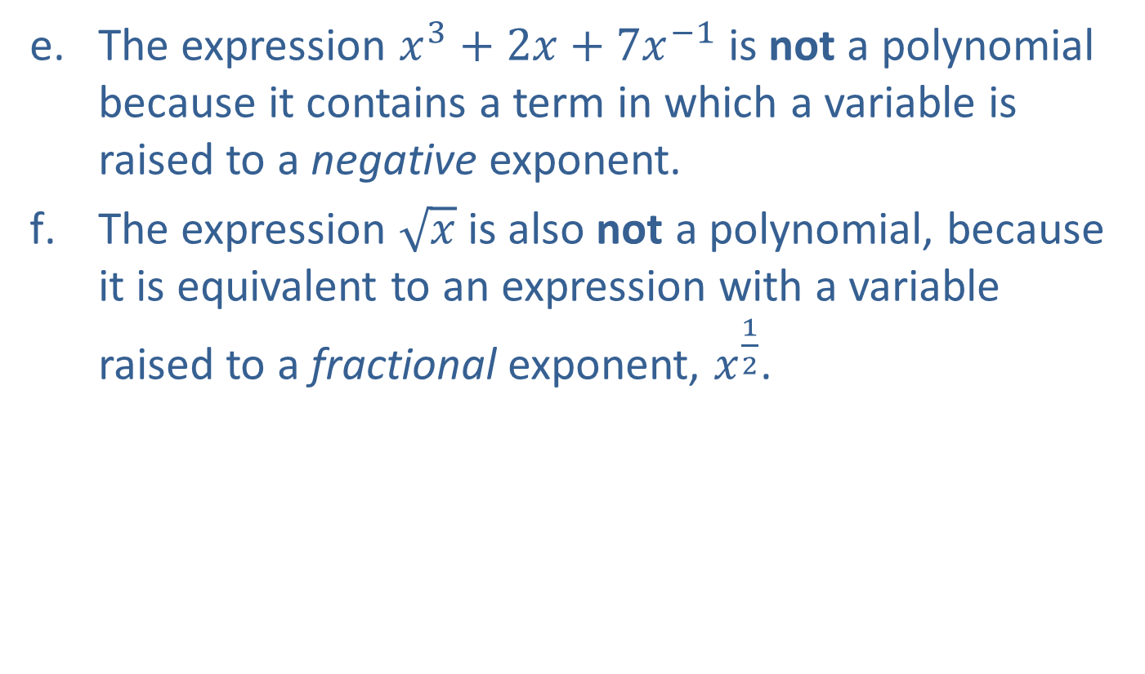
Example 1: Polynomial Expressions—Slide 4
​The expression $x^{3}+2x+7x^{−1}$ is not a polynomial because it contains a term in which a variable is raised to a negative exponent.
​The expression $\sqrt{x}$ is also not a polynomial, because it is equivalent to an expression with a variable raised to a fractional exponent, $x^{\frac{1}{2}}$.

Slide 6
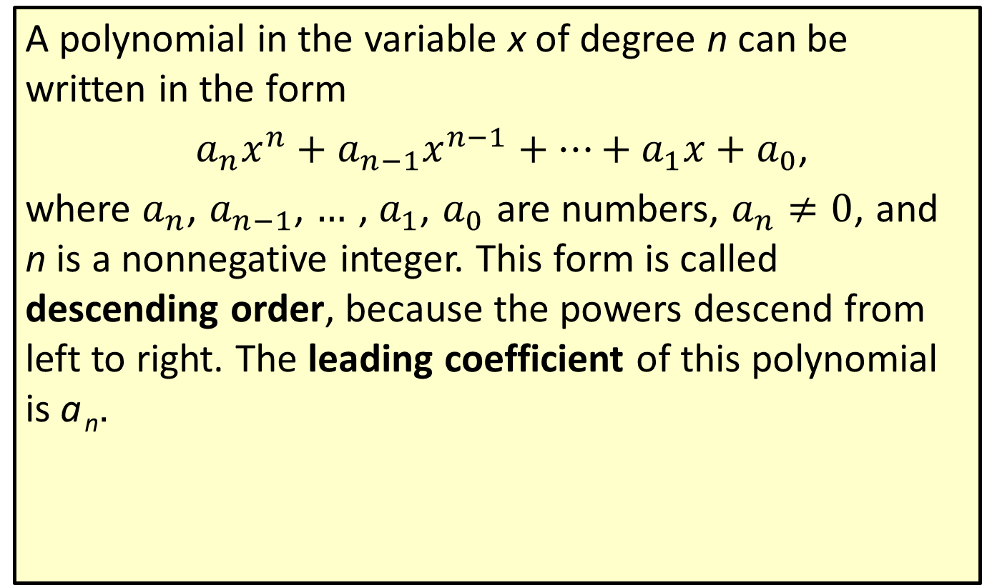
Definition: Polynomials of a Single Variable
A polynomial in the variable x of degree n can be written in the form
$a_{n}x^{n}+a_{n−1}x^{n−1}+…+a_{1}x+a_{0}$,
where $a_{n}$, $a_{n−1}$, … , $a_{1}$, $a_{0}$ are numbers, $a_{n}≠0$, and n is a nonnegative integer. This form is called descending order, because the powers descend from left to right. The leading coefficient of this polynomial is a _{n}.

Slide 7
Example 2: Adding Polynomials
Add:
Solution

Slide 8
Example 3: Subtracting Polynomials
Subtract:
Solution

Slide 9
Example 4: Multiplying Polynomials and Monomials
Multiply:
Solution

Slide 10
Example 5: Multiplying Polynomials—Slide 1
Multiply:
Solution
First multiply , then multiply this result by .

Slide 11
Example 5: Multiplying Polynomials—Slide 2

Slide 12
Example 6: Using the FOIL Method to Multiply Binomials
Use the FOIL method to multiply the binomials:
Solution
6x²
15
F
O
I
L
−9x
−10x

Slide 13
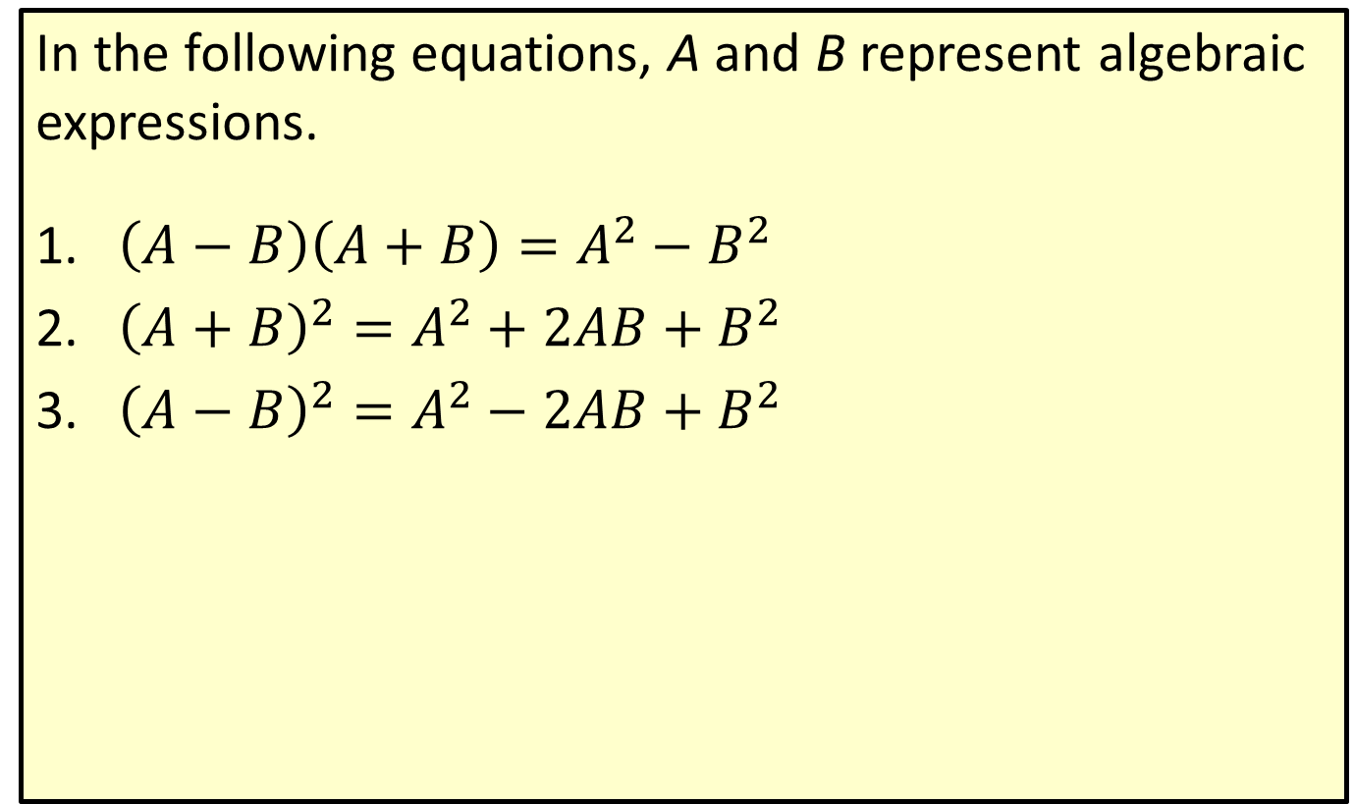
Special Product Formulas
In the following equations, A and B represent algebraic expressions.
​$\left(A−B\right)\left(A+B\right)=A^{2}−B^{2}$
​${\left(A+B\right)}^{2}=A^{2}+2AB+B^{2}$
​${\left(A−B\right)}^{2}=A^{2}−2AB+B^{2}$

Slide 14
Example 7: Using Special Product Formulas—Slide 1
Use a special product formula to perform the indicated operations.
​${\left(2x−y\right)}^{2}$
​$\left(\sqrt{x}−\sqrt{y}\right)\left(\sqrt{x}+\sqrt{y}\right)$

Slide 15
Example 7: Using Special Product Formulas—Slide 2
Solution
​The expression ${\left(2x−y\right)}^{2}$ is of the form ${\left(A−B\right)}^{2}$ with $A=2x$ and $B=y$, so we apply the third special product formula.
2𝑥−𝑦2=2𝑥2−22𝑥𝑦+𝑦22𝑥−𝑦2=4𝑥2−4𝑥𝑦+𝑦2
​Using the first special product formula, we have the following.
𝑥−𝑦𝑥+𝑦=𝑥2−𝑦2𝑥−𝑦𝑥+𝑦=𝑥−𝑦

Slide 16
Caution: Common Error
Wrong Solution Correct Solution
Many algebra students Avoid this error by
make the following error. remembering that the
square of a binomial is a
trinomial.

