Slide 1
Section F.5
Rational Number Exponents

Slide 2
n ^{th} Roots
Type of Root | Radical Notation and Exponential Notation | Example
Square roots
Cube roots
Fourth roots
n^{th} roots
Table 1

Slide 3
Definition: Radical Notation
If n is an integer greater than 1, then (assuming is a real number).
The expression is called a radical.
The symbol is called a radical sign.
n is called the index.
a is called the radicand.
Note: If no index is given, it is understood to be 2. For
example,

Slide 4
Note: Special Notes about the Index n
For the expression (or ) to be a real number (assuming n is an integer greater than 1):
when a is nonnegative, n can be any index, and
when a is negative, n must be odd. (If a is negative and n is even, then is not a real number.)

Slide 5


Example 1: Evaluating n^{th} Roots
because $7^{2}=49$.
because $3^{4}=$ 81.
is not a real number.
Any even root of a negative number is not a real number.

Slide 6
Properties: Summary of the Rules for Exponents—Slide 1
For nonzero real numbers a and b and rational numbers m and n,
a¹ = a (a is any real number.)
a⁰ = 1 (a ≠ 0)
a^{m} ∙ a^{n} = a^{m + n}
.

Slide 7
Properties: Summary of the Rules for Exponents— Slide 2
.
.
.
.

Slide 8

Definition: The General Form $a^{\frac{m}{n}}$
If n is an integer greater than 1, m is any integer, and is a real number, then
In radical notation:

Slide 9
Example 2: Converting from Exponential Notation to Radical Notation—Slide 1
Assume that each variable represents a positive real number. Each expression is changed to an equivalent expression in either radical or exponential notation.
The index, 3, is the denominator in the rational exponent.
The coefficient, 3, is not affected by the exponent.
−1 is the understood coefficient.

Slide 10
Example 2: Converting from Exponential Notation to Radical Notation—Slide 2
The index, 6, is the denominator of the rational exponent.
In a square root, the index is understood to be 2.
The coefficient, −1, is not affected by the exponent. We could also write

Slide 11
Example 3: Simplifying Expressions with Rational Exponents—Slide 1
Simplify each expression using one or more of the rules for exponents.

Slide 12
Example 3: Simplifying Expressions with Rational Exponents—Slide 2
Solution
Add the exponents.
Subtract the exponents.

Slide 13
Example 3: Simplifying Expressions with Rational Exponents—Slide 3
Multiply the exponents of y and reduce.
This is not a real number.
is not real.

Slide 14
Example 3: Simplifying Expressions with Rational Exponents—Slide 4
The exponent can be reduced as long as the expression is real.
Simplify the exponents.
Use the properties of negative exponents.

Slide 15
Example 4: Simplifying Radical Notation by Changing to Exponential Notation—Slide 1
Simplify each expression by first changing it into an equivalent expression with rational exponents. Then rewrite the answer in simplified radical form. Assume that all variables represent positive real numbers.

Slide 16
Example 4: Simplifying Radical Notation by Changing to Exponential Notation—Slide 2
Solution

Slide 17
Example 4: Simplifying Radical Notation by Changing to Exponential Notation—Slide 3

Slide 18
Example 4: Simplifying Radical Notation by Changing to Exponential Notation—Slide 4

Slide 19
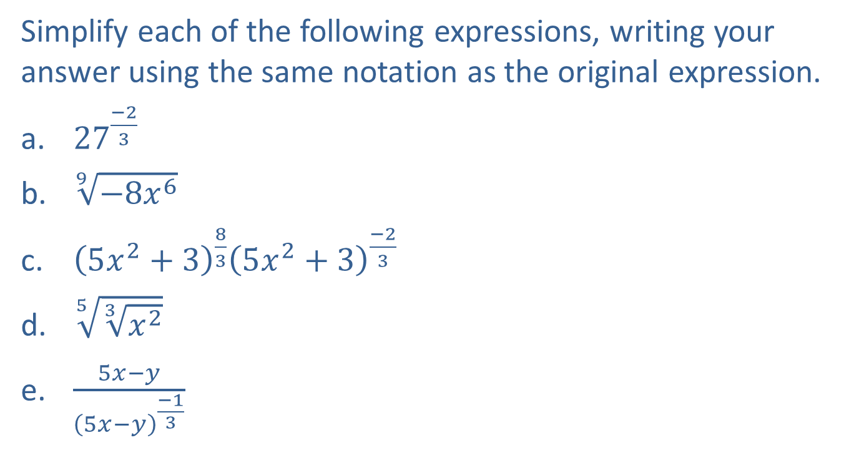
Example 5: Simplifying Expressions—Slide 1
Simplify each of the following expressions, writing your answer using the same notation as the original expression.
​${27}^{\frac{−2}{3}}$
​$\sqrt[9]{−8x^{6}}$
​${\left(5x^{2}+3\right)}^{\frac{8}{3}}{\left(5x^{2}+3\right)}^{\frac{−2}{3}}$
​$\sqrt[5]{\sqrt[3]{x^{2}}}$
​$\frac{5x−y}{{\left(5x−y\right)}^{\frac{−1}{3}}}$

Slide 20
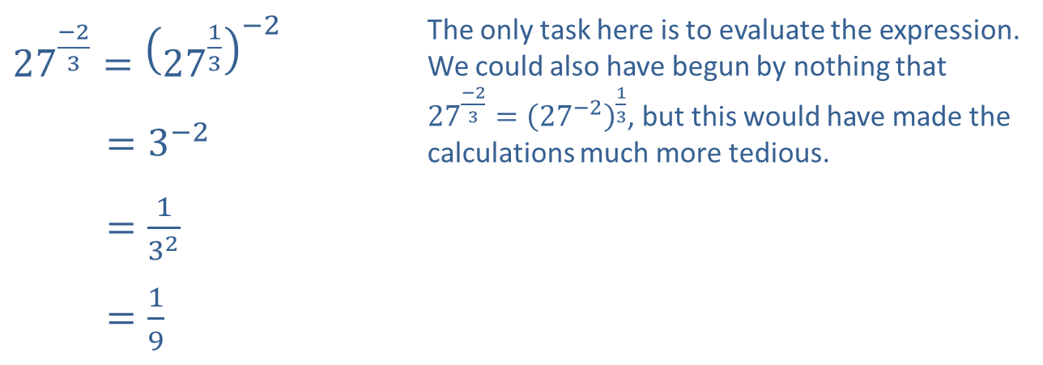
Example 5: Simplifying Expressions—Slide 2
Solution
​
​${27}^{\frac{−2}{3}}={\left({27}^{\frac{1}{3}}\right)}^{−2}$ | The only task here is to evaluate the expression. We could also have begun by nothing that ${27}^{\frac{−2}{3}}={\left({27}^{−2}\right)}^{\frac{1}{3}}$, but this would have made the calculations much more tedious.
​27−23=3−2
​27−23=132
​27−23=19

Slide 21
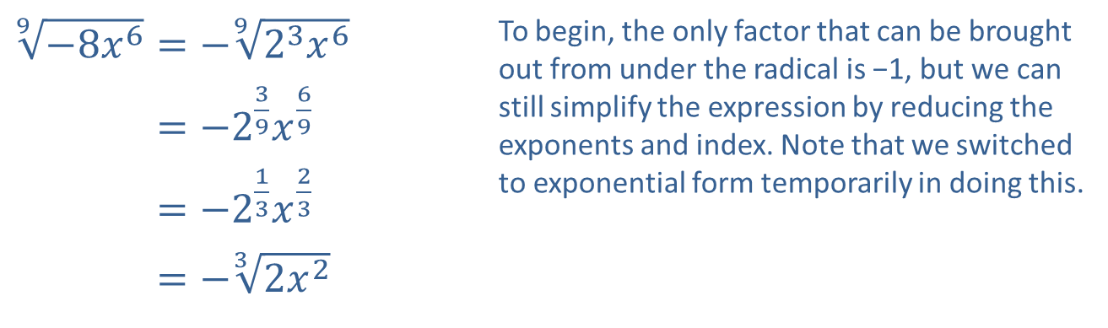
Example 5: Simplifying Expressions—Slide 3
b. ​
​$\sqrt[9]{−8x^{6}}=−\sqrt[9]{2^{3}x^{6}}$ | To begin, the only factor that can be brought out from under the radical is −1, but we can still simplify the expression by reducing the exponents and index. Note that we switched to exponential form temporarily in doing this.
​9−8𝑥6=−239𝑥69
​9−8𝑥6=−213𝑥23
​9−8𝑥6=−32𝑥2

Slide 22
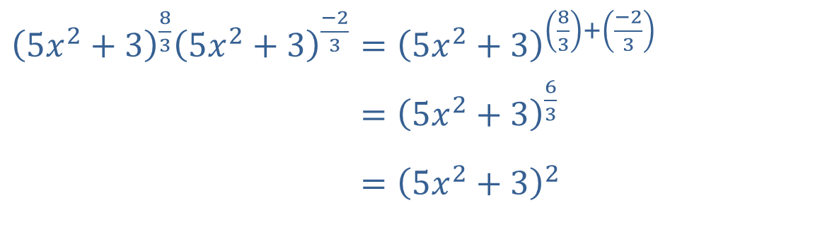

Example 5: Simplifying Expressions—Slide 4
c. Since the bases are the same, we only have to apply the property $a^{n}{a^{m}}=a^{n+m}$.
​${\left(5x^{2}+3\right)}^{\frac{8}{3}}{\left(5x^{2}+3\right)}^{\frac{−2}{3}}={\left(5x^{2}+3\right)}^{\left(\frac{8}{3}\right)+\left(\frac{−2}{3}\right)}$
​5𝑥2+3835𝑥2+3−23=5𝑥2+363
​5𝑥2+3835𝑥2+3−23=5𝑥2+32

Slide 23

Example 5: Simplifying Expressions—Slide 5
d. ​Use the property stating $\sqrt[m]{\sqrt[n]{a}}=\sqrt[mn]{a}$ to simplify this expression.
$\sqrt[5]{\sqrt[3]{x^{2}}}=\sqrt[15]{x^{2}}$

Slide 24
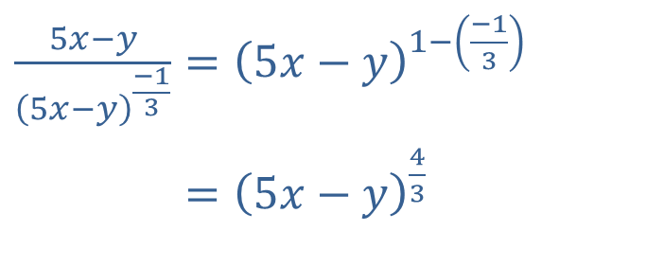

Example 5: Simplifying Expressions—Slide 6
e. We use the property $\frac{a^{n}}{a^{m}}=a^{n−m}$ to simplify this expression.
​$\frac{5x−y}{{\left(5x−y\right)}^{\frac{−1}{3}}}={\left(5x−y\right)}^{1−\left(\frac{−1}{3}\right)}$
​5𝑥−𝑦5𝑥−𝑦−13=5𝑥−𝑦43

Slide 25

Example 6: Simplifying Radical Expressions— Slide 1
​Simplify the expression $\sqrt[4]{x^{2}}$.
​Write $\sqrt[3]{2}⋅\sqrt{3}$ as a single radical.

Slide 26
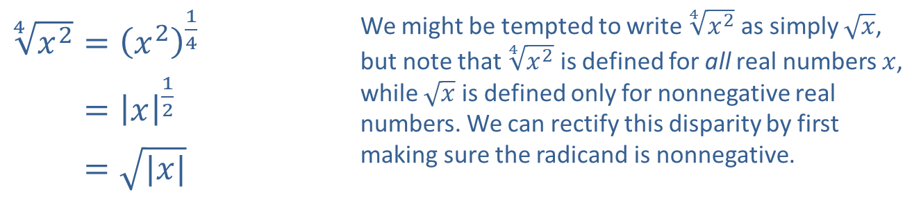
Example 6: Simplifying Radical Expressions— Slide 2
Solution
​
​$\sqrt[4]{x^{2}}={\left(x^{2}\right)}^{\frac{1}{4}}$ | We might be tempted to write $\sqrt[4]{x^{2}}$ as simply $\sqrt{x}$, but note that $\sqrt[4]{x^{2}}$ is defined for all real numbers $x$, while $\sqrt{x}$ is defined only for nonnegative real numbers. We can rectify this disparity by first making sure the radicand is nonnegative.
​4𝑥2=𝑥12
​4𝑥2=|𝑥|

Slide 27
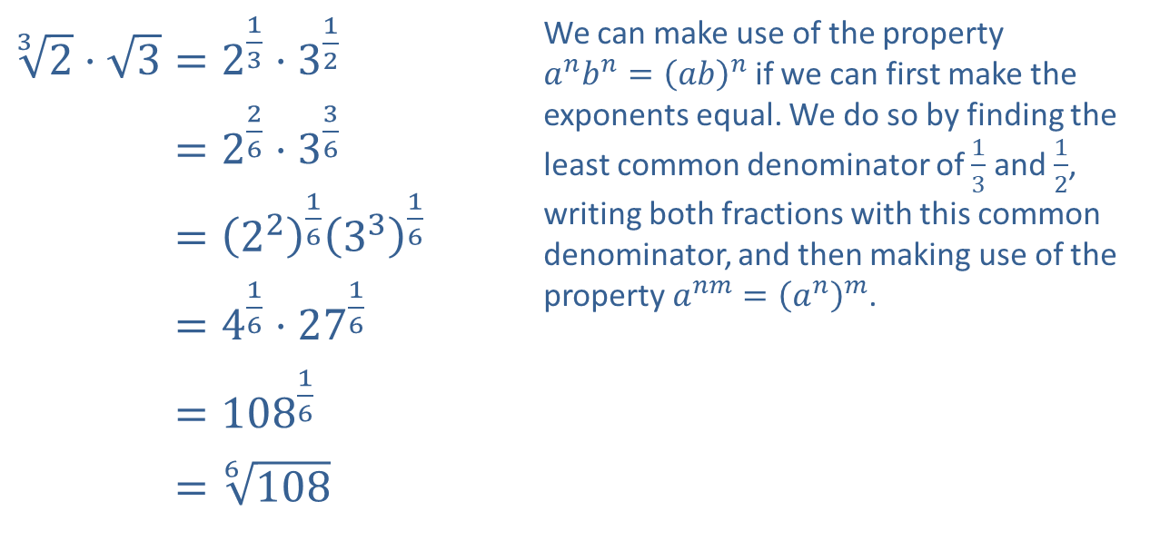
Example 6: Simplifying Radical Expressions— Slide 3
​$\sqrt[3]{2}⋅\sqrt{3}=2^{\frac{1}{3}}⋅3^{\frac{1}{2}}$ | We can make use of the property $a^{n}b^{n}={\left(ab\right)}^{n}$ if we can first make the exponents equal. We do so by finding the least common denominator of $\frac{1}{3}$ and $\frac{1}{2}$, writing both fractions with this common denominator, and then making use of the property $a^{nm}={\left(a^{n}\right)}^{m}$.
​32⋅3=226⋅336
​32⋅3=22163316
​32⋅3=416⋅2716
​32⋅3=10816
​32⋅3=6108
​

Slide 28

Example 7: Evaluating Rational Exponents using a Calculator—Slide 1
Evaluate the following expressions using a TI-84 Plus graphing calculator.
b.
Solution
a. To find proceed as follows.
Step 1: Enter the base, 125.
Step 2: Press the caret key .

Slide 29

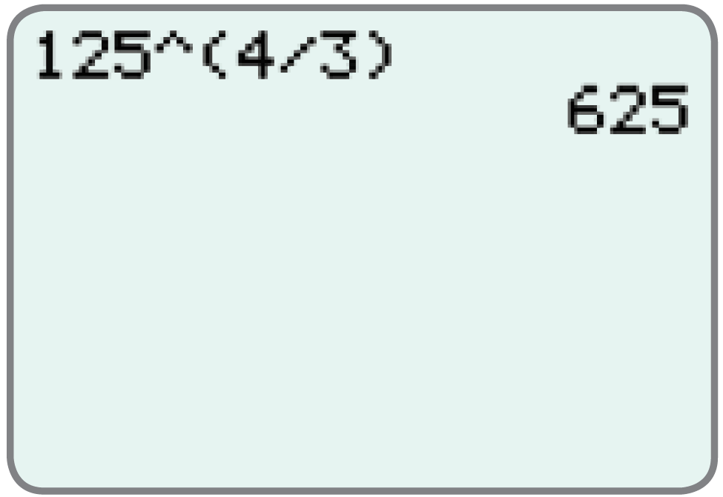
Example 7: Evaluating Rational Exponents using a Calculator—Slide 2
Step 3: Enter the exponent in parentheses,
Step 4: Press .
The display should appear as follows.

Slide 30
Example 7: Evaluating Rational Exponents using a Calculator—Slide 3
To find proceed as follows.
Step 1: Enter the base, 36.
Step 2: Press the caret key .
Step 3: Enter the exponent in parentheses,
Step 4: Press .

Slide 31
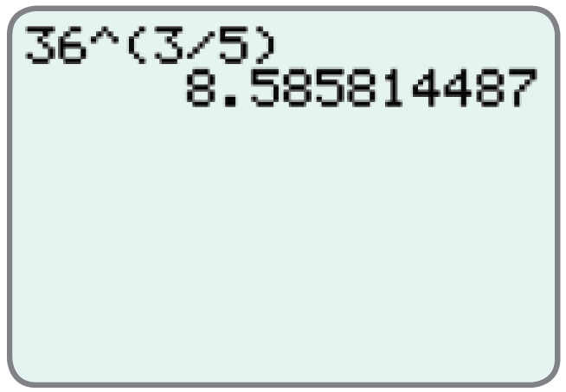
Example 7: Evaluating Rational Exponents using a Calculator—Slide 4
The display should appear as follows.

