Slide 1
Section F.4
Properties of Radicals

Slide 2
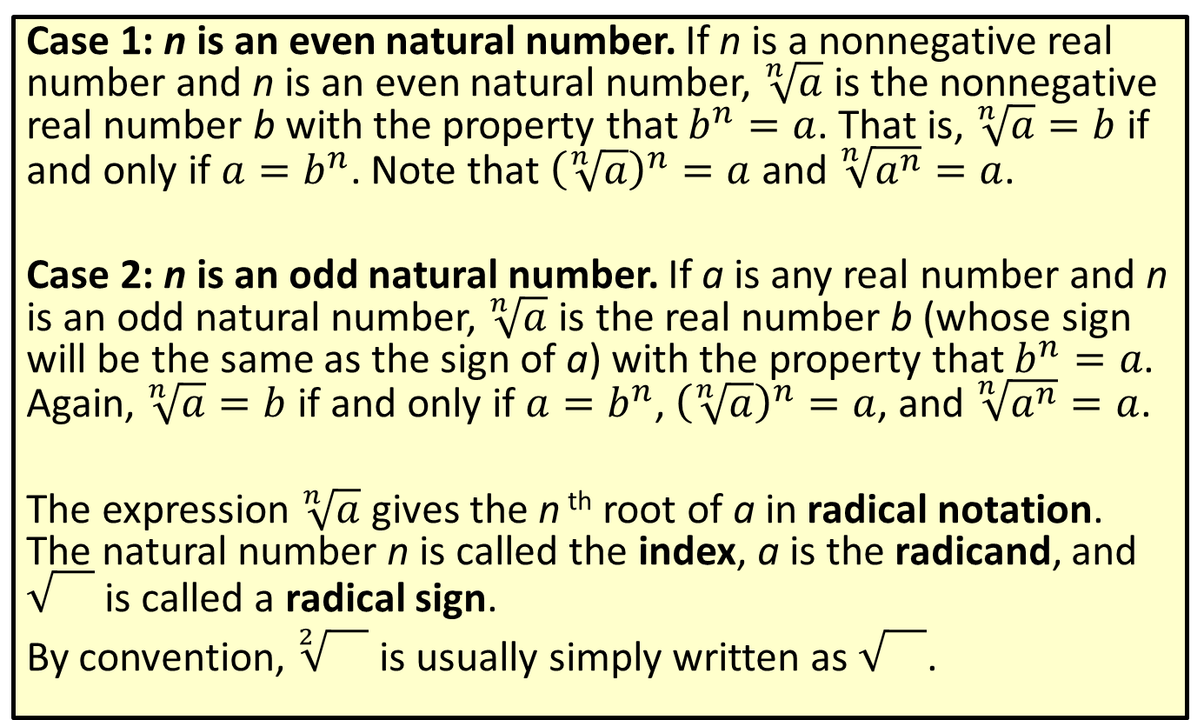
Definition: Radical Notation
Case 1: n is an even natural number. If n is a nonnegative real number and n is an even natural number, $\sqrt[n]{a}$ is the nonnegative real number b with the property that $b^{n}=a$. That is, $\sqrt[n]{a}=b$ if and only if $a=b^{n}$. Note that ${\left(\sqrt[n]{a}\right)}^{n}=a$ and $\sqrt[n]{a^{n}}=a$.
Case 2: n is an odd natural number. If a is any real number and n is an odd natural number, $\sqrt[n]{a}$ is the real number b (whose sign will be the same as the sign of a) with the property that $b^{n}=a$. Again, $\sqrt[n]{a}=b$ if and only if $a=b^{n}$, ${\left(\sqrt[n]{a}\right)}^{n}=a$, and $\sqrt[n]{a^{n}}=a$.
The expression $\sqrt[n]{a}$ gives the n ^{th} root of a in radical notation. The natural number n is called the index, a is the radicand, and is called a radical sign.
By convention, $\sqrt[2]{}$ is usually simply written as .

Slide 3
Definition: Perfect Powers
A perfect square is an integer equal to the square of another integer. The square root of a perfect square is always an integer.
A perfect cube is an integer equal to the cube of another integer. The cube root of a perfect cube is always an integer.

Slide 4
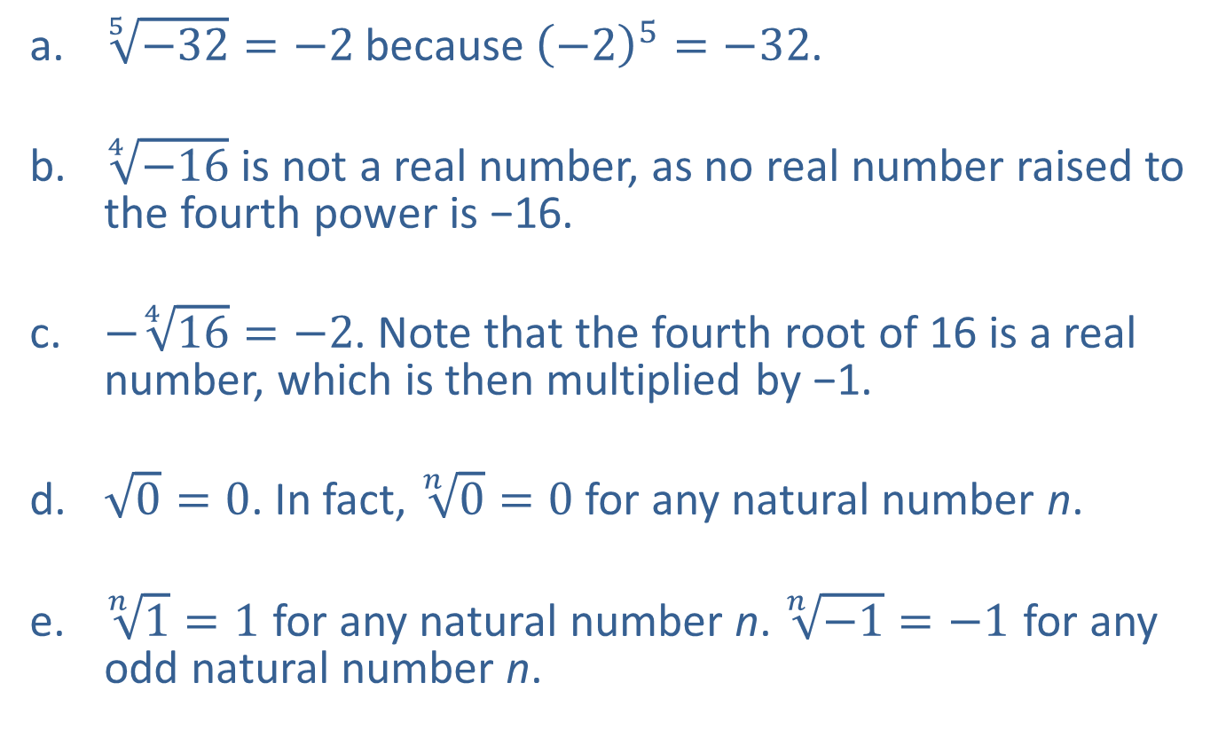
Example 1: Using Radical Notation—Slide 1
​$\sqrt[5]{−32}=−2$ because ${\left(−2\right)}^{5}=−32$.
​$\sqrt[4]{−16}$ is not a real number, as no real number raised to the fourth power is −16.
​$−\sqrt[4]{16}=−2$. Note that the fourth root of 16 is a real number, which is then multiplied by −1.
​$\sqrt{0}=0$. In fact, $\sqrt[n]{0}=0$ for any natural number n.
​​$\sqrt[n]{1}=1$ for any natural number n. $\sqrt[n]{−1}=−1$ for any odd natural number n.

Slide 5
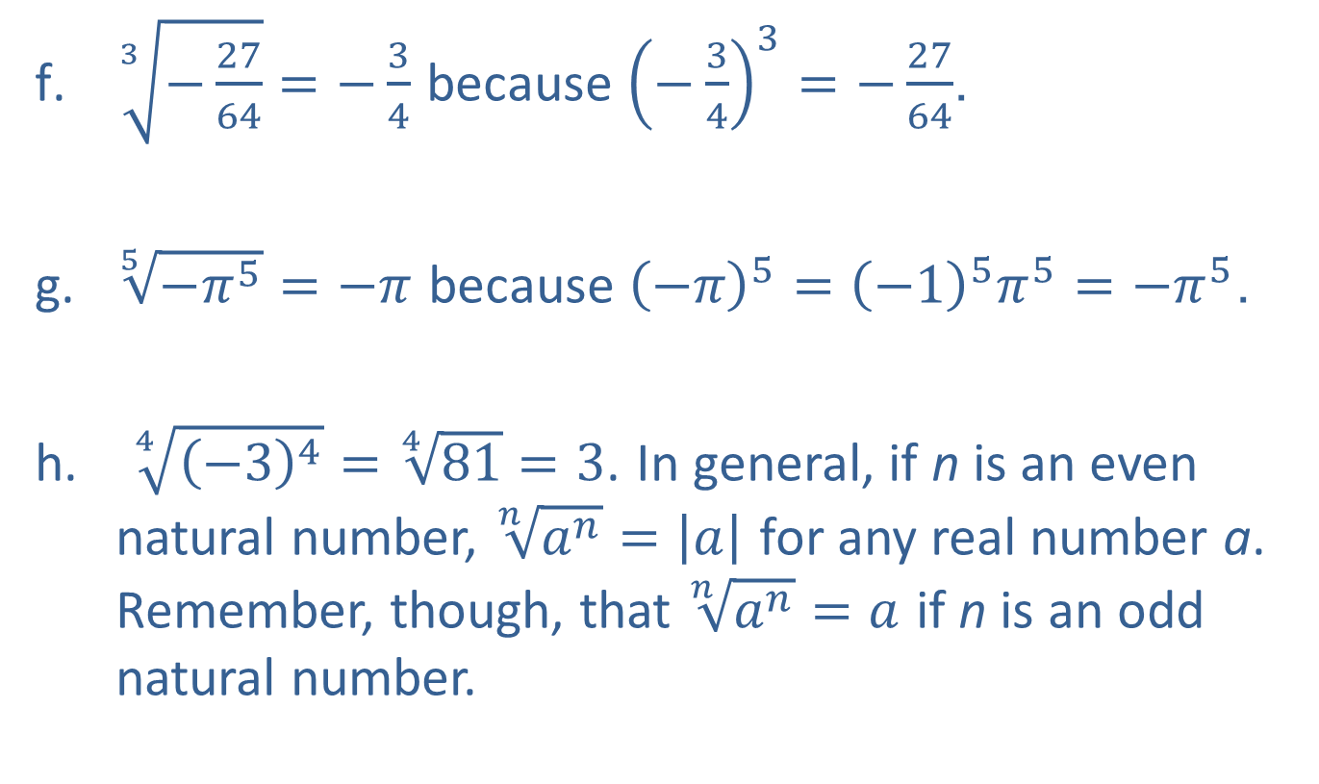
Example 1: Using Radical Notation—Slide 2
​$\sqrt[3]{−\frac{27}{64}}=−\frac{3}{4}$ because ${\left(−\frac{3}{4}\right)}^{3}=−\frac{27}{64}$.
​$\sqrt[5]{−π^{5}}=−π$ because ${\left(−π\right)}^{5}={\left(−1\right)}^{5}π^{5}=−π^{5}$.
$\sqrt[4]{{\left(−3\right)}^{4}}=\sqrt[4]{81}=3$. In general, if n is an even natural number, $\sqrt[n]{a^{n}}=\left|a\right|$ for any real number a. Remember, though, that $\sqrt[n]{a^{n}}=a$ if n is an odd natural number.

Slide 6
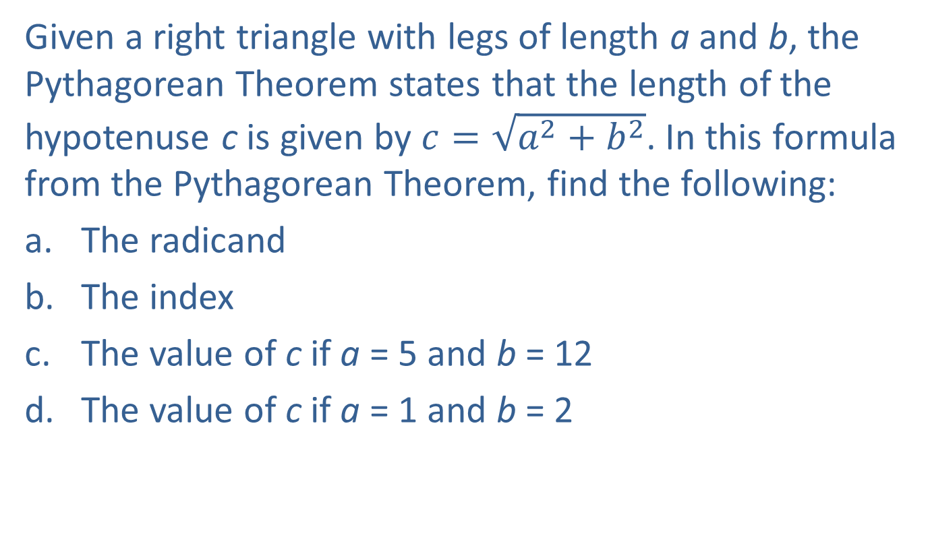
Example 2: Using Radical Notation—Slide 1
Given a right triangle with legs of length a and b, the Pythagorean Theorem states that the length of the hypotenuse c is given by $c=\sqrt{a^{2}+b^{2}}$. In this formula from the Pythagorean Theorem, find the following:
​The radicand
​The index
​The value of c if a = 5 and b = 12
​The value of c if a = 1 and b = 2

Slide 7
Example 2: Using Radical Notation—Slide 2
Solution
​The radicand is the quantity beneath the radical sign, a ² + b ².
​Because no index is indicated, the index is 2.
​

Slide 8
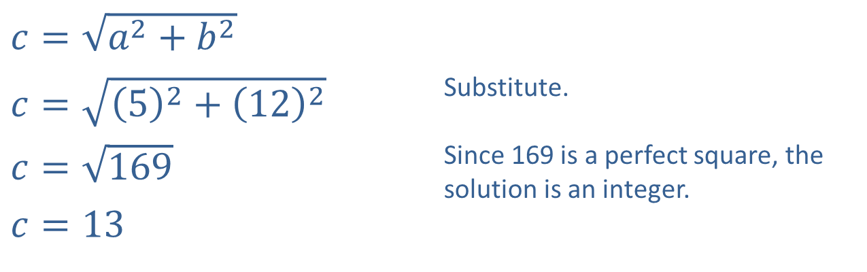
Example 2: Using Radical Notation—Slide 3
​$c=\sqrt{a^{2}+b^{2}}$
​$c=\sqrt{{\left(5\right)}^{2}+{\left(12\right)}^{2}}$ | Substitute.
​$c=\sqrt{169}$ | Since 169 is a perfect square, the solution is an integer.
​$c=13$
c. ​

Slide 9
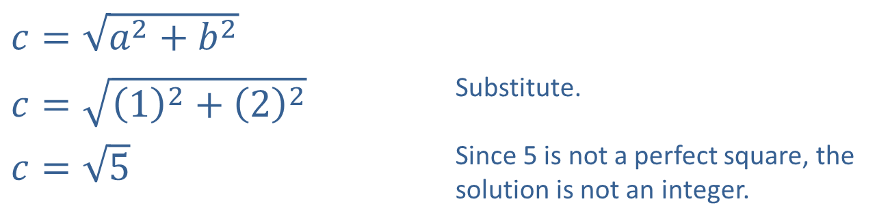
Example 2: Using Radical Notation—Slide 4
​$c=\sqrt{a^{2}+b^{2}}$
​$c=\sqrt{{\left(1\right)}^{2}+{\left(2\right)}^{2}}$ | Substitute.
​$c=\sqrt{5}$ | Since 5 is not a perfect square, the solution is not an integer.
​

Slide 10
Definition: Simplified Radical Form
A radical expression is in simplified form when the following conditions are met:
​The radicand contains no factor with an exponent greater than or equal to the index of the radical.
​The radicand contains no fractions.
​The denominator, if there is one, contains no radical.
​The greatest common factor of the index and any exponent occurring in the radicand is 1. That is, the index and any exponent in the radicand have no common factor other than 1.

Slide 11
Properties of Radicals—Slide 1
In the following properties, a and b may be taken to represent constants, variables, or more complicated algebraic expressions. The letters n and m represent natural numbers. It is assumed that all expressions are defined and are real numbers.

Slide 12
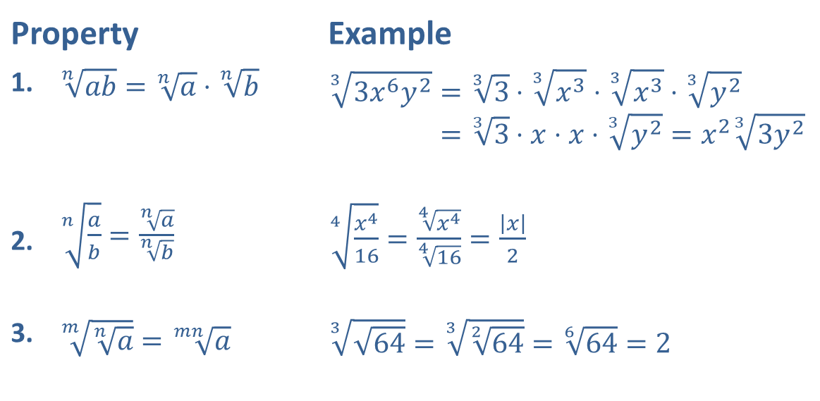
Properties of Radicals—Slide 2
Property |  | Example
1. | ​$\sqrt[n]{ab}=\sqrt[n]{a}⋅\sqrt[n]{b}$ | 33𝑥6𝑦2=33⋅3𝑥3⋅3𝑥3⋅3𝑦233𝑥6𝑦2=33⋅𝑥⋅𝑥⋅3𝑦2=𝑥233𝑦2
2. | ​$\sqrt[n]{\frac{a}{b}}=\frac{\sqrt[n]{a}}{\sqrt[n]{b}}$ | ​$\sqrt[4]{\frac{x^{4}}{16}}=\frac{\sqrt[4]{x^{4}}}{\sqrt[4]{16}}=\frac{\left|x\right|}{2}$
3. | ​$\sqrt[m]{\sqrt[n]{a}}=\sqrt[mn]{a}$ | ​$\sqrt[3]{\sqrt{64}}=\sqrt[3]{\sqrt[2]{64}}=\sqrt[6]{64}=2$

Slide 13

Example 3: Simplifying Radical Expressions— Slide 1
Simplify the following radical expressions.
​$\sqrt[3]{−16x^{8}y^{4}}$
​$\sqrt{8z^{6}}$
​$\sqrt[3]{\frac{72x^{2}}{y^{3}}}$

Slide 14
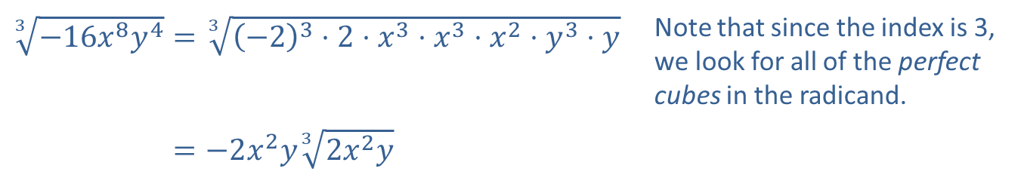
Example 3: Simplifying Radical Expressions— Slide 2
Solution
​
​$\sqrt[3]{−16x^{8}y^{4}}=\sqrt[3]{{\left(−2\right)}^{3}⋅2⋅x^{3}⋅x^{3}⋅x^{2}⋅y^{3}⋅y}$ | Note that since the index is 3, we look for all of the perfect cubes in the radicand.
​3−16𝑥8𝑦4=−2𝑥2𝑦32𝑥2𝑦

Slide 15
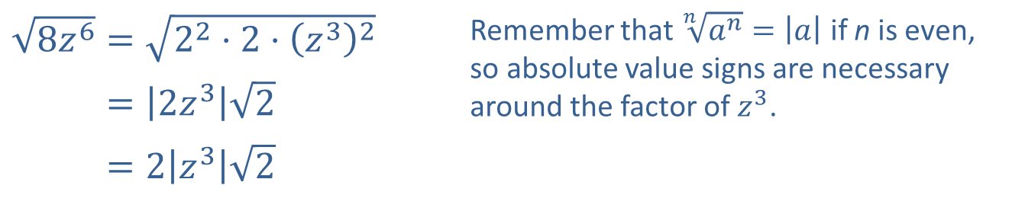
Example 3: Simplifying Radical Expressions— Slide 3
​$\sqrt{8z^{6}}=\sqrt{2^{2}⋅2⋅{\left(z^{3}\right)}^{2}}$ | Remember that $\sqrt[n]{a^{n}}=\left|a\right|$ if n is even, so absolute value signs are necessary around the factor of $z^{3}$.
​8𝑧6=2𝑧32
​8𝑧6=2𝑧32
​

Slide 16
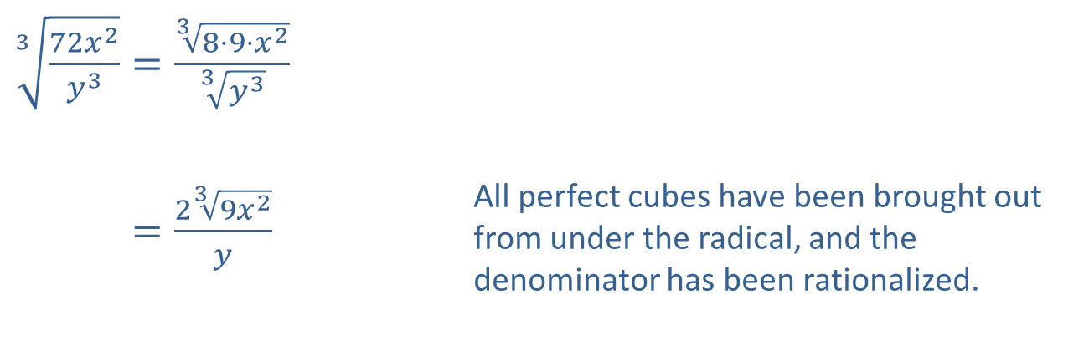
Example 3: Simplifying Radical Expressions— Slide 4
​$\sqrt[3]{\frac{72x^{2}}{y^{3}}}=\frac{\sqrt[3]{8⋅9⋅x^{2}}}{\sqrt[3]{y^{3}}}$
​372𝑥2𝑦3=239𝑥2𝑦 | All perfect cubes have been brought out from under the radical, and the denominator has been rationalized.
​

Slide 17
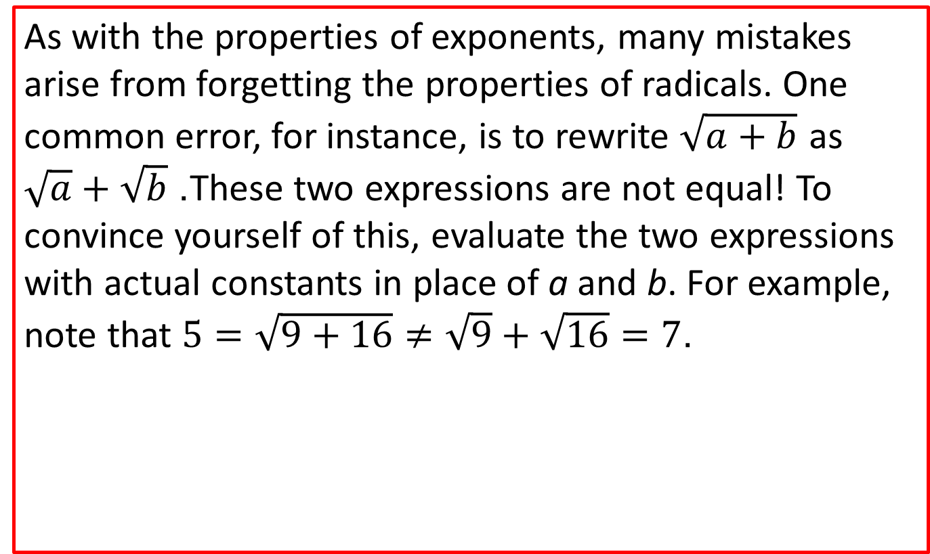
CAUTION!
As with the properties of exponents, many mistakes arise from forgetting the properties of radicals. One common error, for instance, is to rewrite $\sqrt{a+b}$ as $\sqrt{a}+\sqrt{b}$. These two expressions are not equal! To convince yourself of this, evaluate the two expressions with actual constants in place of a and b. For example, note that $5=\sqrt{9+16}≠\sqrt{9}+\sqrt{16}=7$.

Slide 18
Example 4: Combining Radical Expressions— Slide 1
Combine the radical expressions, if possible.

Slide 19
Example 4: Combining Radical Expressions— Slide 2

Slide 20
Example 4: Combining Radical Expressions— Slide 3

Slide 21

Example 5: Combining Radical Expressions— Slide 1
Combine the radical expressions, if possible.
​$−3\sqrt{8x^{5}}+\sqrt{18x}$
​$\sqrt[3]{54x^{3}}+\sqrt{50x^{2}}$

Slide 22
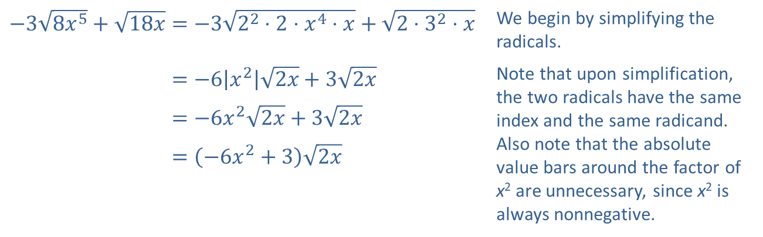
Example 5: Combining Radical Expressions— Slide 2
Solution
​
​$−3\sqrt{8x^{5}}+\sqrt{18x}=−3\sqrt{2^{2}⋅2⋅x^{4}⋅x}+\sqrt{2⋅3^{2}⋅x}$ | We begin by simplifying the radicals.
​−38𝑥5+18𝑥=−6𝑥22𝑥+32𝑥 | Note that upon simplification, the two radicals have the same index and the same radicand. Also note that the absolute value bars around the factor of x² are unnecessary, since x² is always nonnegative.
​−38𝑥5+18𝑥=−6𝑥22𝑥+32𝑥
​−38𝑥5+18𝑥=−6𝑥2+32𝑥

Slide 23
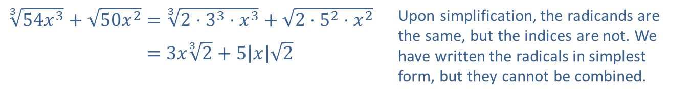
Example 5: Combining Radical Expressions— Slide 3
​
​$\sqrt[3]{54x^{3}}+\sqrt{50x^{2}}=\sqrt[3]{2⋅3^{3}⋅x^{3}}+\sqrt{2⋅5^{2}⋅x^{2}}$ | Upon simplification, the radicands are the same, but the indices are not. We have written the radicals in simplest form, but they cannot be combined.
​354𝑥3+50𝑥2=3𝑥32+5𝑥2

