Slide 1
Section F.1
Real Numbers

Slide 2
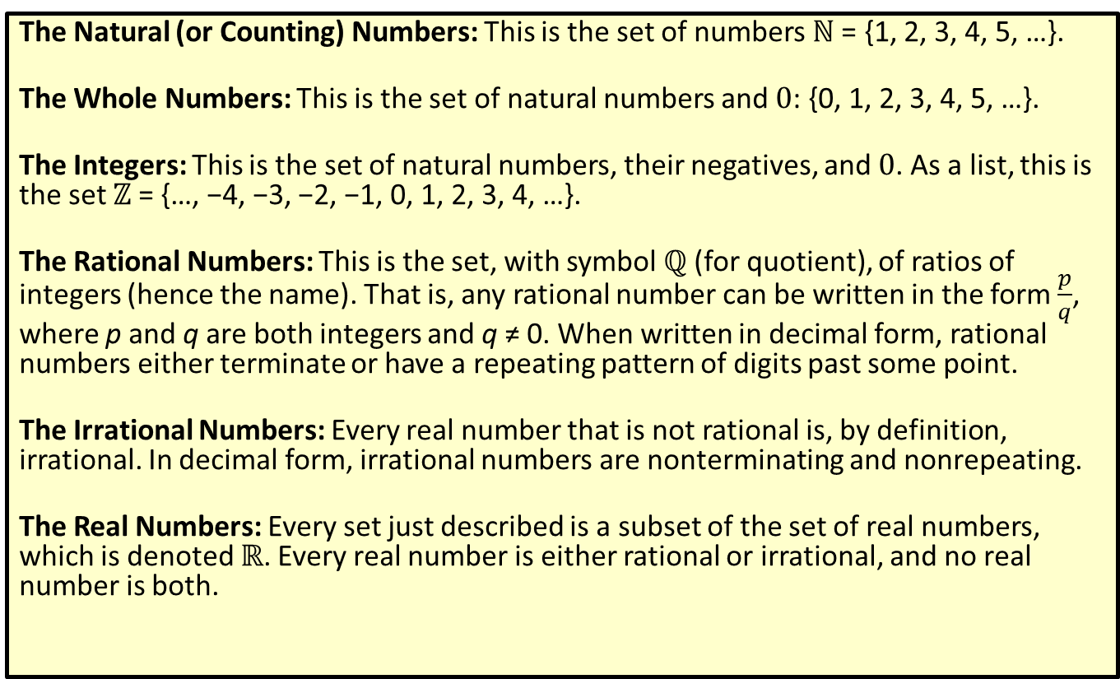
Definition: Types of Real Numbers
The Natural (or Counting) Numbers: This is the set of numbers ℕ = {1, 2, 3, 4, 5, …}.
The Whole Numbers: This is the set of natural numbers and 0: {0, 1, 2, 3, 4, 5, …}.
The Integers: This is the set of natural numbers, their negatives, and 0. As a list, this is the set ℤ = {…, −4, −3, −2, −1, 0, 1, 2, 3, 4, …}.
The Rational Numbers: This is the set, with symbol ℚ (for quotient), of ratios of integers (hence the name). That is, any rational number can be written in the form $\frac{p}{q}$, where p and q are both integers and q ≠ 0. When written in decimal form, rational numbers either terminate or have a repeating pattern of digits past some point.
The Irrational Numbers: Every real number that is not rational is, by definition, irrational. In decimal form, irrational numbers are nonterminating and nonrepeating.
The Real Numbers: Every set just described is a subset of the set of real numbers, which is denoted ℝ. Every real number is either rational or irrational, and no real number is both.

Slide 3
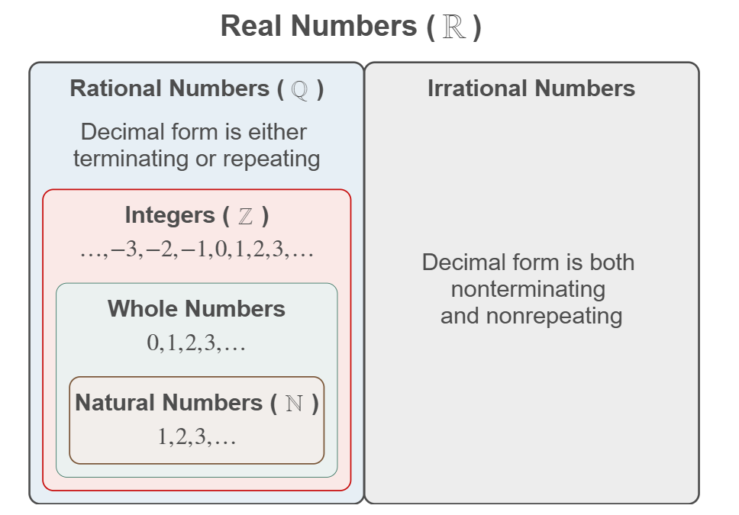
Relationships Among the Subsets of Real Numbers
Note: Any integer p is also a rational number, since it can be written as $\frac{p}{1}$.

Slide 4
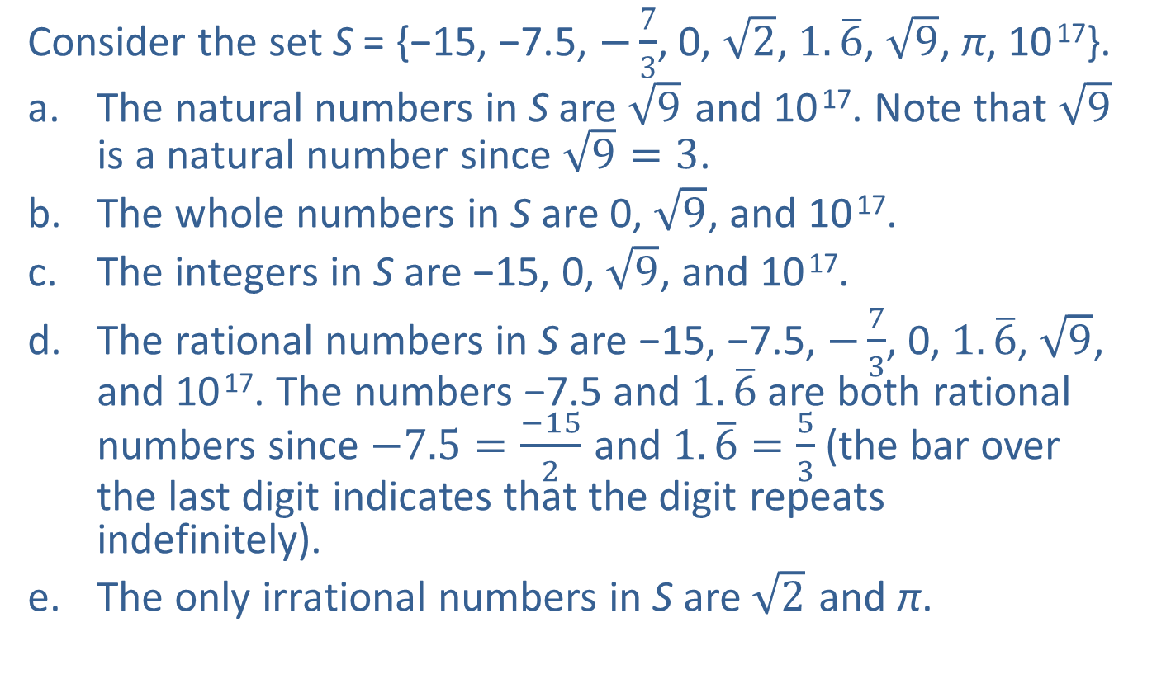
Example 1: Types of Real Numbers
Consider the set S = {−15, −7.5, $−\frac{7}{3}$, 0, $\sqrt{2}$, $1.\overline{6}$, $\sqrt{9}$, π, 10 ¹⁷}.
​The natural numbers in S are $\sqrt{9}$ and 10 ¹⁷. Note that $\sqrt{9}$ is a natural number since $\sqrt{9}=3$.
​The whole numbers in S are 0, $\sqrt{9}$, and 10 ¹⁷.
​The integers in S are −15, 0, $\sqrt{9}$, and 10 ¹⁷.
​The rational numbers in S are −15, −7.5, $−\frac{7}{3}$, 0, $1.\overline{6}$, $\sqrt{9}$, and 10 ¹⁷. The numbers −7.5 and $1.\overline{6}$ are both rational numbers since $−7.5=\frac{−15}{2}$ and $1.\overline{6}=\frac{5}{3}$ (the bar over the last digit indicates that the digit repeats indefinitely).
​The only irrational numbers in S are $\sqrt{2}$ and π.

Slide 5
Example 2: Drawing the Real Number Line—Slide 1
We choose which portion of the real number line to show and the physical length that represents one unit based on the numbers that we wish to plot.
​If we want to plot the numbers 101, 106, and 107, we might construct the graph in Figure 3.
​
Figure 3

Slide 6
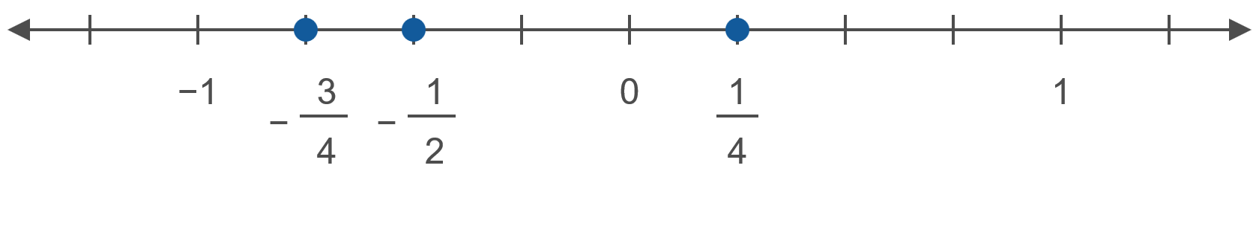

Example 2: Drawing the Real Number Line—Slide 2
​If we want to plot the numbers $−\frac{3}{4}$, $−\frac{1}{2}$, and $\frac{1}{4}$, we might make the unit interval longer.
​
Figure 4

Slide 7
Definition: Inequality Symbols (Order)
The two symbols < and > are called strict inequality signs, while the symbols ≤ and ≥ are nonstrict inequality signs.
Symbol | Reading | Meaning
a < b | “a is less than b” | a lies to the left of b on the number line
a ≤ b | “a is less than or equal to b” | a lies to the left of b or is equal to b
b > a | “b is greater than a” | b lies to the right of a on the number line
b ≥ a | “b is greater than or equal to a” | b lies to the right of a or is equal to a

Slide 8
CAUTION!—1
Remember that order is defined by the placement of real numbers on the number line, not by magnitude (its distance from zero). For instance, −36 < 5 because −36 lies to the left of 5 on the number line.

Slide 9
Example 3: Working with Order—Slide 1
5 ≤ 9, since 5 lies to the left of 9.
5 ≤ 5, since 5 is equal to 5. Note that for every real number a, we have a ≤ a and a ≥ a.
−7 > −163, since −7 lies to the right of −163.
​The statement “5 is greater than −2” can be written 5 > −2.

Slide 10
Example 3: Working with Order—Slide 2
​The statement “a is less than or equal to b + c” can be written a ≤ b + c.
​The statement “x is strictly less than y” can be written x < y.
​The negation of the statement a ≤ b is the statement a > b.
​If a ≤ b and a ≥ b, then it must be the case that
a = b.

Slide 11
Definition: Set-Builder Notation
The notation {x|x has property P} is used to describe a set of real numbers, all of which have the property P. This can be read “the set of all real numbers x having property P.”
The symbol | is also read as “such that,” so the given notation can also be read “the set of all real numbers x, such that x has property P.”

Slide 12
Example 4: Set-Builder Notation
​{x|x is an even integer} is another way of describing the set {…, −4, −2, 0, 2, 4, …}. We could also describe this set as {2n|n is an integer}, since every even integer is a multiple of 2.
​ {x|x is an integer and −3 ≤ x < 2} describes the set {−3, −2, −1, 0, 1}.

Slide 13
Definition: The Empty Set
A set with no elements is called the empty set or the null set, and is denoted by the symbol ∅ or { }.
The empty set can arise from a set defined using
set-builder notation; for example, the set
{y|y > 1 and y ≤ −4} is equivalent to the empty set, since no real number y satisfies the stated property.

Slide 14
Definition: Interval Notation—Slide 1
Interval Notation | Set-Builder Notation | Meaning
(a, b) | {x|a < x < b} | all real numbers strictly between a and b
[a, b] | {x|a ≤ x ≤ b} | all real numbers between a and b, including both a and b
(a, b] | {x|a < x ≤ b} | all real numbers between a and b, including b but not a
(−∞, b) | {x|x < b} | all real numbers less than b
[a, ∞) | {x|x ≥ a} | all real numbers greater than or equal to a

Slide 15
Definition: Interval Notation—Slide 2
Intervals of the form (a, b) are called open intervals, while those of the form [a, b] are closed intervals. The interval (a, b] is half-open (or half-closed). A half-open interval may be open at either endpoint, as long as it is closed at the other. The symbols −∞ and ∞ indicate that the interval extends indefinitely in the left and the right directions, respectively. Note that (−∞, b) excludes the endpoint b, while [a, ∞) includes the endpoint a.

Slide 16
CAUTION!—2
The symbols −∞ and ∞ are just that: symbols! They are not real numbers, so they cannot be solutions to a given equation. The fact that they are symbols, and not numbers, means that they can never be included in a set of real numbers. For this reason, a parenthesis always appears next to either −∞ or ∞; a bracket should never appear next to either infinity symbol.

Slide 17
Example 5: Intervals of Real Numbers—Slide 1
​The interval (2, 8) represents the set {x|2 < x < 8}.
This interval is open at both endpoints, so neither 2 nor 8 is included in the set.
​The interval [−5, −1] is another way to write the set {x|−5 ≤ x ≤ −1}. This interval is closed at both endpoints, so both −5 and −1 are included in the set.
​The interval [−3, 10) stands for the set
{x|−3 ≤ x < 10}. This interval is closed at the left endpoint, −3, and open at the right endpoint, 10.

Slide 18
Example 5: Intervals of Real Numbers—Slide 2
​The interval (4, ∞) stands for the set {x|x > 4}. Since the interval is open on the left endpoint, it is the set of numbers greater than (but not equal to) 4.
​The interval (−∞, ∞) is just another way of describing the entire set of real numbers.

Slide 19
Definition: Union—Slide 1
In this definition, A and B denote two sets, which are represented in the Venn diagram by circles. The operation of union is depicted in Figure 5 by shading.
The union of A and B, denoted A ∪ B, is the set
{x|x ∈ A or x ∈ B}. That is, an element x is in A ∪ B if it is in the set A, the set B, or both. Note that the union of A and B contains both individual sets.

Slide 20
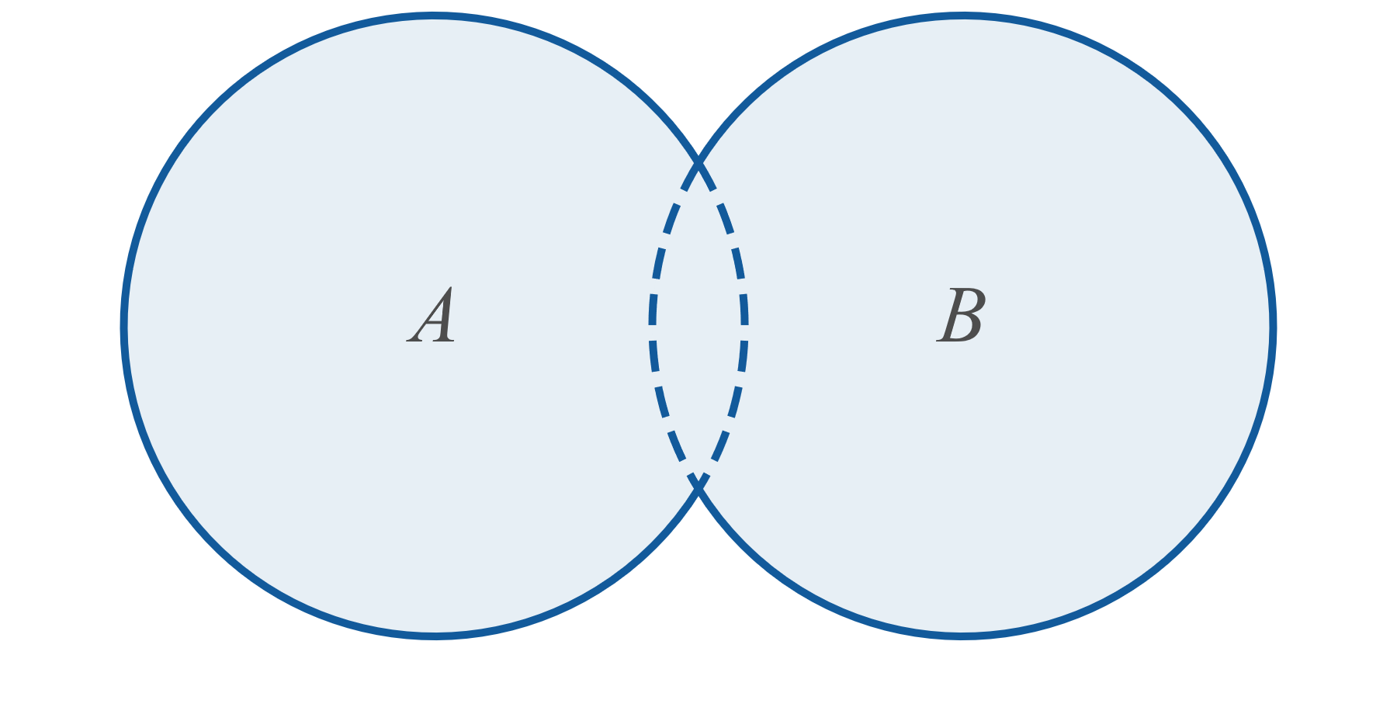
Definition: Union—Slide 2
Figure 5: A ∪ B

Slide 21
Definition: Intersection—Slide 1
In this definition, A and B denote two sets, which are represented in the Venn diagram by circles. The operation of intersection is depicted in Figure 6 by shading.
The intersection of A and B, denoted A ∩ B, is the set {x|x ∈ A and x ∈ B}. That is, an element x is in A ∩ B if it is in both A and B. Note that the intersection of A and B is contained in each individual set.

Slide 22
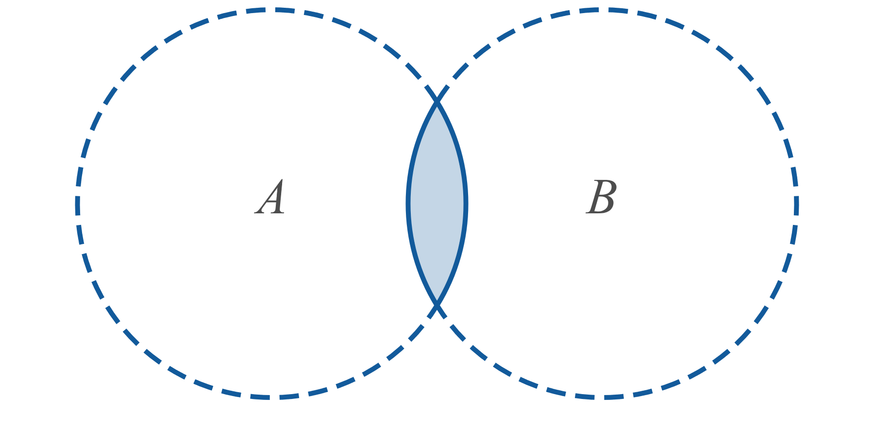
Definition: Intersection—Slide 2
Figure 6: A ∩ B

Slide 23
Example 6: Union and Intersection of Intervals—Slide 1
Simplify the following set expressions.
​(−2, 4] ∪ [0, 9]
(−2, 4] ∩ [0, 9]
[3, 4) ∩ (4, 9)
(−∞, 4] ∪ (−1, ∞)

Slide 24
Example 6: Union and Intersection of Intervals—Slide 2
Solution
​ (−2, 4] ∪ [0, 9] = (−2, 9]
Since these two intervals overlap, their union is described with a single interval.
(−2, 4] ∩ [0, 9] = [0, 4]
This intersection of two intervals can also be described with a single interval.

Slide 25
Example 6: Union and Intersection of Intervals— Slide 3
[3, 4) ∩ (4, 9) = ∅
These two intervals have no elements in common, so their intersection is the empty set.
(−∞, 4] ∪ (−1, ∞) = (−∞, ∞)
The union of these two intervals is the entire set of real numbers.

Slide 26
Example 7: Union and Intersection—Slide 1
Simplify the following set expressions.
{1, 2}​ ∪ {0, 3}
​{x, y, z} ∩ {w, x}
ℤ ∪ ℝ
ℤ ∩ ℝ

Slide 27
Example 7: Union and Intersection—Slide 2
Solution
​The union of the two sets consists of all elements in either set: {0, 1, 2, 3}.
​The intersection consists only of elements in both sets: {x}.
​Since the integers are all also real numbers, the union of these two sets is simply the set of real numbers ℝ. We say that ℤ is contained in ℝ.
​Similarly, since all integers are also real numbers, the integers are the elements contained in both sets. Thus, the intersection is ℤ.

Slide 28
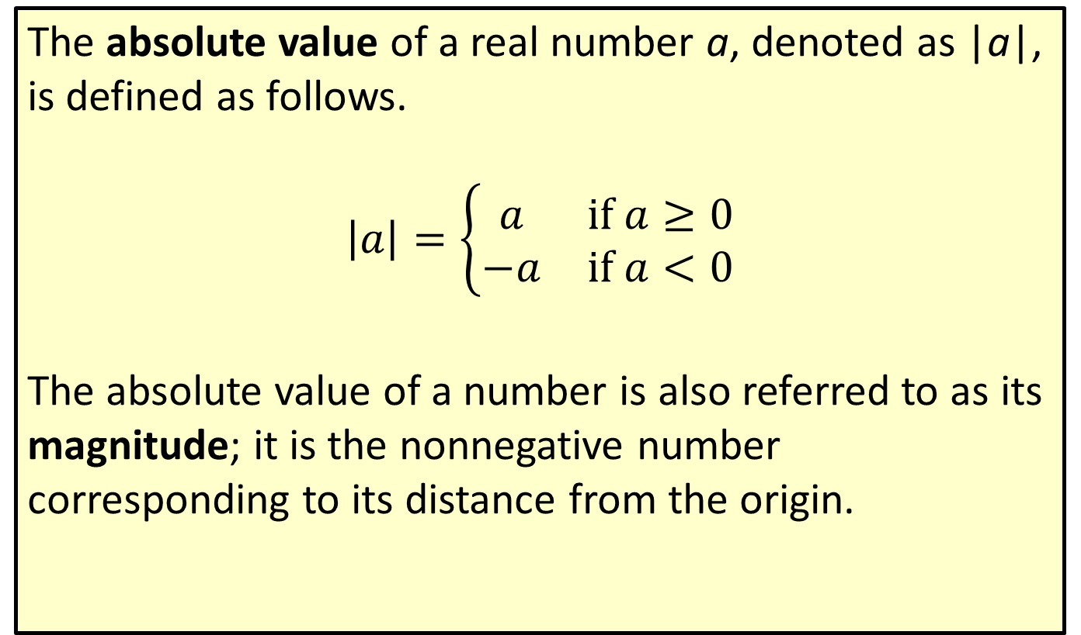
Definition: Absolute Value
The absolute value of a real number a, denoted as |a|, is defined as follows.
$$\left|a\right|=\left\{\begin{matrix}a & \text{if} a≥0 \\ −a & \text{if} a<0\end{matrix}\right.$$
The absolute value of a number is also referred to as its magnitude; it is the nonnegative number corresponding to its distance from the origin.

Slide 29
Definition: Distance on the Real Number Line
Given two real numbers a and b, the distance between them is defined to be |a − b|. In particular, the distance between a and 0 is |a − 0| or just |a|.

Slide 30

Example 8: Absolute Value—Slide 1
|17 − 3| = |3 − 17| = 14
$17$ and 3 are 14 units apart.
|−π| = |π| = π
Both −π and π are π units from 0.
​$\frac{\left|7\right|}{7}=\frac{7}{7}=1$
​$\frac{\left|−7\right|}{−7}=\frac{7}{−7}=−1$

Slide 31
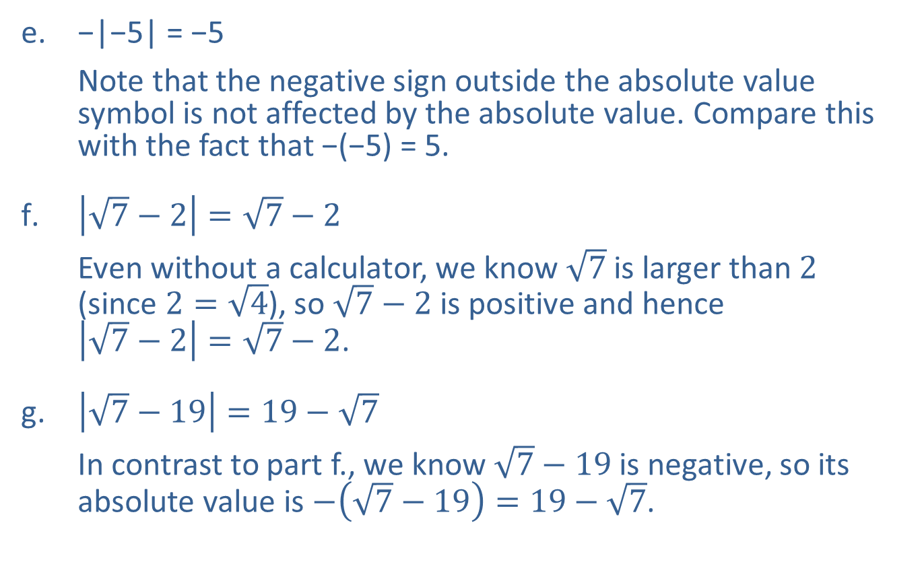
Example 8: Absolute Value—Slide 2
​−|−5| = −5
Note that the negative sign outside the absolute value symbol is not affected by the absolute value. Compare this with the fact that ​−(−5) = 5.
​$\left|\sqrt{7}−2\right|=\sqrt{7}−2$
Even without a calculator, we know $\sqrt{7}$ is larger than 2
(since $2=\sqrt{4}$), so $\sqrt{7}−2$ is positive and hence
$\left|\sqrt{7}−2\right|=\sqrt{7}−2$.
​$\left|\sqrt{7}−19\right|=19−\sqrt{7}$
In contrast to part f., we know $\sqrt{7}−19$ is negative, so its absolute value is $−\left(\sqrt{7}−19\right)=19−\sqrt{7}$.

Slide 32
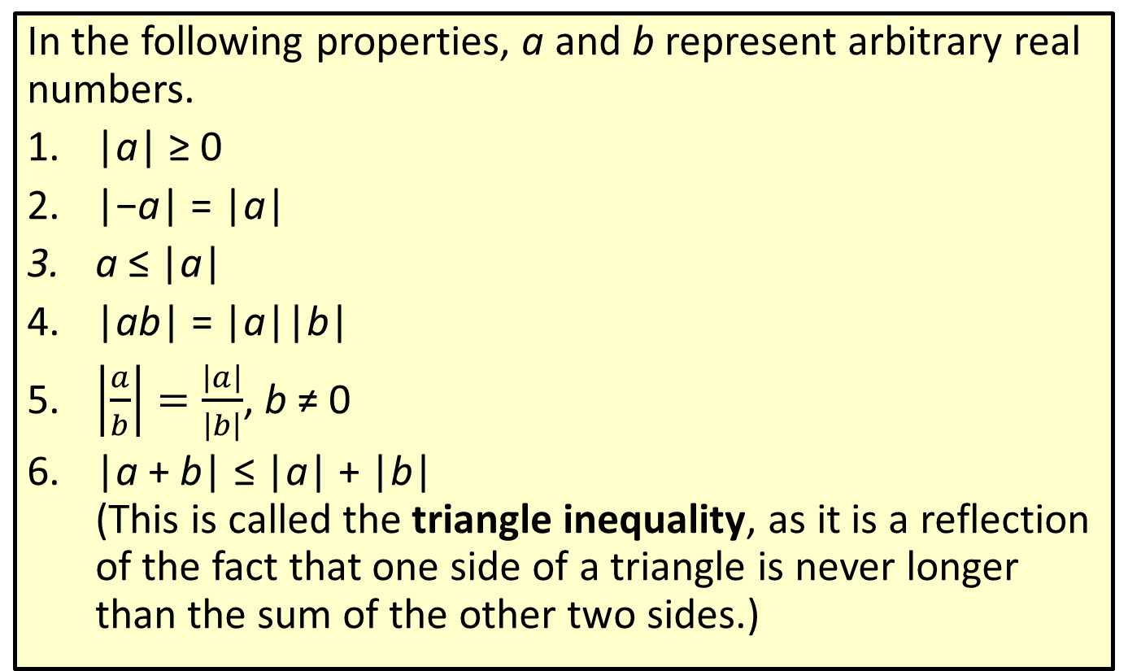
Properties of Absolute Value
In the following properties, a and b represent arbitrary real numbers.
|a| ≥ 0
|−a| = |a|
a ≤ |a|
|ab| = |a||b|
​$\left|\frac{a}{b}\right|=\frac{\left|a\right|}{\left|b\right|}$, b ≠ 0
|a + b| ≤ |a| + |b|
(This is called the triangle inequality, as it is a reflection of the fact that one side of a triangle is never longer than the sum of the other two sides.)

Slide 33

Example 9: Using Absolute Value Properties
|(−3)(5)| = |−15| = 15 = |−3||5|
1 = |−3 + 4| ≤ |−3| + |4| = 7
7 = |−3 − 4| ≤ |−3| + |−4| = 7
​$\left|\frac{−3}{7}\right|=\frac{\left|−3\right|}{\left|7\right|}=\frac{3}{7}$

