Slide 1
Section 9.R.2
Parabolas

Slide 2
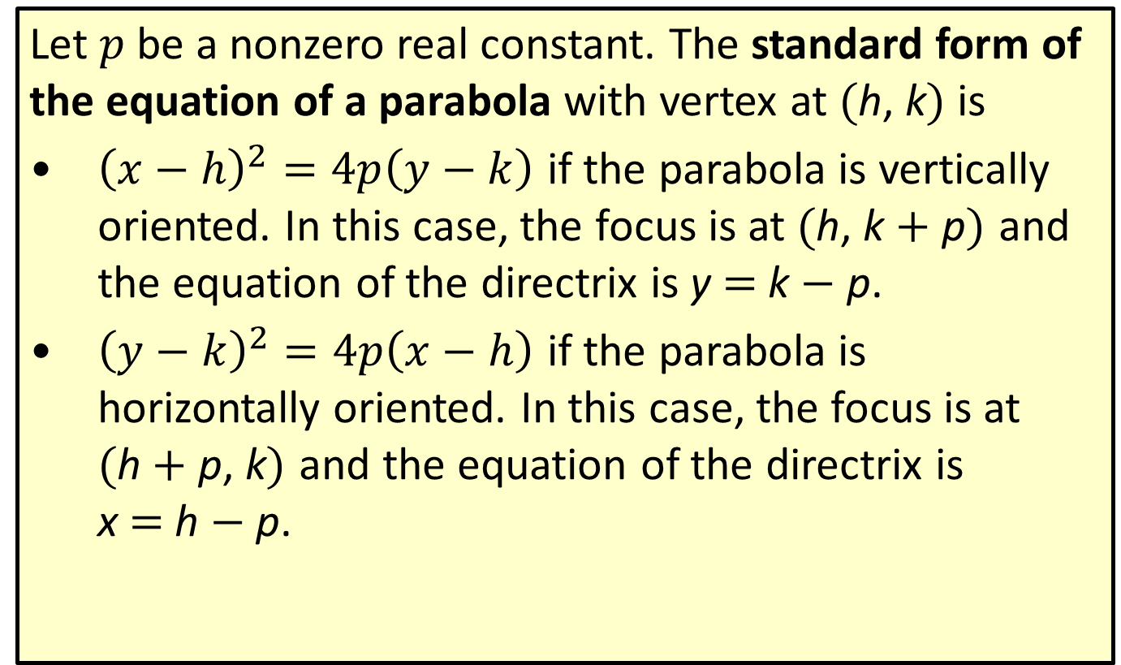
Definition: Standard Form of the Equation of a Parabola
Let $p$ be a nonzero real constant. The standard form of the equation of a parabola with vertex at (h, k) is
​${\left(x−h\right)}^{2}=4p\left(y−k\right)$ if the parabola is vertically oriented. In this case, the focus is at (h, k + p) and the equation of the directrix is y = k − p.
​${\left(y−k\right)}^{2}=4p\left(x−h\right)$ if the parabola is horizontally oriented. In this case, the focus is at
(h + p, k) and the equation of the directrix is
x = h − p.

Slide 3

Example 1: Graphing a Parabola with Equation in Standard Form—Slide 1
Graph the parabola ${\left(y+2\right)}^{2}=8\left(x−4\right)$ and determine its focus and directrix.

Slide 4
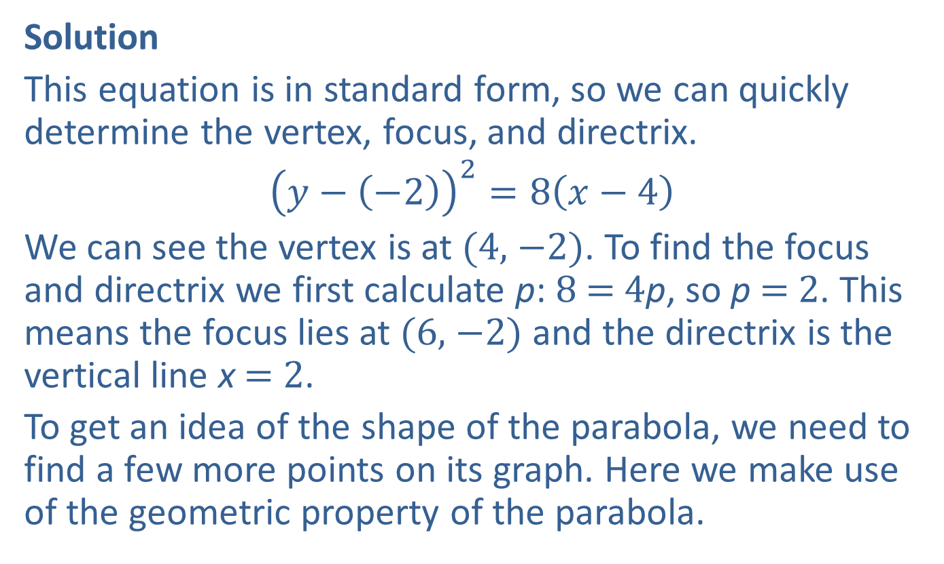
Example 1: Graphing a Parabola with Equation in Standard Form—Slide 2
Solution
This equation is in standard form, so we can quickly determine the vertex, focus, and directrix.
$${\left(y−\left(−2\right)\right)}^{2}=8\left(x−4\right)$$
We can see the vertex is at (4, −2). To find the focus and directrix we first calculate p: 8 = 4p, so p = 2. This means the focus lies at (6, −2) and the directrix is the vertical line x = 2.
To get an idea of the shape of the parabola, we need to find a few more points on its graph. Here we make use of the geometric property of the parabola.

Slide 5
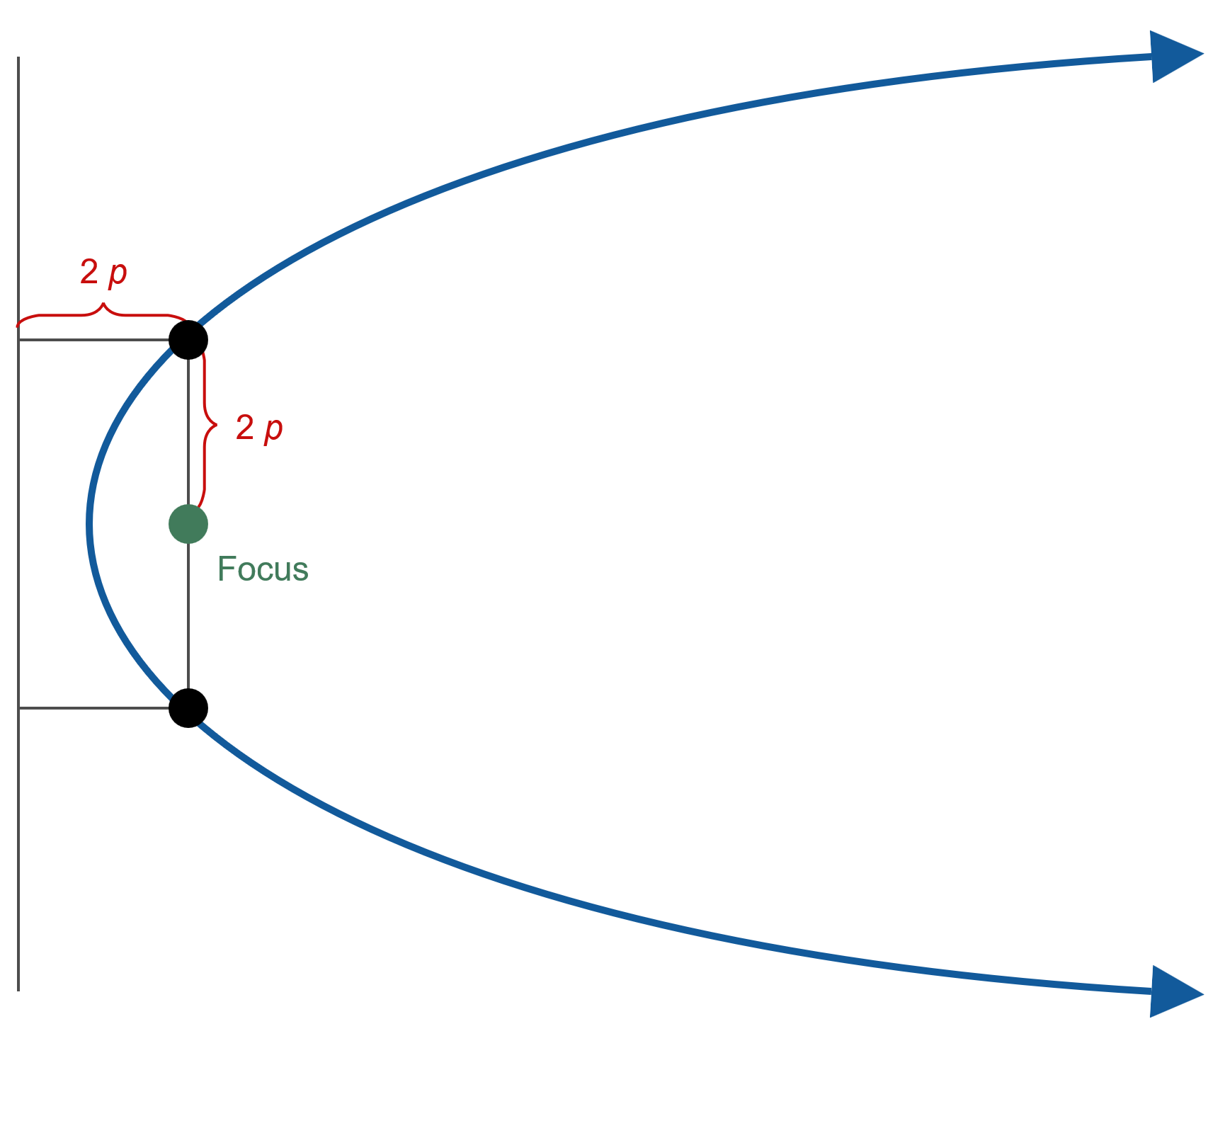
Example 1: Graphing a Parabola with Equation in Standard Form—Slide 3
Figure 2: Two Easily Plotted Points

Slide 6
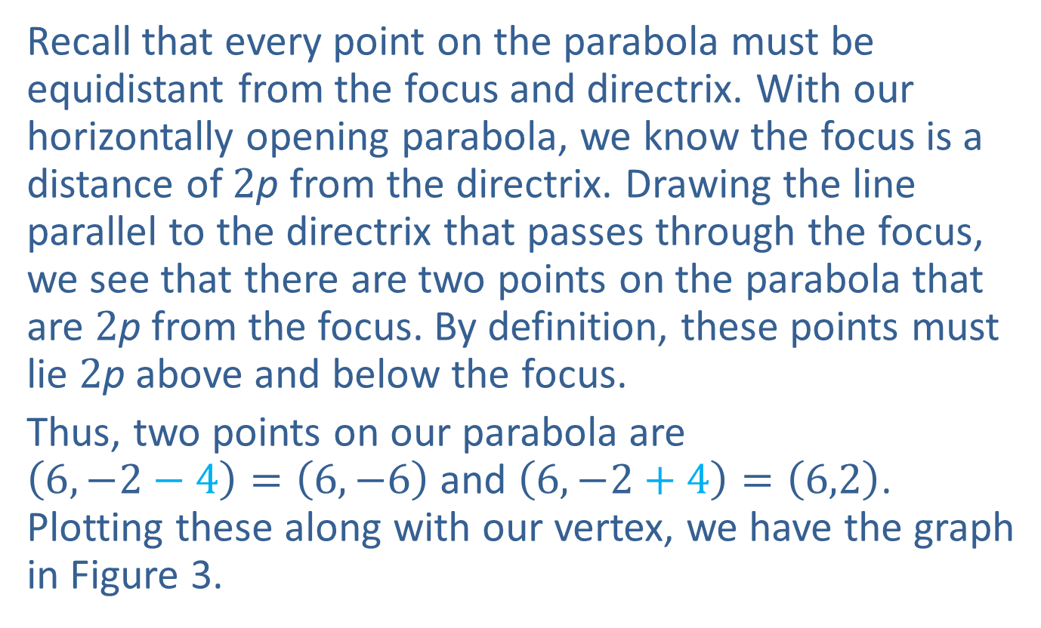
Example 1: Graphing a Parabola with Equation in Standard Form—Slide 4
Recall that every point on the parabola must be equidistant from the focus and directrix. With our horizontally opening parabola, we know the focus is a distance of 2p from the directrix. Drawing the line parallel to the directrix that passes through the focus, we see that there are two points on the parabola that are 2p from the focus. By definition, these points must lie 2p above and below the focus.
Thus, two points on our parabola are
$\left(6,−2−4\right)=\left(6,−6\right)$ and $\left(6,−2+4\right)=\left(6,2\right)$. Plotting these along with our vertex, we have the graph in Figure 3.

Slide 7
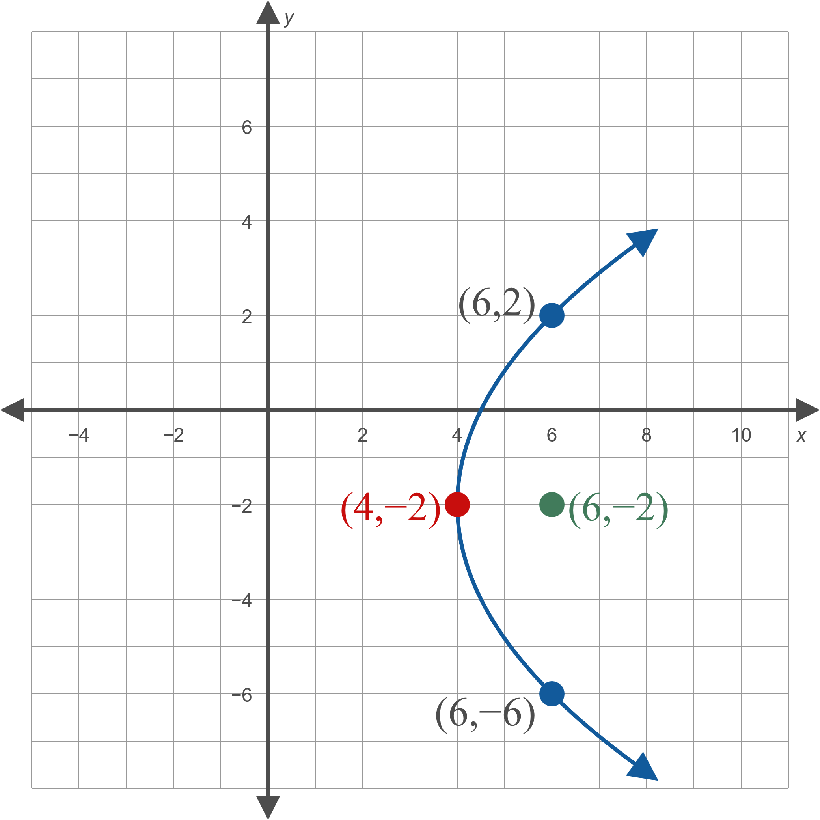
Example 1: Graphing a Parabola with Equation in Standard Form—Slide 5
Figure 3

Slide 8

Example 2: Graphing a Parabola with Equation Not in Standard Form—Slide 1
Graph the parabola $−y^{2}+2x+2y+5=0$ and determine its focus and directrix.

Slide 9
Note 1
Even though it is not in standard form, we know this equation represents a parabola because the product of the coefficients of x ² and y ² is zero.

Slide 10
Example 2: Graphing a Parabola with Equation Not in Standard Form—Slide 2
Solution
Written in this form, it is difficult to graph the parabola. We can rewrite the equation in standard form by completing the square with respect to y (the squared variable).

Slide 11
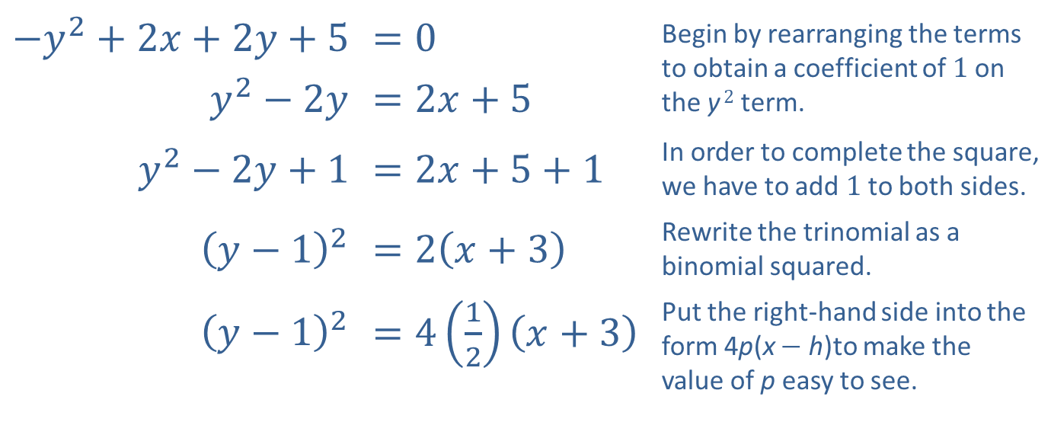
Example 2: Graphing a Parabola with Equation Not in Standard Form—Slide 3
​$−y^{2}+2x+2y+5$ | ​$=0$ | Begin by rearranging the terms to obtain a coefficient of 1 on the y ² term.
​$y^{2}−2y$ | ​$=2x+5$
​$y^{2}−2y+1$ | ​$=2x+5+1$ | In order to complete the square, we have to add 1 to both sides.
​${\left(y−1\right)}^{2}$ | ​$=2\left(x+3\right)$ | Rewrite the trinomial as a binomial squared.
​${\left(y−1\right)}^{2}$ | ​$=4\left(\frac{1}{2}\right)\left(x+3\right)$ | Put the right-hand side into the form 4p(x − h)to make the value of p easy to see.

Slide 12
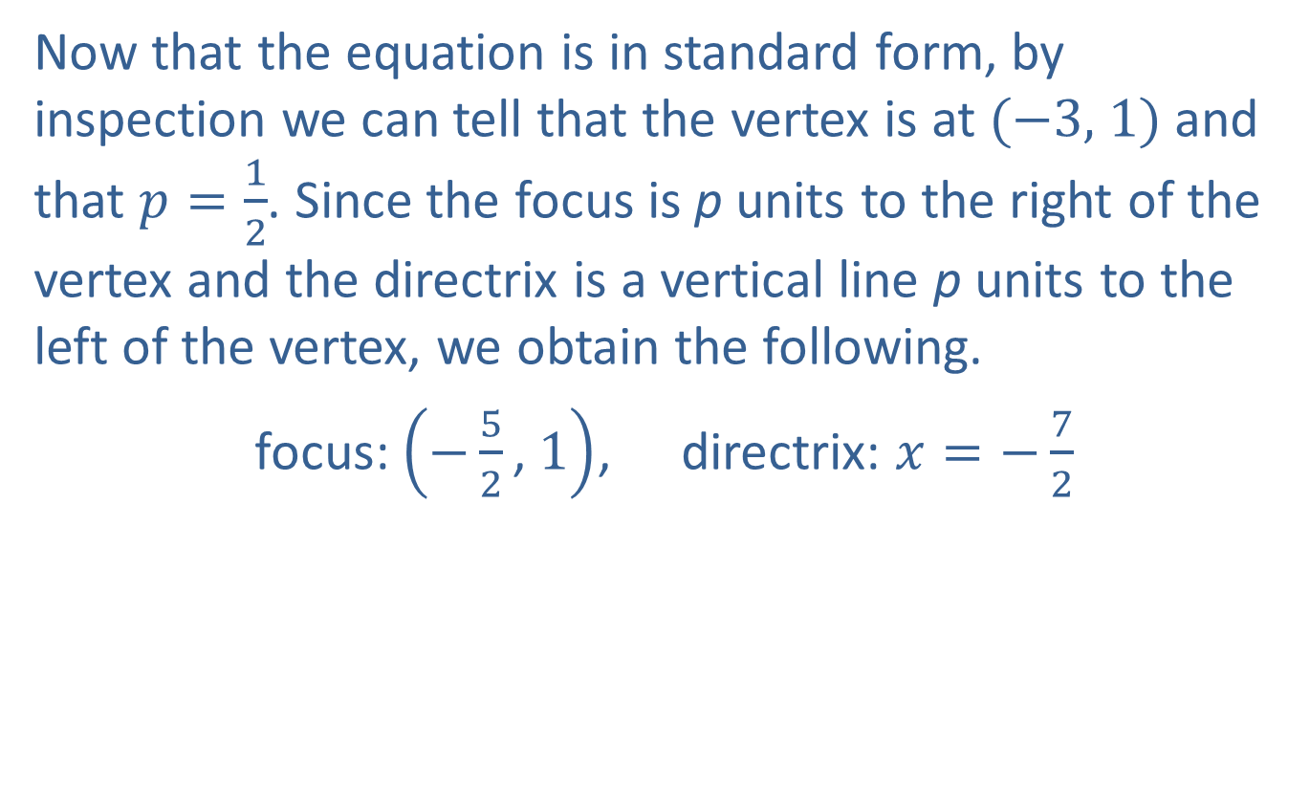
Example 2: Graphing a Parabola with Equation Not in Standard Form—Slide 4
Now that the equation is in standard form, by inspection we can tell that the vertex is at (−3, 1) and that $p=\frac{1}{2}$. Since the focus is p units to the right of the vertex and the directrix is a vertical line p units to the left of the vertex, we obtain the following.
focus: $\left(−\frac{5}{2}\text{, }1\right)$, directrix: $x=−\frac{7}{2}$

Slide 13
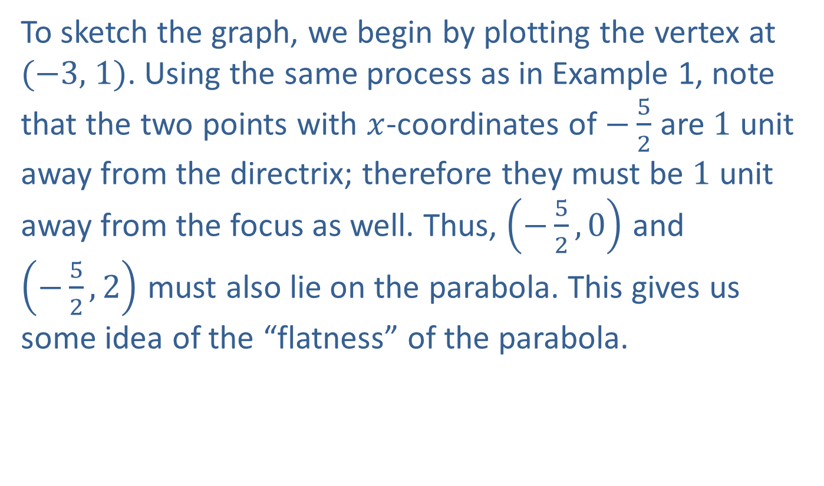
Example 2: Graphing a Parabola with Equation Not in Standard Form—Slide 5
To sketch the graph, we begin by plotting the vertex at (−3, 1). Using the same process as in Example 1, note that the two points with $x$-coordinates of $−\frac{5}{2}$ are 1 unit away from the directrix; therefore they must be 1 unit away from the focus as well. Thus, $\left(−\frac{5}{2},0\right)$ and $\left(−\frac{5}{2},2\right)$ must also lie on the parabola. This gives us some idea of the “flatness” of the parabola.

Slide 14
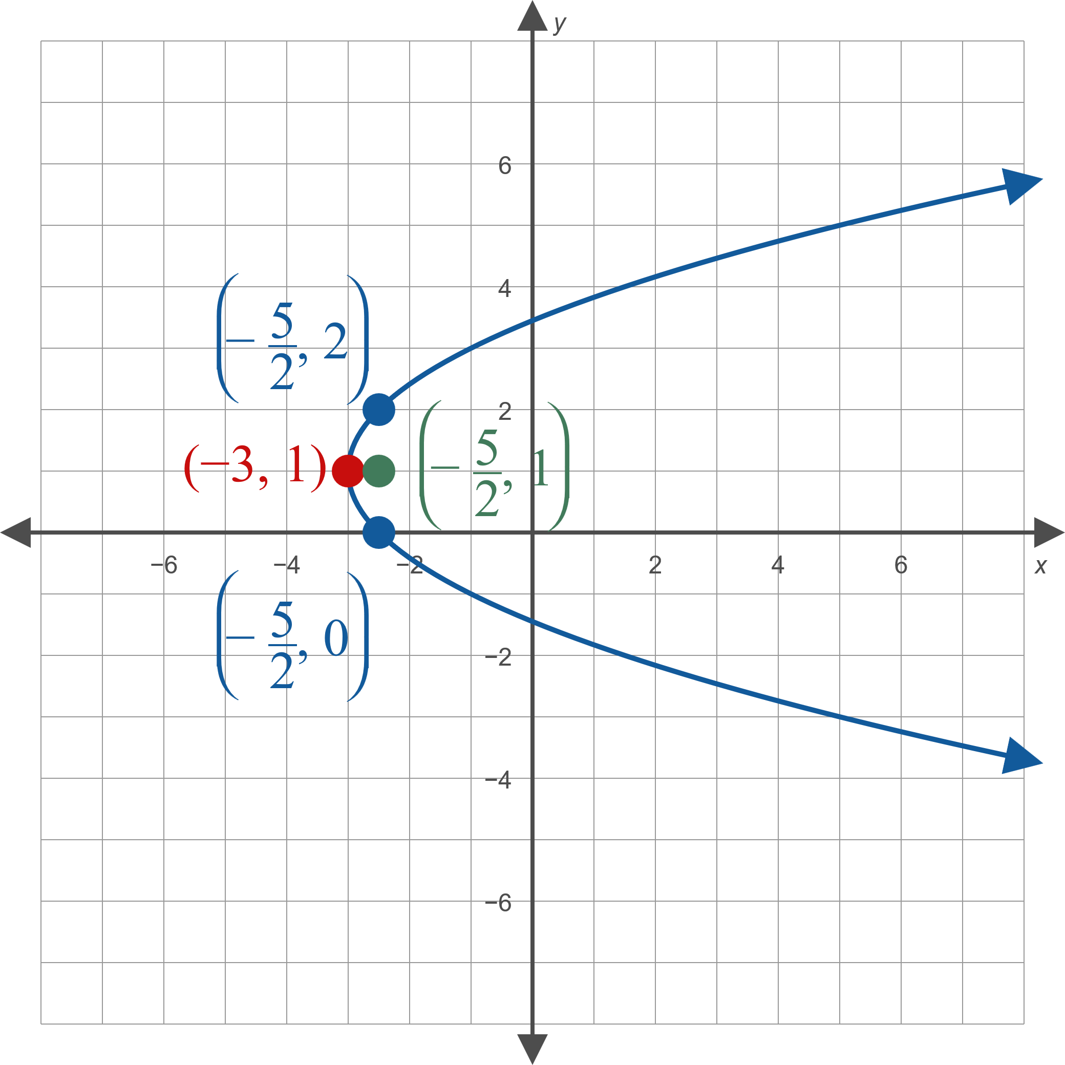
Example 2: Graphing a Parabola with Equation Not in Standard Form—Slide 6
Figure 4

Slide 15
Technology: Graphing a Horizontal Parabola—Slide 1
To graph the parabola in Example 2 using a TI-84 Plus, first press apps. Select Conics, then select PARABOLA. Now select 1: to enter a horizontal parabola and the values from the equation in standard
form, as shown in Figure 5.
To view the graph, press graph. See Figure 6.

Slide 16
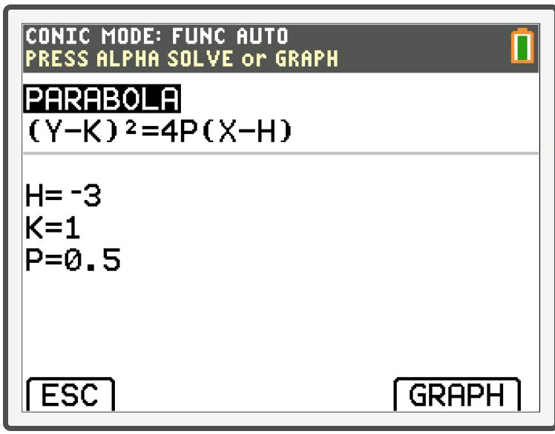
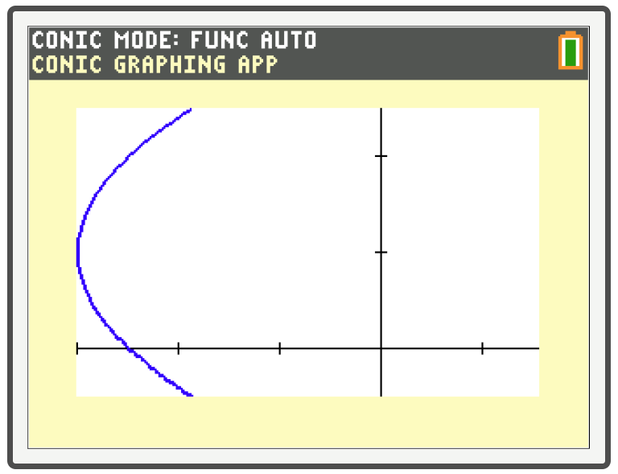
Technology: Graphing a Horizontal Parabola—Slide 2
Figure 5
Figure 6

Slide 17
Example 3: Standard Form Equation of a Parabola—Slide 1
Given that the directrix of a parabola is the line y = 2, that p = −1, and that the parabola is symmetric with respect to the line x = 2, find its standard form equation.

Slide 18
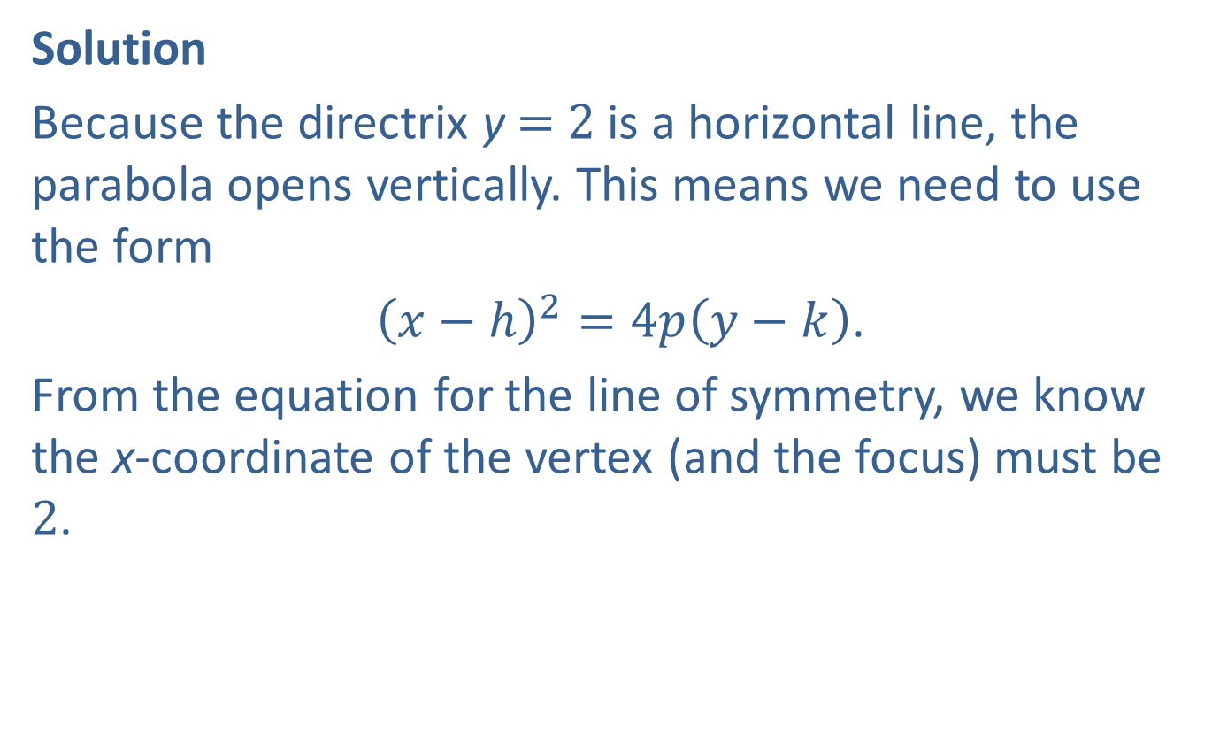
Example 3: Standard Form Equation of a Parabola—Slide 2
Solution
Because the directrix y = 2 is a horizontal line, the parabola opens vertically. This means we need to use the form
${\left(x−h\right)}^{2}=4p\left(y−k\right)$.
From the equation for the line of symmetry, we know the x-coordinate of the vertex (and the focus) must be 2.

Slide 19
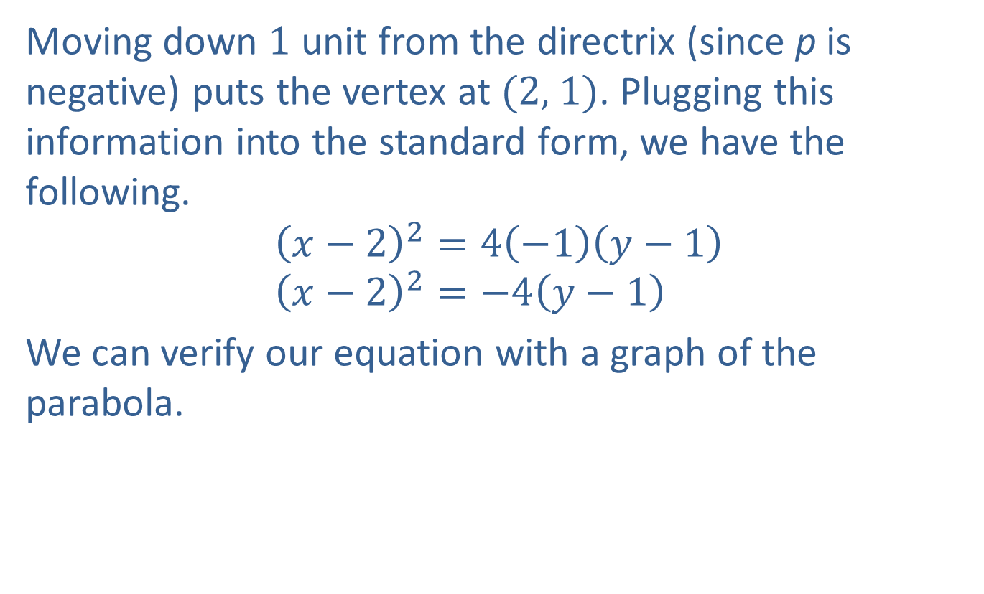
Example 3: Standard Form Equation of a Parabola—Slide 3
Moving down 1 unit from the directrix (since p is negative) puts the vertex at (2, 1). Plugging this information into the standard form, we have the following.
$${\left(x−2\right)}^{2}=4\left(−1\right)\left(y−1\right) \\ {\left(x−2\right)}^{2}=−4\left(y−1\right)$$
We can verify our equation with a graph of the parabola.

Slide 20
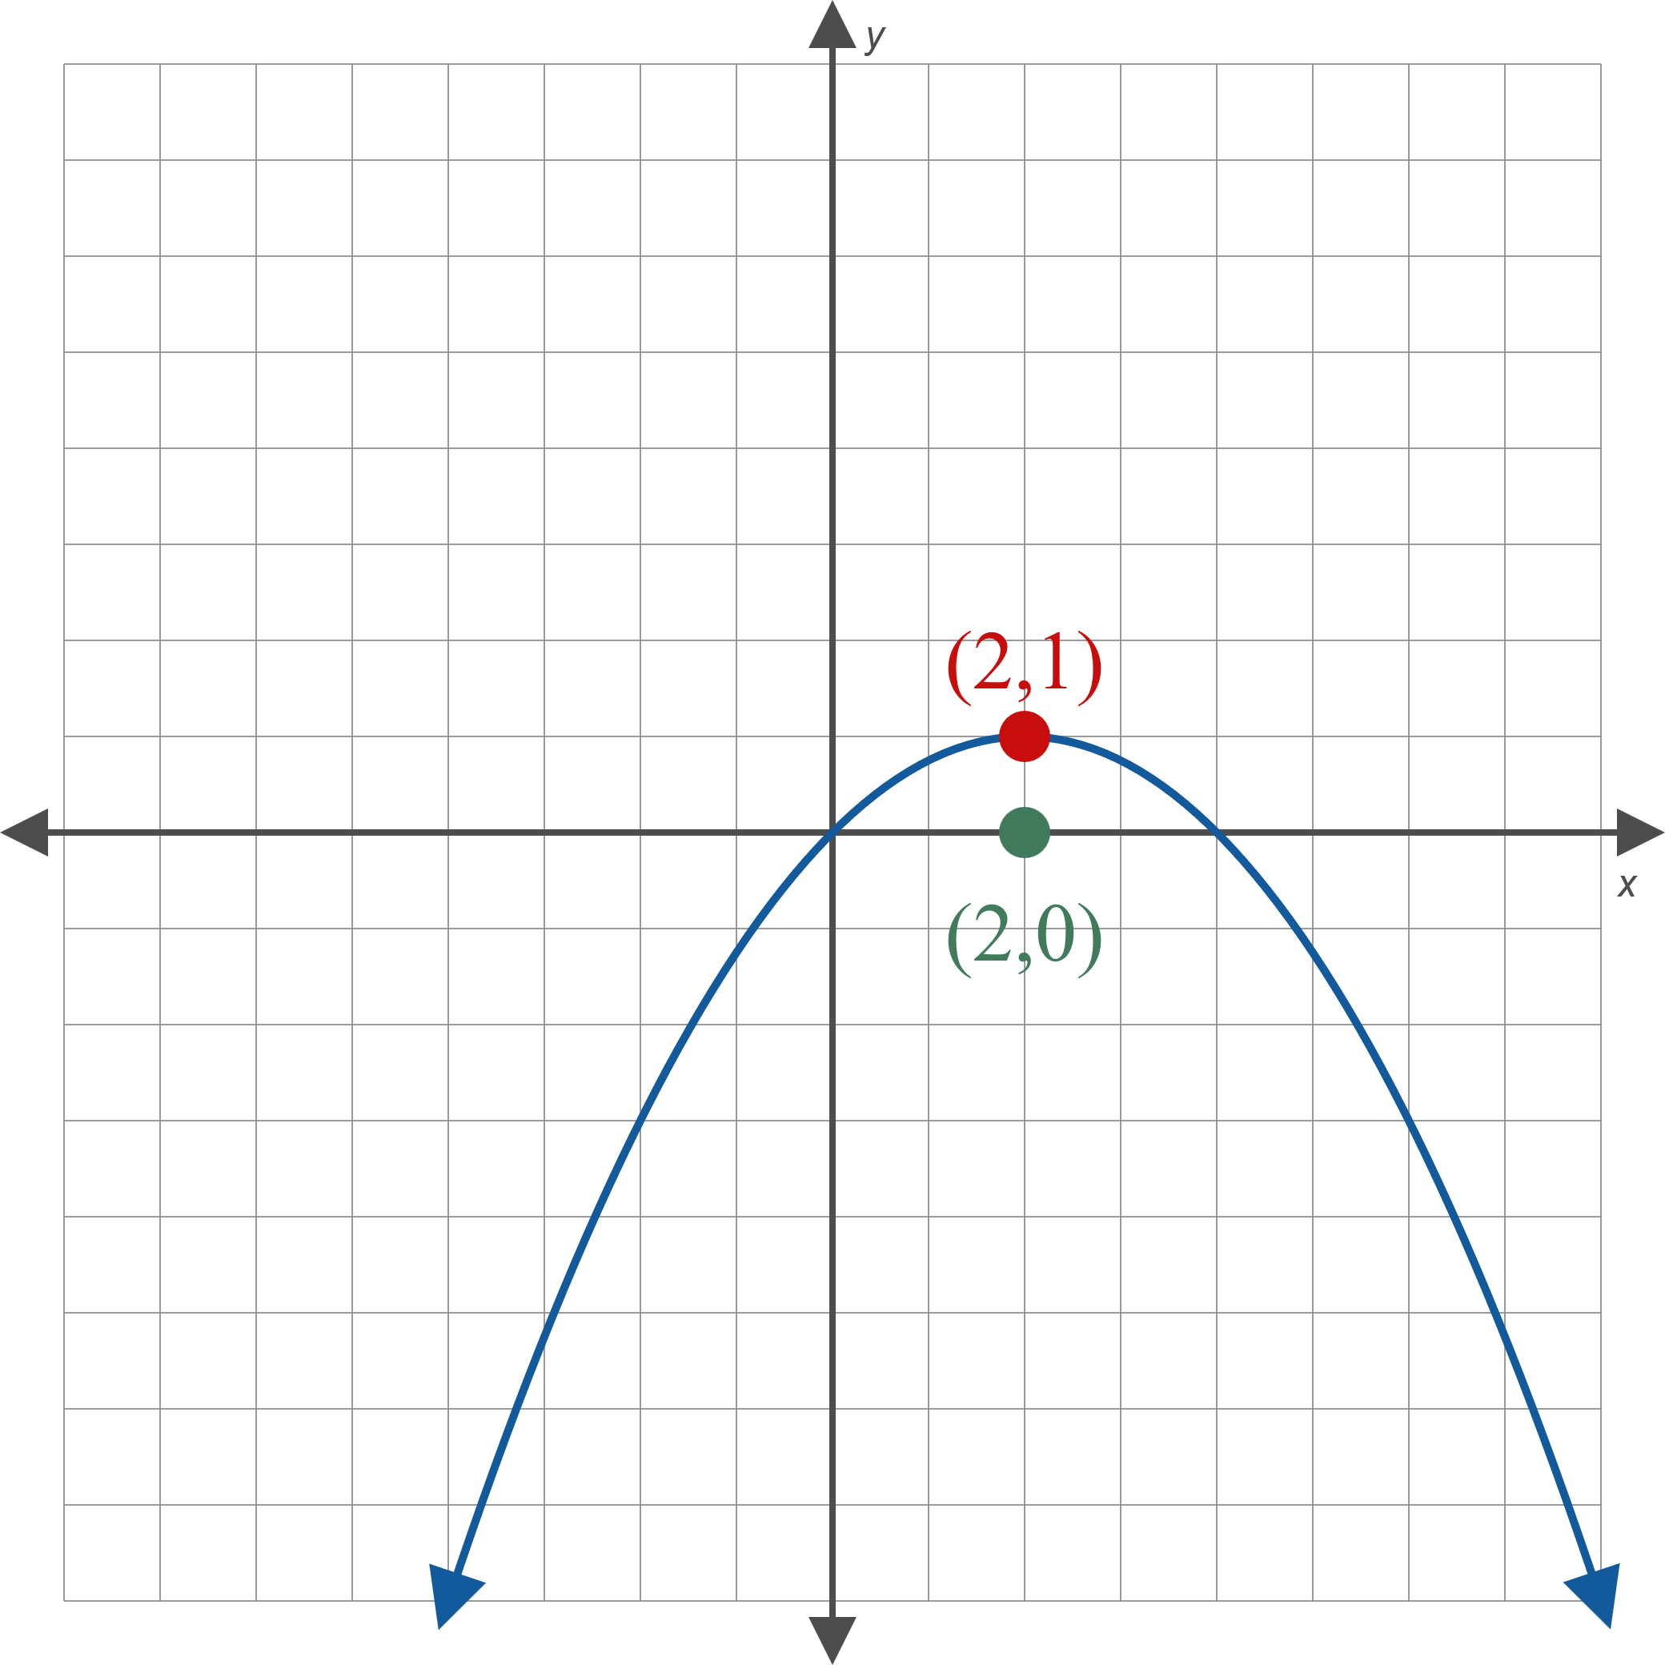
Example 3: Standard Form Equation of a Parabola—Slide 4
Figure 7

Slide 21
Example 4: Parabolic Mirrors—Slide 1
The Hale Telescope at the Mount Palomar observatory in California is a very large reflecting telescope. The paraboloid is the top surface of a large cylinder of Pyrex glass 200 inches in diameter. Along the outer rim, the cylinder is 26.8 inches thick, while at the center, it is 23 inches thick. Where is the focus of the parabolic mirror located?

Slide 22
Note 2
The same concept can be used to focus sunlight, intensely heating a small area at the focus. This is called a parabolic furnace.

Slide 23
Example 4: Parabolic Mirrors—Slide 2
Solution
First, we need to draw a picture of the situation. In order to make the math as easy as possible, we can locate the origin of our coordinate system at the vertex of a parabolic cross section of the mirror, and we can assume the parabola opens upward.

Slide 24
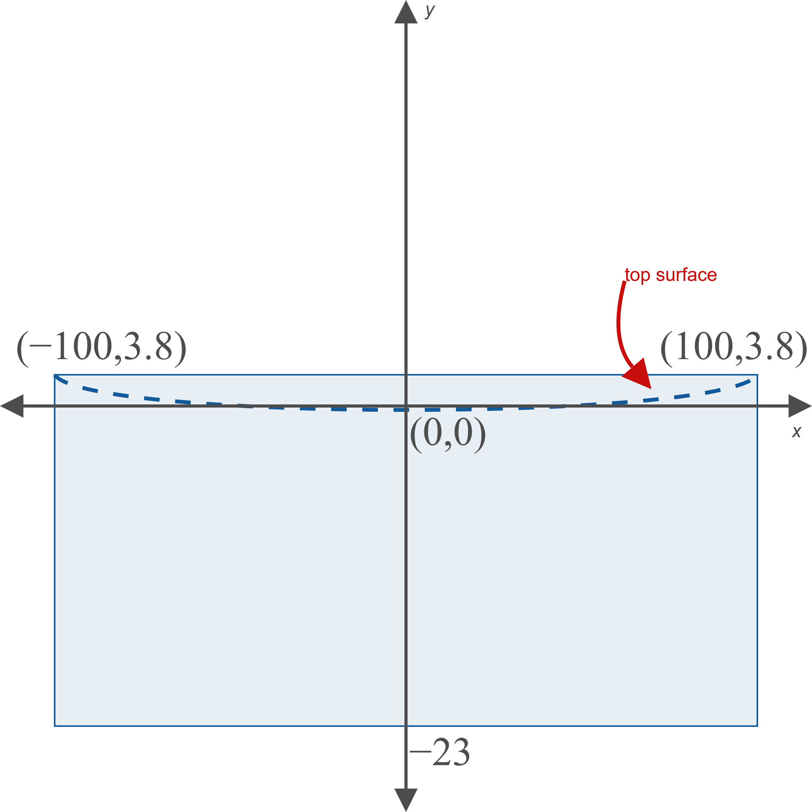
Example 4: Parabolic Mirrors—Slide 3
Figure 9

Slide 25
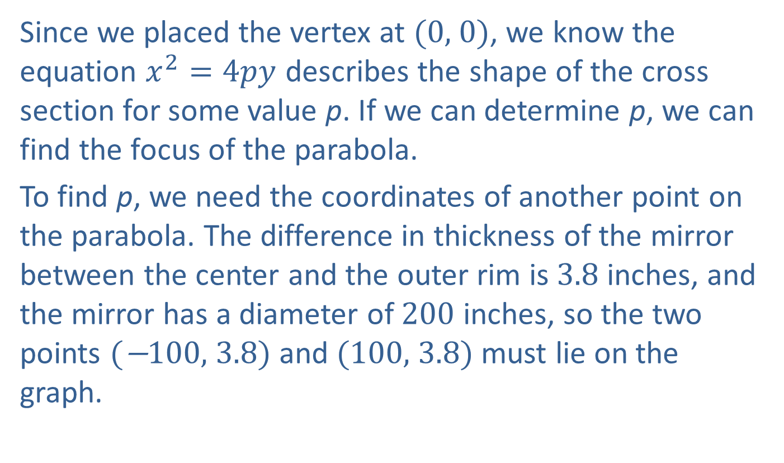
Example 4: Parabolic Mirrors—Slide 4
Since we placed the vertex at (0, 0), we know the equation $x^{2}=4py$ describes the shape of the cross section for some value p. If we can determine p, we can find the focus of the parabola.
To find p, we need the coordinates of another point on the parabola. The difference in thickness of the mirror between the center and the outer rim is 3.8 inches, and the mirror has a diameter of 200 inches, so the two points (−100, 3.8) and (100, 3.8) must lie on the graph.

Slide 26
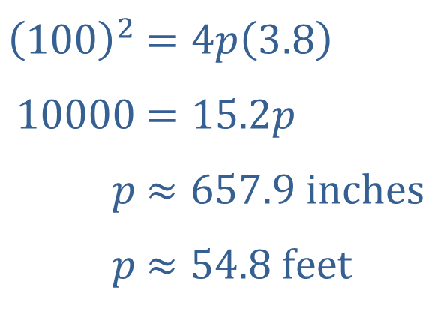

Example 4: Parabolic Mirrors—Slide 5
Plugging a point into the equation $x^{2}=4py$, we can solve for p.
We know that the focus of a parabola is p units from the vertex, so the focus of the Hale Telescope is nearly 55 feet from the mirror.
​${\left(100\right)}^{2}$ | ​$=4p\left(3.8\right)$
​$10000$ | ​$=15.2p$
​$p$ | ​$≈657.9 inches$
​$p$ | ​$≈54.8 feet$

