Slide 1
Section 4.R.5
Solving Systems of Linear Equations by Substitution and Addition

Slide 2
Definition: Solutions to Systems of Linear Equations
​A system of linear equations with no solution is called inconsistent.
​A system of linear equations that has at least one solution is called consistent.
​A consistent system with exactly one solution is called independent.
​A consistent system with more than one solution must have an infinite number of solutions and is called dependent.

Slide 3

Example 1: Solving an Independent System by Substitution—Slide 1
Use the method of substitution to solve the system
$\left\{\begin{aligned}2x−y=1 \\ x+y=5\end{aligned}\right..$

Slide 4
Note
Solving for a variable with a coefficient of 1 will make the process of substitution a bit easier.

Slide 5
Example 1: Solving an Independent System by Substitution—Slide 2
Solution
Either equation can be solved for either variable, and the choice doesn't affect the final answer. We will solve the second equation for x, and then substitute the result in the first equation, giving us one equation in the variable y. Once we have solved for y, we can substitute the value of y into either original equation to find x.

Slide 6
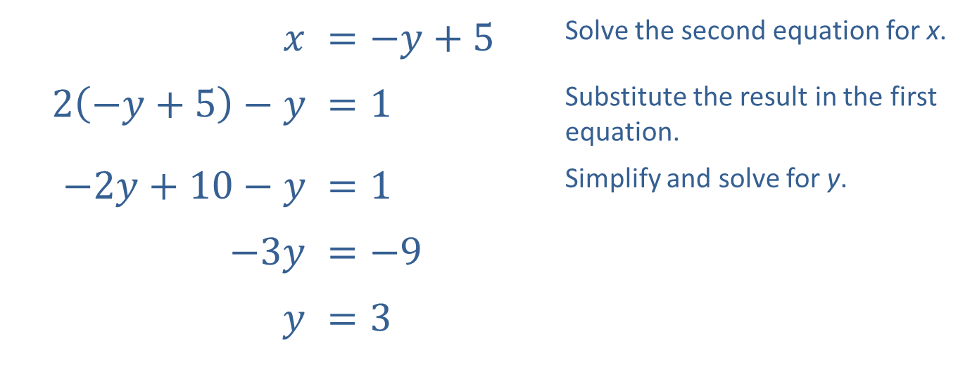
Example 1: Solving an Independent System by Substitution—Slide 3
$$x$$ | ​$=−y+5$ | Solve the second equation for x.
​$2\left(−y+5\right)−y$ | ​$=1$ | Substitute the result in the first equation.
​$−2y+10−y$ | ​$=1$ | Simplify and solve for y.
​$−3y$ | ​$=−9$
$$y$$ | ​$=3$

Slide 7
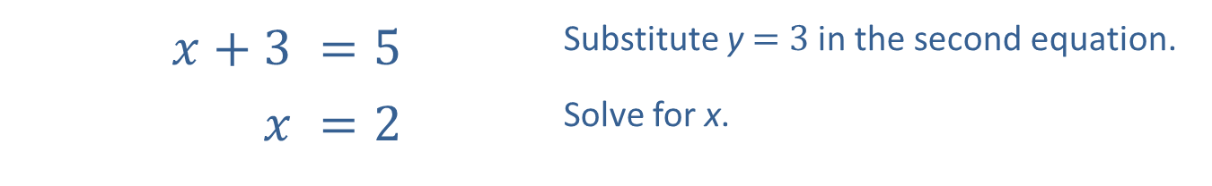

Example 1: Solving an Independent System by Substitution—Slide 4
We then substitute our answer for $y$ into the original second equation.
​$x+3$ | ​$=5$ | Substitute y = 3 in the second equation.
$$x$$ | ​$=2$ | Solve for x.

Slide 8
Example 1: Solving an Independent System by Substitution—Slide 5
Thus, the solution to the system of equations is (2, 3).
Note how the graph in Figure 2 corresponds to the system and the ordered pair solution that we have found.

Slide 9
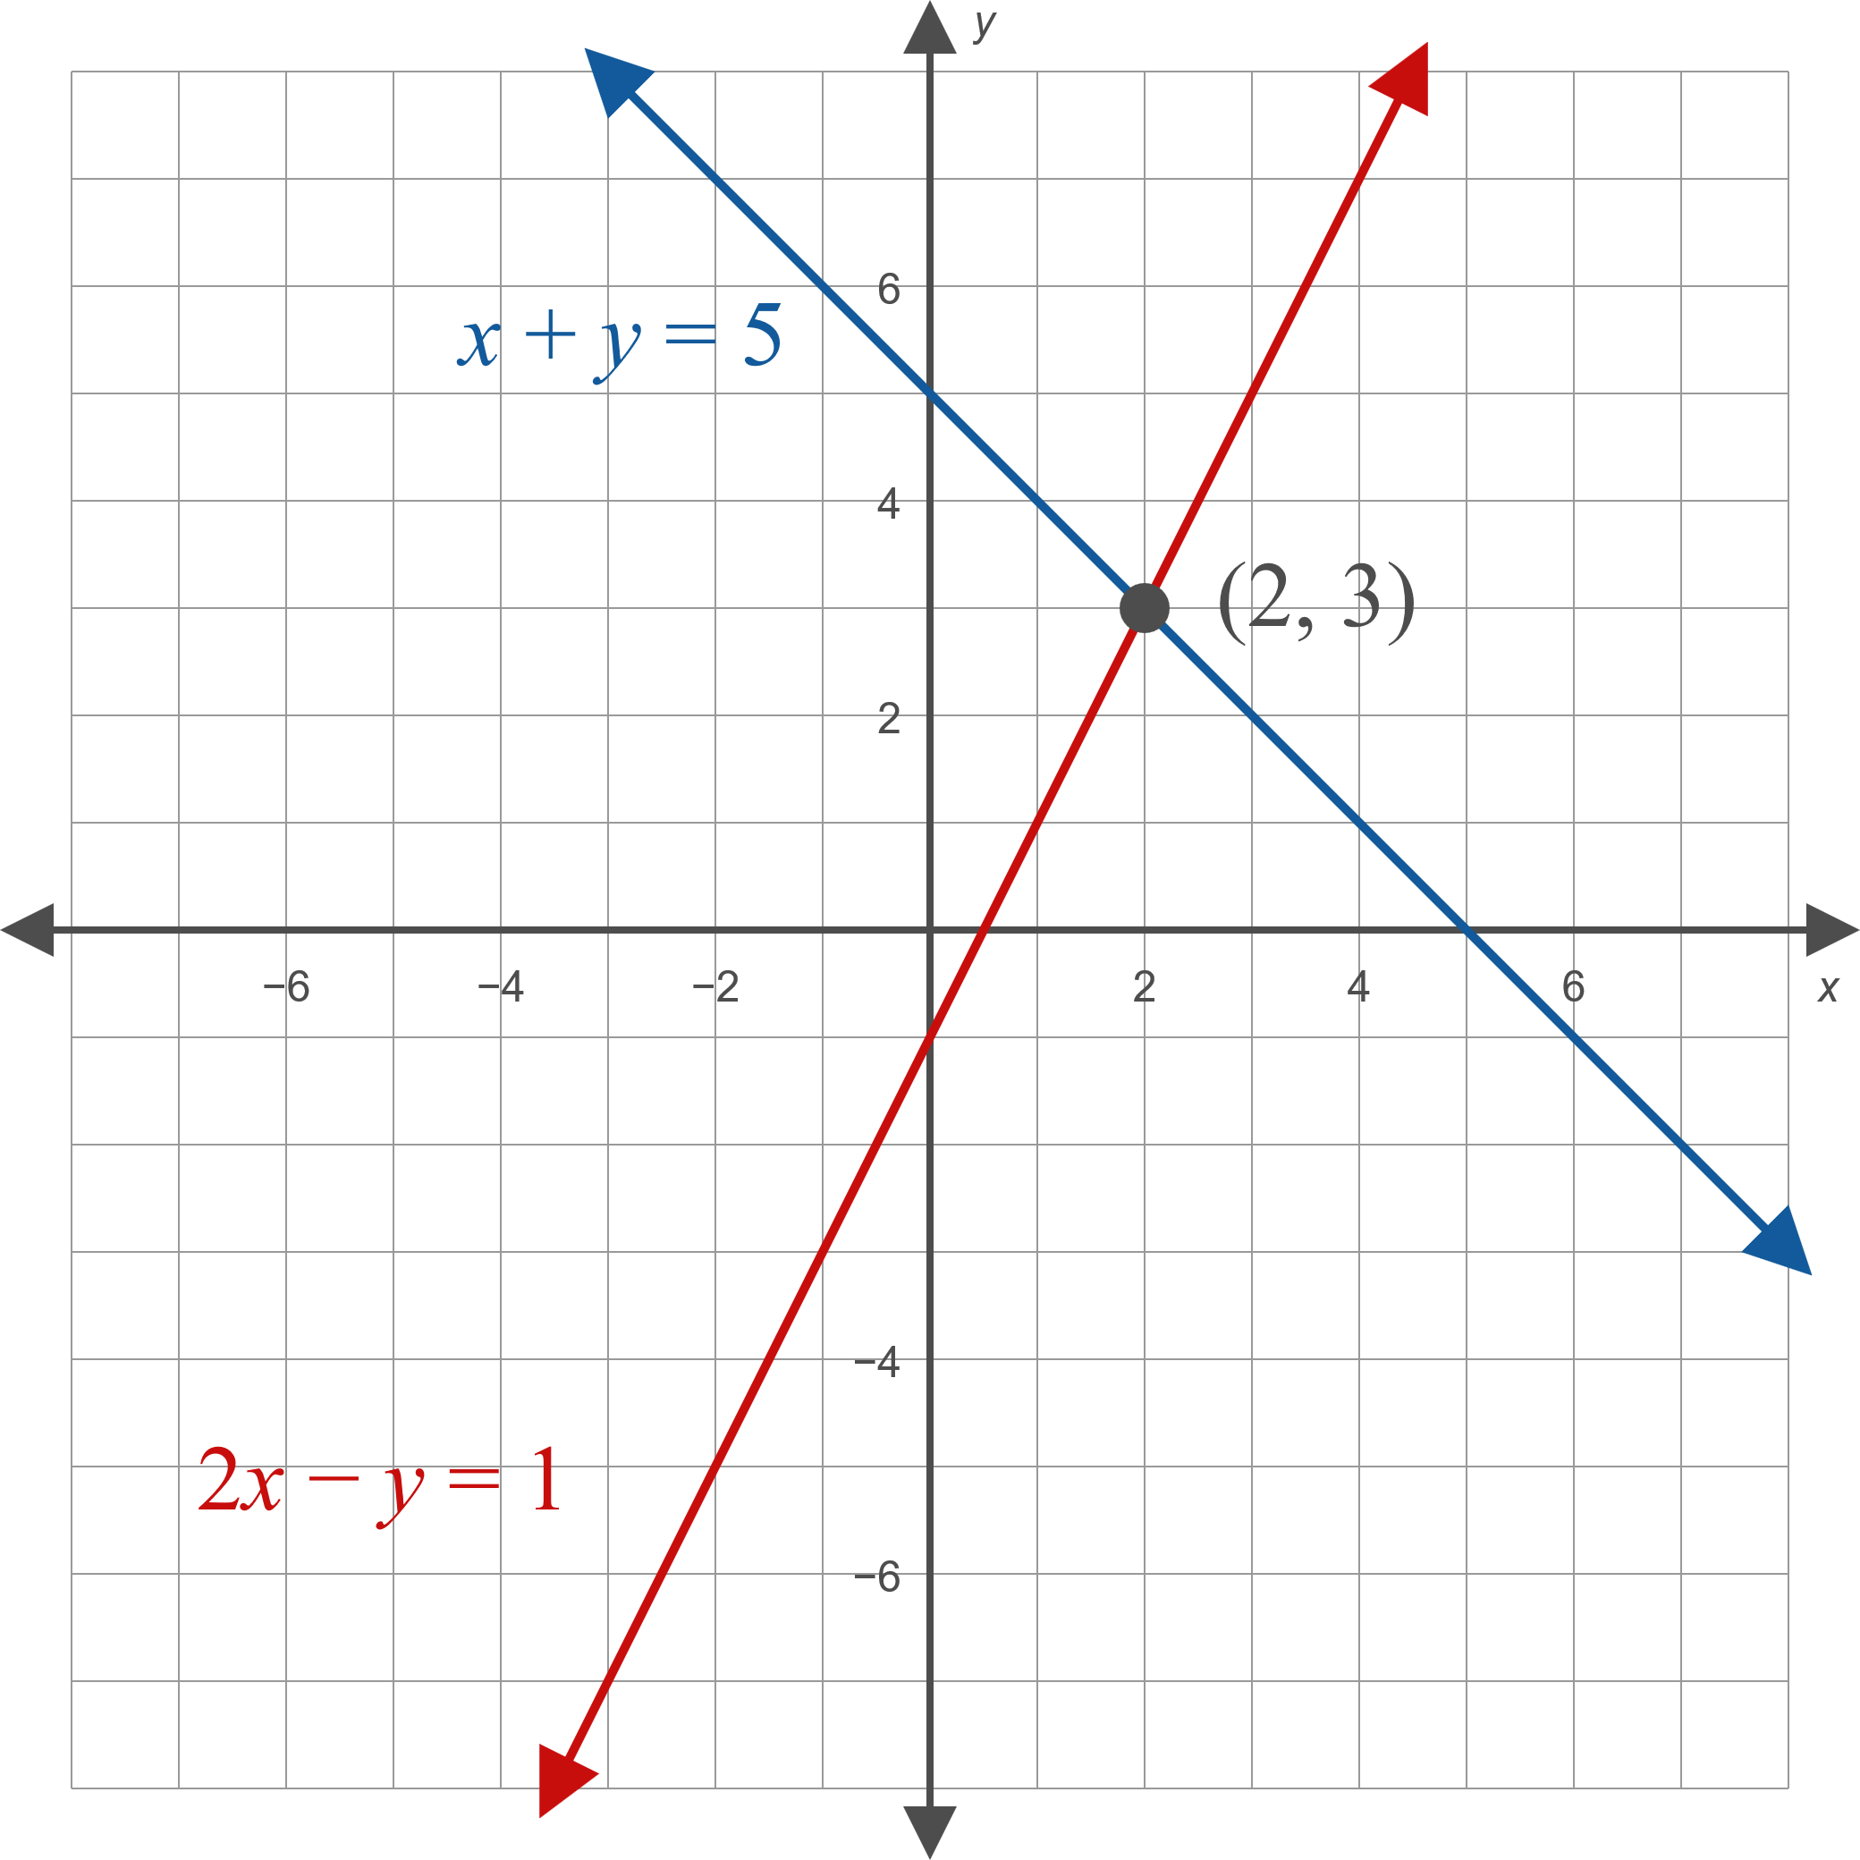
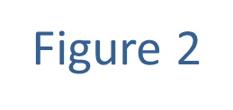
Example 1: Solving an Independent System by Substitution—Slide 6

Slide 10

Example 2: Solving a Dependent System by Substitution—Slide 1
Use the method of substitution to solve the system
$\left\{\begin{matrix}−2x+6y & =6 \\ x+3 & =3y\end{matrix}\right.$.

Slide 11
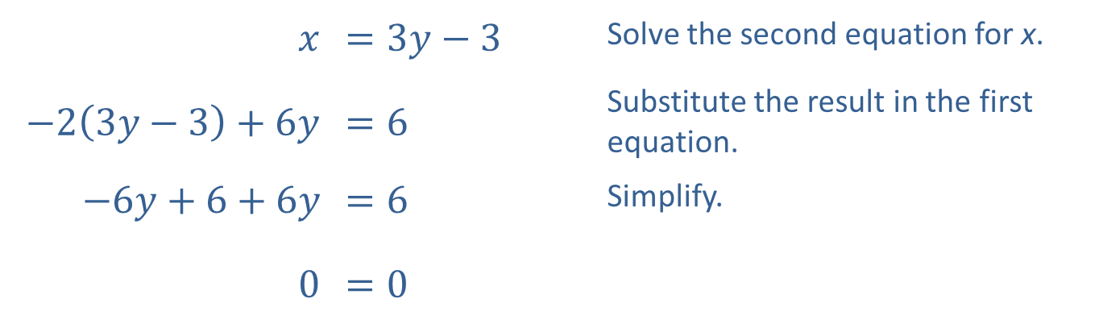
Example 2: Solving a Dependent System by Substitution—Slide 2
Solution
$$x$$ | ​$=3y−3$ | Solve the second equation for x.
​$−2\left(3y−3\right)+6y$ | ​$=6$ | Substitute the result in the first equation.
​$−6y+6+6y$ | ​$=6$ | Simplify.
​0 | ​$=0$

Slide 12
Example 2: Solving a Dependent System by Substitution—Slide 3
The resulting equation is always true. This means that for any value of y, letting x = 3y − 3 results in an ordered pair (x, y) = (3y − 3, y) that solves both equations. Since there are an infinite number of solutions, the system is dependent.
Graphically, this means the graphs of the two equations are exactly the same. In fact, the first equation is simply a rearranged multiple of the second equation.

Slide 13

Example 2: Solving a Dependent System by Substitution—Slide 4
Algebraically, we can describe the solution set as
$\{\left(3y−3,y\right)|y∈ℝ\}$. If we had solved either equation for $y$ instead of x, we would have obtained the alternative but equivalent solution $\left\{\left(x,\frac{x+3}{3}\right)|x∈ℝ\right\}$.

Slide 14

Example 3: Solving an Independent System by Addition—Slide 1
Use the method of addition to solve the system
$\left\{\begin{aligned}5x+3y=−7 \\ 7x−6y=−20\end{aligned}\right.$.

Slide 15
Example 3: Solving an Independent System by Addition—Slide 2
Solution
The coefficient of y in the second equation is −6, while the coefficient of y in the first equation is 3. This means that if we multiply all the terms in the first equation by 2, the coefficients of y will be negatives of one another, so adding the two equations will eliminate the y variable.

Slide 16
Example 3: Solving an Independent System by Addition—Slide 3
In order to keep track of these steps, we annotate our work with labeled arrows. When we modify the system, we are not changing the solutions, we are just writing an equivalent system that is easier to solve. The ultimate goal is to rewrite the system so that we can "read off" the answer.

Slide 17
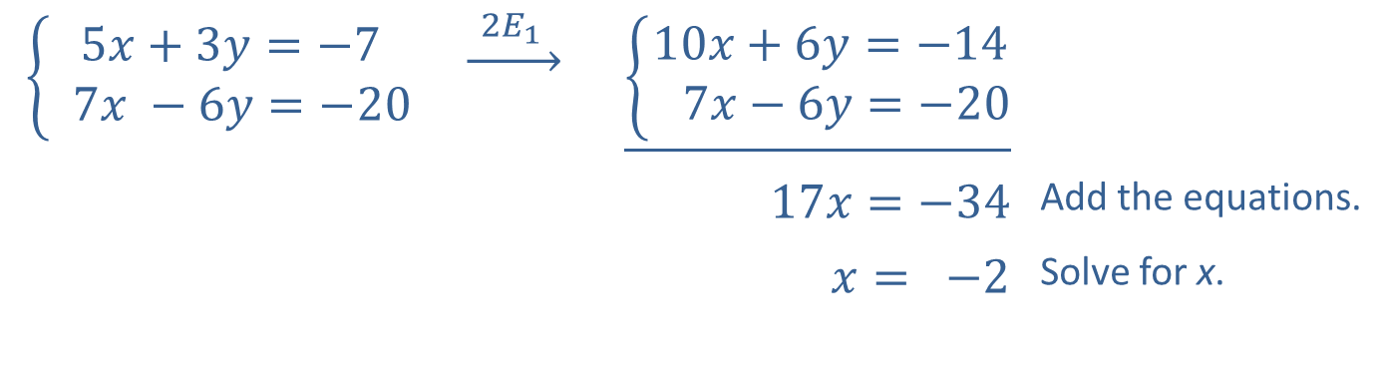
Example 3: Solving an Independent System by Addition—Slide 4
The notation above the arrow indicates that we have modified the system by multiplying each term in equation 1 by the constant 2.
$$\left\{\begin{aligned}5x+3y=−7 \\ 7x −6y=−20\end{aligned}\right.$$ | $$\underset{→}{ 2E_{1 } }$$ | $$\underline{\left\{\begin{aligned}10x+6y=−14 \\ 7x−6y=−20\end{aligned}\right.}$$
 |  | $$17x=−34$$ | Add the equations.
 |  | $$x= −2$$ | Solve for x.

Slide 18
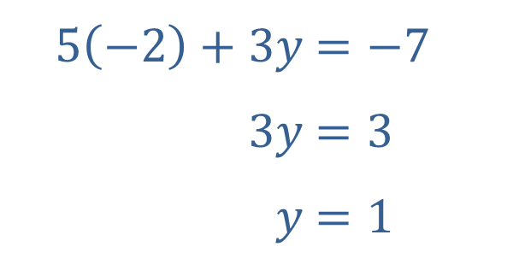
Example 3: Solving an Independent System by Addition—Slide 5
We can then substitute x = −2 into either of the original equations to determine y. Here, we substitute into the first equation of the original system.
​
​$5\left(−2\right)+3y$ | ​$=−7$
​$3y$ | ​$=3$
​$y$ | ​$=1$

Slide 19

Example 3: Solving an Independent System by Addition—Slide 6
The ordered pair (−2, 1) is thus the solution of the system. Note that using the second equation gives the same $y$-value and is a good way to check our work.

Slide 20

Example 4: Solving an Inconsistent System by Addition—Slide 1
Use the method of addition to solve the system
$\left\{\begin{matrix}2x−3y & =3 \\ 3x−\frac{9}{2}y & =5\end{matrix}\right.$.

Slide 21
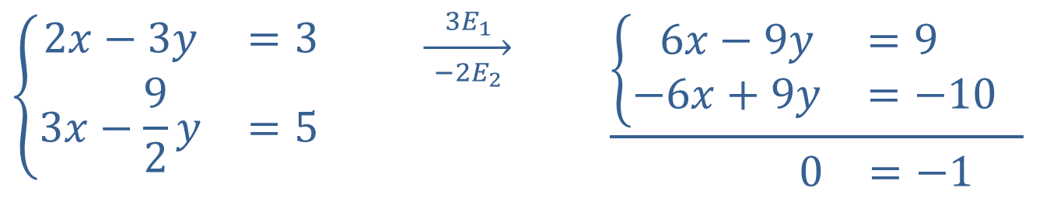
Example 4: Solving an Inconsistent System by Addition—Slide 2
Solution
Eliminate the variable x by multiplying both equations by a constant.
$$\left\{\begin{matrix}2x−3y & =3 \\ 3x−\frac{9}{2}y & =5\end{matrix}\right.$$ | $$\overset{ 3E_{1 }}{\overset{→}{ −2E_{2 }}}$$ | 6𝑥−9𝑦=9 1−6𝑥+9𝑦=−101 0=−1

Slide 22
Example 4: Solving an Inconsistent System by Addition—Slide 3
Although the intent was to obtain coefficients of x that were negatives of one another, we have achieved the same thing for y.
When we add the equations, the result is 0 = −1, a false statement. This means that no ordered pair solves both equations, and the system is inconsistent. Graphically, the two lines defined by the equations are parallel.

Slide 23
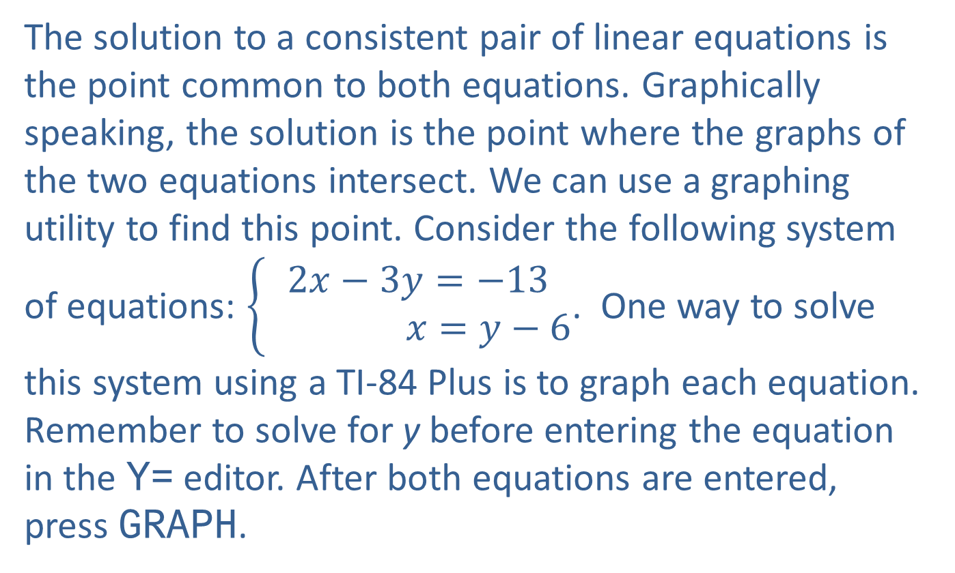
Technology: Solving Systems of Equations—Slide 1
The solution to a consistent pair of linear equations is the point common to both equations. Graphically speaking, the solution is the point where the graphs of the two equations intersect. We can use a graphing utility to find this point. Consider the following system of equations: $\left\{\begin{aligned}2x−3y=−13 \\ x=y−6\end{aligned}\right.$. One way to solve this system using a TI-84 Plus is to graph each equation. Remember to solve for y before entering the equation in the Y= editor. After both equations are entered, press graph.

Slide 24
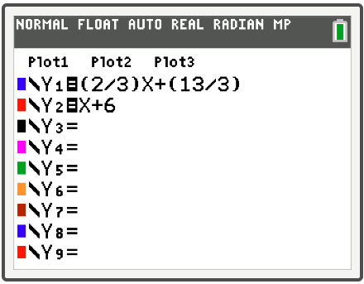
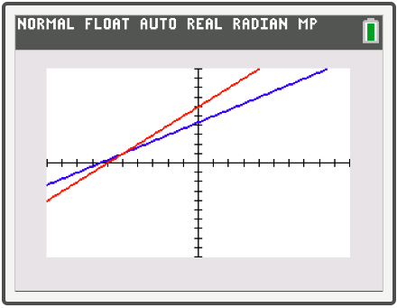
Technology: Solving Systems of Equations—Slide 2
Figure 3
Figure 4

Slide 25
Technology: Solving Systems of Equations—Slide 3
Once the graph of the two lines is displayed, press 2nd trace to access the CALCULATE menu and select intersect. The phrase First curve? should appear. Use the arrows to move the cursor along the first line to where it appears to intersect the other line and press enter. When the phrase second curve? appears, press enter again (as the cursor should now be on the second line, still near the point of intersection). Now the word Guess? should appear. Press enter a final time and the x- and y-values of the point of intersection will appear at the bottom (see Figure 5).

Slide 26
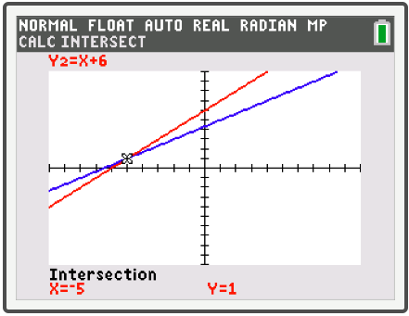
Technology: Solving Systems of Equations—Slide 4
So the point where the lines intersect, and thus the solution to this system of equations, is (−5, 1). This method works with any system of equations that can be graphed on a calculator, not just linear ones.
Figure 5

Slide 27

Example 5: Solving an Independent System by Addition—Slide 1
Solve the system $\left\{\begin{matrix}2x+ y+z & =6 \\ 2x+3y−z & =−2 \\ −3x+2y−z & =5\end{matrix}\right.$.

Slide 28
Example 5: Solving an Independent System by Addition—Slide 2
Solution
We will follow the same type of approach we used in Example 4. If we add the first equation to the second equation or the third equation, we will eliminate z, resulting in a two-equation system in the variables x and y.

Slide 29
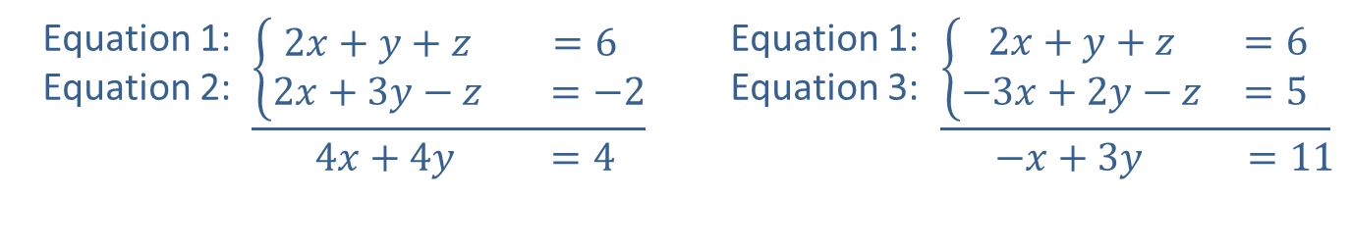
Example 5: Solving an Independent System by Addition—Slide 3
Equation 1: Equation 2: | $$\underline{\left\{\begin{matrix}2x+y+z & =6 \\ 2x+3y−z & =−2\end{matrix}\right.} \\ \begin{matrix} 4x+4y & =4\end{matrix}$$ | Equation 1: Equation 3: | 2𝑥+𝑦+𝑧=61−3𝑥+2𝑦−𝑧=51 −𝑥+3𝑦 =11

Slide 30
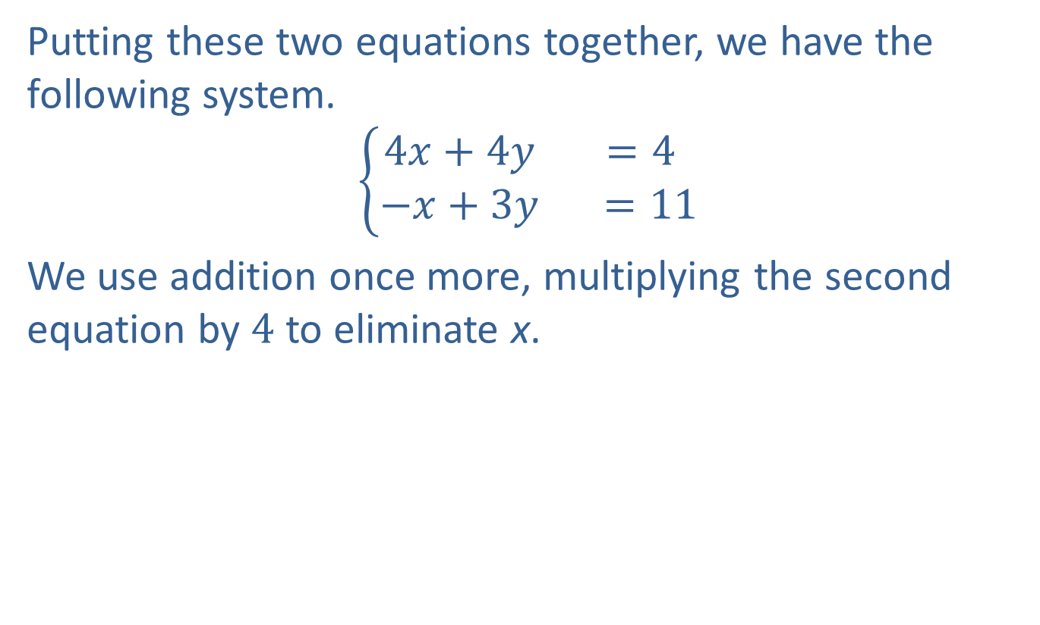
Example 5: Solving an Independent System by Addition—Slide 4
Putting these two equations together, we have the following system.
$$\left\{\begin{matrix}4x+4y & =4 \\ −x+3y & =11\end{matrix}\right.$$
We use addition once more, multiplying the second equation by 4 to eliminate x.

Slide 31
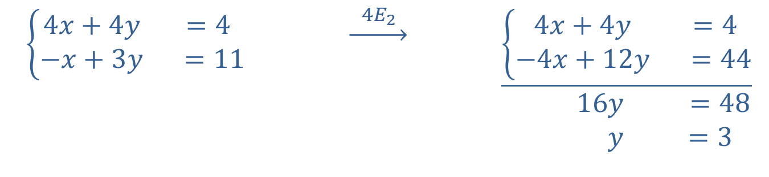
Example 5: Solving an Independent System by Addition—Slide 5
$\left\{\begin{matrix}4x+4y & =4 \\ −x+3y & =11\end{matrix}\right.$ | $$\underset{→}{ 4E_{2 }}$$ | $$\underline{\left\{\begin{matrix}4x+4y & =4 \\ −4x+12y & =44\end{matrix}\right.} \\ \begin{matrix} 16y & =48 \\ y & =3\end{matrix}$$

Slide 32
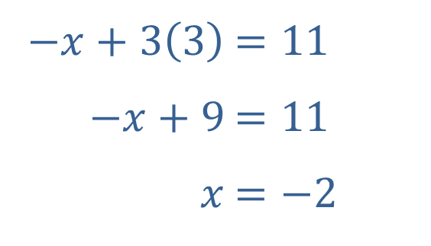
Example 5: Solving an Independent System by Addition—Slide 6
Now that we have solved for y, we can plug this back into one of the equations from the two variable system to solve for x.
​
​$−x+3\left(3\right)$ | ​$=11$
​$−x+9$ | ​$=11$
​$x$ | ​$=−2$

Slide 33
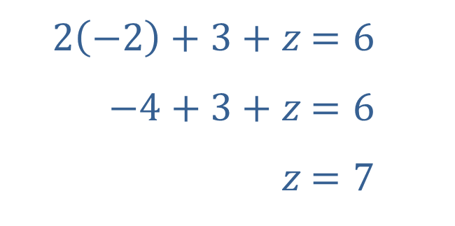
Example 5: Solving an Independent System by Addition—Slide 7
Finally, we substitute both x and y into one of the equations from the original system.
​
Thus, the solution to the system of equations is the ordered triple (−2, 3, 7).
​$2\left(−2\right)+3+z$ | ​$=6$
​$−4+3+z$ | ​$=6$
​$z$ | ​$=7$

Slide 34

Example 6: Solving a Dependent System by Addition—Slide 1
Solve the system $\left\{\begin{matrix}3x−5y+z & = & −10 \\ −x+2y−3z & = & −7 \\ x−y−5z & = & −24\end{matrix}\right.$.

Slide 35
Example 6: Solving a Dependent System by Addition—Slide 2
Solution
In general, a good approach to solving a large system of equations is to try to eliminate a variable and obtain a smaller system.
There are many possible ways to proceed. One option is to use the second equation (or a multiple of it) to eliminate x when we add it to the first and third equations. The result will be a two-equation system in the variables y and z.

Slide 36
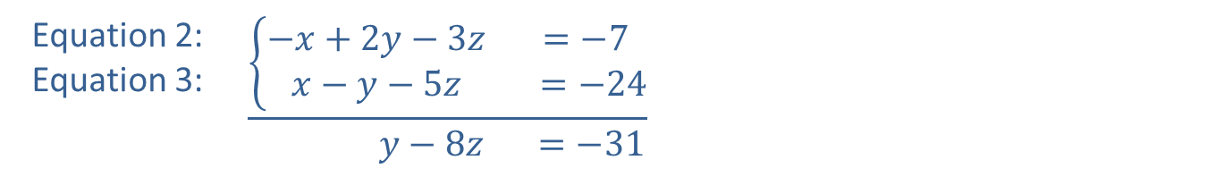
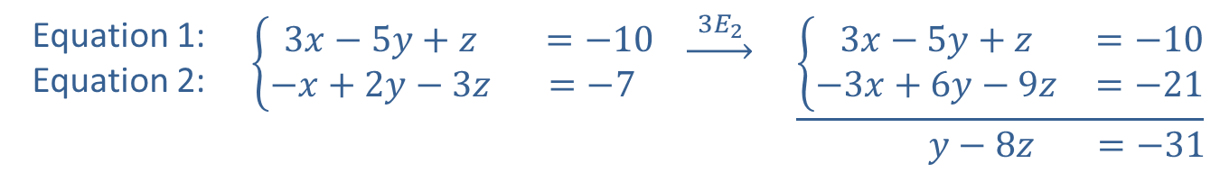
Example 6: Solving a Dependent System by Addition—Slide 3
Equation 1: Equation 2: | $$\left\{\begin{matrix}3x−5y+z & =−10 \\ −x+2y−3z & =−7\end{matrix}\right.$$ | $$\underset{→}{ 3E_{2 }}$$ | $$\underline{\left\{\begin{matrix}3x−5y+z & =−10 \\ −3x+6y−9z & =−21\end{matrix}\right.} \\ \begin{matrix}y−8z & =−31\end{matrix}$$
Equation 2: Equation 3: | $$\underline{\left\{\begin{matrix}−x+2y−3z & =−7 \\ x−y−5z & =−24\end{matrix}\right.} \\ \begin{matrix} y−8z & =−31\end{matrix}$$

Slide 37
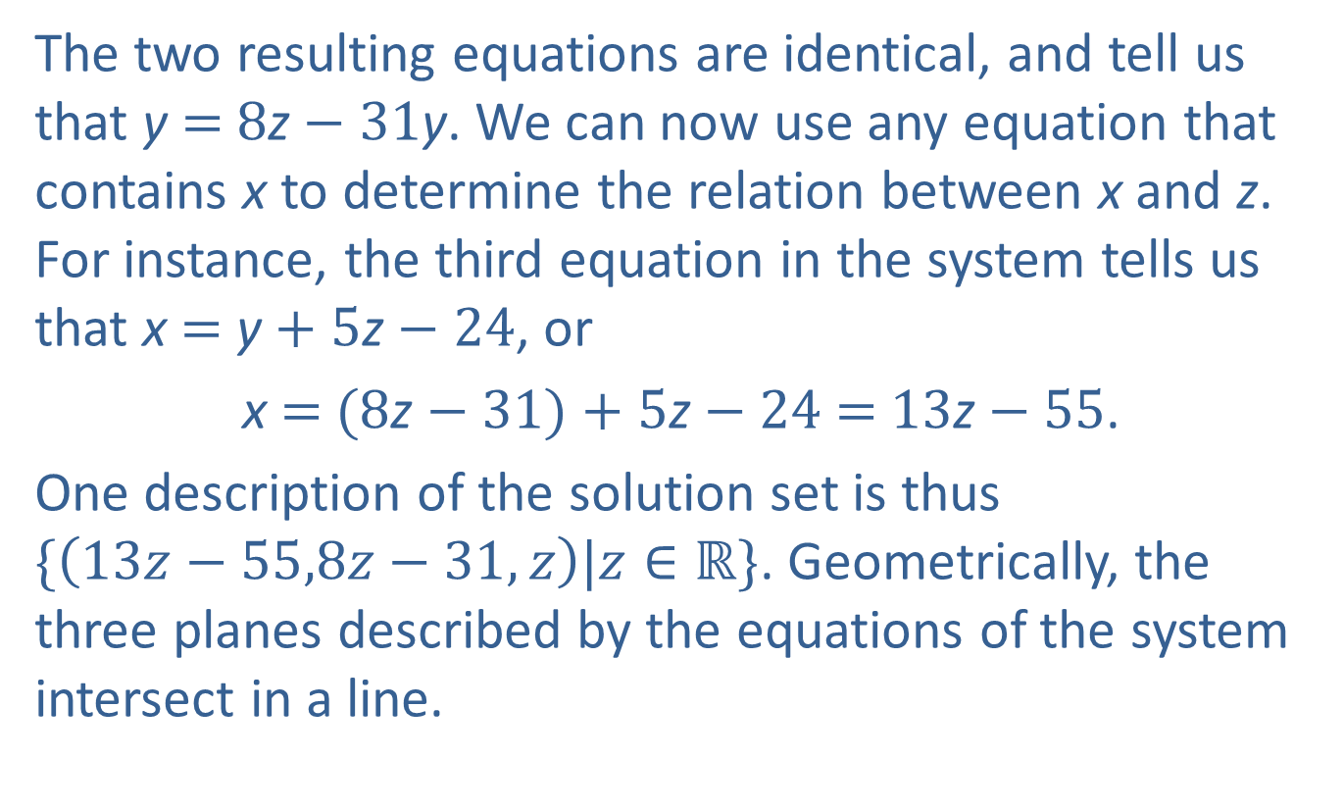
Example 6: Solving a Dependent System by Addition—Slide 4
The two resulting equations are identical, and tell us that y = 8z − 31y. We can now use any equation that contains x to determine the relation between x and z. For instance, the third equation in the system tells us that x = y + 5z − 24, or
x = (8z − 31) + 5z − 24 = 13z − 55.
One description of the solution set is thus
$\{\left(13z−55,8z−31,z\right)|z∈ℝ\}$. Geometrically, the three planes described by the equations of the system intersect in a line.

