Slide 1
Section 4.R.4
Polynomial and Rational Inequalities

Slide 2
Definition: Polynomial Inequalities
A polynomial inequality is any inequality that can be written in the form
p(x) < 0, p(x) ≤ 0, p(x) > 0, or p(x) ≥ 0,
where p(x) is a polynomial function.

Slide 3

Example 1: Solving Polynomial Inequalities Using a Graph—Slide 1
Solve the polynomial inequalities, given the graph of $f\left(x\right)=\left(x+3\right)\left(x+1\right)\left(x−2\right)$.
​$\left(x+3\right)\left(x+1\right)\left(x−2\right)<0$
​$\left(x+3\right)\left(x+1\right)\left(x−2\right)≥0$

Slide 4
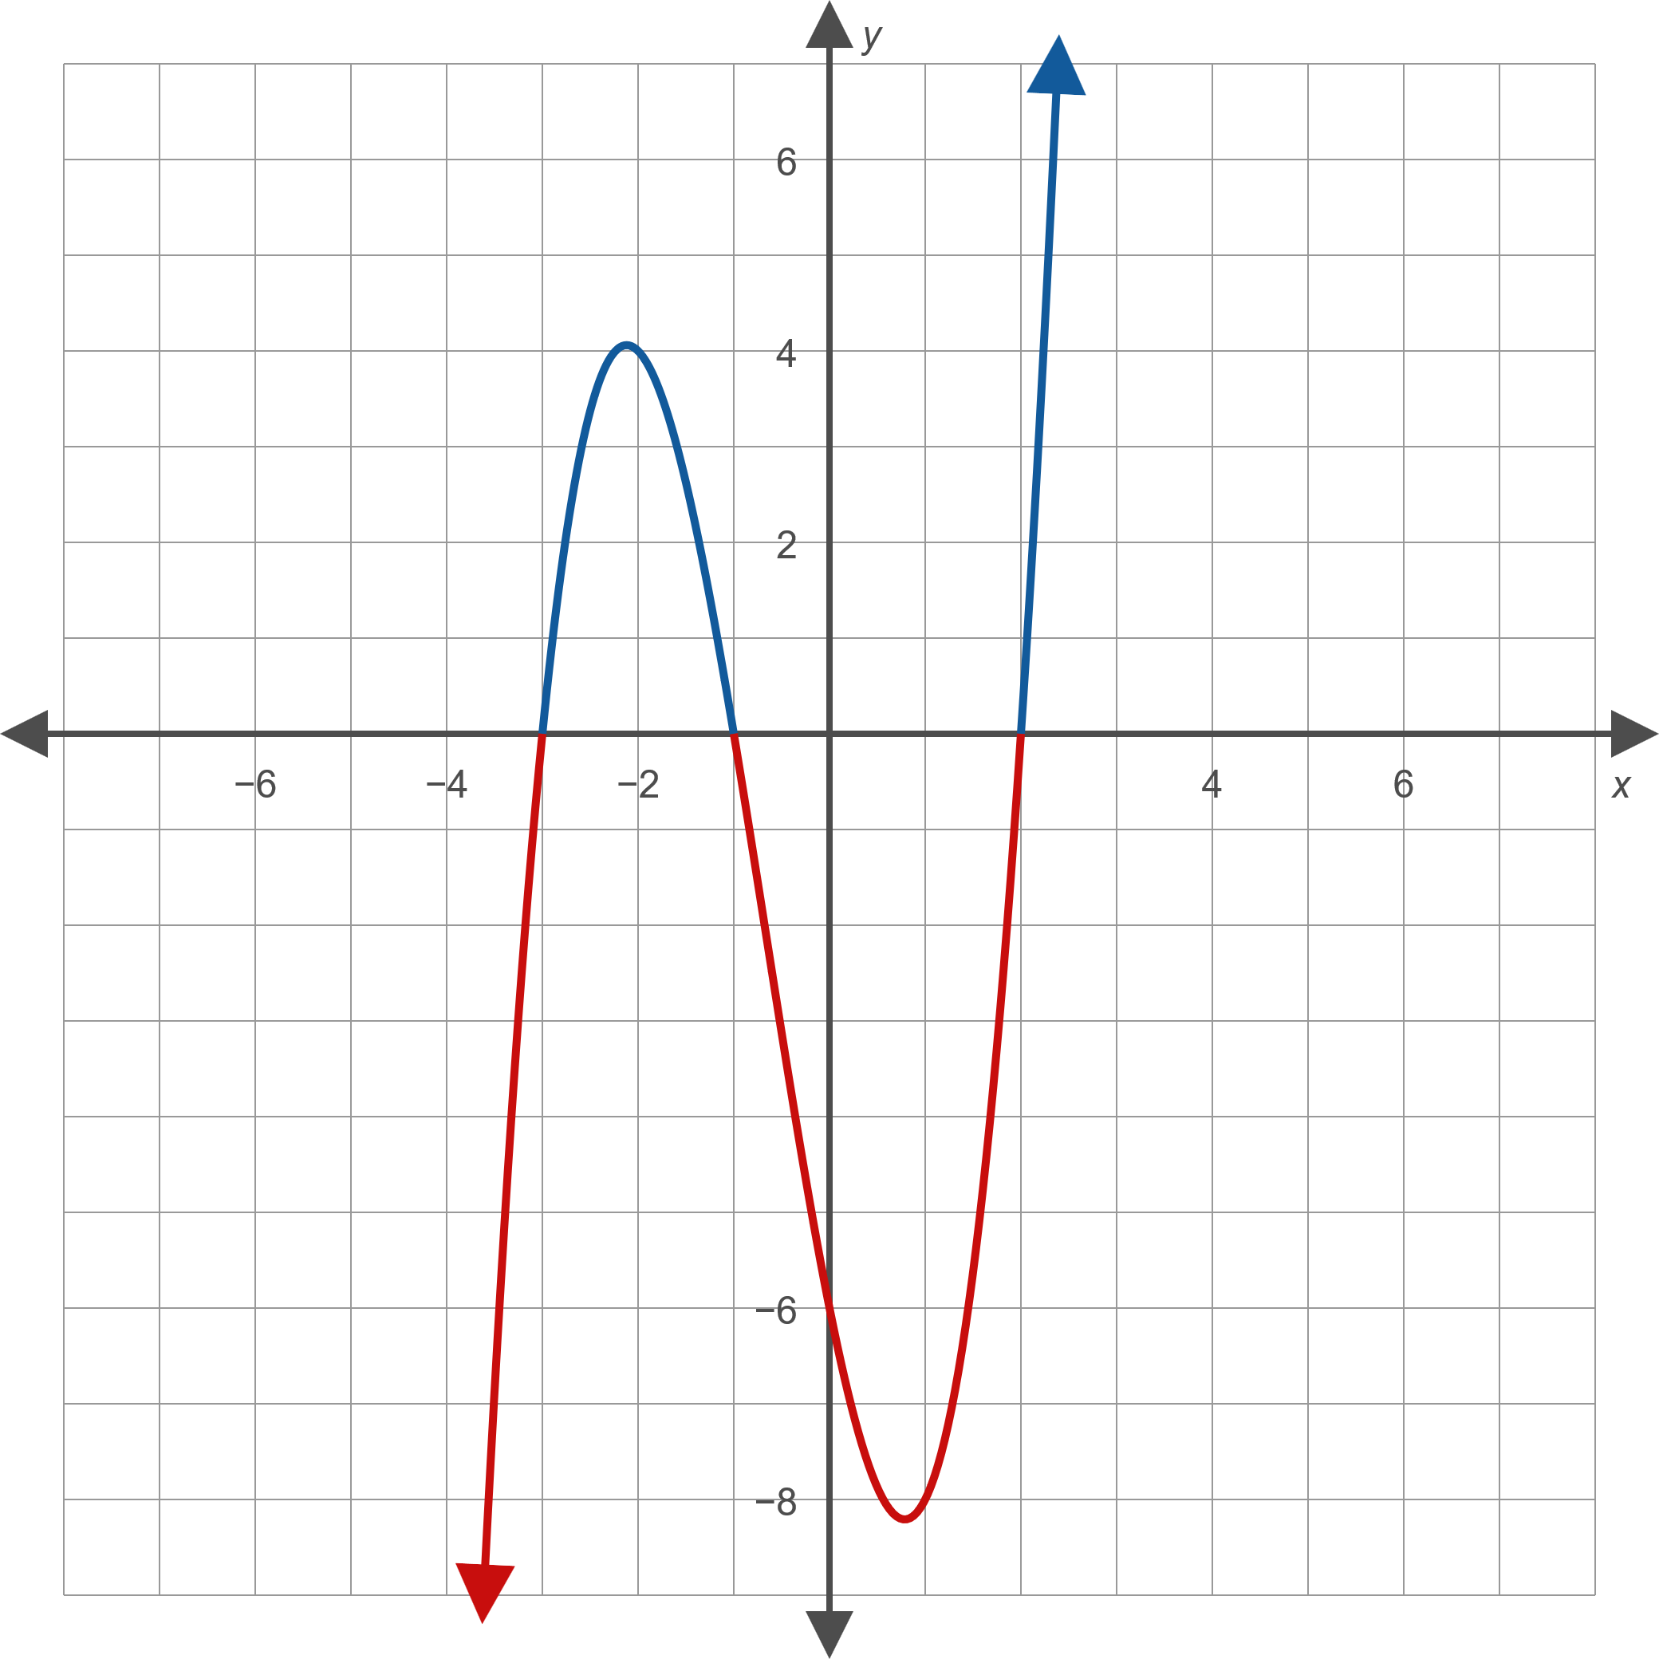
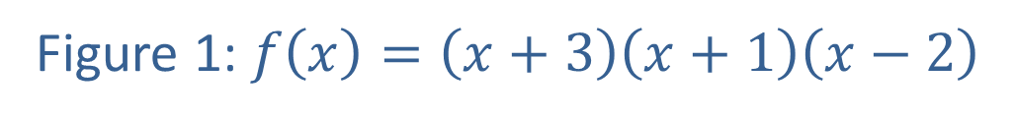
Example 1: Solving Polynomial Inequalities Using a Graph—Slide 2
Figure 1: $f\left(x\right)=\left(x+3\right)\left(x+1\right)\left(x−2\right)$

Slide 5
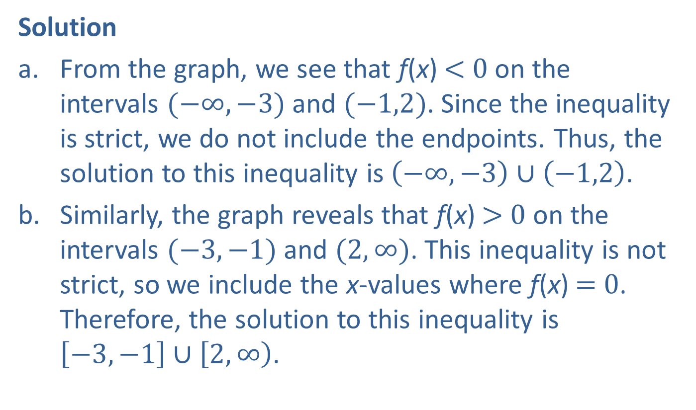
Example 1: Solving Polynomial Inequalities Using a Graph—Slide 3
Solution
​From the graph, we see that f(x) < 0 on the intervals $(−∞,−3)$ and $(−1,2)$. Since the inequality is strict, we do not include the endpoints. Thus, the solution to this inequality is $\left(−∞,−3\right)∪\left(−1,2\right)$.
​Similarly, the graph reveals that f(x) > 0 on the intervals $(−3,−1)$ and $(2,∞)$. This inequality is not strict, so we include the x-values where f(x) = 0. Therefore, the solution to this inequality is $\left[−3,−1\right]∪\left[2,∞\right)$.

Slide 6
Procedure: Solving Polynomial Inequalities Using the Sign-Test Method—Slide 1
To solve a polynomial inequality p(x) < 0, p(x) ≤ 0, p(x) > 0, or p(x) ≥ 0, perform the following steps.
Step 1: Find the real zeros of p(x). Equivalently, find the real solutions of p(x) = 0.
Step 2: Place the zeros on a number line, splitting it into intervals.

Slide 7
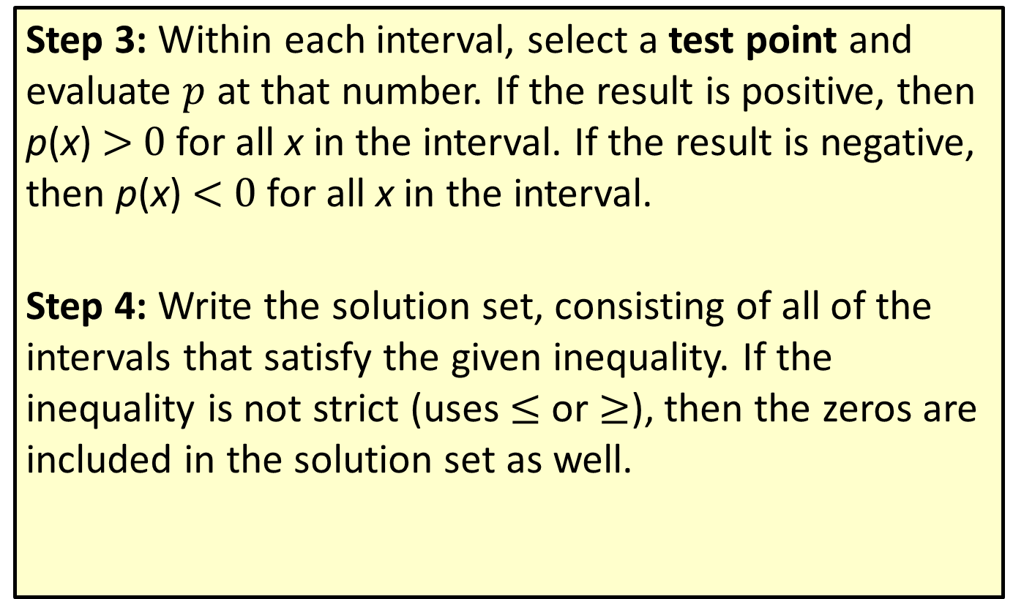
Procedure: Solving Polynomial Inequalities Using the Sign-Test Method—Slide 2
Step 3: Within each interval, select a test point and evaluate $p$ at that number. If the result is positive, then p(x) > 0 for all x in the interval. If the result is negative, then p(x) < 0 for all x in the interval.
Step 4: Write the solution set, consisting of all of the intervals that satisfy the given inequality. If the inequality is not strict (uses $≤$ or $≥$), then the zeros are included in the solution set as well.

Slide 8

Example 2: Solving Polynomial Inequalities Using the Sign-Test Method—Slide 1
Solve the polynomial inequality
$\left(x−2\right)\left(x+5\right)\left(x−4\right)>0$.

Slide 9
Note
When choosing test points, integers (especially 0) are usually easiest to work with.

Slide 10
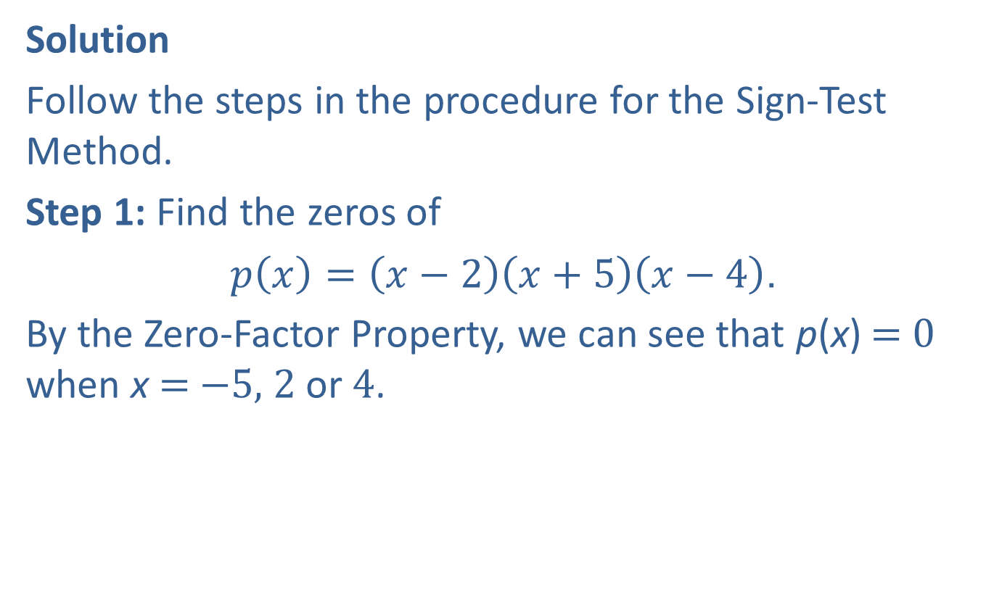
Example 2: Solving Polynomial Inequalities Using the Sign-Test Method—Slide 2
Solution
Follow the steps in the procedure for the Sign-Test Method.
Step 1: Find the zeros of
$p\left(x\right)=\left(x−2\right)\left(x+5\right)\left(x−4\right)$.
By the Zero-Factor Property, we can see that p(x) = 0 when x = −5, 2 or 4.

Slide 11
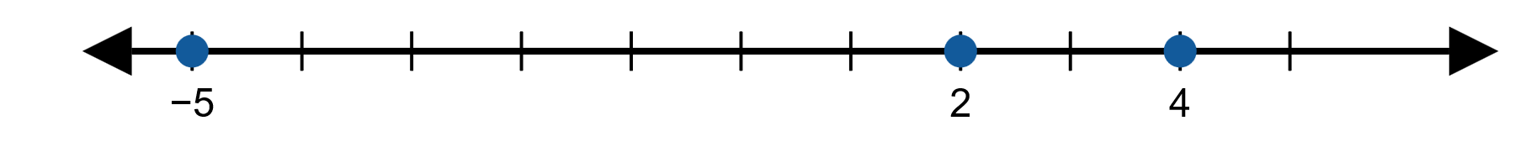
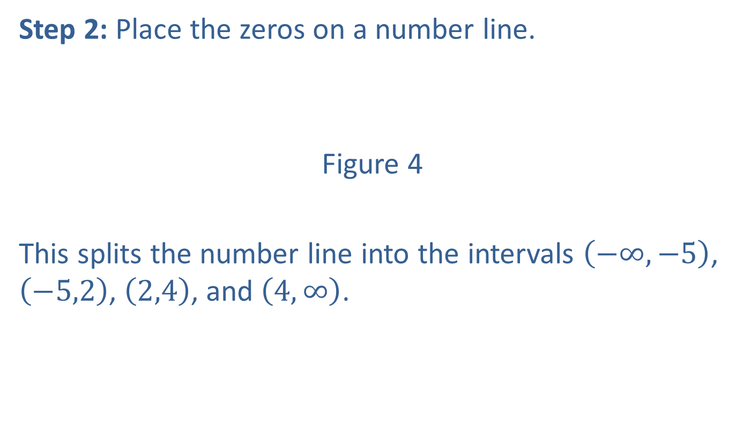
Example 2: Solving Polynomial Inequalities Using the Sign-Test Method—Slide 3
Step 2: Place the zeros on a number line.
Figure 4
This splits the number line into the intervals $\left(−∞,−5\right)$, $\left(−5,2\right)$, $\left(2,4\right)$, and $\left(4,∞\right)$.

Slide 12
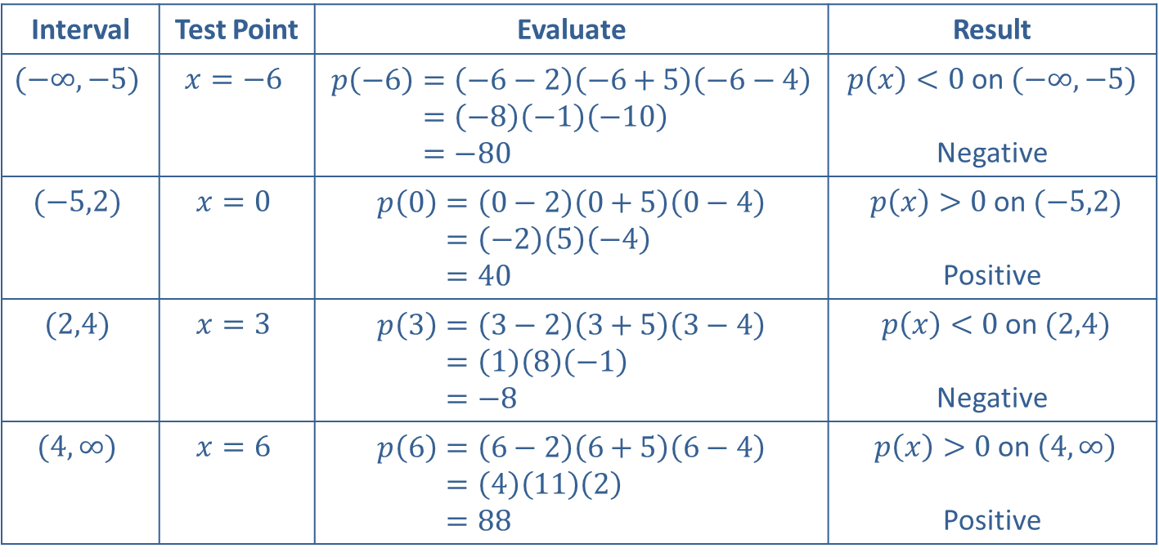
Example 2: Solving Polynomial Inequalities Using the Sign-Test Method—Slide 4
Step 3: Evaluate p(x) for a test point in each interval.
Interval | Test Point | Evaluate | Result
$$(−∞,−5)$$ | $$x=−6$$ | 𝑝−6=−6−2−6+5−6−4𝑝⁡−6=−8−1−10𝑝⁡−6=−80 | $p\left(x\right)<0$ on $(−∞,−5)$ Negative
$$(−5,2)$$ | $$x=0$$ | 𝑝0=0−20+50−4𝑝⁡0=−25−4𝑝⁡0=40 | $p\left(x\right)>0$ on $(−5,2)$ Positive
$$(2,4)$$ | $$x=3$$ | 𝑝3=3−23+53−4𝑝⁡3=18−1𝑝⁡3=−8 | $p\left(x\right)<0$ on $(2,4)$ Negative
$$(4,∞)$$ | $$x=6$$ | 𝑝6=6−26+56−4𝑝⁡6=4112𝑝⁡6=88 | $p\left(x\right)>0$ on $\left(4,∞\right)$ Positive
Table 1

Slide 13
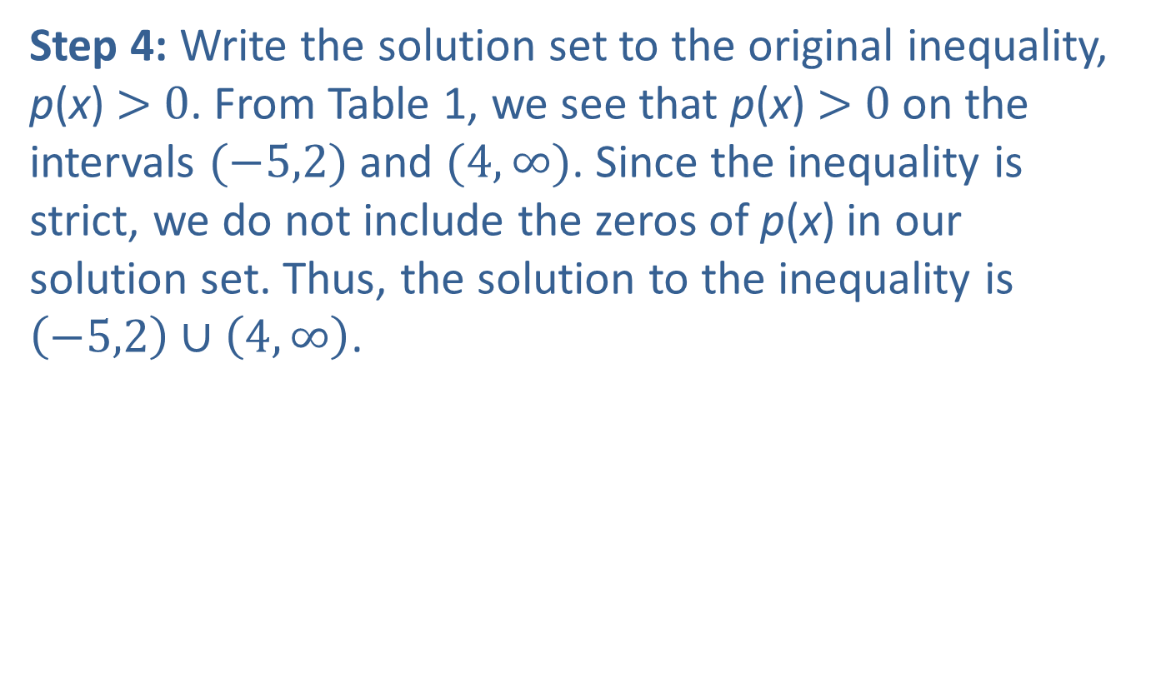
Example 2: Solving Polynomial Inequalities Using the Sign-Test Method—Slide 5
Step 4: Write the solution set to the original inequality, p(x) > 0. From Table 1, we see that p(x) > 0 on the intervals $(−5,2)$ and $(4,∞)$. Since the inequality is strict, we do not include the zeros of p(x) in our solution set. Thus, the solution to the inequality is $\left(−5,2\right)∪\left(4,∞\right)$.

Slide 14
Example 3: Solving Polynomial Inequalities—Slide 1
Solve the inequality by factoring and using a number line. Then, graph the solution set on a number line.
Solution
Set each factor equal to 0 to locate the interval endpoints.
Add −8 to both sides so that one side is 0.
Factor.

Slide 15
Example 3: Solving Polynomial Inequalities—Slide 2
We want to determine where the product is positive. Test one point from each of the intervals to determine if the product is positive or negative in that interval.

Slide 16
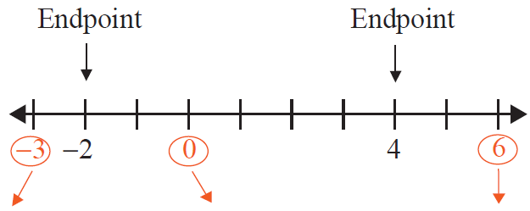
Example 3: Solving Polynomial Inequalities—Slide 3
Figure 5

Slide 17

Example 3: Solving Polynomial Inequalities—Slide 4
Graphically, the solution set is shown in Figure 6.
The solution set can be written in two ways.
algebraic notation or interval notation
Figure 6

Slide 18
Example 4: Solving Polynomial Inequalities—Slide 1
Solve the inequality by factoring and using a number line. Then, graph the solution set on a number line.
Solution

Slide 19
Example 4: Solving Polynomial Inequalities—Slide 2
Set each factor equal to 0 to locate the interval endpoints.
We want to determine where the product is negative. Test one point from each of the intervals to determine if the product is positive or negative in that interval.

Slide 20
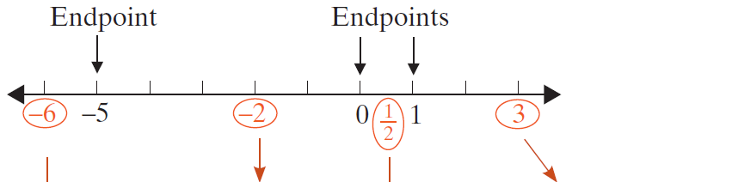
Example 4: Solving Polynomial Inequalities—Slide 3

Slide 21

Example 4: Solving Polynomial Inequalities—Slide 4
Figure 7

Slide 22

Example 4: Solving Polynomial Inequalities—Slide 5
Graphically, the solution set is shown in Figure 8.
The solution set can be written in two ways.
algebraic notation or interval notation
Figure 8

Slide 23

Example 5: Solving Polynomial Inequalities—Slide 1
Solve the polynomial inequality
$\left(x+2\right){\left(x−1\right)}^{2}\left(x−3\right)≤0$.

Slide 24

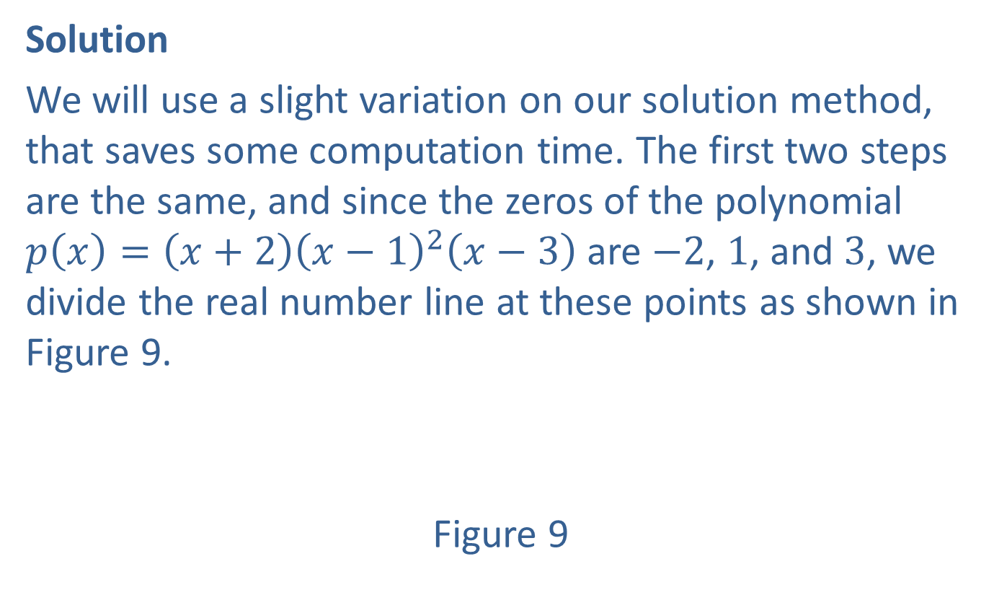
Example 5: Solving Polynomial Inequalities—Slide 2
Solution
We will use a slight variation on our solution method, that saves some computation time. The first two steps are the same, and since the zeros of the polynomial $p\left(x\right)=\left(x+2\right){\left(x−1\right)}^{2}\left(x−3\right)$ are −2, 1, and 3, we divide the real number line at these points as shown in Figure 9.
Figure 9

Slide 25
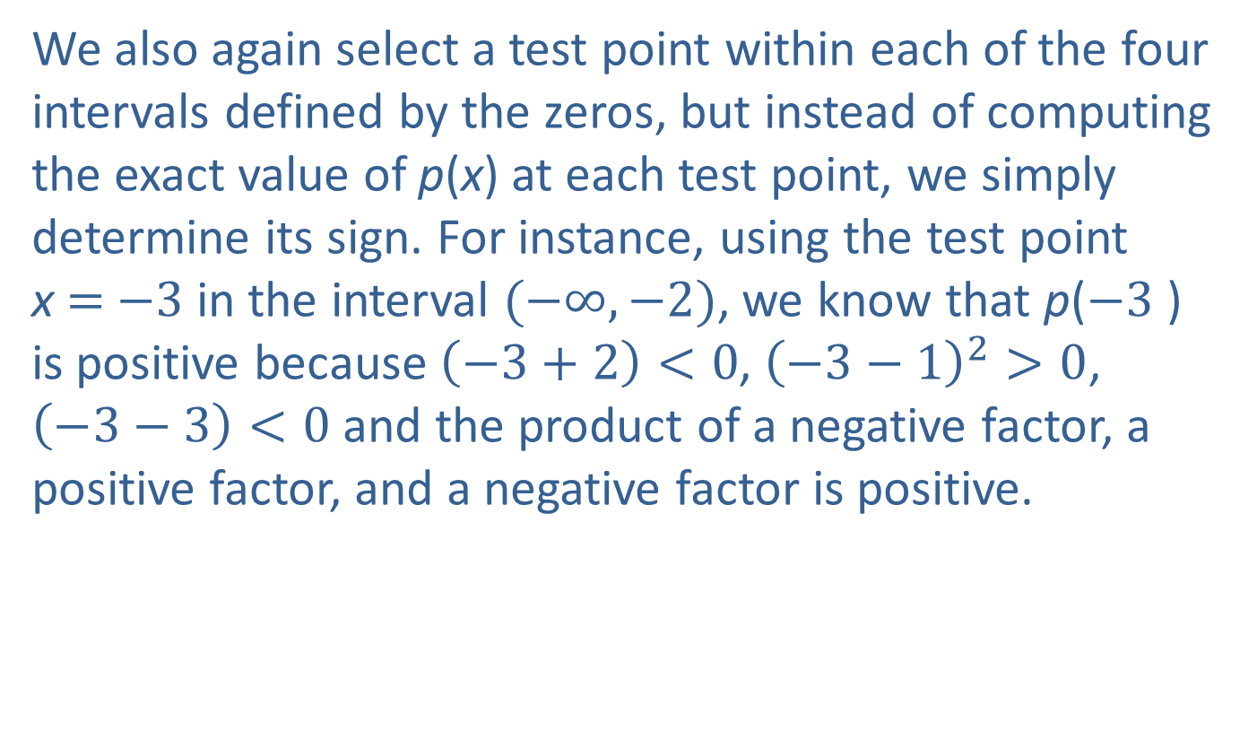
Example 5: Solving Polynomial Inequalities—Slide 3
We also again select a test point within each of the four intervals defined by the zeros, but instead of computing the exact value of p(x) at each test point, we simply determine its sign. For instance, using the test point x = −3 in the interval $(−∞,−2)$, we know that p(−3 ) is positive because $\left(−3+2\right)<0$, ${\left(−3−1\right)}^{2}>0$, $\left(−3−3\right)<0$ and the product of a negative factor, a positive factor, and a negative factor is positive.

Slide 26
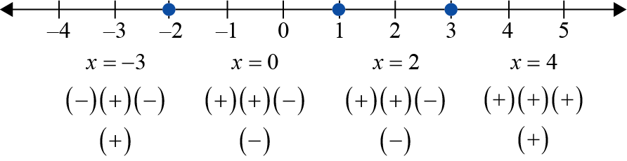
Example 5: Solving Polynomial Inequalities—Slide 4
In Figure 10, a representative test point for each interval is shown, followed by a string of “+” and “−” signs indicating the sign of each factor of p(x) at the test point. Finally, the sign of p(x) overall on the interval is shown.
Figure 10

Slide 27
Example 5: Solving Polynomial Inequalities—Slide 5
The last step of the method is to use the sign chart to identify the interval(s) on which p(x) ≥ 0. Since the inequality is not strict and the two intervals on which p(x) is nonpositive overlap at x = 1, the solution is [−2, 3].

Slide 28
Definition: Rational Inequalities
A rational inequality is any inequality that can be written in the form
f(x) < 0, f(x) ≤ 0, f(x) > 0, or f(x) ≥ 0,
where f(x) is a rational function.

Slide 29

Procedure: Solving Rational Inequalities Using the Sign-Test Method—Slide 1
To solve a rational inequality f(x) < 0, f(x) ≤ 0, f(x) > 0, or f(x) ≥ 0, where the rational function
$f\left(x\right)=\frac{p\left(x\right)}{q\left(x\right)}$ is in reduced form:
Step 1: | Find the real zeros of the numerator p(x). These values are the zeros of f.
Step 2: | Find the real zeros of the denominator q(x). These values are the locations of the vertical asymptotes of f.

Slide 30
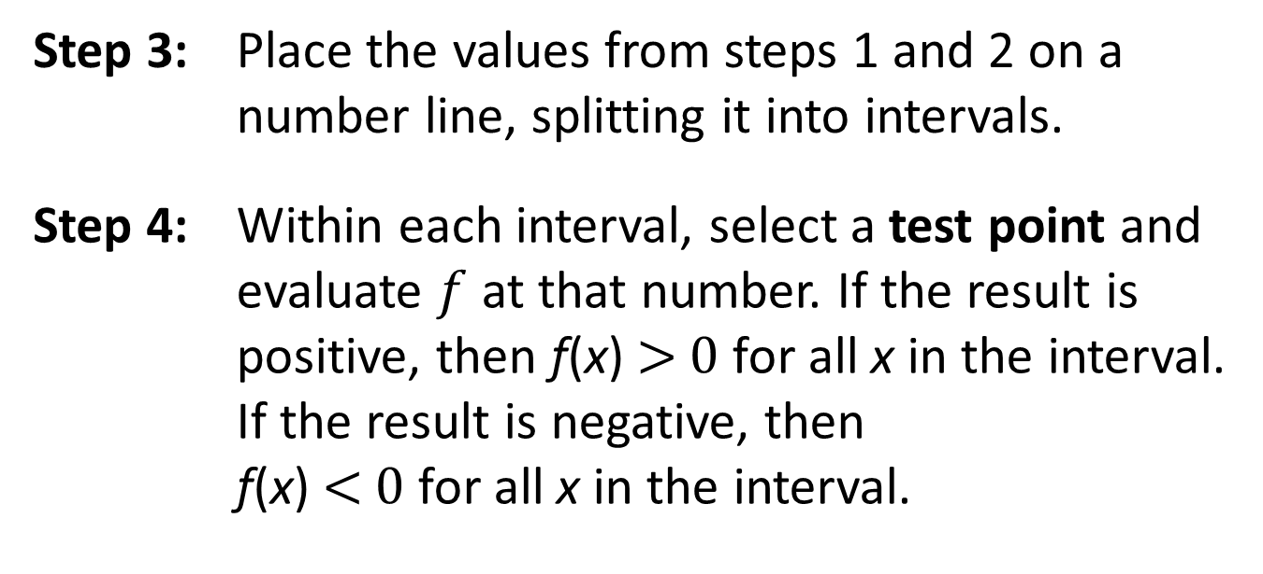
Procedure: Solving Rational Inequalities Using the Sign-Test Method—Slide 2
Step 3: | Place the values from steps 1 and 2 on a number line, splitting it into intervals.
Step 4: | Within each interval, select a test point and evaluate $f$ at that number. If the result is positive, then f(x) > 0 for all x in the interval. If the result is negative, then f(x) < 0 for all x in the interval.

Slide 31
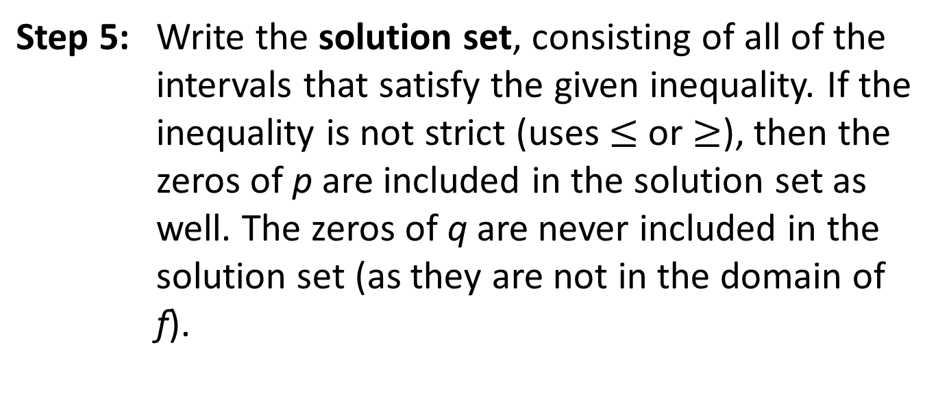
Procedure: Solving Rational Inequalities Using the Sign-Test Method—Slide 3
Step 5: | Write the solution set, consisting of all of the intervals that satisfy the given inequality. If the inequality is not strict (uses $≤$ or $≥$), then the zeros of p are included in the solution set as well. The zeros of q are never included in the solution set (as they are not in the domain of f).

Slide 32

Example 6: Solving Rational Inequalities—Slide 1
Solve the rational inequality $\frac{x^{2}+1}{x^{2}+2x−15}>0$.

Slide 33
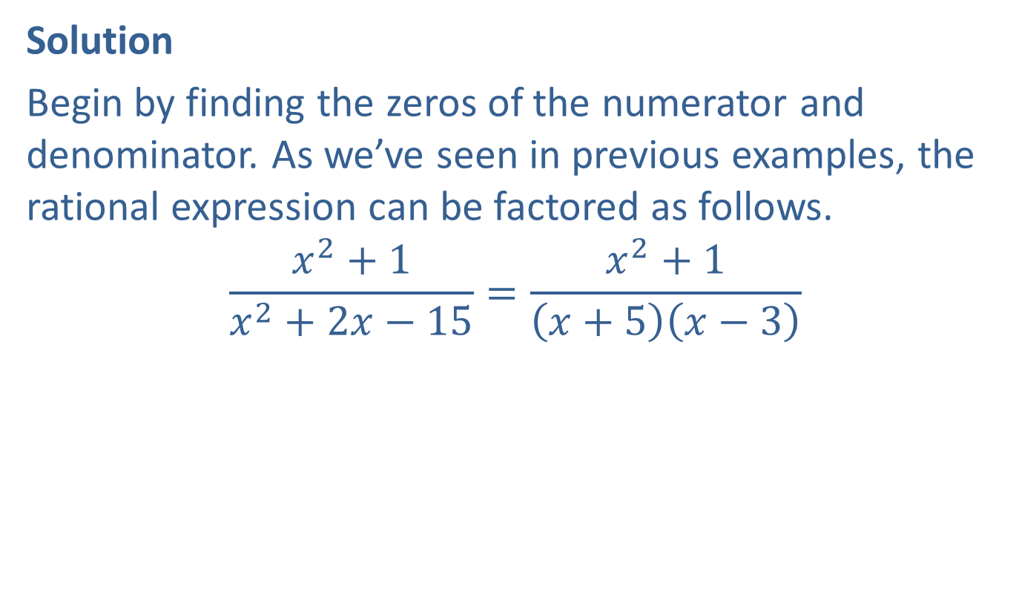
Example 6: Solving Rational Inequalities—Slide 2
Solution
Begin by finding the zeros of the numerator and denominator. As we’ve seen in previous examples, the rational expression can be factored as follows.
$$\frac{x^{2}+1}{x^{2}+2x−15}=\frac{x^{2}+1}{\left(x+5\right)\left(x−3\right)}$$

Slide 34
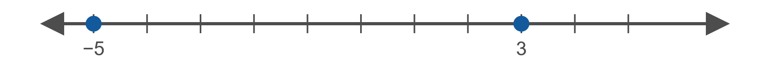
Example 6: Solving Rational Inequalities—Slide 3
Thus, we can see that the numerator has no zeros, while the denominator has zeros at x = −5 and x = 3.
Therefore, we place the values −5 and 3 on a number line.
Figure 11

Slide 35

Example 6: Solving Rational Inequalities—Slide 4
This splits the number line into the intervals $(−∞,−5)$, $(−5,3)$, $(3,∞)$. We then evaluate f(x) for a test point in each interval.

Slide 36
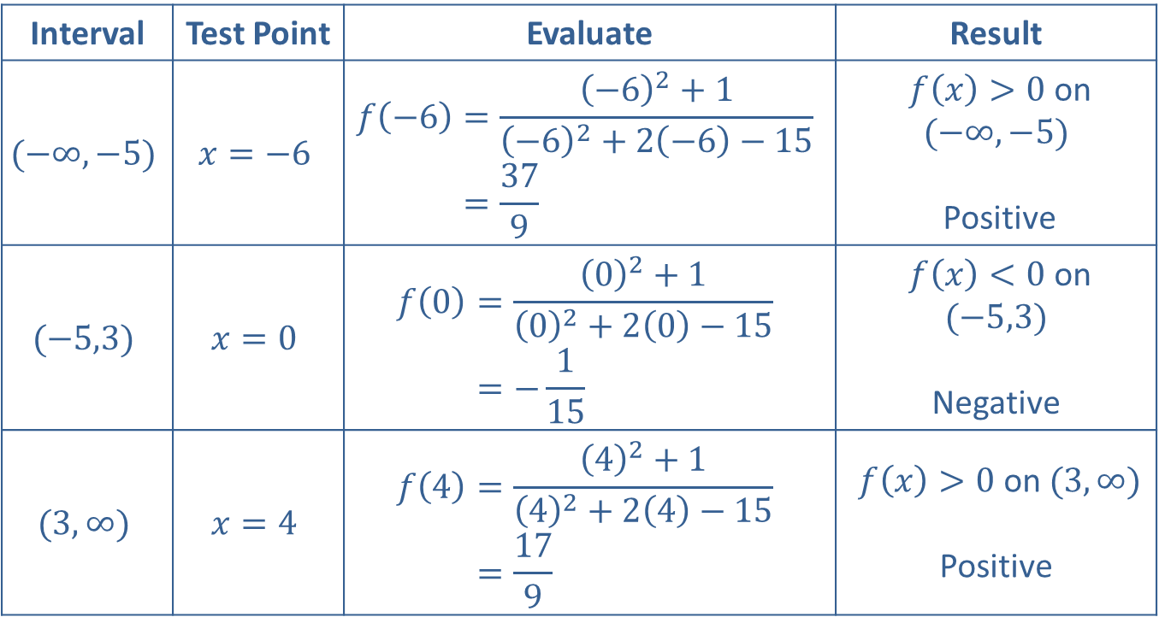
Example 6: Solving Rational Inequalities—Slide 5
Interval | Test Point | Evaluate | Result
$$(−∞,−5)$$ | $$x=−6$$ | 𝑓−6=−62+1−62+2−6−15𝑓⁡−6=379 | $f\left(x\right)>0$ on $(−∞,−5)$ Positive
$$(−5,3)$$ | $$x=0$$ | 𝑓0=02+102+20−15𝑓⁡0=−115 | $f⁡\left(x\right)<0$ on $(−5,3)$ Negative
$$(3,∞)$$ | $$x=4$$ | 𝑓4=42+142+24−15𝑓⁡4=179 | $f\left(x\right)>0$ on $(3,∞)$ Positive
Table 2

Slide 37

Example 6: Solving Rational Inequalities—Slide 6
Then, the solution to the inequality consists of those intervals where f(x) > 0, which is the set $\left(−∞,−5\right)∪\left(3,∞\right)$.

Slide 38
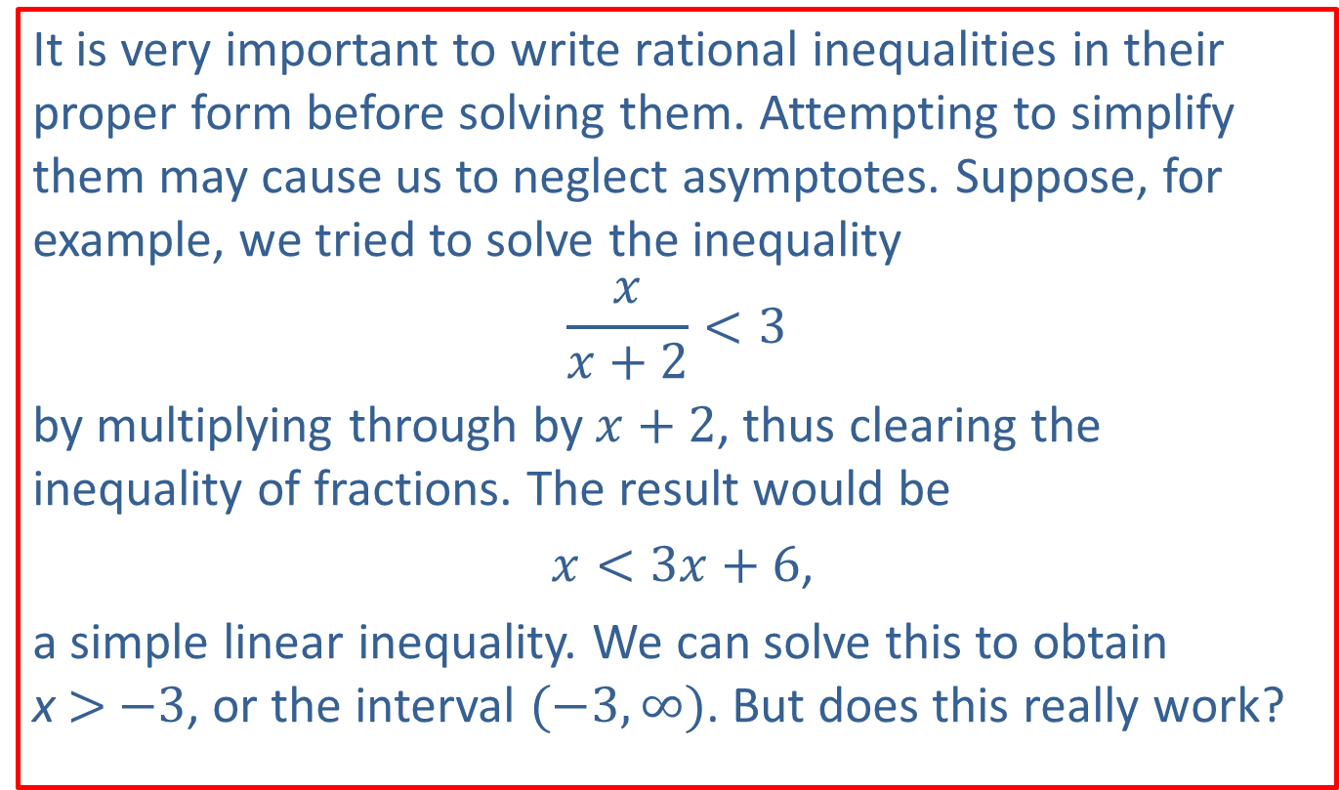
CAUTION!—Slide 1
It is very important to write rational inequalities in their proper form before solving them. Attempting to simplify them may cause us to neglect asymptotes. Suppose, for example, we tried to solve the inequality
$$\frac{x}{x+2}<3$$
by multiplying through by $x+2$, thus clearing the inequality of fractions. The result would be
$x<3x+6$,
a simple linear inequality. We can solve this to obtain x > −3, or the interval $(−3,∞)$. But does this really work?

Slide 39
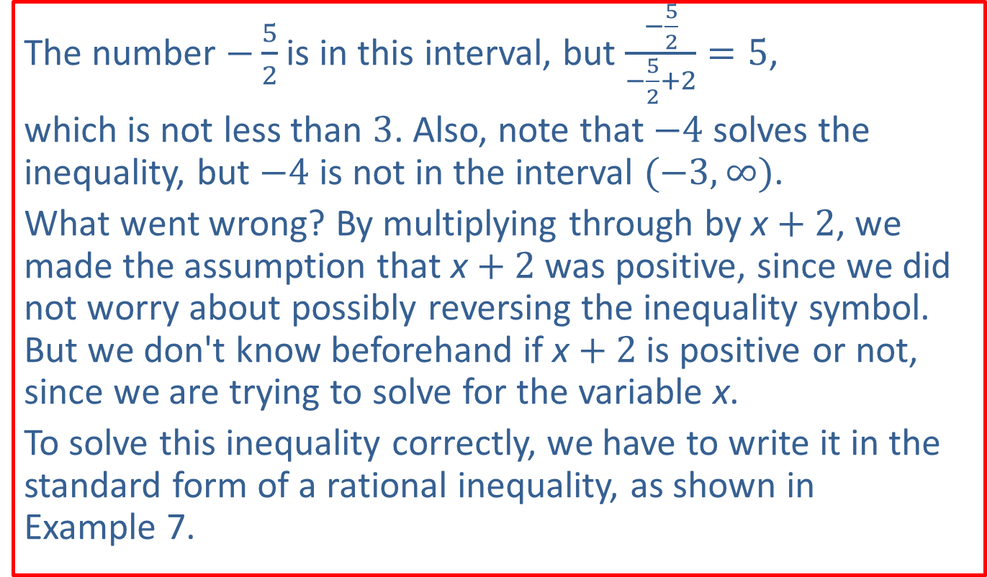
CAUTION!—Slide 2
The number $−\frac{5}{2}$ is in this interval, but $\frac{−\frac{5}{2}}{−\frac{5}{2}+2}=5$,
which is not less than 3. Also, note that −4 solves the inequality, but −4 is not in the interval $(−3,∞)$.
What went wrong? By multiplying through by x + 2, we made the assumption that x + 2 was positive, since we did not worry about possibly reversing the inequality symbol. But we don't know beforehand if x + 2 is positive or not, since we are trying to solve for the variable x.
To solve this inequality correctly, we have to write it in the standard form of a rational inequality, as shown in Example 7.

Slide 40

Example 7: Solving Rational Inequalities—Slide 1
Solve the rational inequalities $\frac{x}{x+2}<3$ and $\frac{x}{x+2}≤3$.

Slide 41
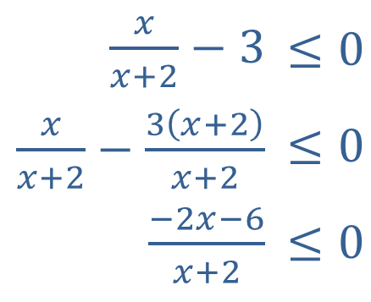
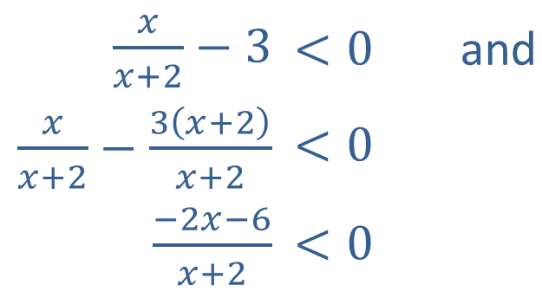
Example 7: Solving Rational Inequalities—Slide 2
Solution
Most of the work can be done for both inequalities at the same time.
We begin by subtracting 3 from both sides and then write the left-hand side as a single rational function.
​$\frac{x}{x+2}−3$ | ​$<0$ | and
​$\frac{x}{x+2}−\frac{3\left(x+2\right)}{x+2}$ | ​$<0$
​$\frac{−2x−6}{x+2}$ | ​$<0$
​$\frac{x}{x+2}−3$ | ​$≤0$
​$\frac{x}{x+2}−\frac{3\left(x+2\right)}{x+2}$ | ​$≤0$
​$\frac{−2x−6}{x+2}$ | ​$≤0$

Slide 42
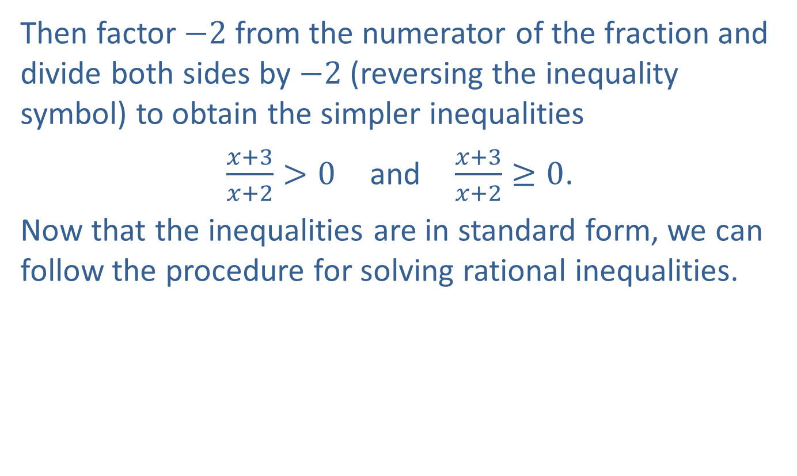
Example 7: Solving Rational Inequalities—Slide 3
Then factor −2 from the numerator of the fraction and divide both sides by −2 (reversing the inequality symbol) to obtain the simpler inequalities
$\frac{x+3}{x+2}>0$ and $\frac{x+3}{x+2}≥0$.
Now that the inequalities are in standard form, we can follow the procedure for solving rational inequalities.

Slide 43
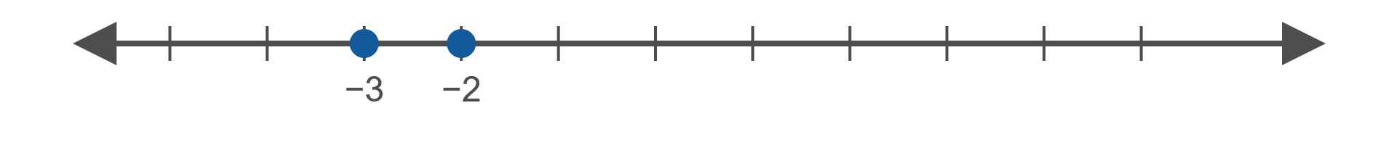
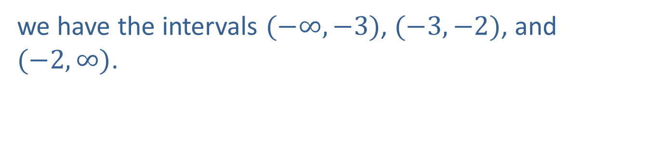
Example 7: Solving Rational Inequalities—Slide 4
The zeros of the numerator and denominator are −3 and −2, respectively. Placing these values on a number line,
Figure 12
we have the intervals $(−∞,−3)$, $(−3,−2)$, and $(−2,∞)$.

Slide 44
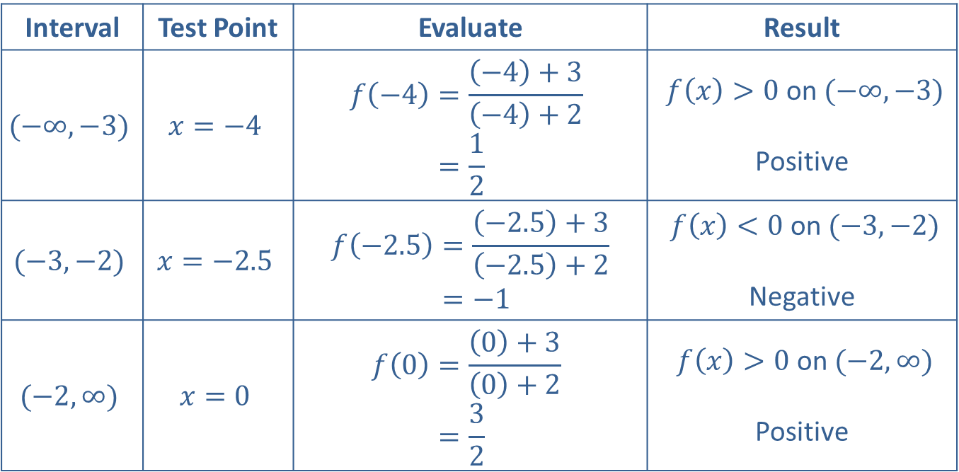
Example 7: Solving Rational Inequalities—Slide 5
Interval | Test Point | Evaluate | Result
$$(−∞,−3)$$ | $$x=−4$$ | 𝑓−4=−4+3−4+2𝑓⁡−4=12 | $f⁡\left(x\right)>0$ on $(−∞,−3)$ Positive
$$(−3,−2)$$ | $$x=−2.5$$ | 𝑓−2.5=−2.5+3−2.5+2𝑓⁡−2.5=−1 | $f⁡\left(x\right)<0$ on $(−3,−2)$ Negative
$$(−2,∞)$$ | $$x=0$$ | 𝑓0=0+30+2𝑓⁡0=32 | $f⁡\left(x\right)>0$ on $(−2,∞)$ Positive
Table 3

Slide 45
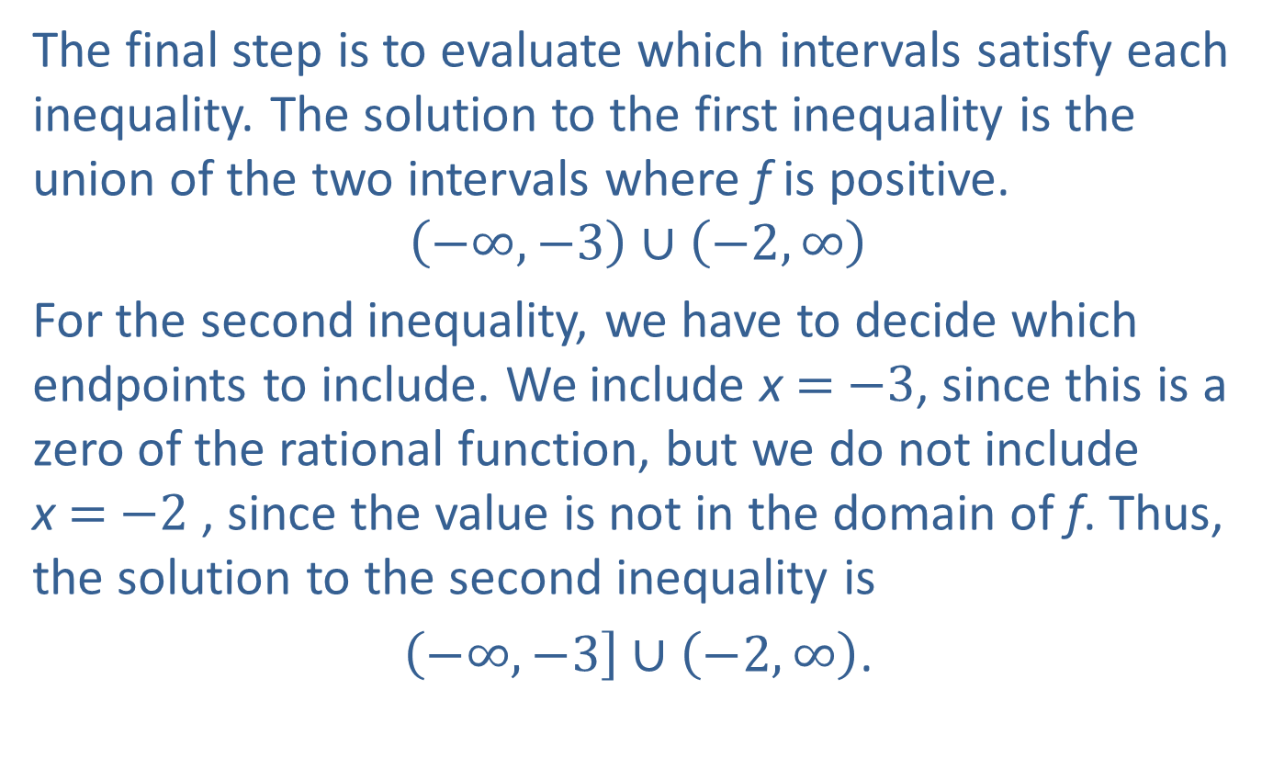
Example 7: Solving Rational Inequalities—Slide 6
The final step is to evaluate which intervals satisfy each inequality. The solution to the first inequality is the union of the two intervals where f is positive.
$$\left(−∞,−3\right)∪\left(−2,∞\right)$$
For the second inequality, we have to decide which endpoints to include. We include x = −3, since this is a zero of the rational function, but we do not include x = −2 , since the value is not in the domain of f. Thus, the solution to the second inequality is
$\left(−∞,−3\right]∪\left(−2,∞\right)$.

