Slide 1
Section 4.R.3
Radical Equations in One Variable

Slide 2
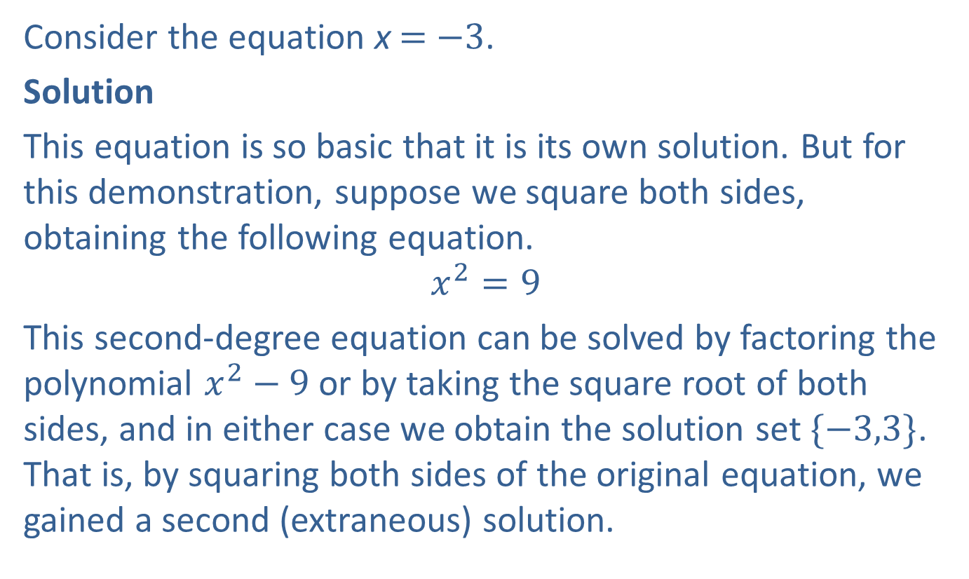
Example 1: Causing Extraneous Solutions
Consider the equation x = −3.
Solution
This equation is so basic that it is its own solution. But for this demonstration, suppose we square both sides, obtaining the following equation.
$$x^{2}=9$$
This second-degree equation can be solved by factoring the polynomial $x^{2}−9$ or by taking the square root of both sides, and in either case we obtain the solution set $\{−3,3\}$. That is, by squaring both sides of the original equation, we gained a second (extraneous) solution.

Slide 3
Procedure: Solving Radical Equations—Slide 1
Step 1: Begin by isolating the radical expression on one side of the equation. If there is more than one radical expression, choose one to isolate on one side.
Step 2: Raise both sides of the equation by the power necessary to "undo" the isolated radical. That is, if the radical is an n ^{th} root, raise both sides to the n ^{th} power.

Slide 4
Procedure: Solving Radical Equations—Slide 2
Step 3: If any radical expressions remain, simplify the equation if possible and then repeat steps 1 and 2 until the result is a polynomial equation. When a polynomial equation has been obtained, solve the equation using polynomial methods.
Step 4: Check your solutions in the original equation! Any extraneous solutions must be discarded.

Slide 5
Example 2: Solving Equations with One Radical—Slide 1
Solve the equation:
Solution
The radical is by itself on one side of the equation, so square both sides.
X = −6
X = 6

Slide 6
Example 2: Solving Equations with One Radical—Slide 2
Check
Check both answers in the original equation.
Both −6 and 6 are solutions.

Slide 7
Example 3: Solving Equations with One Radical—Slide 1
Solve the equation:
Solution
Since there is only one radical and it is by itself on one side of the equation, square both sides.
Square both sides.
Simplifying gives a first-degree equation.

Slide 8
Example 3: Solving Equations with One Radical—Slide 2
Check
There is one solution, −1.

Slide 9
Example 4: Solving Equations with One Radical—Slide 1
Solve the equation:
Solution
We could stop right here. There is no real solution to this equation because the radical on the left is nonnegative and cannot possibly equal −3, a negative number. Suppose we did not notice this relationship. Then, proceeding as usual, we will find an answer that is not a solution to the original equation.

Slide 10
Example 4: Solving Equations with One Radical—Slide 2
Square both sides.
Check
So, 8 does not check, therefore there is no solution.

Slide 11
Example 5: Solving Equations with Two Radicals—Slide 1
Solve the equation:
Solution
There are two radicals on opposite sides of the equation. Squaring both sides will give a new equation with no radicals.
Simplifying gives a first-degree equation.

Slide 12
Example 5: Solving Equations with Two Radicals—Slide 2
Check
There is one solution, 3.

Slide 13

Example 6: Radical Equations—Slide 1
Solve the radical equations.
​$\sqrt{1−x}−1=x$
​$\sqrt{x+1}+\sqrt{x+2}=1$
​$\sqrt[4]{x^{2}+8x+7}−2=0$

Slide 14
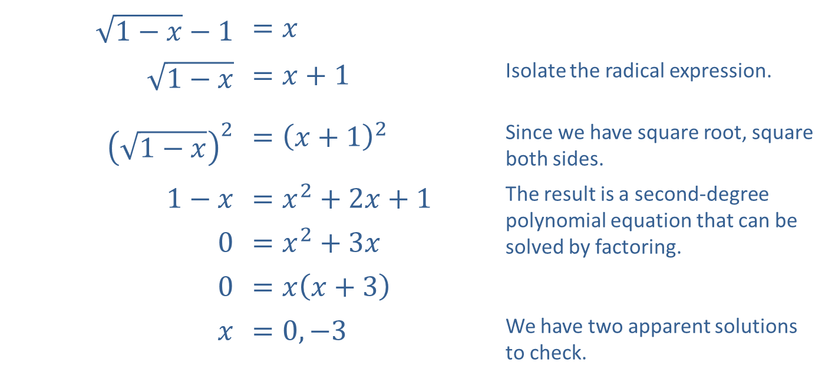
Example 6: Radical Equations—Slide 2
Solution
​
​$\sqrt{1−x}−1$ | ​$=x$
​$\sqrt{1−x}$ | ​$=x+1$ | Isolate the radical expression.
​${\left(\sqrt{1−x}\right)}^{2}$ | ​$={\left(x+1\right)}^{2}$ | Since we have square root, square both sides.
​$1−x$ | ​$=x^{2}+2x+1$ | The result is a second-degree polynomial equation that can be solved by factoring.
​0 | ​$=x^{2}+3x$
​0 | ​$=x\left(x+3\right)$
$$x$$ | ​$=0,−3$ | We have two apparent solutions to check.

Slide 15


Example 6: Radical Equations—Slide 3
​Now we need to check each apparent solution in the original equation.
​Thus, −3 is an extraneous solution, so the solution set is {0}.
​
$$\sqrt{1−0}−1=0 \\ \sqrt{1}−1=0 \\ 0=0$$
​
$$\sqrt{1−\left(−3\right)}−1=−3 \\ \sqrt{4}−1=−3 \\ 1≠−3$$
​

Slide 16
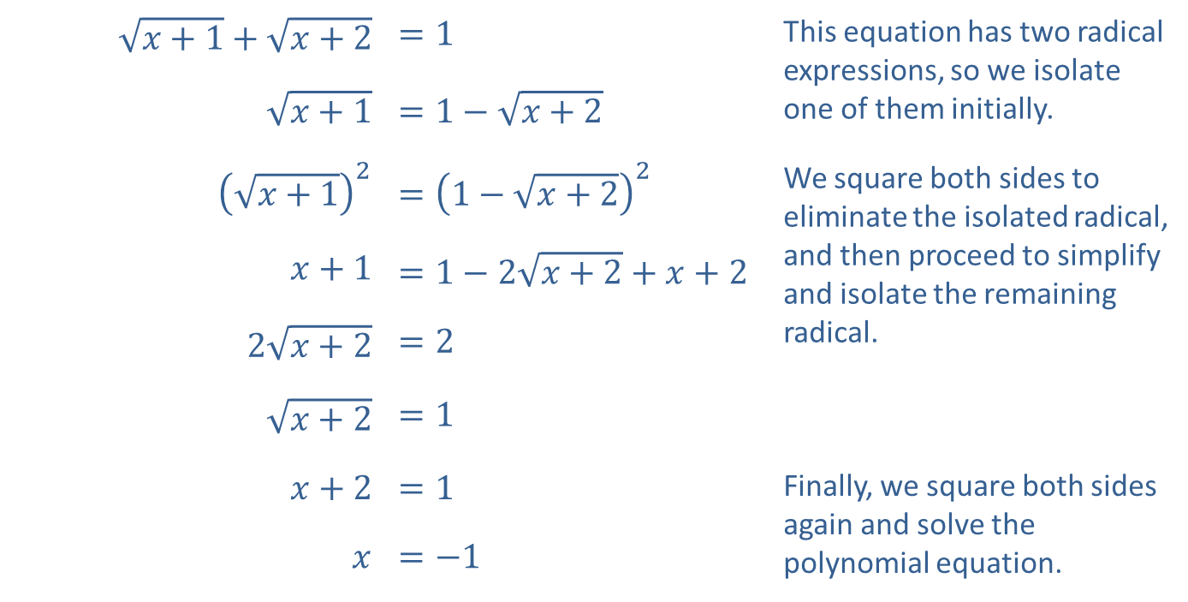
Example 6: Radical Equations—Slide 4
​
​$\sqrt{x+1}+\sqrt{x+2}$ | ​$=1$ | This equation has two radical expressions, so we isolate one of them initially.
​$\sqrt{x+1}$ | ​$=1−\sqrt{x+2}$
​${\left(\sqrt{x+1}\right)}^{2}$ | ​$={\left(1−\sqrt{x+2}\right)}^{2}$ | We square both sides to eliminate the isolated radical, and then proceed to simplify and isolate the remaining radical.
​$x+1$ | ​$=1−2\sqrt{x+2}+x+2$
​$2\sqrt{x+2}$ | ​$=2$
​$\sqrt{x+2}$ | ​$=1$
​$x+2$ | ​$=1$ | Finally, we square both sides again and solve the polynomial equation.
$$x$$ | ​$=−1$

Slide 17

Example 6: Radical Equations—Slide 5
​We check the apparent solution in the original equation.
Thus, the solution set is {−1}.
​
$$\sqrt{\left(−1\right)+1}+\sqrt{\left(−1\right)+2}=1 \\ \sqrt{0}+\sqrt{1}=1 \\ 1=1$$
​

Slide 18
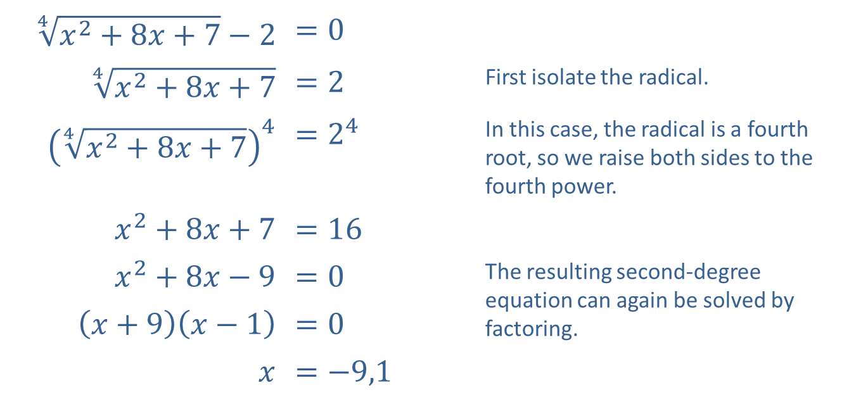
Example 6: Radical Equations—Slide 6
​
​$\sqrt[4]{x^{2}+8x+7}−2$ | ​$=0$
​$\sqrt[4]{x^{2}+8x+7}$ | ​$=2$ | First isolate the radical.
​${\left(\sqrt[4]{x^{2}+8x+7}\right)}^{4}$ | ​$=2^{4}$ | In this case, the radical is a fourth root, so we raise both sides to the fourth power.
​$x^{2}+8x+7$ | ​$=16$
​$x^{2}+8x−9$ | ​$=0$ | The resulting second-degree equation can again be solved by factoring.
​$\left(x+9\right)\left(x−1\right)$ | ​$=0$
$$x$$ | ​$=−9,1$

Slide 19


Example 6: Radical Equations—Slide 7
​Once again, we check the apparent solutions in the original equation.
​Both apparent solutions are actual solutions, so the solution set is {−9, 1}.
​
$$\sqrt[4]{{\left(−9\right)}^{2}+8\left(−9\right)+7}−2=0 \\ \sqrt[4]{16}−2=0 \\ 2−2=0 \\ 0=0$$
​
$$\sqrt[4]{{\left(1\right)}^{2}+8\left(1\right)+7}−2=0 \\ \sqrt[4]{16}−2=0 \\ 2−2=0 \\ 0=0$$
​

Slide 20
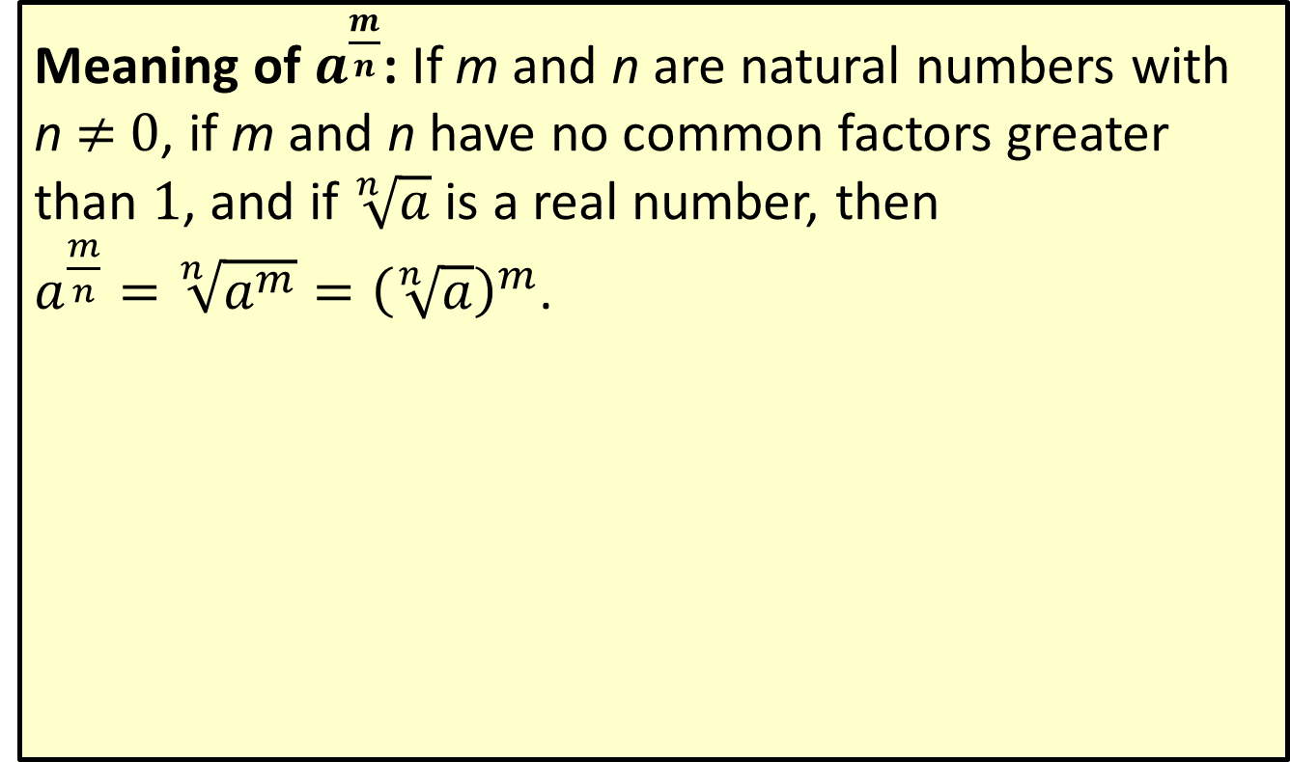
Definition: Positive Rational Number Exponents
Meaning of $a^{\frac{m}{n}}$: If m and n are natural numbers with n ≠ 0, if m and n have no common factors greater than 1, and if $\sqrt[n]{a}$ is a real number, then $a^{\frac{m}{n}}=\sqrt[n]{a^{m}}={\left(\sqrt[n]{a}\right)}^{m}$.

Slide 21

Example 7: Rational Exponents—Slide 1
Solve the following equations with rational exponents.
​$x^{\frac{2}{3}}−9=0$
​${\left(32x^{2}−32x+17\right)}^{\frac{1}{4}}=3$

Slide 22
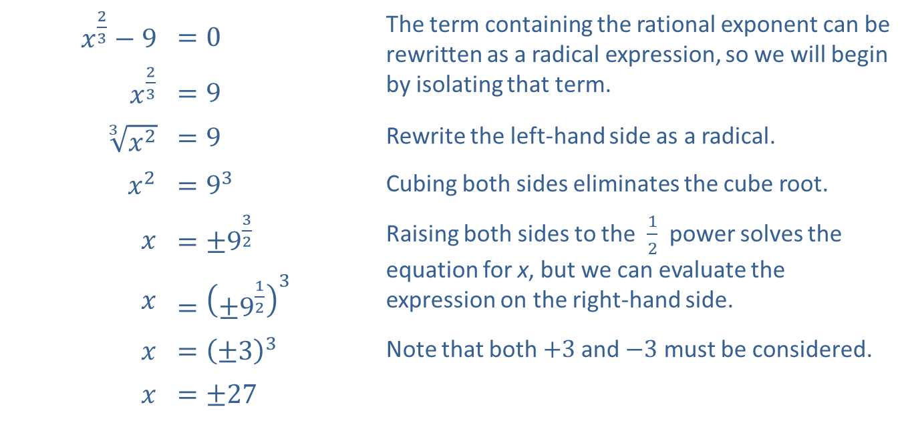
Example 7: Rational Exponents—Slide 2
Solution
​
​$x^{\frac{2}{3}}−9$ | ​$=0$ | The term containing the rational exponent can be rewritten as a radical expression, so we will begin by isolating that term.
​$x^{\frac{2}{3}}$ | ​$=9$
​$\sqrt[3]{x^{2}}$ | ​$=9$ | Rewrite the left-hand side as a radical.
​$x^{2}$ | ​$=9^{3}$ | Cubing both sides eliminates the cube root.
$$x$$ | ​$=±9^{\frac{3}{2}}$ | Raising both sides to the $\frac{1}{2}$ power solves the equation for x, but we can evaluate the expression on the right-hand side.
$$x$$ | ​$={\left({±9}^{\frac{1}{2}}\right)}^{3}$
$$x$$ | ​$={\left(±3\right)}^{3}$ | Note that both +3 and −3 must be considered.
$$x$$ | ​$=±27$

Slide 23

Example 7: Rational Exponents—Slide 3
​Plugging the values in, we see that ${\left(27\right)}^{\frac{2}{3}}=9$ and ${\left(−27\right)}^{\frac{2}{3}}=9$, so both are solutions to the original equation.
​

Slide 24
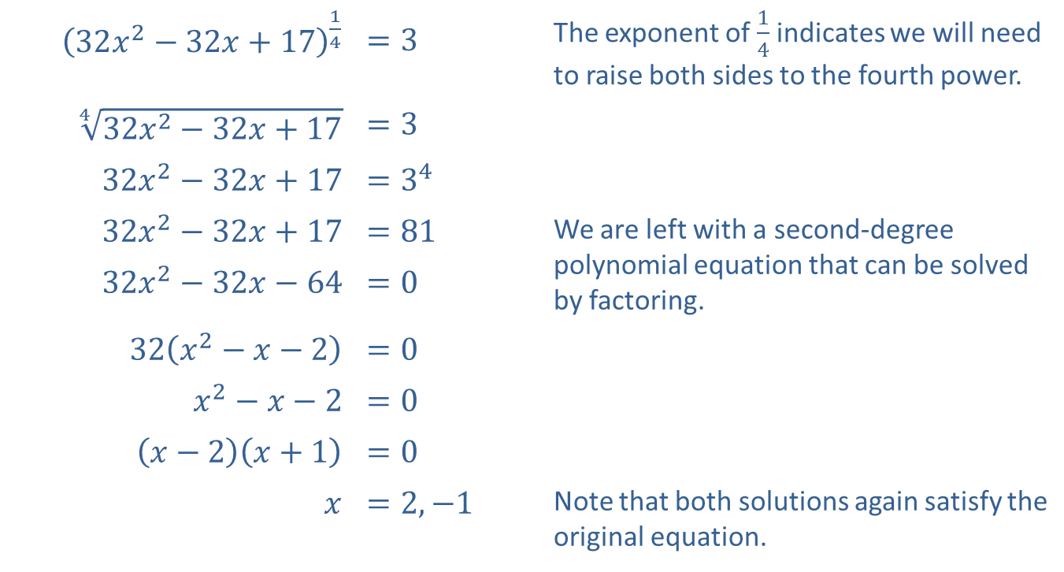
Example 7: Rational Exponents—Slide 4
​${\left(32x^{2}−32x+17\right)}^{\frac{1}{4}}$ | ​$=3$ | The exponent of $\frac{1}{4}$ indicates we will need to raise both sides to the fourth power.
​$\sqrt[4]{32x^{2}−32x+17}$ | ​$=3$
​$32x^{2}−32x+17$ | ​$=3^{4}$
​$32x^{2}−32x+17$ | ​$=81$ | We are left with a second-degree polynomial equation that can be solved by factoring.
​$32x^{2}−32x−64$ | ​$=0$
​$32\left(x^{2}−x−2\right)$ | ​$=0$
​$x^{2}−x−2$ | ​$=0$
​$\left(x−2\right)\left(x+1\right)$ | ​$=0$
$$x$$ | ​$=2,−1$ | Note that both solutions again satisfy the original equation.
​

Slide 25
Example 7: Rational Exponents—Slide 5
​Confirm, by substituting the solutions into the original equation, that both apparent solutions truly solve the equation with rational exponents.

Slide 26
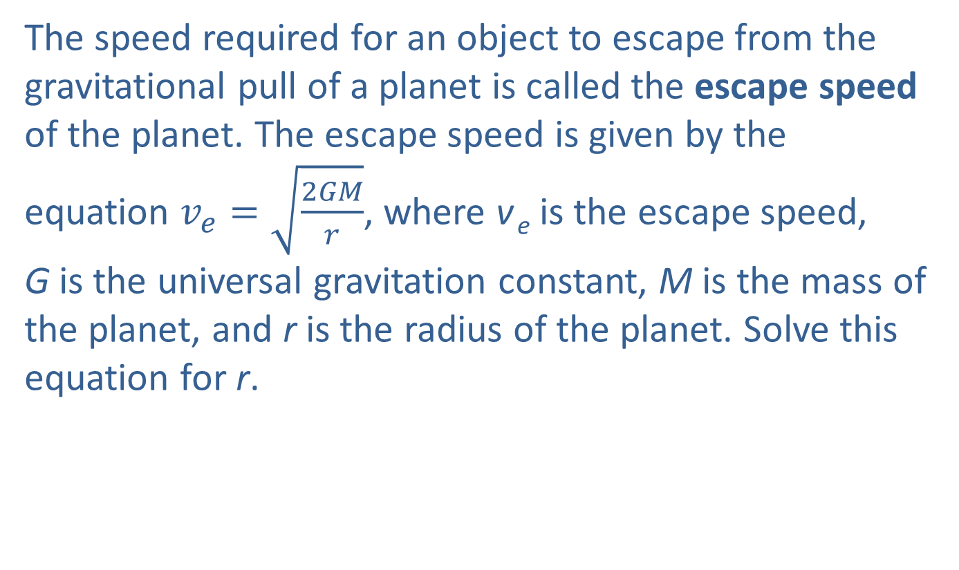
Example 8: Escape Speed—Slide 1
The speed required for an object to escape from the gravitational pull of a planet is called the escape speed of the planet. The escape speed is given by the equation $v_{e}=\sqrt{\frac{2GM}{r}}$, where v _{e} is the escape speed, G is the universal gravitation constant, M is the mass of the planet, and r is the radius of the planet. Solve this equation for r.

Slide 27
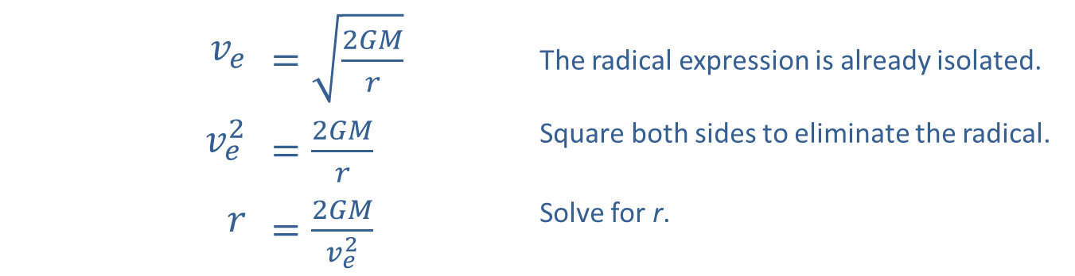
Example 8: Escape Speed—Slide 2
Solution
We follow the same procedure for solving radical equations.
​$v_{e}$ | ​$=\sqrt{\frac{2GM}{r}}$ | The radical expression is already isolated.
​$v_{e}^{2}$ | ​$=\frac{2GM}{r}$ | Square both sides to eliminate the radical.
$$r$$ | ​$=\frac{2GM}{v_{e}^{2}}$ | Solve for r.

