Slide 1
Section 4.R.2
Rational Equations in One Variable

Slide 2
Definition: Proportion
A proportion is an equation stating that two ratios are equal.
In symbols, is a proportion.

Slide 3
Example 1: Solving Proportions—Slide 1
Solve the following proportions.
b.
Solution
a. LCD = 6x
LCD = 6x
LCD = x(x − 6)

Slide 4
Example 1: Solving Proportions—Slide 2
Check
Thus, the solution is x = 9.

Slide 5
Example 1: Solving Proportions—Slide 3
Note: x ≠ 0, 6.
Multiply both sides by the LCD, x(x − 6).

Slide 6
Example 1: Solving Proportions—Slide 4
Check
Thus, the solution is x = 15.

Slide 7
Procedure: Solving an Equation Containing Rational Expressions
Find the LCD of the fractions.
List any restrictions on the variables.
Multiply both sides of the equation by this LCD and simplify.
Solve the resulting equation. (This equation will have only polynomials on both sides.)
Check each solution in the original equation. (Remember that no denominator can be 0. If one of the potential solutions matches a restriction on the variables, then that potential solution must be rejected.)

Slide 8
Example 2: Solving Rational Equations—Slide 1
State any restrictions on the variable, then solve the equation.
Solution
First, find the LCD of the fractions, and then multiply both sides of the equation by the LCD.

Slide 9
Example 2: Solving Rational Equations—Slide 2
Since 6 and 2 are not restrictions, there are two solutions, x = 6 and x = 2.

Slide 10
Example 3: Solving Rational Equations—Slide 1
State any restrictions on the variable, then solve the equation.
Solution
First, find the LCD of the fractions and then multiply each term on both sides of the equation by the LCD.
LCD = x(x − 2)

Slide 11
Example 3: Solving Rational Equations—Slide 2

Slide 12
Example 3: Solving Rational Equations—Slide 3
The only solution is since 2 is a restricted value
(x ≠ 0, 2) and thus not a solution. No denominator can be 0.

Slide 13
Example 4: Solving Rational Equations—Slide 1
State any restrictions on the variable, then solve the equation.
Solution
First, find the LCD of the fractions and then multiply each term on both sides of the equation by the LCD.

Slide 14
Example 4: Solving Rational Equations—Slide 2

Slide 15
Example 4: Solving Rational Equations—Slide 3
There is no solution. The solution set is the empty set, ∅. The original equation is a contradiction.
Note that 3 is one of the restrictions.

Slide 16

Example 5: Solving Rational Equations—Slide 1
Solve the following rational equations.
​ $\frac{x^{3}+3x^{2}}{x^{2}−2x−15}=\frac{4x+5}{x−5}$
​ $\frac{3x^{2}}{5x−1}−1=0$

Slide 17
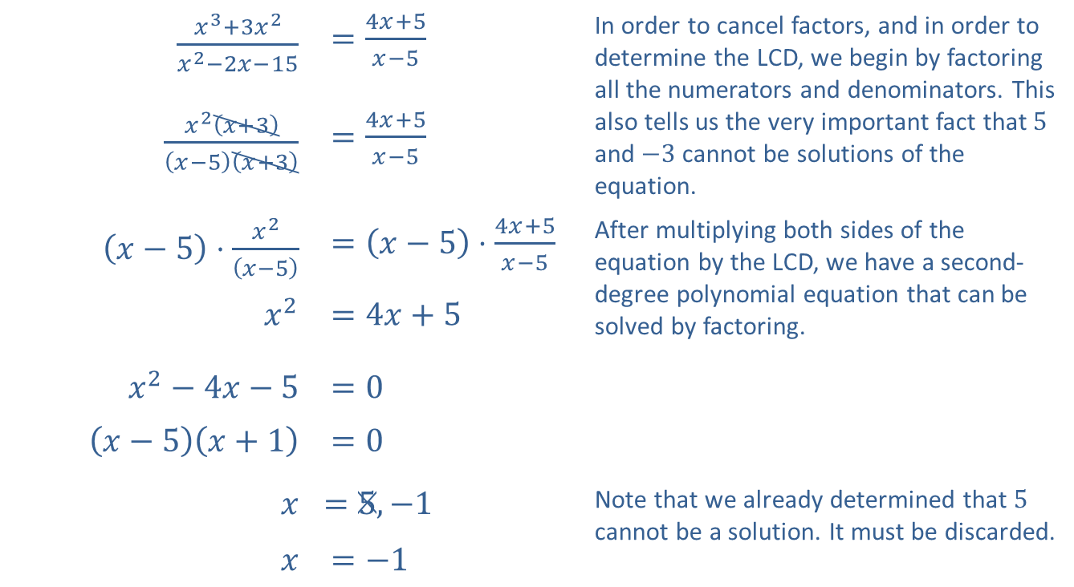
Example 5: Solving Rational Equations—Slide 2
Solution
​
$\frac{x^{3}+3x^{2}}{x^{2}−2x−15}$ | $=\frac{4x+5}{x−5}$ | In order to cancel factors, and in order to determine the LCD, we begin by factoring all the numerators and denominators. This also tells us the very important fact that 5 and −3 cannot be solutions of the equation.
$\frac{x^{2}\left(x+3\right)}{\left(x−5\right)\left(x+3\right)}$ | $=\frac{4x+5}{x−5}$
$\left(x−5\right)⋅\frac{x^{2}}{\left(x−5\right)}$ | $=\left(x−5\right)⋅\frac{4x+5}{x−5}$ | After multiplying both sides of the equation by the LCD, we have a second-degree polynomial equation that can be solved by factoring.
$x^{2}$ | $=4x+5$
$x^{2}−4x−5$ | $=0$
$\left(x−5\right)\left(x+1\right)$ | $=0$
$$x$$ | ​$=5,−1$ | Note that we already determined that 5 cannot be a solution. It must be discarded.
$$x$$ | $=−1$

Slide 18
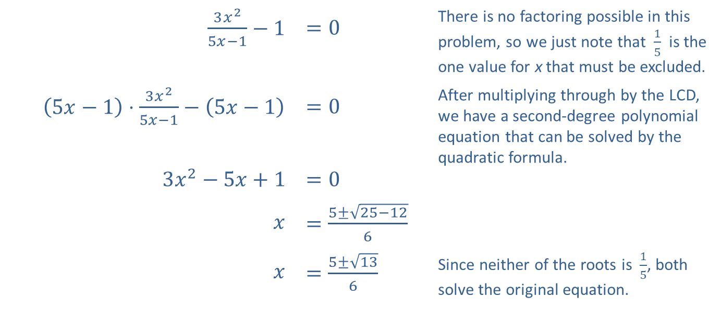
Example 5: Solving Rational Equations—Slide 3
$\frac{3x^{2}}{5x−1}−1$ | $=0$ | There is no factoring possible in this problem, so we just note that $\frac{1}{5}$ is the one value for x that must be excluded.
$\left(5x−1\right)⋅\frac{3x^{2}}{5x−1}−\left(5x−1\right)$ | $=0$ | After multiplying through by the LCD, we have a second-degree polynomial equation that can be solved by the quadratic formula.
$3x^{2}−5x+1$ | $=0$
$$x$$ | $=\frac{5±\sqrt{25−12}}{6}$
$$x$$ | $=\frac{5±\sqrt{13}}{6}$ | Since neither of the roots is $\frac{1}{5}$, both solve the original equation.
​

Slide 19

Example 6: Solving an Absolute Value Rational Equation—Slide 1
Solve the equation $\left|x−5\right|=\frac{7}{x+1}$.

Slide 20
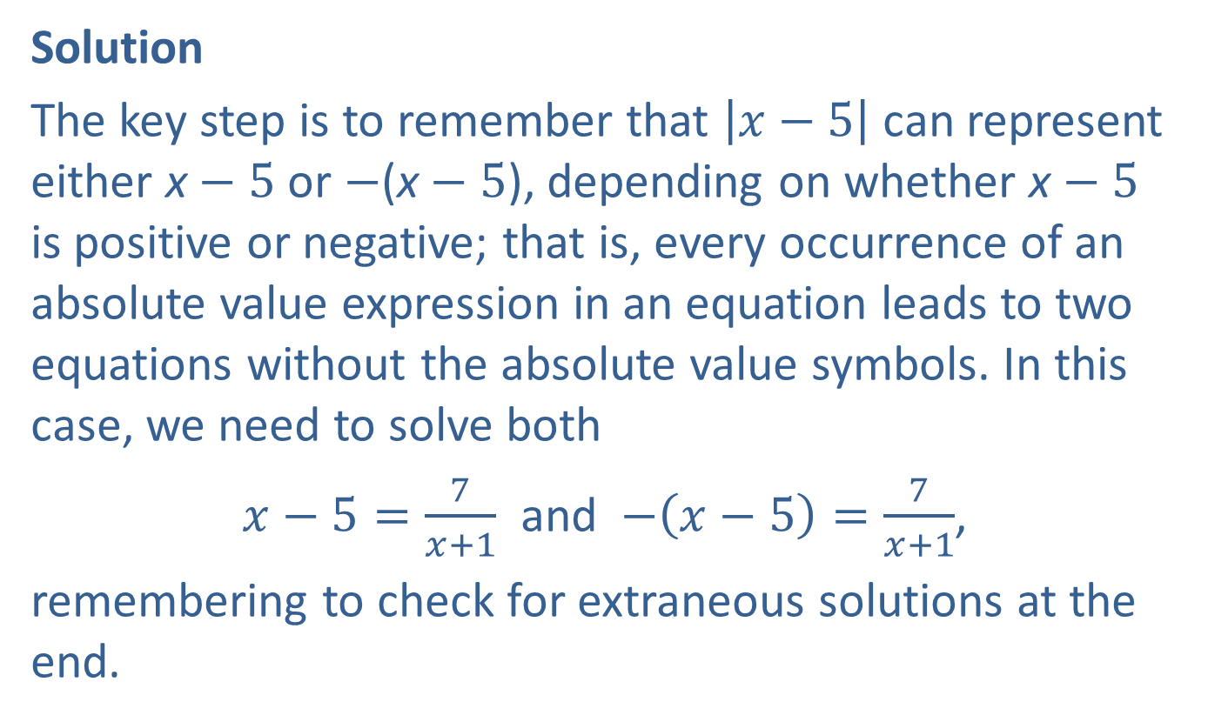
Example 6: Solving an Absolute Value Rational Equation—Slide 2
Solution
The key step is to remember that $\left|x−5\right|$ can represent either x − 5 or −(x − 5), depending on whether x − 5 is positive or negative; that is, every occurrence of an absolute value expression in an equation leads to two equations without the absolute value symbols. In this case, we need to solve both
$x−5=\frac{7}{x+1}$ and $−\left(x−5\right)=\frac{7}{x+1}$,
remembering to check for extraneous solutions at the end.

Slide 21
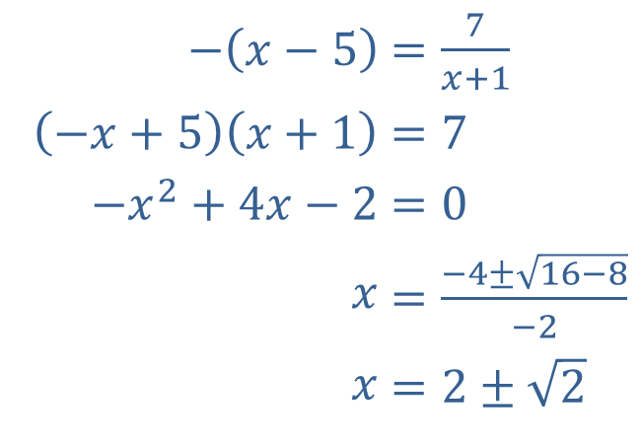
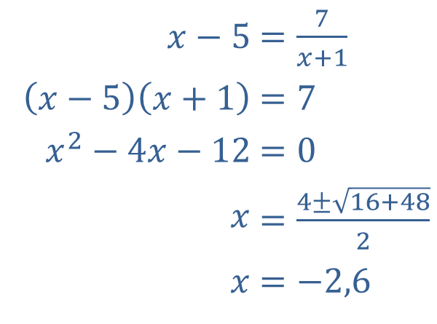
Example 6: Solving an Absolute Value Rational Equation—Slide 3
We will carry out the solutions of the two equations in parallel, as the steps are the same.
​
​$x−5$ | ​$=\frac{7}{x+1}$
​$\left(x−5\right)\left(x+1\right)$ | ​$=7$
​$x^{2}−4x−12$ | ​$=0$
​$x$ | ​$=\frac{4±\sqrt{16+48}}{2}$
​$x$ | ​$=−2,6$
​$−\left(x−5\right)$ | ​$=\frac{7}{x+1}$
​$\left(−x+5\right)\left(x+1\right)$ | ​$=7$
​$−x^{2}+4x−2$ | ​$=0$
​$x$ | ​$=\frac{−4±\sqrt{16−8}}{−2}$
​$x$ | ​$=2±\sqrt{2}$

Slide 22
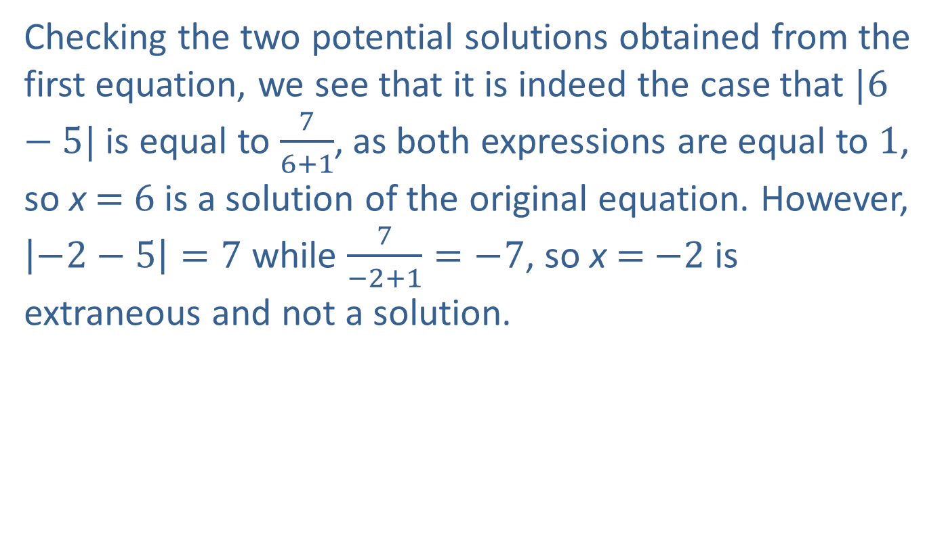
Example 6: Solving an Absolute Value Rational Equation—Slide 4
Checking the two potential solutions obtained from the first equation, we see that it is indeed the case that $|6−5|$ is equal to $\frac{7}{6+1}$, as both expressions are equal to 1, so x = 6 is a solution of the original equation. However, $\left|−2−5\right|=7$ while $\frac{7}{−2+1}=−7$, so x = −2 is extraneous and not a solution.

Slide 23
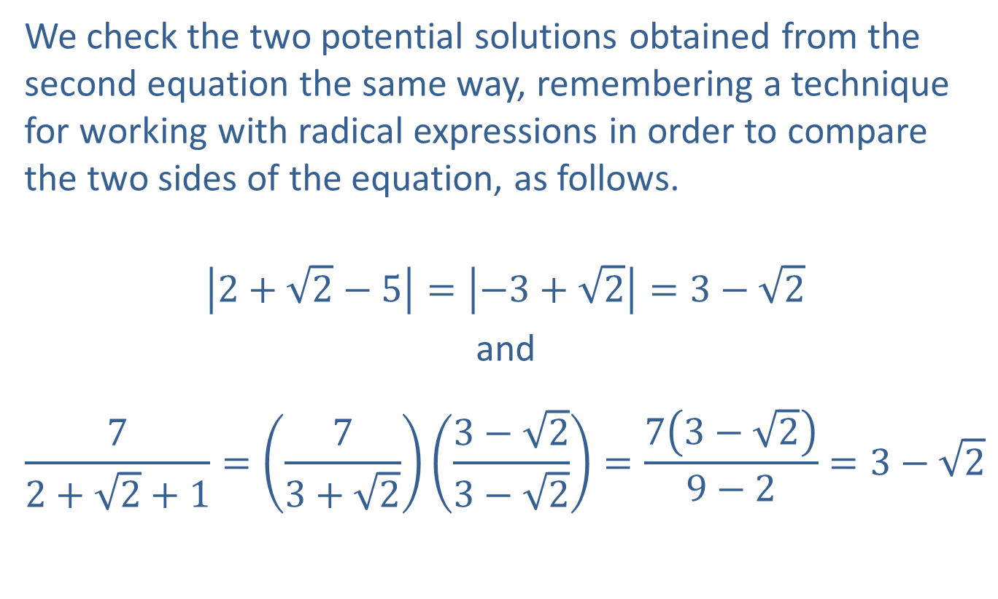
Example 6: Solving an Absolute Value Rational Equation—Slide 5
We check the two potential solutions obtained from the second equation the same way, remembering a technique for working with radical expressions in order to compare the two sides of the equation, as follows.
$$\left|2+\sqrt{2}−5\right|=\left|−3+\sqrt{2}\right|=3−\sqrt{2}$$
and
$$\frac{7}{2+\sqrt{2}+1}=\left(\frac{7}{3+\sqrt{2}}\right)\left(\frac{3−\sqrt{2}}{3−\sqrt{2}}\right)=\frac{7\left(3−\sqrt{2}\right)}{9−2}=3−\sqrt{2}$$

Slide 24
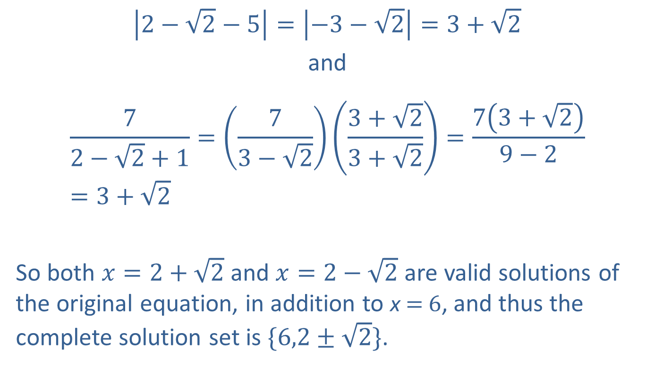
Example 6: Solving an Absolute Value Rational Equation—Slide 6
$$\left|2−\sqrt{2}−5\right|=\left|−3−\sqrt{2}\right|=3+\sqrt{2}$$
and
$$\frac{7}{2−\sqrt{2}+1}=\left(\frac{7}{3−\sqrt{2}}\right)\left(\frac{3+\sqrt{2}}{3+\sqrt{2}}\right)=\frac{7\left(3+\sqrt{2}\right)}{9−2}=3+\sqrt{2}$$
So both $x=2+\sqrt{2}$ and $x=2−\sqrt{2}$ are valid solutions of the original equation, in addition to x = 6, and thus the complete solution set is $\{6,2±\sqrt{2}\}$.

Slide 25
Completion Example 7: Solving Rational Equations—Slide 1
State any restrictions on the variable, then solve the equation.
Solution
−5
1

Slide 26
Completion Example 7: Solving Rational Equations—Slide 2
x − 1
x − 1
x − 1
3x + 1
x − 1
3x
1
x² + x −2
2x − 1
x − 2
−1

Slide 27
Example 8: Solving a Formula for a Specified Variable
The formula is used to find the surface area (S) of a right circular cylinder, where r is the radius of the cylinder and h is the height of the cylinder. Solve the formula for h.
Solution
Write the formula.
Add −2π r ² to both sides of the equation.
Divide both side by 2π r .
Thus, the formula solved for h is

