Slide 1
Section 4.R.1
Polynomial and Polynomial-Like Equations in One Variable

Slide 2
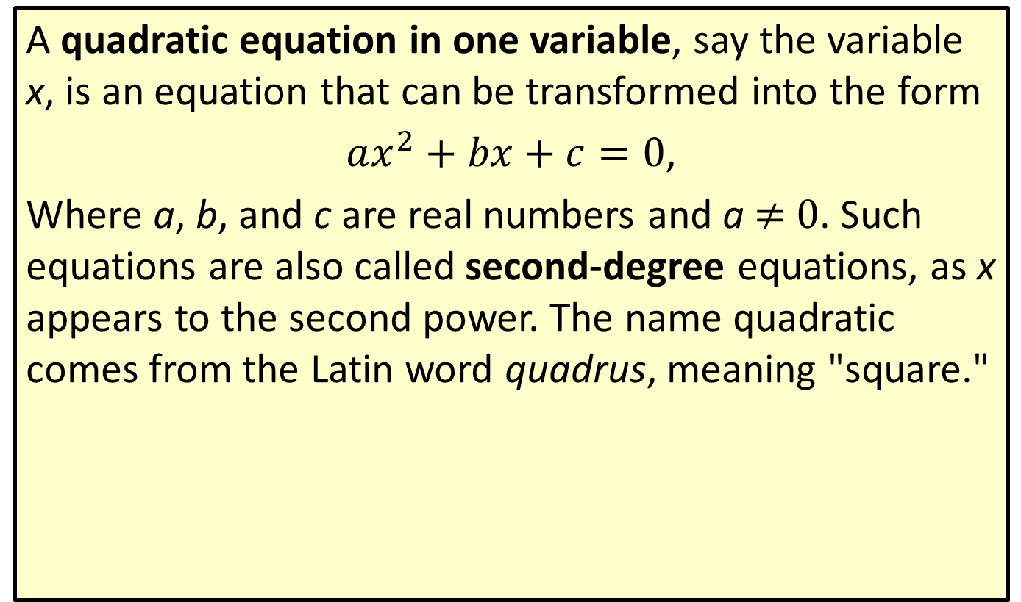
Definition: Quadratic Equations
A quadratic equation in one variable, say the variable x, is an equation that can be transformed into the form
$ax^{2}+bx+c=0$,
Where a, b, and c are real numbers and a ≠ 0. Such equations are also called second-degree equations, as x appears to the second power. The name quadratic comes from the Latin word quadrus, meaning "square."

Slide 3

Example 1: Solving Quadratic Equations by Factoring—Slide 1
Solve the quadratic equations by factoring.
​$x^{2}+\frac{5x}{2}=\frac{3}{2}$
​$s^{2}+9=6s$
​$5x^{2}+10x=0$

Slide 4
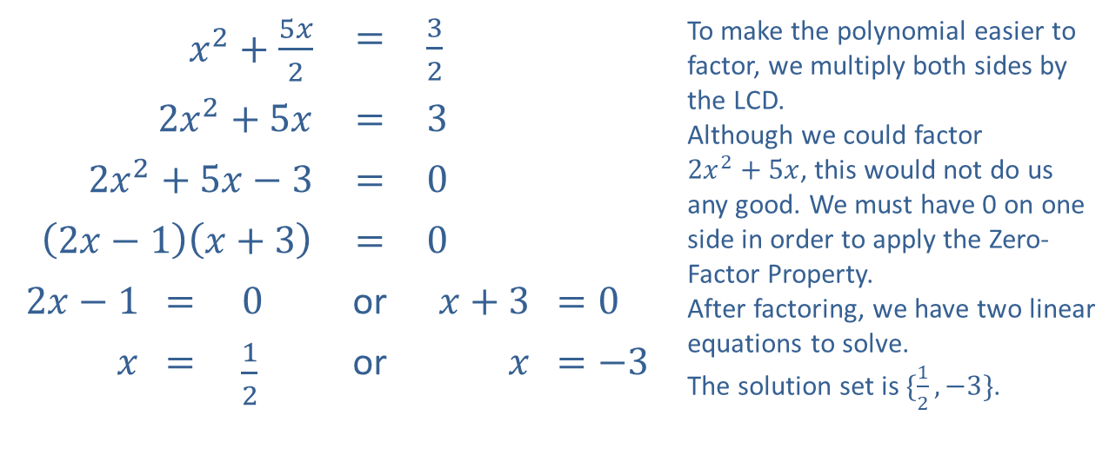
Example 1: Solving Quadratic Equations by Factoring—Slide 2
Solution
​
​$x^{2}+\frac{5x}{2}$ |  |  | ​​$=$ | ​$\frac{3}{2}$ |  | To make the polynomial easier to factor, we multiply both sides by the LCD. Although we could factor $2x^{2}+5x$, this would not do us any good. We must have 0 on one side in order to apply the Zero-Factor Property. After factoring, we have two linear equations to solve. The solution set is $\{\frac{1}{2},−3\}$.
​$2x^{2}+5x$ |  |  | ​​$=$ | ​$3$
​$2x^{2}+5x−3$ |  |  | ​​$=$ | ​$0$
​$\left(2x−1\right)\left(x+3\right)$ |  |  | ​​$=$ | ​$0$
​$2x−1$ | ​​$=$ | ​$0$ | or | ​$x+3$ | ​$=0$
$$x$$ | ​​$=$ | ​$\frac{1}{2}$ | or | $$x$$ | ​​$=−3$

Slide 5
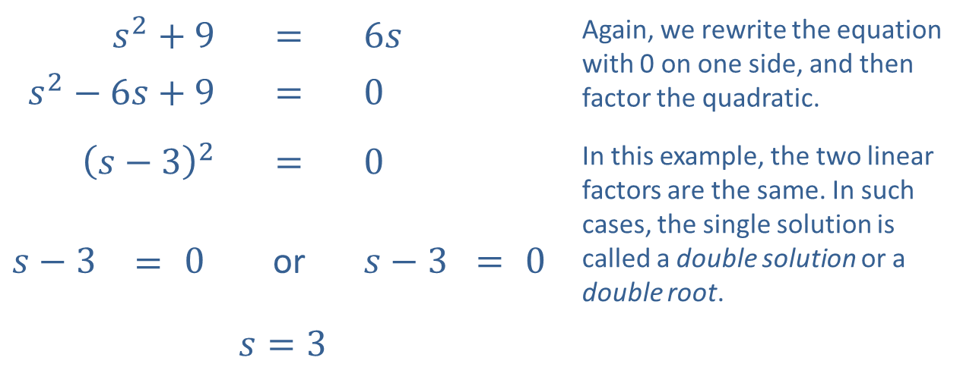
Example 1: Solving Quadratic Equations by Factoring—Slide 3
​
​$s^{2}+9$ |  |  | ​$=$ | ​$6s$ |  |  | Again, we rewrite the equation with 0 on one side, and then factor the quadratic.
​$s^{2}−6s+9$ |  |  | ​$=$ | ​$0$
​${\left(s−3\right)}^{2}$ |  |  | ​$=$ | ​$0$ |  |  | In this example, the two linear factors are the same. In such cases, the single solution is called a double solution or a double root.
​$s−3$ | $$=$$ | ​$0$ | or | ​$s−3$ | $=$ | ​$0$
 |  |  | ​$s=3$

Slide 6
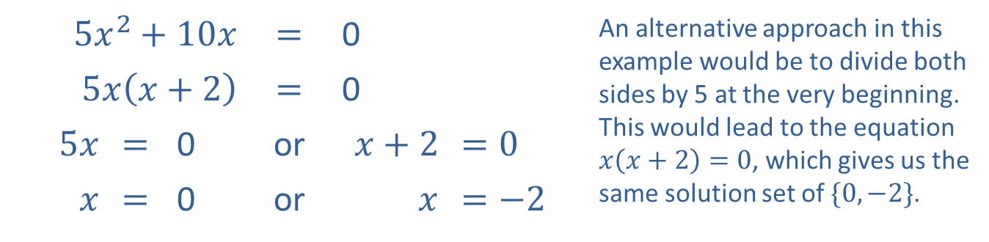
Example 1: Solving Quadratic Equations by Factoring—Slide 4
​
​$5x^{2}+10x$ |  |  | ​$=$ | ​0 |  | An alternative approach in this example would be to divide both sides by 5 at the very beginning. This would lead to the equation $x\left(x+2\right)=0$, which gives us the same solution set of $\{0,−2\}$.
​$5x\left(x+2\right)$ |  |  | ​$=$ | ​0
​$5x$ | ​$=$ | ​0 | or | ​$x+2$ | ​$=0$
$x$ | ​$=$ | ​0 | or | $$x$$ | ​$=−2$

Slide 7

Example 2: Perfect Square Quadratic Equations—Slide 1
Solve the quadratic equation by taking square roots.
​${\left(2x+3\right)}^{2}=8$

Slide 8
Note 1
In the factoring method, we move all terms to one side. Here, we isolate a term that is squared, ideally with only a constant on the other side.

Slide 9
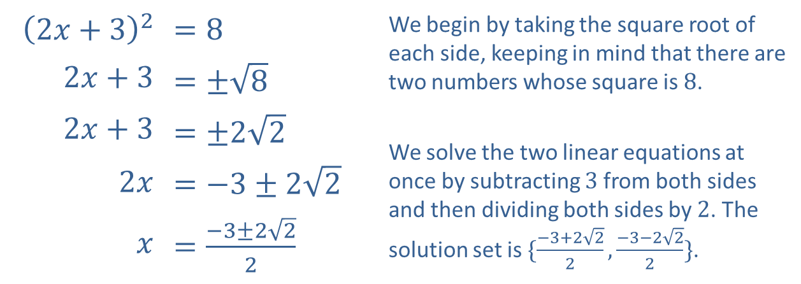
Example 2: Perfect Square Quadratic Equations—Slide 2
Solution
​
​${\left(2x+3\right)}^{2}$ | ​$=8$ | We begin by taking the square root of each side, keeping in mind that there are two numbers whose square is 8.
​$2x+3$ | ​$=±\sqrt{8}$
​$2x+3$ | ​$=±2\sqrt{2}$ | We solve the two linear equations at once by subtracting 3 from both sides and then dividing both sides by 2. The solution set is $\{\frac{−3+2\sqrt{2}}{2},\frac{−3−2\sqrt{2}}{2}\}$.
​$2x$ | ​$=−3±2\sqrt{2}$
$x$ | ​$=\frac{−3±2\sqrt{2}}{2}$

Slide 10
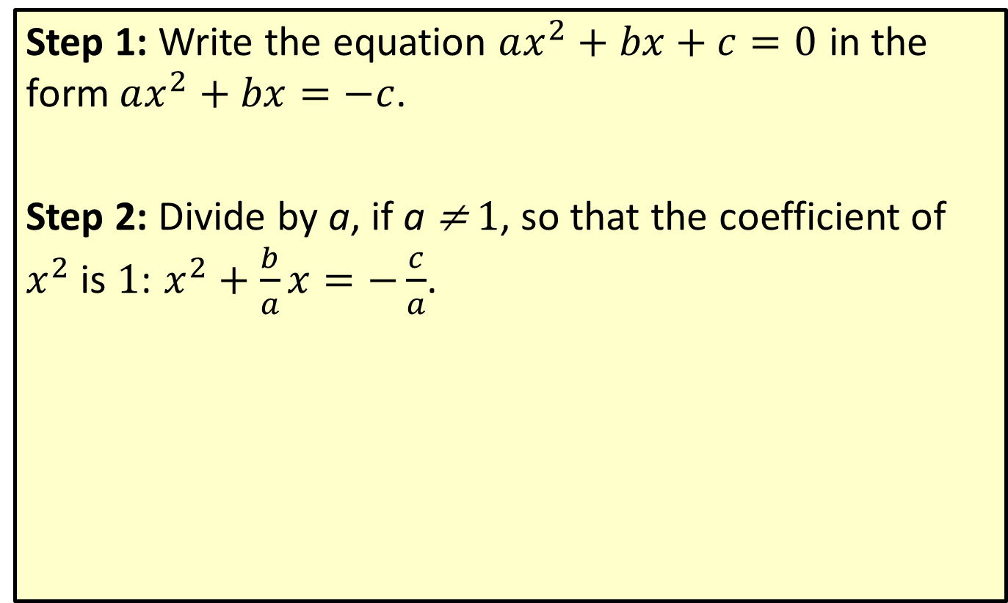
Procedure: Completing the Square—Slide 1
Step 1: Write the equation $ax^{2}+bx+c=0$ in the form $ax^{2}+bx=−c$.
Step 2: Divide by a, if a ≠ 1, so that the coefficient of $x^{2}$ is $1$: $x^{2}+\frac{b}{a}x=−\frac{c}{a}$.

Slide 11
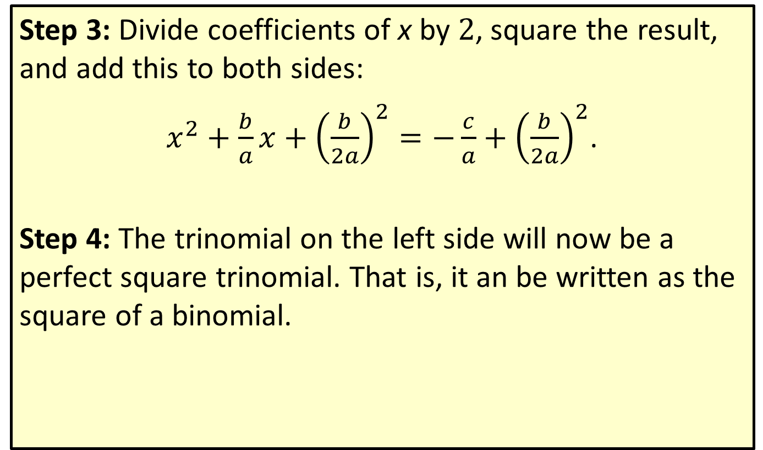
Procedure: Completing the Square—Slide 2
Step 3: Divide coefficients of x by $2$, square the result, and add this to both sides:
$x^{2}+\frac{b}{a}x+{\left(\frac{b}{2a}\right)}^{2}=−\frac{c}{a}+{\left(\frac{b}{2a}\right)}^{2}$.
Step 4: The trinomial on the left side will now be a perfect square trinomial. That is, it an be written as the square of a binomial.

Slide 12

Example 3: Completing the Square—Slide 1
Solve the quadratic equations by completing the square.
​$x^{2}−2x−6=0$
​$9x^{2}+3x=2$

Slide 13
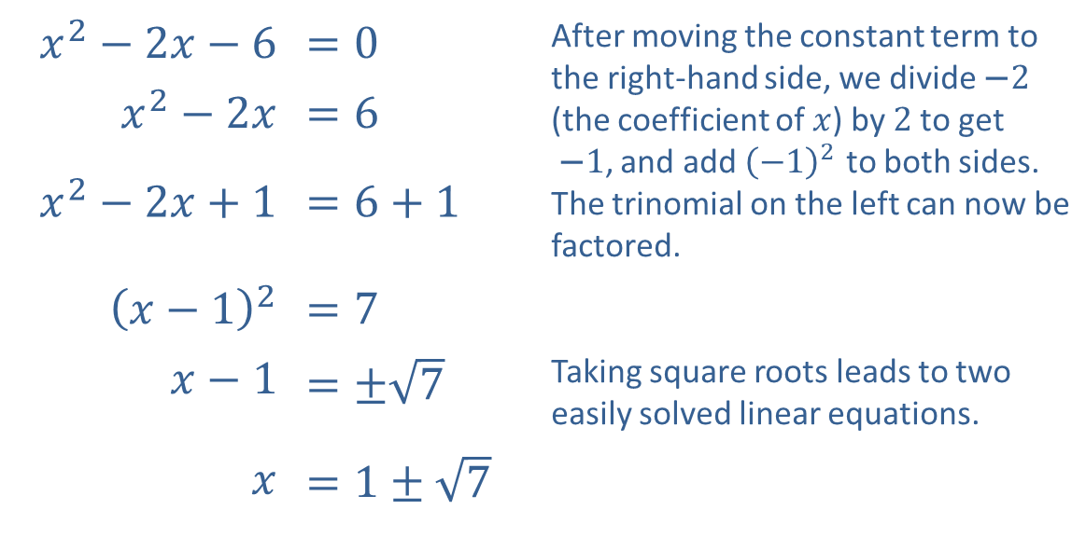
Example 3: Completing the Square—Slide 2
Solution
​
​$x^{2}−2x−6$ | ​$=0$ | After moving the constant term to the right-hand side, we divide −2 (the coefficient of $x$) by 2 to get −1, and add ${\left(−1\right)}^{2}$ to both sides. The trinomial on the left can now be factored.
​$x^{2}−2x$ | ​$=6$
​$x^{2}−2x+1$ | ​$=6+1$
​${\left(x−1\right)}^{2}$ | ​$=7$
​$x−1$ | ​$=±\sqrt{7}$ | Taking square roots leads to two easily solved linear equations.
$x$ | ​$=1±\sqrt{7}$

Slide 14
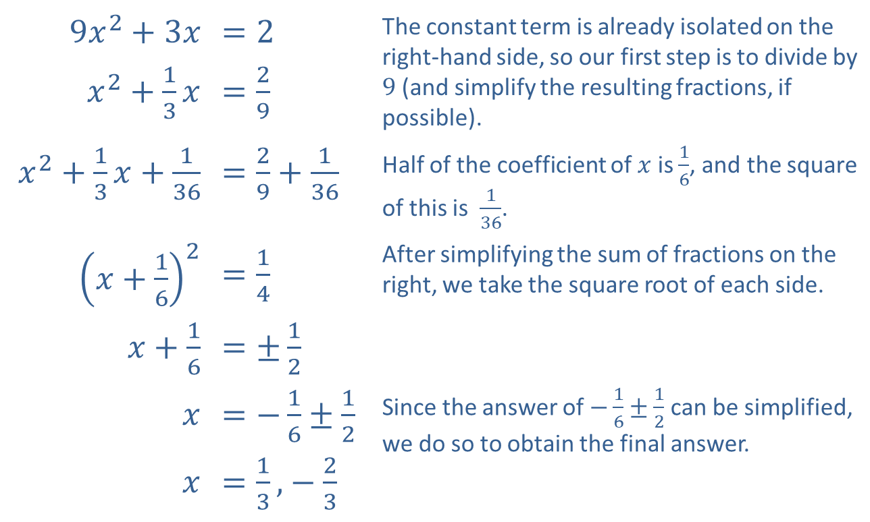
Example 3: Completing the Square—Slide 3
​
​$9x^{2}+3x$ | ​$=2$ | The constant term is already isolated on the right-hand side, so our first step is to divide by 9 (and simplify the resulting fractions, if possible).
​$x^{2}+\frac{1}{3}x$ | ​$=\frac{2}{9}$
​$x^{2}+\frac{1}{3}x+\frac{1}{36}$ | ​$=\frac{2}{9}+\frac{1}{36}$ | Half of the coefficient of $x$ is $\frac{1}{6}$, and the square of this is $\frac{1}{36}$.
​${\left(x+\frac{1}{6}\right)}^{2}$ | ​$=\frac{1}{4}$ | After simplifying the sum of fractions on the right, we take the square root of each side.
​$x+\frac{1}{6}$ | ​$=±\frac{1}{2}$
$$x$$ | ​$=−\frac{1}{6}±\frac{1}{2}$ | Since the answer of $−\frac{1}{6}±\frac{1}{2}$ can be simplified, we do so to obtain the final answer.
$$x$$ | ​$=\frac{1}{3}\text{,}−\frac{2}{3}$

Slide 15
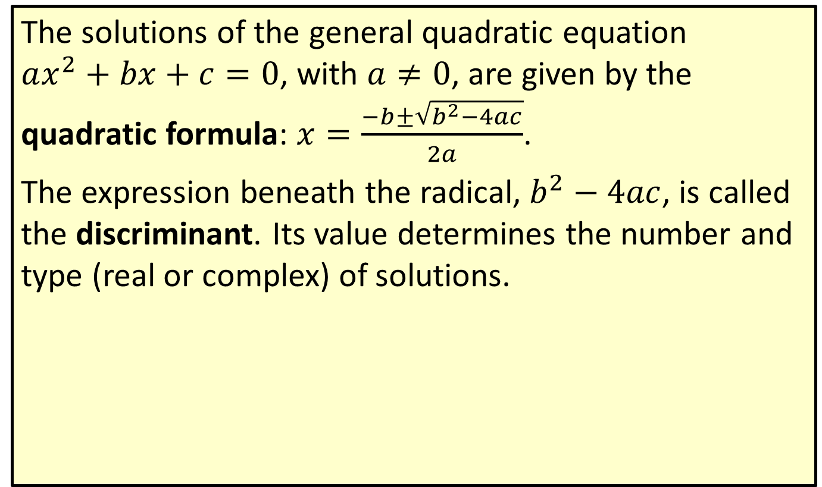
Formula: The Quadratic Formula—Slide 1
The solutions of the general quadratic equation $ax^{2}+bx+c=0$, with $a≠0$, are given by the quadratic formula: $x=\frac{−b±\sqrt{b^{2}−4ac}}{2a}$.
The expression beneath the radical, $b^{2}−4ac$, is called the discriminant. Its value determines the number and type (real or complex) of solutions.

Slide 16
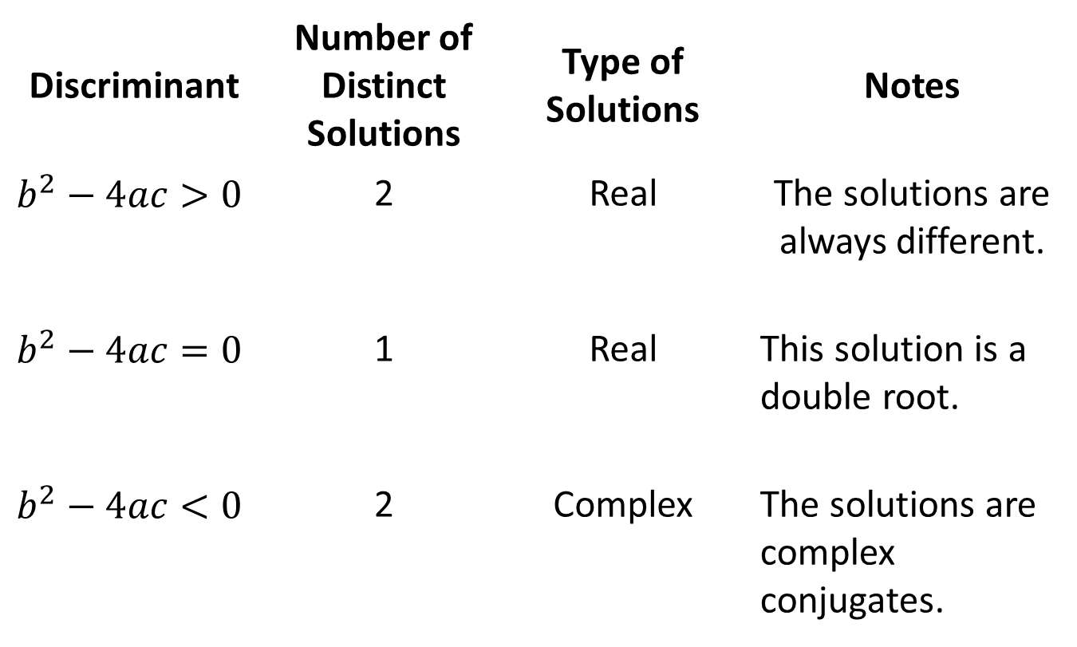
Formula: The Quadratic Formula—Slide 2
Discriminant | Number of Distinct Solutions | Type of Solutions | Notes
$$b^{2}−4ac>0$$ | 2 | Real | The solutions are always different.
$$b^{2}−4ac=0$$ | 1 | Real | This solution is a double root.
$$b^{2}−4ac<0$$ | 2 | Complex | The solutions are complex conjugates.

Slide 17

Example 4: Using the Quadratic Formula—Slide 1
Solve the quadratic equation by using the quadratic formula.
​$8x^{2}−4x=1$

Slide 18
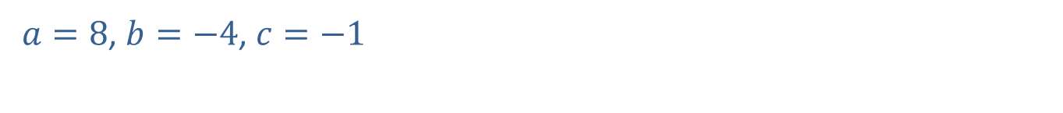
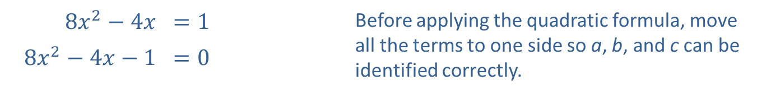
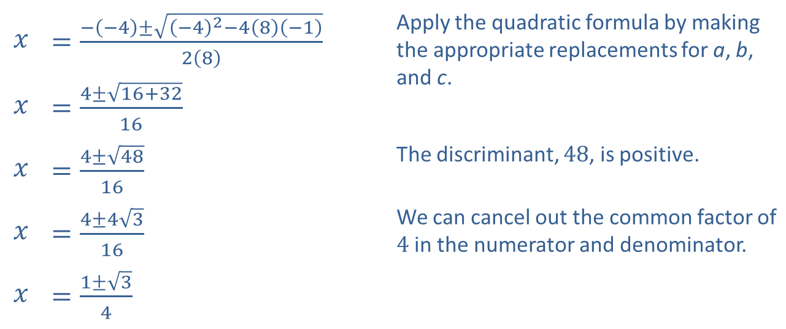
Example 4: Using the Quadratic Formula—Slide 2
Solution
​
​$8x^{2}−4x$ | ​$=1$ | Before applying the quadratic formula, move all the terms to one side so a, b, and c can be identified correctly.
​$8x^{2}−4x−1$ | ​$=0$
​$a=8$, $b=−4$, $c=−1$
​
$$x$$ | ​$=\frac{−\left(−4\right)±\sqrt{{\left(−4\right)}^{2}−4\left(8\right)\left(−1\right)}}{2\left(8\right)}$ | Apply the quadratic formula by making the appropriate replacements for a, b, and c.
$$x$$ | ​$=\frac{4±\sqrt{16+32}}{16}$
$$x$$ | ​$=\frac{4±\sqrt{48}}{16}$ | The discriminant, 48, is positive.
$$x$$ | ​$=\frac{4±4\sqrt{3}}{16}$ | We can cancel out the common factor of 4 in the numerator and denominator.
$$x$$ | ​$=\frac{1±\sqrt{3}}{4}$

Slide 19

Example 4: Using the Quadratic Formula—Slide 3
​Thus, the solutions are $x=\frac{1+\sqrt{3}}{4}$ and $x=\frac{1−\sqrt{3}}{4}$; two unique, real solutions.
​

Slide 20
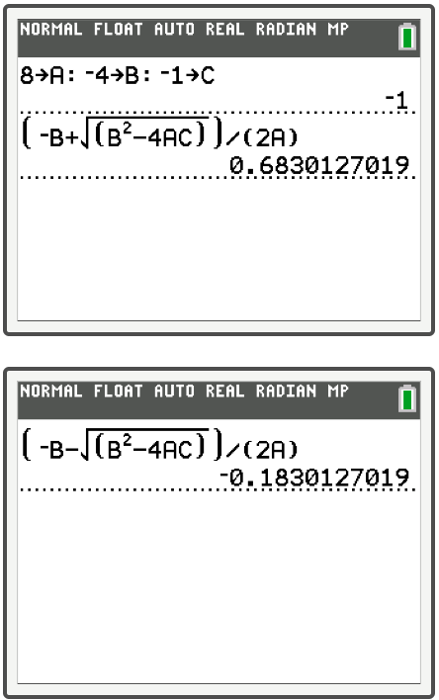
Example 4: Technology—Slide 1

Slide 21
Example 4: Technology—Slide 2
To use the quadratic formula on a TI-84 Plus, first define the variables A, B, and C. Enter the numerical value for A, press sto→, press alpha math for A, and press alpha . to enter a colon. Continue to store the values for B and C, and then press enter.
Once your variables are defined, enter the quadratic formula using alpha and the corresponding letters of the variables. Remember to use parentheses!
To obtain both solutions, enter the formula once with addition of the square root term in the numerator and once with subtraction of the square root term in the numerator.

Slide 22
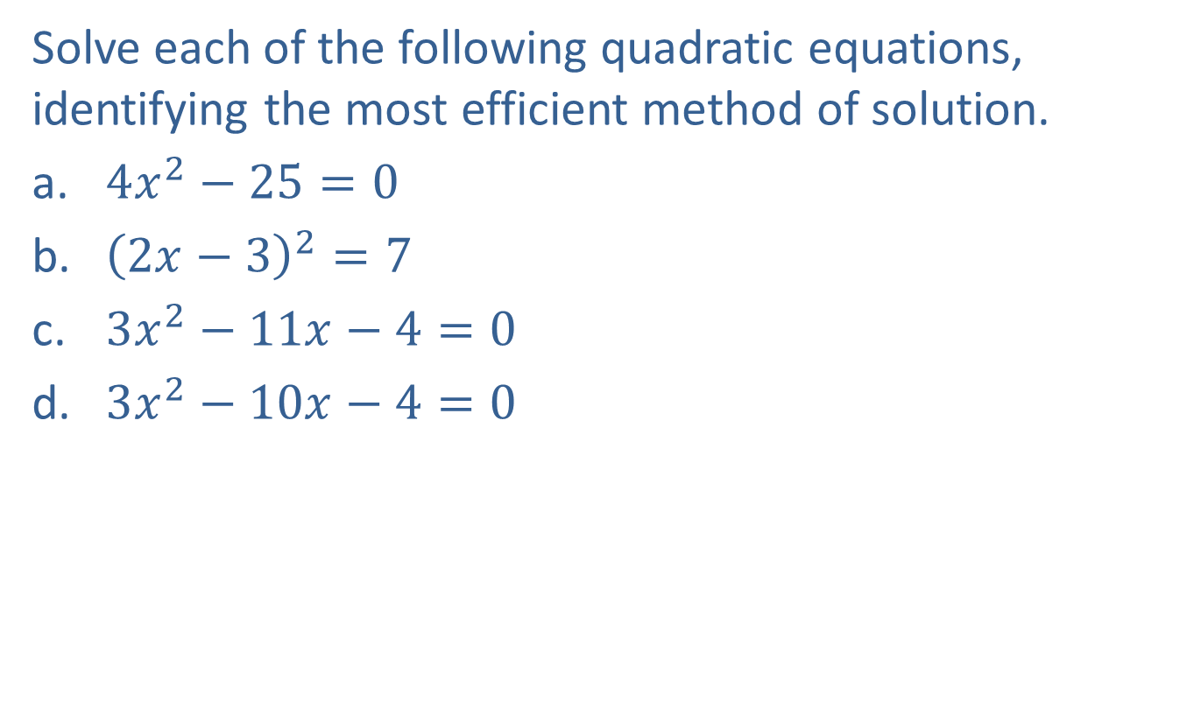
Example 5: Methods of Solving Quadratic Equations—Slide 1
Solve each of the following quadratic equations, identifying the most efficient method of solution.
​$4x^{2}−25=0$
​${\left(2x−3\right)}^{2}=7$
​$3x^{2}−11x−4=0$
​$3x^{2}−10x−4=0$

Slide 23
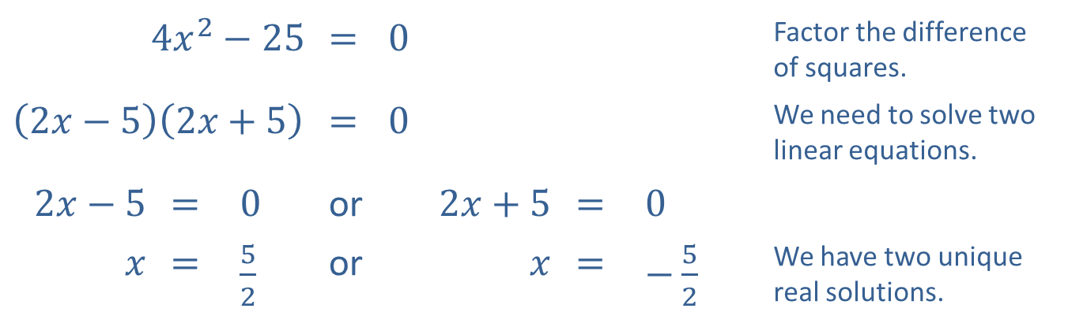
Example 5: Methods of Solving Quadratic Equations—Slide 2
Solutions
​The left-hand side is a difference of squares, so factoring is the easiest method.
​
​$4x^{2}−25$ |  |  | ​= | ​0 |  |  | Factor the difference of squares.
​$\left(2x−5\right)\left(2x+5\right)$ |  |  | ​= | ​0 |  |  | We need to solve two linear equations.
​$2x−5$ | ​= | ​0 | or | ​$2x+5$ | ​= | ​0
$x$ | ​= | ​$\frac{5}{2}$ | or | $x$ | ​= | ​$−\frac{5}{2}$ | We have two unique real solutions.

Slide 24
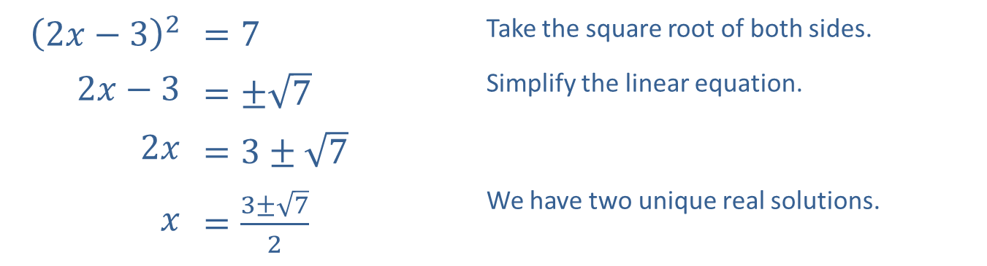
Example 5: Methods of Solving Quadratic Equations—Slide 3
​The left-hand side is already a squared quantity, but the right-hand side is not zero, so we want to use the square root method.
​
​${\left(2x−3\right)}^{2}$ | ​$=7$ | Take the square root of both sides.
​$2x−3$ | ​$=±\sqrt{7}$ | Simplify the linear equation.
​$2x$ | ​$=3±\sqrt{7}$
$x$ | ​$=\frac{3±\sqrt{7}}{2}$ | We have two unique real solutions.

Slide 25
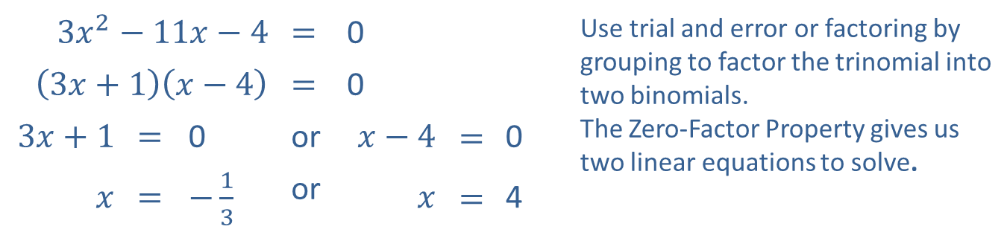
Example 5: Methods of Solving Quadratic Equations—Slide 4
​While the quadratic formula certainly works, this quadratic equation is factorable.
​
​$3x^{2}−11x−4$ |  |  | ​​$=$ | ​0 |  |  | Use trial and error or factoring by grouping to factor the trinomial into two binomials. The Zero-Factor Property gives us two linear equations to solve.
​$\left(3x+1\right)\left(x−4\right)$ |  |  | ​​$=$ | ​0
​$3x+1$ | ​​$=$ | ​0 | or | ​$x−4$ | $$=$$ | ​0
$x$ | ​$=$ | ​$−\frac{1}{3}$ | or | $x$ | $$=$$ | ​4

Slide 26
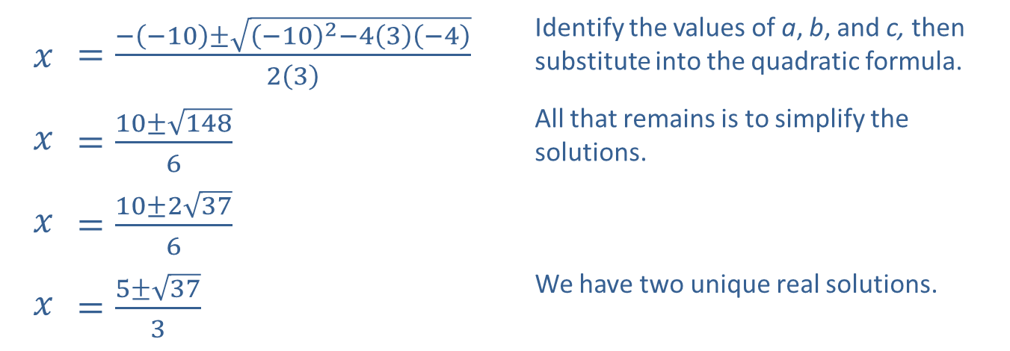

Example 5: Methods of Solving Quadratic Equations—Slide 5
​Here, the equation is not factorable, so we use the quadratic formula.
​$3x^{2}−10x−4=0$
​$a=3,b=−10,c=−4$
​
$$x$$ | ​$=\frac{−\left(−10\right)±\sqrt{{\left(−10\right)}^{2}−4\left(3\right)\left(−4\right)}}{2\left(3\right)}$ | Identify the values of a, b, and c, then substitute into the quadratic formula.
$$x$$ | ​$=\frac{10±\sqrt{148}}{6}$ | All that remains is to simplify the solutions.
$$x$$ | ​$=\frac{10±2\sqrt{37}}{6}$
$$x$$ | ​$=\frac{5±\sqrt{37}}{3}$ | We have two unique real solutions.

Slide 27
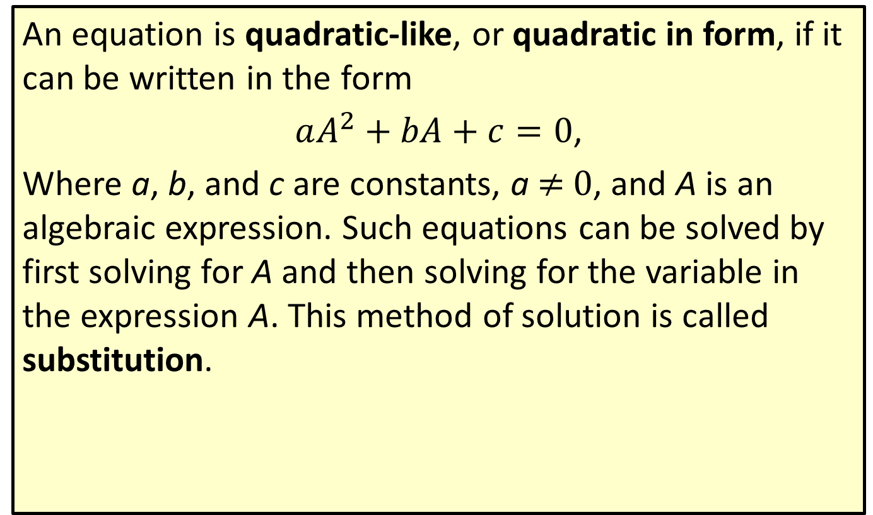
Definition: Quadratic-Like Equations
An equation is quadratic-like, or quadratic in form, if it can be written in the form
$aA^{2}+bA+c=0$,
Where a, b, and c are constants, a ≠ 0, and A is an algebraic expression. Such equations can be solved by first solving for A and then solving for the variable in the expression A. This method of solution is called substitution.

Slide 28

Example 6: Quadratic-Like Equations—Slide 1
Solve the quadratic-like equations.
​${\left(x^{2}+2x\right)}^{2}−7\left(x^{2}+2x\right)−8=0$
​$y^{\frac{2}{3}}+4y^{\frac{1}{3}}−5=0$

Slide 29
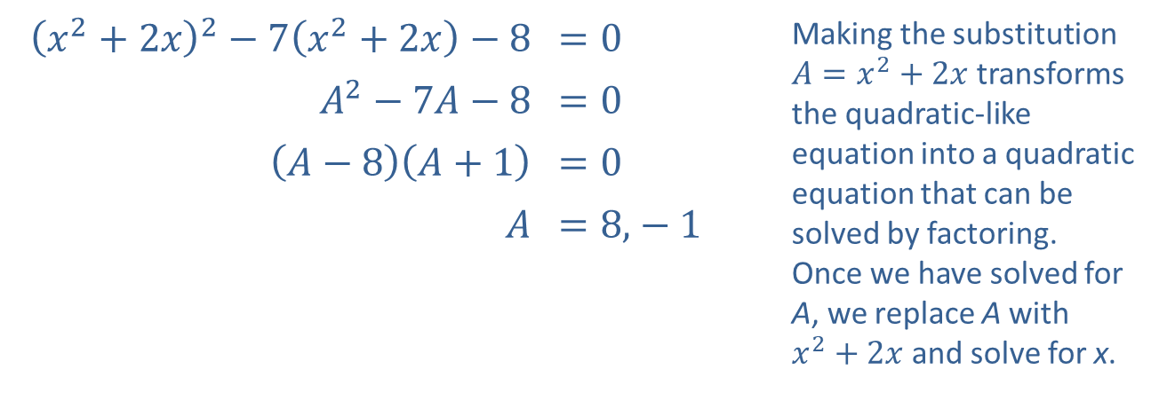
Example 6: Quadratic-Like Equations—Slide 2
Solution
​
​${\left(x^{2}+2x\right)}^{2}−7\left(x^{2}+2x\right)−8$ | ​$=0$ | Making the substitution $A=x^{2}+2x$ transforms the quadratic-like equation into a quadratic equation that can be solved by factoring. Once we have solved for A, we replace A with $x^{2}+2x$ and solve for x.
​$A^{2}−7A−8$ | ​$=0$
​$\left(A−8\right)\left(A+1\right)$ | ​$=0$
$A$ | ​$=8\text{,}−1$

Slide 30
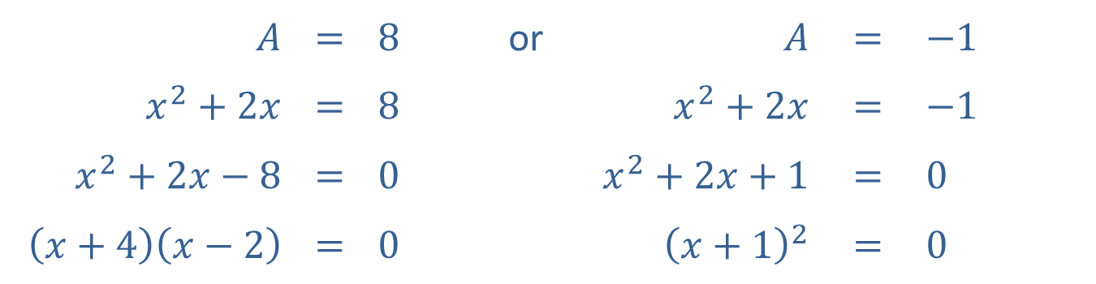

Example 6: Quadratic-Like Equations—Slide 3
$x=−4$ or $x=2$ or $x=−1$
​Note that −1 is a double root, while −4 and 2 are single roots.
While the substitution method does not necessarily introduce extraneous solutions, you should still check that each solution solves the original quadratic-like equation.
$A$ | $$=$$ | $8$ | or | $A$ | $$=$$ | $−1$
$x^{2}+2x$ | $$=$$ | $8$ |  | $x^{2}+2x$ | $$=$$ | $−1$
$x^{2}+2x−8$ | $$=$$ | $0$ |  | $x^{2}+2x+1$ | $$=$$ | $0$
$\left(x+4\right)\left(x−2\right)$ | $$=$$ | $0$ |  | ${\left(x+1\right)}^{2}$ | $$=$$ | $0$

Slide 31
Note 2
The quadratic equations in Example 8a could also be solved using the quadratic formula with the help of a calculator. See Example 4 for instructions on using the quadratic formula with a TI-84 Plus.

Slide 32
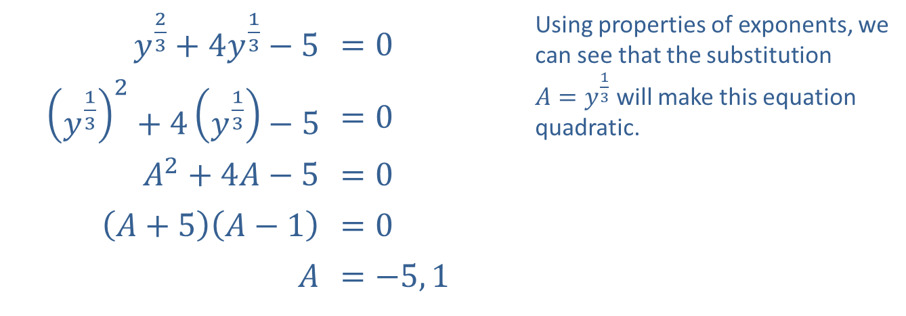
Example 6: Quadratic-Like Equations—Slide 4
​$y^{\frac{2}{3}}+4y^{\frac{1}{3}}−5$ | ​$=0$ | Using properties of exponents, we can see that the substitution $A=y^{\frac{1}{3}}$ will make this equation quadratic.
​${\left(y^{\frac{1}{3}}\right)}^{2}+4\left(y^{\frac{1}{3}}\right)−5$ | ​$=0$
​$A^{2}+4A−5$ | ​$=0$
​$\left(A+5\right)\left(A−1\right)$ | ​$=0$
$A$ | ​$=−5, 1$
​

Slide 33
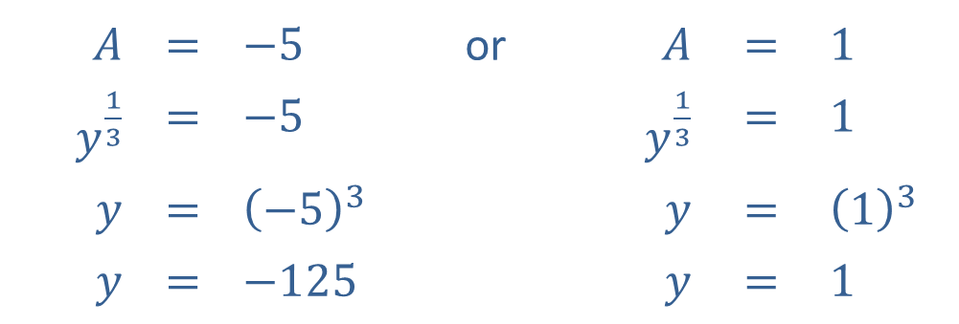

Example 6: Quadratic-Like Equations—Slide 5
Now that we have solved for A, we reverse the substitution and solve for y in each case.​
​Once again, you should confirm that both values do indeed solve the original equation $y^{\frac{2}{3}}+4y^{\frac{1}{3}}−5=0$.
$$A$$ | $$=$$ | $$−5$$ | or | $A$ | $$=$$ | $$1$$
$y^{\frac{1}{3}}$ | $$=$$ | $$−5$$ |  | $y^{\frac{1}{3}}$ | $$=$$ | $$1$$
$y$ | $$=$$ | $${\left(−5\right)}^{3}$$ |  | $y$ | $$=$$ | $${\left(1\right)}^{3}$$
$y$ | $$=$$ | $$−125$$ |  | $y$ | $$=$$ | $$1$$

Slide 34

Example 7: Solving Polynomial Equations by Factoring—Slide 1
Solve the equations by factoring.
a. ​$y^{3}+y^{2}−4y−4=0$
b. ​$3x^{4}+18x^{3}−21x^{2}=0$

Slide 35
Note 3
While checking solutions is always a good practice, solving by factoring does not produce any extraneous solutions.

Slide 36
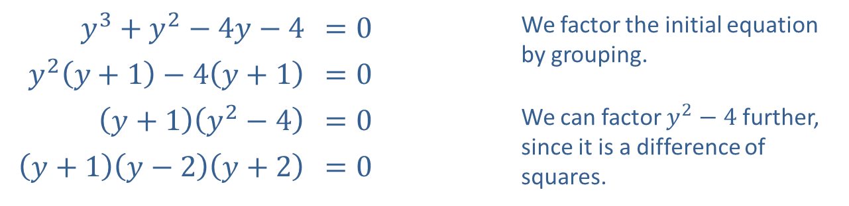
Example 7: Solving Polynomial Equations by Factoring—Slide 2
Solution
a. ​
​$y^{3}+y^{2}−4y−4$ | ​$=0$ | We factor the initial equation by grouping.
​$y^{2}\left(y+1\right)−4\left(y+1\right)$ | ​$=0$
​$\left(y+1\right)\left(y^{2}−4\right)$ | ​$=0$ | We can factor $y^{2}−4$ further, since it is a difference of squares.
​$\left(y+1\right)\left(y−2\right)\left(y+2\right)$ | ​$=0$
​There are three solutions by the Zero-Factor Property.
y = −1 or y = 2 or y = −2 ​​

Slide 37
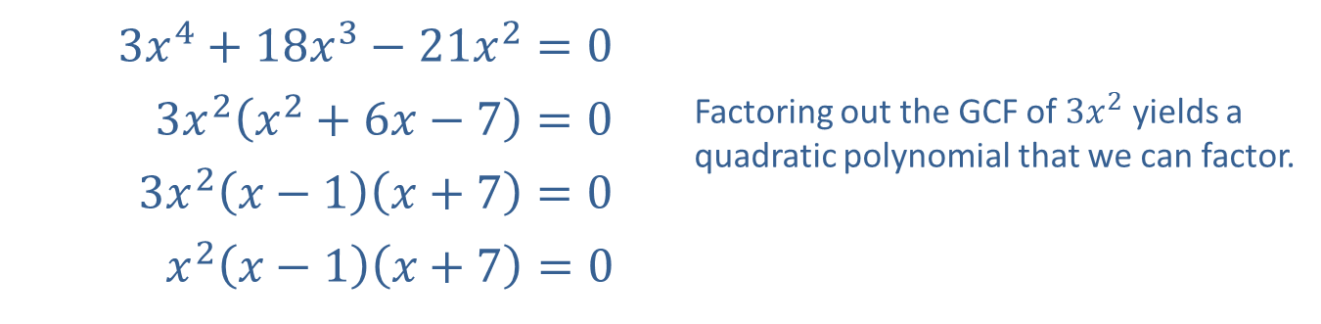
Example 7: Solving Polynomial Equations by Factoring—Slide 3
b. ​
​$3x^{4}+18x^{3}−21x^{2}=0$
​$3x^{2}\left(x^{2}+6x−7\right)=0$ | Factoring out the GCF of $3x^{2}$ yields a quadratic polynomial that we can factor.
​$3x^{2}\left(x−1\right)\left(x+7\right)=0$
​$x^{2}\left(x−1\right)\left(x+7\right)=0$
​The Zero-Factor Property yields three solutions to the original equation.
​x = 0, 1, or −7

Slide 38

Example 8: Solving Polynomial-Like Equations by Factoring—Slide 1
Solve the equations by factoring.
​$x^{\frac{7}{3}}+x^{\frac{4}{3}}−2x^{\frac{1}{3}}=0$
​${\left(x−1\right)}^{\frac{1}{2}}−{\left(x−1\right)}^{−\frac{1}{2}}=0$

Slide 39
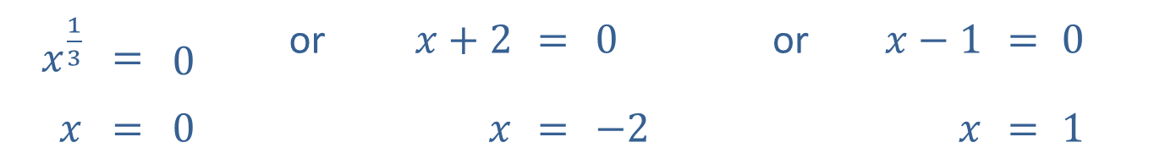
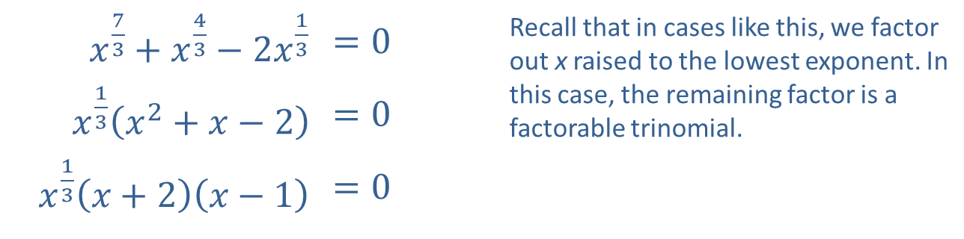
Example 8: Solving Polynomial-Like Equations by Factoring—Slide 2
Solution
​
​$x^{\frac{7}{3}}+x^{\frac{4}{3}}−2x^{\frac{1}{3}}$ | ​$=0$ | Recall that in cases like this, we factor out x raised to the lowest exponent. In this case, the remaining factor is a factorable trinomial.
​$x^{\frac{1}{3}}\left(x^{2}+x−2\right)$ | ​$=0$
​$x^{\frac{1}{3}}\left(x+2\right)\left(x−1\right)$ | ​$=0$
​The Zero-Factor Property leads to three simple equations.
$x^{\frac{1}{3}}$ | $$=$$ | $0$ | or | $x+2$ | $$=$$ | $0$ | or | $x−1$ | $$=$$ | $0$
$x$ | $$=$$ | $0$ |  | $x$ | $$=$$ | $−2$ |  | $x$ | $$=$$ | $1$

Slide 40
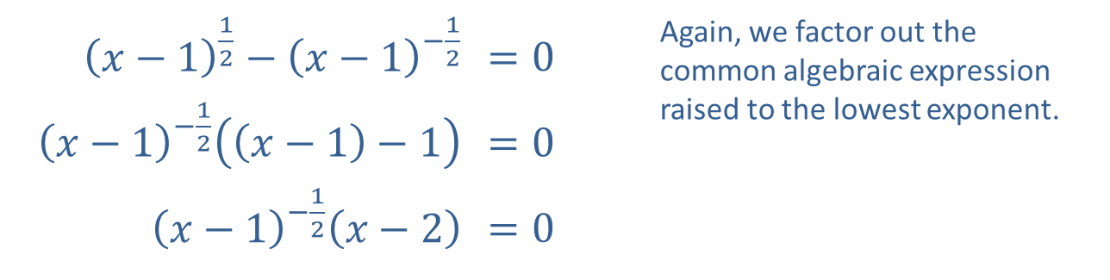
Example 8: Solving Polynomial-Like Equations by Factoring—Slide 3
​${\left(x−1\right)}^{\frac{1}{2}}−{\left(x−1\right)}^{−\frac{1}{2}}$ | ​$=0$ | Again, we factor out the common algebraic expression raised to the lowest exponent.
​${\left(x−1\right)}^{−\frac{1}{2}}\left(\left(x−1\right)−1\right)$ | ​$=0$
​${\left(x−1\right)}^{−\frac{1}{2}}\left(x−2\right)$ | ​$=0$
​

Slide 41
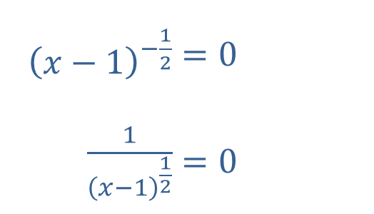
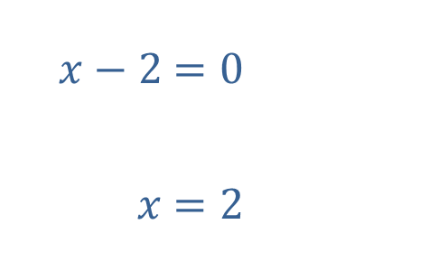
Example 8: Solving Polynomial-Like Equations by Factoring—Slide 4
​This equation leads to two equations, only one of which has a solution. (Note that there is no value for x that would solve the first of the two equations.)
​
​The original equation has only one solution.
​x = 2
​
​${\left(x−1\right)}^{−\frac{1}{2}}$ | ​$=0$
​$\frac{1}{{\left(x−1\right)}^{\frac{1}{2}}}$ | ​$=0$
​$x−2$ | ​$=0$
​$x$ | ​$=2$
or

Slide 42

Example 9: Solving Equations by Factoring—Slide 1
Solve the equation $x^{−2}−7x^{−1}+12=0$ by factoring.

Slide 43
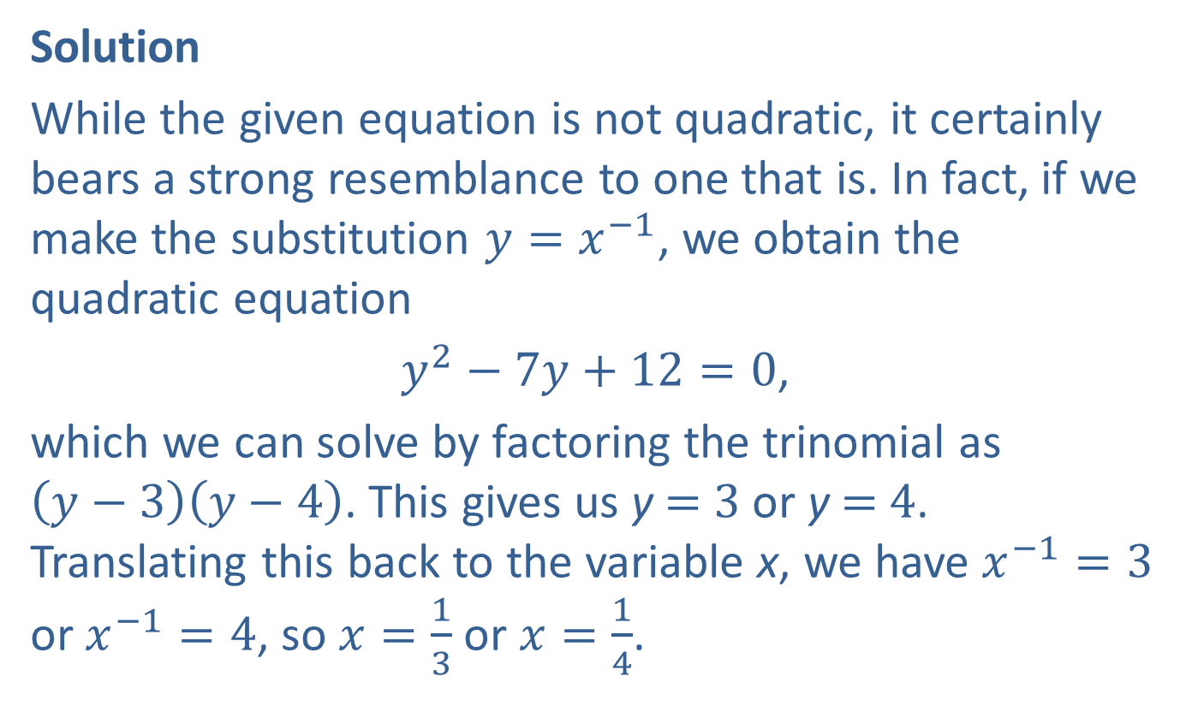
Example 9: Solving Equations by Factoring—Slide 2
Solution
While the given equation is not quadratic, it certainly bears a strong resemblance to one that is. In fact, if we make the substitution $y=x^{−1}$, we obtain the quadratic equation
$y^{2}−7y+12=0$,
which we can solve by factoring the trinomial as $\left(y−3\right)\left(y−4\right)$. This gives us y = 3 or y = 4. Translating this back to the variable x, we have $x^{−1}=3$ or $x^{−1}=4$, so $x=\frac{1}{3}$ or $x=\frac{1}{4}$.

