Slide 1
Section 3.R.7
Trigonometric Equations

Slide 2
Example 1: Solving Equations by Isolating the Trigonometric Function—Slide 1
Solve the equation 3 − 6cos x = 0.

Slide 3
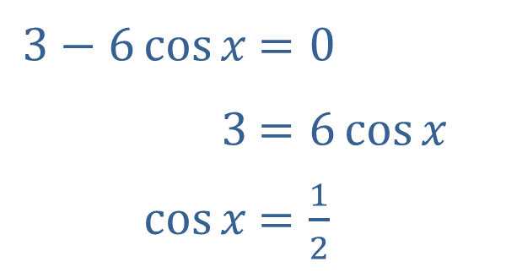
Example 1: Solving Equations by Isolating the Trigonometric Function—Slide 2
Solution
Isolating cos x is easily accomplished.
​
​$3−6\cos{x}$ | ​$=0$
​$3$ | ​$=6\cos{x}$
​$cos⁡x$ | ​$=\frac{1}{2}$

Slide 4
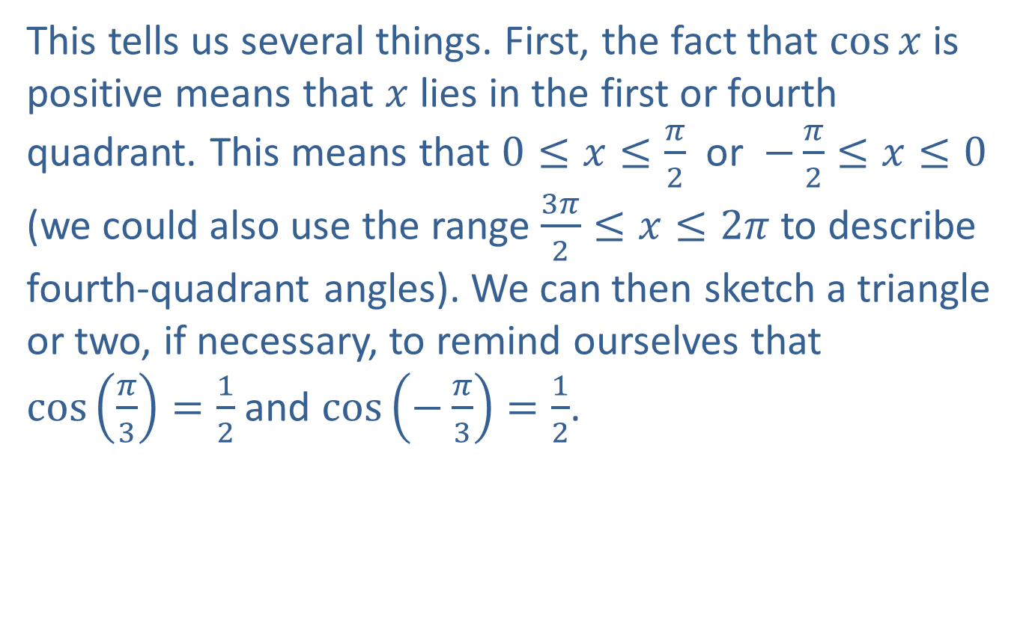
Example 1: Solving Equations by Isolating the Trigonometric Function—Slide 3
This tells us several things. First, the fact that $cos⁡x$ is positive means that $x$ lies in the first or fourth quadrant. This means that $0≤x≤\frac{π}{2}$ or $−\frac{π}{2}≤x≤0$ (we could also use the range $\frac{3π}{2}≤x≤2π$ to describe fourth-quadrant angles). We can then sketch a triangle or two, if necessary, to remind ourselves that $\cos\left(\frac{π}{3}\right)=\frac{1}{2}$ and $\cos\left(−\frac{π}{3}\right)=\frac{1}{2}$.

Slide 5
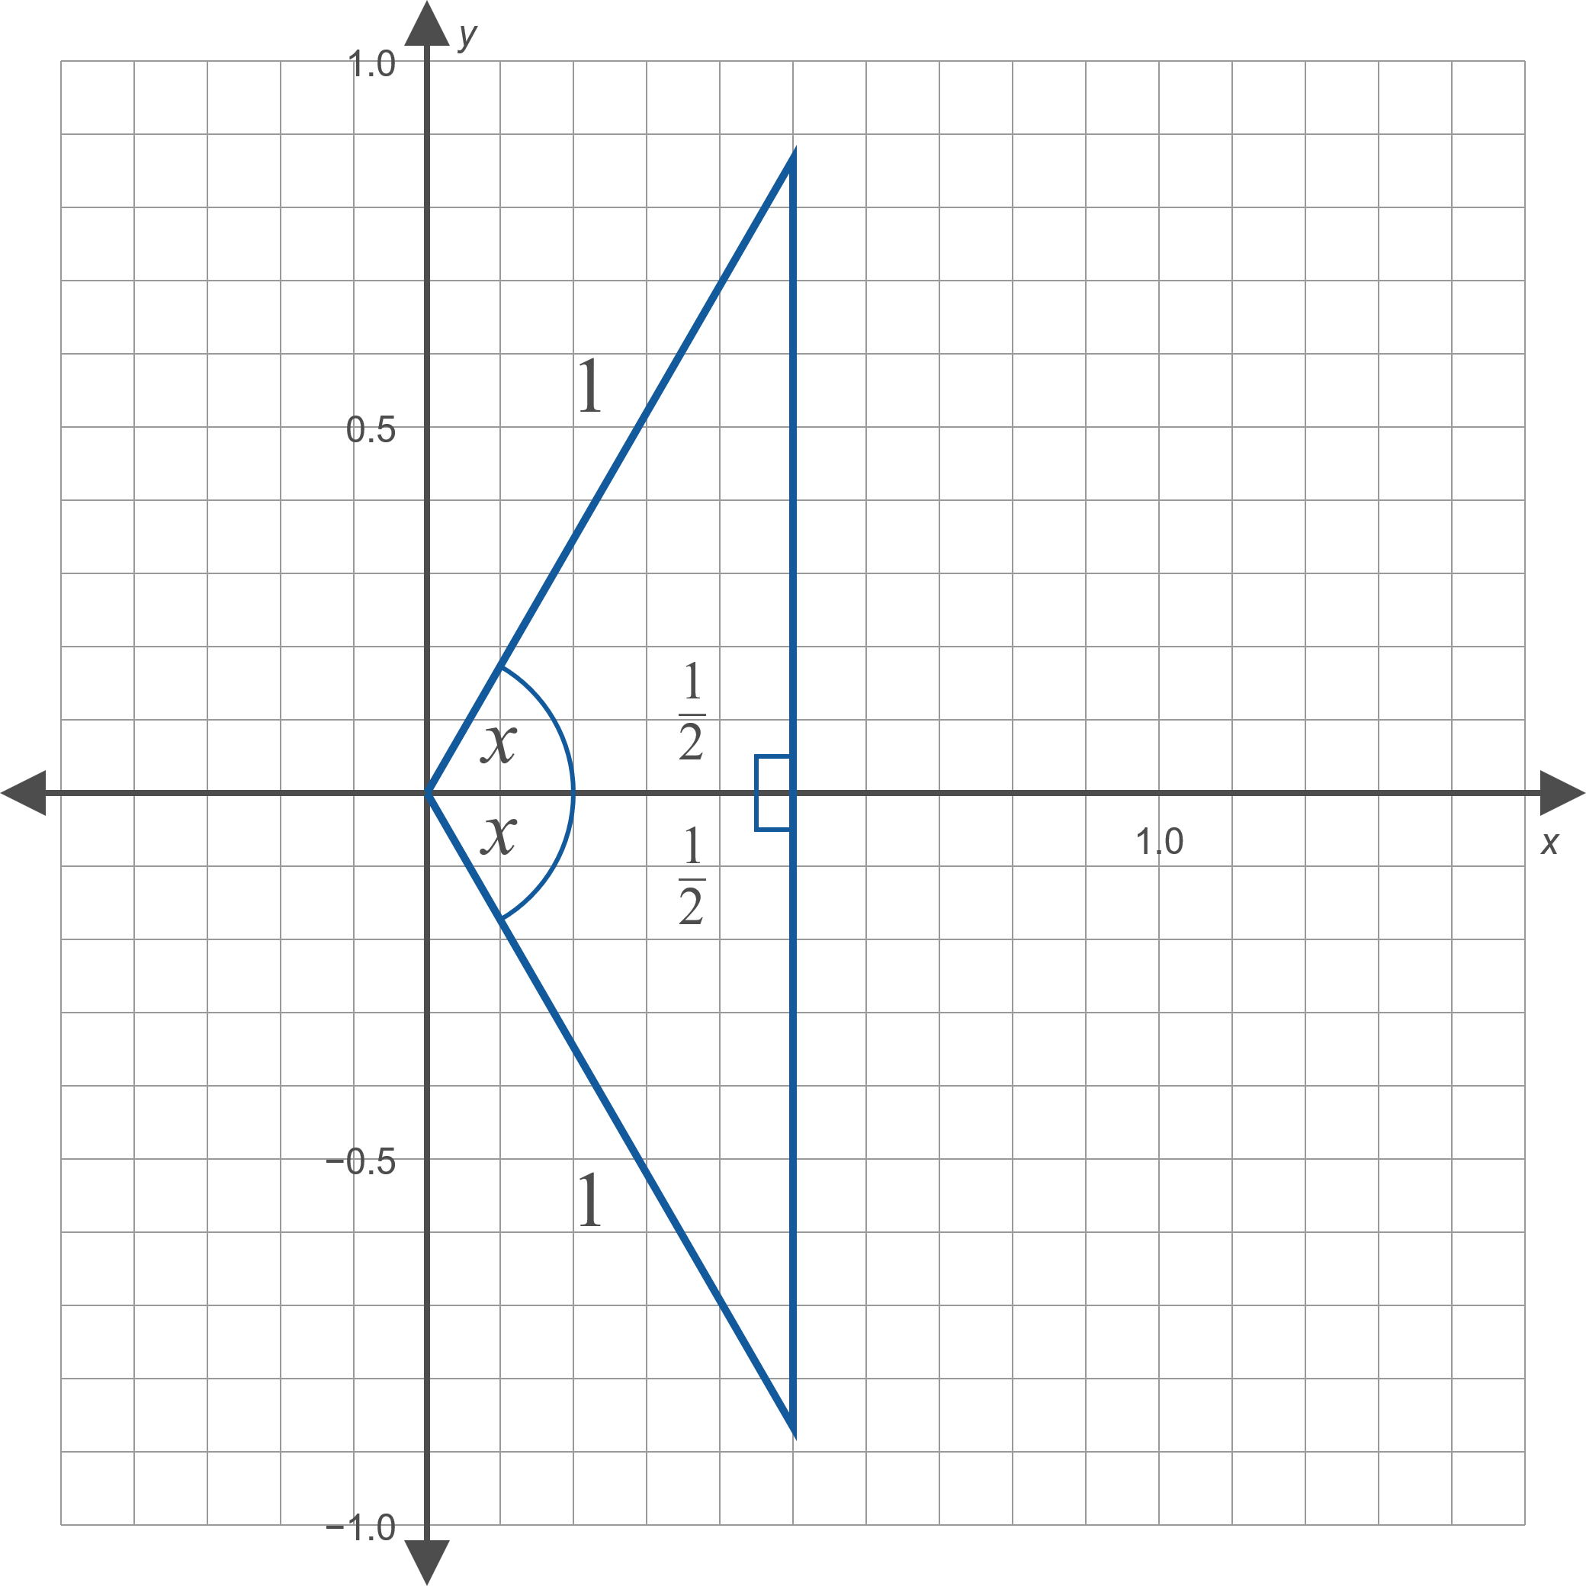
Example 1: Solving Equations by Isolating the Trigonometric Function—Slide 4
Figure 2

Slide 6
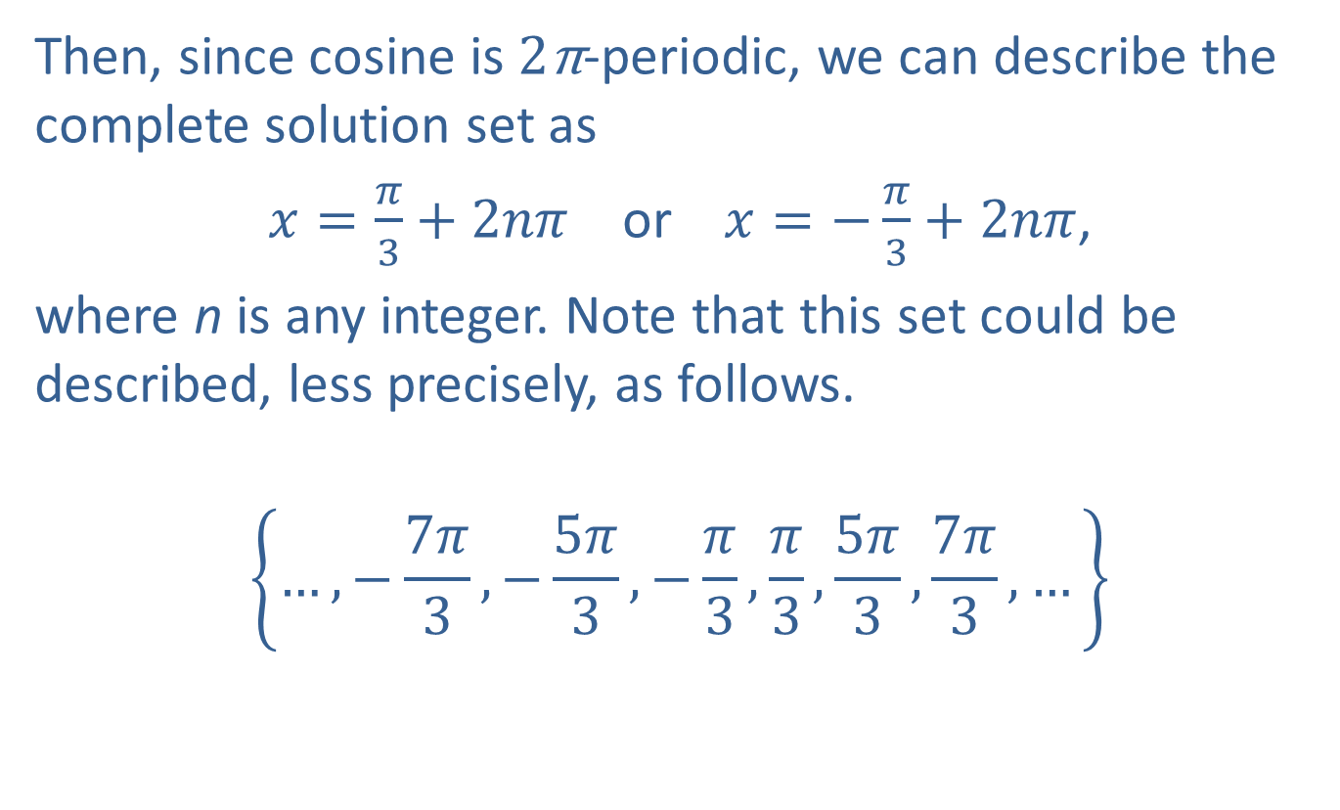
Example 1: Solving Equations by Isolating the Trigonometric Function—Slide 5
Then, since cosine is 2π-periodic, we can describe the complete solution set as
$x=\frac{π}{3}+2nπ$ or $x=−\frac{π}{3}+2nπ$,
where n is any integer. Note that this set could be described, less precisely, as follows.
$$\left\{…,−\frac{7π}{3},−\frac{5π}{3},−\frac{π}{3},\frac{π}{3},\frac{5π}{3},\frac{7π}{3},…\right\}$$

Slide 7
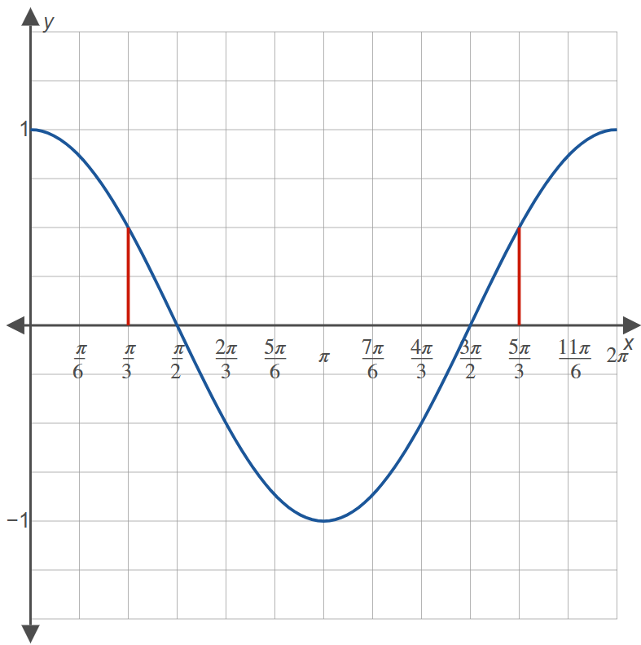
Example 1: Solving Equations by Isolating the Trigonometric Function—Slide 6
Figure 3

Slide 8

Example 2: Solving Equations by Isolating the Trigonometric Function—Slide 1
Solve the equation $\tan^{2}{x}−1=2$.

Slide 9
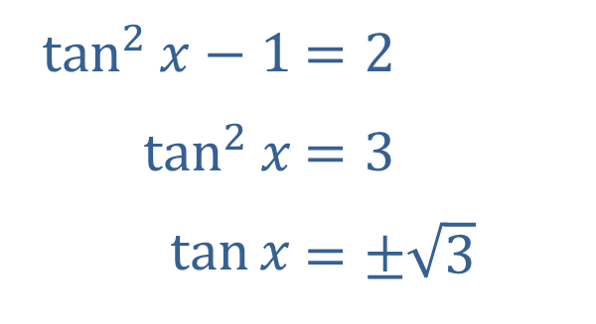
Example 2: Solving Equations by Isolating the Trigonometric Function—Slide 2
Solution
The trigonometric function can again be isolated fairly easily.
​
​$\tan^{2}{x}−1$ | ​$=2$
​$\tan^{2}⁡x$ | ​$=3$
​$tan⁡x$ | ​$=±\sqrt{3}$

Slide 10
Example 2: Solving Equations by Isolating the Trigonometric Function—Slide 3
As in Example 1, the task now is to identify all the angles that solve the last equation (which, because of the plus-or-minus symbol, is actually two equations). Since tangent has a period of π, we'll be done if we find all the solutions in an interval of length π and add to them all integer multiples of π.

Slide 11
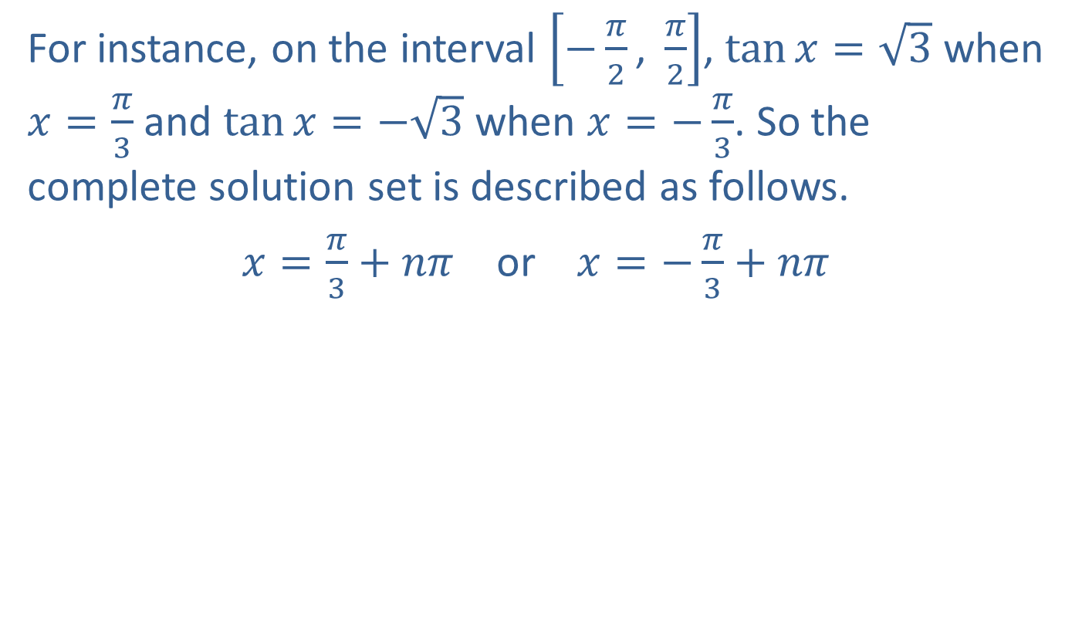
Example 2: Solving Equations by Isolating the Trigonometric Function—Slide 4
For instance, on the interval $\left[−\frac{π}{2}\text{, }\frac{π}{2}\right]$, $\tan{x}=\sqrt{3}$ when $x=\frac{π}{3}$ and $\tan{x}=−\sqrt{3}$ when $x=−\frac{π}{3}$. So the complete solution set is described as follows.
$x=\frac{π}{3}+nπ$ or $x=−\frac{π}{3}+nπ$

Slide 12

Example 3: Solving Trigonometric Equations by Factoring—Slide 1
Solve the equation $\sin^{2}{x}−\sin{x}=\sin{x}+3$.

Slide 13
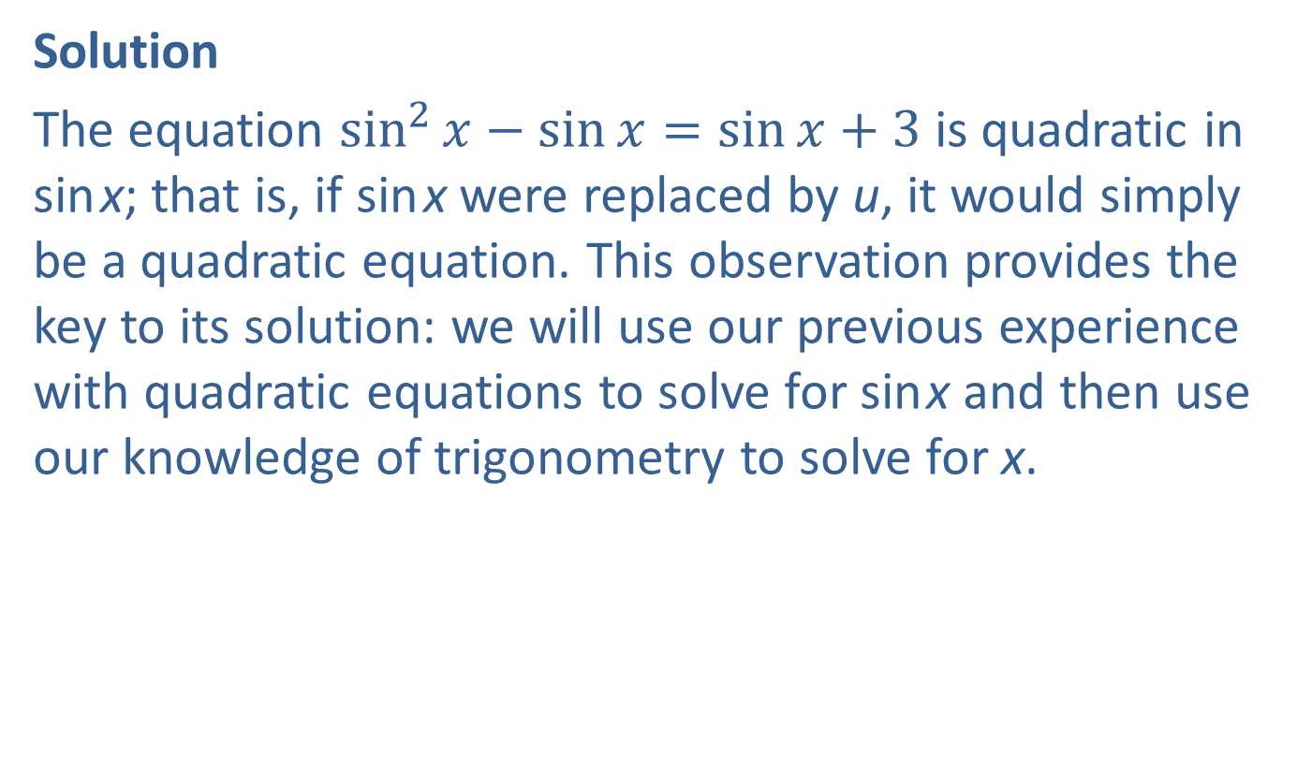
Example 3: Solving Trigonometric Equations by Factoring—Slide 2
Solution
The equation $\sin^{2}{x}−\sin{x}=\sin{x}+3$ is quadratic in sin x; that is, if sin x were replaced by u, it would simply be a quadratic equation. This observation provides the key to its solution: we will use our previous experience with quadratic equations to solve for sin x and then use our knowledge of trigonometry to solve for x.

Slide 14
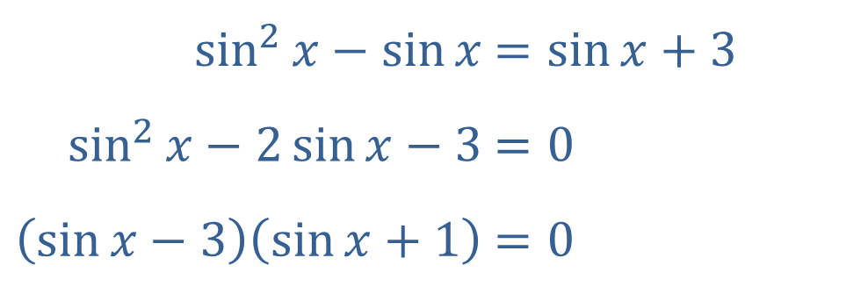
Example 3: Solving Trigonometric Equations by Factoring—Slide 3
​$\sin^{2}{x}−\sin{x}$ | ​$=\sin{x}+3$
​$\sin^{2}{x}−2\sin{x}−3$ | ​$=0$
​$\left(\sin{x}−3\right)\left(\sin{x}+1\right)$ | ​$=0$
Remember that the first step in solving quadratic equations by factoring or by the quadratic formula is to collect all the terms on one side. In this problem, we can easily factor the resulting left-hand side.

Slide 15
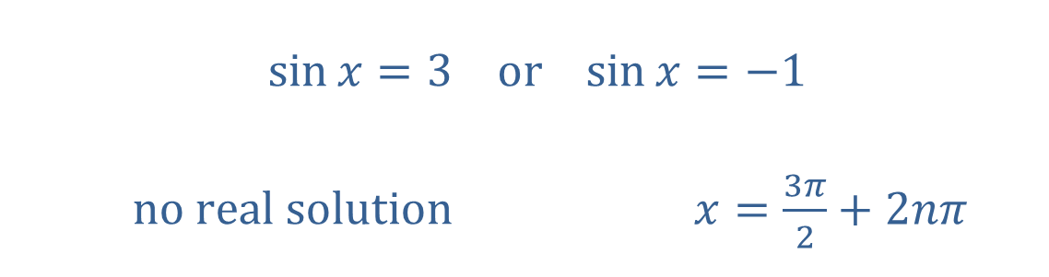
Example 3: Solving Trigonometric Equations by Factoring—Slide 4
As in any quadratic equation solved by factoring, the two factors now lead to two equations.
​$\sin{x}=3$ | ​$\text{or}$ | ​$\sin{x}=−1$ | ​
​$\text{no} \text{real} \text{solution}$ | ​ | ​$x=\frac{3π}{2}+2nπ$
The first equation has no real number solution, as 3 lies outside the range of the sine function. The second equation has an infinite number of solutions.

Slide 16

Example 4: Solving Equations Using Trigonometric Identities—Slide 1
Solve the equation $−2\cos^{2}{x}+1=\sin{x}$.

Slide 17

Example 4: Solving Equations Using Trigonometric Identities—Slide 2
Solution
The presence of a ${cos⁡}^{2}⁡x$ or $\sin^{2}⁡x$ term is almost always an indication that the first Pythagorean identity $\sin^{2}x+\cos^{2}x=1$ may be useful.

Slide 18
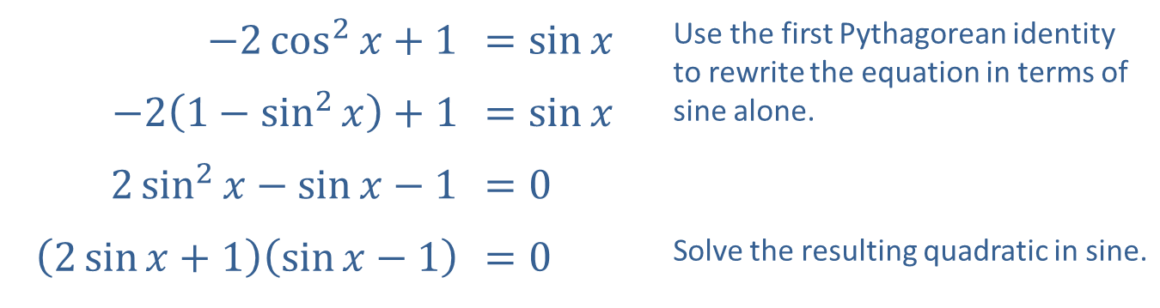
Example 4: Solving Equations Using Trigonometric Identities—Slide 3
​$−2\cos^{2}{x}+1$ | ​$=\sin{x}$ | Use the first Pythagorean identity to rewrite the equation in terms of sine alone.
​$−2\left(1−\sin^{2}{x}\right)+1$ | ​$=\sin{x}$
​$2\sin^{2}{x}−\sin{x}−1$ | ​$=0$
​$\left(2\sin{x}+1\right)\left(\sin{x}−1\right)$ | ​$=0$ | Solve the resulting quadratic in sine.

Slide 19
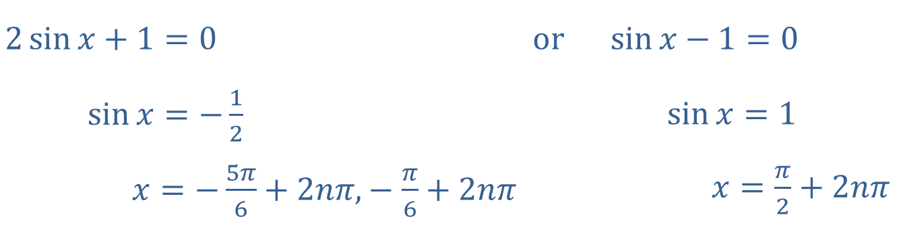
Example 4: Solving Equations Using Trigonometric Identities—Slide 4
As in the last example, we have two equations to solve.
​$2\sin{x}+1=0$ | ​$\text{or}$ | ​$\sin{x}−1=0$
​1+2sin𝑥=−12 | ​ | ​1−sin𝑥=1
​1+2 sin𝑥=−5𝜋6+2𝑛𝜋,−𝜋6+2𝑛𝜋 | ​ | ​1−sin𝑥=𝜋2+2𝑛𝜋
The solutions to the first equation are angles lying in the third and fourth quadrants, while the solution to the second equation is a right angle. Three equations are thus necessary to describe the solution set.

Slide 20
Example 5: Solving Trigonometric Equations by Graphing—Slide 1
Solve the equation sin x = cos x on the interval [0, 2π).

Slide 21
Example 5: Solving Trigonometric Equations by Graphing—Slide 2
Solution
Graphically, we are looking for those x's at which sine and cosine coincide. The graph in Figure 5 illustrates the two points on the interval [0, 2π) where this happens.

Slide 22
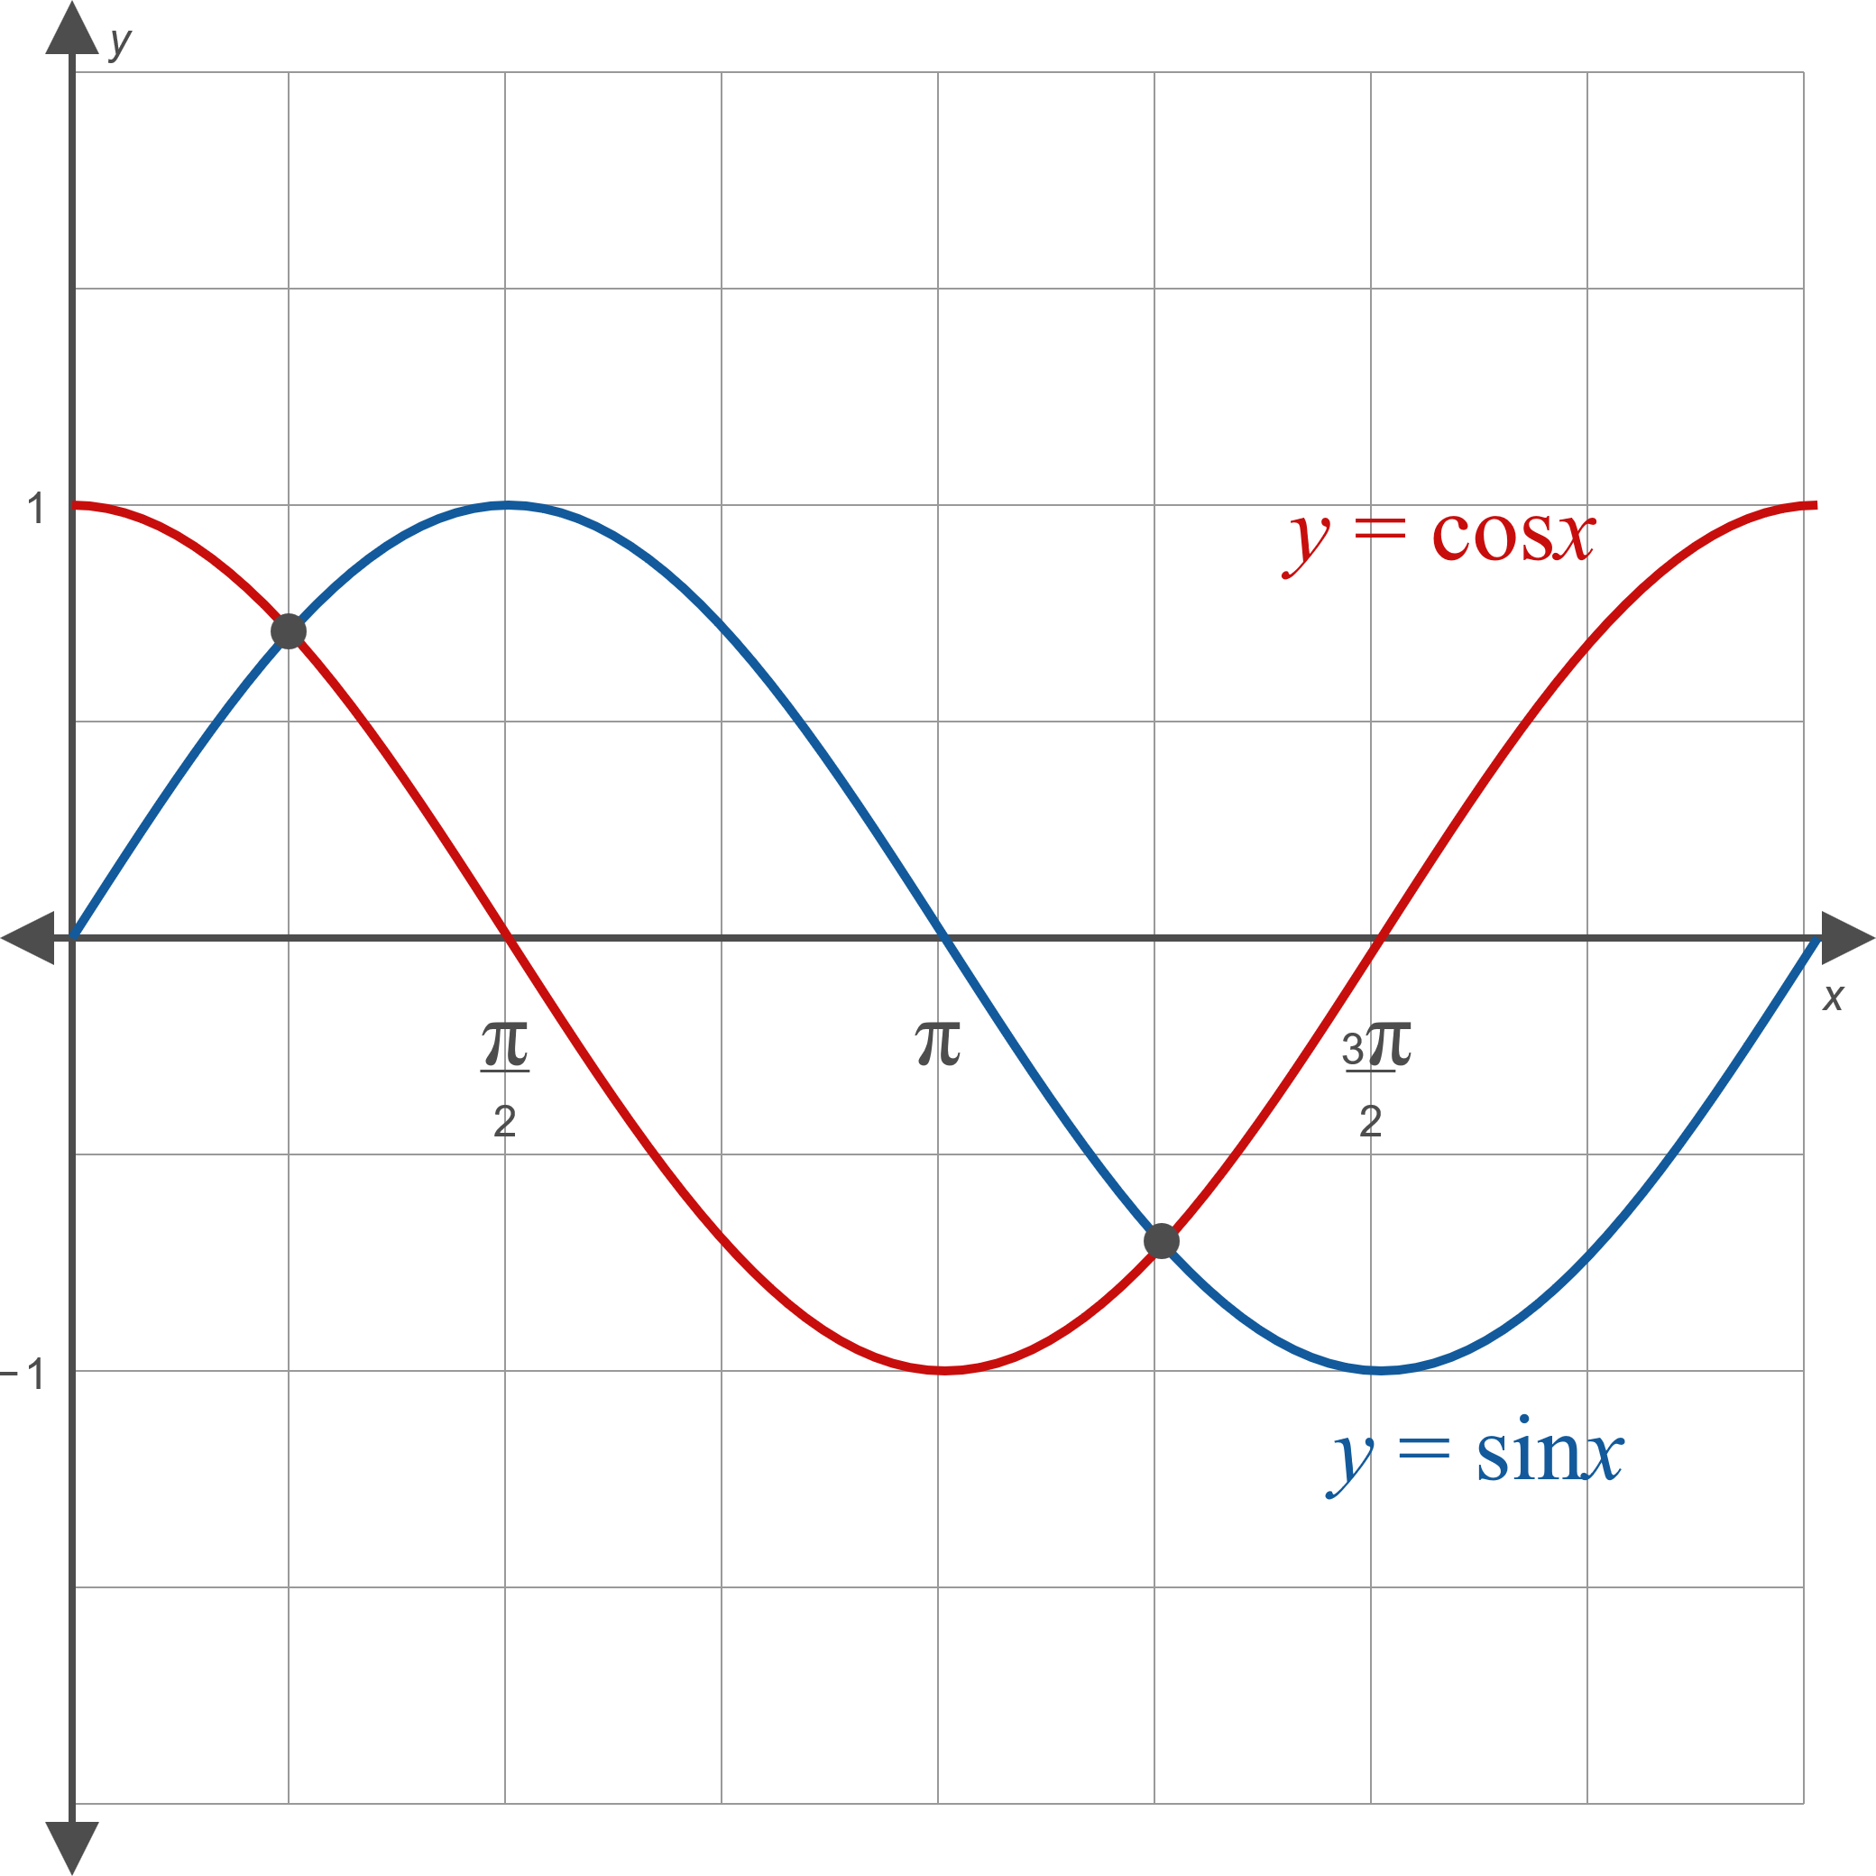
Example 5: Solving Trigonometric Equations by Graphing—Slide 3
Figure 5

Slide 23
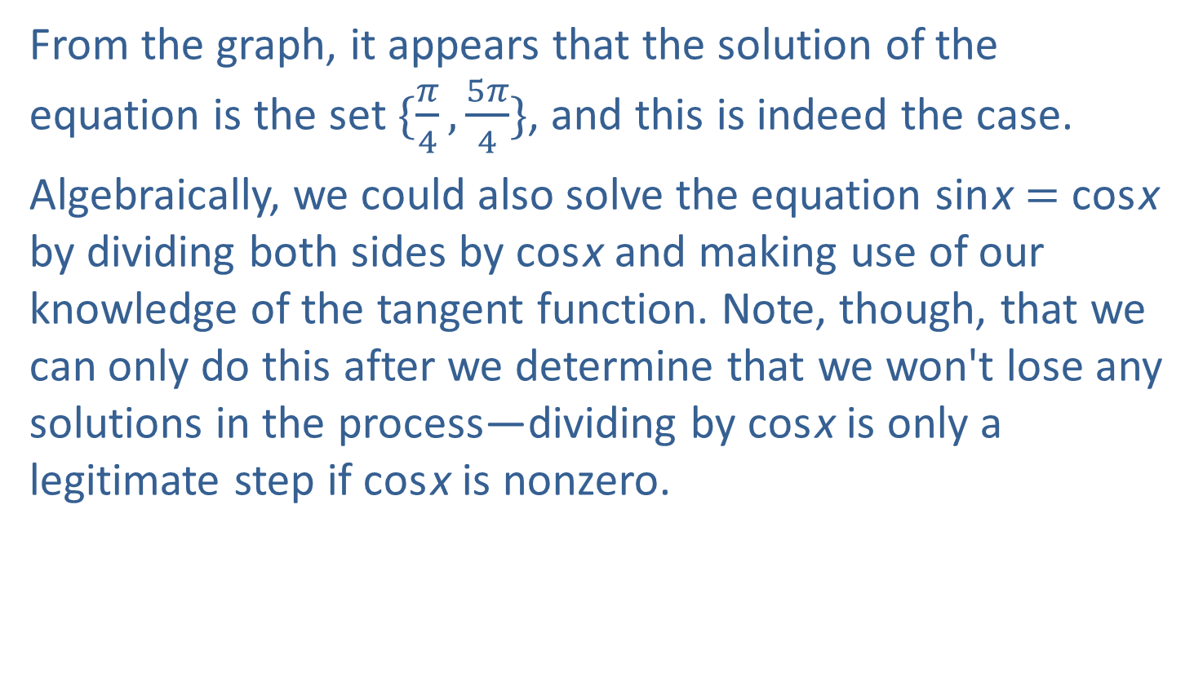
Example 5: Solving Trigonometric Equations by Graphing—Slide 4
From the graph, it appears that the solution of the equation is the set $\{\frac{π}{4},\frac{5π}{4}\}$, and this is indeed the case.
Algebraically, we could also solve the equation sin x = cos x by dividing both sides by cos x and making use of our knowledge of the tangent function. Note, though, that we can only do this after we determine that we won't lose any solutions in the process—dividing by cos x is only a legitimate step if cos x is nonzero.

Slide 24

Example 5: Solving Trigonometric Equations by Graphing—Slide 5
But when cosine is zero, sine is not, so we can safely discard those values of x as they can't possibly be part of the solution set. After the division, we have the equation tan x = 1, and the solution set of this equation in the interval [0, 2π) is $\{\frac{π}{4},\frac{5π}{4}\}$.

Slide 25
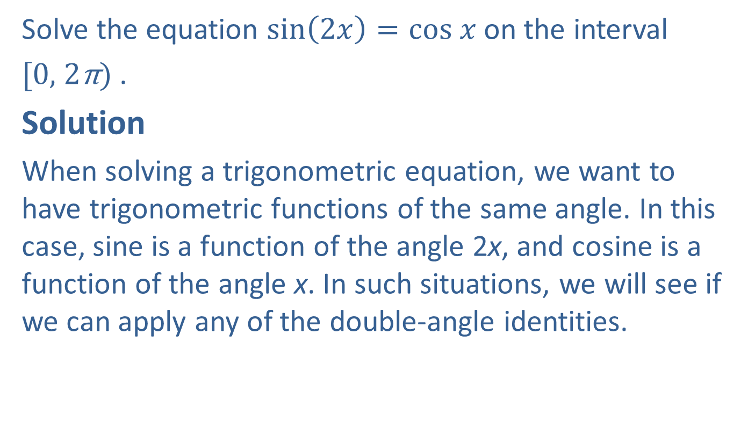
Example 6: Solving Equations Using Trigonometric Identities—Slide 1
Solve the equation $sin\left(2x\right)=cos x$ on the interval
[0, 2π) .
Solution
When solving a trigonometric equation, we want to have trigonometric functions of the same angle. In this case, sine is a function of the angle 2x, and cosine is a function of the angle x. In such situations, we will see if we can apply any of the double-angle identities.

Slide 26
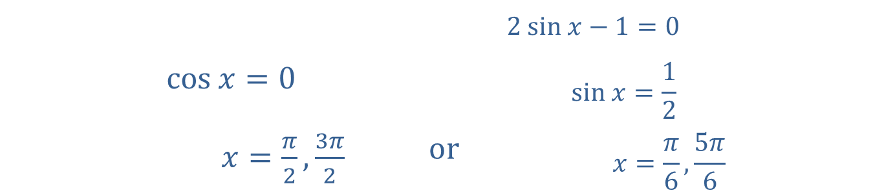
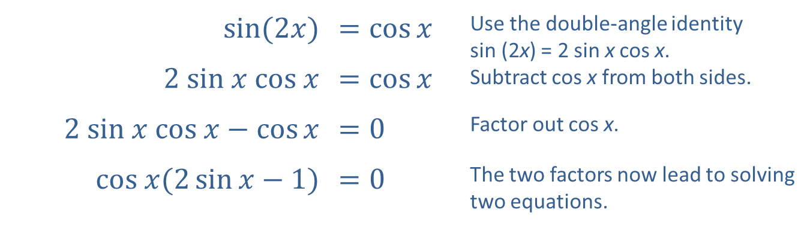
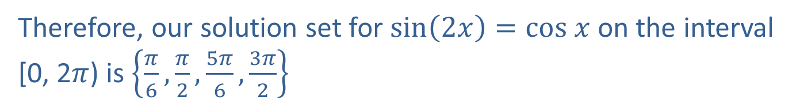
Example 6: Solving Equations Using Trigonometric Identities—Slide 2
​$sin(2x)$ | ​$=\cos{x}$ | Use the double-angle identity sin (2x) = 2 sin x cos x. Subtract cos x from both sides.
​$2 sin x cos x$ | ​$=\cos{x}$
​$2 sin x cos x−\cos{x}$ | ​$=0$ | Factor out cos x.
​$cos x(2\sin{x−1})$ | ​$=0$ | The two factors now lead to solving two equations.
​ | ​ | $$2 sin x−1=0$$
​$cos x=0$ | ​ | $$sin x=\frac{1}{2}$$
​$x=\frac{π}{2},\frac{3π}{2}$ | ​$or$ | $$x=\frac{π}{6},\frac{5π}{6}$$
Therefore, our solution set for $sin\left(2x\right)=cos x$ on the interval [0, 2$π$) is $\left\{\frac{π}{6},\frac{π}{2},\frac{5π}{6},\frac{3π}{2}\right\}$

Slide 27
Example 7: Solving Equations Using Trigonometric Identities—Slide 1
Solve the equation sin x – 1 = cos x on the interval
[0, 2π).

Slide 28
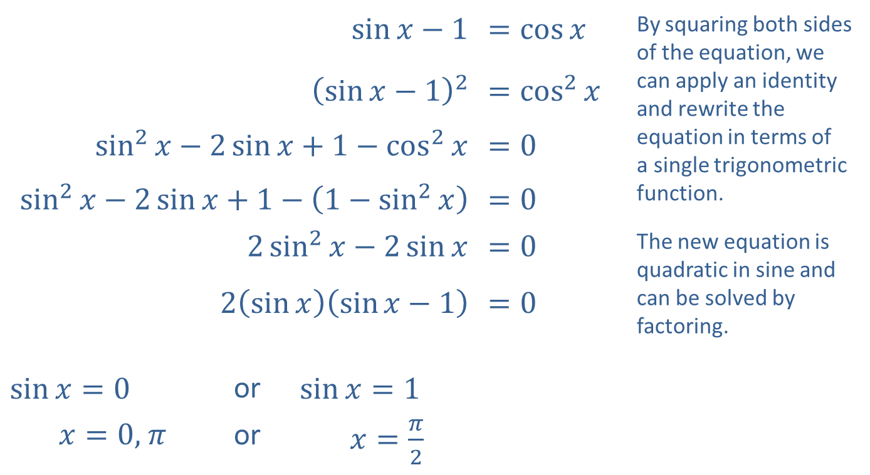
Example 7: Solving Equations Using Trigonometric Identities—Slide 2
Solution
​$\sin{x}−1$ |  |  | ​$=\cos{x}$ | By squaring both sides of the equation, we can apply an identity and rewrite the equation in terms of a single trigonometric function.
​${\left(\sin{x}−1\right)}^{2}$ |  |  | ​$={cos⁡}^{2}{x}$
​$\sin^{2}{x}−2\sin{x}+1−\cos^{2}{x}$ |  |  | ​$=0$
​$\sin^{2}{x}−2\sin{x}+1−\left(1−\sin^{2}{x}\right)$ |  |  | ​$=0$
​$2\sin^{2}{x}−2\sin{x}$ |  |  | ​$=0$ | The new equation is quadratic in sine and can be solved by factoring.
​$2\left(\sin{x}\right)\left(\sin{x}−1\right)$ |  |  | ​$=0$
​$\sin{x}=0$ | or | ​$\sin{x}=1$
​ $x=0\text{,} π$ | or | ​$x=\frac{π}{2}$

Slide 29
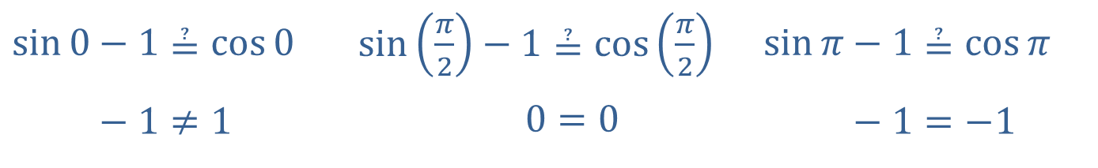
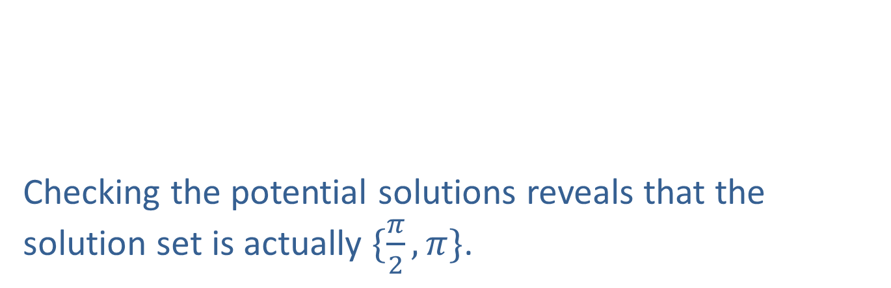
Example 7: Solving Equations Using Trigonometric Identities—Slide 3
At this point, there are three potential solutions that we must test in the original equation.
Checking the potential solutions reveals that the solution set is actually $\{\frac{π}{2},π\}$.
​$\sin{0}−1≟\cos{0}$ | ​$sin\left(\frac{π}{2}\right)−1≟\cos\left(\frac{π}{2}\right)$ | ​$\sin{π}−1≟\cos{π}$
​sin⁡0−1≠1 | ​sin𝜋2− 0=0 | ​sin⁡𝜋−1=−1

Slide 30
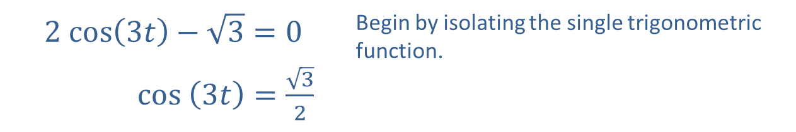
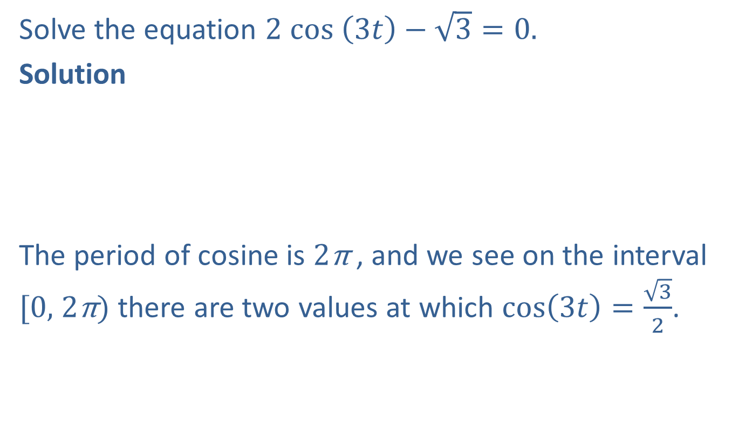
Example 8: Solving Equations with Multiples of Angles—Slide 1
Solve the equation $2 cos \left(3t\right)−\sqrt{3}=0.$
Solution
The period of cosine is 2π , and we see on the interval [0, 2π) there are two values at which $cos\left(3t\right)=$ $\frac{\sqrt{3}}{2}$.
$$2 cos\left(3t\right)−\sqrt{3}=0$$ | Begin by isolating the single trigonometric function.
​ $cos \left(3t\right)=\frac{\sqrt{3}}{2}$

Slide 31
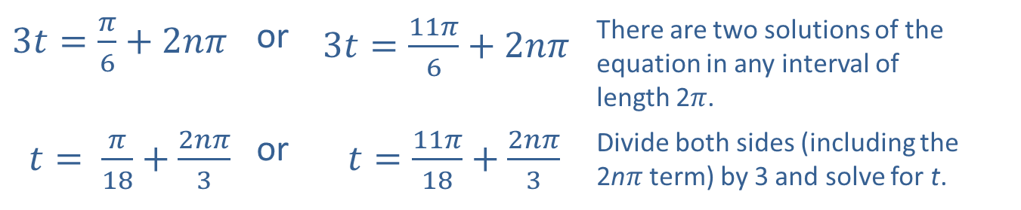
Example 8: Solving Equations with Multiples of Angles—Slide 2
​$3t=\frac{π}{6}+2nπ$ | or | ​$3t=\frac{11π}{6}+2nπ$ | There are two solutions of the equation in any interval of length 2$π$.
​$t= \frac{π}{18}+\frac{2nπ}{3}$ | or | ​$t=\frac{11π}{18}+\frac{2nπ}{3}$ | Divide both sides (including the 2n$π$ term) by 3 and solve for t.

Slide 32

Example 9: Solving Equations Using Inverse Trigonometric Functions—Slide 1
Solve the equation $\tan^{2}{x}+2\tan{x}=3$ on the interval $(−\frac{π}{2},\frac{π}{2})$.

Slide 33
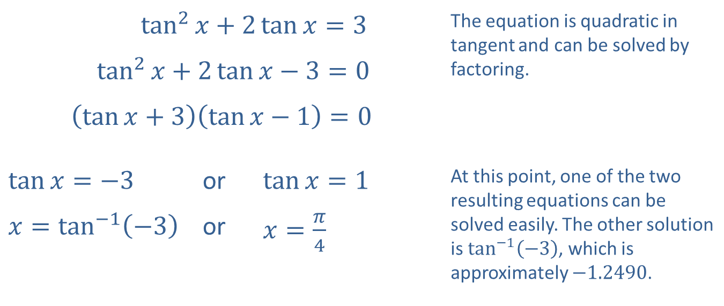
Example 9: Solving Equations Using Inverse Trigonometric Functions—Slide 2
Solution
​$\tan^{2}{x}+2\tan{x}=3$ |  |  | The equation is quadratic in tangent and can be solved by factoring.
​$\tan^{2}{x}+2\tan{x}−3=0$
​$\left(\tan{x}+3\right)\left(\tan{x}−1\right)=0$
​$\tan{x}=−3$ | or | ​$\tan{x}=1$ | At this point, one of the two resulting equations can be solved easily. The other solution is $\tan^{−1}⁡\left(−3\right)$, which is approximately −1.2490.
​$x=\tan^{−1}\left(−3\right)$ | or | ​$x=\frac{π}{4}$

Slide 34
Example 10: Solving Equations Using Inverse Trigonometric Functions—Slide 1
Solve the equation 6sin x – 2 = sin x on the interval
[0, 2π).

Slide 35
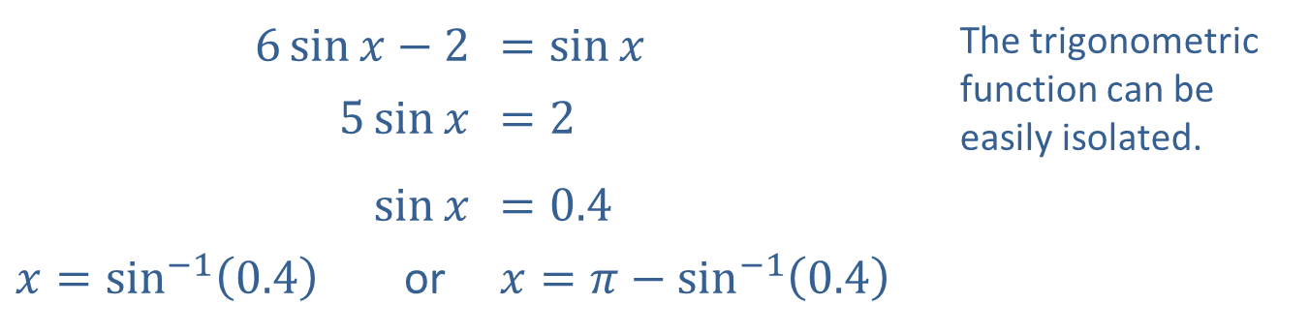

Example 10: Solving Equations Using Inverse Trigonometric Functions—Slide 2
Solution
Note that since sin x is positive, x lies in the first or second quadrant. The solution in the first quadrant is $\sin^{−1}⁡\left(0.4\right)$, and the solution in the second quadrant has $\sin^{−1}⁡\left(0.4\right)$ as its reference angle.
​$6\sin{x}−2$ |  | ​$=\sin{x}$ | The trigonometric function can be easily isolated.
​$5\sin{x}$ |  | ​$=2$
​$sin⁡x$ |  | ​$=0.4$
​$x=\sin^{−1}\left(0.4\right)$ | or | ​$x=π−\sin^{−1}\left(0.4\right)$

Slide 36
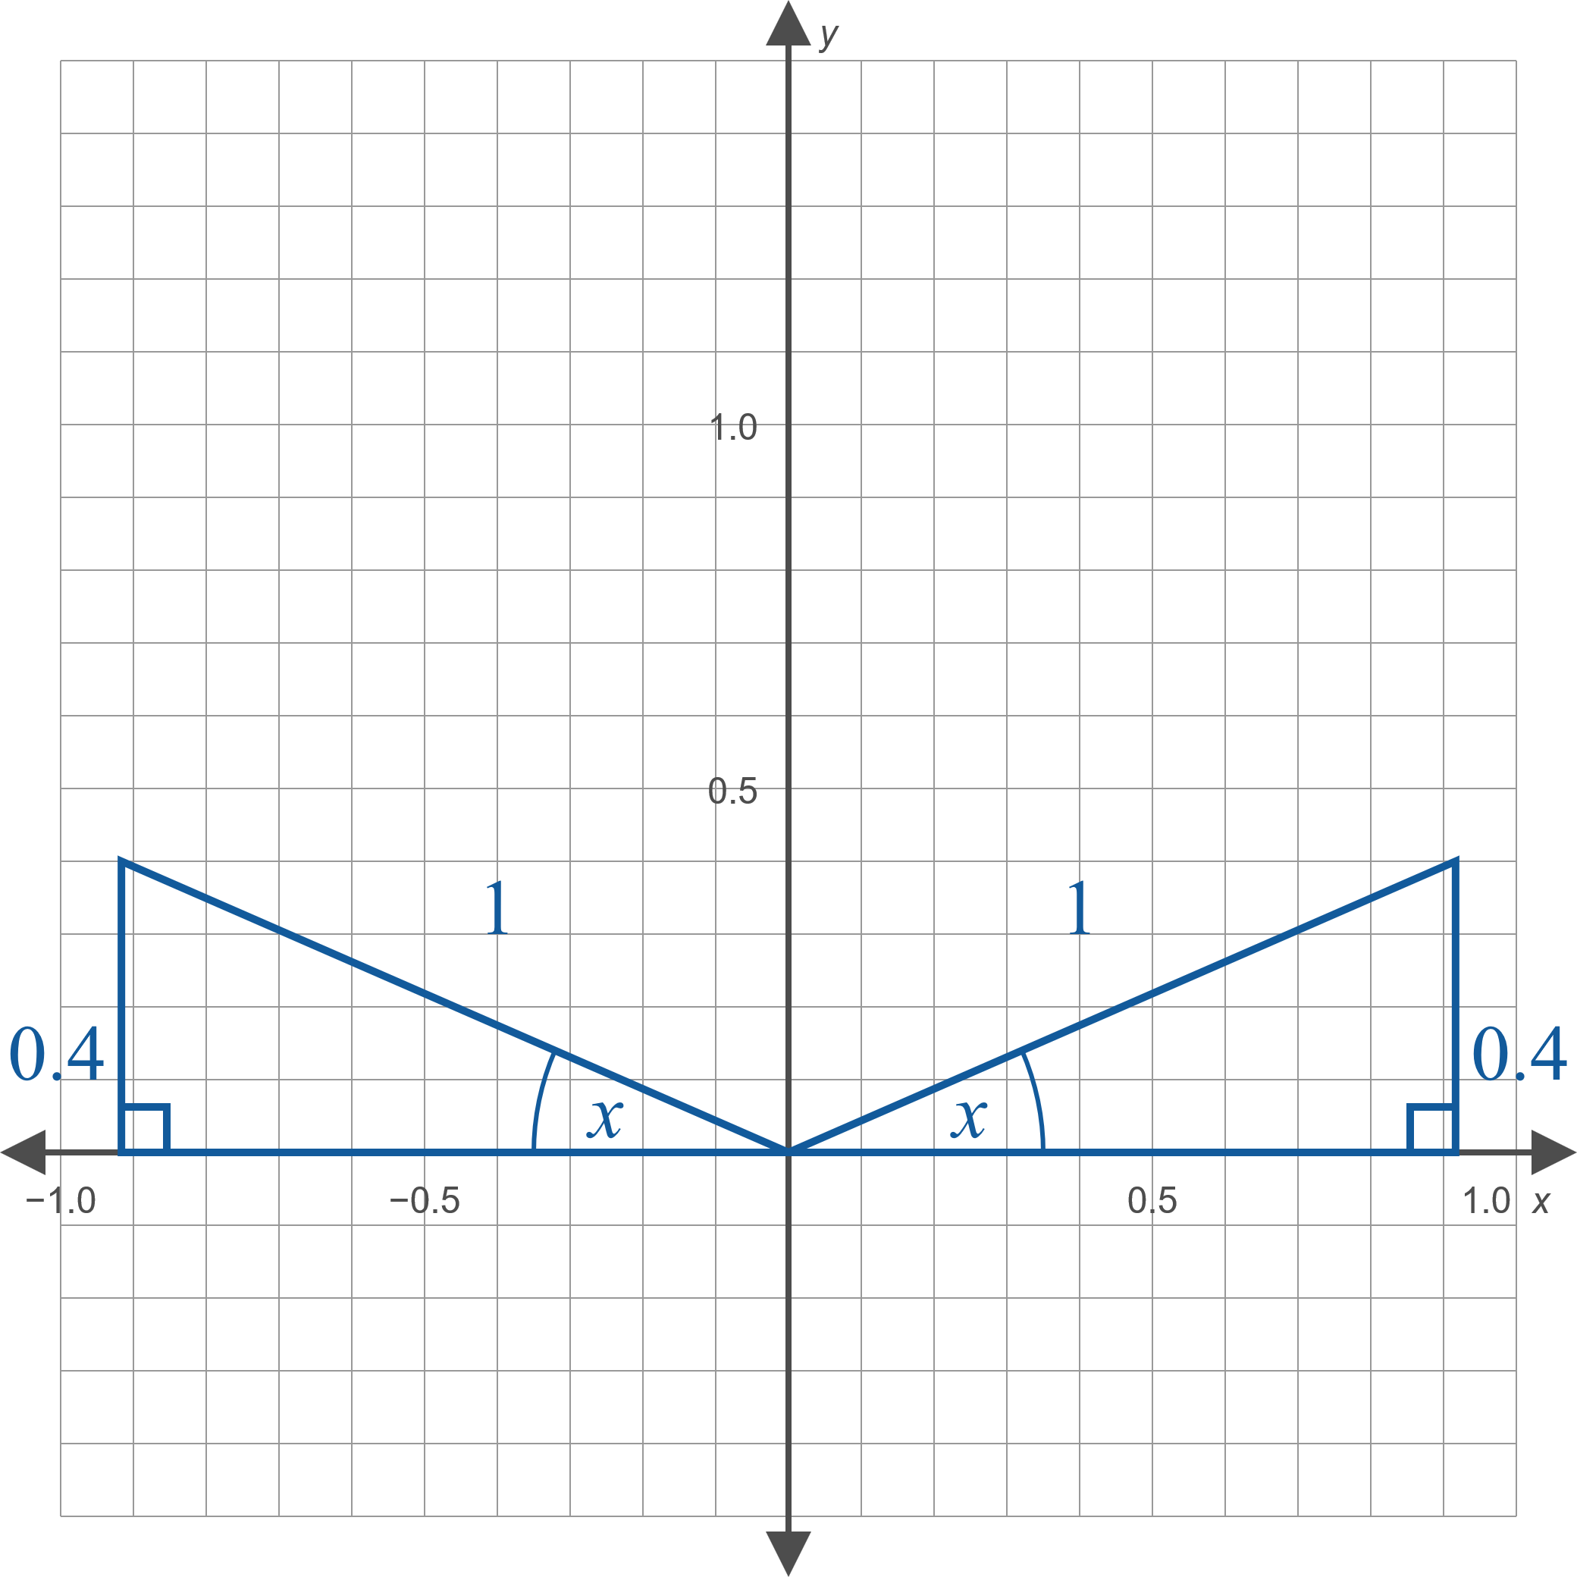
Example 10: Solving Equations Using Inverse Trigonometric Functions—Slide 3
Figure 6

