Slide 1
Section 3.R.6
Trigonometric Identities

Slide 2

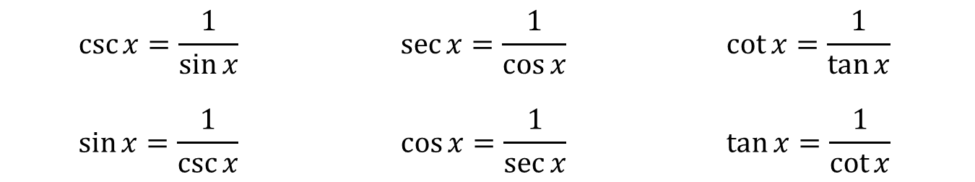
Identities Already Seen—Slide 1
Reciprocal Identities
Quotient Identities
$$\csc{x}=\frac{1}{\sin{x}}$$ | $$\sec{x}=\frac{1}{\cos{x}}$$ | $$\cot{x}=\frac{1}{\tan{x}}$$
$$\sin{x}=\frac{1}{\csc{x}}$$ | $$\cos{x}=\frac{1}{\sec{x}}$$ | $$\tan{x}=\frac{1}{\cot{x}}$$
$$\tan{x}=\frac{\sin{x}}{\cos{x}}$$ | $$\cot{x}=\frac{\cos{x}}{\sin{x}}$$

Slide 3
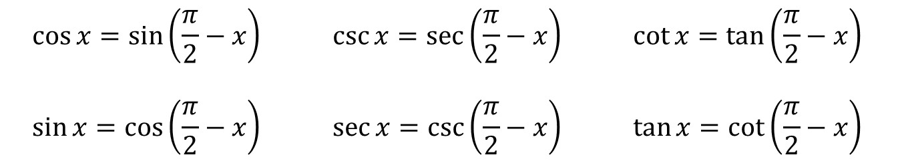
Identities Already Seen—Slide 2
Cofunction Identities
$$\cos{x}=\sin\left(\frac{π}{2}−x\right)$$ | $$\csc{x}=\sec\left(\frac{π}{2}−x\right)$$ | $$\cot{x}=\tan\left(\frac{π}{2}−x\right)$$
$$\sin{x}=\cos\left(\frac{π}{2}−x\right)$$ | $$\sec{x}=\csc\left(\frac{π}{2}−x\right)$$ | $$\tan{x}=\cot\left(\frac{π}{2}−x\right)$$

Slide 4
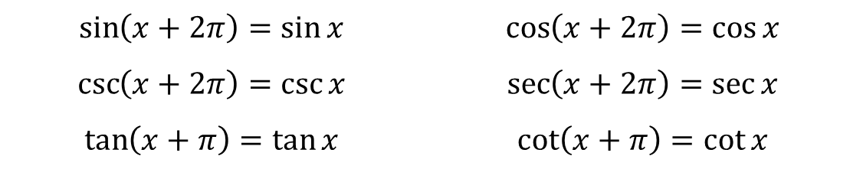
Identities Already Seen—Slide 3
Period Identities
$$\sin\left(x+2π\right)=\sin{x}$$ | $$\cos\left(x+2π\right)=\cos{x}$$
$$\csc\left(x+2π\right)=\csc{x}$$ | $$\sec\left(x+2π\right)=\sec{x}$$
$$\tan\left(x+π\right)=\tan{x}$$ | $$\cot\left(x+π\right)=\cot{x}$$

Slide 5
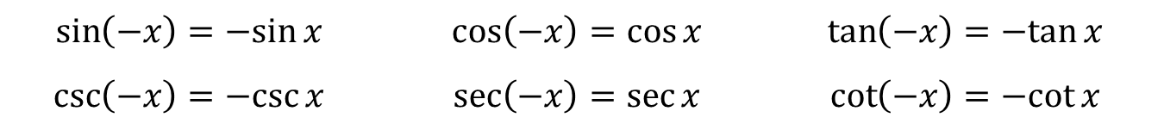
Identities Already Seen—Slide 4
Even/Odd Identities
Pythagorean Identities
$$\sin\left(−x\right)=−sin{x}$$ | $$\cos\left(−x\right)=\cos{x}$$ | $$\tan\left(−x\right)=−tan{x}$$
$$\csc\left(−x\right)=−csc{x}$$ | $$\sec\left(−x\right)=\sec{x}$$ | $$\cot\left(−x\right)=−cot{x}$$
$$\sin^{2}{x}+\cos^{2}{x}=1$$ | $$\tan^{2}{x}+1=\sec^{2}{x}$$ | $$1+\cot^{2}{x}=\csc^{2}{x}$$

Slide 6

Example 1: Simplifying Trigonometric Expressions—Slide 1
Simplify the expression $\cos{θ}+\sin{θ}\tan{θ}$.

Slide 7
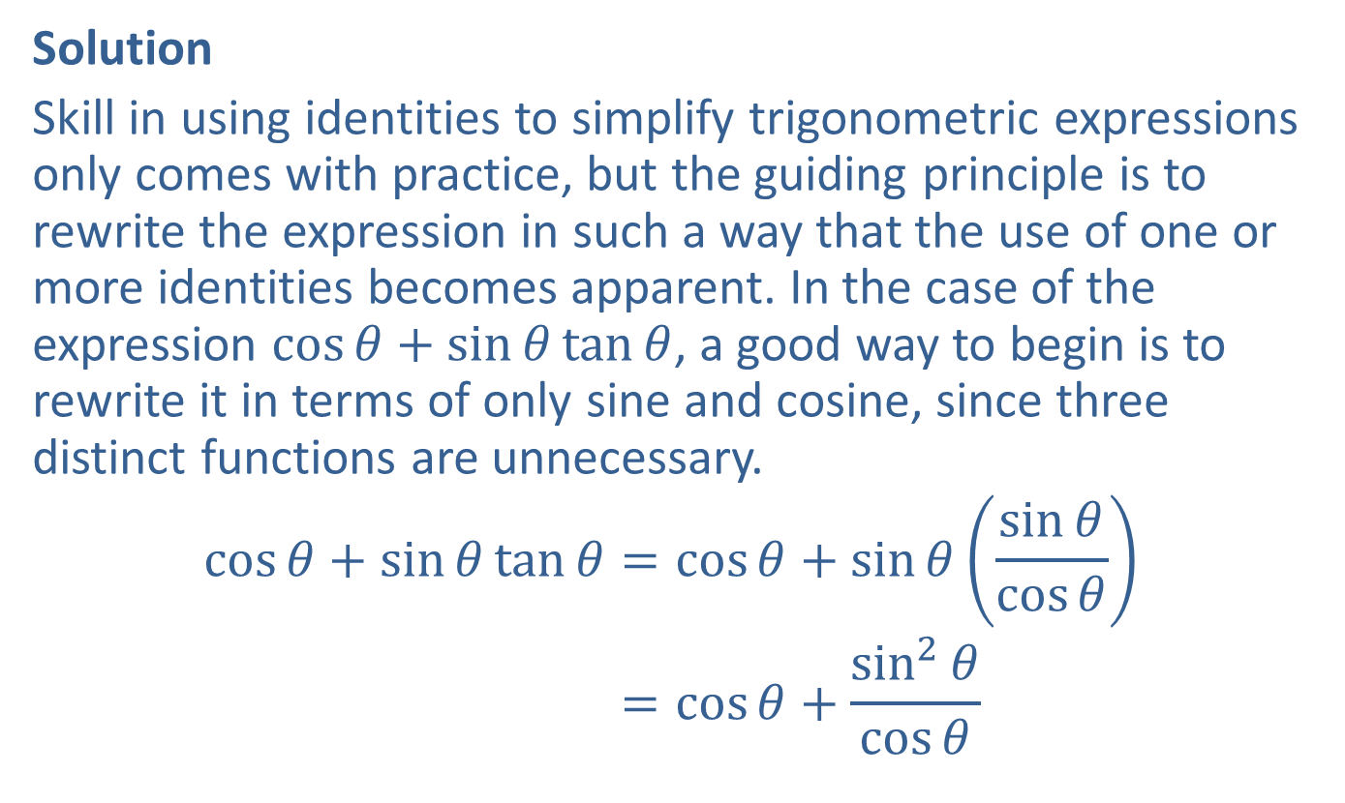
Example 1: Simplifying Trigonometric Expressions—Slide 2
Solution
Skill in using identities to simplify trigonometric expressions only comes with practice, but the guiding principle is to rewrite the expression in such a way that the use of one or more identities becomes apparent. In the case of the expression $\cos{θ}+\sin{θ}\tan{θ}$, a good way to begin is to rewrite it in terms of only sine and cosine, since three distinct functions are unnecessary.
cos𝜃+sin𝜃tan𝜃=cos𝜃+sin𝜃sin𝜃cos𝜃cos𝜃+sin𝜃tan𝜃=cos𝜃+sin2𝜃cos𝜃

Slide 8
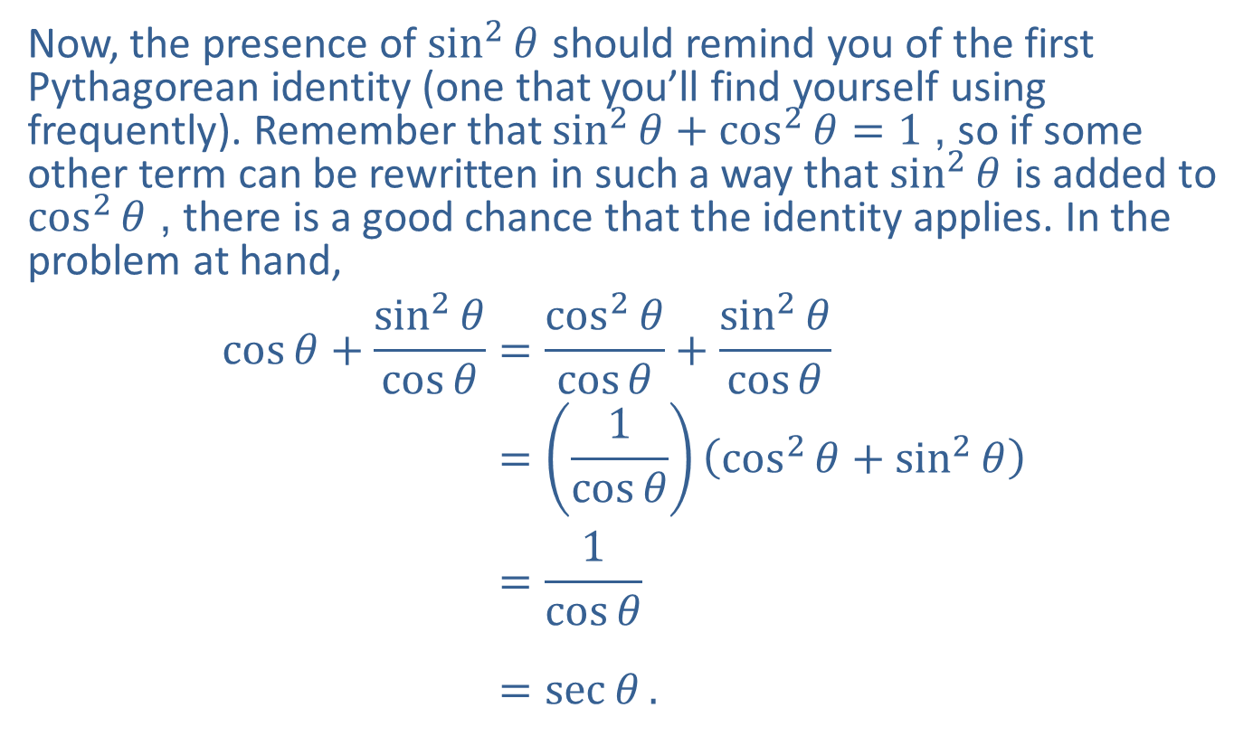
Example 1: Simplifying Trigonometric Expressions—Slide 3
Now, the presence of $\sin^{2}⁡θ$ should remind you of the first Pythagorean identity (one that you’ll find yourself using frequently). Remember that $\sin^{2}{θ}+\cos^{2}{θ}=1$, so if some other term can be rewritten in such a way that $\sin^{2}⁡θ$ is added to $\cos^{2}⁡θ$, there is a good chance that the identity applies. In the problem at hand,
cos𝜃+sin2𝜃cos𝜃=cos2𝜃cos𝜃+sin2𝜃cos𝜃cos𝜃+sin2𝜃cos𝜃=1cos𝜃cos2𝜃+sin2𝜃cos𝜃+sin2𝜃cos𝜃=1cos𝜃cos𝜃+sin2𝜃cos𝜃=sec𝜃.

Slide 9

Example 2: Simplifying Trigonometric Expressions—Slide 1
Simplify the expression $\cot{α}+\frac{\sin{α}}{1+\cos{α}}$.

Slide 10
Example 2: Simplifying Trigonometric Expressions—Slide 2
Solution
As in Example 1, rewriting the expression in terms of only sine and cosine is a good way to start. And as in so many problems, finding a common denominator and combining the resulting fractions is a promising way to proceed. After that, the remaining steps suggest themselves clearly.

Slide 11
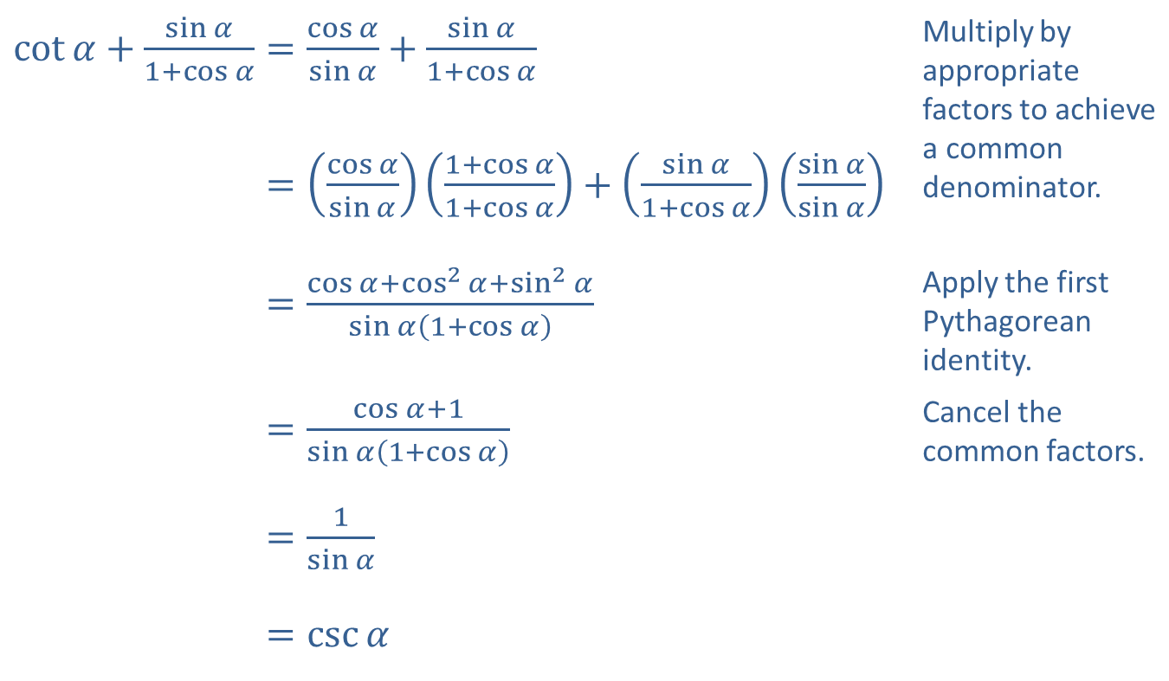
Example 2: Simplifying Trigonometric Expressions—Slide 3
​$\cot{α}+\frac{\sin{α}}{1+\cos{α}}=\frac{\cos{α}}{\sin{α}}+\frac{\sin{α}}{1+\cos{α}}$ | Multiply by appropriate factors to achieve a common denominator.
​cot𝛼+sin𝛼1+cos𝛼=cos𝛼sin𝛼1+cos𝛼1+cos𝛼+sin𝛼1+cos𝛼sin𝛼sin𝛼
​cot𝛼+sin𝛼1+cos𝛼=cos𝛼+cos2𝛼+sin2𝛼sin𝛼1+cos𝛼 | Apply the first Pythagorean identity.
​cot𝛼+sin𝛼1+cos𝛼=cos𝛼+1sin𝛼1+cos𝛼 | Cancel the common factors.
​cot𝛼+sin𝛼1+cos𝛼=1sin𝛼
​cot𝛼+sin𝛼1+cos𝛼=csc𝛼

Slide 12
Procedure: Guidelines for Verifying Trigonometric Identities
​Work with one side at a time. Choose one side of the equation to work with and simplify it. The more complicated side is usually the best choice. The goal is to transform it into the other side.
​Apply trigonometric identities as appropriate. To do so, it will probably be necessary to combine fractions, add or subtract terms, factor expressions, or use other algebraic manipulations.
​Rewrite in terms of sine and cosine if necessary. If you are stuck, expressing everything in terms of sine and cosine often leads to inspiration.

Slide 13

Example 3: Verifying Trigonometric Identities—Slide 1
Verify the identity $2\csc^{2}{x}=\frac{1}{1−\cos{x}}+\frac{1}{1+\cos{x}}$.

Slide 14

Example 3: Verifying Trigonometric Identities—Slide 2
Solution
The right-hand side is more complicated, so we'll begin with it. Combining the two fractions is a good way to begin, especially if we notice that a denominator of
$1−\cos^{2}{x}$ will eventually appear.

Slide 15
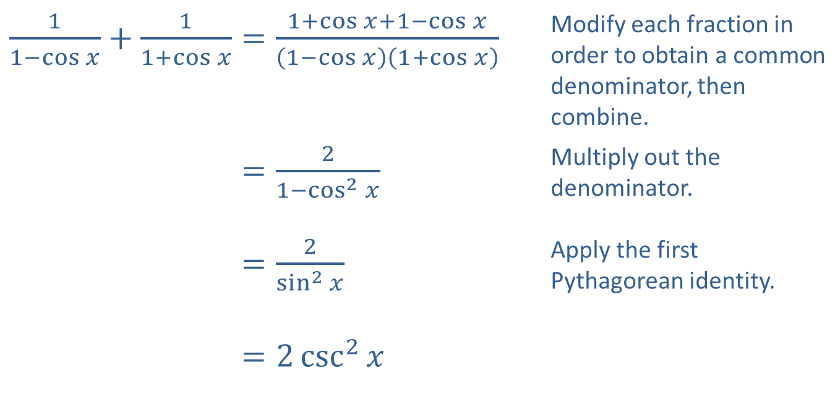
Example 3: Verifying Trigonometric Identities—Slide 3
​$\frac{1}{1−\cos{x}}+\frac{1}{1+\cos{x}}=\frac{1+\cos{x}+1−\cos{x}}{\left(1−\cos{x}\right)\left(1+\cos{x}\right)}$ | Modify each fraction in order to obtain a common denominator, then combine.
​11−cos𝑥+11+cos𝑥=21−cos2𝑥 | Multiply out the denominator.
​11−cos𝑥+11+cos𝑥=2sin2𝑥 | Apply the first Pythagorean identity.
​11−cos𝑥+11+cos𝑥=2csc2𝑥

Slide 16

Example 4: Verifying Trigonometric Identities—Slide 1
Verify the identity $\frac{\tan^{2}{x}}{1+\sec{x}}=\frac{1−\cos{x}}{\cos{x}}$.

Slide 17
Example 4: Verifying Trigonometric Identities—Slide 2
Solution
It's not immediately clear that either side is more complicated than the other, so we can try simplifying both. Beginning with the left-hand side, we can use another of the Pythagorean identities as follows.

Slide 18
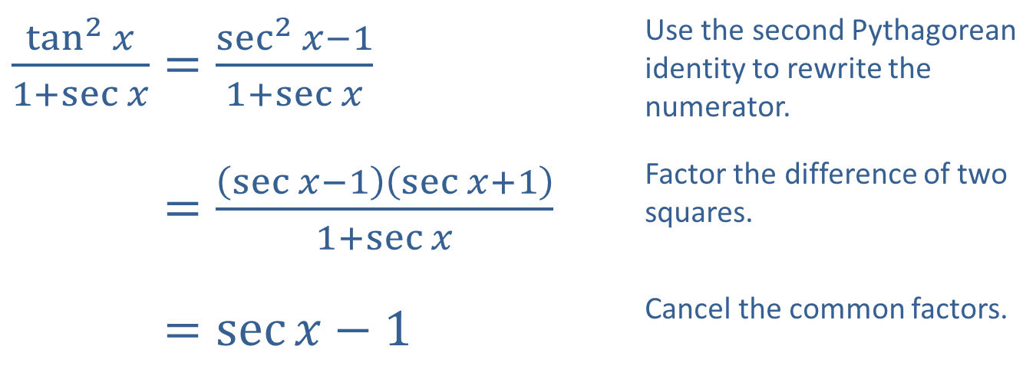
Example 4: Verifying Trigonometric Identities—Slide 3
​$\frac{\tan^{2}{x}}{1+\sec{x}}=\frac{\sec^{2}{x}−1}{1+\sec{x}}$ | Use the second Pythagorean identity to rewrite the numerator.
​tan2𝑥1+sec𝑥=sec𝑥−1sec𝑥+11+sec𝑥 | Factor the difference of two squares.
​tan2𝑥1+sec𝑥=sec𝑥−1 | Cancel the common factors.

Slide 19
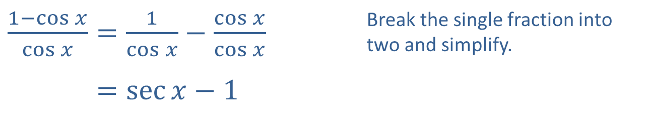
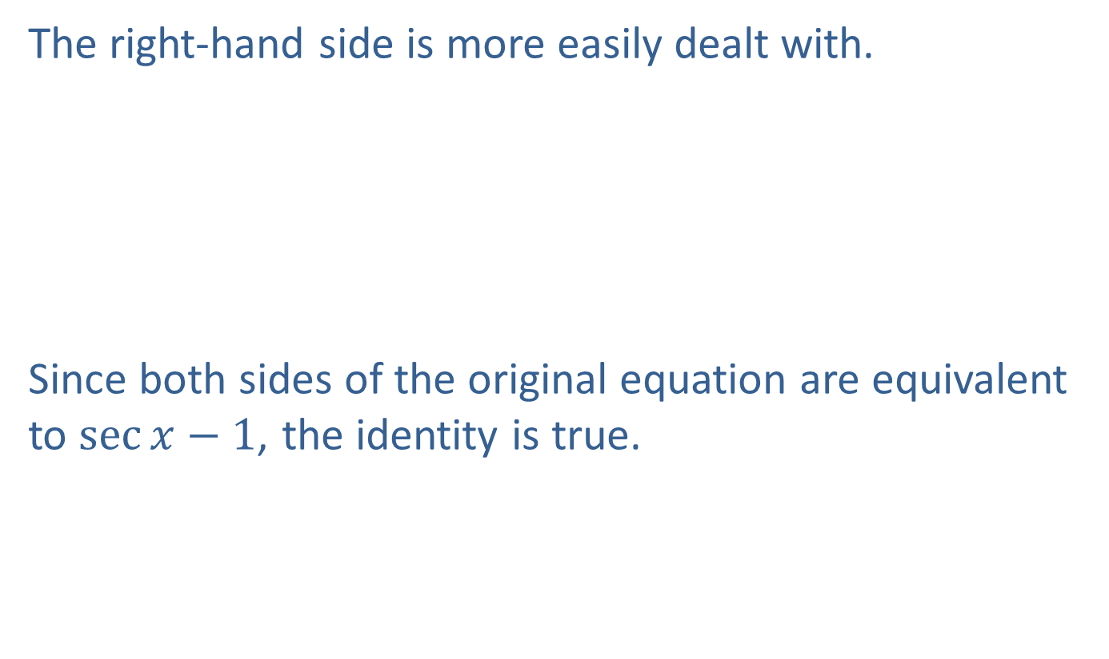
Example 4: Verifying Trigonometric Identities—Slide 4
The right-hand side is more easily dealt with.
Since both sides of the original equation are equivalent to $\sec{x}−1$, the identity is true.
​$\frac{1−\cos{x}}{\cos{x}}=\frac{1}{\cos{x}}−\frac{\cos{x}}{\cos{x}}$ | Break the single fraction into two and simplify.
​1−cos𝑥cos𝑥=sec𝑥−1

Slide 20

Example 5: Verifying Trigonometric Identities—Slide 1
Verify the identity $\frac{\cos{φ}\cot{φ}}{1−\sin{φ}}−1=\csc{φ}$.

Slide 21
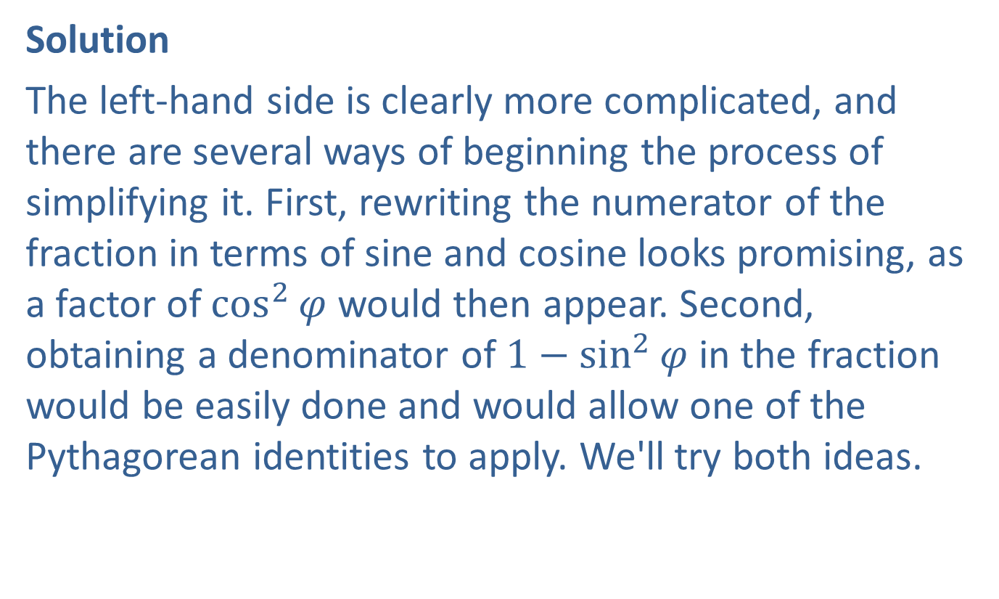
Example 5: Verifying Trigonometric Identities—Slide 2
Solution
The left-hand side is clearly more complicated, and there are several ways of beginning the process of simplifying it. First, rewriting the numerator of the fraction in terms of sine and cosine looks promising, as a factor of $\cos^{2}⁡φ$ would then appear. Second, obtaining a denominator of $1−\sin^{2}{φ}$ in the fraction would be easily done and would allow one of the Pythagorean identities to apply. We'll try both ideas.

Slide 22
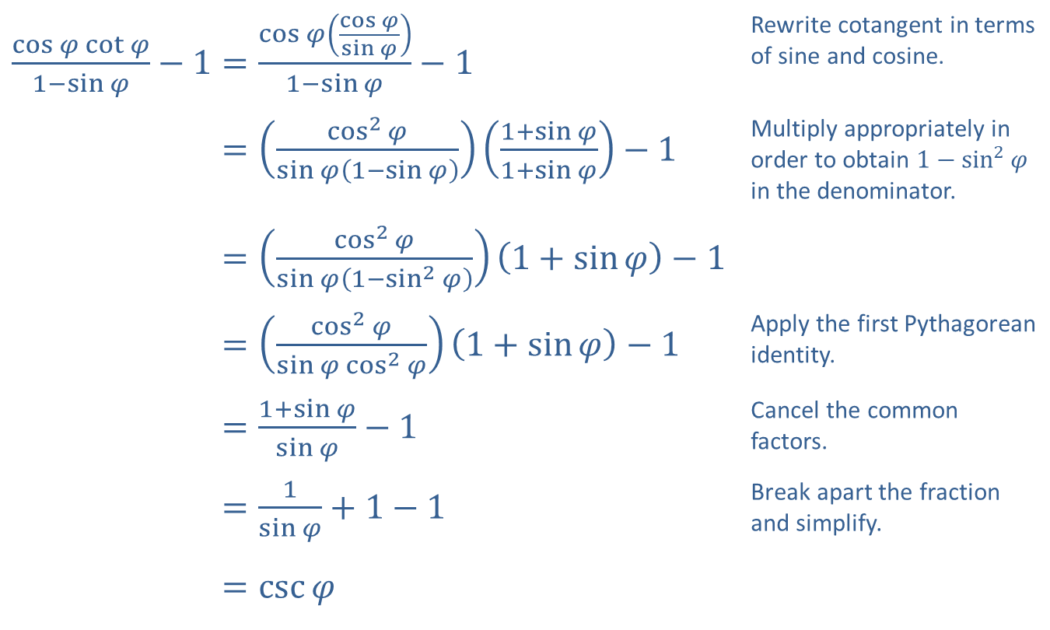
Example 5: Verifying Trigonometric Identities—Slide 3
​$\frac{\cos{φ}\cot{φ}}{1−\sin{φ}}−1=\frac{\cos{φ}\left(\frac{\cos{φ}}{\sin{φ}}\right)}{1−\sin{φ}}−1$ | Rewrite cotangent in terms of sine and cosine.
​cos𝜑cot𝜑1−sin𝜑−1=cos2𝜑sin𝜑1−sin𝜑1+sin𝜑1+sin𝜑−1 | Multiply appropriately in order to obtain $1−\sin^{2}{φ}$ in the denominator.
​cos𝜑cot𝜑1−sin𝜑−1=cos2𝜑sin𝜑1−sin2𝜑1+sin𝜑−1
​cos𝜑cot𝜑1−sin𝜑−1=cos2𝜑sin𝜑cos2𝜑1+sin𝜑−1 | Apply the first Pythagorean identity.
​cos𝜑cot𝜑1−sin𝜑−1=1+sin𝜑sin𝜑−1 | Cancel the common factors.
​cos𝜑cot𝜑1−sin𝜑−1=1sin𝜑+1−1 | Break apart the fraction and simplify.
​cos𝜑cot𝜑1−sin𝜑−1=csc𝜑

Slide 23

Example 6: Using Trigonometric Substitutions—Slide 1
Use the substitution $\sin{θ}=\frac{x}{2}$ to write $\sqrt{4−x^{2}}$ as a trigonometric expression. Assume $0≤θ≤\frac{π}{2}$.

Slide 24
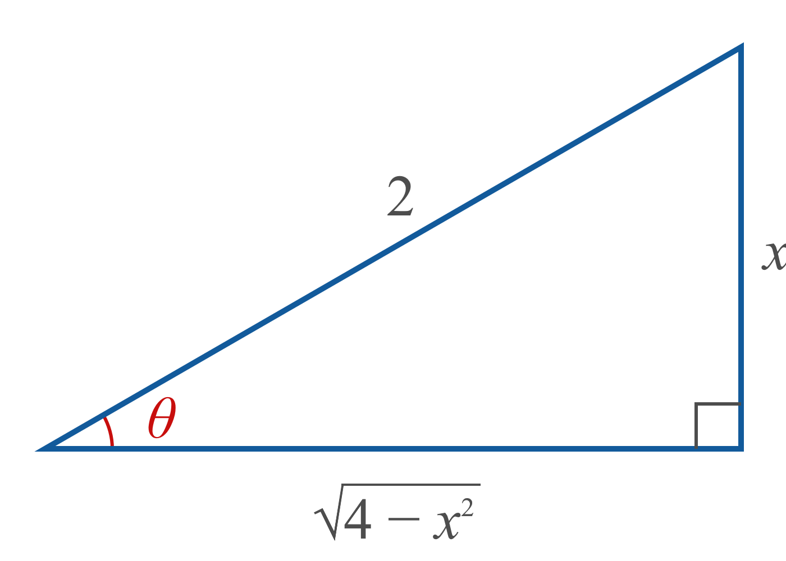
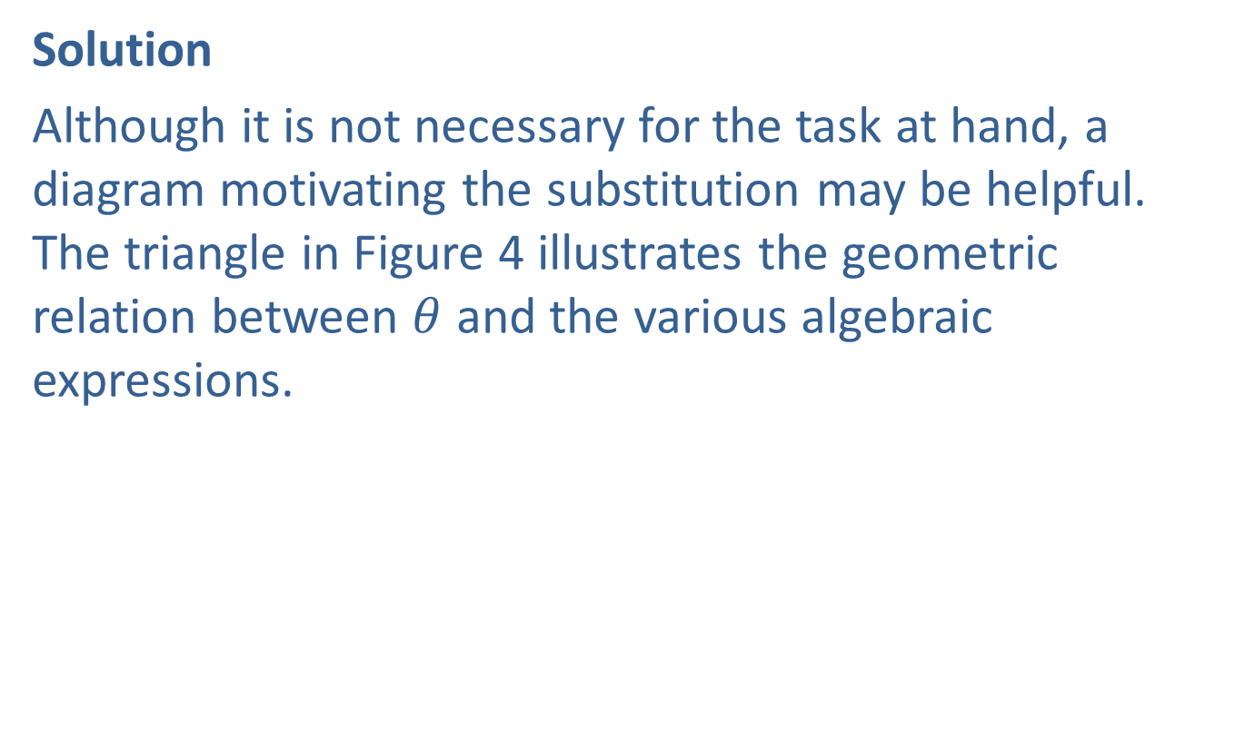
Example 6: Using Trigonometric Substitutions—Slide 2
Solution
Although it is not necessary for the task at hand, a diagram motivating the substitution may be helpful. The triangle in Figure 4 illustrates the geometric relation between $θ$ and the various algebraic expressions.
Figure 4

Slide 25
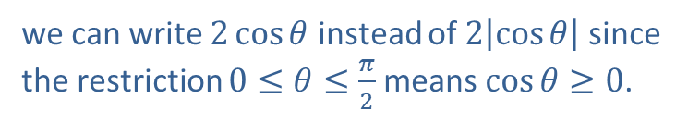
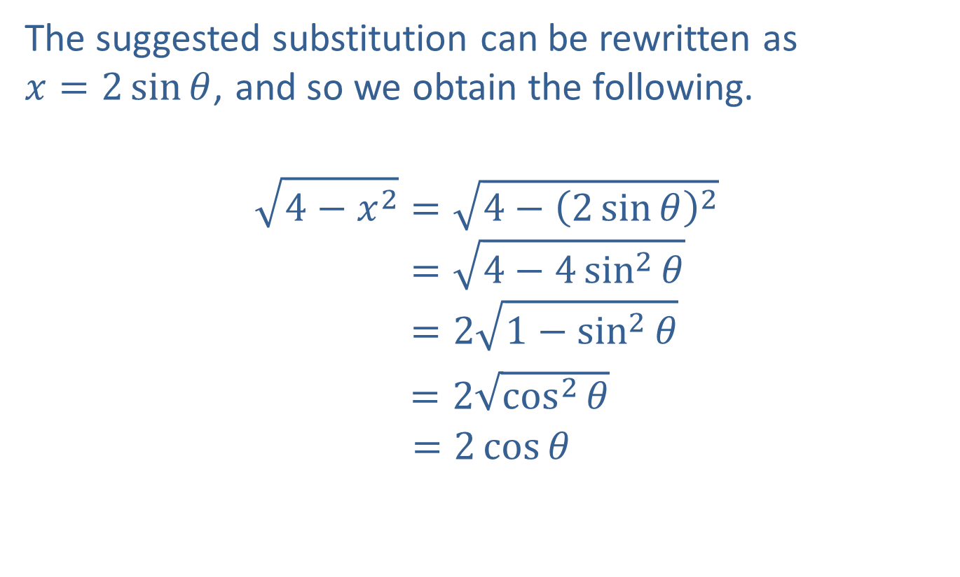
Example 6: Using Trigonometric Substitutions—Slide 3
The suggested substitution can be rewritten as
$x=2\sin{θ}$, and so we obtain the following.
4−𝑥2=4−2sin𝜃24−𝑥2=4−4sin2𝜃4−𝑥2=21−sin2𝜃
$=2\sqrt{\cos^{2}⁡θ}$
$$=2\cos{θ}$$
we can write $2\cos{θ}$ instead of $2\left|\cos{θ}\right|$ since the restriction $0≤θ≤\frac{π}{2}$ means $\cos{θ}≥0$.

Slide 26
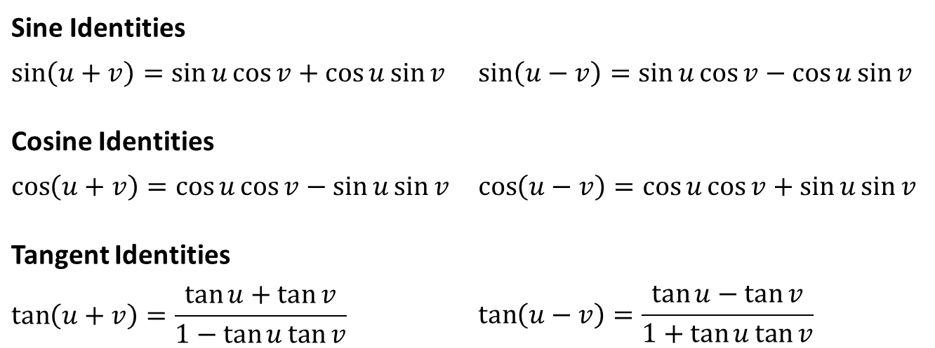
Sum and Difference Identities
Sine Identities
$$\sin\left(u+v\right)=\sin{u}\cos{v}+\cos{u}\sin{v}$$ | $$\sin\left(u−v\right)=\sin{u}\cos{v}−\cos{u}\sin{v}$$
Cosine Identities
$$\cos\left(u+v\right)=\cos{u}\cos{v}−\sin{u}\sin{v}$$ | $$\cos\left(u−v\right)=\cos{u}\cos{v}+\sin{u}\sin{v}$$
Tangent Identities
$$\tan\left(u+v\right)=\frac{\tan{u}+\tan{v}}{1−\tan{u}\tan{v}}$$ | $$\tan\left(u−v\right)=\frac{\tan{u}−\tan{v}}{1+\tan{u}\tan{v}}$$

Slide 27
Example 7: Using the Sum and Difference Identities for Exact Evaluation—Slide 1
Determine the exact value of sin 75°.

Slide 28
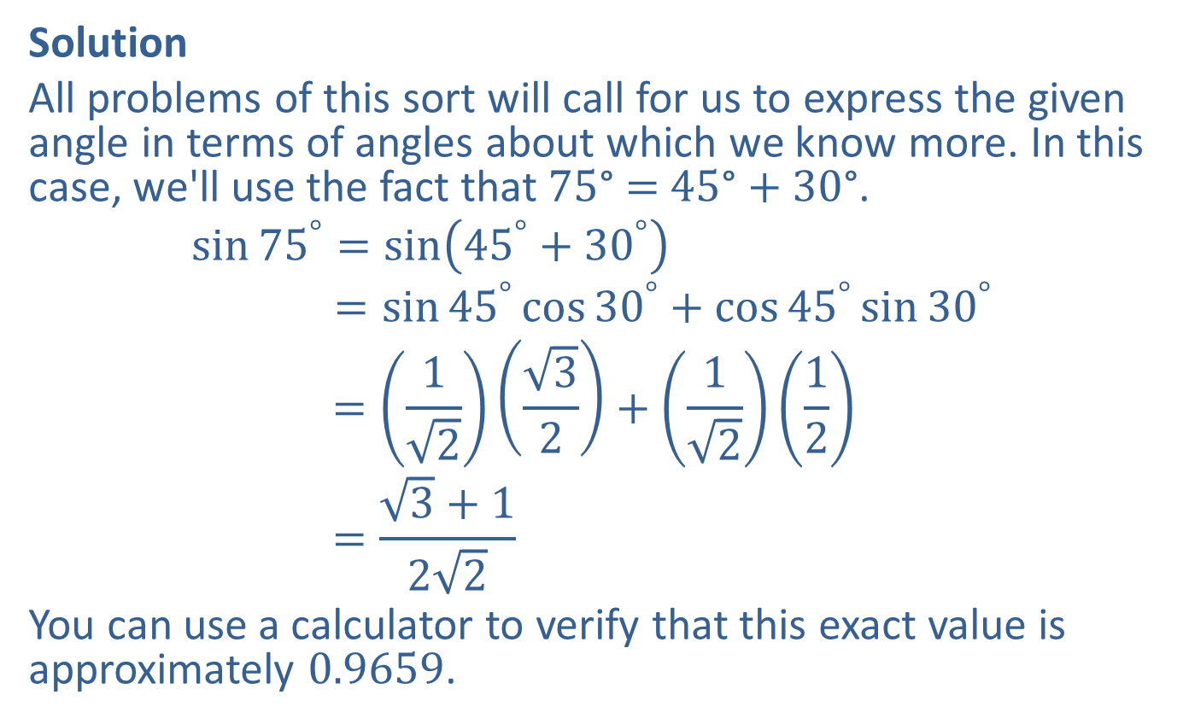
Example 7: Using the Sum and Difference Identities for Exact Evaluation—Slide 2
Solution
All problems of this sort will call for us to express the given angle in terms of angles about which we know more. In this case, we'll use the fact that 75° = 45° + 30°.
sin75°=sin45°+30°sin⁡75 =sin45°cos30°+cos45°sin30°sin⁡75 =1232+1212sin⁡75 =3+122
You can use a calculator to verify that this exact value is approximately 0.9659.

Slide 29
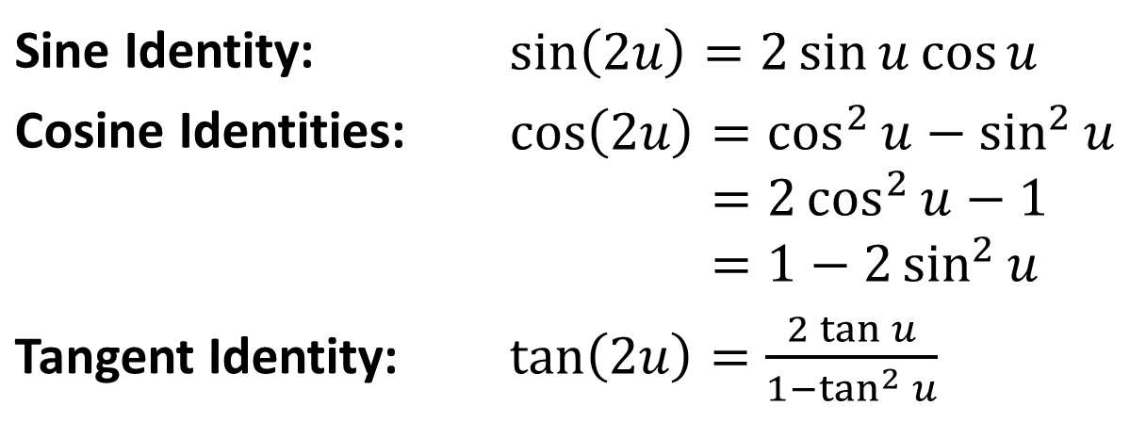
Double-Angle Identities
Sine Identity: | ​$\sin\left(2u\right)=2\sin{u}\cos{u}$
Cosine Identities: | cos2𝑢=cos2𝑢−sin2𝑢cos⁡2𝑢=2cos2𝑢−1cos⁡2𝑢=1−2sin2𝑢
Tangent Identity: | ​$\tan\left(2u\right)=\frac{2\tan{u}}{1−\tan^{2}{u}}$

Slide 30

Example 8: Using the Double-Angle Identities—Slide 1
Given that $\cos{x}=−\frac{2}{\sqrt{5}}$ and that sin x is positive, determine cos (2x), sin (2x), and tan (2x).

Slide 31

Example 8: Using the Double-Angle Identities—Slide 2
Solution
First, note that since $cos⁡x$ is negative and $sin⁡x$ is positive, we know that x lies in quadrant II.

Slide 32
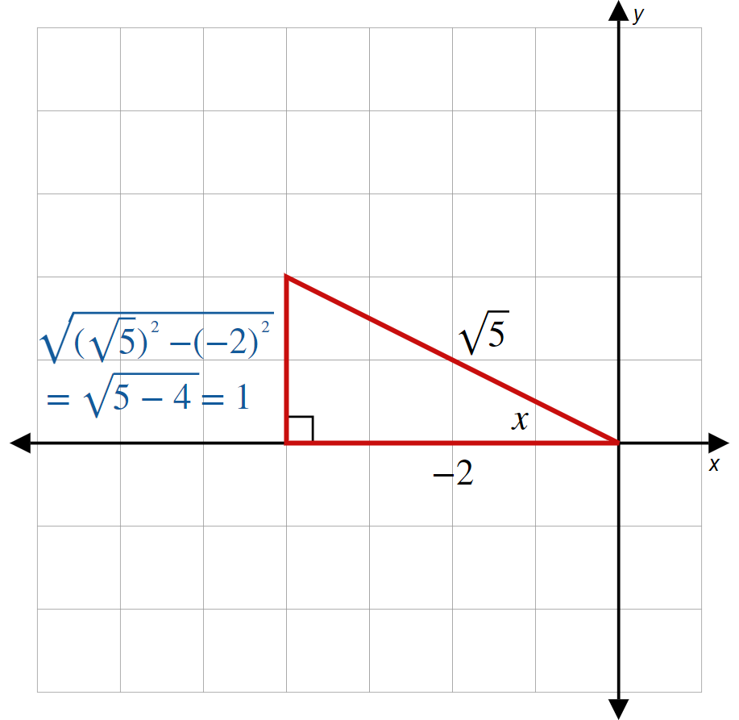
Example 8: Using the Double-Angle Identities—Slide 3
Figure 5

Slide 33
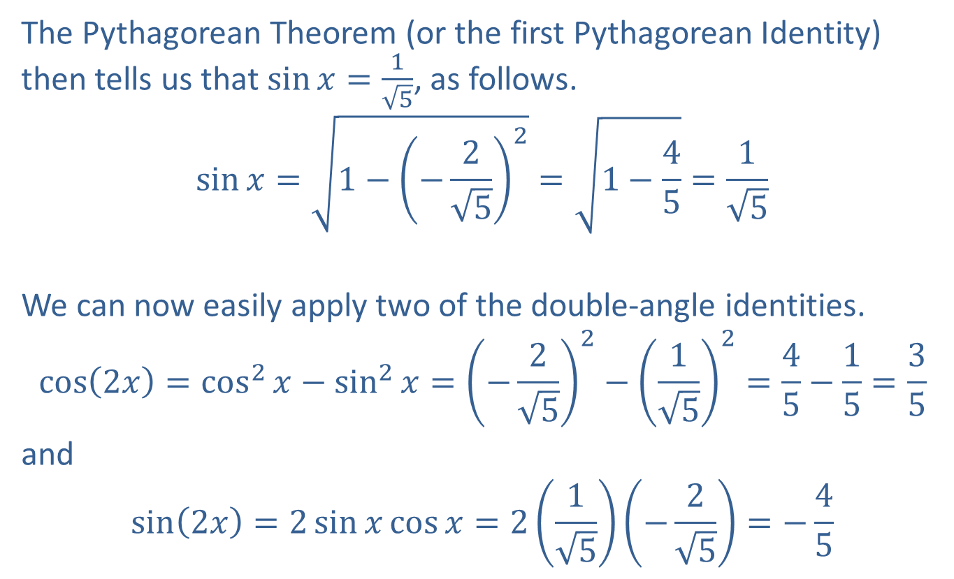
Example 8: Using the Double-Angle Identities—Slide 4
The Pythagorean Theorem (or the first Pythagorean Identity) then tells us that $\sin{x}=\frac{1}{\sqrt{5}}$, as follows.
$$\sin{x}=\sqrt{1−{\left(−\frac{2}{\sqrt{5}}\right)}^{2}}=\sqrt{1−\frac{4}{5}}=\frac{1}{\sqrt{5}}$$
We can now easily apply two of the double-angle identities.
$$\cos\left(2x\right)=\cos^{2}{x}−\sin^{2}{x}={\left(−\frac{2}{\sqrt{5}}\right)}^{2}−{\left(\frac{1}{\sqrt{5}}\right)}^{2}=\frac{4}{5}−\frac{1}{5}=\frac{3}{5}$$
and
$$\sin\left(2x\right)=2\sin{x}\cos{x}=2\left(\frac{1}{\sqrt{5}}\right)\left(−\frac{2}{\sqrt{5}}\right)=−\frac{4}{5}$$

Slide 34
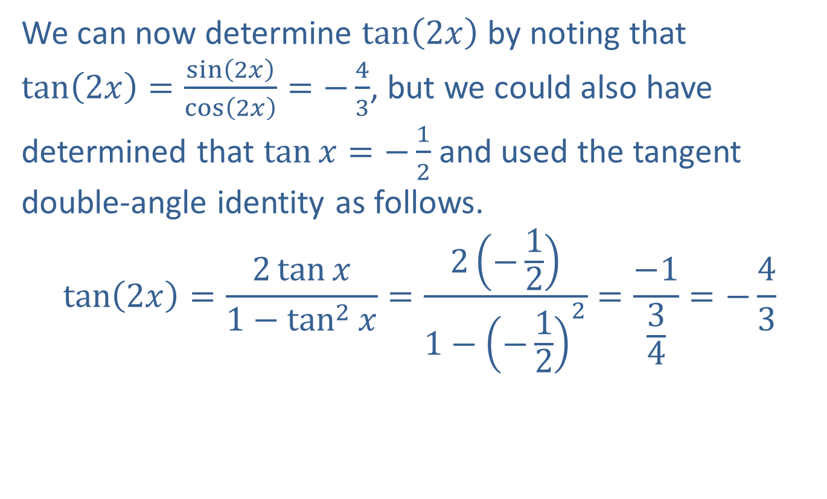
Example 8: Using the Double-Angle Identities—Slide 5
We can now determine $tan⁡\left(2x\right)$ by noting that
$\tan\left(2x\right)=\frac{\sin\left(2x\right)}{\cos\left(2x\right)}=−\frac{4}{3}$, but we could also have determined that $\tan{x}=−\frac{1}{2}$ and used the tangent double-angle identity as follows.
$$\tan\left(2x\right)=\frac{2\tan{x}}{1−\tan^{2}{x}}=\frac{2\left(−\frac{1}{2}\right)}{1−{\left(−\frac{1}{2}\right)}^{2}}=\frac{−1}{\frac{3}{4}}=−\frac{4}{3}$$

Slide 35

Example 9: Using Trigonometric Identities—Slide 1
Prove that $\sin\left(3x\right)=3\sin{x}−4\sin^{3}{x}$.

Slide 36
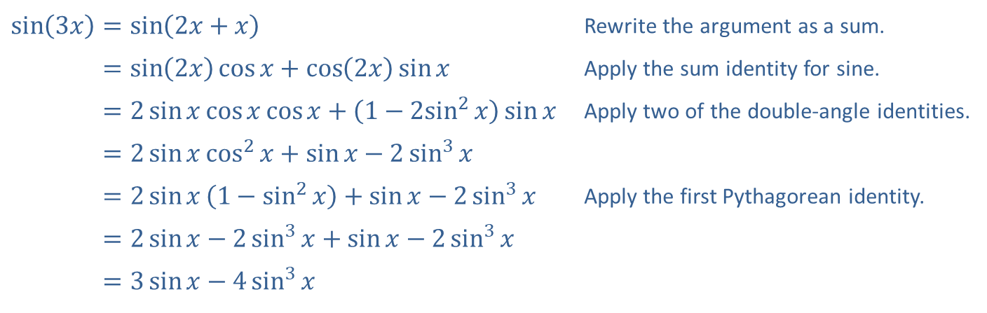
Example 9: Using Trigonometric Identities—Slide 2
Solution
​$\sin\left(3x\right)=\sin\left(2x+x\right)$ | Rewrite the argument as a sum.
​sin⁡3𝑥=sin2𝑥cos𝑥+cos2𝑥sin𝑥 | Apply the sum identity for sine.
​sin⁡3𝑥=2sin𝑥cos𝑥cos𝑥+1−2sin2⁡𝑥sin𝑥 | Apply two of the double-angle identities.
​sin⁡3𝑥=2sin𝑥cos2𝑥+sin𝑥−2sin3𝑥
​sin⁡3𝑥=2sin𝑥1−sin2𝑥+sin𝑥−2sin3𝑥 | Apply the first Pythagorean identity.
​sin⁡3𝑥=2sin𝑥−2sin3𝑥+sin𝑥−2sin3𝑥
​sin⁡3𝑥=3sin𝑥−4sin3𝑥

Slide 37
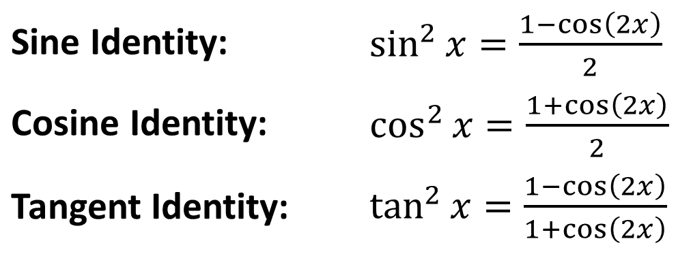
Power-Reducing Identities
Sine Identity: | ​$\sin^{2}{x}=\frac{1−\cos\left(2x\right)}{2}$
Cosine Identity: | ​$\cos^{2}{x}=\frac{1+\cos\left(2x\right)}{2}$
Tangent Identity: | ​$\tan^{2}{x}=\frac{1−\cos\left(2x\right)}{1+\cos\left(2x\right)}$

Slide 38

Example 10: Using the Power-Reducing Identities—Slide 1
Express $\sin^{5}⁡x$ in terms containing only first powers of sine and cosine.

Slide 39
Example 10: Using the Power-Reducing Identities—Slide 2
Solution
The procedure is to break the expression down into pieces to which the power-reducing identities apply, repeating the process if necessary.

Slide 40
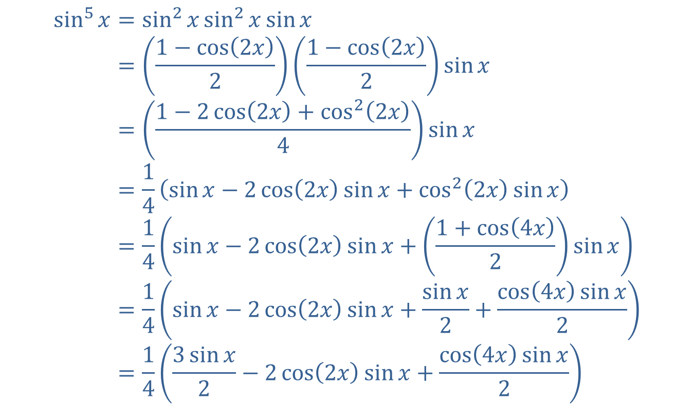
Example 10: Using the Power-Reducing Identities—Slide 3
sin5𝑥=sin2𝑥sin2𝑥sin𝑥sin⁡5⁡𝑥=1−cos2𝑥21−cos2𝑥2sin𝑥sin⁡5⁡𝑥=1−2cos2𝑥+cos22𝑥4sin𝑥sin⁡5⁡𝑥=14sin𝑥−2cos2𝑥sin𝑥+cos22𝑥sin𝑥sin⁡5⁡𝑥=14sin𝑥−2cos2𝑥sin𝑥+1+cos4𝑥2sin𝑥sin⁡5⁡𝑥=14sin𝑥−2cos2𝑥sin𝑥+sin𝑥2+cos4𝑥sin𝑥2sin⁡5⁡𝑥=143sin𝑥2−2cos2𝑥sin𝑥+cos4𝑥sin𝑥2

Slide 41
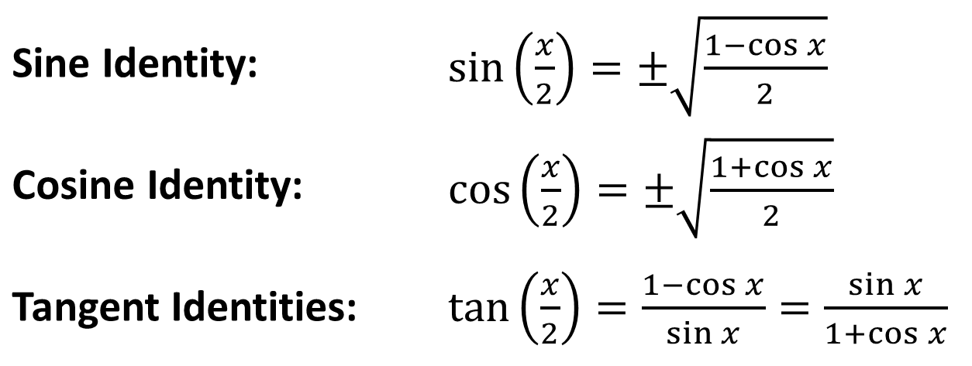
Half-Angle Identities
Sine Identity: | ​$\sin\left(\frac{x}{2}\right)=±\sqrt{\frac{1−\cos{x}}{2}}$
Cosine Identity: | ​$\cos\left(\frac{x}{2}\right)=±\sqrt{\frac{1+\cos{x}}{2}}$
Tangent Identities: | ​$\tan\left(\frac{x}{2}\right)=\frac{1−\cos{x}}{\sin{x}}=\frac{\sin{x}}{1+\cos{x}}$

Slide 42
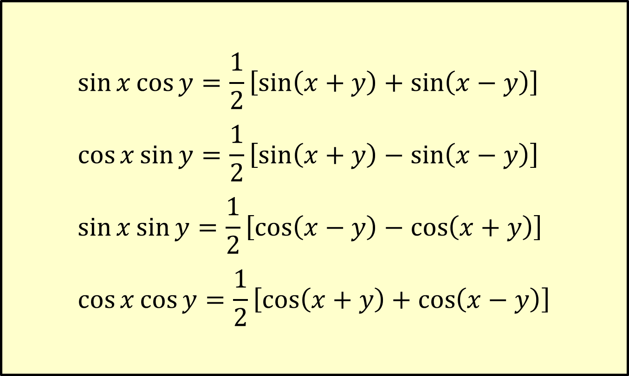
Product-to-Sum Identities
$$\sin{x}\cos{y}=\frac{1}{2}\left[\sin\left(x+y\right)+\sin\left(x−y\right)\right]$$
$$\cos{x}\sin{y}=\frac{1}{2}\left[\sin\left(x+y\right)−\sin\left(x−y\right)\right]$$
$$\sin{x}\sin{y}=\frac{1}{2}\left[\cos\left(x−y\right)−\cos\left(x+y\right)\right]$$
$$\cos{x}\cos{y}=\frac{1}{2}\left[\cos\left(x+y\right)+\cos\left(x−y\right)\right]$$

Slide 43
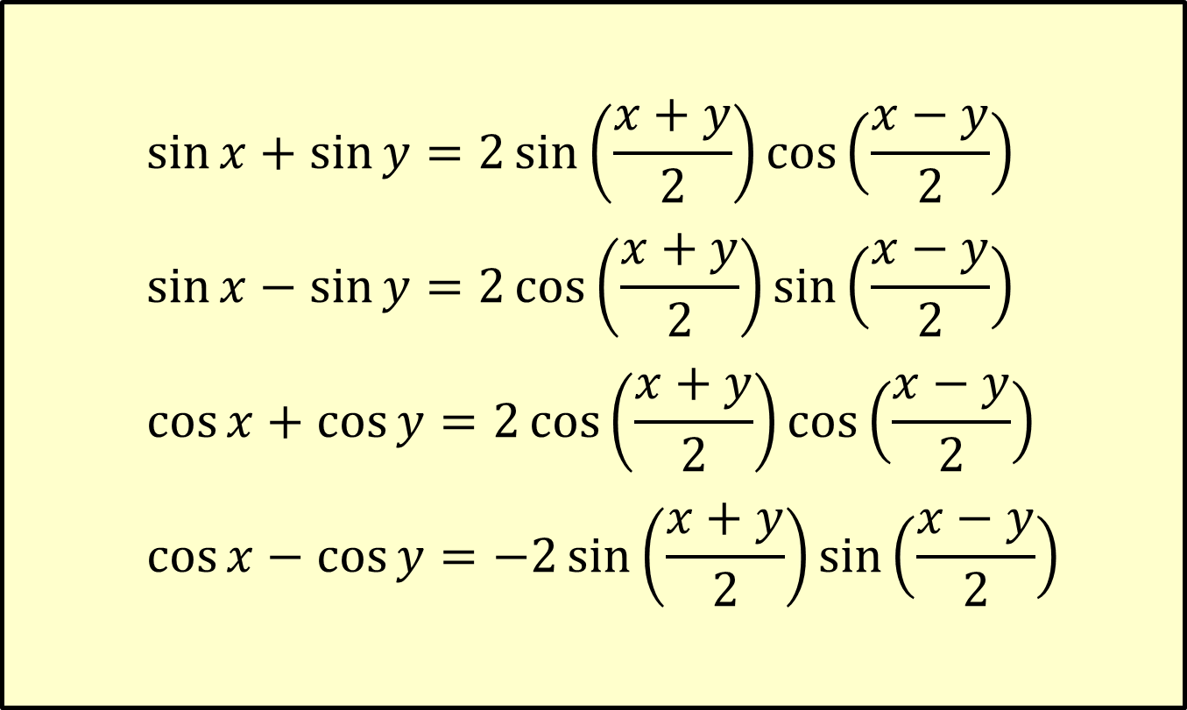
Sum-to-Product Identities
$$\sin{x}+\sin{y}=2\sin\left(\frac{x+y}{2}\right)\cos\left(\frac{x−y}{2}\right)$$
$$\sin{x}−\sin{y}=2\cos\left(\frac{x+y}{2}\right)\sin\left(\frac{x−y}{2}\right)$$
$$\cos{x}+\cos{y}=2\cos\left(\frac{x+y}{2}\right)\cos\left(\frac{x−y}{2}\right)$$
$$\cos{x}−\cos{y}=−2\sin\left(\frac{x+y}{2}\right)\sin\left(\frac{x−y}{2}\right)$$

