Slide 1
Section 3.R.5
Trigonometric Functions

Slide 2
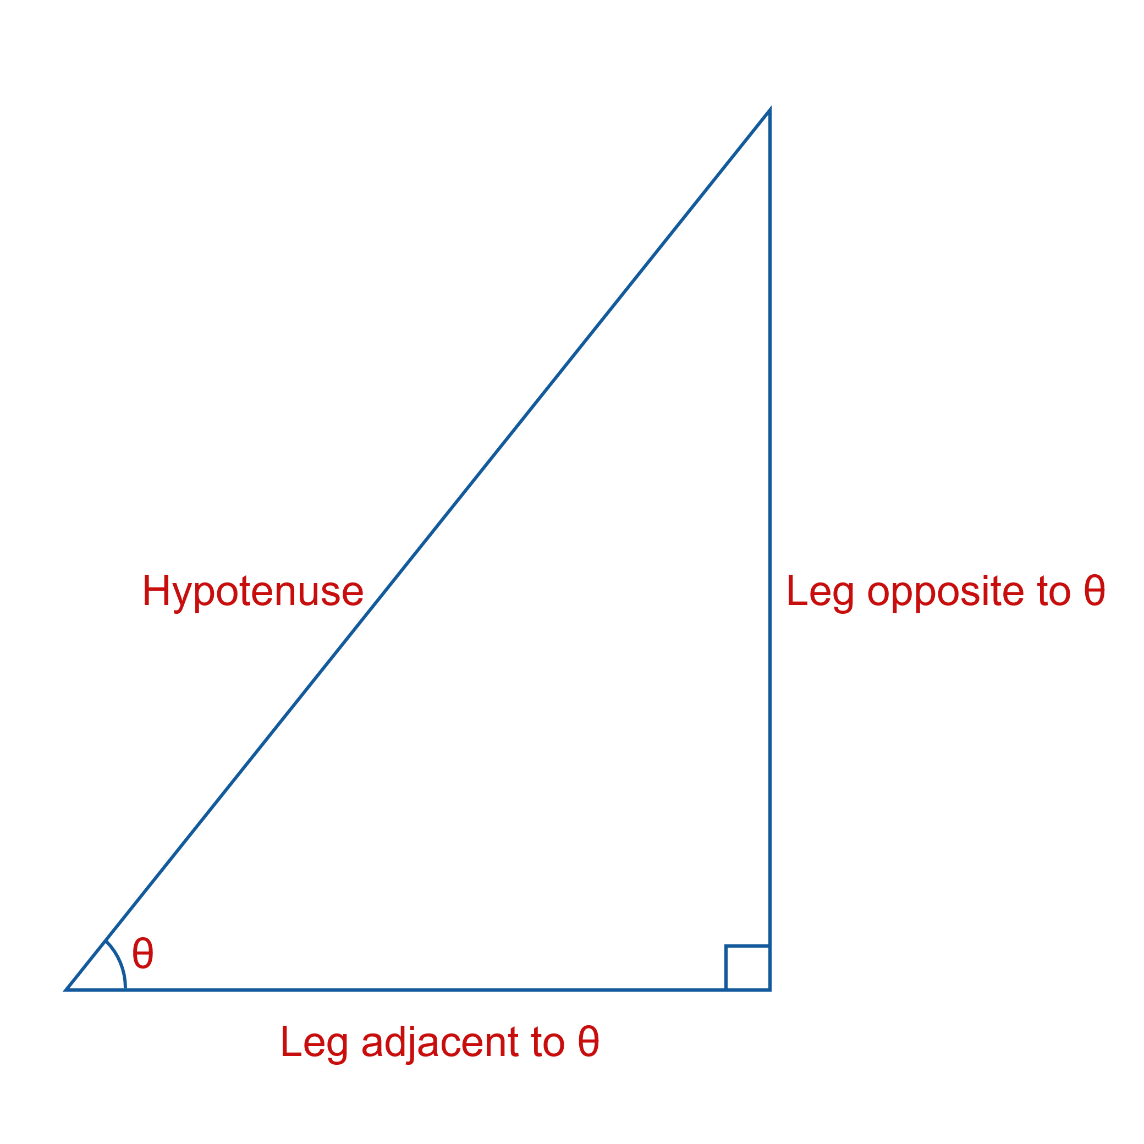

Trigonometric Functions and Right Triangles
Figure 1: Legs Labeled Relative to $θ$

Slide 3
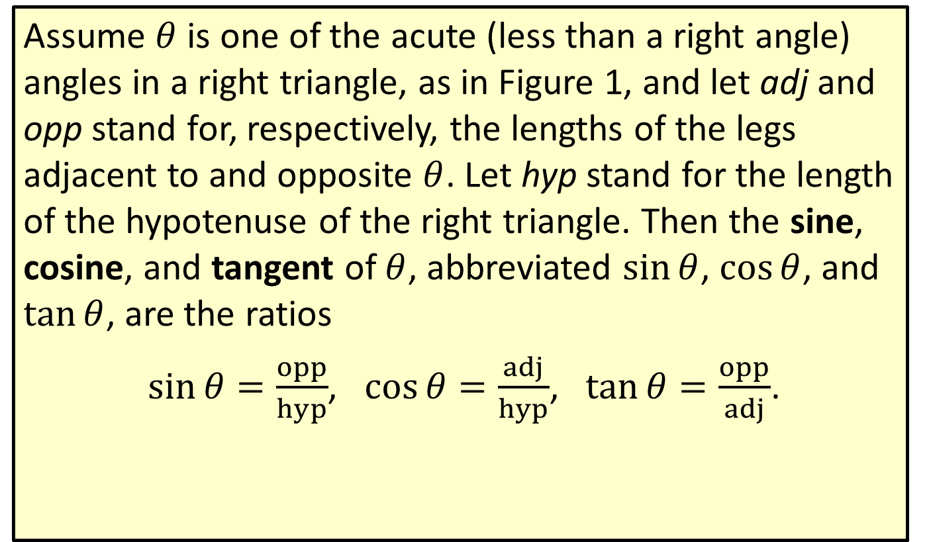
Definition: Sine, Cosine, and Tangent
Assume $θ$ is one of the acute (less than a right angle) angles in a right triangle, as in Figure 1, and let adj and opp stand for, respectively, the lengths of the legs adjacent to and opposite $θ$. Let hyp stand for the length of the hypotenuse of the right triangle. Then the sine, cosine, and tangent of $θ$, abbreviated $sin⁡θ$, $cos⁡θ$, and $tan⁡θ$, are the ratios
$\sin{θ}=\frac{opp}{hyp}$, $\cos{θ}=\frac{adj}{hyp}$, $\tan{θ}=\frac{opp}{adj}$.

Slide 4
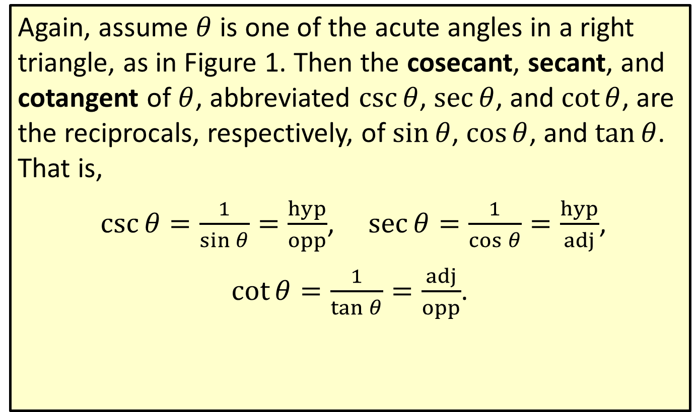
Definition: Cosecant, Secant, and Cotangent
Again, assume $θ$ is one of the acute angles in a right triangle, as in Figure 1. Then the cosecant, secant, and cotangent of $θ$, abbreviated $csc⁡θ$, $sec⁡θ$, and $cot⁡θ$, are the reciprocals, respectively, of $sin⁡θ$, $cos⁡θ$, and $tan⁡θ$. That is,
$\csc{θ}=\frac{1}{\sin{θ}}=\frac{hyp}{opp}$, $\sec{θ}=\frac{1}{\cos{θ}}=\frac{hyp}{adj}$,
$\cot{θ}=\frac{1}{\tan{θ}}=\frac{adj}{opp}$.

Slide 5
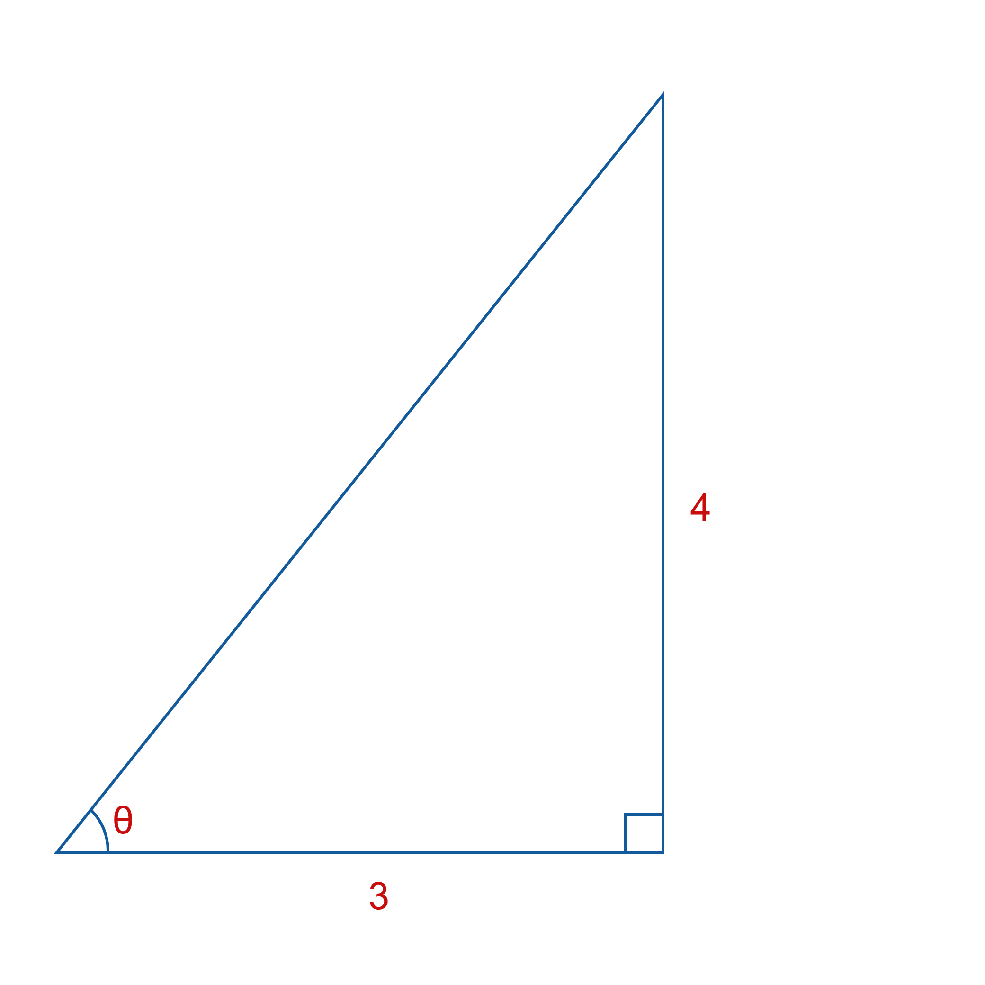
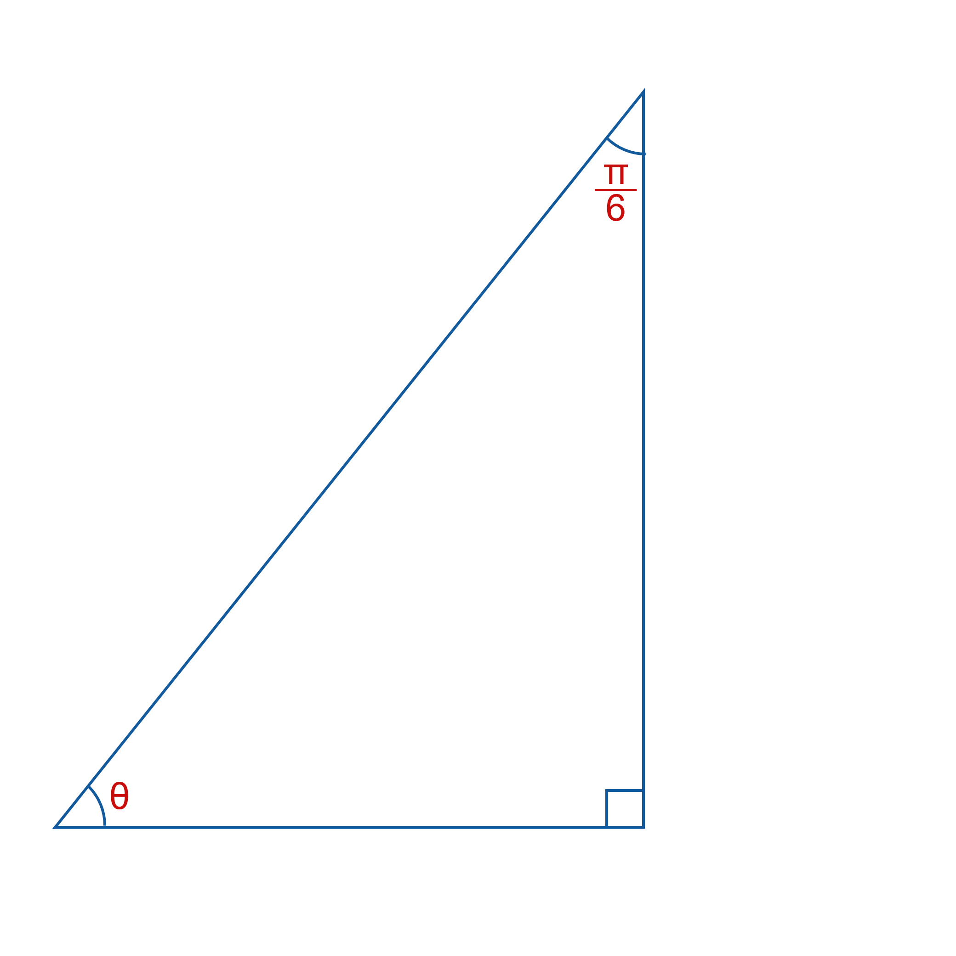

Example 1: Evaluating Trigonometric Functions Using Right Triangles—Slide 1
Use the information contained in these two figures to determine the values of the six trigonometric functions of $θ$.
​ b.

Slide 6
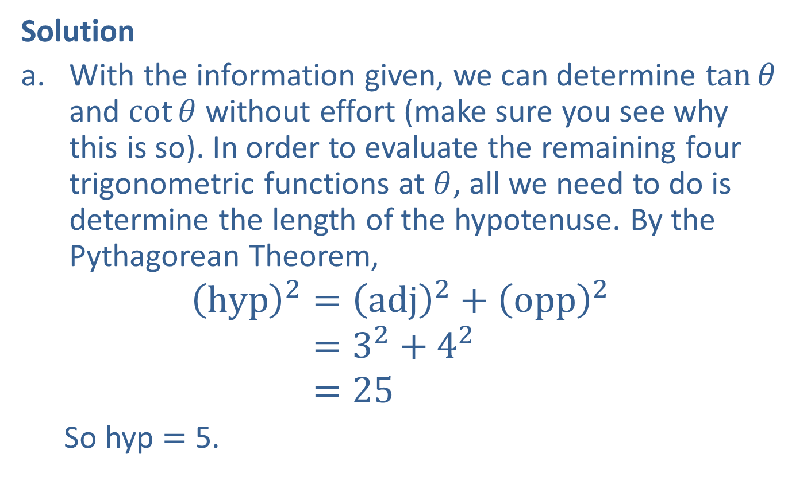
Example 1: Evaluating Trigonometric Functions Using Right Triangles—Slide 2
Solution
​With the information given, we can determine $tan⁡θ$ and $cot⁡θ$ without effort (make sure you see why this is so). In order to evaluate the remaining four trigonometric functions at $θ$, all we need to do is determine the length of the hypotenuse. By the Pythagorean Theorem,
hyp2=adj2+opp2hyp2=32+42hyp2=25
So hyp = 5.

Slide 7

Example 1: Evaluating Trigonometric Functions Using Right Triangles—Slide 3
Thus,
​ $\sin{θ}=\frac{opp}{hyp}=\frac{4}{5}$, $\cos{θ}=\frac{adj}{hyp}=\frac{3}{5}$, $\tan{θ}=\frac{opp}{adj}=\frac{4}{3}$
​and
​ $\csc{θ}=\frac{1}{\sin{θ}}=\frac{5}{4}$, $\sec{θ}=\frac{1}{\cos{θ}}=\frac{5}{3}$, $\cot{θ}=\frac{1}{\tan{θ}}=\frac{3}{4}$.

Slide 8
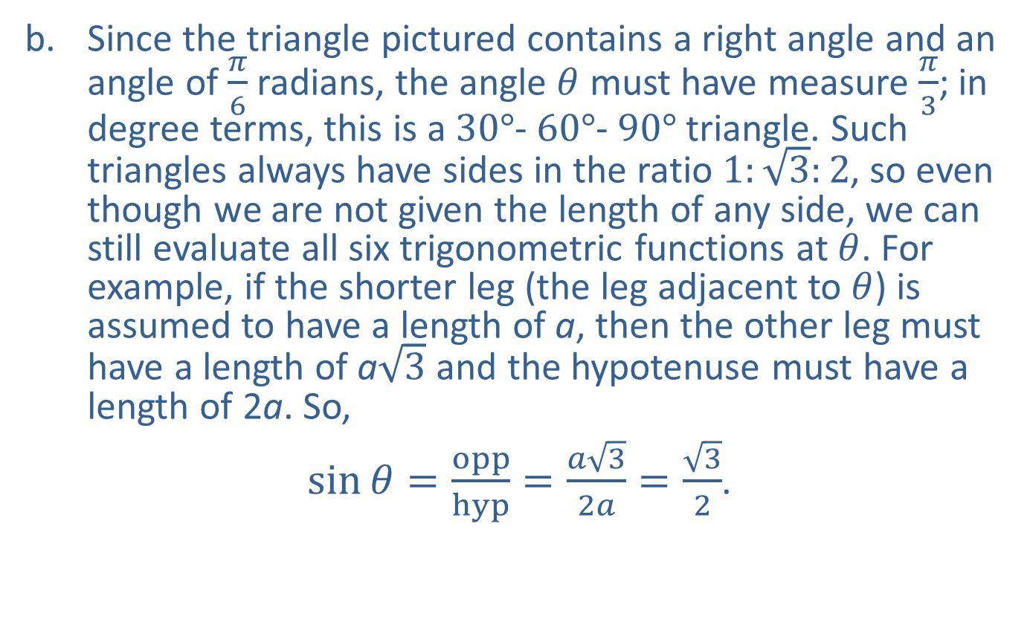
Example 1: Evaluating Trigonometric Functions Using Right Triangles—Slide 4
​Since the triangle pictured contains a right angle and an angle of $\frac{π}{6}$ radians, the angle $θ$ must have measure $\frac{π}{3}$; in degree terms, this is a $30°$‐ $60°$‐ $90°$ triangle. Such triangles always have sides in the ratio $1:\sqrt{3}:2$, so even though we are not given the length of any side, we can still evaluate all six trigonometric functions at $θ$. For example, if the shorter leg (the leg adjacent to $θ$) is assumed to have a length of a, then the other leg must have a length of a$\sqrt{3}$ and the hypotenuse must have a length of 2a. So,
​ $\sin{θ}=\frac{opp}{hyp}=\frac{a\sqrt{3}}{2a}=\frac{\sqrt{3}}{2}$.
​

Slide 9

Example 1: Evaluating Trigonometric Functions Using Right Triangles—Slide 5
​Similarly,
​ $\cos{θ}=\frac{adj}{hyp}=\frac{1}{2}$,
$\tan{θ}=\frac{opp}{adj}=\sqrt{3}$,
​ $\csc{θ}=\frac{1}{\sin{θ}}=\frac{2}{\sqrt{3}}$,
$\sec{θ}=\frac{1}{\cos{θ}}=2$,
$\cot{θ}=\frac{1}{\tan{θ}}=\frac{1}{\sqrt{3}}$.

Slide 10

Example 2: Evaluating Trigonometric Functions Using Right Triangles—Slide 1
Evaluate the tangent and secant of $θ=\frac{π}{4}$.

Slide 11
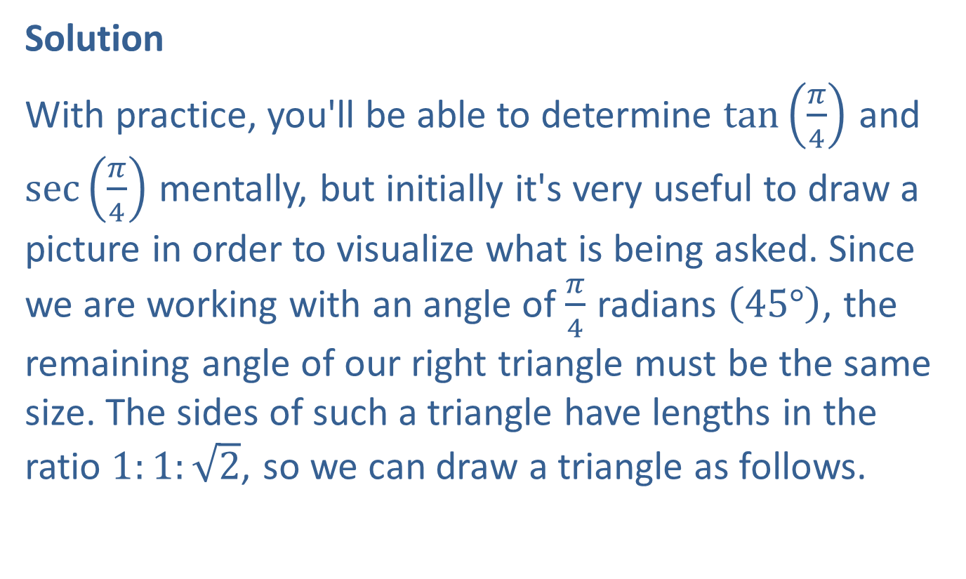
Example 2: Evaluating Trigonometric Functions Using Right Triangles—Slide 2
Solution
With practice, you'll be able to determine $tan⁡\left(\frac{π}{4}\right)$ and $sec⁡\left(\frac{π}{4}\right)$ mentally, but initially it's very useful to draw a picture in order to visualize what is being asked. Since we are working with an angle of $\frac{π}{4}$ radians $\left(45°\right)$, the remaining angle of our right triangle must be the same size. The sides of such a triangle have lengths in the ratio $1:1:\sqrt{2}$, so we can draw a triangle as follows.

Slide 12
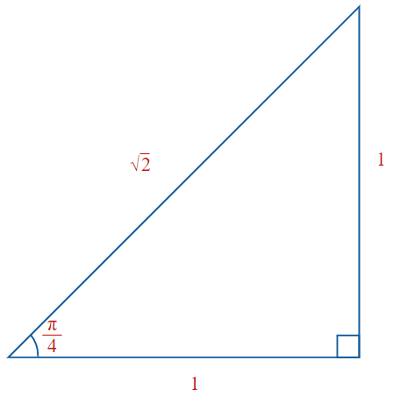
Example 2: Evaluating Trigonometric Functions Using Right Triangles—Slide 3

Slide 13
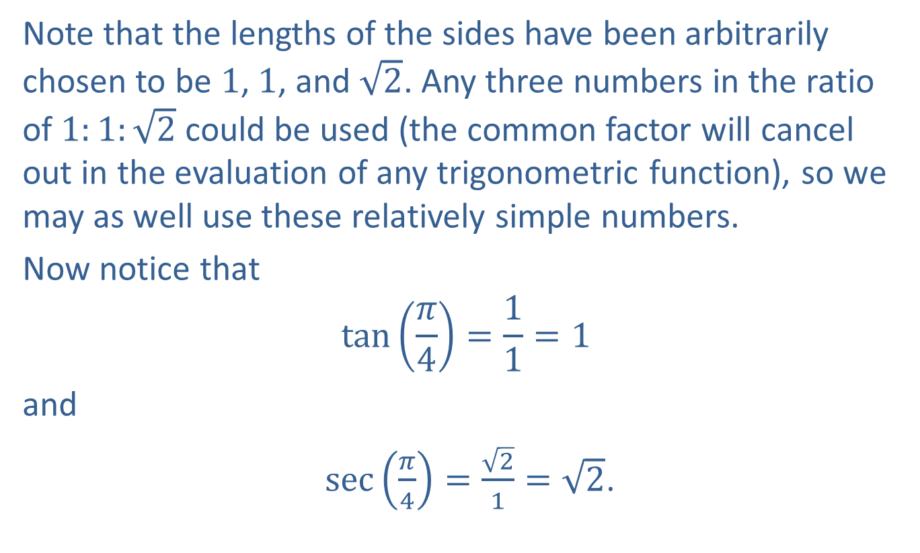
Example 2: Evaluating Trigonometric Functions Using Right Triangles—Slide 4
Note that the lengths of the sides have been arbitrarily chosen to be 1, 1, and $\sqrt{2}$. Any three numbers in the ratio of $1:1:\sqrt{2}$ could be used (the common factor will cancel out in the evaluation of any trigonometric function), so we may as well use these relatively simple numbers.
Now notice that
$$\tan\left(\frac{π}{4}\right)=\frac{1}{1}=1$$
and
$\sec\left(\frac{π}{4}\right)=\frac{\sqrt{2}}{1}=\sqrt{2}$.

Slide 14
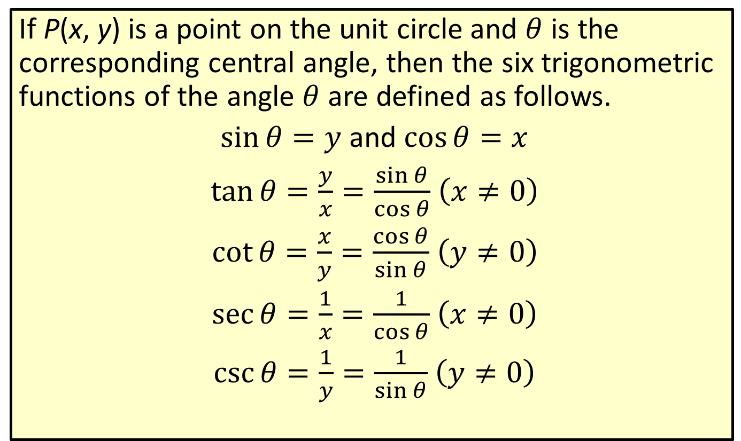
Trigonometric Functions and the Unit Circle
If P(x, y) is a point on the unit circle and $θ$ is the corresponding central angle, then the six trigonometric functions of the angle $θ$ are defined as follows.
$\sin{θ}=y$ and $\cos{θ}=x$
$\tan{θ}=\frac{y}{x}=\frac{\sin{θ}}{\cos{θ}}$ $\left(x≠0\right)$
$\cot{θ}=\frac{x}{y}=\frac{\cos{θ}}{\sin{θ}}$ $\left(y≠0\right)$
$\sec{θ}=\frac{1}{x}=\frac{1}{\cos{θ}}$ $\left(x≠0\right)$
$\csc{θ}=\frac{1}{y}=\frac{1}{\sin{θ}}$ $\left(y≠0\right)$

Slide 15
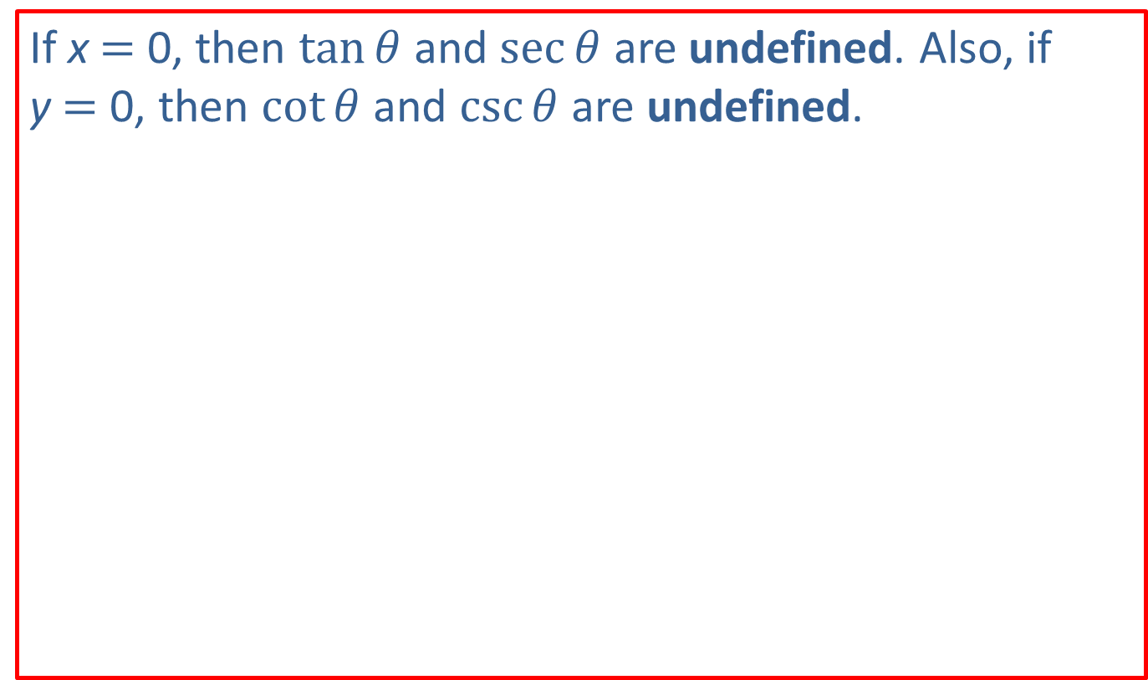
Note 1
If x = 0, then $tan⁡θ$ and $sec⁡θ$ are undefined. Also, if y = 0, then $cot⁡θ$ and $csc⁡θ$ are undefined.

Slide 16

Example 3: Evaluating Trigonometric Functions Using the Unit Circle—Slide 1
Use the given figure and the definitions to find the values of $sin⁡θ$, $cos⁡θ$, and $tan⁡θ$ for angle $θ$.

Slide 17
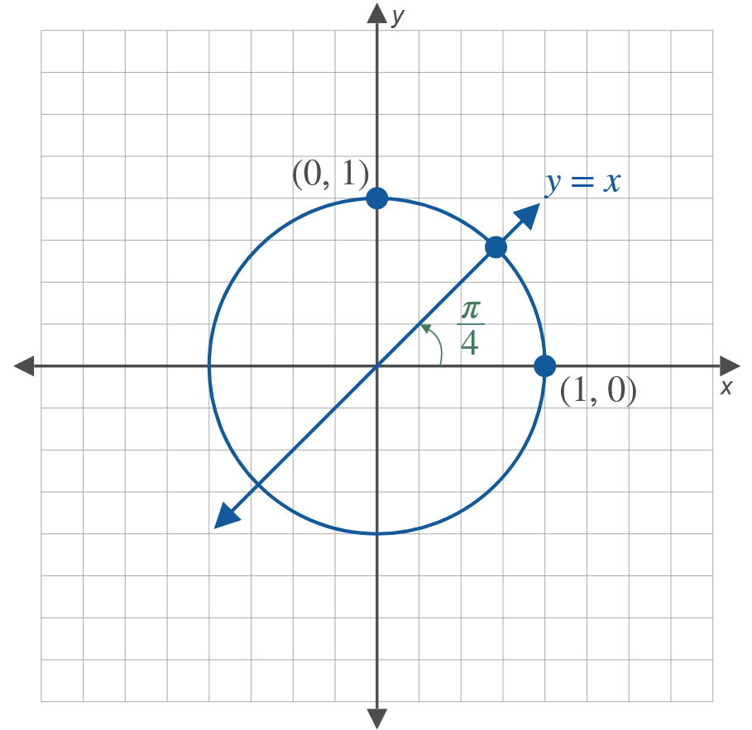
Example 3: Evaluating Trigonometric Functions Using the Unit Circle—Slide 2

Slide 18

Example 3: Evaluating Trigonometric Functions Using the Unit Circle—Slide 3
​$θ=0$
​$θ=\frac{π}{2}$
​$θ=\frac{π}{4}$

Slide 19
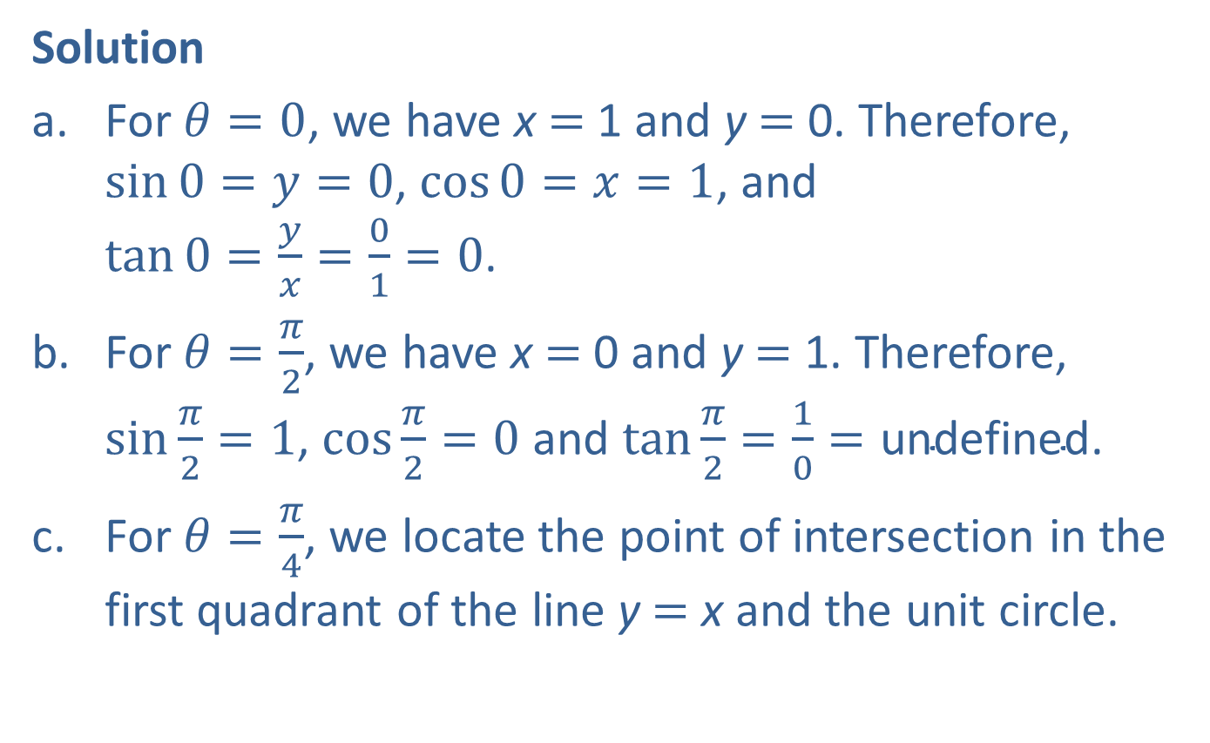
Example 3: Evaluating Trigonometric Functions Using the Unit Circle—Slide 4
Solution
​For $θ=0$, we have x = 1 and y = 0. Therefore, $\sin{0}=y=0$, $\cos{0}=x=1$, and $\tan{0}=\frac{y}{x}=\frac{0}{1}=0$.
​For $θ=\frac{π}{2}$, we have x = 0 and y = 1. Therefore, $sin⁡\frac{π}{2}=1$, $cos⁡\frac{π}{2}=0$ and $tan⁡\frac{π}{2}=\frac{1}{0}=\text{undefined}$.
​For $θ=\frac{π}{4}$, we locate the point of intersection in the first quadrant of the line y = x and the unit circle.
​

Slide 20
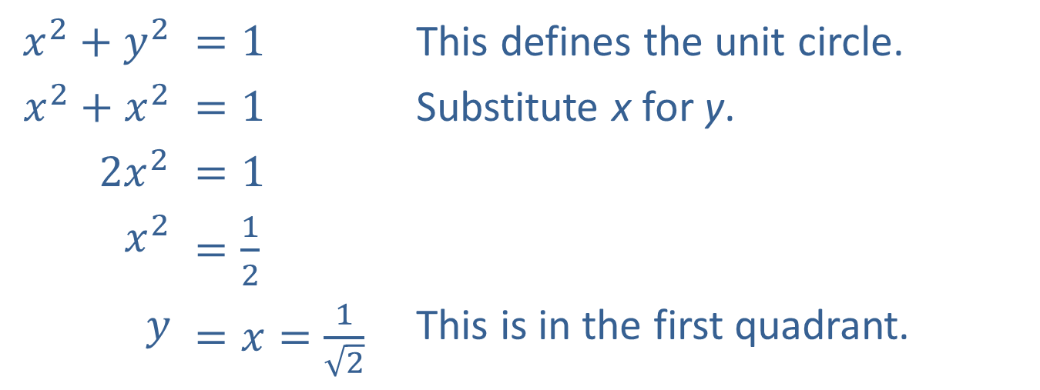
Example 3: Evaluating Trigonometric Functions Using the Unit Circle—Slide 5
​$x^{2}+y^{2}$ | ​$=1$ | This defines the unit circle.
​$x^{2}+x^{2}$ | ​$=1$ | Substitute x for y.
​$2x^{2}$ | ​$=1$
​$x^{2}$ | ​$=\frac{1}{2}$
$$y$$ | ​$=x=\frac{1}{\sqrt{2}}$ | This is in the first quadrant.
Therefore, $\sin{\frac{π}{4}}=\cos{\frac{π}{4}}=\frac{1}{\sqrt{2}}$ and $\tan{\frac{π}{4}}=\frac{y}{x}=1$.

Slide 21
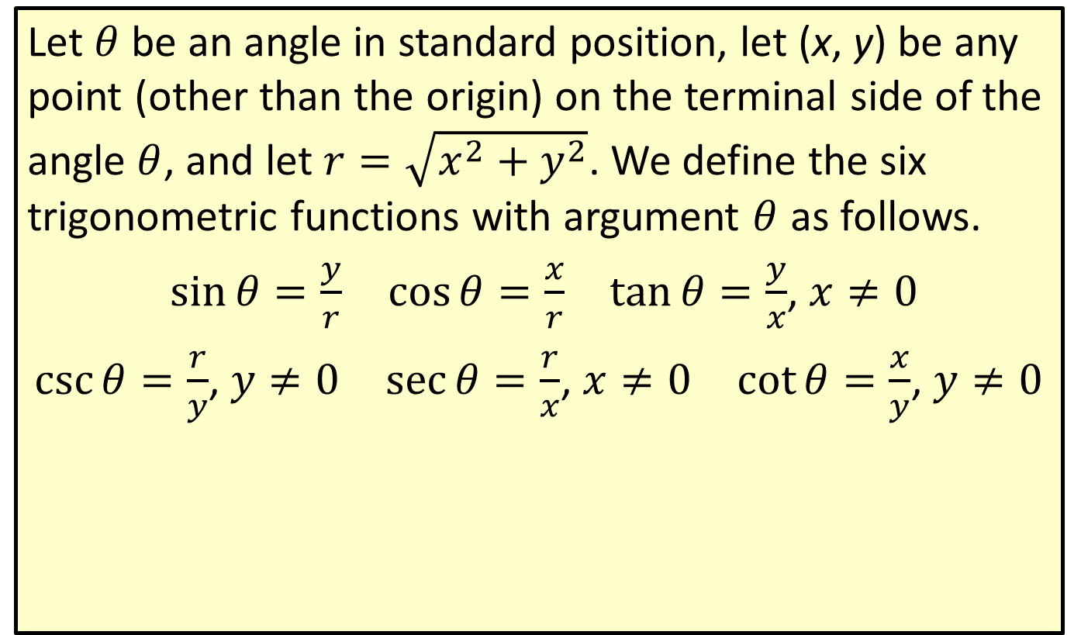
Definition: Trigonometric Functions Defined for an Arbitrary Angle
Let $θ$ be an angle in standard position, let (x, y) be any point (other than the origin) on the terminal side of the angle $θ$, and let $r=\sqrt{x^{2}+y^{2}}$. We define the six trigonometric functions with argument $θ$ as follows.
$\sin{θ}=\frac{y}{r}$ $\cos{θ}=\frac{x}{r}$ $\tan{θ}=\frac{y}{x}$, $x≠0$
$\csc{θ}=\frac{r}{y}$, $y≠0$ $\sec{θ}=\frac{r}{x}$, $x≠0$ $\cot{θ}=\frac{x}{y}$, $y≠0$

Slide 22
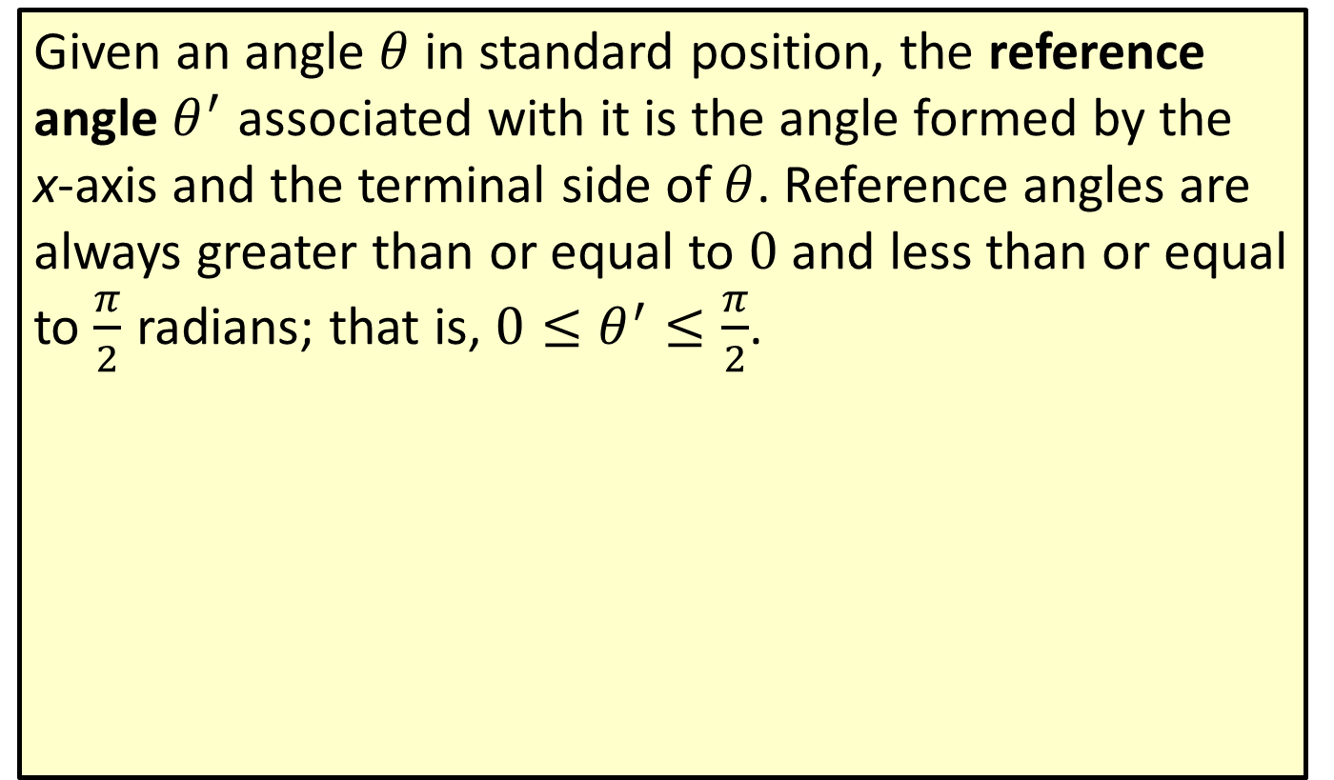
Definition: Reference Angle
Given an angle $θ$ in standard position, the reference angle $θ^{′}$ associated with it is the angle formed by the x-axis and the terminal side of $θ$. Reference angles are always greater than or equal to 0 and less than or equal to $\frac{π}{2}$ radians; that is, $0≤θ^{′}≤\frac{π}{2}$.

Slide 23

Example 4: Evaluating Trigonometric Functions Using Reference Angles—Slide 1
Evaluate the following expressions.
​$cos⁡\left(\frac{4π}{3}\right)$
​$tan⁡\left(−{225}^{°}\right)$

Slide 24
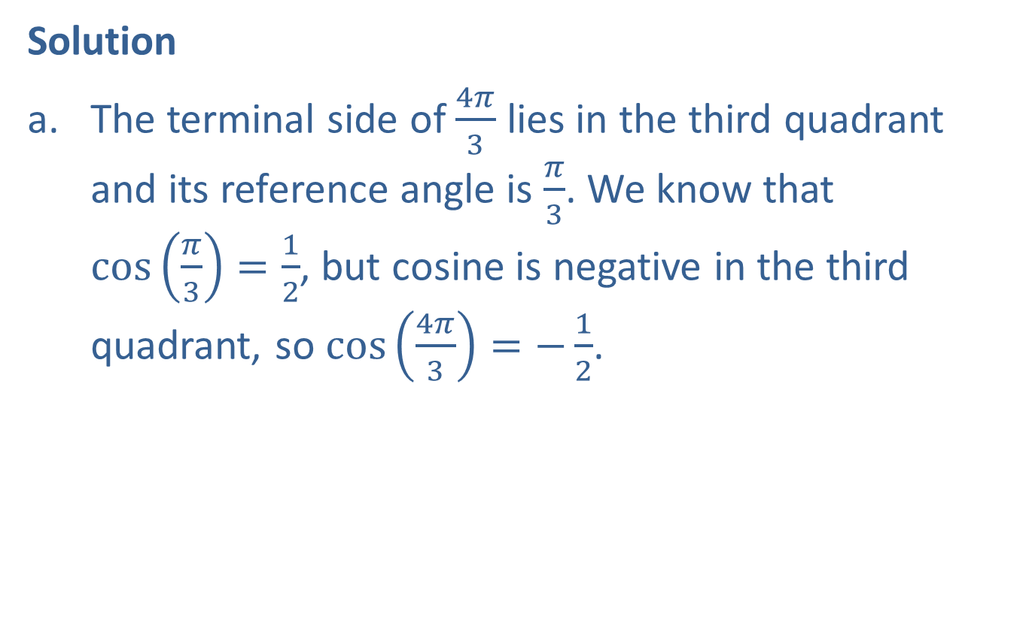
Example 4: Evaluating Trigonometric Functions Using Reference Angles—Slide 2
Solution
​The terminal side of $\frac{4π}{3}$ lies in the third quadrant and its reference angle is $\frac{π}{3}$. We know that $\cos\left(\frac{π}{3}\right)=\frac{1}{2}$, but cosine is negative in the third quadrant, so $\cos\left(\frac{4π}{3}\right)=−\frac{1}{2}$.

Slide 25
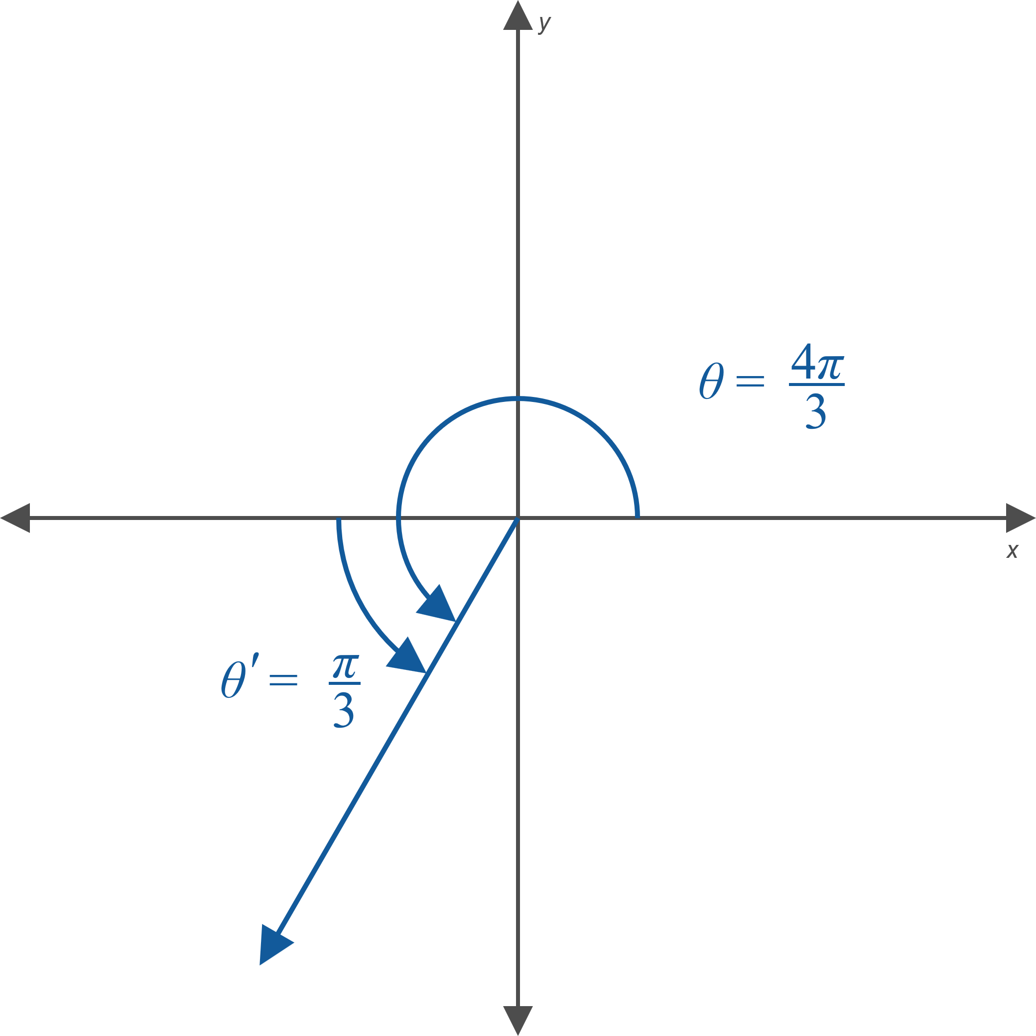
Example 4: Evaluating Trigonometric Functions Using Reference Angles—Slide 3

Slide 26

Example 4: Evaluating Trigonometric Functions Using Reference Angles—Slide 4
​The terminal side of −225° lies in the second quadrant and its reference angle is 45°. Since tangent is negative in the second quadrant, $\tan\left(−{225}^{°}\right)=−\tan{{45}^{°}}=−1$.​

Slide 27
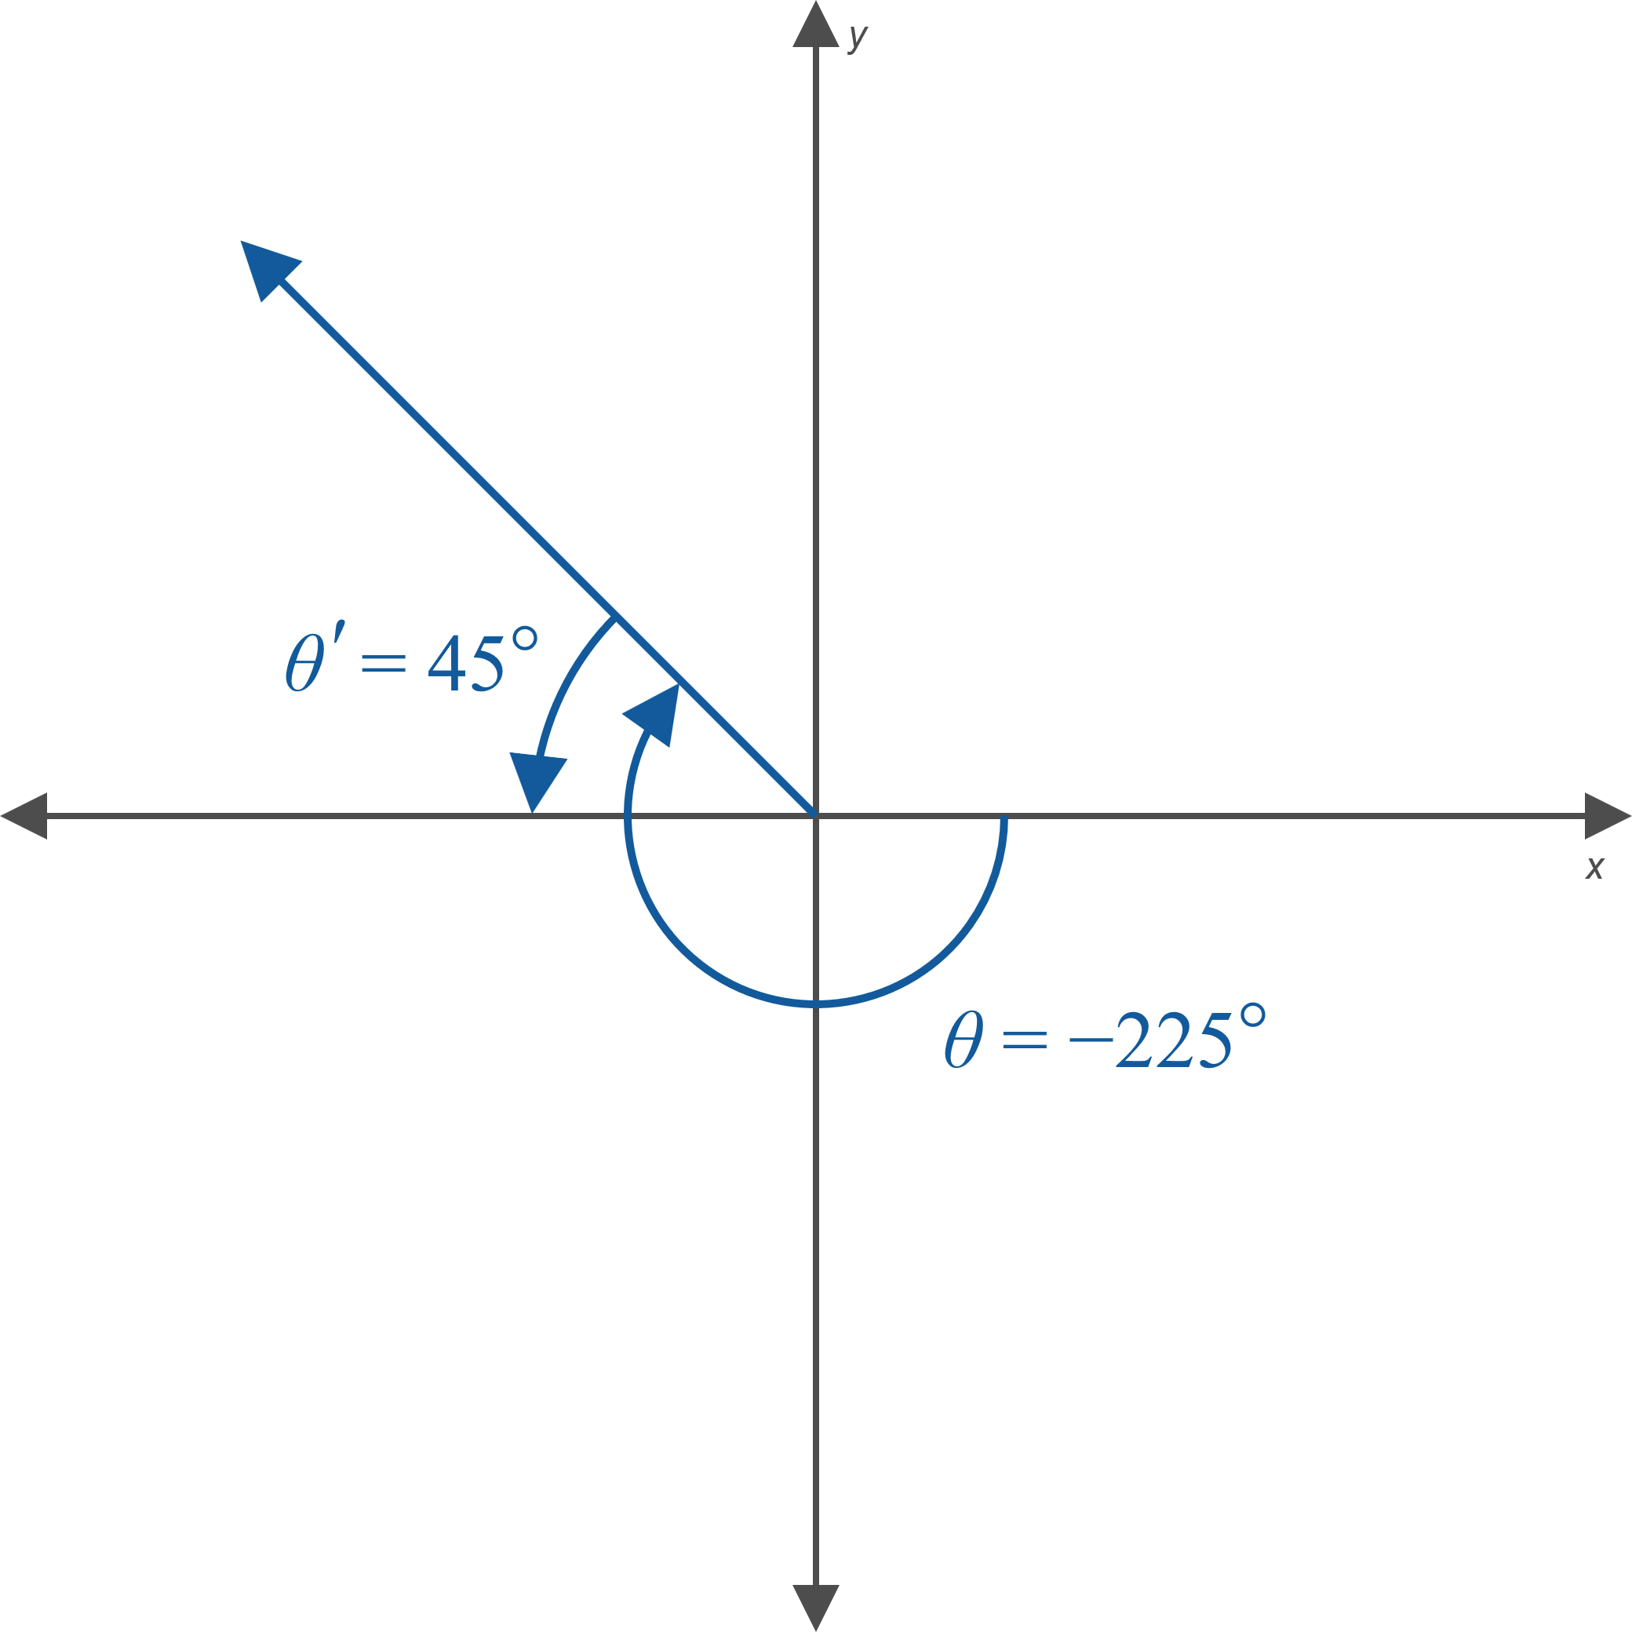
Example 4: Evaluating Trigonometric Functions Using Reference Angles—Slide 5

Slide 28
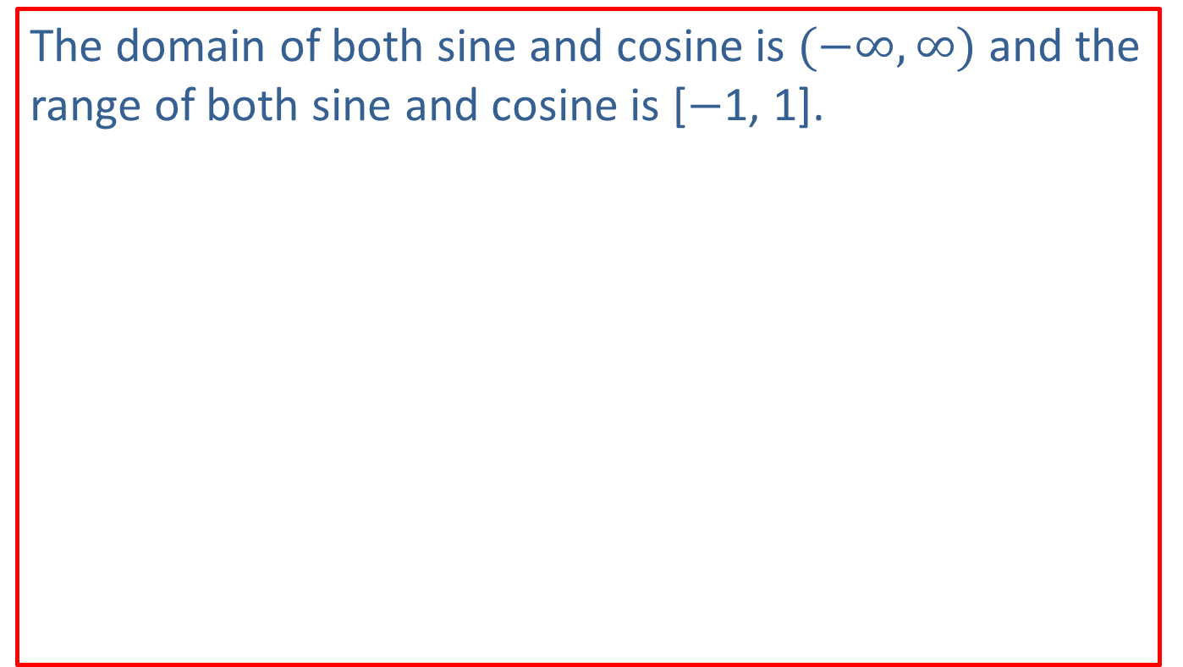
Note 2
The domain of both sine and cosine is $(−∞,∞)$ and the range of both sine and cosine is [−1, 1].

Slide 29
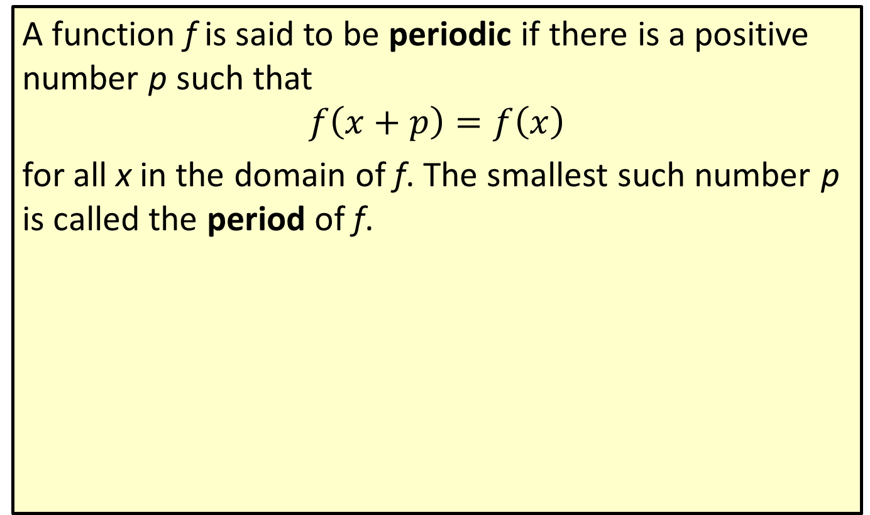
Definition: Period of a Function
A function f is said to be periodic if there is a positive number p such that
$$f\left(x+p\right)=f\left(x\right)$$
for all x in the domain of f. The smallest such number p is called the period of f.

Slide 30
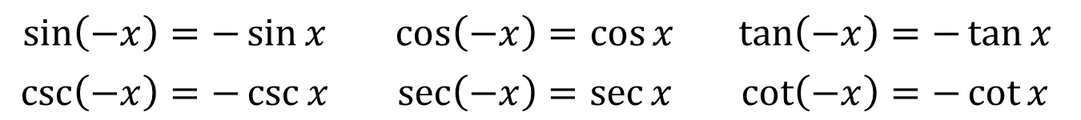
Even/Odd Identities
$$\sin\left(−x\right)=−\sin{x}$$ | $$\cos\left(−x\right)=\cos{x}$$ | $$\tan\left(−x\right)=−\tan{x}$$
$$\csc\left(−x\right)=−\csc{x}$$ | $$\sec\left(−x\right)=\sec{x}$$ | $$\cot\left(−x\right)=−\cot{x}$$

Slide 31
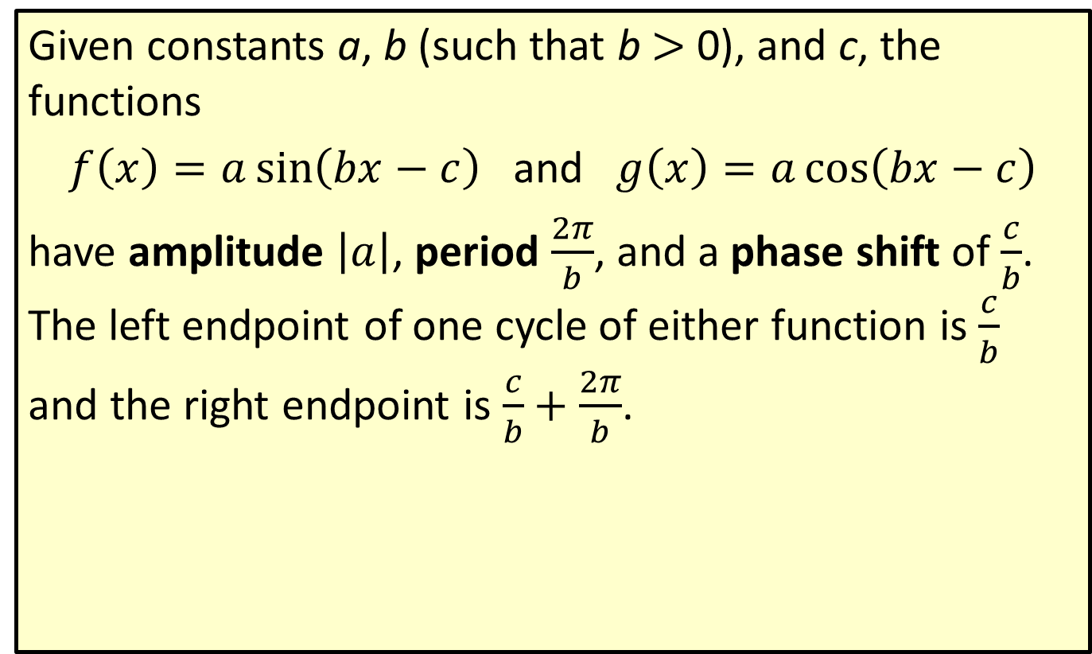
Definition: Amplitude, Period, and Phase Shift—Slide 1
Given constants a, b (such that b > 0), and c, the functions
$f\left(x\right)=a\sin\left(bx−c\right)$ and $g\left(x\right)=a\cos\left(bx−c\right)$
have amplitude $\left|a\right|$, period $\frac{2π}{b}$, and a phase shift of $\frac{c}{b}$. The left endpoint of one cycle of either function is $\frac{c}{b}$ and the right endpoint is $\frac{c}{b}+\frac{2π}{b}$.

Slide 32
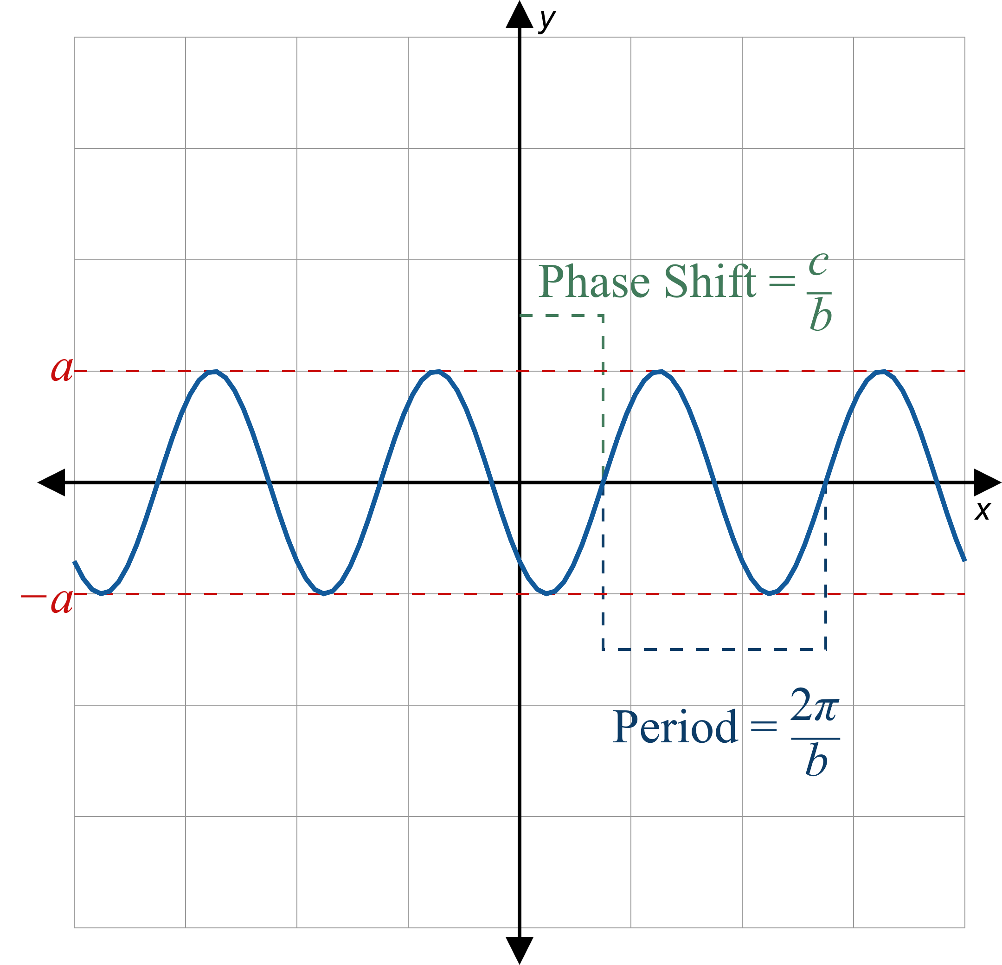
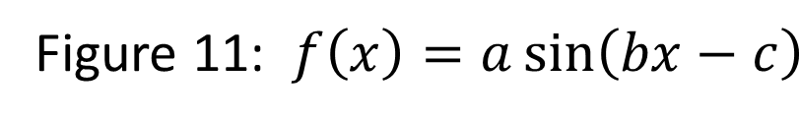
Definition: Amplitude, Period, and Phase Shift—Slide 2

Slide 33
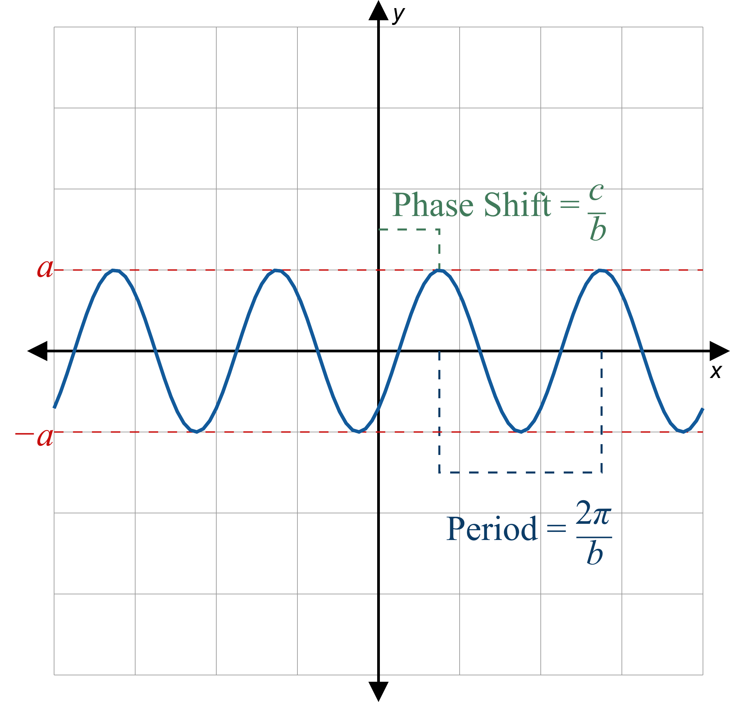
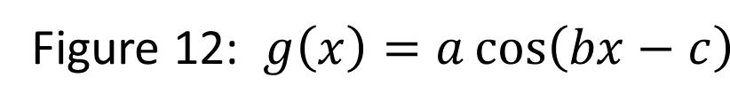
Definition: Amplitude, Period, and Phase Shift—Slide 3

Slide 34

Example 5: Graphing Transformations Trigonometric Functions—Slide 1
Sketch the graph of $f\left(x\right)=−2\cos\left(πx−π\right)$.

Slide 35
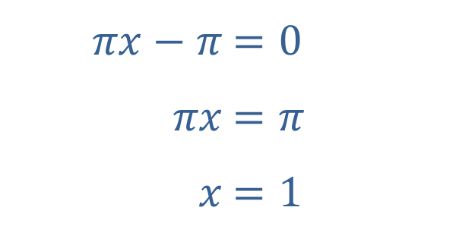

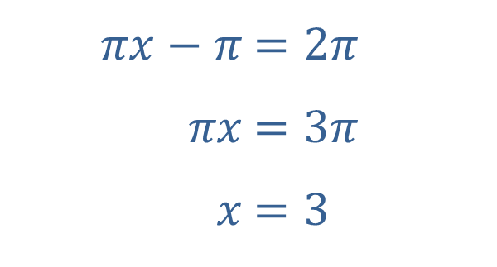
Example 5: Graphing Transformations Trigonometric Functions—Slide 2
Solution
The graph of the basic cosine function completes one cycle over an interval of length 2π, so we can determine the left and right endpoints of one cycle of f by solving $πx−π=0$ and $πx−π=2π$.
​
​$πx−π$ | ​$=0$
​$πx$ | ​$=π$
​$x$ | ​$=1$
​$πx−π$ | ​$=2π$
​$πx$ | ​$=3π$
​$x$ | ​$=3$

Slide 36
Example 5: Graphing Transformations Trigonometric Functions—Slide 3
This tells us that f has a period of 2 and the cycle of cosine that occurs over the interval [0, 2π] instead occurs for f over the interval [1, 3]. However, the −2 factor of f tells us that the amplitude of f is 2 and the graph of the cycle is reflected with respect to the x-axis. Putting this all together we get the following graph, which shows two complete cycles of f.

Slide 37
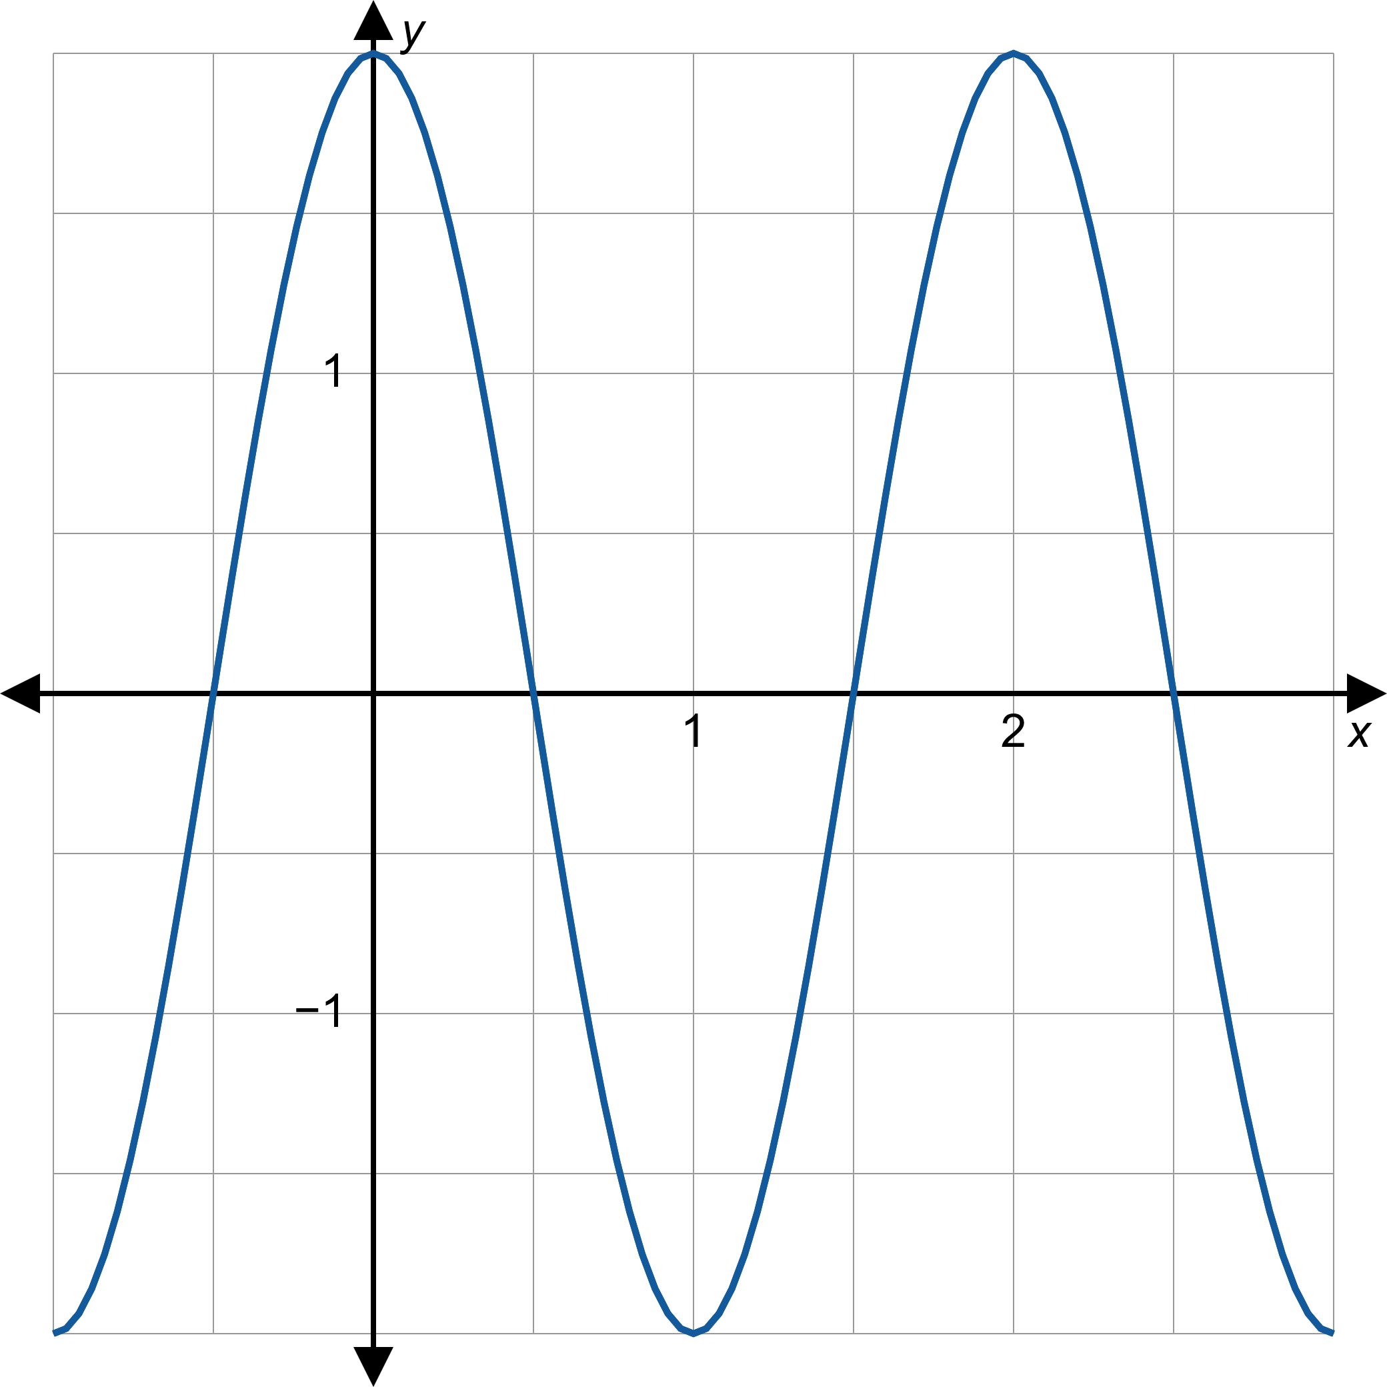
Example 5: Graphing Transformations Trigonometric Functions—Slide 4

Slide 38

Example 6: Graphing Transformations Trigonometric Functions—Slide 1
Sketch the graph of $g\left(x\right)=1+\sin\left(x−\frac{π}{4}\right)$.

Slide 39
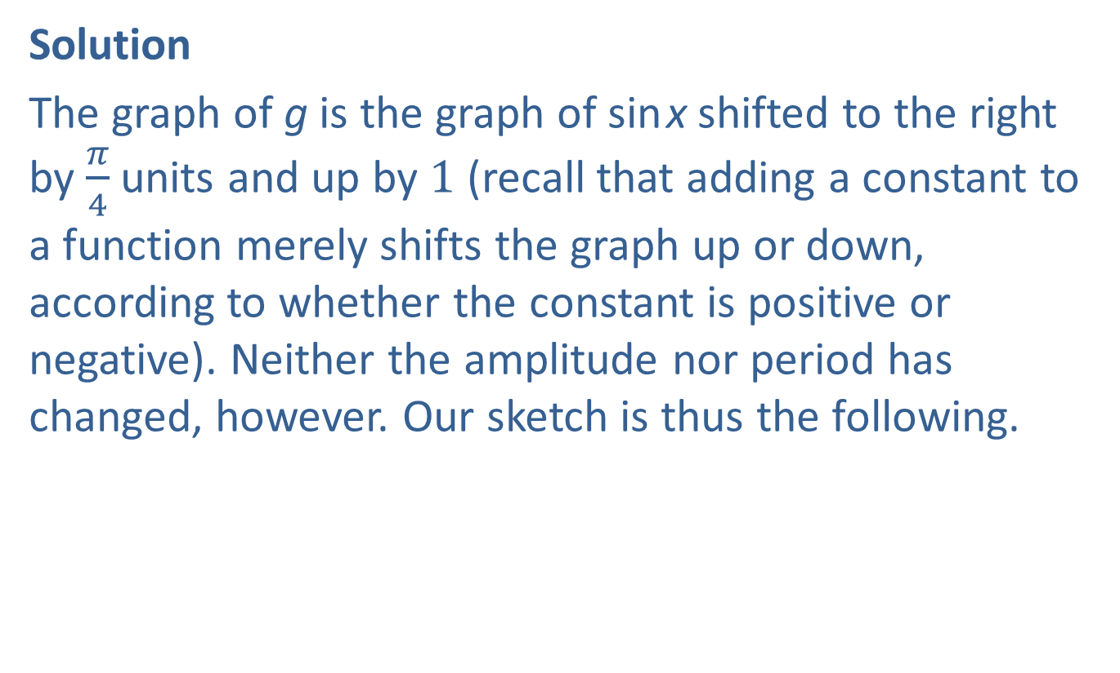
Example 6: Graphing Transformations Trigonometric Functions—Slide 2
Solution
The graph of g is the graph of sin x shifted to the right by $\frac{π}{4}$ units and up by 1 (recall that adding a constant to a function merely shifts the graph up or down, according to whether the constant is positive or negative). Neither the amplitude nor period has changed, however. Our sketch is thus the following.

Slide 40
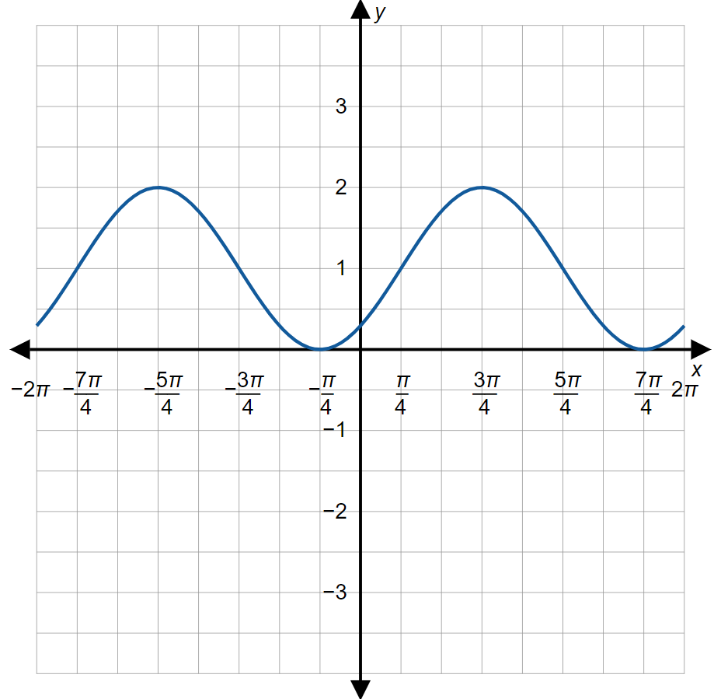
Example 6: Graphing Transformations Trigonometric Functions—Slide 3

Slide 41
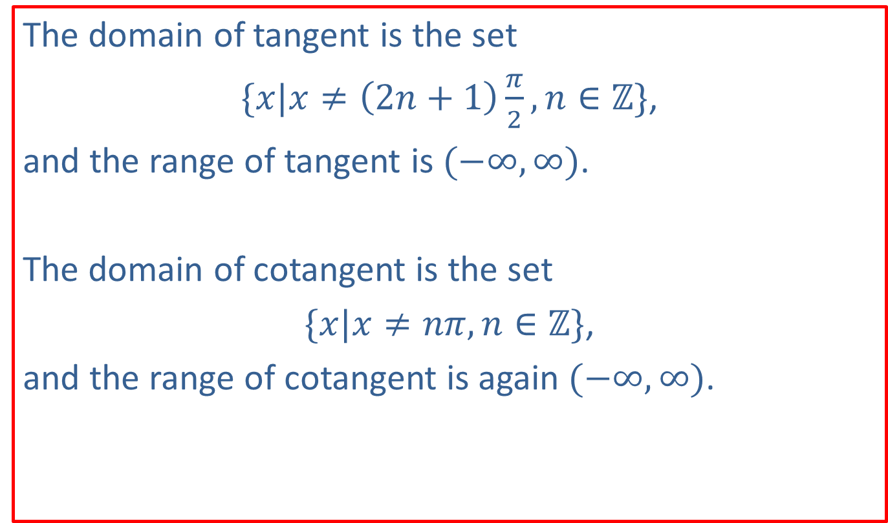
Note 3
The domain of tangent is the set
$\{x|x≠\left(2n+1\right)\frac{π}{2},n∈ℤ\}$,
and the range of tangent is $(−∞,∞)$.
The domain of cotangent is the set
$\{x|x≠nπ,n∈ℤ\}$,
and the range of cotangent is again $(−∞,∞)$.

Slide 42

Example 7: Graphing Transformations of Trigonometric Functions—Slide 1
Sketch the graph of $f\left(x\right)=1+3 tan⁡x$.

Slide 43
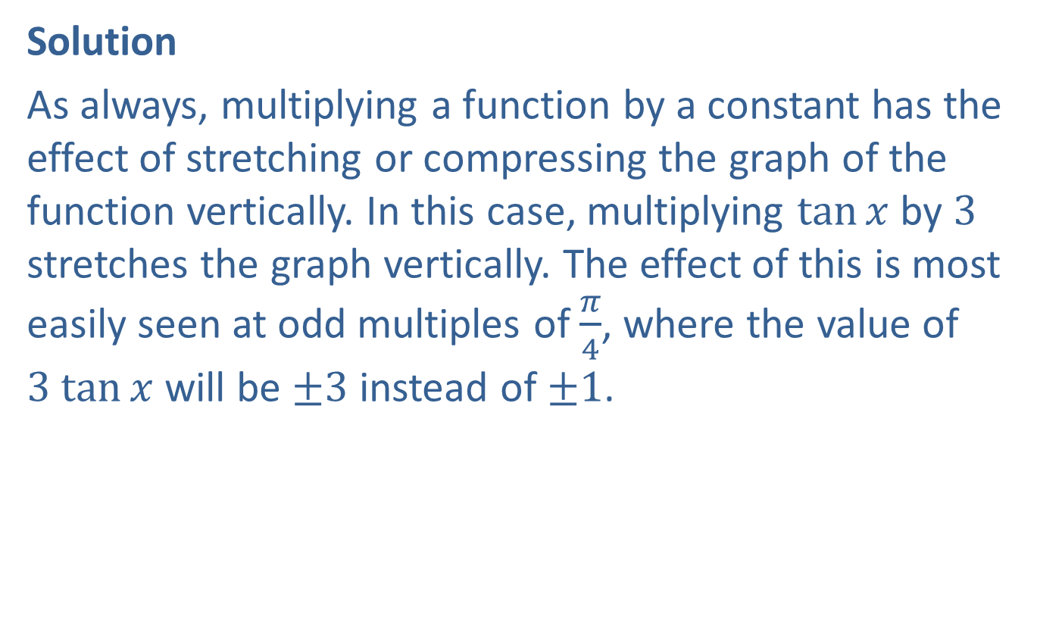
Example 7: Graphing Transformations of Trigonometric Functions—Slide 2
Solution
As always, multiplying a function by a constant has the effect of stretching or compressing the graph of the function vertically. In this case, multiplying $tan⁡x$ by 3 stretches the graph vertically. The effect of this is most easily seen at odd multiples of $\frac{π}{4}$, where the value of $3 tan⁡x$ will be ±3 instead of ±1.

Slide 44
Example 7: Graphing Transformations of Trigonometric Functions—Slide 3
The effect of adding a constant, in this case 1, to a function simply shifts the entire graph upward by 1 unit. Incorporating these two transformations into the graph of the basic tangent function, we are led to the following graph.

Slide 45
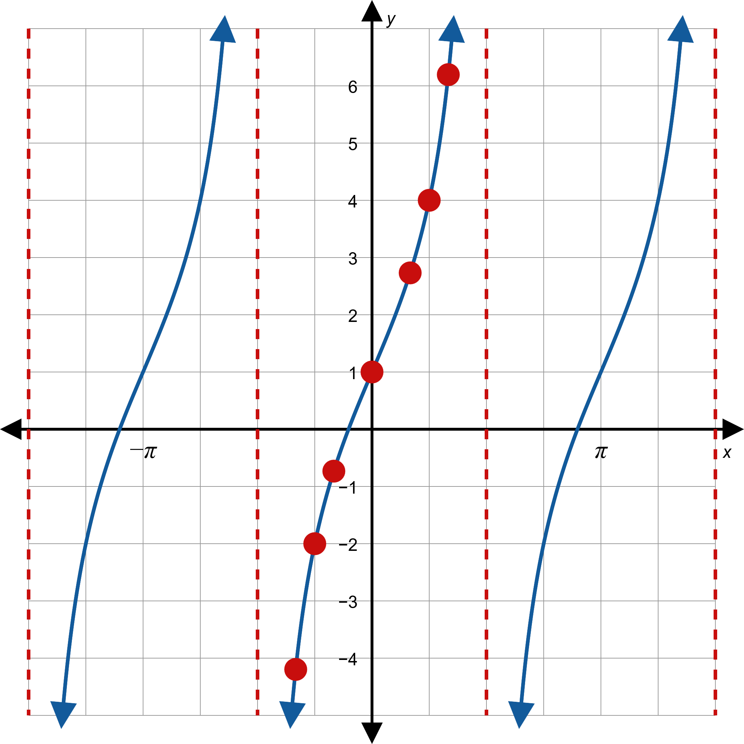

Example 7: Graphing Transformations of Trigonometric Functions—Slide 4
$$f\left(x\right)=1+3\tan{x}$$

Slide 46

Example 8: Graphing Transformations of Trigonometric Functions—Slide 1
Sketch the graph of $f\left(x\right)=\tan\left(\frac{πx}{4}−\frac{π}{2}\right)$.

Slide 47
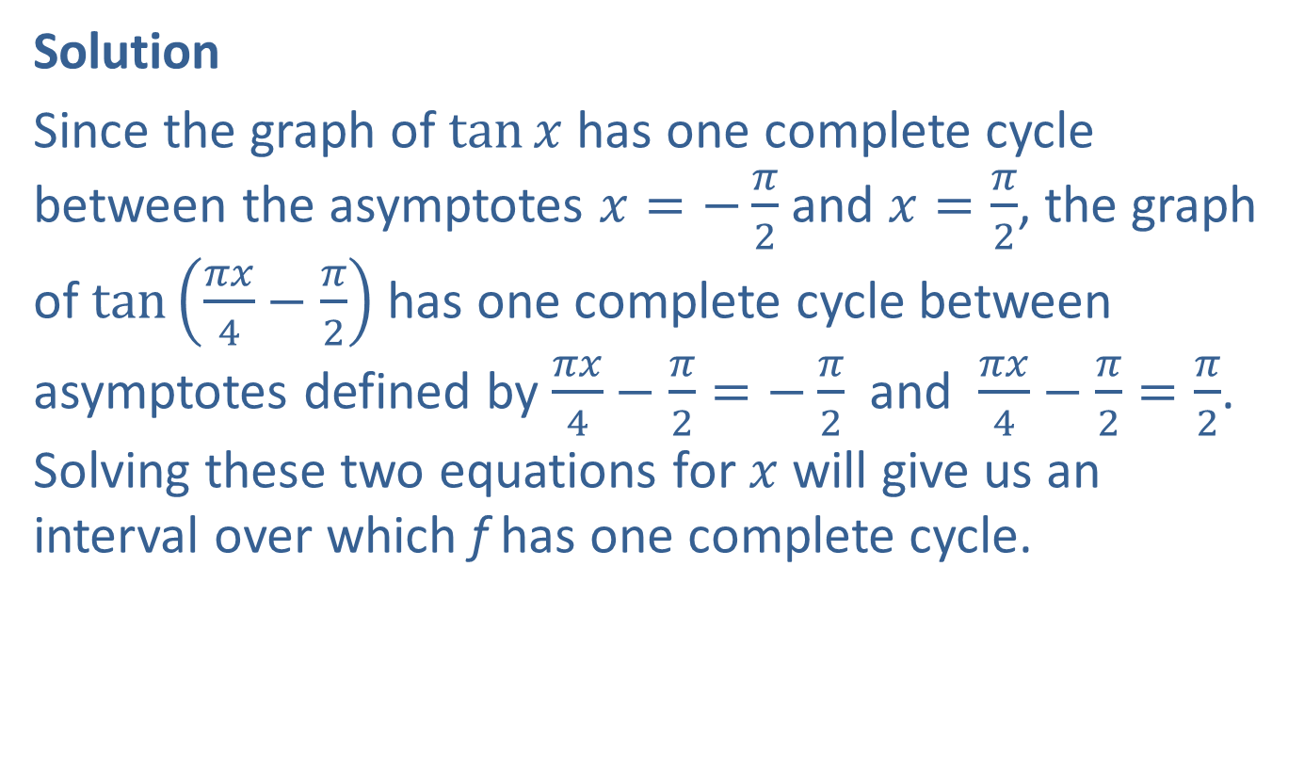
Example 8: Graphing Transformations of Trigonometric Functions—Slide 2
Solution
Since the graph of $tan⁡x$ has one complete cycle between the asymptotes $x=−\frac{π}{2}$ and $x=\frac{π}{2}$, the graph of $tan⁡\left(\frac{πx}{4}−\frac{π}{2}\right)$ has one complete cycle between asymptotes defined by $\frac{πx}{4}−\frac{π}{2}=−\frac{π}{2}$ and $\frac{πx}{4}−\frac{π}{2}=\frac{π}{2}$. Solving these two equations for $x$ will give us an interval over which f has one complete cycle.
​

Slide 48


Example 8: Graphing Transformations of Trigonometric Functions—Slide 3
​
​$\frac{πx}{4}−\frac{π}{2}$ | ​$=−\frac{π}{2}$
​$\frac{πx}{4}$ | ​$=0$
​$x$ | ​$=0$
​$\frac{πx}{4}−\frac{π}{2}$ | ​$=\frac{π}{2}$
​$\frac{πx}{4}$ | ​$=π$
​$x$ | ​$=4$

Slide 49
Example 8: Graphing Transformations of Trigonometric Functions—Slide 4
This tells us that f has a period of 4 and vertical asymptotes at multiples of 4, with the graph of tangent being stretched out a bit horizontally accordingly. The graph is shown below, with values of f at x = 1, x = 2, and x = 3 highlighted.

Slide 50


Example 8: Graphing Transformations of Trigonometric Functions—Slide 5
$$f\left(x\right)=tan\left(\frac{πx}{4}−\frac{π}{2}\right)$$

