Slide 1
Section 3.R.4
Exponential and Logarithmic Equations

Slide 2
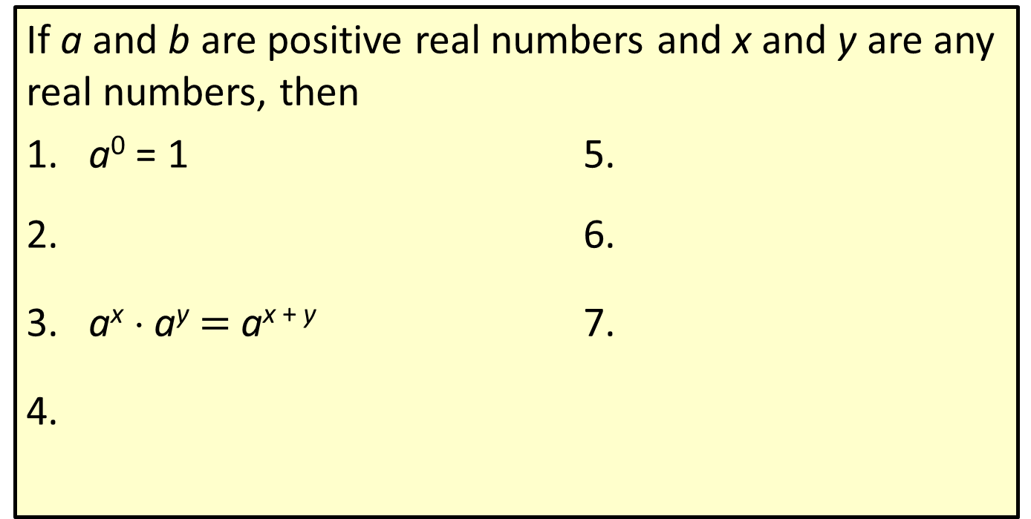
Properties: Properties of Real Exponents
If a and b are positive real numbers and x and y are any real numbers, then
1. a⁰ = 1 5.
2. 6.
3. a^{x} ⋅ a^{y} $=$ a^{x + y} 7.
4.

Slide 3
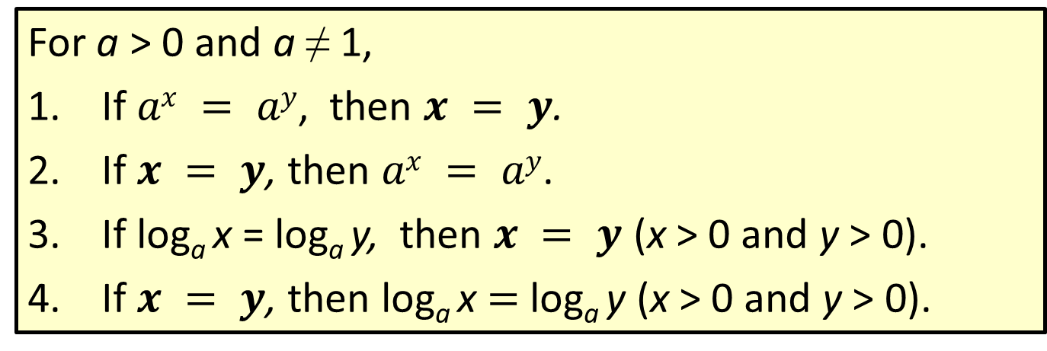
Properties: Properties of Equations with Exponents and Logarithms
For a > 0 and a ≠ 1,
If $ax = ay$, then $x = y$.
If $x = y$, then $ax = ay$.
If log_{a} x = log_{a} y, then $x = y$ (x > 0 and y > 0).
If $x = y$, then log_{a} x $=$ log_{a} y (x > 0 and y > 0).

Slide 4
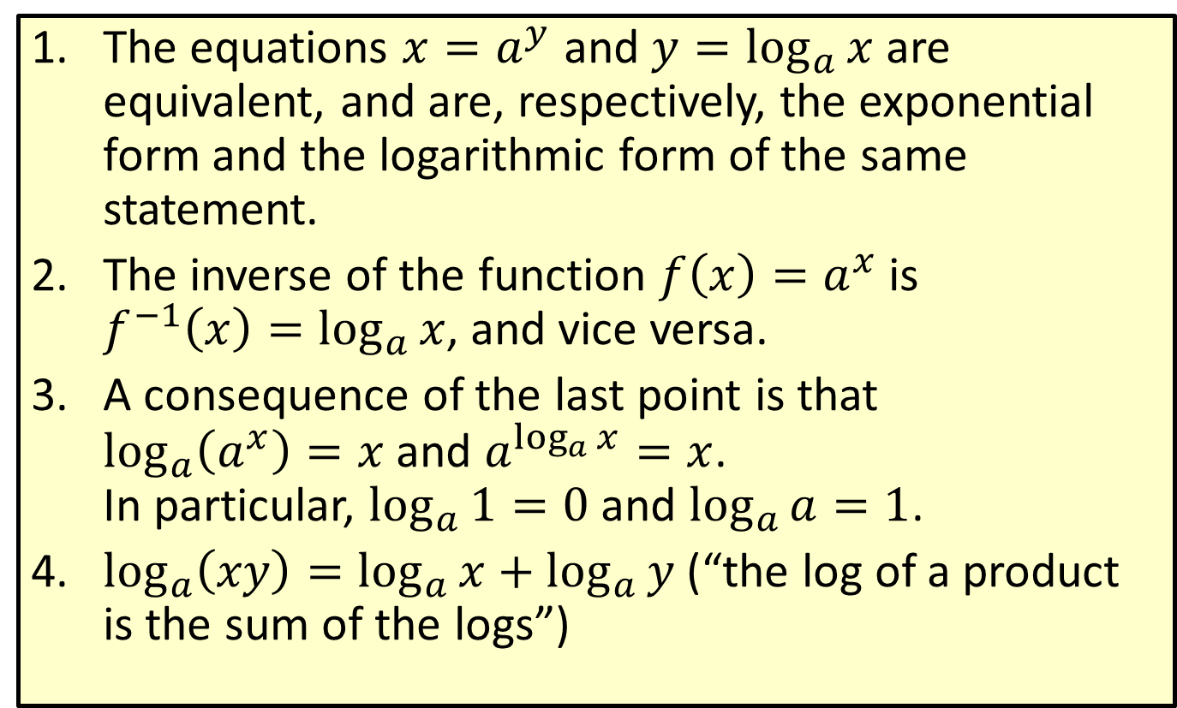
Properties: Summary of Logarithmic Properties—Slide 1
​The equations $x=a^{y}$ and $y=\log_{a}{x}$ are equivalent, and are, respectively, the exponential form and the logarithmic form of the same statement.
​The inverse of the function $f\left(x\right)=a^{x}$ is $f^{−1}\left(x\right)=\log_{a}{x}$, and vice versa.
​A consequence of the last point is that $\log_{a}\left(a^{x}\right)=x$ and $a^{\log_{a}{x}}=x$. In particular, $\log_{a}{1}=0$ and $\log_{a}{a}=1$.
​$\log_{a}\left(xy\right)=\log_{a}{x}+\log_{a}{y}$ (“the log of a product is the sum of the logs”)

Slide 5
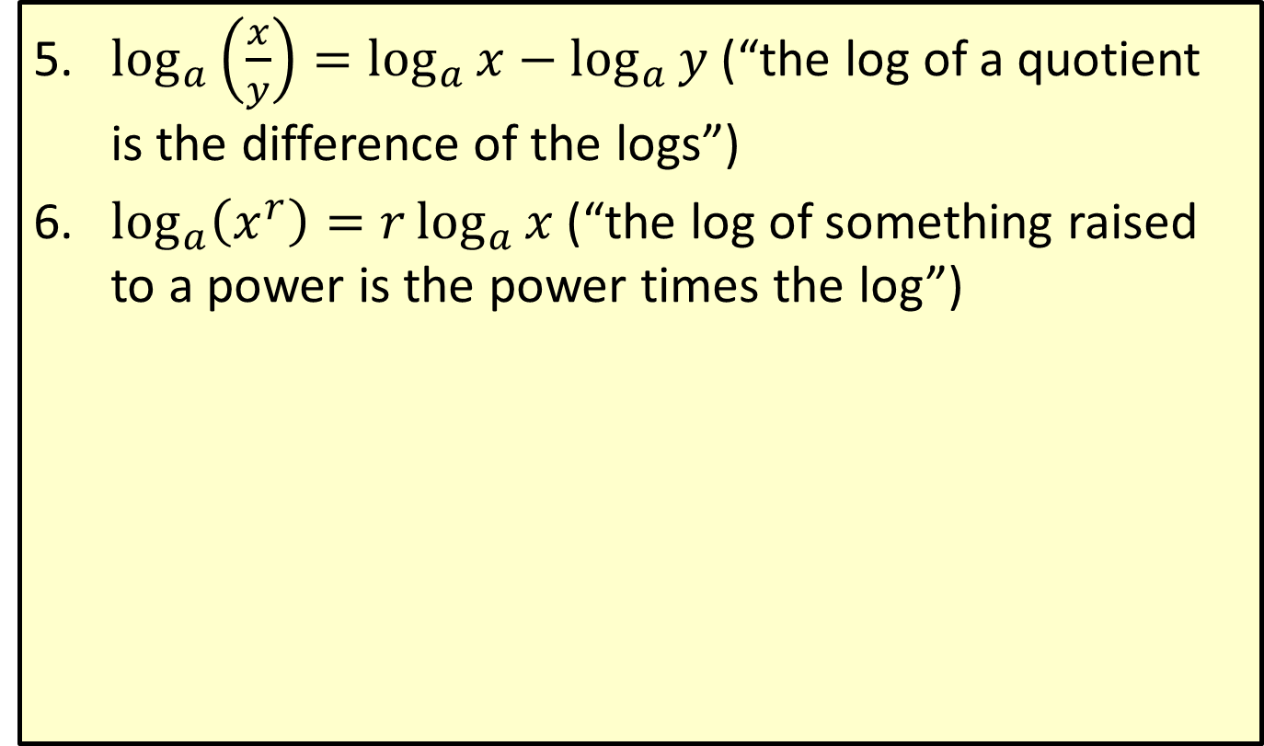
Properties: Summary of Logarithmic Properties—Slide 2
​$\log_{a}\left(\frac{x}{y}\right)=\log_{a}{x}−\log_{a}{y}$ (“the log of a quotient is the difference of the logs”)
​$\log_{a}\left(x^{r}\right)=r\log_{a}{x}$ (“the log of something raised to a power is the power times the log”)

Slide 6
Example 1: Solving Exponential Equations with the Same Base—Slide 1
Solve each equation for x.
a. b.
Solution
Both bases are 2.
The exponents are equal because the bases are the same.
Solve for x.

Slide 7
Example 1: Solving Exponential Equations with the Same Base—Slide 2
Here the bases are different.
Rewrite both sides so that the bases are the same.
Use the property
The exponents are equal because the bases are the same.
Solve for x.

Slide 8
Example 2: Solving Exponential Equations with Different Bases—Slide 1
Solve each of the following exponential equations by taking the log (or ln) of both sides or using the definition of logarithm as an exponent.
a. 10^{3x} = 2.1 b. 6^{x} = 18 c. 5^{2x − 1} = 10^{x}
Solution
First, take the log of both sides. Then use the definition of logarithm as an exponent.
Take the log of both sides.

Slide 9
Example 2: Solving Exponential Equations with Different Bases—Slide 2
Use a calculator to find a decimal approximation:
Power rule
By the definition of a common logarithm

Slide 10
Example 2: Solving Exponential Equations with Different Bases—Slide 3
The base is 6, not 10 or e, but we can solve by taking the log of both sides or by taking the ln of both sides. The result is the same.
Taking the log of both sides: Taking the ln of both sides:

Slide 11
Example 2: Solving Exponential Equations with Different Bases—Slide 4
Using a calculator: Using a calculator:
Take the log of both sides.
Power rule

Slide 12
Example 2: Solving Exponential Equations with Different Bases—Slide 5
As a decimal approximation,
Distributive property; log 10 = 1
Arrange x-terms on one side.
Factor out the x.
Using rounded values

Slide 13

Example 3: Solving Exponential Equations with Different Bases—Slide 1
Solve the equation $3^{2−5x}=11$. Express the answer exactly and as a decimal approximation.

Slide 14
Example 3: Solving Exponential Equations with Different Bases—Slide 2
Solution
There are two ways to convert the equation into logarithmic form. We will explore both, and find that they lead to the same answer.

Slide 15
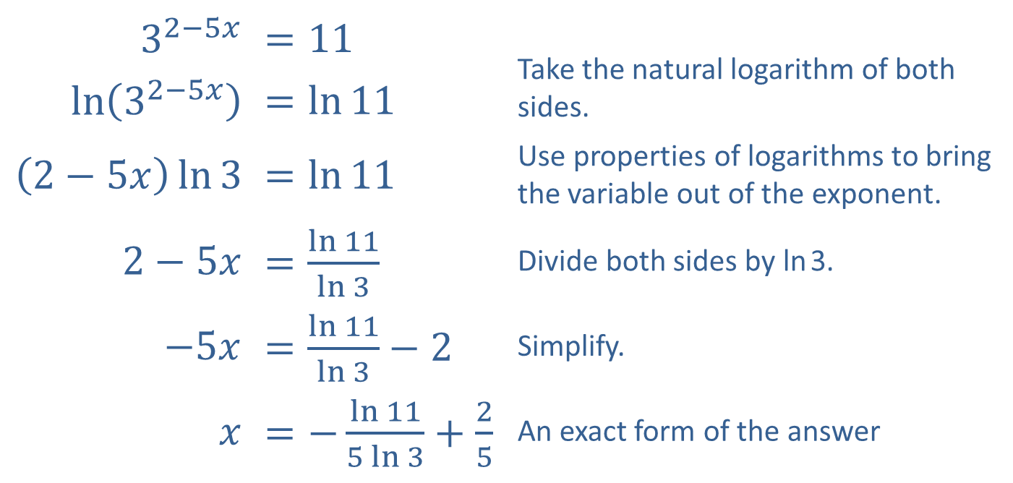
Example 3: Solving Exponential Equations with Different Bases—Slide 3
The first method is to take the natural (or common) logarithm of both sides.
​$3^{2−5x}$ | ​$=11$ | Take the natural logarithm of both sides.
​$ln⁡\left(3^{2−5x}\right)$ | ​$=\ln{11}$
​$\left(2−5x\right)\ln{3}$ | ​$=\ln{11}$ | Use properties of logarithms to bring the variable out of the exponent.
​$2−5x$ | ​$=\frac{\ln{11}}{\ln{3}}$ | Divide both sides by ln 3.
​$−5x$ | ​$=\frac{\ln{11}}{\ln{3}}−2$ | Simplify.
$x$ | ​$=−\frac{\ln{11}}{5\ln{3}}+\frac{2}{5}$ | An exact form of the answer

Slide 16
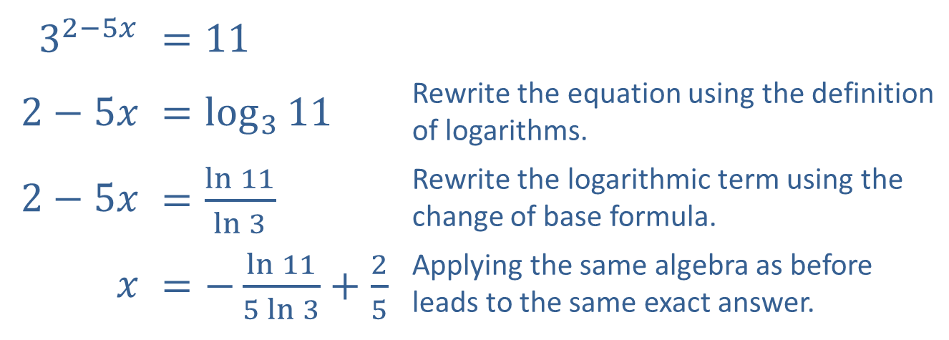
Example 3: Solving Exponential Equations with Different Bases—Slide 4
The second method is to rewrite the equation using the definition of logarithms, then apply the change of base formula to work with natural (or common) logarithms.
​$3^{2−5x}$ | ​$=11$
​$2−5x$ | ​$=\log_{3}{11}$ | Rewrite the equation using the definition of logarithms.
​$2−5x$ | ​$=\frac{\ln{11}}{\ln{3}}$ | Rewrite the logarithmic term using the change of base formula.
$x$ | ​$=−\frac{\ln{11}}{5\ln{3}}+\frac{2}{5}$ | Applying the same algebra as before leads to the same exact answer.

Slide 17
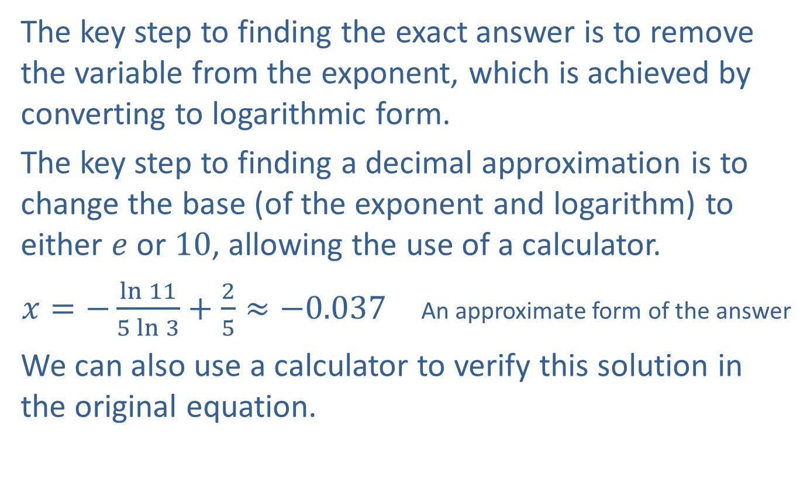
Example 3: Solving Exponential Equations with Different Bases—Slide 5
The key step to finding the exact answer is to remove the variable from the exponent, which is achieved by converting to logarithmic form.
The key step to finding a decimal approximation is to change the base (of the exponent and logarithm) to either $e$ or 10, allowing the use of a calculator.
$x=−\frac{\ln{11}}{5\ln{3}}+\frac{2}{5}≈−0.037$ An approximate form of the answer
We can also use a calculator to verify this solution in the original equation.

Slide 18

Example 4: Solving Exponential Equations with Different Bases—Slide 1
Solve the equation $5^{3x−1}=2^{x+3}$. Express the answer exactly and as a decimal approximation.

Slide 19
Example 4: Solving Exponential Equations with Different Bases—Slide 2
Solution
As in the first example, taking a logarithm of both sides is the key. We will use the common logarithm this time, but the natural logarithm would work just as well.

Slide 20
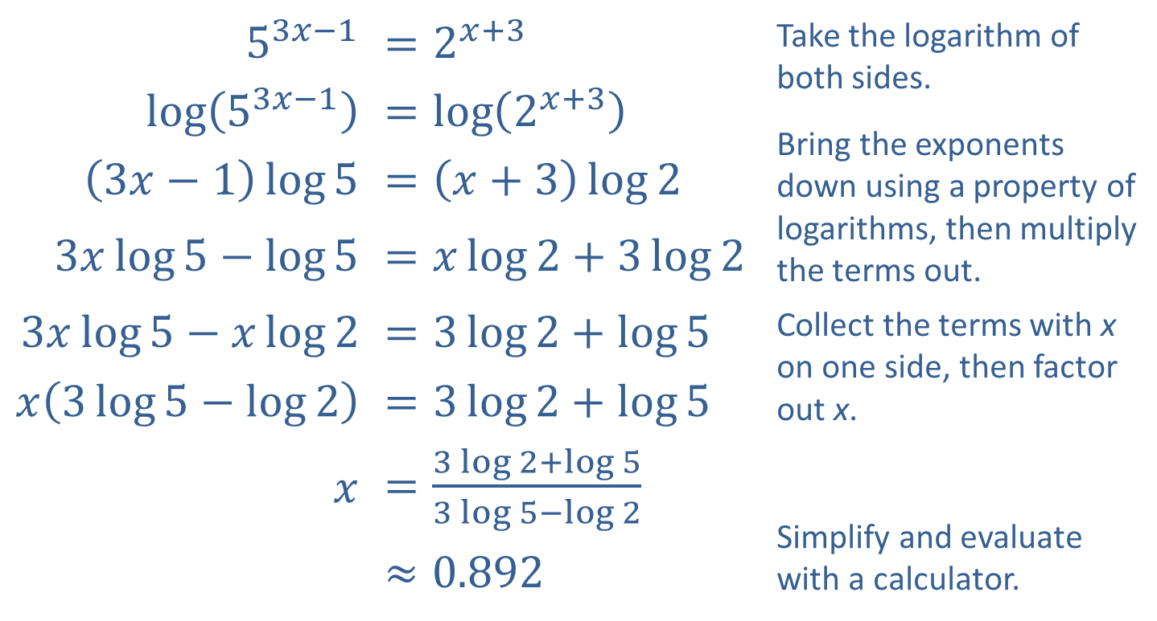
Example 4: Solving Exponential Equations with Different Bases—Slide 3
​$5^{3x−1}$ | ​$=2^{x+3}$ | Take the logarithm of both sides. Bring the exponents down using a property of logarithms, then multiply the terms out.
​$log⁡\left(5^{3x−1}\right)$ | ​$=\log\left(2^{x+3}\right)$
​$\left(3x−1\right)\log{5}$ | ​$=\left(x+3\right)\log{2}$
​$3x\log{5}−\log{5}$ | ​$=x\log{2}+3\log{2}$
​$3x\log{5}−x\log{2}$ | ​$=3\log{2}+\log{5}$ | Collect the terms with x on one side, then factor out x.
​$x\left(3\log{5}−\log{2}\right)$ | ​$=3\log{2}+\log{5}$
$x$ | ​$=\frac{3\log{2}+\log{5}}{3\log{5}−\log{2}}$ | Simplify and evaluate with a calculator.
 | $$≈0.892$$

Slide 21
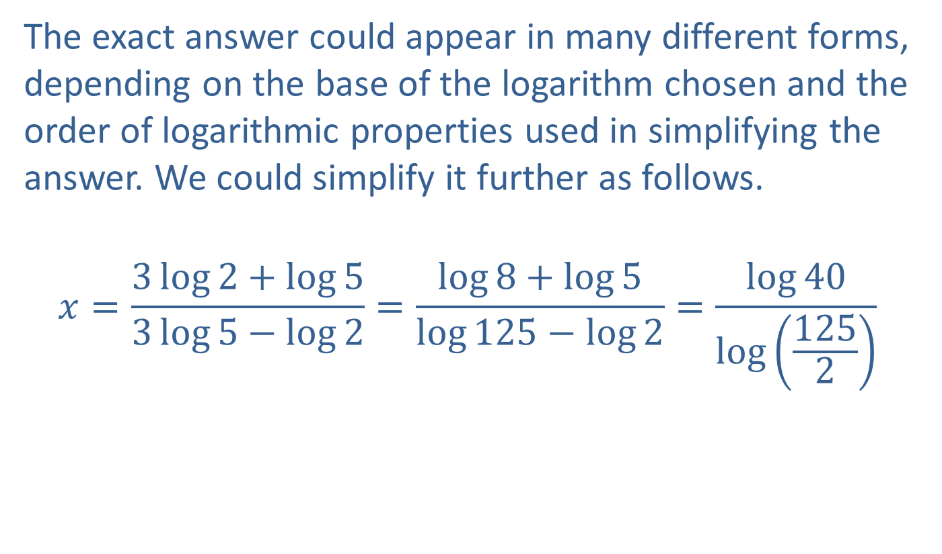
Example 4: Solving Exponential Equations with Different Bases—Slide 4
The exact answer could appear in many different forms, depending on the base of the logarithm chosen and the order of logarithmic properties used in simplifying the answer. We could simplify it further as follows.
$$x=\frac{3\log{2}+\log{5}}{3\log{5}−\log{2}}=\frac{\log{8}+\log{5}}{\log{125}−\log{2}}=\frac{\log{40}}{\log\left(\frac{125}{2}\right)}$$

Slide 22
Example 5: Solving Exponential Equations with Different Bases—Slide 1
Use the change-of-base formula to find the value of x (accurate to the nearest ten-thousandth) in the equation 5^{x} = 16.
Solution
Because the base is 5, we can take log ₅ of both sides.
(This method is not necessary, but it does show how the change-of-base formula can be used.)

Slide 23
Example 5: Solving Exponential Equations with Different Bases—Slide 2
Change-of-base formula

Slide 24
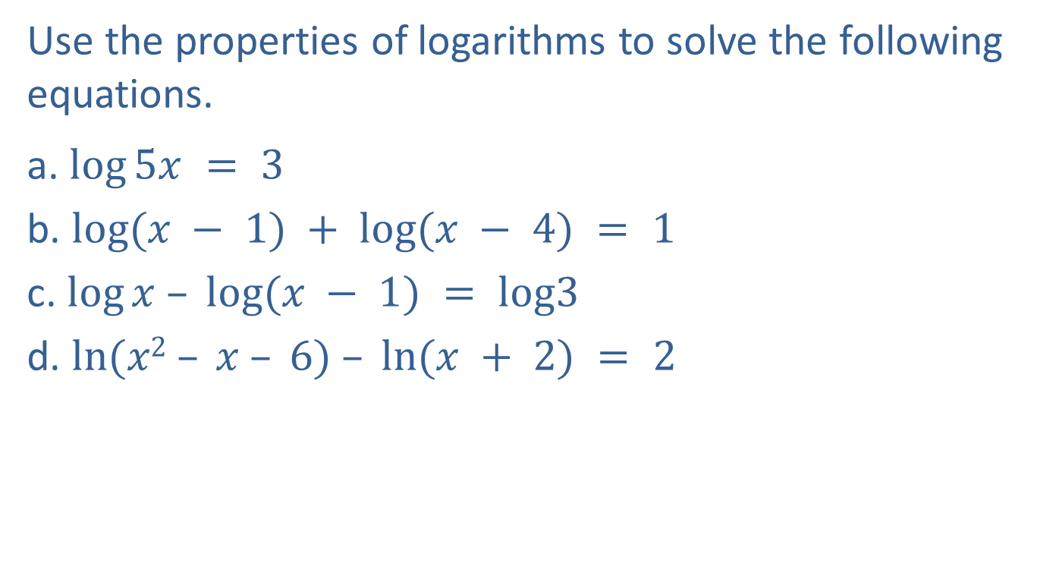
Example 6: Solving Logarithmic Equations—Slide 1
Use the properties of logarithms to solve the following equations.
a. $log⁡5x = 3$
b. $log⁡(x − 1) + log⁡(x − 4) = 1$
c. $log⁡x – log⁡(x − 1) = log3$
d. $ln⁡(x2 – x – 6) – ln⁡(x + 2) = 2$

Slide 25
Example 6: Solving Logarithmic Equations—Slide 2
Solution
a.
Definition of a common logarithm
Checking will show that the equation is defined at x = 200.

Slide 26
Example 6: Solving Logarithmic Equations—Slide 3
Product rule
Definition of a common logarithm
Solve by factoring.
Checking x = −1 yields log(−1 −1 ) = log(−2), which is undefined.

Slide 27

Example 6: Solving Logarithmic Equations—Slide 4
Quotient rule
If log_{a}x = log_{a}y, then x $=$ y.
Solve for x.

Slide 28
Example 6: Solving Logarithmic Equations—Slide 5
Quotient rule
Factor the numerator.
Simplify.
Change to exponential form with base e.

Slide 29

Example 6: Solving Logarithmic Equations—Slide 6
Or, using a calculator,
$x = 3 + e2 ≈ 3 + 7.3891$
$= 10.3891.$

Slide 30
Example 7: Solving Logarithmic Equations—Slide 1
Solve the equation log ₇ (3x − 2) = 2.

Slide 31
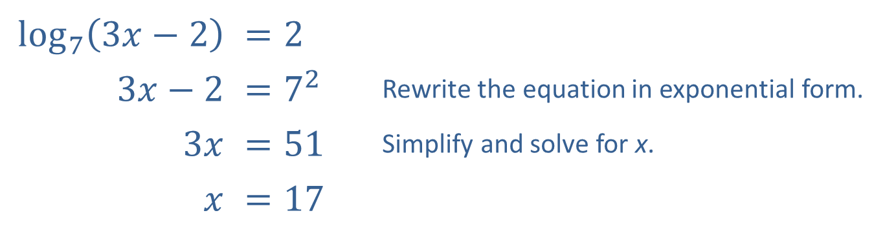
Example 7: Solving Logarithmic Equations—Slide 2
Solution
Note that rewriting this equation using the change of base formula does not help, since the variable would still be trapped inside the logarithm. Instead, we use the definition of logarithms to rewrite the equation in exponential form.
​$\log_{7}⁡\left(3x−2\right)$ | ​$=2$
​$3x−2$ | ​$=7^{2}$ | Rewrite the equation in exponential form.
​$3x$ | ​$=51$ | Simplify and solve for x.
$x$ | ​$=17$

Slide 32

Example 8: Solving Logarithmic Equations—Slide 1
Solve the equation
$\log_{5}{x}=\log_{5}\left(2x+3\right)−\log_{5}\left(2x−3\right)$.

Slide 33
Note
We need to check for extraneous solutions when solving logarithmic equations. In particular, remember that logarithms of negative numbers are undefined.

Slide 34
Example 8: Solving Logarithmic Equations—Slide 2
Solution
This is an example of a logarithmic equation that is not easily solved in logarithmic form. Once a few properties of logarithms have been utilized, the equation can be rewritten in a very familiar form.

Slide 35
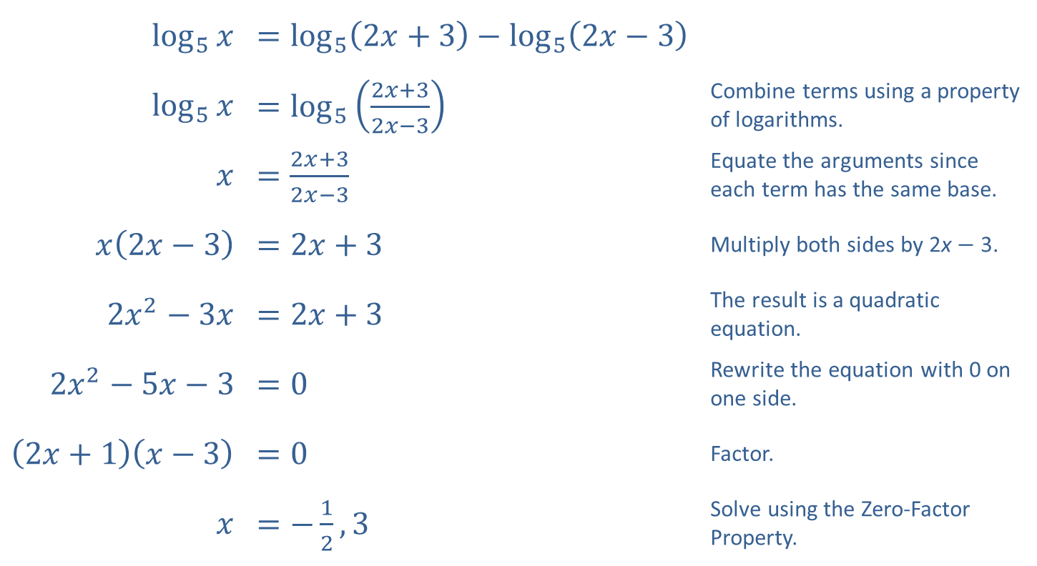
Example 8: Solving Logarithmic Equations—Slide 3
​$\log_{5}⁡x$ | ​$=\log_{5}\left(2x+3\right)−\log_{5}\left(2x−3\right)$
​$\log_{5}⁡x$ | ​$=\log_{5}\left(\frac{2x+3}{2x−3}\right)$ | Combine terms using a property of logarithms.
$$x$$ | ​$=\frac{2x+3}{2x−3}$ | Equate the arguments since each term has the same base.
​$x\left(2x−3\right)$ | ​$=2x+3$ | Multiply both sides by 2x − 3.
​$2x^{2}−3x$ | ​$=2x+3$ | The result is a quadratic equation.
​$2x^{2}−5x−3$ | ​$=0$ | Rewrite the equation with 0 on one side.
​$\left(2x+1\right)\left(x−3\right)$ | ​$=0$ | Factor.
$x$ | ​$=−\frac{1}{2},3$ | Solve using the Zero-Factor Property.

Slide 36
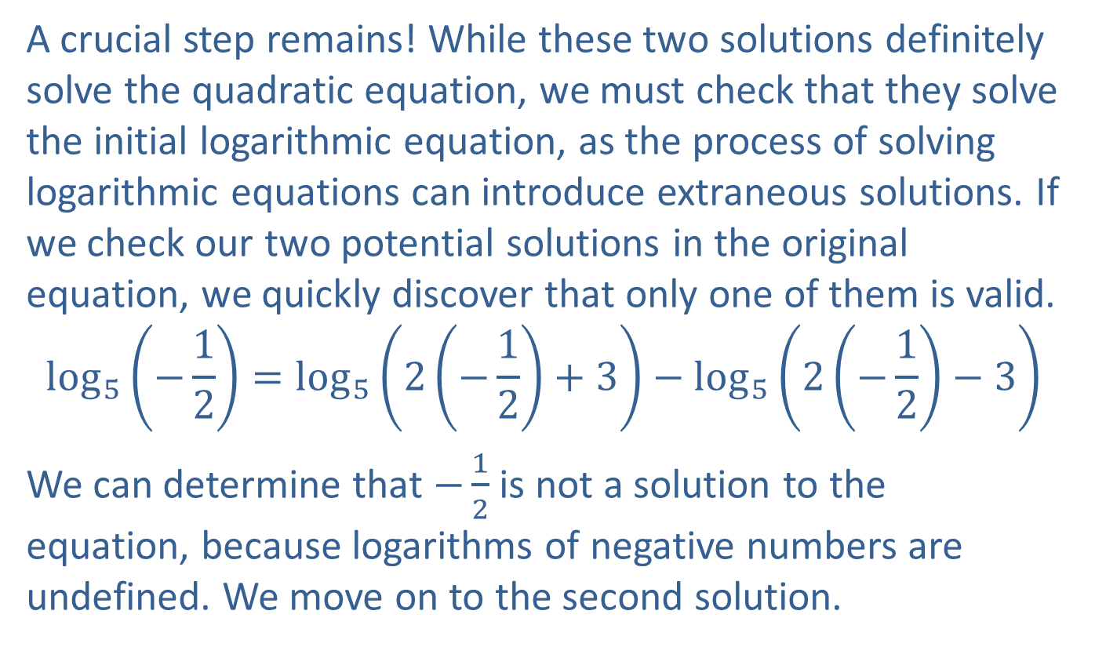
Example 8: Solving Logarithmic Equations—Slide 4
A crucial step remains! While these two solutions definitely solve the quadratic equation, we must check that they solve the initial logarithmic equation, as the process of solving logarithmic equations can introduce extraneous solutions. If we check our two potential solutions in the original equation, we quickly discover that only one of them is valid.
$$\log_{5}\left(−\frac{1}{2}\right)=\log_{5}\left(2\left(−\frac{1}{2}\right)+3\right)−\log_{5}\left(2\left(−\frac{1}{2}\right)−3\right)$$
We can determine that $−\frac{1}{2}$ is not a solution to the equation, because logarithms of negative numbers are undefined. We move on to the second solution.

Slide 37
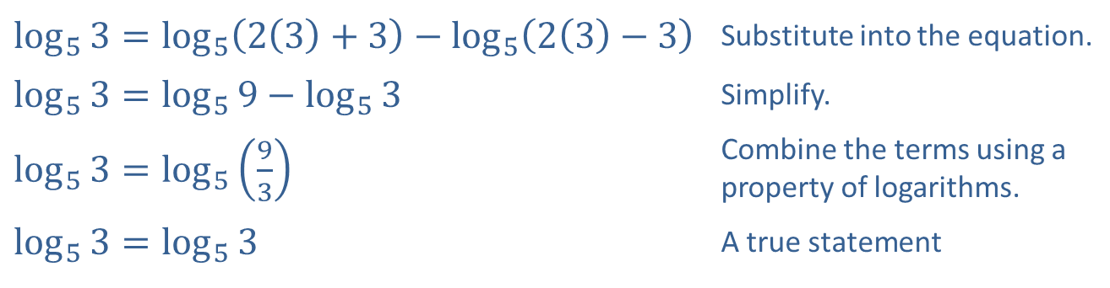
Example 8: Solving Logarithmic Equations—Slide 5
​$\log_{5}{3}=\log_{5}\left(2\left(3\right)+3\right)−\log_{5}\left(2\left(3\right)−3\right)$ | Substitute into the equation.
​$\log_{5}{3}=\log_{5}{9}−\log_{5}{3}$ | Simplify.
​$\log_{5}{3}=\log_{5}\left(\frac{9}{3}\right)$ | Combine the terms using a property of logarithms.
​$\log_{5}{3}=\log_{5}{3}$ | A true statement
Thus, the solution to the equation is the single value x = 3.

