Slide 1
Section 3.R.3
Properties of Logarithms

Slide 2
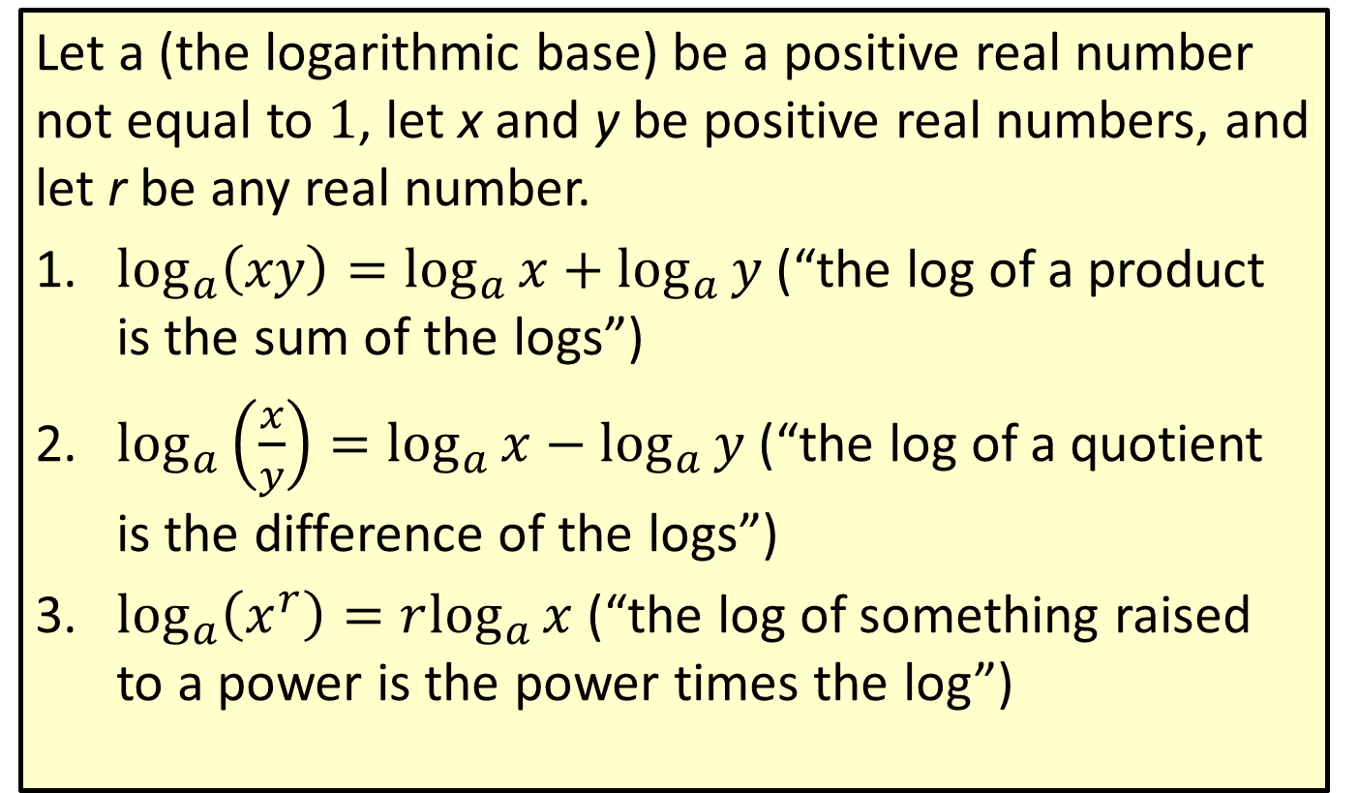
Properties: Properties of Logarithms
Let a (the logarithmic base) be a positive real number not equal to 1, let x and y be positive real numbers, and let r be any real number.
​$\log_{a}\left(xy\right)=\log_{a}{x}+\log_{a}{y}$ (“the log of a product is the sum of the logs”)
​$\log_{a}\left(\frac{x}{y}\right)=\log_{a}{x}−\log_{a}{y}$ (“the log of a quotient is the difference of the logs”)
​$\log_{a}\left(x^{r}\right)=r\log_{a}⁡x$ (“the log of something raised to a power is the power times the log”)

Slide 3
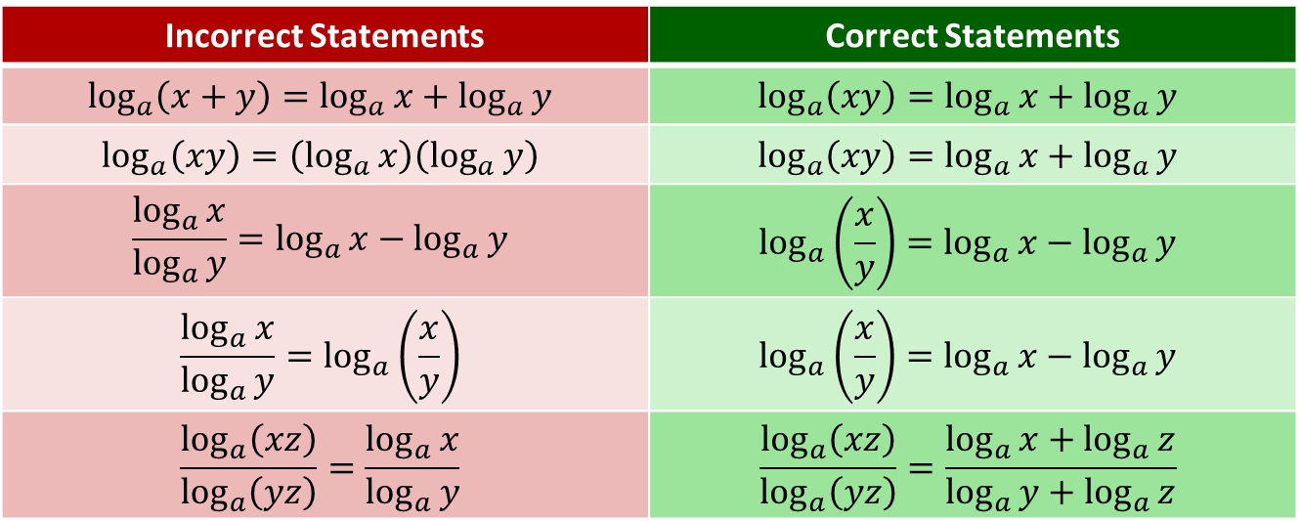
CAUTION!
Errors in working with logarithms often arise from incorrect recall of the logarithmic properties. The comparisons below highlight some common mistakes.
Incorrect Statements | Correct Statements
$$\log_{a}\left(x+y\right)=\log_{a}{x}+\log_{a}{y}$$ | $$\log_{a}\left(xy\right)=\log_{a}{x}+\log_{a}{y}$$
$$\log_{a}\left(xy\right)=\left(\log_{a}{x}\right)\left(\log_{a}{y}\right)$$ | $$\log_{a}\left(xy\right)=\log_{a}{x}+\log_{a}{y}$$
$$\frac{\log_{a}{x}}{\log_{a}{y}}=\log_{a}{x}−\log_{a}{y}$$ | $$\log_{a}\left(\frac{x}{y}\right)=\log_{a}{x}−\log_{a}{y}$$
$$\frac{\log_{a}{x}}{\log_{a}{y}}=\log_{a}\left(\frac{x}{y}\right)$$ | $$\log_{a}\left(\frac{x}{y}\right)=\log_{a}{x}−\log_{a}{y}$$
$$\frac{\log_{a}\left(xz\right)}{\log_{a}\left(yz\right)}=\frac{\log_{a}{x}}{\log_{a}{y}}$$ | $$\frac{\log_{a}\left(xz\right)}{\log_{a}\left(yz\right)}=\frac{\log_{a}{x}+\log_{a}{z}}{\log_{a}{y}+\log_{a}{z}}$$

Slide 4
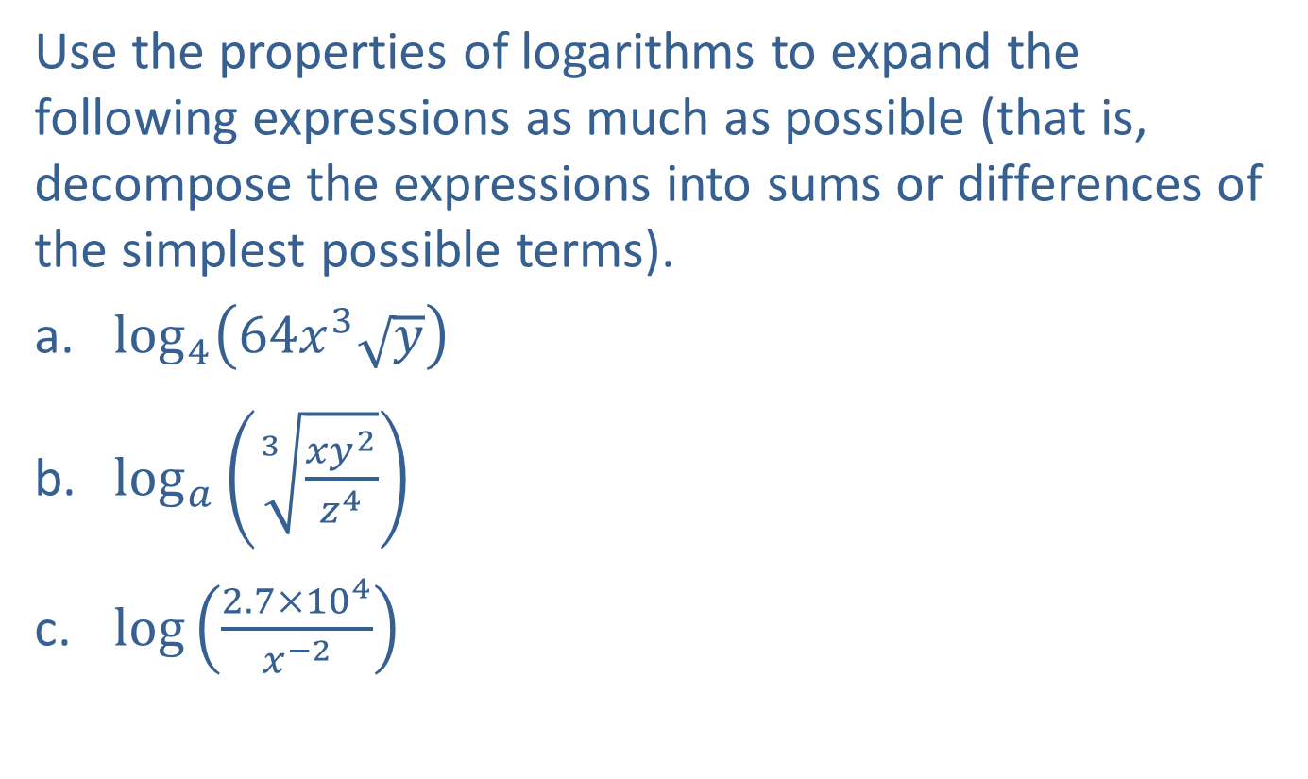
Example 1: Expanding Logarithmic Expressions—Slide 1
Use the properties of logarithms to expand the following expressions as much as possible (that is, decompose the expressions into sums or differences of the simplest possible terms).
​$\log_{4}⁡\left(64x^{3}\sqrt{y}\right)$
​$\log_{a}⁡\left(\sqrt[3]{\frac{xy^{2}}{z^{4}}}\right)$
​$log⁡\left(\frac{2.7×{10}^{4}}{x^{−2}}\right)$

Slide 5
Note 1
As long as the base is the same for each term, its value does not affect the use of the properties.

Slide 6
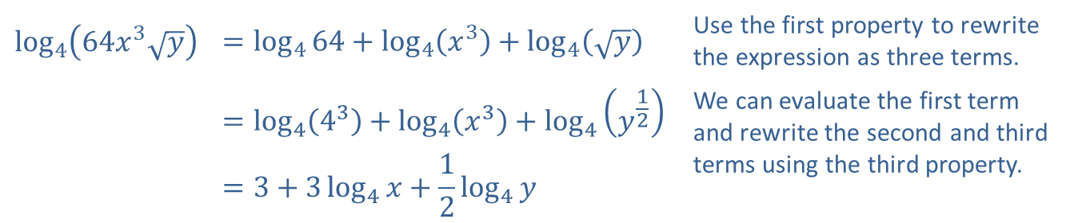
Example 1: Expanding Logarithmic Expressions—Slide 2
Solution
​
​$\log_{4}\left(64x^{3}\sqrt{y}\right)$ | $$=\log_{4}{64}+\log_{4}\left(x^{3}\right)+\log_{4}\left(\sqrt{y}\right)$$ | Use the first property to rewrite the expression as three terms.
​ | $$=\log_{4}\left(4^{3}\right)+\log_{4}\left(x^{3}\right)+\log_{4}\left(y^{\frac{1}{2}}\right)$$ | We can evaluate the first term and rewrite the second and third terms using the third property.
​ | $$=3+3\log_{4}{x}+\frac{1}{2}\log_{4}{y}$$

Slide 7
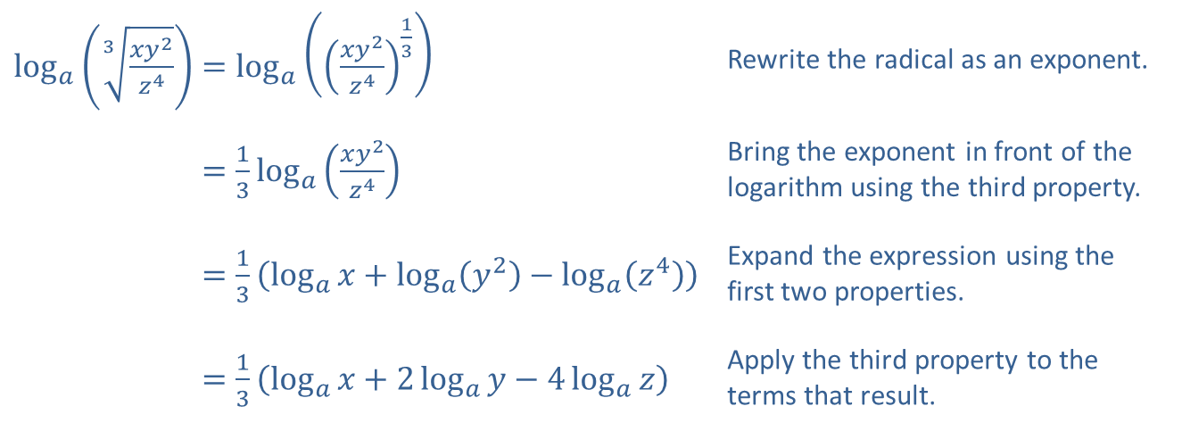
Example 1: Expanding Logarithmic Expressions—Slide 3
​$\log_{a}\left(\sqrt[3]{\frac{xy^{2}}{z^{4}}}\right)=\log_{a}\left({\left(\frac{xy^{2}}{z^{4}}\right)}^{\frac{1}{3}}\right)$ | Rewrite the radical as an exponent.
​log𝑎⁡3𝑥𝑦2𝑧4=13log𝑎⁡𝑥𝑦2𝑧4 | Bring the exponent in front of the logarithm using the third property.
​log𝑎⁡3𝑥𝑦2𝑧4=13log𝑎𝑥+log𝑎𝑦2−log𝑎𝑧4 | Expand the expression using the first two properties.
​log𝑎⁡3𝑥𝑦2𝑧4=13log𝑎𝑥+2log𝑎𝑦−4log𝑎𝑧 | Apply the third property to the terms that result.
​

Slide 8
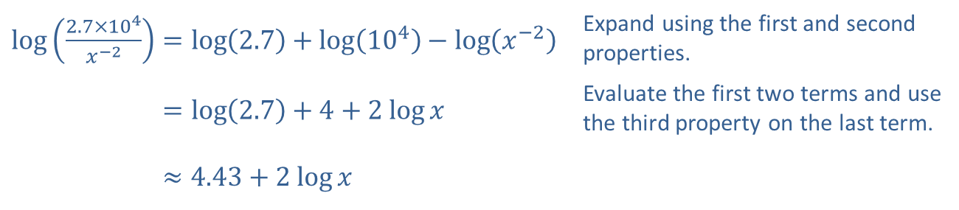
Example 1: Expanding Logarithmic Expressions—Slide 4
​Recall that if a base is not explicitly written, it is assumed to be 10. This base is convenient when working with numbers in scientific notation.
It is appropriate to either evaluate log (2.7) or leave it in exact form. Use the context of the problem to decide which form is more convenient.
​$\log\left(\frac{2.7×{10}^{4}}{x^{−2}}\right)=\log\left(2.7\right)+\log\left({10}^{4}\right)−\log\left(x^{−2}\right)$ | Expand using the first and second properties.
​log⁡2.7×104𝑥−2=log2.7+4+2 log⁡𝑥 | Evaluate the first two terms and use the third property on the last term.
​log⁡2.7×104𝑥−2≈4.43+2 log⁡𝑥

Slide 9
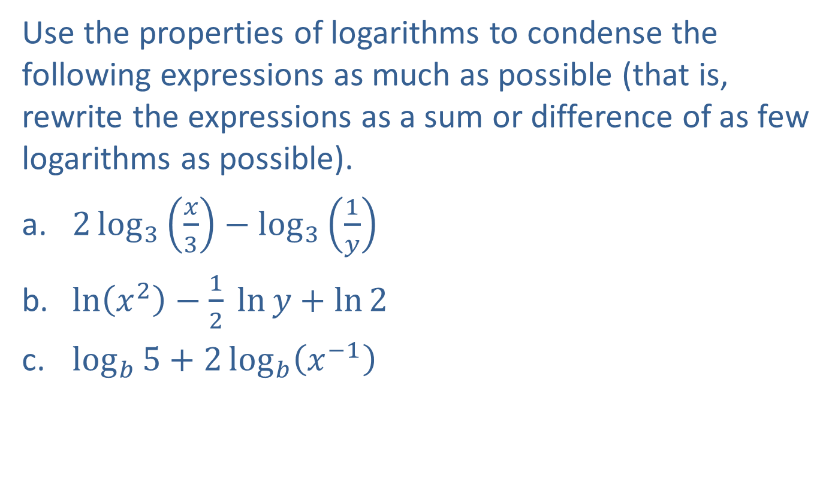
Example 2: Condensing Logarithmic Expressions—Slide 1
Use the properties of logarithms to condense the following expressions as much as possible (that is, rewrite the expressions as a sum or difference of as few logarithms as possible).
​$2\log_{3}\left(\frac{x}{3}\right)−\log_{3}\left(\frac{1}{y}\right)$
​$\ln\left(x^{2}\right)−\frac{1}{2} ln⁡y+\ln{2}$
​$\log_{b}{5}+2\log_{b}\left(x^{−1}\right)$

Slide 10
Note 2
Often, there will be multiple orders in which we can apply the properties to find the final result.

Slide 11
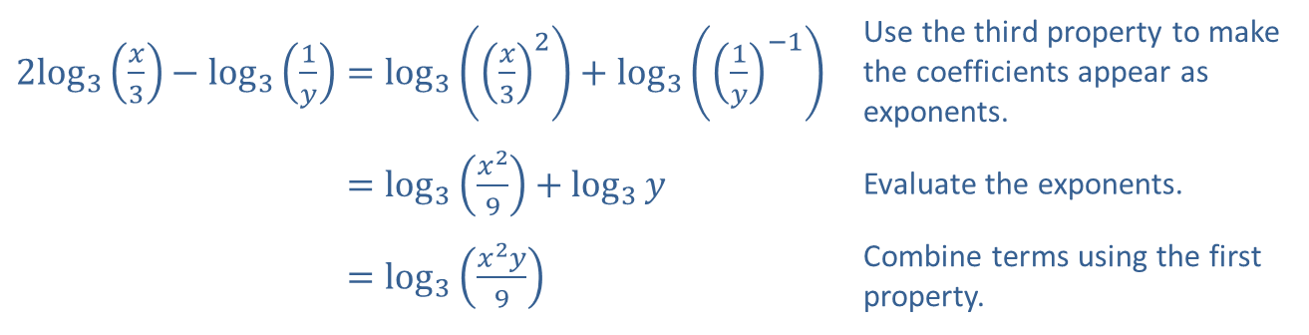
Example 2: Condensing Logarithmic Expressions—Slide 2
Solution
​
​$2\log_{3}⁡\left(\frac{x}{3}\right)−\log_{3}\left(\frac{1}{y}\right)=\log_{3}\left({\left(\frac{x}{3}\right)}^{2}\right)+\log_{3}\left({\left(\frac{1}{y}\right)}^{−1}\right)$ | Use the third property to make the coefficients appear as exponents.
​2log3⁡𝑥3−log31𝑦=log3𝑥29+log3𝑦 | Evaluate the exponents.
​2log3⁡𝑥3−log31𝑦=log3𝑥2𝑦9 | Combine terms using the first property.

Slide 12
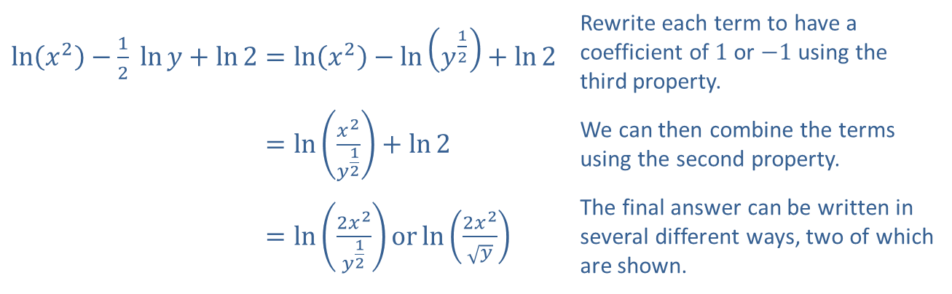
Example 2: Condensing Logarithmic Expressions—Slide 3
​$\ln\left(x^{2}\right)−\frac{1}{2} ln⁡y+\ln{2}=\ln\left(x^{2}\right)−\ln\left(y^{\frac{1}{2}}\right)+\ln{2}$ | Rewrite each term to have a coefficient of 1 or −1 using the third property.
​ln𝑥2−12 ln⁡𝑦+ln2=ln𝑥2𝑦12+ln2 | We can then combine the terms using the second property.
​ln𝑥2−12 ln⁡𝑦+ln2=ln2𝑥2𝑦12orln2𝑥2𝑦 | The final answer can be written in several different ways, two of which are shown.
​

Slide 13
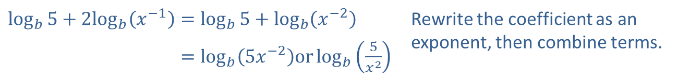
Example 2: Condensing Logarithmic Expressions—Slide 4
​
​$\log_{b}{5}+2\log_{b}⁡\left(x^{−1}\right)=\log_{b}{5}+\log_{b}\left(x^{−2}\right)$ | Rewrite the coefficient as an exponent, then combine terms.
​log𝑏5+2log𝑏⁡𝑥−1=log𝑏⁡5𝑥−2orlog𝑏5𝑥2

Slide 14
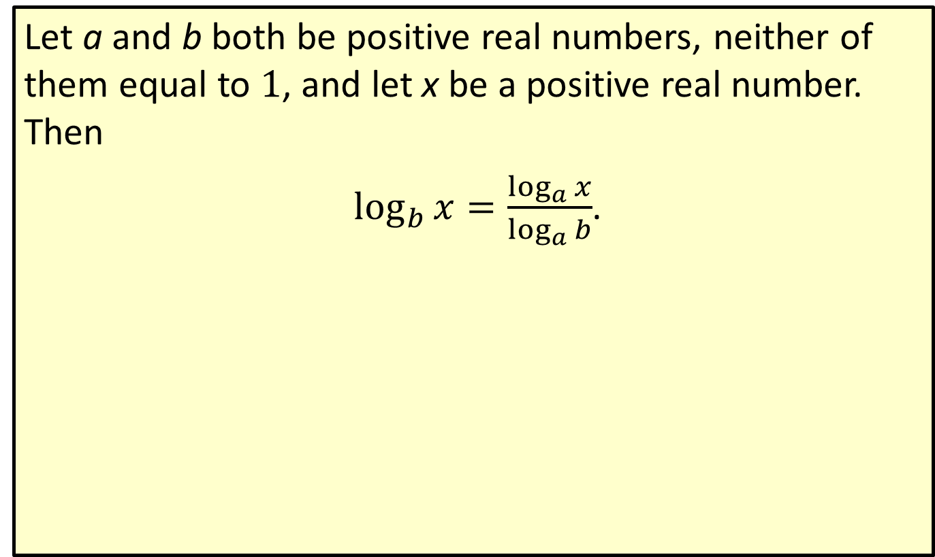
Formula: Change of Base Formula
Let a and b both be positive real numbers, neither of them equal to 1, and let x be a positive real number. Then
$\log_{b}{x}=\frac{\log_{a}{x}}{\log_{a}{b}}$.

Slide 15

Example 3: Using the Change of Base Formula—Slide 1
Evaluate the following logarithmic expressions, using the base of your choice.
​$\log_{7}15$
​$\log_{\frac{1}{2}}⁡3$
​$\log_{π}⁡5$

Slide 16
Note 3
Both the common and natural logarithm work in solving these problems.

Slide 17
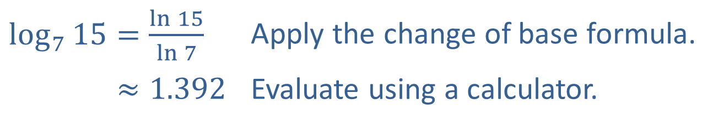
Example 3: Using the Change of Base Formula—Slide 2
Solution
​
​$\log_{7}{15}=\frac{\ln{15}}{\ln{7}}$ | Apply the change of base formula.
​log7⁡15≈1.392 | Evaluate using a calculator.

Slide 18
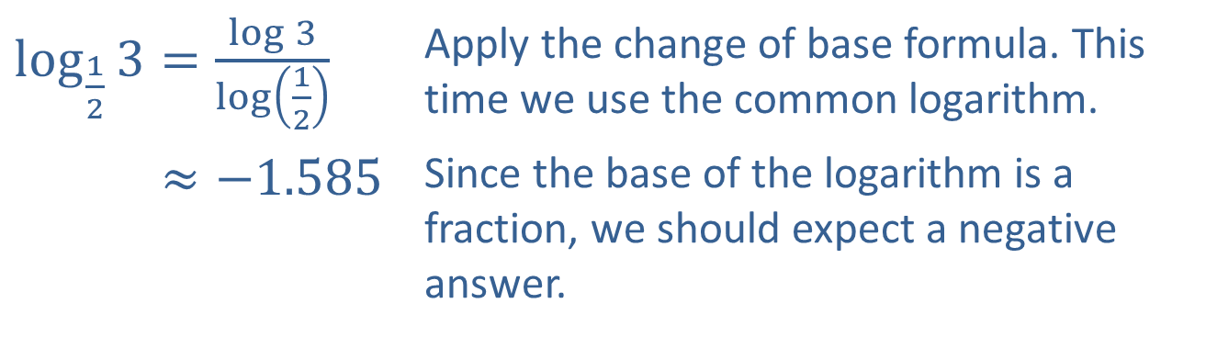
Example 3: Using the Change of Base Formula—Slide 3
​$\log_{\frac{1}{2}}{3}=\frac{\log{3}}{\log\left(\frac{1}{2}\right)}$ | Apply the change of base formula. This time we use the common logarithm.
​log12⁡3≈−1.585 | Since the base of the logarithm is a fraction, we should expect a negative answer.
​

Slide 19
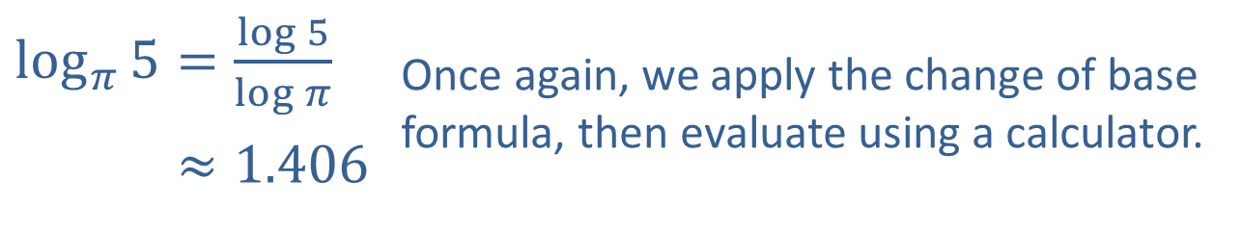
Example 3: Using the Change of Base Formula—Slide 4
​$\log_{π}{5}=\frac{\log{5}}{\log{π}}$ | Once again, we apply the change of base formula, then evaluate using a calculator.
​log𝜋⁡5≈1.406
​

Slide 20
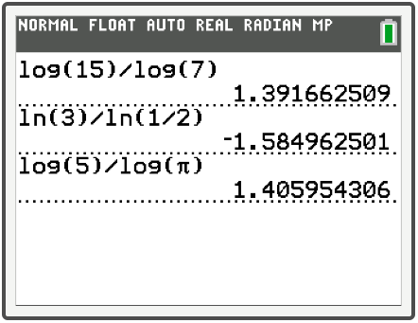
Example 3: Technology

