Slide 1
Section 3.R.2
Logarithmic Functions

Slide 2
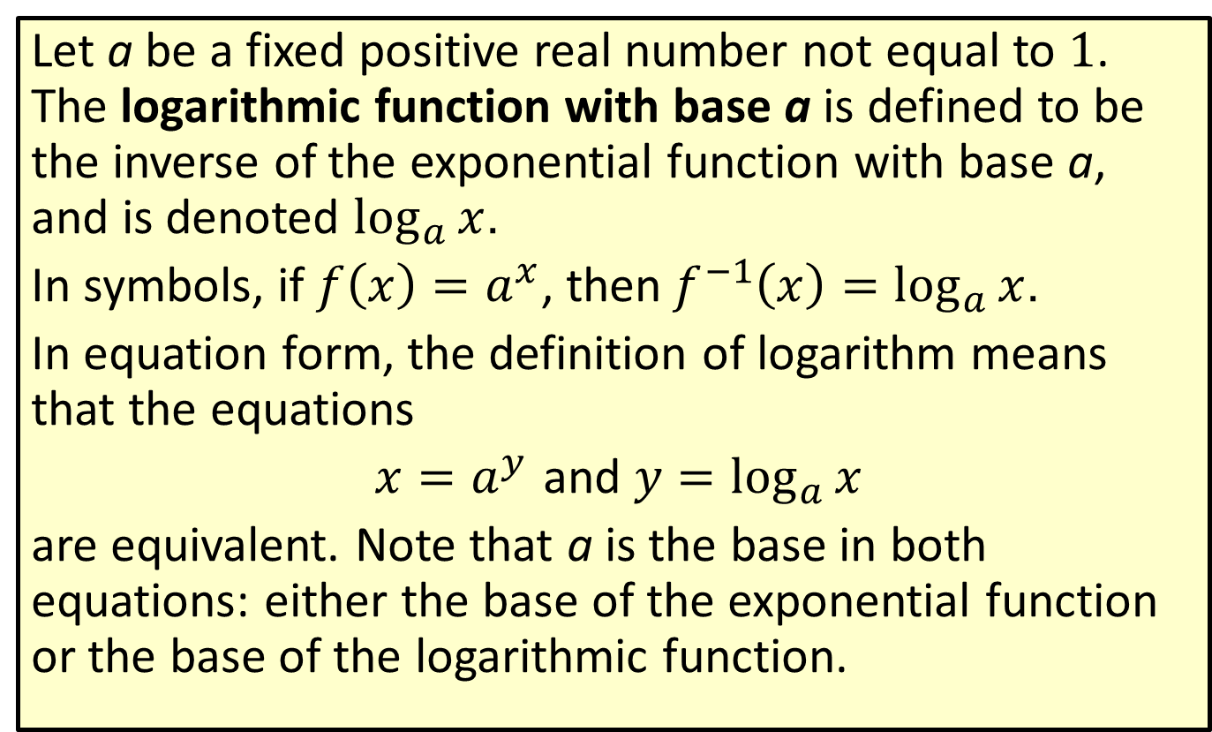
Definition: Logarithmic Functions
Let a be a fixed positive real number not equal to 1. The logarithmic function with base a is defined to be the inverse of the exponential function with base a, and is denoted $\log_{a}⁡x$.
In symbols, if $f\left(x\right)=a^{x}$, then$f^{−1}\left(x\right)=\log_{a}{x}$.
In equation form, the definition of logarithm means that the equations
$x=a^{y}$ and $y=\log_{a}{x}$
are equivalent. Note that a is the base in both equations: either the base of the exponential function or the base of the logarithmic function.

Slide 3
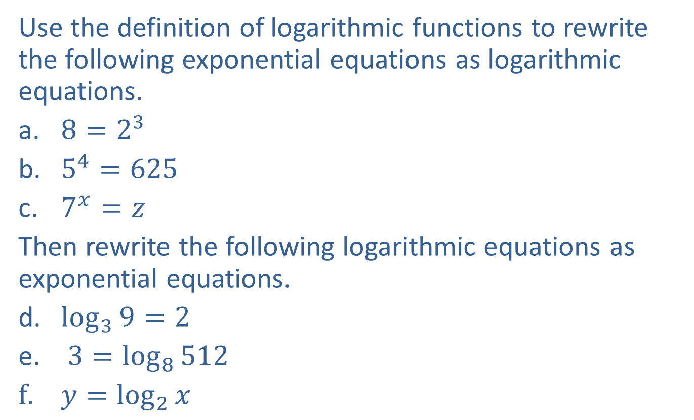
Example 1: Equivalent Exponential and Logarithmic Equations—Slide 1
Use the definition of logarithmic functions to rewrite the following exponential equations as logarithmic equations.
​$8=2^{3}$
​$5^{4}=625$
​$7^{x}=z$
Then rewrite the following logarithmic equations as exponential equations.
​$\log_{3}{9}=2$
$3=\log_{8}{512}$
$y=\log_{2}{x}$

Slide 4
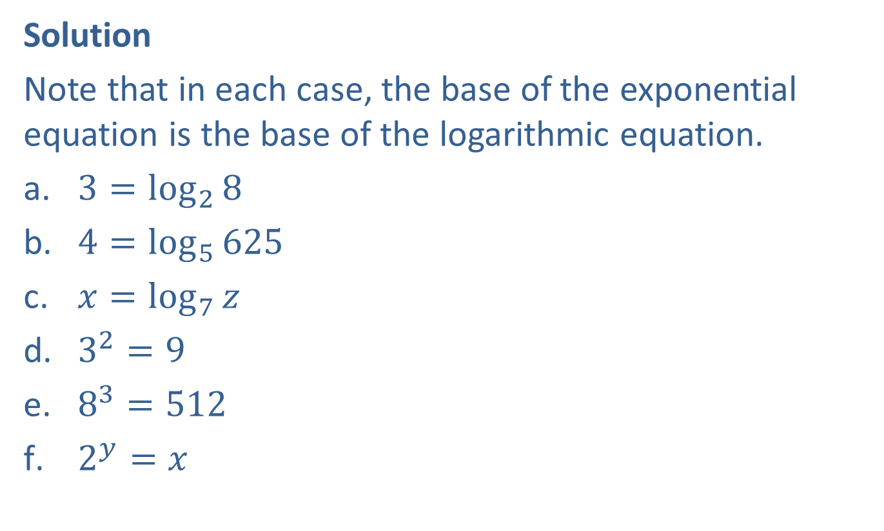
Example 1: Equivalent Exponential and Logarithmic Equations—Slide 2
Solution
Note that in each case, the base of the exponential equation is the base of the logarithmic equation.
​$3=\log_{2}{8}$
​$4=\log_{5}{625}$
​$x=\log_{7}{z}$
​$3^{2}=9$
​$8^{3}=512$
​$2^{y}=x$

Slide 5
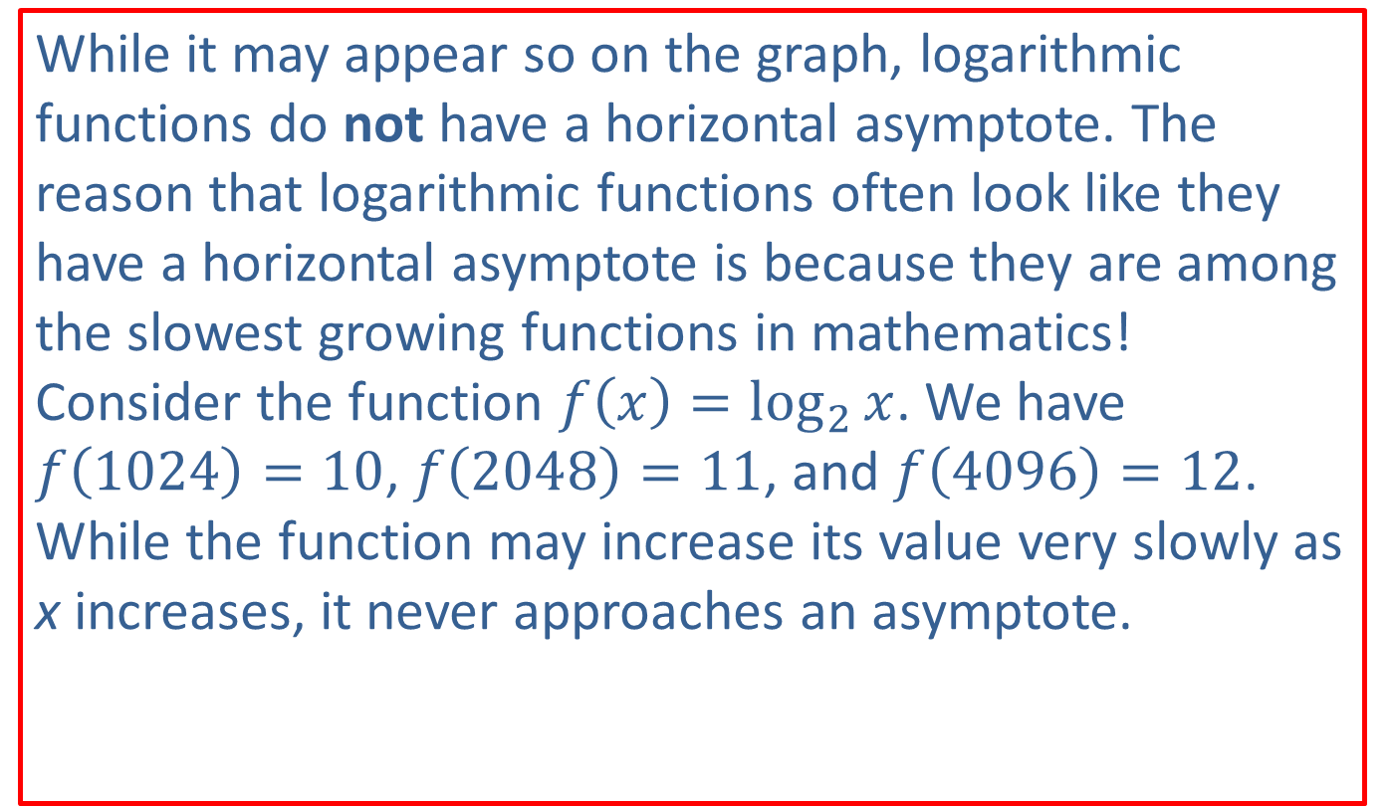
CAUTION!—1
While it may appear so on the graph, logarithmic functions do not have a horizontal asymptote. The reason that logarithmic functions often look like they have a horizontal asymptote is because they are among the slowest growing functions in mathematics! Consider the function $f⁡\left(x\right)=\log_{2}{x}$. We have $f⁡\left(1024\right)=10$, $f\left(2048\right)=11$, and $f\left(4096\right)=12$. While the function may increase its value very slowly as x increases, it never approaches an asymptote.

Slide 6

Example 2: Graphing Logarithmic Functions—Slide 1
Sketch the graphs of the following logarithmic functions.
​$f\left(x\right)=\log_{3}{x}$
​$g\left(x\right)=\log_{\frac{1}{2}}{x}$

Slide 7
Note 1
Once again, plotting a few key points will provide a good idea of the shape of the function.

Slide 8
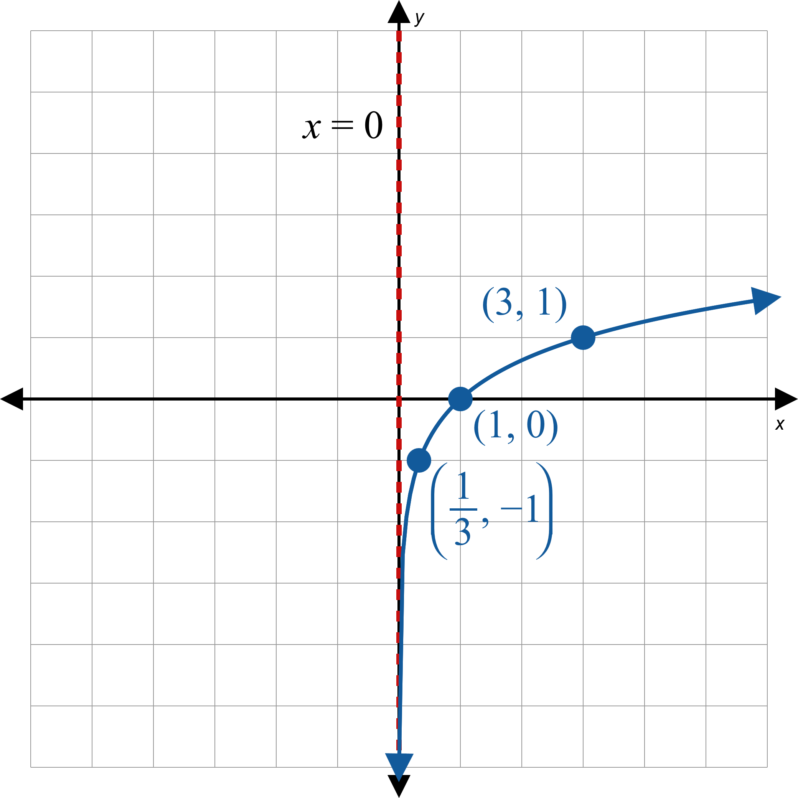
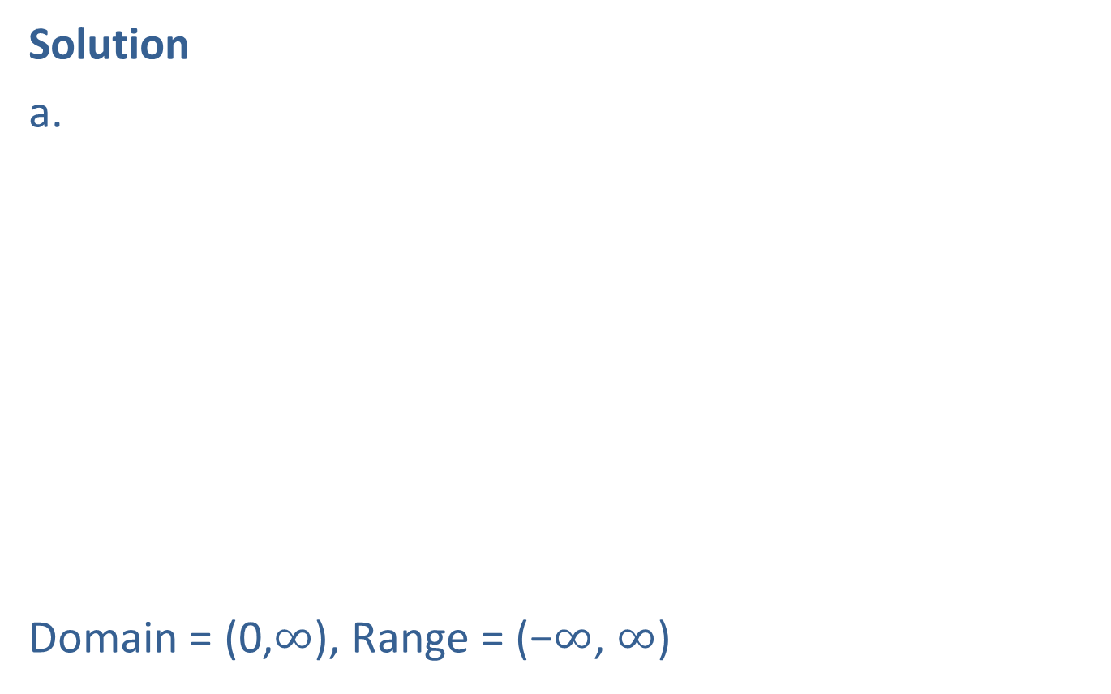
Example 2: Graphing Logarithmic Functions—Slide 2
Solution
a.
Domain = (0,$∞$), Range = (−$∞$, $∞$)
Figure 3

Slide 9
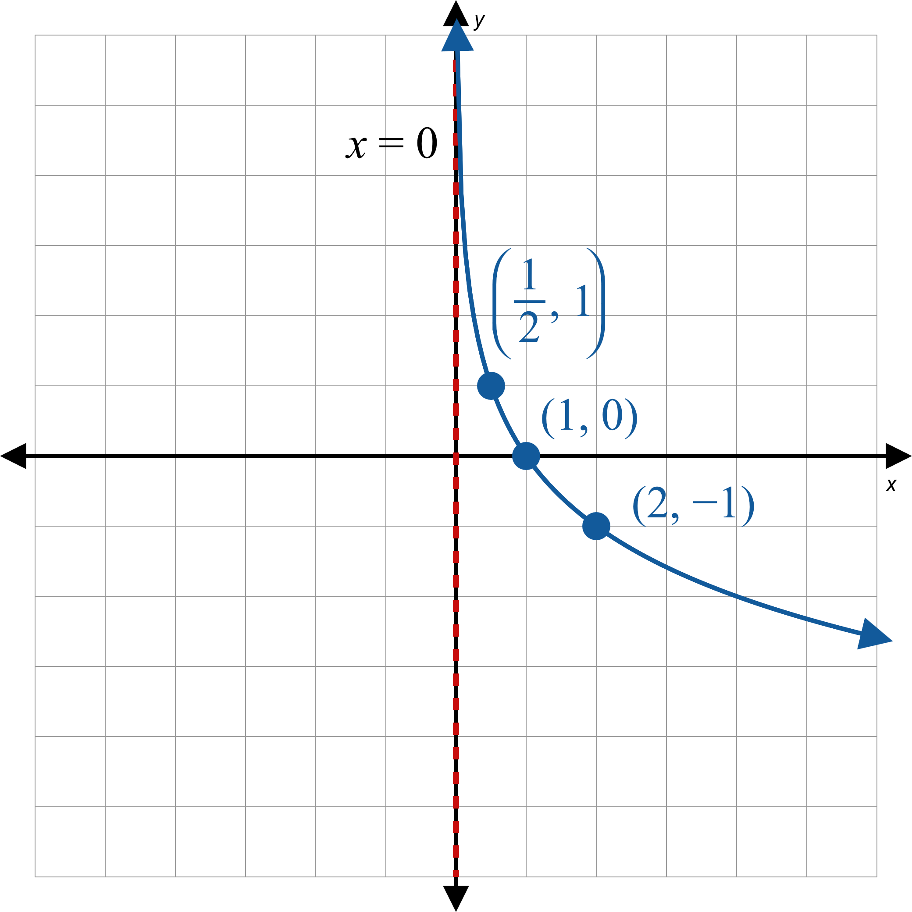
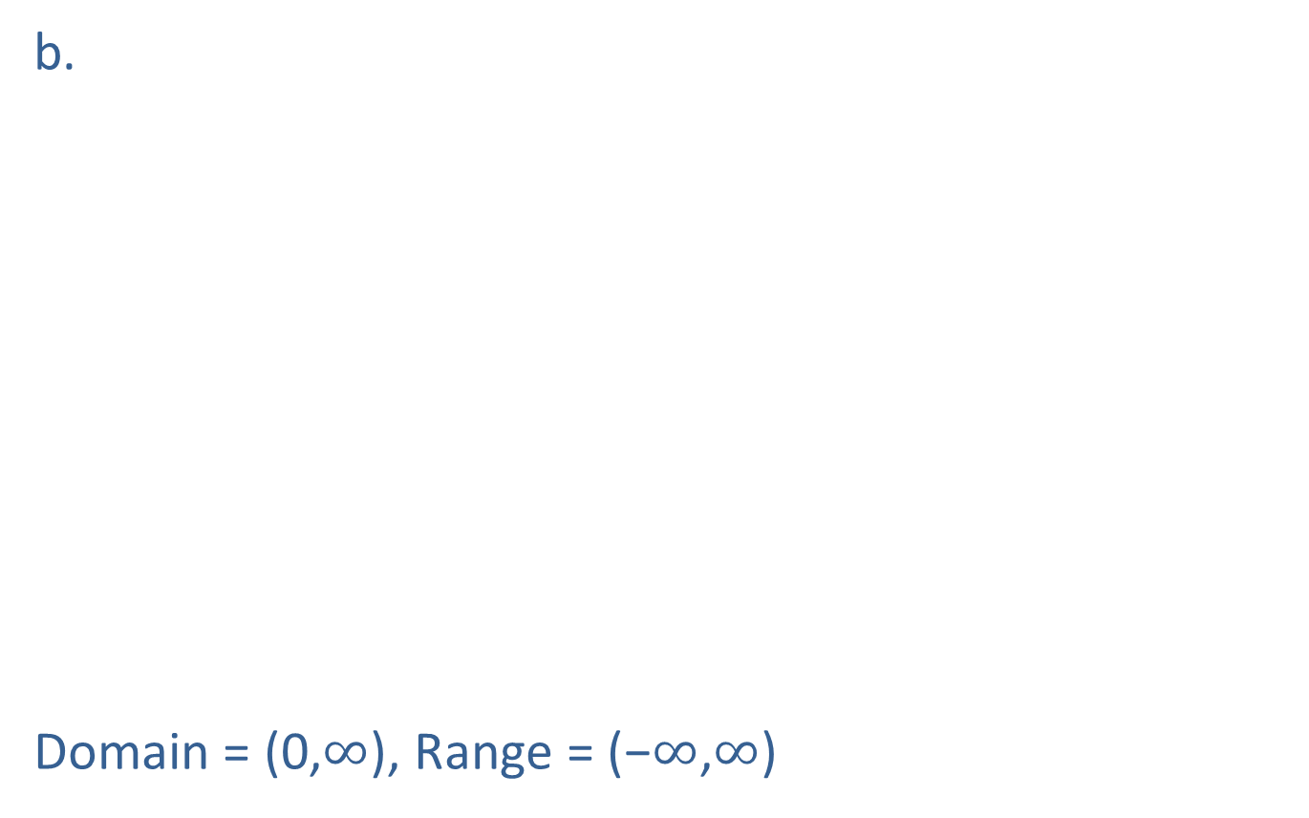
Example 2: Graphing Logarithmic Functions—Slide 3
b.
Domain = (0,$∞$), Range = (−$∞$,$∞$)
Figure 4

Slide 10
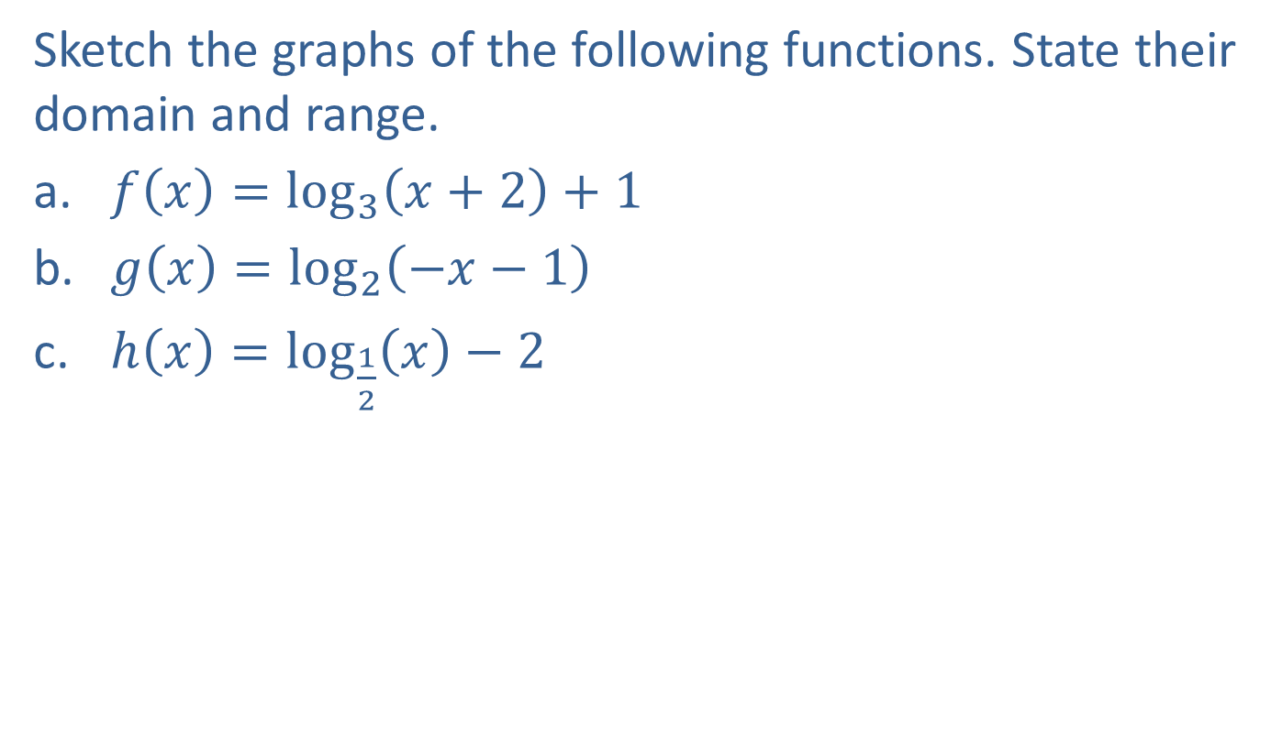
Example 3: Graphing Logarithmic Functions with Transformations—Slide 1
Sketch the graphs of the following functions. State their domain and range.
​$f\left(x\right)=\log_{3}\left(x+2\right)+1$
​$g\left(x\right)=\log_{2}\left(−x−1\right)$
​$h\left(x\right)=\log_{\frac{1}{2}}⁡\left(x\right)−2$

Slide 11
Note 2
Begin by graphing the base function, then apply any transformations.

Slide 12
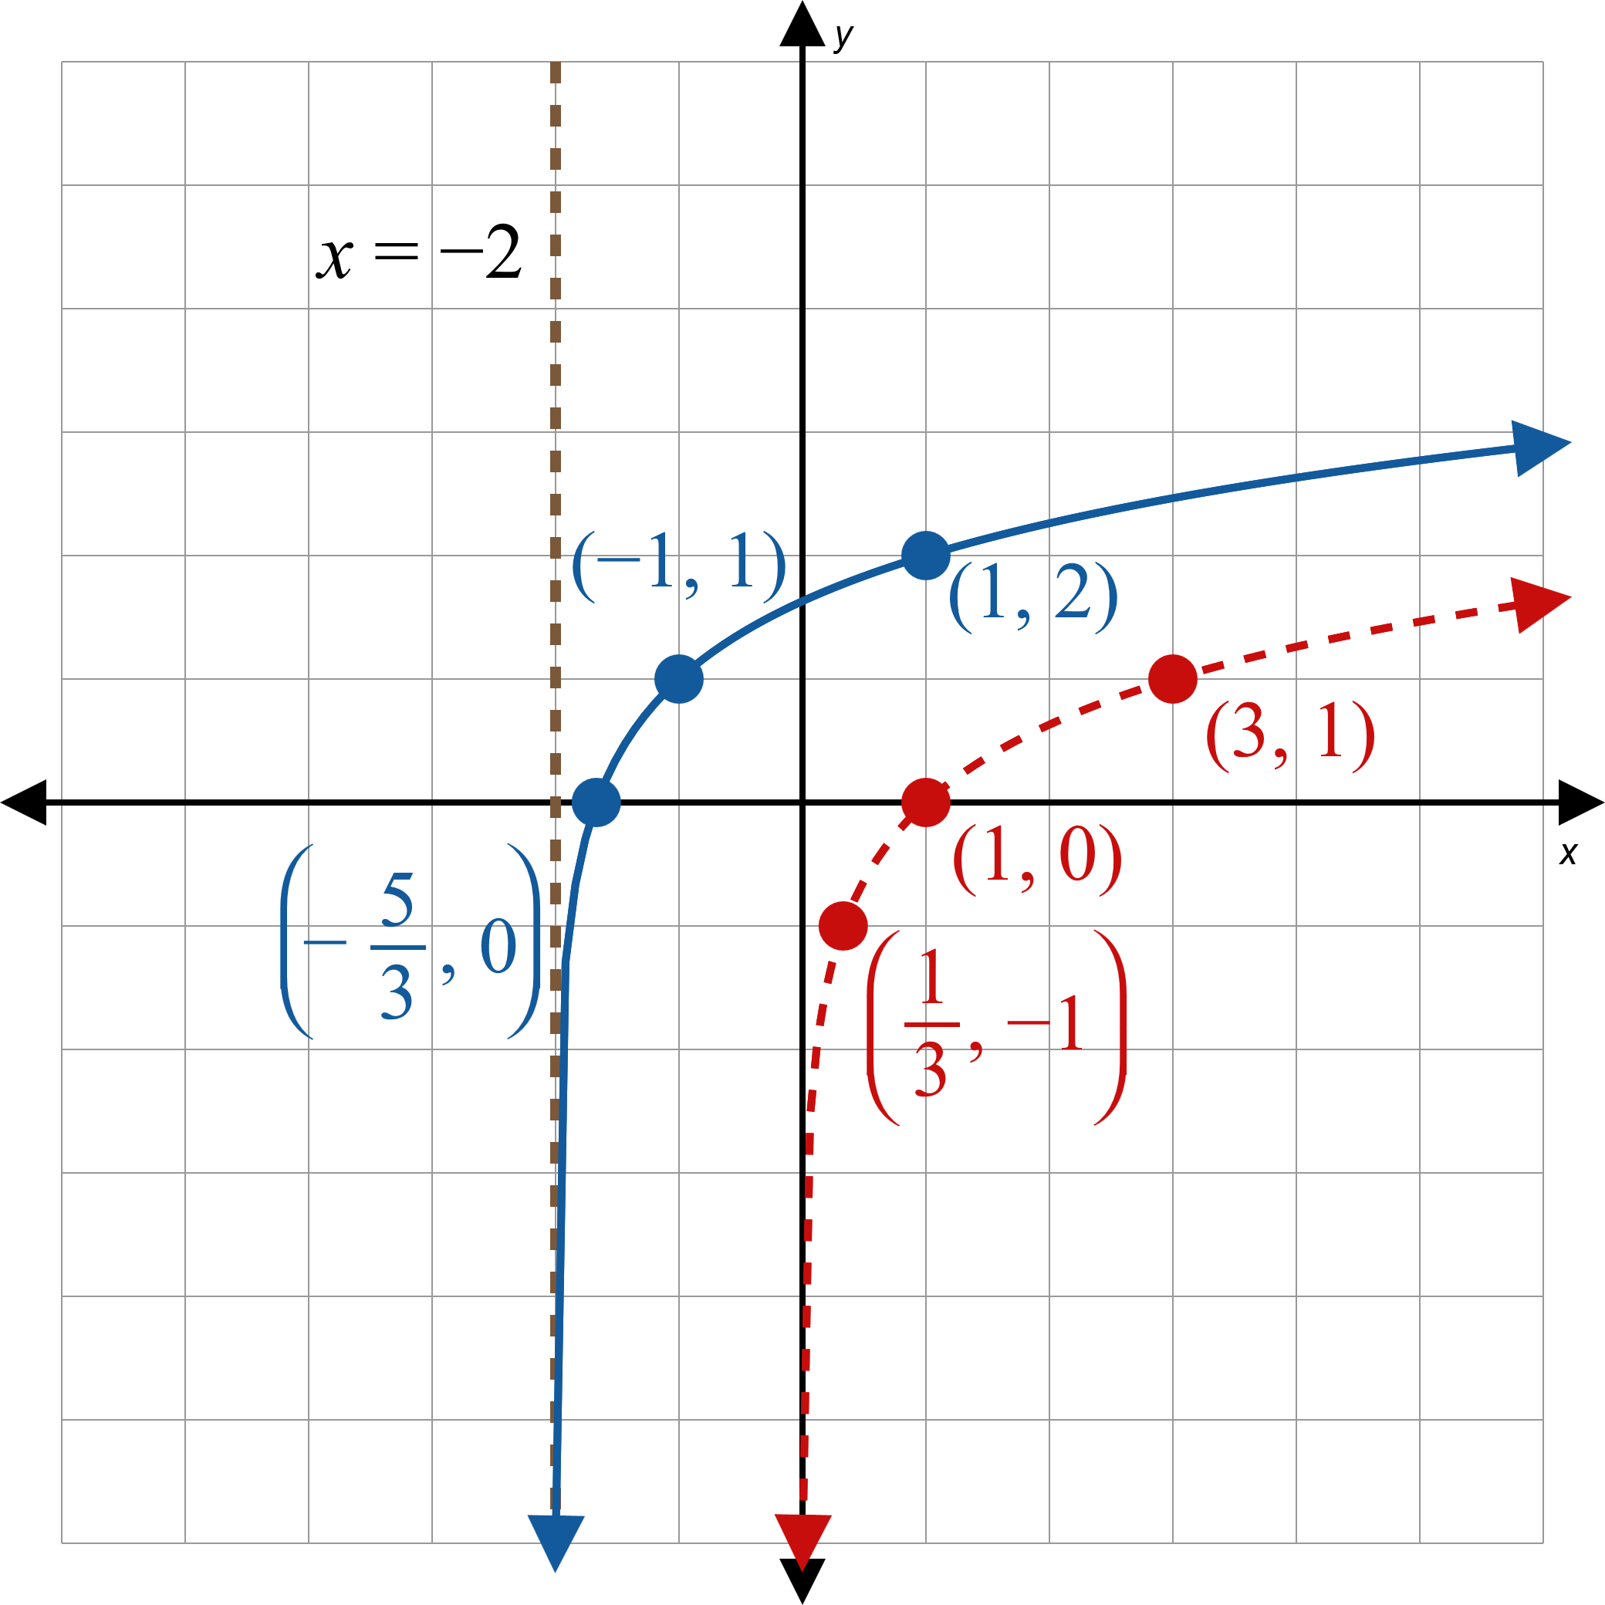


Example 3: Graphing Logarithmic Functions with Transformations—Slide 2
Solution
a.
Begin by graphing the base function, which is $\log_{3}{x}$. This is the dashed curve in Figure 5.
Since x has been replaced by x + 2, we shift the graph 2 units to the left.
To find the graph of f, we shift the result up 1 unit, since 1 has been added to the function. This is the solid curve in Figure 5.
Note that the asymptote has also been shifted to the left.
Figure 5
Domain$=(−2,∞)$, Range $=(−∞,∞)$

Slide 13
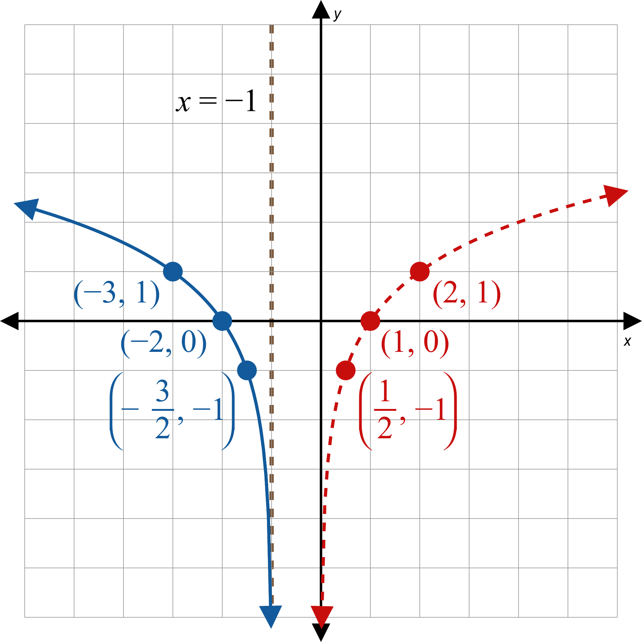


Example 3: Graphing Logarithmic Functions with Transformations—Slide 3
b.
The basic shape of the graph of g is the same as the shape of $y=\log_{2}{x}$, which is the dashed curve in Figure 6.
To obtain g from $\log_{2}{x}$, the variable x is replaced with x − 1, which shifts the graph 1 unit to the right, and then x is replaced by −x, which reflects the graph with respect to the y-axis.
Figure 6
Domain$=(−∞,−1)$, Range $=(−∞,∞)$

Slide 14
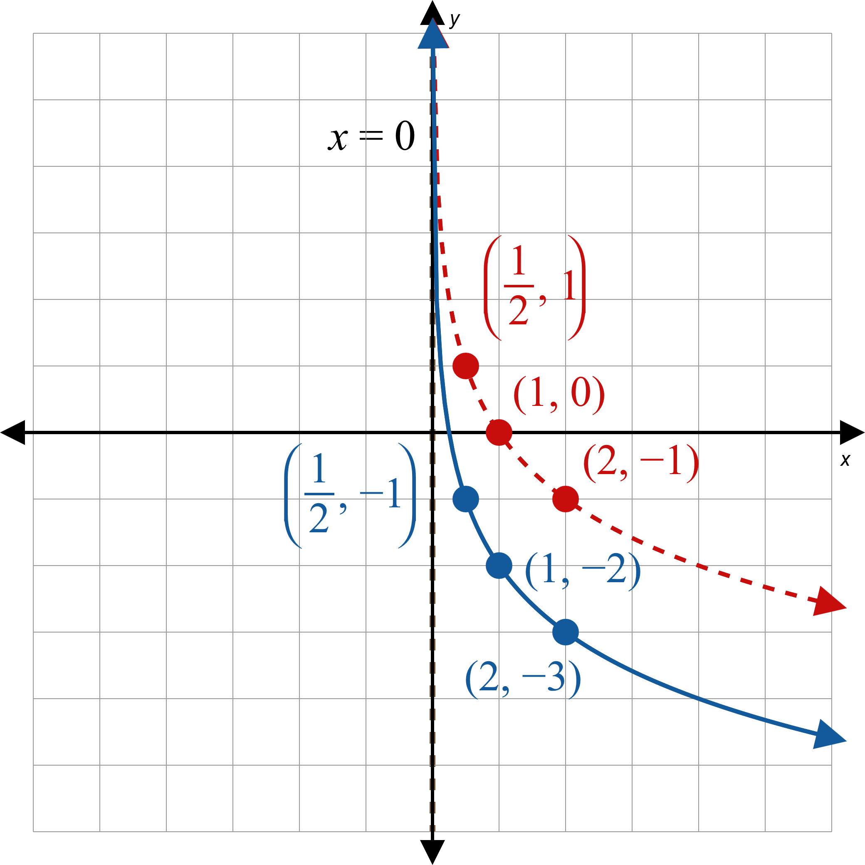


Example 3: Graphing Logarithmic Functions with Transformations—Slide 4
c.
We begin with the dashed curve in Figure 7, which is the graph of $\log_{\frac{1}{2}}x.$
We then shift the graph 2 units down to obtain the graph of the function h.
Figure 7
Domain$=(0,∞)$, Range $=(−∞,∞)$

Slide 15
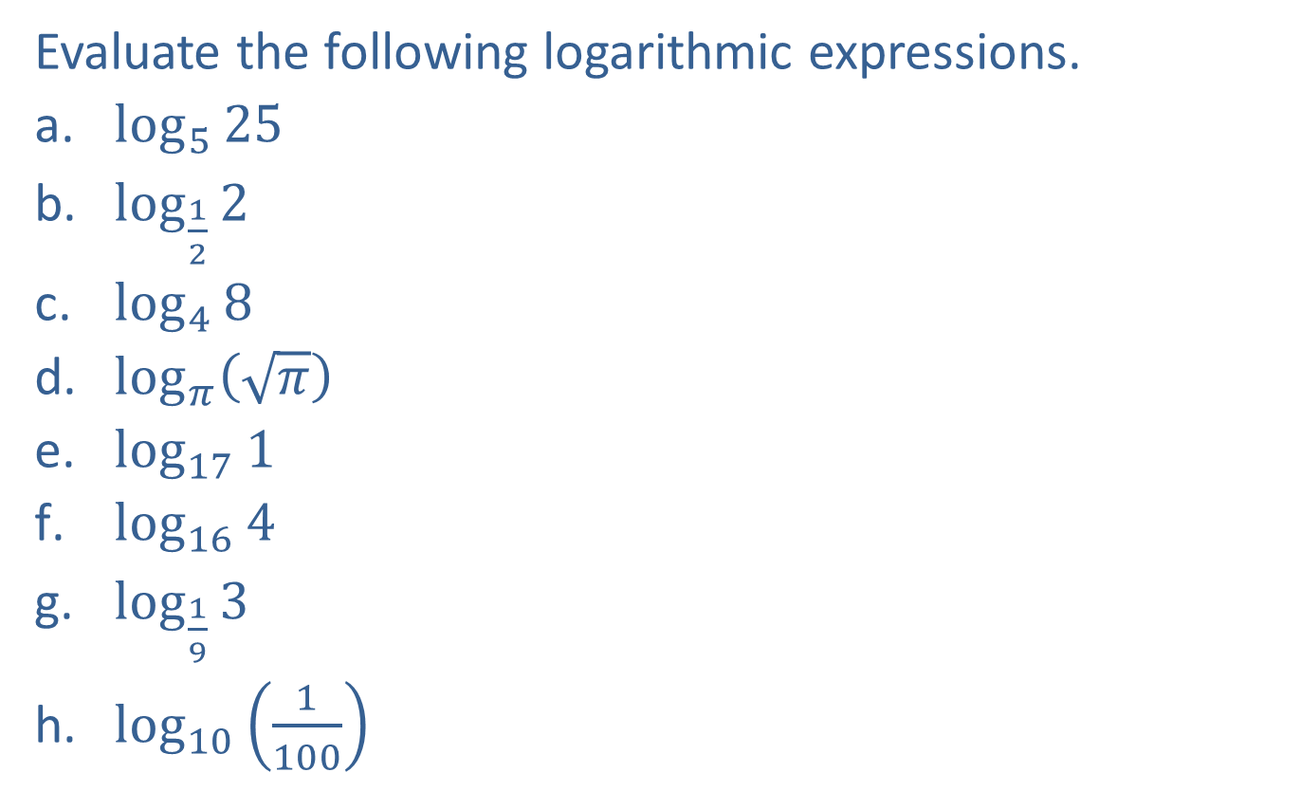
Example 4: Evaluating Elementary Logarithmic Expressions—Slide 1
Evaluate the following logarithmic expressions.
​$\log_{5}⁡25$
​$\log_{\frac{1}{2}}⁡2$
​$\log_{4}{8}$
​$\log_{π}⁡\left(\sqrt{π}\right)$
​$\log_{17}⁡1$
​$\log_{16}⁡4$
​$\log_{\frac{1}{9}}{3}$
​$\log_{10}⁡\left(\frac{1}{100}\right)$

Slide 16
Note 3
We write each of the equivalent exponential equations as a reference.

Slide 17
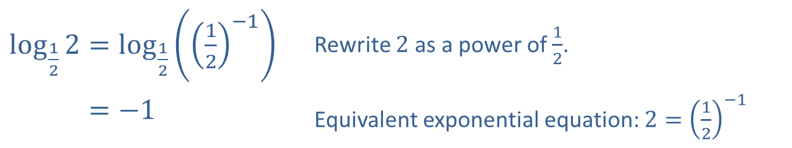
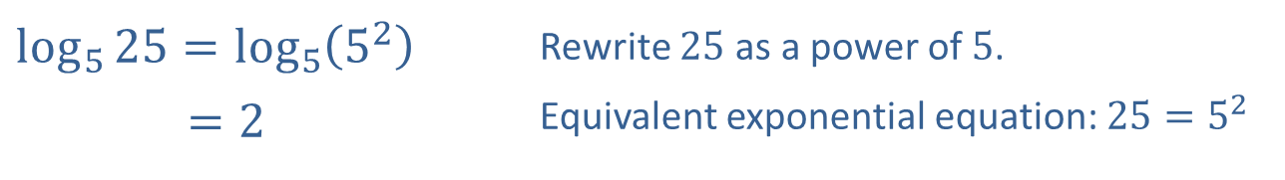
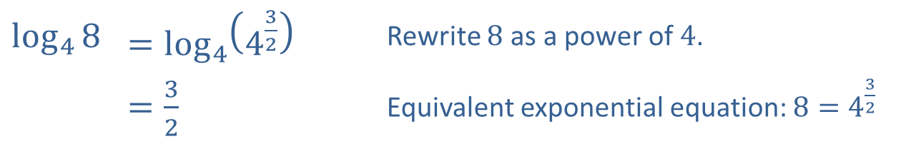
Example 4: Evaluating Elementary Logarithmic Expressions—Slide 2
Solution
​
​$\log_{5}{25}=\log_{5}\left(5^{2}\right)$ | Rewrite 25 as a power of 5.
​𝑙𝑜𝑔5⁡25=2 | Equivalent exponential equation: $25=5^{2}$
​$\log_{\frac{1}{2}}{2}=\log_{\frac{1}{2}}\left({\left(\frac{1}{2}\right)}^{−1}\right)$ | Rewrite 2 as a power of $\frac{1}{2}$.
​log12⁡2=−1 | Equivalent exponential equation: $2={\left(\frac{1}{2}\right)}^{−1}$
​
​$\log_{4}⁡8$ | ​$=\log_{4}\left(4^{\frac{3}{2}}\right)$ | Rewrite 8 as a power of 4.
​ | ​$=\frac{3}{2}$ | Equivalent exponential equation: $8=4^{\frac{3}{2}}$
​

Slide 18
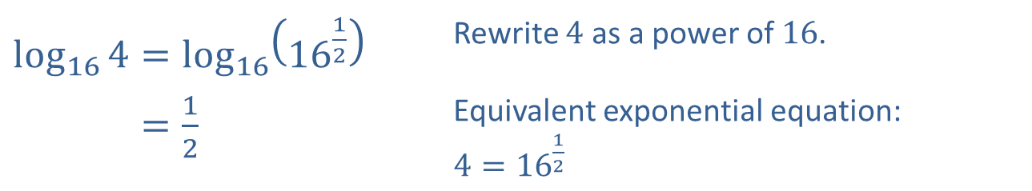
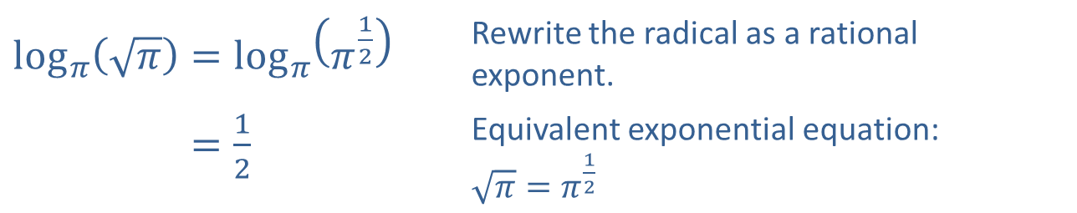
Example 4: Evaluating Elementary Logarithmic Expressions—Slide 3
​$\log_{π}\left(\sqrt{π}\right)=\log_{π}\left(π^{\frac{1}{2}}\right)$ | Rewrite the radical as a rational exponent.
​log𝜋⁡𝜋=12 | Equivalent exponential equation: $\sqrt{π}=π^{\frac{1}{2}}$
​
e.​
$$log_{17}1=0$$ | Equivalent exponential equation: $1=17^{0}$
​$\log_{16}{4}=\log_{16}\left({16}^{\frac{1}{2}}\right)$ | Rewrite 4 as a power of 16.
​log16⁡4=12 | Equivalent exponential equation: $4={16}^{\frac{1}{2}}$
f.​

Slide 19
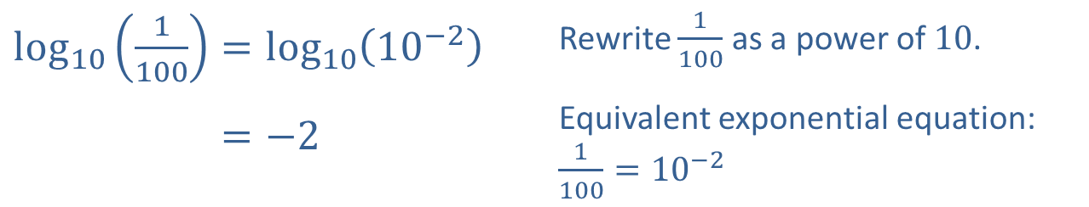
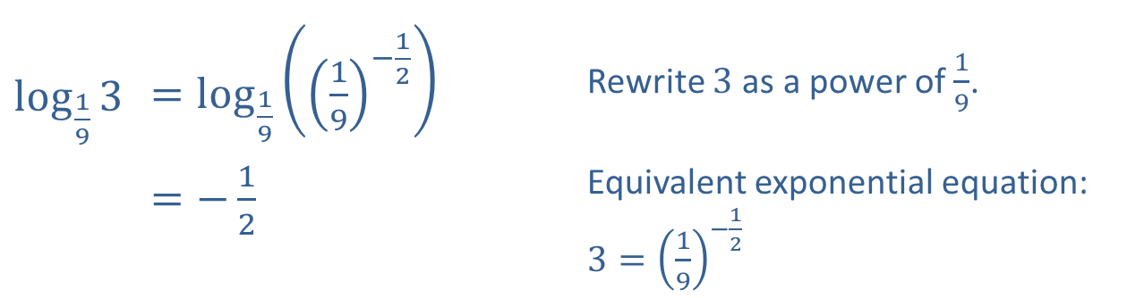
Example 4: Evaluating Elementary Logarithmic Expressions—Slide 4
​$\log_{\frac{1}{9}}⁡3$ | ​$=\log_{\frac{1}{9}}\left({\left(\frac{1}{9}\right)}^{−\frac{1}{2}}\right)$ | Rewrite 3 as a power of $\frac{1}{9}$.
 | ​$=−\frac{1}{2}$ | Equivalent exponential equation: $3={\left(\frac{1}{9}\right)}^{−\frac{1}{2}}$
​
​$\log_{10}\left(\frac{1}{100}\right)=\log_{10}\left({10}^{−2}\right)$ | Rewrite $\frac{1}{100}$ as a power of 10.
​log10⁡1100=−2 | Equivalent exponential equation: $\frac{1}{100}={10}^{−2}$
​

Slide 20

Example 5: Solving Elementary Logarithmic Equations—Slide 1
Use elementary properties of exponents and logarithms to solve the following equations.
​$\log_{6}\left(2x\right)=−1$
​$3^{\log_{3x}{2}}=2$

Slide 21
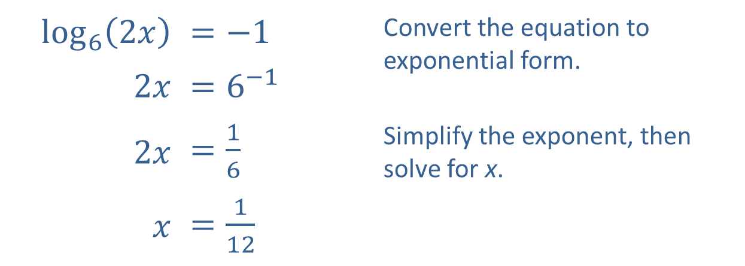
Example 5: Solving Elementary Logarithmic Equations—Slide 2
Solution
​
​$\log_{6}⁡\left(2x\right)$ | ​$=−1$ | Convert the equation to exponential form.
​$2x$ | ​$=6^{−1}$
​$2x$ | ​$=\frac{1}{6}$ | Simplify the exponent, then solve for x.
$x$ | ​$=\frac{1}{12}$

Slide 22
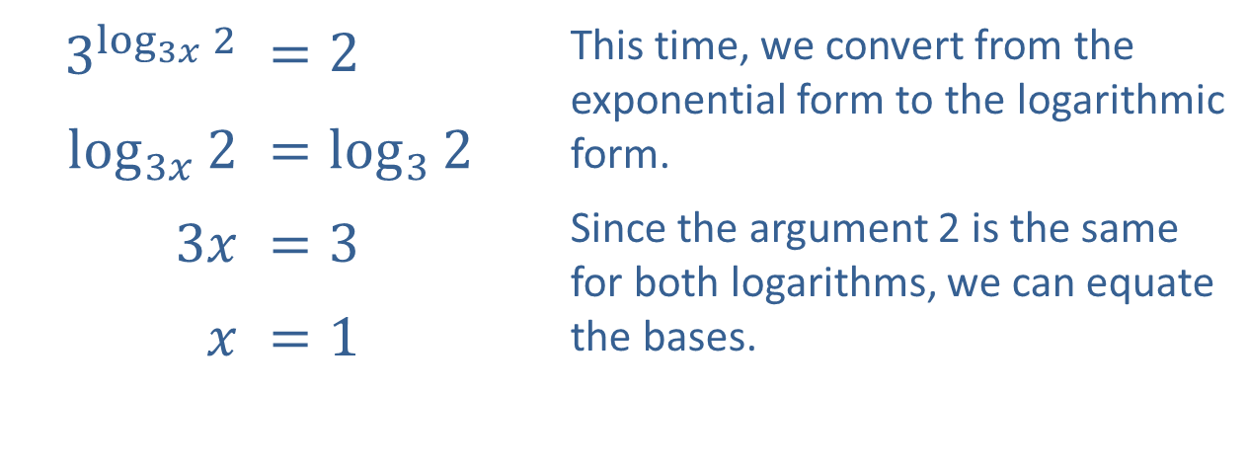
Example 5: Solving Elementary Logarithmic Equations—Slide 3
​$3^{\log_{3x}{2}}$ | ​$=2$ | This time, we convert from the exponential form to the logarithmic form. Since the argument 2 is the same for both logarithms, we can equate the bases.
​$\log_{3x}⁡2$ | ​$=\log_{3}{2}$
​$3x$ | ​$=3$
$x$ | ​$=1$
​

Slide 23
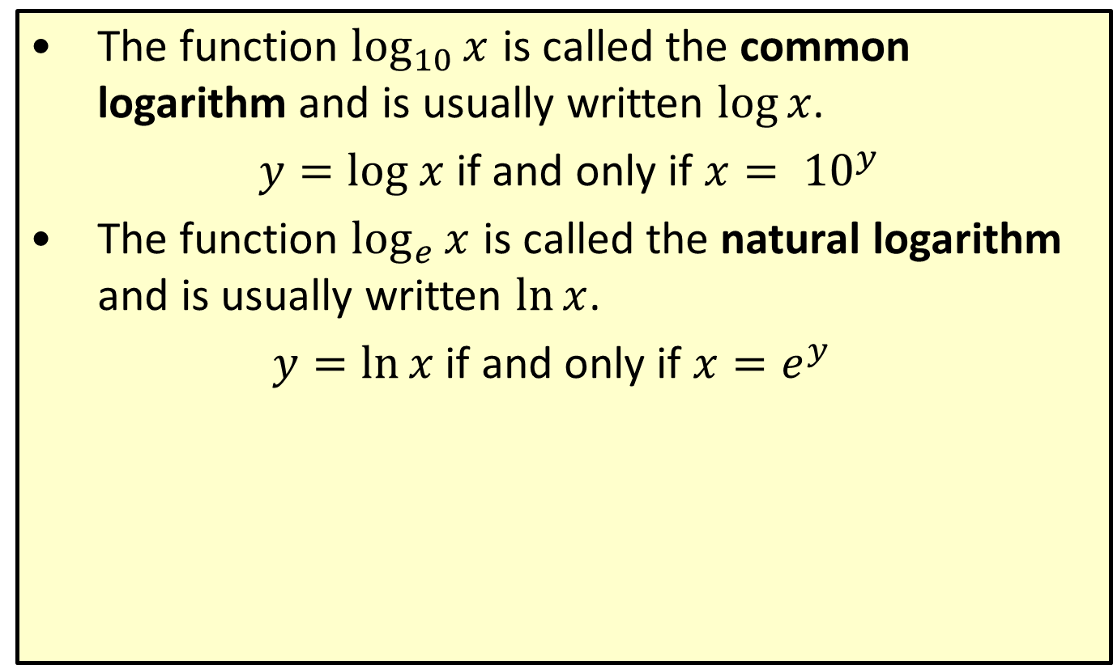
Definition: Common and Natural Logarithms
​The function $\log_{10}⁡x$ is called the common logarithm and is usually written $log⁡x$.
$y=log x$ if and only if $x= {10}^{y}$
​The function $\log_{e}⁡x$ is called the natural logarithm and is usually written $ln⁡x$.
$y=\ln{x}$ if and only if $x=e^{y}$

Slide 24
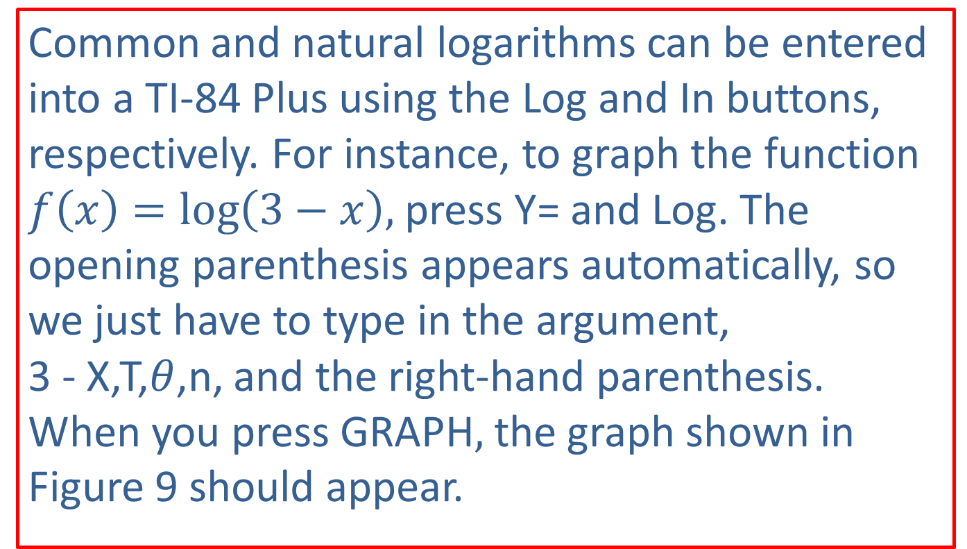
Technology: Inputting Logarithms, Graphing Logarithmic Functions—Slide 1
Common and natural logarithms can be entered into a TI-84 Plus using the Log and In buttons, respectively. For instance, to graph the function $f\left(x\right)=log\left(3−x\right),$ press Y= and Log. The opening parenthesis appears automatically, so we just have to type in the argument, 3 - X,T,$θ$,n, and the right-hand parenthesis. When you press graph$,$the graph shown in Figure 9 should appear.

Slide 25
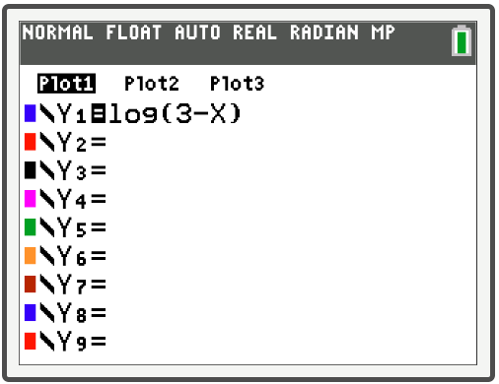
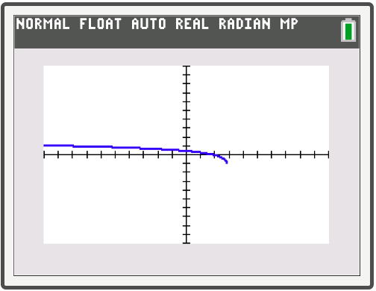
Technology: Inputting Logarithms, Graphing Logarithmic Functions—Slide 2
Figure 8
Figure 9

Slide 26
CAUTION!—2
Notice that the graph appears to cut off around the point where x = 3. We know, however, that the graph has a vertical asymptote at x = 3, and approaches that asymptote even though it does not show on the graphing calculator.

Slide 27
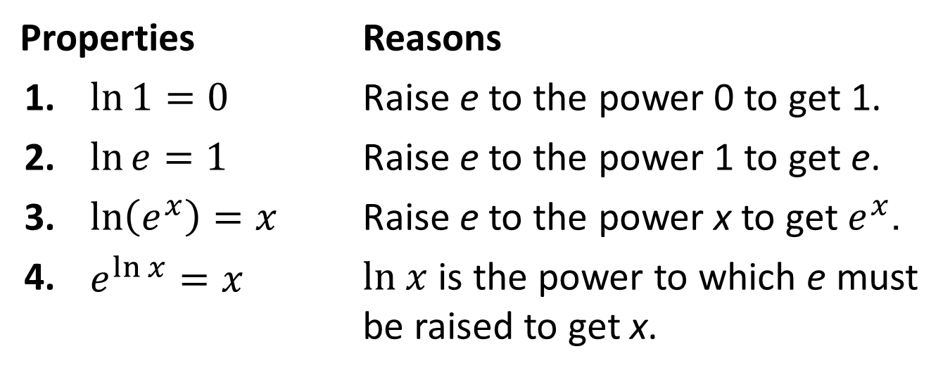

Properties: Properties of Natural Logarithms
$$\ln{x}=y \text{⇔}{ e}^{y}=x$$
Properties |  | Reasons
1. | $\ln{1}=0$ | Raise e to the power 0 to get 1.
2. | $\ln{e}=1$ | Raise e to the power 1 to get e.
3. | $\ln\left(e^{x}\right)=x$ | Raise e to the power x to get $e^{x}$.
4. | $e^{\ln{x}}=x$ | $ln x$ is the power to which e must be raised to get x.

Slide 28
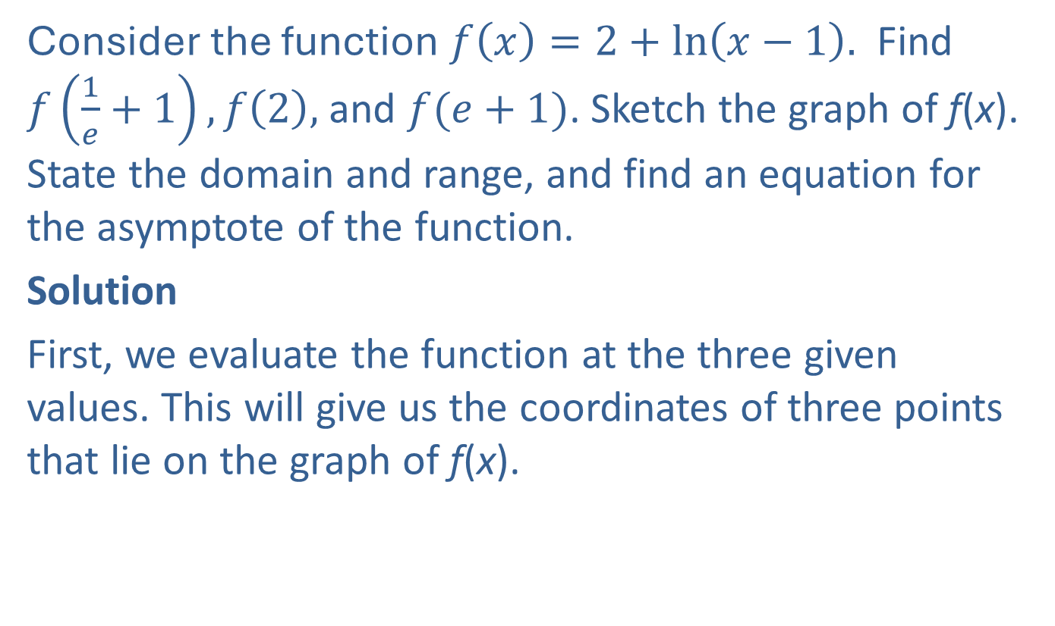
Example 6: Graphing the Natural Logarithm with Transformations—Slide 1
Consider the function $f\left(x\right)=2+ln\left(x−1\right).$ Find $f\left(\frac{1}{e}+1\right), f\left(2\right),$ and $f(e+1)$. Sketch the graph of f(x). State the domain and range, and find an equation for the asymptote of the function.
Solution
First, we evaluate the function at the three given values. This will give us the coordinates of three points that lie on the graph of f(x).

Slide 29
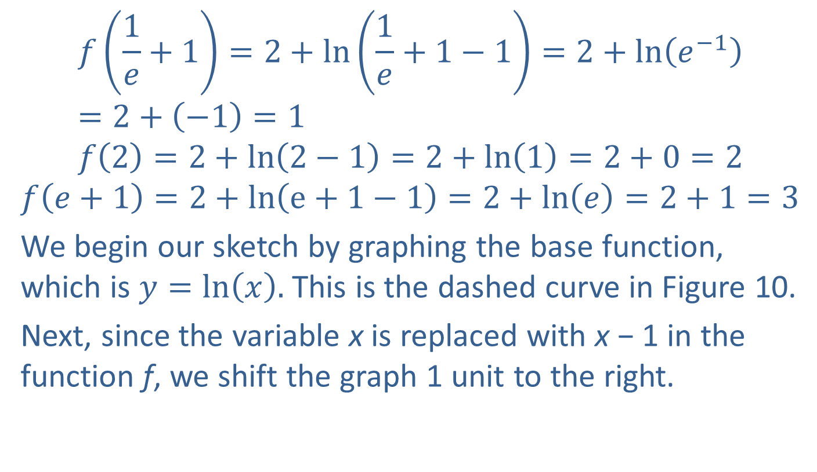
Example 6: Graphing the Natural Logarithm with Transformations—Slide 2
$$f\left(\frac{1}{e}+1\right)=2+ln\left(\frac{1}{e}+1−1\right)=2+ln\left(e^{−1}\right)=2+\left(−1\right)=1$$
$$f\left(2\right)=2+ln\left(2−1\right)=2+ln\left(1\right)=2+0=2$$
$$f\left(e+1\right)=2+ln\left(e+1−1\right)=2+ln\left(e\right)=2+1=3$$
We begin our sketch by graphing the base function, which is $y=ln\left(x\right).$ This is the dashed curve in Figure 10.
Next, since the variable x is replaced with x − 1 in the function f, we shift the graph 1 unit to the right.

Slide 30
Example 6: Graphing the Natural Logarithm with Transformations—Slide 3
Finally, we shift the graph upward by 2 units since 2 is added to the function. The graph of f is the solid curve in Figure 10.
Notice that the vertical asymptote has also shifted to the right, and the points we found lie on the curve.

Slide 31
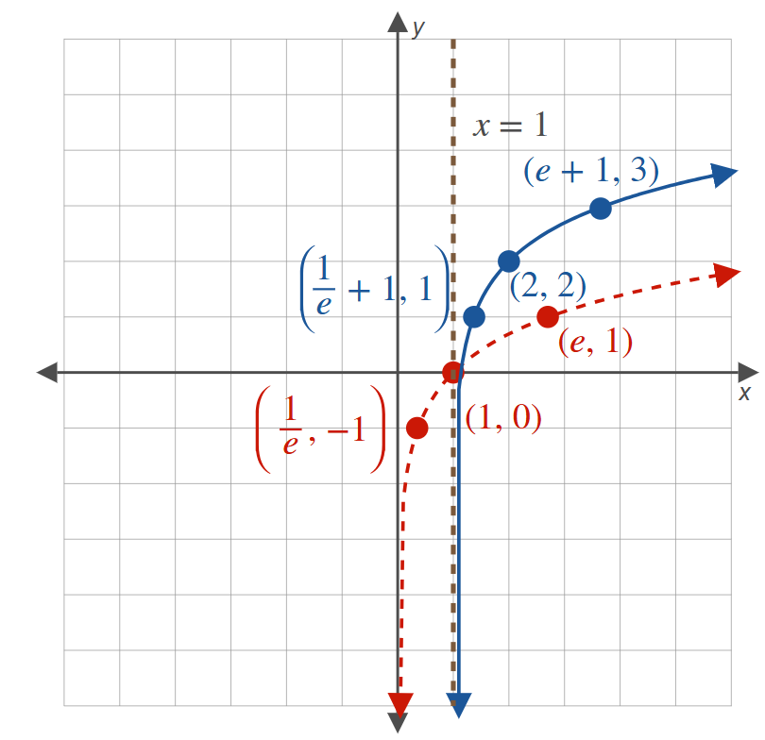
Example 6: Graphing the Natural Logarithm with Transformations—Slide 4
Figure 10
Domain$=(1,∞)$, Range $=\left(−∞,∞\right)$, Vertical asymptote: x $=$ 1

