Slide 1
Section 3.R.1
Exponential Functions

Slide 2
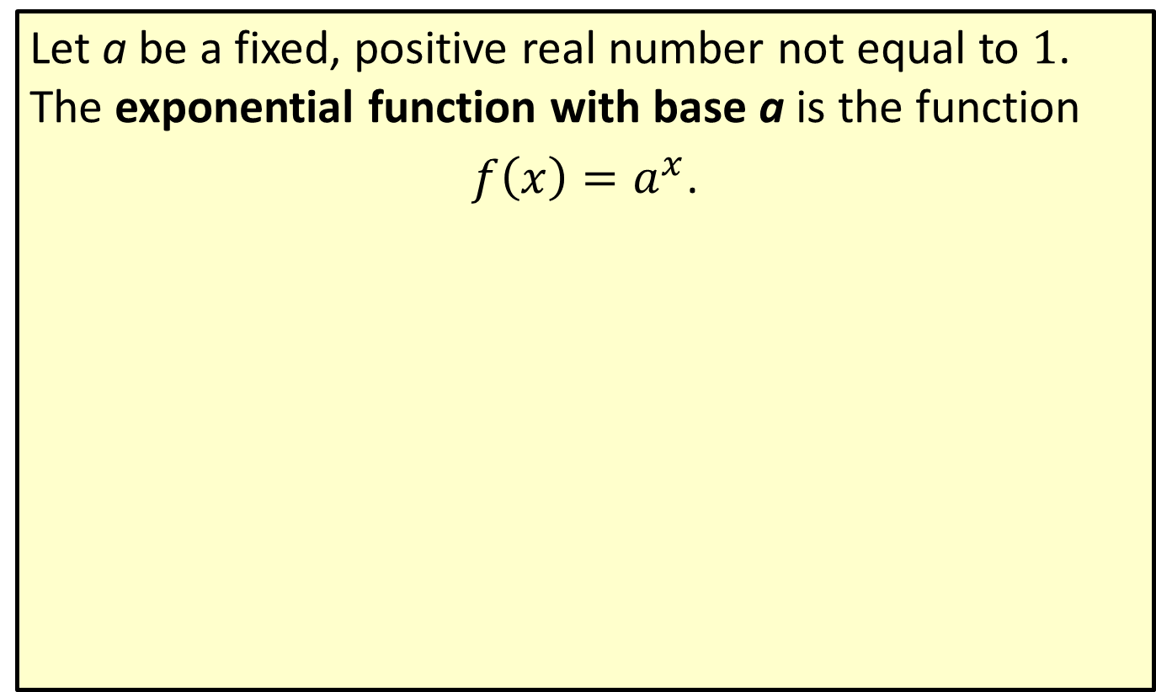
Definition: Exponential Functions
Let a be a fixed, positive real number not equal to 1. The exponential function with base a is the function
$f\left(x\right)=a^{x}$.

Slide 3
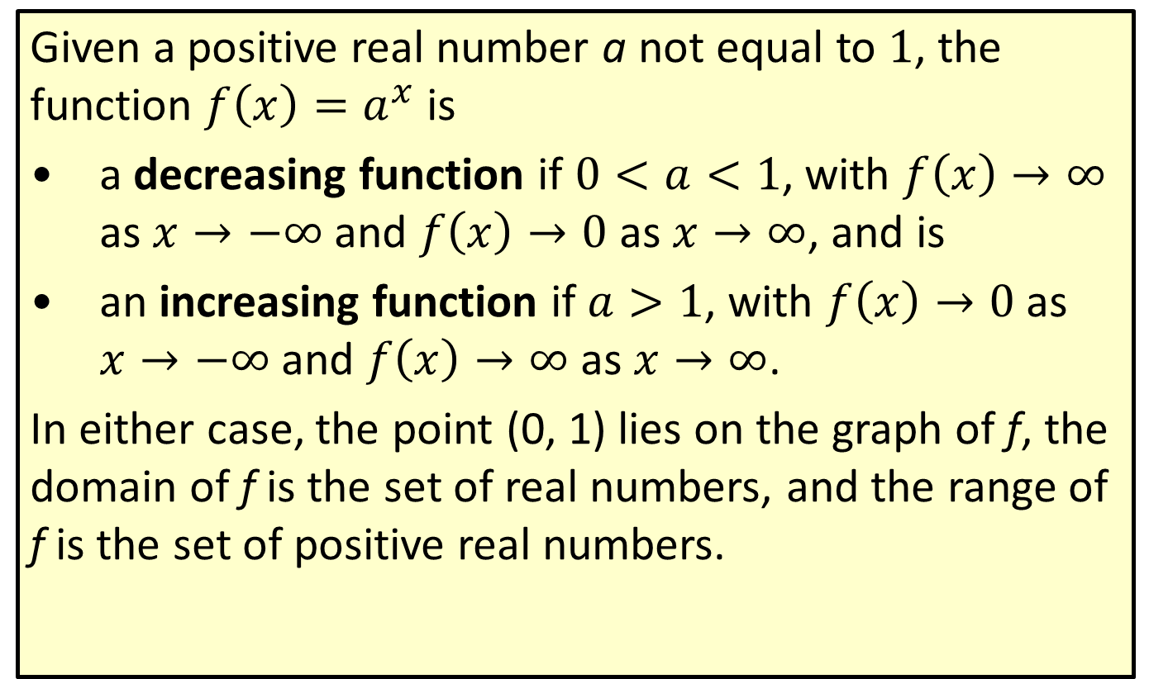
Properties: Behavior of Exponential Functions
Given a positive real number a not equal to 1, the function $f\left(x\right)=a^{x}$ is
​a decreasing function if $0<a<1$, with $f\left(x\right)→∞$ as $x→−∞$ and $f\left(x\right)→0$ as $x→∞$, and is
​an increasing function if $a>1$, with $f\left(x\right)→0$ as $x→−∞$ and $f\left(x\right)→∞$ as $x→∞$.
In either case, the point (0, 1) lies on the graph of f, the domain of f is the set of real numbers, and the range of f is the set of positive real numbers.

Slide 4
Example 1: Graphing Exponential Functions—Slide 1
Sketch the graphs of the following exponential functions.
​$f\left(x\right)=3^{x}$
​$g\left(x\right)={\left(\frac{1}{2}\right)}^{x}$

Slide 5
Note 1
Plugging in x = −1, x = 0, and x = 1 will produce a good idea of the shape of the graph.

Slide 6
Example 1: Graphing Exponential Functions—Slide 2
Solution
In both cases, we plot 3 points by plugging in x = −1, x = 0, and x = 1. We then connect the points with a smooth curve.

Slide 7
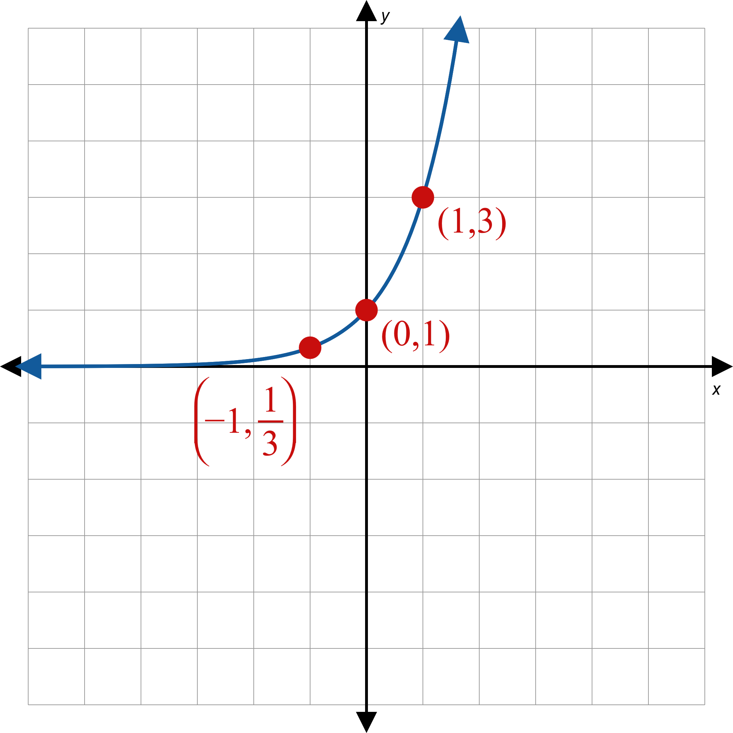
Example 1: Graphing Exponential Functions—Slide 3
a.
Figure 2

Slide 8
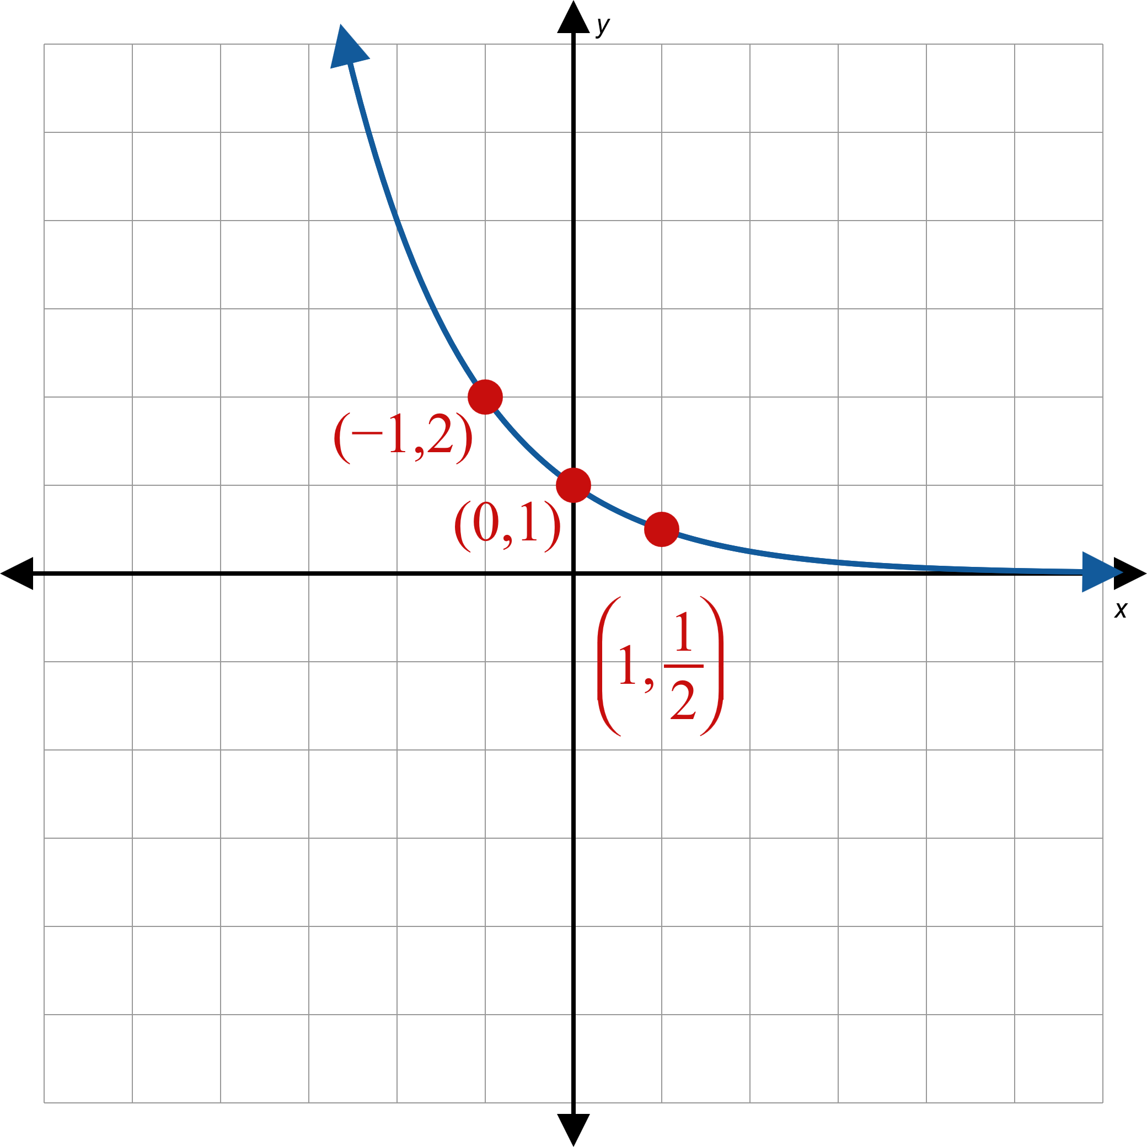
Example 1: Graphing Exponential Functions—Slide 4
b.
Figure 3

Slide 9
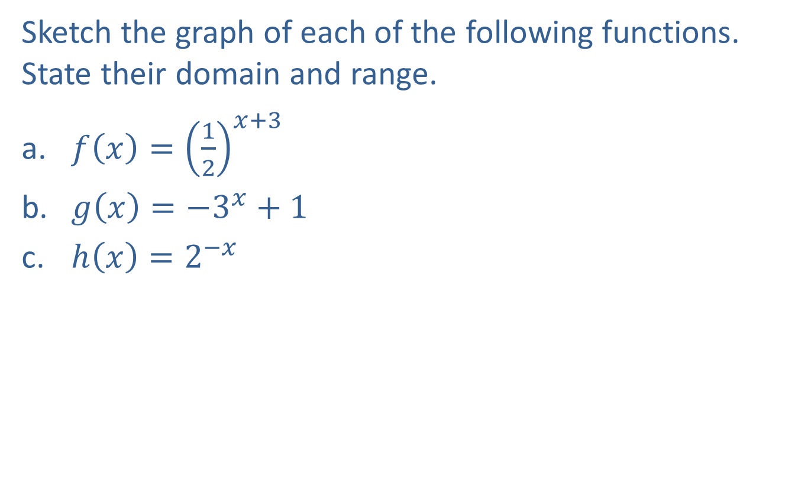
Example 2: Graphing Exponential Functions with Transformations—Slide 1
Sketch the graph of each of the following functions. State their domain and range.
​$f\left(x\right)={\left(\frac{1}{2}\right)}^{x+3}$
​$g\left(x\right)=−3^{x}+1$
​$h\left(x\right)=2^{−x}$

Slide 10
Note 2
For each example, first graph the base function, then apply any transformations.

Slide 11

Example 2: Graphing Exponential Functions with Transformations—Slide 2
Solution
First, draw the graph of the function ${\left(\frac{1}{2}\right)}^{x}$, as in Example 1b. Then, since x has been replaced by x + 3, shift the graph to the left by 3 units.

Slide 12
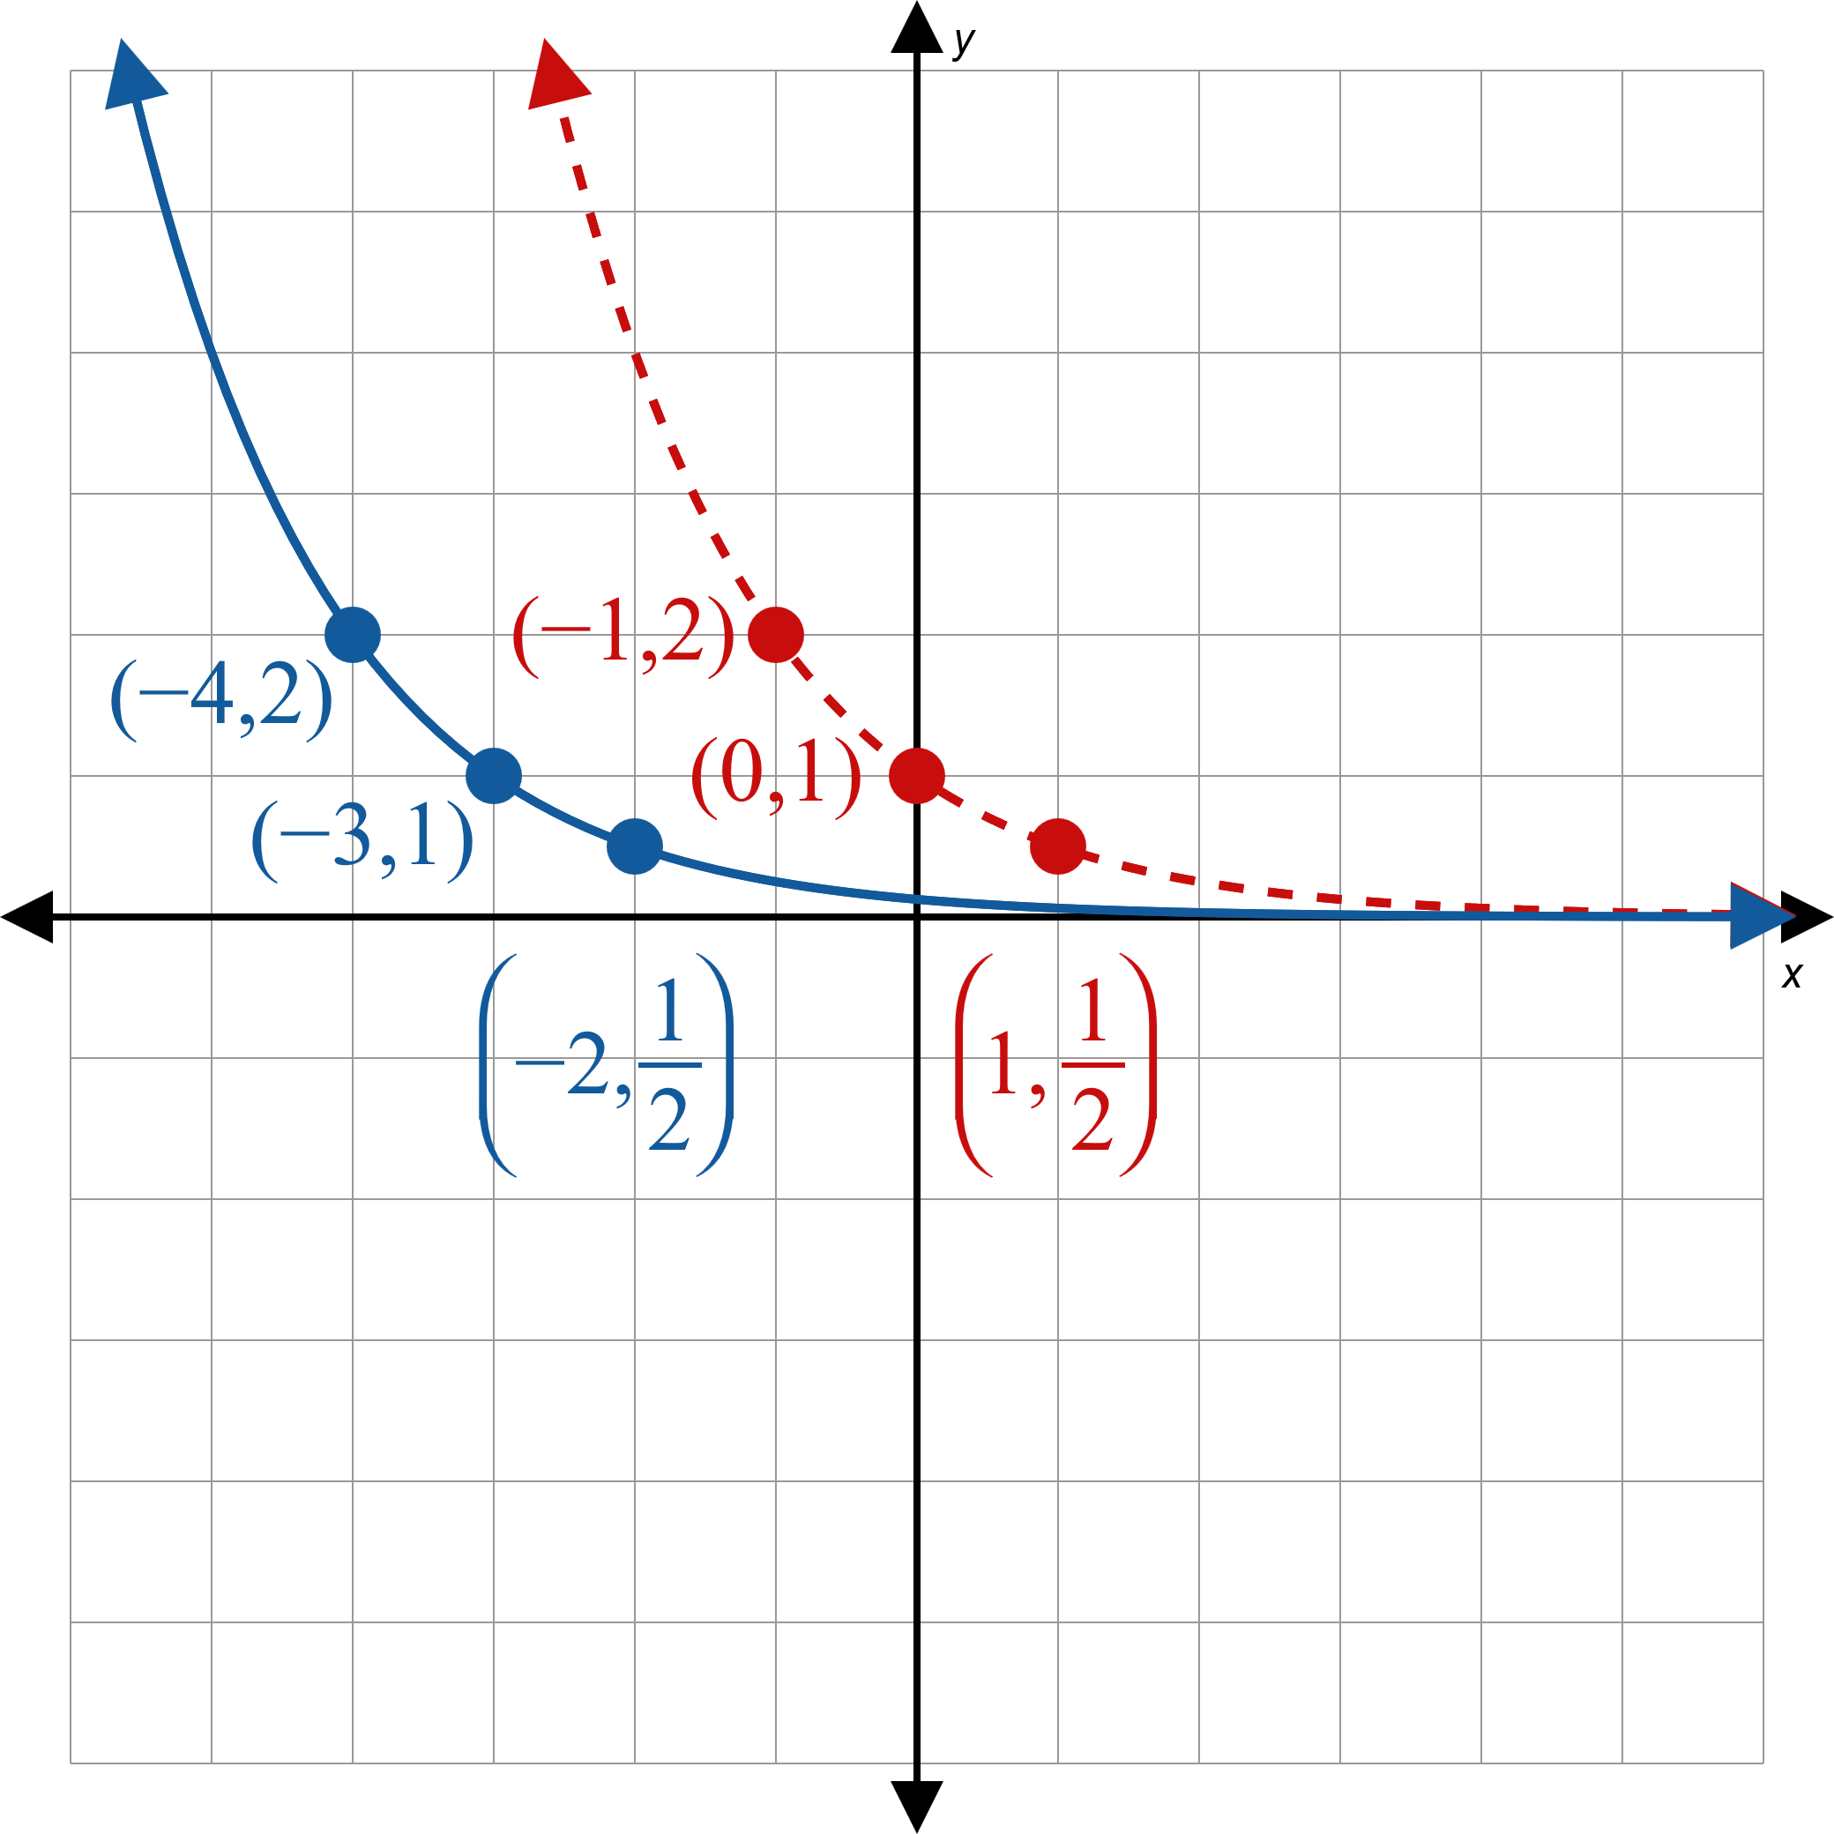
Example 2: Graphing Exponential Functions with Transformations—Slide 3
Figure 4

Slide 13
Example 2: Graphing Exponential Functions with Transformations—Slide 4
Domain $=(−∞, ∞)$, Range $=(0, ∞)$

Slide 14
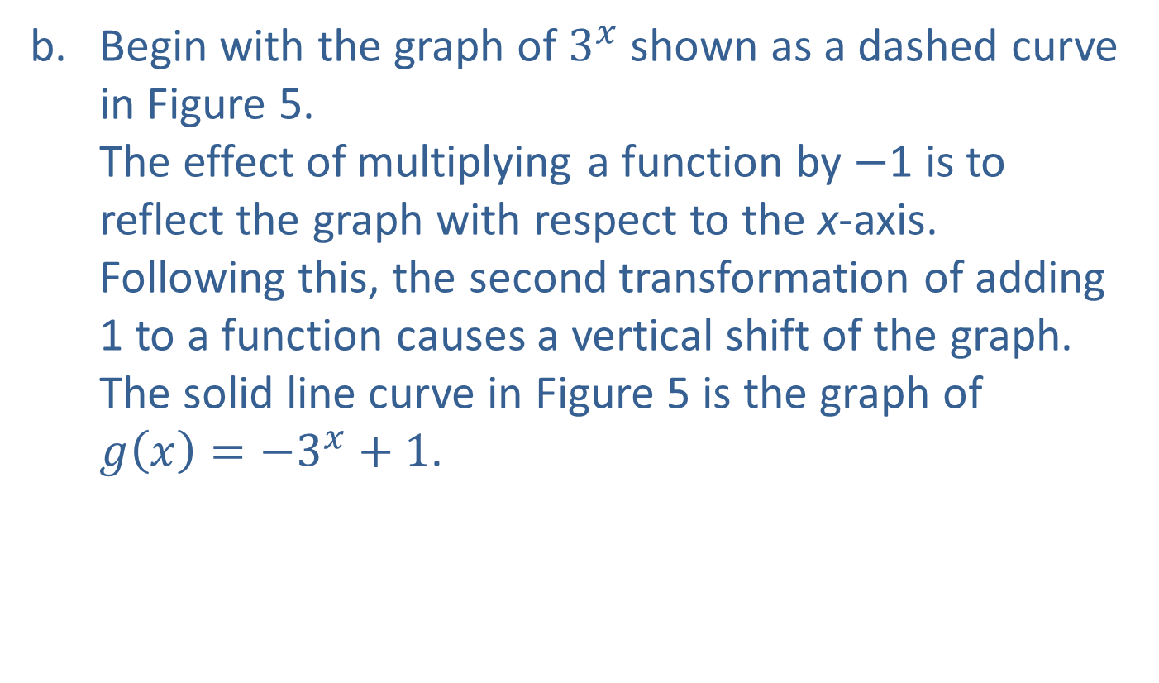
Example 2: Graphing Exponential Functions with Transformations—Slide 5
Begin with the graph of $3^{x}$ shown as a dashed curve in Figure 5. The effect of multiplying a function by −1 is to reflect the graph with respect to the x-axis. Following this, the second transformation of adding 1 to a function causes a vertical shift of the graph. The solid line curve in Figure 5 is the graph of $g\left(x\right)=−3^{x}+1$.

Slide 15
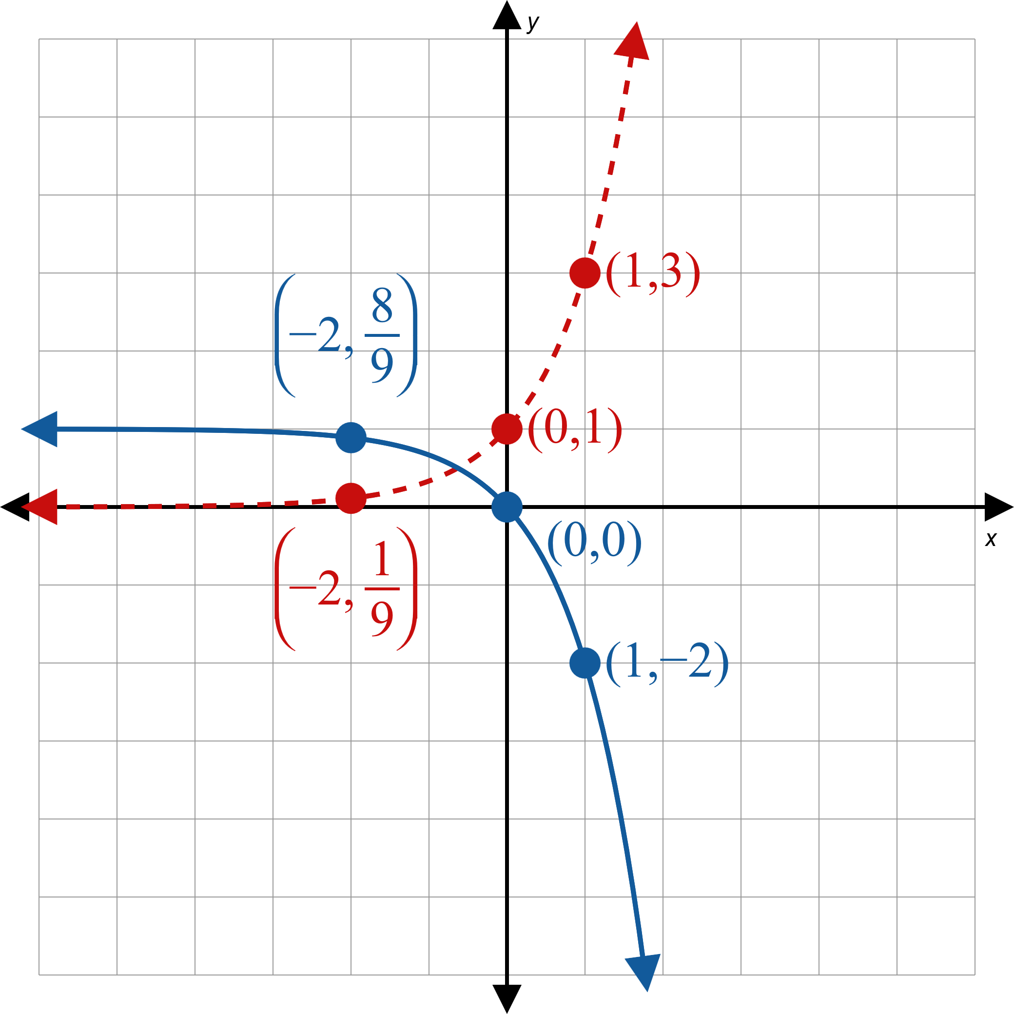
Example 2: Graphing Exponential Functions with Transformations—Slide 6
Figure 5

Slide 16
Example 2: Graphing Exponential Functions with Transformations—Slide 7
Domain $=(−∞, ∞)$, Range $=(−∞, 1)$

Slide 17
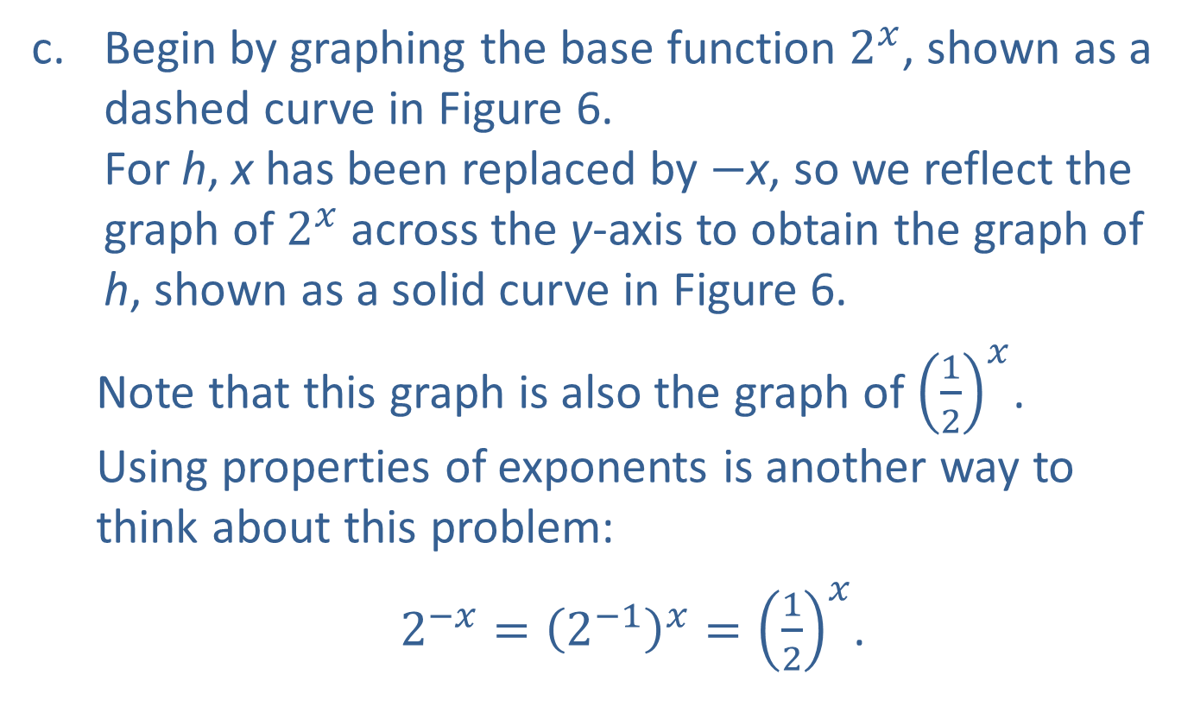
Example 2: Graphing Exponential Functions with Transformations—Slide 8
Begin by graphing the base function $2^{x}$, shown as a dashed curve in Figure 6. For h, x has been replaced by −x, so we reflect the graph of $2^{x}$ across the y-axis to obtain the graph of h, shown as a solid curve in Figure 6.
Note that this graph is also the graph of ${\left(\frac{1}{2}\right)}^{x}$. Using properties of exponents is another way to think about this problem:
$2^{−x}={\left(2^{−1}\right)}^{x}={\left(\frac{1}{2}\right)}^{x}$.

Slide 18
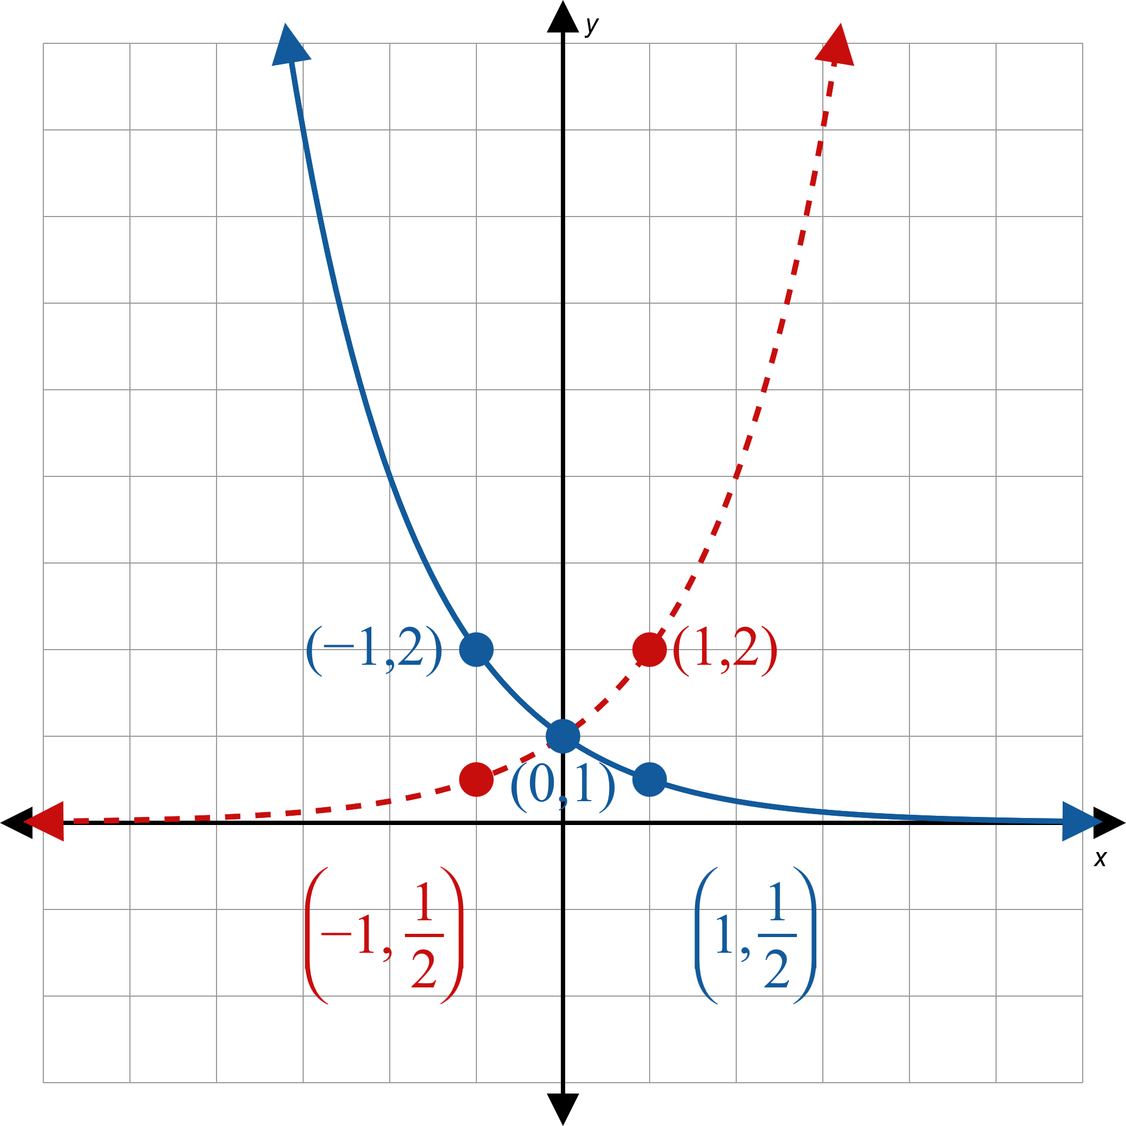
Example 2: Graphing Exponential Functions with Transformations—Slide 9
Figure 6

Slide 19
Example 2: Graphing Exponential Functions with Transformations—Slide 10
Domain $=(−∞, ∞)$, Range $=(0, ∞)$

Slide 20
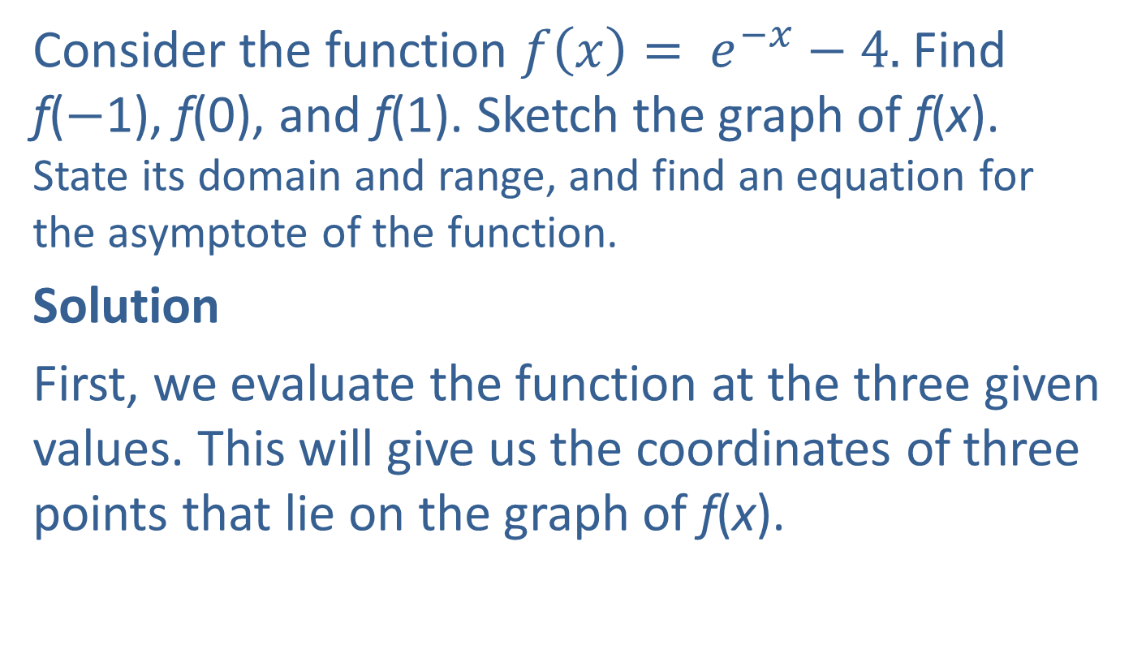
Example 3: Graphing the Natural Exponential Function with Transformations—Slide 1
Consider the function $f\left(x\right)= e^{−x}−4.$Find f(−1), f(0), and f(1). Sketch the graph of f(x). State its domain and range, and find an equation for the asymptote of the function.
Solution
First, we evaluate the function at the three given values. This will give us the coordinates of three points that lie on the graph of f(x).

Slide 21
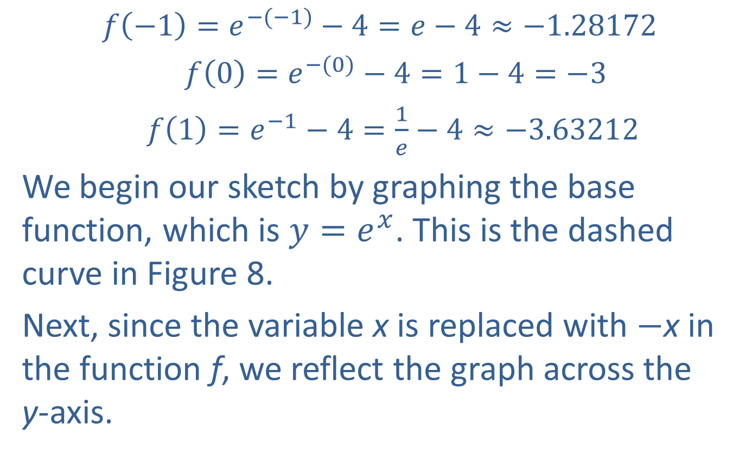
Example 3: Graphing the Natural Exponential Function with Transformations—Slide 2
$$f\left(−1\right)=e^{−(−1)}−4=e−4≈−1.28172$$
$f\left(0\right)=e^{−(0)}−4=1−4=−3$
$f\left(1\right)=e^{−1}−4=\frac{1}{e}−4≈−3.63212$
We begin our sketch by graphing the base function, which is $y=e^{x}$. This is the dashed curve in Figure 8.
Next, since the variable x is replaced with −x in the function f, we reflect the graph across the y-axis.

Slide 22
Example 3: Graphing the Natural Exponential Function with Transformations—Slide 3
Finally, we shift the graph downward by 4 units since 4 is subtracted from the function. The graph of f is the solid curve in Figure 8.
Notice that the horizontal asymptote has also shifted downward, and the points we found lie on the curve.

Slide 23
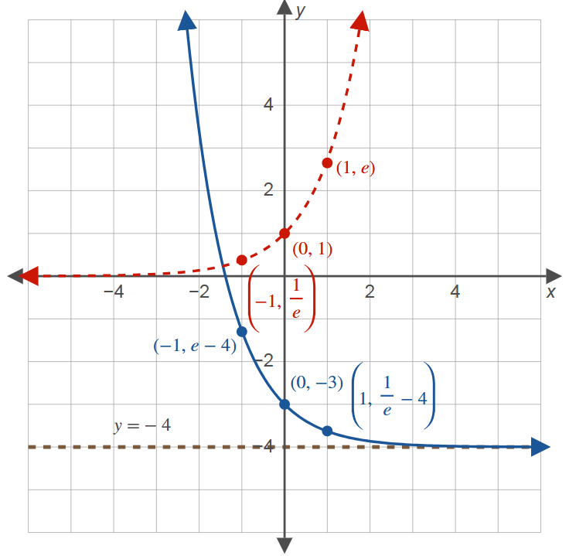
Example 3: Graphing the Natural Exponential Function with Transformations—Slide 4
Figure 8

Slide 24

Example 3: Graphing the Natural Exponential Function with Transformations—Slide 5
Domain $=\left(−∞,∞\right)$, Range $=\left(−4,∞\right)$, Horizontal asymptote: y = −4

