Slide 1
Section 2.R.5
Linear Inequalities in One Variable

Slide 2
Example 1: Multiplying Inequalities by Negative Numbers—Slide 1
Consider the following two inequalities: −3 < 2 and x < 0. Observe what happens if we multiply both sides of each inequality by −1.
​The statement −3 < 2 is true, but if we multiply both sides by −1, we obtain the false statement 3 < − 2.
​Now consider the inequality x < 0. If we multiply both sides by −1, we have the inequality − x < 0. But these two statements can't both be true!

Slide 3
Example 1: Multiplying Inequalities by Negative Numbers—Slide 2
These examples show that multiplicative cancellation must behave a bit differently for linear inequalities. Note that if we reverse the inequality sign in our results, we actually get true statements. This provides a clue to how we approach multiplicative cancellation in the case of linear inequalities.

Slide 4
Properties: Cancellation Properties for Inequalities—Slide 1
In the following properties, A, B, and C represent algebraic expressions and D represents a nonzero constant. Each of the properties is stated for the inequality symbol <, but they are also true when the symbol < is replaced with >, ≤, or ≥ and the restrictions on D remain the same.

Slide 5
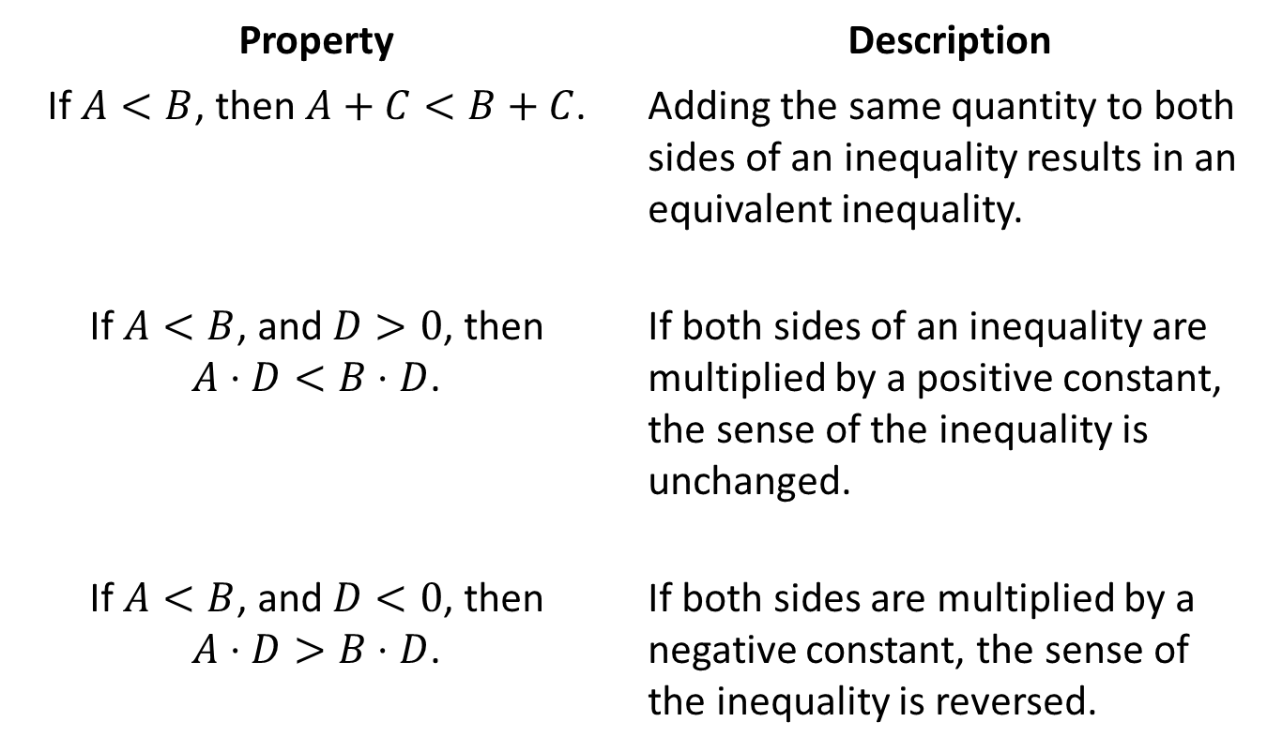
Properties: Cancellation Properties for Inequalities—Slide 2
Property | Description
If $A<B$, then $A+C<B+C$. | Adding the same quantity to both sides of an inequality results in an equivalent inequality.
If $A<B$, and $D>0$, then $A⋅D<B⋅D$. | If both sides of an inequality are multiplied by a positive constant, the sense of the inequality is unchanged.
If $A<B$, and $D<0$, then $A⋅D>B⋅D$. | If both sides are multiplied by a negative constant, the sense of the inequality is reversed.

Slide 6
Example 2: Solving Linear Inequalities—Slide 1
Solve the following inequalities, using interval notation to describe the solution set.
​ $5−2\left(x−3\right)≤−\left(1−x\right)$
​ $\frac{3\left(a−2\right)}{2}<\frac{5a}{4}$

Slide 7
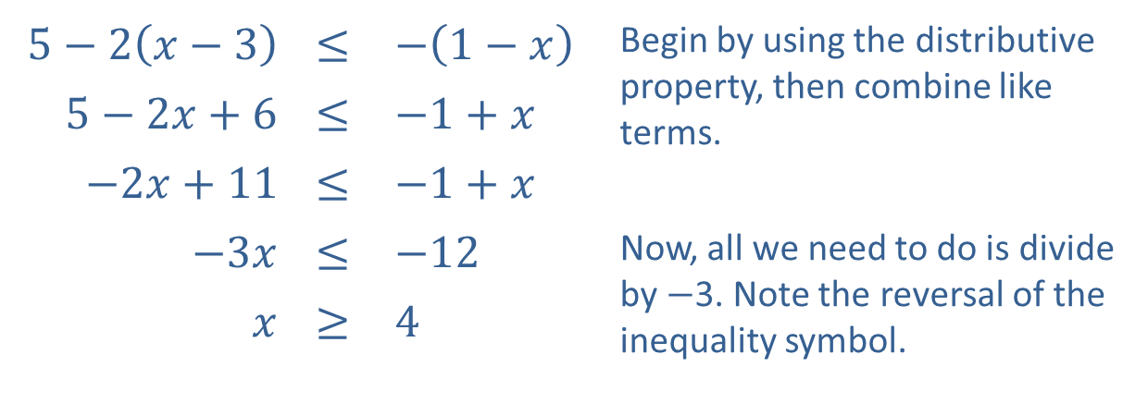
Example 2: Solving Linear Inequalities—Slide 2
Solution
​
$5−2\left(x−3\right)$ | ≤ | $−\left(1−x\right)$ | Begin by using the distributive property, then combine like terms.
$5−2x+6$ | ≤ | $−1+x$
$−2x+11$ | ≤ | $−1+x$
$−3x$ | ≤ | $−12$ | Now, all we need to do is divide by −3. Note the reversal of the inequality symbol.
$x$ | ≥ | 4
​In interval notation, the solution is $\left[4\text{, }∞\right)$.

Slide 8
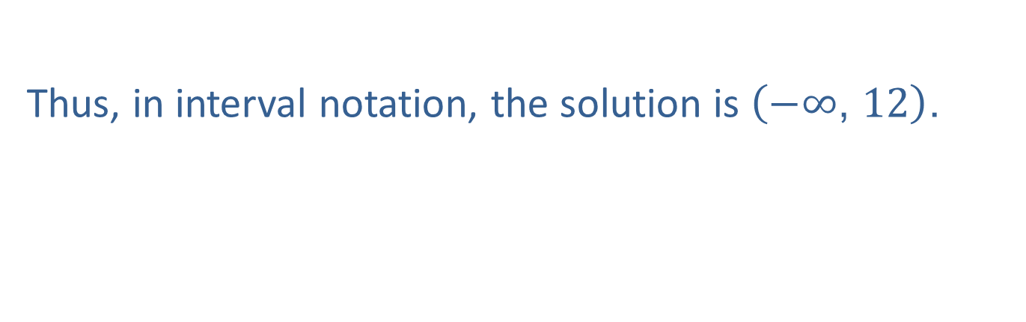
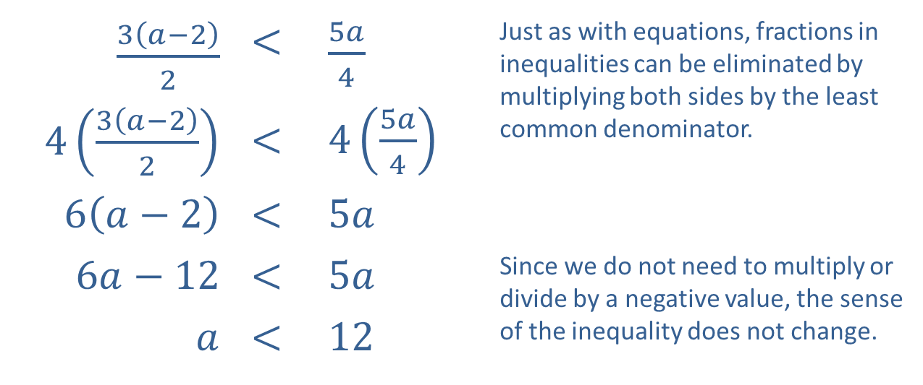
Example 2: Solving Linear Inequalities—Slide 3
$\frac{3\left(a−2\right)}{2}$ | < | $\frac{5a}{4}$ | Just as with equations, fractions in inequalities can be eliminated by multiplying both sides by the least common denominator.
$4\left(\frac{3\left(a−2\right)}{2}\right)$ | < | $4\left(\frac{5a}{4}\right)$
$6\left(a−2\right)$ | < | $5a$
$6a−12$ | < | $5a$ | Since we do not need to multiply or divide by a negative value, the sense of the inequality does not change.
$a$ | < | 12
​
​
Thus, in interval notation, the solution is $\left(−∞\text{, }12\right)$.

Slide 9

Example 3: Graphing Intervals of Real Numbers—Slide 1
Graph the following intervals.
​$[−3,6]$
​$(−∞,5]$
​$[2,9)$

Slide 10
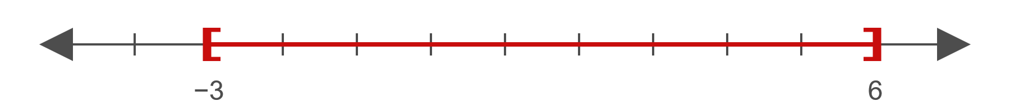
Example 3: Graphing Intervals of Real Numbers—Slide 2
Solution
​
Figure 3
Both endpoints are included in the interval.

Slide 11
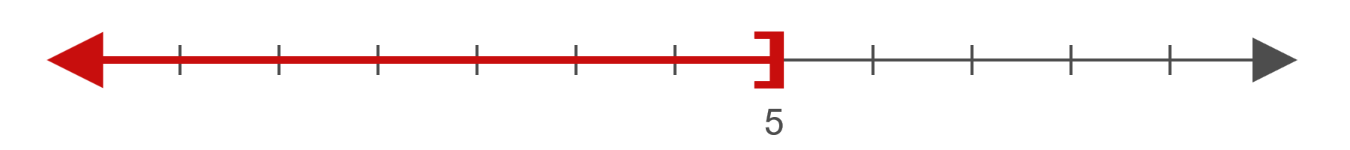
Example 3: Graphing Intervals of Real Numbers—Slide 3
​
Figure 4
The left-hand side of the graph extends to negative infinity.

Slide 12
Example 3: Graphing Intervals of Real Numbers—Slide 4
​
Figure 5
The left endpoint is included in the interval, while the right endpoint is excluded.

Slide 13

Example 4: Solving Double Linear Inequalities—Slide 1
Solve the following double inequalities.
​$−1<3−2x≤5$
​$2\left(2x−1\right)≤4x+2≤4\left(x+1\right)$

Slide 14
Note
We follow the same process in solving double inequalities as we do for standard ones. The only difference is that operations are applied to all three "sides" of the statements.

Slide 15

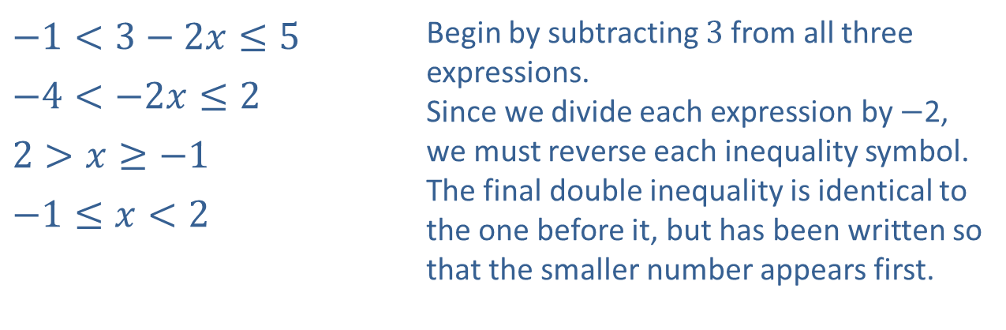
Example 4: Solving Double Linear Inequalities—Slide 2
Solution
​
​$−1<3−2x≤5$ | Begin by subtracting 3 from all three expressions. Since we divide each expression by −2, we must reverse each inequality symbol. The final double inequality is identical to the one before it, but has been written so that the smaller number appears first.
​$−4<−2x≤2$
​$2>x≥−1$
​$−1≤x<2$
​In interval notation, the solution is $[−1,2)$.

Slide 16

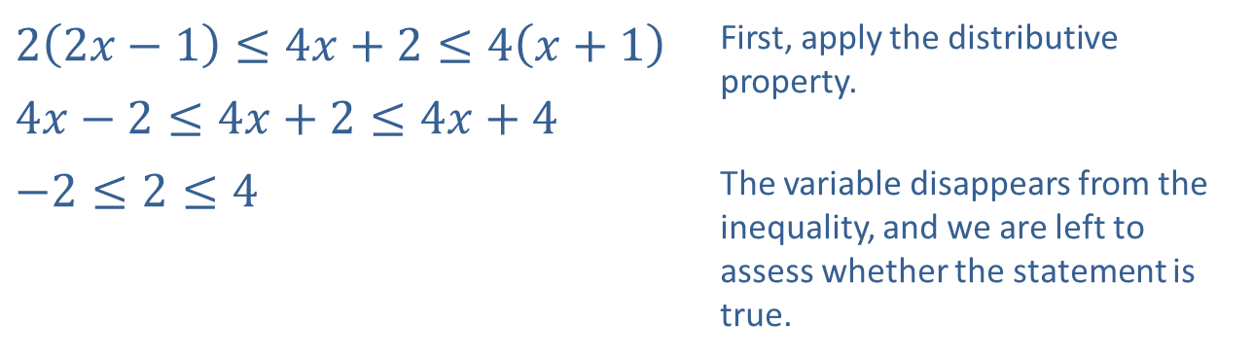
Example 4: Solving Double Linear Inequalities—Slide 3
​
​$2\left(2x−1\right)≤4x+2≤4\left(x+1\right)$ | First, apply the distributive property.
​$4x−2≤4x+2≤4x+4$
​$−2≤2≤4$ | The variable disappears from the inequality, and we are left to assess whether the statement is true.
​Since we are left with a true statement, the double inequality is true for all values of the variable x, and the solution set is $(−∞,∞)$.

Slide 17

Example 5: Solving Linear Absolute Value Inequalities—Slide 1
Solve the following absolute value inequalities.
​$\left|4−2x\right|>6$
​$2\left|3y−2\right|+3≤11$
​$\left|5+2s\right|≤−3$
​$\left|5+2s\right|≥−3$

Slide 18


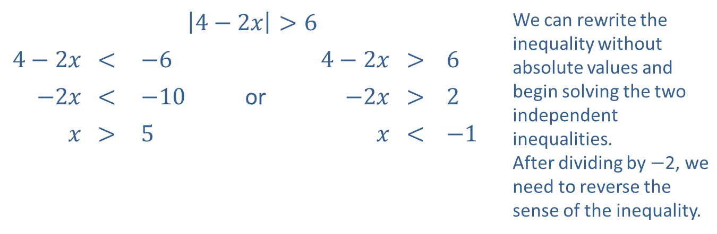
Example 5: Solving Linear Absolute Value Inequalities—Slide 2
Solution
​
​$\left|4−2x\right|>6$ |  |  |  |  |  |  | We can rewrite the inequality without absolute values and begin solving the two independent inequalities. After dividing by −2, we need to reverse the sense of the inequality.
​$4−2x$ | ​< | ​$−6$ |  | ​$4−2x$ | ​> | ​6
​$−2x$ | ​< | ​$−10$ | or | ​$−2x$ | ​> | ​2
$x$ | ​> | ​5 |  | $x$ | ​< | ​$−1$
​The solution is $(−∞,−1)∪(5,∞)$.
​
Figure 7

Slide 19
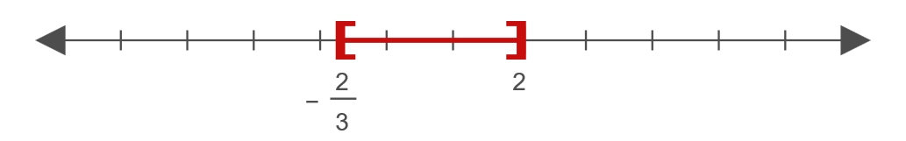

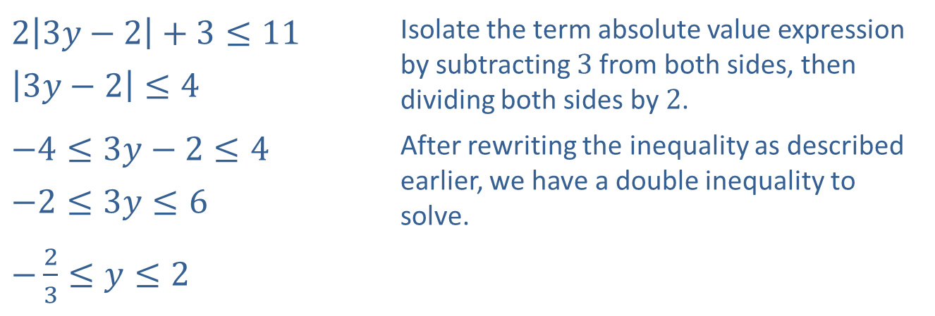
Example 5: Solving Linear Absolute Value Inequalities—Slide 3
​
​$2\left|3y−2\right|+3≤11$ | Isolate the term absolute value expression by subtracting 3 from both sides, then dividing both sides by 2.
​$\left|3y−2\right|≤4$
​$−4≤3y−2≤4$ | After rewriting the inequality as described earlier, we have a double inequality to solve.
​$−2≤3y≤6$
​$−\frac{2}{3}≤y≤2$
​Thus, the solution is $[−\frac{2}{3},2]$.
​
Figure 8

Slide 20
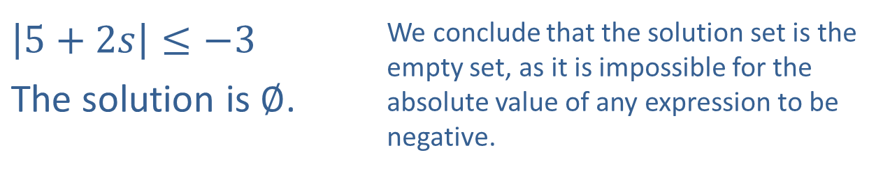
Example 5: Solving Linear Absolute Value Inequalities—Slide 4
​
$\left|5+2s\right|≤−3$ | We conclude that the solution set is the empty set, as it is impossible for the absolute value of any expression to be negative.
​The solution is $∅$.

Slide 21
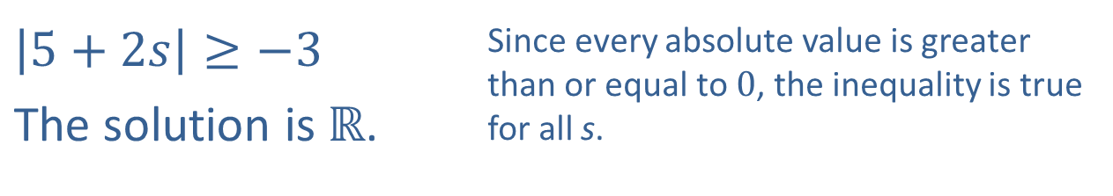
Example 5: Solving Linear Absolute Value Inequalities—Slide 5
d.
​$\left|5+2s\right|≥−3$ | Since every absolute value is greater than or equal to 0, the inequality is true for all s.
The solution is $ℝ$.

