Slide 1
Section 2.R.4
Linear Equations in One Variable

Slide 2
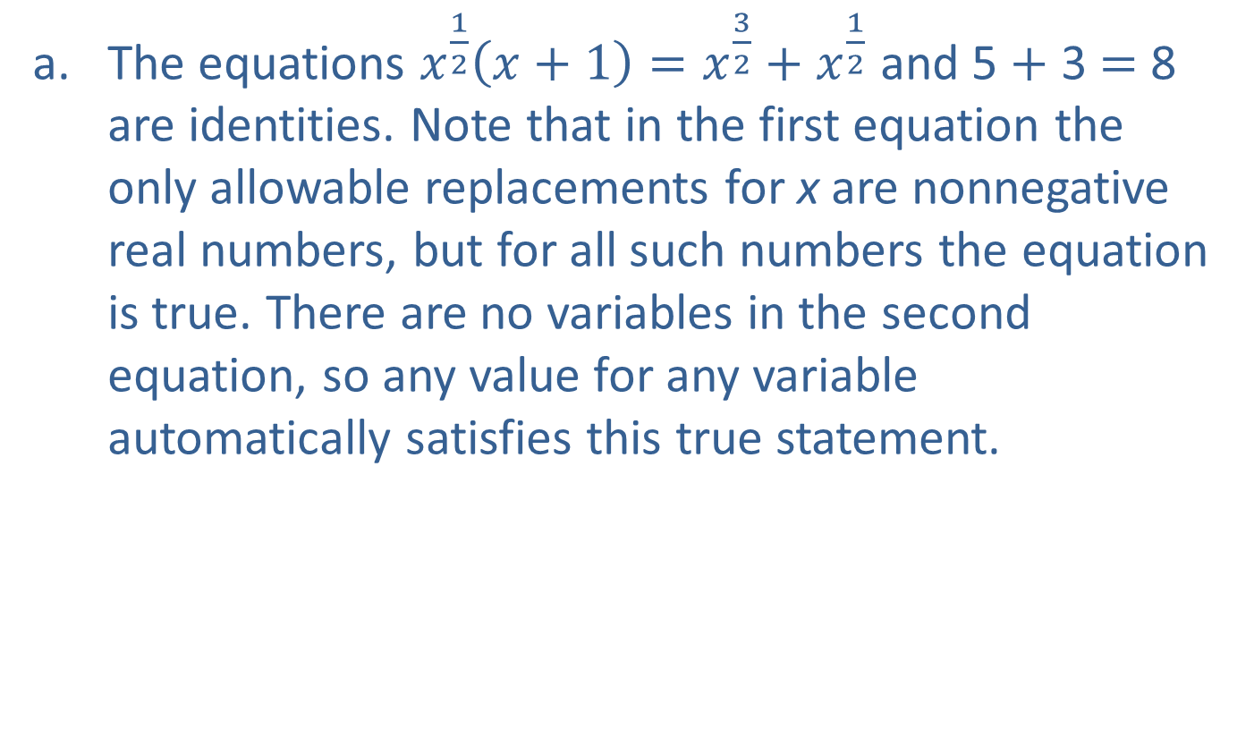
Example 1: Identifying Types of Equations—Slide 1
​The equations $x^{\frac{1}{2}}\left(x+1\right)=x^{\frac{3}{2}}+x^{\frac{1}{2}}$ and 5 + 3 = 8 are identities. Note that in the first equation the only allowable replacements for x are nonnegative real numbers, but for all such numbers the equation is true. There are no variables in the second equation, so any value for any variable automatically satisfies this true statement.

Slide 3
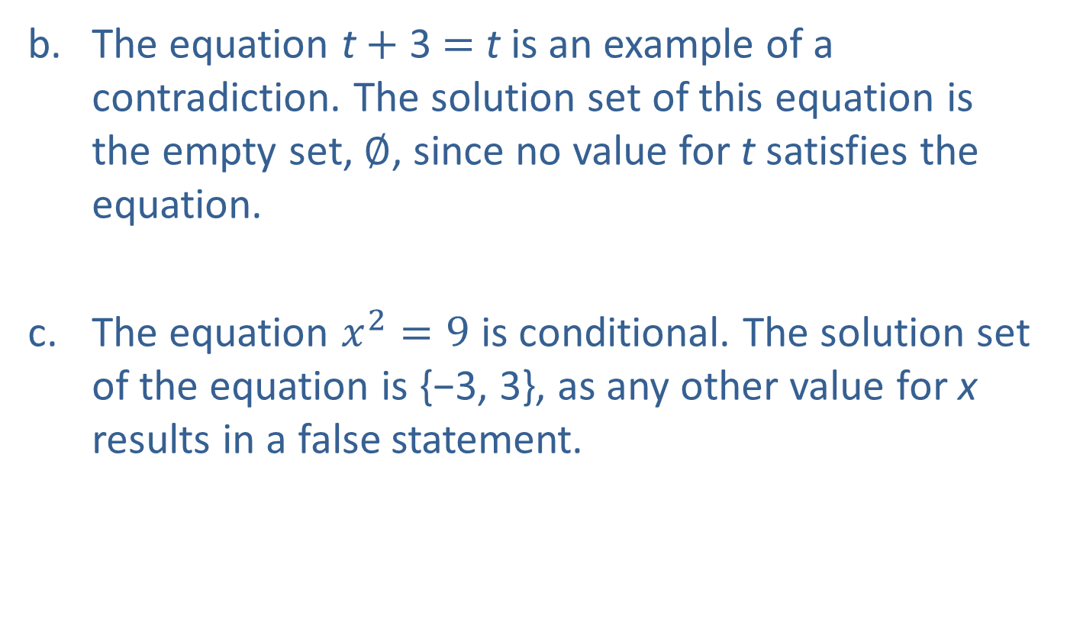
Example 1: Identifying Types of Equations—Slide 2
​The equation t + 3 = t is an example of a contradiction. The solution set of this equation is the empty set, $∅$, since no value for t satisfies the equation.
The equation $x^{2}=9$ is conditional. The solution set of the equation is {−3, 3}, as any other value for x results in a false statement.

Slide 4
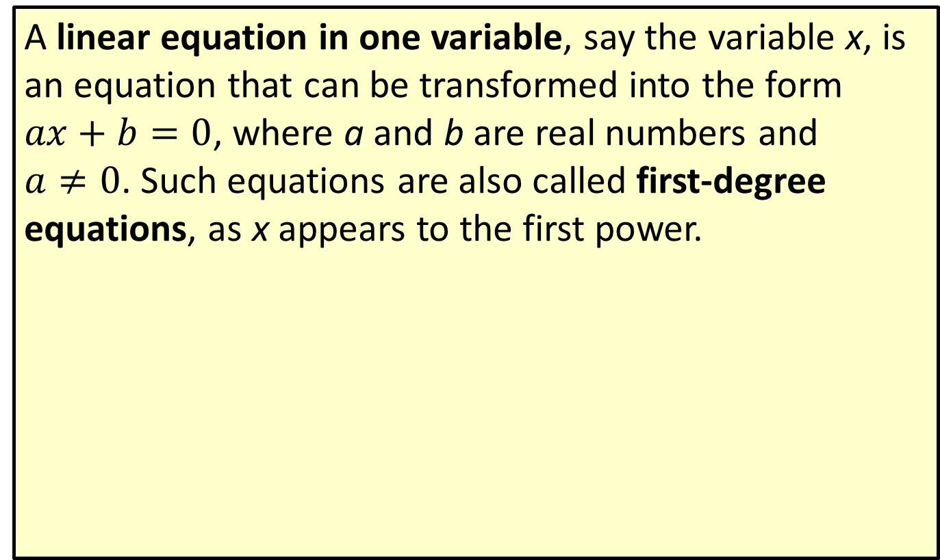
Definition: Linear Equations in One Variable
A linear equation in one variable, say the variable x, is an equation that can be transformed into the form $ax+b=0$, where a and b are real numbers and $a≠0$. Such equations are also called first-degree equations, as x appears to the first power.

Slide 5
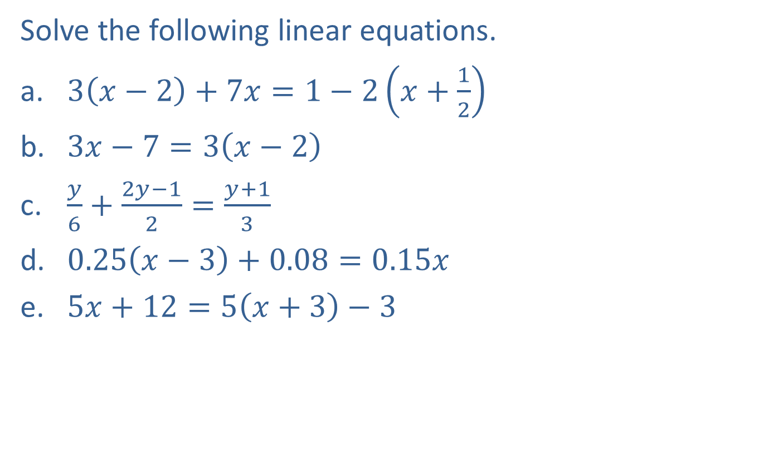
Example 2: Solving Linear Equations in One Variable—Slide 1
Solve the following linear equations.
​$3\left(x−2\right)+7x=1−2\left(x+\frac{1}{2}\right)$
​$3x−7=3\left(x−2\right)$
​$\frac{y}{6}+\frac{2y−1}{2}=\frac{y+1}{3}$
​$0.25\left(x−3\right)+0.08=0.15x$
​$5x+12=5\left(x+3\right)−3$

Slide 6
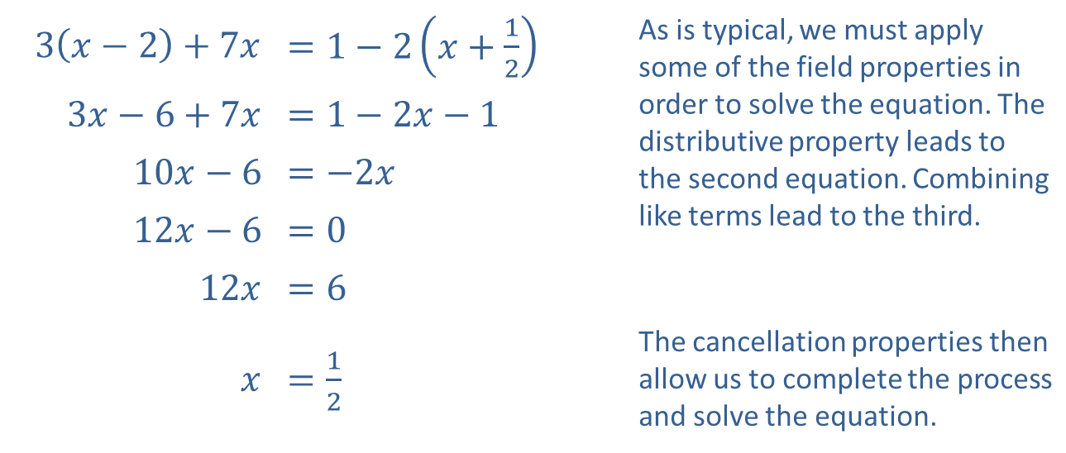
Example 2: Solving Linear Equations in One Variable—Slide 2
Solution
​
​$3\left(x−2\right)+7x$ | ​$=1−2\left(x+\frac{1}{2}\right)$ | As is typical, we must apply some of the field properties in order to solve the equation. The distributive property leads to the second equation. Combining like terms lead to the third.
​$3x−6+7x$ | ​$=1−2x−1$
​$10x−6$ | ​$=−2x$
​$12x−6$ | ​$=0$
​$12x$ | ​$=6$
$x$ | ​$=\frac{1}{2}$ | The cancellation properties then allow us to complete the process and solve the equation.

Slide 7
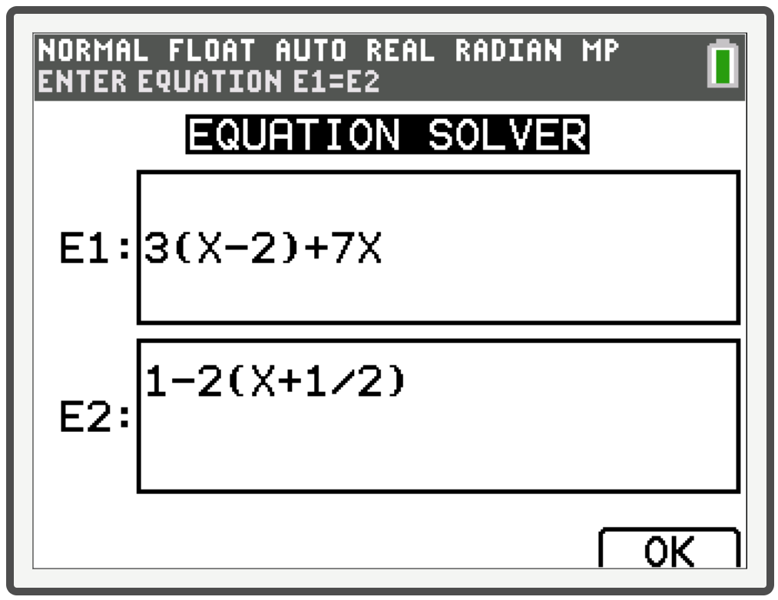
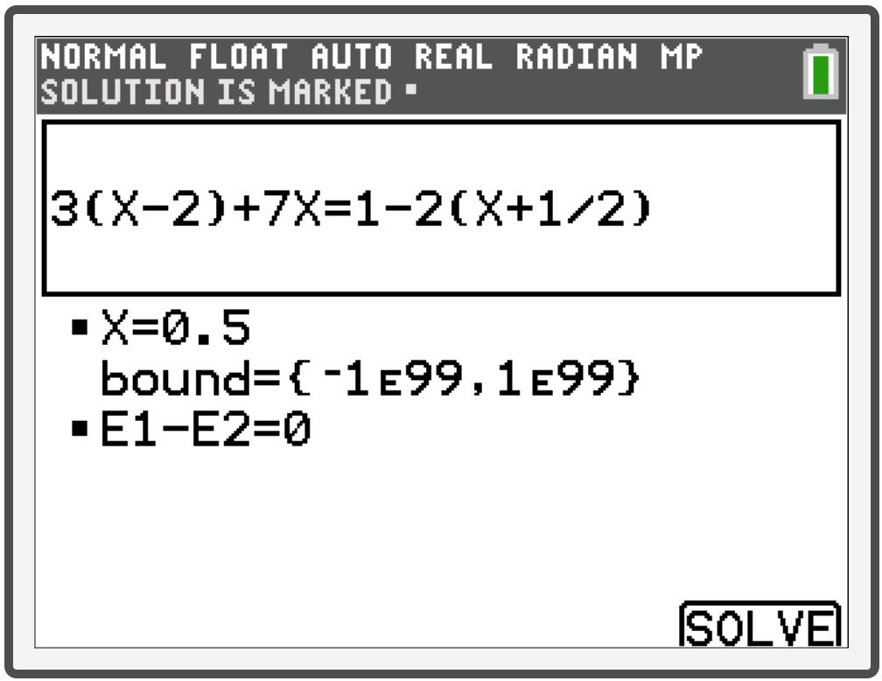
Example 2: Technology
To access the equation solver on a TI-84 Plus CE, press math and then press the up arrow key to select the last option. Press enter to open it. For E1 enter the left-hand side of the equation, and for E2 enter the right-hand side of the equation. Press graph twice to select OK and then SOLVE.

Slide 8

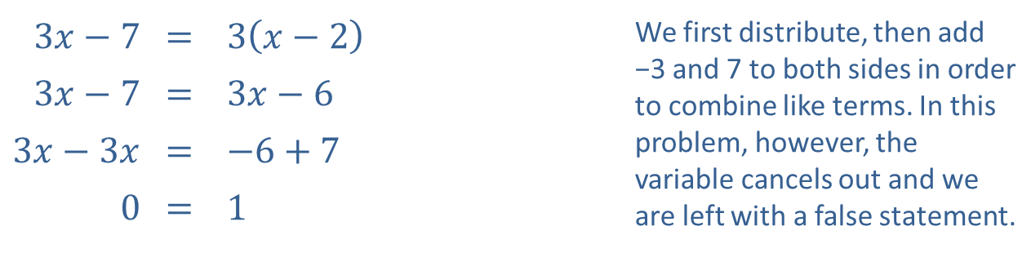
Example 2: Solving Linear Equations in One Variable—Slide 3
​
​$3x−7$ | ​= | ​$3\left(x−2\right)$ | We first distribute, then add −3 and 7 to both sides in order to combine like terms. In this problem, however, the variable cancels out and we are left with a false statement.
​$3x−7$ | ​= | ​$3x−6$
​$3x−3x$ | ​= | ​$−6+7$
​0 | ​= | ​1
​Thus, the equation is a contradiction and has no solutions. The solution set is the empty set, $∅$.

Slide 9
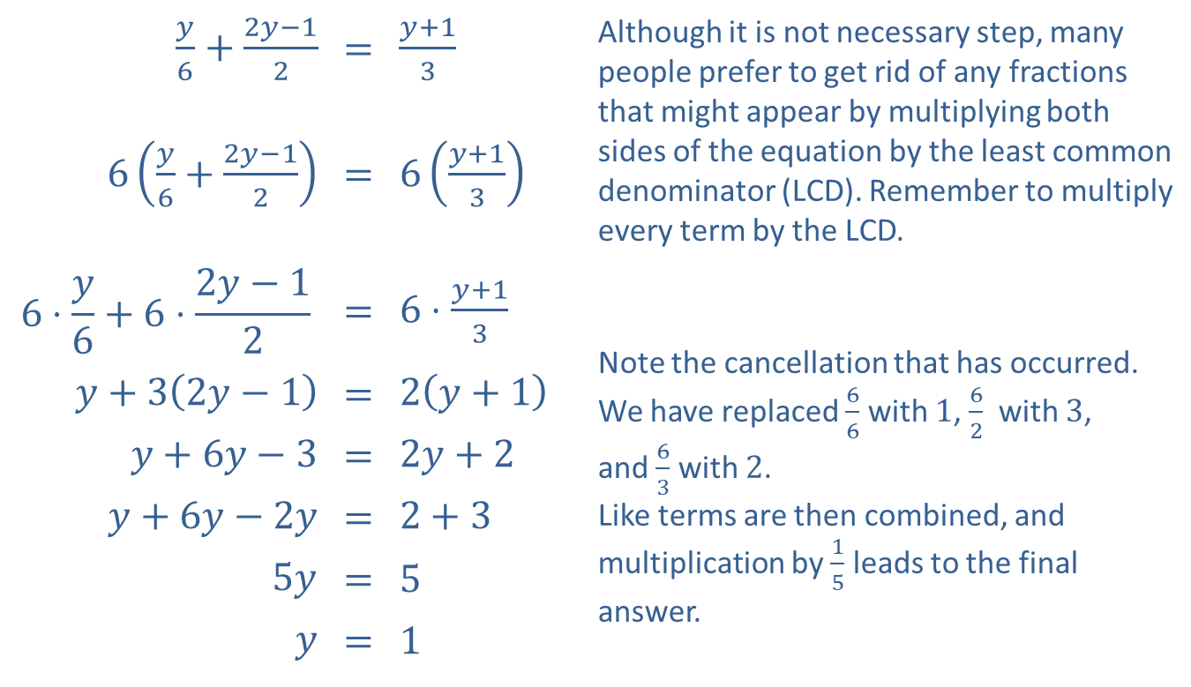
Example 2: Solving Linear Equations in One Variable—Slide 4
​
$\frac{y}{6}+\frac{2y−1}{2}$ | = | $\frac{y+1}{3}$ | Although it is not necessary step, many people prefer to get rid of any fractions that might appear by multiplying both sides of the equation by the least common denominator (LCD). Remember to multiply every term by the LCD.
$6\left(\frac{y}{6}+\frac{2y−1}{2}\right)$ | = | $6\left(\frac{y+1}{3}\right)$
$$6⋅\frac{y}{6}+6⋅\frac{2y−1}{2}$$ | = | $6⋅\frac{y+1}{3}$ | Note the cancellation that has occurred. We have replaced $\frac{6}{6}$ with 1, $\frac{6}{2}$ with 3, and $\frac{6}{3}$ with 2. Like terms are then combined, and multiplication by $\frac{1}{5}$ leads to the final answer.
$y+3\left(2y−1\right)$ | = | $2\left(y+1\right)$
$y+6y−3$ | = | $2y+2$
$y+6y−2y$ | = | $2+3$
$5y$ | = | 5
$y$ | = | 1

Slide 10
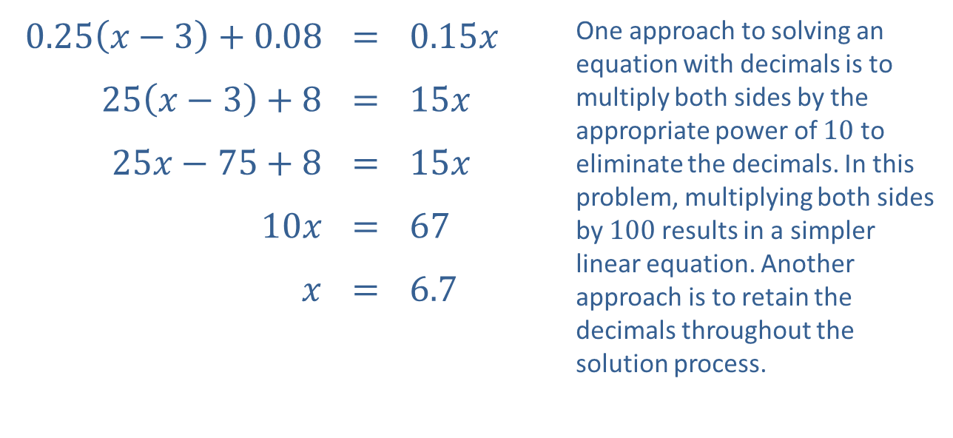
Example 2: Solving Linear Equations in One Variable—Slide 5
​
​$0.25\left(x−3\right)+0.08$ | ​= | ​$0.15x$ | One approach to solving an equation with decimals is to multiply both sides by the appropriate power of 10 to eliminate the decimals. In this problem, multiplying both sides by 100 results in a simpler linear equation. Another approach is to retain the decimals throughout the solution process.
​$25\left(x−3\right)+8$ | ​= | ​$15x$
​$25x−75+8$ | ​= | ​$15x$
​$10x$ | ​= | ​67
$x$ | ​= | ​6.7

Slide 11
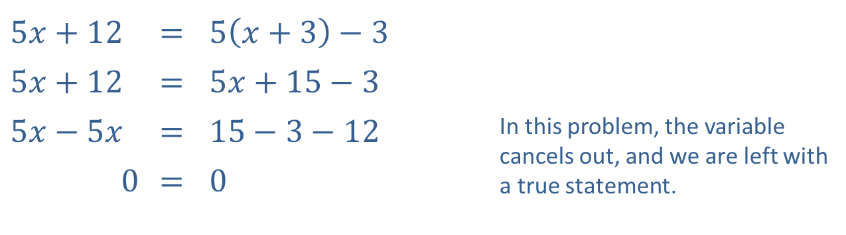
Example 2: Solving Linear Equations in One Variable—Slide 6
​
​$5x+12$ | ​= | ​$5\left(x+3\right)−3$
​$5x+12$ | ​= | ​$5x+15−3$
​$5x−5x$ | ​= | ​$15−3−12$ | In this problem, the variable cancels out, and we are left with a true statement.
​0 | ​= | ​0
​Thus, the equation is an identity. The solution set is all real numbers, ℝ.

Slide 12
CAUTION!
A word of warning: the apparent solutions obtained by the previous method may not solve the original absolute value equation! Absolute value equations are one class of equations (there are others, as we shall see) in which it is very important to check your final answer in the original equation. An apparent solution that does not solve the original problem is called an extraneous solution.

Slide 13

Example 3: Solving Absolute Value Equations—Slide 1
Solve the absolute value equations.
​$\left|3x−2\right|=1$
​$\left|x−4\right|=\left|2x+1\right|$
​$\left|6x−7\right|+5=3$

Slide 14
Note
Begin by rewriting each absolute value term as two new equations, one with a positive sign and one with a negative sign.

Slide 15
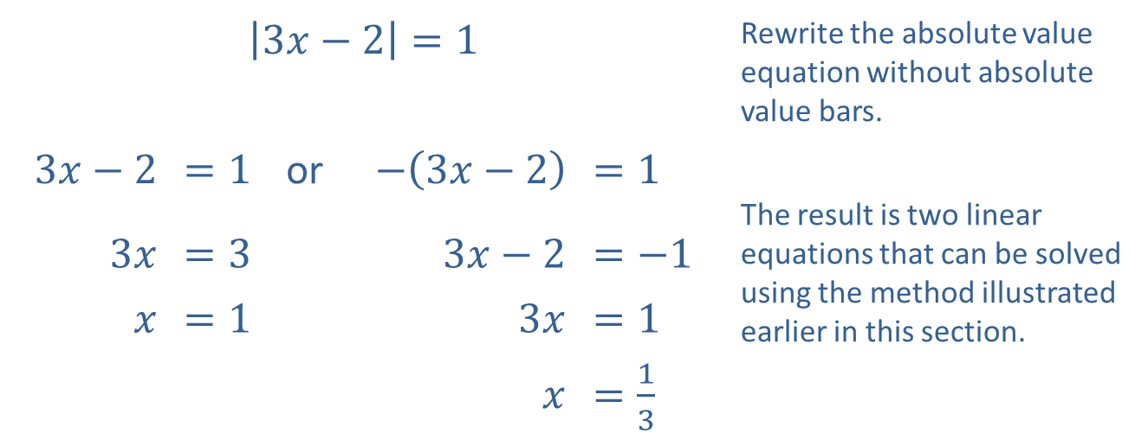
Example 3: Solving Absolute Value Equations—Slide 2
Solution
​
​$\left|3x−2\right|=1$ |  |  |  |  | Rewrite the absolute value equation without absolute value bars.
​$3x−2$ | ​$=1$ | or | ​$−\left(3x−2\right)$ | ​$=1$
 |  |  |  |  | The result is two linear equations that can be solved using the method illustrated earlier in this section.
​$3x$ | ​$=3$ |  | ​$3x−2$ | ​$=−1$
$x$ | ​$=1$ |  | ​$3x$ | ​$=1$
 |  |  | $x$ | ​$=\frac{1}{3}$

Slide 16

Example 3: Solving Absolute Value Equations—Slide 3
​Now check each solution in the original equation: $\left|3\left(1\right)−2\right|=\left|3−2\right|=\left|1\right|=1$, and $\left|3\left(\frac{1}{3}\right)−2\right|=\left|1−2\right|=\left|−1\right|=1$, so the solution set is $x=\frac{1}{3}, 1$.

Slide 17
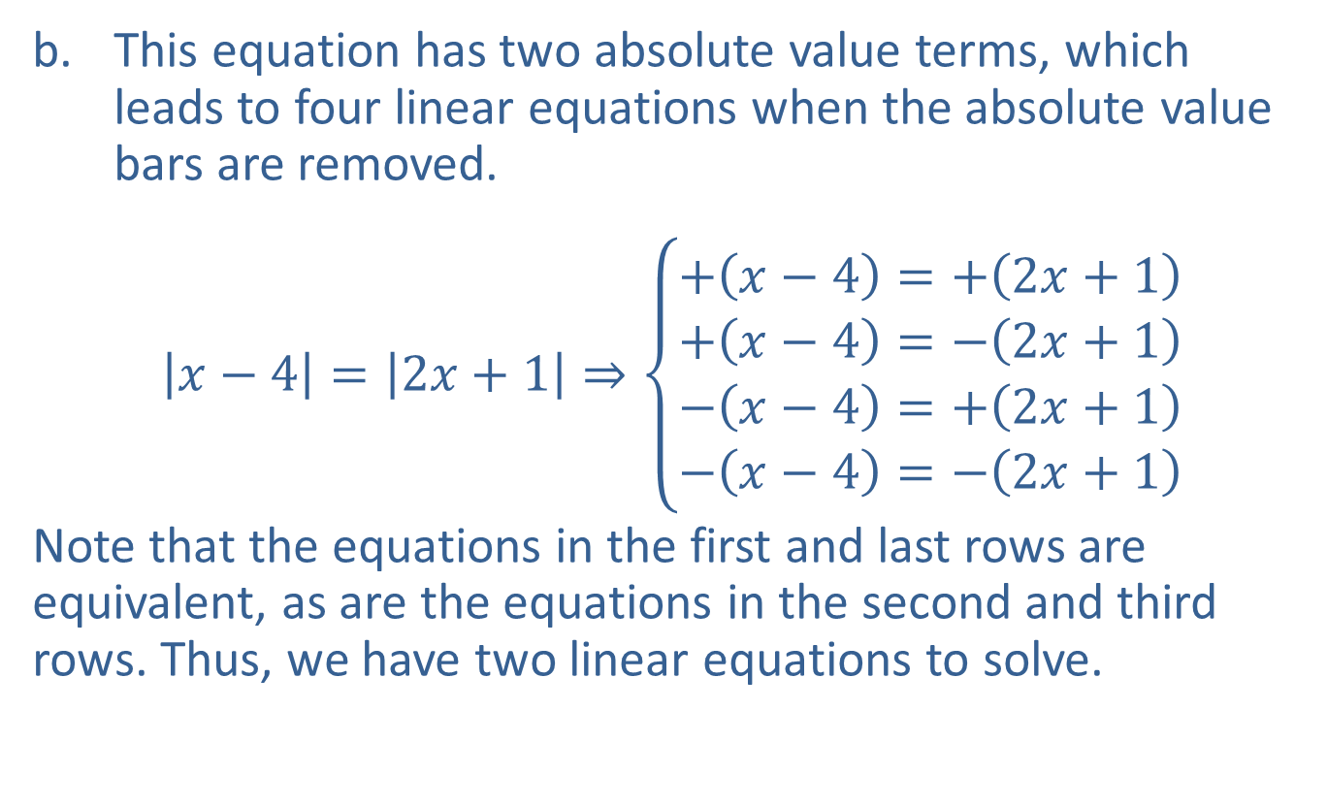
Example 3: Solving Absolute Value Equations—Slide 4
​This equation has two absolute value terms, which leads to four linear equations when the absolute value bars are removed.
​$\left|x−4\right|=\left|2x+1\right|⇒\left\{\begin{aligned}+\left(x−4\right)=+\left(2x+1\right) \\ +\left(x−4\right)=−\left(2x+1\right) \\ −\left(x−4\right)=+\left(2x+1\right) \\ −\left(x−4\right)=−\left(2x+1\right)\end{aligned}\right.$
​Note that the equations in the first and last rows are equivalent, as are the equations in the second and third rows. Thus, we have two linear equations to solve.
​

Slide 18
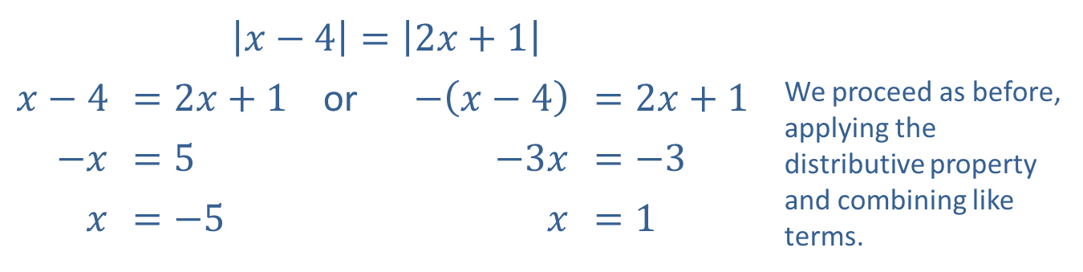
Example 3: Solving Absolute Value Equations—Slide 5
​$\left|x−4\right|=\left|2x+1\right|$
​$x−4$ | ​$=2x+1$ | or | ​$−\left(x−4\right)$ | ​$=2x+1$ | We proceed as before, applying the distributive property and combining like terms.
​$−x$ | ​$=5$ |  | ​$−3x$ | ​$=−3$
$x$ | ​$=−5$ |  | $x$ | ​$=1$

Slide 19
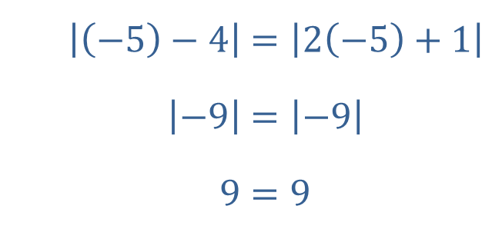
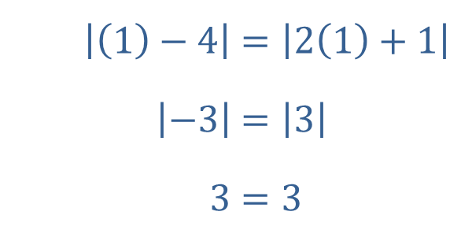
Example 3: Solving Absolute Value Equations—Slide 6
​Finally, we check the apparent solutions in the original equation.
​
​Both apparent solutions are actual solutions, so the solution set is x = −5, 1.
​$\left|\left(−5\right)−4\right|$ | ​$=\left|2\left(−5\right)+1\right|$
​$\left|−9\right|$ | ​$=\left|−9\right|$
​$9$ | ​$=9$
​$\left|\left(1\right)−4\right|$ | ​$=\left|2\left(1\right)+1\right|$
​$\left|−3\right|$ | ​$=\left|3\right|$
​$3$ | ​$=3$

Slide 20
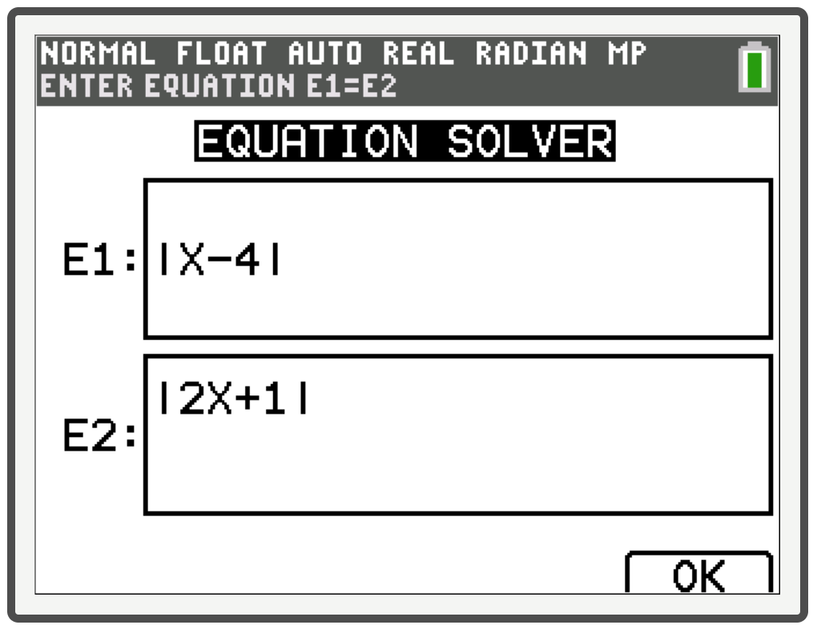
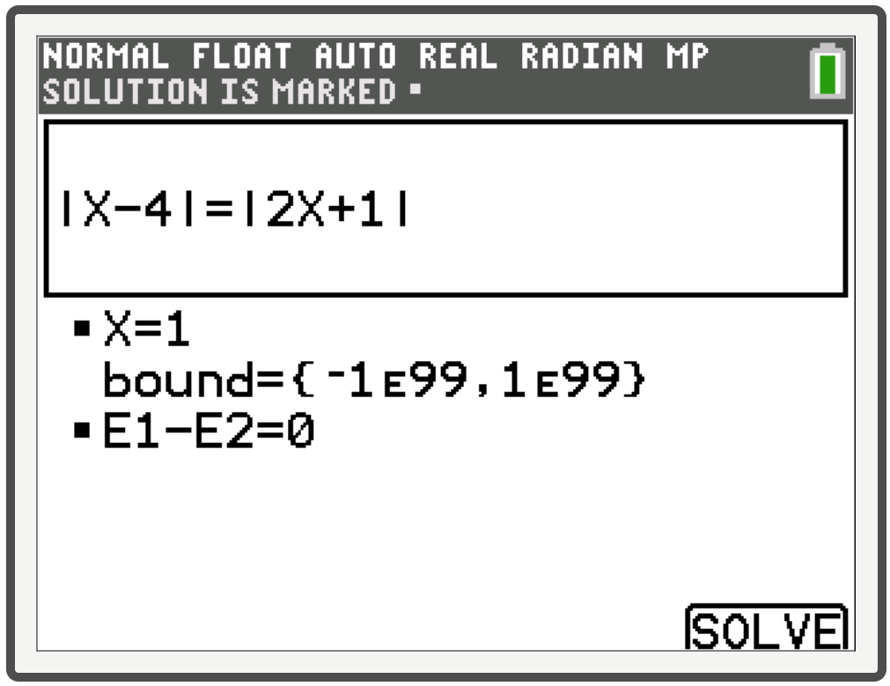
Example 3: Technology
A word of caution—only one answer is generated here using the equation solver, but there are two solutions. Additional work must be done to find multiple solutions.

Slide 21
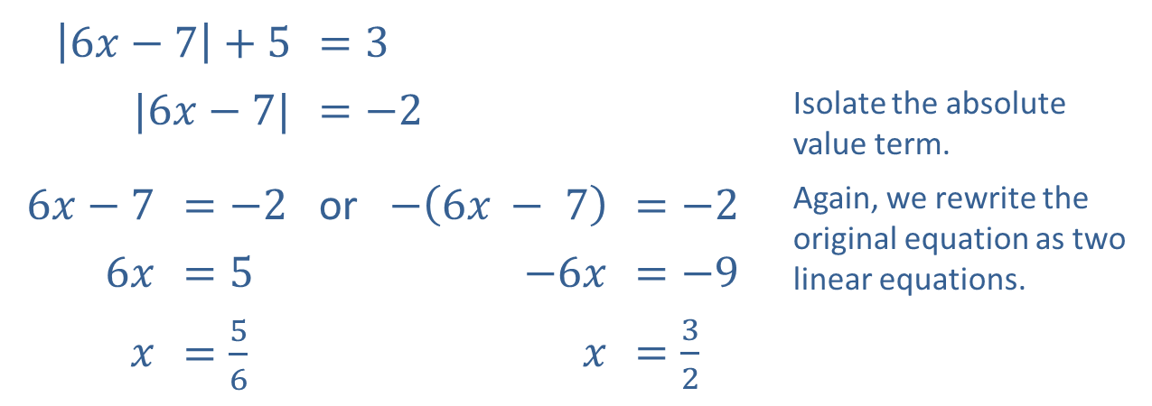
Example 3: Solving Absolute Value Equations—Slide 7
​
​$\left|6x−7\right|+5$ |  | ​$=3$
​$|6x−7|$ |  | ​$=−2$ |  |  | Isolate the absolute value term.
​$6x−7$ | ​$=−2$ | or | ​$−\left(6x − 7\right)$ | ​$=−2$ | Again, we rewrite the original equation as two linear equations.
​$6x$ | ​$=5$ |  | ​$−6x$ | ​$=−9$
$x$ | ​$=\frac{5}{6}$ |  | $x$ | ​$=\frac{3}{2}$

Slide 22
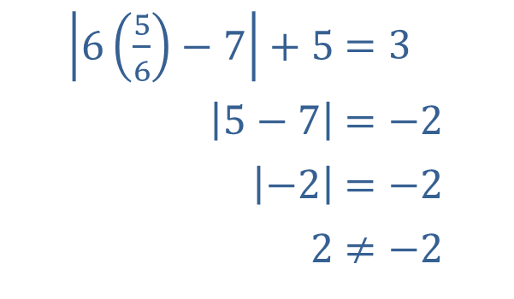

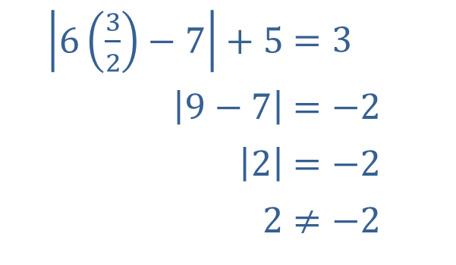
Example 3: Solving Absolute Value Equations—Slide 8
​When we check the solutions this time, we find that neither apparent solution actually solves the equation!
​
​Thus, the equation is a contradiction, and the solution set is $∅$.
​$\left|6\left(\frac{5}{6}\right)−7\right|+5$ | ​$=3$
​$\left|5−7\right|$ | ​$=−2$
​$\left|−2\right|$ | ​$=−2$
​$2$ | ​$≠−2$
​$\left|6\left(\frac{3}{2}\right)−7\right|+5$ | ​$=3$
​$\left|9−7\right|$ | ​$=−2$
​$\left|2\right|$ | ​$=−2$
​$2$ | ​$≠−2$

Slide 23
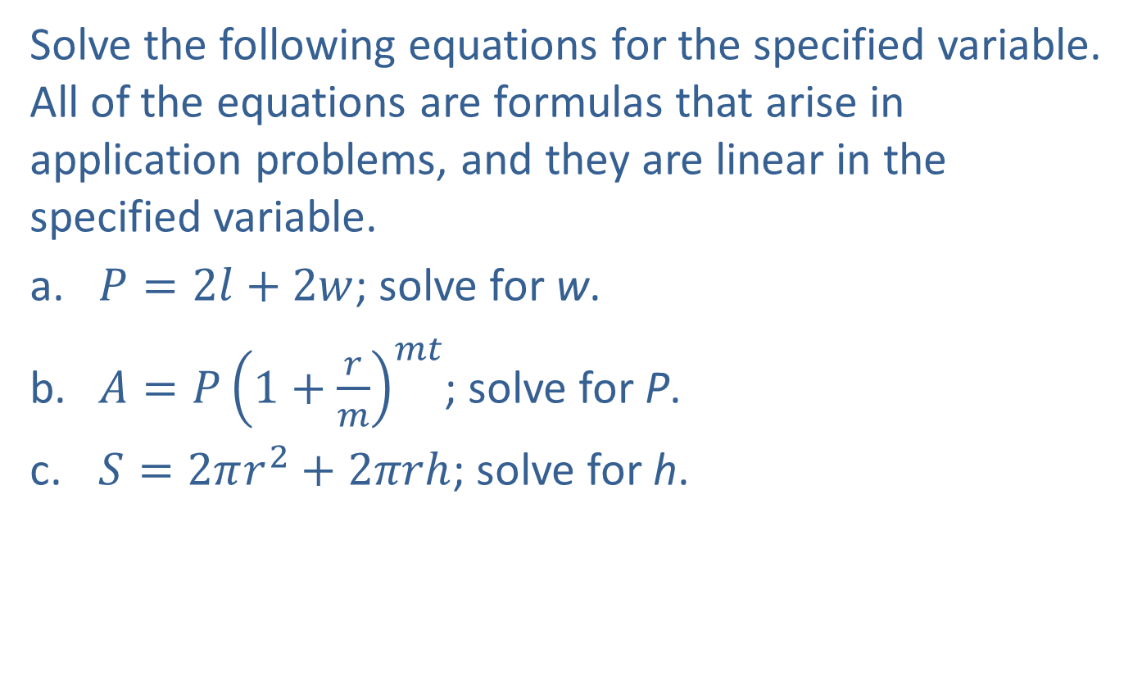
Example 4: Solving Linear Equations for One Variable—Slide 1
Solve the following equations for the specified variable. All of the equations are formulas that arise in application problems, and they are linear in the specified variable.
​$P=2l+2w$; solve for w.
​$A=P{\left(1+\frac{r}{m}\right)}^{mt}$; solve for P.
​$S=2πr^{2}+2πrh$; solve for h.

Slide 24
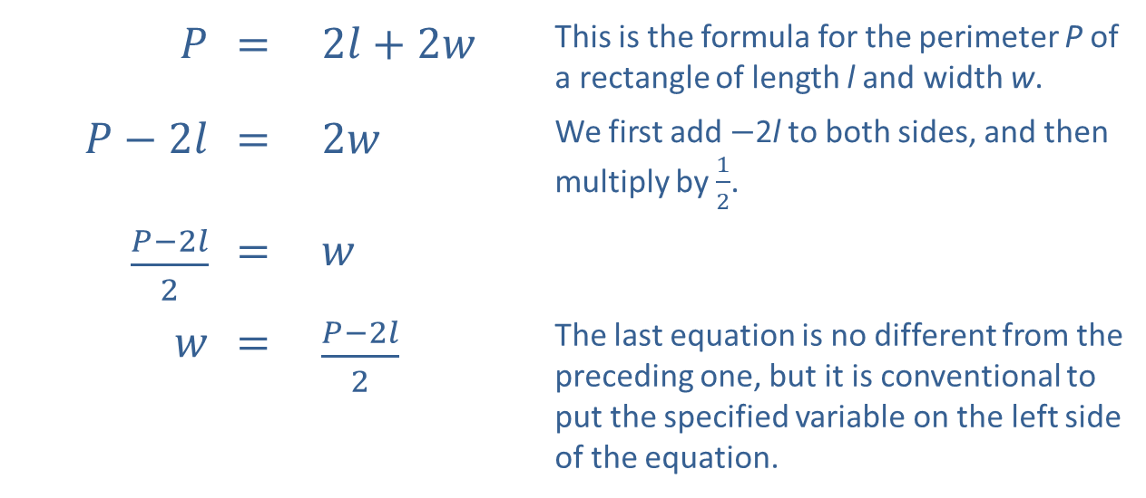
Example 4: Solving Linear Equations for One Variable—Slide 2
Solution
​
$P$ | ​= | ​$2l+2w$ | This is the formula for the perimeter P of a rectangle of length l and width w.
​$P−2l$ | ​= | ​$2w$ | We first add −2l to both sides, and then multiply by $\frac{1}{2}$.
​$\frac{P−2l}{2}$ | ​= | $w$
$w$ | ​= | ​$\frac{P−2l}{2}$ | The last equation is no different from the preceding one, but it is conventional to put the specified variable on the left side of the equation.

Slide 25
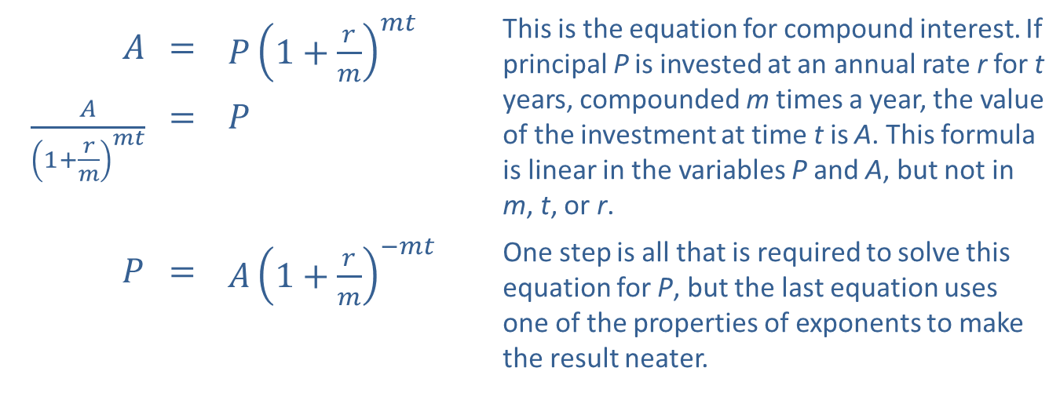
Example 4: Solving Linear Equations for One Variable—Slide 3
$A$ | ​= | ​$P{\left(1+\frac{r}{m}\right)}^{mt}$ | This is the equation for compound interest. If principal P is invested at an annual rate r for t years, compounded m times a year, the value of the investment at time t is A. This formula is linear in the variables P and A, but not in m, t, or r.
​$\frac{A}{{\left(1+\frac{r}{m}\right)}^{mt}}$ | ​= | $P$
$P$ | ​= | ​$A{\left(1+\frac{r}{m}\right)}^{−mt}$ | One step is all that is required to solve this equation for P, but the last equation uses one of the properties of exponents to make the result neater.
​

Slide 26
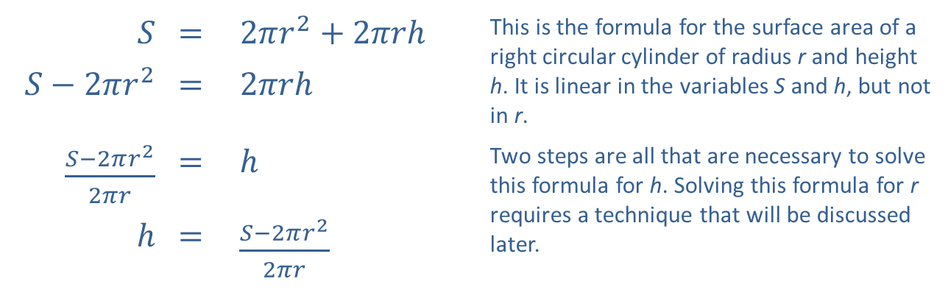
Example 4: Solving Linear Equations for One Variable—Slide 4
​
$$S$$ | ​= | ​$2πr^{2}+2πrh$ | This is the formula for the surface area of a right circular cylinder of radius r and height h. It is linear in the variables S and h, but not in r.
​$S−2πr^{2}$ | ​= | ​$2πrh$
​$\frac{S−2πr^{2}}{2πr}$ | ​= | $h$ | Two steps are all that are necessary to solve this formula for h. Solving this formula for r requires a technique that will be discussed later.
$$h$$ | ​= | ​$\frac{S−2πr^{2}}{2πr}$

