Slide 1
Section 2.R.3
Simplifying Complex Rational Expressions and Algebraic Expressions

Slide 2
Procedure: Simplifying Complex Rational Expressions (First Method)
Simplify the numerator so that it is a single rational expression.
Simplify the denominator so that it is a single rational expression.
Divide the numerator by the denominator and reduce to lowest terms.

Slide 3
Example 1: First Method for Simplifying Complex Rational Expressions
Simplify the complex rational expression.
Solution
Notice that the numerator and denominator are already simplified into a single rational expression. So we can jump to Step 3.
To divide, multiply by the reciprocal of the denominator.

Slide 4
Example 2: First Method for Simplifying Complex Rational Expressions—Slide 1
Simplify the complex rational expression.
Solution
Combine the rational expressions in the numerator and in the denominator separately.

Slide 5
Example 2: First Method for Simplifying Complex Rational Expressions—Slide 2
To divide, multiply by the reciprocal of the denominator.

Slide 6
Example 3: First Method for Simplifying Complex Rational Expressions—Slide 1
Simplify the complex rational expression.
Solution

Slide 7
Example 3: First Method for Simplifying Complex Rational Expressions—Slide 2
Multiply by the reciprocal of the denominator.
Note: x + y and y + x are equal by the commutative property of addition

Slide 8
Procedure: Simplifying Complex Rational Expressions (Second Method)
Find the LCM of all the denominators in the numerator and denominator of the complex fraction.
Multiply both the numerator and denominator of the complex rational expression by this LCM.
Simplify both the numerator and denominator and reduce to lowest terms.

Slide 9
Example 4: Second Method for Simplifying Complex Rational Expressions—Slide 1
Simplify the complex rational expression.
Solution
Multiply by x(x + 3), the LCM of {x, x + 3}. This multiplication can be done because the net effect is that the fraction is multiplied by 1.

Slide 10
Example 4: Second Method for Simplifying Complex Rational Expressions—Slide 2
Factor the denominator by grouping.
Note that this matches the result found in Example 2 using Method 1.

Slide 11
Example 5: Second Method for Simplifying Complex Rational Expressions
Simplify the complex rational expression.
Solution
Multiply by xy, the LCM of {1, x, y}.

Slide 12

Example 6: Simplifying Complex Rational Expressions—Slide 1
Simplify the complex rational expressions.
​$\frac{\frac{1}{x+h}−\frac{1}{x}}{h}$
​$\frac{x^{−1}−y^{−1}}{x^{−2}−y^{−2}}$

Slide 13
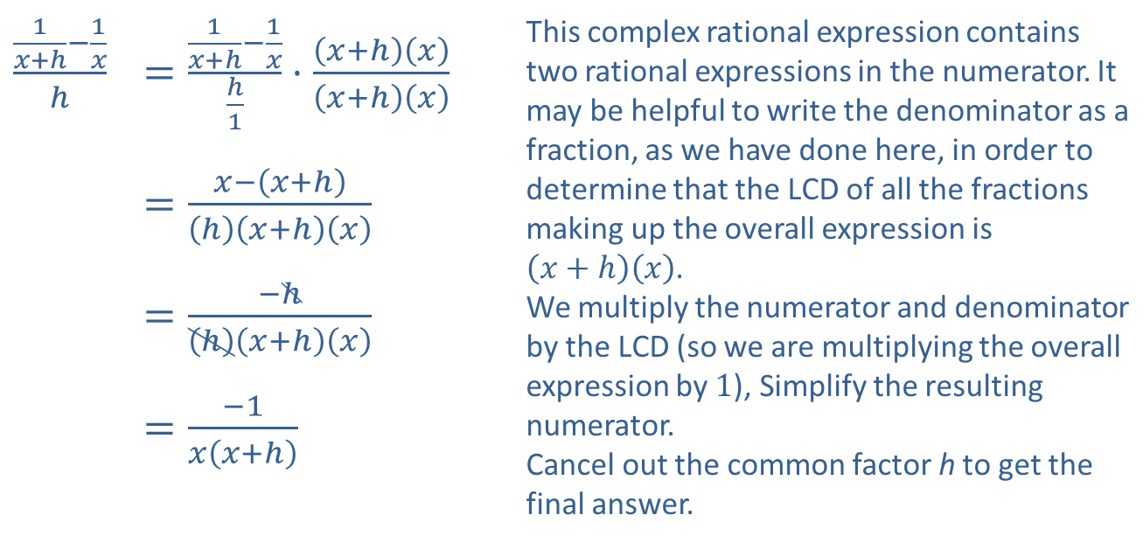
Example 6: Simplifying Complex Rational Expressions—Slide 2
Solution
​
​$\frac{\frac{1}{x+h}−\frac{1}{x}}{h}$ | ​$=\frac{\frac{1}{x+h}−\frac{1}{x}}{\frac{h}{1}}⋅\frac{\left(x+h\right)\left(x\right)}{\left(x+h\right)\left(x\right)}$ | This complex rational expression contains two rational expressions in the numerator. It may be helpful to write the denominator as a fraction, as we have done here, in order to determine that the LCD of all the fractions making up the overall expression is $\left(x+h\right)\left(x\right)$. We multiply the numerator and denominator by the LCD (so we are multiplying the overall expression by 1), Simplify the resulting numerator. Cancel out the common factor h to get the final answer.
 | ​$=\frac{x−\left(x+h\right)}{\left(h\right)\left(x+h\right)\left(x\right)}$
 | ​$=\frac{−h}{\left(h\right)\left(x+h\right)\left(x\right)}$
 | ​$=\frac{−1}{x\left(x+h\right)}$

Slide 14
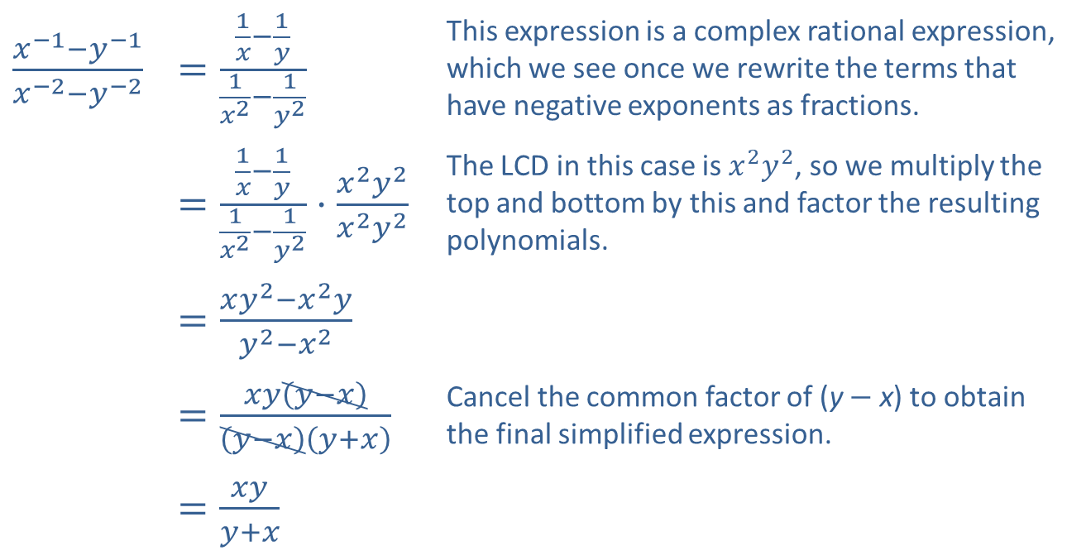
Example 6: Simplifying Complex Rational Expressions—Slide 3
​$\frac{x^{−1}−y^{−1}}{x^{−2}−y^{−2}}$ | ​$=\frac{\frac{1}{x}−\frac{1}{y}}{\frac{1}{x^{2}}−\frac{1}{y^{2}}}$ | This expression is a complex rational expression, which we see once we rewrite the terms that have negative exponents as fractions.
 | ​$=\frac{\frac{1}{x}−\frac{1}{y}}{\frac{1}{x^{2}}−\frac{1}{y^{2}}}⋅\frac{x^{2}y^{2}}{x^{2}y^{2}}$ | The LCD in this case is $x^{2}y^{2}$, so we multiply the top and bottom by this and factor the resulting polynomials.
 | ​$=\frac{xy^{2}−x^{2}y}{y^{2}−x^{2}}$
 | ​$=\frac{xy\left(y−x\right)}{\left(y−x\right)\left(y+x\right)}$ | Cancel the common factor of (y − x) to obtain the final simplified expression.
 | ​$=\frac{xy}{y+x}$
​

Slide 15
Example 7: Simplifying Complex Algebraic Expressions—Slide 1
Simplify the following expression.
Solution
The rules for order of operations indicate that the division is to be done first, followed by the addition.

Slide 16
Example 7: Simplifying Complex Algebraic Expressions—Slide 2

Slide 17
Example 8: Simplifying Complex Algebraic Expressions—Slide 1
Simplify the complex algebraic expressions. Write each answer as a single polynomial or rational expression with positive exponents.

Slide 18
Example 8: Simplifying Complex Algebraic Expressions—Slide 2
Solution

Slide 19
Example 9: Simplifying Complex Algebraic Expressions—Slide 1
Simplify the complex algebraic expressions. Write each answer as a single polynomial or rational expression with positive exponents.

Slide 20
Example 9: Simplifying Complex Algebraic Expressions—Slide 2
Solution

Slide 21
Example 9: Simplifying Complex Algebraic Expressions—Slide 3
b.

