Slide 1
Section 2.R.1
Simplifying Radical Expressions by Rationalizing

Slide 2
Procedure: Rationalizing a Denominator Containing a Square Root or a Cube Root
If the denominator contains a square root, multiply both the numerator and denominator by an expression that will give a denominator with no square roots.
If the denominator contains a cube root, multiply both the numerator and denominator by an expression that will give a denominator with no cube roots.

Slide 3
Example 1: Rationalizing Denominators Containing Square Roots—Slide 1
Rationalize each denominator. Assume that all variables represent positive real numbers.
b. c. d.
Solution
a. Multiply the numerator and denominator by because is a rational number.

Slide 4
Example 1: Rationalizing Denominators Containing Square Roots—Slide 2
b. Multiply the numerator and denominator by because There is no guarantee that x is rational, but the radical sign does not appear in the denominator of the result.

Slide 5
Example 1: Rationalizing Denominators Containing Square Roots—Slide 3
c. Multiply the numerator and denominator by because is a rational number.

Slide 6
Example 1: Rationalizing Denominators Containing Square Roots—Slide 4
d. Multiply the numerator and denominator by because is a rational number.
(Note: 8 · 2 = 16 and 16 is a perfect square.)

Slide 7
Example 2: Rationalizing Denominators Containing Cube Roots—Slide 1
Rationalize each denominator. Assume that all variables represent positive real numbers.
b.
Solution
a. Multiply the numerator and denominator by because is a rational number. (Note: 5 · 25 = 125 and 125 is a perfect cube.)

Slide 8
Example 2: Rationalizing Denominators Containing Cube Roots—Slide 2
b. Multiply the numerator and denominator by because (Note: and is a perfect cube.)

Slide 9
Procedure: Rationalizing a Denominator Containing a Sum or Difference Involving Square Roots
If the denominator of a fraction contains a sum or difference involving a square root, rationalize the denominator by multiplying both the numerator and denominator by the conjugate of the denominator.
If the denominator is of the form a − b, multiply both the numerator and denominator by a + b.
If the denominator is of the form a + b, multiply both the numerator and denominator by a − b.
The new denominator will be the difference of two squares, and therefore will not contain a radical term.

Slide 10
Example 3: Rationalizing Denominators with a Sum or Difference in the Denominator—Slide 1
Rationalize each denominator and simplify, if possible. Assume that all variables represent positive real numbers.
d. (Assume x ≠ 1.)
e. (Assume x ≠ y.)
c.

Slide 11
Example 3: Rationalizing Denominators with a Sum or Difference in the Denominator—Slide 2
Solution
a. Multiply the numerator and denominator by

Slide 12
Example 3: Rationalizing Denominators with a Sum or Difference in the Denominator—Slide 3

Slide 13
Example 3: Rationalizing Denominators with a Sum or Difference in the Denominator—Slide 4
b. Multiply the numerator and denominator by

Slide 14
Example 3: Rationalizing Denominators with a Sum or Difference in the Denominator—Slide 5
c. Multiply the numerator and denominator by

Slide 15
Example 3: Rationalizing Denominators with a Sum or Difference in the Denominator—Slide 6
d. Multiply the numerator and denominator by
or

Slide 16
Example 3: Rationalizing Denominators with a Sum or Difference in the Denominator—Slide 7
e. Multiply the numerator and denominator by

Slide 17
Completion Example 4: Rationalizing Denominators with a Sum or Difference in the Denominator
Rationalize the denominator and simplify:
Solution
Cancel out 74 in both the numerator and denominator

Slide 18

Example 5: Rationalizing the Numerator with a Sum or Difference in the Numerator—Slide 1
Rationalize the numerator of the fraction $\frac{\sqrt{4x}−\sqrt{6y}}{2x−3y}$.

Slide 19
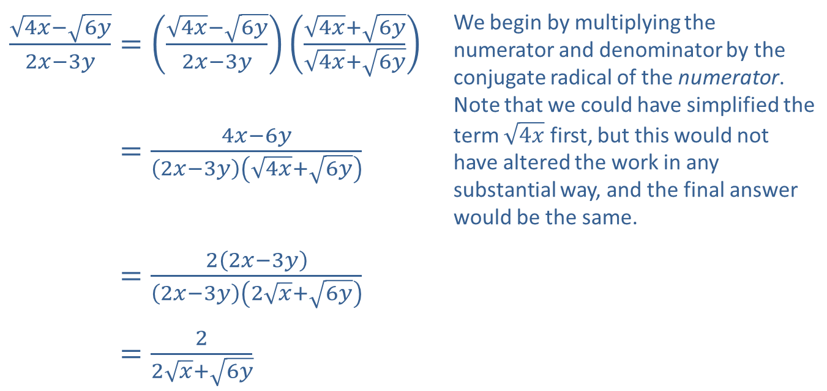
Example 5: Rationalizing the Numerator with a Sum or Difference in the Numerator—Slide 2
Solution
​$\frac{\sqrt{4x}−\sqrt{6y}}{2x−3y}=\left(\frac{\sqrt{4x}−\sqrt{6y}}{2x−3y}\right)\left(\frac{\sqrt{4x}+\sqrt{6y}}{\sqrt{4x}+\sqrt{6y}}\right)$ | We begin by multiplying the numerator and denominator by the conjugate radical of the numerator. Note that we could have simplified the term $\sqrt{4x}$ first, but this would not have altered the work in any substantial way, and the final answer would be the same.
​4𝑥−6𝑦2𝑥−3𝑦=4𝑥−6𝑦2𝑥−3𝑦4𝑥+6𝑦
​4𝑥−6𝑦2𝑥−3𝑦=22𝑥−3𝑦2𝑥−3𝑦2𝑥+6𝑦
​4𝑥−6𝑦2𝑥−3𝑦=22𝑥+6𝑦

