Slide 1
Section 1.R.9
Introduction to Exponential and Logarithmic Functions

Slide 2
Definition: Exponential Functions
An exponential function with base a is a function of the form
f(x) = a ^{x},
where a > 0, a ≠ 1, and x is any real number.

Slide 3
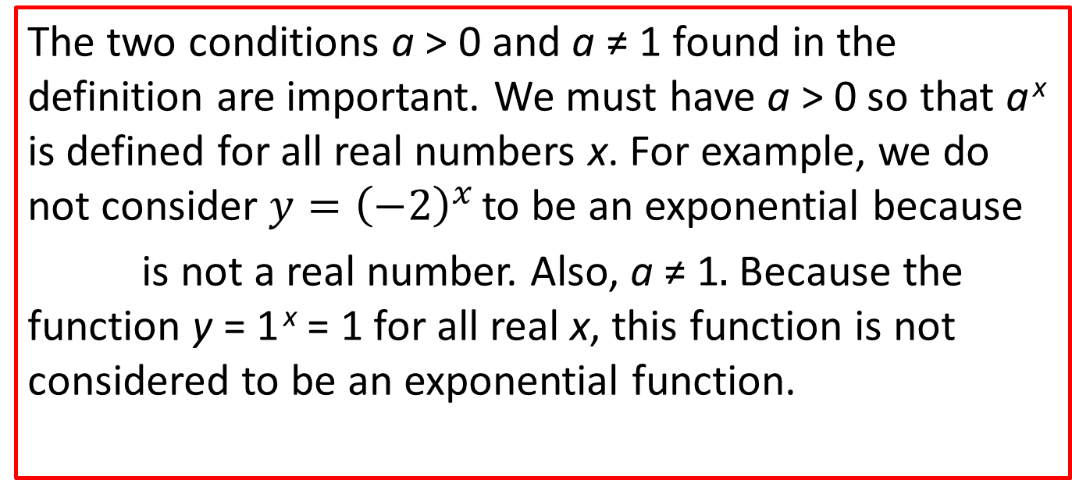
Note 1
The two conditions a > 0 and a ≠ 1 found in the definition are important. We must have a > 0 so that a ^{x} is defined for all real numbers x. For example, we do not consider $y={\left(−2\right)}^{x}$ to be an exponential because
is not a real number. Also, a ≠ 1$.$Because the function y = 1 ^{x} = 1 for all real x, this function is not considered to be an exponential function.

Slide 4
Note 2
Because and so on, for fractions between 0 and 1, we can write
an exponential function with a fractional base between 0 and 1 (these are exponential decay functions) in the form of an exponential function with a base greater than 1 and a negative exponent.
Thus, we write
and

Slide 5
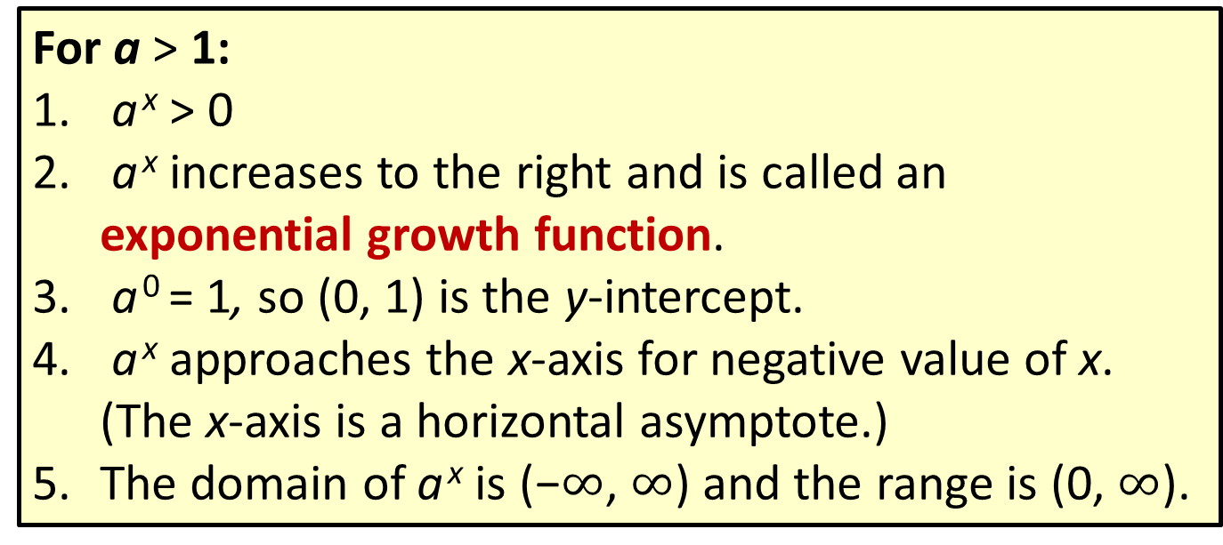
Definition: General Characteristics of Exponential Functions—Slide 1
For a > 1:
a ^{x} > 0
a ^{x} increases to the right and is called an exponential growth function.
a ⁰ = 1, so (0, 1) is the y‑intercept.
a ^{x} approaches the x-axis for negative value of x. (The x-axis is a horizontal asymptote.)
The domain of a ^{x} is (−$∞$, $∞$) and the range is (0, $∞$).

Slide 6
Definition: General Characteristics of Exponential Functions—Slide 2
For 0 < a < 1:
a ^{x} > 0
a ^{x} decreases to the right and is called an exponential decay function.
a ⁰ = 1, so (0, 1) is the y‑intercept.
a ^{x} approaches the x-axis for positive value of x. (The
x-axis is a horizontal asymptote.)

Slide 7
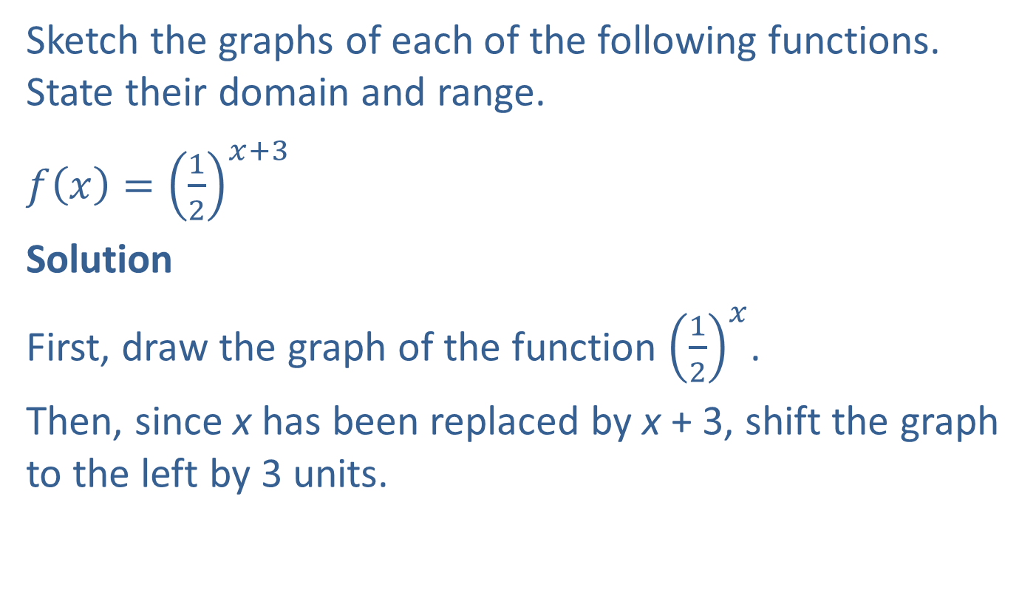
Example 1: Graphing Exponential Functions—Slide 1
Sketch the graphs of each of the following functions. State their domain and range.
​$f\left(x\right)={\left(\frac{1}{2}\right)}^{x+3}$
Solution
First, draw the graph of the function ${\left(\frac{1}{2}\right)}^{x}$.
Then, since x has been replaced by x + 3, shift the graph to the left by 3 units.

Slide 8
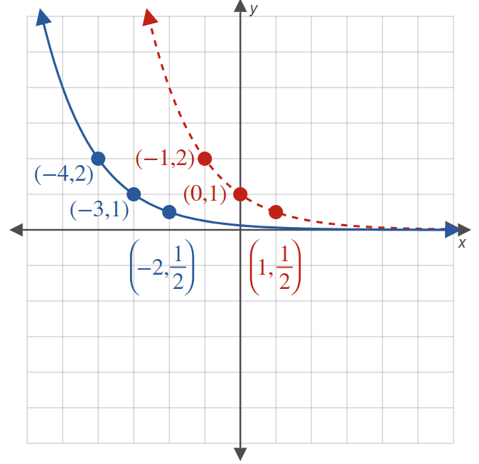

Example 1: Graphing Exponential Functions—Slide 2
Figure 6
Domain = ($−∞, ∞),$ Range = (0, $∞$)

Slide 9
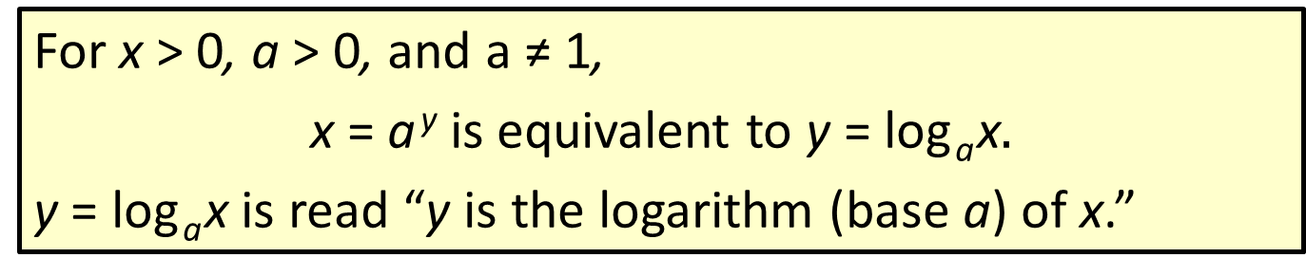
Definition: Definition of Logarithm (Base a)
For x > 0, a > 0, and a ≠ 1,
x = a ^{y} is equivalent to y = log _{a} x$.$
y = log _{a} x is read “y is the logarithm (base a) of x.”

Slide 10
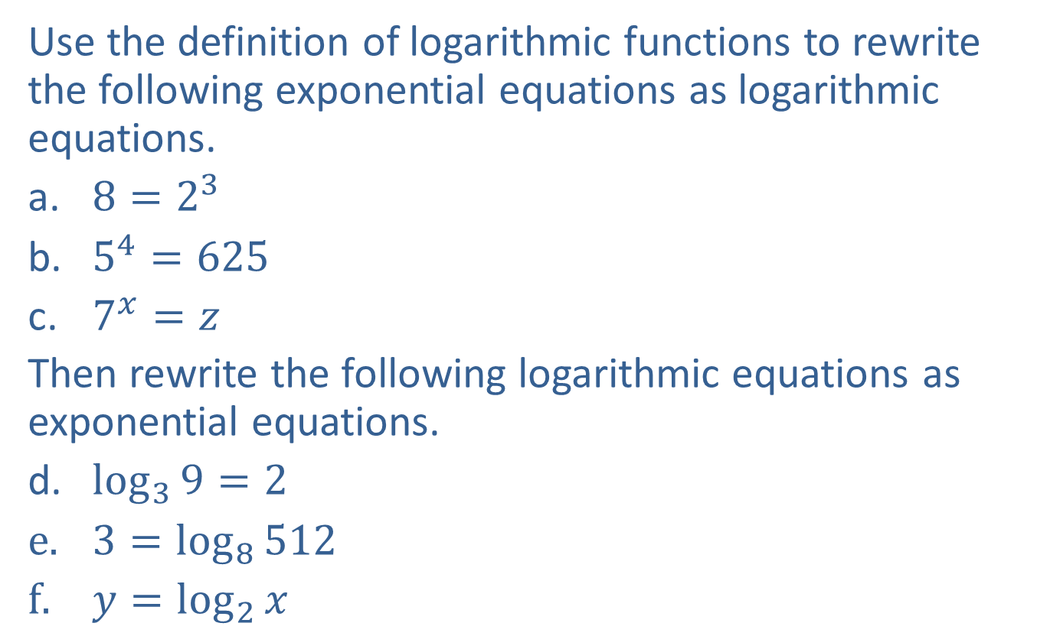
Example 2: Equivalent Exponential and Logarithmic Equations—Slide 1
Use the definition of logarithmic functions to rewrite the following exponential equations as logarithmic equations.
​$8=2^{3}$
​$5^{4}=625$
​$7^{x}=z$
Then rewrite the following logarithmic equations as exponential equations.
​$\log_{3}{9}=2$
$3=\log_{8}{512}$
$y=\log_{2}{x}$

Slide 11
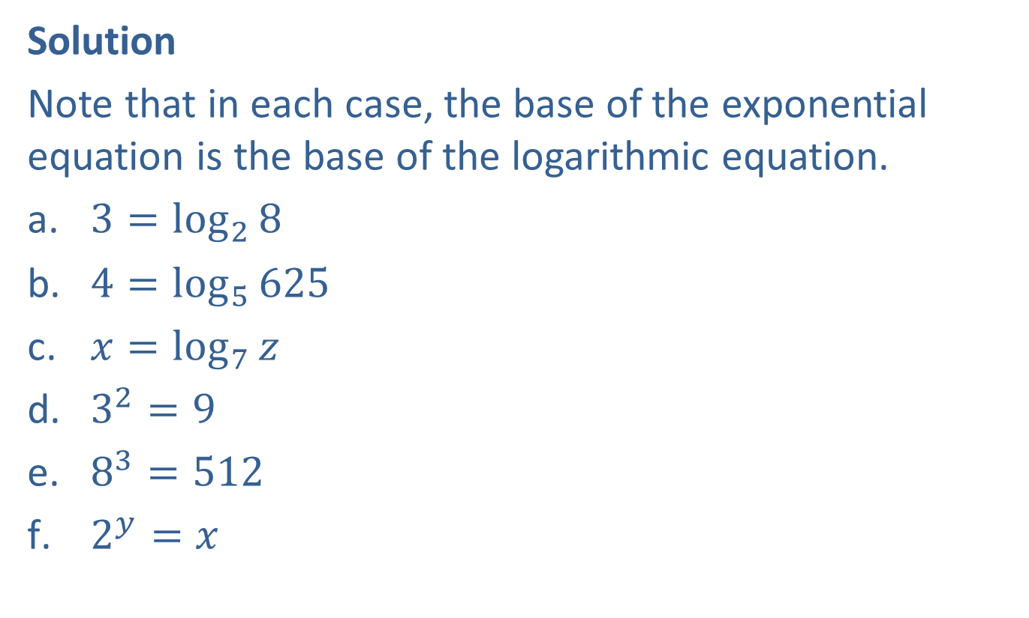
Example 2: Equivalent Exponential and Logarithmic Equations—Slide 2
Solution
Note that in each case, the base of the exponential equation is the base of the logarithmic equation.
​$3=\log_{2}{8}$
​$4=\log_{5}{625}$
​$x=\log_{7}{z}$
​$3^{2}=9$
​$8^{3}=512$
​$2^{y}=x$

Slide 12

Example 3: Graphing Logarithmic Functions—Slide 1
Sketch the graphs of the following logarithmic functions.
​​$g\left(x\right)=\log_{\frac{1}{2}}{x}$
$h\left(x\right)=\log_{\frac{1}{2}}{x}−2$

Slide 13
Note 3
Once again, plotting a few key points will provide a good idea of the shape of the function.

Slide 14
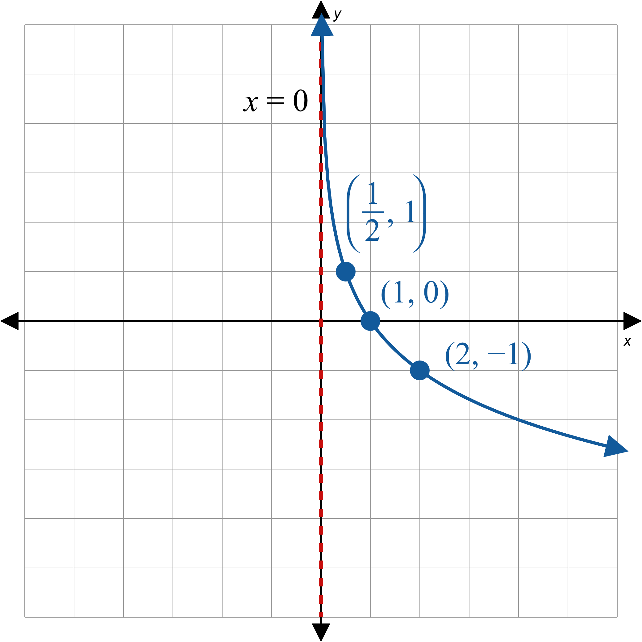

Example 3: Graphing Logarithmic Functions—Slide 2
a.
Figure 10
Domain $=$ (0, $∞$)$,$ Range $=$ ($−∞, ∞)$

Slide 15
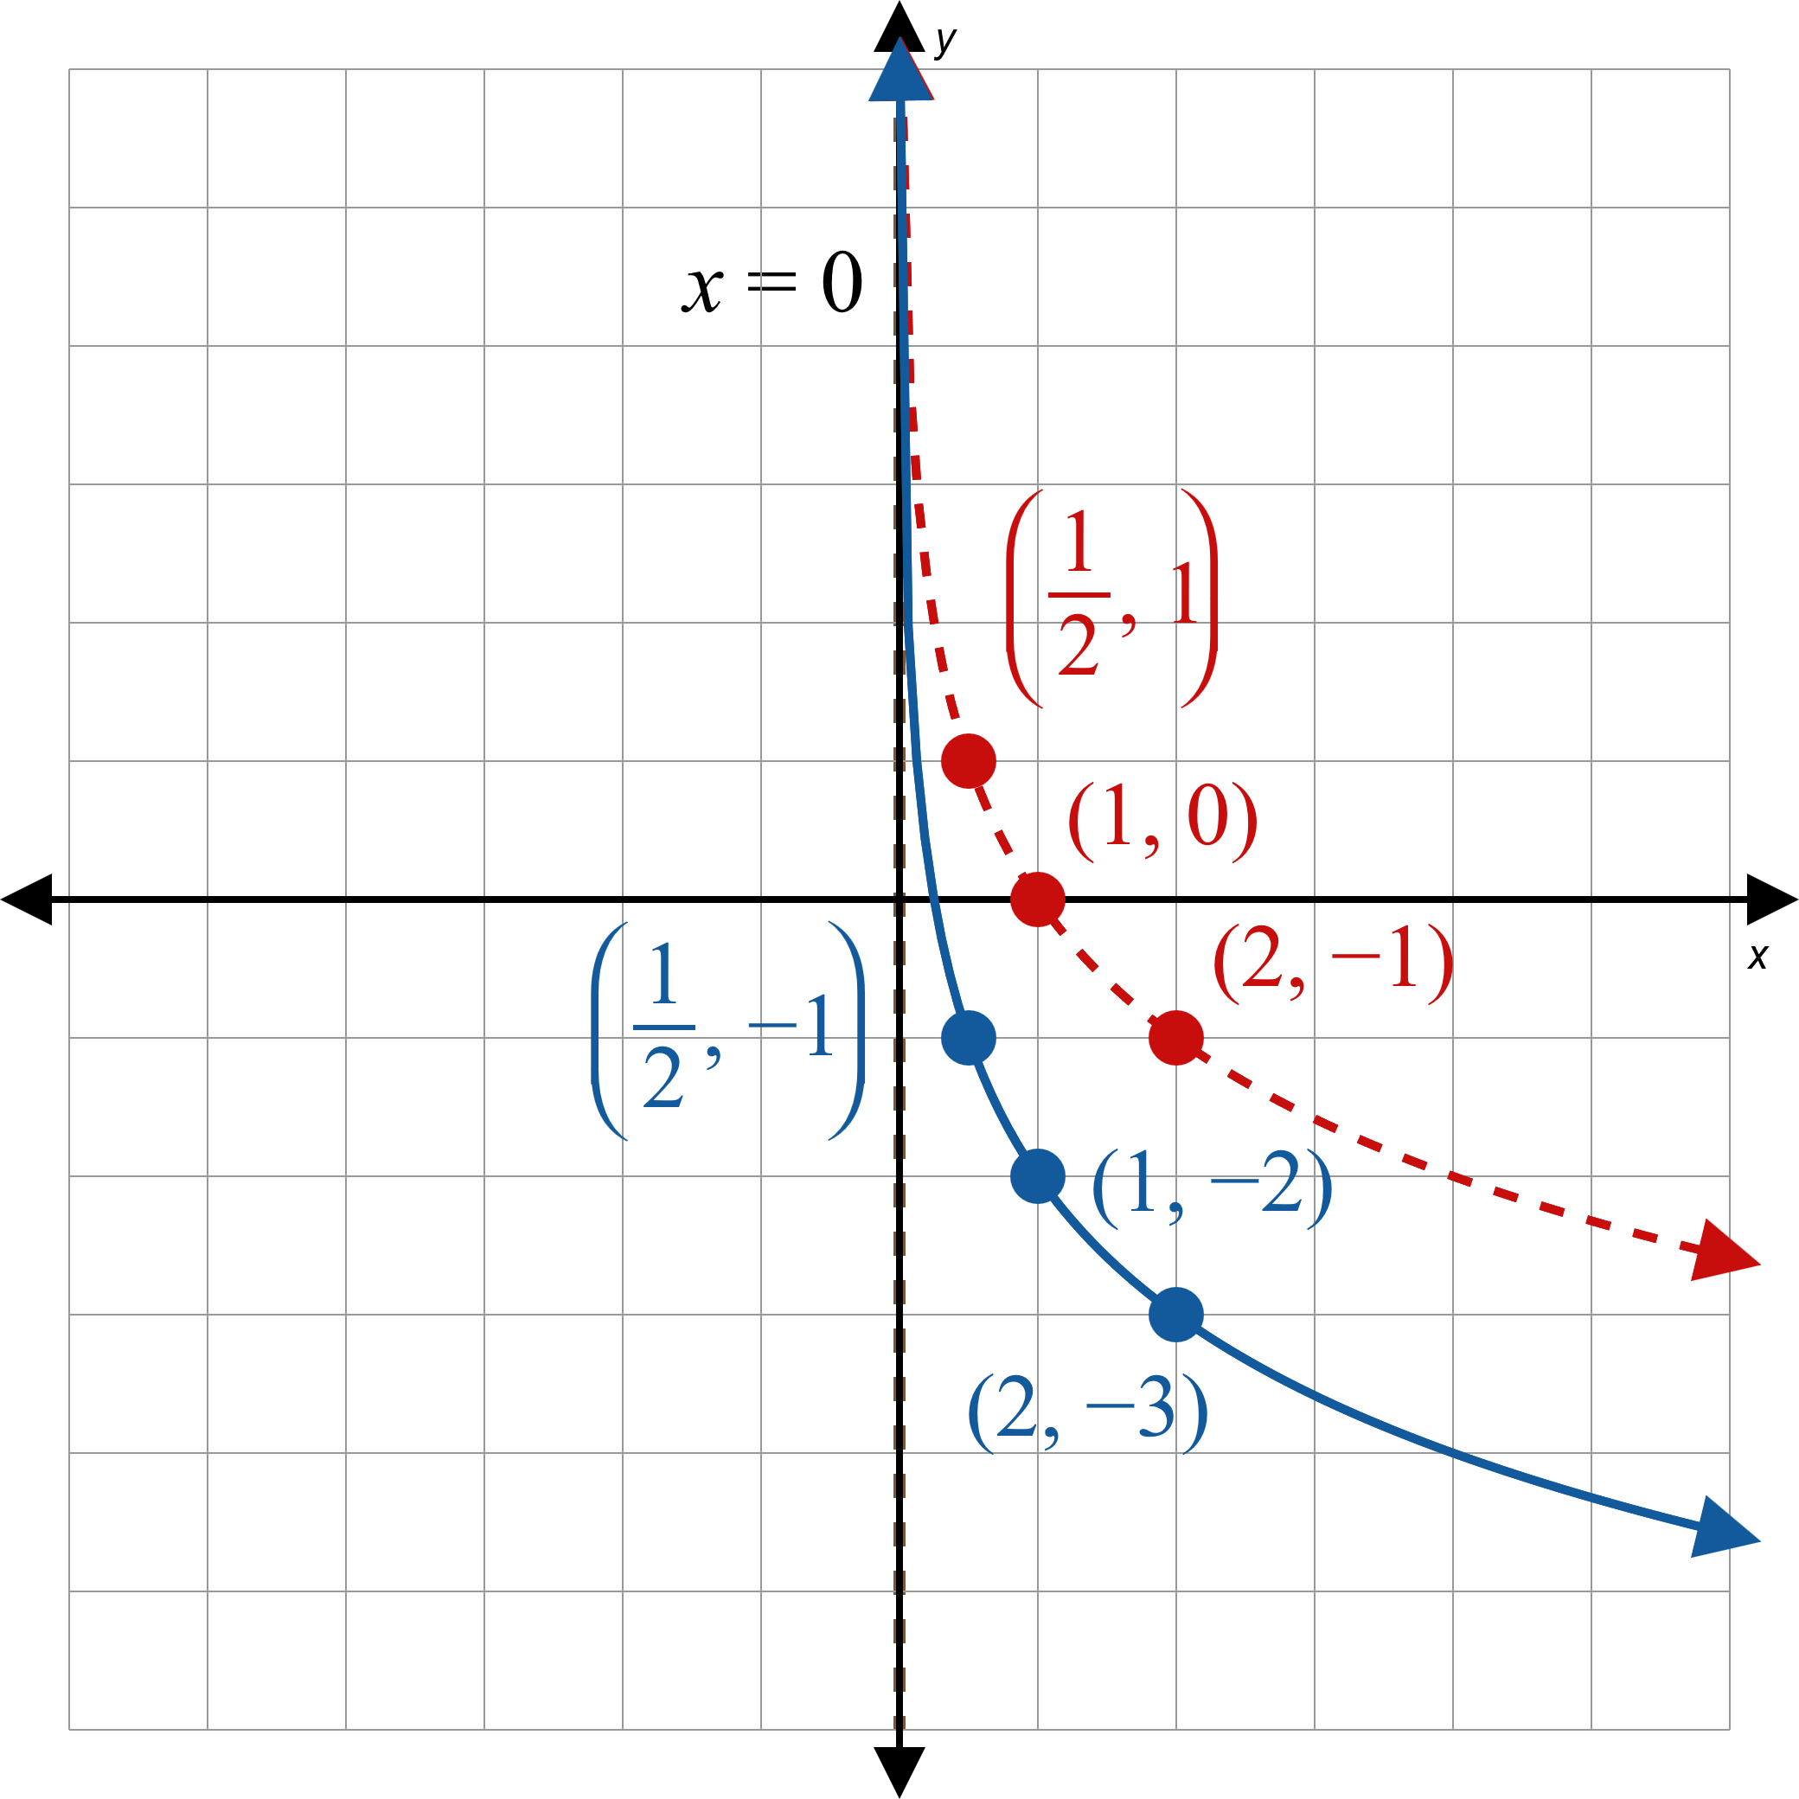


Example 3: Graphing Logarithmic Functions—Slide 3
We begin with the dashed curve in Figure 11, which is the graph of
We then shift the graph 2 units down to obtain the graph of the function h.
$$\log_{\frac{1}{2}}{x}$$
Figure 11
Domain$=(0,∞)$, Range $=(−∞,∞)$

Slide 16
Definition: Common and Natural Logarithms
The function log ₁₀ x is called the common logarithm and is usually written log x.
  y = log x if and only if x = 10 ^{y}
​The function log _{e} x is called the natural logarithm and is usually written ln x.
  y = ln x if and only if x = e ^{y}

Slide 17
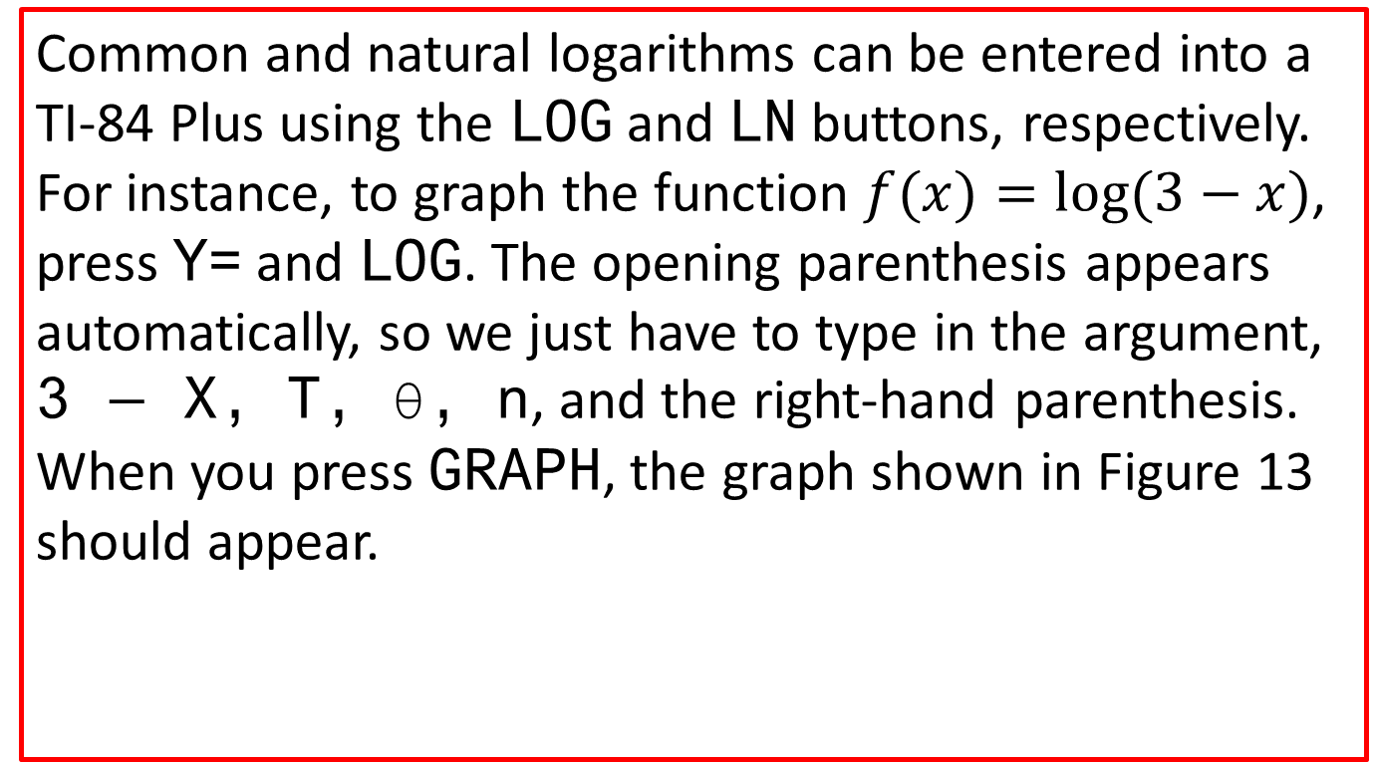
Technology: Inputting Logarithms, Graphing Logarithmic Functions—Slide 1
Common and natural logarithms can be entered into a TI-84 Plus using the log and ln buttons, respectively. For instance, to graph the function $f(x)=log⁡(3−x)$, press Y= and log. The opening parenthesis appears automatically, so we just have to type in the argument, 3 $−$ X, T, θ, n, and the right-hand parenthesis. When you press graph, the graph shown in Figure 13 should appear.

Slide 18
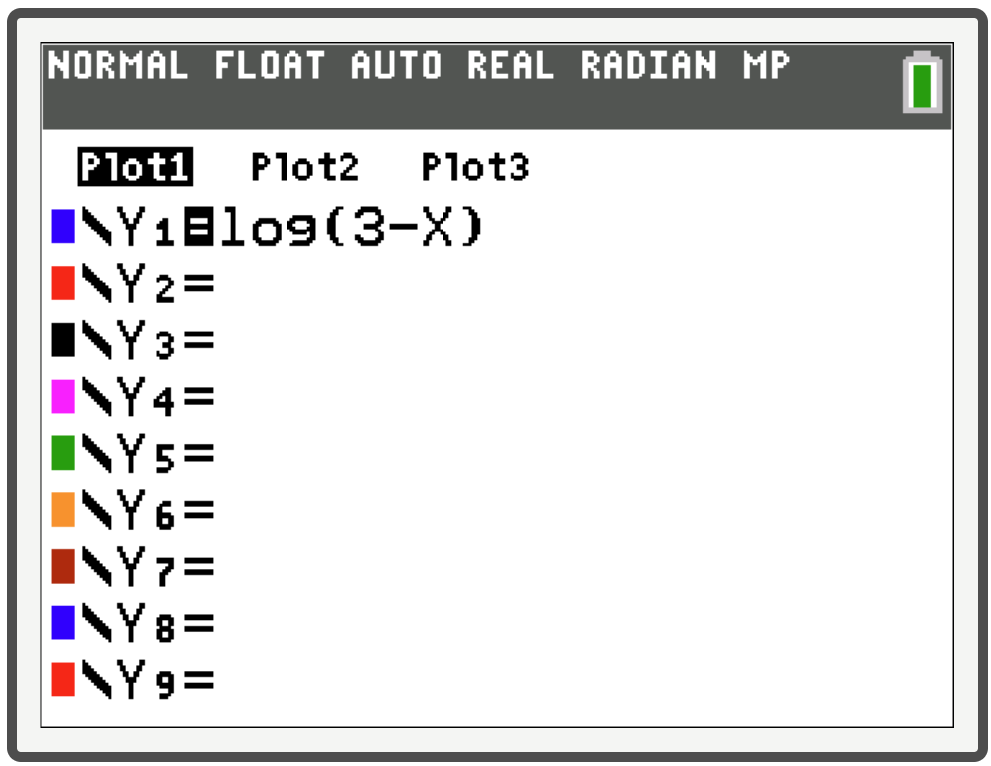
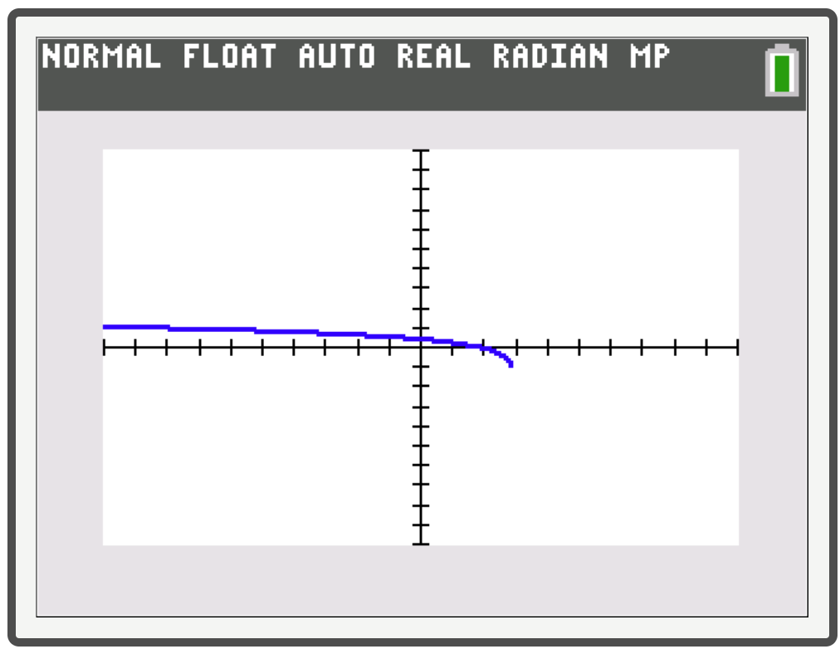
Technology: Inputting Logarithms, Graphing Logarithmic Functions—Slide 2
Figure 12
Figure 13

Slide 19
CAUTION!
Notice that the graph appears to cut off around the point where x = 3. We know, however, that the graph has a vertical asymptote at x = 3, and approaches that asymptote even though it does not show on the graphing calculator.

Slide 20

Properties: Properties of Natural Logarithms
$$\ln{x}=y \text{⇔}{ e}^{y}=x$$
Properties |  | Reasons
1. | ln 1 = 0 | Raise e to the power 0 to get 1.
2. | ln e = 1 | Raise e to the power 1 to get e.
3. | ln(e ^{x}) = x | Raise e to the power x to get e ^{x}.
4. | e ^{ln x} = x | ln x is the power to which e must be raised to get x.

Slide 21

Example 4: Evaluating Logarithmic Expressions—Slide 1
Evaluate the following logarithmic expressions.
​$ln⁡\left(\sqrt[3]{e}\right)$
​$log⁡1000$
​$ln⁡\left(4.78\right)$
​$log⁡\left(10.5\right)$

Slide 22
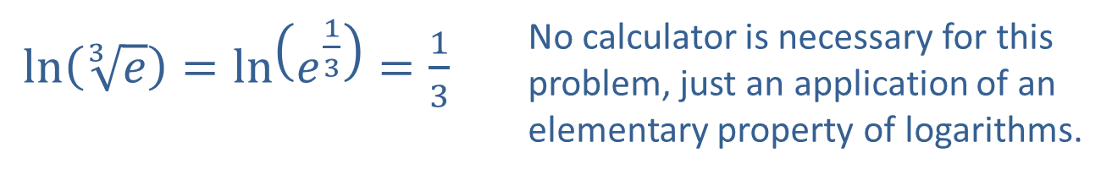
Example 4: Evaluating Logarithmic Expressions—Slide 2
Solution
​
$\ln\left(\sqrt[3]{e}\right)=\ln\left(e^{\frac{1}{3}}\right)=\frac{1}{3}$ | No calculator is necessary for this problem, just an application of an elementary property of logarithms.
b.
$\log{1000}=\log\left({10}^{3}\right)=3$ | Again, no calculator is required.

Slide 23
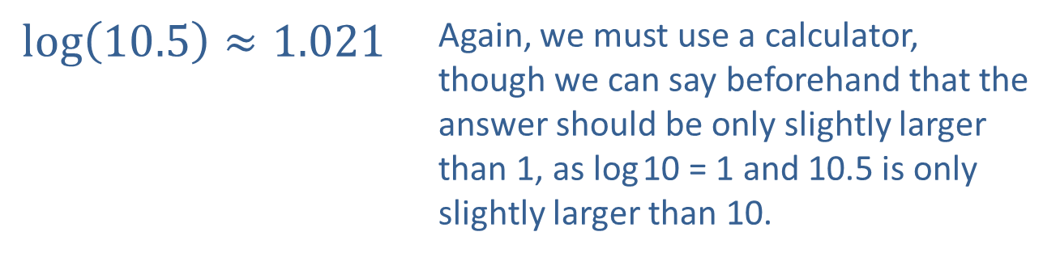
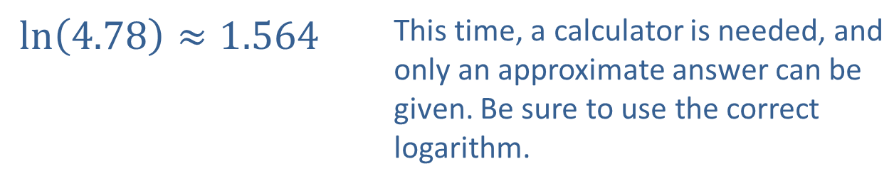
Example 3: Evaluating Logarithmic Expressions—Slide 3
$\ln\left(4.78\right)≈1.564$ | This time, a calculator is needed, and only an approximate answer can be given. Be sure to use the correct logarithm.
​
​
$\log\left(10.5\right)≈1.021$ | Again, we must use a calculator, though we can say beforehand that the answer should be only slightly larger than 1, as log 10 = 1 and 10.5 is only slightly larger than 10.

