Slide 1
Section 1.R.7
Polynomial Functions

Slide 2
Definition: Zeros of a Polynomial
The number c (c may be a complex number) is a zero of the polynomial function p(x) if p(c) = 0. This is also expressed by saying that c is a root of the polynomial or a solution of the equation p(x) = 0.

Slide 3
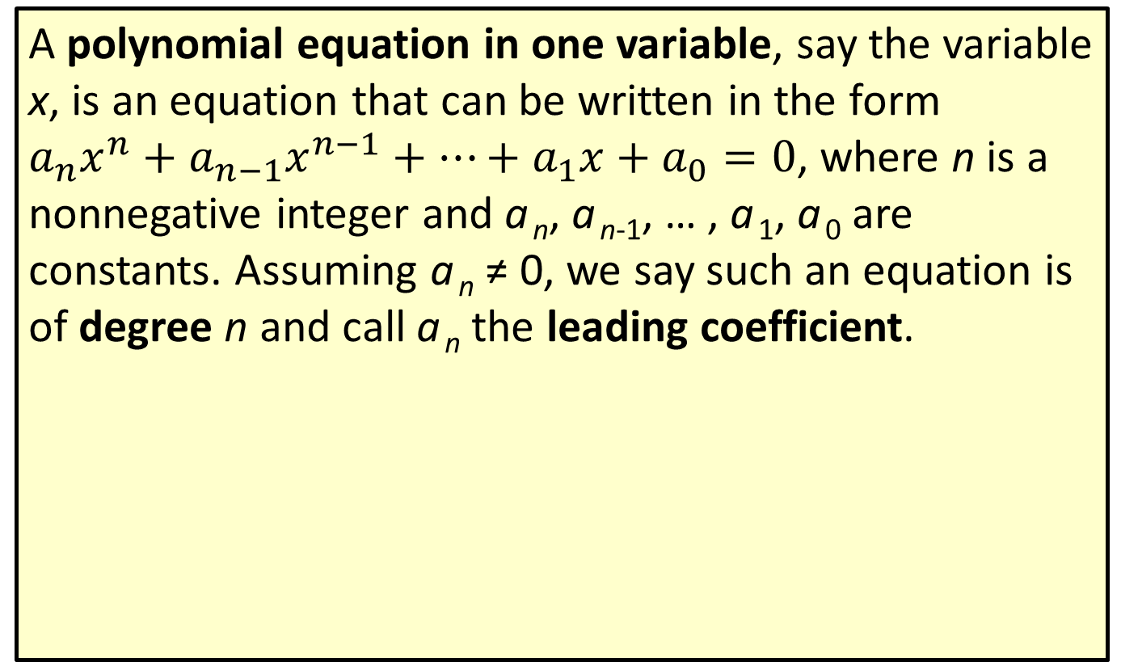
Definition: Polynomial Equations
A polynomial equation in one variable, say the variable x, is an equation that can be written in the form $a_{n}x^{n}+a_{n−1}x^{n−1}+…+a_{1}x+a_{0}=0$, where n is a nonnegative integer and a _{n}, a _{n-1}, … , a ₁, a ₀ are constants. Assuming a _{n} ≠ 0, we say such an equation is of degree n and call a _{n} the leading coefficient.

Slide 4

Example 1: Solutions of Polynomial Equations—Slide 1
Verify that the given values of x solve the corresponding polynomial equations.
​$6x^{2}−x^{3}=12+5x$; $x=4$
​$6x^{7}−3x^{5}=3x^{4}−6x^{2}$; $x=−1$

Slide 5
Note 1
When verifying a zero, there is no need to rewrite the equation in the form of the definition.

Slide 6
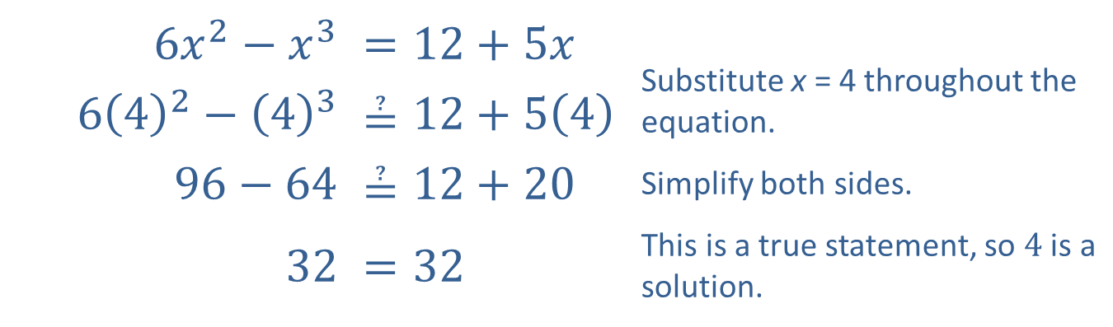
Example 1: Solutions of Polynomial Equations—Slide 2
Solution
​
​$6x^{2}−x^{3}$ | ​$=12+5x$ | Substitute x = 4 throughout the equation.
​$6{\left(4\right)}^{2}−{\left(4\right)}^{3}$ | ​$≟12+5\left(4\right)$
​$96−64$ | ​$≟12+20$ | Simplify both sides.
​32 | ​$=32$ | This is a true statement, so 4 is a solution.

Slide 7
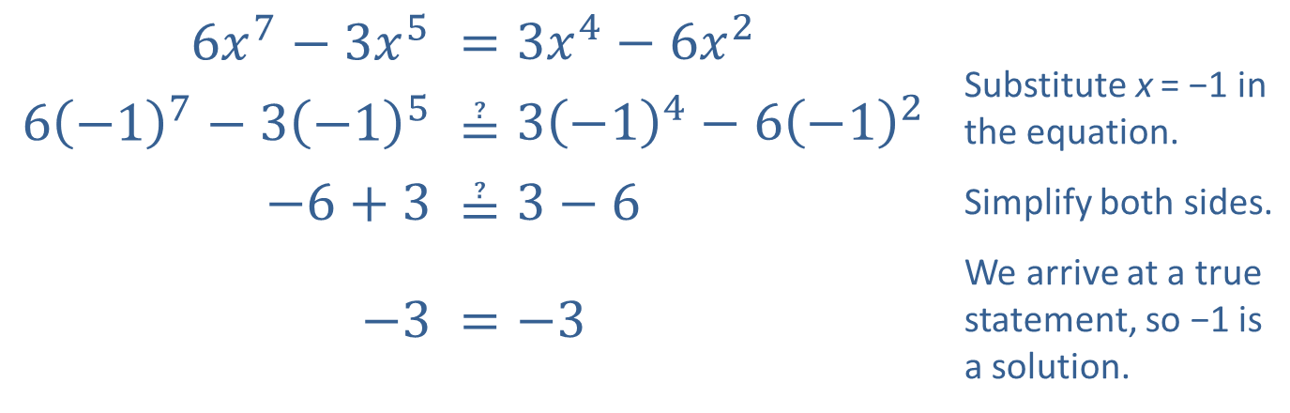
Example 1: Solutions of Polynomial Equations—Slide 3
Solution
​
​$6x^{7}−3x^{5}$ | ​$=3x^{4}−6x^{2}$ | Substitute x = −1 in the equation.
​$6{\left(−1\right)}^{7}−{3\left(−1\right)}^{5}$ | ​$≟{3\left(−1\right)}^{4}−{6\left(−1\right)}^{2}$
​$−6+3$ | ​$≟3−6$ | Simplify both sides.
$−$​3 | ​$=−3$ | We arrive at a true statement, so −1 is a solution.

Slide 8
Technology: Finding Zeros of Polynomials—Slide 1
The same method that is used to find the x-intercept of a linear function can be used to find the x-intercepts, or zeros, of any function graphed on a TI-84 Plus. The main difference is that with linear functions, there can be no more than one zero, but other functions might have more. Consider the graph of the function f(x) = x ² + 4x − 6.

Slide 9
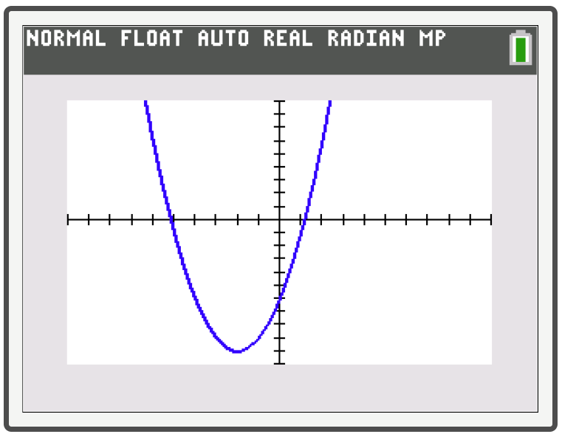
Technology: Finding Zeros of Polynomials—Slide 2
Figure 1
We can see that there are two zeros that appear to be located near x = −5 and x = 1. To check more accurately, press 2nd trace to access the CALC menu, then select zero.

Slide 10
Technology: Finding Zeros of Polynomials—Slide 3
The screen should now display the graph with the words Left Bound? shown at the graph. Choose which zero you want to find and use the arrows to move the cursor anywhere to the left of that intercept and press enter. The screen should now say Right Bound? Use the right arrow to move the cursor to the right of that same intercept and press enter again. (Be sure there is only one x-intercept between what you select as the left bound and what you select as the right bound.) The text should now read Guess? Press enter a third time and the x- and y-values of that x-intercept will appear in the graph.

Slide 11
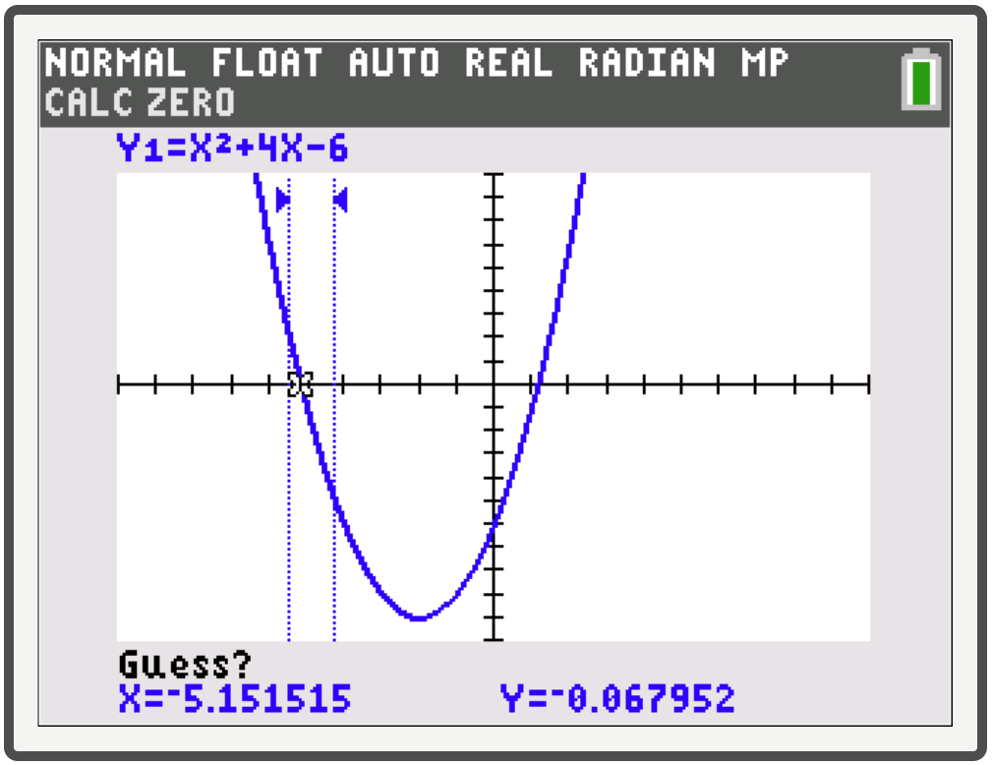
Technology: Finding Zeros of Polynomials—Slide 4
Figure 2

Slide 12
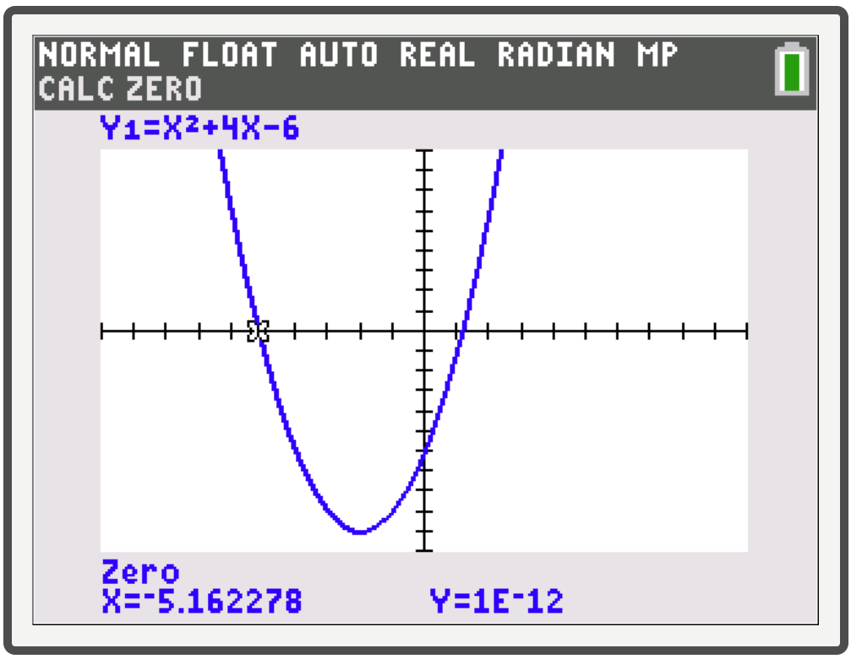
Technology: Finding Zeros of Polynomials—Slide 5
The leftmost zero occurs at approximately x ≈ −5.162. Note that sometimes, as in Figure 3, the display will read a very small number rather than exactly zero. To find the other zero, repeat the process, this time focusing on the rightmost zero. We find that it occurs at x ≈ 1.162.
Figure 3

Slide 13
Properties: Behavior of Polynomials as x → ±∞—Slide 1
Given a polynomial function p(x) with degree n, the behavior of p(x) as x → ±∞ can be determined from the leading term a _{n}x ^{n}.

Slide 14
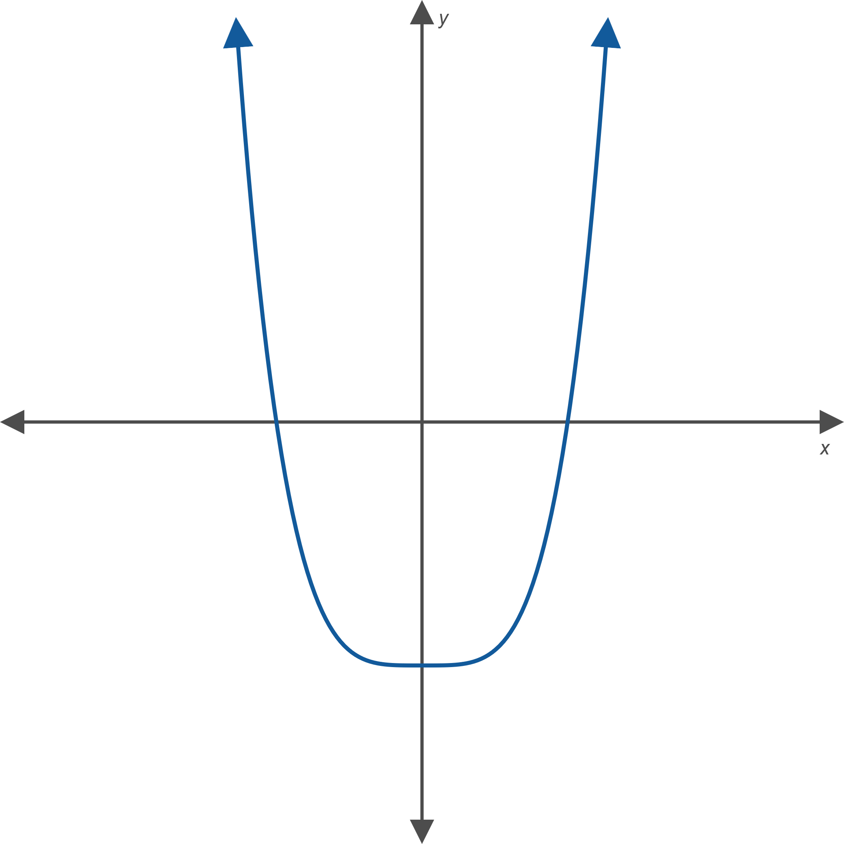
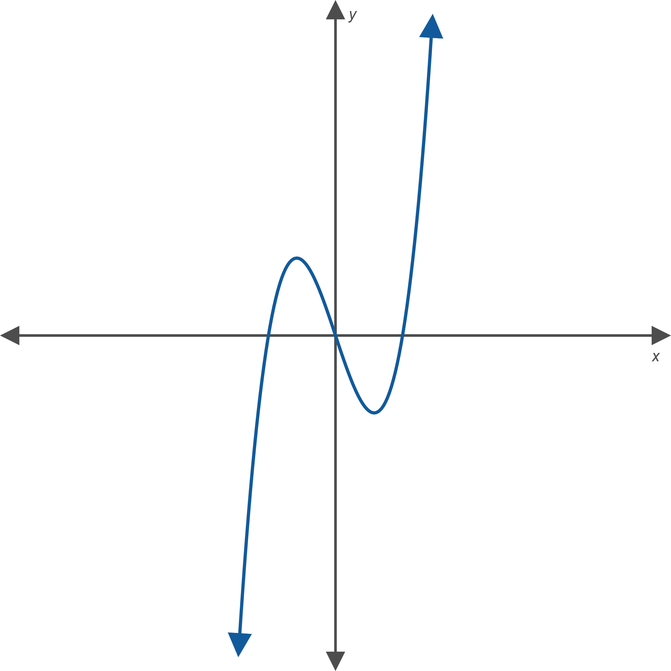
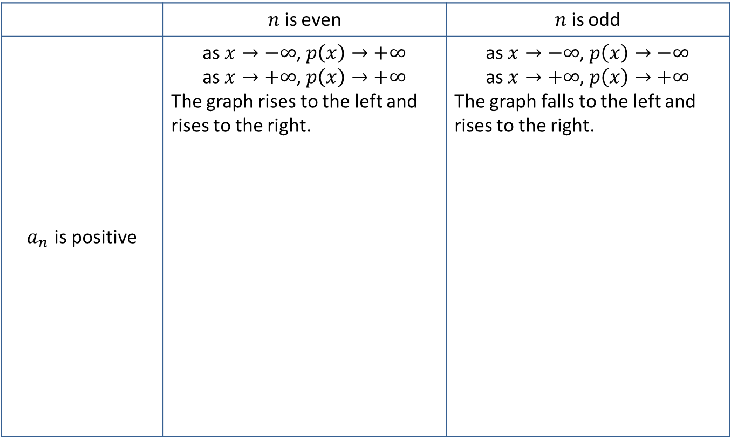
Properties: Behavior of Polynomials as x → ±∞—Slide 2
 | $n$ is even | $n$ is odd
$a_{n}$ is positive | as $x→−∞$, $p\left(x\right)→+∞$ as $x→+∞$, $p\left(x\right)→+∞$ The graph rises to the left and rises to the right. | as $x→−∞$, $p\left(x\right)→−∞$ as $x→+∞$, $p\left(x\right)→+∞$ The graph falls to the left and rises to the right.

Slide 15
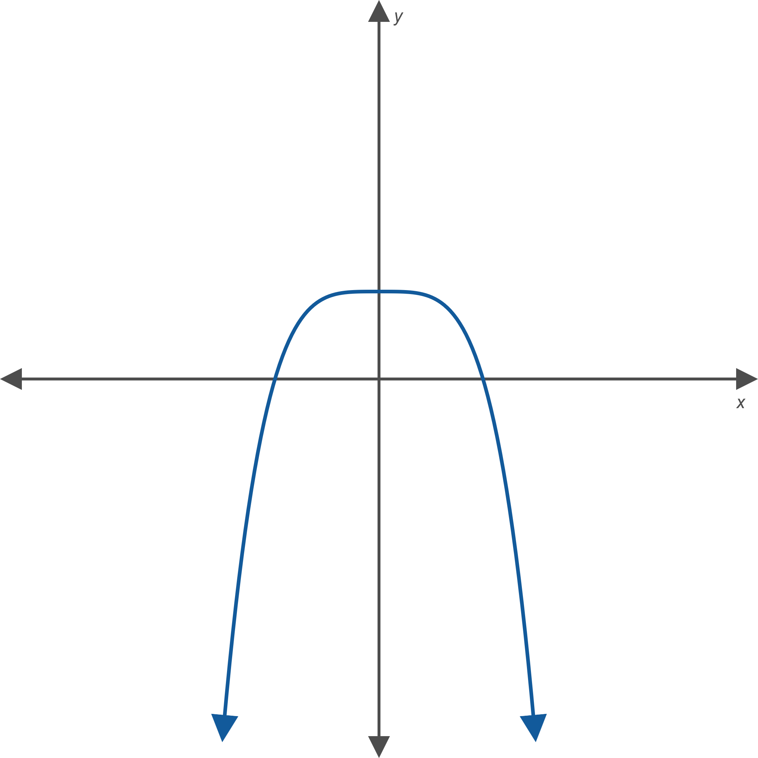
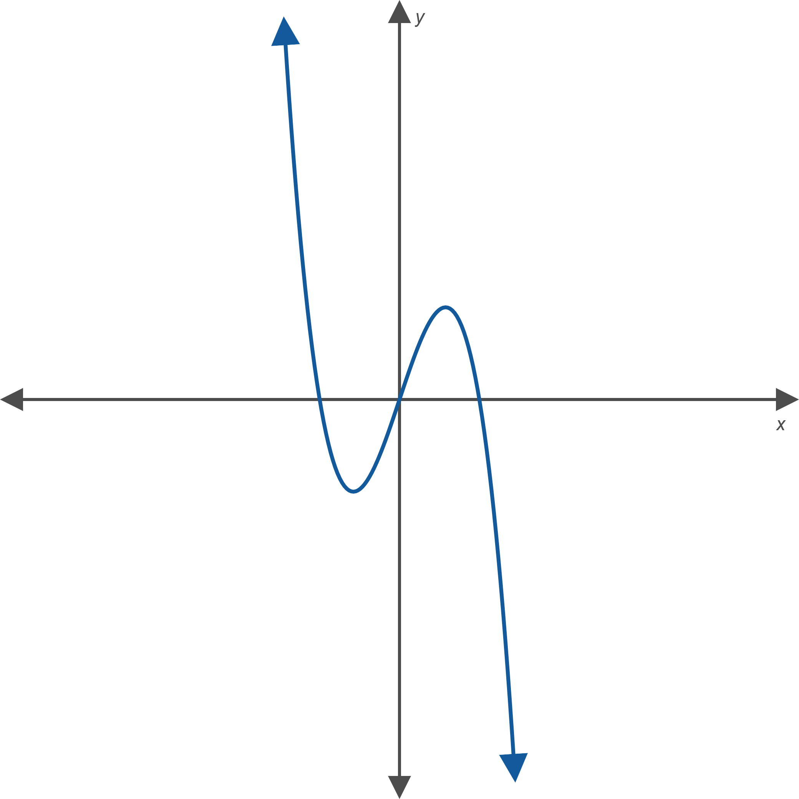

Properties: Behavior of Polynomials as x → ±∞—Slide 3
 | $n$ is even | $n$ is odd
$a_{n}$ is negative | as $x→−∞$, $p\left(x\right)→−∞$ as $x→+∞$, $p\left(x\right)→−∞$ The graph falls to the left and falls to the right. | as $x→−∞$, $p\left(x\right)→+∞$ as $x→+∞$, $p\left(x\right)→−∞$ The graph rises to the left and falls to the right.

Slide 16
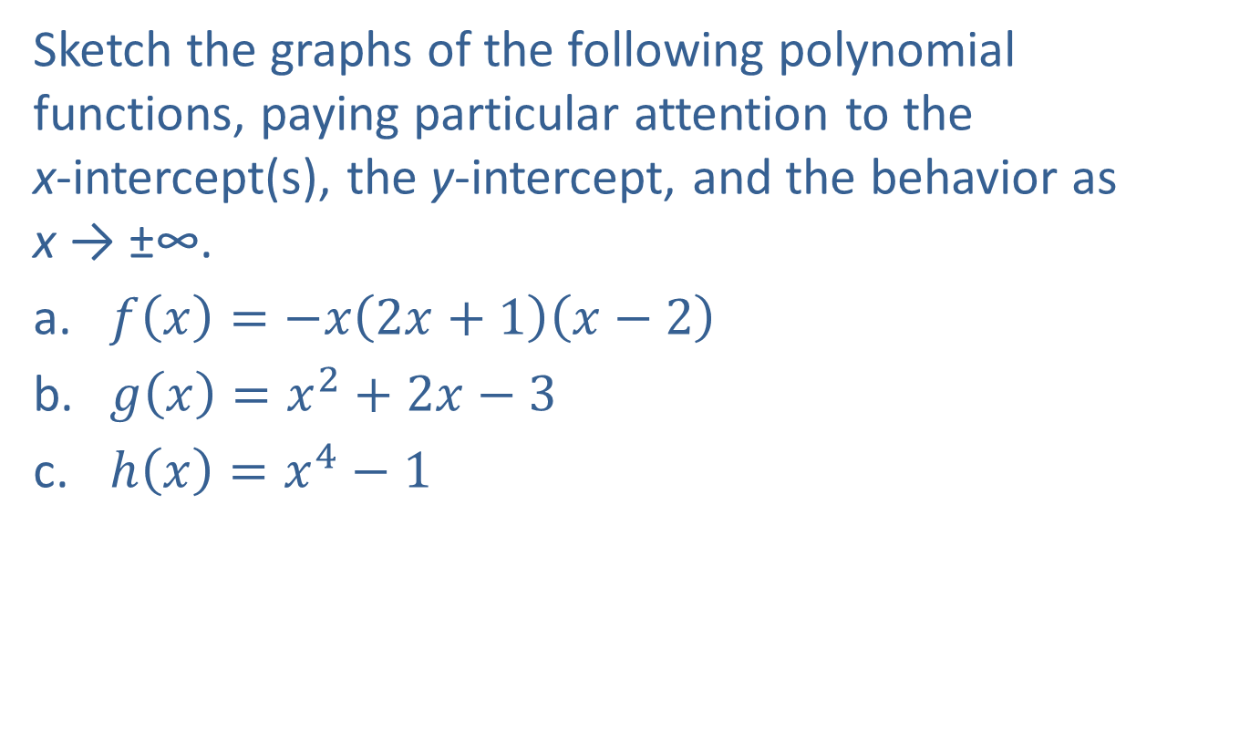
Example 2: Graphing Polynomial Functions—Slide 1
Sketch the graphs of the following polynomial functions, paying particular attention to the x-intercept(s), the y-intercept, and the behavior as x → ±∞.
​$f\left(x\right)=−x\left(2x+1\right)\left(x−2\right)$
​$g\left(x\right)=x^{2}+2x−3$
​$h\left(x\right)=x^{4}−1$

Slide 17
Note 2
As always, plotting additional points will help in sketching an accurate graph.

Slide 18
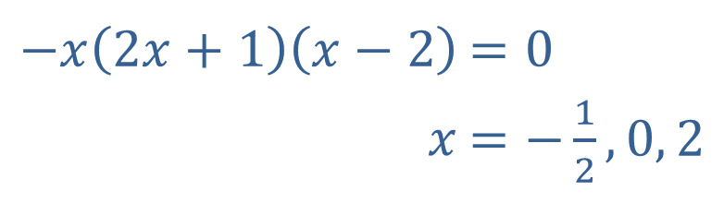
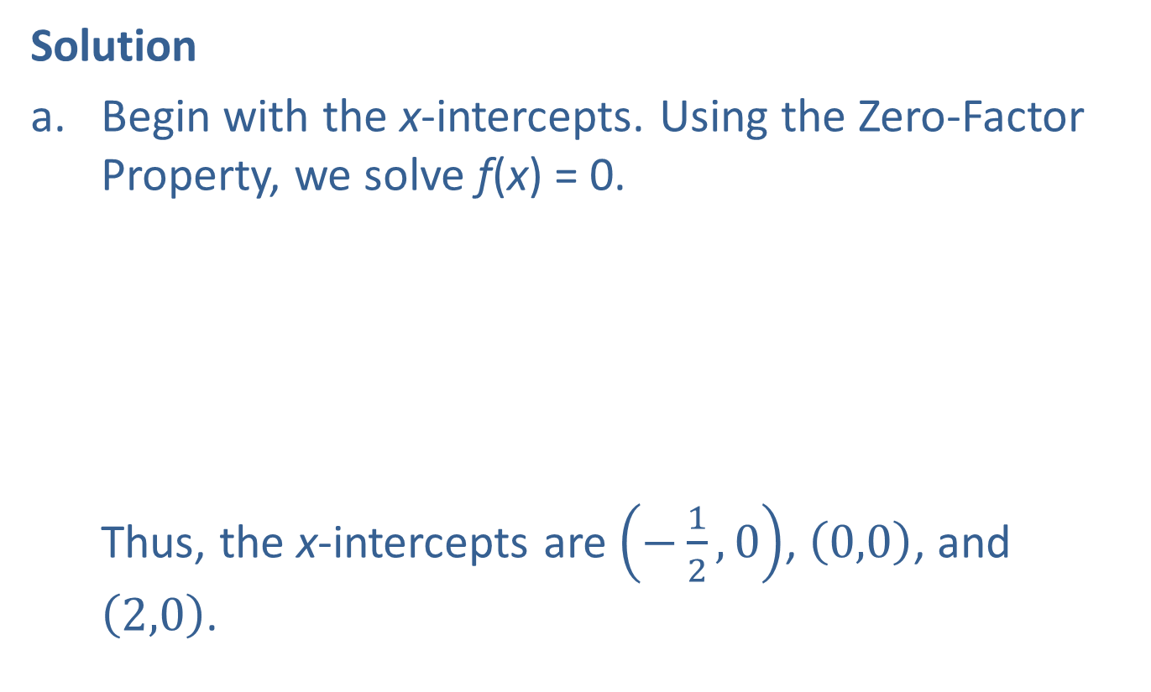
Example 2: Graphing Polynomial Functions—Slide 2
Solution
​Begin with the x-intercepts. Using the Zero-Factor Property, we solve f(x) = 0. ​ Thus, the x-intercepts are $\left(−\frac{1}{2},0\right)$, $\left(0,0\right)$, and $\left(2,0\right)$.
​$−x\left(2x+1\right)\left(x−2\right)$ | ​$=0$
​$x$ | ​$=\left.−\frac{1}{2}\right., 0, 2$

Slide 19
Example 2: Graphing Polynomial Functions—Slide 3
We could plug in x = 0 to find the y-intercept, but we already found it when calculating the x-intercepts! The y-intercept is the origin (0, 0).
All that remains is to determine the end behavior. Find the highest-degree term by multiplying
(−x)(2x)(x) = −2x ³.
The leading coefficient is negative, and the degree is odd, so f(x) → ∞ as x → −∞ and f(x) → −∞ as x → ∞.
Putting all this together, we obtain the graph. ​

Slide 20
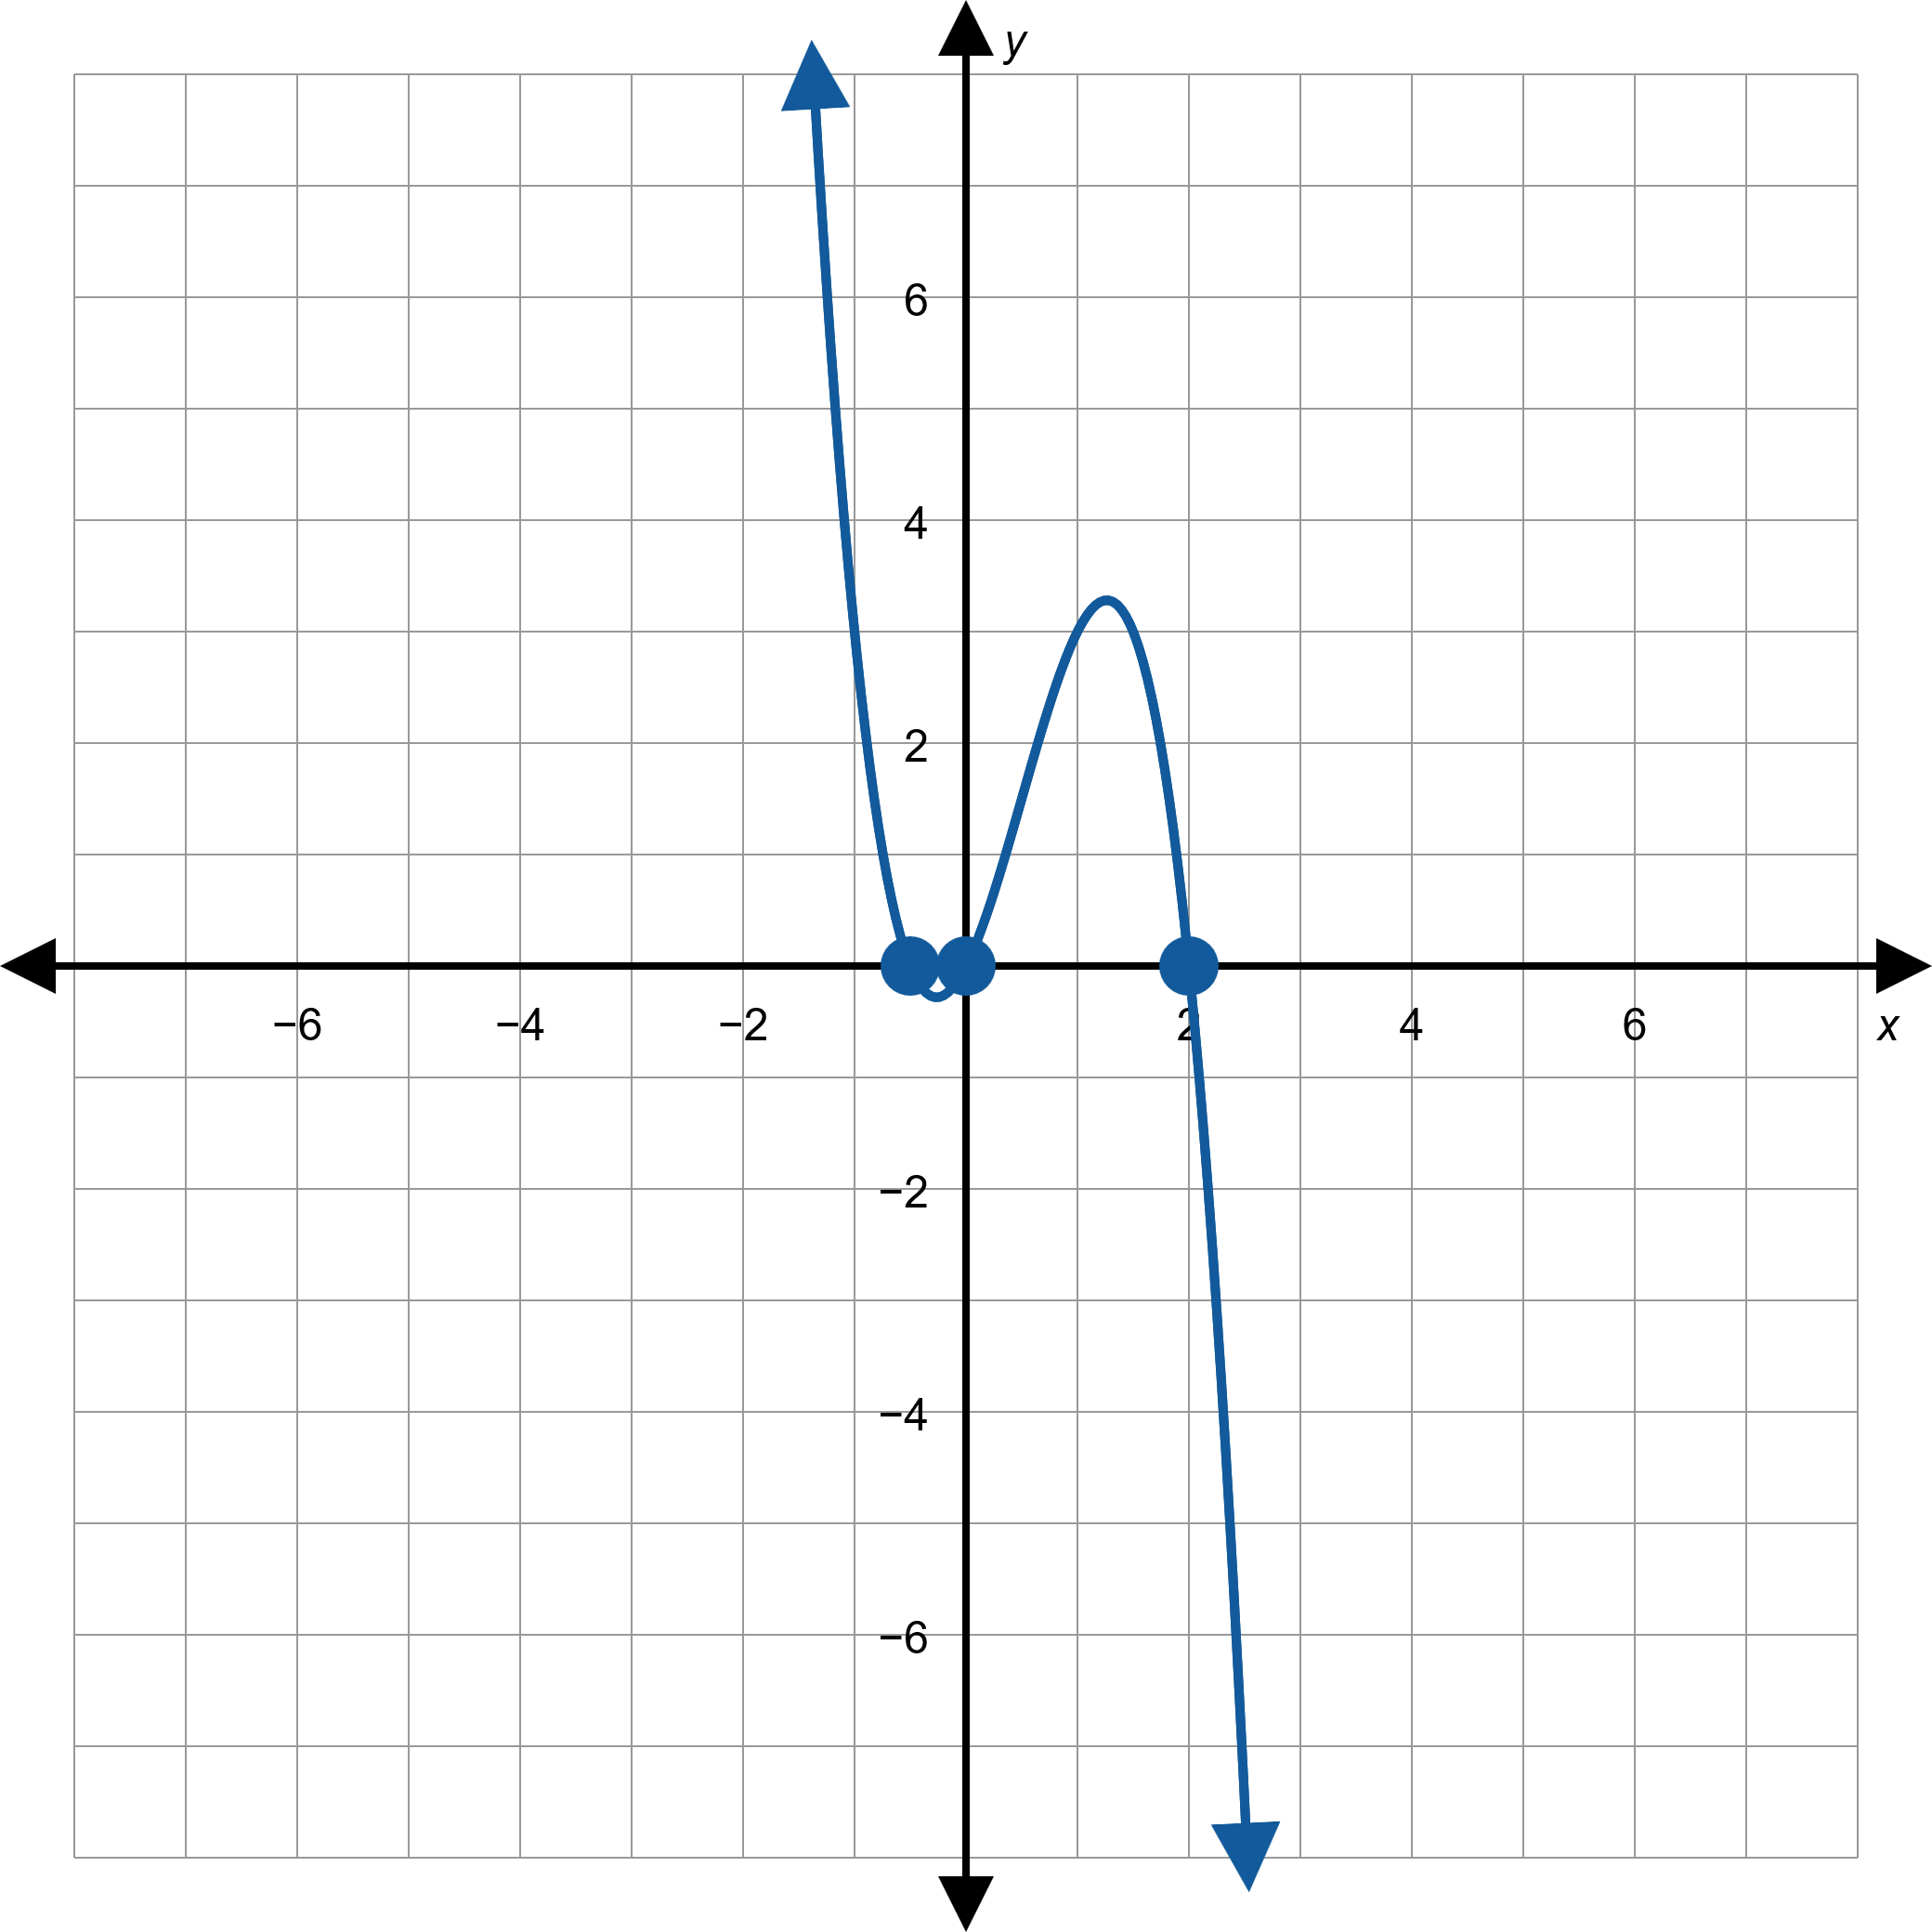
Example 2: Graphing Polynomial Functions—Slide 4
Figure 8: f(x) = −x(2x + 1)(x − 2)

Slide 21
Example 2: Graphing Polynomial Functions—Slide 5
​This polynomial is not in factored form. Before factoring, we can collect information about the y-intercept and behavior as x → ±∞.
​ g(x) = x ² + 2x − 3, so a ₀ = −3 and the leading term is x ². This means that the y-intercept is (0, −3) and that g(x) → ∞ as x → ±∞.

Slide 22
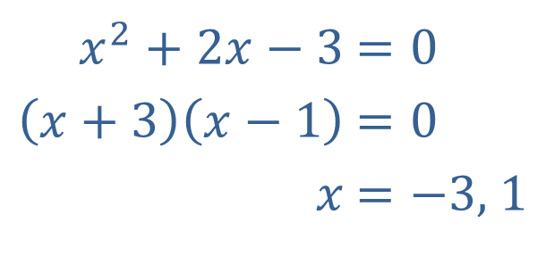
Example 2: Graphing Polynomial Functions—Slide 6
​Now, to find the x-intercepts, we factor the polynomial.
​Thus, the x-intercepts are (−3, 0) and (1, 0).
​
​$x^{2}+2x−3$ | ​$=0$
​$\left(x+3\right)\left(x−1\right)$ | ​$=0$
​$x$ | ​$=\left.−3\text{, }1\right.$

Slide 23
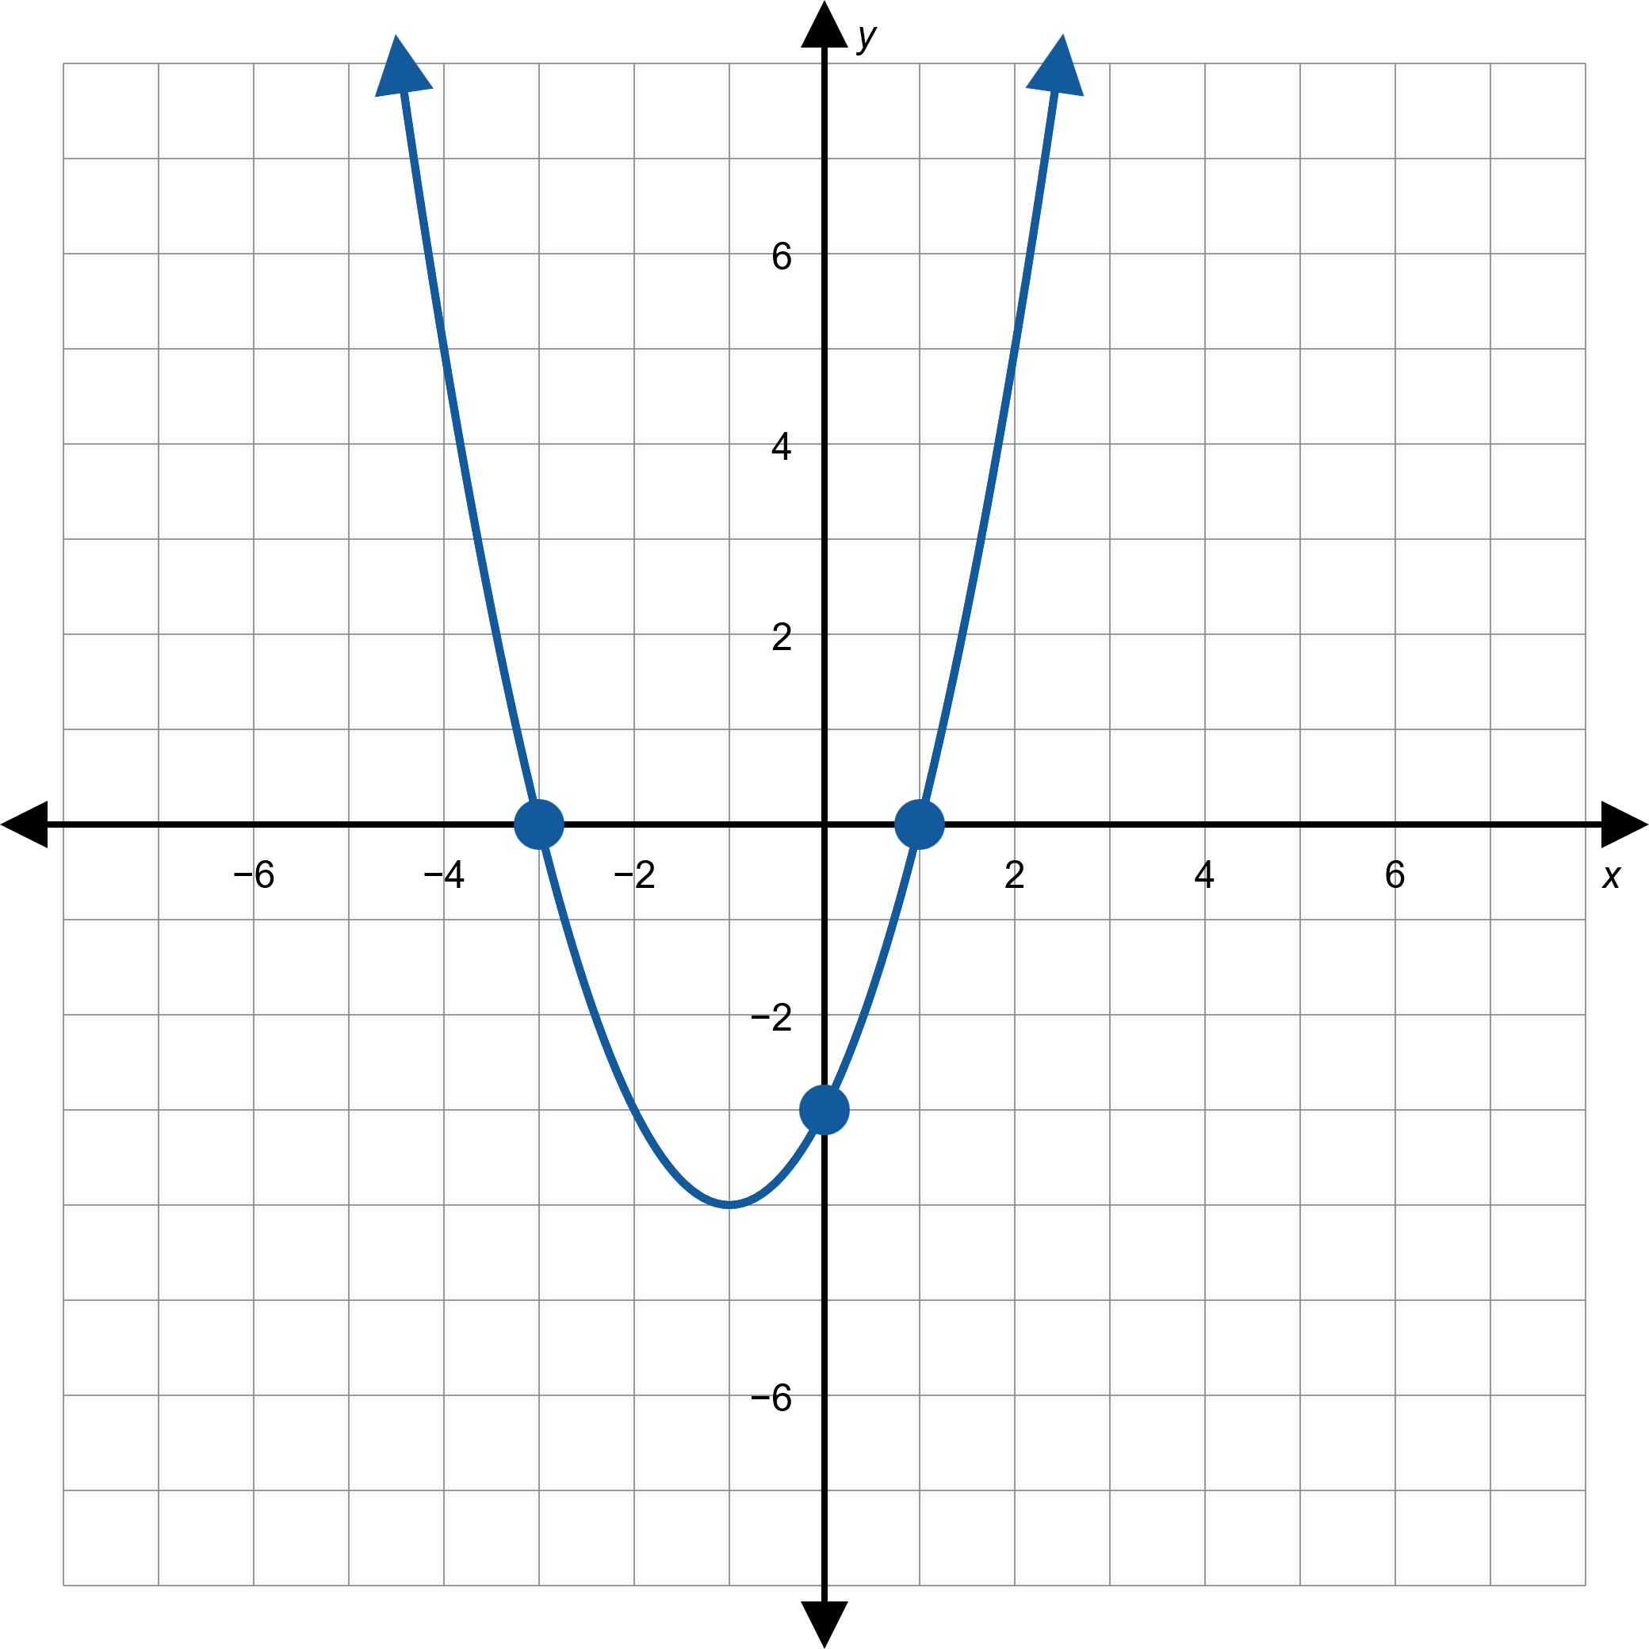
Example 2: Graphing Polynomial Functions—Slide 7
Figure 9: g(x) = x ² + 2x − 3

Slide 24
Example 2: Graphing Polynomial Functions—Slide 8
As with the previous example, we determine the y-intercept and behavior before factoring. h(x) = x ⁴ − 1, so a₀ = −1 and the leading term is x ⁴ . This tells us that the y-intercept is (0, −1) and that h(x) → ∞ as x → ±∞.

Slide 25
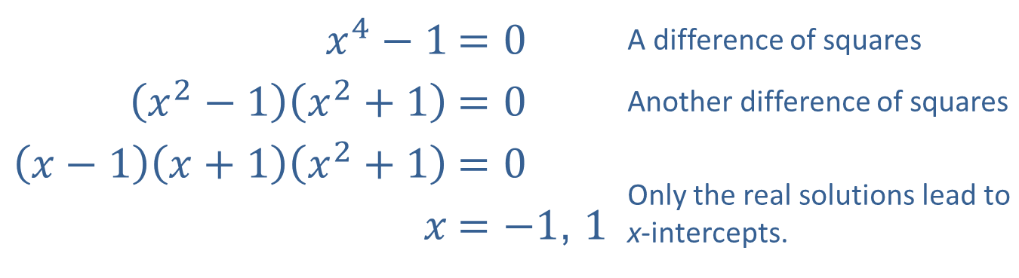
Example 2: Graphing Polynomial Functions—Slide 9
​Once again, we factor the polynomial to calculate the x-intercepts.
​
Here, the x-intercepts are (−1, 0) and (1, 0).
​
​$x^{4}−1$ | ​$=0$ | A difference of squares
​$\left(x^{2}−1\right)\left(x^{2}+1\right)$ | ​$=0$ | Another difference of squares
$$\left(x−1\right)\left(x+1\right)\left(x^{2}+1\right)$$ | $$=0$$ | Only the real solutions lead to x-intercepts.
​$x$ | ​$=\left.−1\text{, }1\right.$

Slide 26
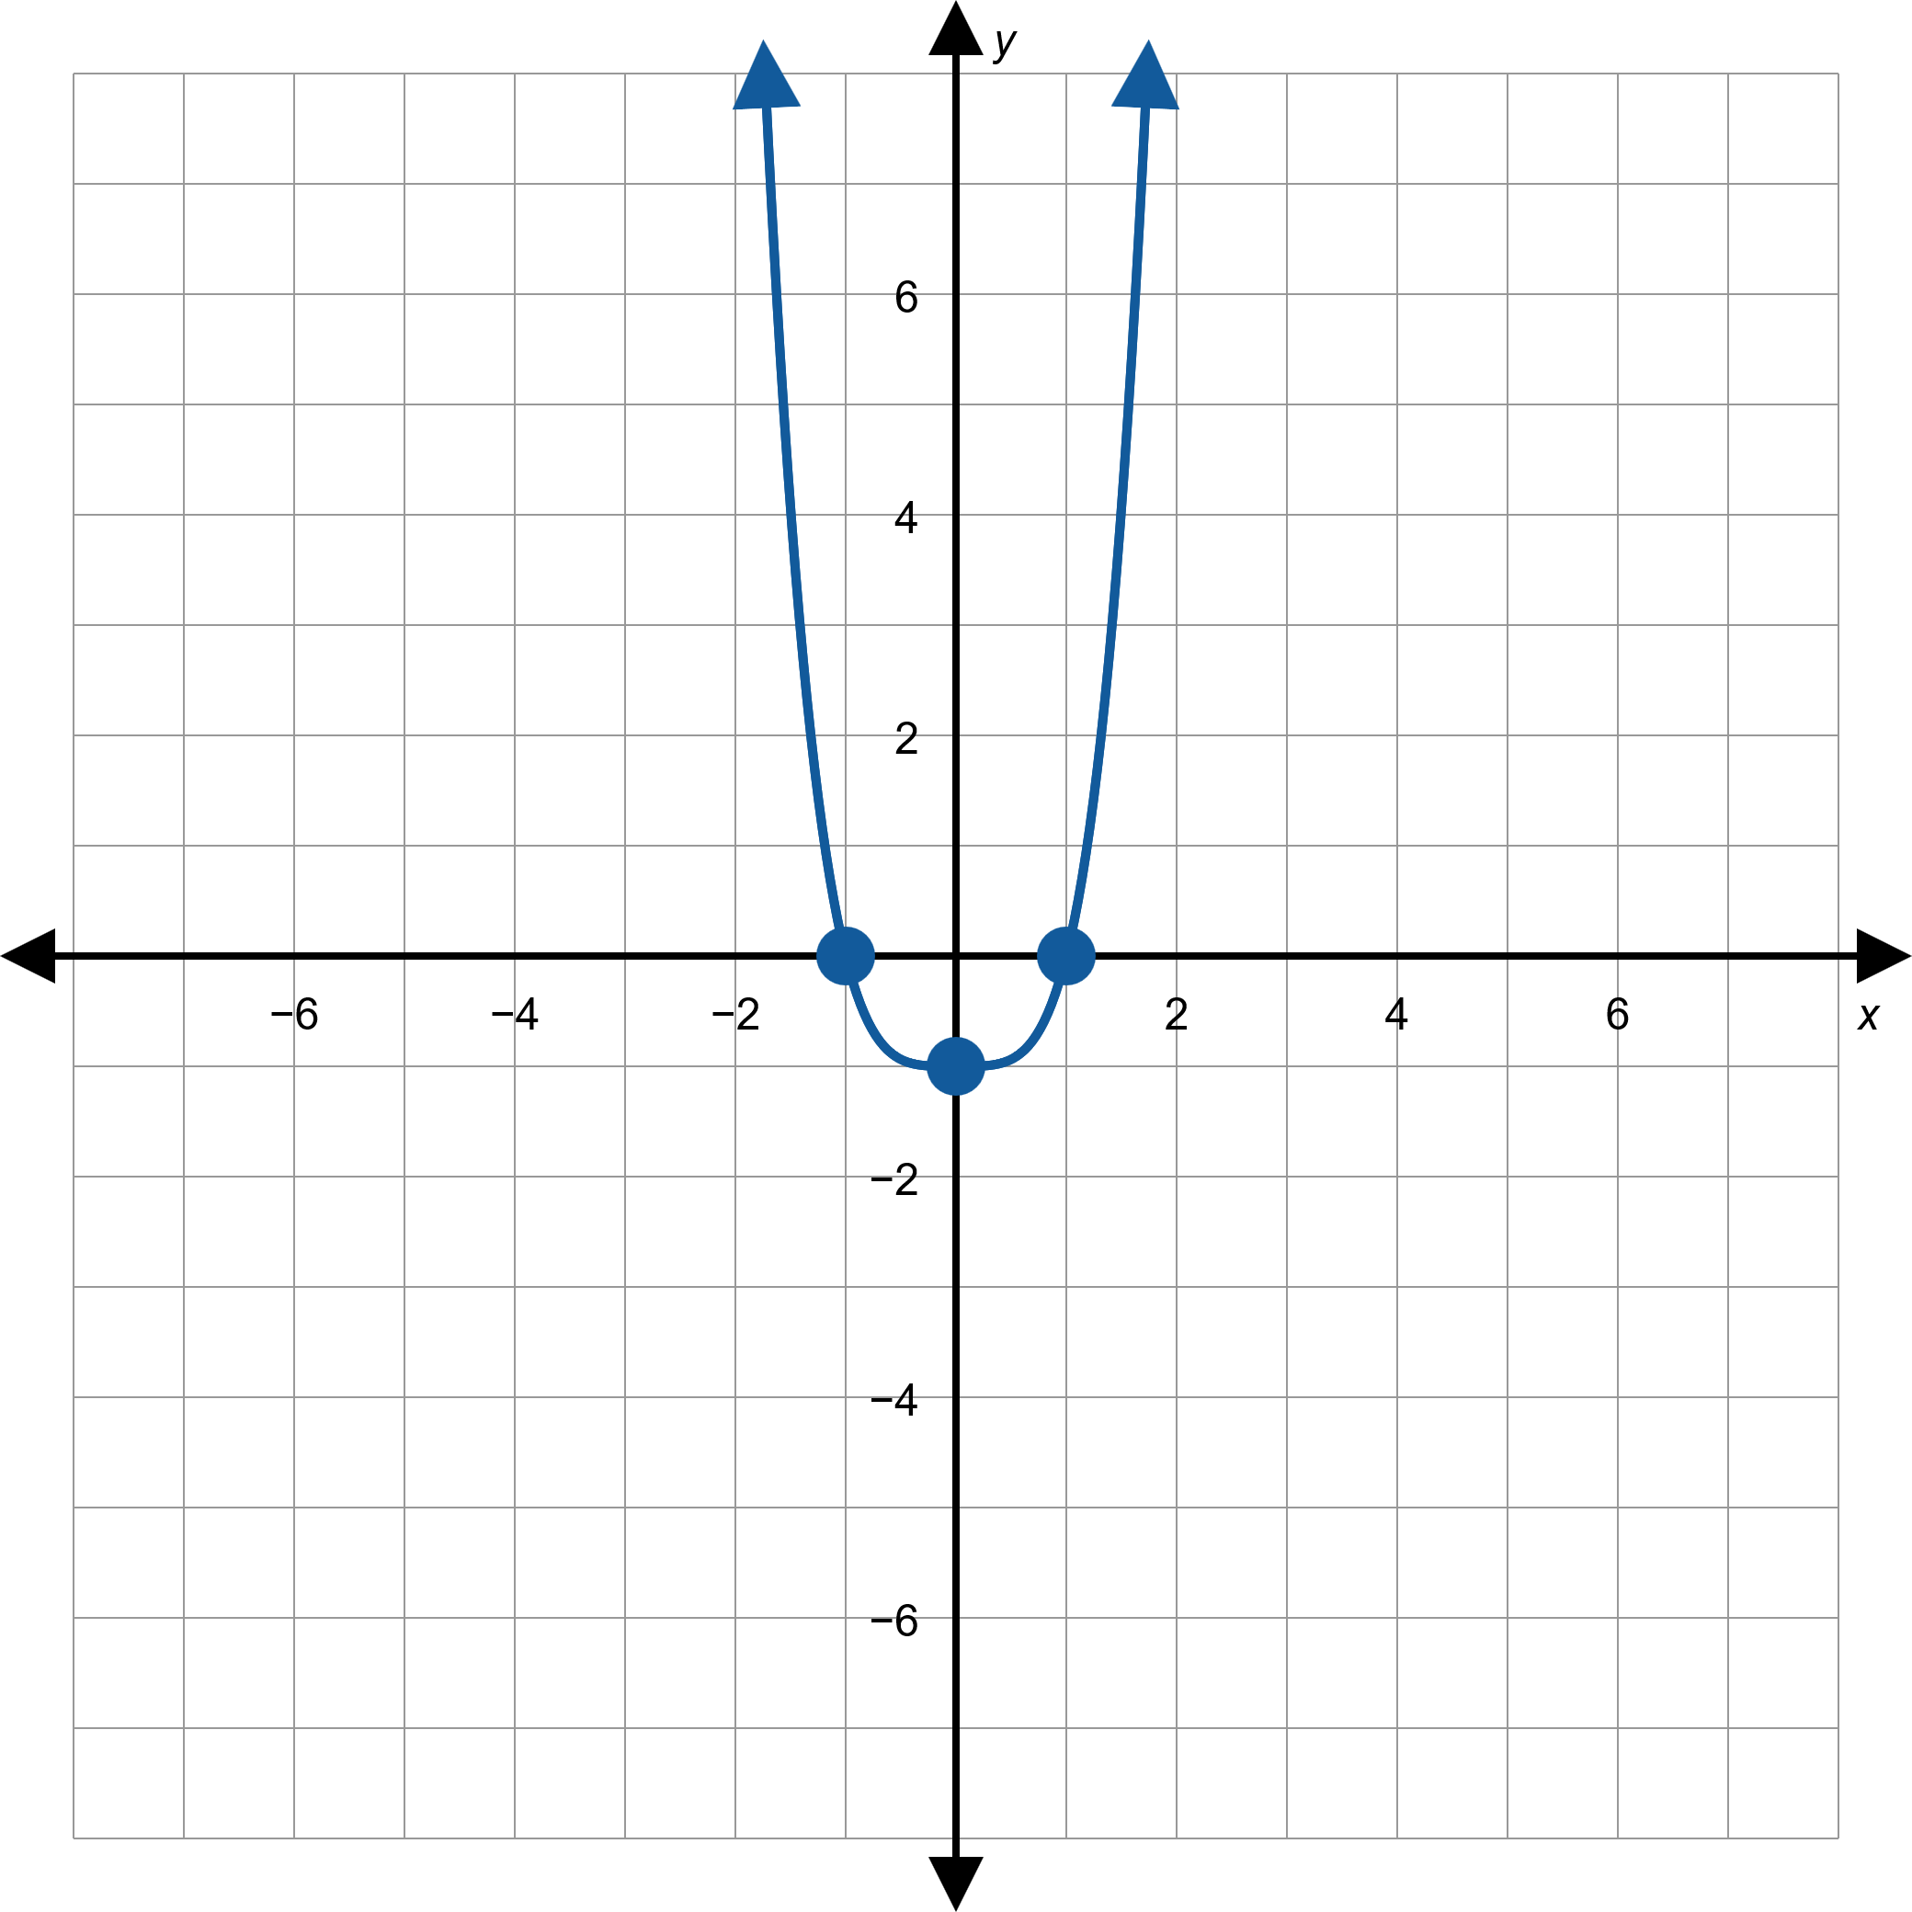
Example 2: Graphing Polynomial Functions—Slide 10
Figure 10: h(x) = x ⁴ − 1

Slide 27
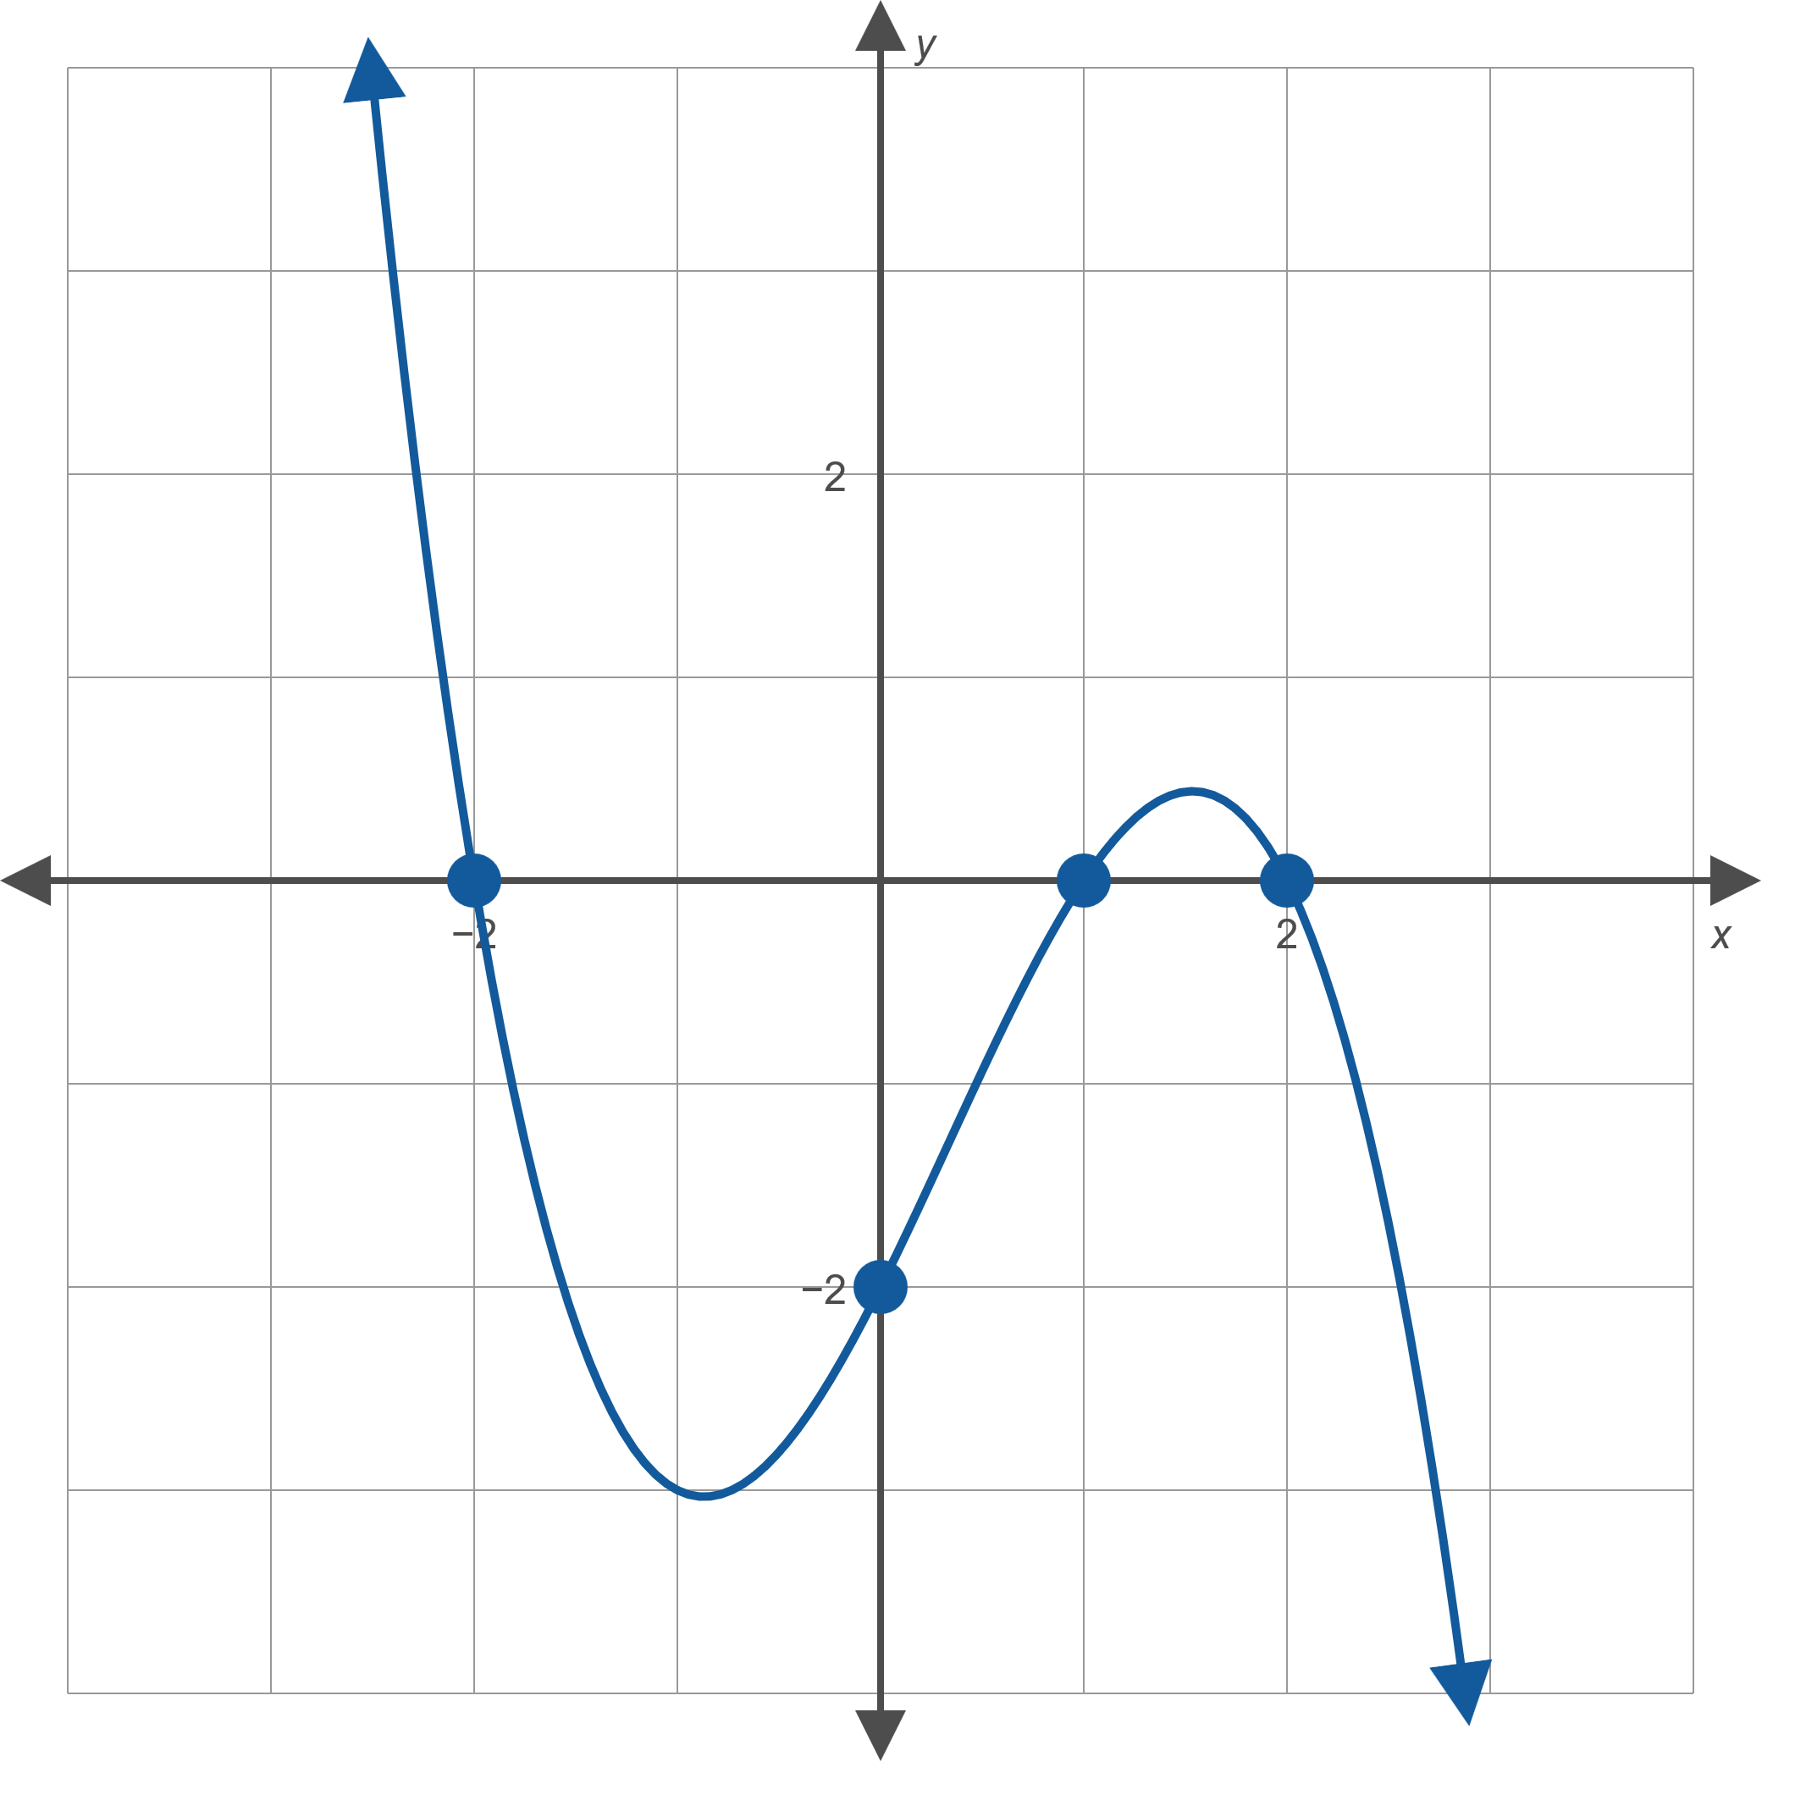
Example 3: Constructing a Polynomial Function from a Graph—Slide 1
Find the polynomial of lowest possible degree that corresponds to the graph in Figure 11.
Figure 11

Slide 28
Example 3: Constructing a Polynomial Function from a Graph—Slide 2
Solution
Let p(x) represent the polynomial to be found. The graph indicates that the zeros of p are − 2, 1, and 2, so p(x) must have factors of (x + 2), (x − 1), and (x − 2). In addition, p(x) may have a constant factor a—in fact, we know a must be a negative number because the graph has the appearance of a cubic polynomial with a negative leading coefficient. So, we know that p(x) = a(x + 2)(x − 1)(x − 2), with a still to be determined.

Slide 29
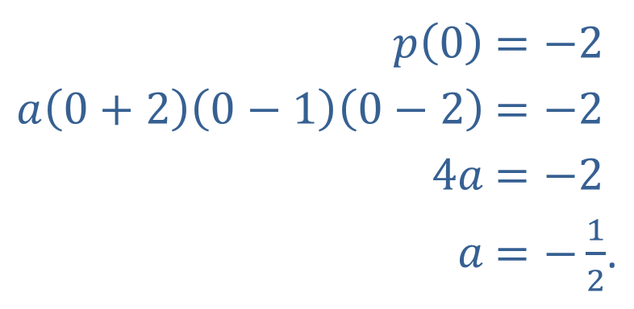

Example 3: Constructing a Polynomial Function from a Graph—Slide 3
We can solve for a $a$ by noting that the graph has a y-intercept at (0, −2), so
​
Hence, $p\left(x\right)=\left(−\frac{1}{2}\right)\left(x+2\right)\left(x−1\right)\left(x−2\right)$ is the desired polynomial.
​$p⁡\left(0\right)$ | ​$=−2$
​$a\left(0+2\right)\left(0−1\right)\left(0−2\right)$ | ​$=−2$
​$4a$ | ​$=−2$
​$a$ | ​$=−\frac{1}{2}$.

