Slide 1
Section 1.R.6
Power Functions and Other Common Functions

Slide 2
Definition: Power Functions
A power function is a function of the form f(x) = a ^{r}, where a and r and are real numbers.

Slide 3

Example 1: Power Functions of the Form ax ^{n}—Slide 1
Sketch the graphs of the following functions.
​$f\left(x\right)=\frac{x^{4}}{5}$
​$g\left(x\right)=−x^{3}$

Slide 4
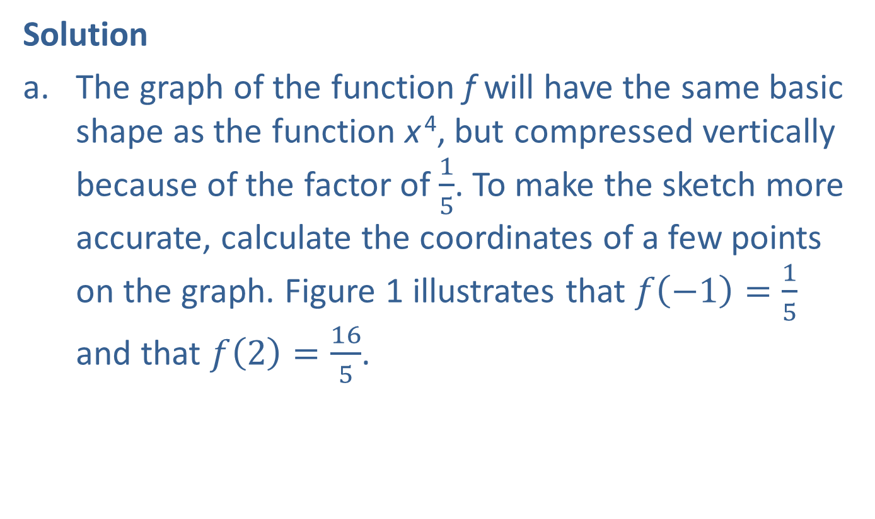
Example 1: Power Functions of the Form ax ^{n}—Slide 2
Solution
​The graph of the function f will have the same basic shape as the function x ⁴, but compressed vertically because of the factor of $\frac{1}{5}$. To make the sketch more accurate, calculate the coordinates of a few points on the graph. Figure 1 illustrates that $f\left(−1\right)=\frac{1}{5}$ and that $f\left(2\right)=\frac{16}{5}$.
​

Slide 5
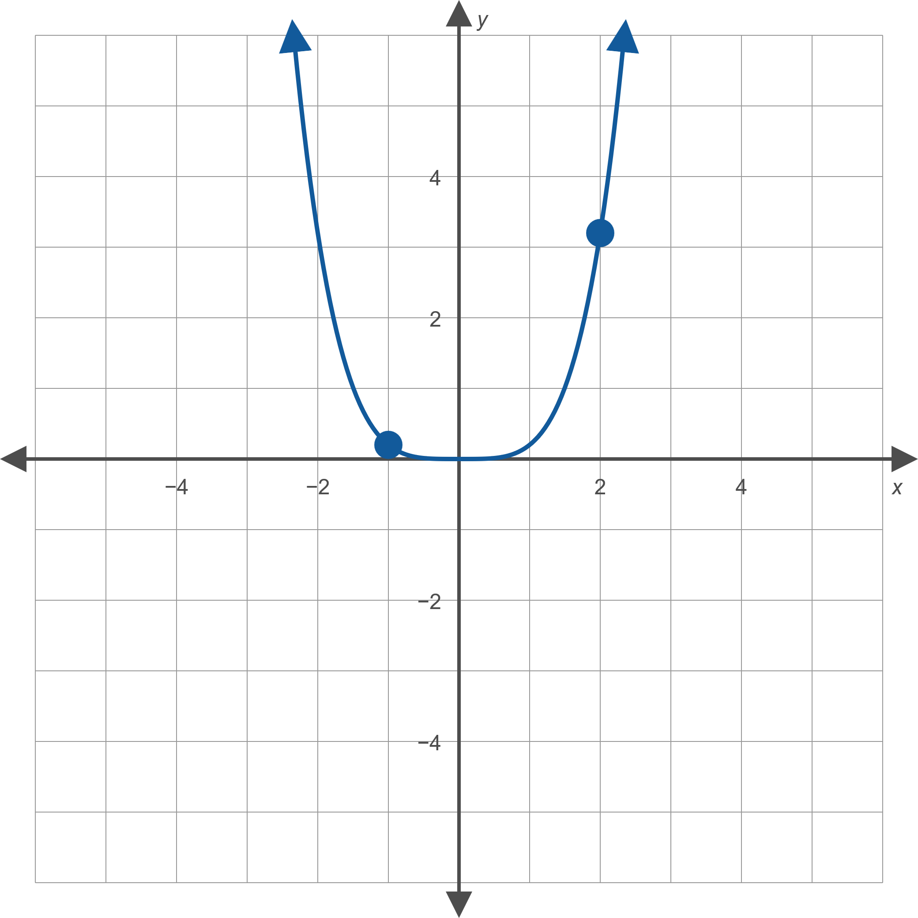
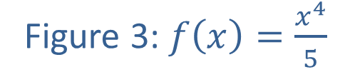
Example 1: Power Functions of the Form ax ^{n}—Slide 3
Figure 3: $f\left(x\right)=\frac{x^{4}}{5}$

Slide 6
Example 1: Power Functions of the Form ax ^{n}—Slide 4
​We know that the function g will have the same shape as the function x ³, but reflected over the x-axis because of the factor of −1. The graph in Figure 4 illustrates this.
​We also plot a few points on the graph of g, namely (−1, 1) and (1, −1), as a check.
​

Slide 7
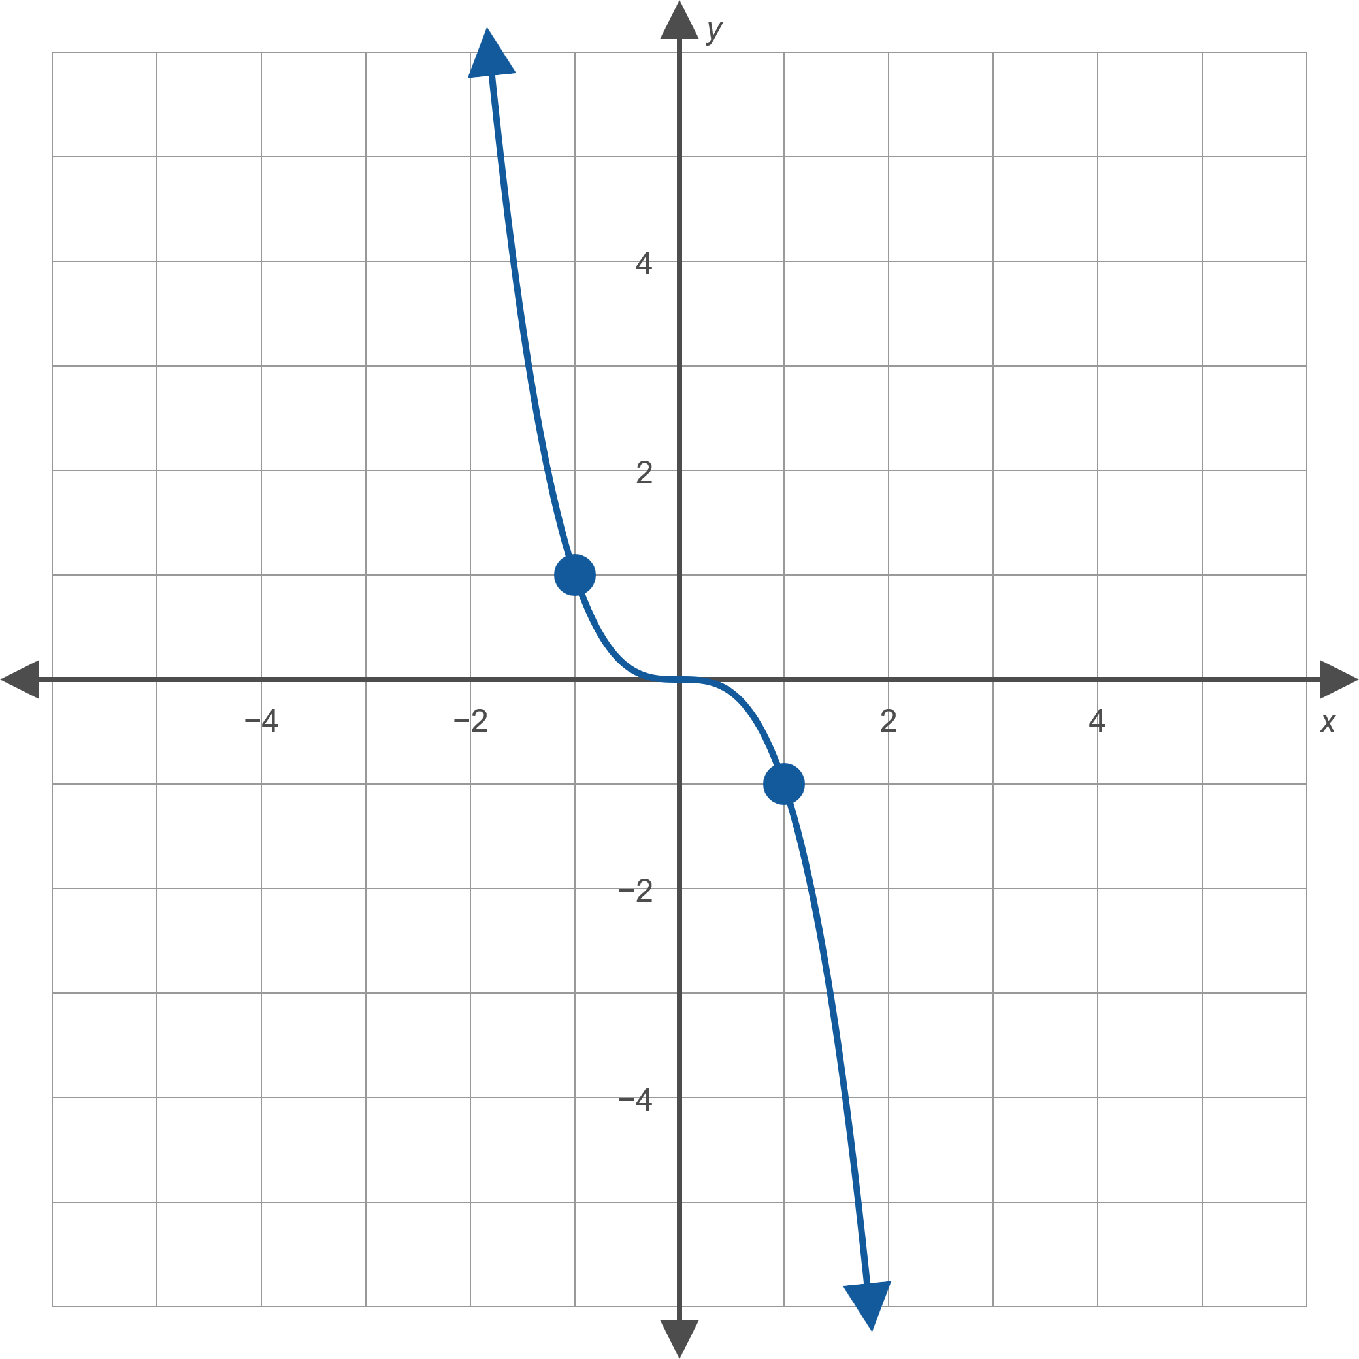
Example 1: Power Functions of the Form ax ^{n}—Slide 5
Figure 4: g(x) = −x ³

Slide 8

Example 2: Power Functions of the Form ax ^{−n}—Slide 1
Sketch the graph of the function $f\left(x\right)=−\frac{1}{4x}$.

Slide 9
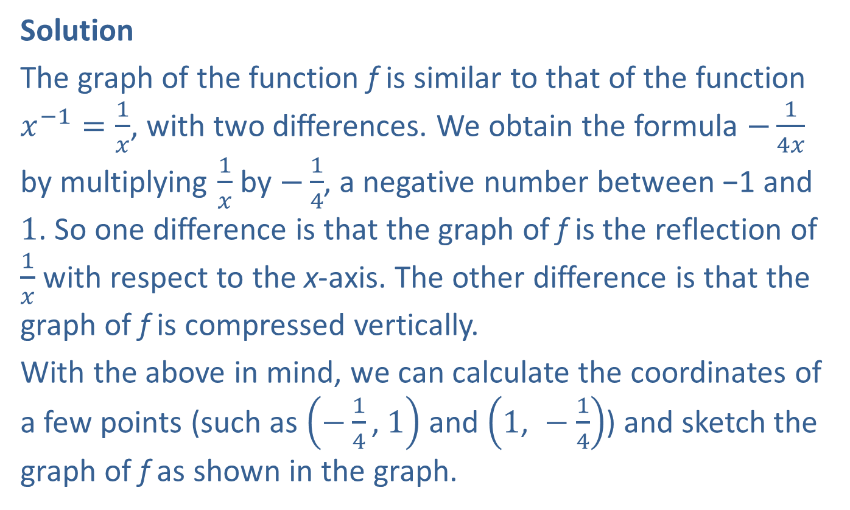
Example 2: Power Functions of the Form ax ^{−n}—Slide 2
Solution
The graph of the function f is similar to that of the function $x^{−1}=\frac{1}{x}$, with two differences. We obtain the formula $−\frac{1}{4x}$ by multiplying $\frac{1}{x}$ by $−\frac{1}{4}$, a negative number between −1 and 1. So one difference is that the graph of f is the reflection of $\frac{1}{x}$ with respect to the x-axis. The other difference is that the graph of f is compressed vertically.
With the above in mind, we can calculate the coordinates of a few points (such as $\left(−\frac{1}{4}\text{, }1\right)$ and $\left(1\text{, }−\frac{1}{4}\right)$) and sketch the graph of f as shown in the graph.

Slide 10
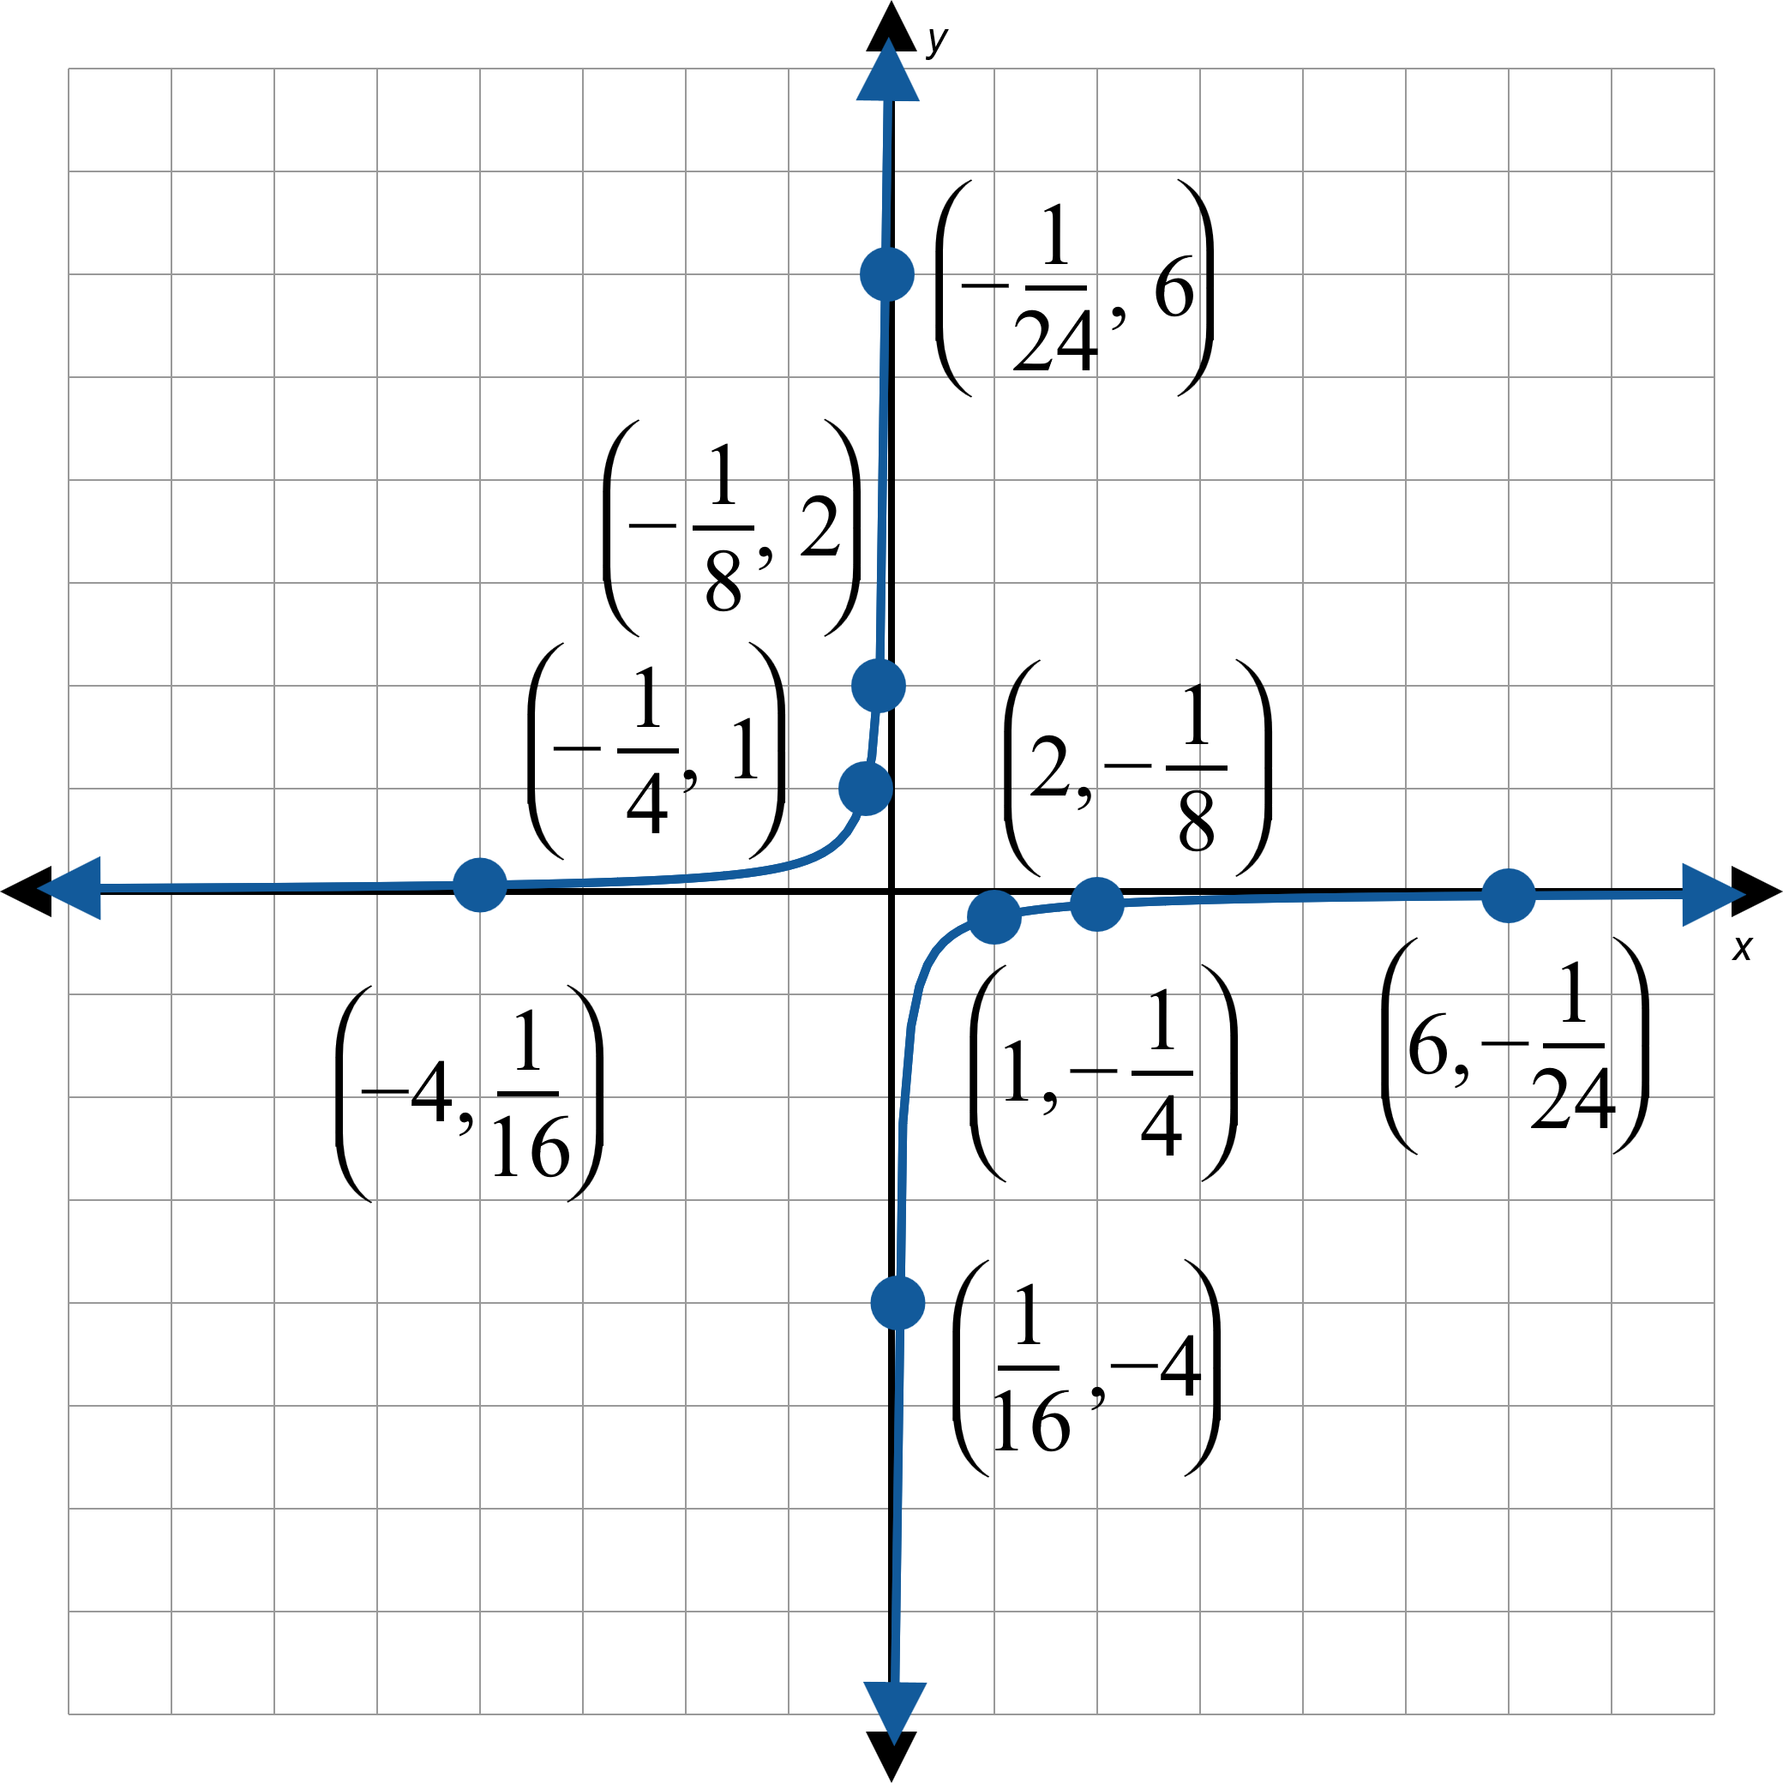

Example 2: Power Functions of the Form ax ^{−n}—Slide 3
Figure 7: $f\left(x\right)=−\frac{1}{4x}$

Slide 11

Example 3: The Absolute Value Function—Slide 1
Sketch the graph of the function $f\left(x\right)=−2\left|x\right|$.

Slide 12

Example 3: The Absolute Value Function—Slide 2
Solution
The graph of f will be a vertically stretched version of $y=|x|$ reflected over the x-axis. As always, we can plot a few points to verify that our reasoning is correct. In Figure 11, we have plotted the values of f(−4) and f(2).

Slide 13
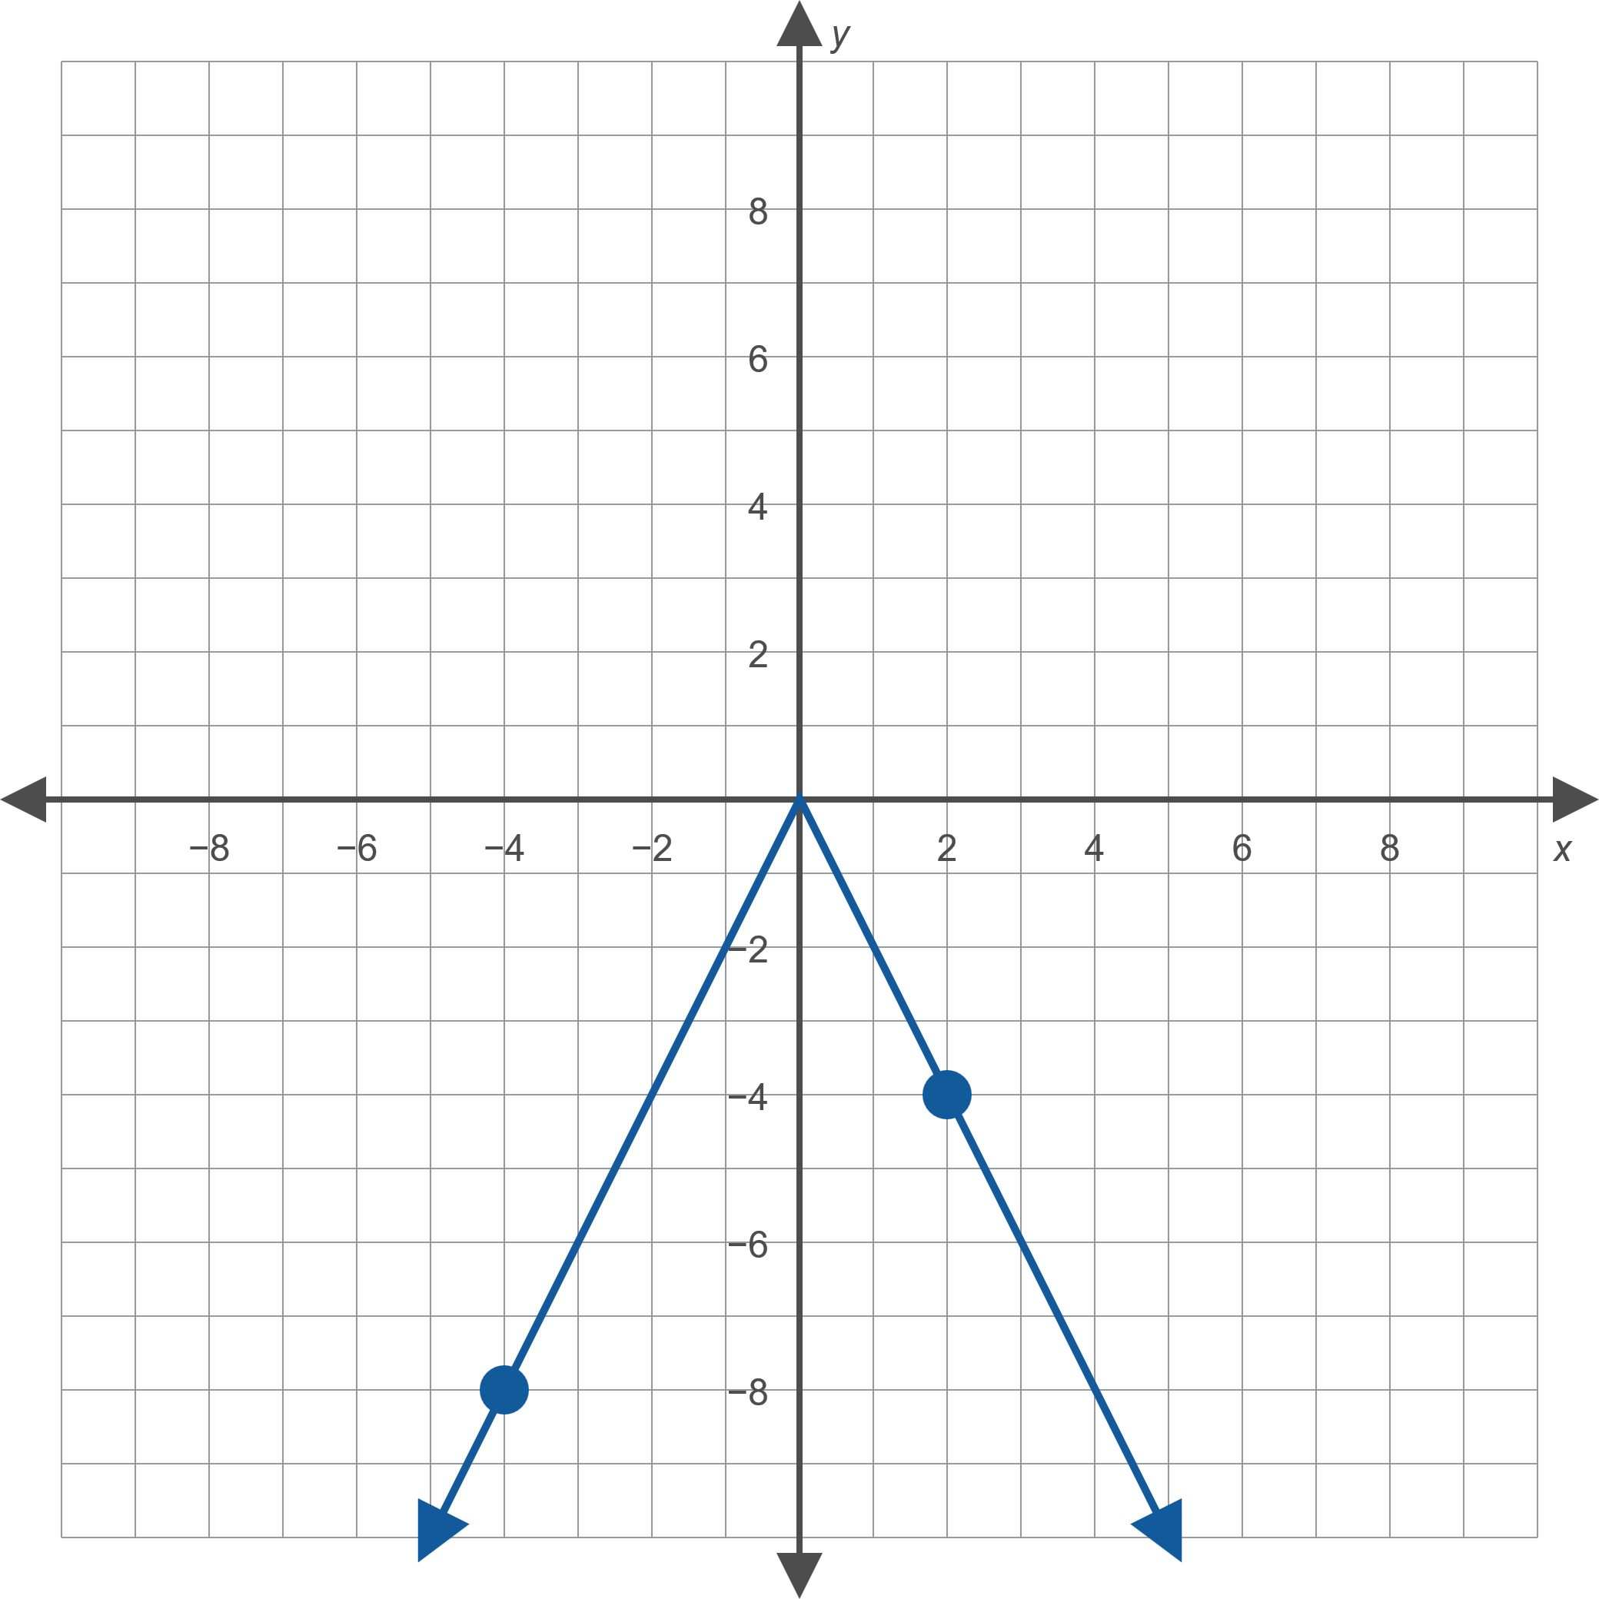
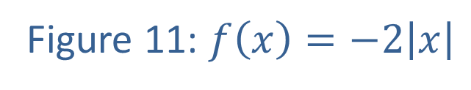
Example 3: The Absolute Value Function—Slide 3
Figure 11: $f\left(x\right)=−2\left|x\right|$

Slide 14
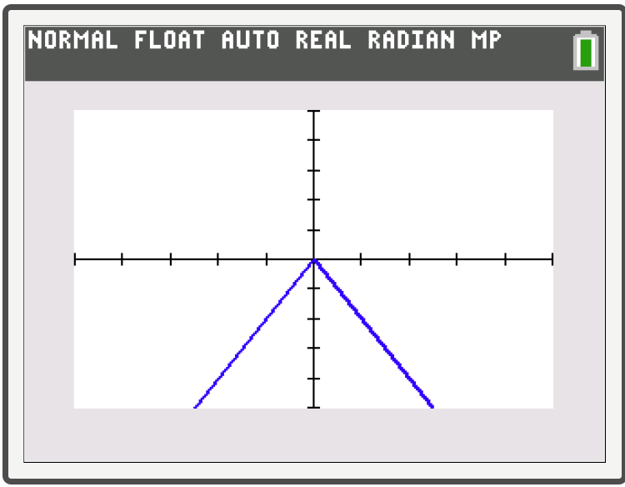
Technology
To graph an absolute value function, press Y=. To enter the absolute value, press math and then use the right arrow to select NUM. Select abs(. The absolute value symbol will appear in your equation.

Slide 15
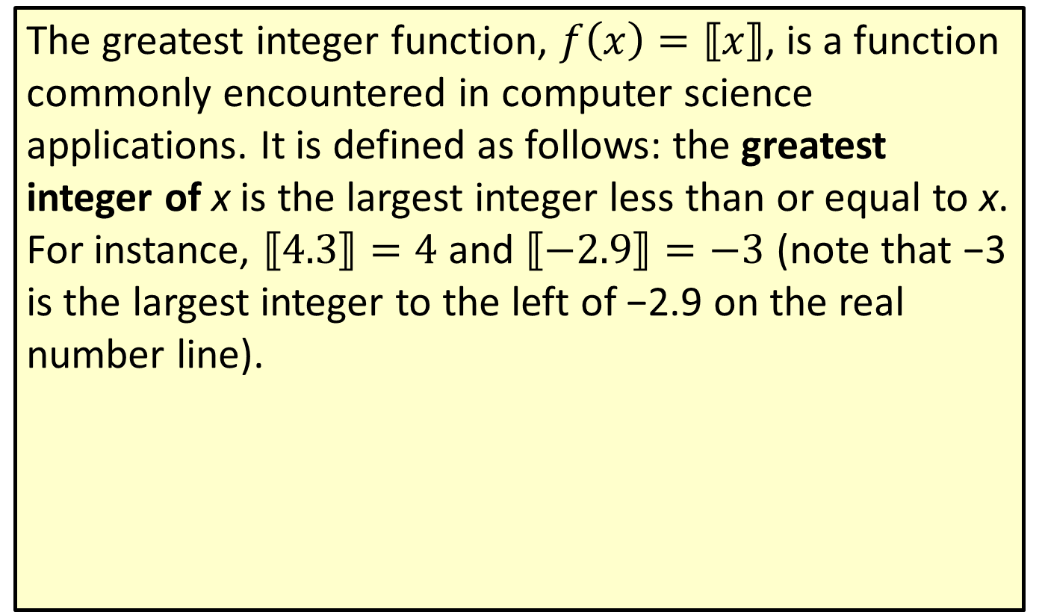
Definition: The Greatest Integer Function
The greatest integer function, $f\left(x\right)=⟦x⟧$, is a function commonly encountered in computer science applications. It is defined as follows: the greatest integer of x is the largest integer less than or equal to x. For instance, $⟦4.3⟧=4$ and $⟦−2.9⟧=−3$ (note that −3 is the largest integer to the left of −2.9 on the real number line).

Slide 16
Definition: Piecewise-Defined Function
A piecewise-defined function is a function defined in terms of two or more formulas, each valid for its own unique portion of the real number line. In evaluating a piecewise-defined function f at a certain value of x, it is important to correctly identify which formula is valid for that particular value.

Slide 17

Example 4: Piecewise-Defined Function—Slide 1
Sketch the graph of the function
$f\left(x\right)=\left\{\begin{matrix}−2x−2 & \text{if} x≤−1 \\ x^{2} & \text{if} x>−1\end{matrix}\right.$.

Slide 18
Note
Always pay close attention to the boundary points of each interval. Remember that only one rule applies at each point.

Slide 19
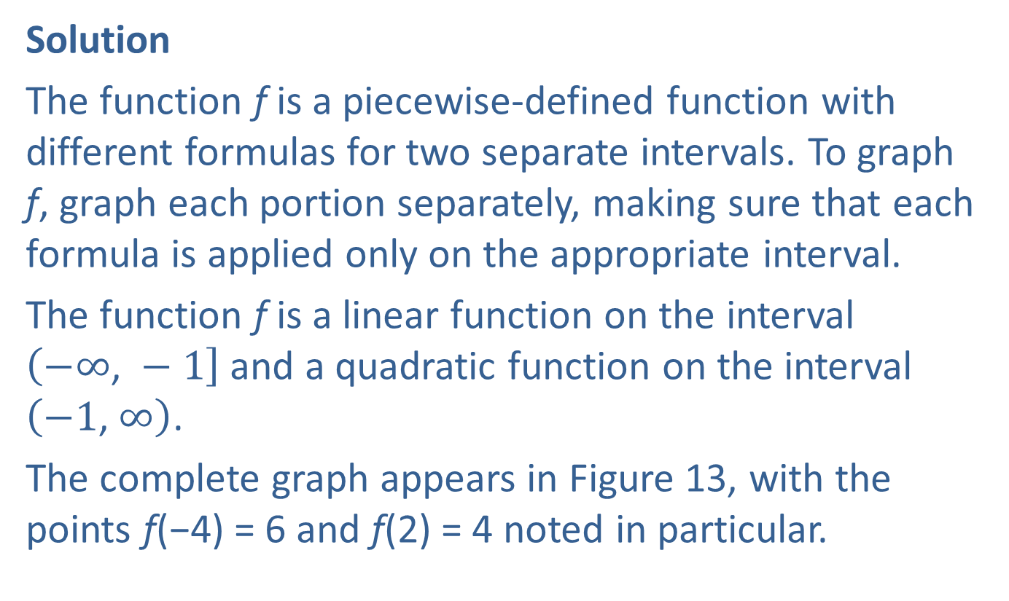
Example 4: Piecewise-Defined Function—Slide 2
Solution
The function f is a piecewise-defined function with different formulas for two separate intervals. To graph f, graph each portion separately, making sure that each formula is applied only on the appropriate interval.
The function f is a linear function on the interval $\left(−∞\text{, }−1\right]$ and a quadratic function on the interval $\left(−1\text{, }∞\right)$.
The complete graph appears in Figure 13, with the points f(−4) = 6 and f(2) = 4 noted in particular.

Slide 20
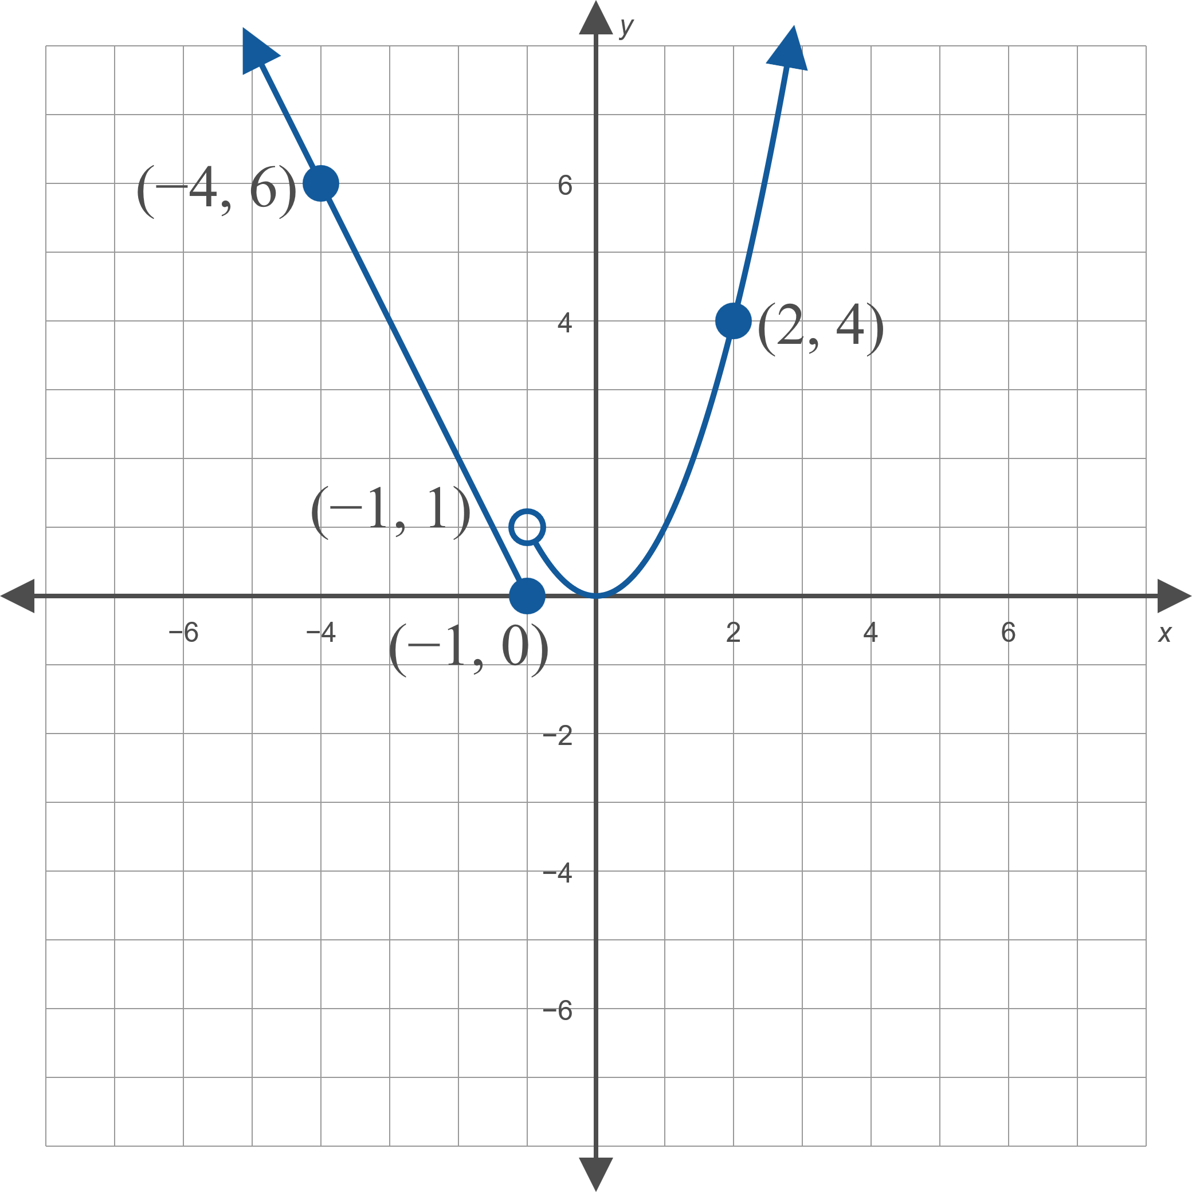
Example 4: Piecewise-Defined Function—Slide 3
Figure 13: y = f(x)

Slide 21
Example 4: Piecewise-Defined Function—Slide 4
Note the use of a closed circle at (−1, 0) to emphasize that this point is part of the graph and the use of an open circle at (−1, 1) to indicate that this point is not part of the graph. That is, the value of f(−1) is 0, not 1.

