Slide 1
Section 1.R.5
Linear and Quadratic Functions

Slide 2
Definition: Linear Function
A linear function f in the variable x is any function that can be written in the form f(x) = mx + b, where m and b are real numbers. If m ≠ 0, f(x) = mx + b is also called a first-degree polynomial function.

Slide 3
Note 1
A function cannot represent a vertical line (since it fails the vertical line test). Vertical lines can represent the graphs of equations, but not functions.

Slide 4
Example 1: Graphing Linear Functions—Slide 1
Graph the following linear functions.
​f(x) = 3x + 2
​g(x) = 3

Slide 5
Example 1: Graphing Linear Functions—Slide 2
Solution
The function f(x) = 3x + 2 is a line with a slope of 3 and a y-intercept of 2. To graph the function, plot the ordered pair (0, 2) and locate another point on the line by moving up 3 units and over to the right
1 unit, giving the ordered pair (1, 5). Once these two points have been plotted, connecting them with a straight line completes the process.

Slide 6
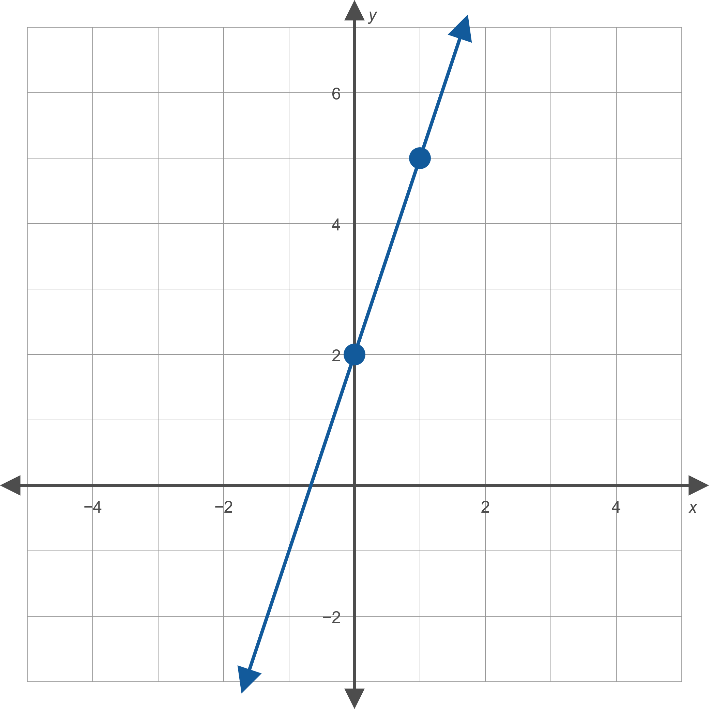
Example 1: Graphing Linear Functions—Slide 3
​
Figure 2: f(x) = 3x + 2

Slide 7
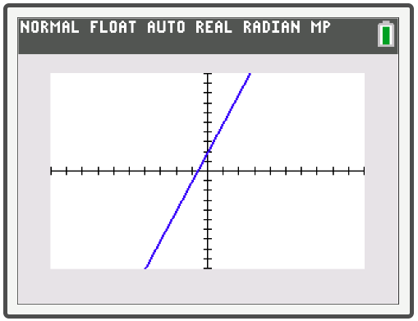
Example 1: Technology

Slide 8
Example 1: Graphing Linear Functions—Slide 4
The graph of the function g(x) = 3 is a straight line with a slope of 0 and a y-intercept of 3. A linear function with a slope of 0 is also called a constant function, as it turns any input into one fixed constant—in this case the number 3. The graph of a constant function is always a horizontal line.
​

Slide 9
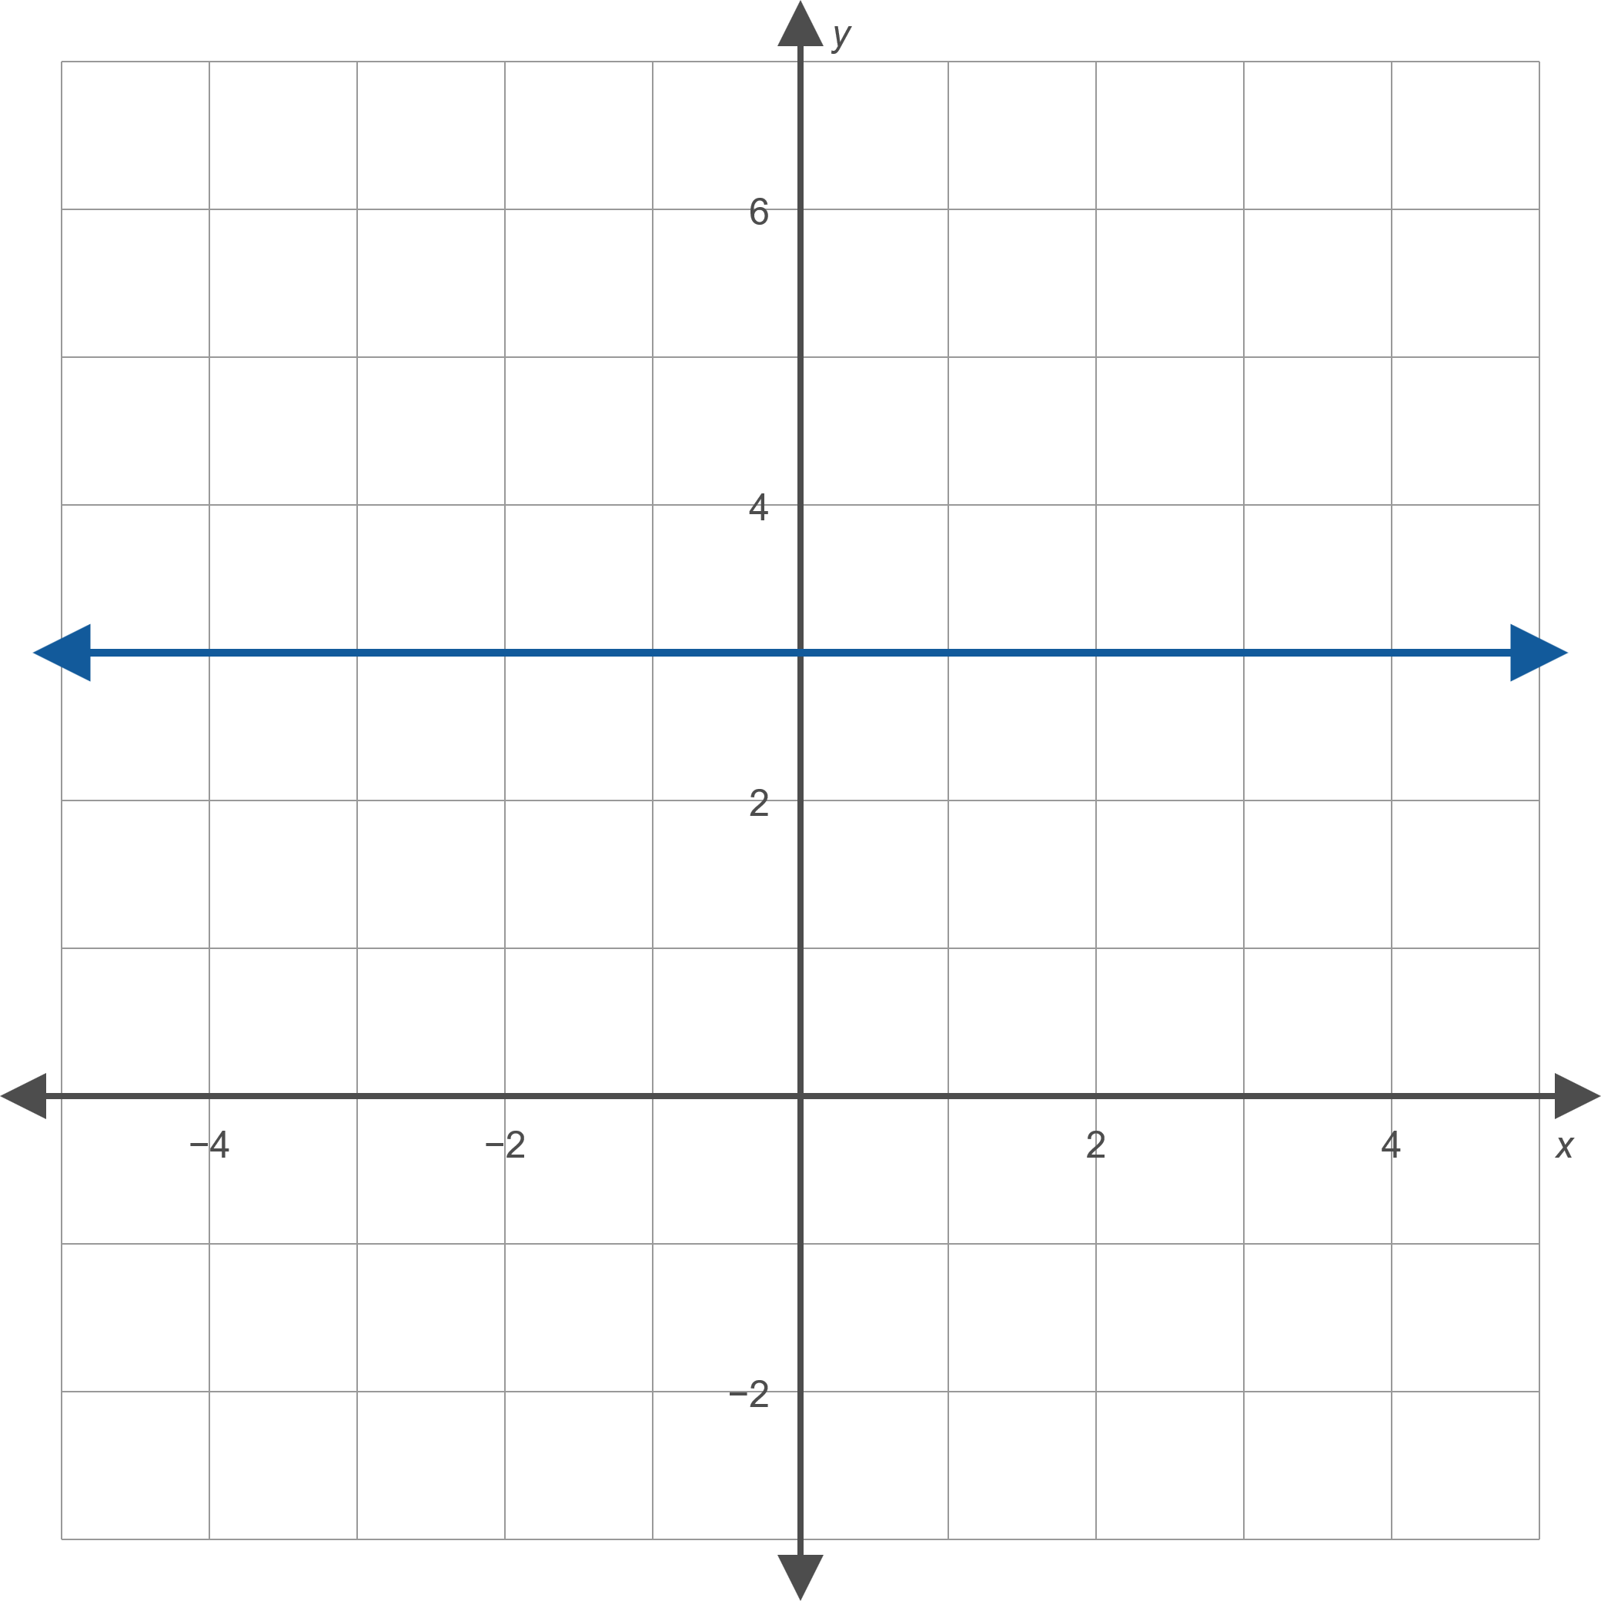
Example 1: Graphing Linear Functions—Slide 5
Figure 3: g(x) = 3

Slide 10
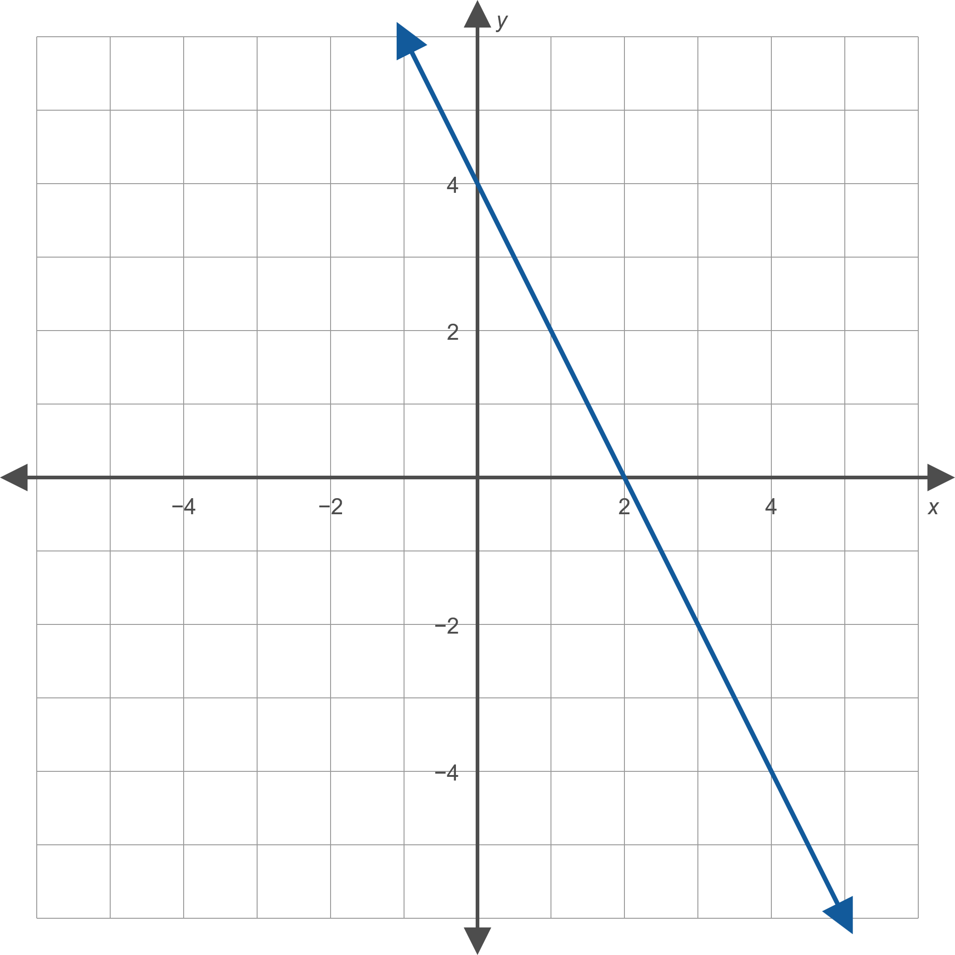
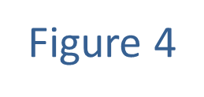
Example 2: Finding a Linear Function Given its Graph—Slide 1
Find a formula for the linear function whose graph is given in Figure 4.

Slide 11
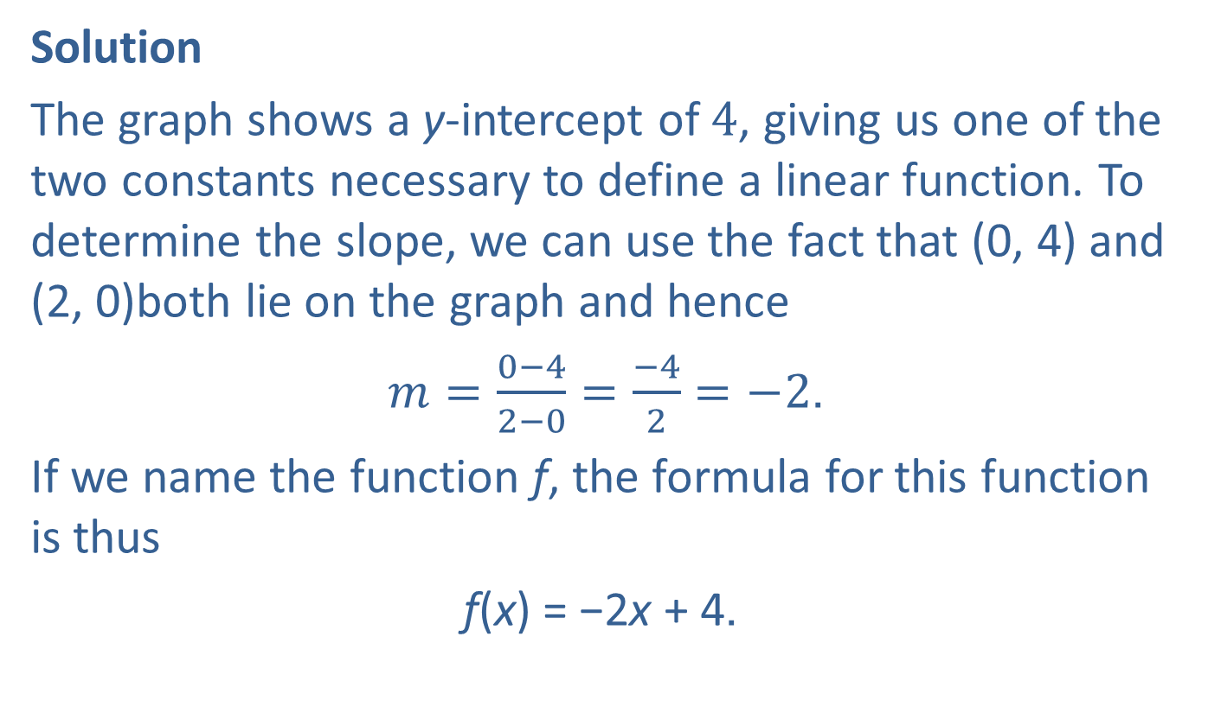
Example 2: Finding a Linear Function Given its Graph—Slide 2
Solution
The graph shows a y-intercept of 4, giving us one of the two constants necessary to define a linear function. To determine the slope, we can use the fact that (0, 4) and (2, 0)both lie on the graph and hence
$m=\frac{0−4}{2−0}=\frac{−4}{2}=−2$.
If we name the function f, the formula for this function is thus
f(x) = −2x + 4.

Slide 12
Definition: Quadratic Function
A quadratic function f in the variable x, also known as a second-degree polynomial function, is any function that can be written in the form f(x) = ax ² + bx + c, where a, b, and c and are real numbers and a ≠ 0.

Slide 13
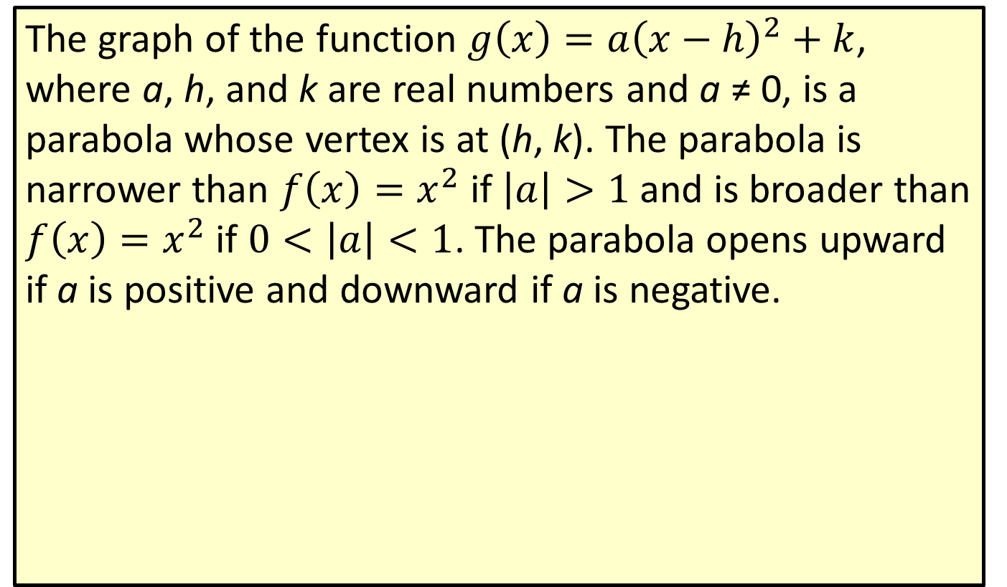
Definition: Vertex Form of a Quadratic Function
The graph of the function $g\left(x\right)=a{\left(x−h\right)}^{2}+k$, where a, h, and k are real numbers and a ≠ 0, is a parabola whose vertex is at (h, k). The parabola is narrower than $f\left(x\right)=x^{2}$ if $\left|a\right|>1$ and is broader than $f\left(x\right)=x^{2}$ if $0<\left|a\right|<1$. The parabola opens upward if a is positive and downward if a is negative.

Slide 14

Example 3: Graphing Quadratic Functions—Slide 1
Sketch the graph of the function
$f\left(x\right)=−x^{2}−2x+3$.
Locate the vertex and the x-intercepts.

Slide 15
Note 2
Finding and plotting the x-intercepts is a great way to see the shape of the function.

Slide 16
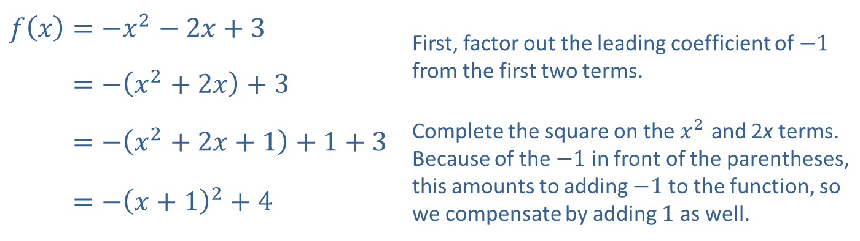

Example 3: Graphing Quadratic Functions—Slide 2
Solution
First, identify the vertex of the function by completing the square as follows.
Completing the square places the equation in vertex form, and we rewrite the expression $−{\left(x+1\right)}^{2}+4$ as
$−{\left(x−\left(−1\right)\right)}^{2}+4$, so the vertex is (−1, 4).
​$f\left(x\right)=−x^{2}−2x+3$ | First, factor out the leading coefficient of $−1$ from the first two terms.
​𝑓⁡𝑥=−𝑥2+2𝑥+3
​𝑓⁡𝑥=−𝑥2+2𝑥+1+1+3 | Complete the square on the $x^{2}$ and 2x terms. Because of the $−1$ in front of the parentheses, this amounts to adding $−1$ to the function, so we compensate by adding 1 as well.
​𝑓⁡𝑥=−𝑥+12+4

Slide 17
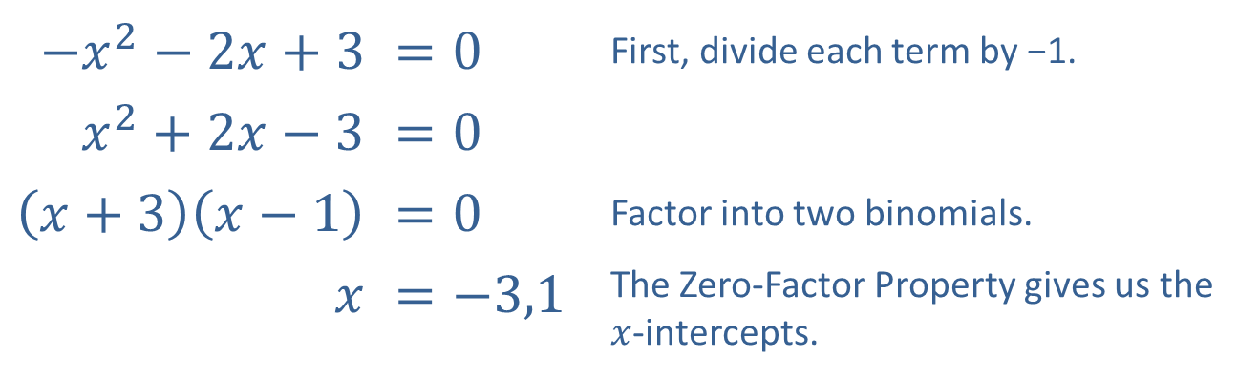

Example 3: Graphing Quadratic Functions—Slide 3
The instructions also ask us to identify the x-intercepts. An x-intercept of the function f is any point on the
x-axis where f(x) = 0, so we need to solve the equation
$−x^{2}−2x+3=0$. This can be done by factoring.
Therefore, the x-intercepts are located at (−3, 0) and (1, 0).
​$−x^{2}−2x+3$ | $$=0$$ | First, divide each term by −1.
​$x^{2}+2x−3$ | $$=0$$
​$\left(x+3\right)\left(x−1\right)$ | $$=0$$ | Factor into two binomials.
​$x$ | $$=−3,1$$ | The Zero-Factor Property gives us the $x$-intercepts.

Slide 18
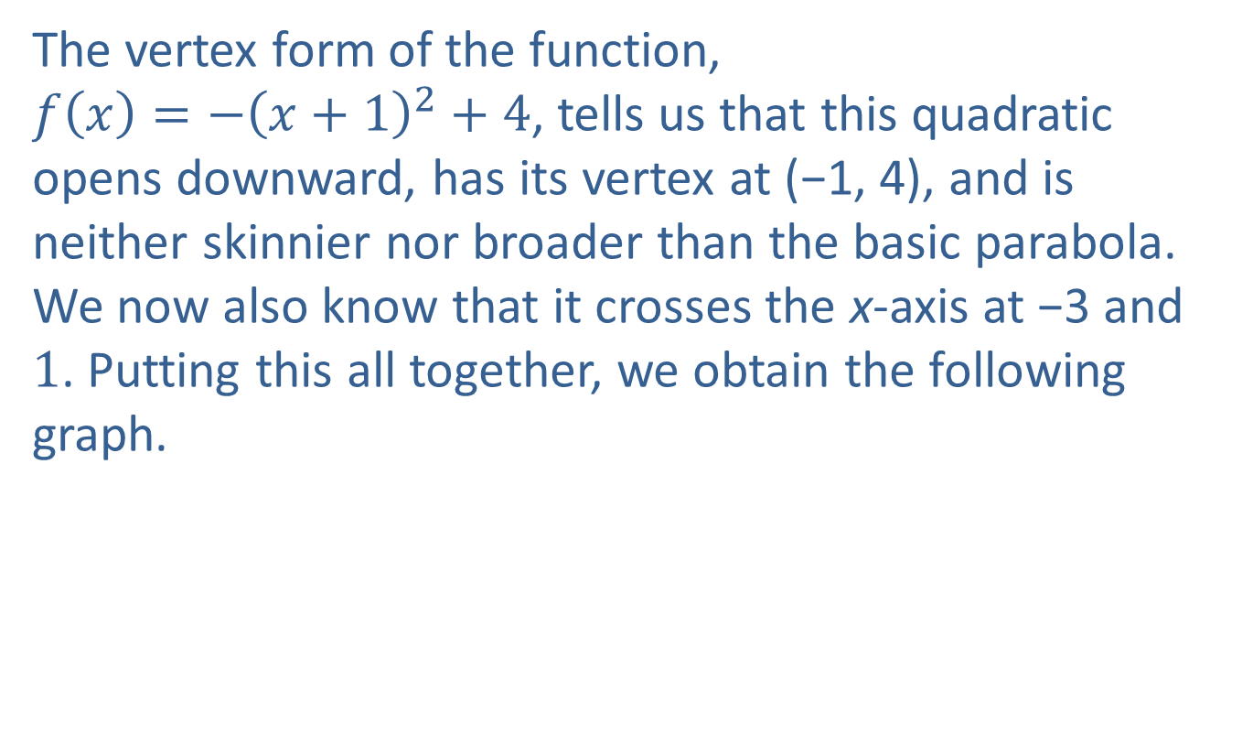
Example 3: Graphing Quadratic Functions—Slide 4
The vertex form of the function,
$f\left(x\right)=−{\left(x+1\right)}^{2}+4$, tells us that this quadratic opens downward, has its vertex at (−1, 4), and is neither skinnier nor broader than the basic parabola. We now also know that it crosses the x-axis at −3 and 1. Putting this all together, we obtain the following graph.

Slide 19
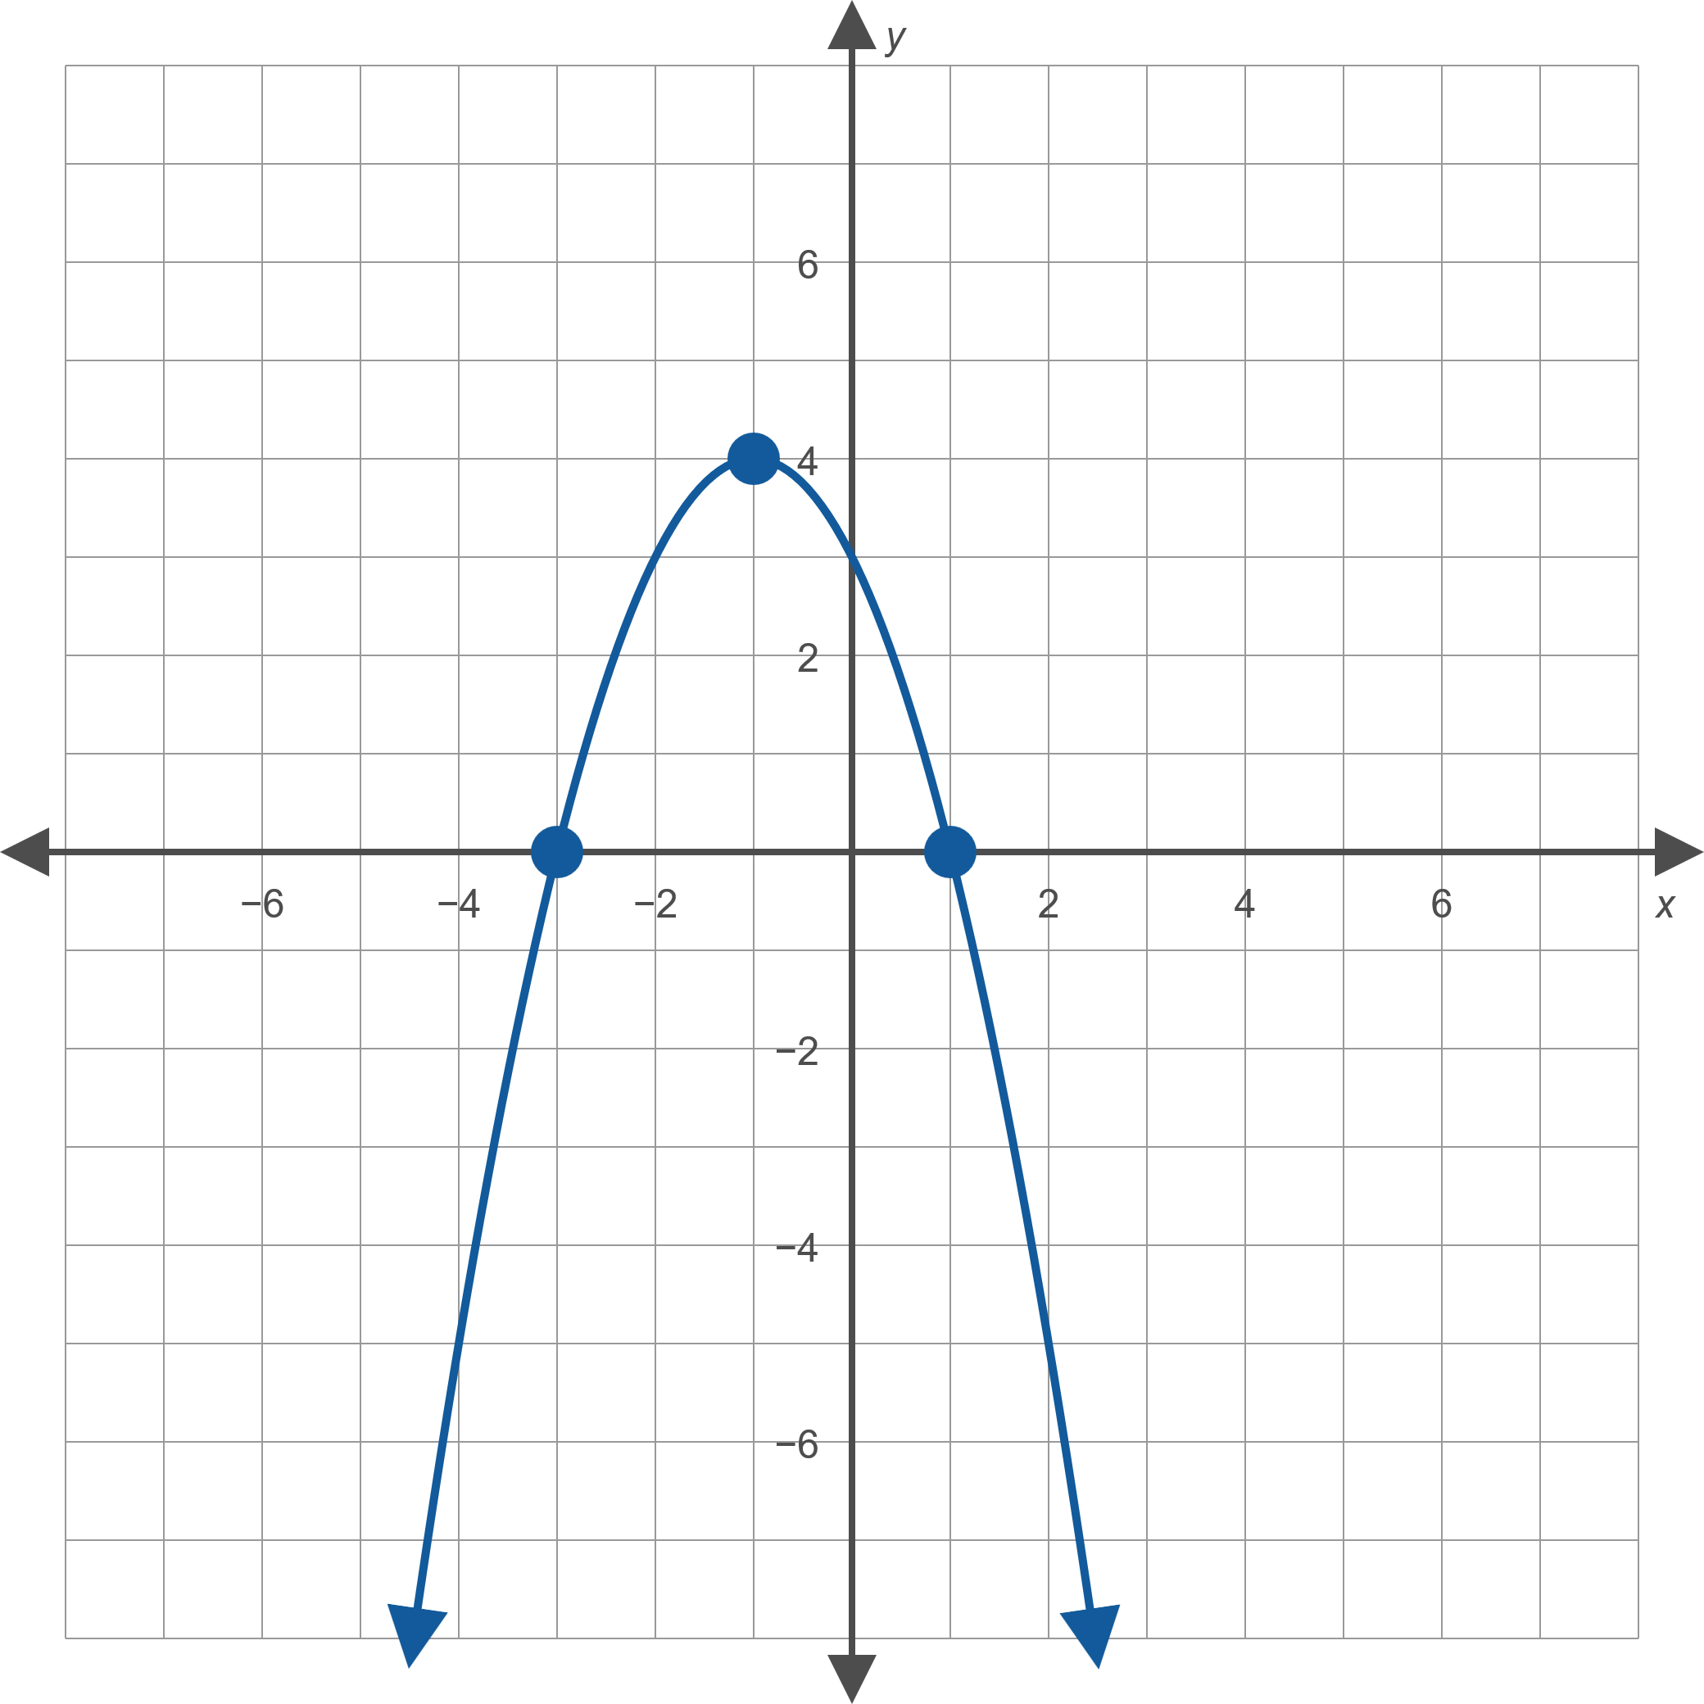
Example 3: Graphing Quadratic Functions—Slide 5
Figure 10: f(x) = −x ² − 2x + 3

Slide 20
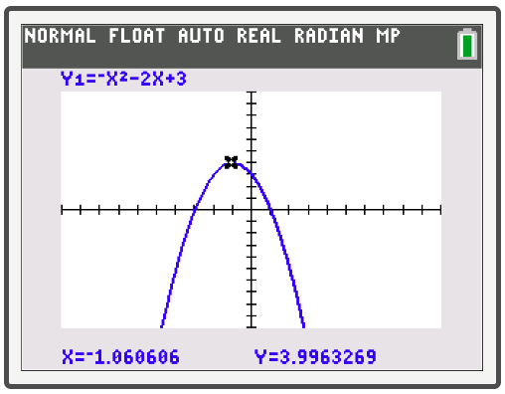
Example 3: Technology
After graphing the equation on a TI-84 Plus in the usual manner using Y= and then graph, individual coordinates can be seen by pressing trace and using the left and right arrow keys to move along the graph.

Slide 21
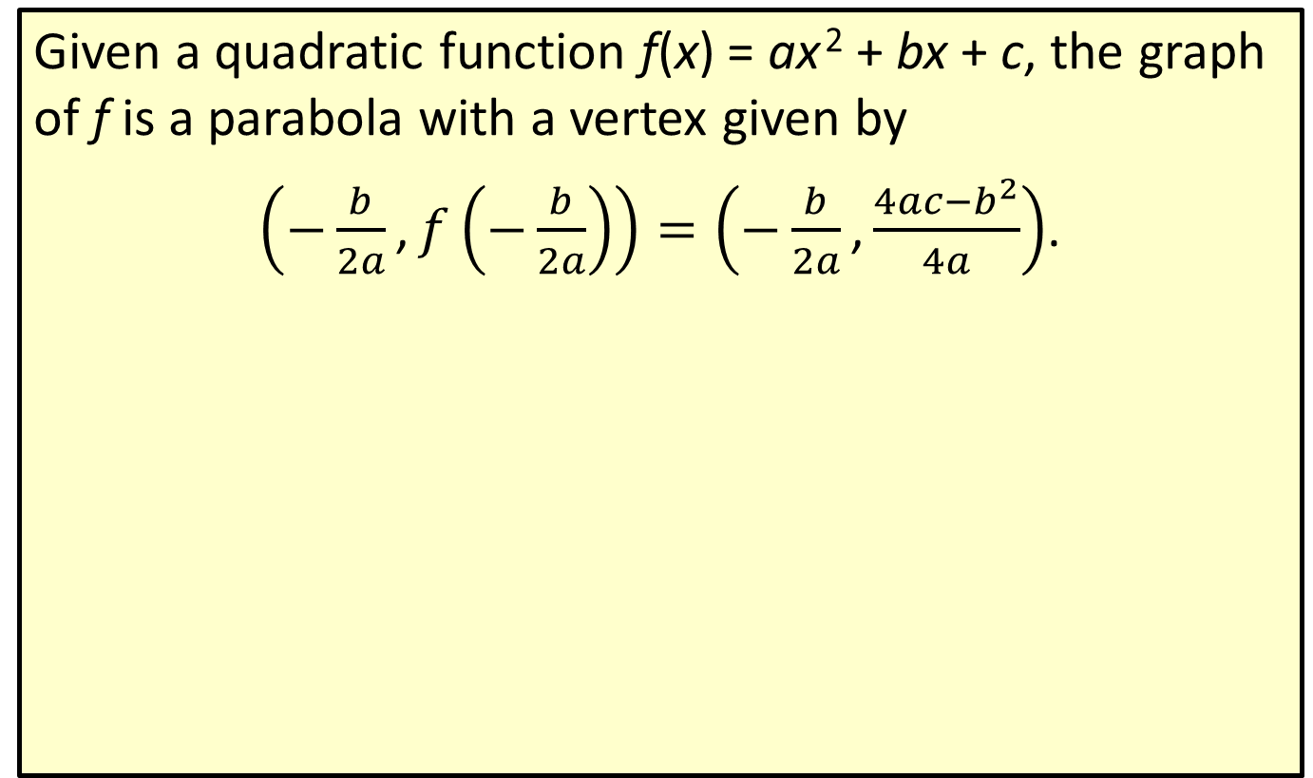
Formula: Vertex of a Quadratic Function
Given a quadratic function f(x) = ax ² + bx + c, the graph of f is a parabola with a vertex given by
$\left(−\frac{b}{2a}\text{,}f\left(−\frac{b}{2a}\right)\right)=\left(−\frac{b}{2a}\text{,}\frac{4ac−b^{2}}{4a}\right)$.

Slide 22

Example 4: Using the Vertex Formula—Slide 1
Find the vertex of the following quadratic functions using the vertex formula.
​$f\left(x\right)=x^{2}−4x+8$
​$g\left(x\right)=3x^{2}+5x−1$

Slide 23
Note 3
If the x-coordinate of the vertex is simple, use substitution to find the y-coordinate.
If the x-coordinate is complicated, use the explicit formula (the right-hand form in the vertex formula).

Slide 24
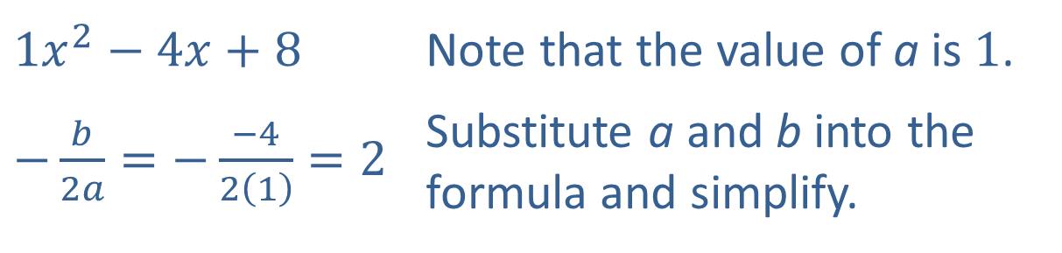
Example 4: Using the Vertex Formula—Slide 2
Solution
​Begin by using the formula to find the x-coordinate of the vertex.
​
​$1x^{2}−4x+8$ | Note that the value of a is 1.
​$−\frac{b}{2a}=−\frac{−4}{2\left(1\right)}=2$ | Substitute a and b into the formula and simplify.

Slide 25
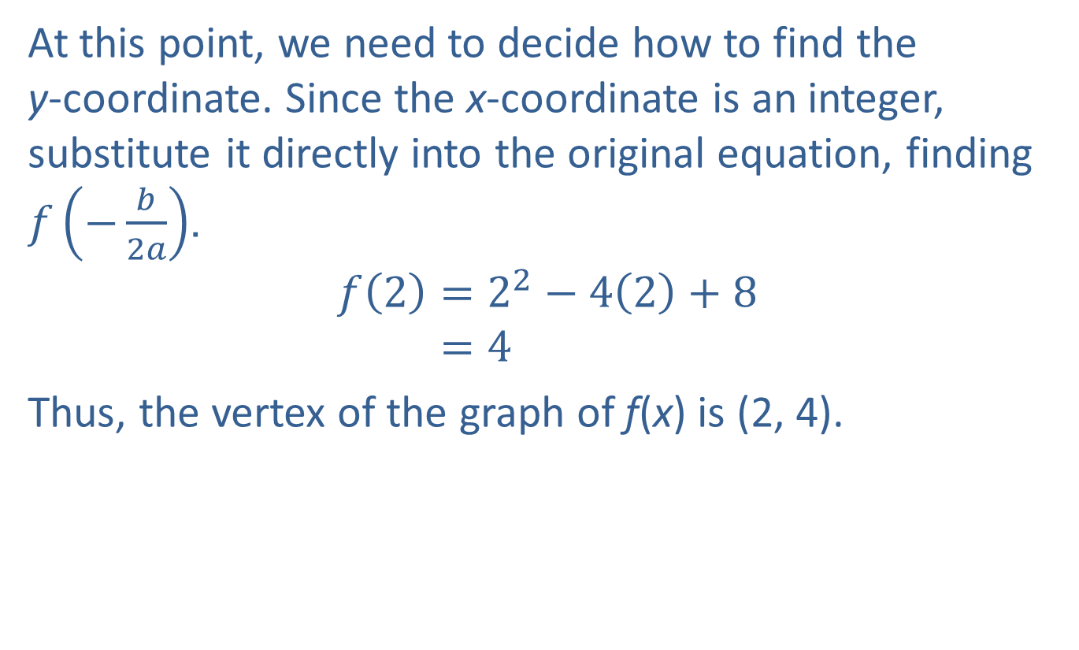
Example 4: Using the Vertex Formula—Slide 3
​At this point, we need to decide how to find the
y-coordinate. Since the x-coordinate is an integer, substitute it directly into the original equation, finding $f⁡\left(−\frac{b}{2a}\right)$.
𝑓2=22−42+8𝑓⁡2=4
​Thus, the vertex of the graph of f(x) is (2, 4).

Slide 26
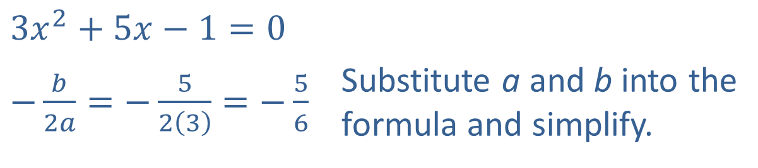
Example 4: Using the Vertex Formula—Slide 4
​Again, begin by finding the x-coordinate of the vertex.
​
​$3x^{2}+5x−1=0$ | Substitute a and b into the formula and simplify.
​$−\frac{b}{2a}=−\frac{5}{2\left(3\right)}=−\frac{5}{6}$

Slide 27
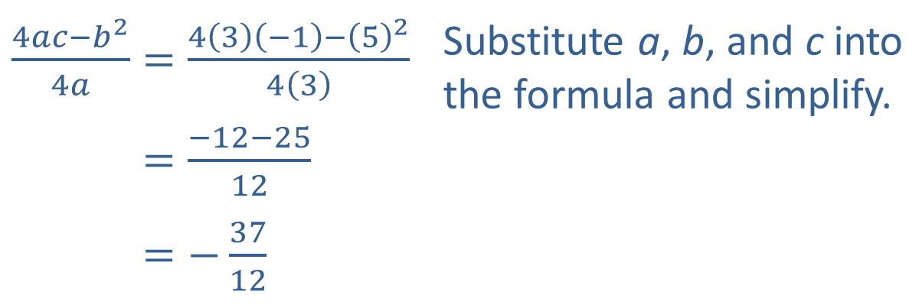

Example 4: Using the Vertex Formula—Slide 5
​Here, the x-coordinate is a fraction, so substituting it into the original equation leads to messy calculations. Instead, use the explicit formula to find the y-coordinate.
​
Thus, the vertex of the graph of g(x) is $\left(−\frac{5}{6},−\frac{37}{12}\right)$.
​$\frac{4ac−b^{2}}{4a}=\frac{4\left(3\right)\left(−1\right)−{\left(5\right)}^{2}}{4\left(3\right)}$ | Substitute a, b, and c into the formula and simplify.
​4𝑎𝑐−𝑏24𝑎=−12−2512
​4𝑎𝑐−𝑏24𝑎=−3712

Slide 28
Example 5: Finding a Quadratic Function Given Its Graph—Slide 1
​Find a formula for the quadratic function whose graph is given in Figure 11.
​Use the formula to determine the coordinates of the parabola’s vertex.

Slide 29
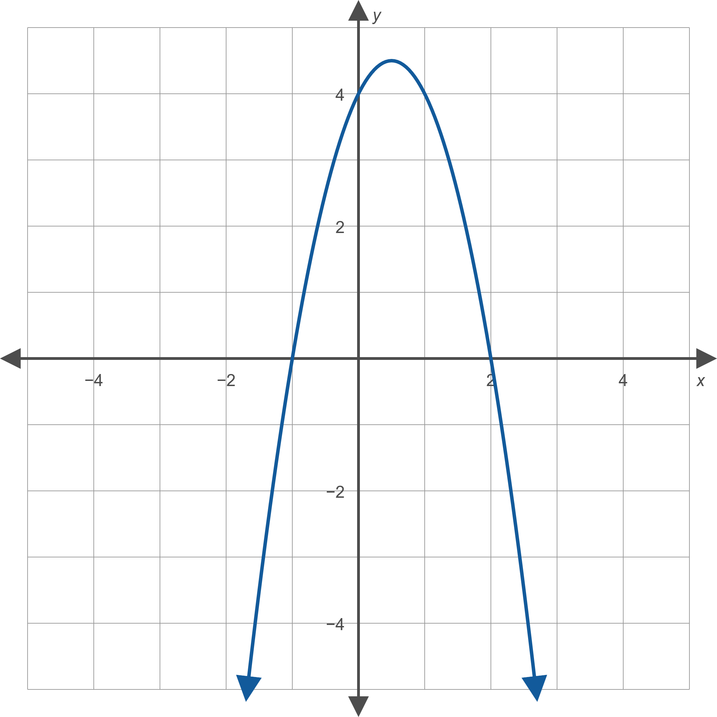
Example 5: Finding a Quadratic Function Given Its Graph—Slide 2
Figure 11

Slide 30
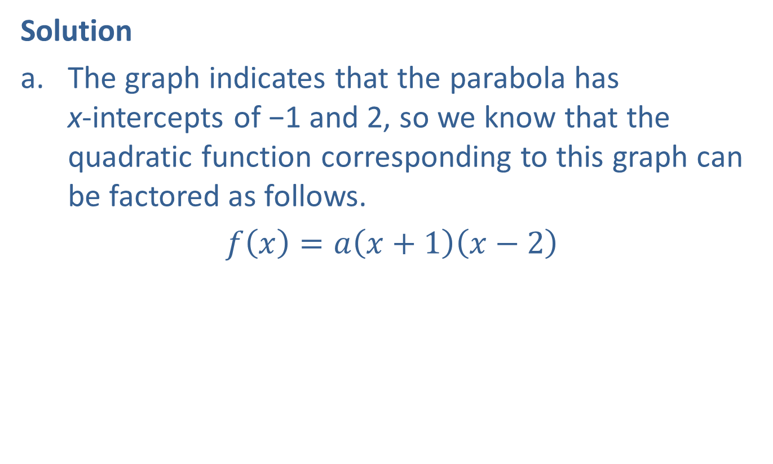
Example 5: Finding a Quadratic Function Given Its Graph—Slide 3
Solution
​The graph indicates that the parabola has
x-intercepts of −1 and 2, so we know that the quadratic function corresponding to this graph can be factored as follows.
​$f\left(x\right)=a\left(x+1\right)\left(x−2\right)$

Slide 31
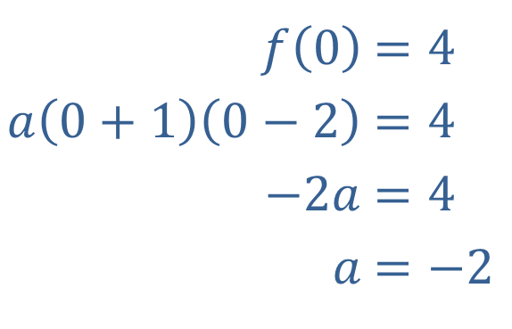
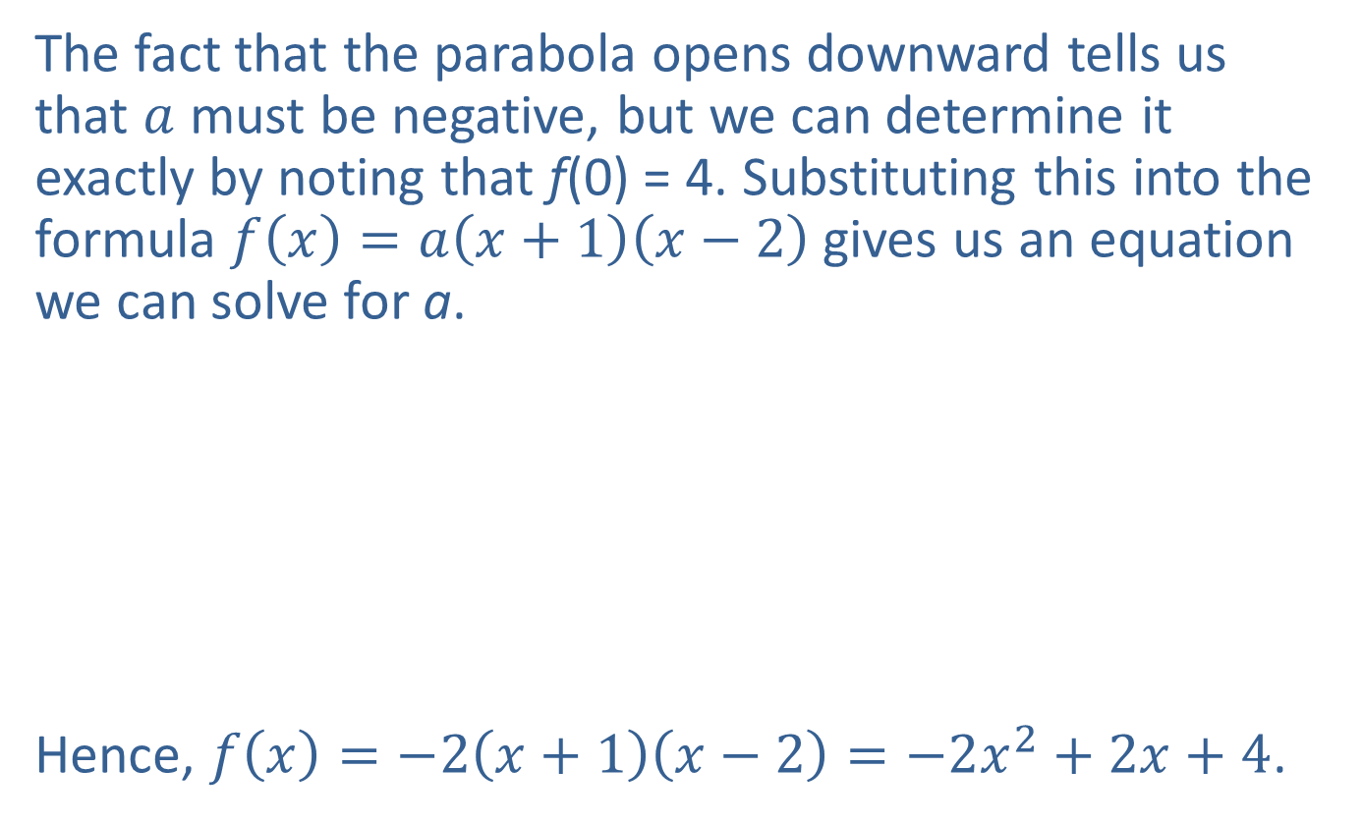
Example 5: Finding a Quadratic Function Given Its Graph—Slide 4
​The fact that the parabola opens downward tells us that $a$ must be negative, but we can determine it exactly by noting that f(0) = 4. Substituting this into the formula $f\left(x\right)=a\left(x+1\right)\left(x−2\right)$gives us an equation we can solve for a.
​
​Hence, $f\left(x\right)=−2\left(x+1\right)\left(x−2\right)=−2x^{2}+2x+4$.
​$f⁡\left(0\right)$ | ​$=4$
​$a\left(0+1\right)\left(0−2\right)$ | ​$=4$
​$−2a$ | ​$=4$
​$a$ | ​$=−2$

Slide 32
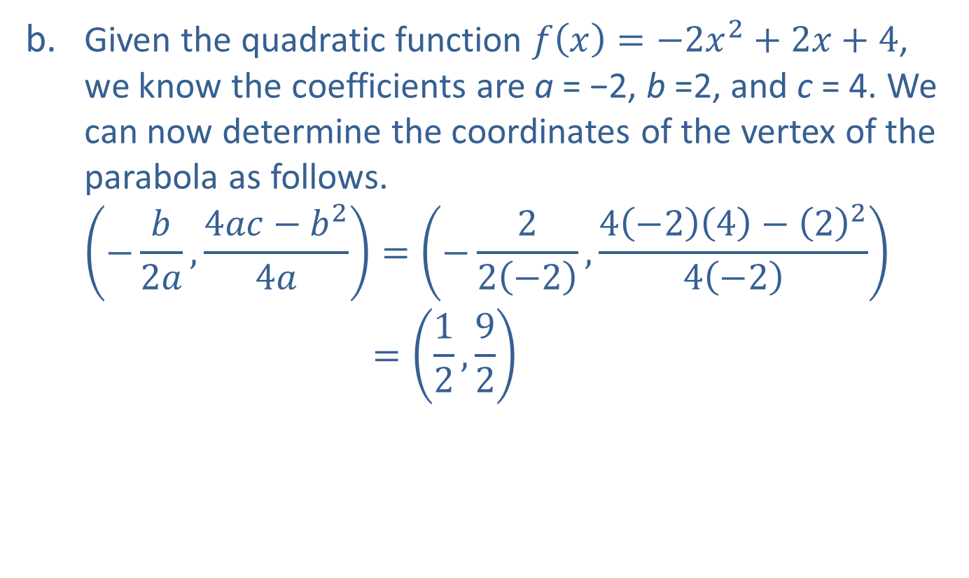
Example 5: Finding a Quadratic Function Given its Graph—Slide 5
​Given the quadratic function $f\left(x\right)=−2x^{2}+2x+4$, we know the coefficients are a = −2, b =2, and c = 4. We can now determine the coordinates of the vertex of the parabola as follows.
−𝑏2𝑎,4𝑎𝑐−𝑏24𝑎=−22−2,4−24−224−2(−𝑏2𝑎,4𝑎𝑎−𝑏24𝑎)=12,92

Slide 33
Example 6: Fencing a Garden—Slide 1
A farmer plans to use 100 feet of spare fencing material to form a rectangular garden plot against the side of a long barn, using the barn as one side of the plot. How should he split up the fencing among the other three sides in order to maximize the area of the garden plot?

Slide 34
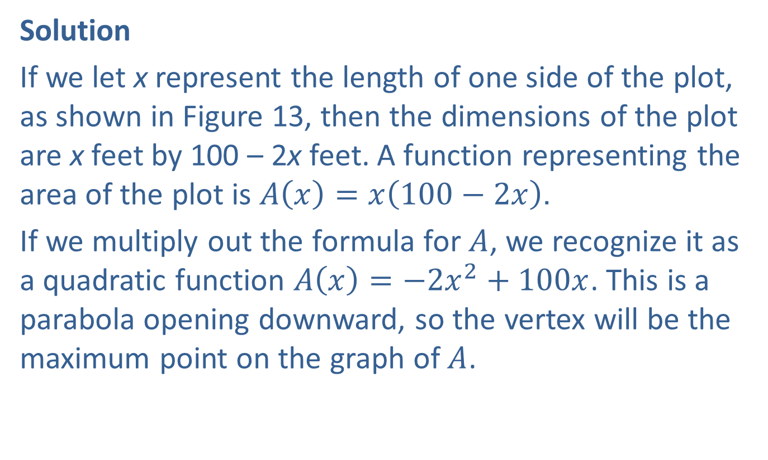
Example 6: Fencing a Garden—Slide 2
Solution
If we let x represent the length of one side of the plot, as shown in Figure 13, then the dimensions of the plot are x feet by 100 – 2x feet. A function representing the area of the plot is $A\left(x\right)=x\left(100−2x\right)$.
If we multiply out the formula for $A$, we recognize it as a quadratic function $A\left(x\right)=−2x^{2}+100x$. This is a parabola opening downward, so the vertex will be the maximum point on the graph of $A$.

Slide 35
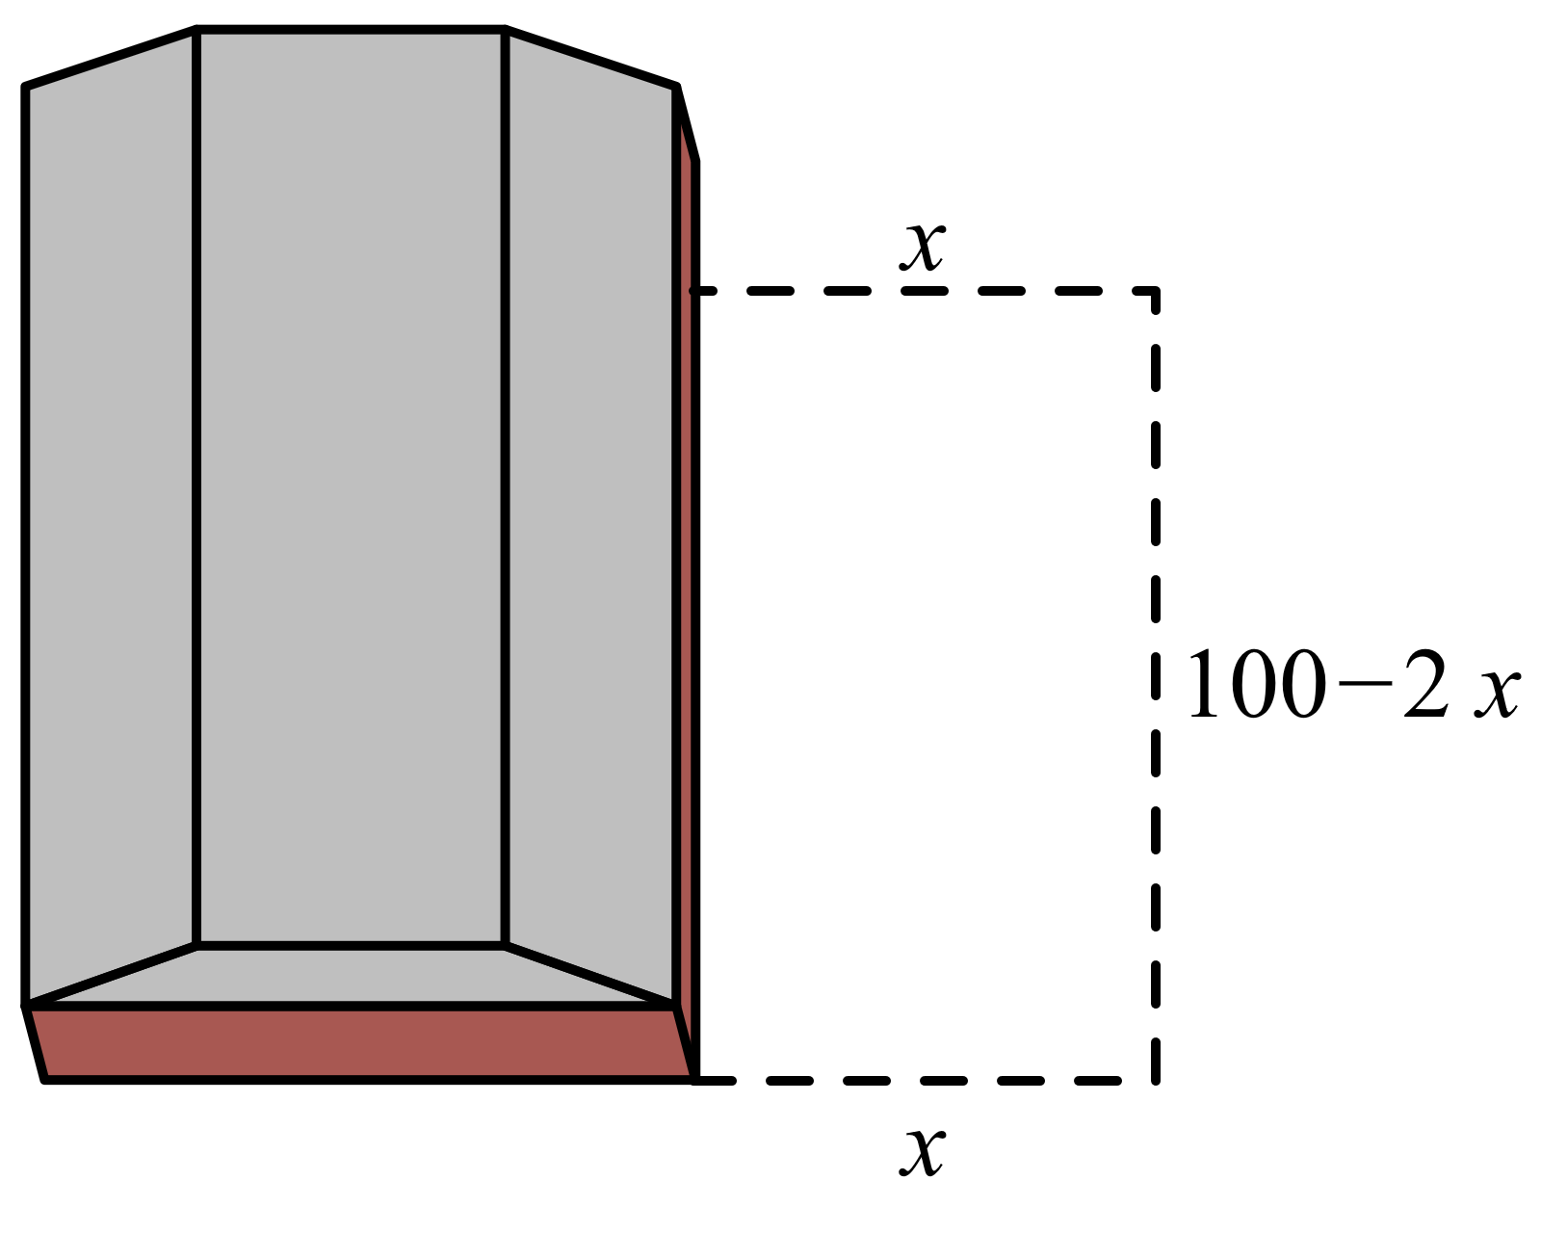
Example 6: Fencing a Garden—Slide 3
Figure 13

Slide 36
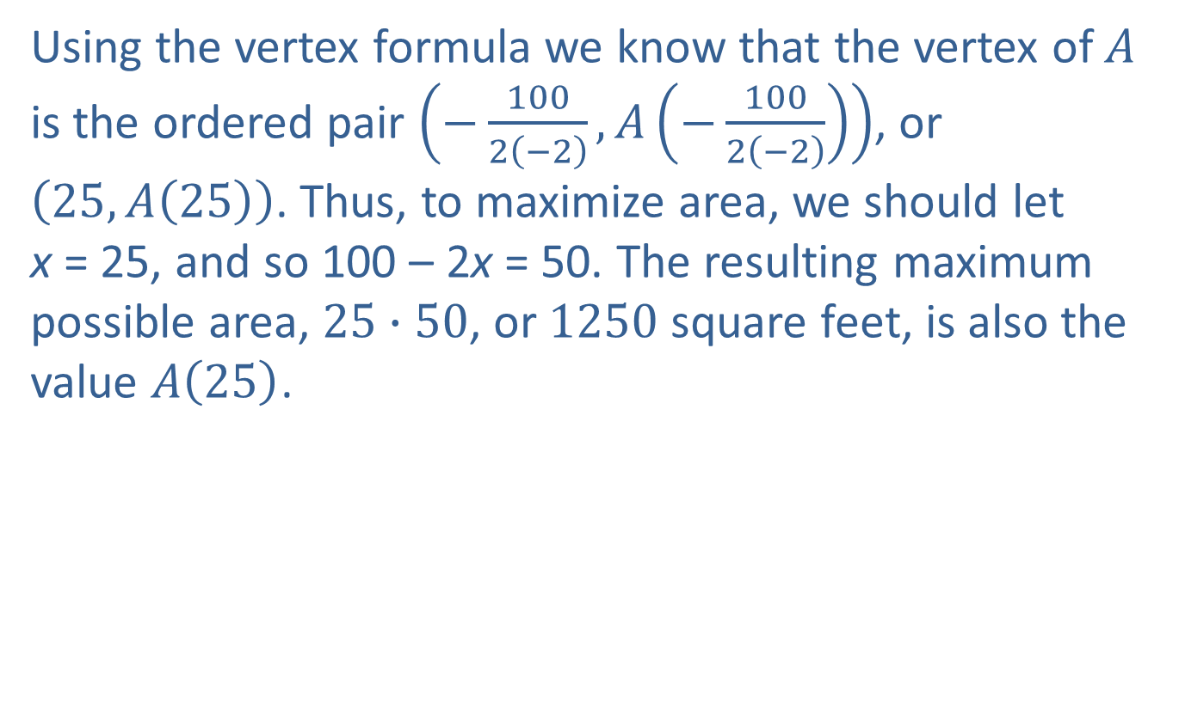
Example 6: Fencing a Garden—Slide 4
Using the vertex formula we know that the vertex of $A$ is the ordered pair $\left(−\frac{100}{2\left(−2\right)},A\left(−\frac{100}{2\left(−2\right)}\right)\right)$, or $\left(25,A\left(25\right)\right)$. Thus, to maximize area, we should let
x = 25, and so 100 – 2x = 50. The resulting maximum possible area, $25∙50$, or 1250 square feet, is also the value $A\left(25\right)$.

Slide 37
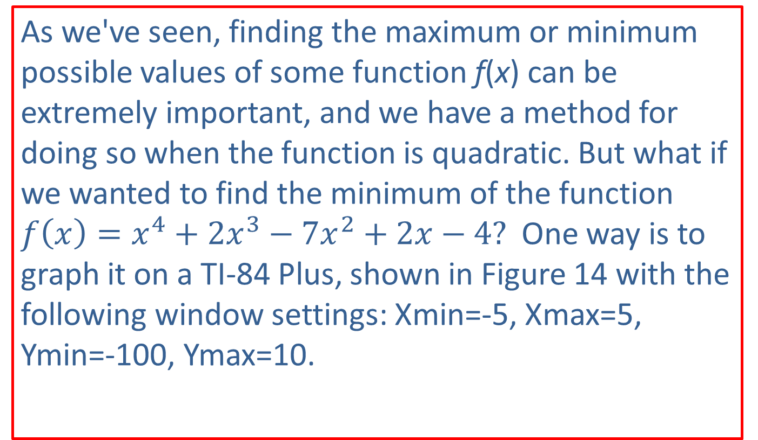
Technology: Finding the Maximum or Minimum of a Function—Slide 1
As we've seen, finding the maximum or minimum possible values of some function f(x) can be extremely important, and we have a method for doing so when the function is quadratic. But what if we wanted to find the minimum of the function $f\left(x\right)=x^{4}+2x^{3}−7x^{2}+2x−4?$ One way is to graph it on a TI-84 Plus, shown in Figure 14 with the following window settings: Xmin=-5, Xmax=5,
Ymin=-100, Ymax=10.

Slide 38
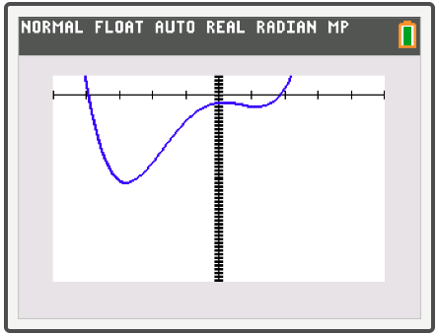
Technology: Finding the Maximum or Minimum of a Function—Slide 2
Figure 14
To find the minimum, press 2nd trace to access the CALCULATE menu and select minimum. (If we were trying to find the maximum, we would select maximum.)

Slide 39
Technology: Finding the Maximum or Minimum of a Function—Slide 3
The screen should now display the graph with LeftBound? shown at the bottom. Use the left arrow to move the cursor anywhere to the left of where the minimum appears to be and press enter. The screen should now say RightBound? at the bottom of the graph. Use the right arrow to move the cursor to the right of where the minimum appears to be and press enter again. The text at the bottom of the graph should now read Guess?

Slide 40
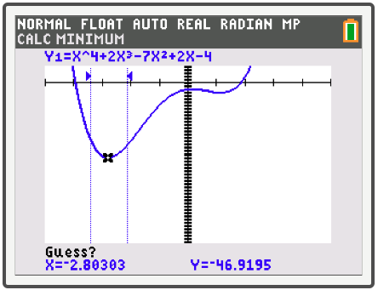
Technology: Finding the Maximum or Minimum of a Function—Slide 4
Press enter a third time and the x- and y-values of the minimum will appear at the bottom of the screen
Figure 15

Slide 41
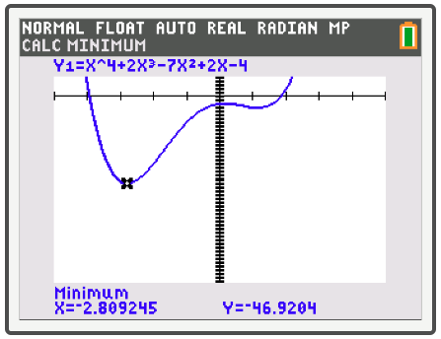
Technology: Finding the Maximum or Minimum of a Function—Slide 5
So the minimum is approximately (−2.809, −46.920).
Figure 16

