Slide 1
Section 1.R.4
Relations and Functions

Slide 2
Definition: Relation, Domain, and Range
A relation is a set of ordered pairs of real numbers.
The domain, D, of a relation is the set of all first coordinates in the relation.
The range, R, of a relation is the set of all second coordinates in the relation.

Slide 3
Example 1: Finding the Domain and Range of a Relation—Slide 1
Find the domain and range for each of the following relations.
g = {(5, 7), (6, 2), (6, 3), (−1, 2)}
Solution
Note that 6 is written only once in the domain and 2 is written only once in the range, even though each appears more than once in the relation.

Slide 4
Example 1: Finding the Domain and Range of a Relation—Slide 2
f = {(−1, 1), (1, 5), (0, 3)}
Solution

Slide 5
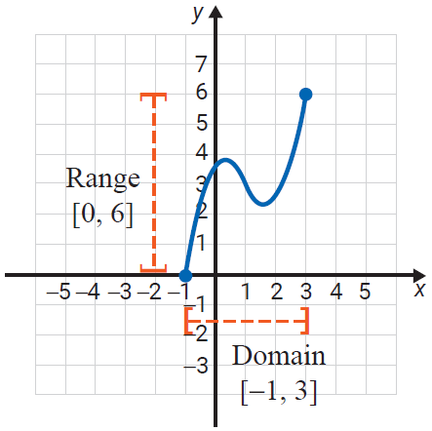
Example 2: Reading Domain and Range from the Graph of a Relation—Slide 1
Identify the domain and range from the graph of each relation.
The domain consists of the set of x-values for all points on the graph. In this case, the domain is the interval [−1, 3].
The range consists of the set of y-values for all points on the graph. In this case, the range is the interval [0, 6].

Slide 6
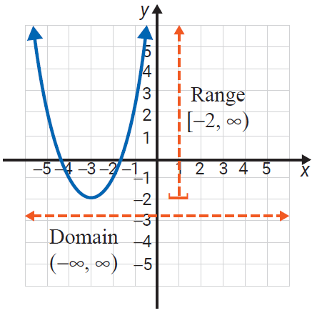
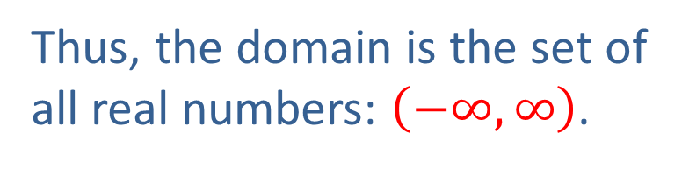
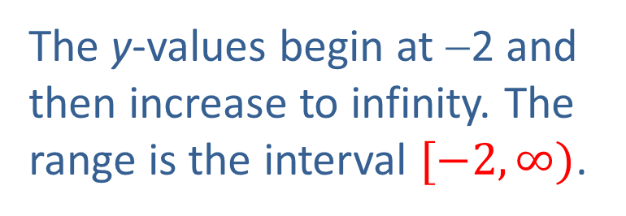
Example 2: Reading Domain and Range from the Graph of a Relation—Slide 2
There is no restriction on the x-values which means that for every real number there is a point on the graph with that number as its x-value.
Thus, the domain is the set of all real numbers: $\left(−∞,∞\right)$.
The y-values begin at −2 and then increase to infinity. The range is the interval $[−2, ∞)$.

Slide 7
Definition: Functions
A function is a relation in which each domain element has exactly one corresponding range element.

Slide 8
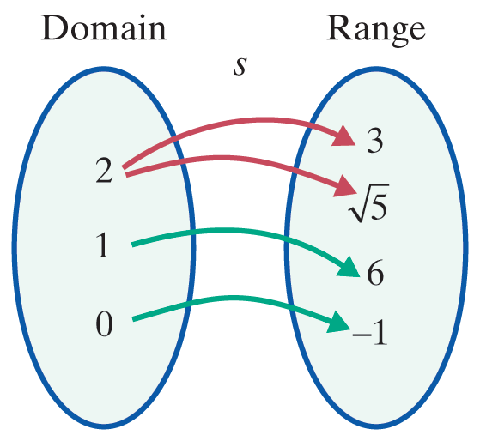
Example 3: Determining if a Relation is a Function—Slide 1
Determine whether each of the following relations is a function.
Solution
s is not a function. The number 2 appears as a first coordinate more than once.

Slide 9
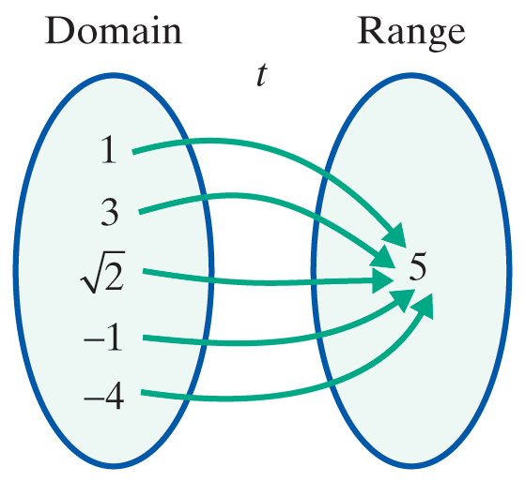
Example 3: Determining if a Relation is a Function—Slide 2
Solution
t is a function. Each first coordinate appears only once. The fact that the second coordinates are all the same has no effect on the concept of a function.

Slide 10
Procedure: Vertical Line Test
If any vertical line intersects the graph of a relation at more than one point, then the relation is not a function.

Slide 11
CAUTION!—1
Note that vertical lines that miss the graph of a relation entirely don’t prevent the relation from being a function; it is only the presence of a vertical line that hits the graph two or more times that indicates the relation isn’t a function.

Slide 12
Example 4: Using the Vertical Line Test—Slide 1
Use the vertical line test to determine whether each graph represents a function. Then list the domain and range of each graph.

Slide 13
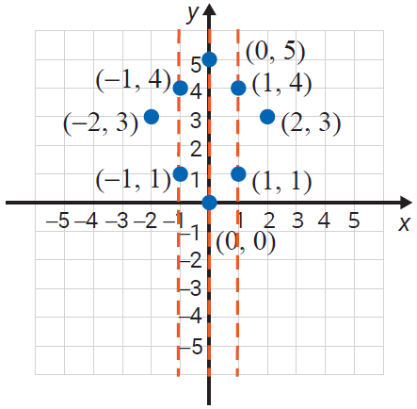
Example 4: Using the Vertical Line Test—Slide 2
a.
The relation is not a function since a vertical line can be drawn that intersects the graph at more than one point. Listing the ordered pairs shows that several x-coordinates appear more than once.
Here, D = {−2 , −1, 0, 1, 2} and R = {0, 1, 3, 4, 5}.

Slide 14
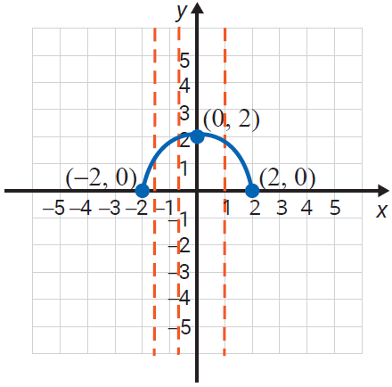
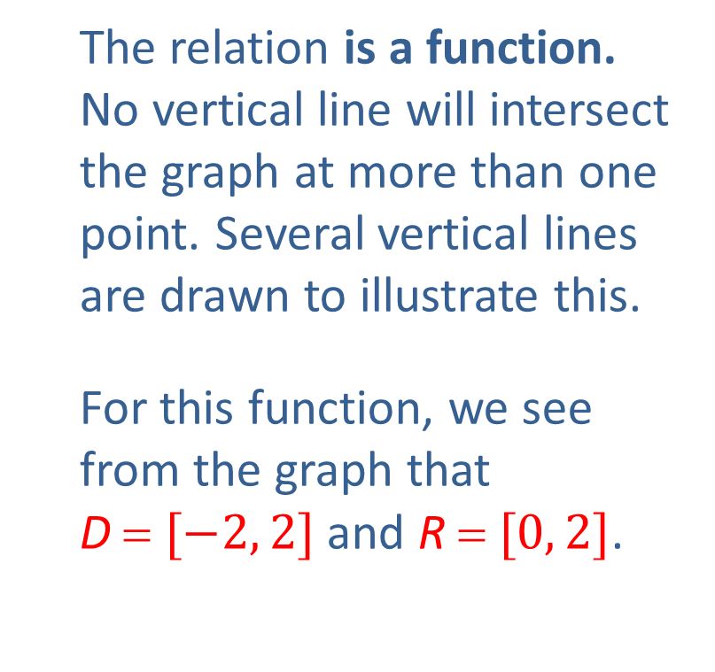
Example 4: Using the Vertical Line Test—Slide 3
The relation is a function.
No vertical line will intersect
the graph at more than one
point. Several vertical lines are drawn to illustrate this.
For this function, we see
from the graph that
D = $[−2, 2]$ and R = $[0, 2]$.

Slide 15
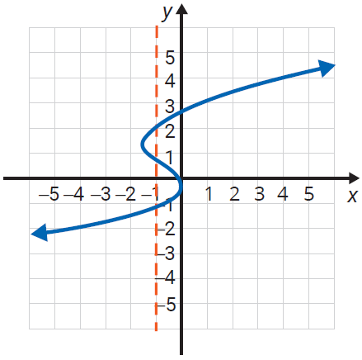
Example 4: Using the Vertical Line Test—Slide 4
The relation is not a function.
At least one vertical line (drawn) intersects the graph at more than one point.
Here,
and

Slide 16
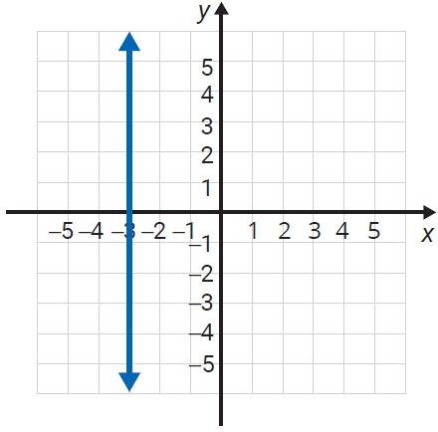
Example 4: Using the Vertical Line Test—Slide 5
The relation is not a function. Every point has the same x‑value: x = −3. In fact, no vertical line is a function since every point will have the same x‑value.
Here, and

Slide 17
Definition: Linear Function
A linear function is a function represented by an equation of the form
y = mx + b.
The domain of a linear function is the set of all real numbers:

Slide 18
Example 5: Finding the Domain of a Function
Find the domain for the function
Solution
The domain is all real numbers for which the
expression is defined. Thus,
or because the denominator is 0 when x = 5.
Note: Here interval notation tells us that x can be any real number except 5.

Slide 19
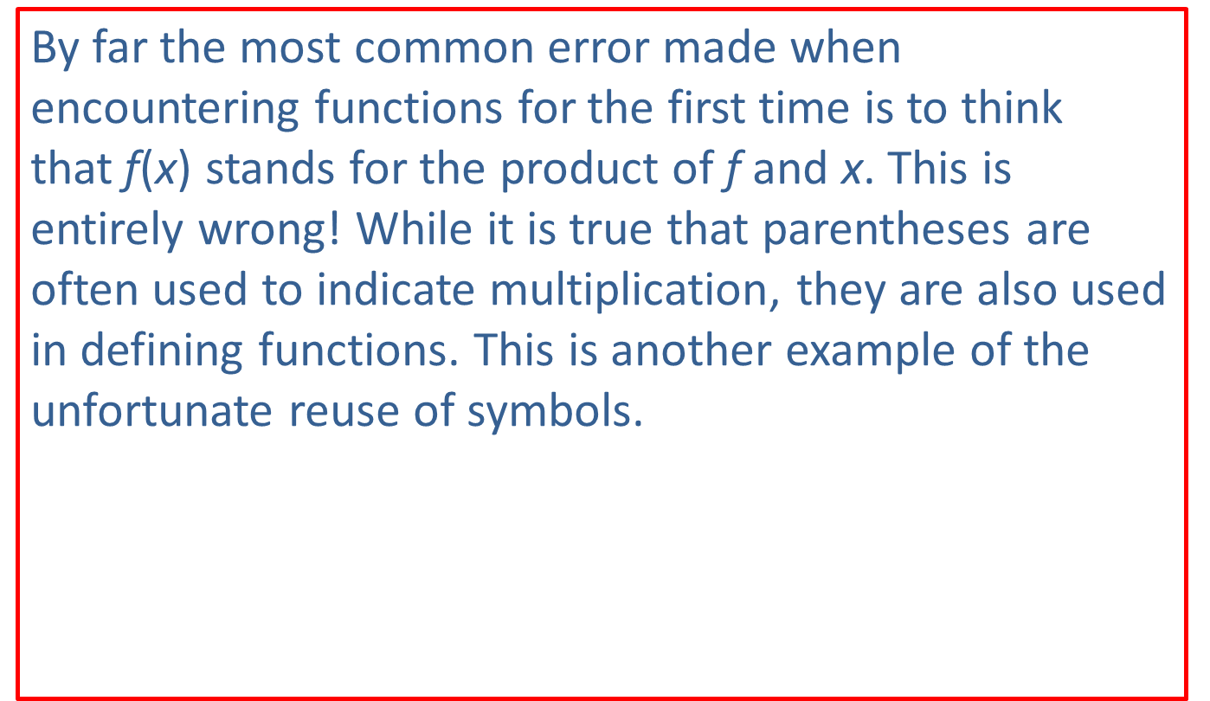
CAUTION!—2
By far the most common error made when encountering functions for the first time is to think that f(x) stands for the product of f and x. This is entirely wrong! While it is true that parentheses are often used to indicate multiplication, they are also used in defining functions. This is another example of the unfortunate reuse of symbols.

Slide 20
Example 6: Evaluating Functions
For the function g(x) = 4x + 5, find:
g(2)
g(−1)
g(0)
Solution
g(2) = 4(2) + 5 = 13
g(−1) = 4(−1) + 5 = 1
g(0) = 4(0) + 5 = 5

Slide 21
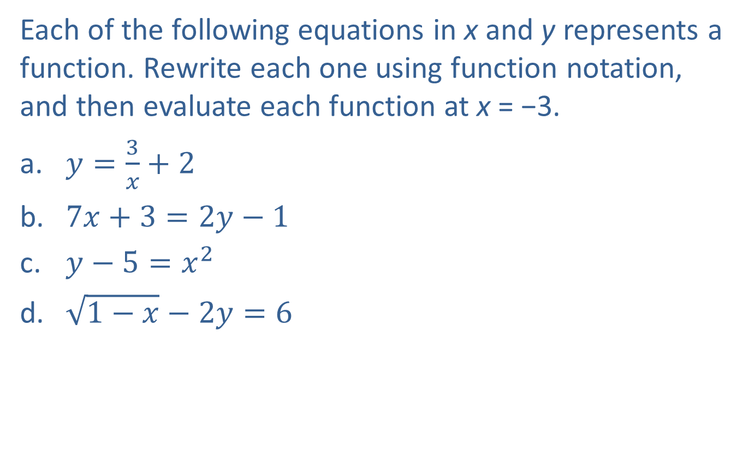
Example 7: Function Notation—Slide 1
Each of the following equations in x and y represents a function. Rewrite each one using function notation, and then evaluate each function at x = −3.
​$y=\frac{3}{x}+2$
​$7x+3=2y−1$
​$y−5=x^{2}$
​$\sqrt{1−x}−2y=6$

Slide 22
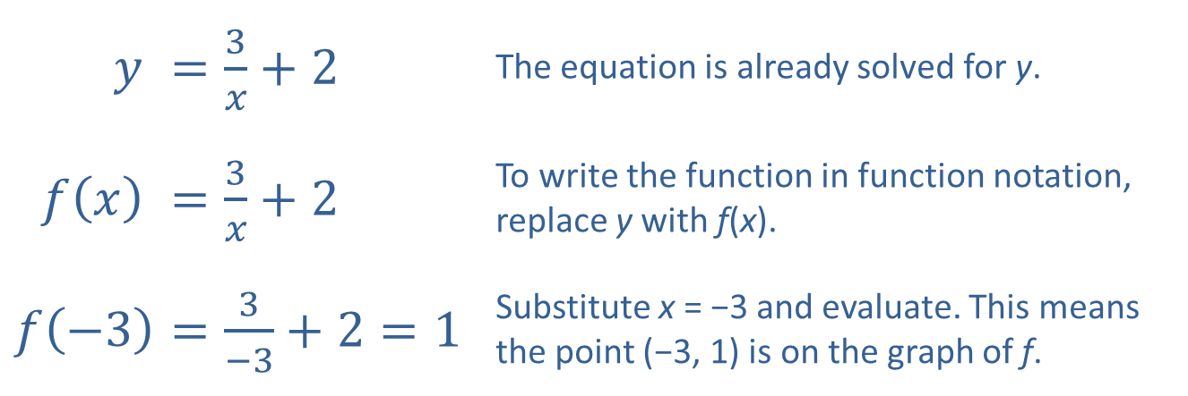
Example 7: Function Notation—Slide 2
Solution
​
$$y$$ | ​$=\frac{3}{x}+2$ | The equation is already solved for y.
​$f⁡\left(x\right)$ | ​$=\frac{3}{x}+2$ | To write the function in function notation, replace y with f(x).
$$f⁡\left(−3\right)$$ | ​$=\frac{3}{−3}+2=1$ | Substitute x = −3 and evaluate. This means the point (−3, 1) is on the graph of f.

Slide 23
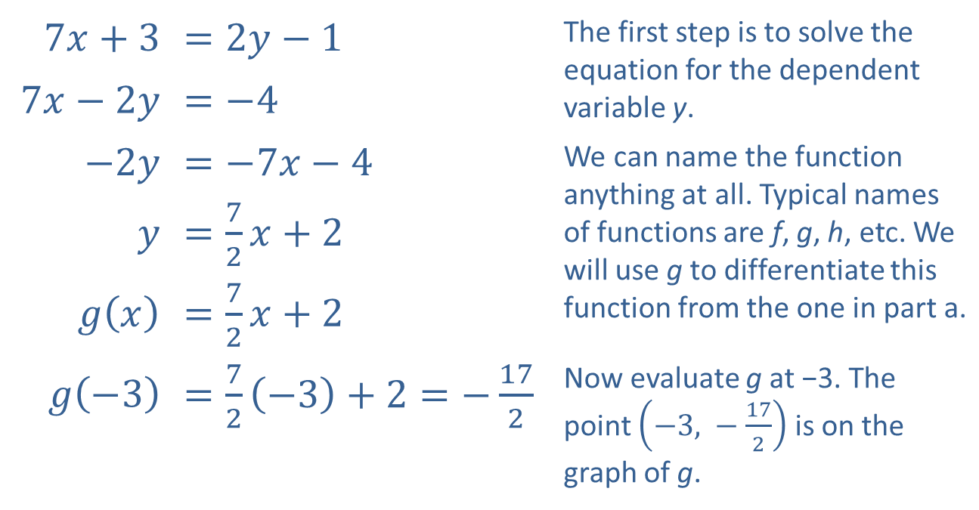
Example 7: Function Notation—Slide 3
​
​$7x+3$ | ​$=2y−1$ | The first step is to solve the equation for the dependent variable y.
​$7x−2y$ | ​$=−4$
​$−2y$ | ​$=−7x−4$ | We can name the function anything at all. Typical names of functions are f, g, h, etc. We will use g to differentiate this function from the one in part a.
$y$ | ​$=\frac{7}{2}x+2$
​$g⁡\left(x\right)$ | ​$=\frac{7}{2}x+2$
​$g⁡\left(−3\right)$ | ​$=\frac{7}{2}\left(−3\right)+2=−\frac{17}{2}$ | Now evaluate g at −3. The point $\left(−3\text{, }−\frac{17}{2}\right)$ is on the graph of g.

Slide 24
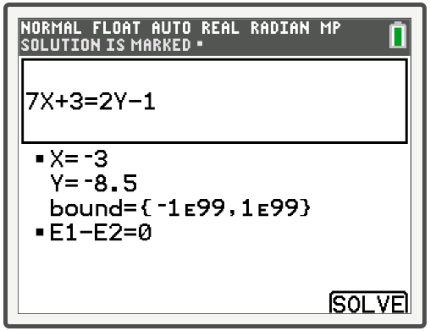
Example 7: Technology
This screen was obtained using the equation solver on a TI-84 Plus CE.

Slide 25
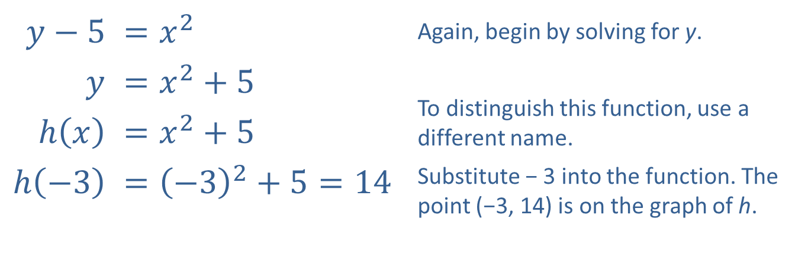
Example 7: Function Notation—Slide 4
​
​$y−5$ | ​$=x^{2}$ | Again, begin by solving for y.
$y$ | ​$=x^{2}+5$ | To distinguish this function, use a different name.
​$h⁡\left(x\right)$ | ​$=x^{2}+5$
​$h⁡\left(−3\right)$ | ​$={\left(−3\right)}^{2}+5=14$ | Substitute − 3 into the function. The point (−3, 14) is on the graph of h.

Slide 26
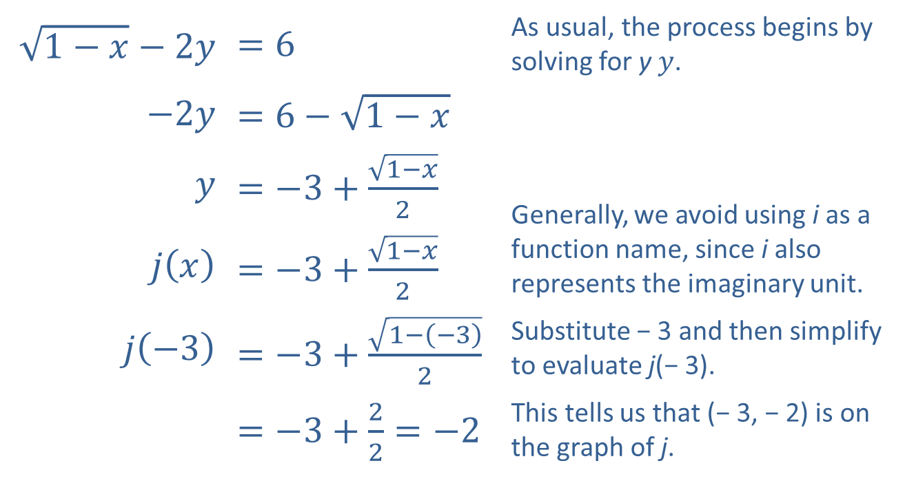
Example 7: Function Notation—Slide 5
​$\sqrt{1−x}−2y$ | ​$=6$ | As usual, the process begins by solving for y $y$.
​$−2y$ | ​$=6−\sqrt{1−x}$
$y$ | ​$=−3+\frac{\sqrt{1−x}}{2}$ | Generally, we avoid using i as a function name, since i also represents the imaginary unit.
​$j⁡\left(x\right)$ | ​$=−3+\frac{\sqrt{1−x}}{2}$
​$j⁡\left(−3\right)$ | ​$=−3+\frac{\sqrt{1−\left(−3\right)}}{2}$ | Substitute − 3 and then simplify to evaluate j(− 3).
​ | ​$=−3+\frac{2}{2}=−2$ | This tells us that (− 3, − 2) is on the graph of j.
​

Slide 27

Example 8: Evaluating Functions—Slide 1
Given the function $f⁡\left(x\right)=3x^{2}−2$, evaluate the following.
​$f⁡\left(a\right)$
​$f⁡\left(x+h\right)$
​$\frac{f⁡\left(x+h\right)−f⁡\left(x\right)}{h}$

Slide 28
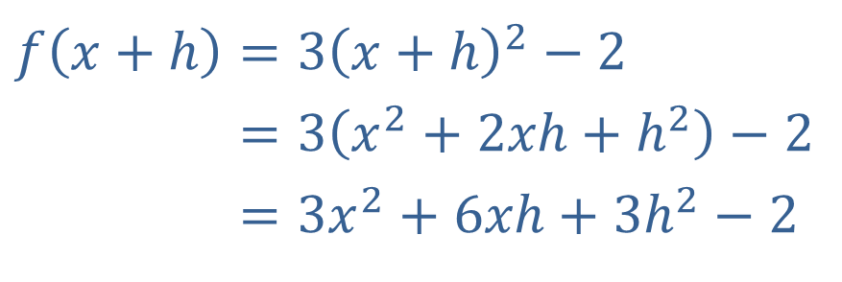

Example 8: Evaluating Functions—Slide 2
​Solution
a. $f⁡\left(a\right)=3a^{2}−2$
This is just a matter of replacing x with a.
​$f\left(x+h\right)=3{\left(x+h\right)}^{2}−2$
​𝑓⁡𝑥+h=3𝑥2+2𝑥h+h2−2
​𝑓⁡𝑥+h=3𝑥2+6𝑥h+3h2−2
Here we replace x with x + h and simplify the result.

Slide 29
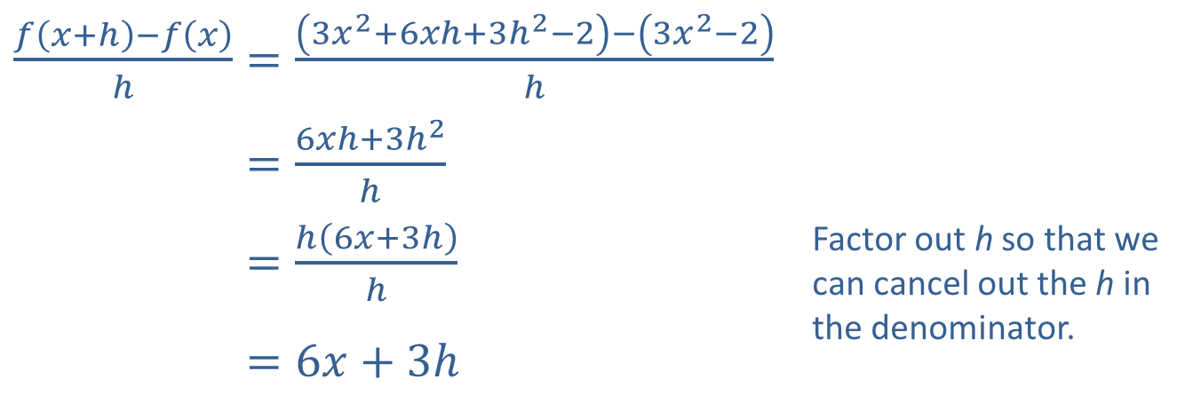
Example 8: Evaluating Functions—Slide 3
​
​$\frac{f⁡\left(x+h\right)−f⁡\left(x\right)}{h}=\frac{\left(3x^{2}+6xh+3h^{2}−2\right)−\left(3x^{2}−2\right)}{h}$
​𝑓⁡𝑥+h−𝑓⁡𝑥h=6𝑥h+3h2h
​𝑓⁡𝑥+h−𝑓⁡𝑥h=h6𝑥+3hh | Factor out h so that we can cancel out the h in the denominator.
​𝑓⁡𝑥+h−𝑓⁡𝑥h=6𝑥+3h
We can use the result from part b. in simplifying this expression.

Slide 30
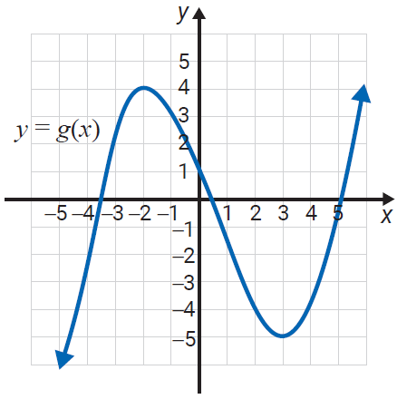
Example 9: Evaluating Functions from a Graph—Slide 1
Using the graph of g(x), find each of the following values.
g(−2)
g(0)
g(3)

Slide 31
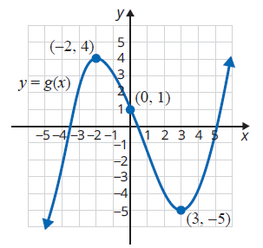
Example 9: Evaluating Functions from a Graph—Slide 2
Solution
Using the graph, we need to find the y‑value that corresponds to each x‑value.
Thus, the function values are as follows.
g(−2) = 4
g(0) = 1
g(3) = −5

Slide 32
Example 10: Graphing Functions with a TI-84 Plus—Slide 1
Use a TI-84 Plus graphing calculator to find the graphs of each of the following functions. Then, use the option 2:zero from the CALC key to find the point(s) where each graph intersects the x-axis. Changing the window may help you get a “better” or “more complete” picture of the function. This is a judgement call on your part.
3x + y = −1
y = 2x − 1; y = 2x + 1; y = 2x + 3

Slide 33
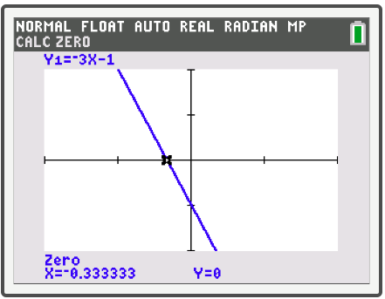
Example 10: Graphing Functions with a TI-84 Plus—Slide 2
Solution
To have the calculator graph a nonvertical straight line, you must first solve the equation for y. Solving for y gives
y = −3x − 1.
(It is important that the key be used to indicate the negative sign in front of 3x. This is not the same as the subtraction key.)
Note: Vertical lines are not functions and cannot be graphed by the calculator in function mode.

Slide 34
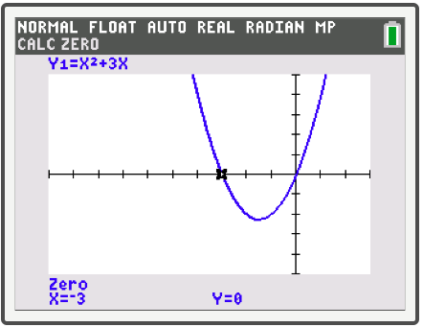
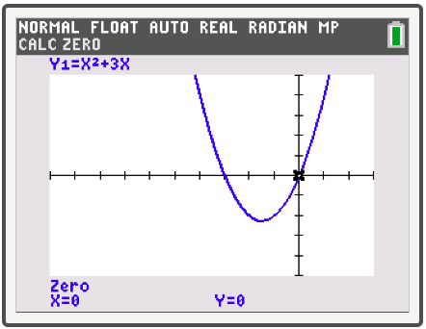
Example 10: Graphing Functions with a TI-84 Plus—Slide 3
b.
Since the graph of this function has two x-intercepts, we have shown the graph twice. Each graph shows the coordinates of a distinct x-intercept.

Slide 35
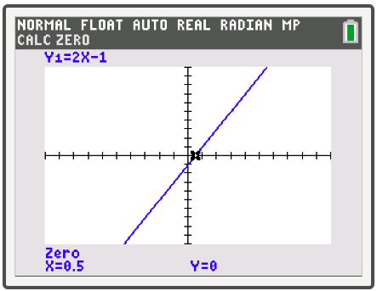
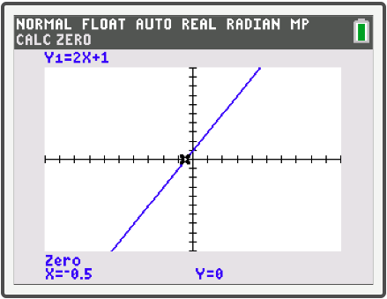
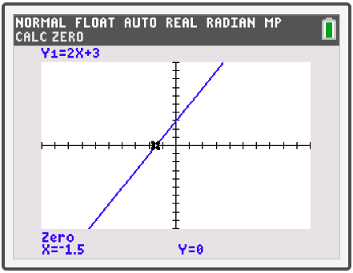
Example 10: Graphing Functions with a TI-84 Plus—Slide 4
y = 2x − 1
y = 2x + 1
y = 2x + 3

