Slide 1
Section 1.R.3
Lines

Slide 2
Definition: Linear Equations in Two Variables
A linear equation in two variables, say the variables x and y, is an equation that can be written in the form ax + by = c, where a, b, and c are constants and a and b are not both zero. This form of such an equation is called the standard form.

Slide 3
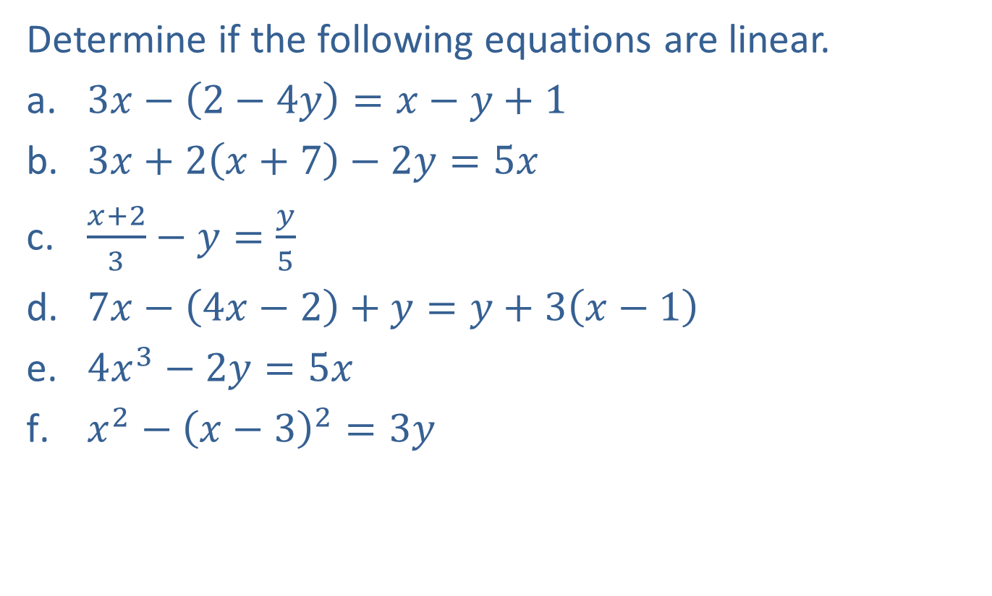
Example 1: Linear Equations in Two Variables—Slide 1
Determine if the following equations are linear.
​$3x−\left(2−4y\right)=x−y+1$
​$3x+2\left(x+7\right)−2y=5x$
​$\frac{x+2}{3}−y=\frac{y}{5}$
​$7x−\left(4x−2\right)+y=y+3\left(x−1\right)$
​$4x^{3}−2y=5x$
​$x^{2}−{\left(x−3\right)}^{2}=3y$

Slide 4
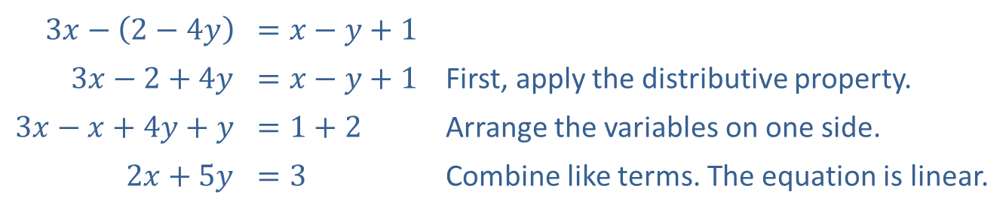
Example 1: Linear Equations in Two Variables—Slide 2
Solution
​
​$3x−\left(2−4y\right)$ | ​$=x−y+1$
​$3x−2+4y$ | ​$=x−y+1$ | First, apply the distributive property.
​$3x−x+4y+y$ | ​$=1+2$ | Arrange the variables on one side.
​$2x+5y$ | ​$=3$ | Combine like terms. The equation is linear.

Slide 5
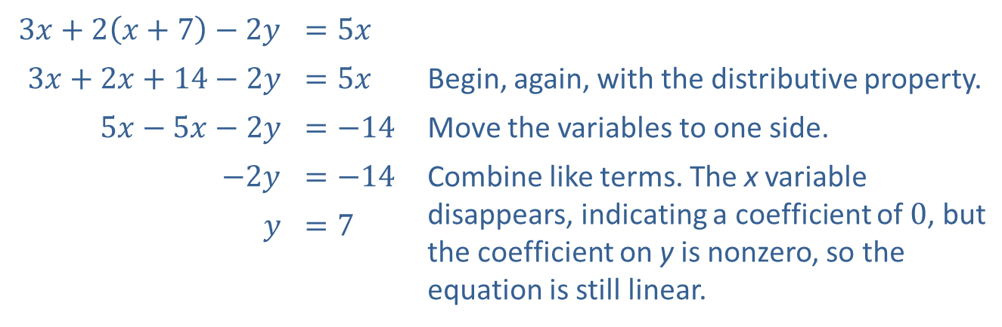
Example 1: Linear Equations in Two Variables—Slide 3
​
​$3x+2\left(x+7\right)−2y$ | ​$=5x$
​$3x+2x+14−2y$ | ​$=5x$ | Begin, again, with the distributive property.
​$5x−5x−2y$ | ​$=−14$ | Move the variables to one side.
​$−2y$ | ​$=−14$ | Combine like terms. The x variable disappears, indicating a coefficient of 0, but the coefficient on y is nonzero, so the equation is still linear.
$$y$$ | ​$=7$

Slide 6
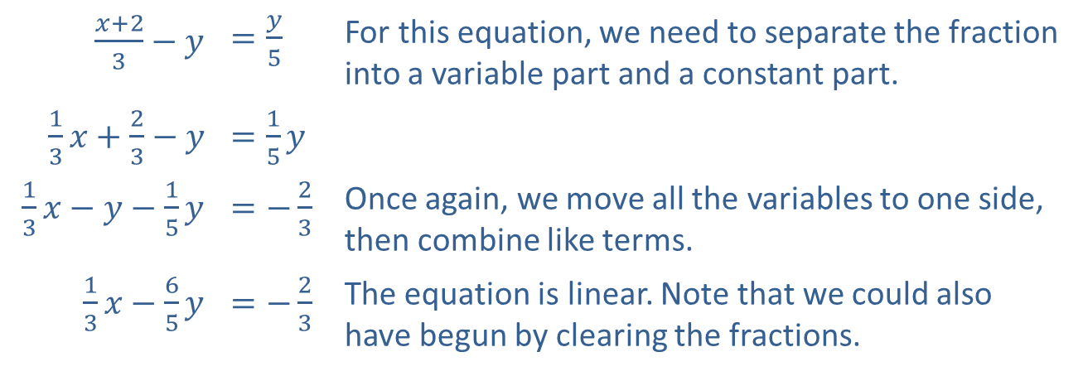
Example 1: Linear Equations in Two Variables—Slide 4
​
​$\frac{x+2}{3}−y$ | ​$=\frac{y}{5}$ | For this equation, we need to separate the fraction into a variable part and a constant part.
​$\frac{1}{3}x+\frac{2}{3}−y$ | ​$=\frac{1}{5}y$
​$\frac{1}{3}x−y−\frac{1}{5}y$ | ​$=−\frac{2}{3}$ | Once again, we move all the variables to one side, then combine like terms.
​$\frac{1}{3}x−\frac{6}{5}y$ | ​$=−\frac{2}{3}$ | The equation is linear. Note that we could also have begun by clearing the fractions.

Slide 7
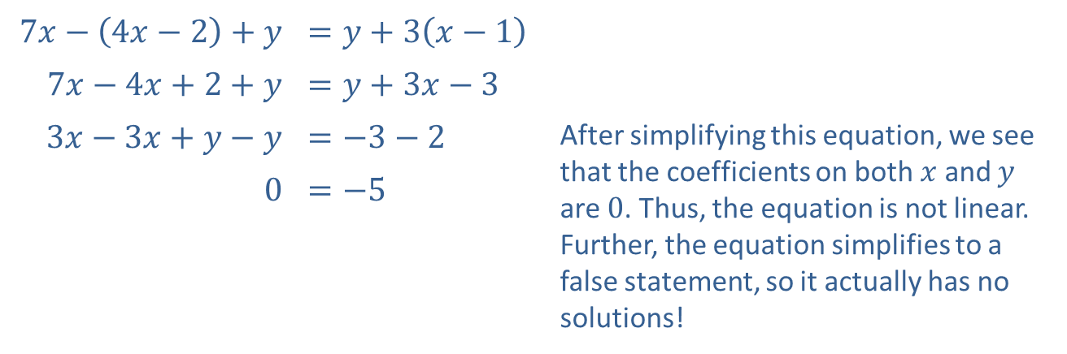
Example 1: Linear Equations in Two Variables—Slide 5
​
​$7x−\left(4x−2\right)+y$ | ​$=y+3\left(x−1\right)$
​$7x−4x+2+y$ | ​$=y+3x−3$
​$3x−3x+y−y$ | ​$=−3−2$ | After simplifying this equation, we see that the coefficients on both $x$ and $y$ are 0. Thus, the equation is not linear. Further, the equation simplifies to a false statement, so it actually has no solutions!
​0 | ​$=−5$

Slide 8

Example 1: Linear Equations in Two Variables—Slide 6
$4x^{3}−2y=5x$
The presence of the cubed term in this already simplified equation makes it not linear.​

Slide 9
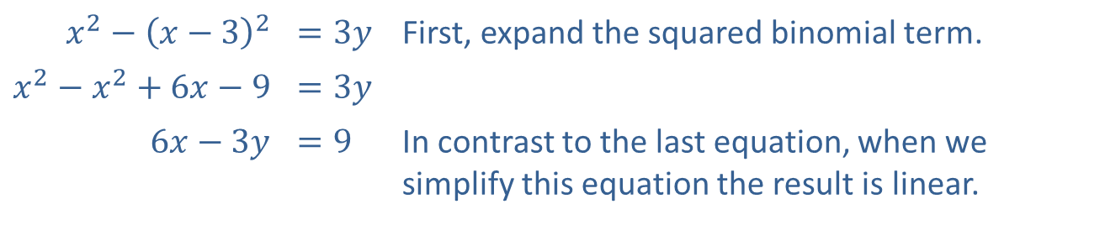
Example 1: Linear Equations in Two Variables—Slide 7
​
​$x^{2}−{\left(x−3\right)}^{2}$ | ​$=3y$ | First, expand the squared binomial term.
​$x^{2}−x^{2}+6x−9$ | ​$=3y$
​$6x−3y$ | ​$=9$ | In contrast to the last equation, when we simplify this equation the result is linear.

Slide 10
Definition: The x- and y-Intercepts
Given a graph in the Cartesian plane, any point where the graph intersects the x-axis is called an x-intercept and any point where the graph intersects the y-axis is called a y-intercept.
All x-intercepts are of the form (c, 0) and all
y-intercepts are of the form (0, c).

Slide 11

Example 2: Finding Intercepts and Graphing Linear Equations—Slide 1
Find the x- and y-intercepts of the given equations, and sketch their graphs.
​$3x−4y=12$
​$4x−\left(3−x\right)+2y=7$

Slide 12
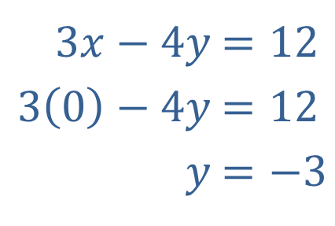
Example 2: Finding Intercepts and Graphing Linear Equations—Slide 2
Solution
To find the two intercepts, first set x equal to 0 and solve for y.
​
​
​​
​$3x−4y$ | ​$=12$
​$3\left(0\right)−4y$ | ​$=12$
​$y$ | ​$=−3$

Slide 13
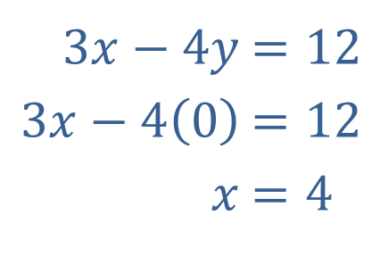
Example 2: Finding Intercepts and Graphing Linear Equations—Slide 3
Then set y equal to 0 and solve for x.
This gives us the coordinates of the two intercepts,
y-intercept: (0, −3)and x-intercept: (4, 0), which we plot in Figure 1. Once we have plotted the intercepts, drawing a straight line through them gives us the graph of the equation.
​$3x−4y$ | ​$=12$
​$3x−4\left(0\right)$ | ​$=12$
​$x$ | ​$=4$

Slide 14
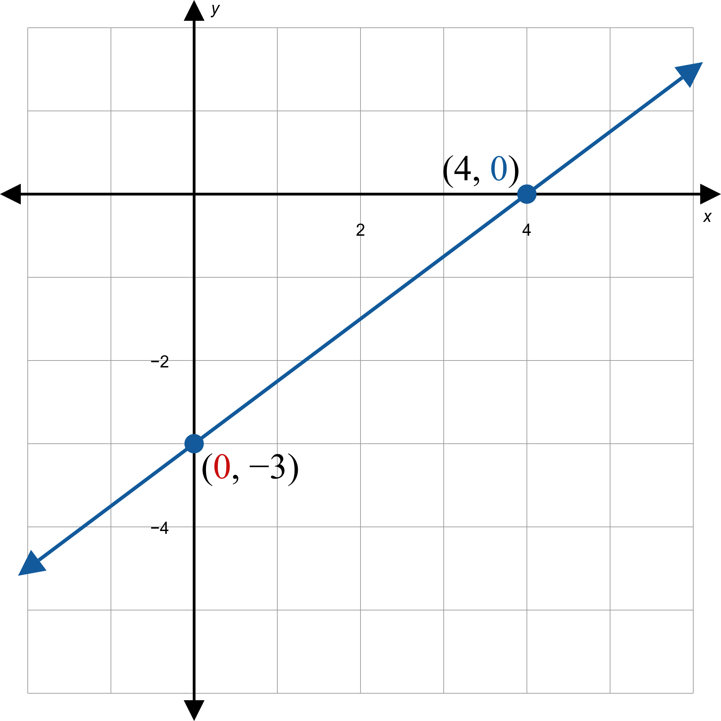
Example 2: Finding Intercepts and Graphing Linear Equations—Slide 4
Figure 1

Slide 15
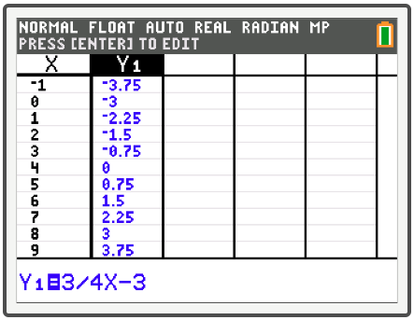
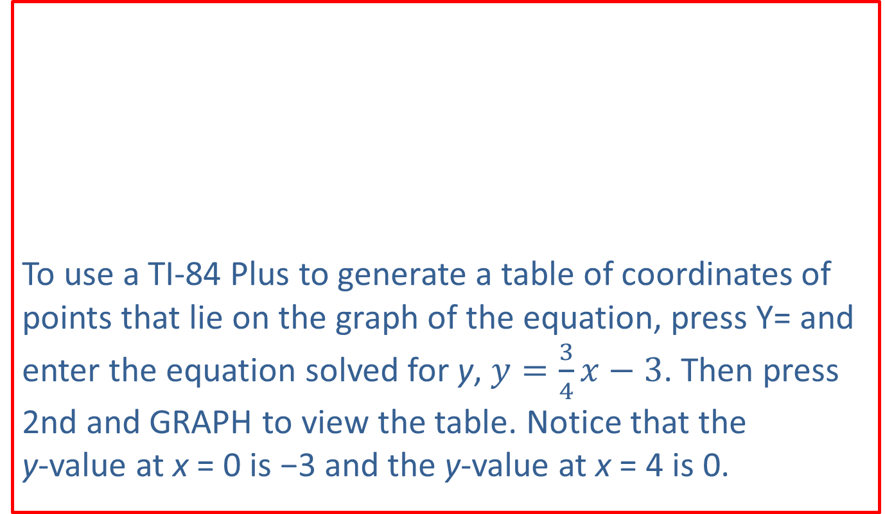
Example 2: Technology
To use a TI-84 Plus to generate a table of coordinates of points that lie on the graph of the equation, press Y= and enter the equation solved for y, $y=\frac{3}{4}x−3$. Then press 2nd and graph to view the table. Notice that the
y-value at x = 0 is −3 and the y-value at x = 4 is 0.

Slide 16
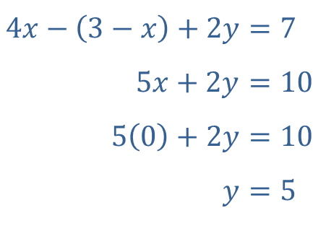
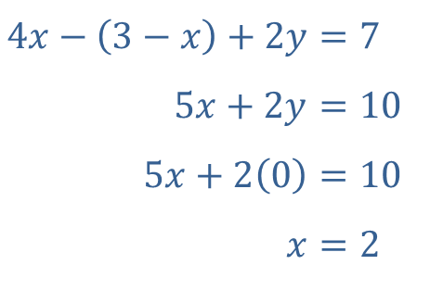
Example 2: Finding Intercepts and Graphing Linear Equations—Slide 5
​Again, find the two intercepts by setting the appropriate variables equal to 0.
Solving the resulting equations in one variable yields the intercept solutions, y-intercept: (0, 5) and
x-intercept: (2, 0). Plot the two intercepts, then draw the line passing through these two points.
​$4x−\left(3−x\right)+2y$ | ​$=7$
​$5x+2y$ | ​$=10$
​$5\left(0\right)+2y$ | ​$=10$
​$y$ | ​$=5$
​$4x−\left(3−x\right)+2y$ | ​$=7$
​$5x+2y$ | ​$=10$
​$5x+2\left(0\right)$ | ​$=10$
​$x$ | ​$=2$

Slide 17
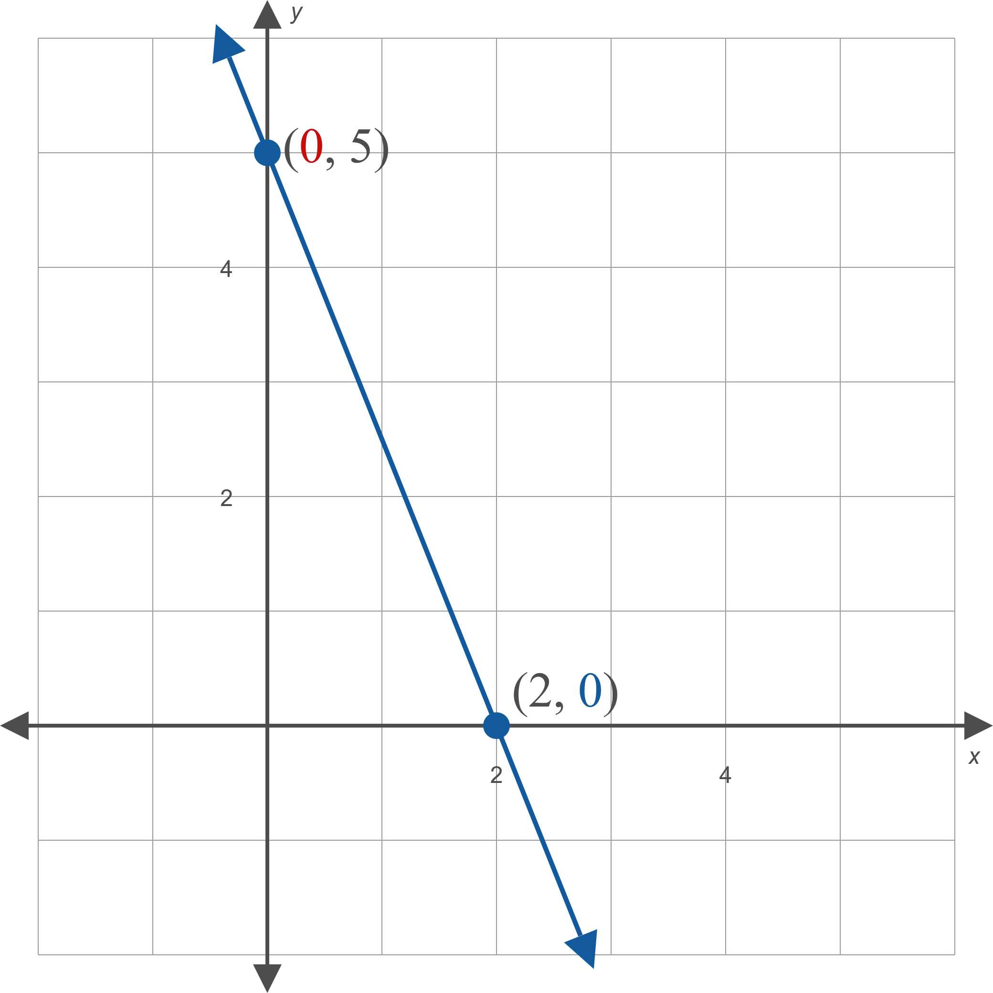
Example 2: Finding Intercepts and Graphing Linear Equations—Slide 6
Figure 2

Slide 18
Technology: Finding Intercepts—Slide 1
Since all linear equations can be solved for the variable y, we can use a TI-84 Plus to graph them. Doing so enables us to use the TI-84 Plus to find the x- and y-intercepts. Suppose we've graphed the equation y = 2x − 6.
To find the y-intercept, press trace. Since the y-intercept occurs where x = 0, use the arrows to move the cursor along the line until the x-value is 0.

Slide 19
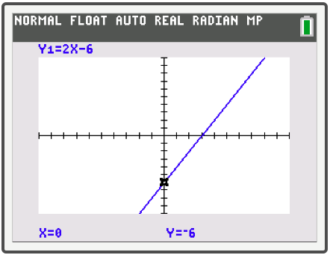
Technology: Finding Intercepts—Slide 2
Alternatively, just press press 0 and enter to place the cursor at that point. The corresponding y-value, −6, is shown at the bottom of the screen (Figure 3). So the point (0, −6) is the y-intercept.
Figure 3

Slide 20
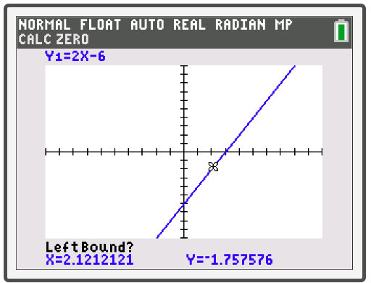
Technology: Finding Intercepts—Slide 3
We will find the x-intercept using a different method. Press 2nd trace to access the CALCULATE menu and select zero and press enter. The screen should now display the graph with LeftBound? Shown at the bottom (Figure 4).
Figure 4

Slide 21
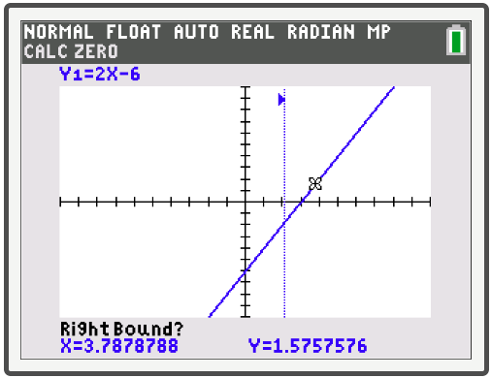
Technology: Finding Intercepts—Slide 4
Use the arrows to move the cursor anywhere to the left of where the line crosses the x-axis and press enter. The screen should now say RightBound? (Figure 5).
Figure 5

Slide 22
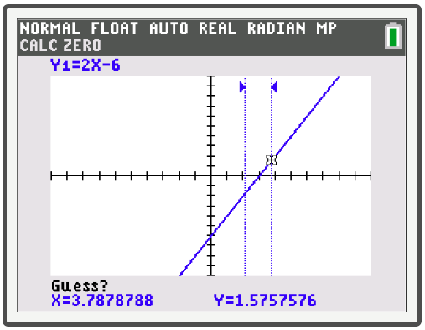
Technology: Finding Intercepts—Slide 5
Use the right arrow to move the cursor to the right of where the line crosses the x-axis and press enter again. The text should now read Guess? (Figure 6).
Figure 6

Slide 23
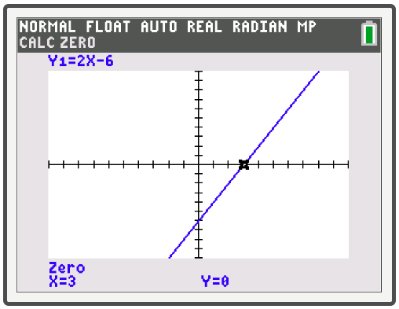
Technology: Finding Intercepts—Slide 6
Press enter a third time and the x- and y-values of the x-intercept will appear at the bottom of the screen (Figure 7).
Figure 7

Slide 24
Technology: Finding Intercepts—Slide 7
So the x-intercept is (3,0). Both of these techniques can be used to find the x- and y-intercepts of any equation graphed with a TI-84 Plus, not just linear equations.

Slide 25

Example 3: Graphing Horizontal and Vertical Lines—Slide 1
Graph the following equations.
​$5x=0$
​$2x−2=3$
​$3x+2\left(x+7\right)−2y=5x$

Slide 26
Example 3: Graphing Horizontal and Vertical Lines—Slide 2
Solution
​The first step is to divide both sides by 5, leaving the simple equation x = 0.
5x = 0
x = 0
The graph of this equation is the y-axis, as all ordered pairs on the y-axis have an x-coordinate of 0.
​

Slide 27
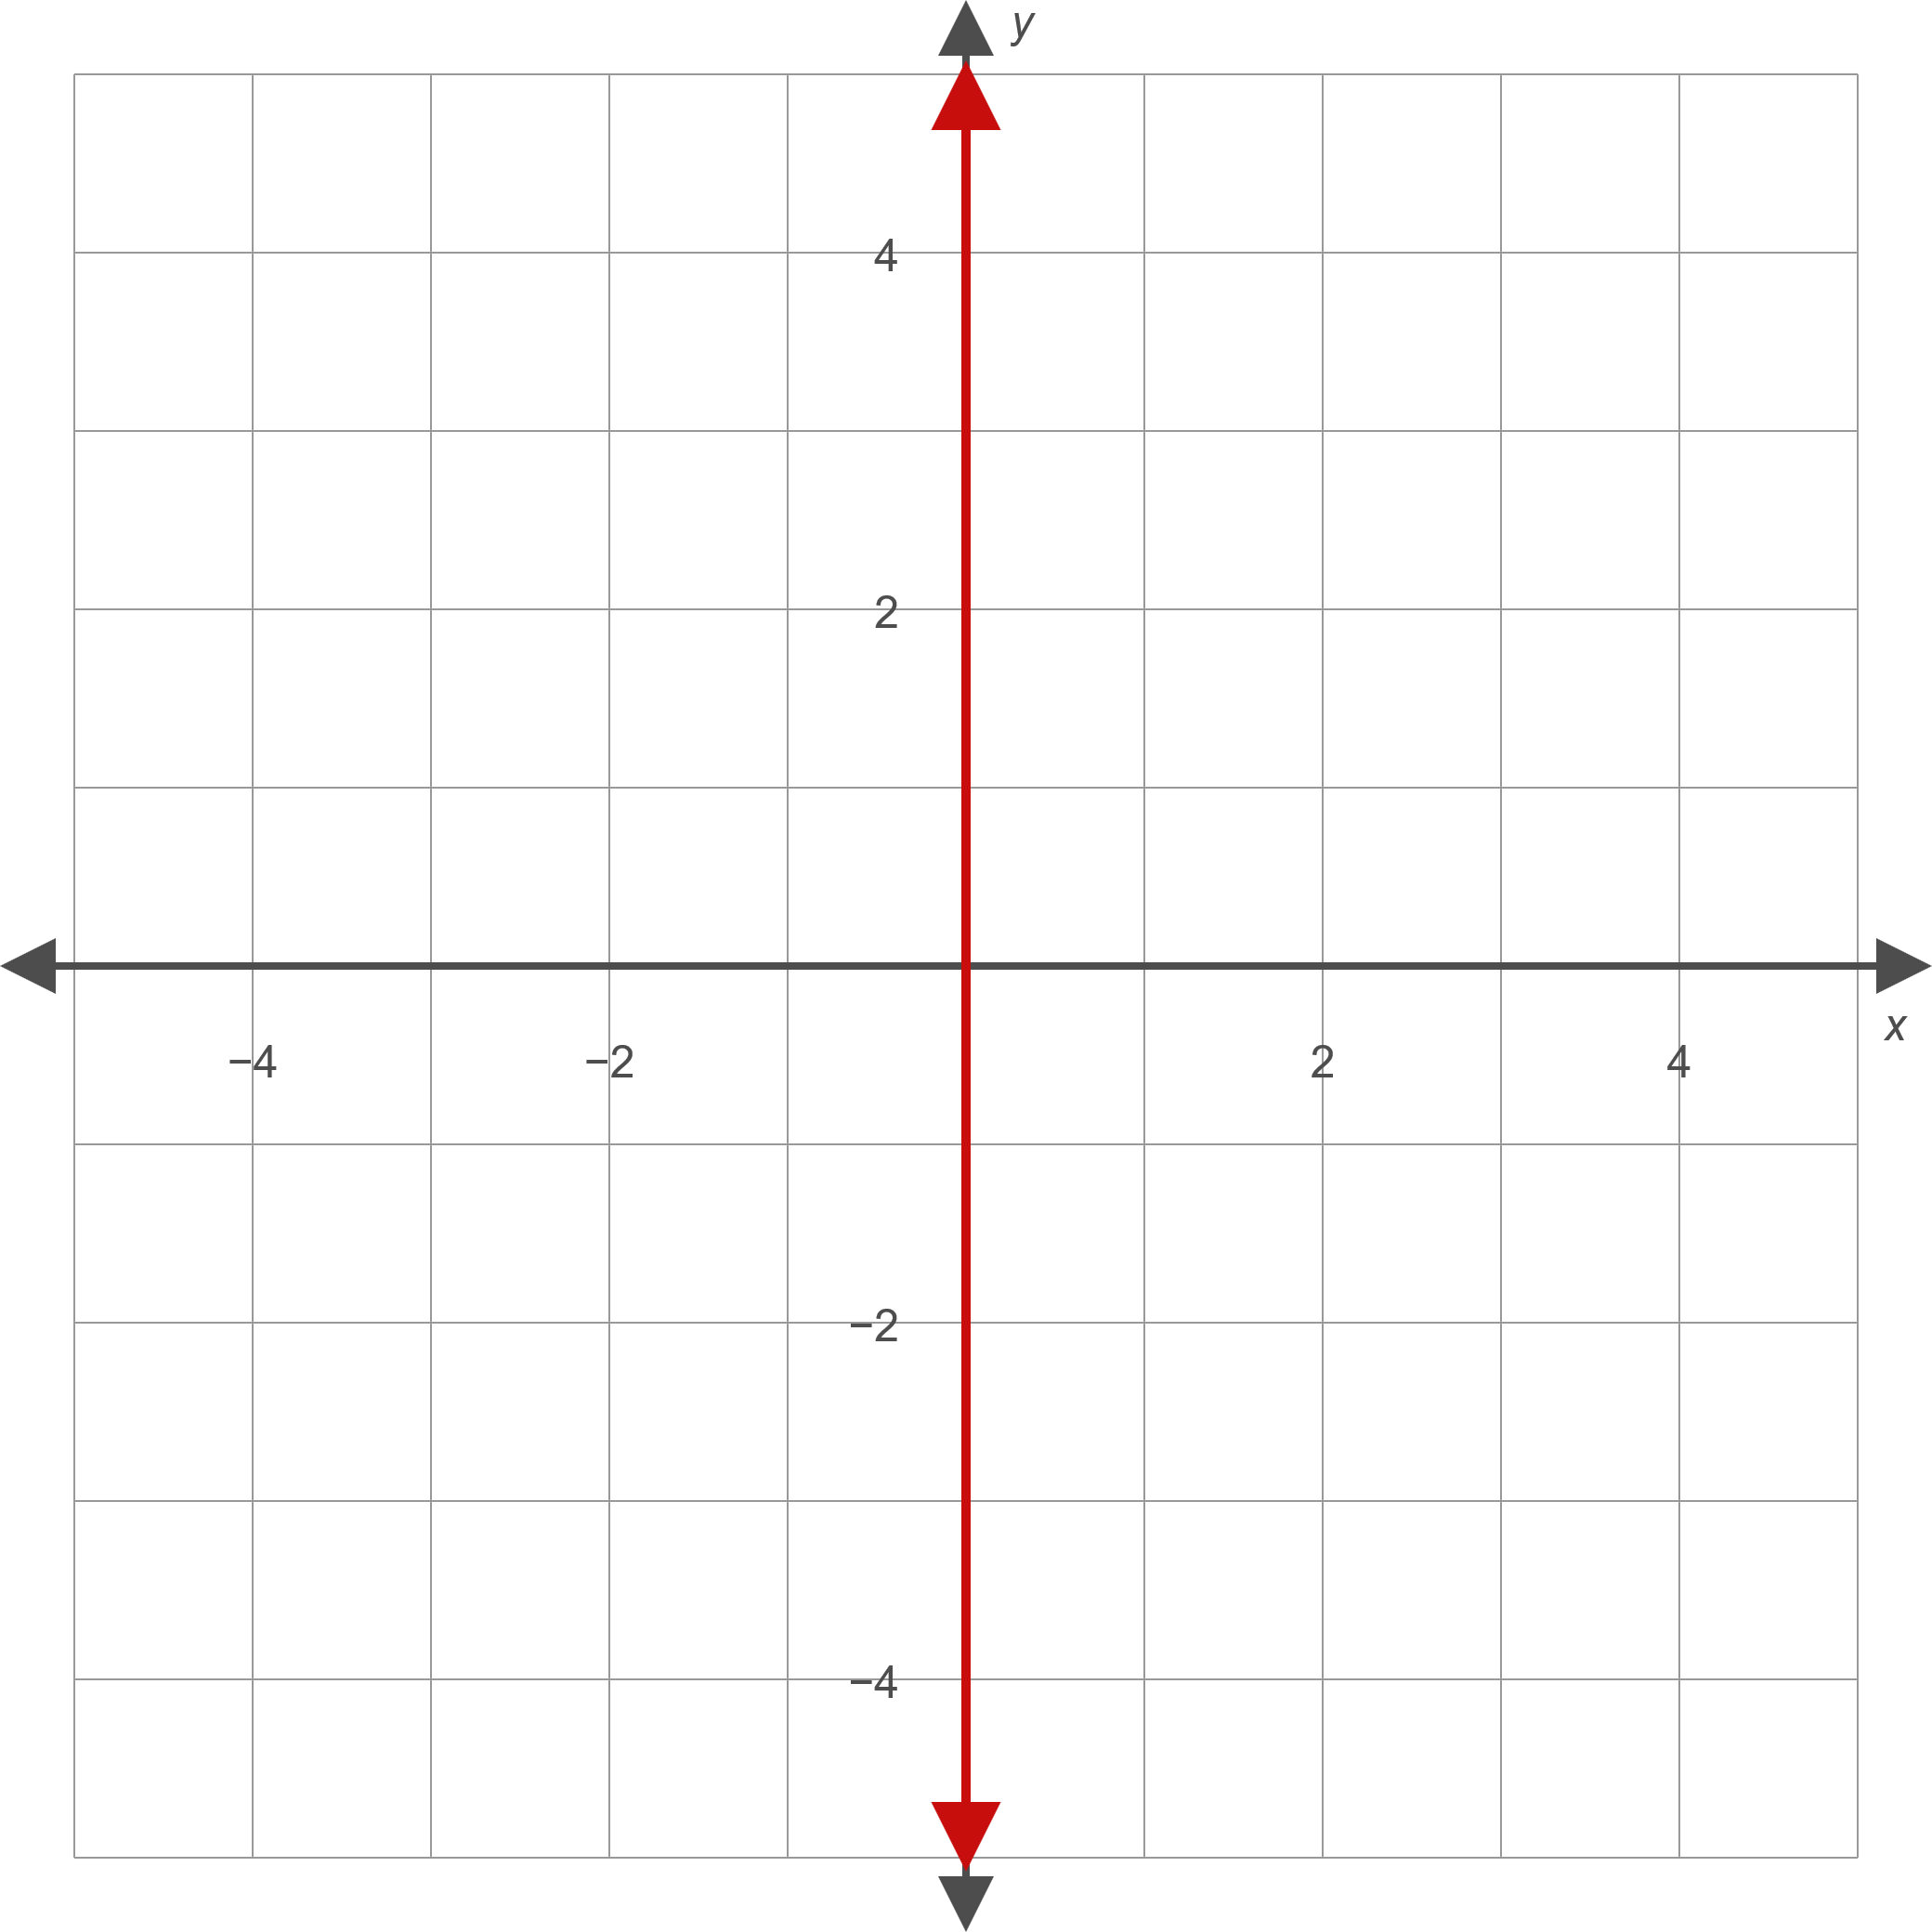
Example 3: Graphing Horizontal and Vertical Lines—Slide 3
Figure 8

Slide 28
Example 3: Graphing Horizontal and Vertical Lines—Slide 4
​The equation is unique in that it has an infinite number of y-intercepts (since each point on the graph is on the y-axis) and one x-intercept (the origin).
​Similarly, the equation y = 0 has an infinite number of x-intercepts and one y-intercept.

Slide 29
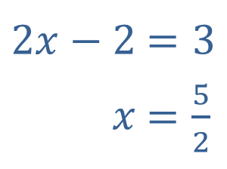

Example 3: Graphing Horizontal and Vertical Lines—Slide 5
​Upon simplifying, note that this equation also represents a vertical line, this time passing through $\frac{5}{2}$ on the x-axis.
​
​
​$2x−2$ | ​$=3$
​$x$ | ​$=\frac{5}{2}$

Slide 30
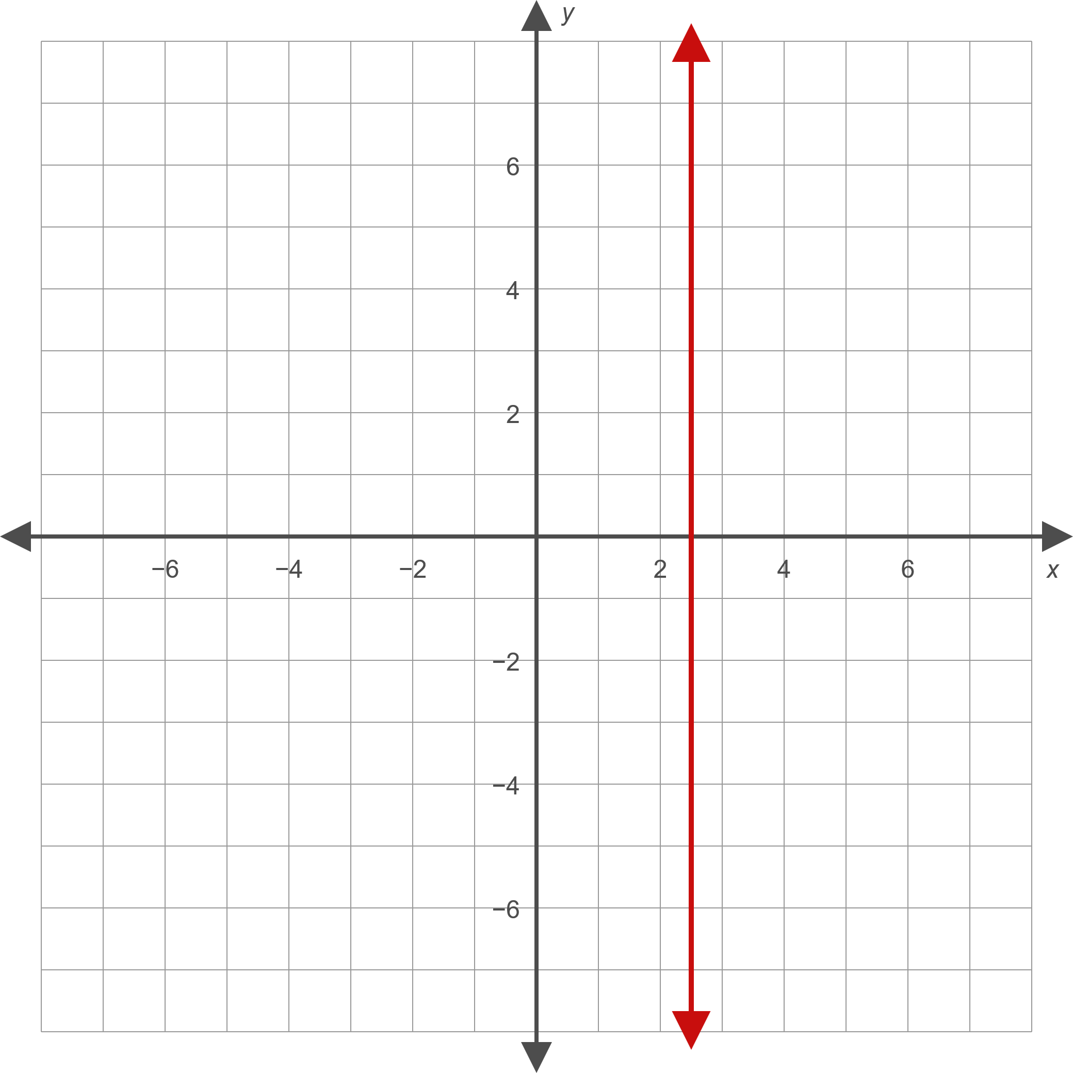
Example 3: Graphing Horizontal and Vertical Lines—Slide 6
Figure 9

Slide 31
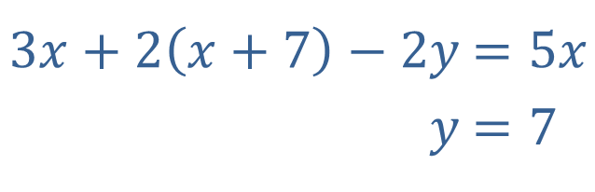
Example 3: Graphing Horizontal and Vertical Lines—Slide 7
​We encountered this equation in Example 1b and have already written it in standard form as shown.
The graph of this equation is the horizontal line consisting of all those ordered pairs whose
y-coordinate is 7.
​$3x+2\left(x+7\right)−2y$ | ​$=5x$
​$y$ | ​$=7$

Slide 32
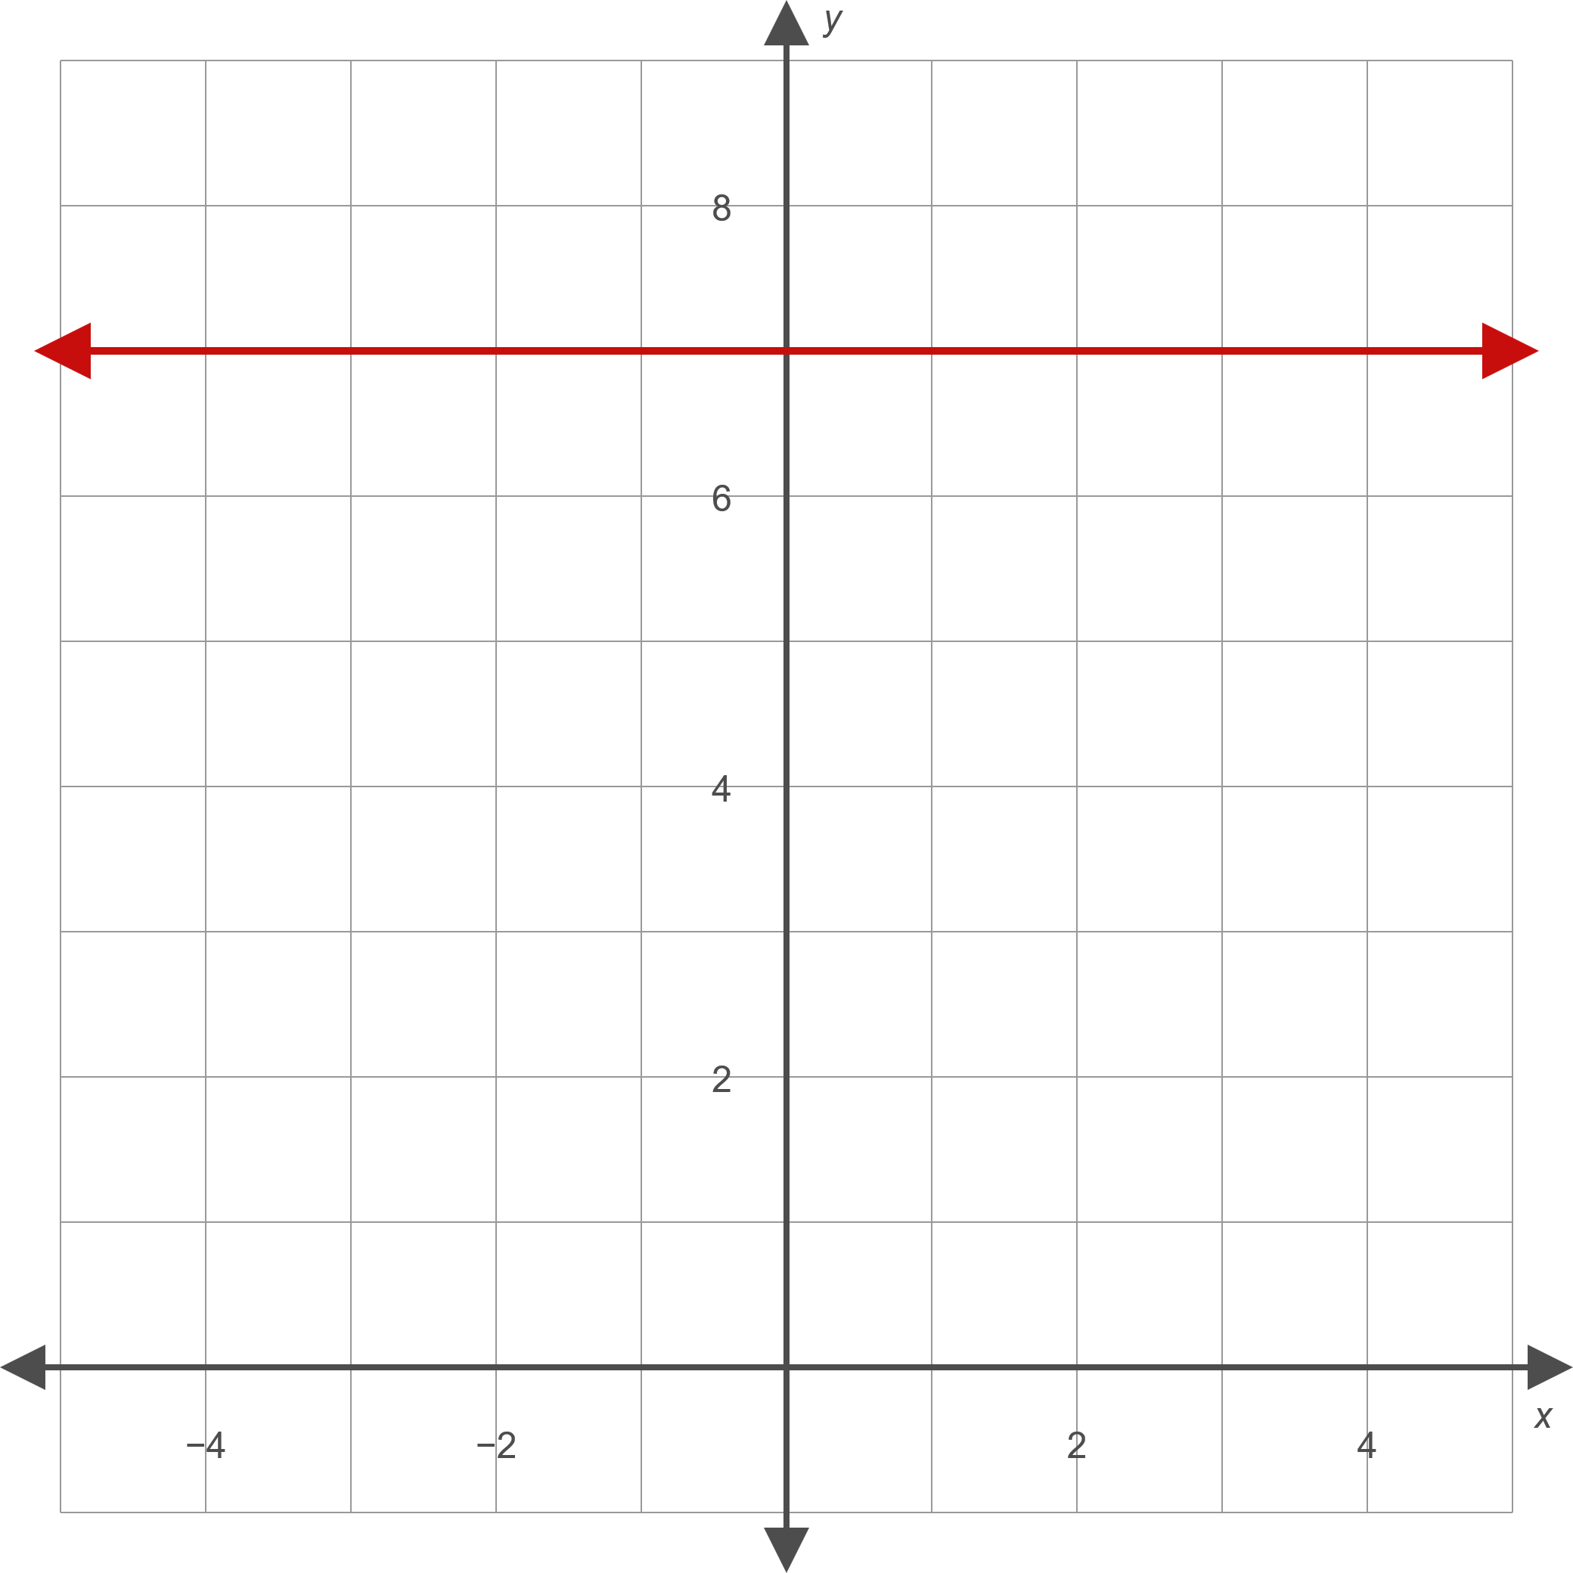
Example 3: Graphing Horizontal and Vertical Lines—Slide 8
Figure 10

Slide 33
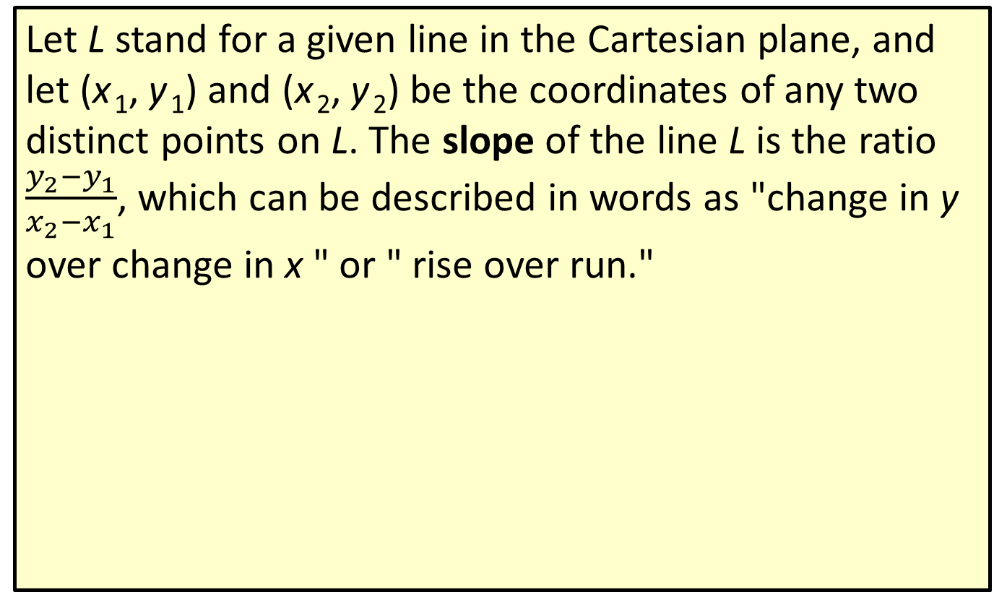
Definition: The Slope of a Line
Let L stand for a given line in the Cartesian plane, and let (x ₁, y ₁) and (x ₂, y ₂) be the coordinates of any two distinct points on L. The slope of the line L is the ratio $\frac{y_{2}−y_{1}}{x_{2}−x_{1}}$, which can be described in words as "change in y over change in x " or " rise over run."

Slide 34
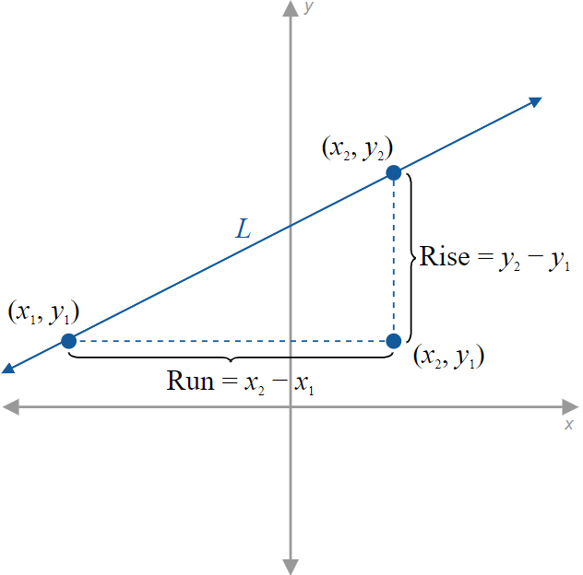
Figure 11: Rise and Run between Two Points
Figure 11

Slide 35
CAUTION!—Slide 1
It doesn't matter how you assign the labels (x ₁, y ₁) and (x ₂, y ₂) to the two points you are using to calculate slope, but it is important that you are consistent as you apply the formula. You cannot change the order in which you are subtracting as you determine the numerator and denominator in the slope formula.

Slide 36
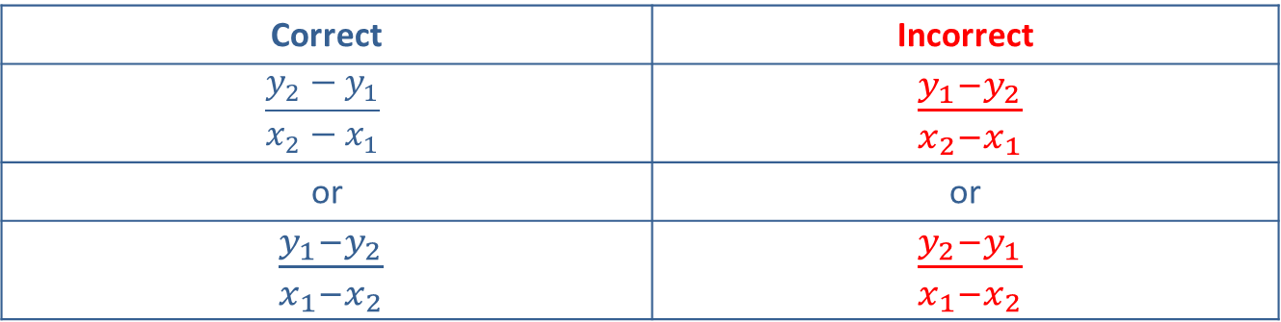
CAUTION!—Slide 2
Correct | Incorrect
$$\frac{y_{2}−y_{1}}{x_{2}−x_{1}}$$ | $\frac{y_{1}−y_{2}}{x_{2}−x_{1}}$
or | or
$\frac{y_{1}−y_{2}}{x_{1}−x_{2}}$ | $\frac{y_{2}−y_{1}}{x_{1}−x_{2}}$

Slide 37
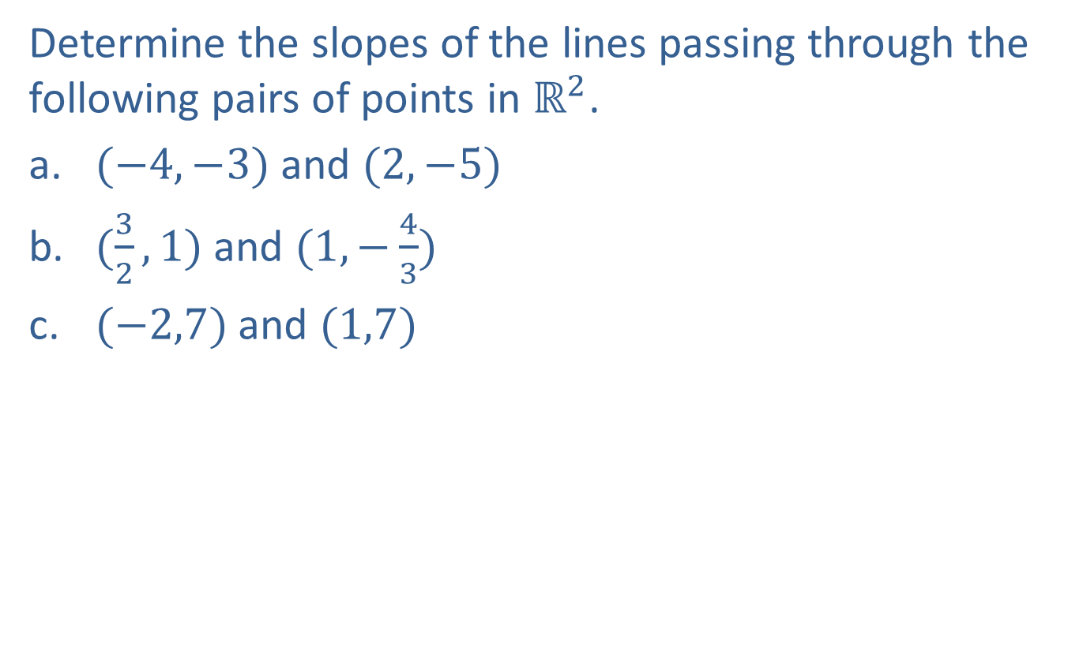
Example 4: Calculating the Slope of a Line—Slide 1
Determine the slopes of the lines passing through the following pairs of points in $ℝ^{2}$.
​$(−4,−3)$ and $(2,−5)$
​$(\frac{3}{2},1)$ and $(1,−\frac{4}{3})$
​$(−2,7)$ and $(1,7)$

Slide 38
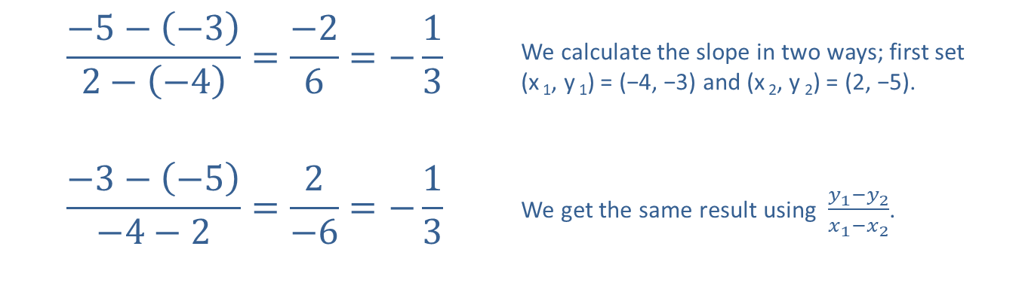
Example 4: Calculating the Slope of a Line—Slide 2
Solution
​
$$\frac{−5−\left(−3\right)}{2−\left(−4\right)}=\frac{−2}{6}=−\frac{1}{3}$$ | We calculate the slope in two ways; first set (x ₁, y ₁) = (−4, −3) and (x ₂, y ₂) = (2, −5).
$$\frac{−3−\left(−5\right)}{−4−2}=\frac{2}{−6}=−\frac{1}{3}$$ | We get the same result using $\frac{y_{1}−y_{2}}{x_{1}−x_{2}}$.

Slide 39
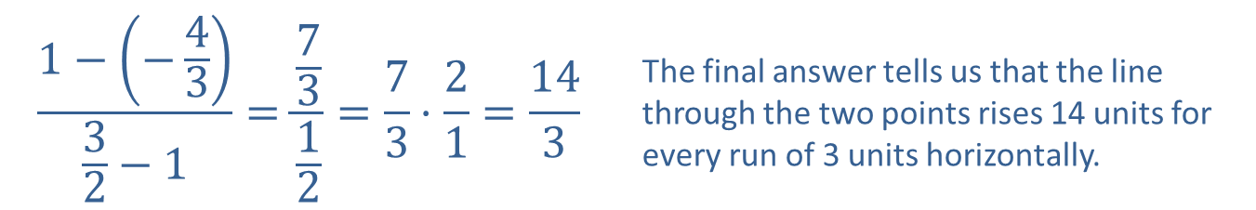
Example 4: Calculating the Slope of a Line—Slide 3
$$\frac{1−\left(−\frac{4}{3}\right)}{\frac{3}{2}−1}=\frac{\frac{7}{3}}{\frac{1}{2}}=\frac{7}{3}⋅\frac{2}{1}=\frac{14}{3}$$ | The final answer tells us that the line through the two points rises 14 units for every run of 3 units horizontally.
​

Slide 40
Example 4: Calculating the Slope of a Line—Slide 4
$$\frac{7−7}{−2−1}=\frac{0}{−3}=0$$ | These two points have the same y-coordinate and thus lie on a horizontal line.
​

Slide 41
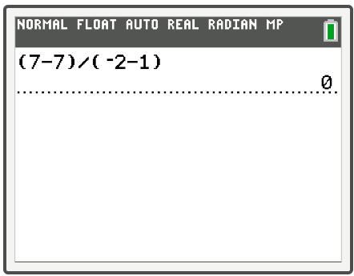
Example 4: Technology

Slide 42
Properties: Slopes of Horizontal and
Vertical Lines
Horizontal lines, which can be written in the form y = c, have a slope of 0.
Vertical lines, which can be written in the form x = c, have an undefined slope.

Slide 43

Example 5: Calculating the Slope of a Line—Slide 1
Determine the slopes of the lines defined by the following equations.
​$4x−3y=12$
​$2x+7y=9$
​$x=−\frac{3}{4}$
​$y=9$

Slide 44
Note 1
Intercepts are often good points to use in calculating the slope, since they have at least one coordinate equal to zero.

Slide 45
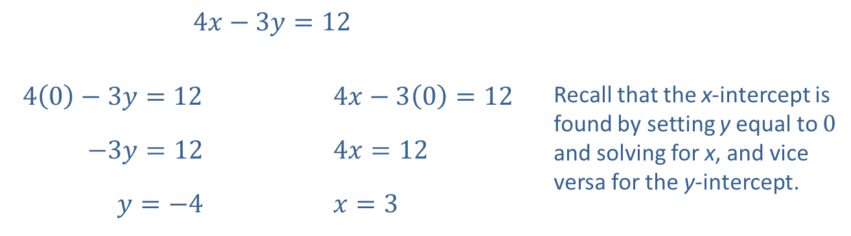
Example 5: Calculating the Slope of a Line—Slide 2
Solution
​First, we find two points on the line by calculating the intercepts.
​
​$4x−3y=12$
​$4\left(0\right)−3y=12$ |  | ​$4x−3\left(0\right)=12$ | Recall that the x-intercept is found by setting y equal to 0 and solving for x, and vice versa for the y-intercept.
​$−3y=12$ |  | ​$4x=12$
​$y=−4$ |  | ​$x=3$

Slide 46

Example 5: Calculating the Slope of a Line—Slide 3
​y-intercept: $(0,−4)$
​x-intercept: $(3,0)$
​slope $=\frac{−4−0}{0−3}=\frac{−4}{−3}=\frac{4}{3}$
Once we have two points, we apply the slope formula.

Slide 47
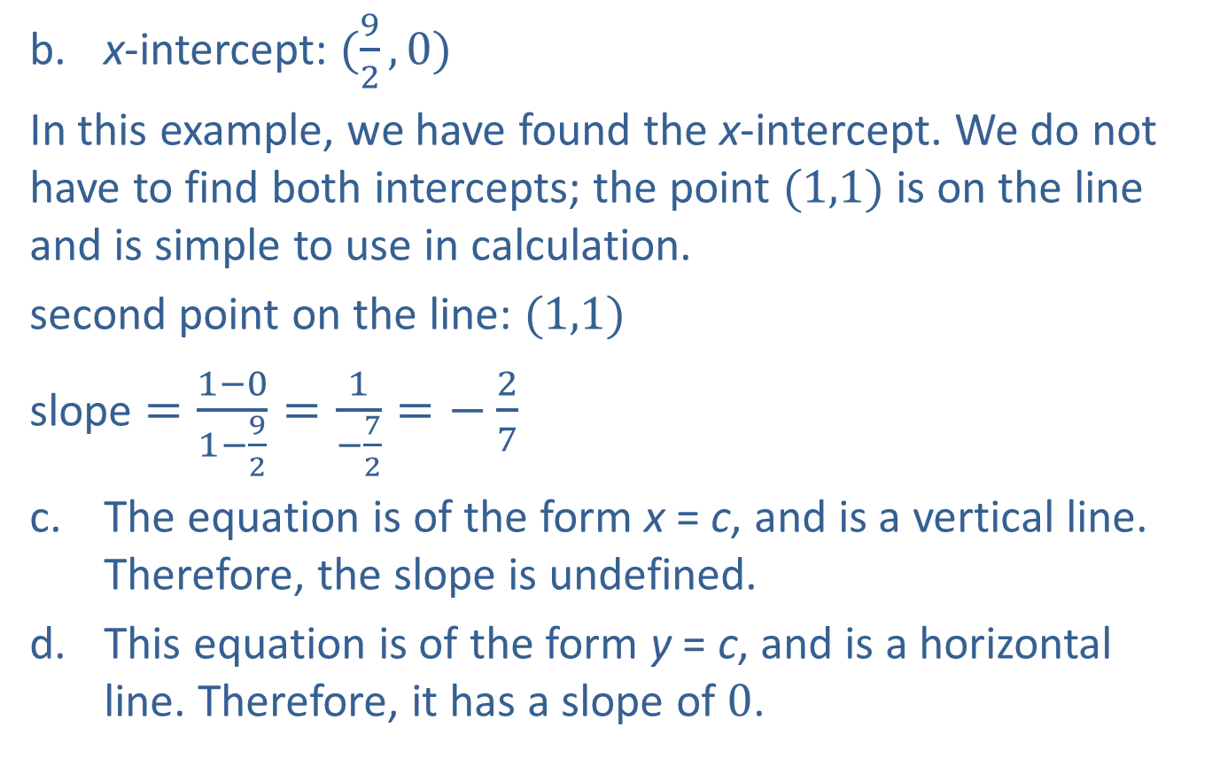
Example 5: Calculating the Slope of a Line—Slide 4
​x-intercept: $(\frac{9}{2},0)$
In this example, we have found the x-intercept. We do not have to find both intercepts; the point $(1,1)$ is on the line and is simple to use in calculation.
​second point on the line: $(1,1)$
​slope $=\frac{1−0}{1−\frac{9}{2}}=\frac{1}{−\frac{7}{2}}=−\frac{2}{7}$
​The equation is of the form x = c, and is a vertical line. Therefore, the slope is undefined.
​This equation is of the form y = c, and is a horizontal line. Therefore, it has a slope of 0.

Slide 48
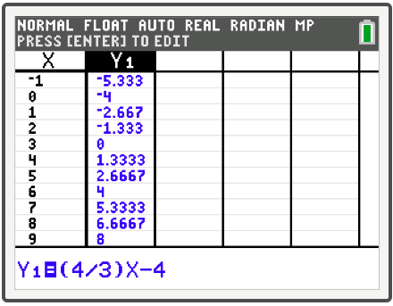
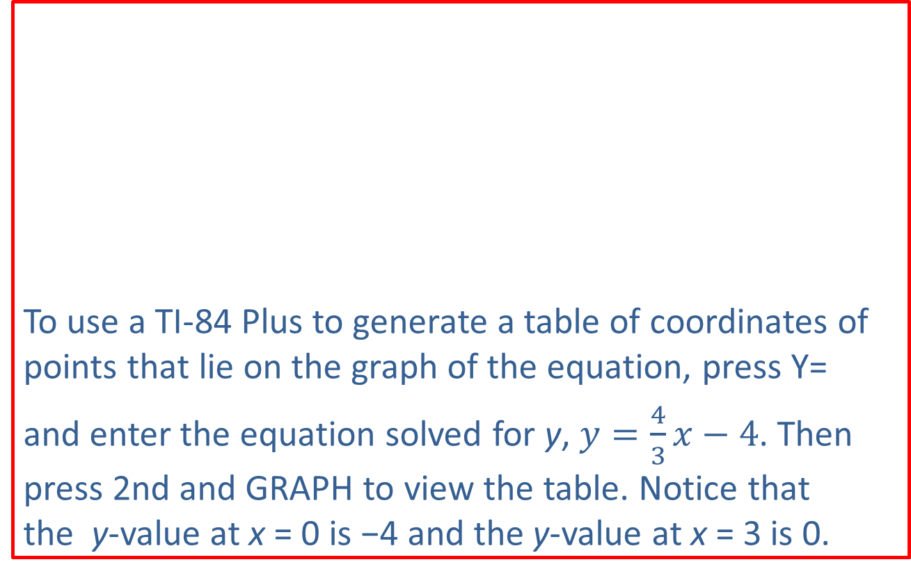
Example 5: Technology
To use a TI-84 Plus to generate a table of coordinates of points that lie on the graph of the equation, press Y=
and enter the equation solved for y, $y=\frac{4}{3}x−4$. Then press 2nd and graph to view the table. Notice that the y-value at x = 0 is −4 and the y-value at x = 3 is 0.

Slide 49
Definition: Slope-Intercept Form of a Line
If the equation of a nonvertical line in x and y is solved for y, the result is an equation in slope-intercept form.
y = mx + b
The constant m is the slope of the line, and the
y-intercept of the line is (0, b).
If the variable x does not appear in the equation, the slope is 0 and the equation is simply of the form y = b and is a horizontal line.

Slide 50
Example 6: Slope-Intercept Form of a Line—Slide 1
Use the slope-intercept form of the line to graph the equation 4x – 3y = 6.

Slide 51
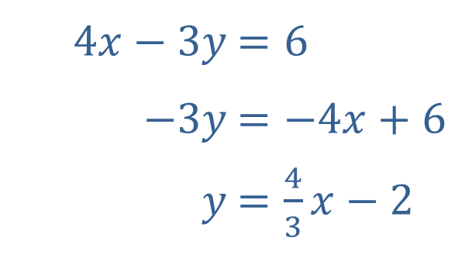
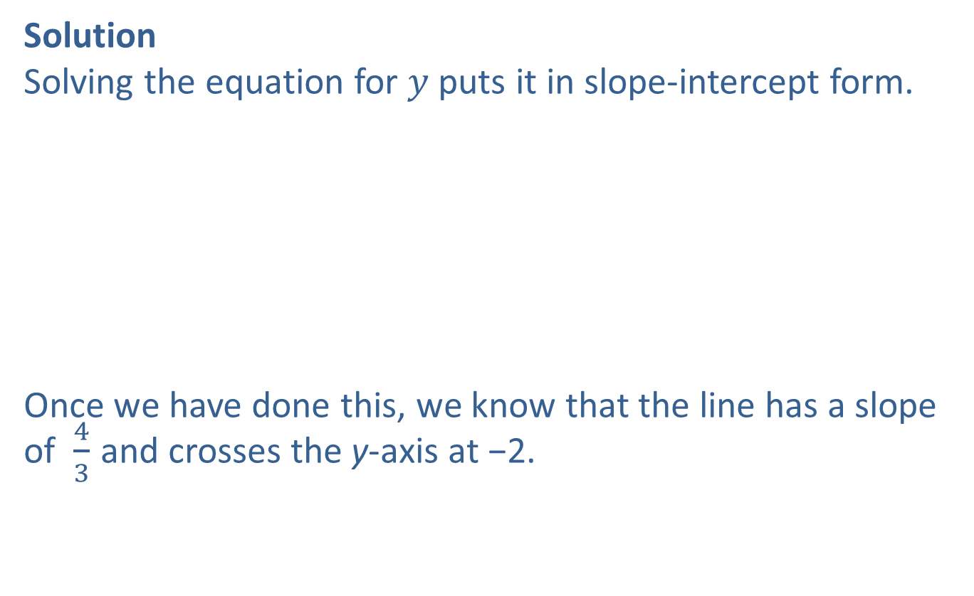
Example 6: Slope-Intercept Form of a Line—Slide 2
Solution
Solving the equation for $y$ puts it in slope-intercept form.
Once we have done this, we know that the line has a slope of $\frac{4}{3}$ and crosses the y-axis at −2.
​
​$4x−3y$ | ​$=6$
​$−3y$ | ​$=−4x+6$
​$y$ | ​$=\frac{4}{3}x−2$

Slide 52
Example 6: Slope-Intercept Form of a Line—Slide 3
Immediately, we can plot the y-intercept.
A second point can now be found by using the fact that slope is "rise over run." This means a second point must lie 4 units up and 3 units to the right, i.e. at (3, 2).
Alternatively, we could locate a second point by moving down 4 units and moving to the left 3 units.

Slide 53
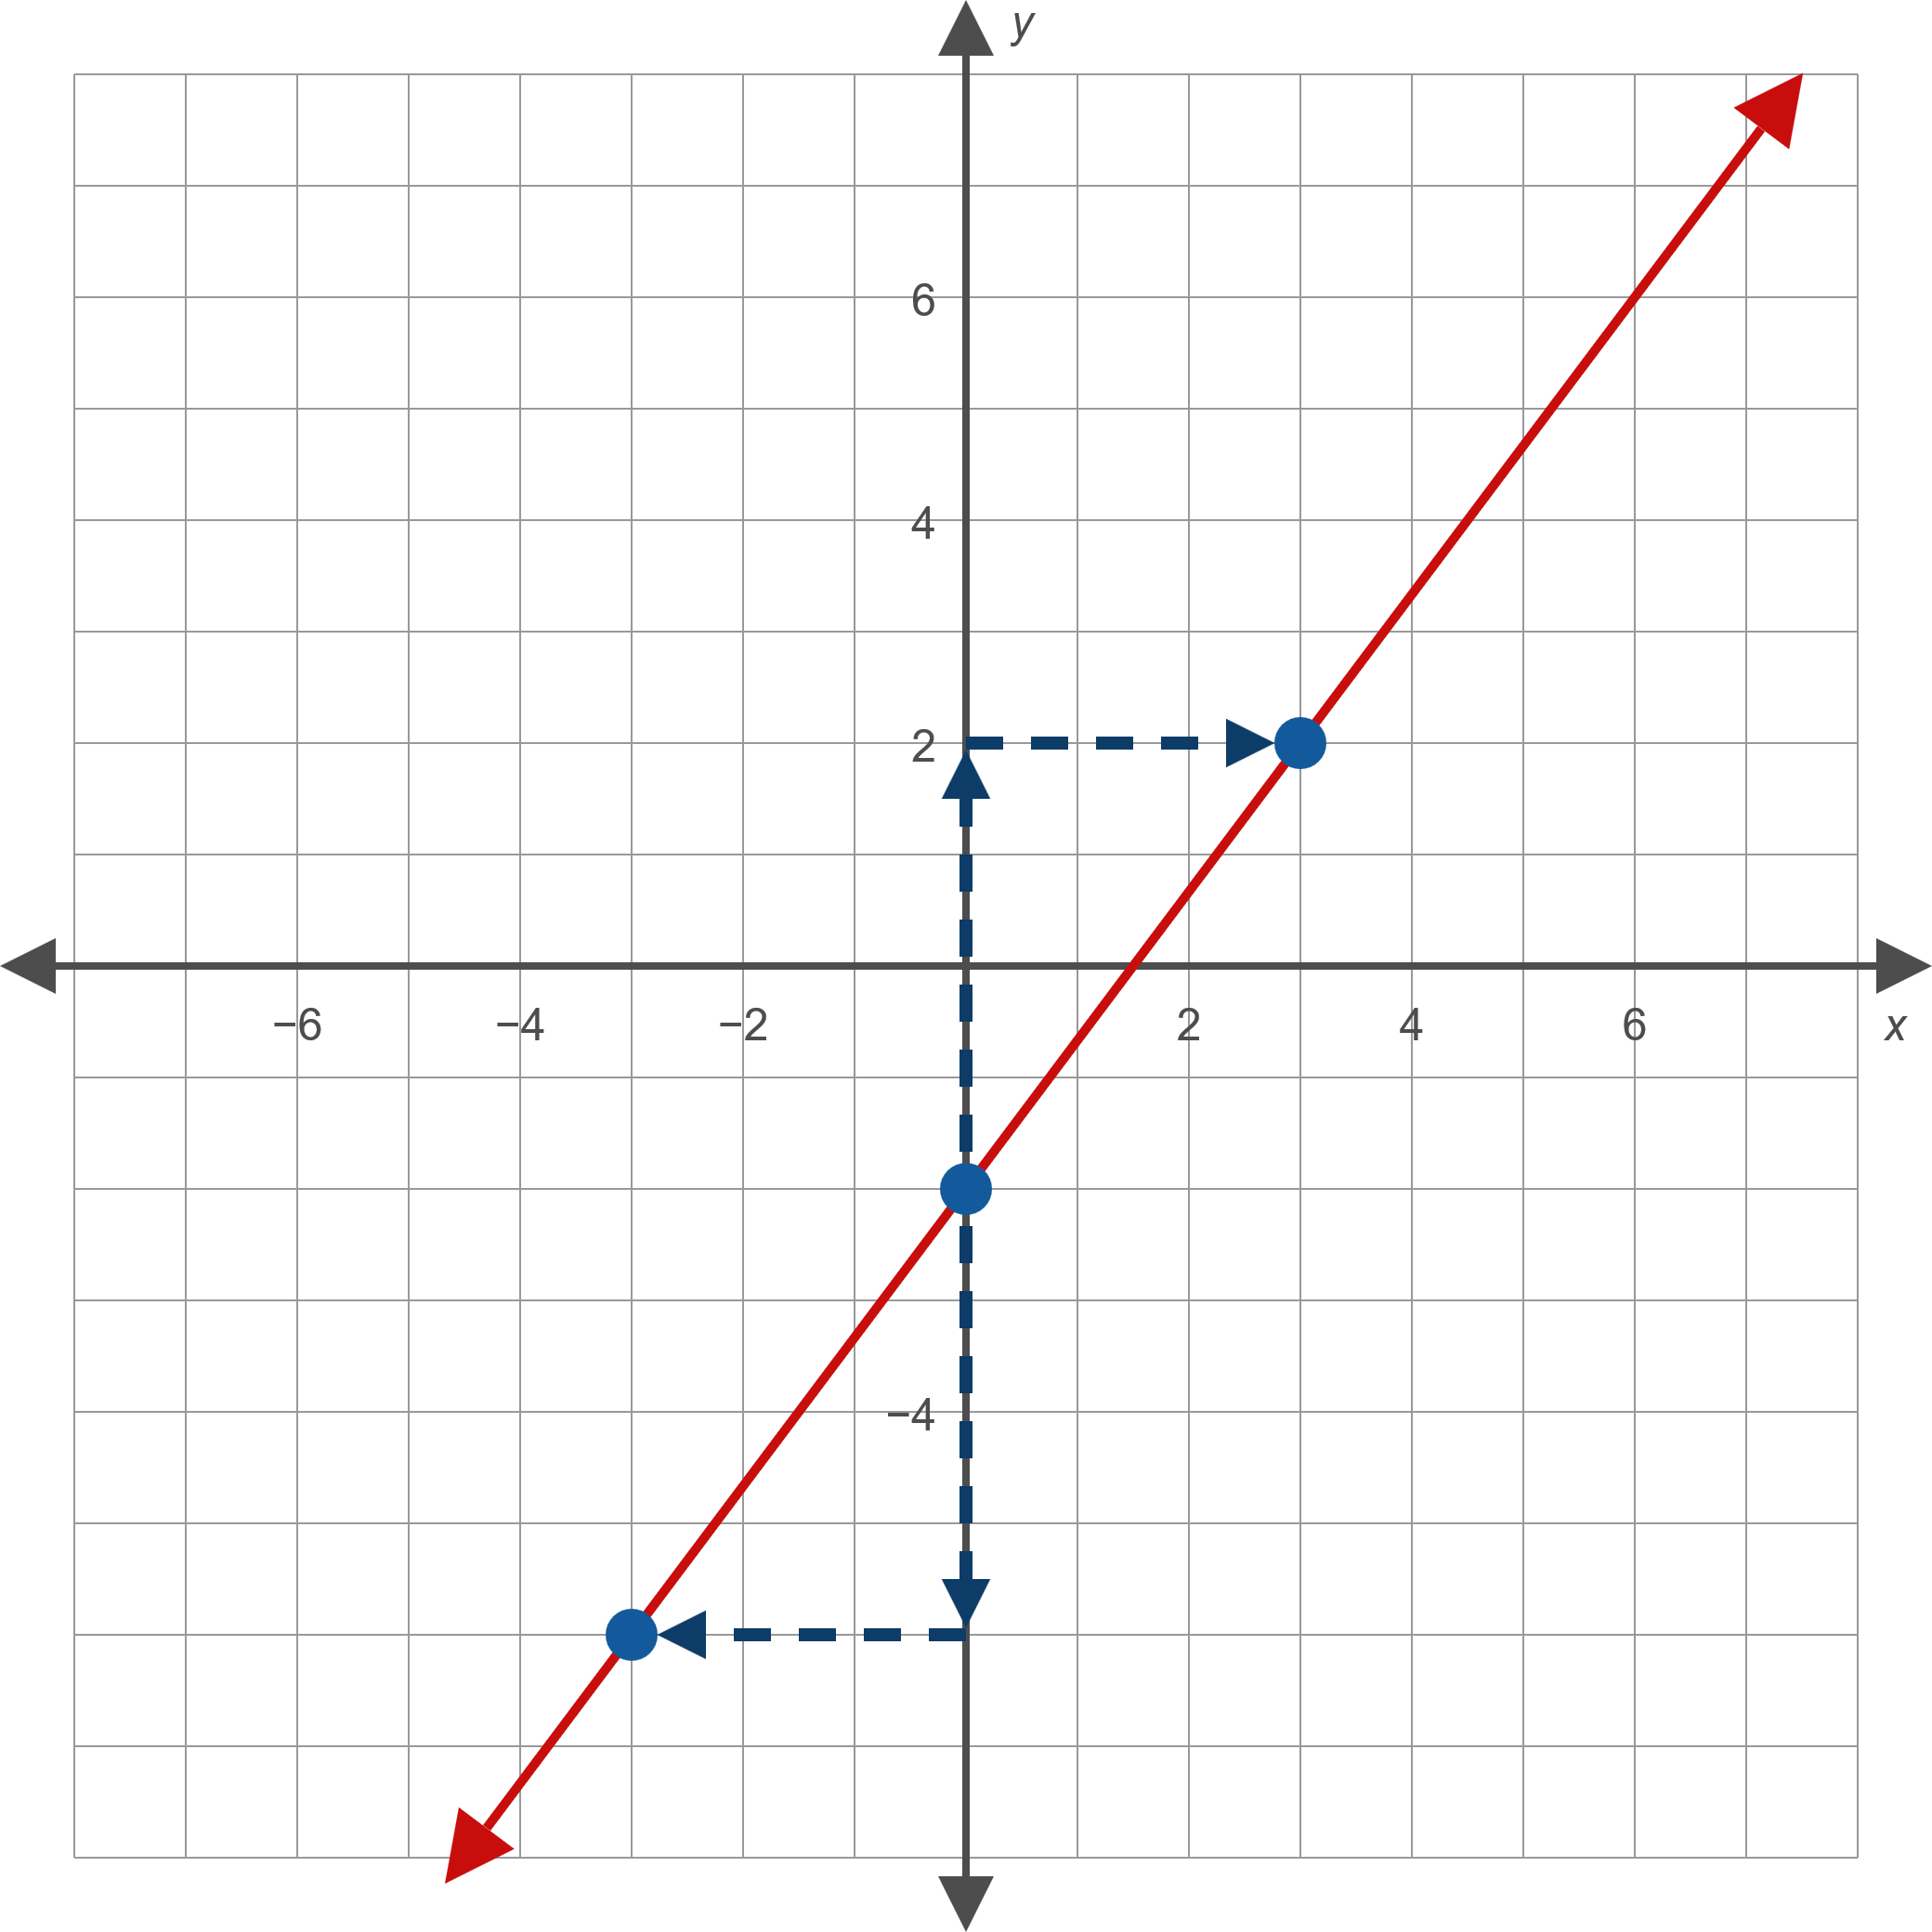
Example 6: Slope-Intercept Form of a Line—Slide 4
Figure 12

Slide 54

Example 7: Slope-Intercept Form of a Line—Slide 1
Find the equation of the line that passes through the point (0, 3) and has a slope of $−\frac{3}{5}$. Then graph the line.

Slide 55
Note 2
If a line is already in slope-intercept form, it's usually easiest to graph the line by plotting the y-intercept and then using the slope to find a second point.

Slide 56
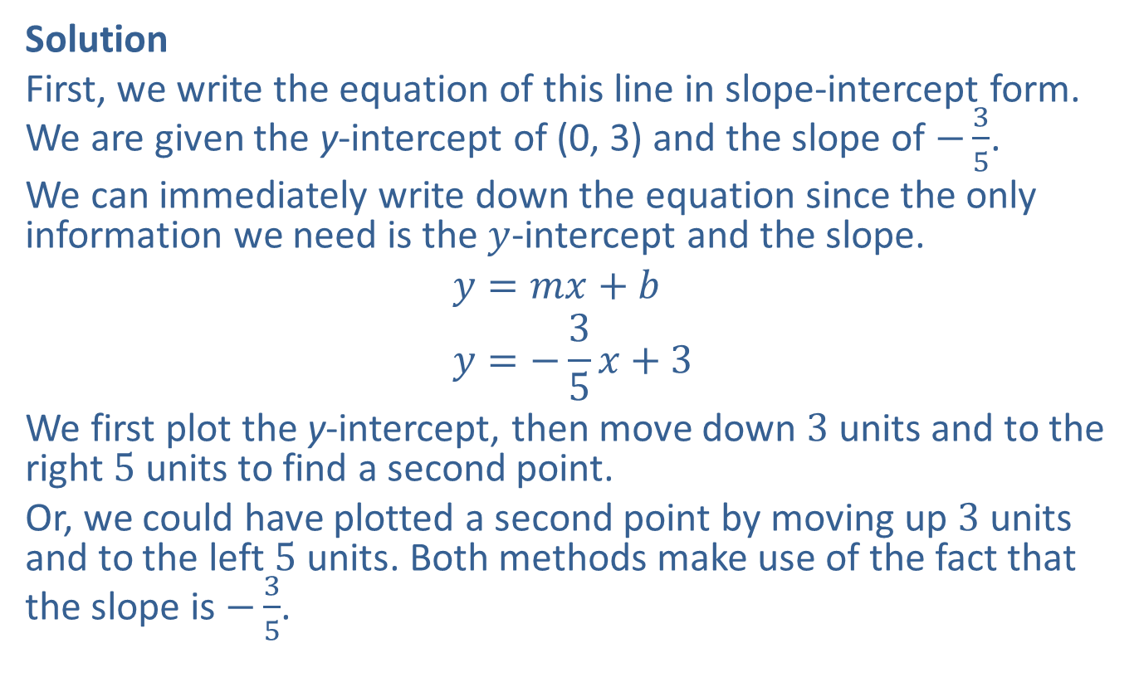
Example 7: Slope-Intercept Form of a Line—Slide 2
Solution
First, we write the equation of this line in slope-intercept form. We are given the y-intercept of (0, 3) and the slope of $−\frac{3}{5}$.
We can immediately write down the equation since the only information we need is the $y$-intercept and the slope.
$$y=mx+b \\ y=−\frac{3}{5}x+3$$
We first plot the y-intercept, then move down 3 units and to the right 5 units to find a second point.
Or, we could have plotted a second point by moving up 3 units and to the left 5 units. Both methods make use of the fact that the slope is $−\frac{3}{5}$.

Slide 57
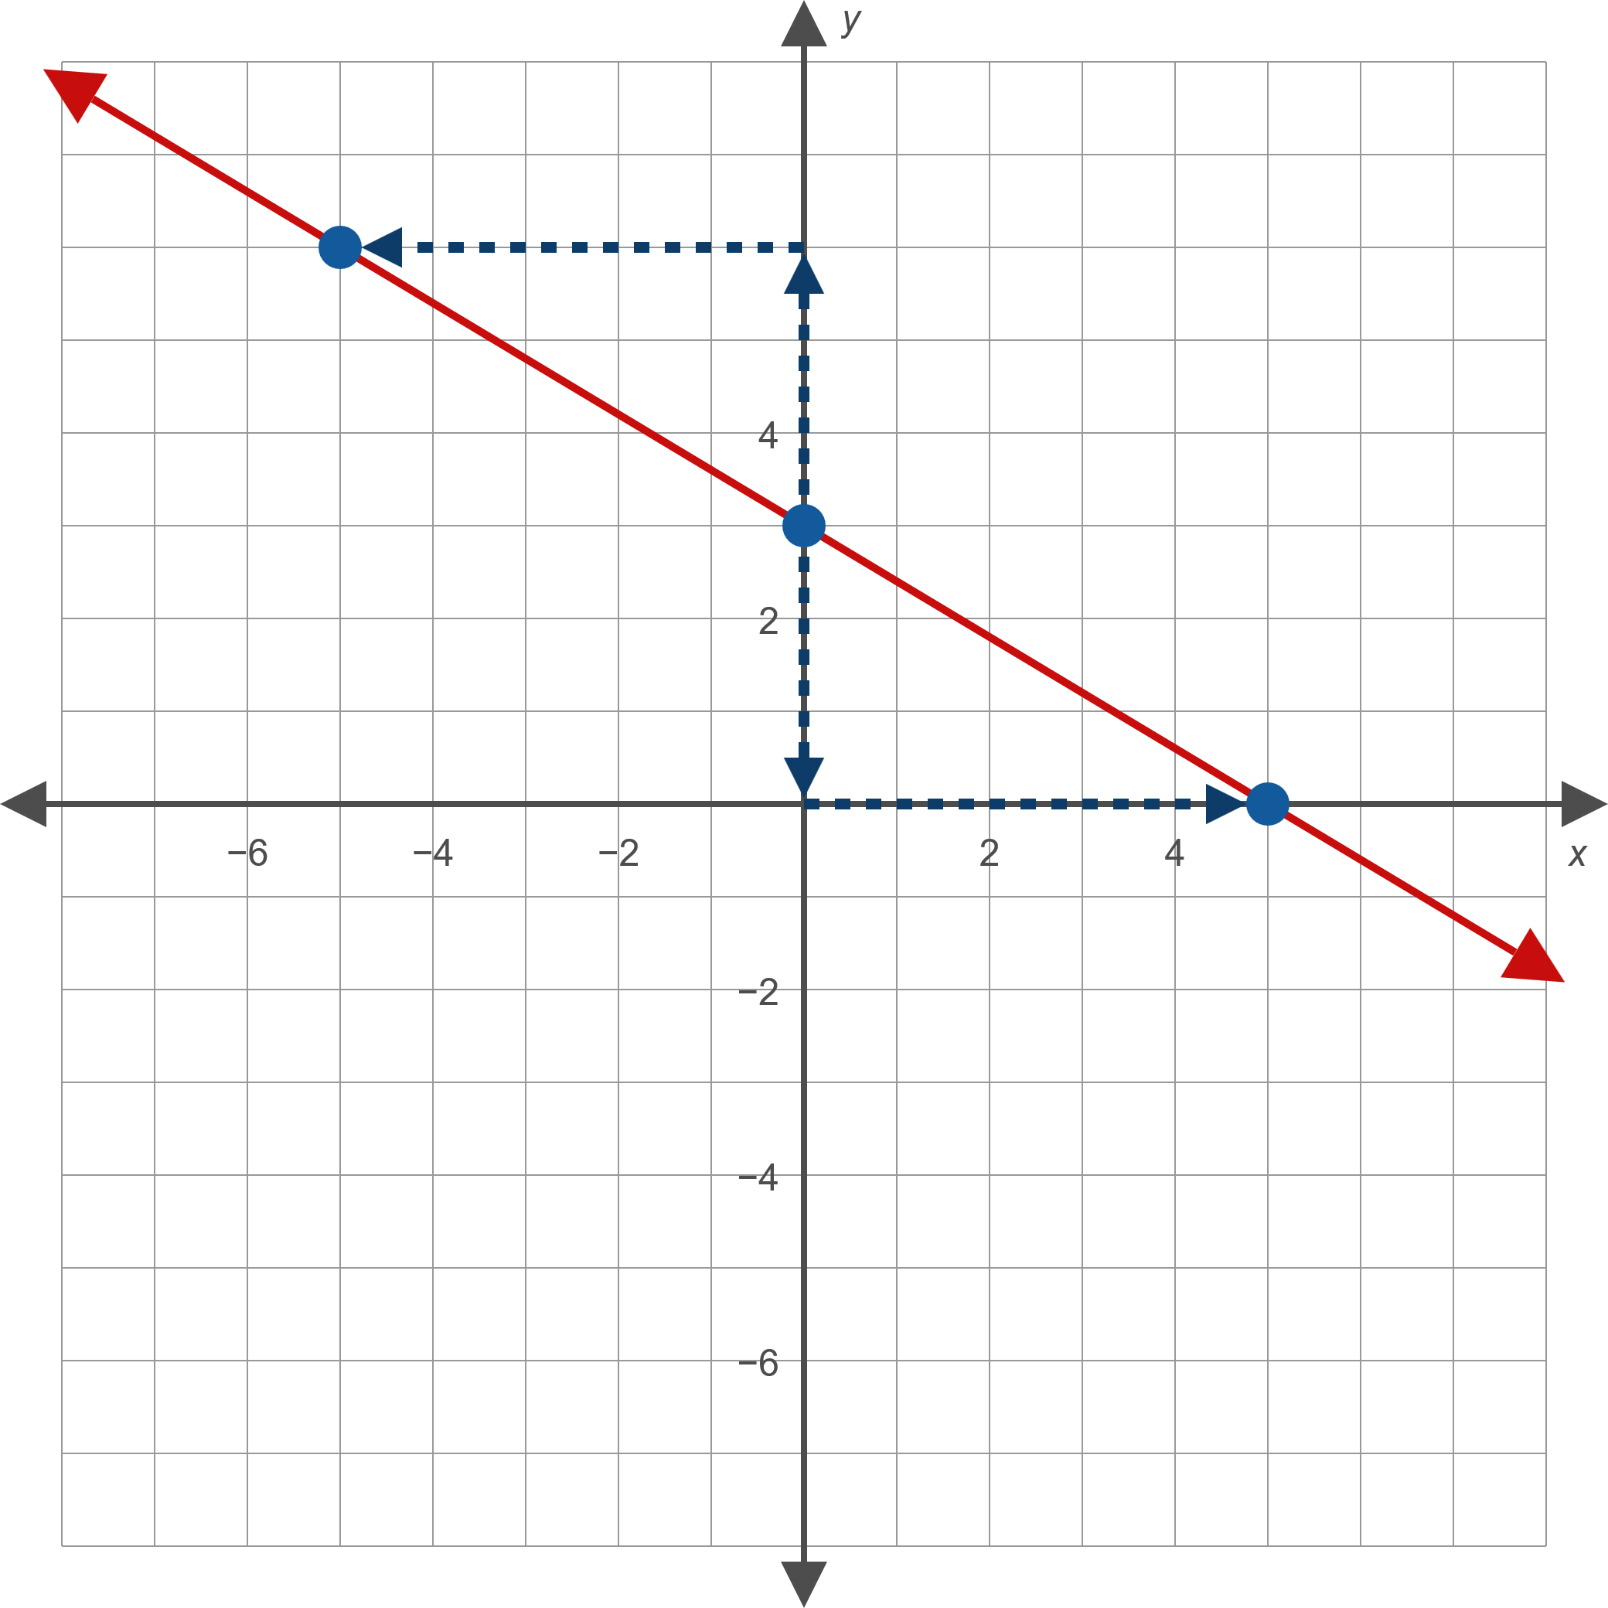
Example 7: Slope-Intercept Form of a Line—Slide 3
Figure 13

Slide 58
Definition: Point-Slope Form of a Line
The point-slope form of the equation for the line passing through the point (x ₁, y ₁) with slope m is
y − y ₁ = m(x − x ₁).
Note that m, x ₁ , and y ₁ are all constants, while x and y are variables. Note also that since a line, by definition, has slope m, vertical lines cannot be described in this form.

Slide 59
Example 8: Using the Point-Slope Form of a Line—Slide 1
Find the equation, in slope-intercept form, of the line that passes through the point (−2, 5) with slope 3.

Slide 60
Note 3
When asked for an equation in either standard form or slope-intercept form, it's frequently easiest to write the point-slope form and then convert the equation to the desired form.

Slide 61

Example 8: Using the Point-Slope Form of a Line—Slide 2
Solution
Since we are given the slope of the line and a point on the line, we can substitute directly into the point-slope form, then solve for $y$ to obtain the slope-intercept form.

Slide 62
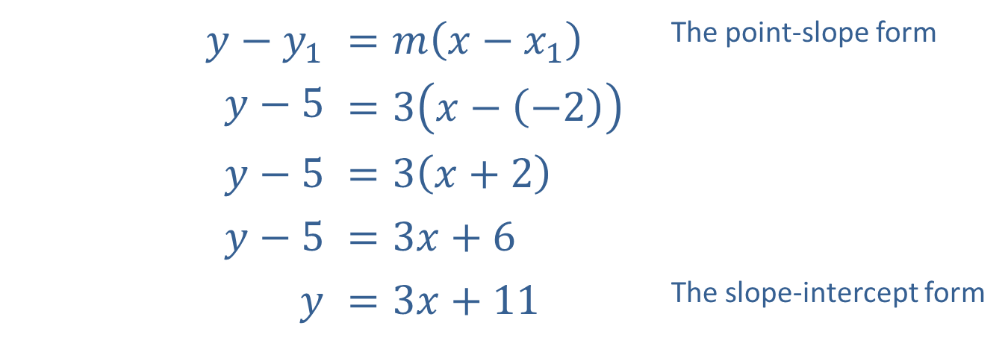
Example 8: Using the Point-Slope Form of a Line—Slide 3
​$y−y_{1}$ | ​$=m\left(x−x_{1}\right)$ | The point-slope form
​$y−5$ | ​$=3\left(x−\left(−2\right)\right)$
​$y−5$ | ​$=3\left(x+2\right)$
​$y−5$ | ​$=3x+6$
$$y$$ | ​$=3x+11$ | The slope-intercept form

Slide 63
Example 9: Using the Point-Slope Form of a Line—Slide 1
Find the equation, in slope-intercept form, of the line that passes through the two points (−3, −2) and (1, 6).

Slide 64
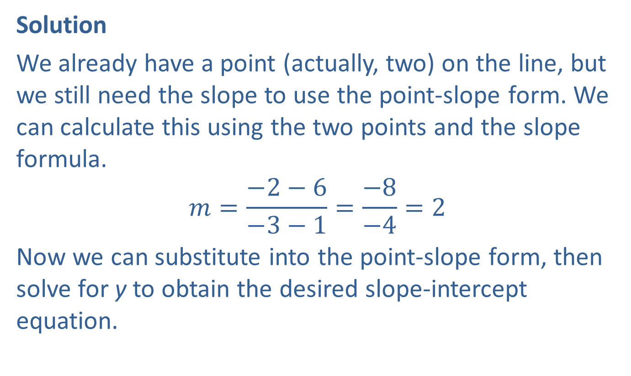
Example 9: Using the Point-Slope Form of a Line—Slide 2
Solution
We already have a point (actually, two) on the line, but we still need the slope to use the point-slope form. We can calculate this using the two points and the slope formula.
$$m=\frac{−2−6}{−3−1}=\frac{−8}{−4}=2$$
Now we can substitute into the point-slope form, then solve for y to obtain the desired slope-intercept equation.

Slide 65
Example 9: Using the Point-Slope Form of a Line—Slide 3
​ | y − y ₁ = m(x − x ₁)
​ | y − 6 = 2(x − 1)
​ | ​ y − 6 = 2x − 2
 | y = 2x + 4
Note that no matter which point we substitute into the point-slope form, the resulting slope-intercept equation is the same.

Slide 66
Theorem: Slopes of Parallel Lines
Two nonvertical lines with slopes m ₁ and m ₂ and are parallel if and only if m ₁ = m ₂. Also, two vertical lines (with undefined slopes) are always parallel to each other.

Slide 67

Example 10: Finding Equations of Parallel Lines—Slide 1
Find equations for two lines parallel to each of the given lines.
​$y=−\frac{2}{3}x+4$
​$10x−2y=14$

Slide 68
Note 4
When given a line in standard form, it is usually easiest to find its slope by rewriting it in slope-intercept form than to find two points on the line and calculate the slope directly.

Slide 69

Example 10: Finding Equations of Parallel Lines—Slide 2
Solution
​This line is already in slope-intercept form, so we immediately know the slope of the line is $−\frac{2}{3}$. Any line parallel to this one must also have a slope of $−\frac{2}{3}$. To find two parallel lines, we can simply change the value of the $y$-intercept.
​Two such examples are $y=−\frac{2}{3}x+1$ and
$y=−\frac{2}{3}x−10$.

Slide 70

Example 10: Finding Equations of Parallel Lines—Slide 3
​This line is in standard form. Our first step is to rewrite it in slope-intercept form.​
​$10x−2y$ | ​$=14$
​$−2y$ | ​$=−10x+14$ | Subtract 10x from both sides.
$$y$$ | ​$=\frac{−10}{−2}x+\frac{14}{−2}$ | Divide each term by −2.
$$y$$ | ​$=5x−7$ | Simplify.

Slide 71
Example 10: Finding Equations of Parallel Lines—Slide 4
​Again, once the line is in slope-intercept form, we can change the y-intercept to find two lines parallel to the original line.
​Two such examples are y = 5x and y = 5x + 8.

Slide 72
Example 11: Finding Equations of Parallel Lines—Slide 1
Find the equation, in slope-intercept form, for the line that is parallel to the line 3x + 5y = 23 and which passes through the point (−2, 1).

Slide 73


Example 11: Finding Equations of Parallel Lines—Slide 2
Solution
Again, our first step is to write the initial equation in slope-intercept form.
​
This tells us that the slope of the line whose equation we seek is $−\frac{3}{5}$. We also know that the line is to pass through (−2, 1), so we can use the point-slope form to obtain the desired equation.
​$3x+5y$ | ​$=23$
​$5y$ | ​$=−3x+23$
​$y$ | ​$=−\frac{3}{5}x+\frac{23}{5}$

Slide 74

Example 11: Finding Equations of Parallel Lines—Slide 3
​$y−y_{1}$ | ​$=m\left(x−x_{1}\right)$ | Begin by substituting our known information into the point-slope form: $m=−\frac{3}{5}$, $\left(x_{1},y_{1}\right)=\left(−2,1\right)$.
​$y−1$ | ​$=−\frac{3}{5}\left(x−\left(−2\right)\right)$
​$y−1$ | ​$=−\frac{3}{5}\left(x+2\right)$
​$y−1$ | ​$=−\frac{3}{5}x−\frac{6}{5}$ | The instructions asked for the equation in slope-intercept form, so we solve for y to obtain the final answer.
$$y$$ | ​$=−\frac{3}{5}x−\frac{1}{5}$

Slide 75

Example 11: Technology
The screen displays the graphs of both
3x + 5y = 23 and the parallel line passing through (−2, 1). To view multiple graphs on aTI-84 Plus, press Y= and enter the equations in terms of y. Then press graph.

Slide 76
Example 12: Identifying a Quadrilateral—Slide 1
Determine if the quadrilateral (four-sided figure) in Figure 15 is a parallelogram (a quadrilateral in which both pairs of opposite sides are parallel).

Slide 77

Example 12: Identifying a Quadrilateral—Slide 2
Figure 15

Slide 78
Example 12: Identifying a Quadrilateral—Slide 3
Solution
The four vertices are plotted in Figure 15, and the sides of the quadrilateral drawn. The figure is a parallelogram if the left and right sides are parallel and the top and bottom sides are parallel.

Slide 79

Example 12: Identifying a Quadrilateral—Slide 4
The slopes of the left and right sides are, respectively,
$\frac{4−2}{−3−\left(−4\right)}=2$ and $\frac{3−1}{2−1}=2$,
and the slopes of the top and bottom sides are, respectively,
$\frac{4−3}{−3−2}=−\frac{1}{5}$ and $\frac{2−1}{−4−1}=−\frac{1}{5}$.
Thus, the figure is indeed a parallelogram.

Slide 80

Theorem: Slopes of Perpendicular Lines
Suppose m ₁ and m ₂represent the slopes of two lines, neither of which is vertical. The two lines are perpendicular if and only if $m_{1}=−\frac{1}{m_{2}}$ (equivalently, $m_{2}=−\frac{1}{m_{1}}$ and $m_{1}m_{2}=−1$). If one of two perpendicular lines is vertical, the other is horizontal, and the slopes are, respectively, undefined and zero.

Slide 81

Example 13: Finding Equations of Perpendicular Lines—Slide 1
For each line given, find the equation of a perpendicular line.
​$y=−\frac{4}{9}x+2$
​The line passing through the points (−1, 3) and
(4, 1).

Slide 82

Example 13: Finding Equations of Perpendicular Lines—Slide 2
Solution
​This line is in slope-intercept form, so we can immediately identify the slope as $−\frac{4}{9}$. The slope of any perpendicular line must equal $\frac{9}{4}$, the negative reciprocal of the original slope. Thus, one solution is $y=\frac{9}{4}x$.

Slide 83

Example 13: Finding Equations of Perpendicular Lines—Slide 3
​Since we only need the slope of the original line, there is no need to find its equation; we can calculate the slope directly from the given points.
​$m=\frac{1−3}{4−\left(−1\right)}=−\frac{2}{5}$
  ​
  Again, the slope of a line perpendicular to the line through the given points must have a slope equal to the negative reciprocal of $−\frac{2}{5}$, which is $\frac{5}{2}$. One perpendicular line is $y=\frac{5}{2}x+6$.

Slide 84
Example 14: Finding Equations of Perpendicular Lines—Slide 1
Find the equation, in standard form, of the line that passes through the point (−3, 13) and is perpendicular to the line y = −7.

Slide 85
Note 5
Remember that if you encounter a horizontal or vertical line, you cannot use the slope formulas to find a perpendicular line.

Slide 86
Example 14: Finding Equations of Perpendicular Lines—Slide 2
Solution
The line y = −7 is a horizontal line, and hence any line perpendicular to it must be a vertical line, having the form x = c. Since the perpendicular line must pass through the point (−3, 13), the desired solution is
x = −3.

Slide 87

Example 14: Technology

Slide 88

Example 15: Identifying Parallel and Perpendicular Lines—Slide 1
For each pair of lines, determine if the lines are parallel, perpendicular, or neither.
​$3x−7y=12$ and $14x+6y=−5$
​$y−\frac{263}{4}=9\left(x+\frac{77}{13}\right)$ and the line passing through the points (0, 4) and (2, 22)
​$y=\frac{3}{4}x+1$ and $y=\frac{4}{3}x−5$

Slide 89
Note 6
A pair of lines cannot be both parallel and perpendicular.

Slide 90


Example 15: Identifying Parallel and Perpendicular Lines—Slide 2
Solution
​Both equations are in standard form, so our first step is to rewrite them in slope-intercept form to identify the slopes.
​
​
Are the lines parallel?
​No, the slopes are not equal.
​Are the lines perpendicular?
​Yes, the slopes are negative reciprocals of each other.
​Thus, the lines are perpendicular.
​$3x−7y$ | ​$=12$
​$−7y$ | ​$=−3x+12$
​$y$ | ​$=\frac{3}{7}x−\frac{12}{7}$
​$14x+6y$ | ​$=−5$
​$6y$ | ​$=−14x−5$
​$y$ | ​$=−\frac{7}{3}x−\frac{5}{6}$

Slide 91

Example 15: Technology

Slide 92

Example 15: Identifying Parallel and Perpendicular Lines—Slide 3
​One line is in point-slope form, so we can see its slope is 9. We calculate the slope of the other line using the two points given.
​$m=\frac{22−4}{2−0}=\frac{18}{2}=9$
​
Are the lines parallel?
​Yes, the slopes are equal.
​
Thus, the lines are parallel. (Note that we didn’t need to find the equation of the second line.)

Slide 93

Example 15: Identifying Parallel and Perpendicular Lines—Slide 4
​Both lines are in slope-intercept form, so we can read off the slopes: $\frac{3}{4}$ and $\frac{4}{3}$.
​Are the lines parallel?
​ No, the slopes are not equal.
​Are the lines perpendicular?
​No, the slopes are reciprocals, not negative reciprocals.
​
Thus, the lines are neither parallel nor perpendicular.

