Slide 1
Section 1.R.10
Introduction to Trigonometric Functions

Slide 2
Definition: Radian Measure—Slide 1
Let θ (the Greek letter theta) be an angle at the center of a circle of radius 1 (the unit circle), as shown in Figure 1. The measure of θ in radians (abbreviated as rad) is the length of that portion of the circle subtended by θ , which is the portion of the circumference shown in red in Figure 1. (Subtended, in mathematics, can be taken to mean opposite of, and stretching between. An arc of a circle is subtended by its central angle and, conversely, a central angle is subtended by an arc of the circle.) Note that the unit of length measurement is immaterial. As long as the circle has a radius of 1 (unit), the length of the subtended portion of the circle (in the same units) is defined to be the radian measure of the angle.

Slide 3
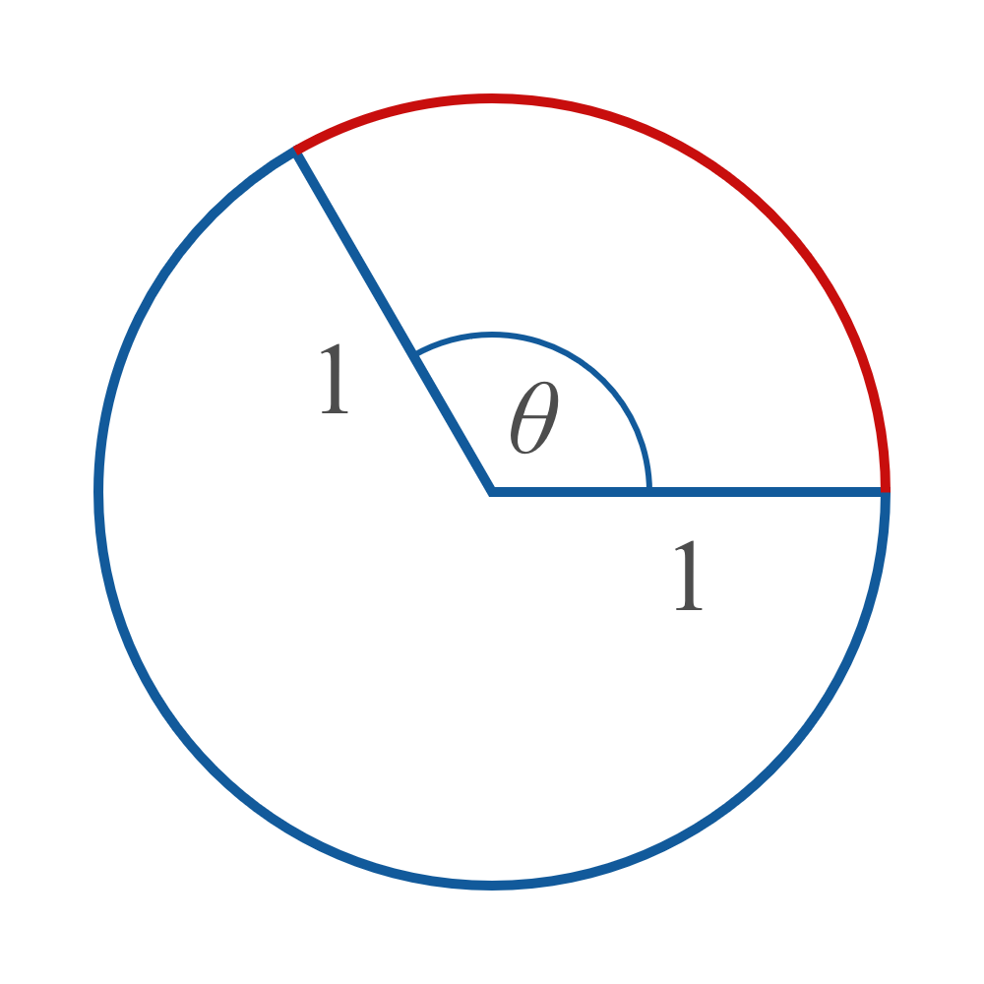
Definition: Radian Measure—Slide 2
Figure 1: Radian measure of θ

Slide 4
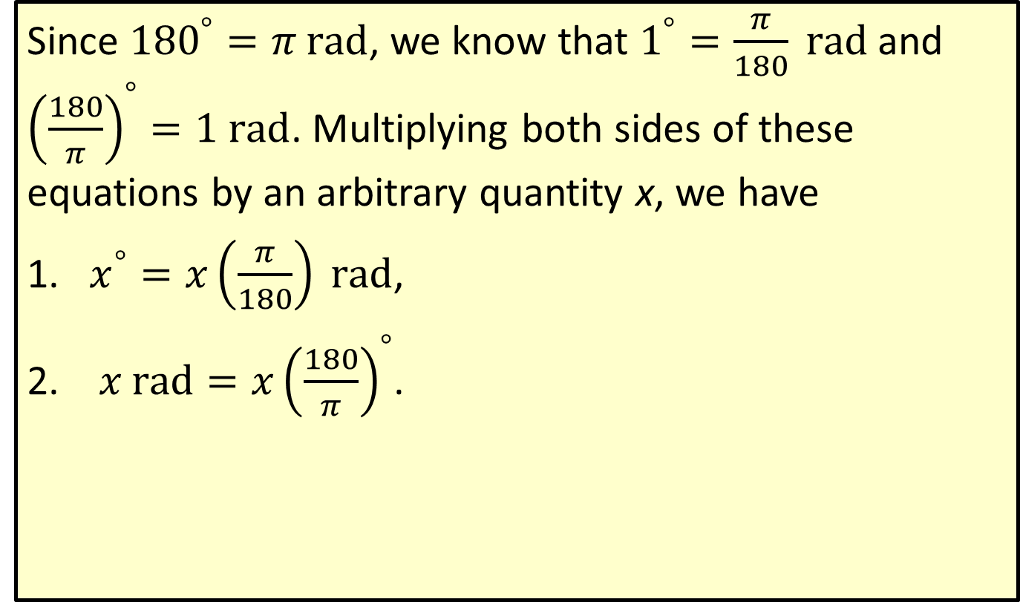
Formula: Angle Measurement Conversion
Since ${180}^{°}=π \text{rad}$, we know that $1^{°}=\frac{π}{180} \text{rad}$ and ${\left(\frac{180}{π}\right)}^{°}=1 \text{rad}$. Multiplying both sides of these equations by an arbitrary quantity x, we have
​$x^{°}=x\left(\frac{π}{180}\right) \text{rad}$,
​ $x rad=x{\left(\frac{180}{π}\right)}^{°}$.

Slide 5

Example 1: Converting between Degrees and Radians—Slide 1
Convert the following angle measures as directed.
​Express $\frac{π}{3}$rad in degrees.
​Express ${270}^{°}$ in radians.
​Express −2 rad in degrees.

Slide 6

Example 1: Converting between Degrees and Radians—Slide 2
Solution
​$\frac{π}{3} \text{rad}=\left(\frac{π}{3}\right){\left(\frac{180}{π}\right)}^{°}={60}^{°}$
​${270}^{°}=\left(270\right)\left(\frac{π}{180}\right) \text{rad}=\frac{3π}{2} \text{rad}$
​$−2 \text{rad}=\left(−2\right){\left(\frac{180}{π}\right)}^{°}≈{−114.592}^{°}$

Slide 7
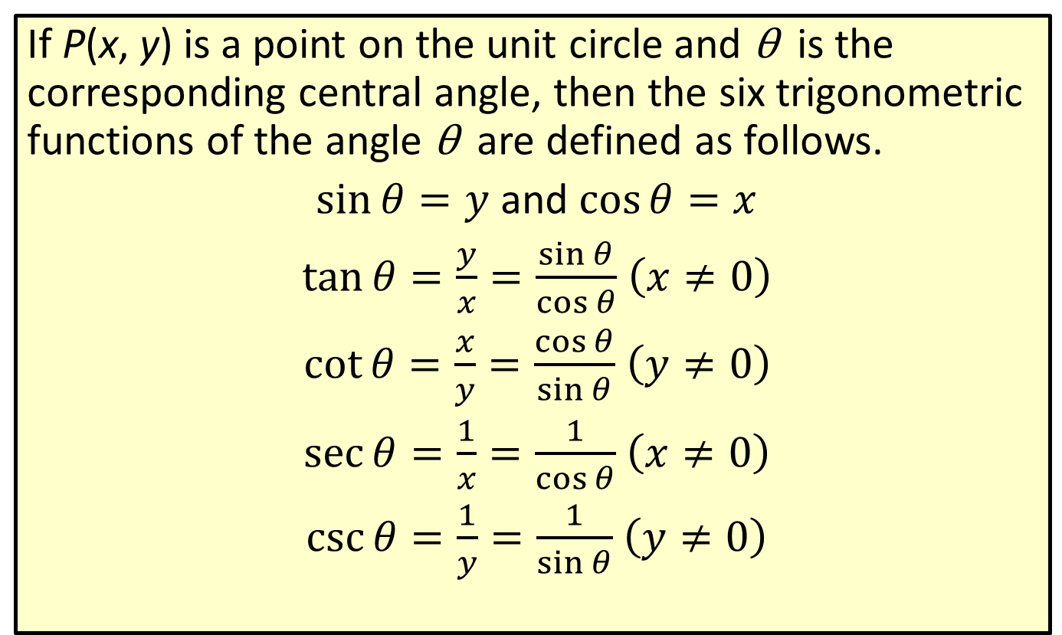
Definition: The Trigonometric Functions and the Unit Circle
If P(x, y) is a point on the unit circle and θ is the corresponding central angle, then the six trigonometric functions of the angle θ are defined as follows.
$\sin{θ}=y$ and $\cos{θ}=x$
$\tan{θ}=\frac{y}{x}=\frac{\sin{θ}}{\cos{θ}}$ $\left(x≠0\right)$
$\cot{θ}=\frac{x}{y}=\frac{\cos{θ}}{\sin{θ}}$ $\left(y≠0\right)$
$\sec{θ}=\frac{1}{x}=\frac{1}{\cos{θ}}$ $\left(x≠0\right)$
$\csc{θ}=\frac{1}{y}=\frac{1}{\sin{θ}}$ $\left(y≠0\right)$

Slide 8
Note
If x = 0, then tan θ and sec θ are undefined. Also, if y = 0, then cot θ and csc θ are undefined.

Slide 9
Example 2: Evaluating Trigonometric Functions Using the Unit Circle—Slide 1
Use the given figure and the definitions to find the values of sin θ, cos θ, and tan θ for angle θ.

Slide 10
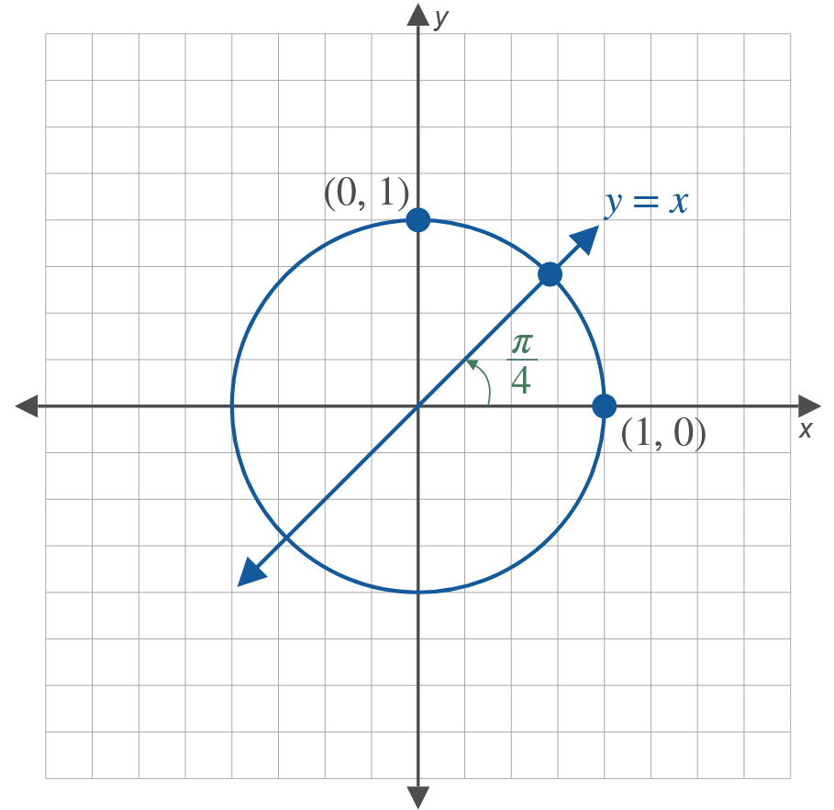
Example 2: Evaluating Trigonometric Functions Using the Unit Circle—Slide 2

Slide 11

Example 2: Evaluating Trigonometric Functions Using the Unit Circle—Slide 3
​$θ=0$
​$θ=\frac{π}{2}$
​$θ=\frac{π}{4}$

Slide 12
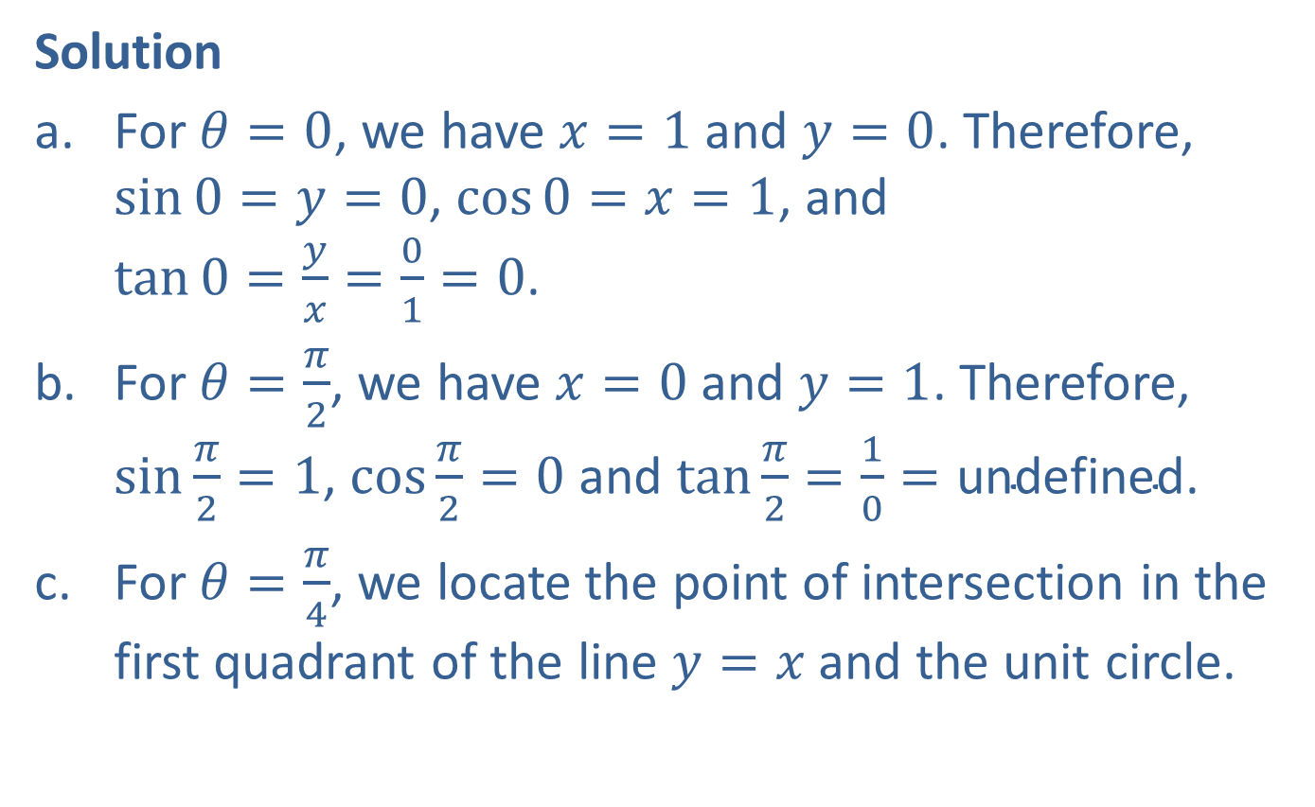
Example 2: Evaluating Trigonometric Functions Using the Unit Circle—Slide 4
Solution
​For $θ=0$, we have $x=1$ and $y=0$. Therefore, $\sin{0}=y=0$, $\cos{0}=x=1$, and $\tan{0}=\frac{y}{x}=\frac{0}{1}=0$.
​For $θ=\frac{π}{2}$, we have $x=0$ and $y=1$. Therefore, $sin⁡\frac{π}{2}=1$, $cos⁡\frac{π}{2}=0$ and $tan⁡\frac{π}{2}=\frac{1}{0}=\text{undefined}$.
​For $θ=\frac{π}{4}$, we locate the point of intersection in the first quadrant of the line $y=x$ and the unit circle.
​

Slide 13
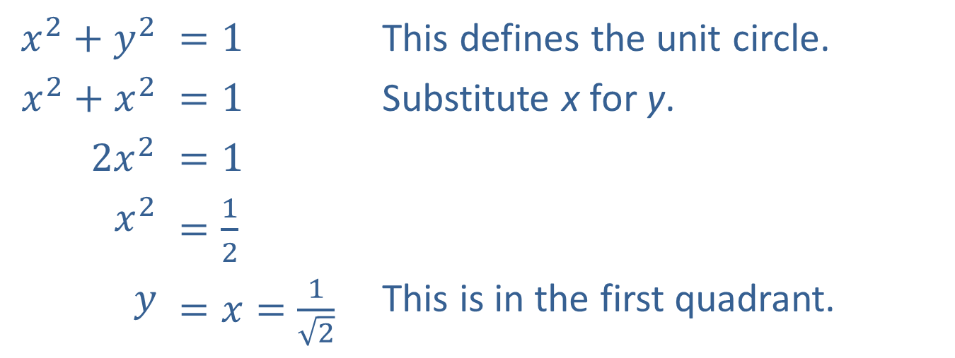
Example 2: Evaluating Trigonometric Functions Using the Unit Circle—Slide 5
​$x^{2}+y^{2}$ | ​$=1$ | This defines the unit circle.
​$x^{2}+x^{2}$ | ​$=1$ | Substitute x for y.
​$2x^{2}$ | ​$=1$
​$x^{2}$ | ​$=\frac{1}{2}$
$$y$$ | ​$=x=\frac{1}{\sqrt{2}}$ | This is in the first quadrant.
Therefore, $\sin{\frac{π}{4}}=\cos{\frac{π}{4}}=\frac{1}{\sqrt{2}}$ and $\tan{\frac{π}{4}}=\frac{y}{x}=1$.

Slide 14
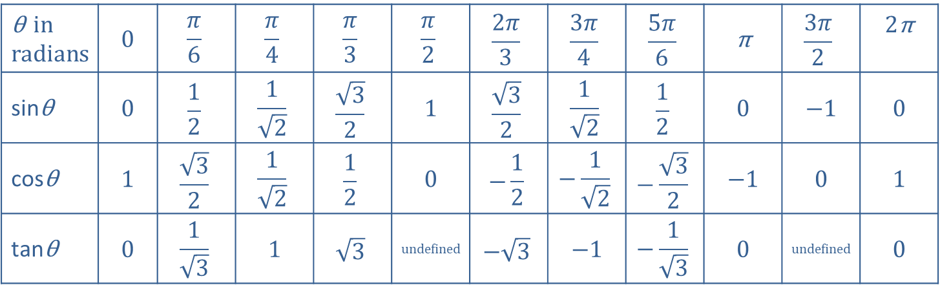
Table 2: Commonly Used Angles
θ in radians | 0 | $$\frac{π}{6}$$ | $$\frac{π}{4}$$ | $$\frac{π}{3}$$ | $$\frac{π}{2}$$ | $$\frac{2π}{3}$$ | $$\frac{3π}{4}$$ | $$\frac{5π}{6}$$ | π | $$\frac{3π}{2}$$ | 2π
sinθ | 0 | $$\frac{1}{2}$$ | $$\frac{1}{\sqrt{2}}$$ | $$\frac{\sqrt{3}}{2}$$ | 1 | $$\frac{\sqrt{3}}{2}$$ | $$\frac{1}{\sqrt{2}}$$ | $$\frac{1}{2}$$ | 0 | −1 | 0
cosθ | 1 | $$\frac{\sqrt{3}}{2}$$ | $$\frac{1}{\sqrt{2}}$$ | $$\frac{1}{2}$$ | 0 | $$−\frac{1}{2}$$ | $$−\frac{1}{\sqrt{2}}$$ | $$−\frac{\sqrt{3}}{2}$$ | −1 | 0 | 1
tanθ | 0 | $$\frac{1}{\sqrt{3}}$$ | 1 | $$\sqrt{3}$$ | undefined | $$−\sqrt{3}$$ | −1 | $$−\frac{1}{\sqrt{3}}$$ | 0 | undefined | 0

Slide 15
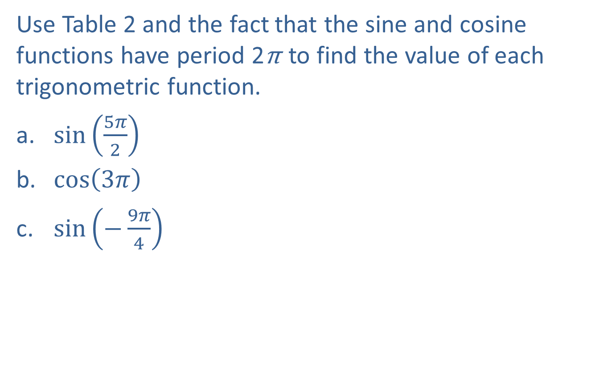
Example 3: Evaluating Trigonometric Functions—Slide 1
Use Table 2 and the fact that the sine and cosine functions have period 2π to find the value of each trigonometric function.
​$sin⁡\left(\frac{5π}{2}\right)$
​$cos⁡\left(3π\right)$
​$sin⁡\left(−\frac{9π}{4}\right)$

Slide 16
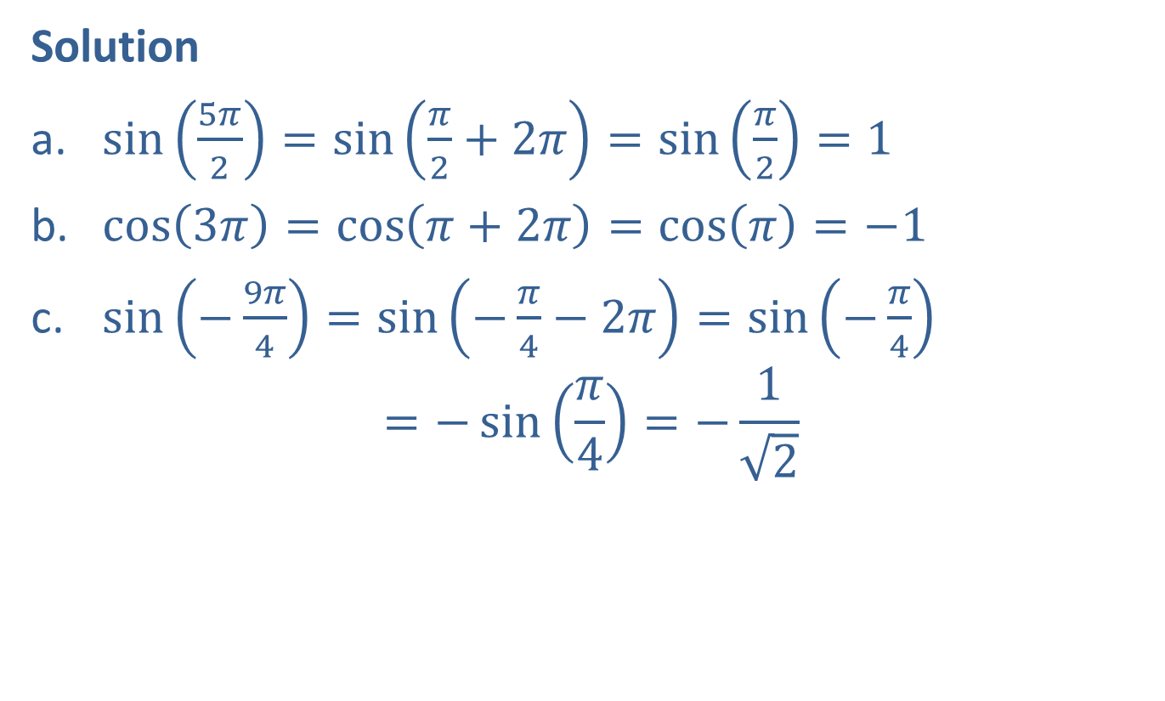
Example 3: Evaluating Trigonometric Functions—Slide 2
Solution
​$\sin\left(\frac{5π}{2}\right)=\sin\left(\frac{π}{2}+2π\right)=\sin\left(\frac{π}{2}\right)=1$
​$\cos\left(3π\right)=\cos\left(π+2π\right)=\cos\left(π\right)=−1$
​$\sin\left(−\frac{9π}{4}\right)=\sin\left(−\frac{π}{4}−2π\right)=\sin\left(−\frac{π}{4}\right)$ $=−\sin\left(\frac{π}{4}\right)=−\frac{1}{\sqrt{2}}$

Slide 17
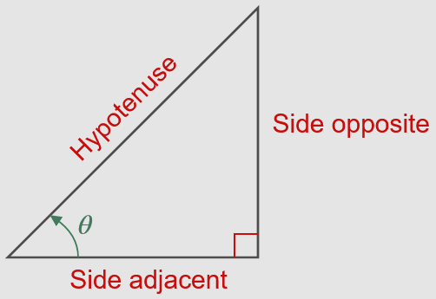



Definition: Right-Triangle Definitions of Sine, Cosine, and Tangent
$$\sin{θ}=\frac{\text{opp}}{\text{hyp}}$$
$$\cos{θ}=\frac{\text{adj}}{\text{hyp}}$$
$$\tan{θ}=\frac{\text{opp}}{\text{adj}}$$

Slide 18



Definition: Right-Triangle Definitions of Cosecant, Secant, and Cotangent
$$\csc{θ}=\frac{\text{1}}{\text{sin} θ}=\frac{\text{hyp}}{\text{op}\text{p}}$$
$$\sec{θ}=\frac{\text{1}}{\text{cos} θ}=\frac{\text{hyp}}{\text{adj}}$$
$$\cot{θ}=\frac{\text{1}}{\text{tan} θ}=\frac{\text{adj}}{\text{opp}}$$

Slide 19
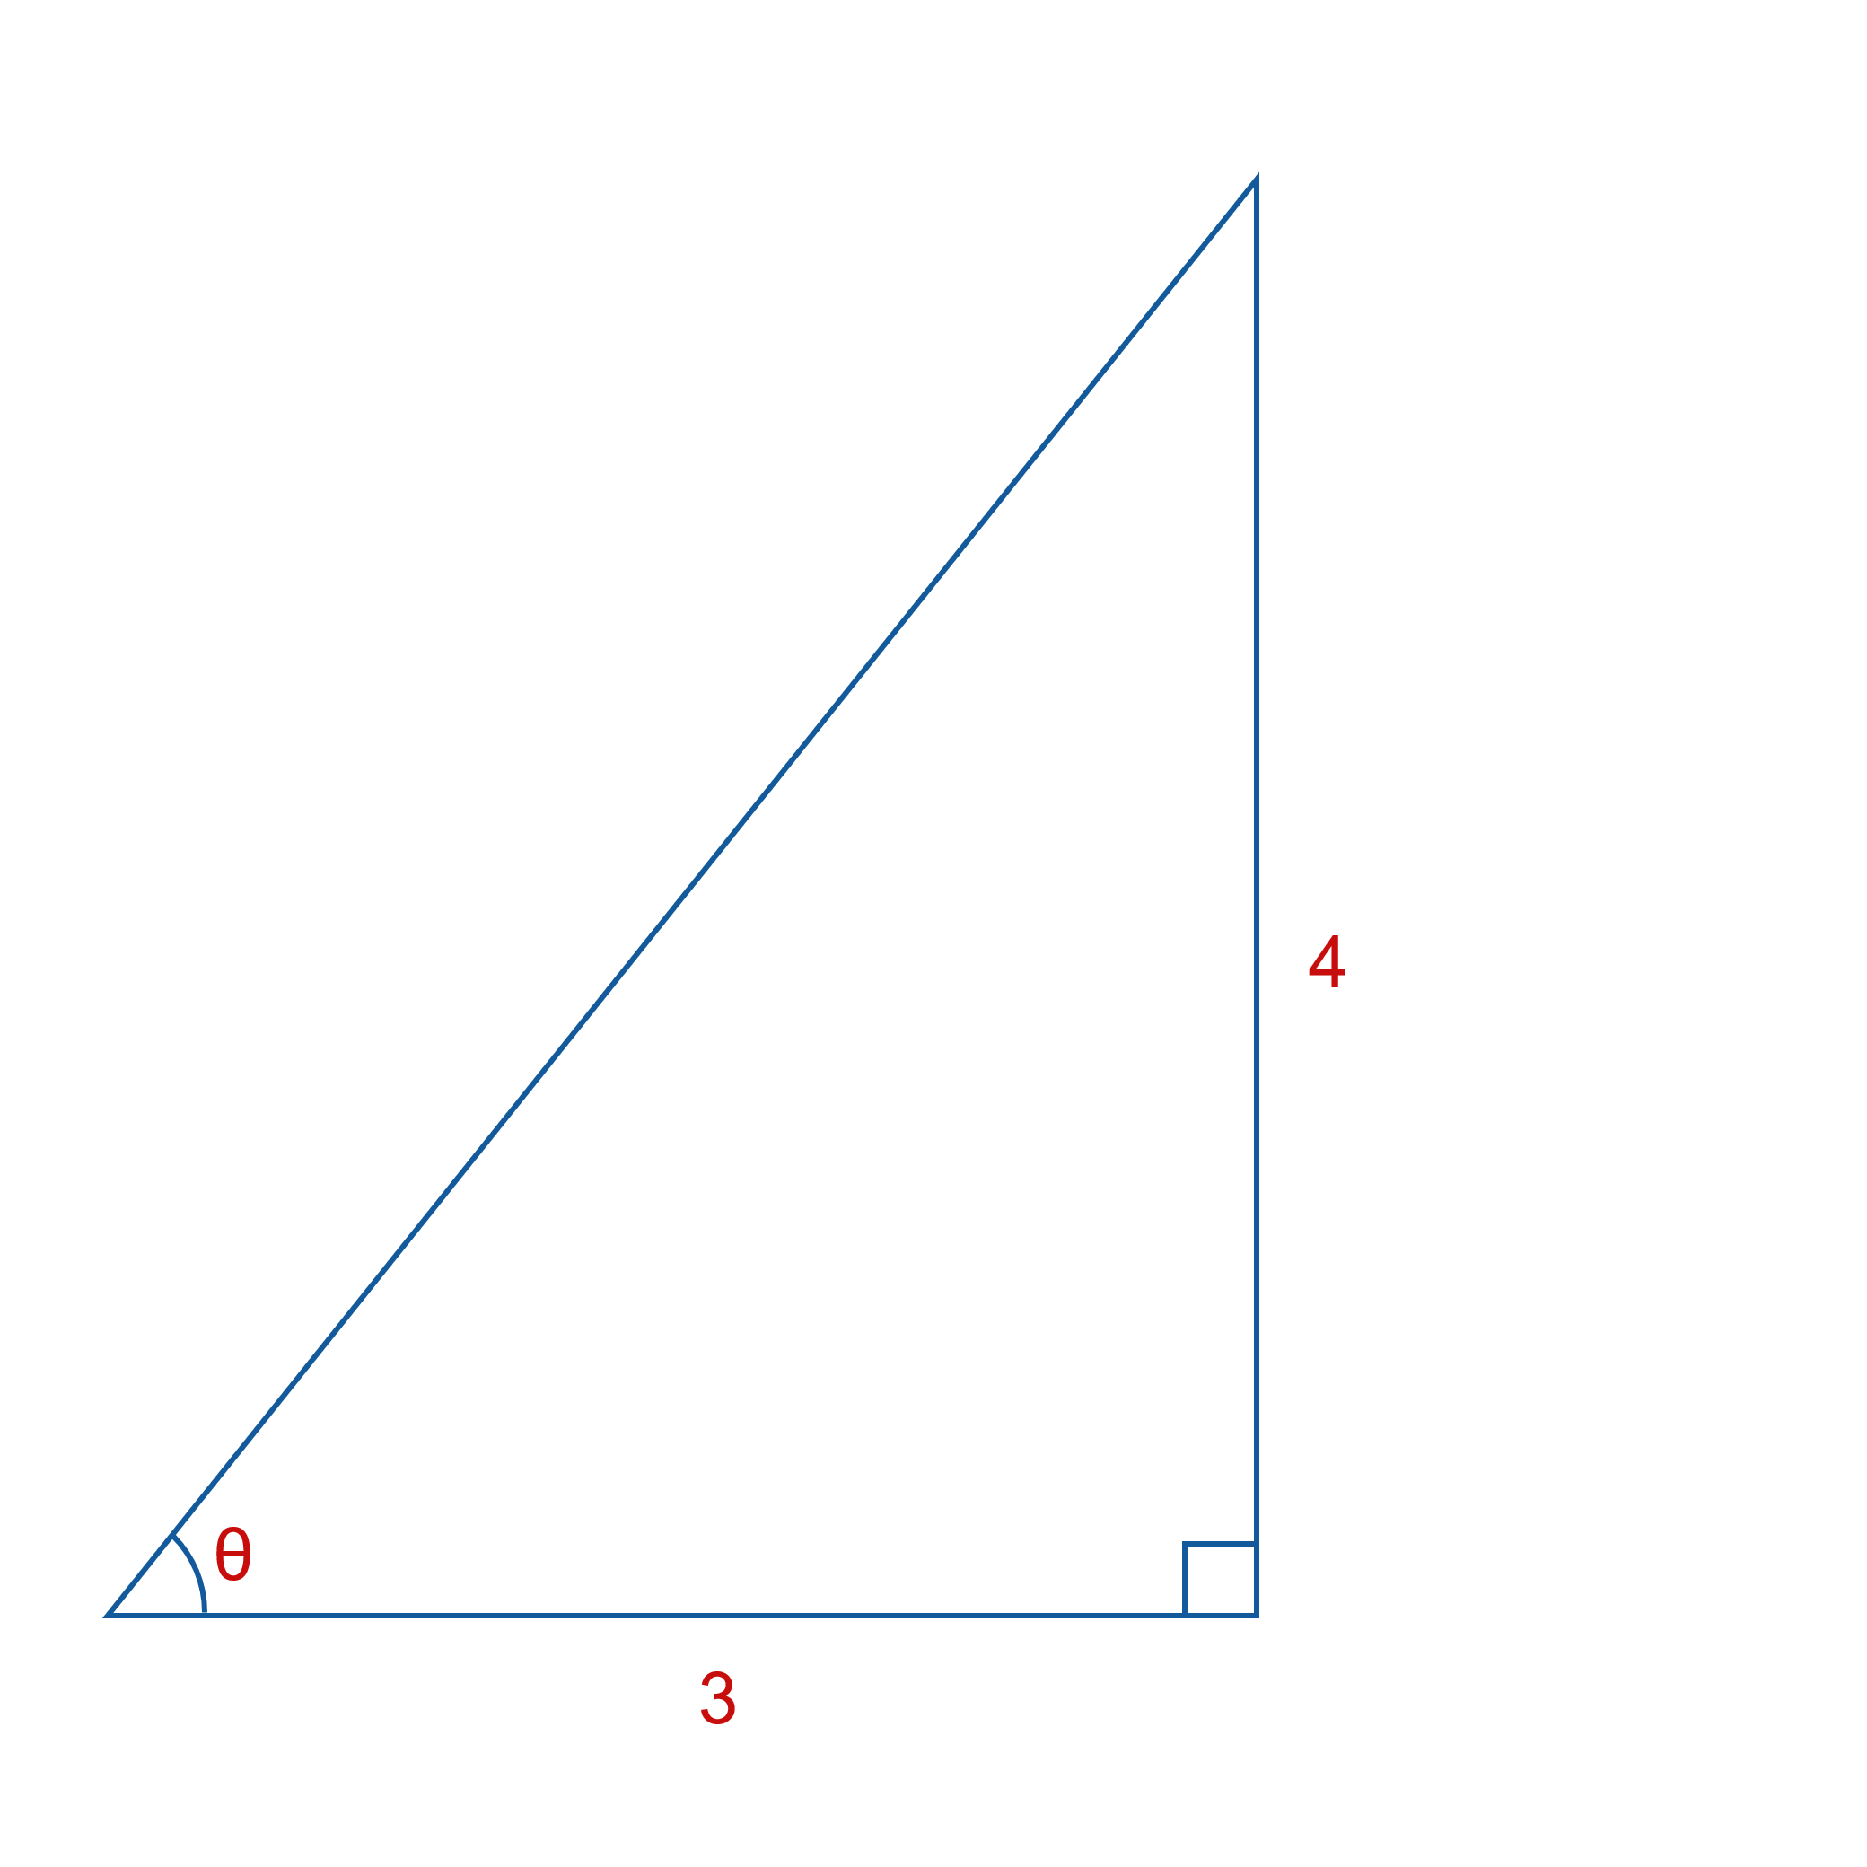
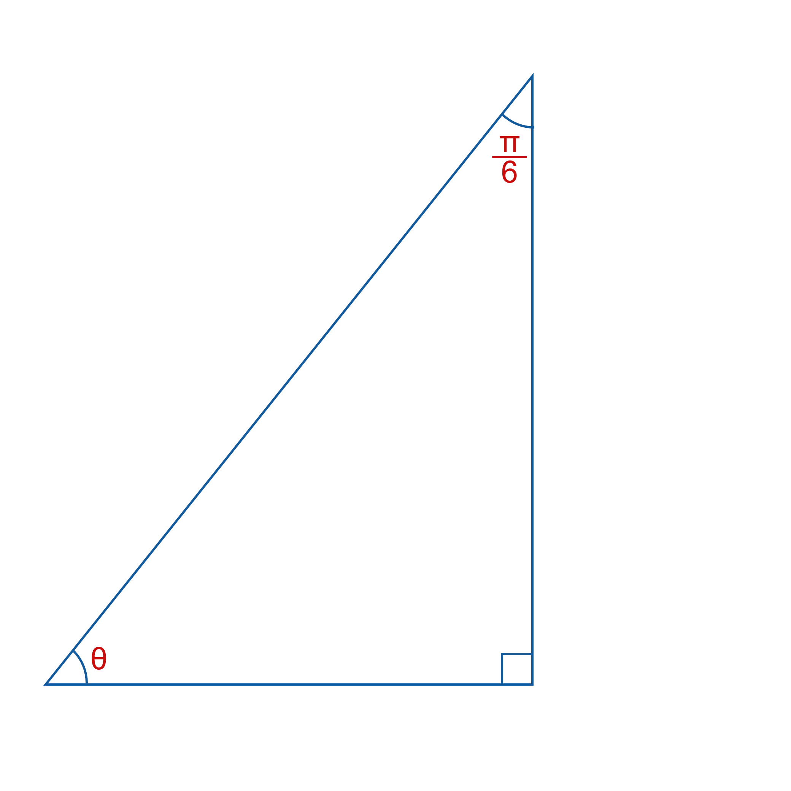
Example 4: Evaluating Trigonometric Functions Using Right Triangles—Slide 1
Use the information contained in these two figures to determine the values of the six trigonometric functions of θ.
​ b.

Slide 20
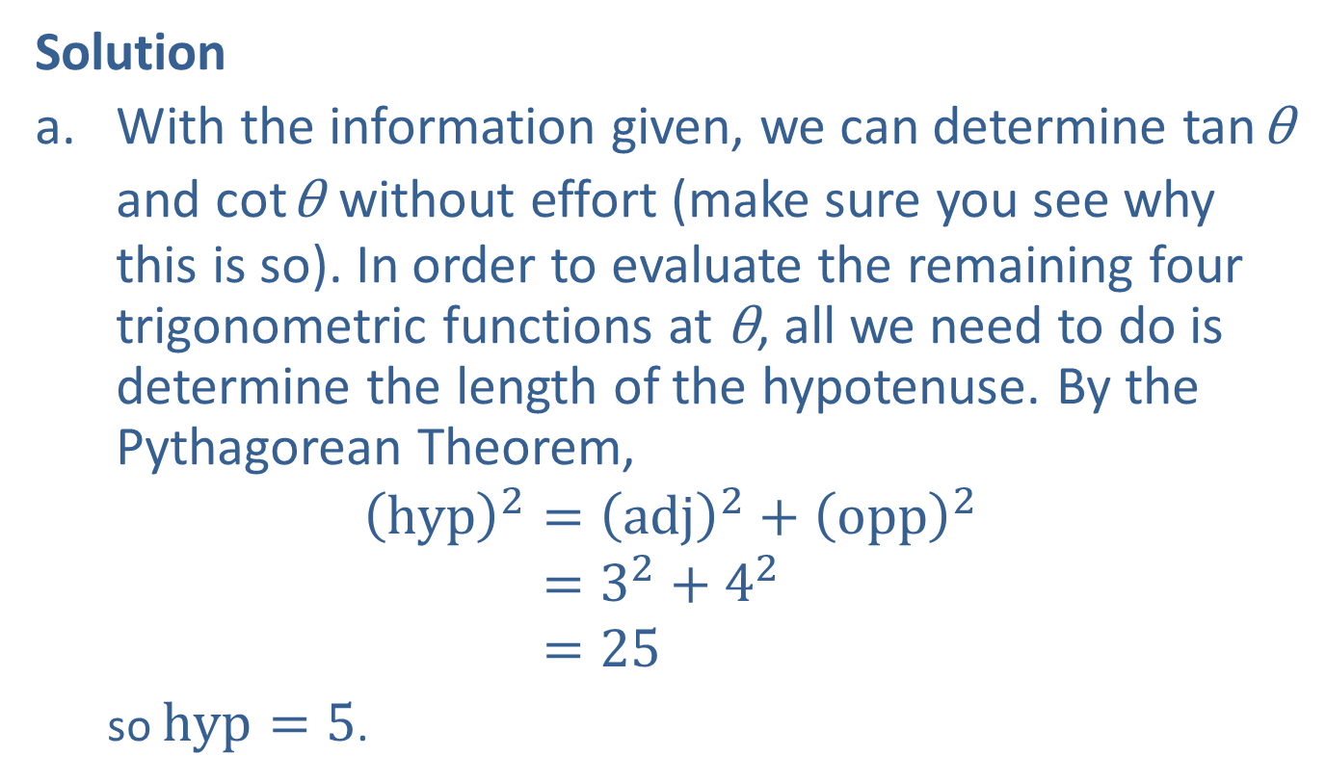
Example 4: Evaluating Trigonometric Functions Using Right Triangles—Slide 2
Solution
​With the information given, we can determine tan θ and cot θ without effort (make sure you see why this is so). In order to evaluate the remaining four trigonometric functions at θ, all we need to do is determine the length of the hypotenuse. By the Pythagorean Theorem,
hyp2=adj2+opp2hyp2=32+42hyp2=25
so $hyp=5$.

Slide 21

Example 4: Evaluating Trigonometric Functions Using Right Triangles—Slide 3
Thus,
​ $\sin{θ}=\frac{opp}{hyp}=\frac{4}{5}$, $\cos{θ}=\frac{adj}{hyp}=\frac{3}{5}$, $\tan{θ}=\frac{opp}{adj}=\frac{4}{3}$
​and
​ $\csc{θ}=\frac{1}{\sin{θ}}=\frac{5}{4}$, $\sec{θ}=\frac{1}{\cos{θ}}=\frac{5}{3}$, $\cot{θ}=\frac{1}{\tan{θ}}=\frac{3}{4}$.

Slide 22
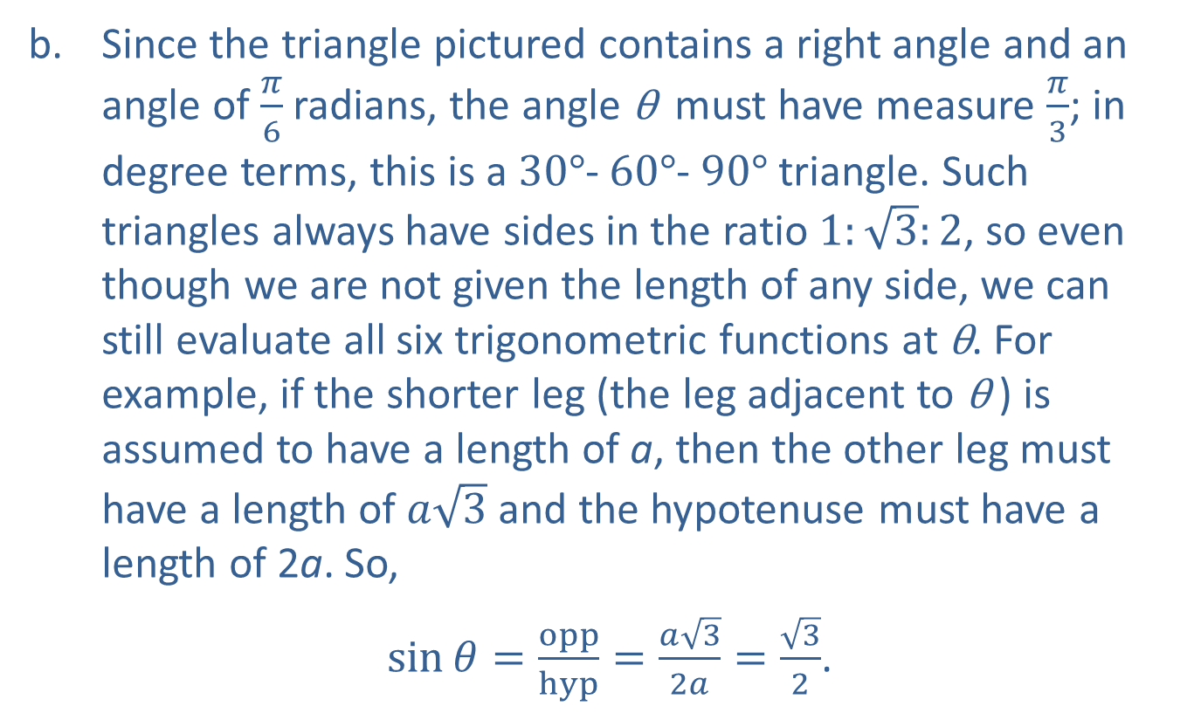
Example 4: Evaluating Trigonometric Functions Using Right Triangles—Slide 4
​Since the triangle pictured contains a right angle and an angle of $\frac{π}{6}$ radians, the angle θ must have measure $\frac{π}{3}$; in degree terms, this is a $30°$‐ $60°$‐ $90°$ triangle. Such triangles always have sides in the ratio $1:\sqrt{3}:2$, so even though we are not given the length of any side, we can still evaluate all six trigonometric functions at θ. For example, if the shorter leg (the leg adjacent to θ ) is assumed to have a length of a, then the other leg must have a length of $a\sqrt{3}$ and the hypotenuse must have a length of 2a. So,
​ $\sin{θ}=\frac{opp}{hyp}=\frac{a\sqrt{3}}{2a}=\frac{\sqrt{3}}{2}$.

Slide 23

Example 4: Evaluating Trigonometric Functions Using Right Triangles—Slide 5
​Similarly,
​ $\cos{θ}=\frac{adj}{hyp}=\frac{1}{2}$,
$\tan{θ}=\frac{opp}{adj}=\sqrt{3}$,
​ $\csc{θ}=\frac{1}{\sin{θ}}=\frac{2}{\sqrt{3}}$,
$\sec{θ}=\frac{1}{\cos{θ}}=2$,
$\cot{θ}=\frac{1}{\tan{θ}}=\frac{1}{\sqrt{3}}$.

Slide 24
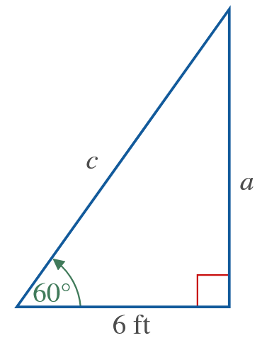
Example 5: Trigonometric Functions and Right Triangles—Slide 1
Find the lengths of c and a in the right triangle shown in the figure.

Slide 25

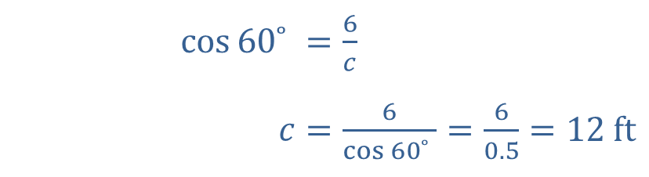


Example 5: Trigonometric Functions and Right Triangles—Slide 2
Solution
​
​
​$\cos{{60˚}^{ }}$ | ​$=\frac{6}{c}$
​$c$ | ​$=\frac{6}{\cos{{60˚}^{ }}}=\frac{6}{0.5}=12 ft$
$$cos60˚=\cos{\frac{π}{3}}=\frac{1}{2}$$
​$\tan{{60˚}^{ }}$ | ​$=\frac{a}{6}$
​$a$ | ​$=6 tan⁡{60˚}^{ }=6\left(\sqrt{3}\right)≈6\left(1.73\right)=10.39 ft$
$$tan{60˚}^{ }=\tan{\frac{π}{3}}=\sqrt{3}$$

Slide 26

Example 6: Evaluating Trigonometric Functions Using Right Triangles—Slide 1
Evaluate the tangent and secant of $θ=\frac{π}{4}$.

Slide 27
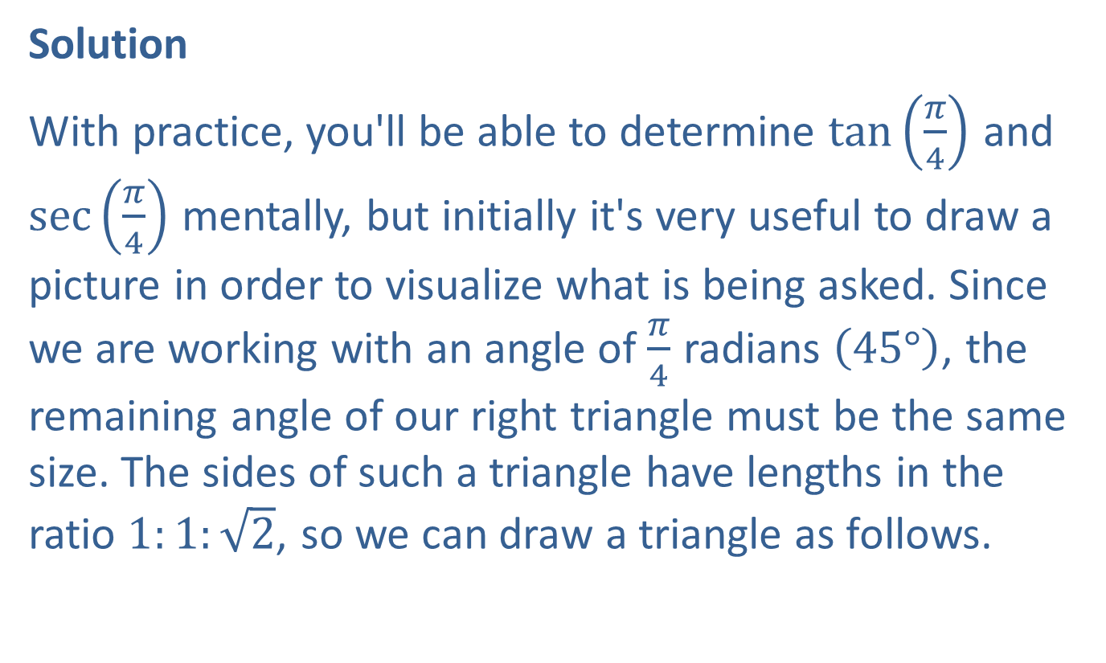
Example 6: Evaluating Trigonometric Functions Using Right Triangles—Slide 2
Solution
With practice, you'll be able to determine $tan⁡\left(\frac{π}{4}\right)$ and $sec⁡\left(\frac{π}{4}\right)$ mentally, but initially it's very useful to draw a picture in order to visualize what is being asked. Since we are working with an angle of $\frac{π}{4}$ radians $\left(45°\right)$, the remaining angle of our right triangle must be the same size. The sides of such a triangle have lengths in the ratio $1:1:\sqrt{2}$, so we can draw a triangle as follows.

Slide 28
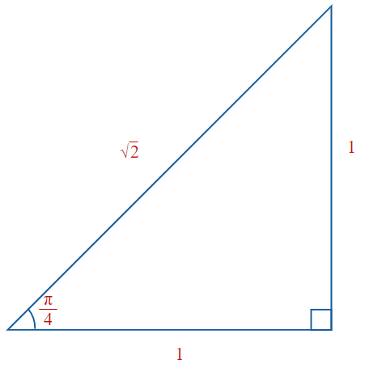
Example 6: Evaluating Trigonometric Functions Using Right Triangles—Slide 3

Slide 29
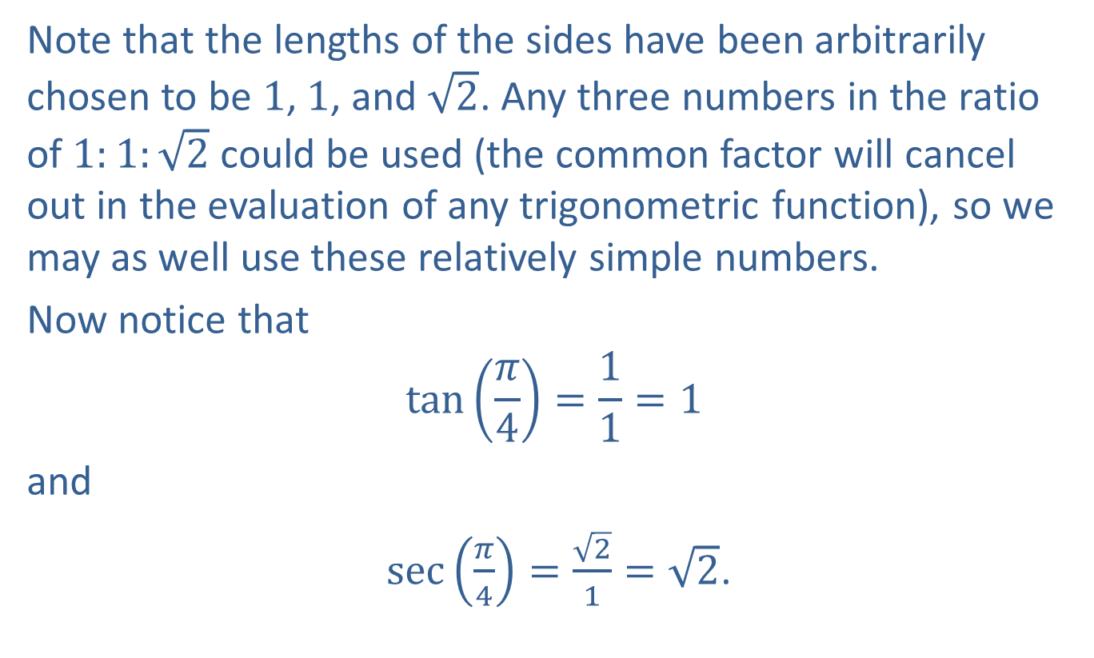
Example 6: Evaluating Trigonometric Functions Using Right Triangles—Slide 4
Note that the lengths of the sides have been arbitrarily chosen to be 1, 1, and $\sqrt{2}$. Any three numbers in the ratio of $1:1:\sqrt{2}$ could be used (the common factor will cancel out in the evaluation of any trigonometric function), so we may as well use these relatively simple numbers.
Now notice that
$$\tan\left(\frac{π}{4}\right)=\frac{1}{1}=1$$
and
$\sec\left(\frac{π}{4}\right)=\frac{\sqrt{2}}{1}=\sqrt{2}$.

Slide 30
CAUTION!
Before using a calculator to evaluate a given trigonometric expression, determine whether the angle in the expression is measured in degrees or radians. Then put the calculator in the appropriate mode prior to the evaluation.

Slide 31

Example 7: Evaluating Trigonometric Functions Using a Calculator—Slide 1
Use a calculator to evaluate the following expressions.
​$sin⁡\left(56.4°\right)$
​$cot⁡\left(\frac{5π}{11}\right)$

Slide 32
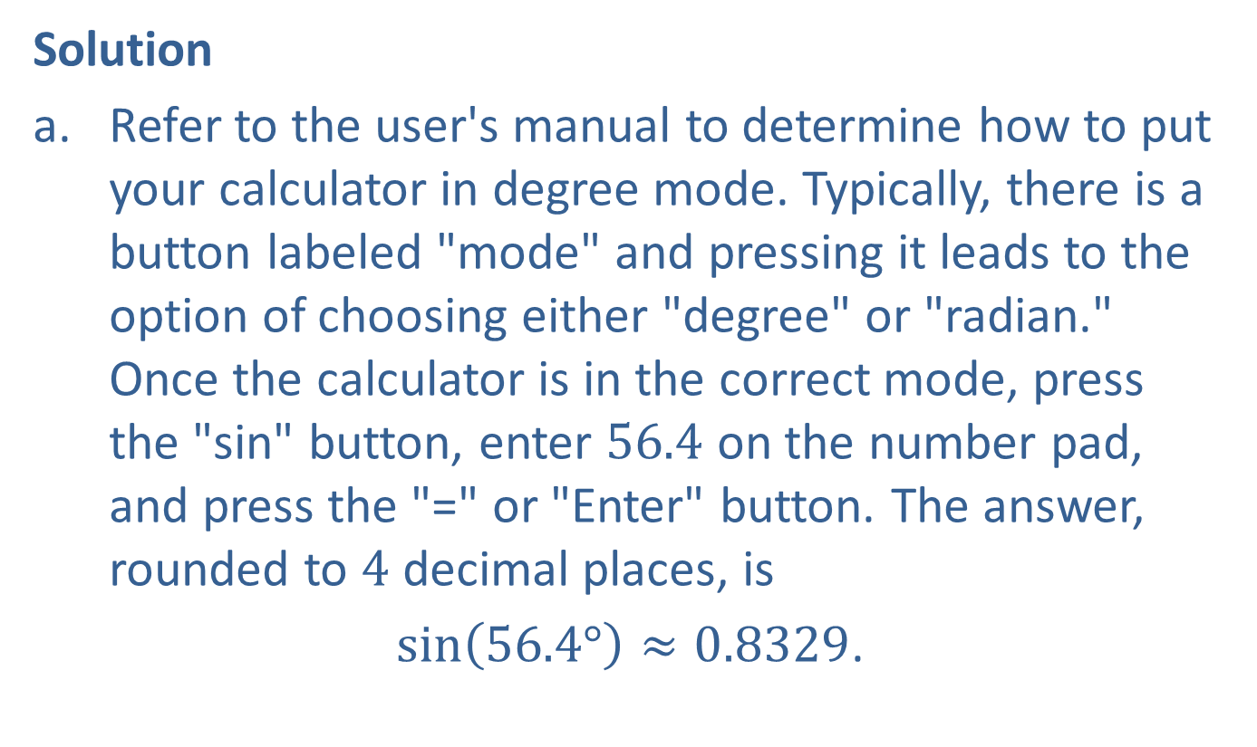
Example 7: Evaluating Trigonometric Functions Using a Calculator—Slide 2
Solution
​Refer to the user's manual to determine how to put your calculator in degree mode. Typically, there is a button labeled "mode" and pressing it leads to the option of choosing either "degree" or "radian." Once the calculator is in the correct mode, press the "sin" button, enter 56.4 on the number pad, and press the "=" or "Enter" button. The answer, rounded to 4 decimal places, is
$sin\left(56.4°\right)≈0.8329$.

Slide 33
Example 7: Evaluating Trigonometric Functions Using a Calculator—Slide 3
The exact number of digits on your display will depend on the calculator and its current settings. If your display reads −0.1481, your calculator is in the incorrect (radian) mode for this problem.

Slide 34
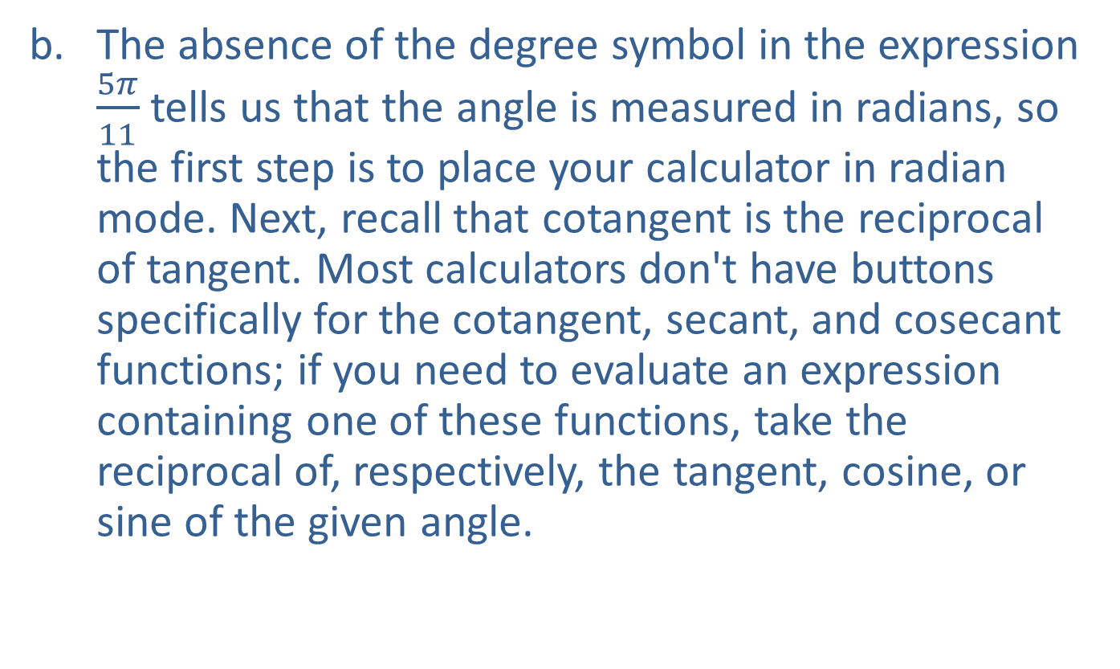
Example 7: Evaluating Trigonometric Functions Using a Calculator—Slide 4
​The absence of the degree symbol in the expression $\frac{5π}{11}$ tells us that the angle is measured in radians, so the first step is to place your calculator in radian mode. Next, recall that cotangent is the reciprocal of tangent. Most calculators don't have buttons specifically for the cotangent, secant, and cosecant functions; if you need to evaluate an expression containing one of these functions, take the reciprocal of, respectively, the tangent, cosine, or sine of the given angle.
​

Slide 35

Example 7: Evaluating Trigonometric Functions Using a Calculator—Slide 5
​In this case, use your calculator to confirm that
​ $\tan\left(\frac{5π}{11}\right)≈6.9552$,
and therefore
​ $\cot\left(\frac{5π}{11}\right)=\frac{1}{\tan\left(\frac{5π}{11}\right)}≈0.1438$.

