Slide 1
Section 1.R.1
The Cartesian Coordinate System

Slide 2
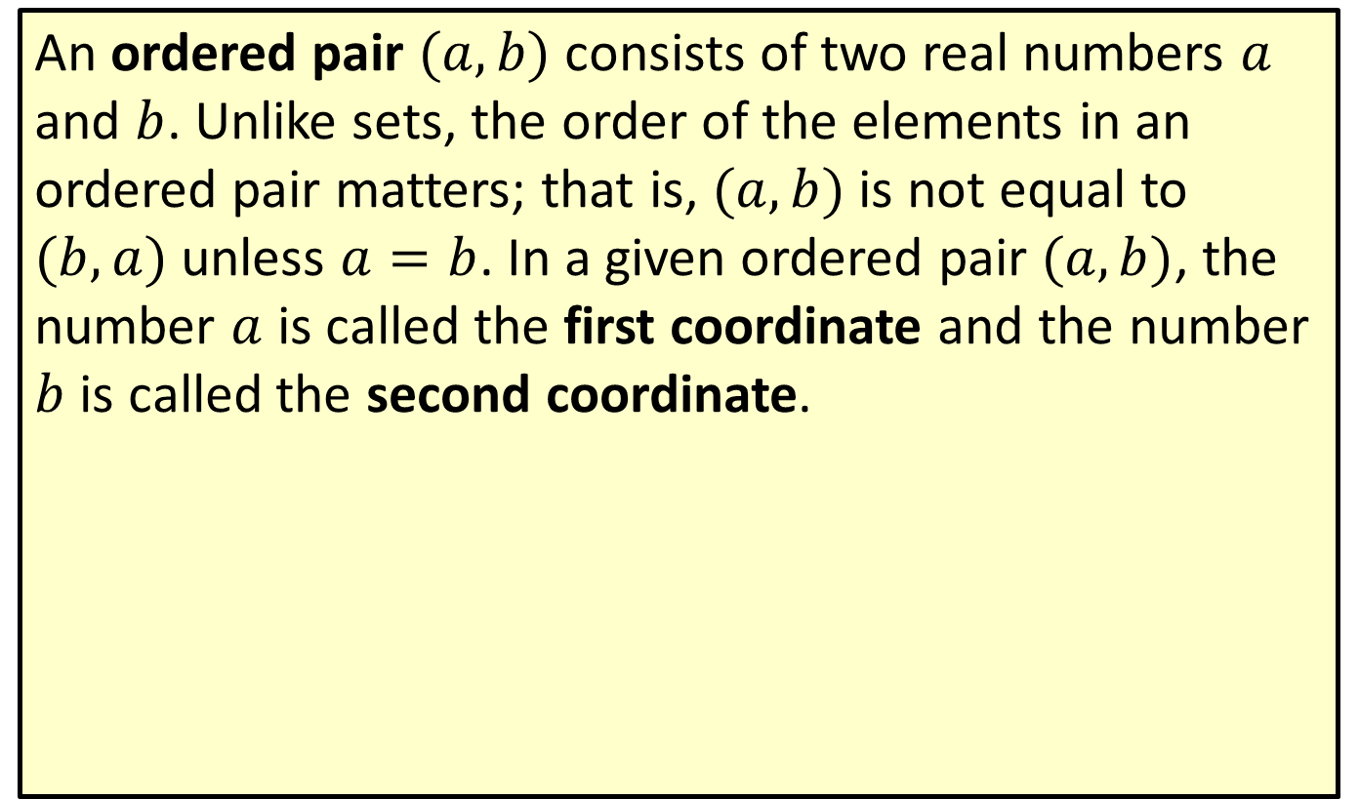
Definition: Ordered Pairs
An ordered pair $(a,b)$ consists of two real numbers $a$ and $b$. Unlike sets, the order of the elements in an ordered pair matters; that is, $(a,b)$ is not equal to $(b,a)$ unless $a=b$. In a given ordered pair $(a,b)$, the number $a$ is called the first coordinate and the number $b$ is called the second coordinate.

Slide 3
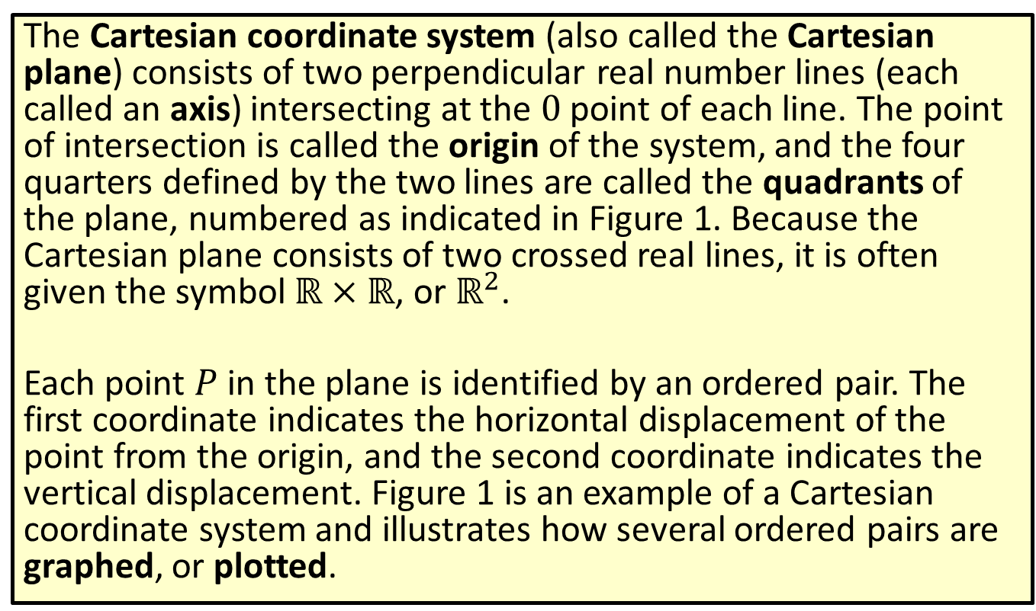
Definition: The Cartesian Coordinate System
The Cartesian coordinate system (also called the Cartesian plane) consists of two perpendicular real number lines (each called an axis) intersecting at the 0 point of each line. The point of intersection is called the origin of the system, and the four quarters defined by the two lines are called the quadrants of the plane, numbered as indicated in Figure 1. Because the Cartesian plane consists of two crossed real lines, it is often given the symbol $ℝ×ℝ$, or $ℝ^{2}$.
Each point $P$ in the plane is identified by an ordered pair. The first coordinate indicates the horizontal displacement of the point from the origin, and the second coordinate indicates the vertical displacement. Figure 1 is an example of a Cartesian coordinate system and illustrates how several ordered pairs are graphed, or plotted.

Slide 4
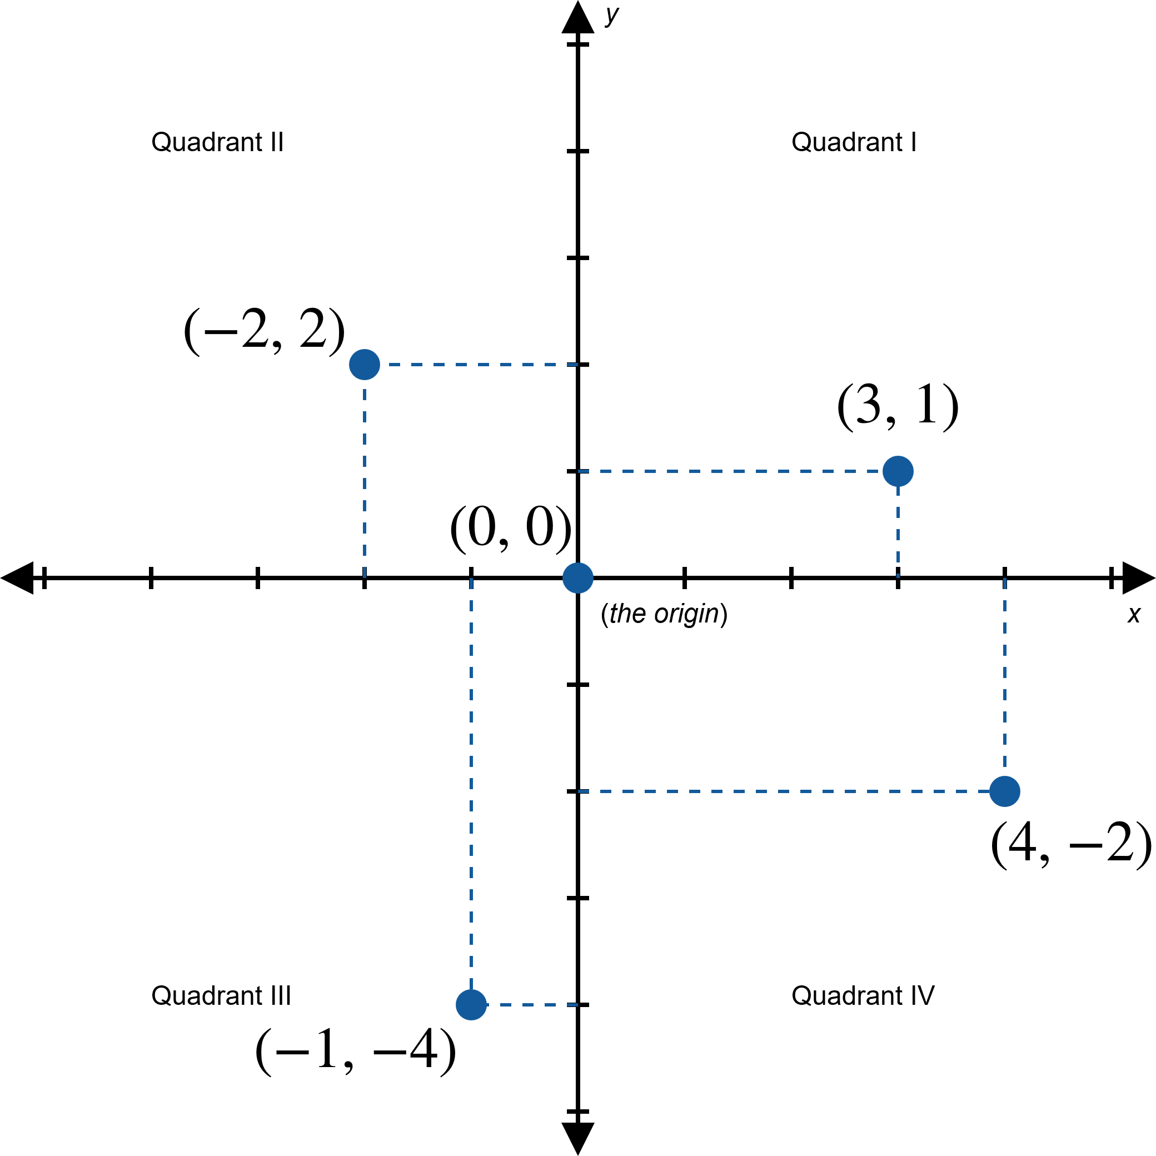
Figure 1: The Cartesian Plane

Slide 5
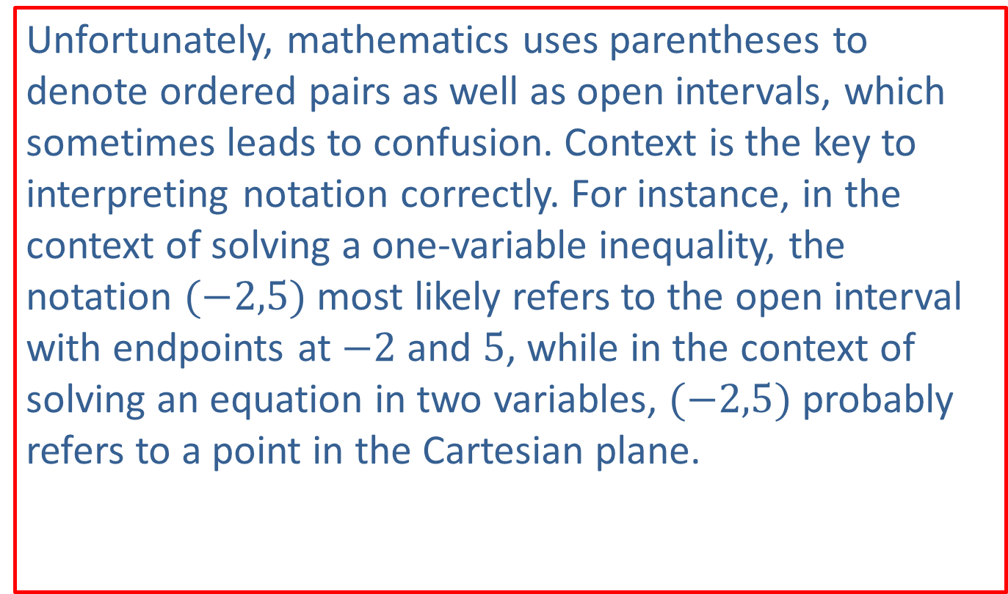
CAUTION!
Unfortunately, mathematics uses parentheses to denote ordered pairs as well as open intervals, which sometimes leads to confusion. Context is the key to interpreting notation correctly. For instance, in the context of solving a one-variable inequality, the notation $(−2,5)$ most likely refers to the open interval with endpoints at $−2$ and 5, while in the context of solving an equation in two variables, $(−2,5)$ probably refers to a point in the Cartesian plane.

Slide 6
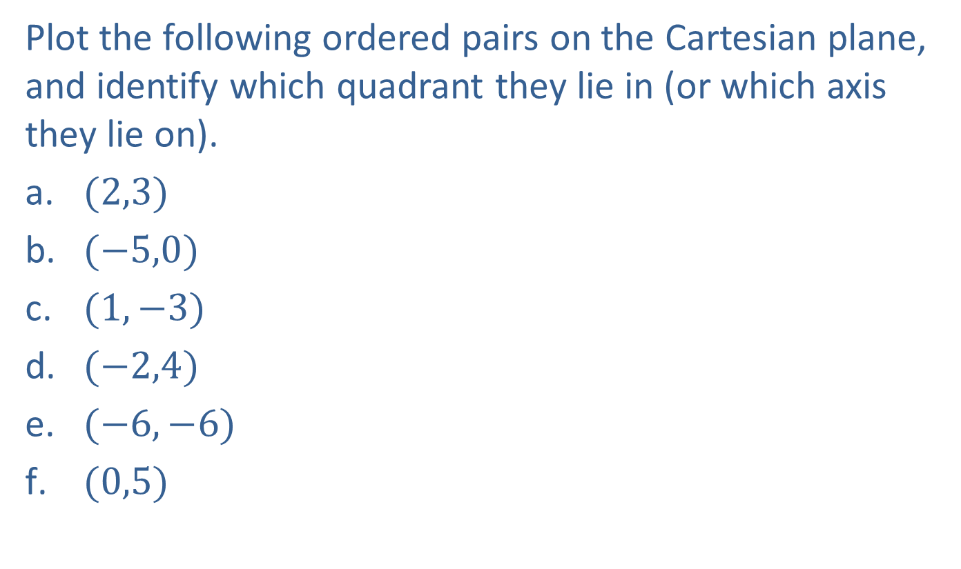
Example 1: Plotting Points in the Cartesian Coordinate System—Slide 1
Plot the following ordered pairs on the Cartesian plane, and identify which quadrant they lie in (or which axis they lie on).
​$(2,3)$
​$(−5,0)$
​$(1,−3)$
​$(−2,4)$
​$(−6,−6)$
​$(0,5)$

Slide 7
Note 1
There is no required method when plotting points, but it is helpful to establish a set pattern that you follow. For example, you may always count the horizontal value first, then the vertical displacement.

Slide 8
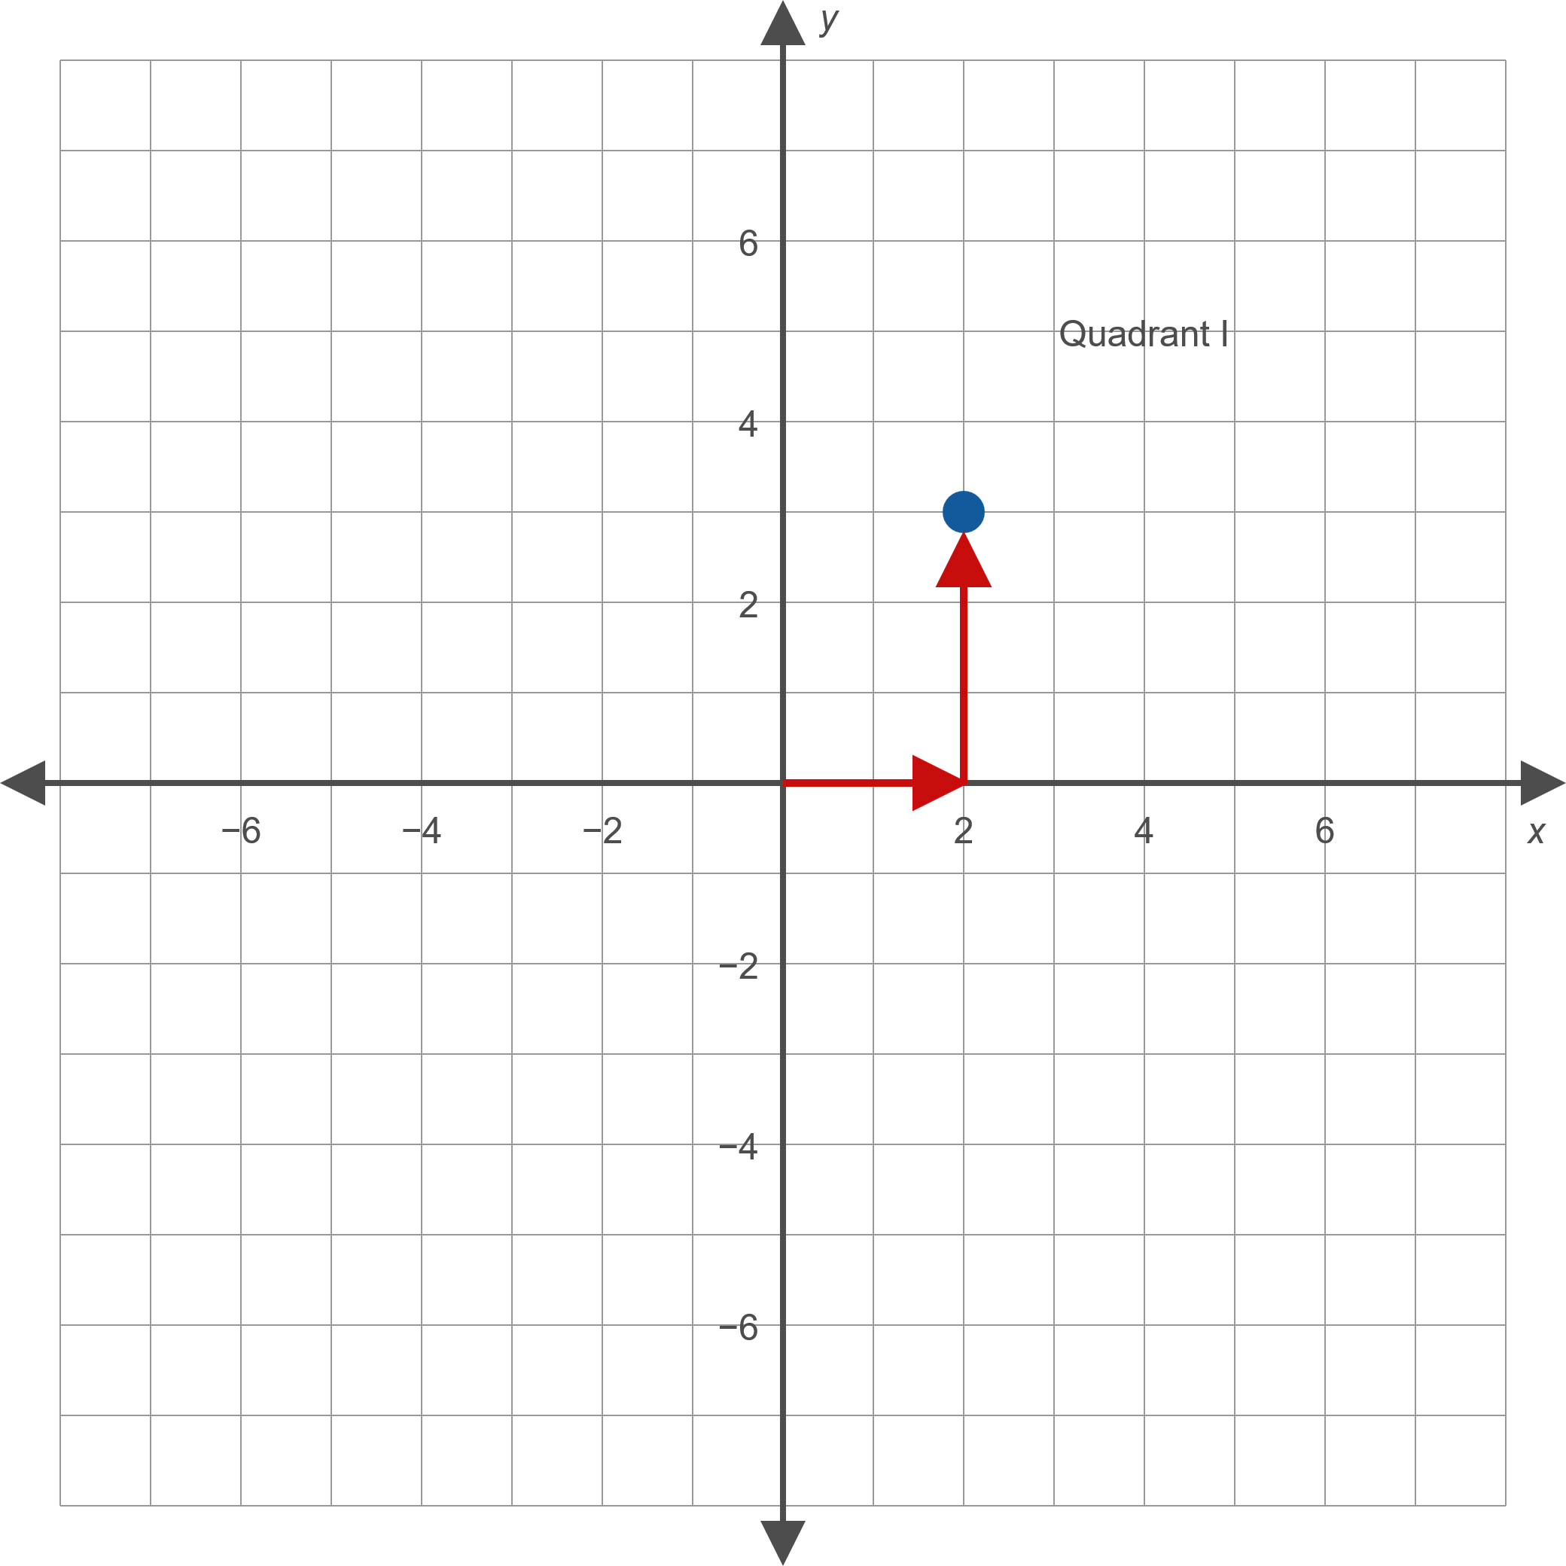
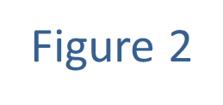
Example 1: Plotting Points in the Cartesian Coordinate System—Slide 2
Solution
​

Slide 9
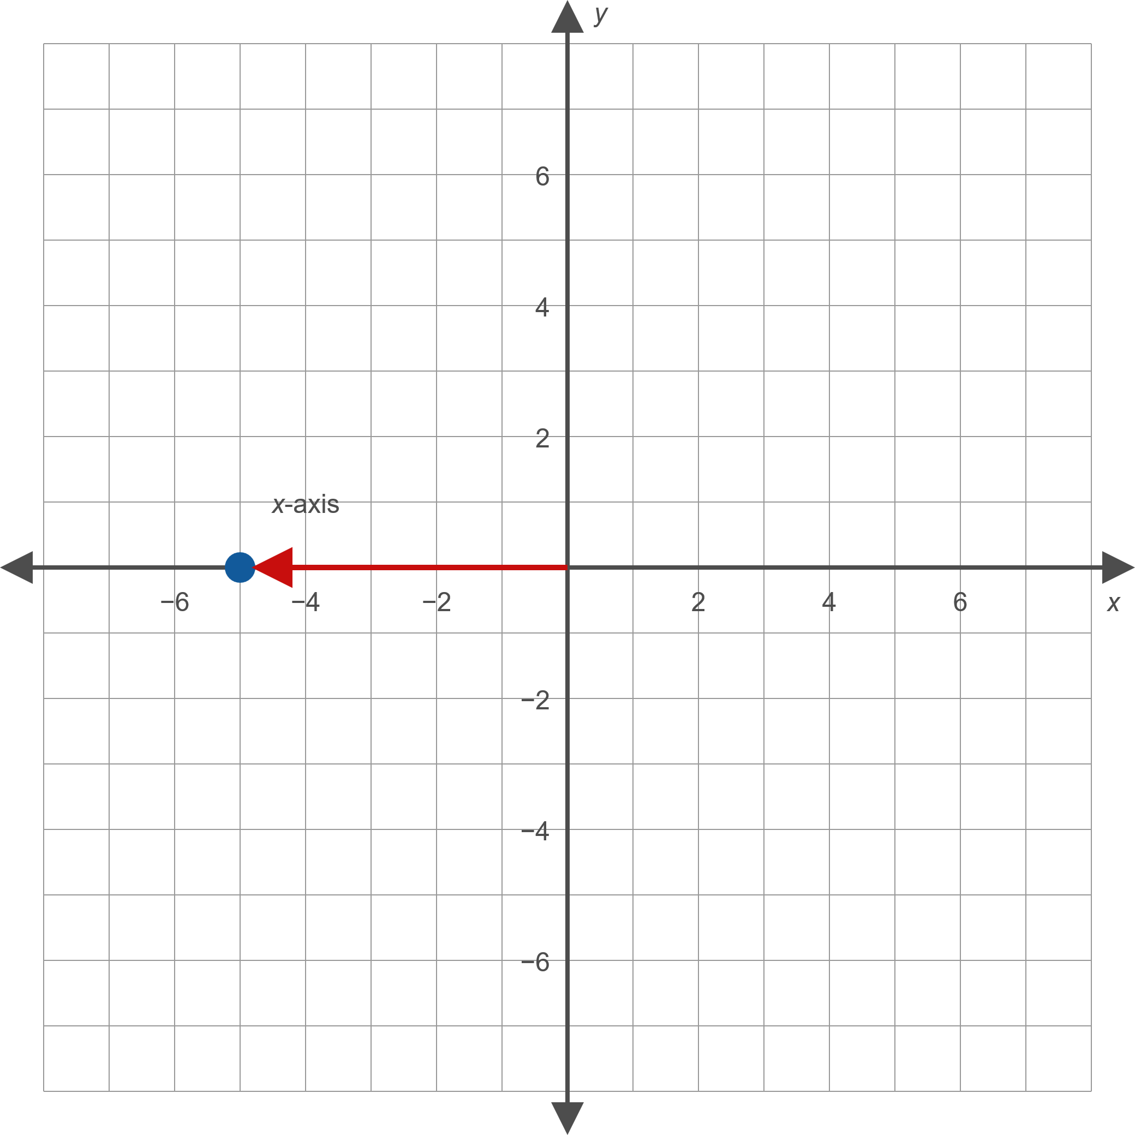
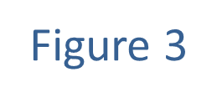
Example 1: Plotting Points in the Cartesian Coordinate System—Slide 3
​

Slide 10
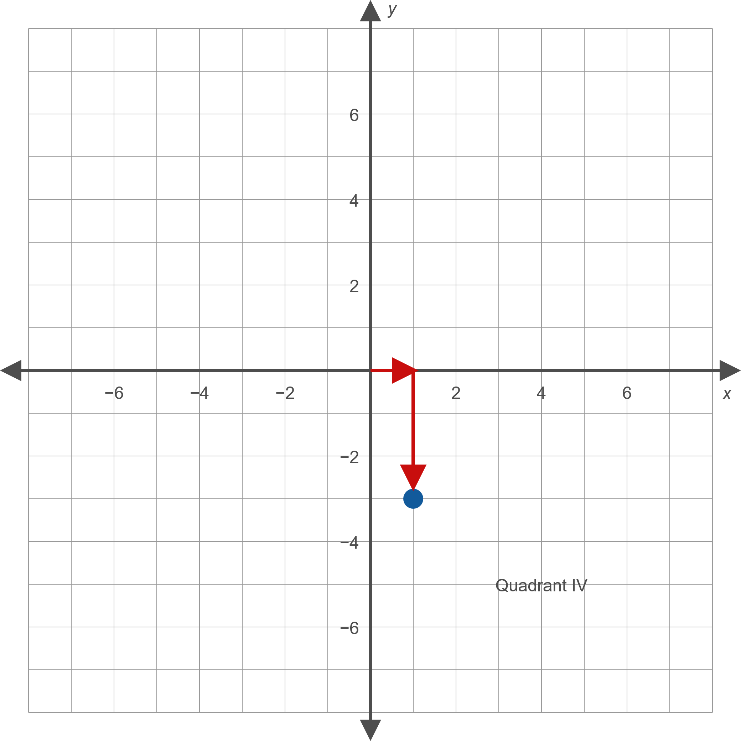
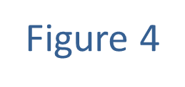
Example 1: Plotting Points in the Cartesian Coordinate System—Slide 4
​

Slide 11
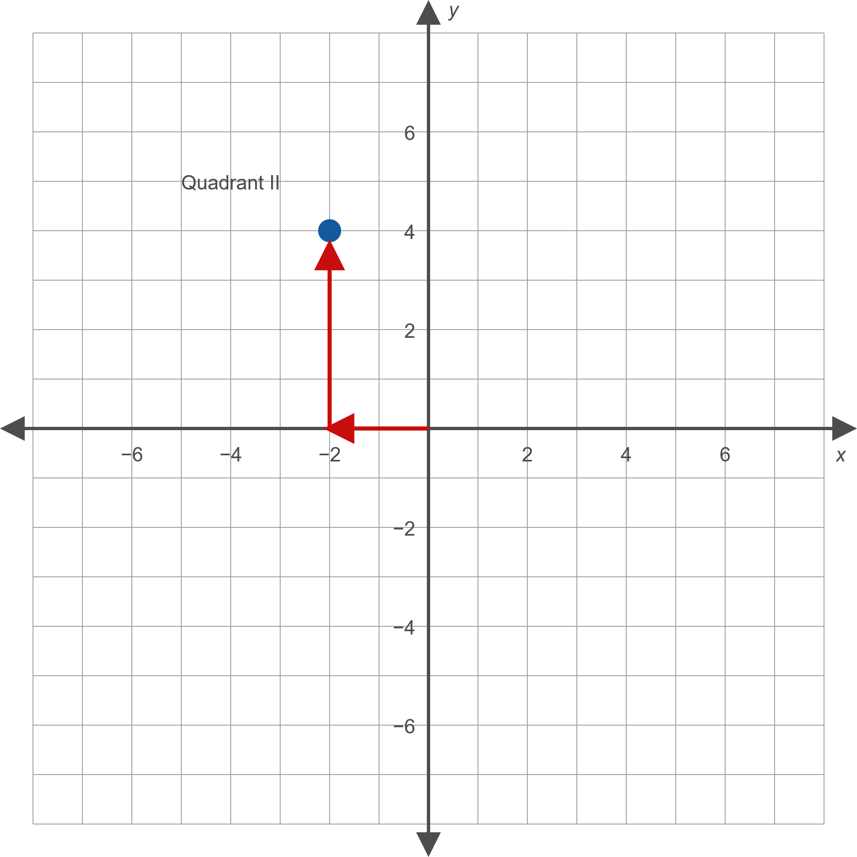
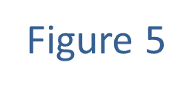
Example 1: Plotting Points in the Cartesian Coordinate System—Slide 5
​

Slide 12
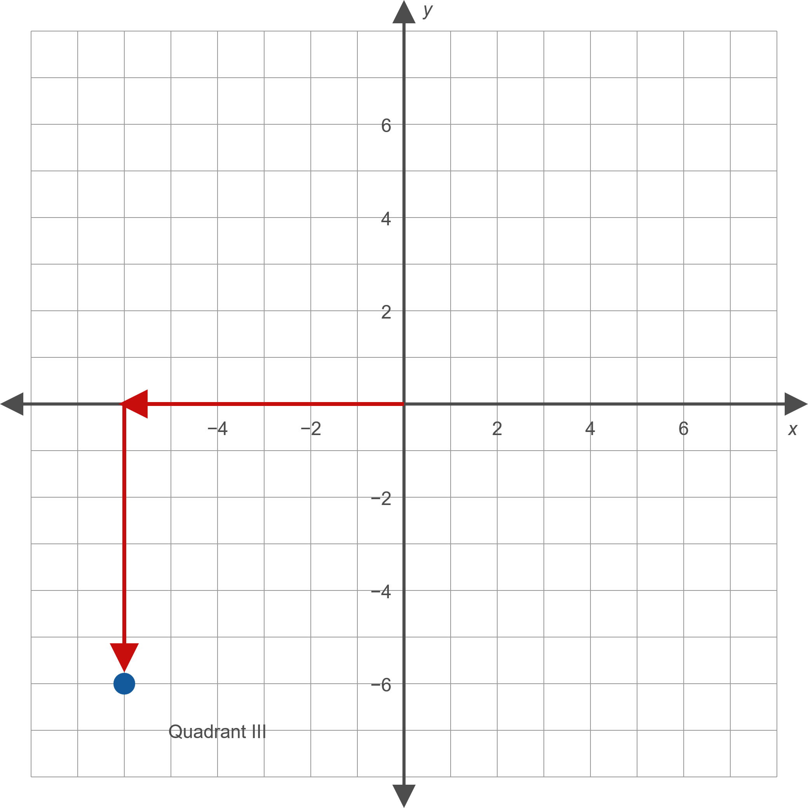
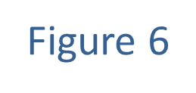
Example 1: Plotting Points in the Cartesian Coordinate System—Slide 6
​

Slide 13
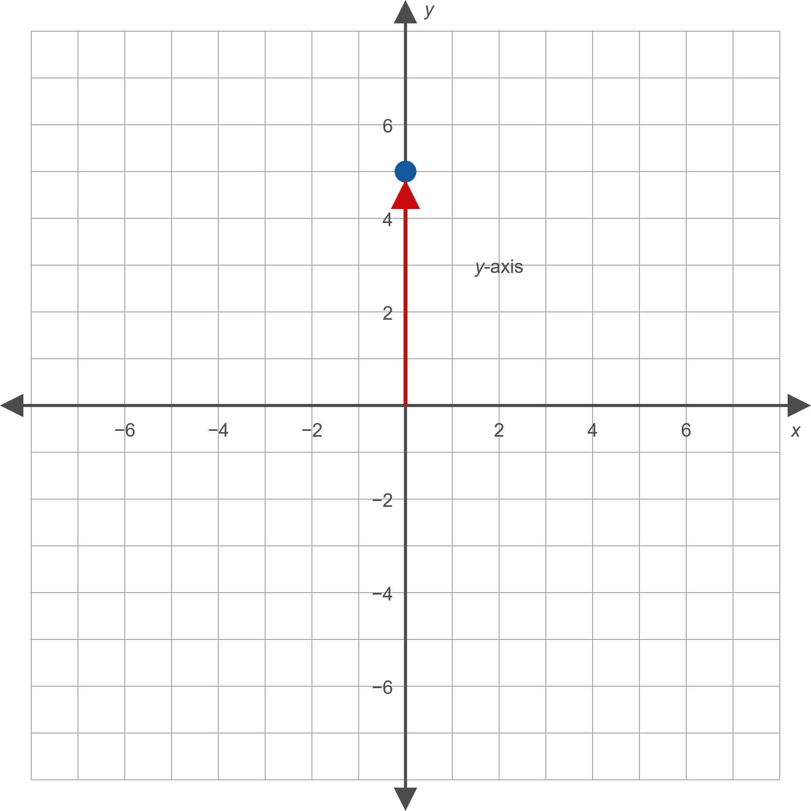
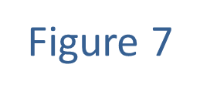
Example 1: Plotting Points in the Cartesian Coordinate System—Slide 7
​

Slide 14

Example 2: Graphing Equations in Two Variables—Slide 1
Sketch graphs of the following equations by plotting points.
​$2x−5y=10$
​$x^{2}+y^{2}−6x=0$
​$y=x^{2}−2x$

Slide 15
Note 2
Rather than solving a new equation each time you substitute a value, it is more efficient to solve the equation for one variable before making substitutions. This method is shown in Example 2b.

Slide 16
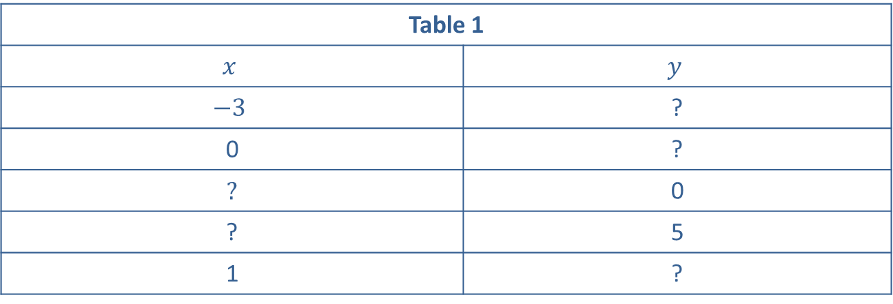
Example 2: Graphing Equations in Two Variables—Slide 2
Solution
​In each row in Table 1, we select a value for one of the two variables.
​
Table 1
$$x$$ | $$y$$
$$−3$$ | ?
0 | ?
? | 0
? | 5
1 | ?

Slide 17
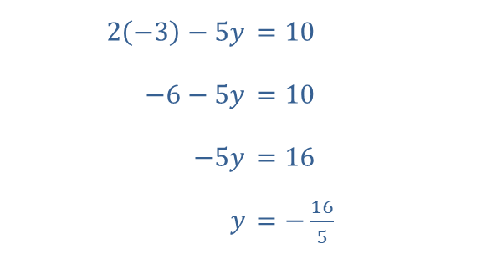
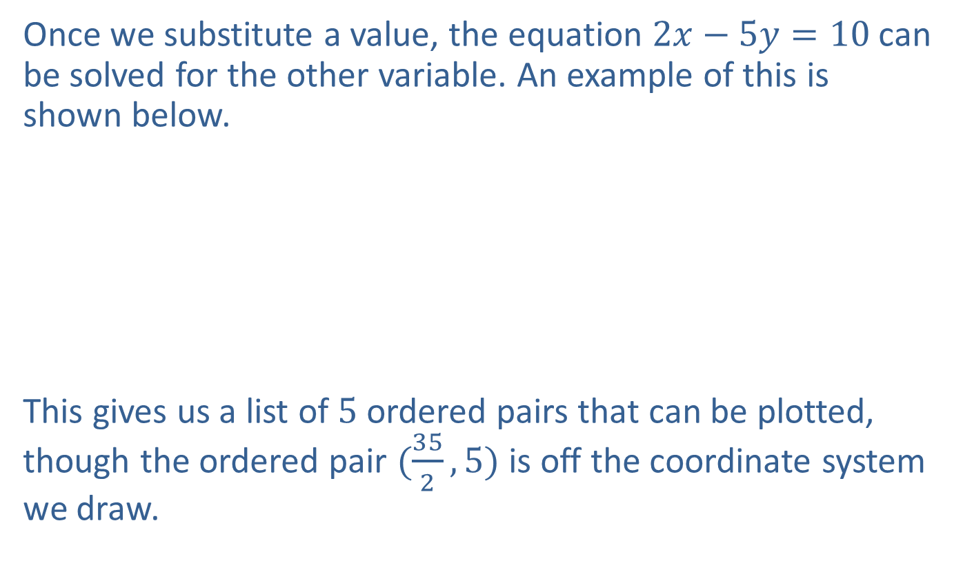
Example 2: Graphing Equations in Two Variables—Slide 3
​Once we substitute a value, the equation $2x−5y=10$ can be solved for the other variable. An example of this is shown below.
​
​
This gives us a list of 5 ordered pairs that can be plotted, though the ordered pair $(\frac{35}{2},5)$ is off the coordinate system we draw.​

Slide 18
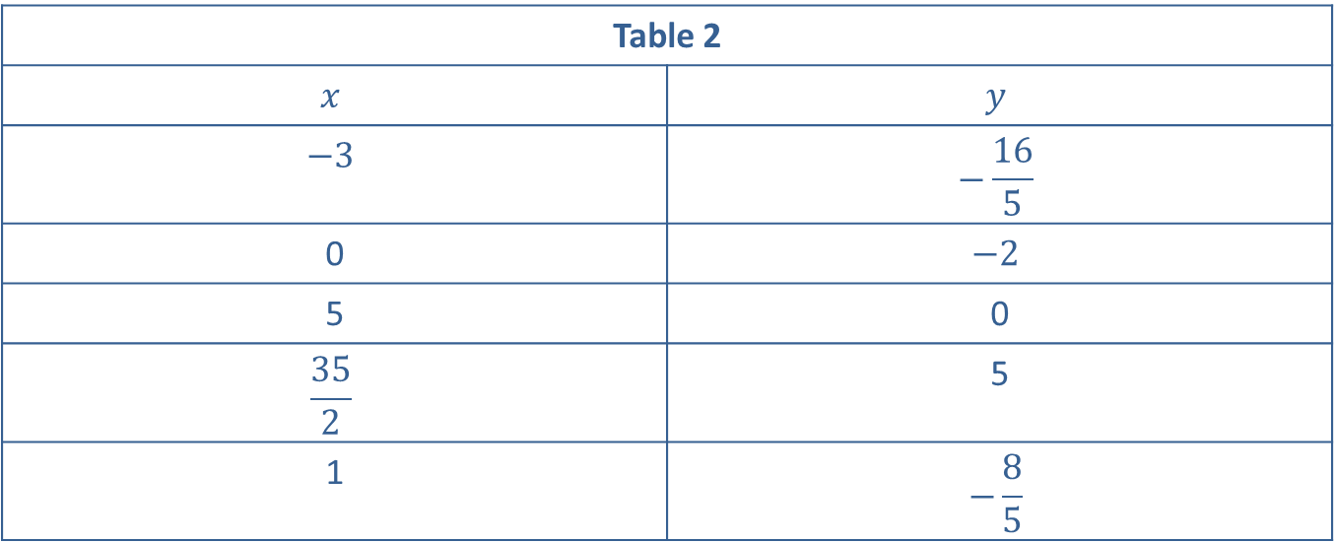
Example 2: Graphing Equations in Two Variables—Slide 4
Table 2
$$x$$ | $$y$$
$$−3$$ | $$−\frac{16}{5}$$
0 | $$−2$$
5 | 0
$$\frac{35}{2}$$ | 5
1 | $$−\frac{8}{5}$$

Slide 19
Example 2: Graphing Equations in Two Variables—Slide 5
​The four ordered pairs appear to lie on a straight line, and this is indeed the case. To gain more confidence in this fact, we could continue to plot more solutions of the equation, and we would find they all lie along the line that has been drawn through the four plotted ordered pairs. The infinite number of solutions of the equation are depicted by the line drawn through the plotted points.
​

Slide 20
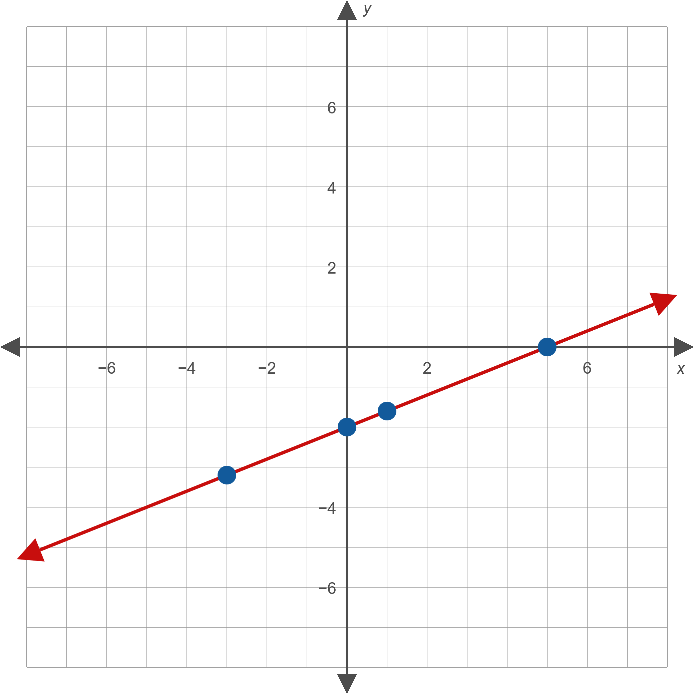
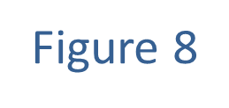
Example 2: Graphing Equations in Two Variables—Slide 6

Slide 21
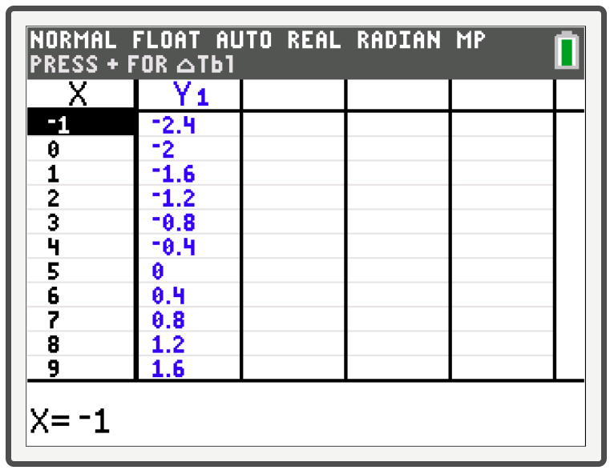
Example 2: Technology
On a TI-84 Plus, you can view a table of specific points on the graph of an equation by selecting Y= and entering the equation, and then selecting 2nd and GRAPH.

Slide 22
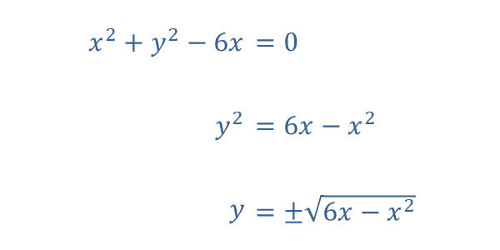

Example 2: Graphing Equations in Two Variables—Slide 7
​For this example, we solve the original equation for $y$, then substitute several values for $x$ to generate a series of $y$-values.
​

Slide 23
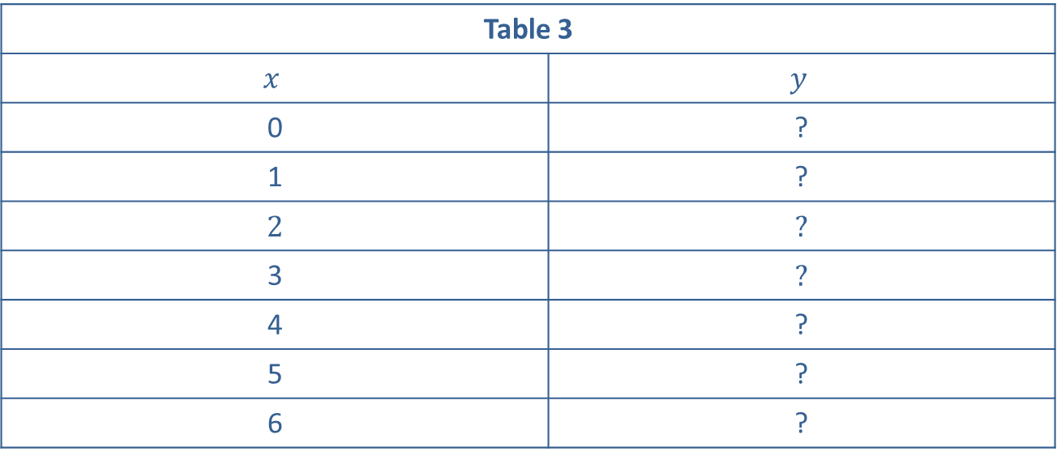
Example 2: Graphing Equations in Two Variables—Slide 8
​Again, we plot enough solutions to feel confident in sketching the entire solution set.
​
Table 3
$$x$$ | $$y$$
0 | ?
1 | ?
2 | ?
3 | ?
4 | ?
5 | ?
6 | ?

Slide 24
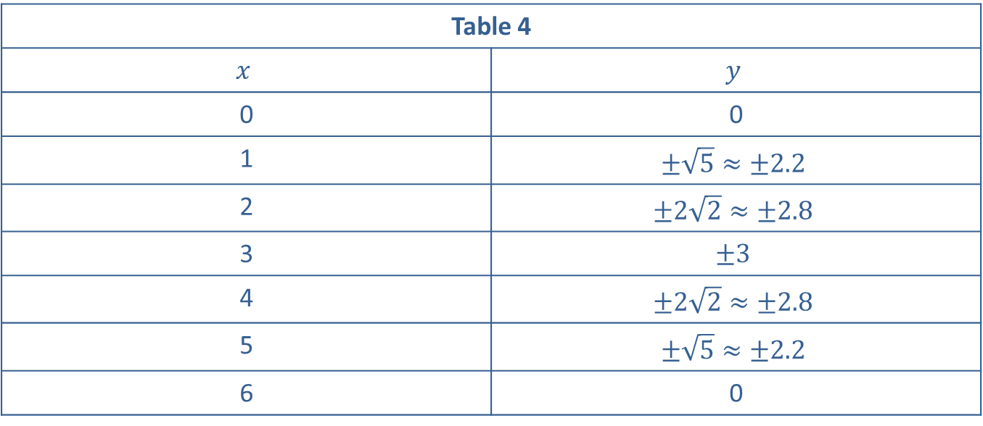
Example 2: Graphing Equations in Two Variables—Slide 9
Table 4
$$x$$ | $$y$$
0 | 0
1 | $$±\sqrt{5}≈±2.2$$
2 | $$±2\sqrt{2}≈±2.8$$
3 | $$±3$$
4 | $$±2\sqrt{2}≈±2.8$$
5 | $$±\sqrt{5}≈±2.2$$
6 | 0

Slide 25
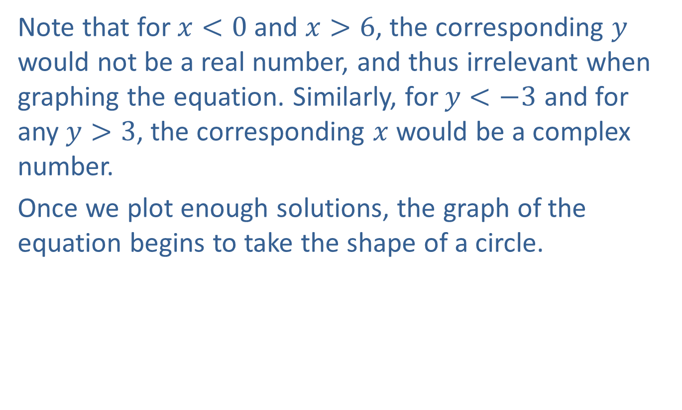
Example 2: Graphing Equations in Two Variables—Slide 10
​Note that for $x<0$ and $x>6$, the corresponding $y$ would not be a real number, and thus irrelevant when graphing the equation. Similarly, for $y<−3$ and for any $y>3$, the corresponding $x$ would be a complex number.
​Once we plot enough solutions, the graph of the equation begins to take the shape of a circle.

Slide 26
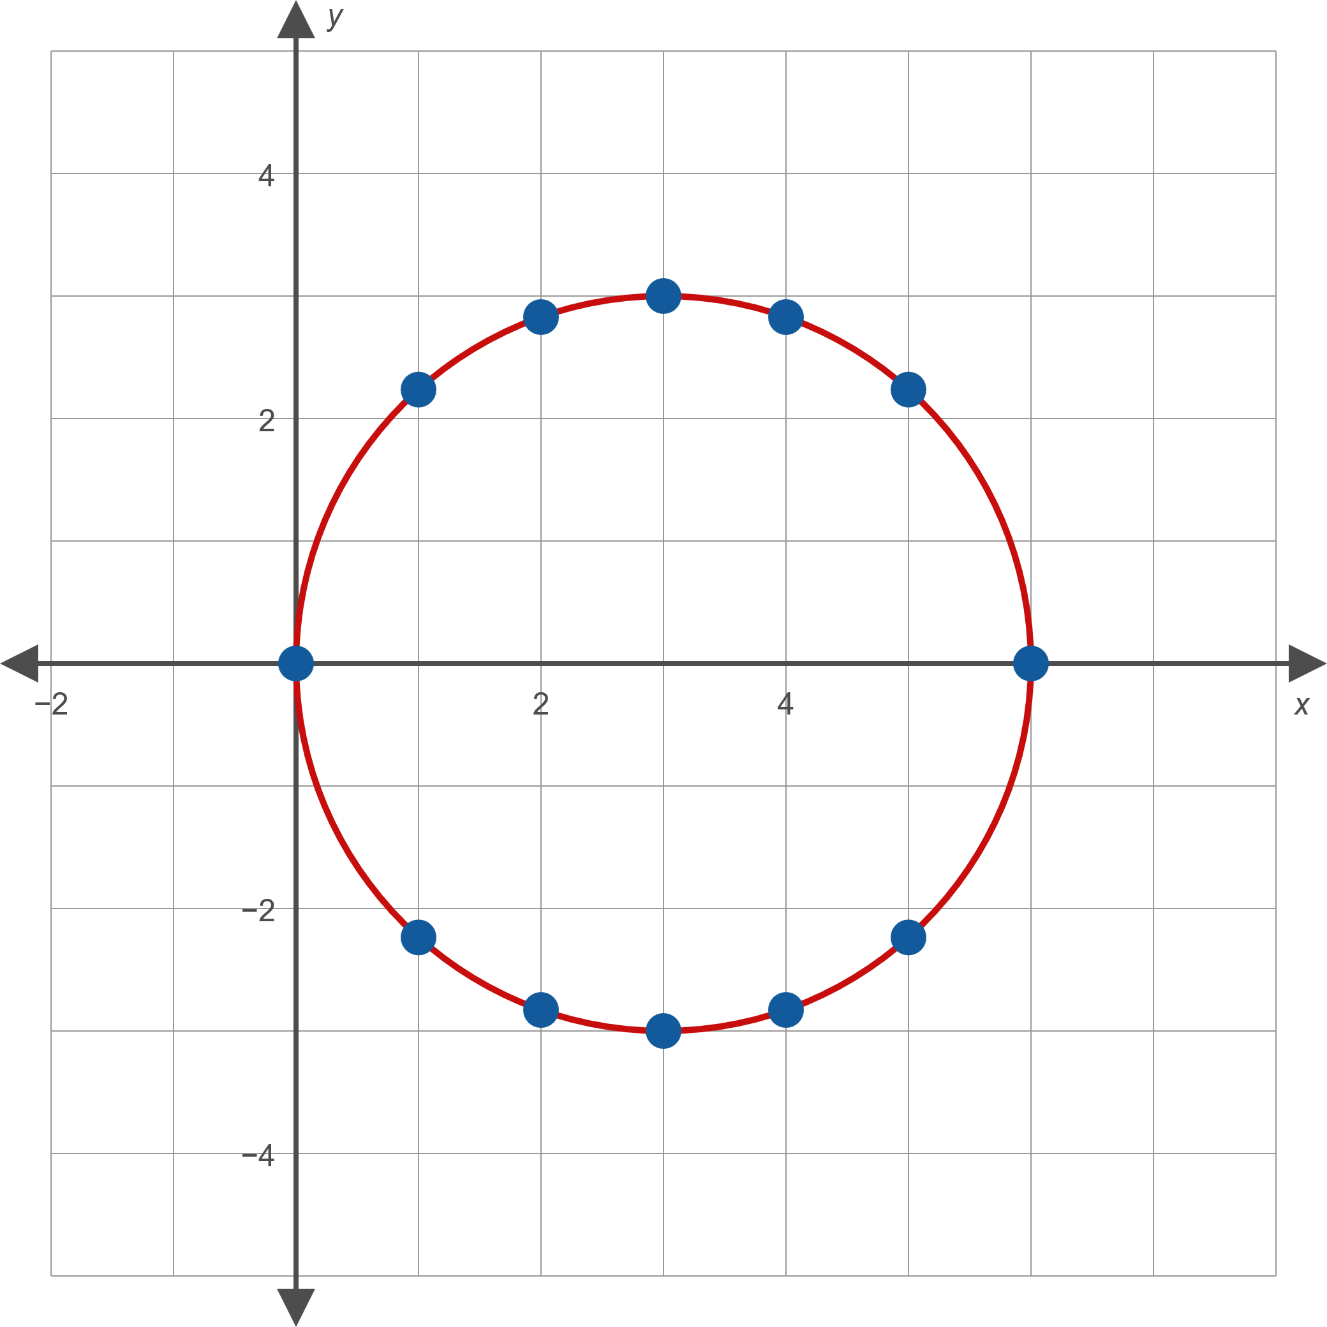
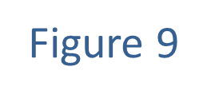
Example 2: Graphing Equations in Two Variables—Slide 11

Slide 27

Example 2: Graphing Equations in Two Variables—Slide 12
​Since this equation is already solved for $y$ we use a table of $x$-values and substitute them in the given equation. Again, enough points should be plotted to give some idea of the nature of the entire solution set of the equation.
​

Slide 28
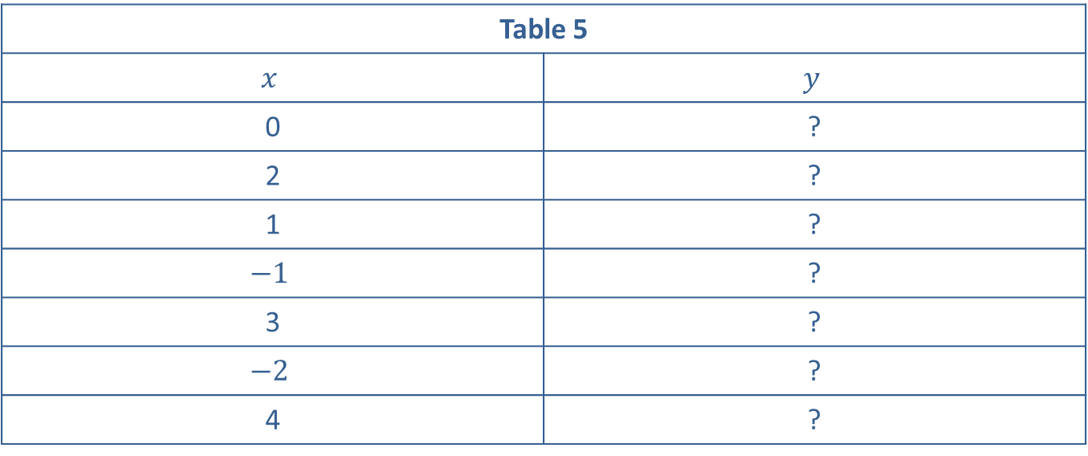
Example 2: Graphing Equations in Two Variables—Slide 13
Table 5
$$x$$ | $$y$$
0 | ?
2 | ?
1 | ?
$$−1$$ | ?
3 | ?
$$−2$$ | ?
4 | ?

Slide 29
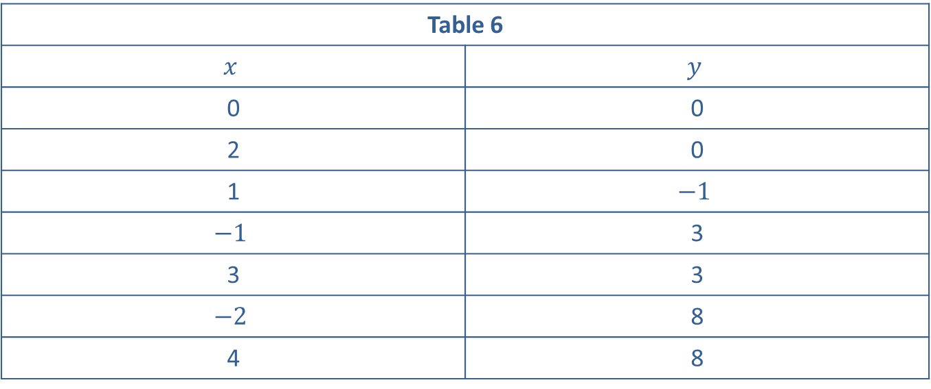
Example 2: Graphing Equations in Two Variables—Slide 14
Table 6
$$x$$ | $$y$$
0 | 0
2 | 0
1 | $$−1$$
$$−1$$ | 3
3 | 3
$$−2$$ | 8
4 | 8

Slide 30

Example 2: Graphing Equations in Two Variables—Slide 15
​The graph of $y=x^{2}−2x$ is a shape known as a parabola. We will encounter these shapes again in a later lesson, and we will be able, at that time, to prove that our rough sketch in Figure 10 is indeed the graph of the solution set of$y=x^{2}−2x$.
​

Slide 31
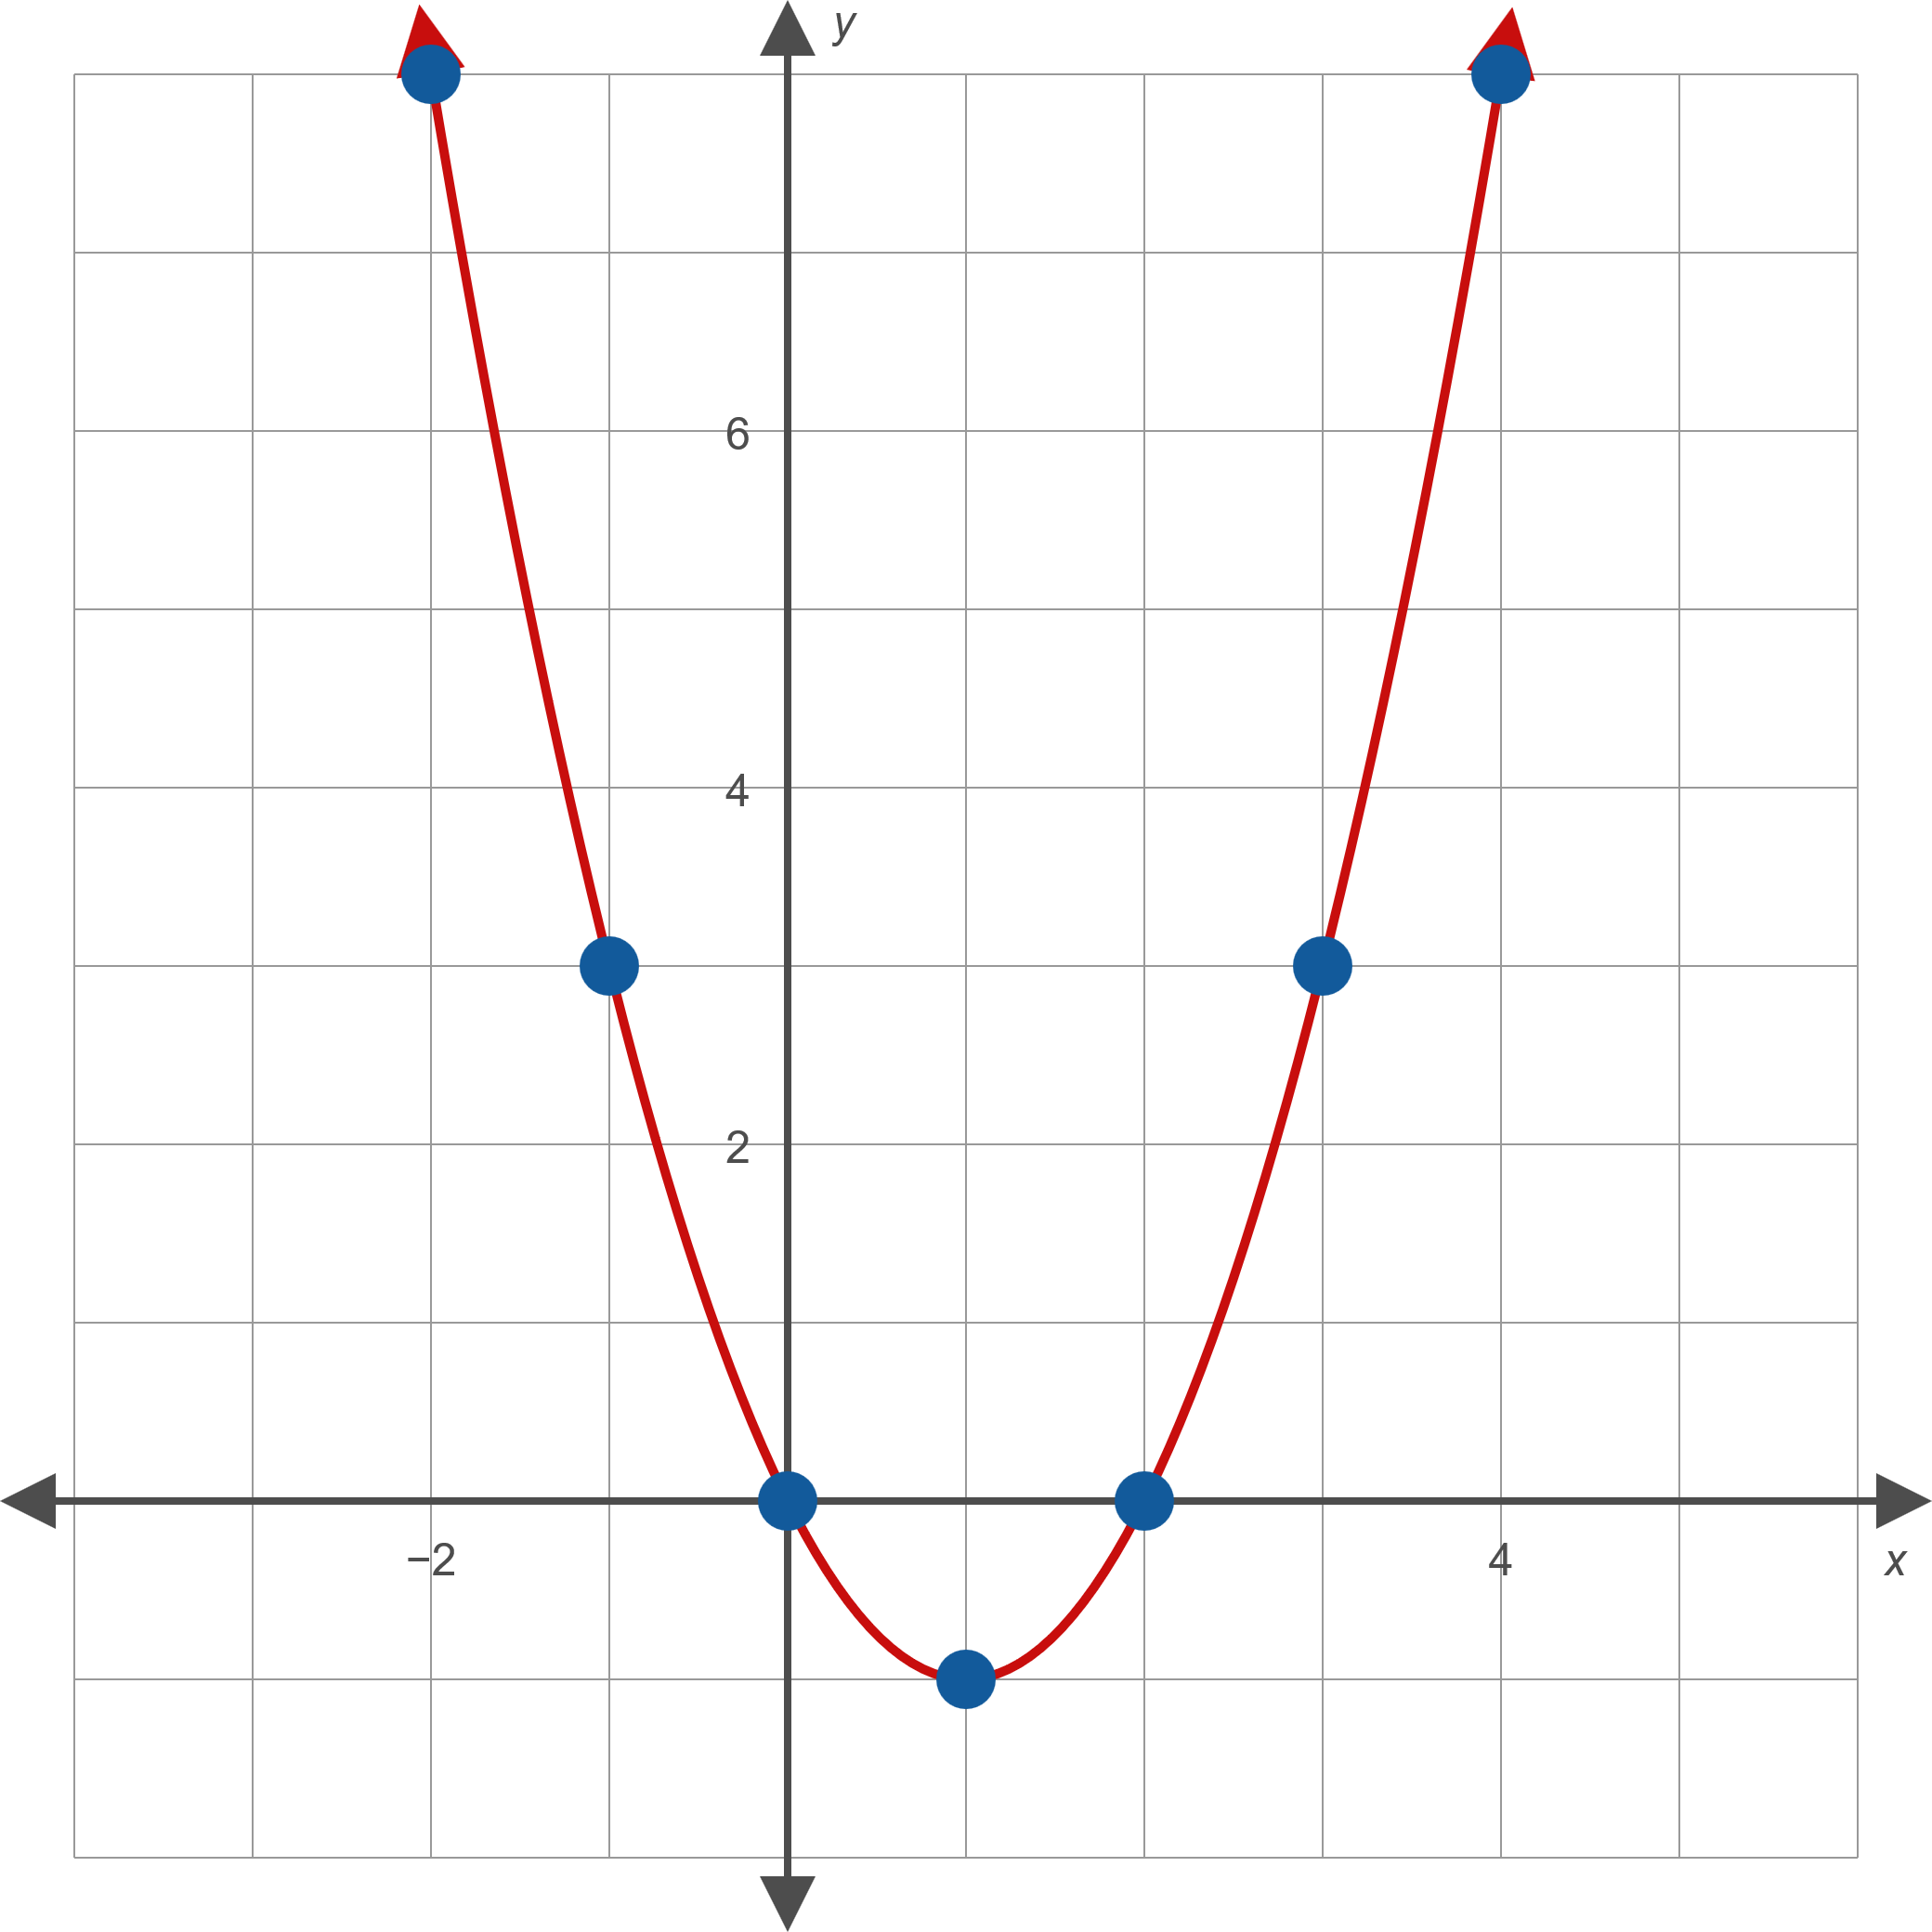
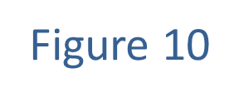
Example 2: Graphing Equations in Two Variables—Slide 16

Slide 32
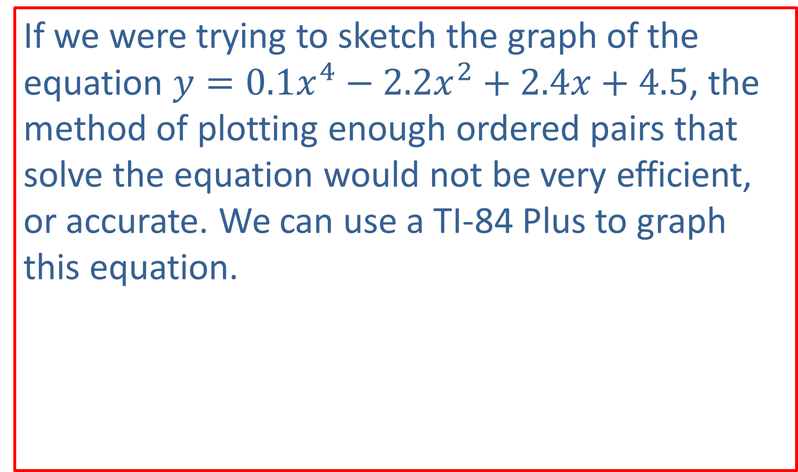
Technology: Graphing an Equation—Slide 1
If we were trying to sketch the graph of the equation $y=0.1x^{4}−2.2x^{2}+2.4x+4.5$, the method of plotting enough ordered pairs that solve the equation would not be very efficient, or accurate. We can use a TI-84 Plus to graph this equation.

Slide 33
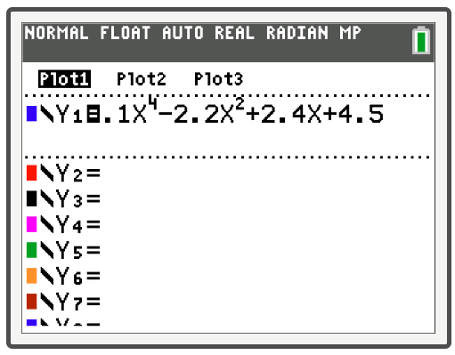
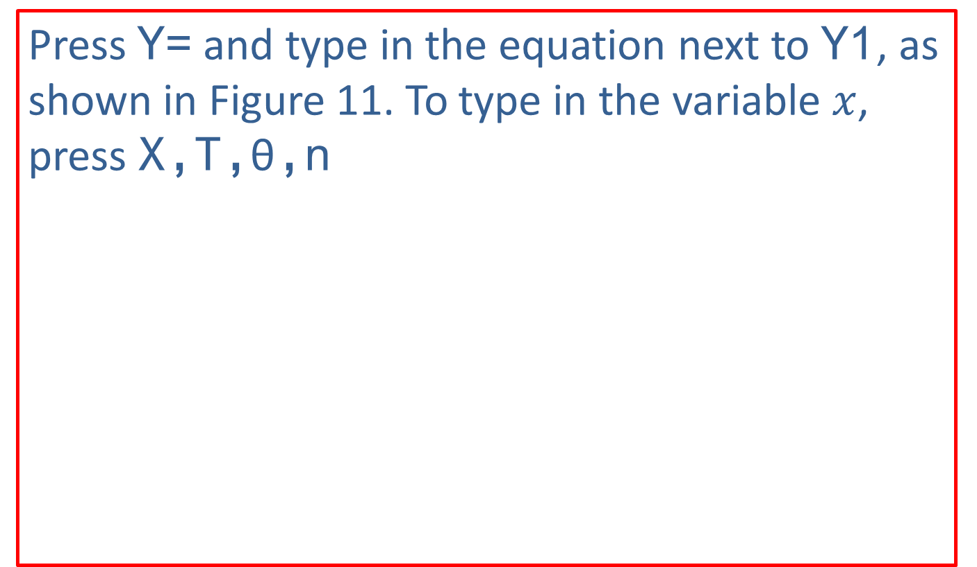
Technology: Graphing an Equation—Slide 2
Press Y= and type in the equation next to Y1, as shown in Figure 11. To type in the variable $x$, press X,T,θ,n
Figure 11

Slide 34
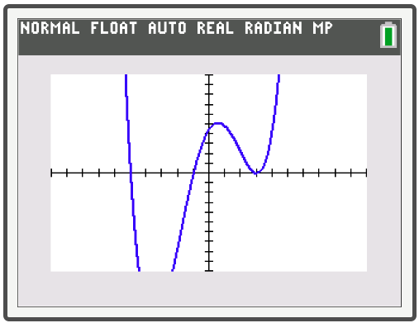
Technology: Graphing an Equation—Slide 3
Press graph and the graph in Figure 12 should appear.
Figure 12

Slide 35
Technology: Graphing an Equation—Slide 4
Notice that you can't see the very bottom of the curve. Oftentimes when we use a TI-84 Plus to graph equations, we have to adjust the viewing window to see the whole graph. To do so, press WINDOW. The default window displays the graph with x- and y-values ranging from −10 to 10. This window can be changed by changing the values for Xmin, Xmax, Ymin, and Ymax.

Slide 36
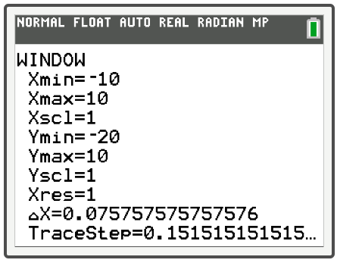
Technology: Graphing an Equation—Slide 5
Since the graph that appears descends below our viewing screen, we need to change the value for Ymin to something smaller, like −20, as shown in Figure 13.
Figure 13

Slide 37
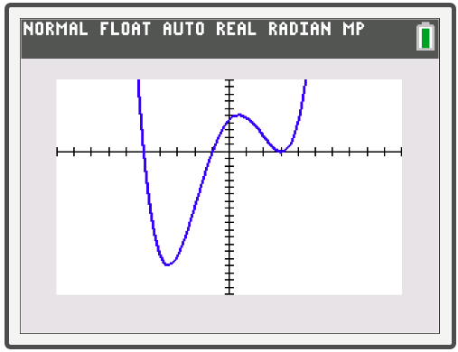
Technology: Graphing an Equation—Slide 6
Press graph again and the TI-84 Plus will display the graph again with the new window settings (see Figure 14).
Figure 14

Slide 38
Technology: Graphing an Equation—Slide 7
Keep in mind that the screen is not square: one unit on the x-axis looks longer than one unit on the y-axis, so the picture will not be an accurate representation unless the window is set to a ratio of about 3:2. One way to attain a window with this ratio is to press ZOOM and select Zsquare. This will change the values in the WINDOW screen.

Slide 39
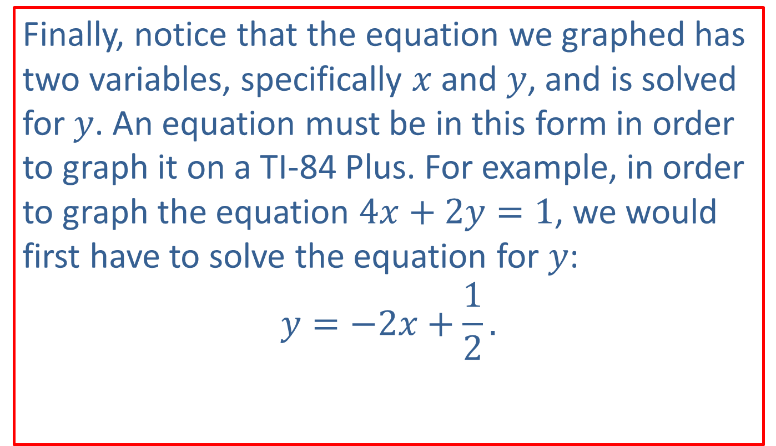
Technology: Graphing an Equation—Slide 8
Finally, notice that the equation we graphed has two variables, specifically $x$ and $y$, and is solved for $y$. An equation must be in this form in order to graph it on a TI-84 Plus. For example, in order to graph the equation $4x+2y=1$, we would first have to solve the equation for $y$: $$y=−2x+\frac{1}{2}.$$

Slide 40
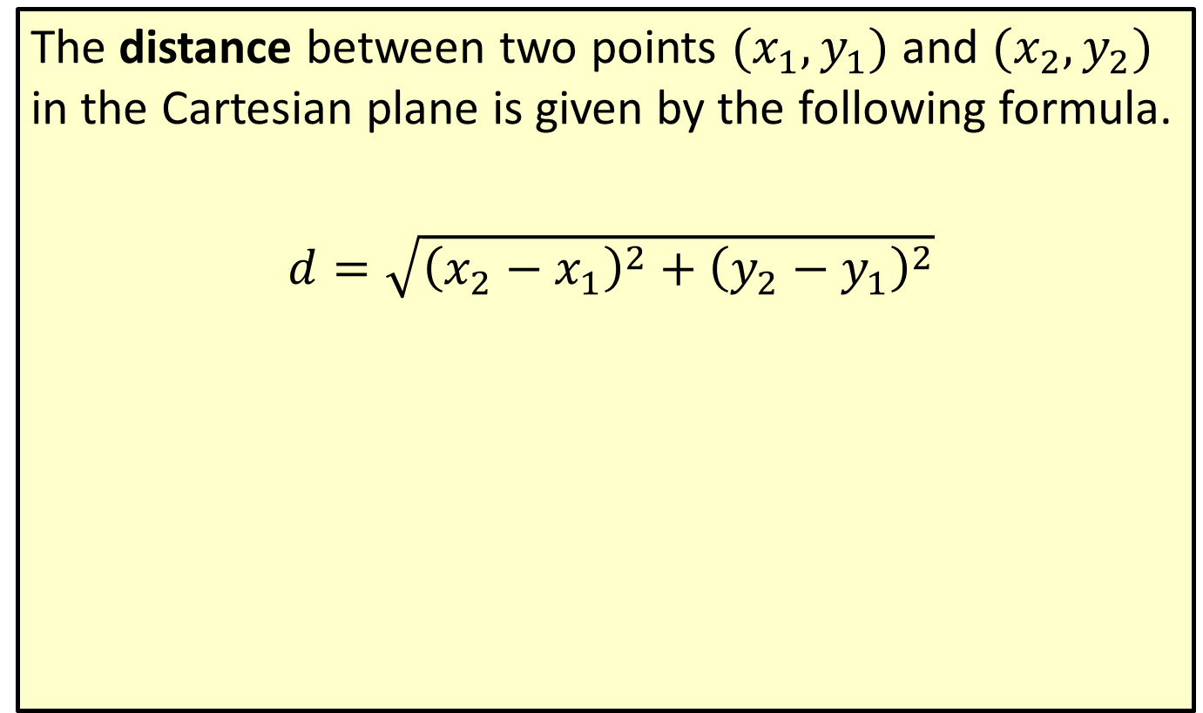
Formula: Distance Formula
The distance between two points $(x_{1},y_{1})$ and $(x_{2},y_{2})$ in the Cartesian plane is given by the following formula.
$d=\sqrt{{\left(x_{2}−x_{1}\right)}^{2}+{\left(y_{2}−y_{1}\right)}^{2}}$

Slide 41

Example 3: Using the Distance Formula—Slide 1
Calculate the distance between the following pairs of points.
​$(−4,−2)$ and $(−7,2)$
​$(5,1)$ and $(−1,3)$

Slide 42
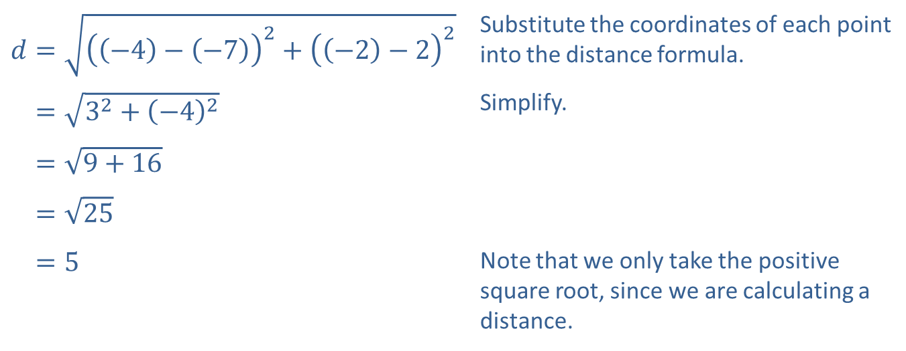
Example 3: Using the Distance Formula—Slide 2
Solution
​
​$d=\sqrt{{\left(\left(−4\right)−\left(−7\right)\right)}^{2}+{\left(\left(−2\right)−2\right)}^{2}}$ | Substitute the coordinates of each point into the distance formula.
​𝑑=32+−42 | Simplify.
​𝑑=9+16
​𝑑=25
​𝑑=5 | Note that we only take the positive square root, since we are calculating a distance.

Slide 43
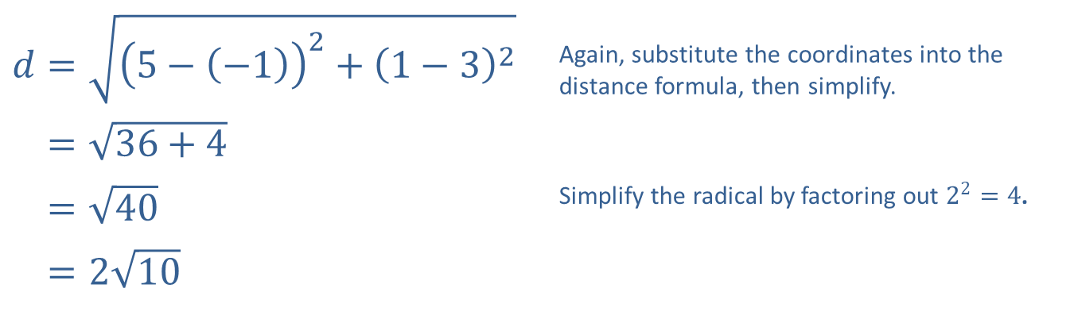
Example 3: Using the Distance Formula—Slide 3
​$d=\sqrt{{\left(5−\left(−1\right)\right)}^{2}+{\left(1−3\right)}^{2}}$ | Again, substitute the coordinates into the distance formula, then simplify.
​𝑑=36+4
​𝑑=40 | Simplify the radical by factoring out $2^{2}=4$.
​𝑑=210
​

Slide 44
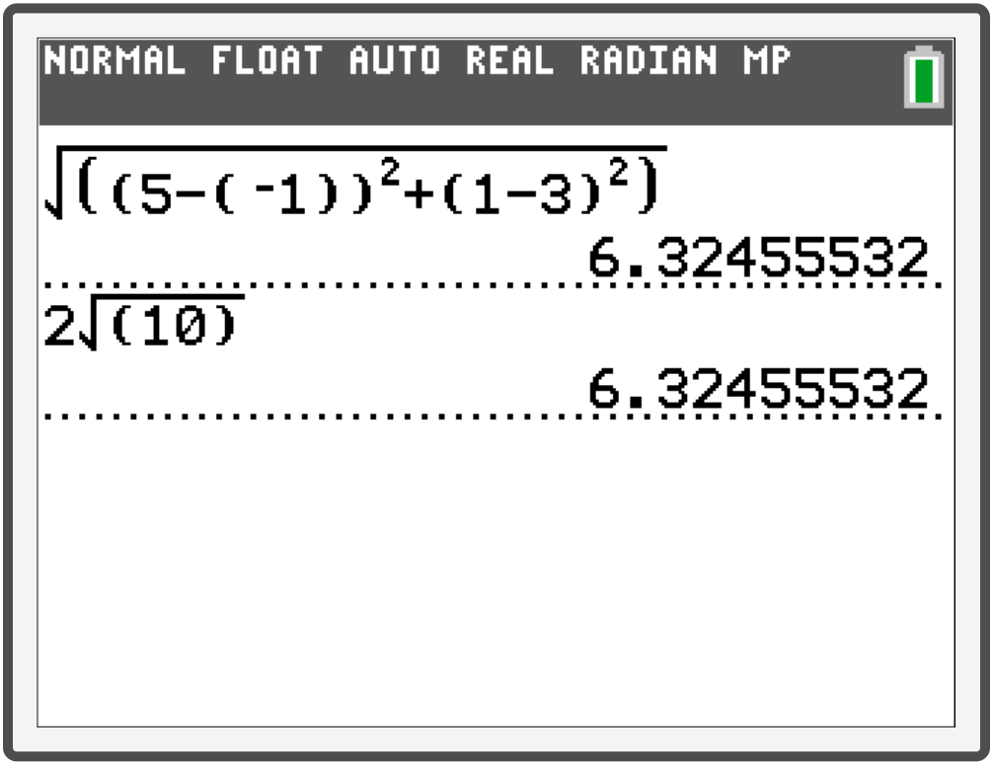
Example 3: Technology
When entering the distance formula, be sure to include all the necessary parentheses.

Slide 45

Formula: Midpoint Formula
The midpoint between two points $(x_{1},y_{1})$ and $(x_{2},y_{2})$ in the Cartesian plane has the following coordinates.
$(\frac{x_{1}+x_{2}}{2},\frac{y_{1}+y_{2}}{2})$

Slide 46

Example 4: Using the Midpoint Formula—Slide 1
Calculate the midpoint of the line connecting each pair of points.
​$(5,1)$ and $(−1,3)$
​$(3,0)$ and $(−6,11)$

Slide 47

Example 4: Using the Midpoint Formula—Slide 2
Solution
In each case, we simply substitute the coordinates of each point into the midpoint formula. This has the effect of averaging both $x$-coordinates and both $y$-coordinates.
​ $(\frac{5+\left(−1\right)}{2},\frac{1+3}{2})=\left(2,2\right)$
​
​$(\frac{3+\left(−6\right)}{2},\frac{0+11}{2})=(−\frac{3}{2},\frac{11}{2})$

