Slide 1
Lesson 35.3
Mammalian Heart and Blood Vessels

Slide 2
Objectives
  Describe the cardiac cycle.
  Describe the structure of the heart and explain how cardiac muscle is different from other muscles.
  Explain the structure of arteries, veins, and capillaries, and how blood flows through the body.

Slide 3
Mammalian Heart and Blood Vessels
The heart is a complex muscle that pumps blood through the three divisions of the circulatory system: the coronary (vessels that serve the heart), pulmonary (heart and lungs), and systemic (systems of the body).
Coronary circulation intrinsic to the heart takes blood directly from the main artery (aorta) coming from the heart.
For pulmonary and systemic circulation, the heart has to pump blood to the lungs or the rest of the body, respectively.
In vertebrates, the lungs are relatively close to the heart in the thoracic cavity.

Slide 4
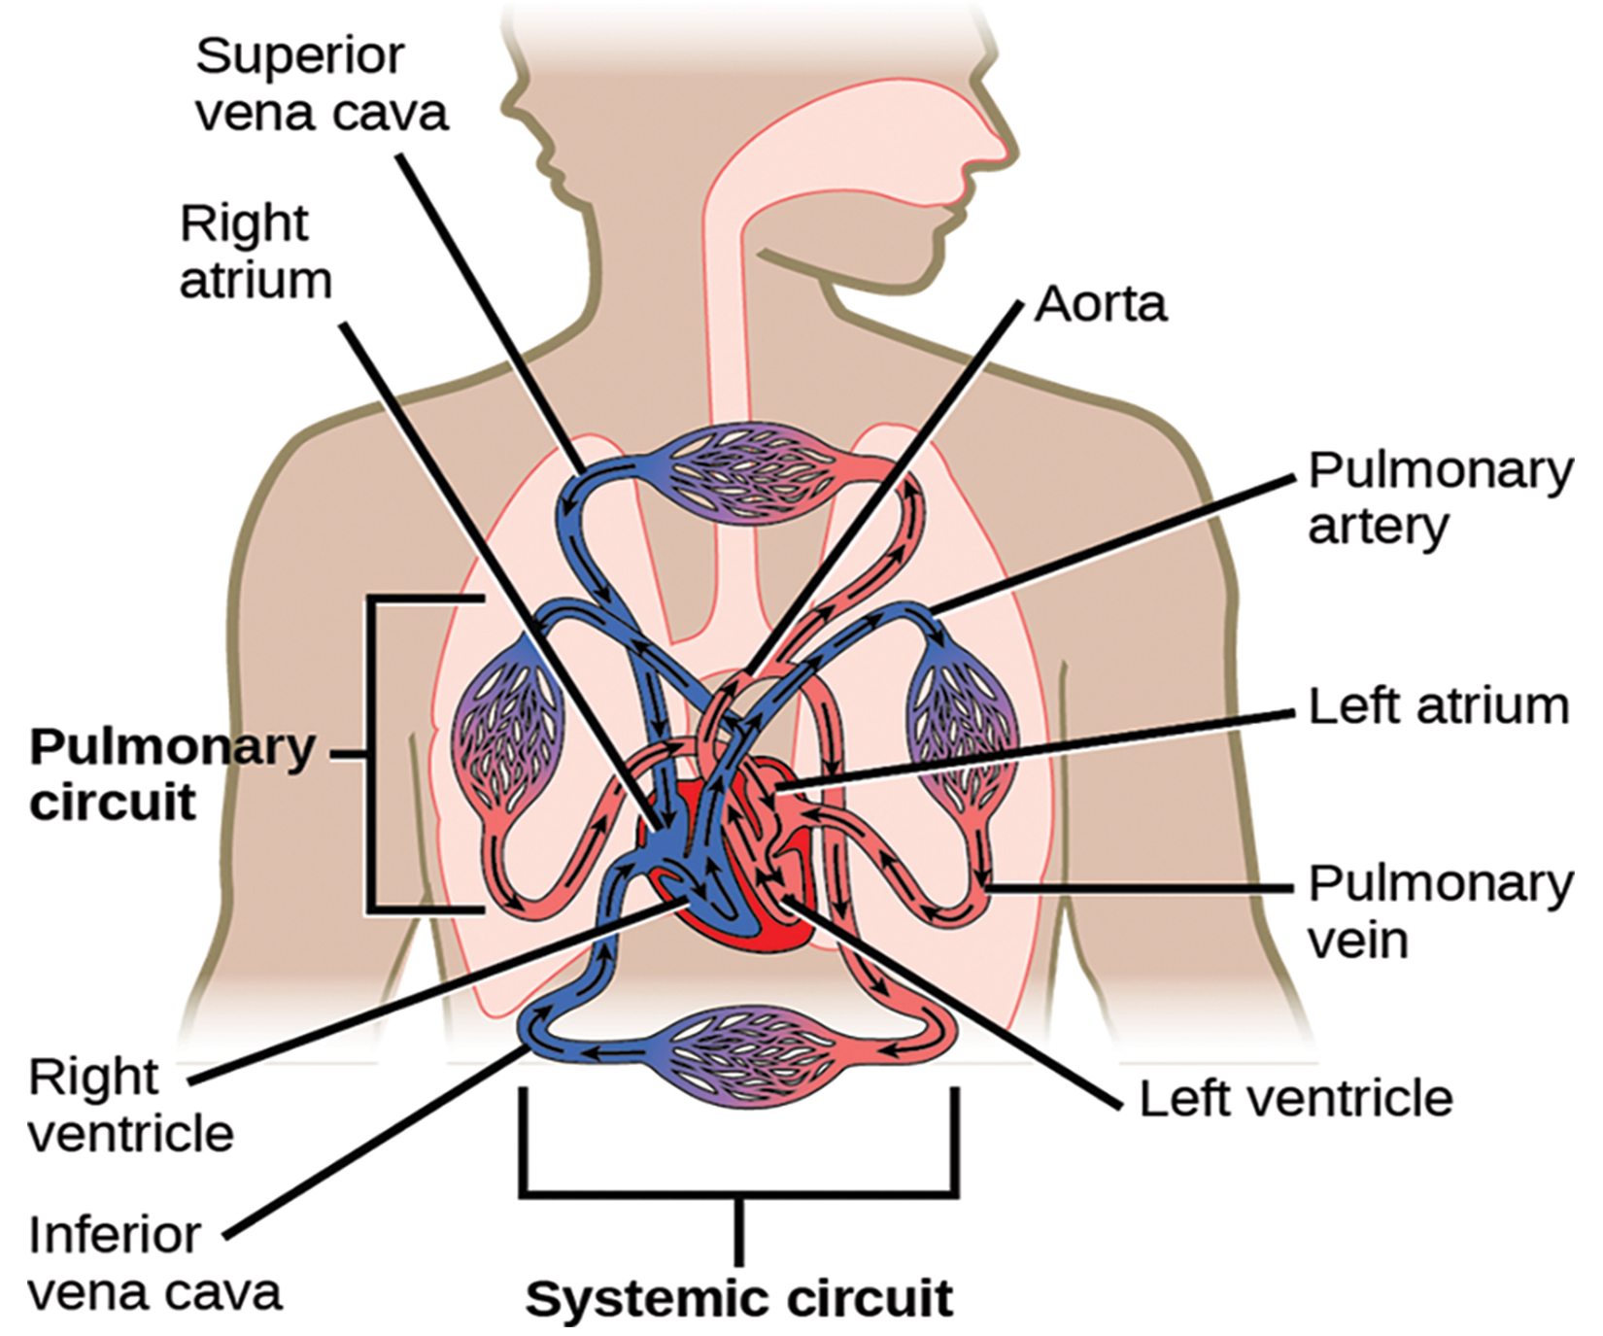
Lesson 35.3 Figure 1
CNX OpenStax on Wikimedia Commons. "Systemic circulation."
Notes:
Figure 1: The mammalian circulatory system is divided into three circuits: the systemic circuit, the pulmonary circuit, and the coronary circuit. Blood is pumped from the veins of the systemic circuit into the right atrium of the heart, then into the right ventricle. Blood then enters the pulmonary circuit and is oxygenated by the lungs. From the pulmonary circuit, blood re-enters the heart through the left atrium. From the left ventricle, blood re-enters the systemic circuit through the aorta and is distributed to the rest of the body. The coronary circuit, which provides blood to the heart, is not shown.

Slide 5
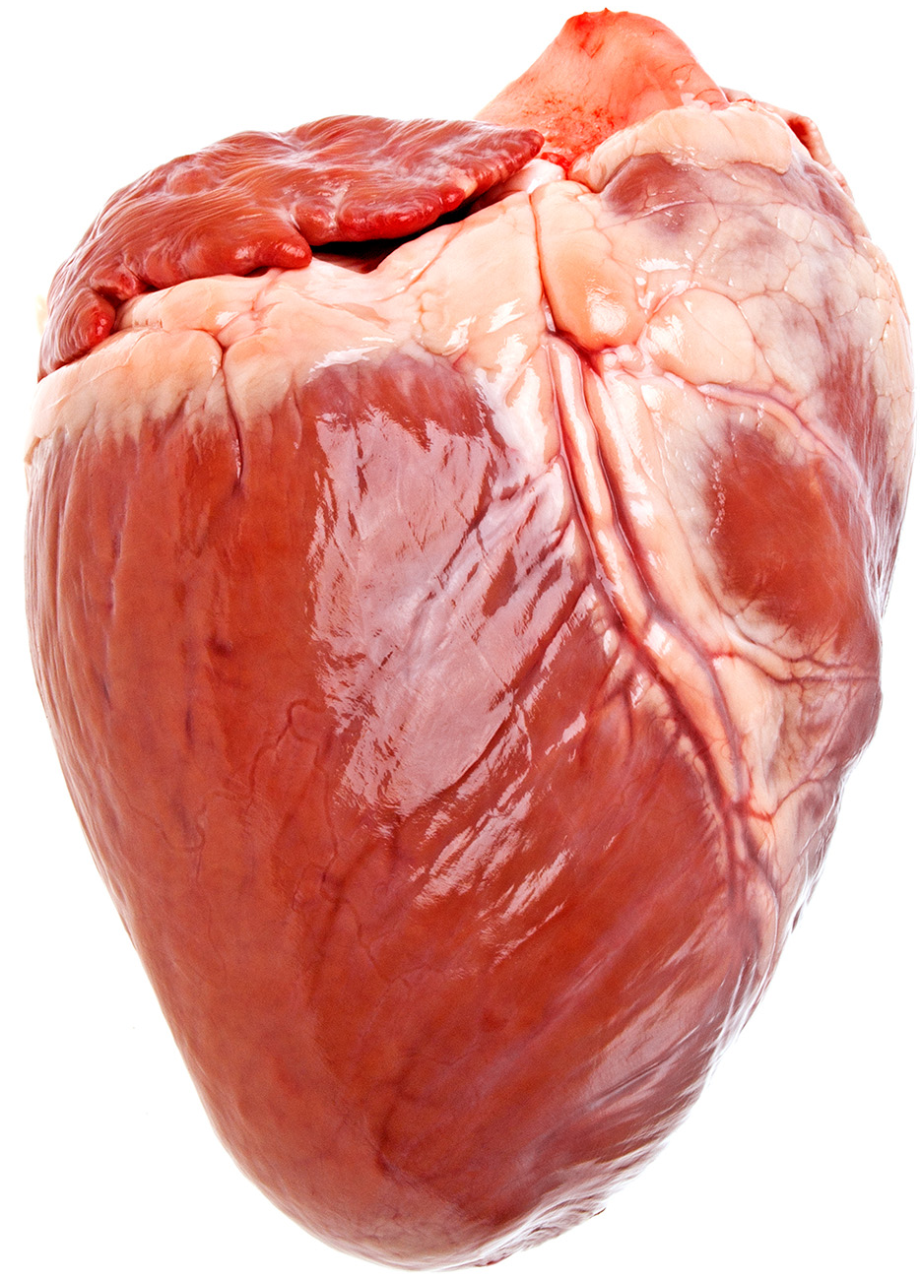
Structure of the Heart₁
The heart muscle is asymmetrical. The right side of the heart is smaller than the left side.
The heart is divided into four chambers: two atria and two ventricles.
There is one atrium and one ventricle on the right side and one atrium and one ventricle on the left side.
The atria receives blood, and the ventricles pump blood.
35.3 Figure 2
Notes:
Figure 2: This pig heart is approximately the same size and shape as a human heart.

Slide 6
Structure of the Heart₂
The inner wall of the heart has a lining called the endocardium.
The myocardium consists of the heart muscle cells that make up the middle layer and the bulk of the heart wall.
The outer layer of cells is called the epicardium, of which the second layer is a membranous layered structure called the pericardium that surrounds and protects the heart.
  It allows enough room for vigorous pumping but also keeps the heart in place.
Notes:
Figure 2: This pig heart is approximately the same size and shape as a human heart.

Slide 7
Structure of the Heart₃
The heart has its own blood vessels that supply the heart muscle with blood.
The coronary arteries branch from the aorta and surround the outer surface of the heart like a crown.
They diverge into capillaries before converging again into the coronary veins to take the deoxygenated blood back to the right atrium.
Atherosclerosis is the blockage of an artery by the buildup of fatty plaques.
  The slowdown of blood flow and subsequent oxygen deprivation causes severe pain, known as angina.
  Complete blockage of the arteries will cause myocardial infarction: the death of cardiac muscle tissue (heart attack).
Notes:
Figure 2: This pig heart is approximately the same size and shape as a human heart.

Slide 8
Think It Through₁
Describe what changes occur in the lead-up to a heart attack. What is a heart attack?
Notes:
Originally an On Your Own. This is included here to use as a talking point or for a think-pair-share activity.

Slide 9
Flow of Blood through the Heart₁
The right atrium receives deoxygenated blood from the:
Superior vena cava, which drains blood from the jugular vein that comes from the brain
Veins coming from the arms
Inferior vena cava, which drains blood from the veins that come from the lower organs and the legs
Coronary sinus, which drains deoxygenated blood from the heart itself

Slide 10
Flow of Blood through the Heart₂
Deoxygenated blood travels to the right ventricle through the atrioventricular valve, or tricuspid valve (a flap of connective tissue that opens in only one direction to prevent the backflow of blood).
The valve separating the chambers on the left side of the heart is called the bicuspid valve, or mitral valve.
The right ventricle pumps blood through the pulmonary arteries(bypassing the semilunar valve (or pulmonic valve)) to the lungs for reoxygenation.

Slide 11
Flow of Blood through the Heart₃
After blood passes through the pulmonary arteries, the right semilunar valves close.
The left atrium receives oxygen-rich blood from the lungs via the pulmonary veins.
This blood passes through the bicuspid valve to the left ventricle where blood pumps out through the aorta sending oxygenated blood to organs and muscles of the body.
This pattern of pumping is referred to as double circulation and is found in all mammals.

Slide 12
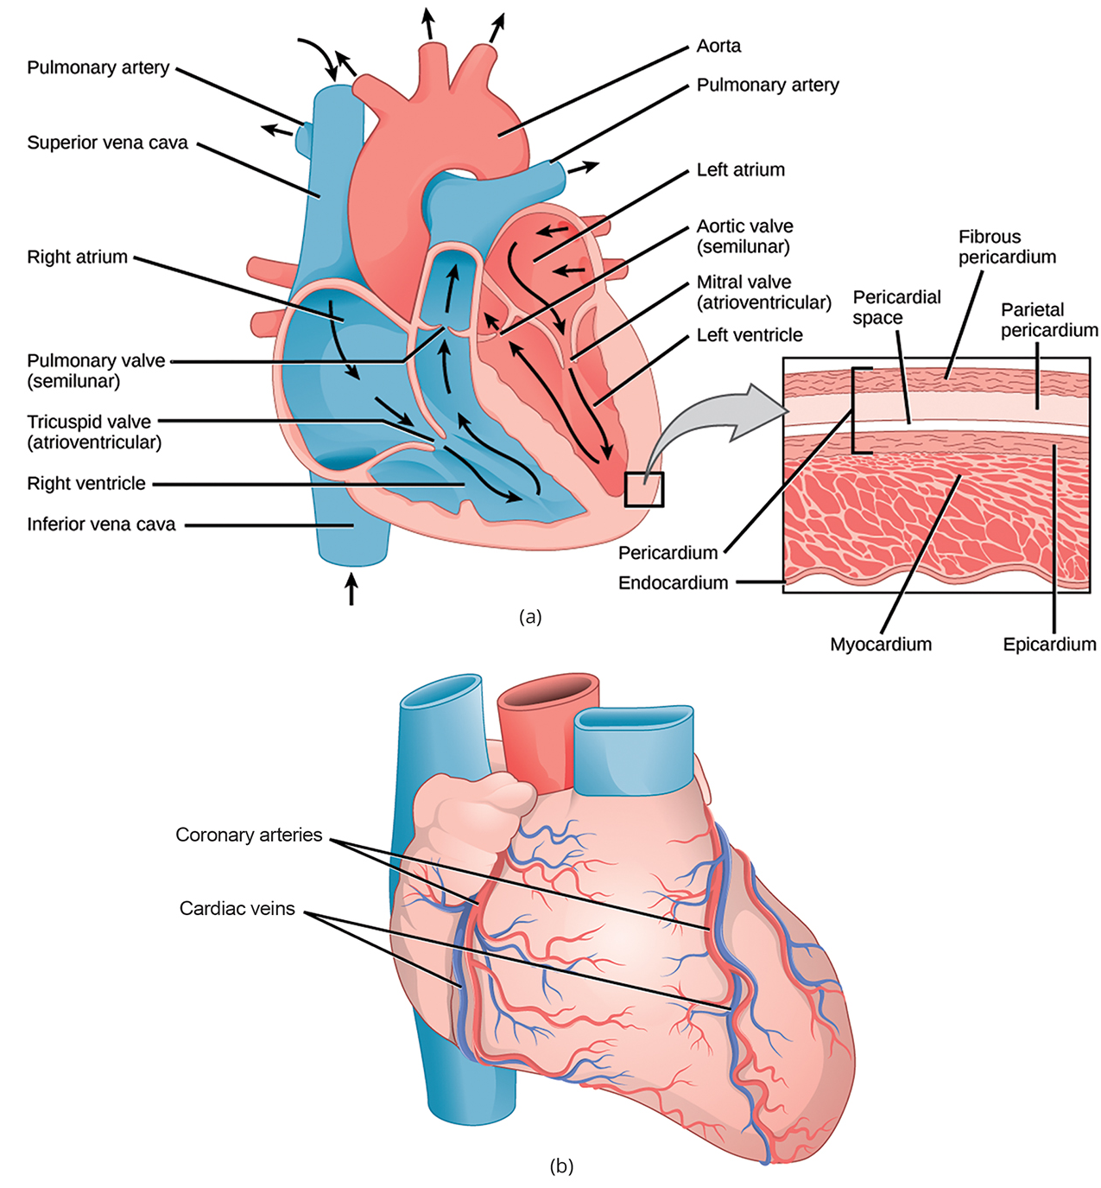
Lesson 35.3 Figure 3
OpenStax. "Heart structure." Modified.
Notes:
Figure 3: (a) The heart is primarily made of a thick muscle layer, called the myocardium, surrounded by membranes. One-way valves separate the four chambers. (b) Blood vessels of the coronary system, including the coronary arteries and veins, keep the heart musculature oxygenated.

Slide 13
Science and You
In the United States, heart disease kills 1 out of every 4 people and is the #1 cause of death for both men and women.
How can we keep our hearts healthy?
A healthy diet and an active lifestyle reduce your chances of heart disease. Coronary heart disease is the most common type of heart disease.
Coronary heart disease happens when the blood vessels can't provide blood fast enough due to increased peripheral resistance. Often, this resistance results from clogged arteries or a buildup of plaque.
A sedentary lifestyle, excess body weight, and an unhealthy diet increase your risk of coronary heart disease.
Notes:
This is included as a relevant application for this topic.

Slide 14
The Cardiac Cycle₁
The cardiac cycle coordinates the filling and emptying of the heart of blood by electrical signals that cause the heart muscles to contract and relax.
In each cardiac cycle, the heart contracts (systole), pushing out the blood and pumping it through the body; this is followed by a relaxation phase (diastole), where the heart fills with blood.
The atria contract at the same time, forcing blood through the atrioventricular valves into the ventricles. The atrioventricular valves closing produce a "lup" sound.
Following a brief delay, the ventricles contract at the same time, forcing blood through the semilunar valves into the aorta and the artery, transporting blood to the lung. The closing of the semilunar valves produces a "dup" sound.

Slide 15
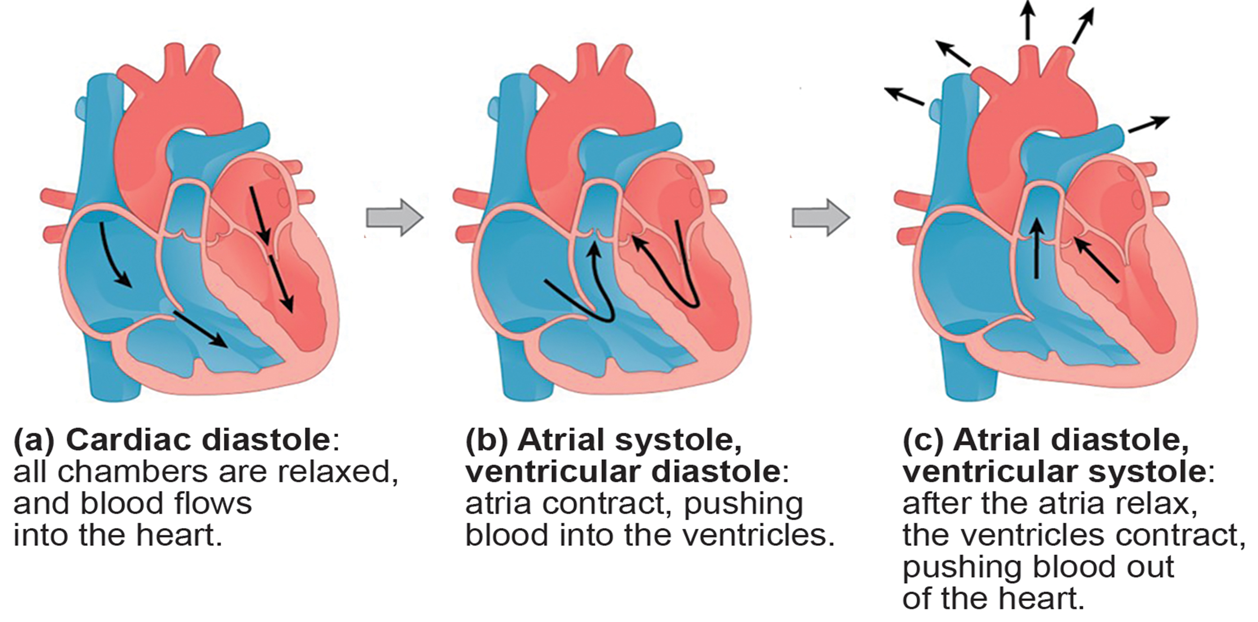
Lesson 35.3 Figure 4
CNX OpenStax on Wikimedia Commons. "Heart." Modified.
Notes:
Figure 4: During (a) cardiac diastole, the heart muscle is relaxed, and blood flows into the heart. During (b) atrial systole, the atria contract, pushing blood into the ventricles. During (c) atrial diastole, the ventricles contract, forcing blood out of the heart.

Slide 16
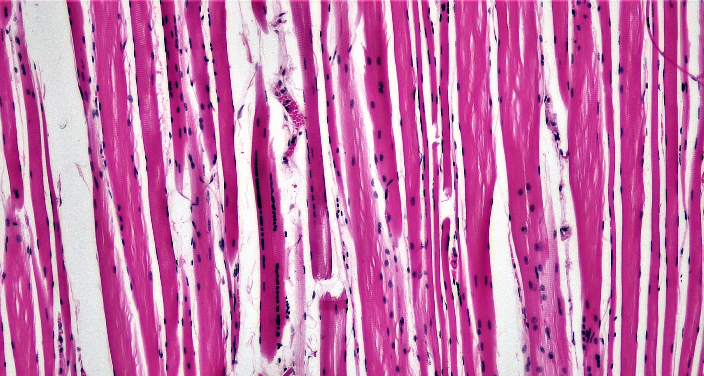
The Cardiac Cycle₂
The pumping of the heart is a function of the cardiac muscle cells, or cardiomyocytes.
Cardiomyocytes are distinctive muscle cells that are striated like skeletal muscle but pump rhythmically and involuntarily like smooth muscle.
35.3 Figure 5
Berkshire Community College Bioscience Image Library on Wikimedia Commons. "Cardiac muscle tissue."
Notes:
Figure 5: Cardiomyocytes are striated muscle cells found in cardiac tissue.

Slide 17
The Cardiac Cycle₃
The autonomous beating of cardiac muscle cells is regulated by the heart's internal pacemaker that uses electrical signals to time the beating of the heart.
The internal pacemaker starts at the sinoatrial (SA) node, which is located near the wall of the right atrium.
Electrical charges spontaneously pulse from the SA node, causing the two atria to contract in unison.
The pulse reaches a second node, called the atrioventricular (AV) node, between the right atrium and right ventricle where it pauses for approximately 0.1 second before spreading to the walls of the ventricles.

Slide 18
The Cardiac Cycle₄
From the AV node, the electrical impulse enters the bundle of His, then to the left and right bundle branches, extending through the interventricular septum.
Finally, the Purkinje fibers conduct the impulse from the apex of the heart up the ventricular myocardium, and then the ventricles contract.
The electrical impulses in the heart produce electrical currents that flow through the body and can be measured on the skin using electrodes.
  This information can be observed as an electrocardiogram (ECG): a recording of the electrical impulses of the cardiac muscle.

Slide 19
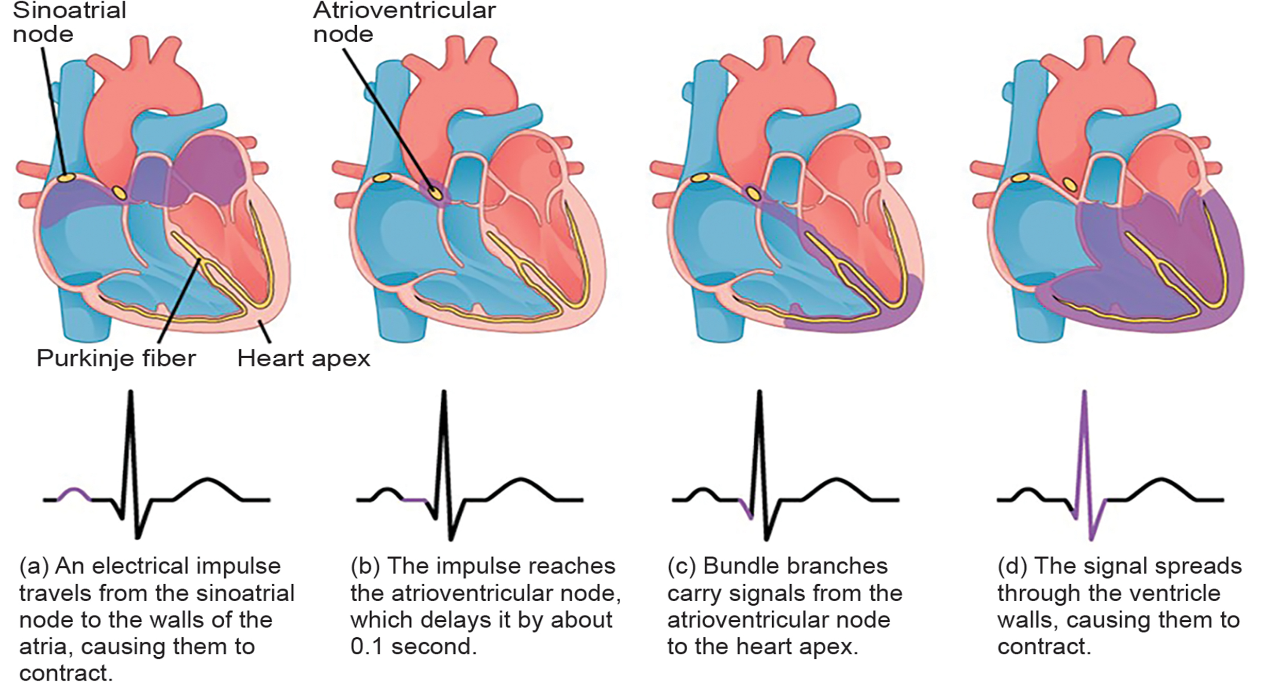
Lesson 35.3 Figure 6
OpenStax. "Heartbeat." Modified.
Notes:
Figure 6: The beating of the heart is regulated by an electrical impulse that causes the characteristic reading of an ECG. The signal is initiated at the sinoatrial valve. The signal then (a) spreads to the atria, causing them to contract. The signal is (b) delayed at the atrioventricular node before it is passed on to the (c) heart apex. The delay allows the atria to relax before the (d) ventricles contract. The final part of the ECG cycle prepares the heart for the next beat.

Slide 20
Arteries, Veins, and Capillaries₁
Arteries take blood away from the heart. The main artery is the aorta that branches into major arteries that take blood to different limbs and organs.
These major arteries include:
The carotid artery that takes blood to the brain
The brachial arteries that take blood to the arms
The thoracic artery that takes blood to the thorax
The iliac artery takes blood to the lower limbs.
The major arteries diverge into minor arteries, and then into smaller vessels called arterioles, to reach more deeply into the muscles and organs of the body.

Slide 21
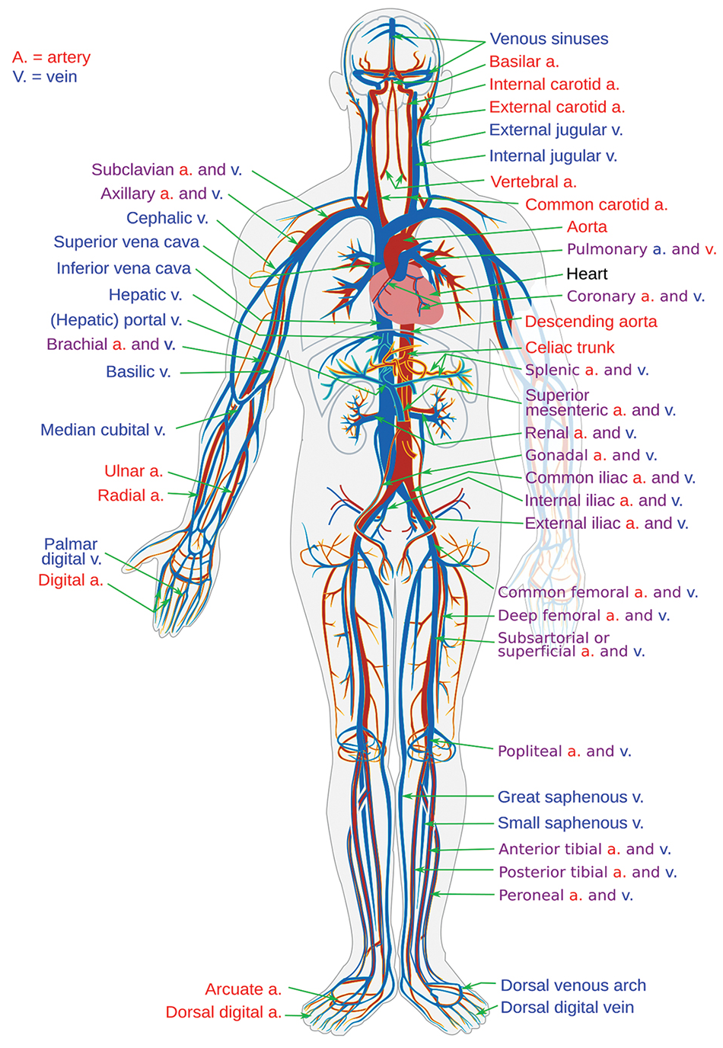
Lesson 35.3 Figure 7
Mariana Ruiz Villarreal on Wikimedia Commons. "Major arteries and veins of the body."
Notes:
Figure 7: The major human arteries and veins are shown.

Slide 22
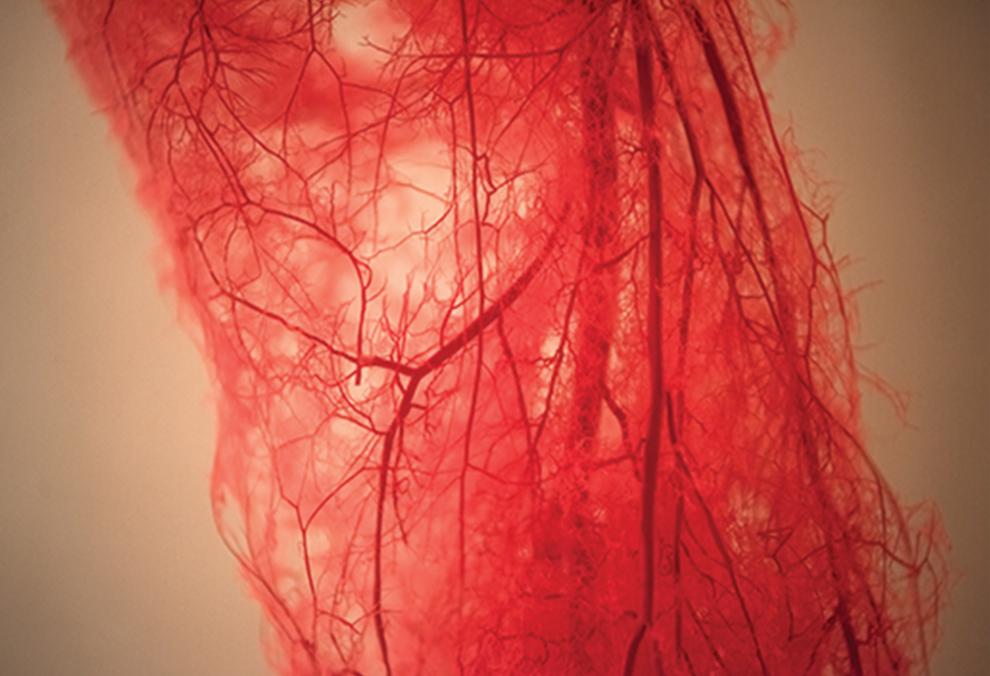
Arteries, Veins, and Capillaries₂
Arterioles diverge into capillary beds.
Capillary beds contain many capillaries that branch among the cells and tissues of the body.
Capillaries are narrow-diameter tubes where red blood cells move through in single file and are the sites for nutrients, waste, and oxygen exchange with tissues at the cellular level.
Fluid also crosses into the interstitial space from the capillaries.
35.3 Figure 8
Notes:
Figure 8: Blood vessels branch into capillaries in a human leg.

Slide 23
Arteries, Veins, and Capillaries₃
Capillaries converge into venules that connect to minor veins that finally connect to major veins that take blood high in carbon dioxide back to the heart.
Veins are blood vessels that bring blood back to the heart.
The major veins drain blood from the same organs and limbs that the major arteries supply.
Fluid is also brought back to the heart via the lymphatic system (the network of vessels that collect excess fluid, called lymph, and return it to the blood).

Slide 24
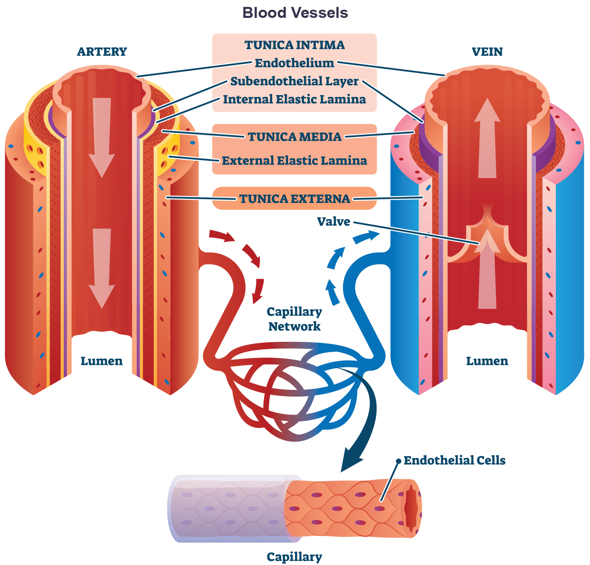
Blood Vessel Structure
There are three distinct layers, or tunics, that form the walls of blood vessels.
The first tunic is a smooth, inner lining of endothelial cells that are in contact with the red blood cells.
In capillaries, this single layer of cells is the location of diffusion of oxygen and carbon dioxide between the endothelial cells and red blood cells.
Veins and arteries have two further tunics that surround the endothelium: the middle tunic is composed of smooth muscle and the outermost layer is connective tissue.
35.3 Figure 9
Notes:
Figure 9: Arteries and veins consist of three layers: an outer tunica externa, a middle tunica media, and an inner tunica intima. Capillaries consist of a single layer of epithelial cells: the tunica intima.

Slide 25
Movement in Blood Vessels and Capillaries
The movement of materials at the site of capillaries is regulated by two forces:
Vasoconstriction: the narrowing of the blood vessels
Vasodilation: the widening of the blood vessels
The overall balance of blood movement by vasoconstriction and vasodilation is important in the overall regulation of blood pressure.

Slide 26
Think It Through₂
Describe the difference between vasoconstriction and vasodilation.
Which is likely to increase blood pressure?
Which is likely to decrease blood pressure?
Notes:
Originally an On Your Own. This is included here to use as a talking point or for a think-pair-share activity.

Slide 27
Group Activity
Each heartbeat sends a wave of increased blood pressure throughout your blood vessels. These pressure waves are readily detectable in some parts of our body, allowing an opportunity to count our heart rate in beats per minute. This measurement is called our pulse. The inner wrist is a commonly used location for detecting pulse.
First, find your pulse using two fingers to press gently along the inner wrist, under the thumb area. Be careful not to press too hard.
Now, find a partner and work together to measure your pulse in beats per minute.

Slide 28
Summary
The heart muscle pumps blood through three divisions of the circulatory system: coronary, pulmonary, and system.
There is one atrium and one ventricle on the right side and one atrium and one ventricle on the left side.
The pumping of the heart is a function of cardiomyocytes.
The blood from the heart is carried through the body by a complex network of blood vessels; arteries take blood away from the heart, and veins bring blood back to the heart.

Slide 29

End of Hawkes Learning PowerPoint

