Slide 1
Chapter 42
The Nervous System

Slide 2
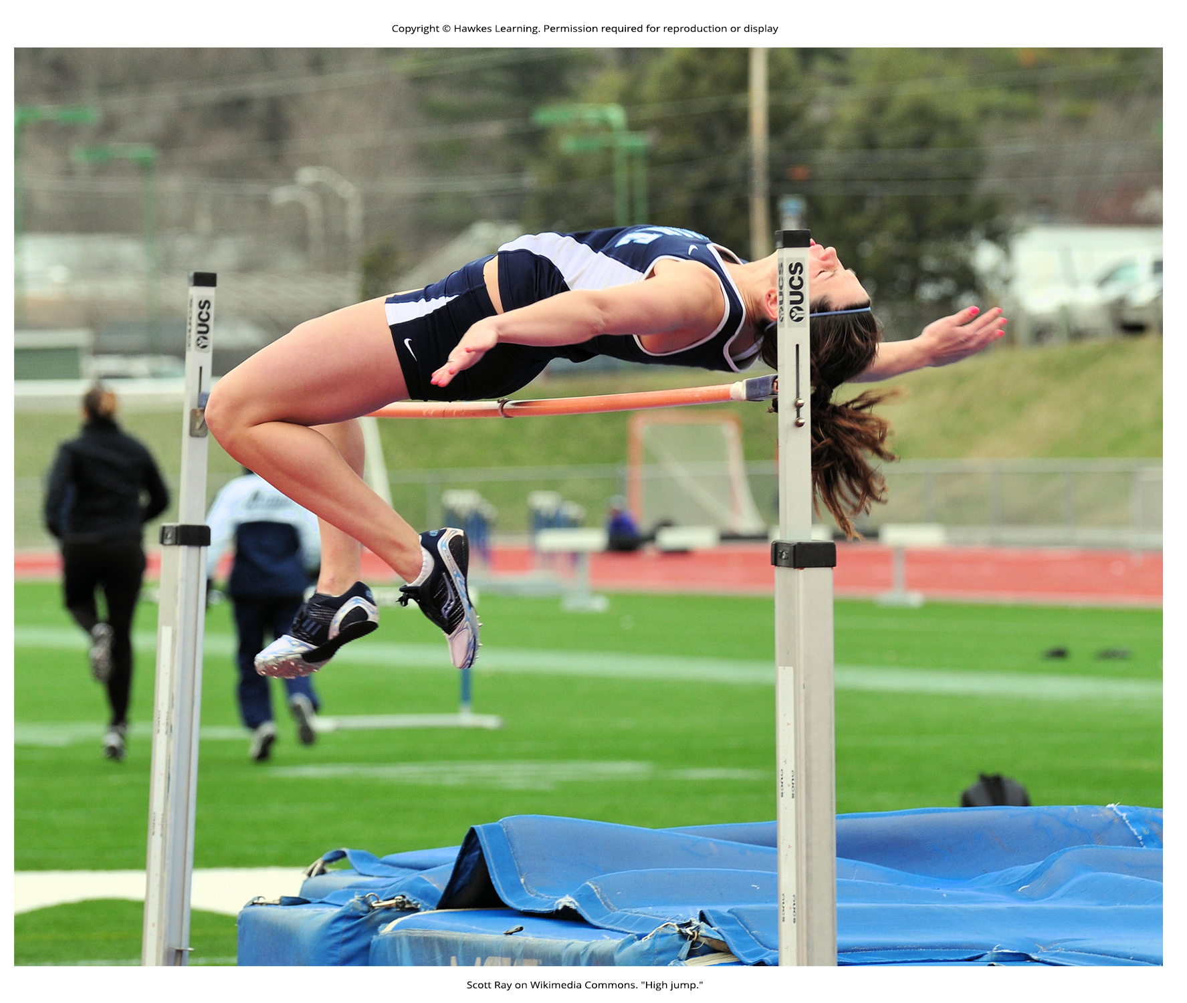
Lesson 42.1 Figure 1

Slide 3
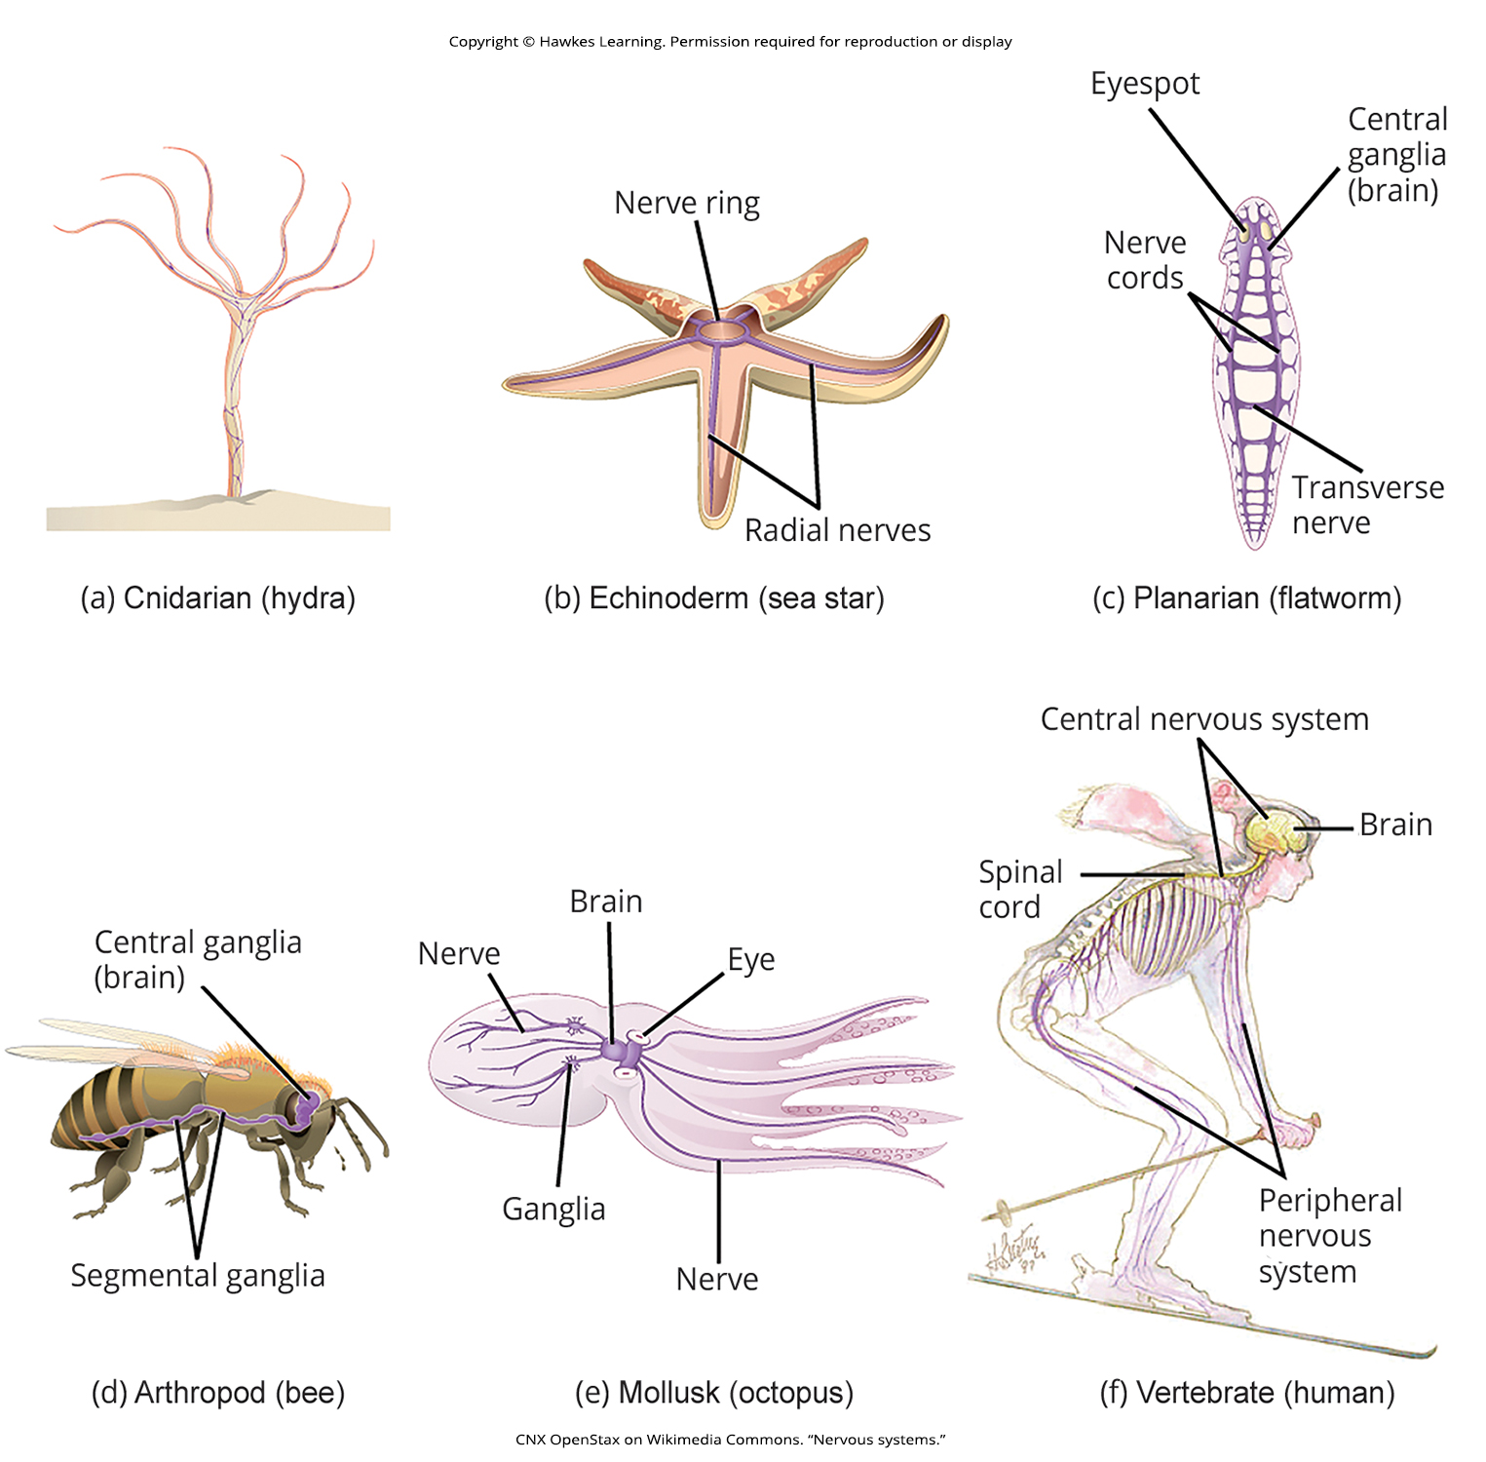
Lesson 42.1 Figure 2

Slide 4
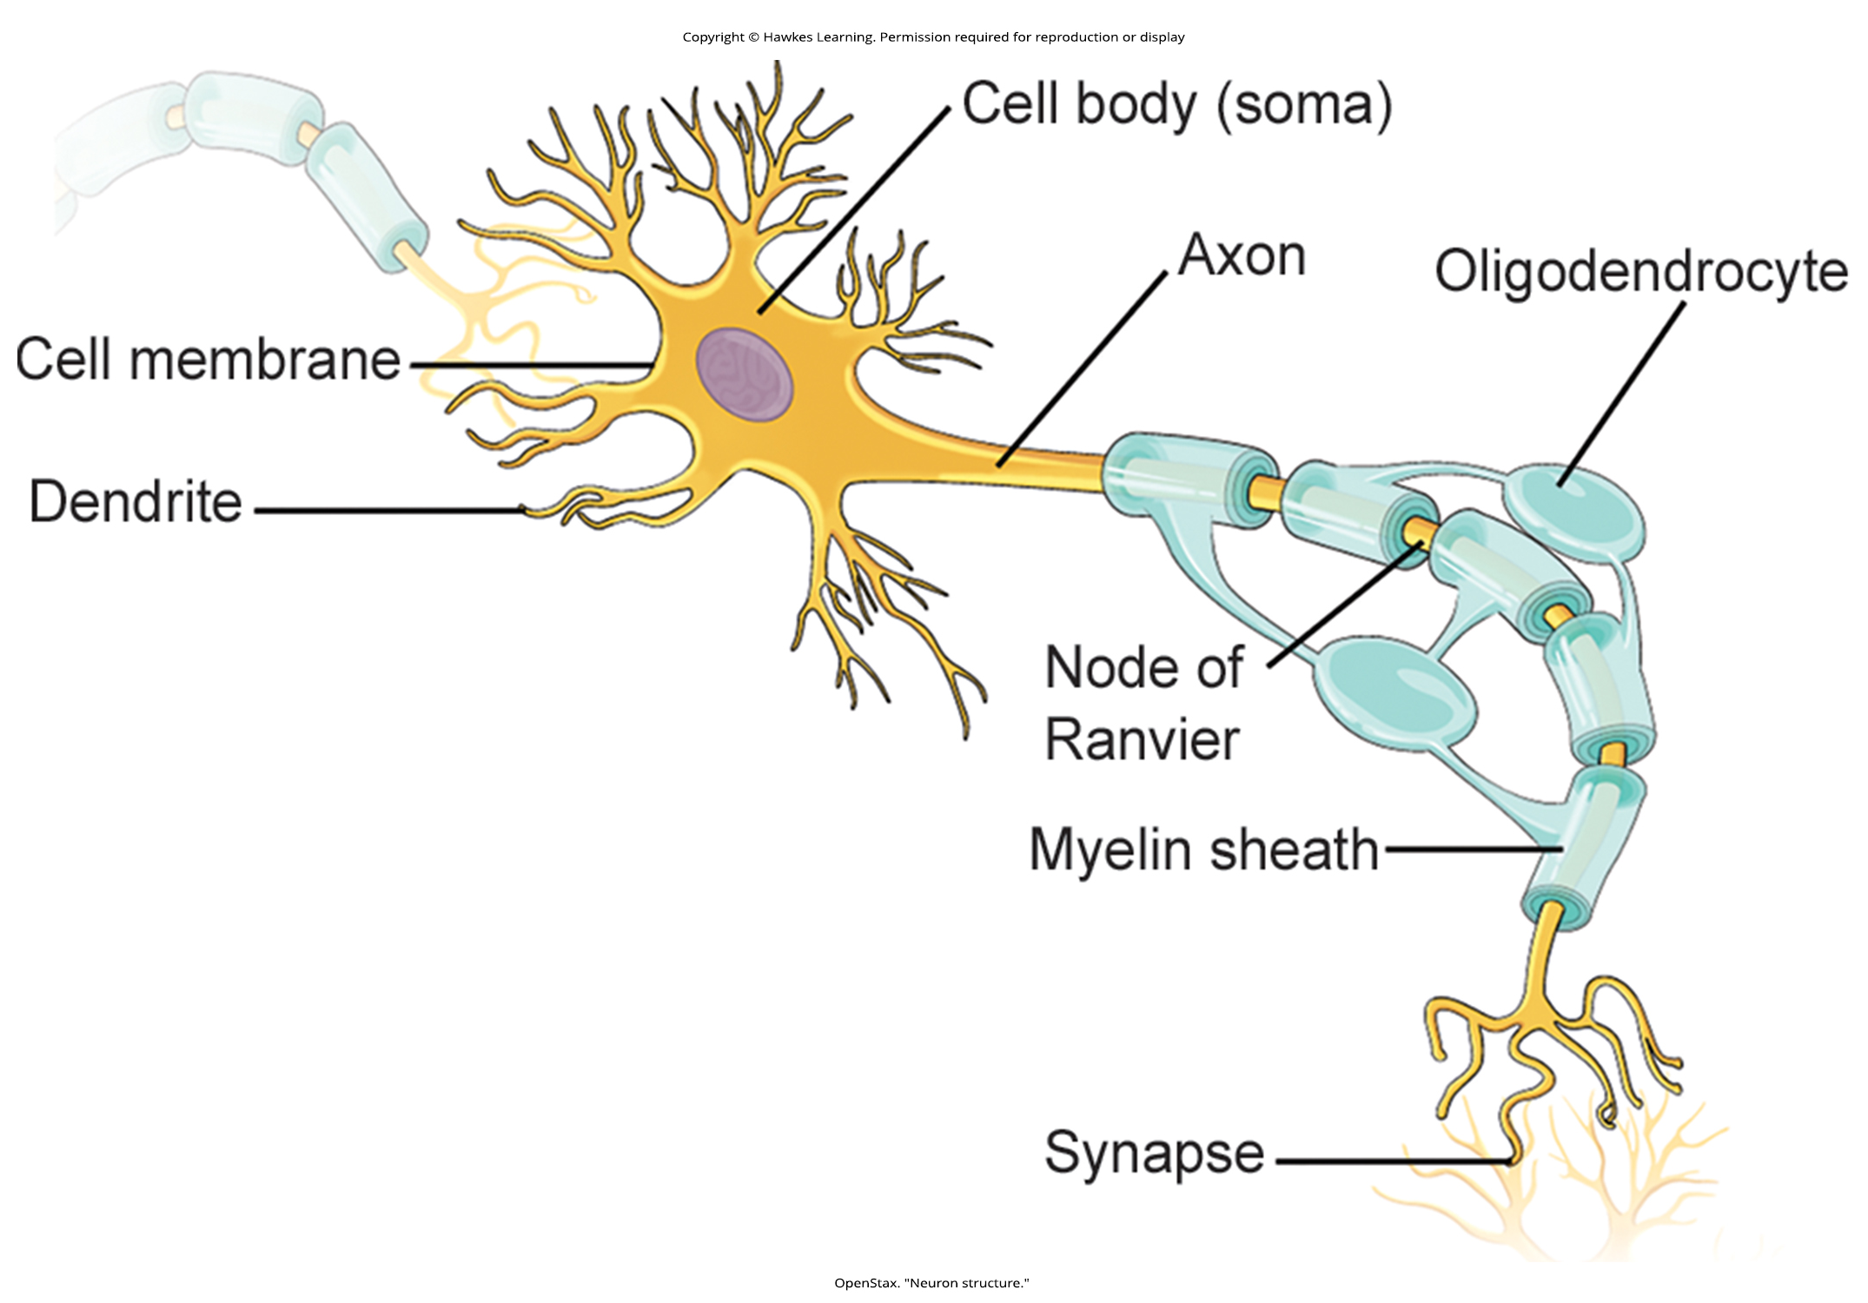
Lesson 42.1 Figure 3

Slide 5
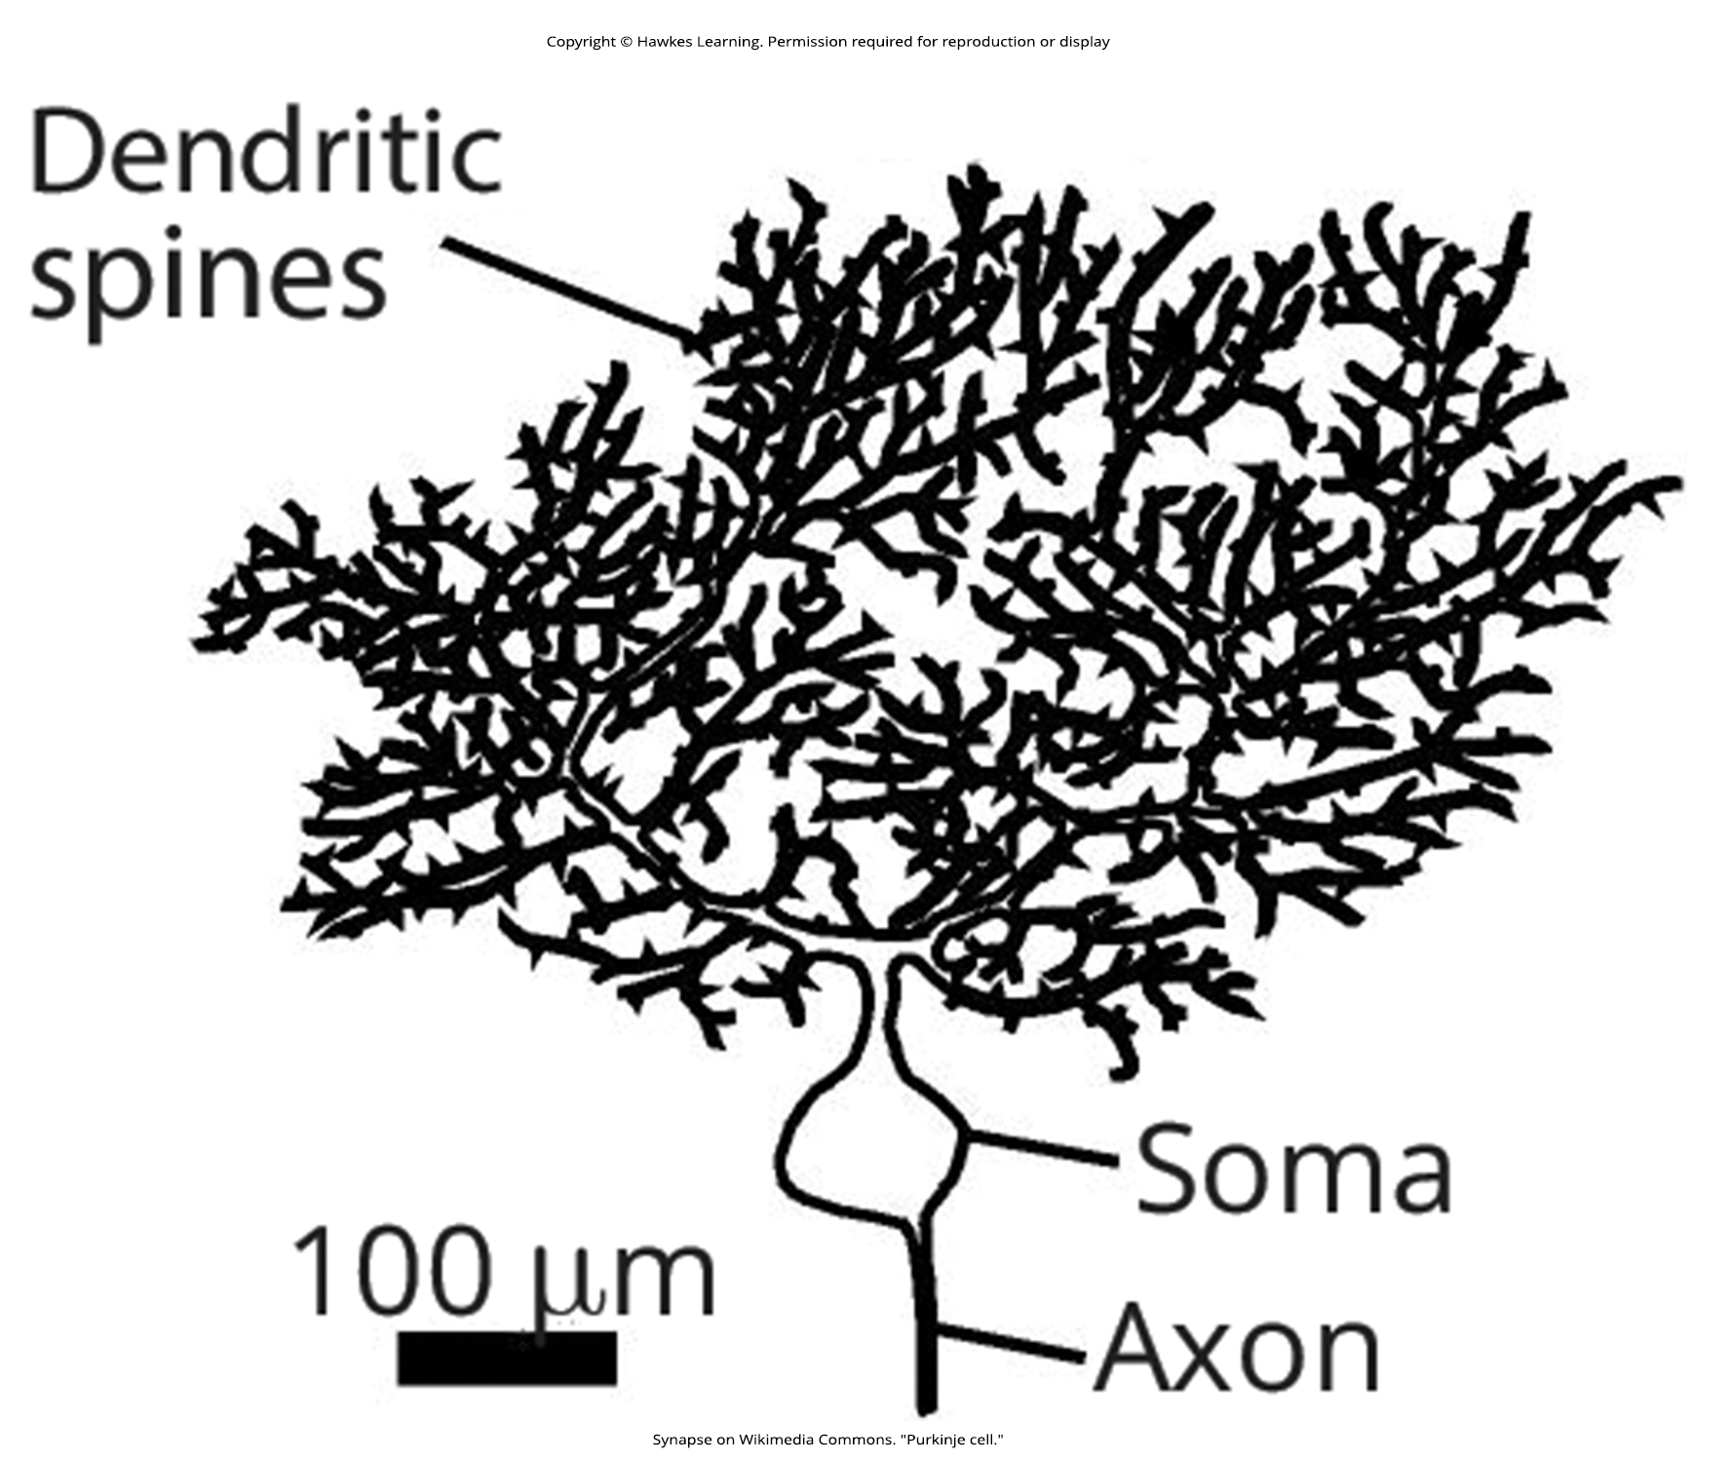
Lesson 42.1 Figure 4

Slide 6
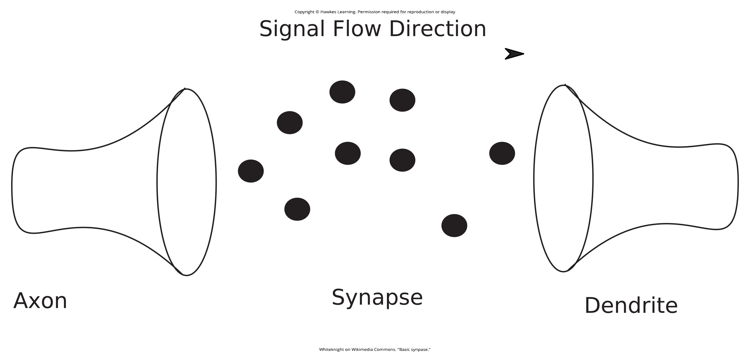
Lesson 42.1 Figure 5

Slide 7
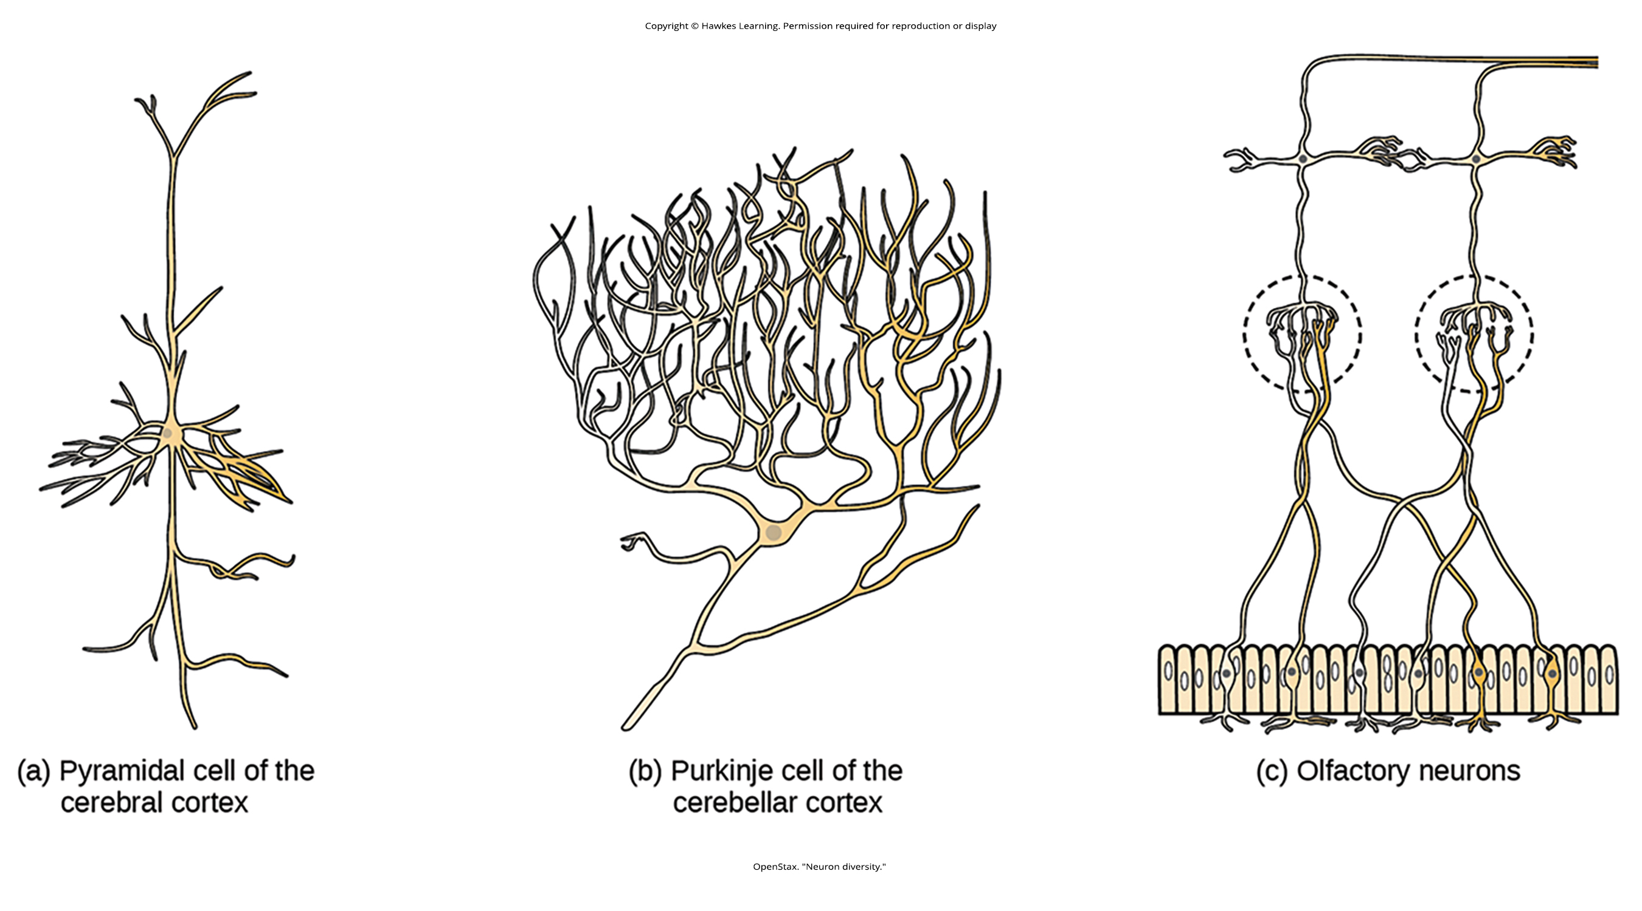
Lesson 42.1 Figure 6

Slide 8
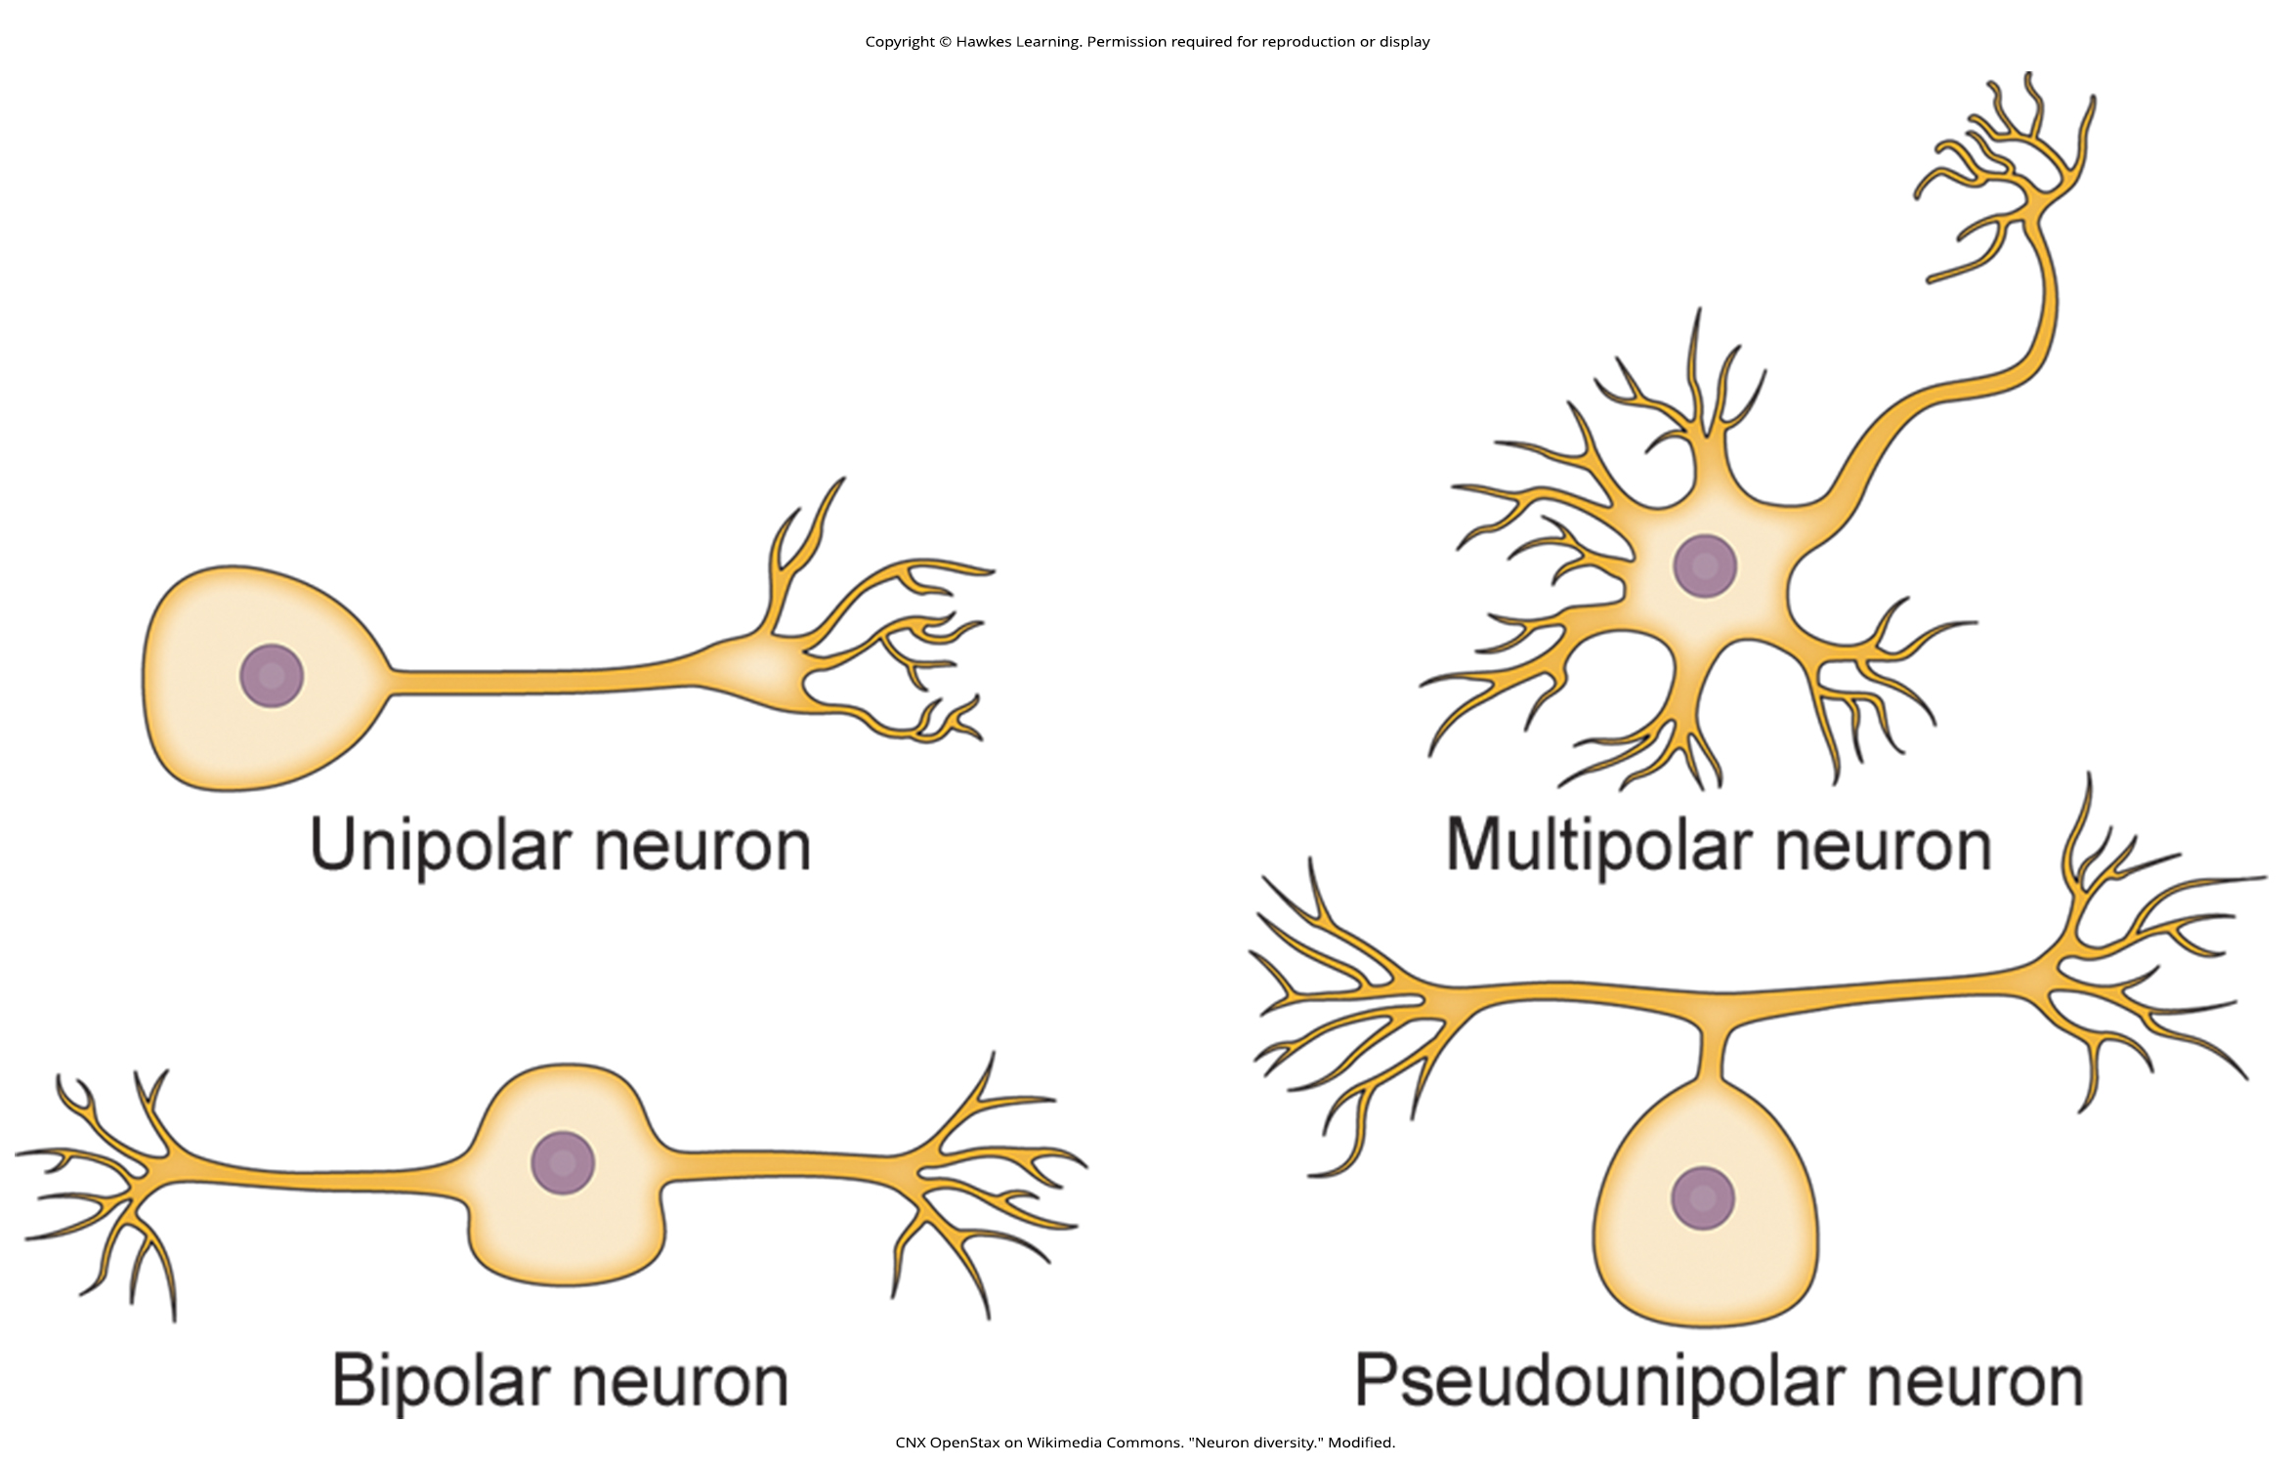
Lesson 42.1 Figure 7

Slide 9
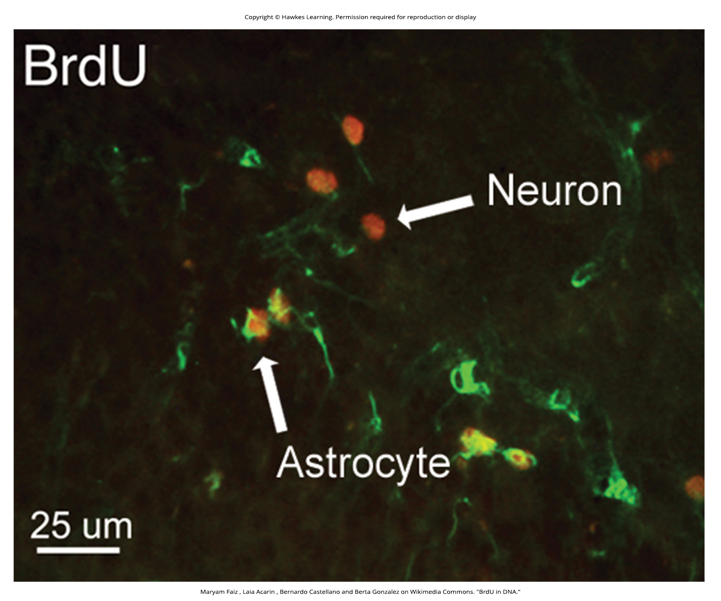
Lesson 42.1 Figure 8

Slide 10
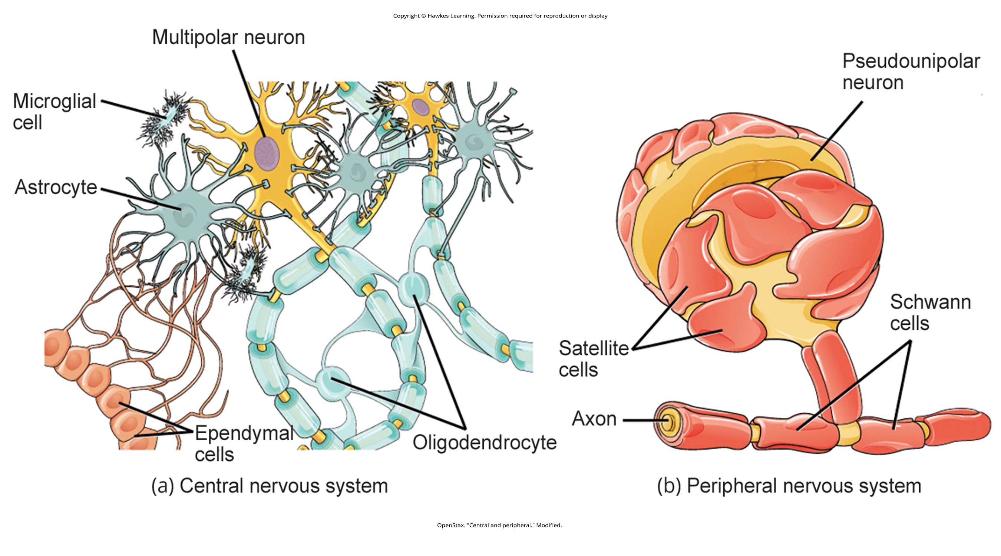
Lesson 42.1 Figure 9

Slide 11
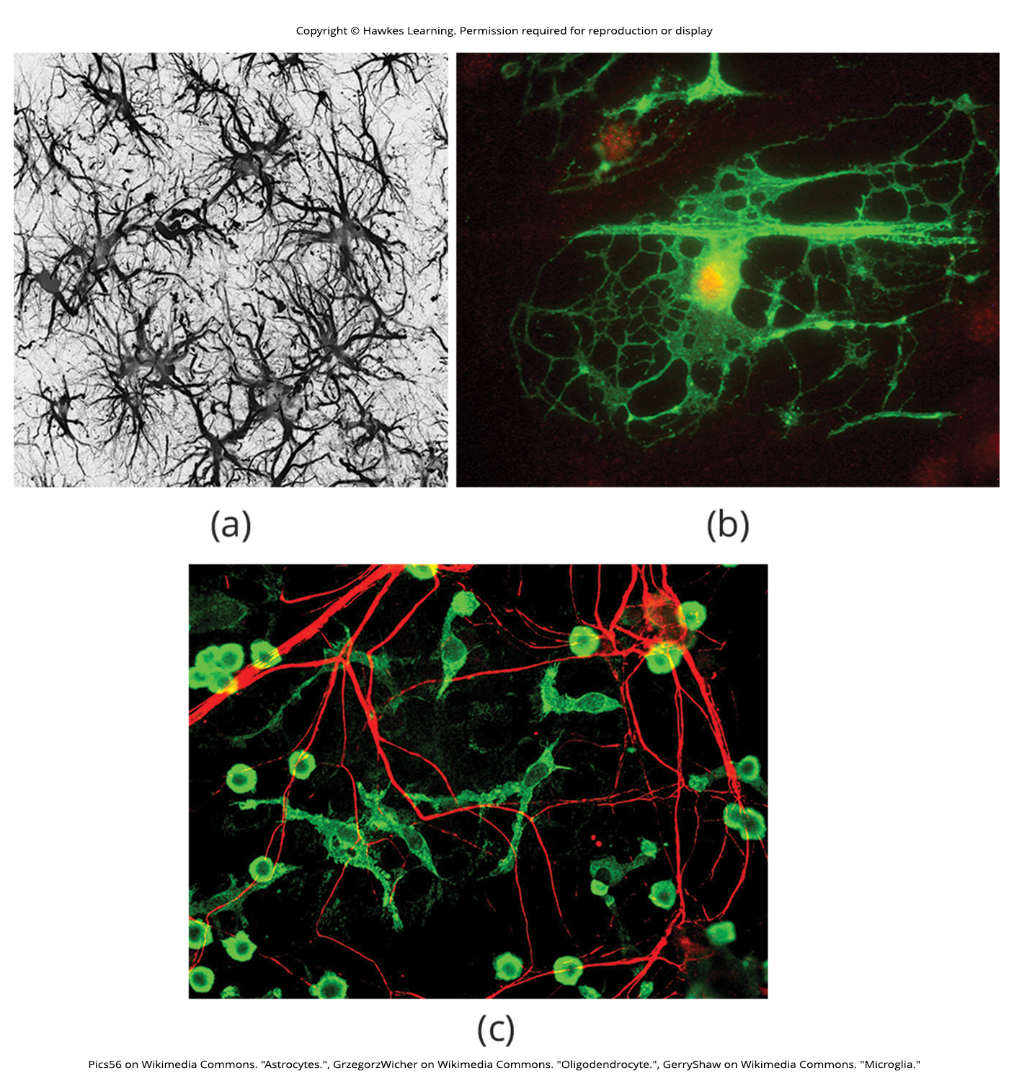
Lesson 42.1 Figure 10

Slide 12
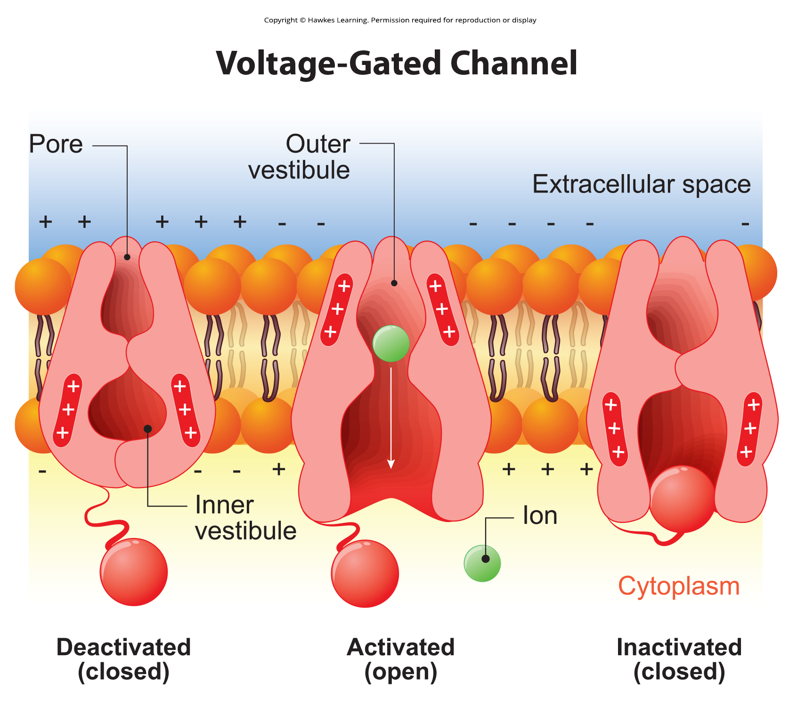
Lesson 42.2 Figure 1

Slide 13
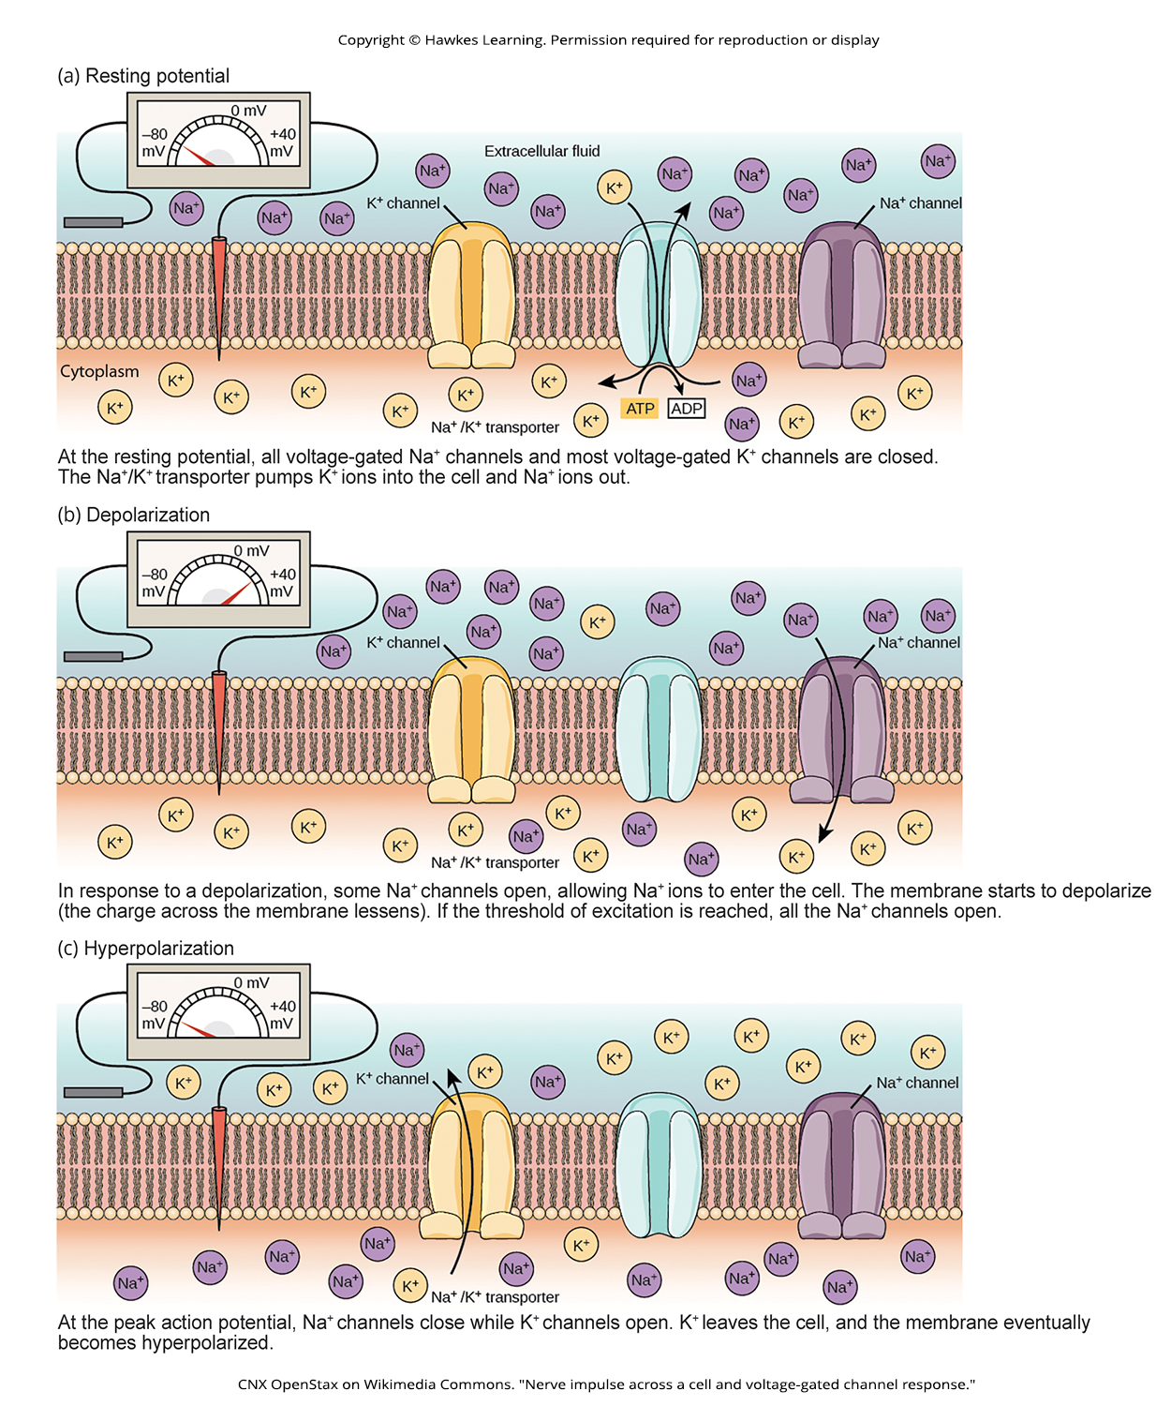
Lesson 42.2 Figure 2

Slide 14
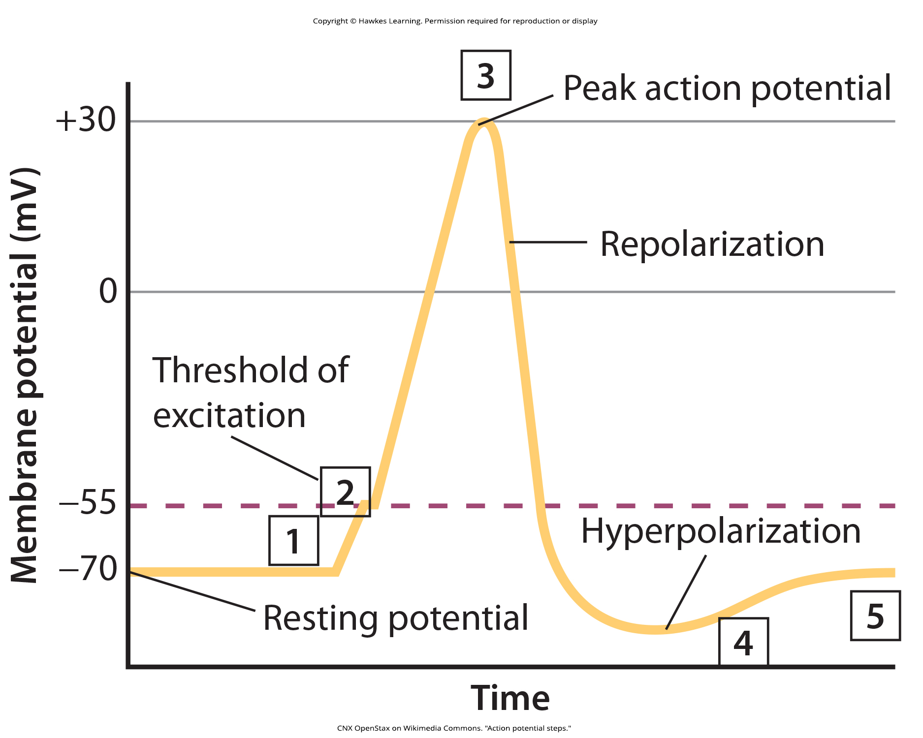
Lesson 42.2 Figure 3

Slide 15
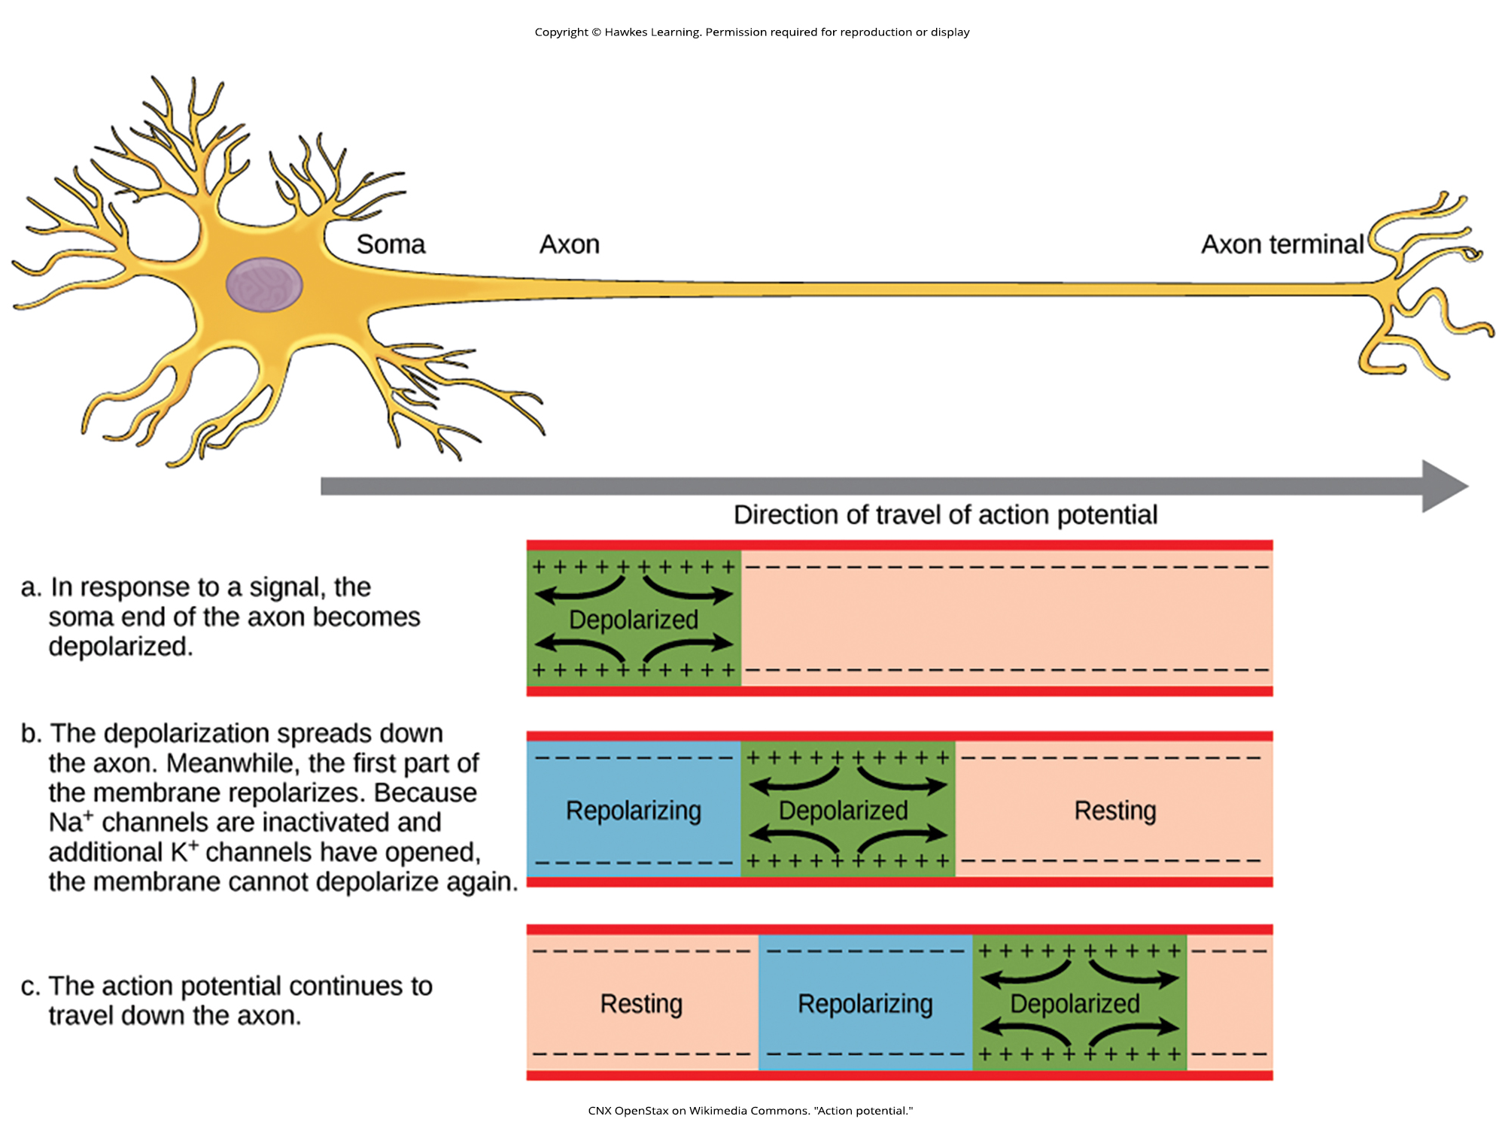
Lesson 42.2 Figure 4

Slide 16
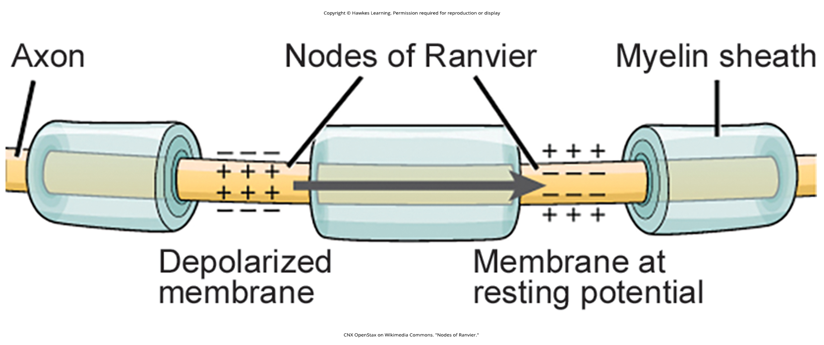
Lesson 42.2 Figure 5

Slide 17
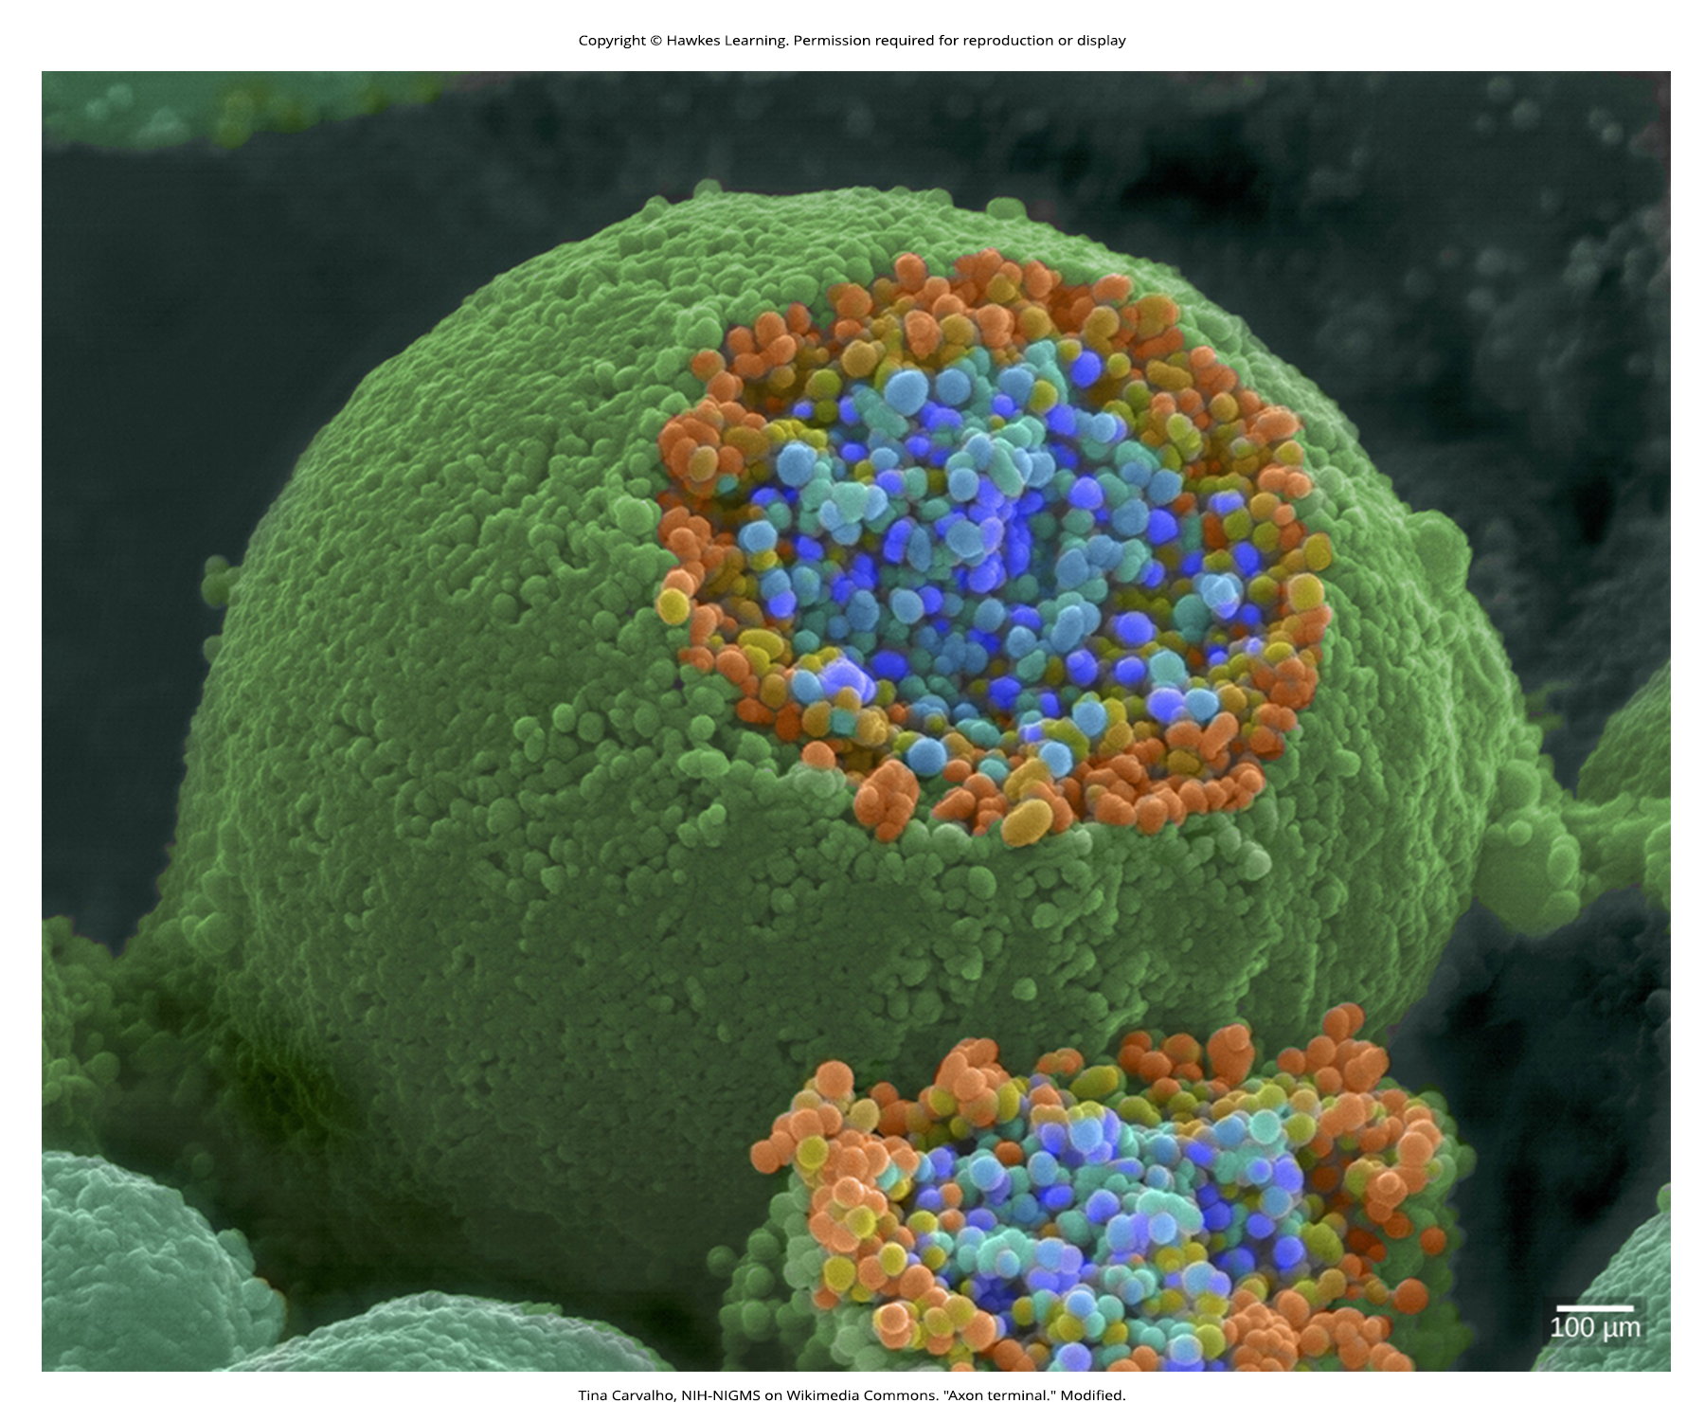
Lesson 42.2 Figure 6

Slide 18
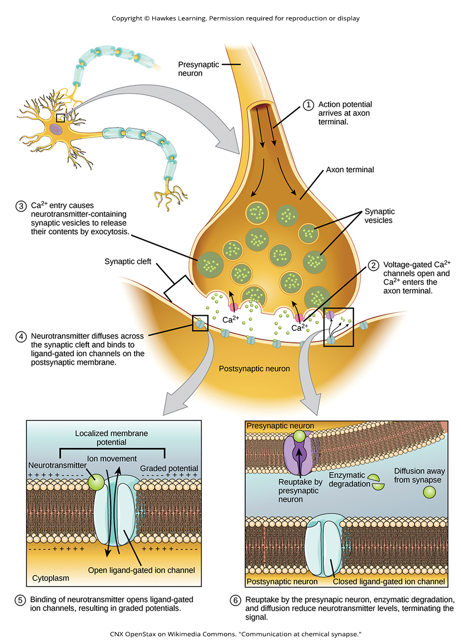
Lesson 42.2 Figure 7

Slide 19
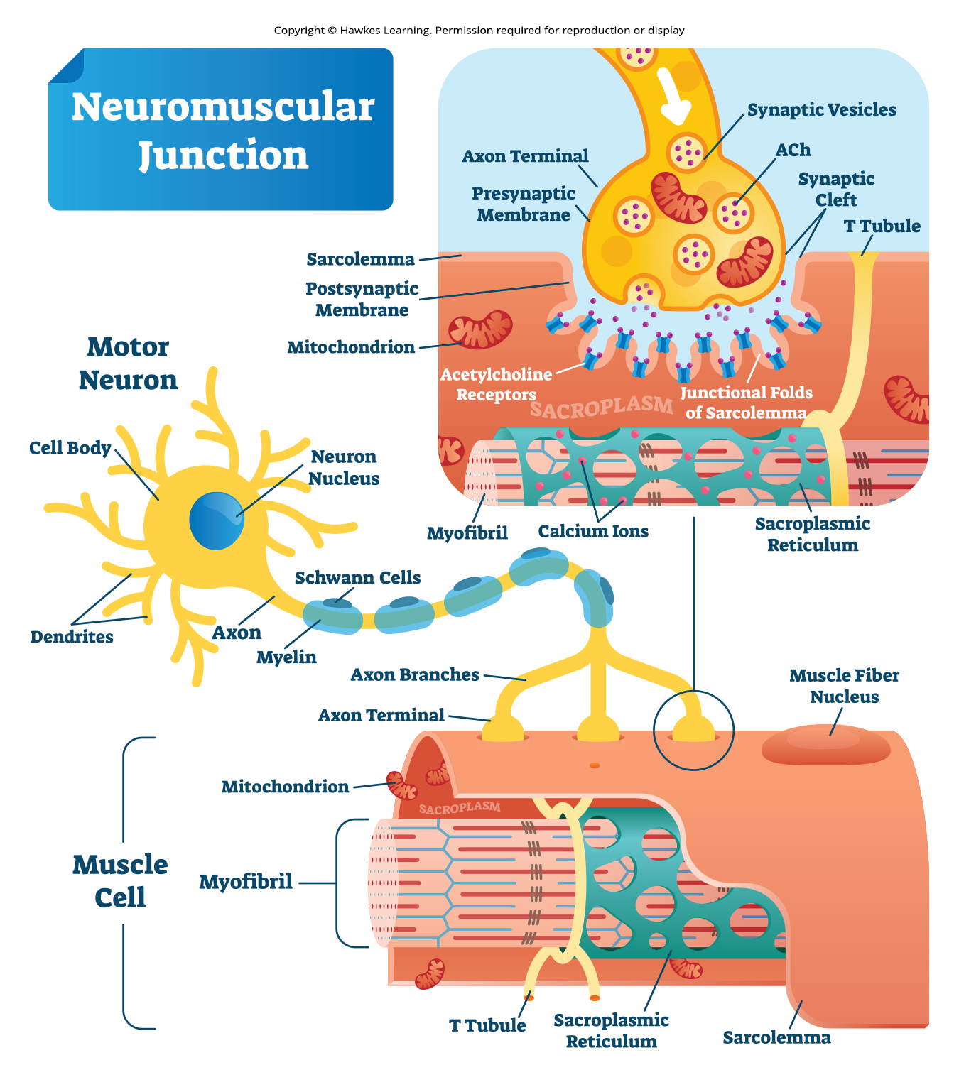
Lesson 42.2 Figure 8

Slide 20
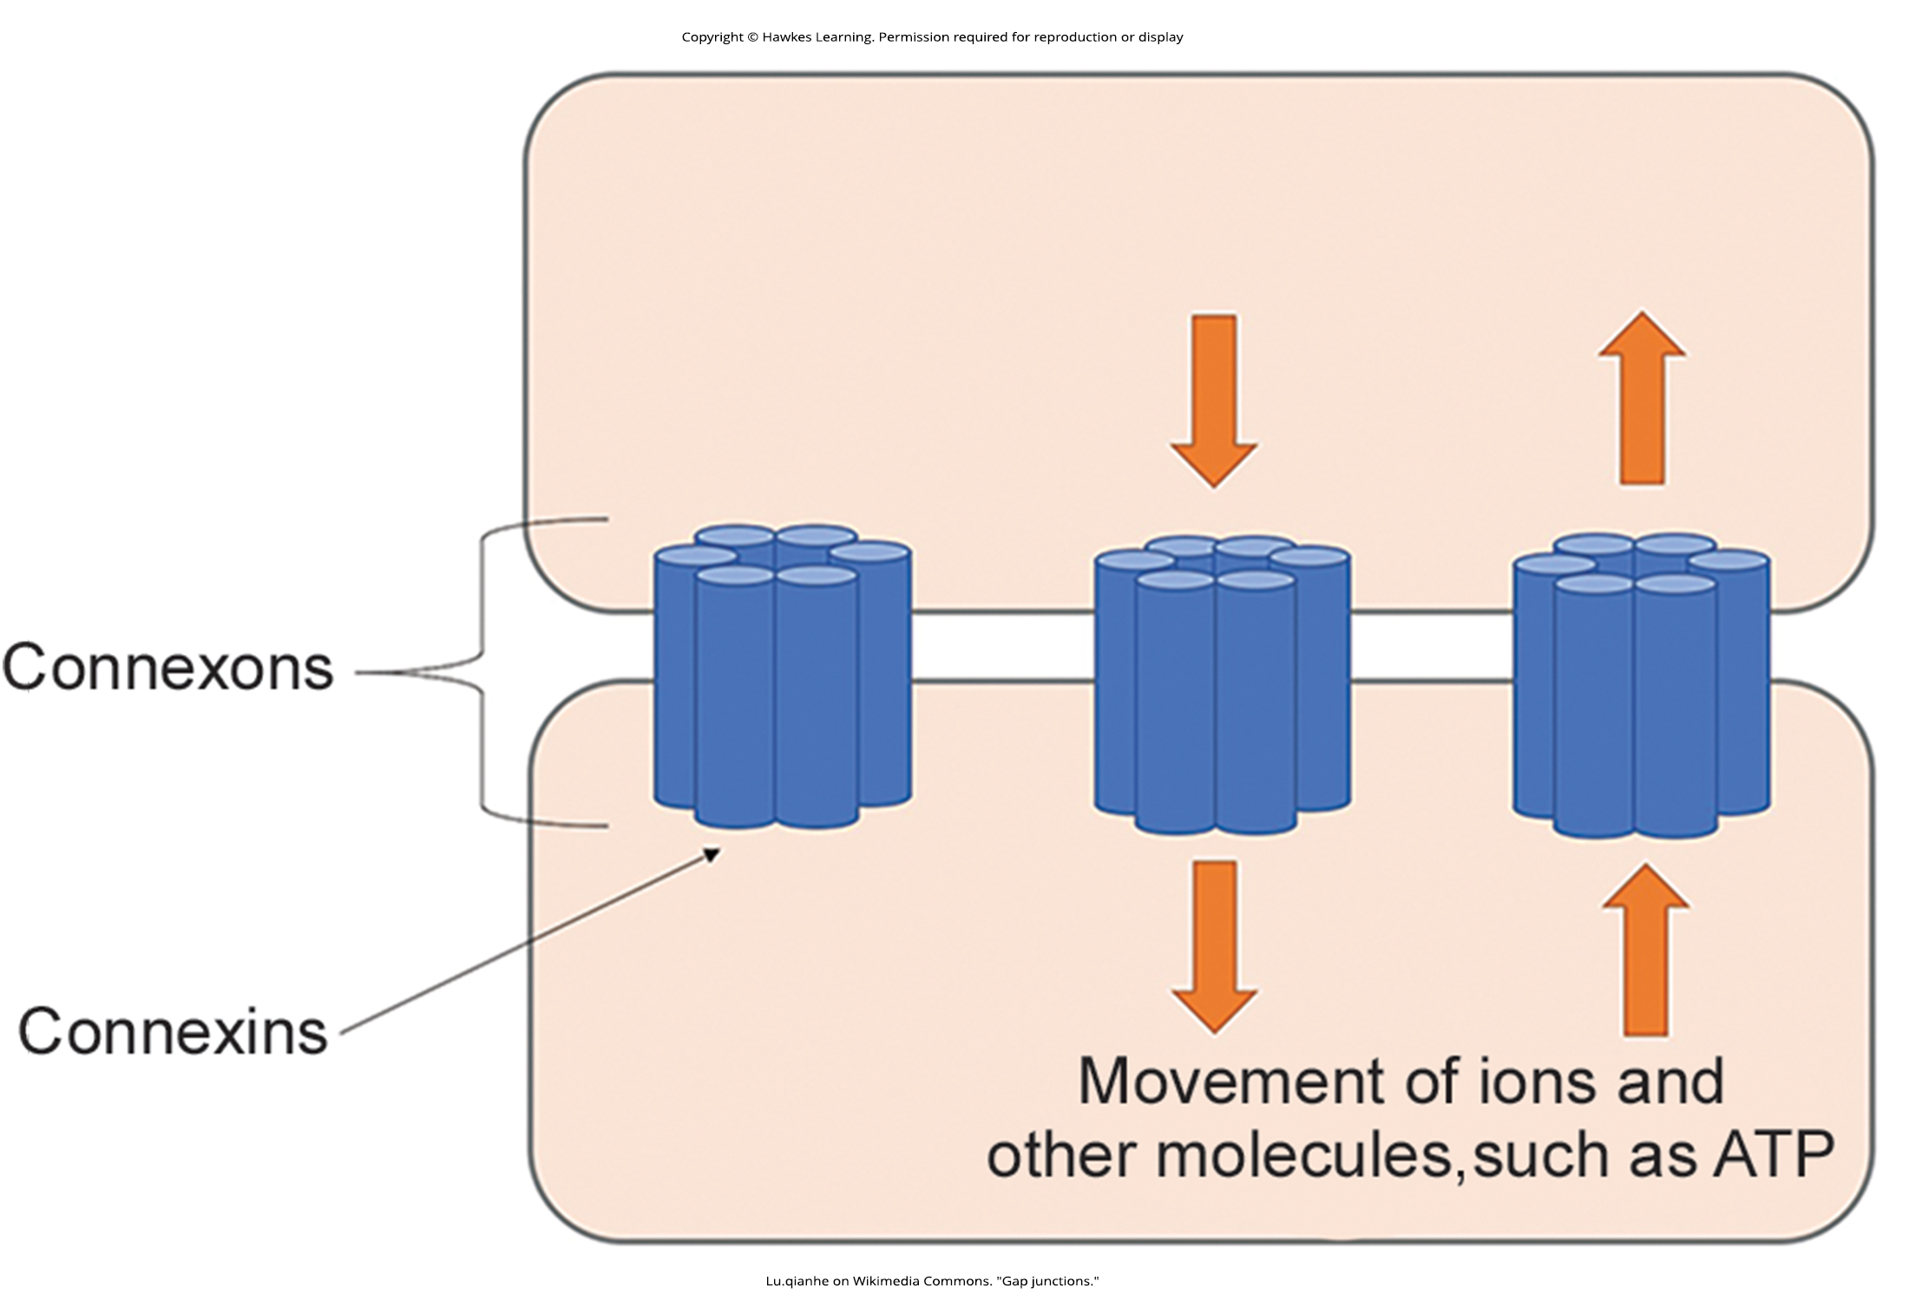
Lesson 42.2 Figure 9

Slide 21
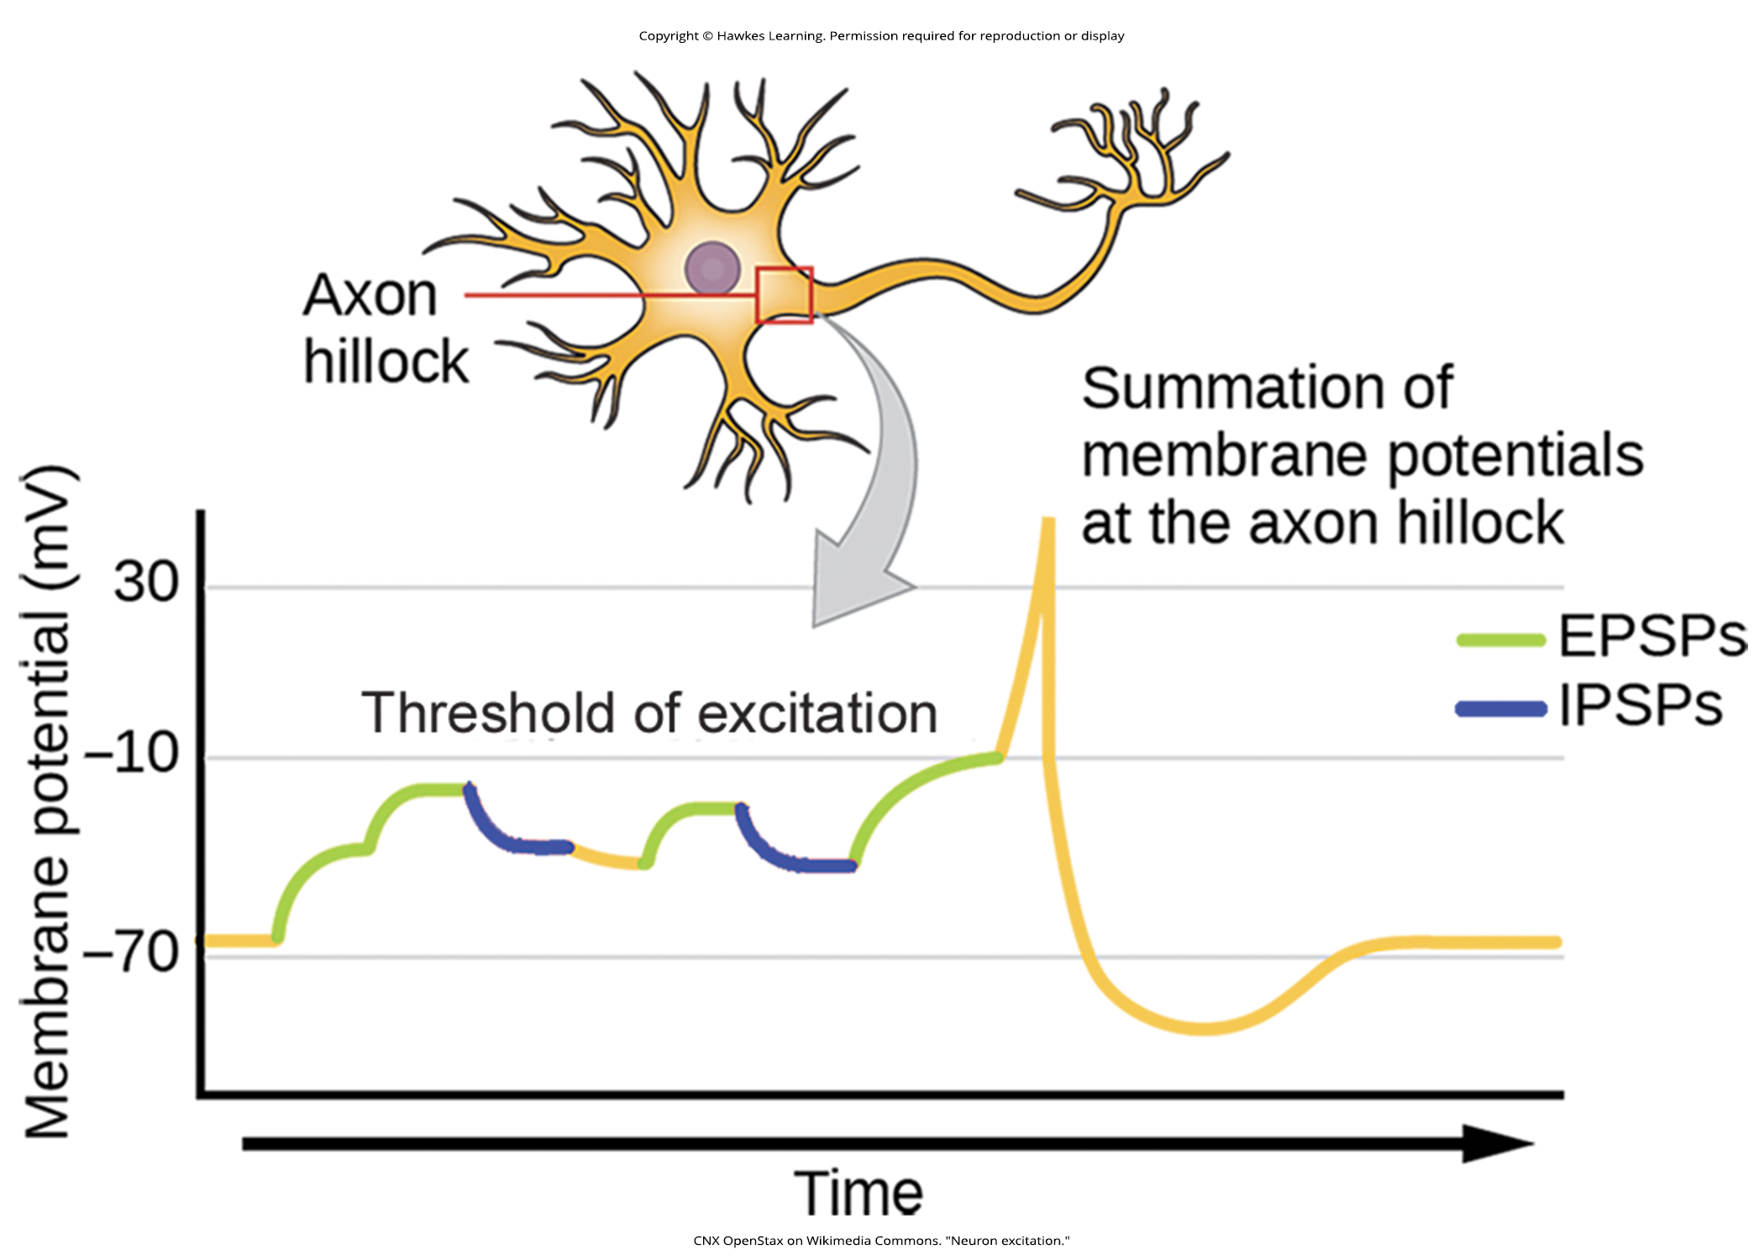
Lesson 42.2 Figure 10

Slide 22
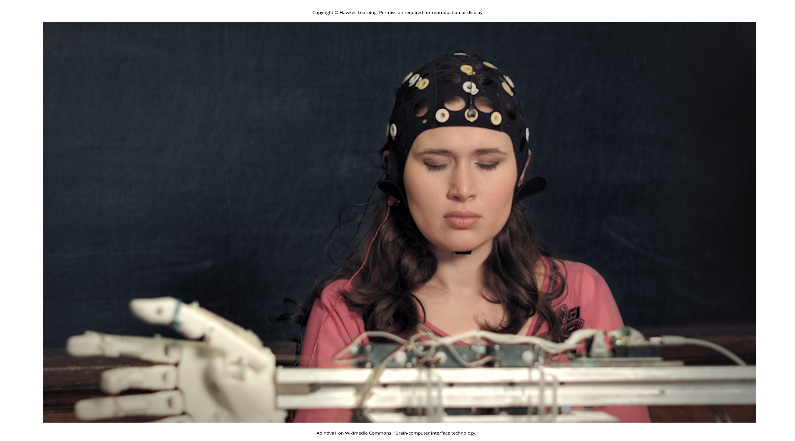
Lesson 42.2 Figure 11

Slide 23
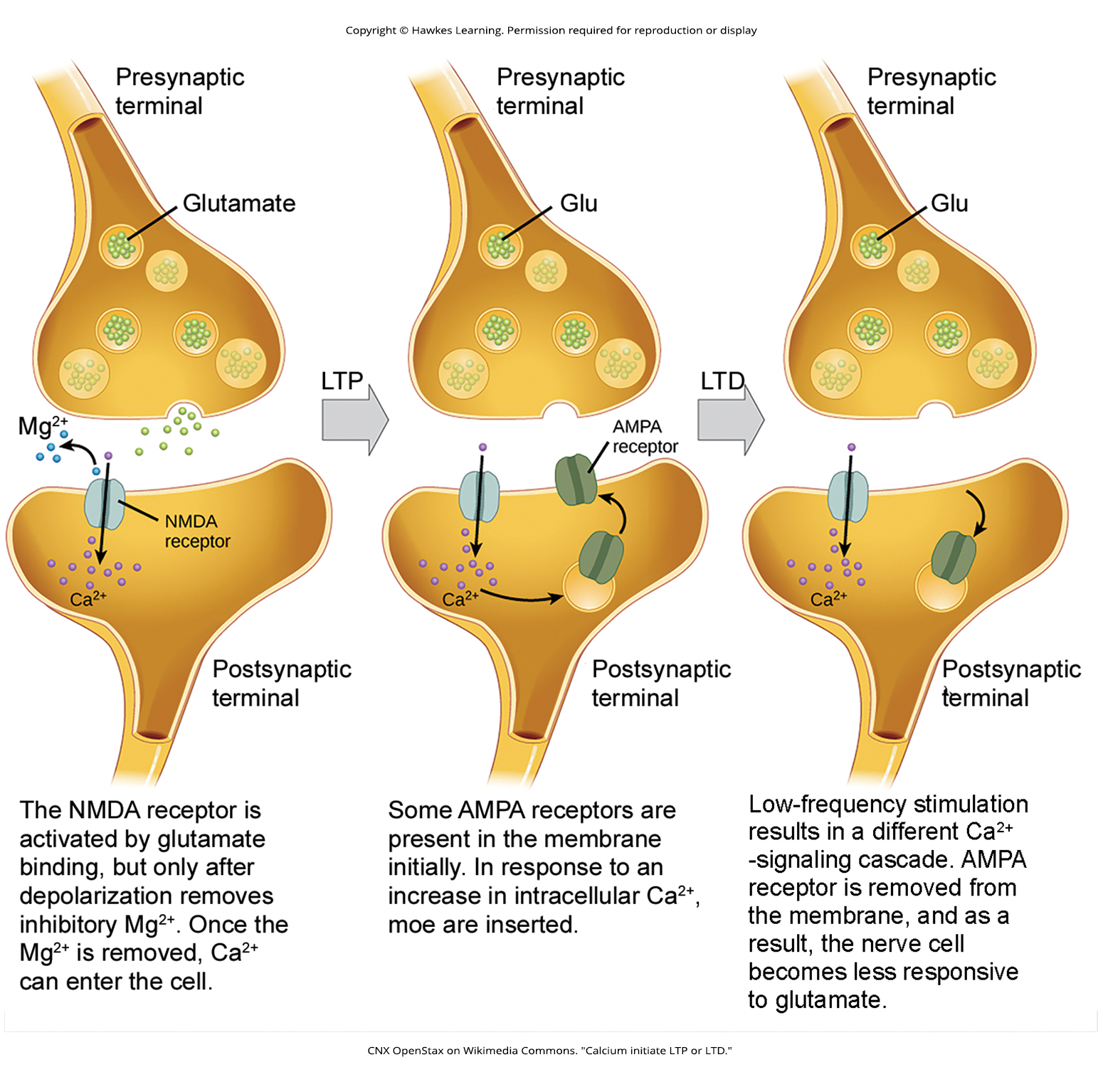
Lesson 42.2 Figure 12

Slide 24
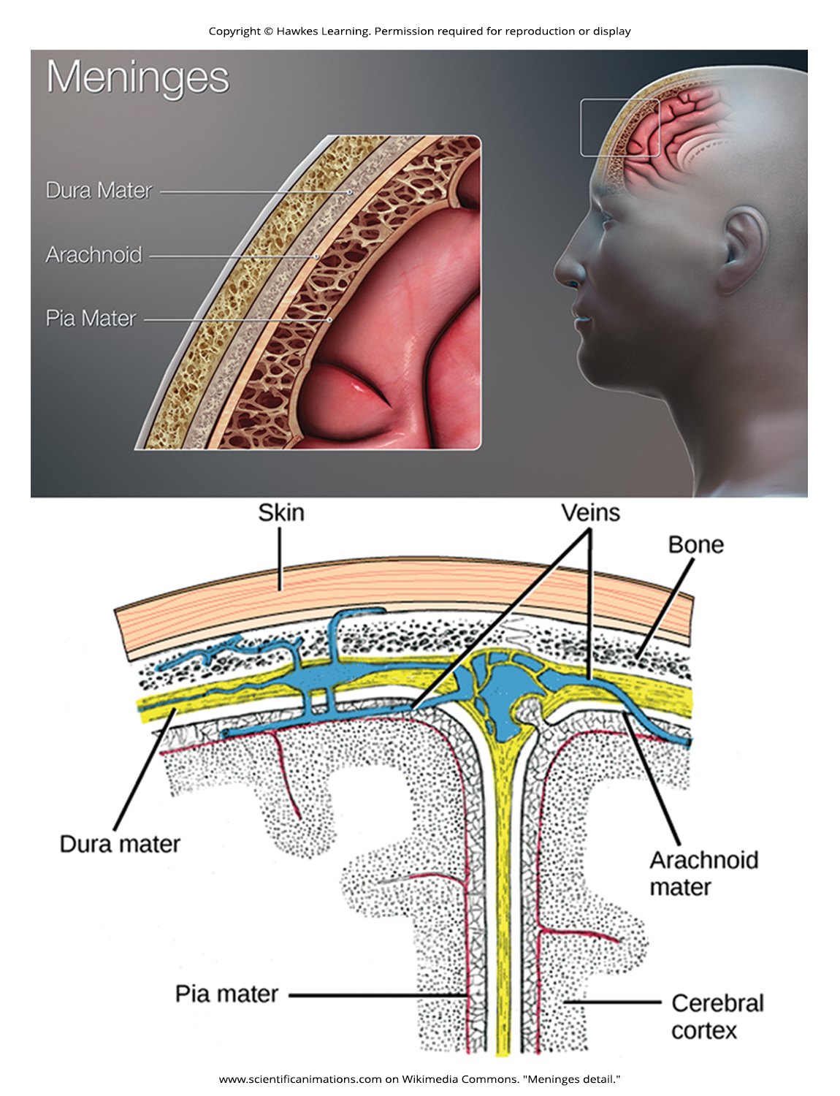
Lesson 42.3 Figure 1

Slide 25
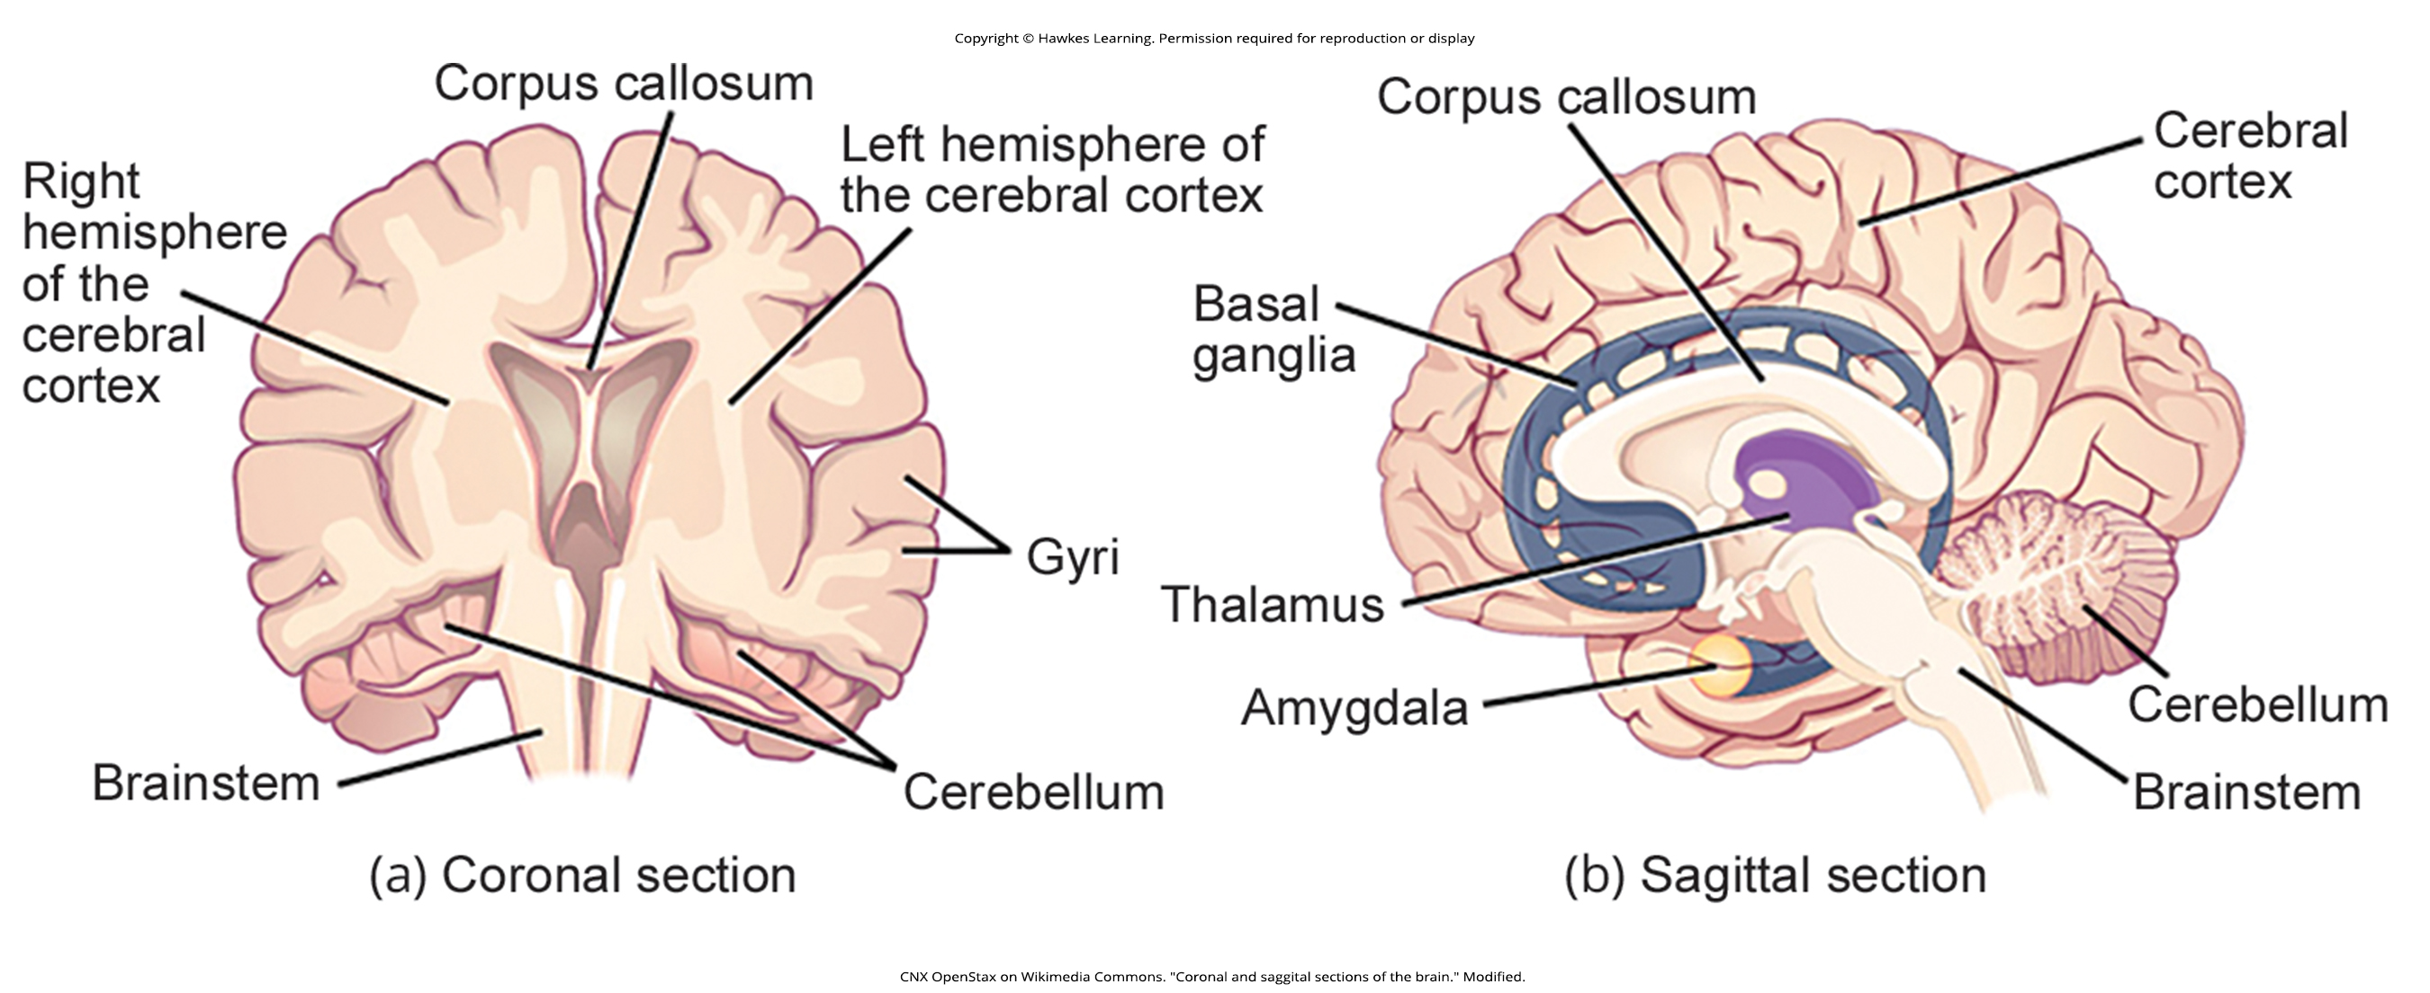
Lesson 42.3 Figure 2

Slide 26
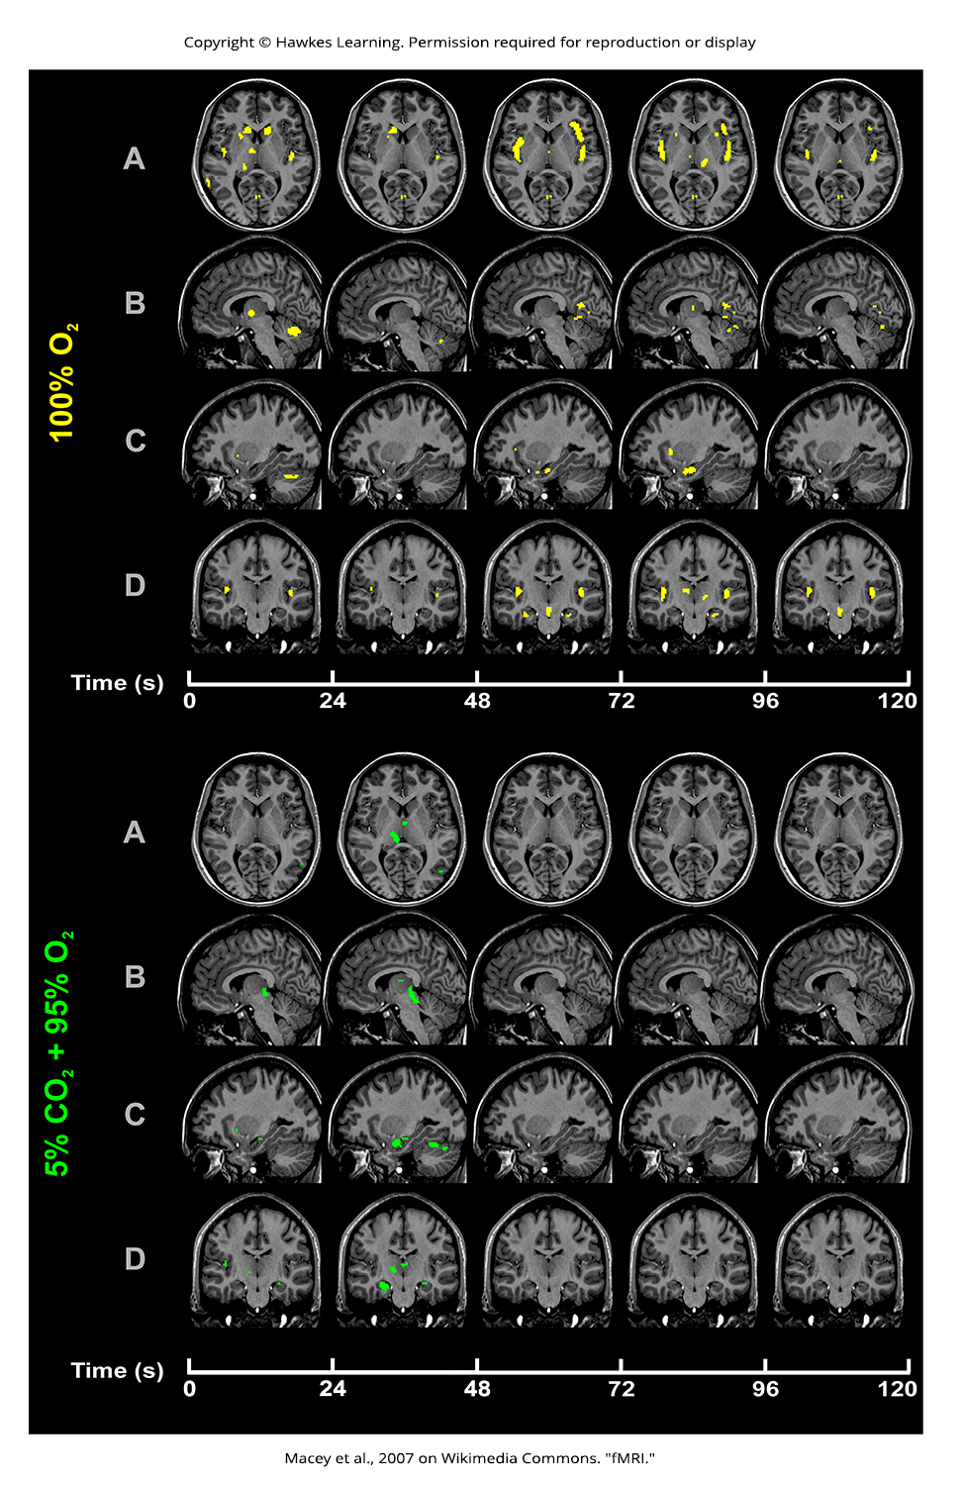
Lesson 42.3 Figure 3

Slide 27
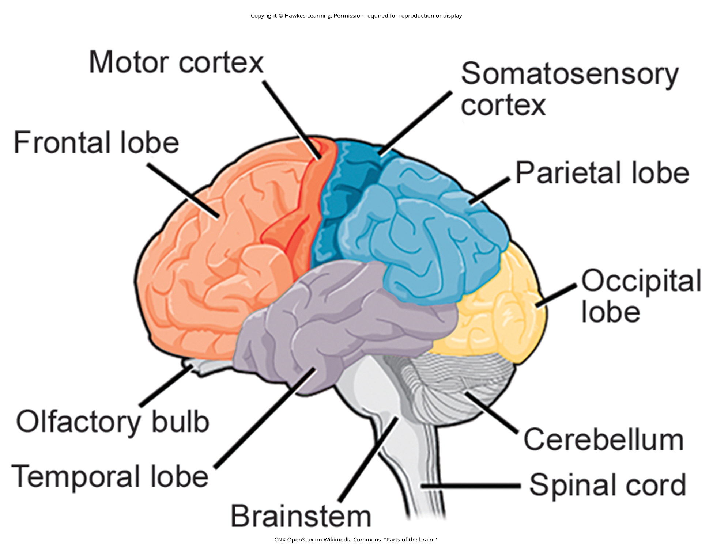
Lesson 42.3 Figure 4

Slide 28
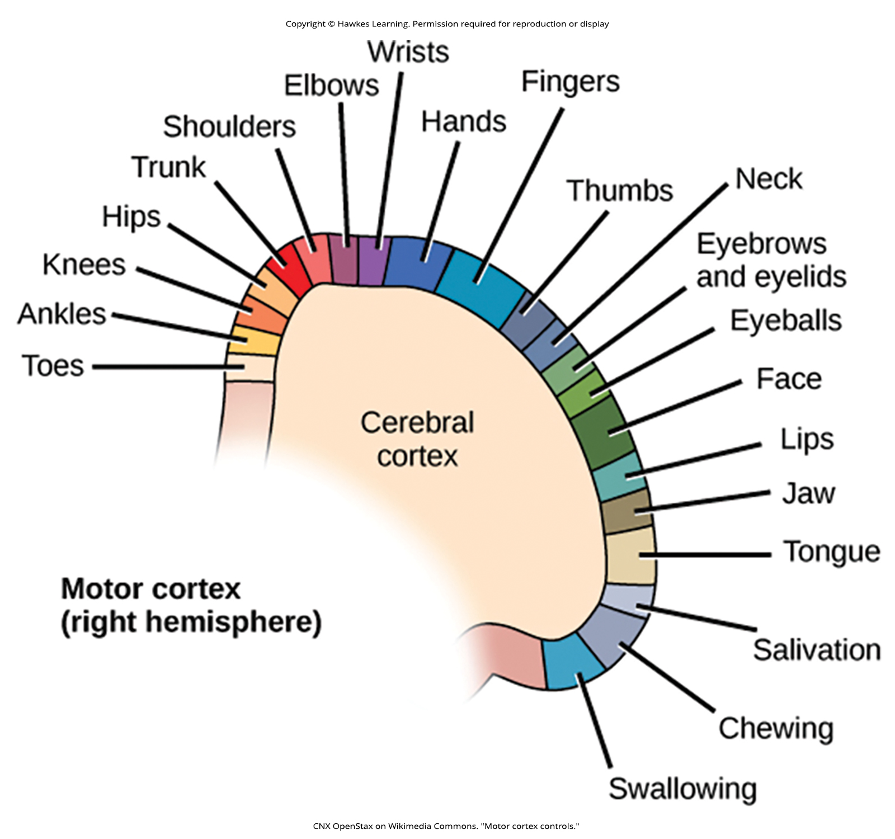
Lesson 42.3 Figure 5

Slide 29
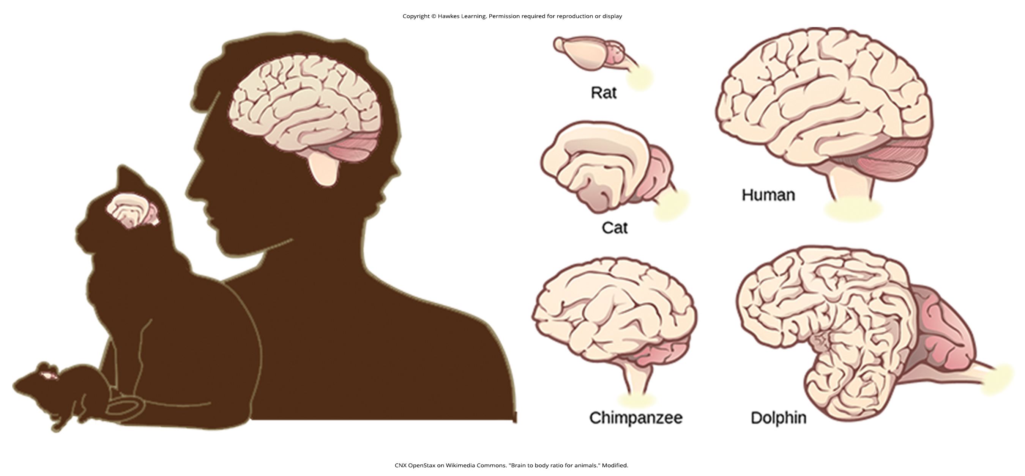
Lesson 42.3 Figure 6

Slide 30
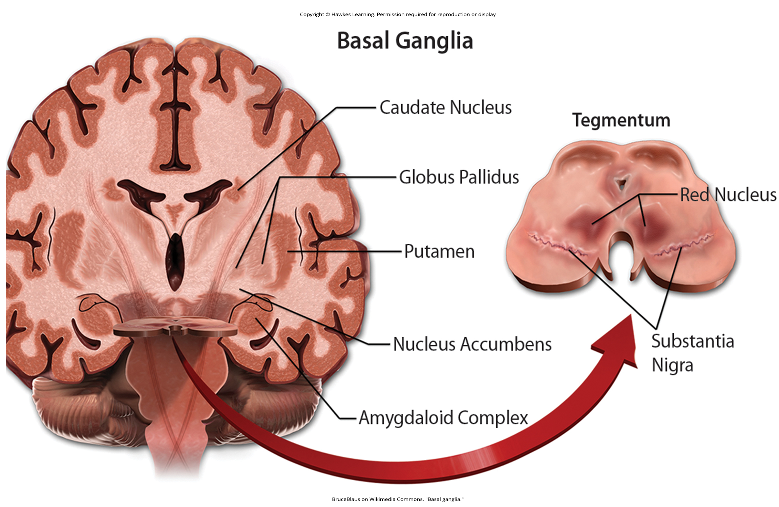
Lesson 42.3 Figure 7

Slide 31
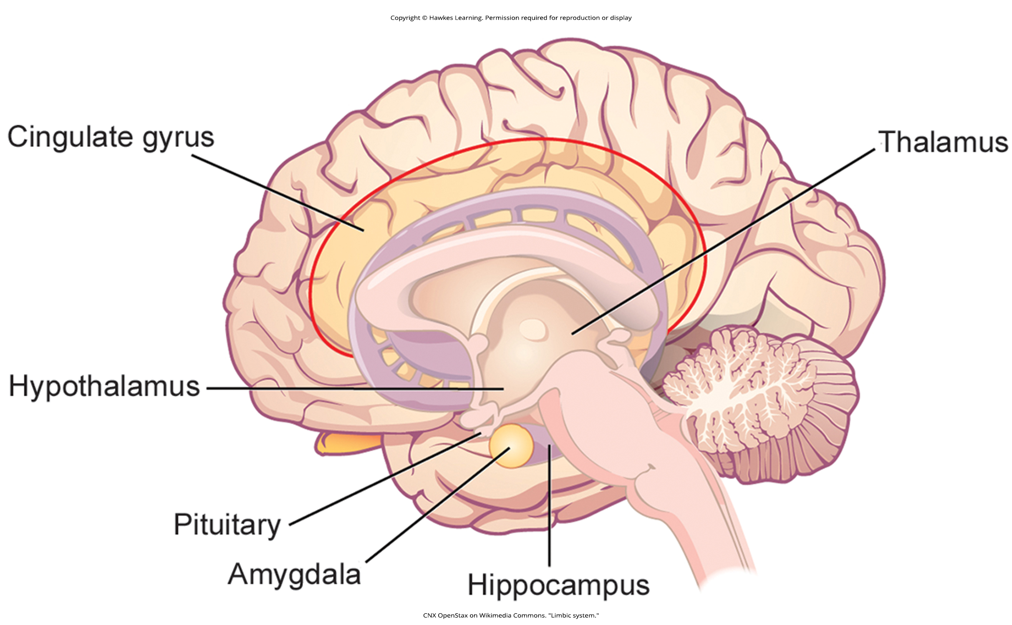
Lesson 42.3 Figure 8

Slide 32
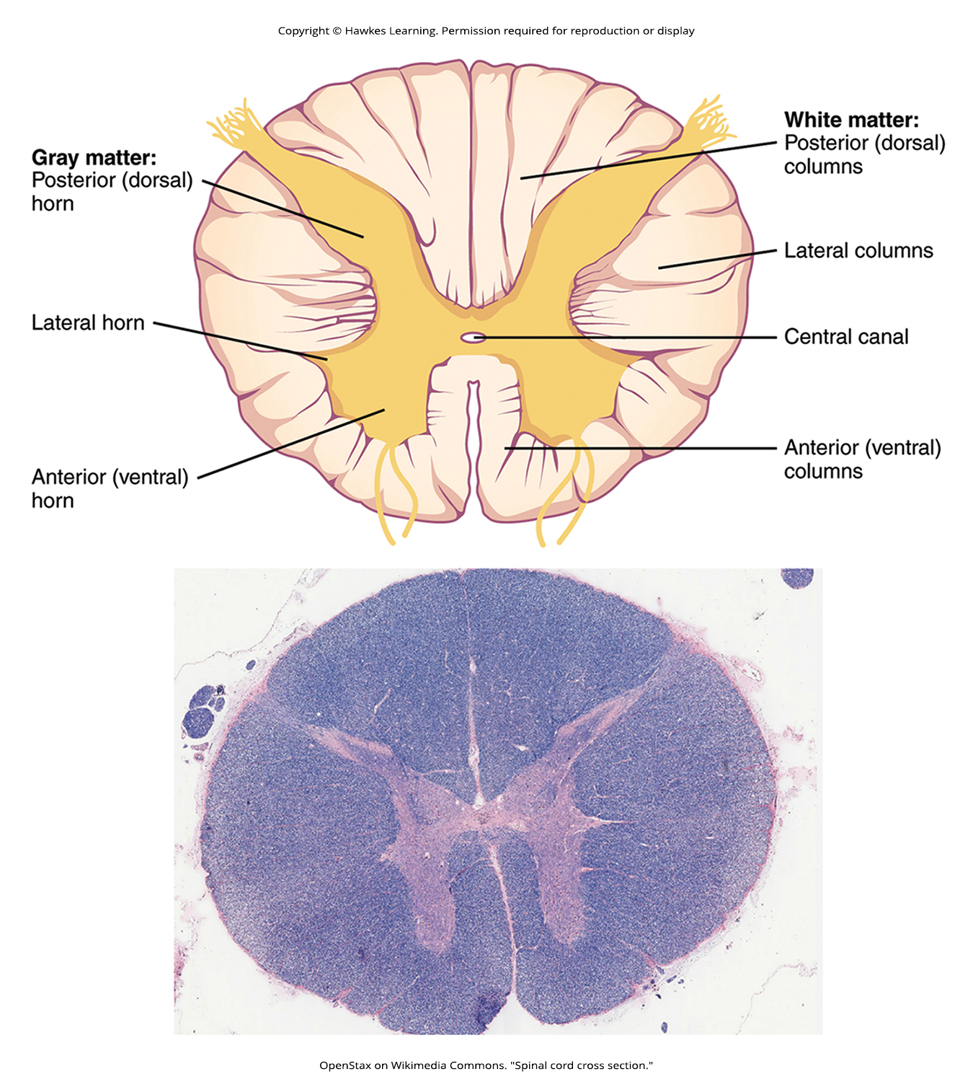
Lesson 42.3 Figure 9

Slide 33
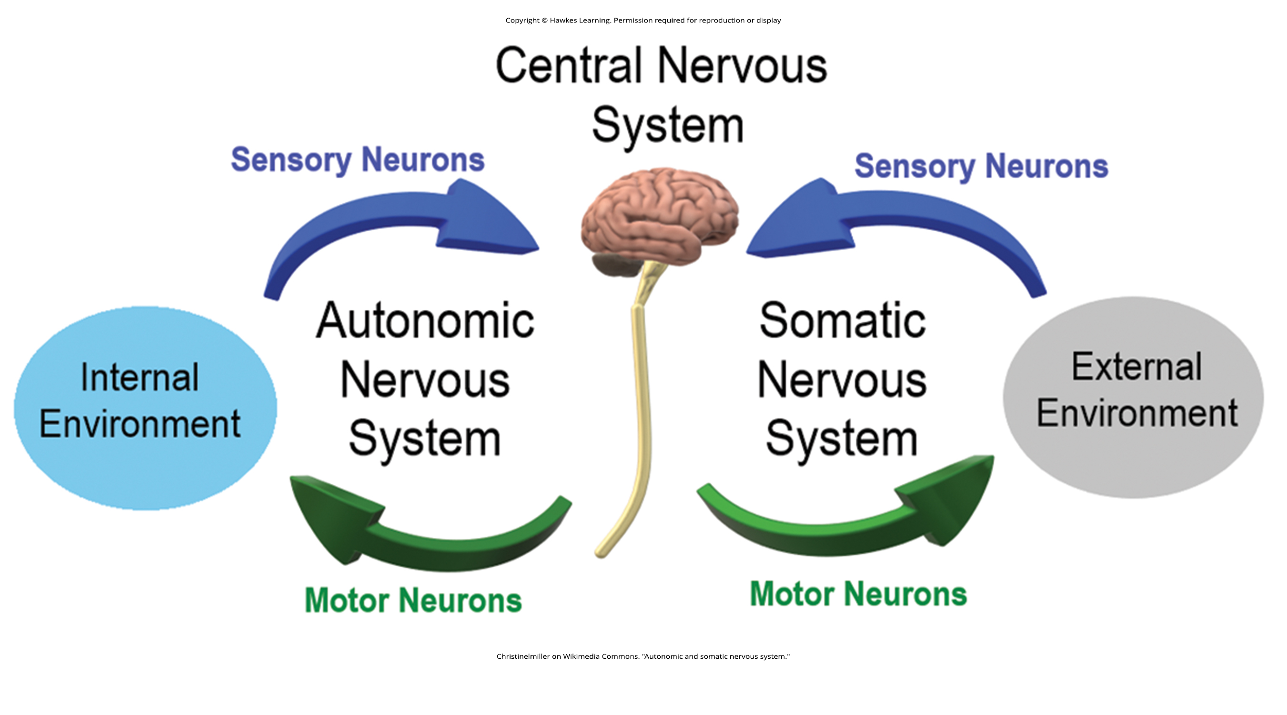
Lesson 42.4 Figure 1

Slide 34
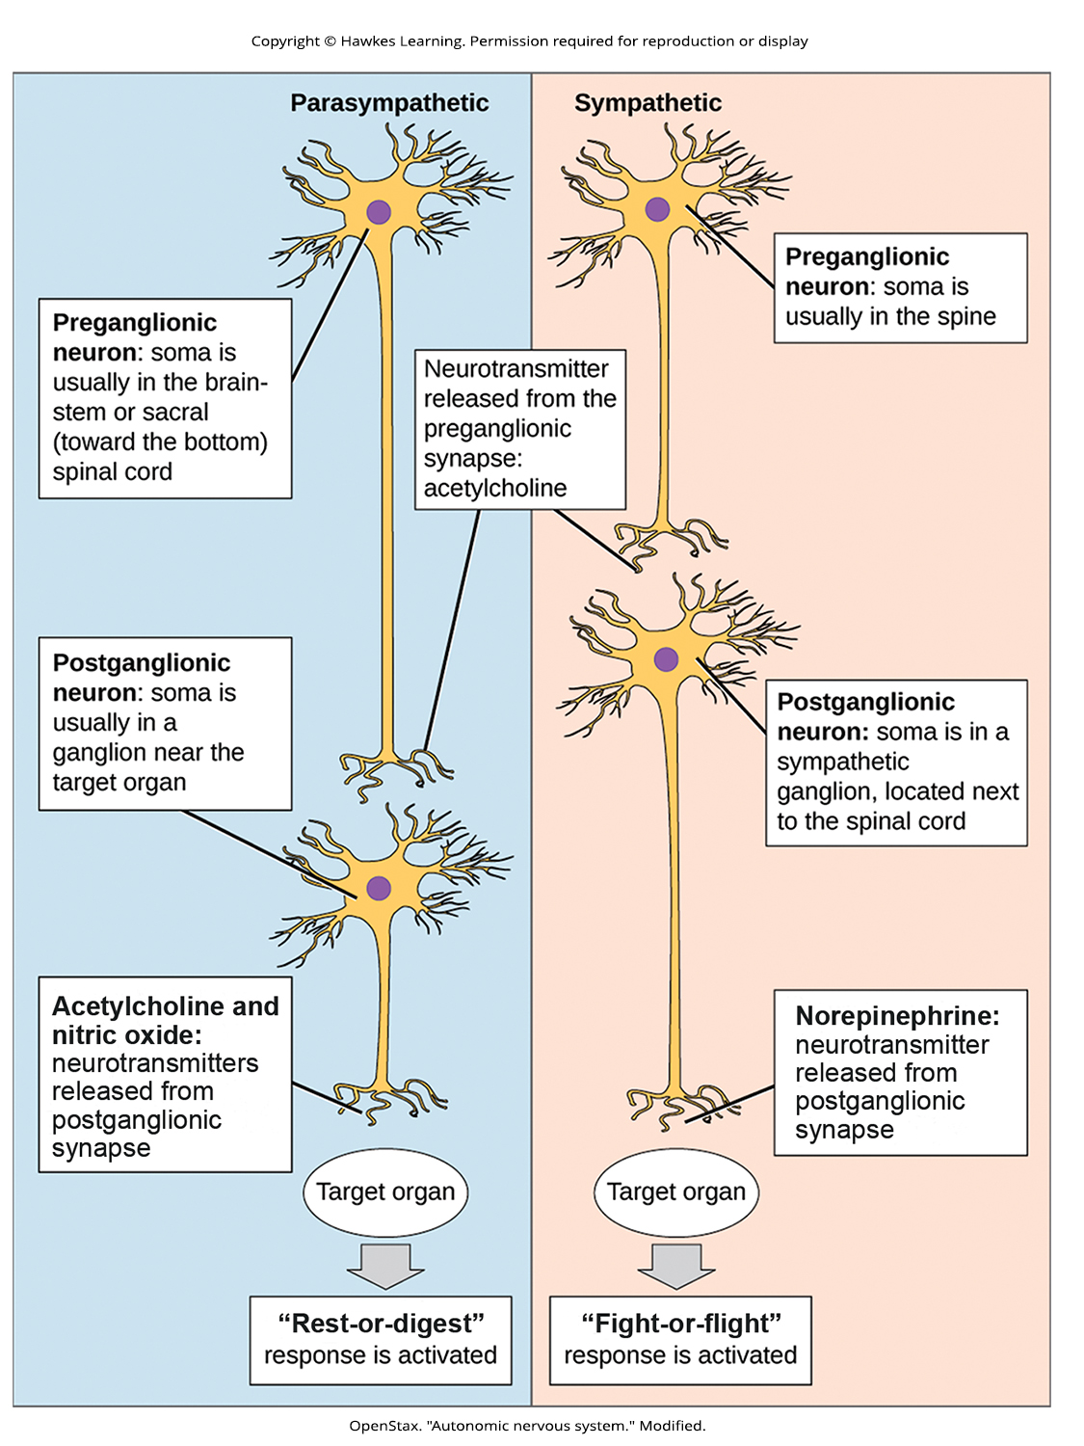
Lesson 42.4 Figure 2

Slide 35
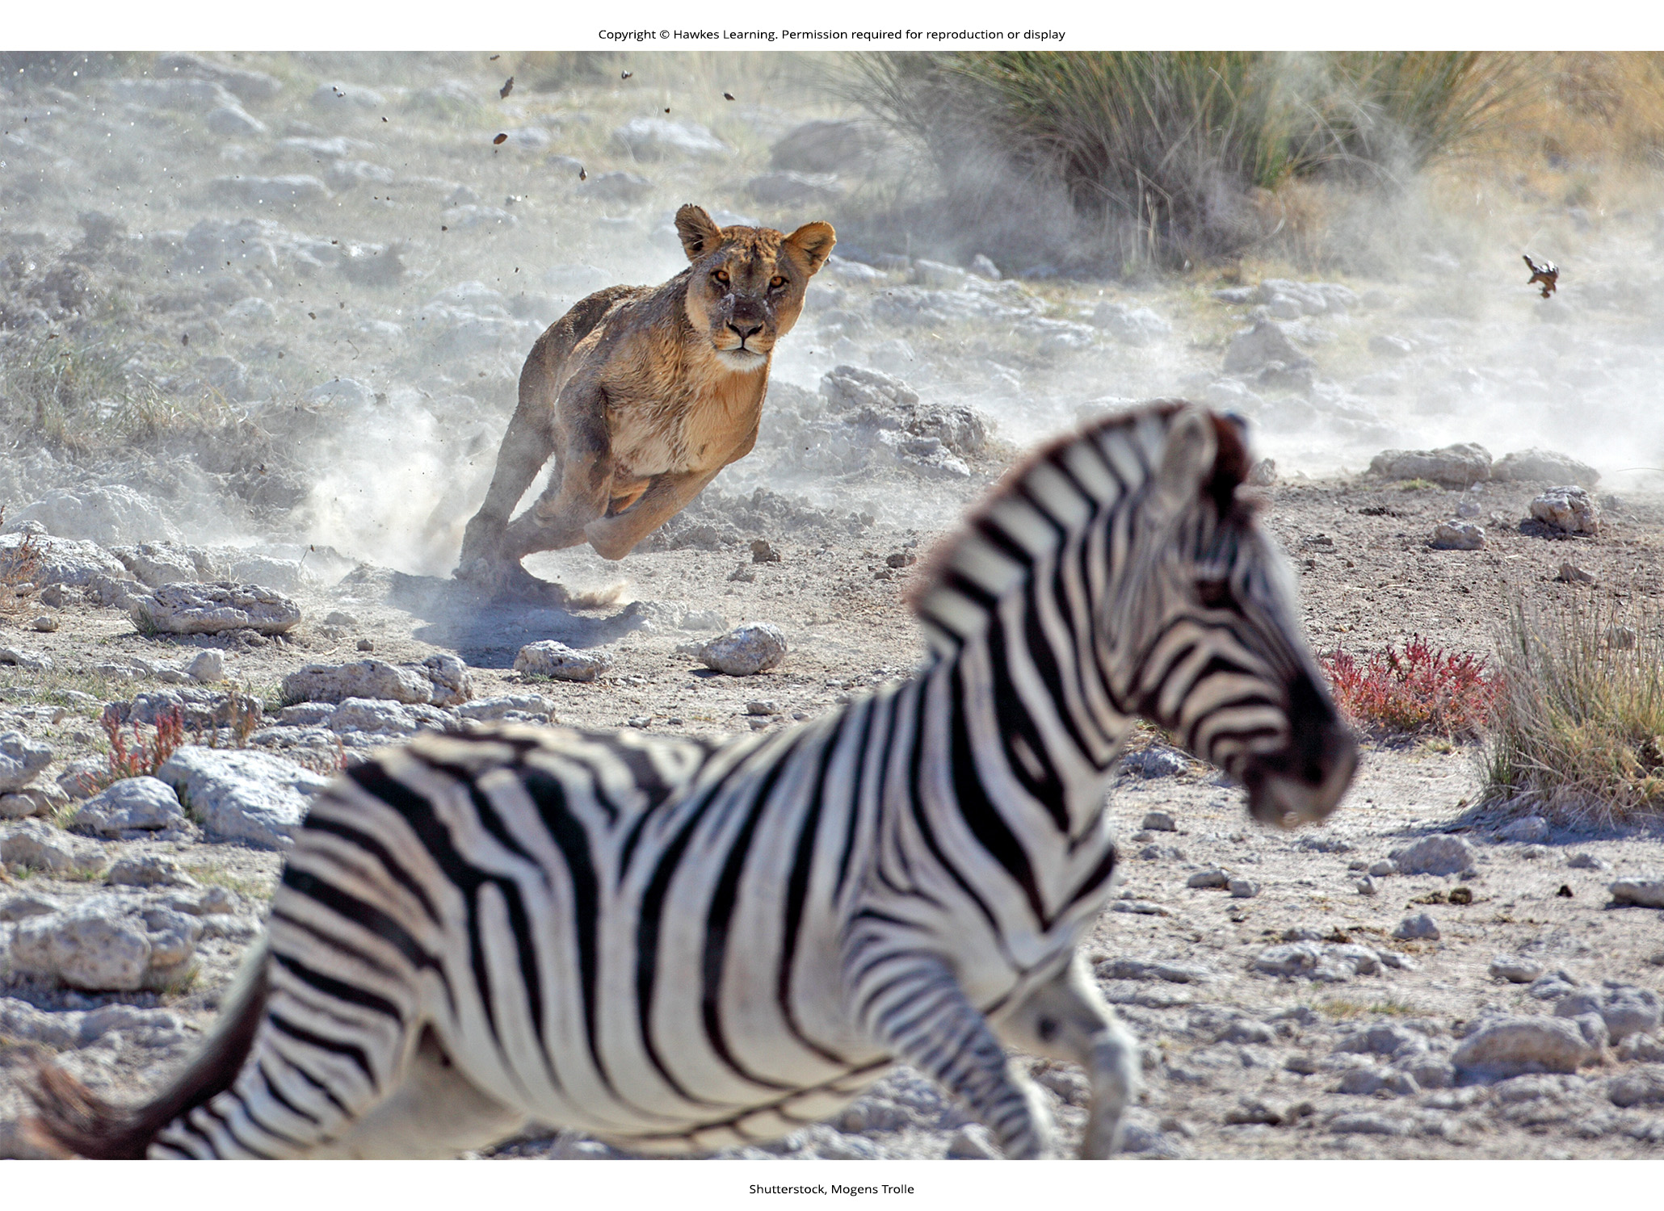
Lesson 42.4 Figure 3

Slide 36
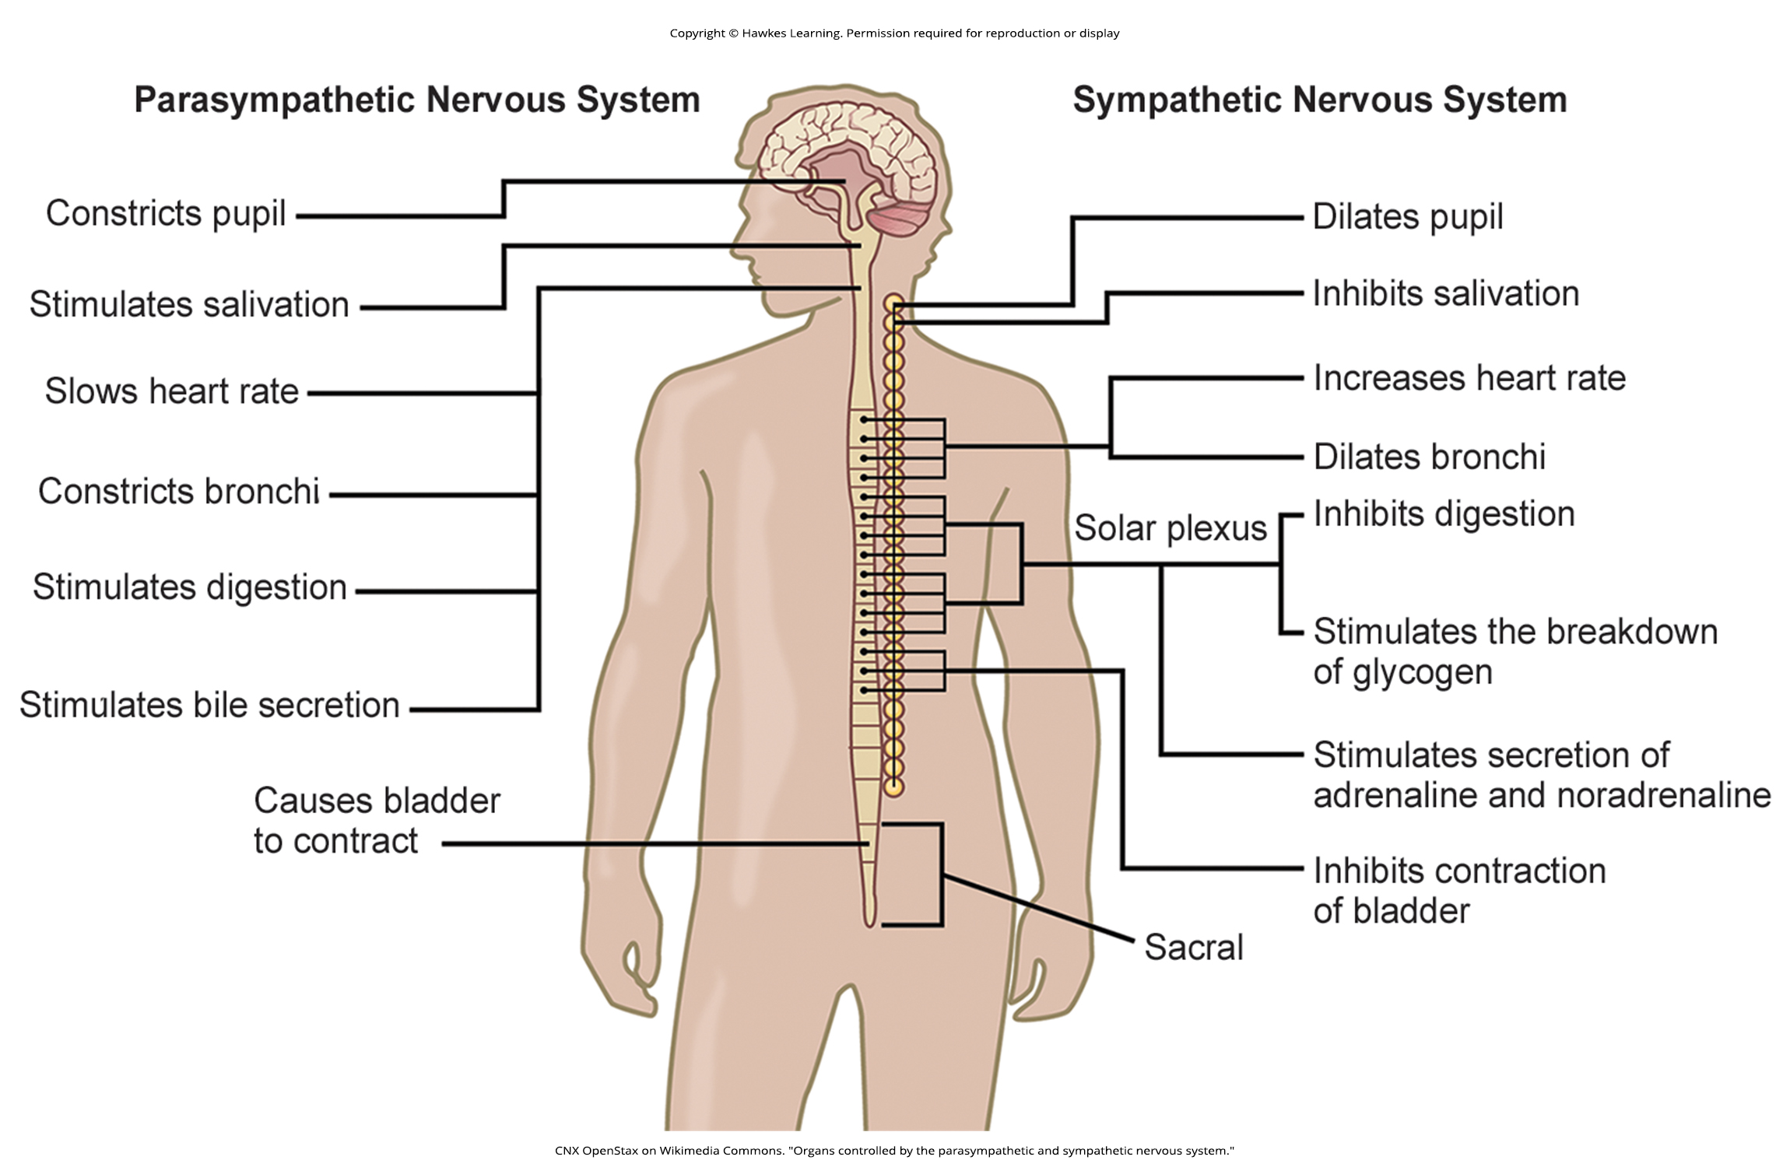
Lesson 42.4 Figure 4

Slide 37
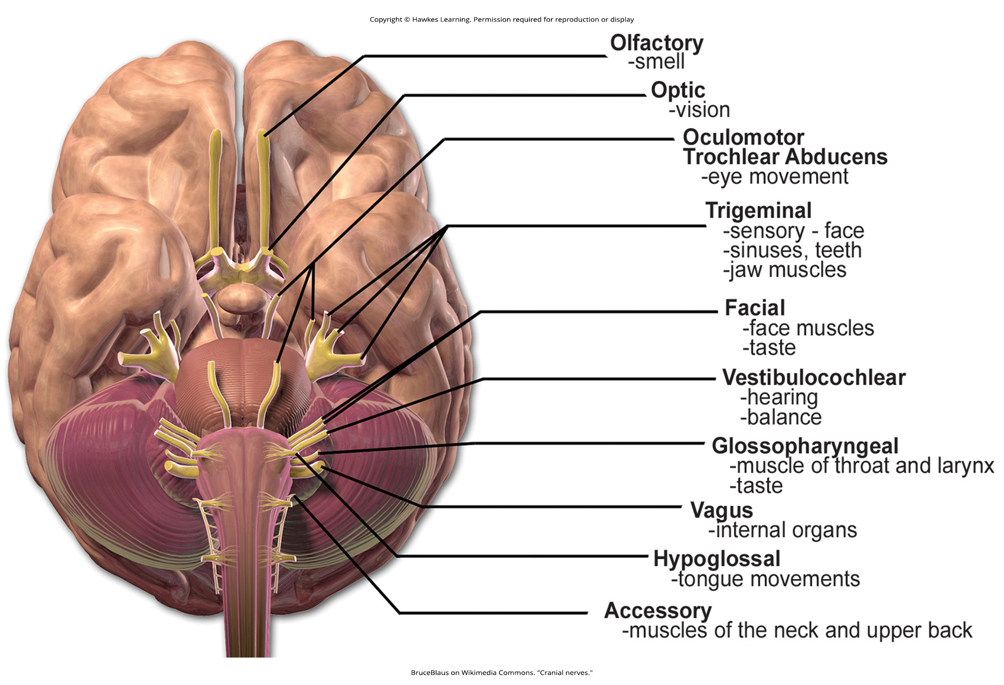
Lesson 42.4 Figure 5

Slide 38
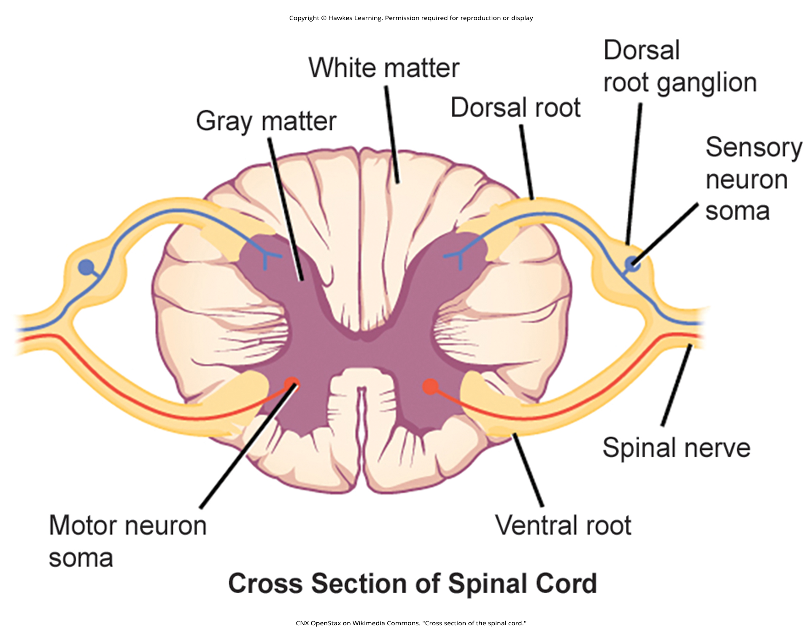
Lesson 42.4 Figure 6

Slide 39
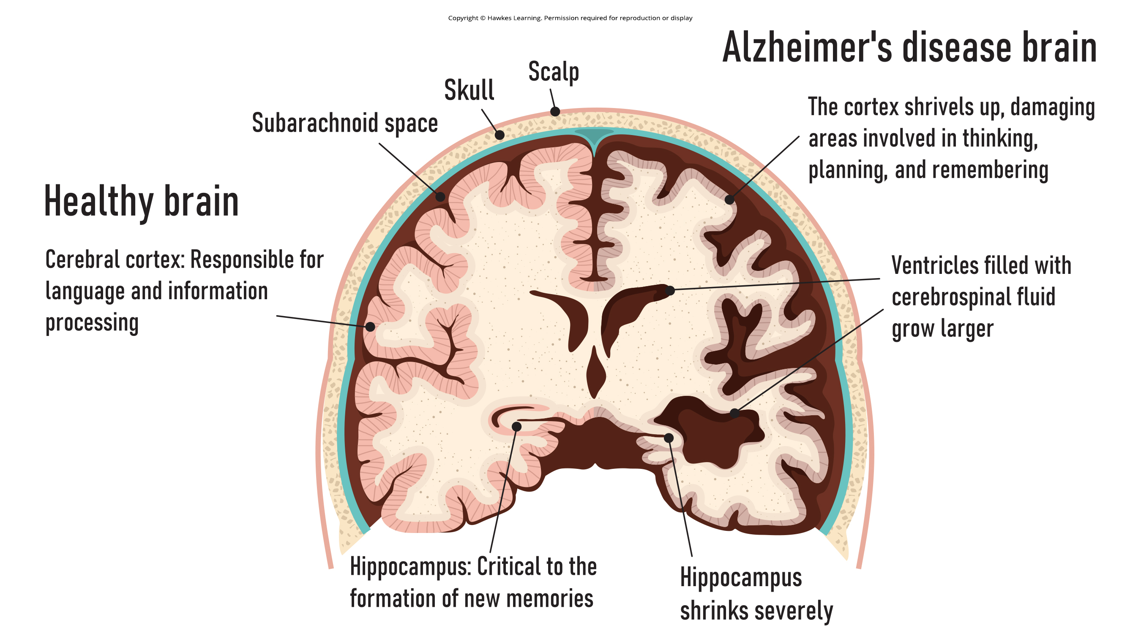
Lesson 42.5 Figure 1

Slide 40
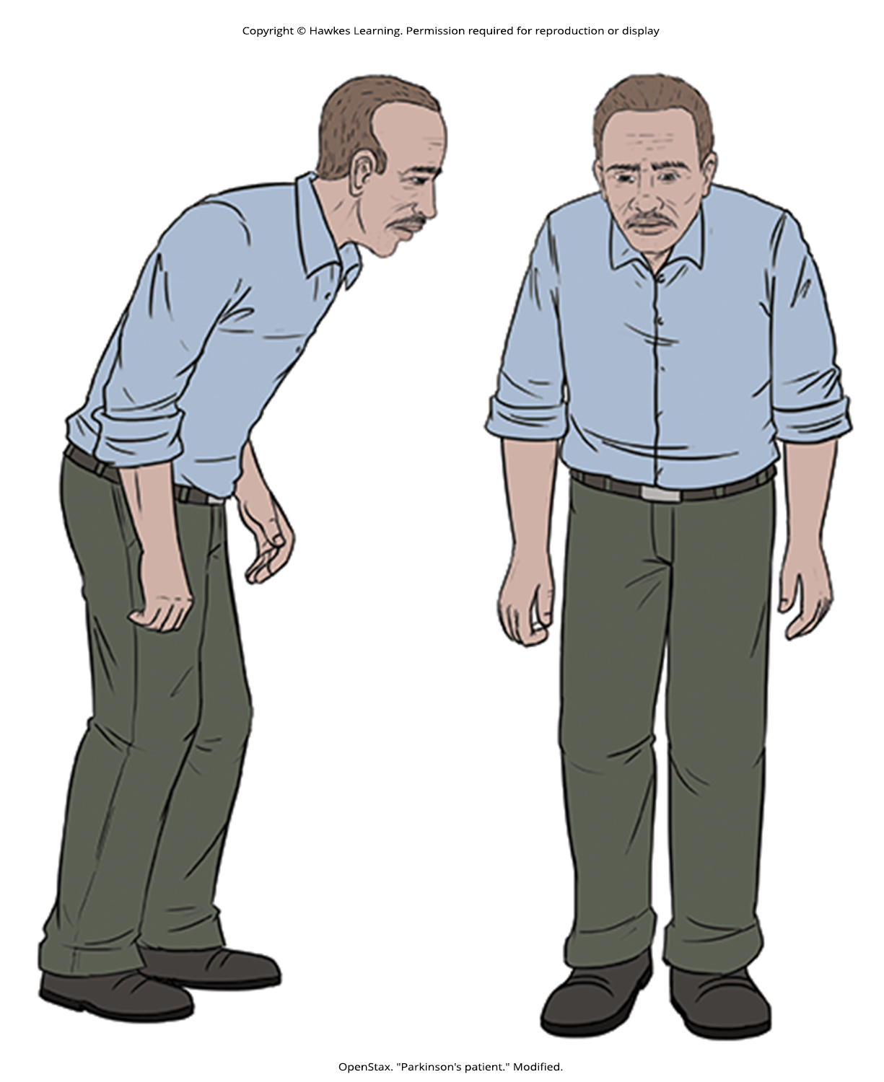
Lesson 42.5 Figure 2

Slide 41
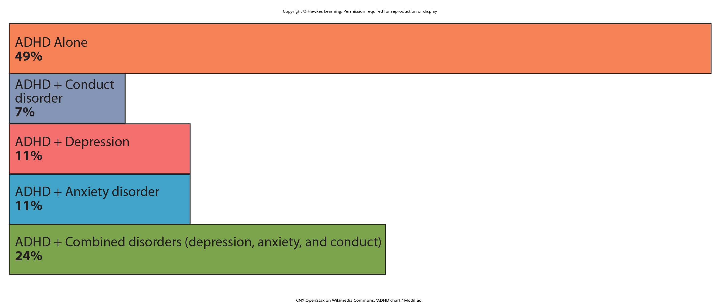
Lesson 42.5 Figure 3

Slide 42
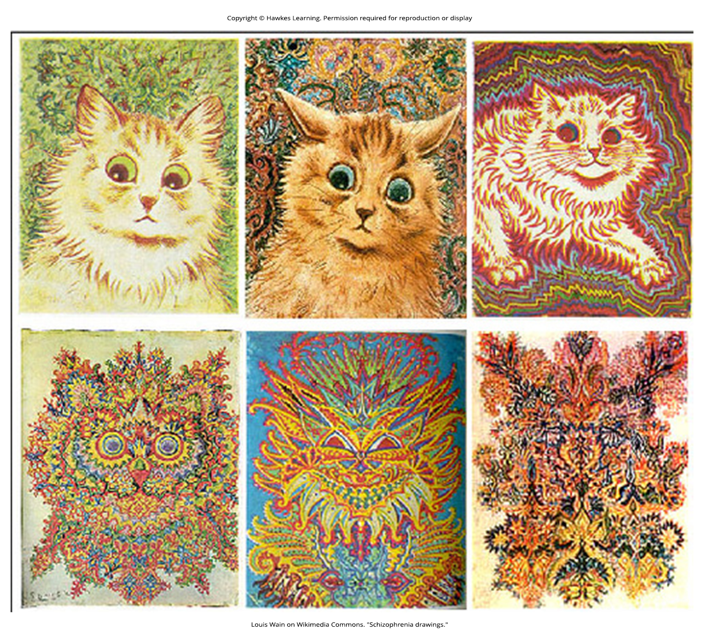
Lesson 42.5 Figure 4

Slide 43
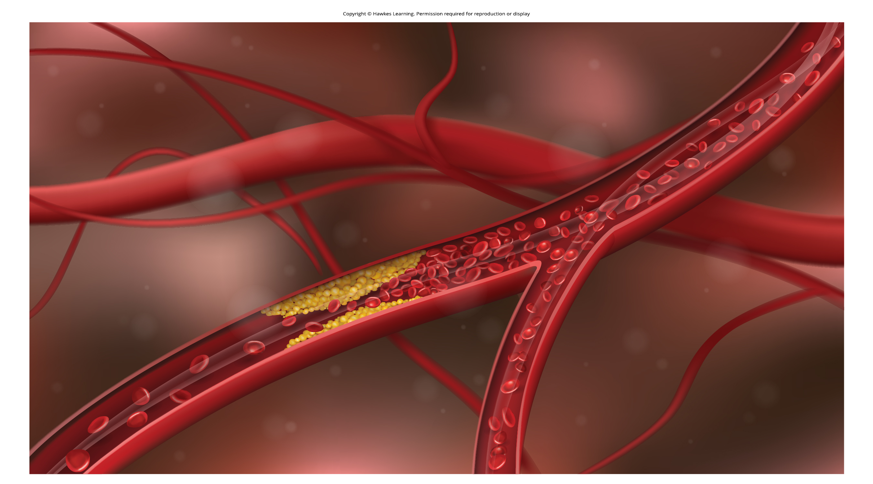
Lesson 42.5 Figure 5

Slide 44
Hawkes Learning – End of PowerPoint

