Slide 1
Chapter 15
Genes and Proteins

Slide 2
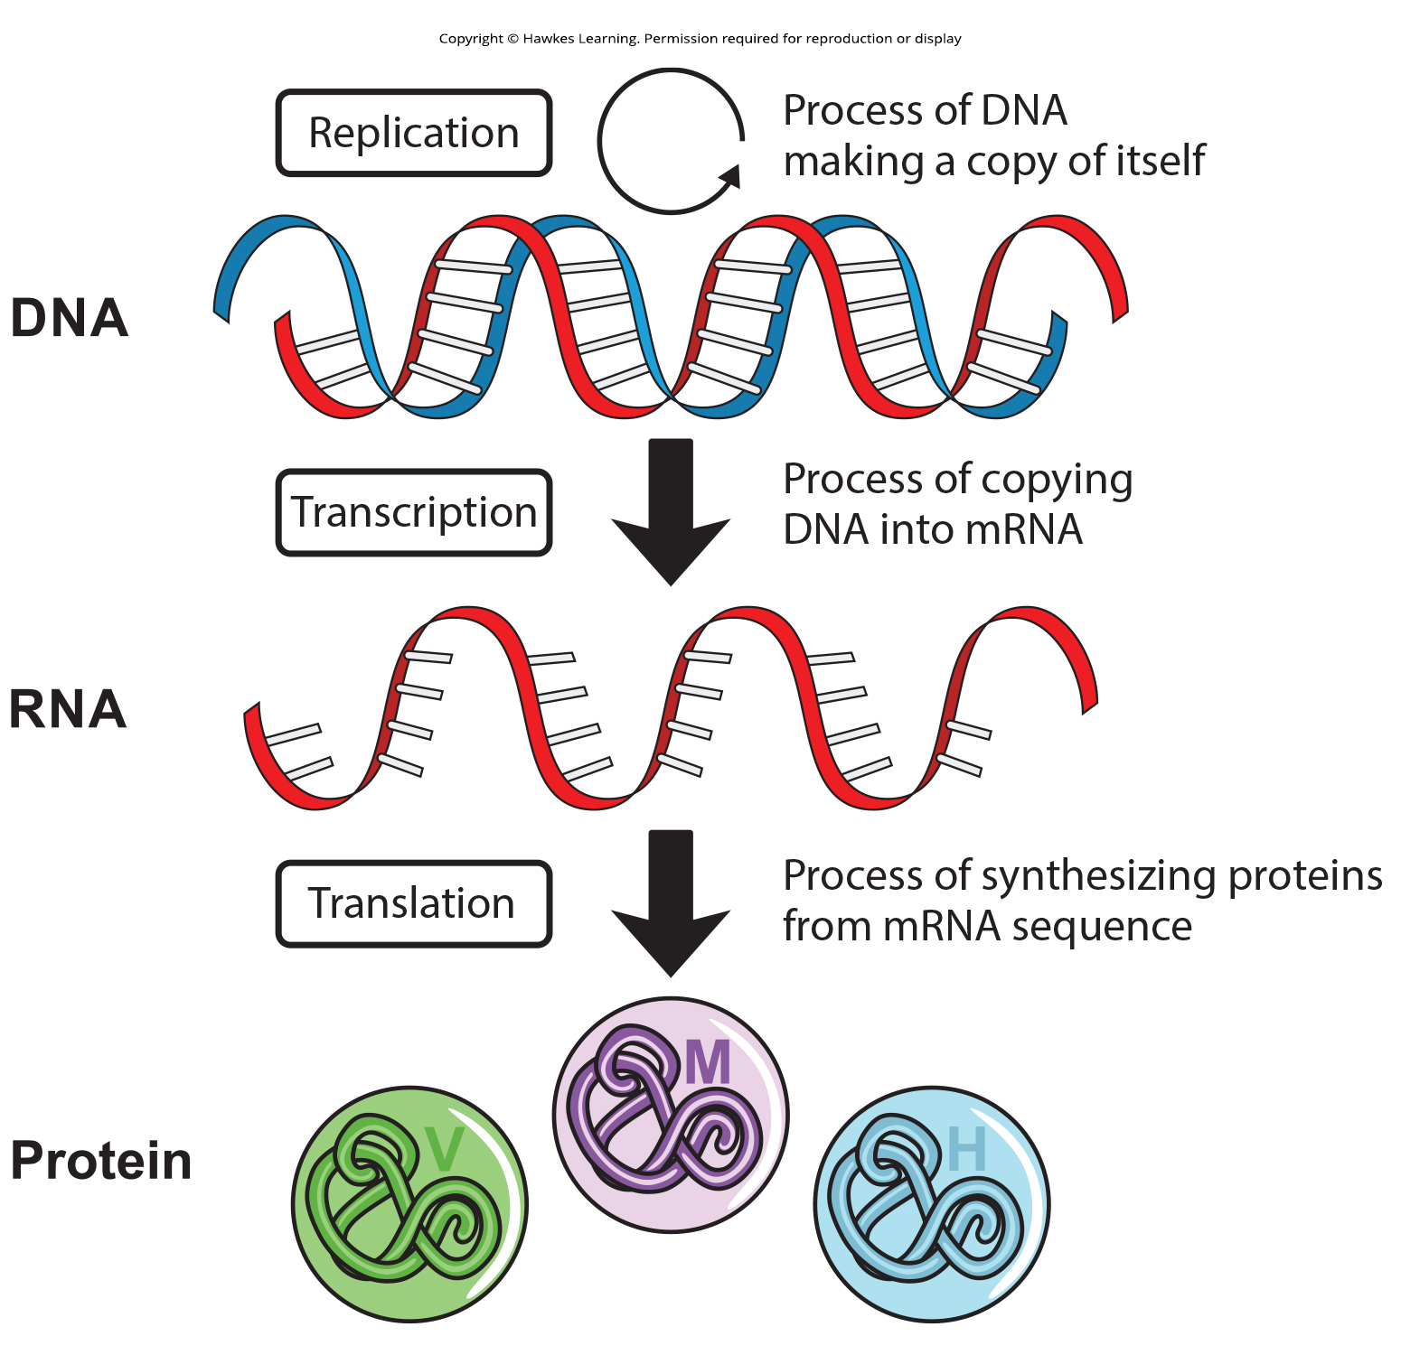
Lesson 15.1 Figure 1

Slide 3
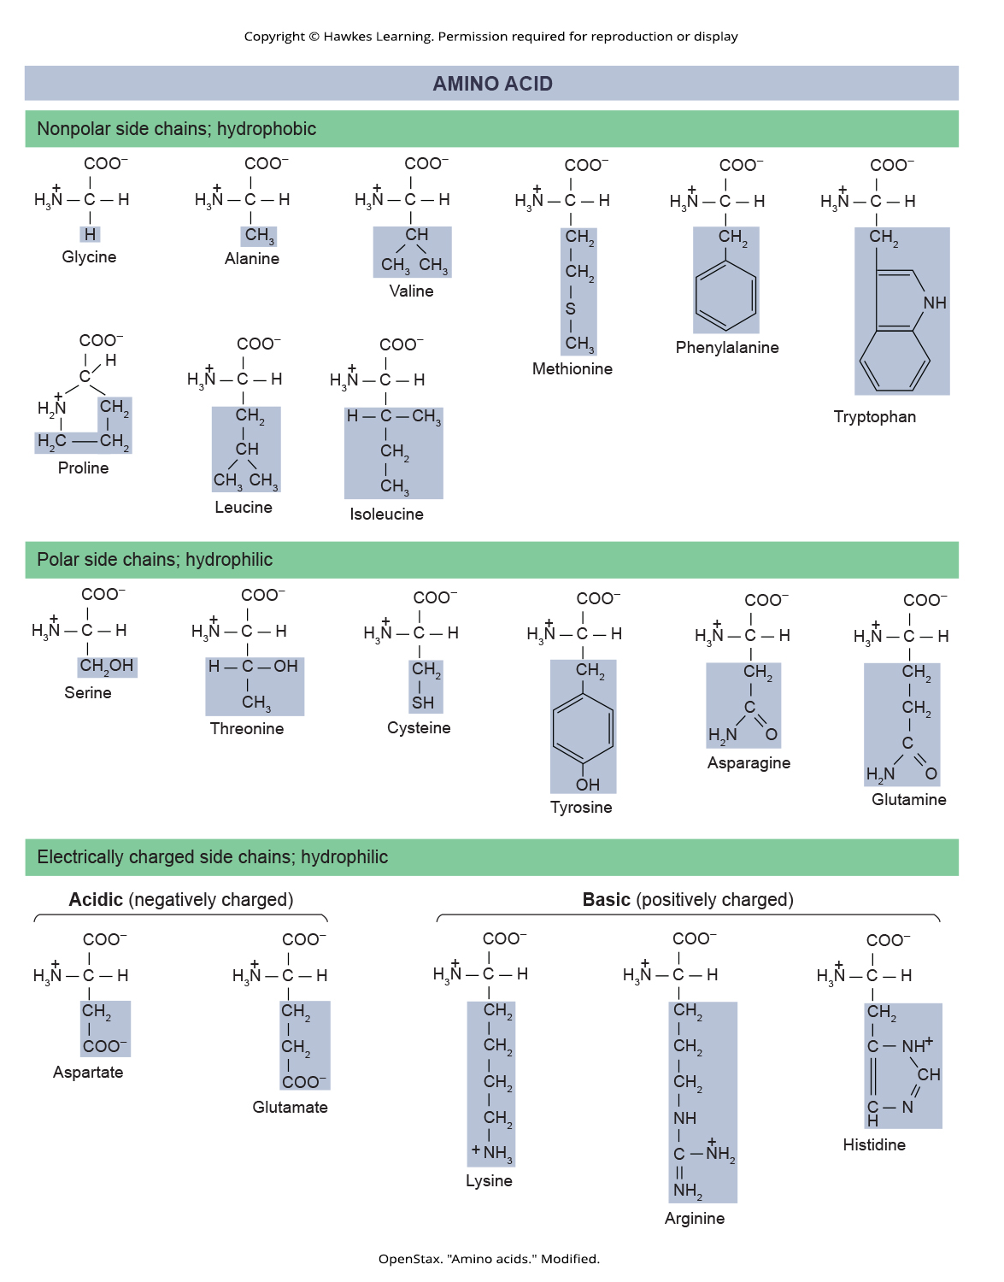
Lesson 15.1 Figure 2

Slide 4
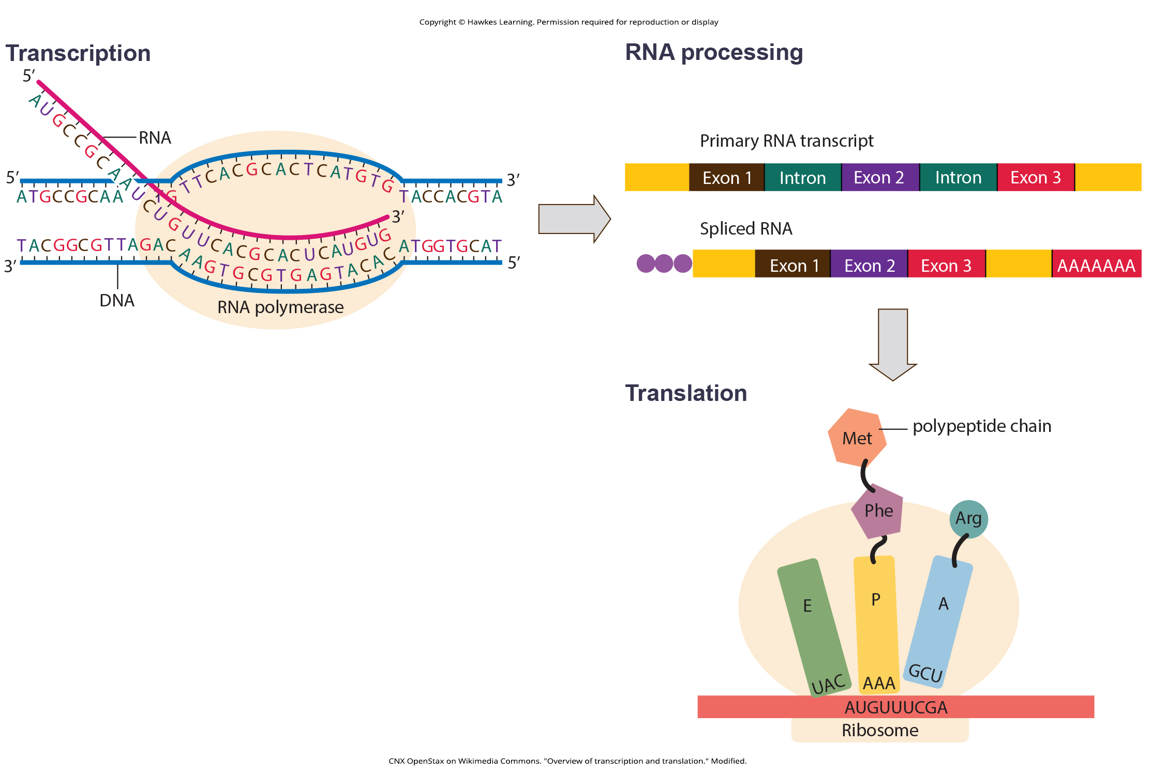
Lesson 15.1 Figure 3

Slide 5
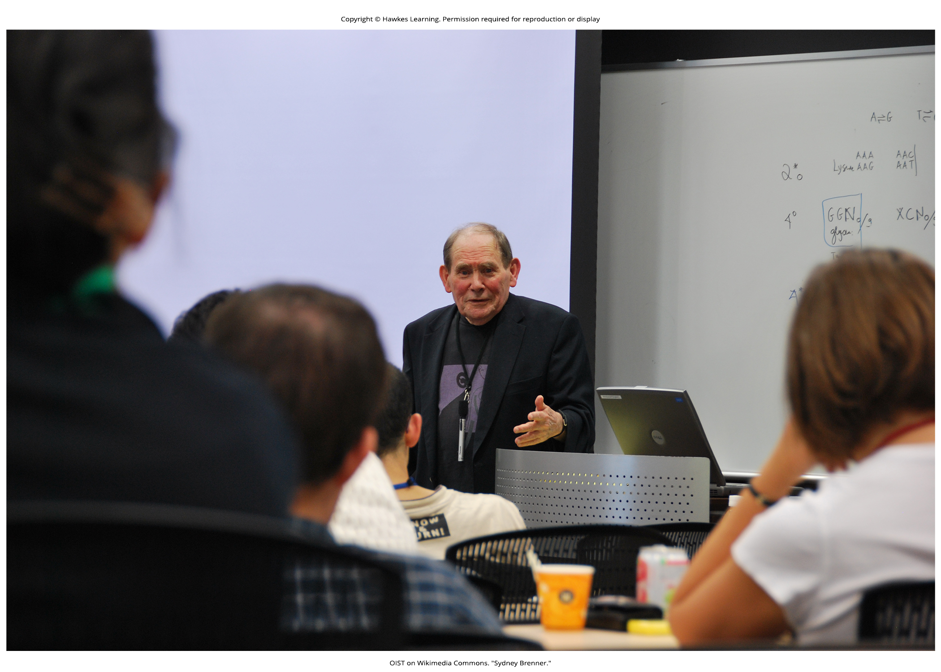
Lesson 15.1 Figure 4

Slide 6
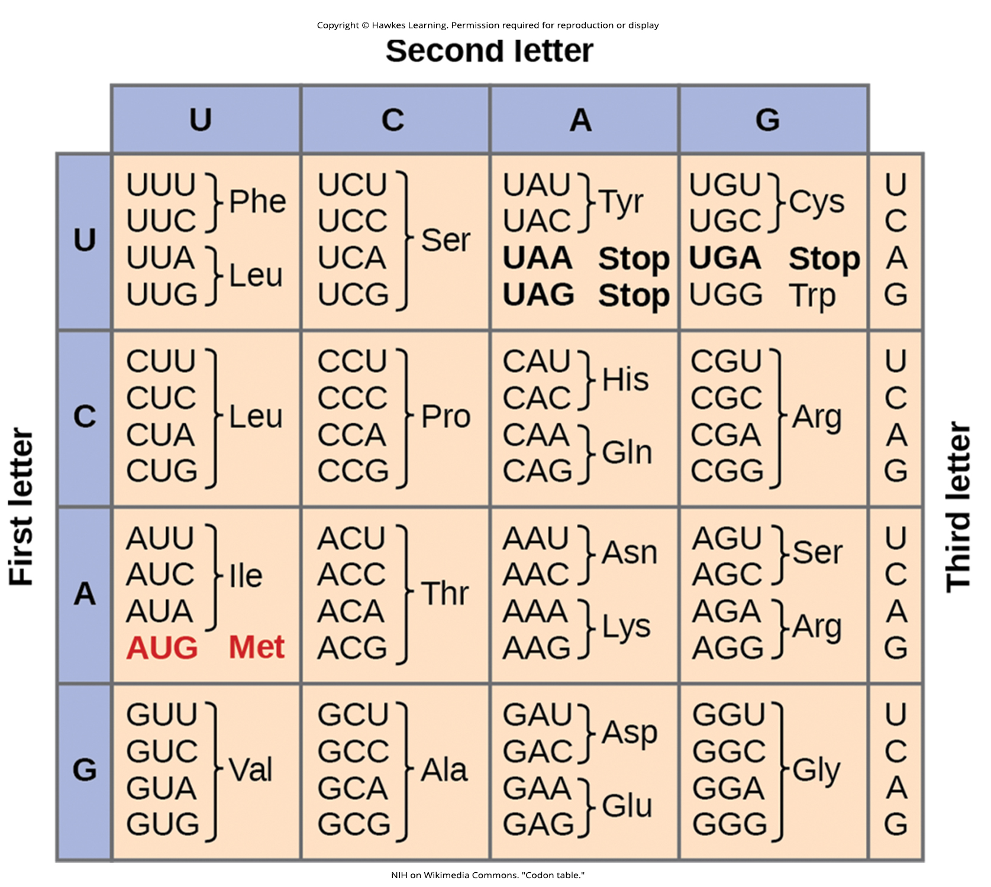
Lesson 15.1 Figure 5

Slide 7
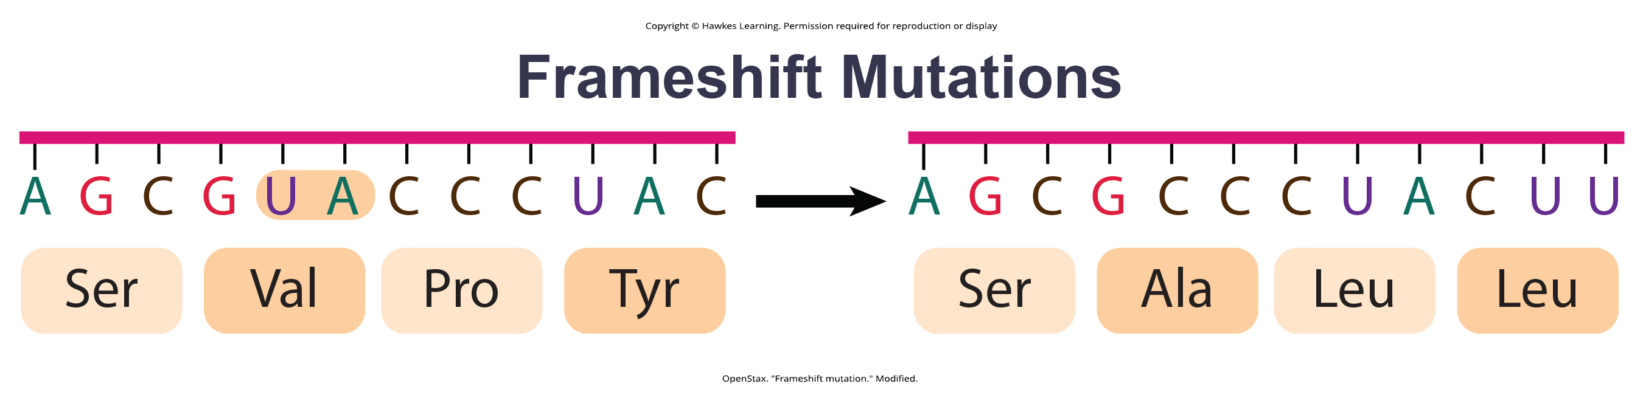
Lesson 15.1 Figure 6

Slide 8
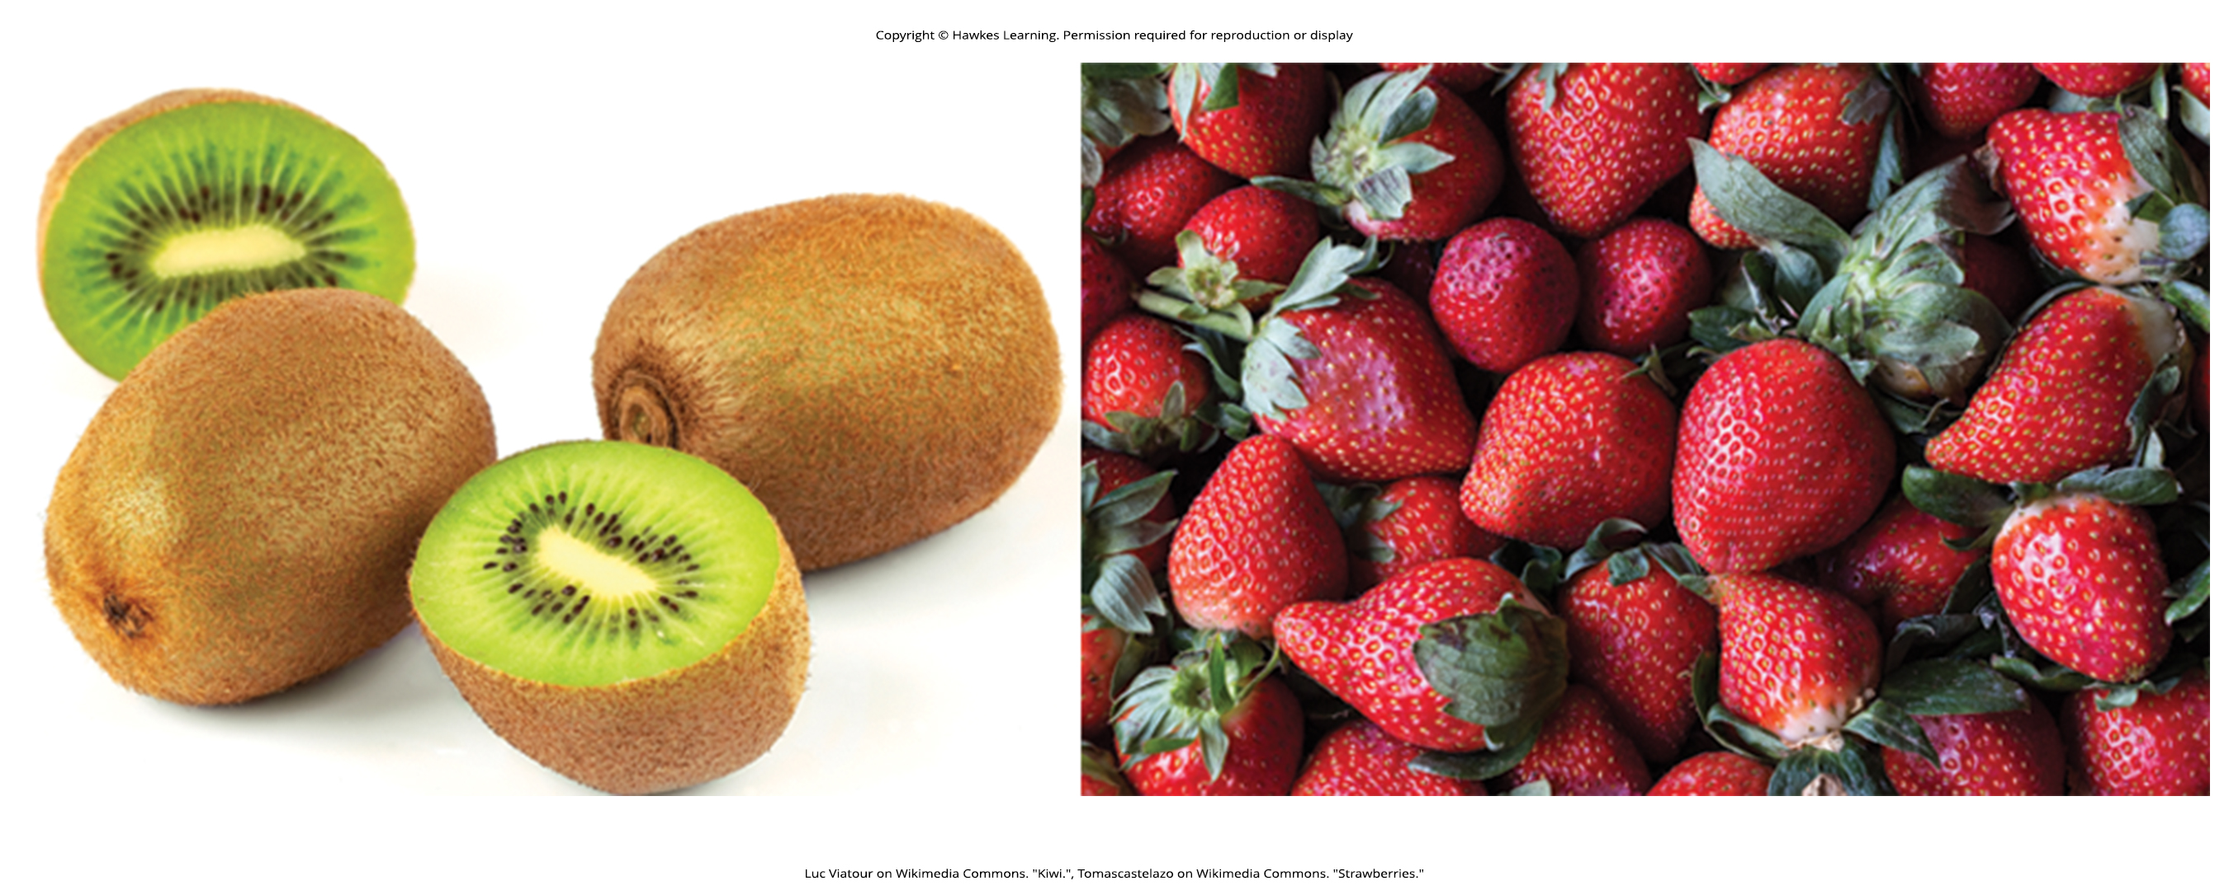
Lesson 15.1 Figure 7

Slide 9
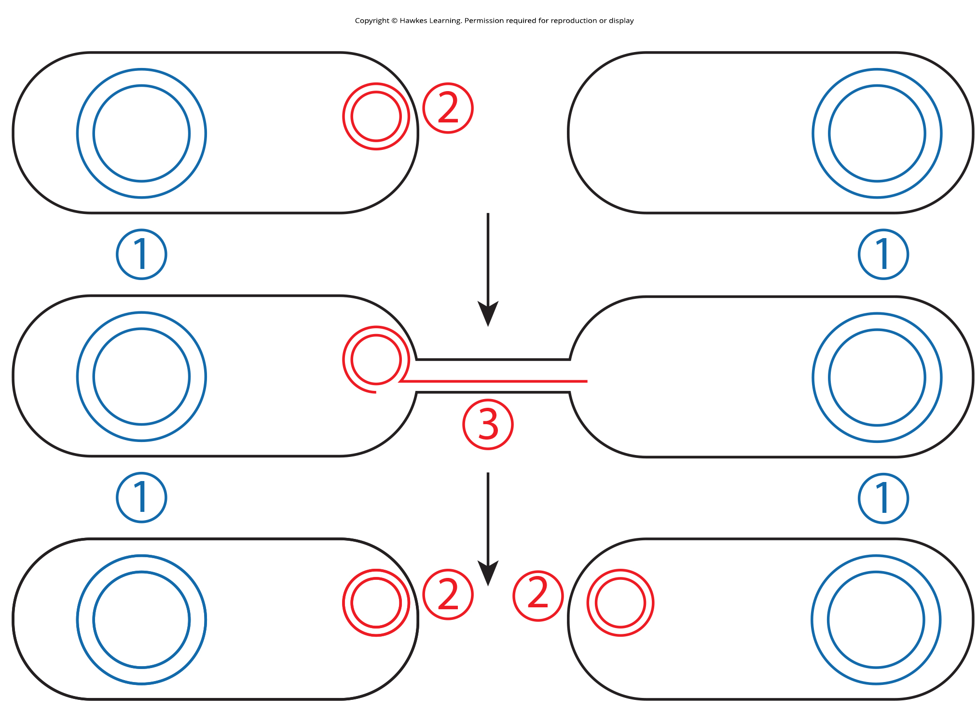
Lesson 15.2 Figure 1

Slide 10
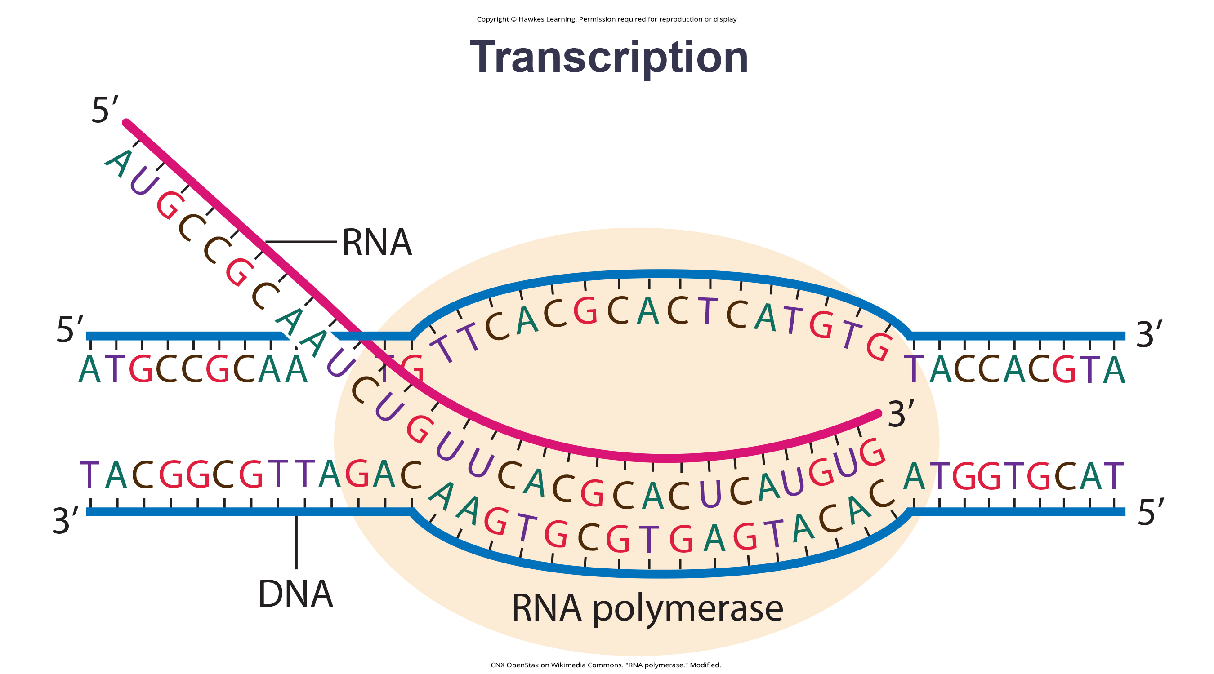
Lesson 15.2 Figure 2

Slide 11
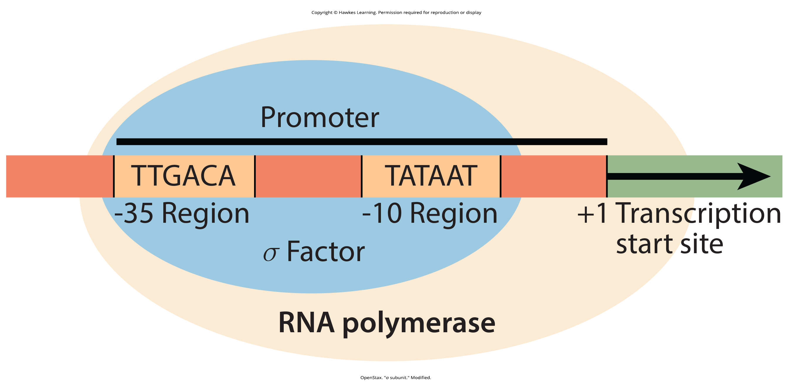
Lesson 15.2 Figure 3

Slide 12
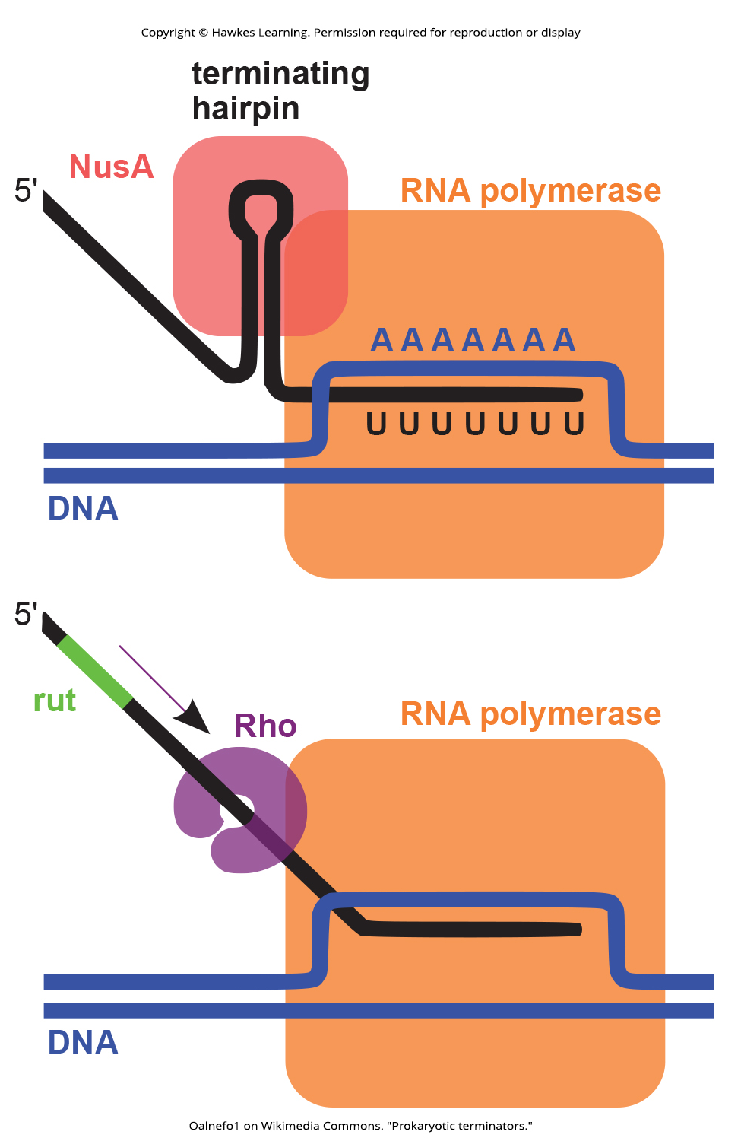
Lesson 15.2 Figure 4

Slide 13
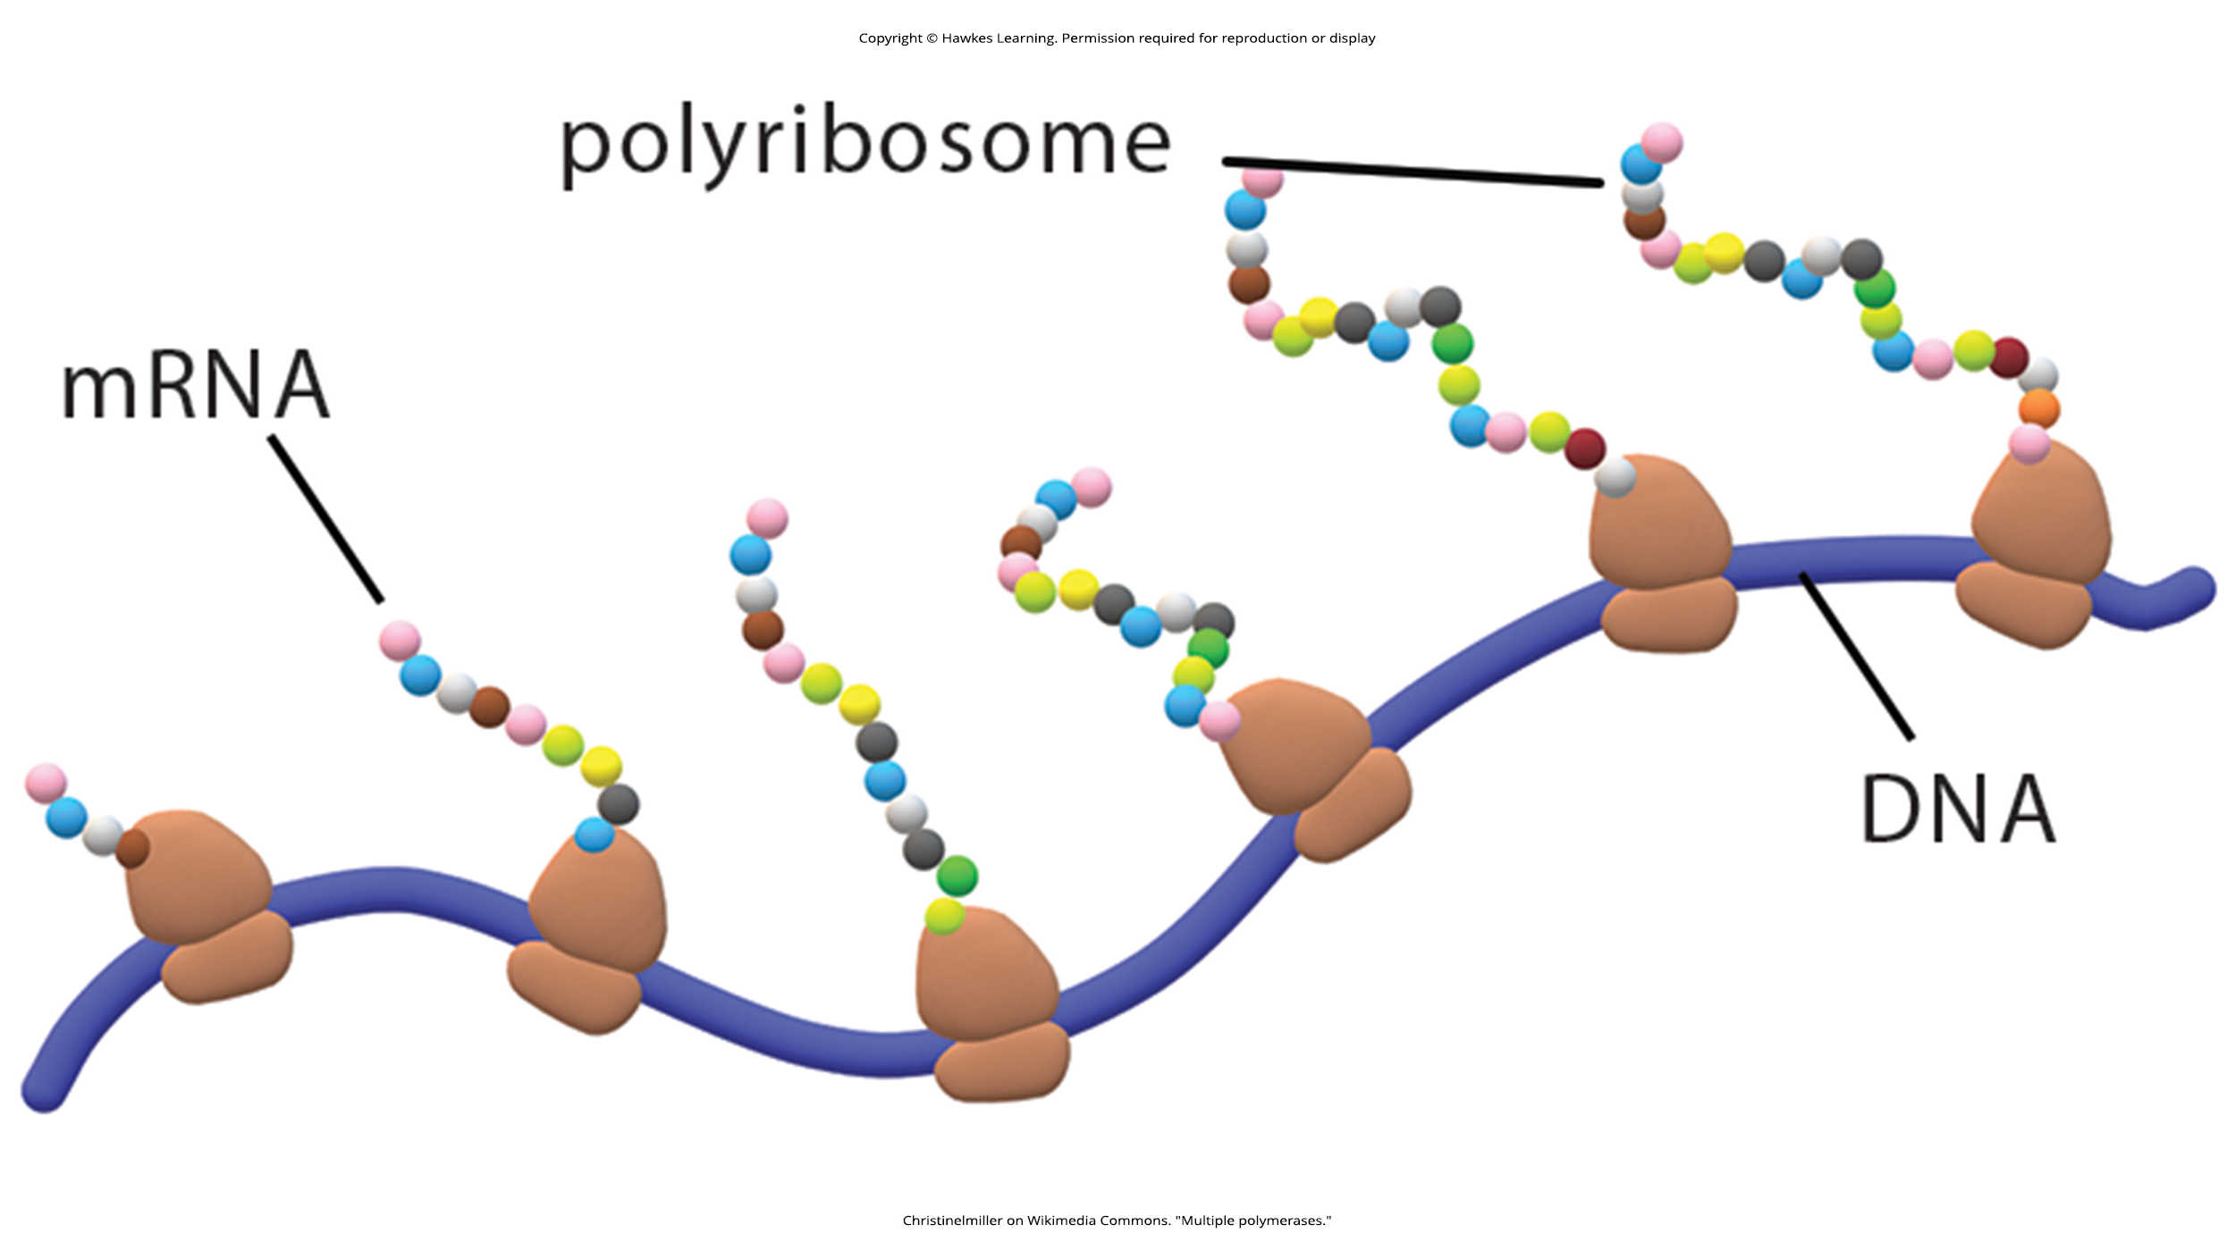
Lesson 15.2 Figure 5

Slide 14
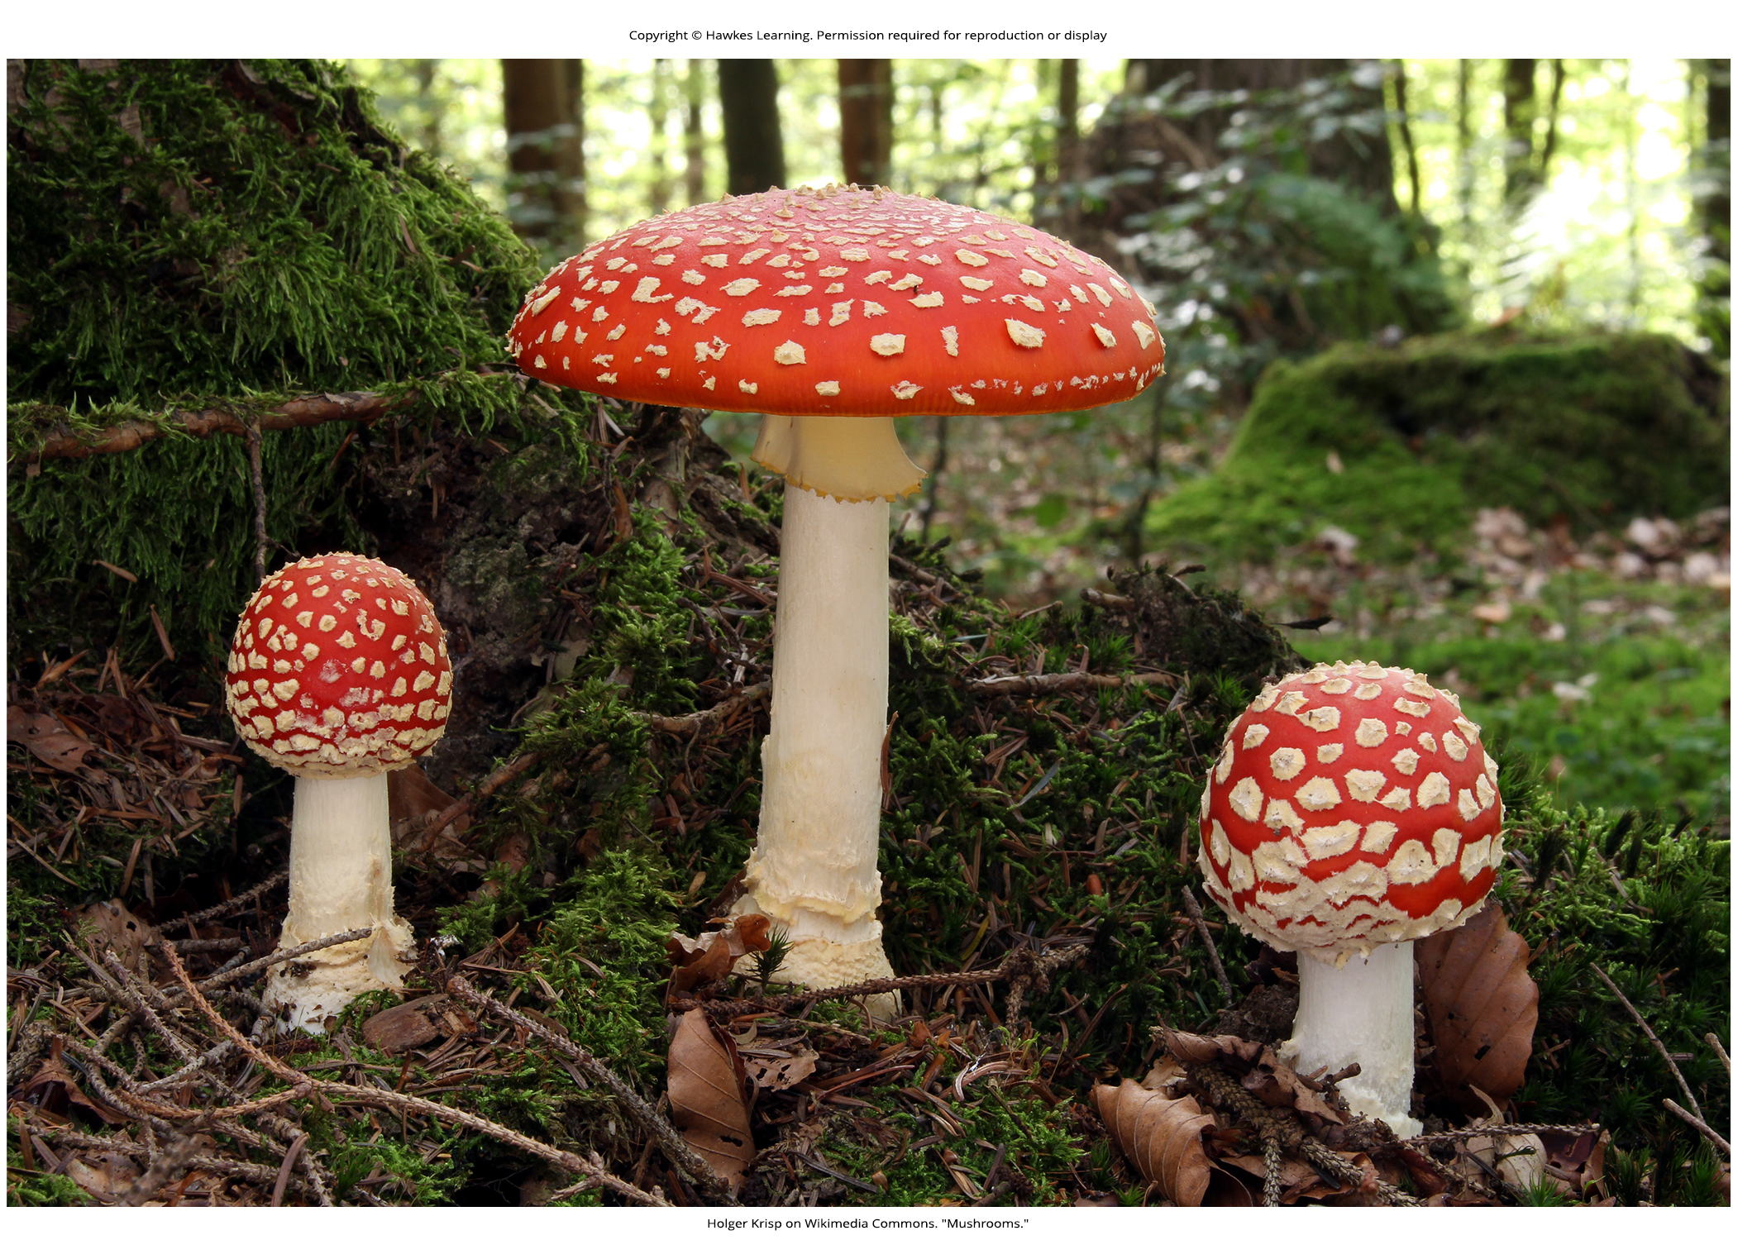
Lesson 15.3 Figure 1

Slide 15
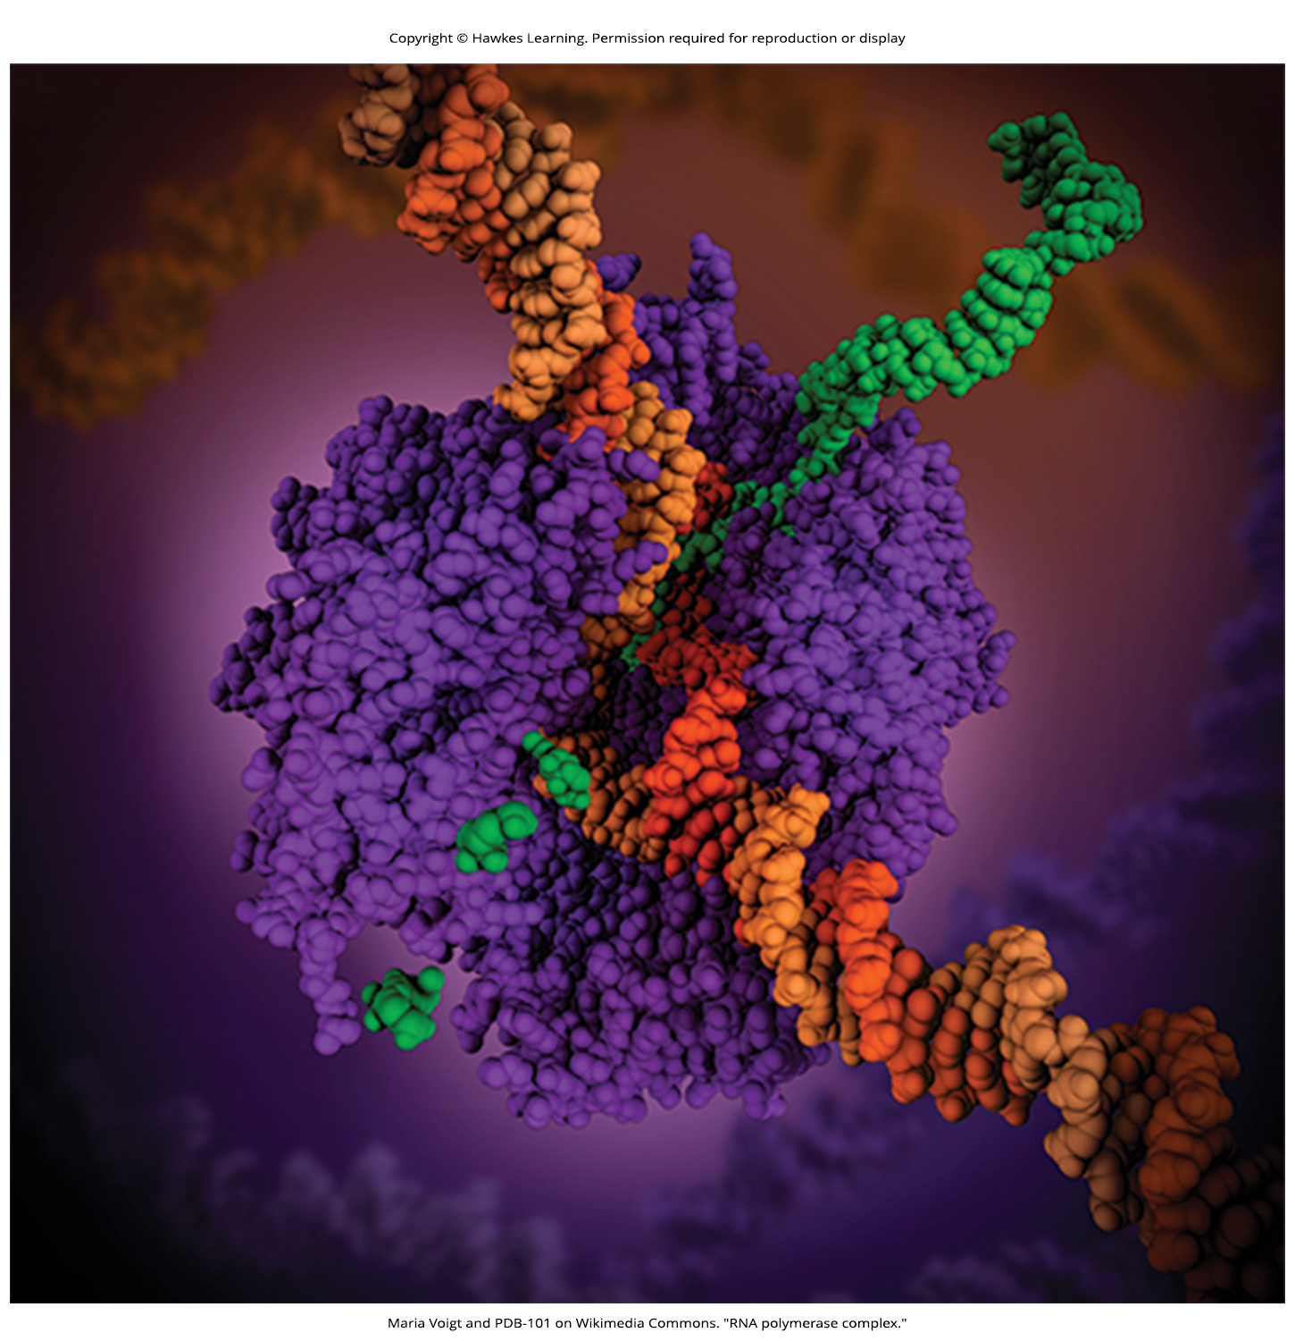
Lesson 15.3 Figure 2

Slide 16
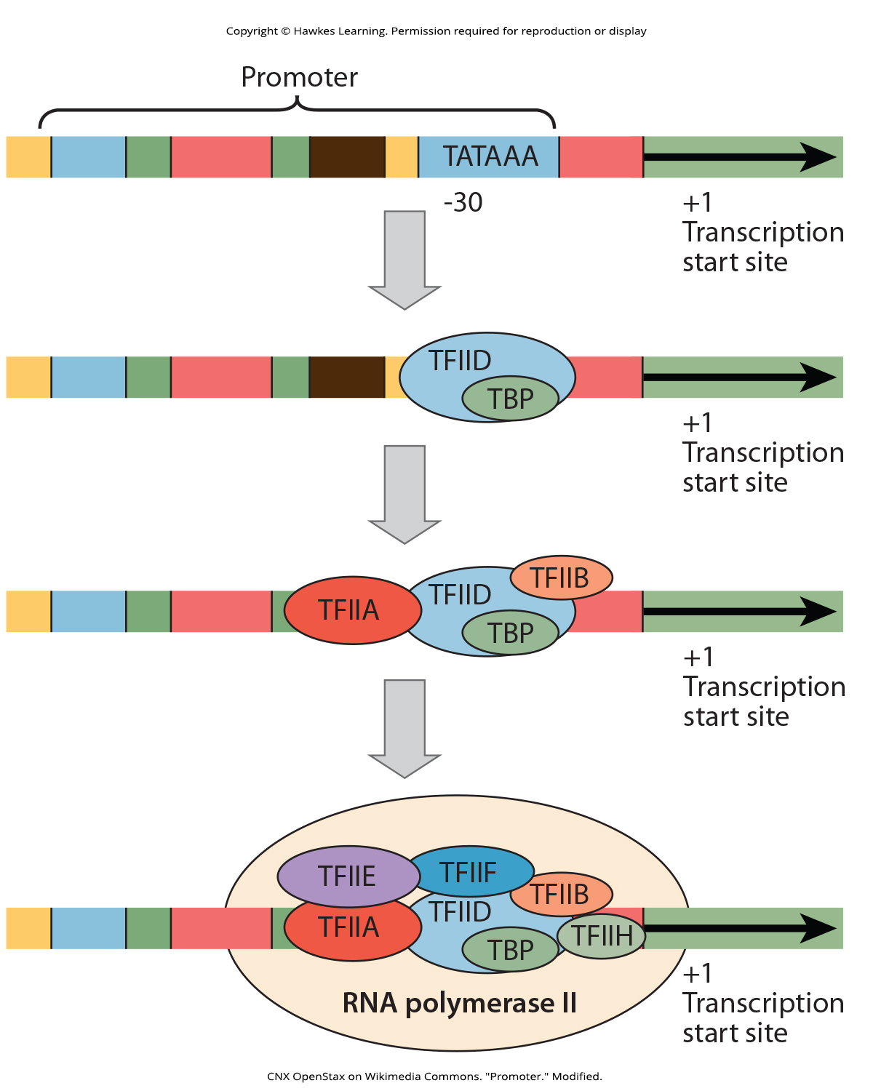
Lesson 15.3 Figure 3

Slide 17
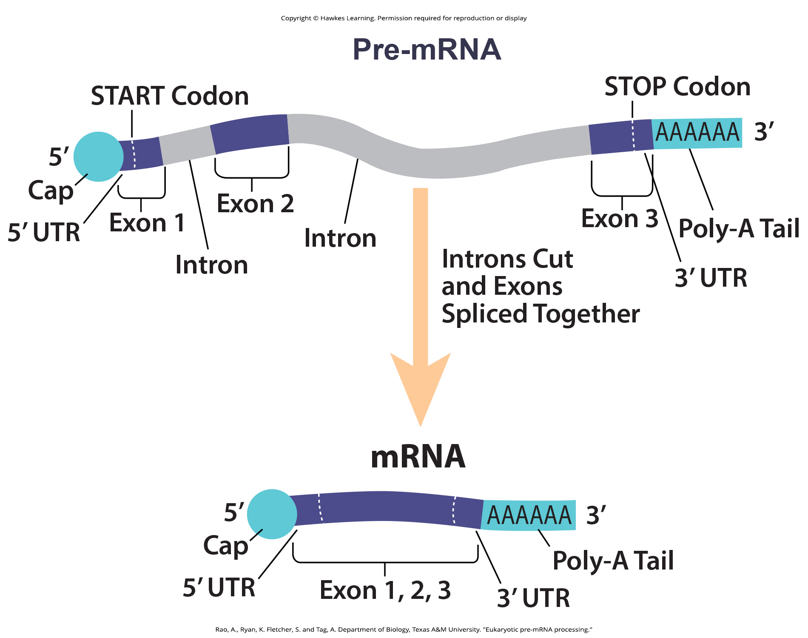
Lesson 15.4 Figure 1

Slide 18
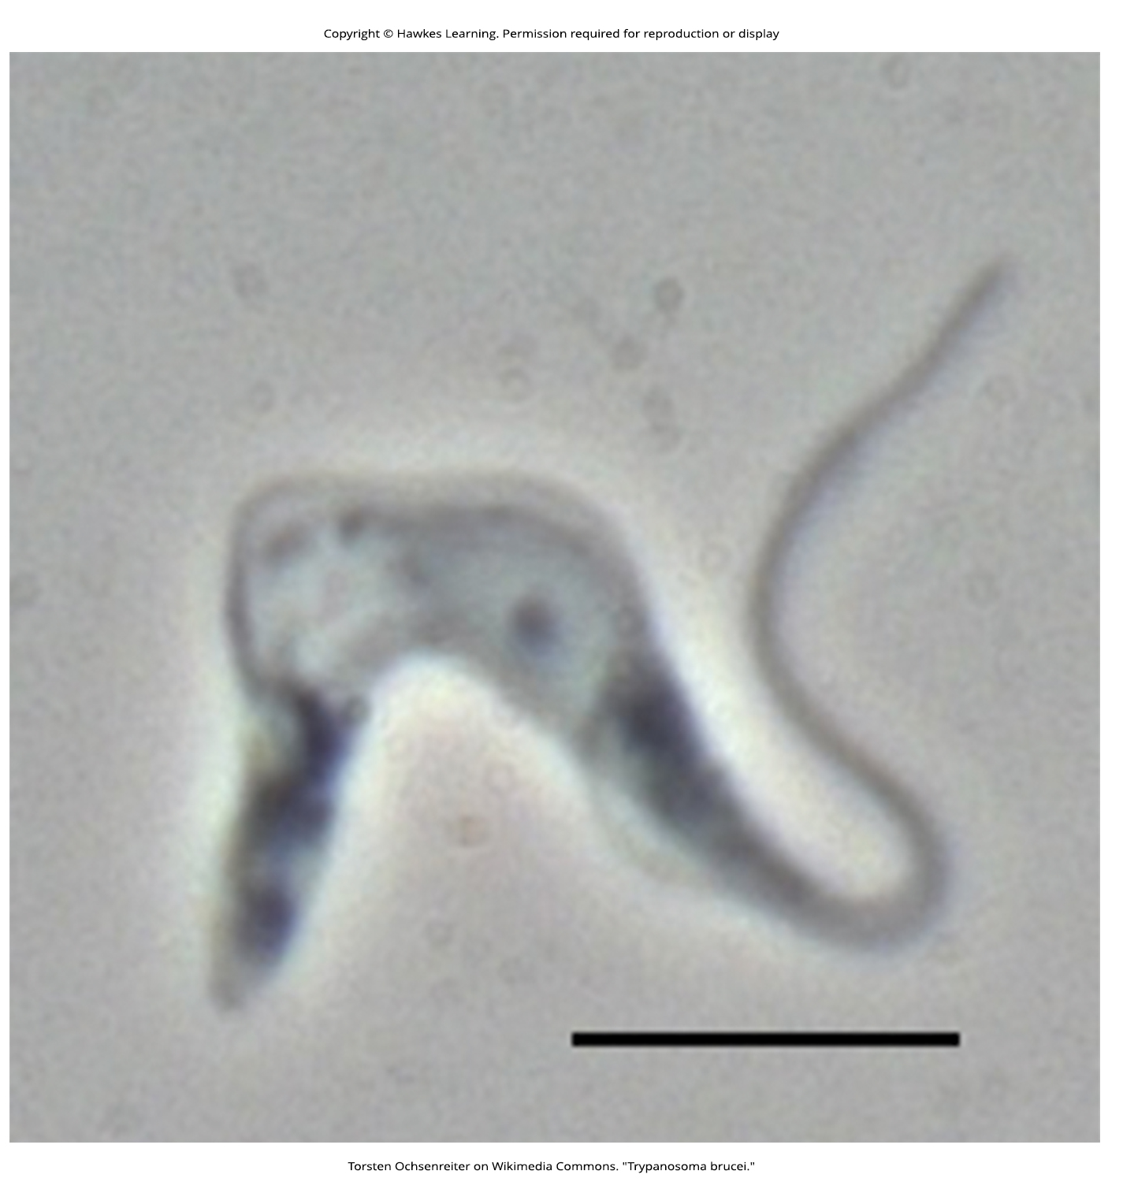
Lesson 15.4 Figure 2

Slide 19
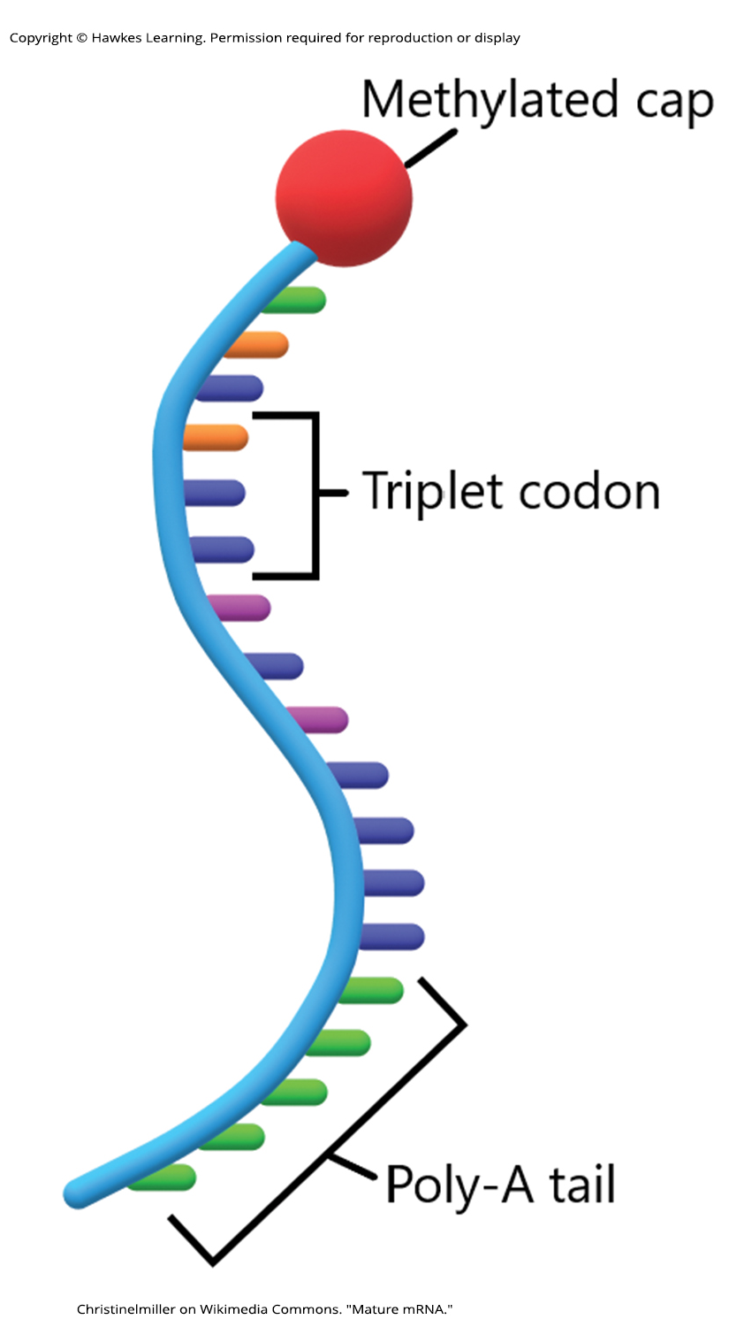
Lesson 15.4 Figure 3

Slide 20
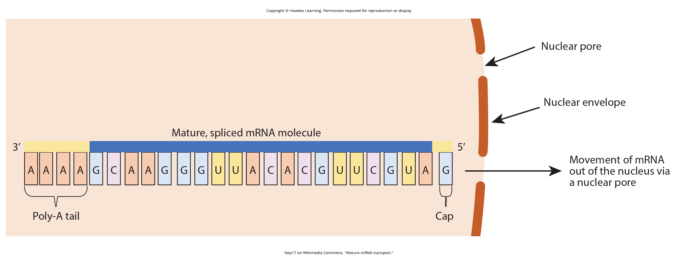
Lesson 15.4 Figure 4

Slide 21
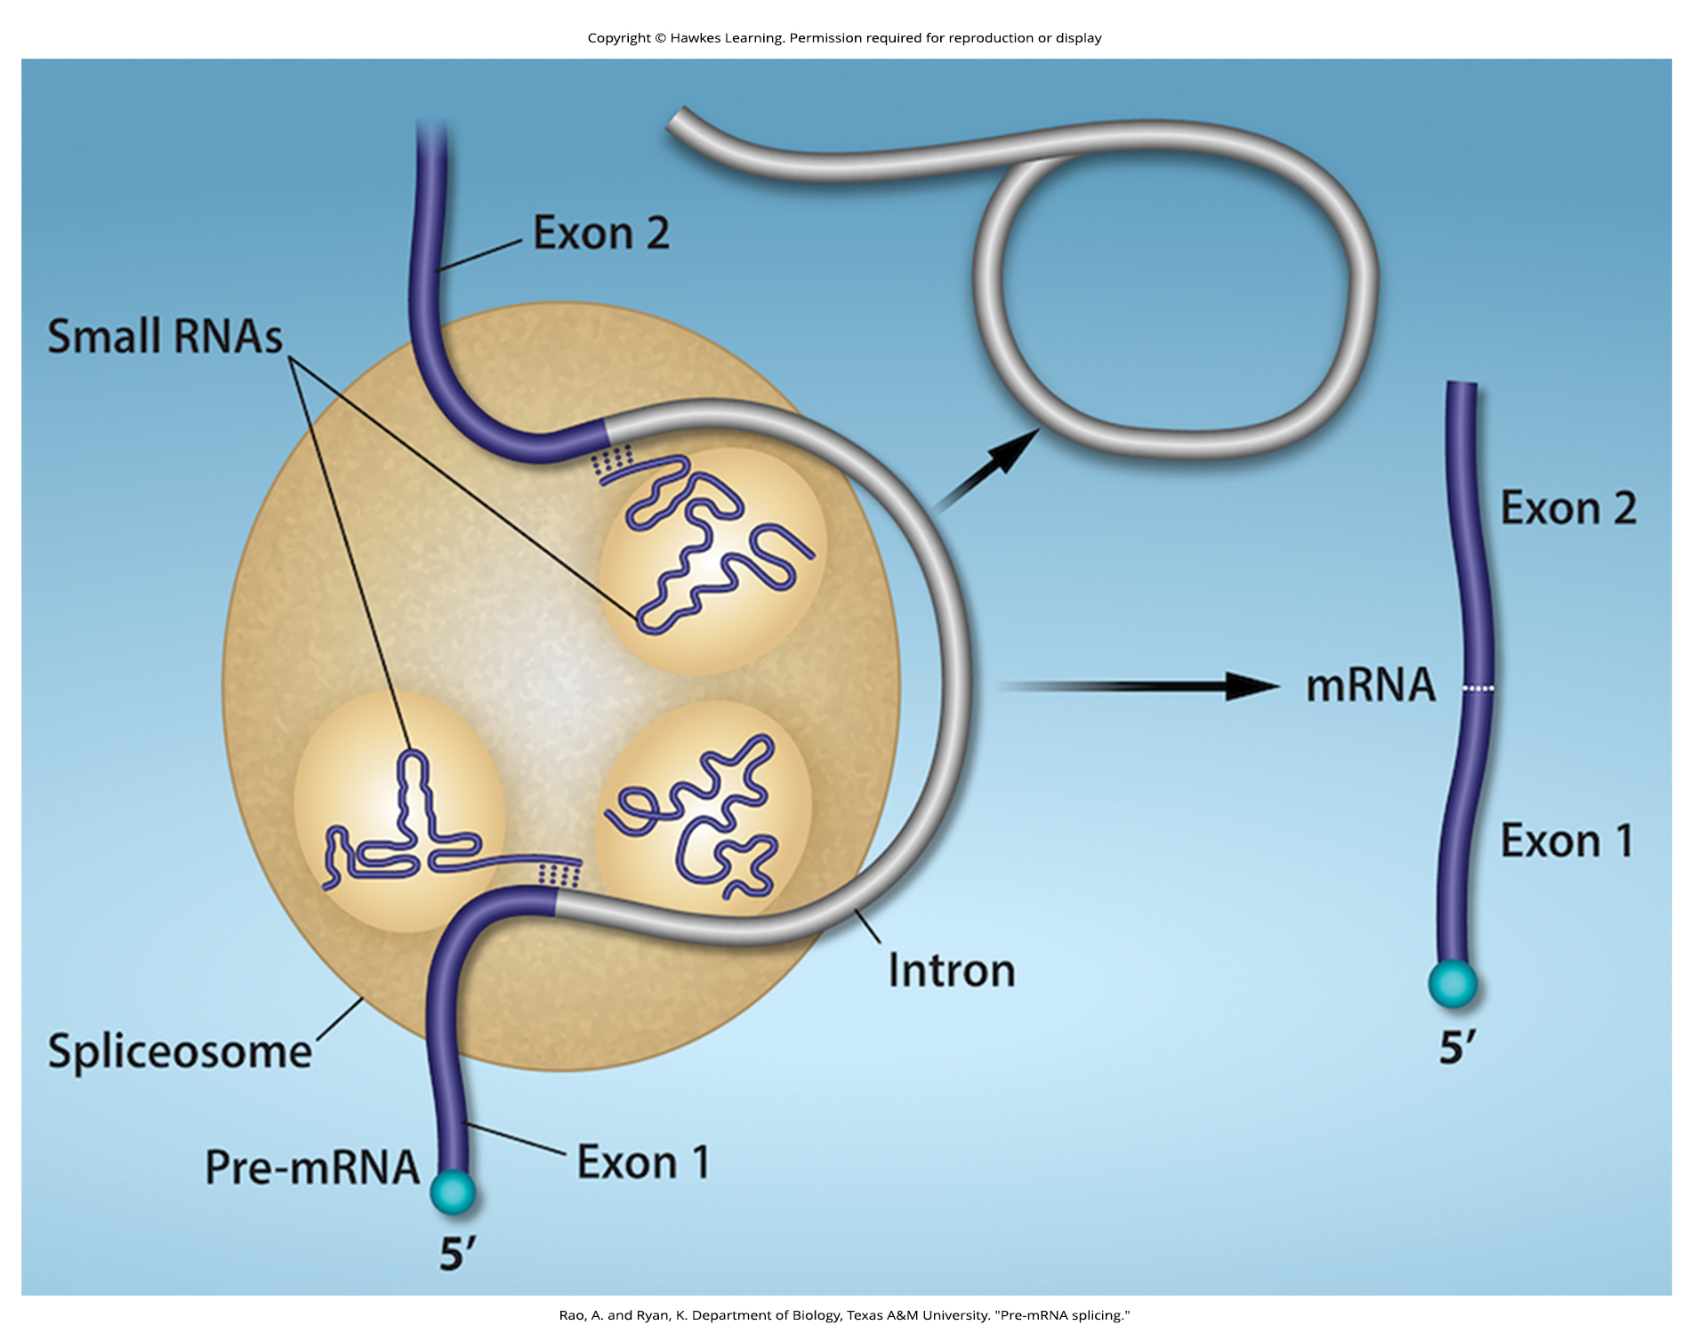
Lesson 15.4 Figure 5

Slide 22
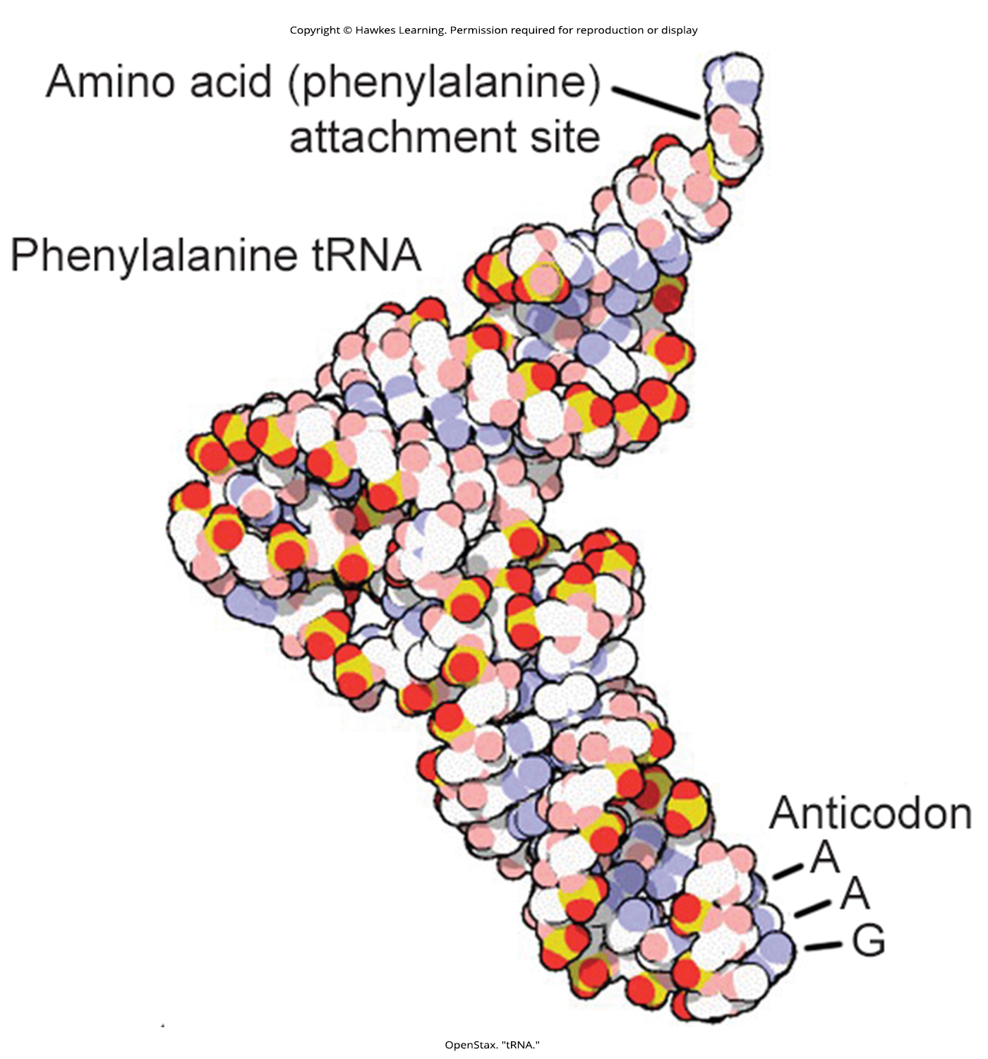
Lesson 15.4 Figure 6

Slide 23
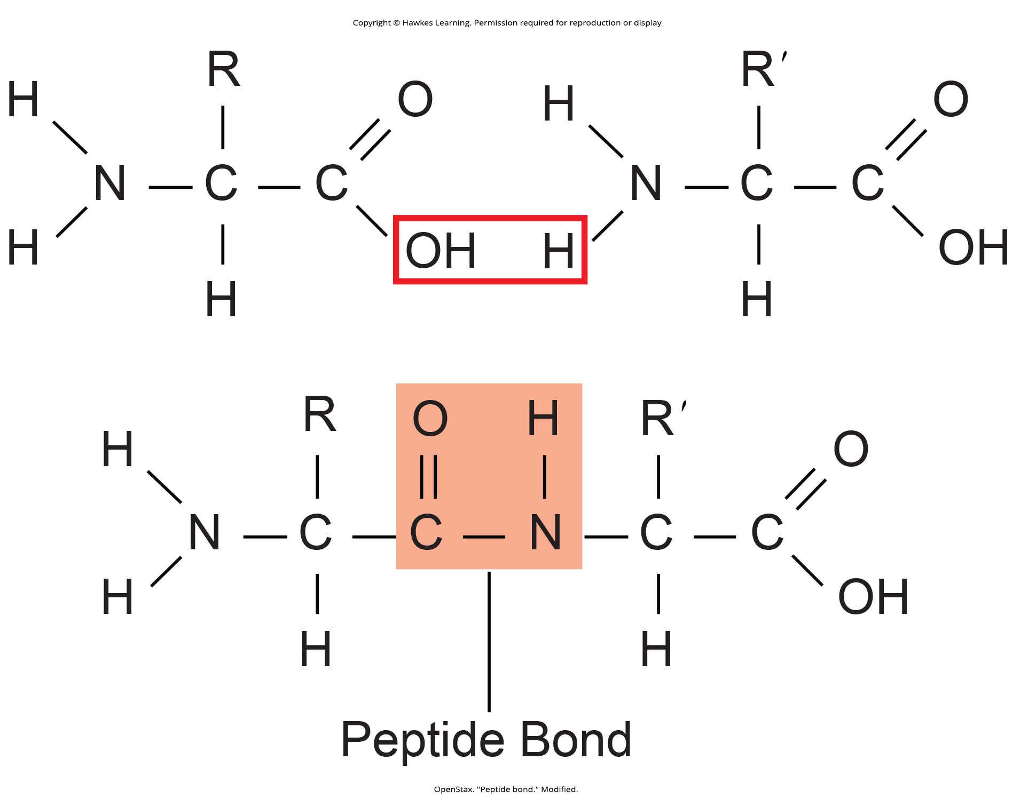
Lesson 15.5 Figure 1

Slide 24
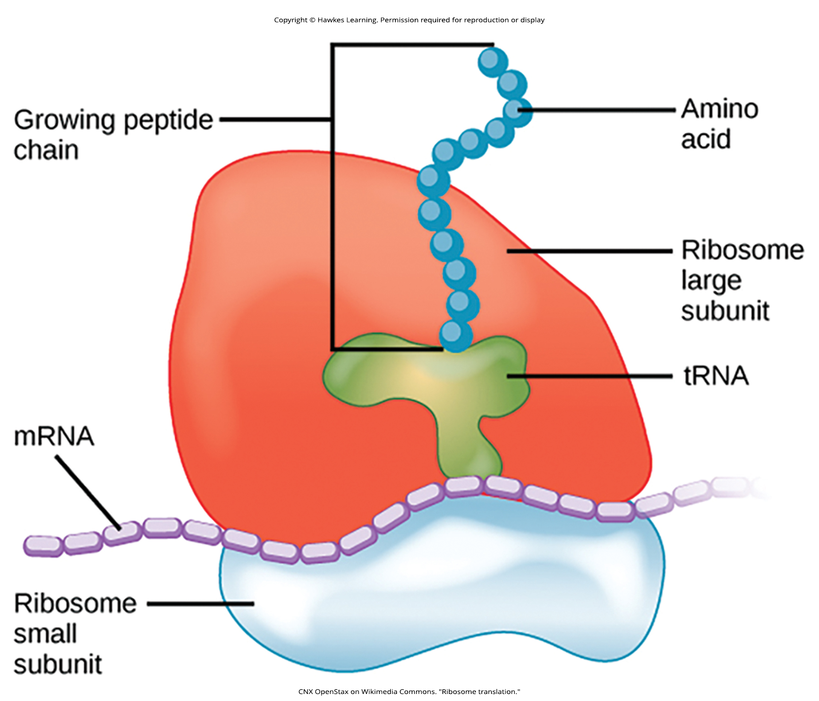
Lesson 15.5 Figure 2

Slide 25
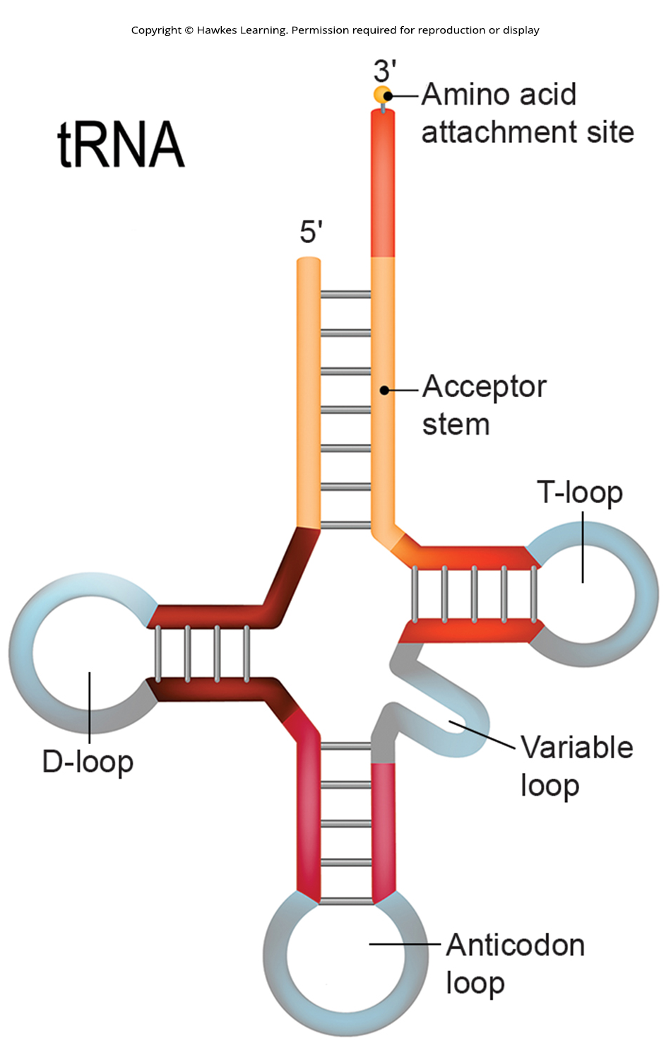
Lesson 15.5 Figure 3

Slide 26
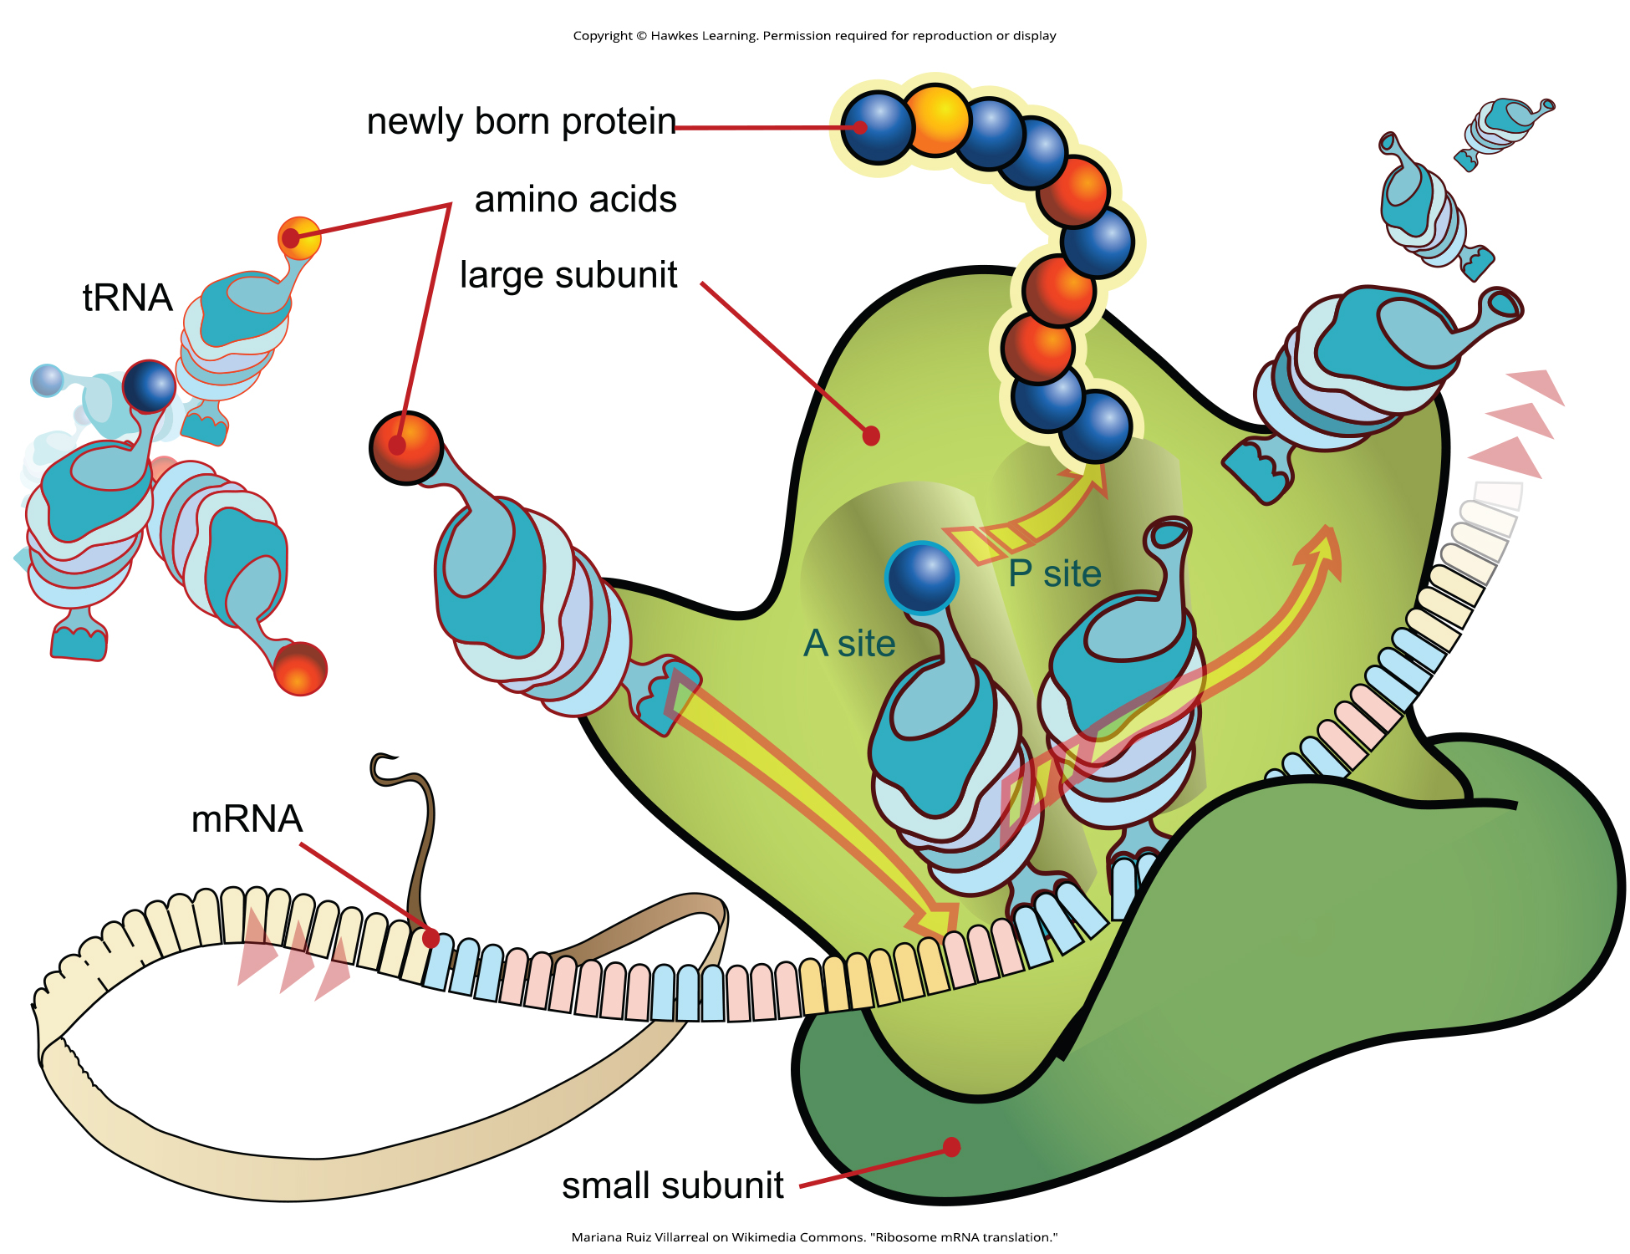
Lesson 15.5 Figure 4

Slide 27
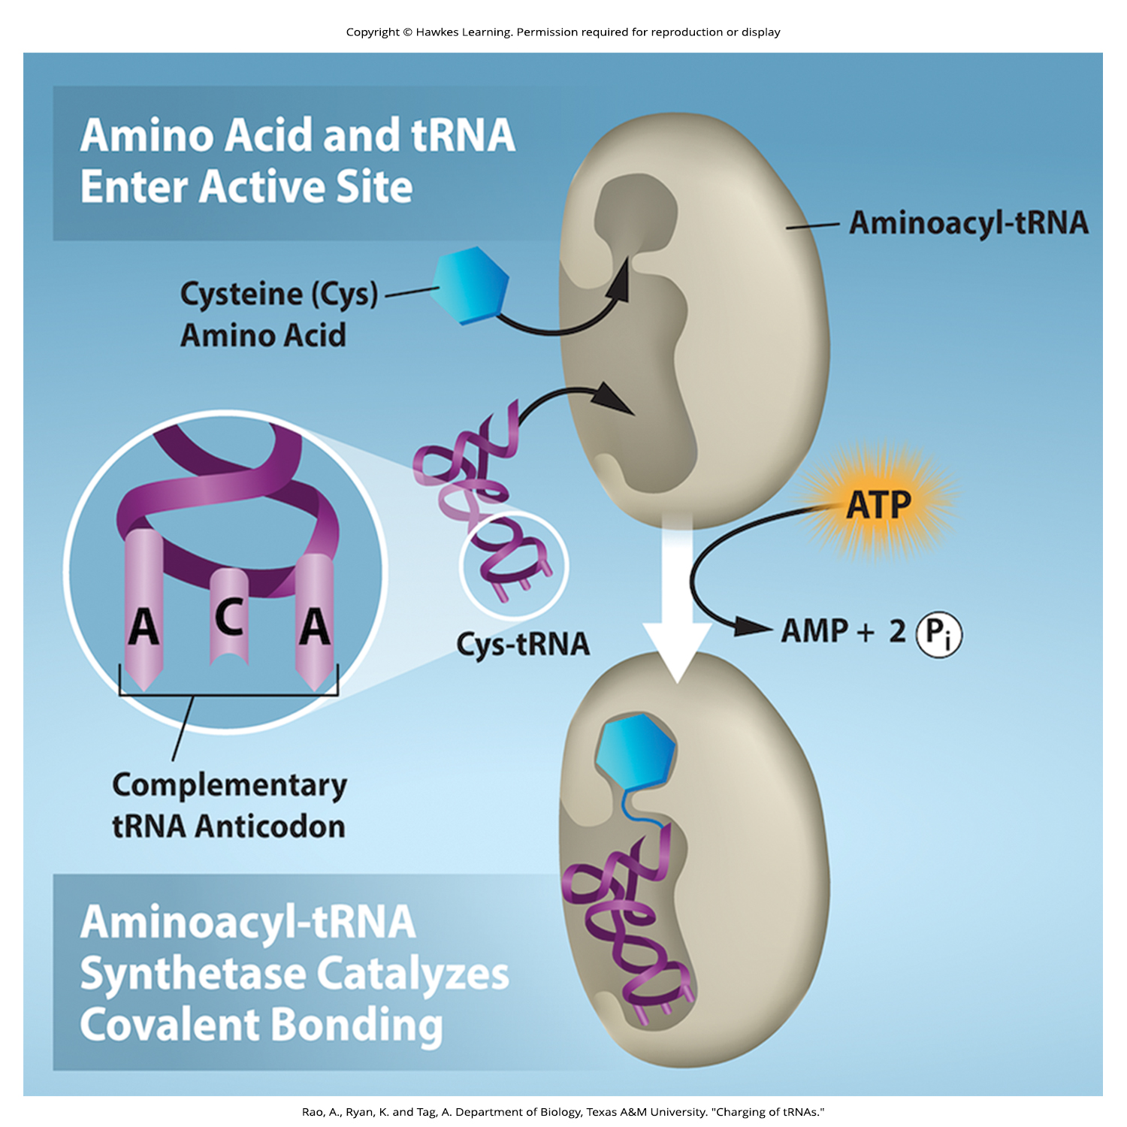
Lesson 15.5 Figure 5

Slide 28
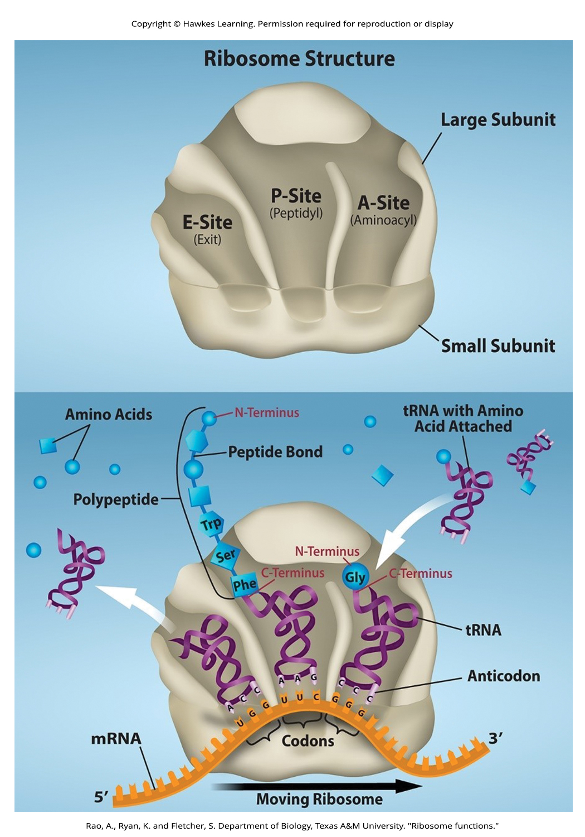
Lesson 15.5 Figure 6

Slide 29
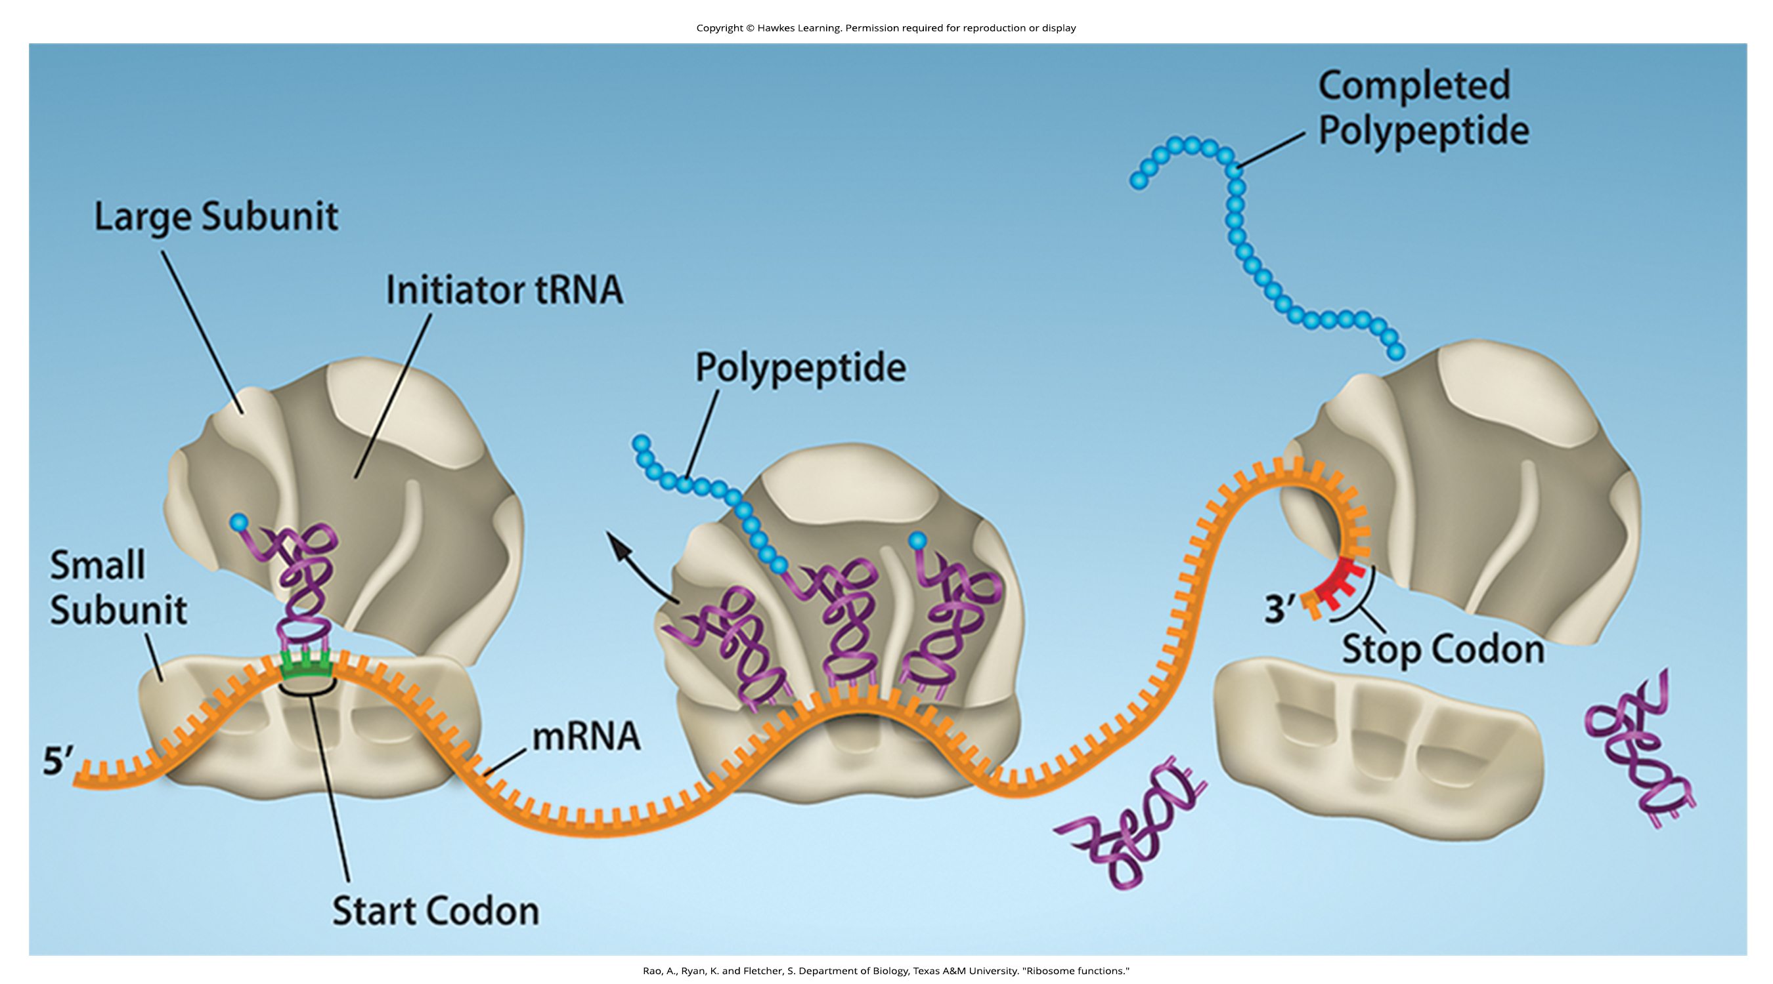
Lesson 15.5 Figure 7

Slide 30
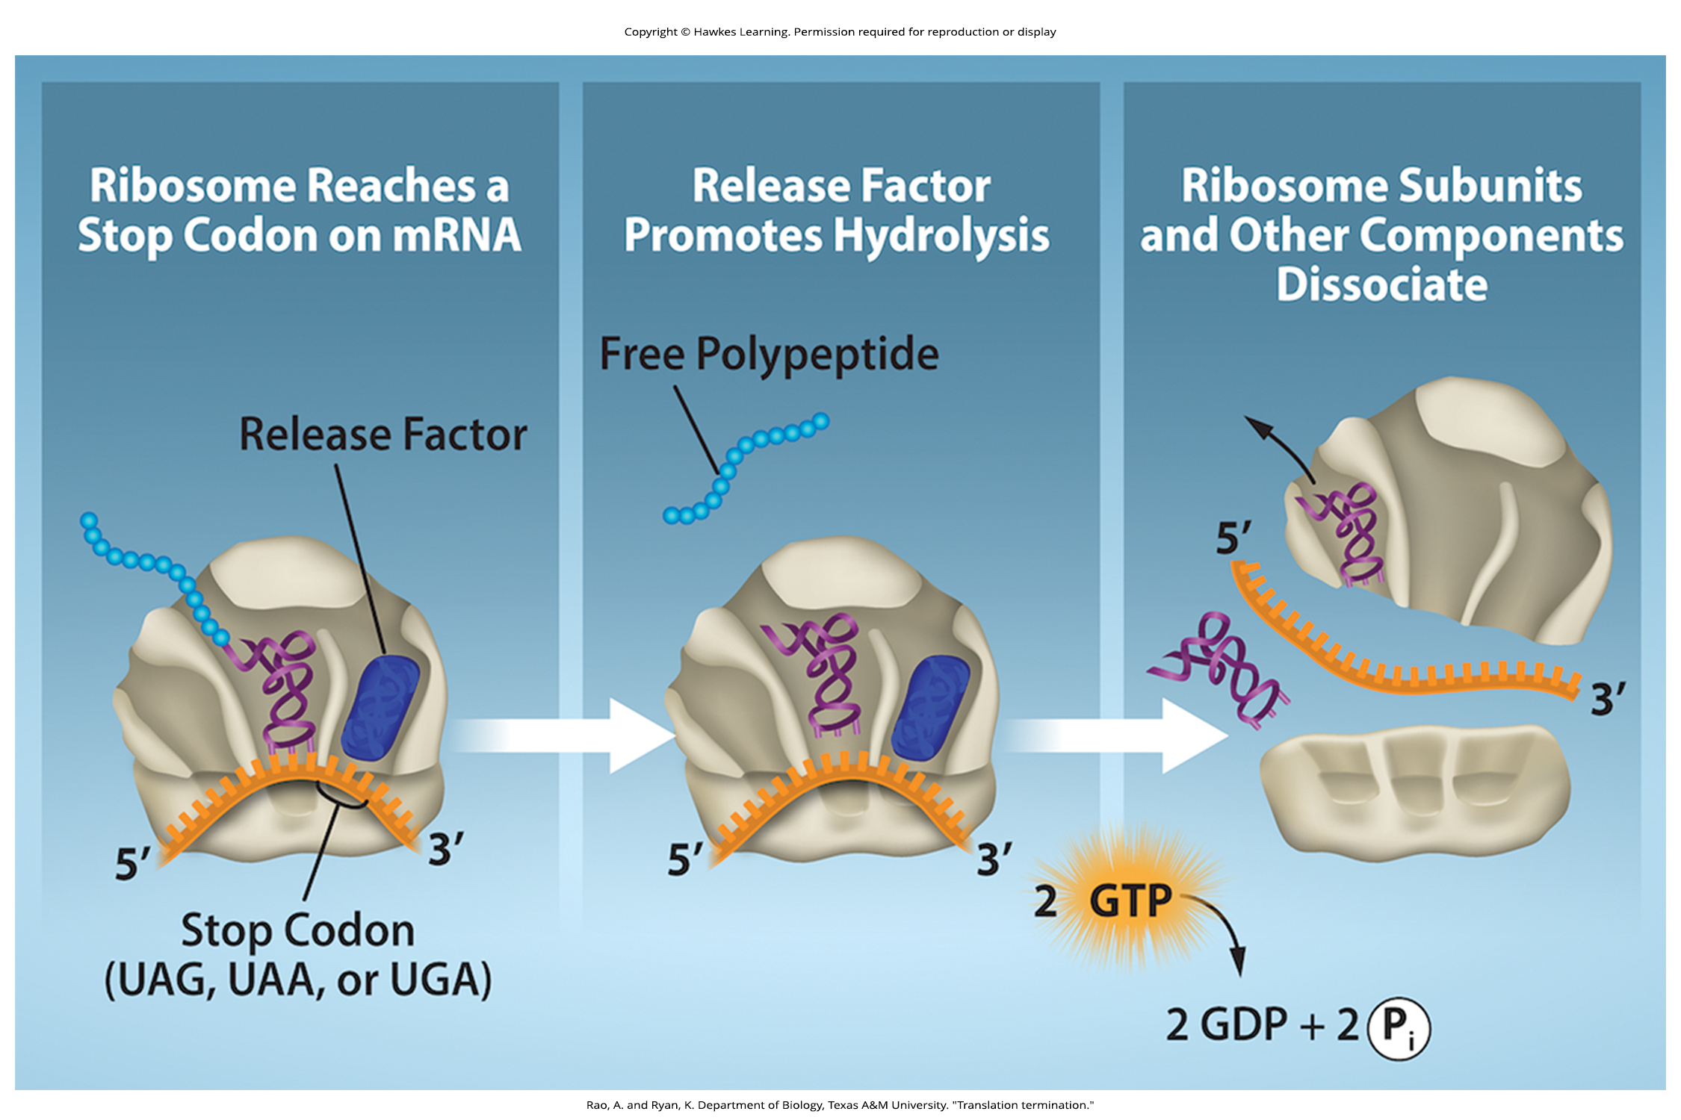
Lesson 15.5 Figure 8

Slide 31
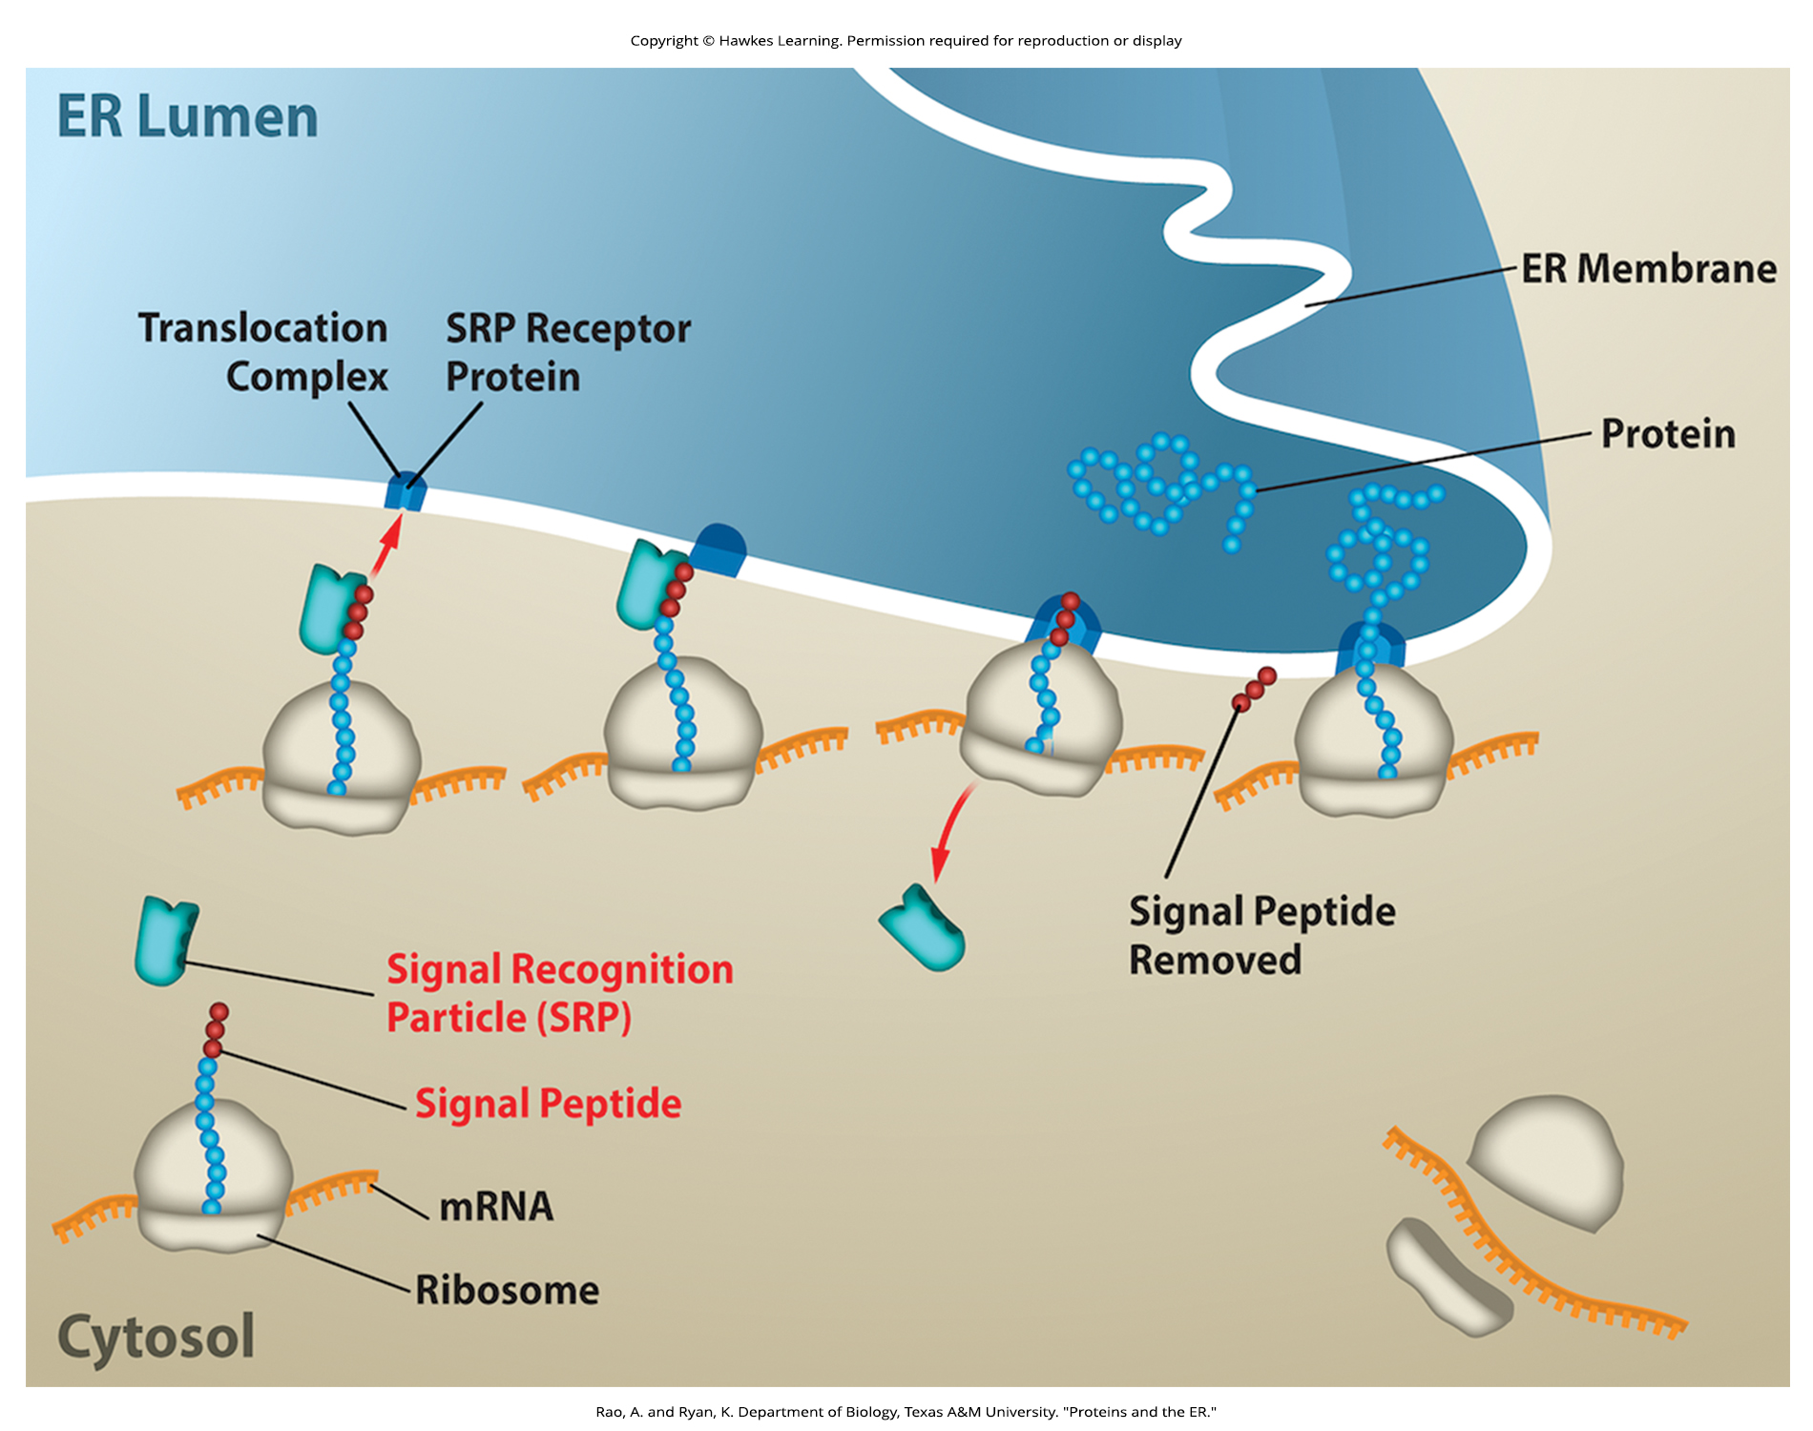
Lesson 15.5 Figure 9

Slide 32
Hawkes Learning – End of PowerPoint

