Slide 1
Chapter 14
DNA: Deoxyribonucleic

Slide 2
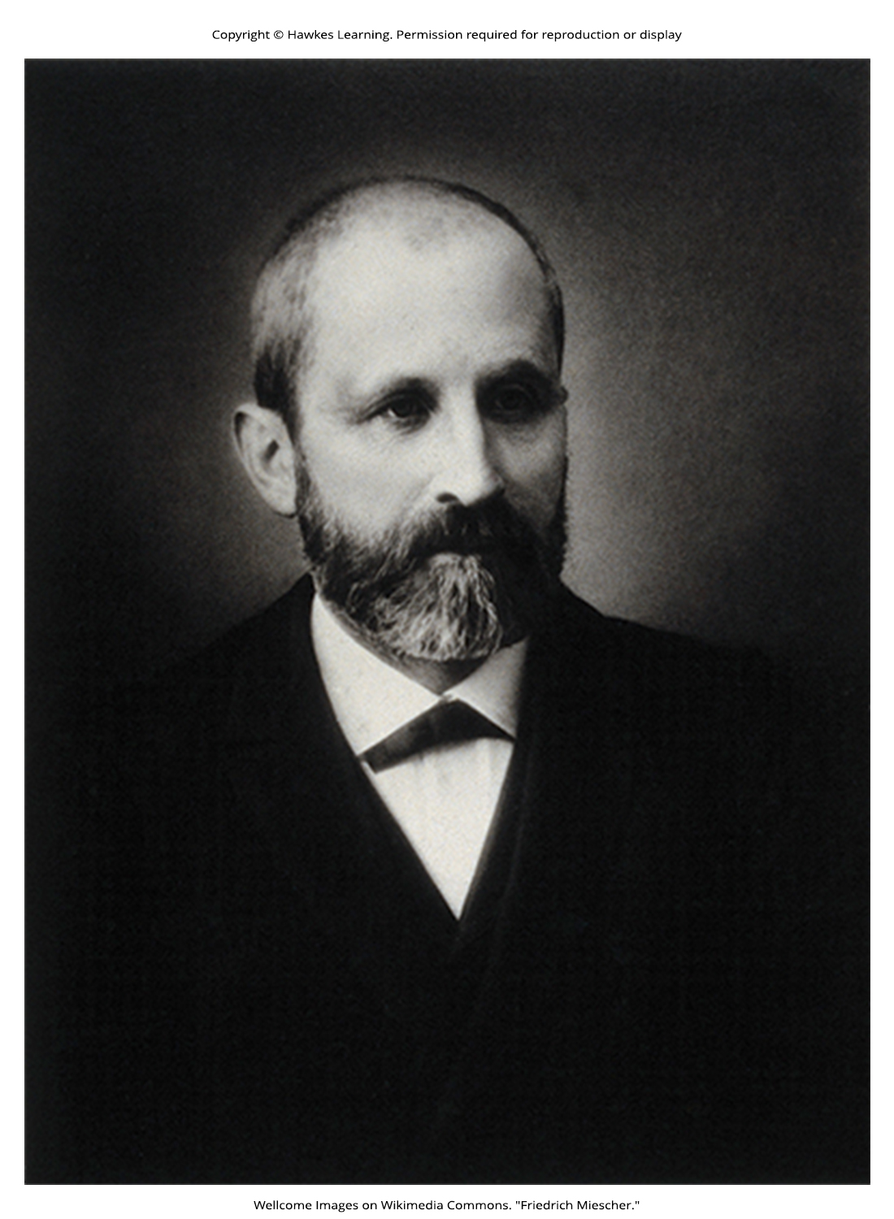
Lesson 14.1 Figure 1

Slide 3
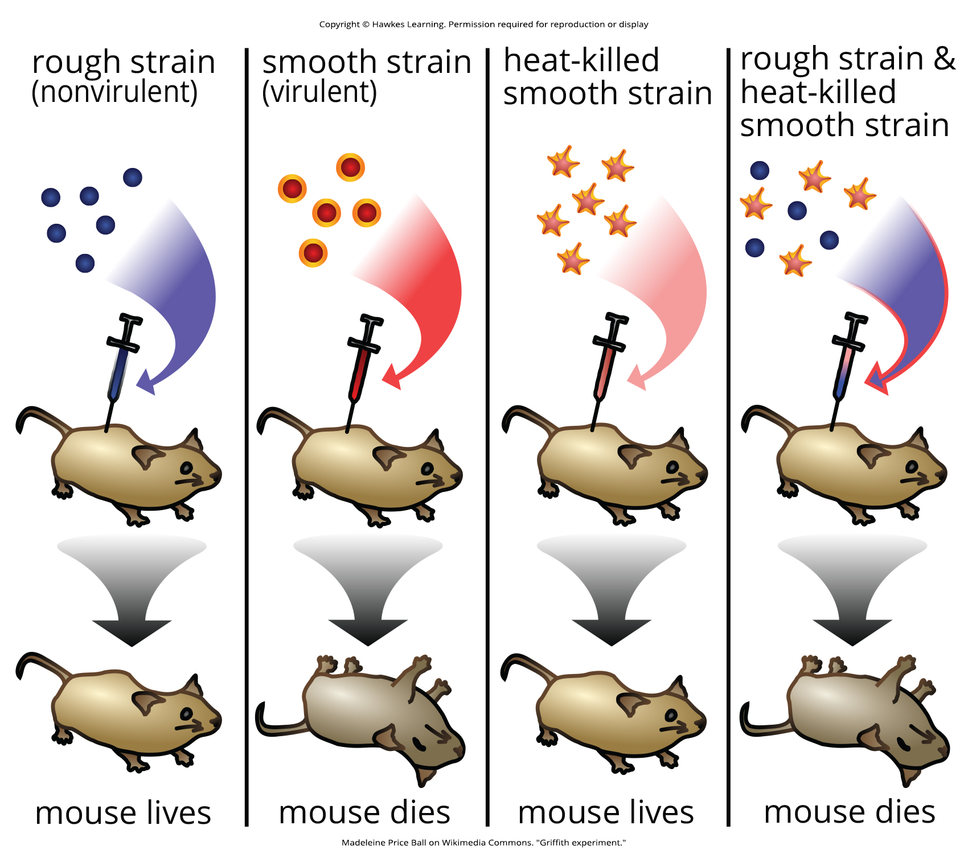
Lesson 14.1 Figure 2

Slide 4
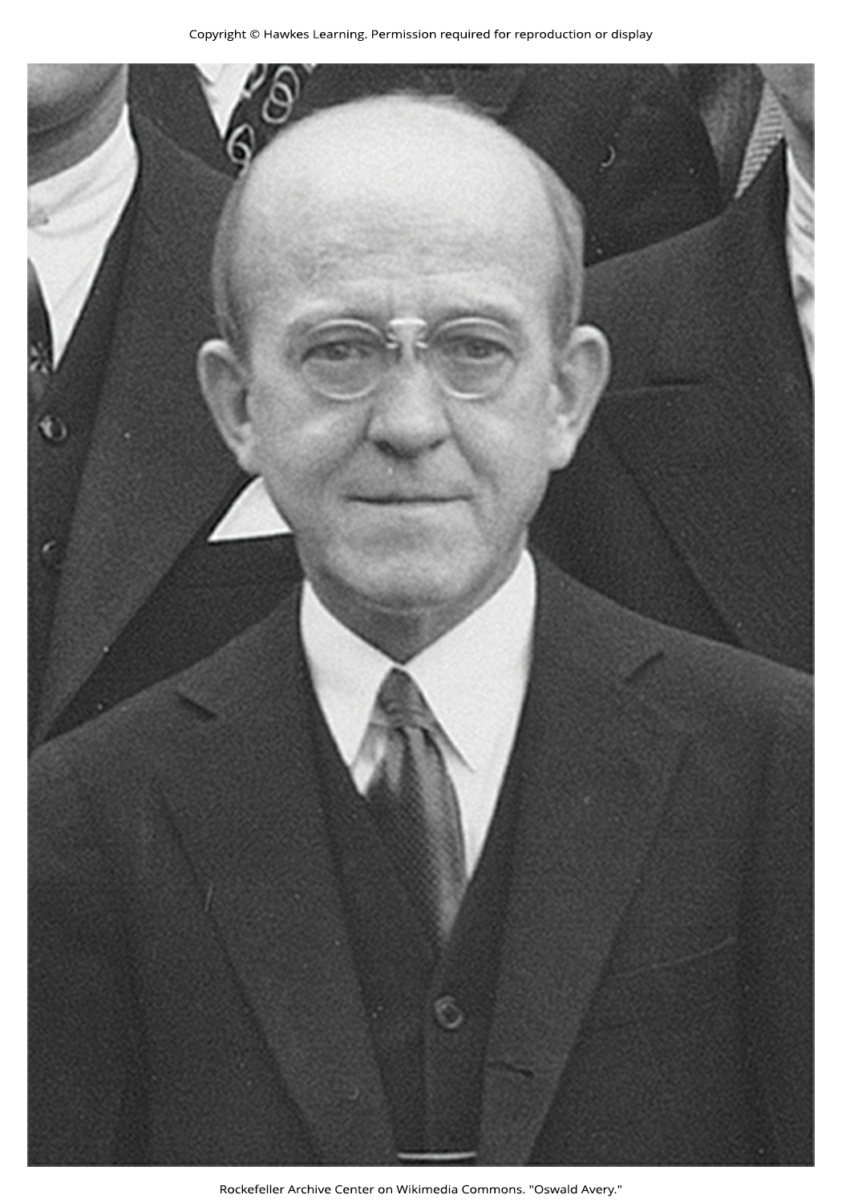
Lesson 14.1 Figure 3

Slide 5
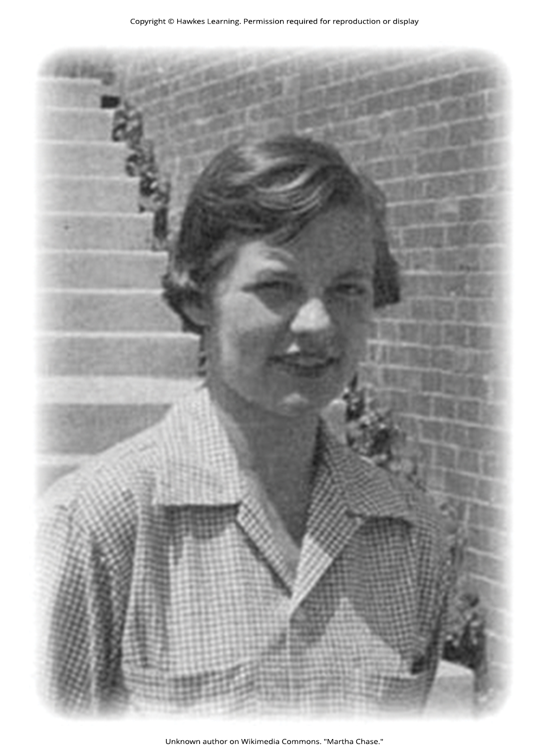
Lesson 14.1 Figure 4

Slide 6
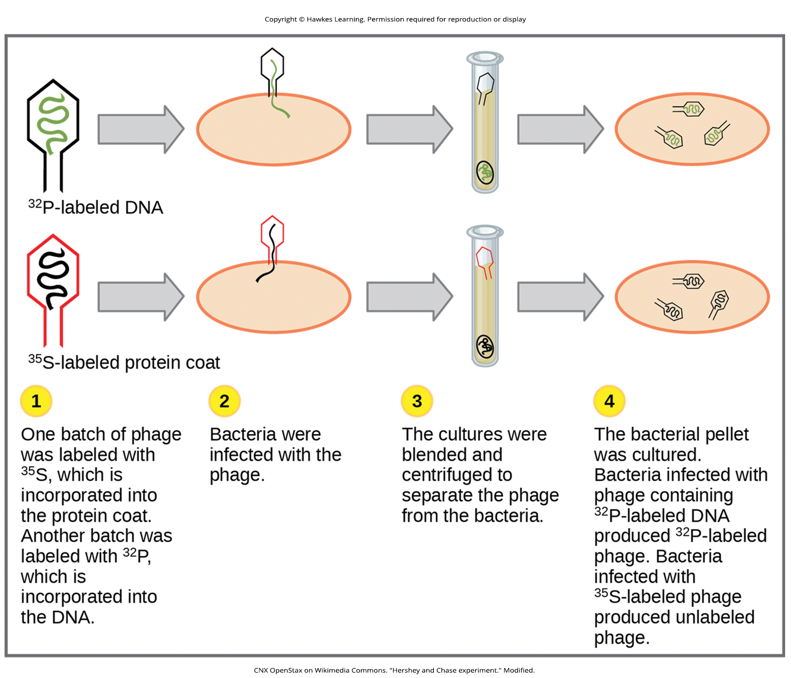
Lesson 14.1 Figure 5

Slide 7
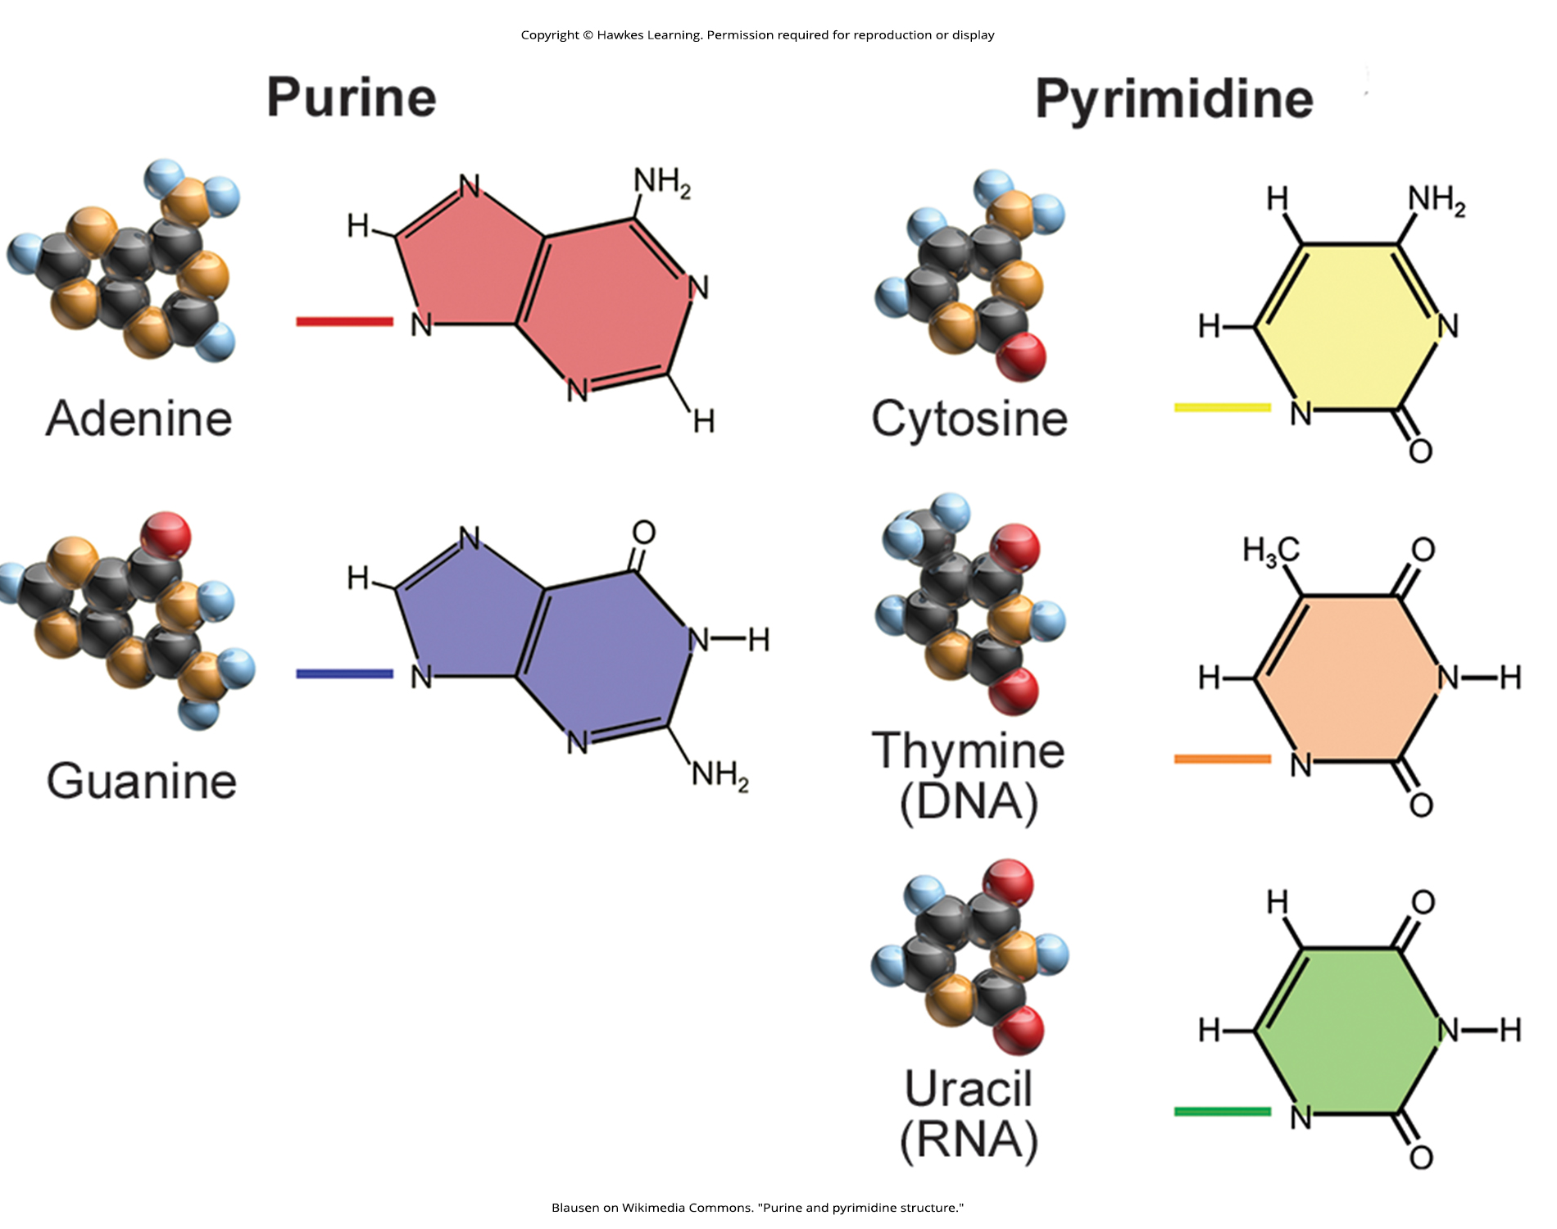
Lesson 14.2 Figure 1

Slide 8
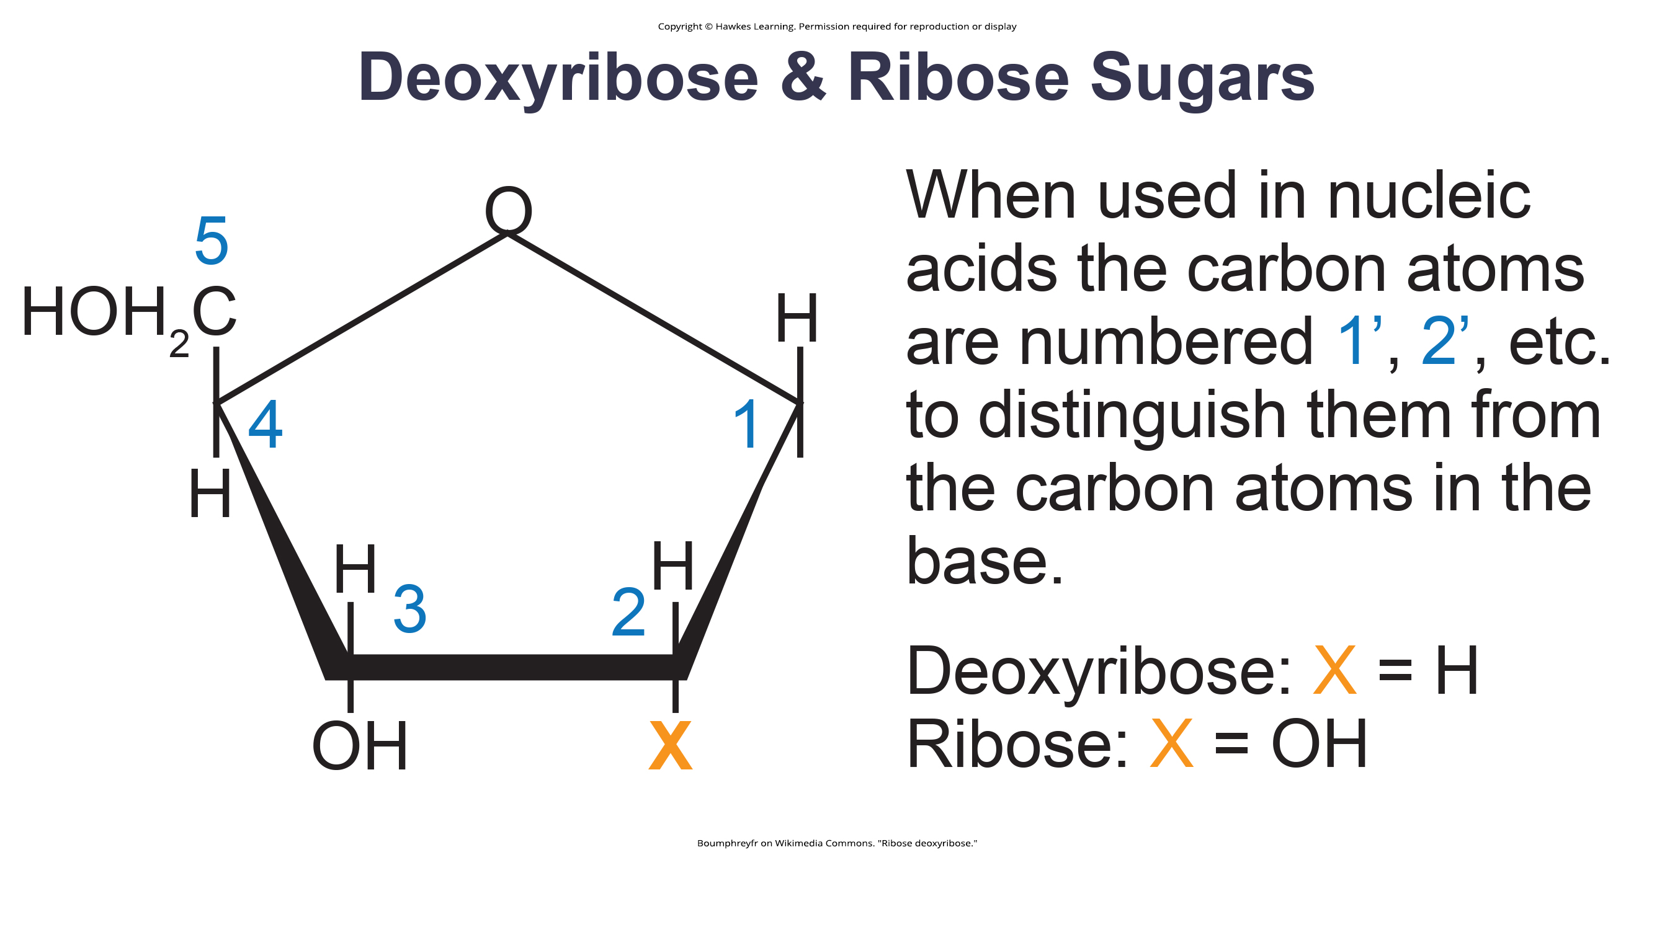
Lesson 14.2 Figure 2

Slide 9
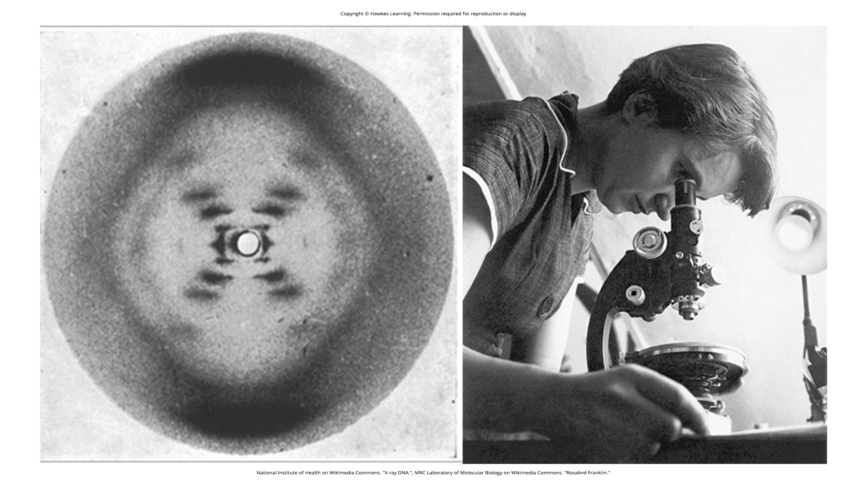
Lesson 14.2 Figure 3

Slide 10
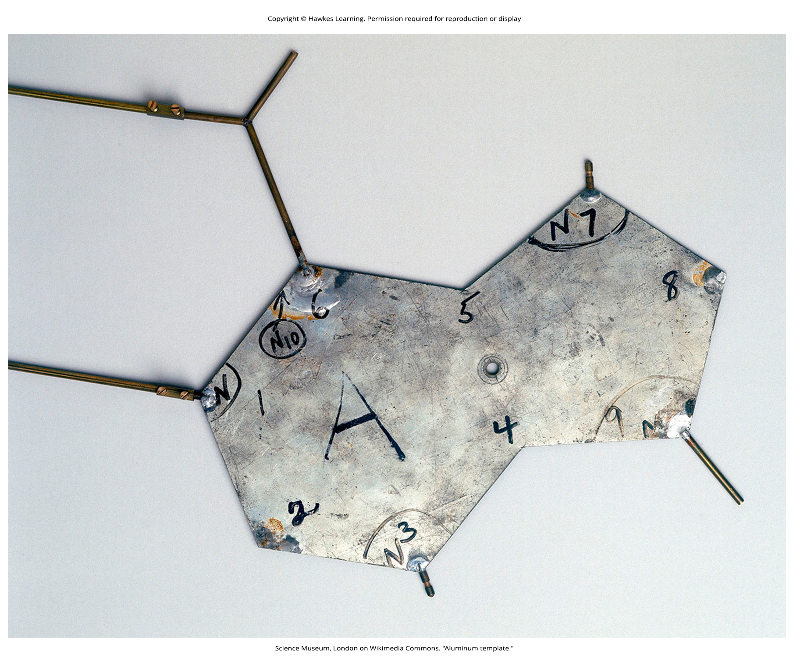
Lesson 14.2 Figure 4

Slide 11
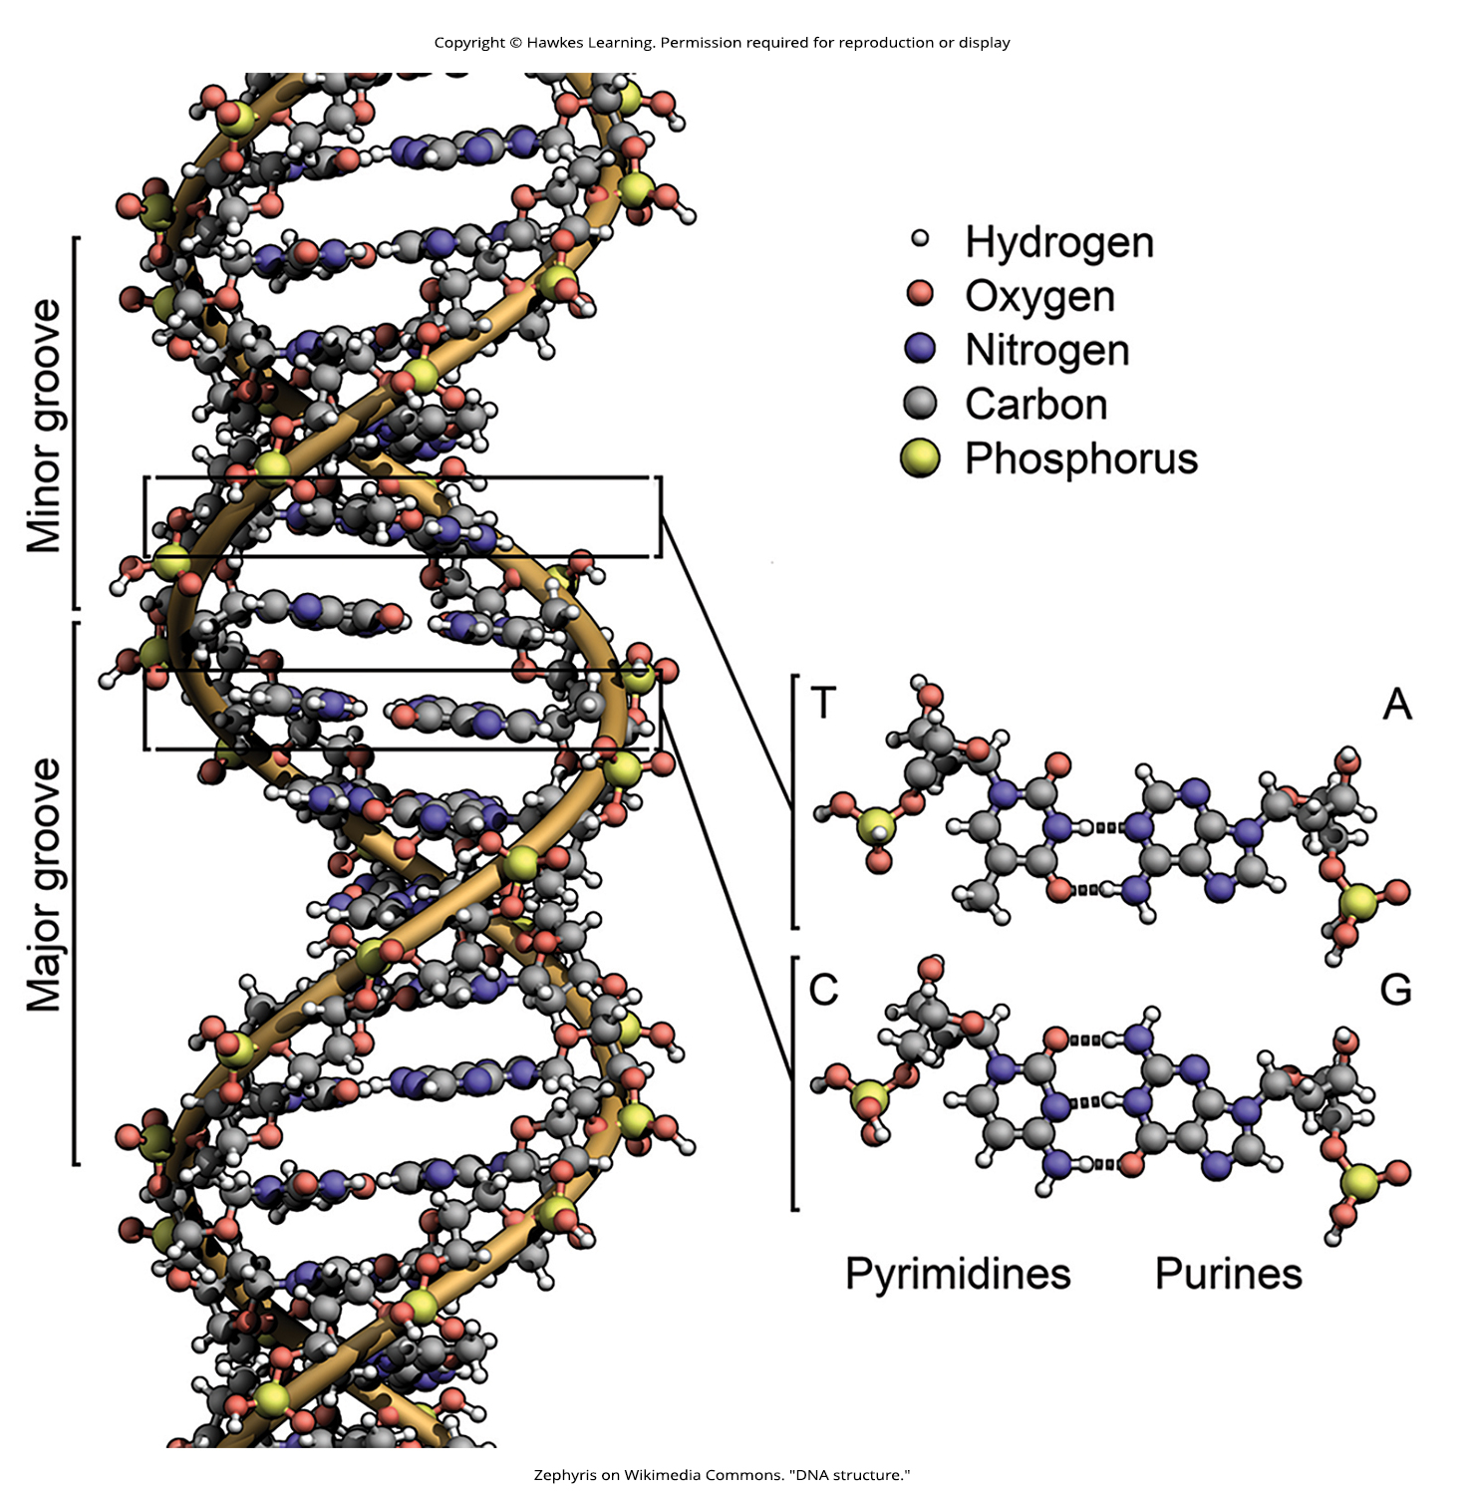
Lesson 14.2 Figure 5

Slide 12
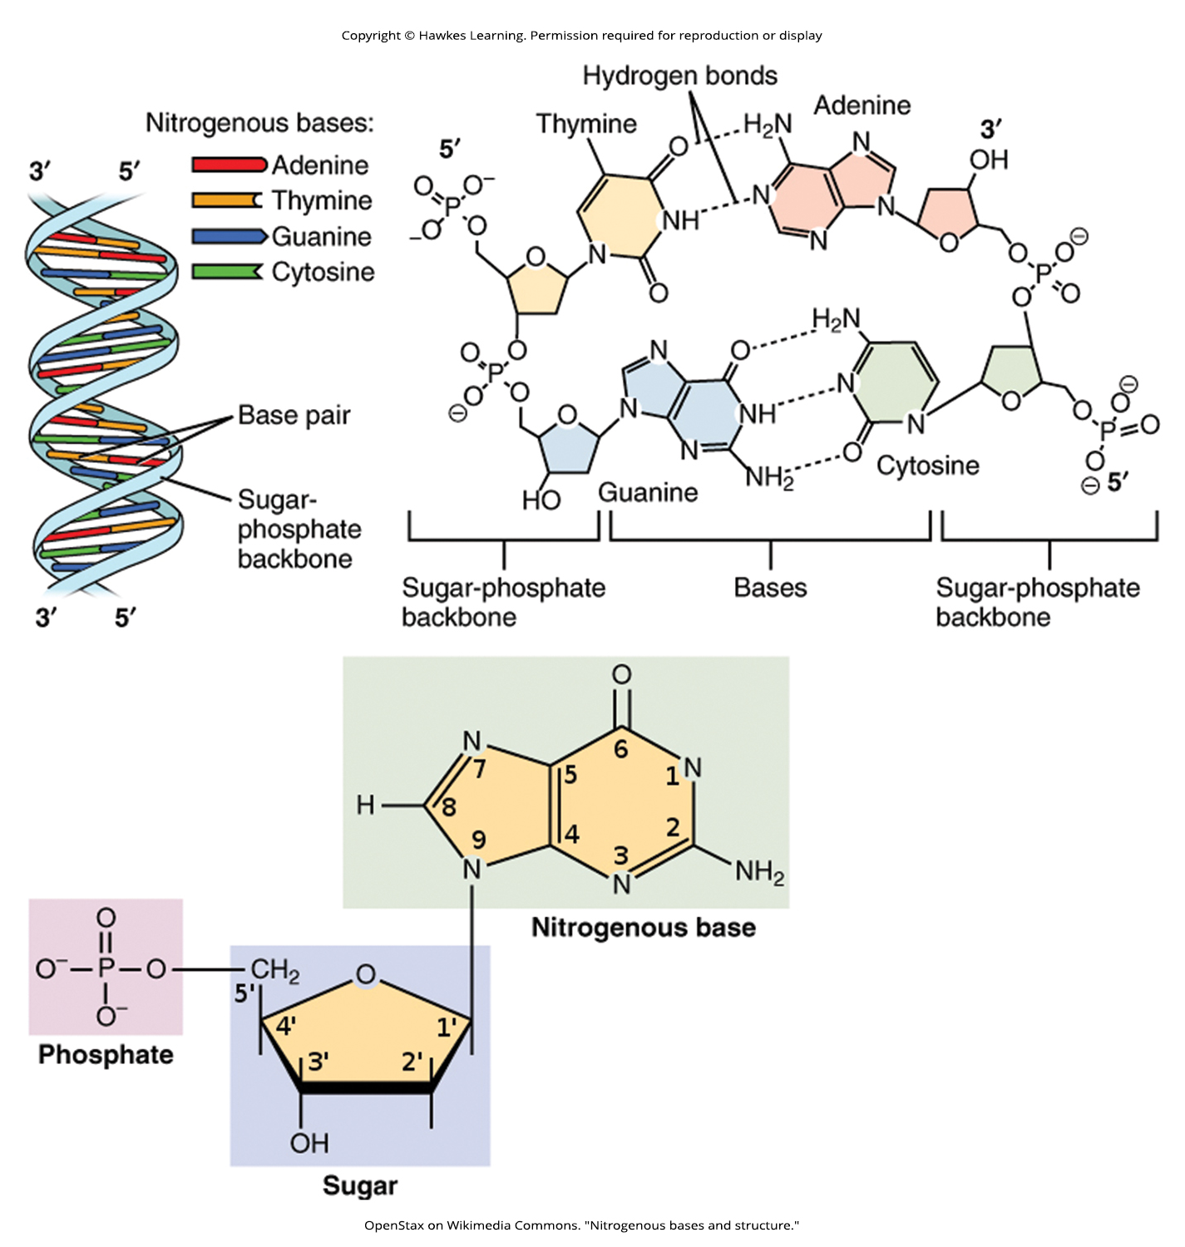
Lesson 14.2 Figure 6

Slide 13
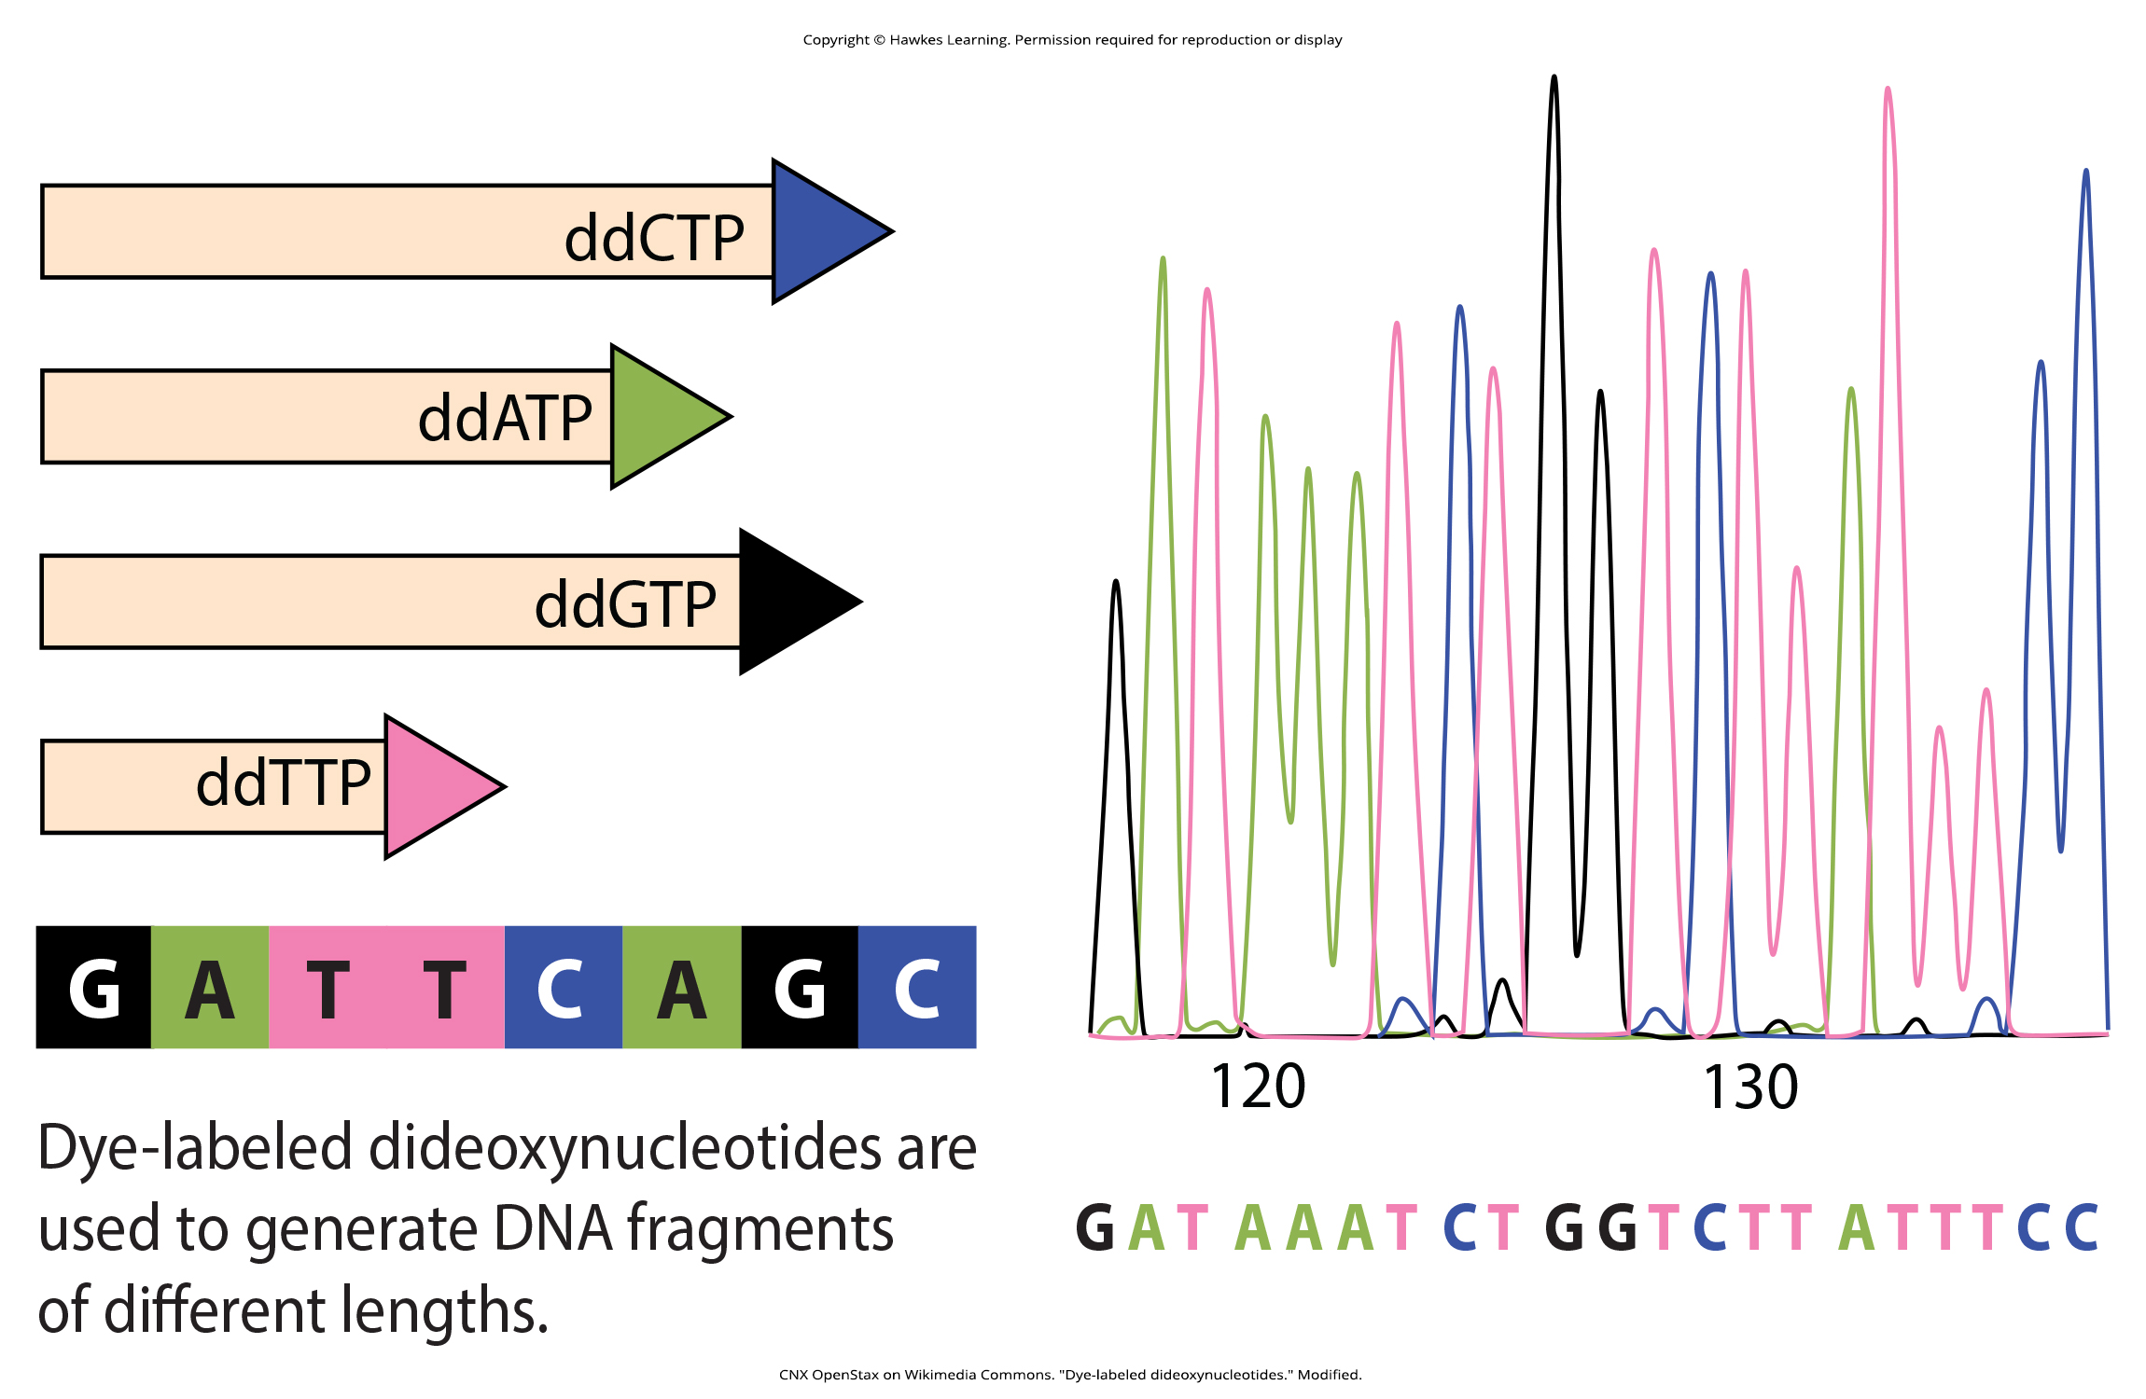
Lesson 14.2 Figure 7

Slide 14
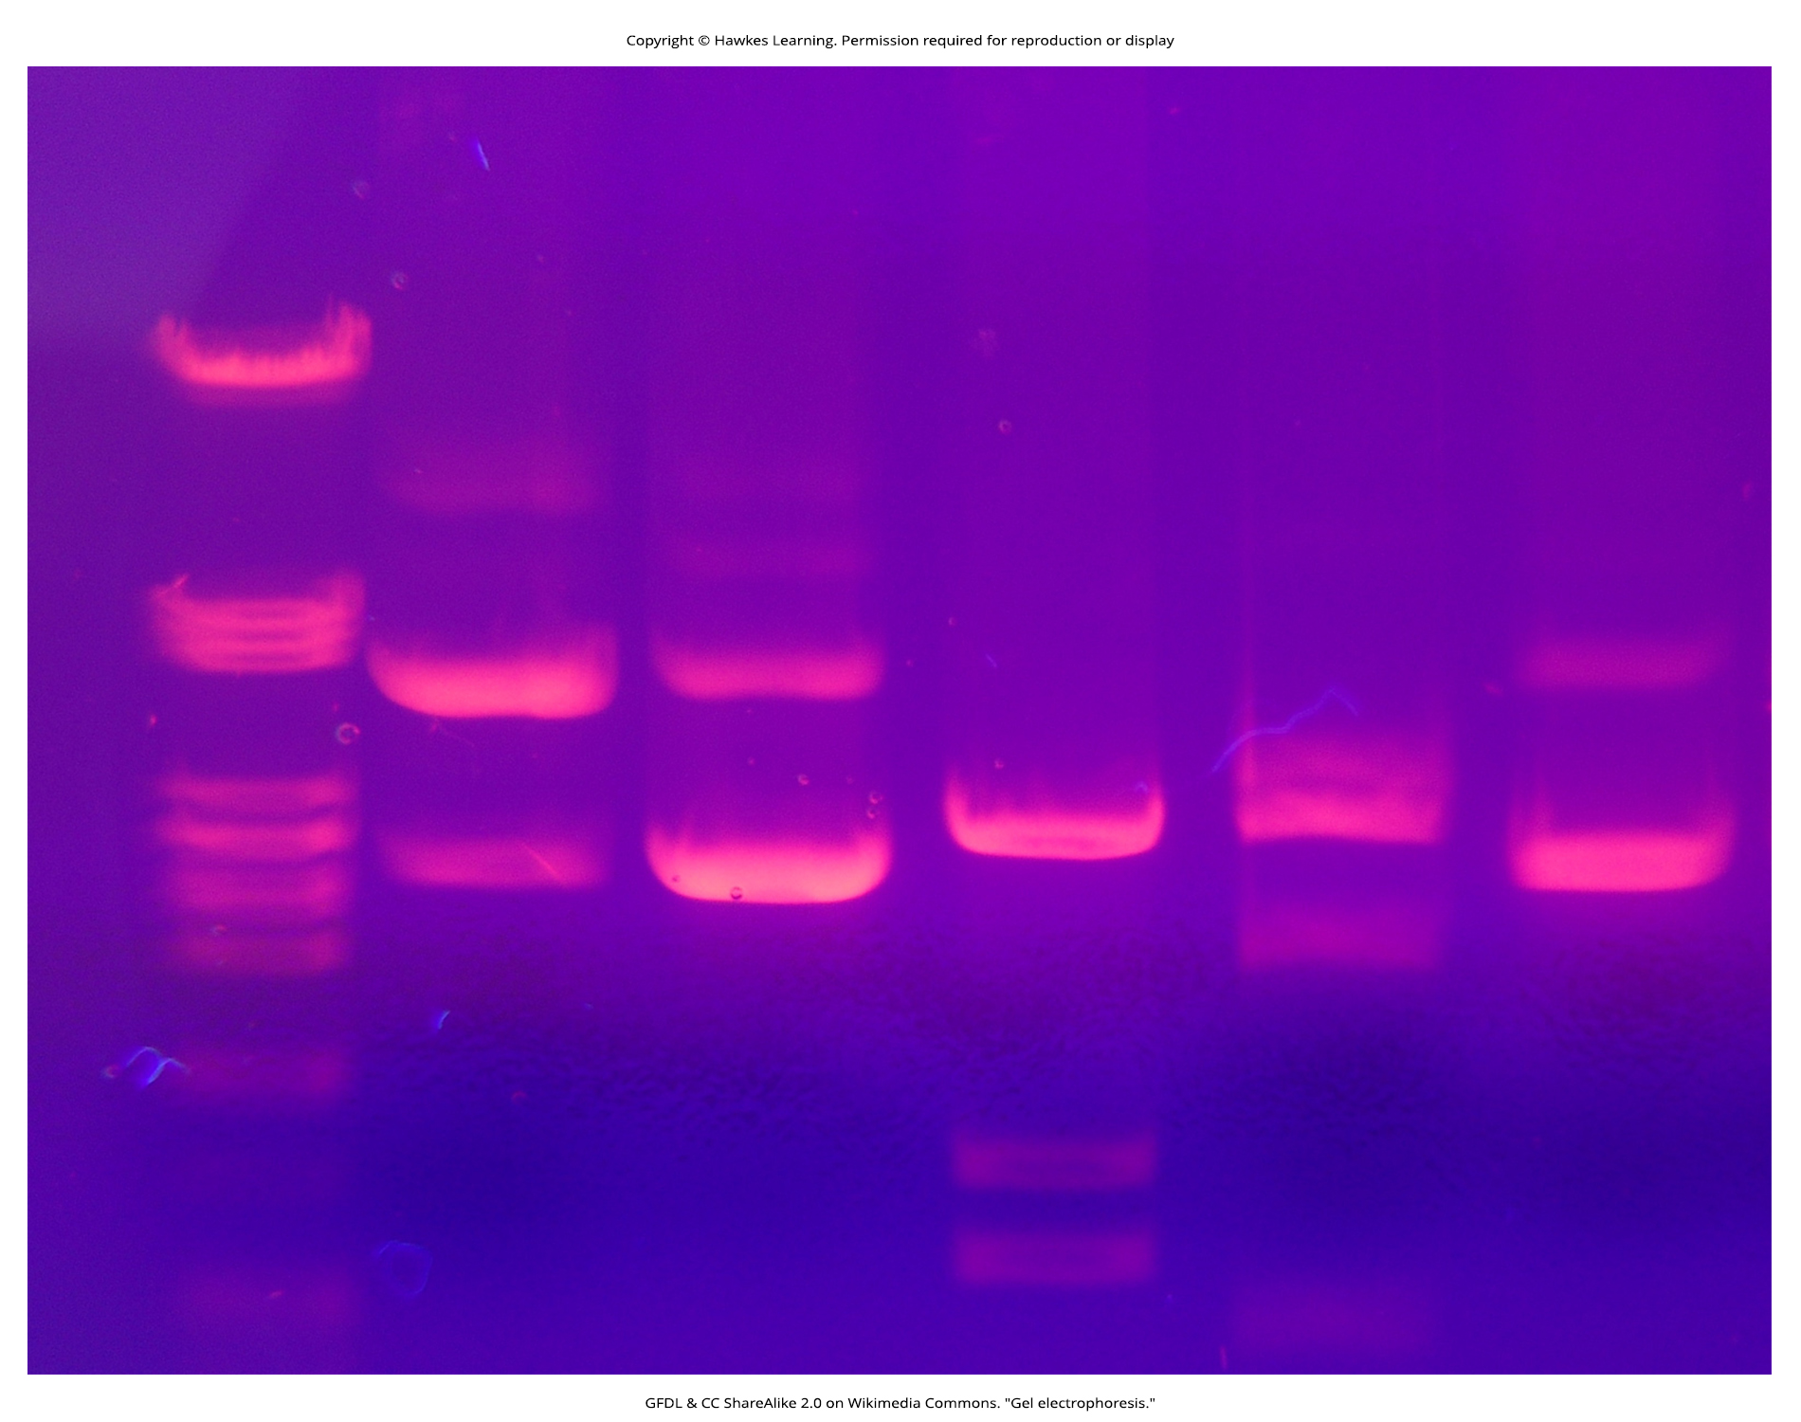
Lesson 14.2 Figure 8

Slide 15
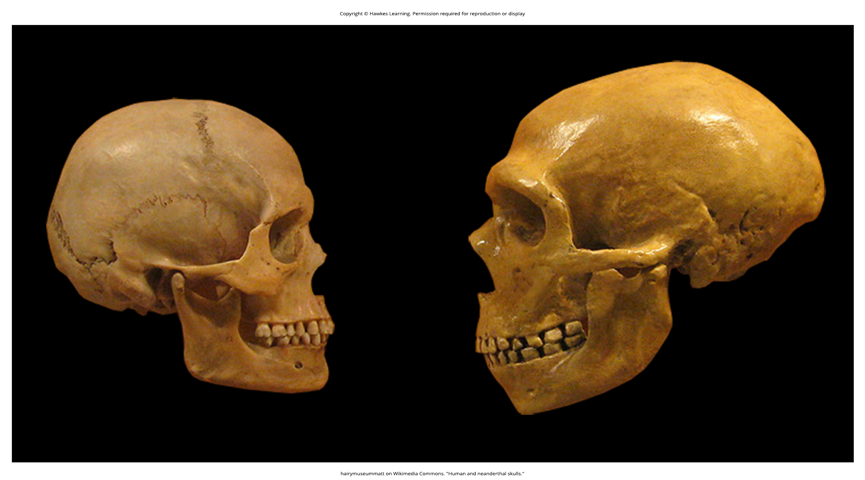
Lesson 14.2 Figure 9

Slide 16
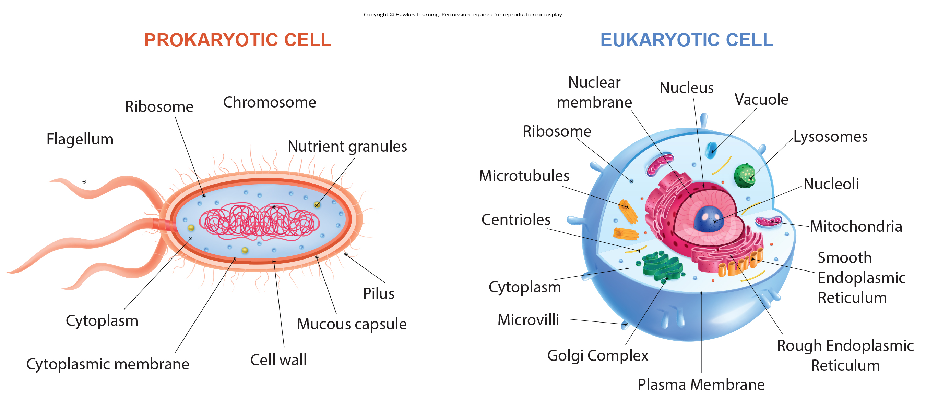
Lesson 14.2 Figure 10

Slide 17
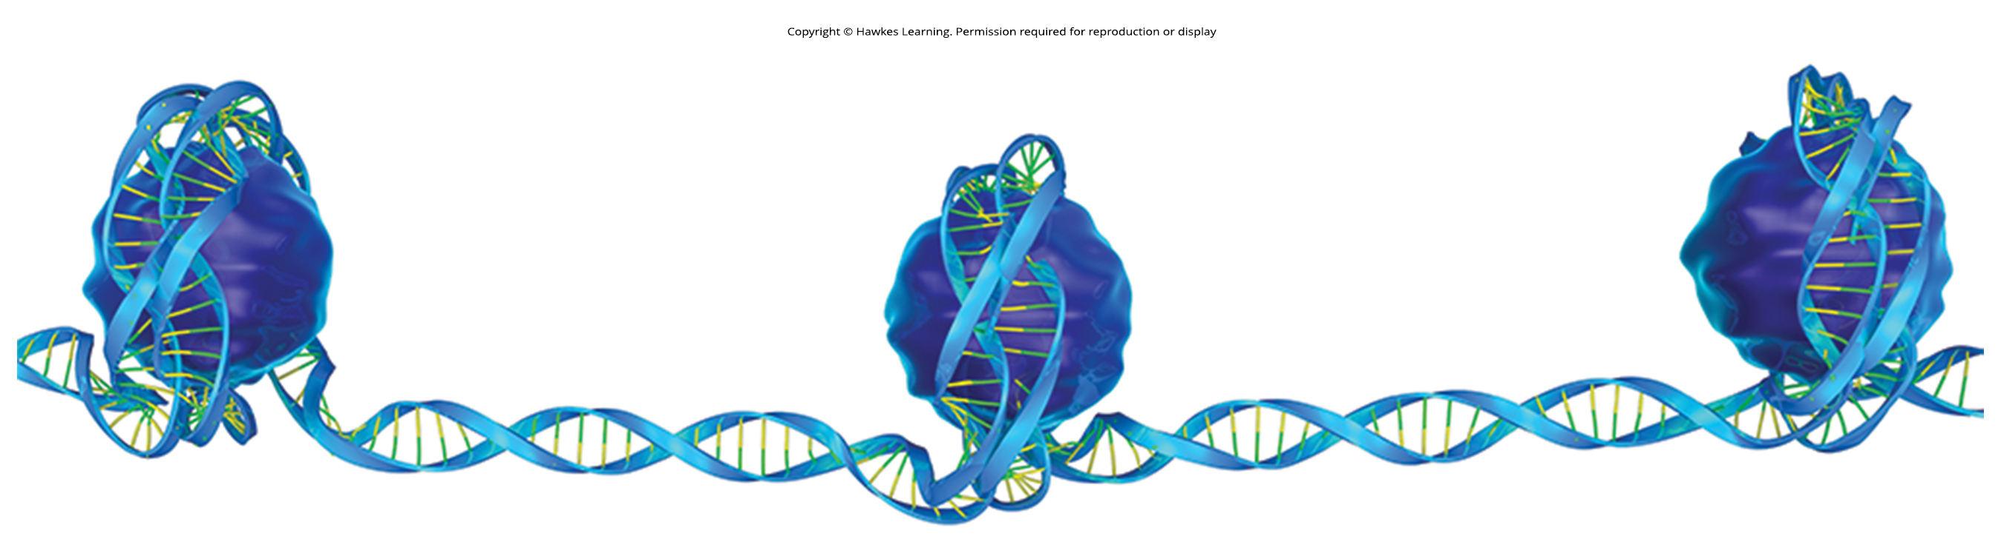
Lesson 14.2 Figure 11

Slide 18
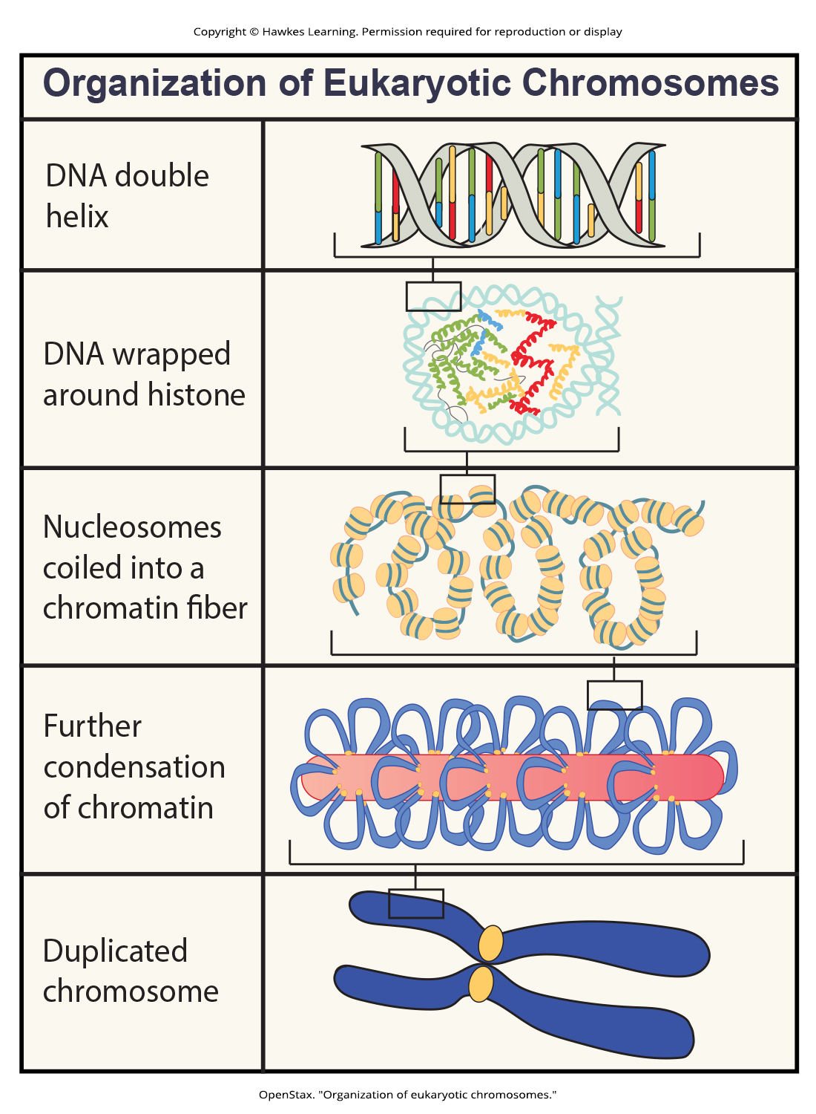
Lesson 14.2 Figure 12

Slide 19
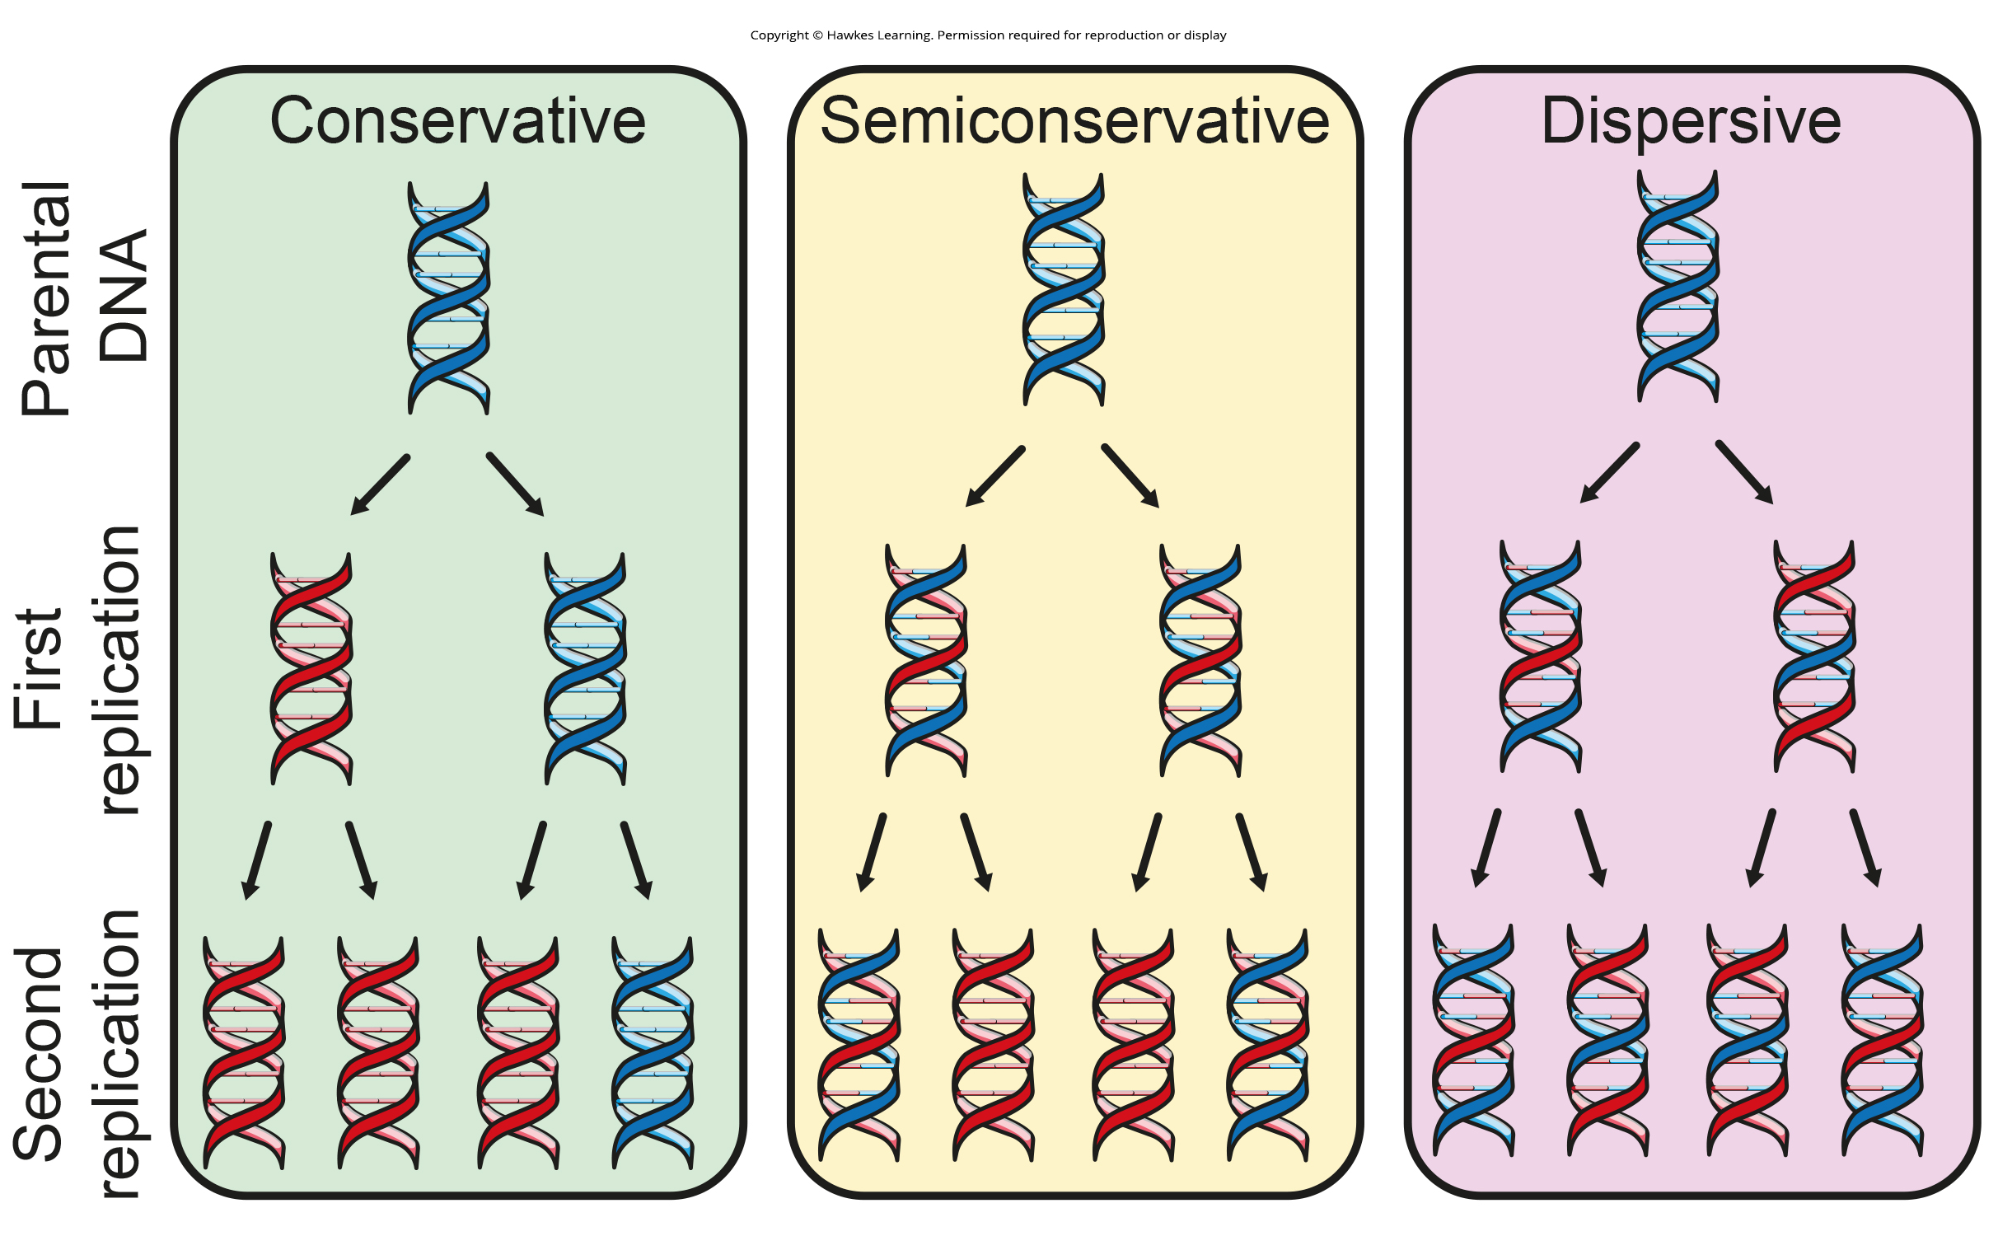
Lesson 14.3 Figure 1

Slide 20
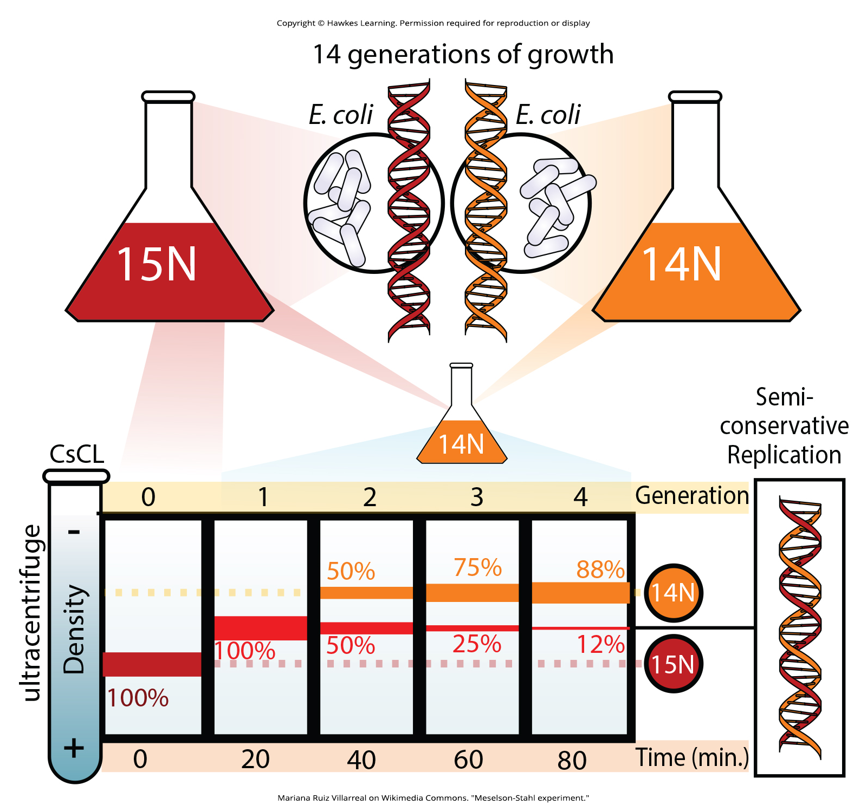
Lesson 14.3 Figure 2

Slide 21
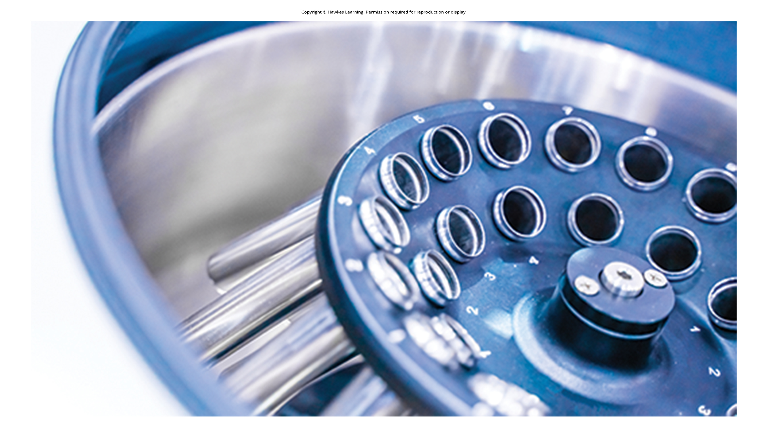
Lesson 14.3 Figure 3

Slide 22
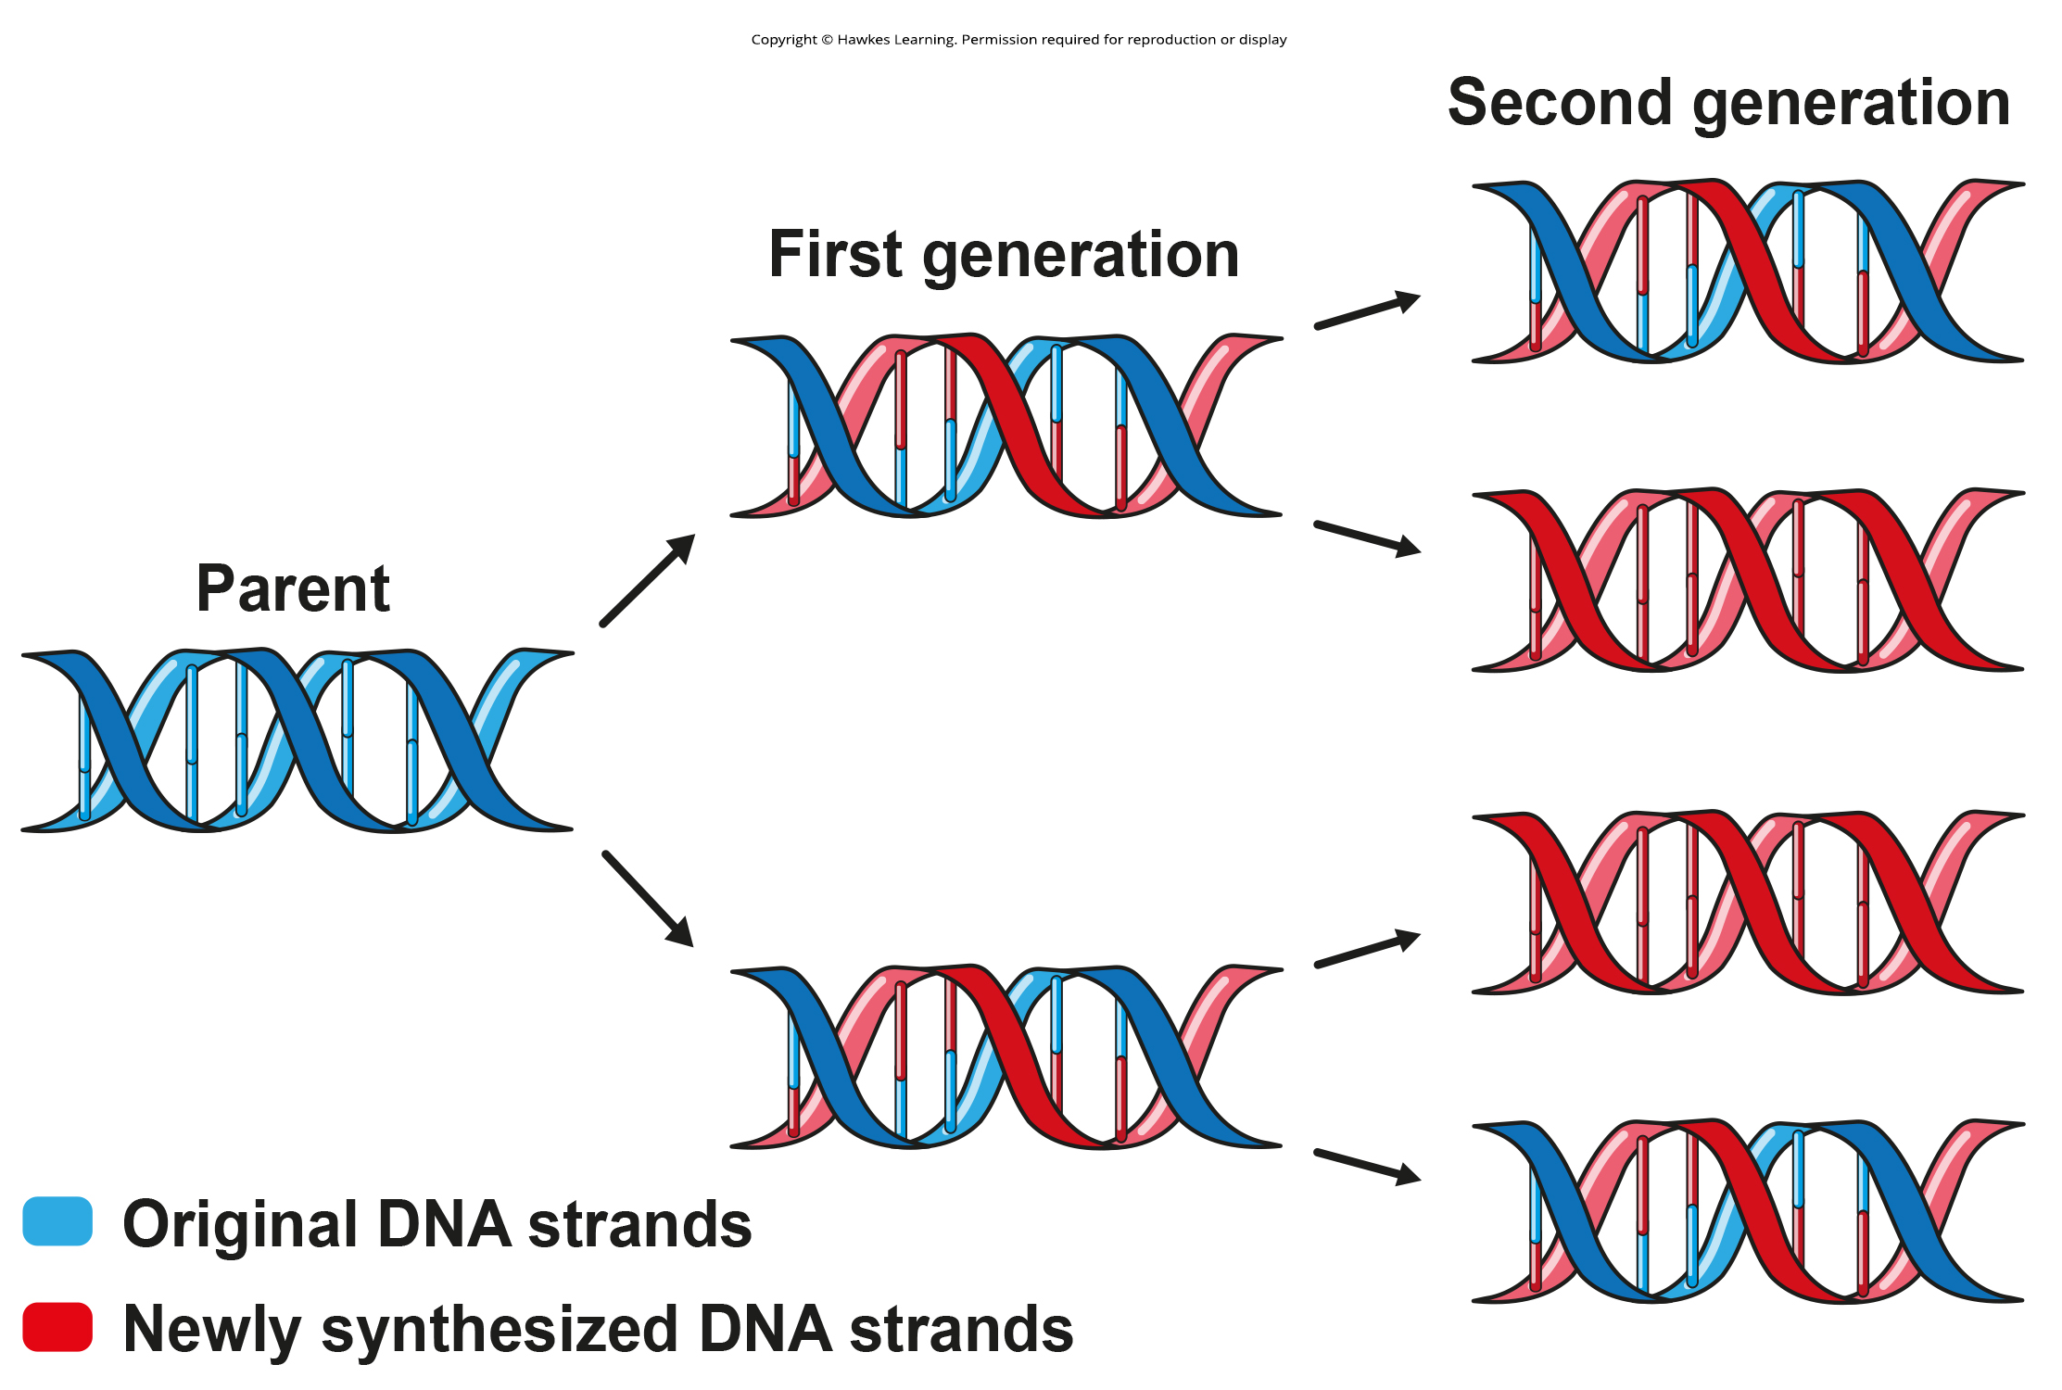
Lesson 14.3 Figure 4

Slide 23
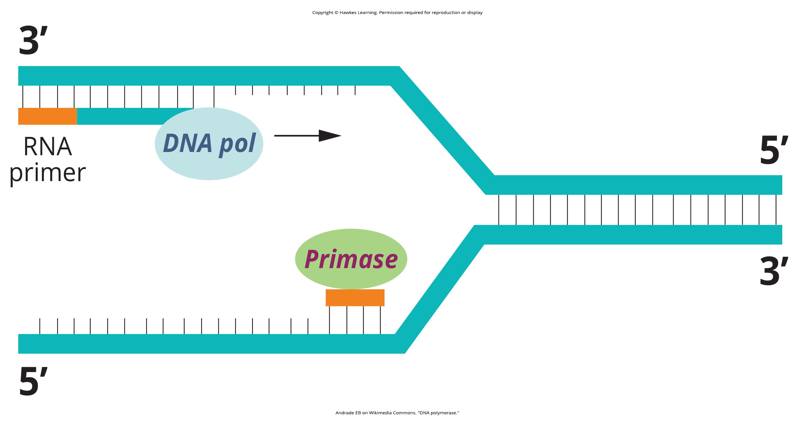
Lesson 14.3 Figure 5

Slide 24
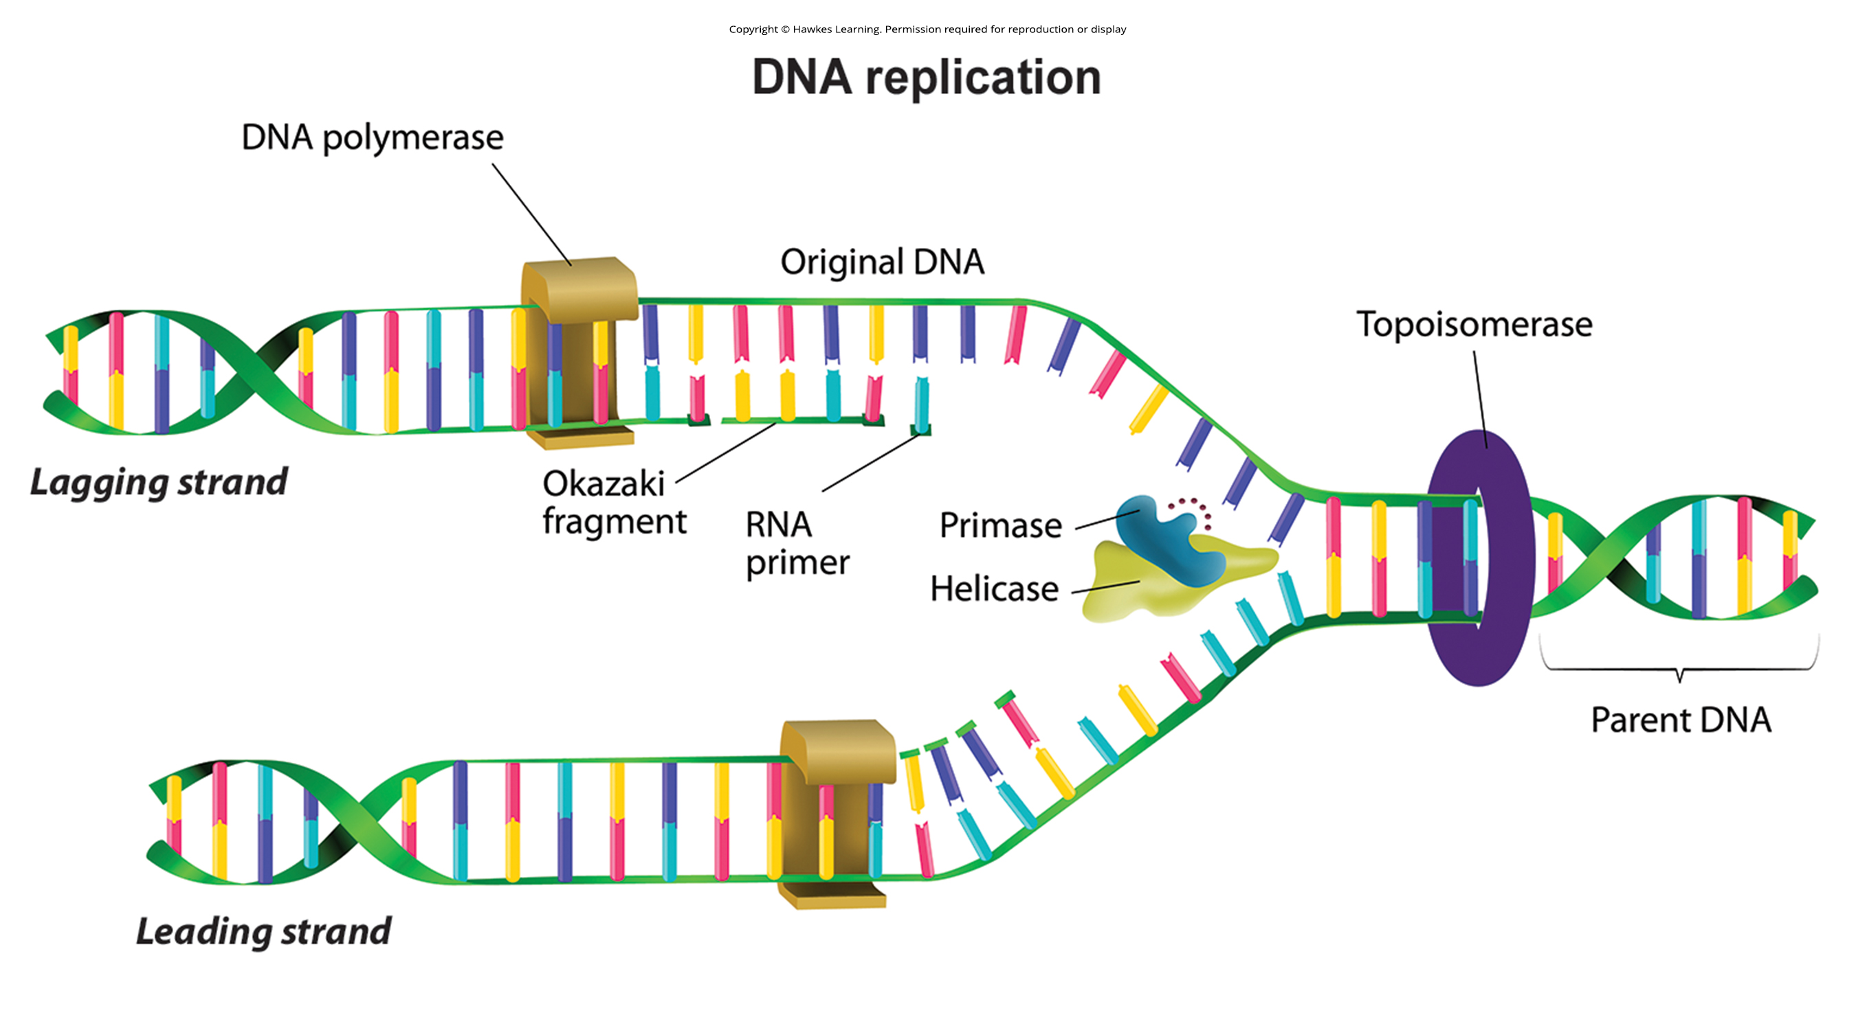
Lesson 14.3 Figure 6

Slide 25
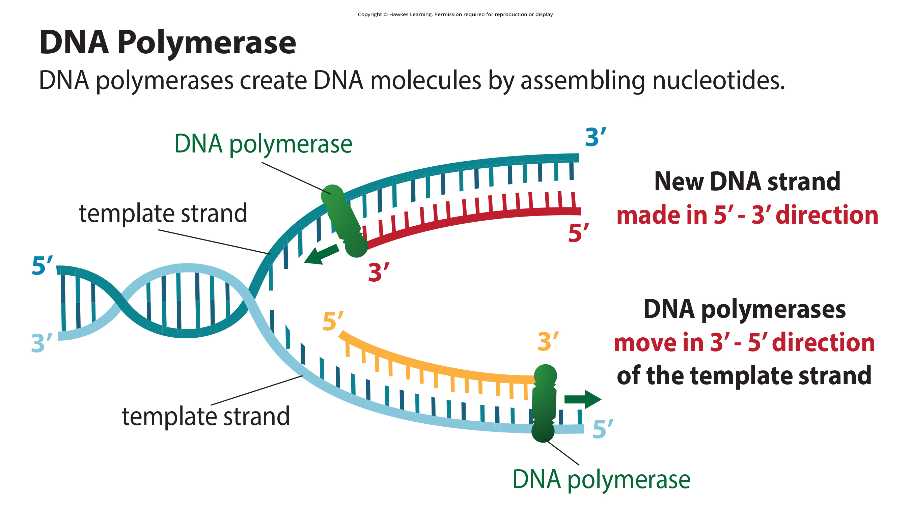
Lesson 14.4 Figure 1

Slide 26
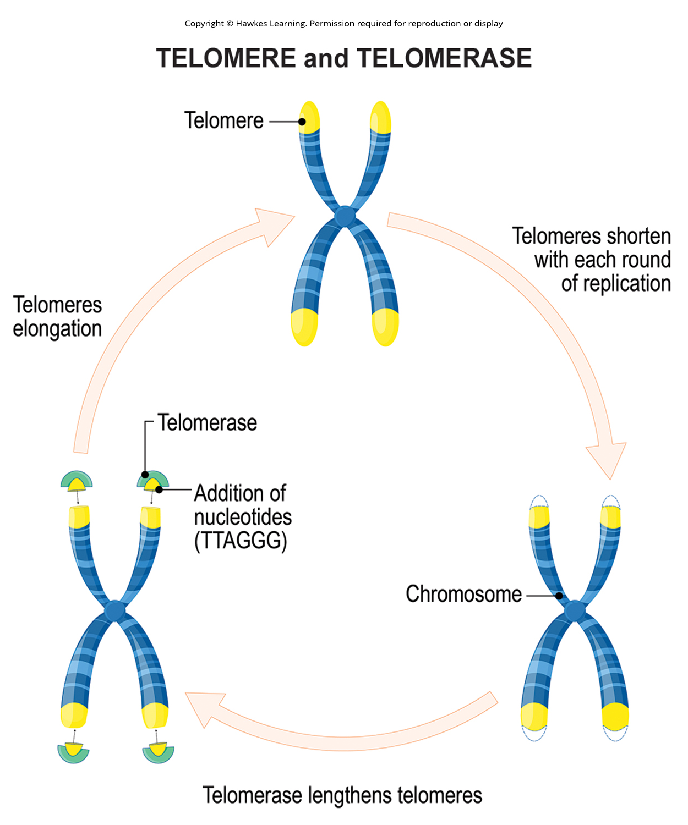
Lesson 14.4 Figure 2

Slide 27
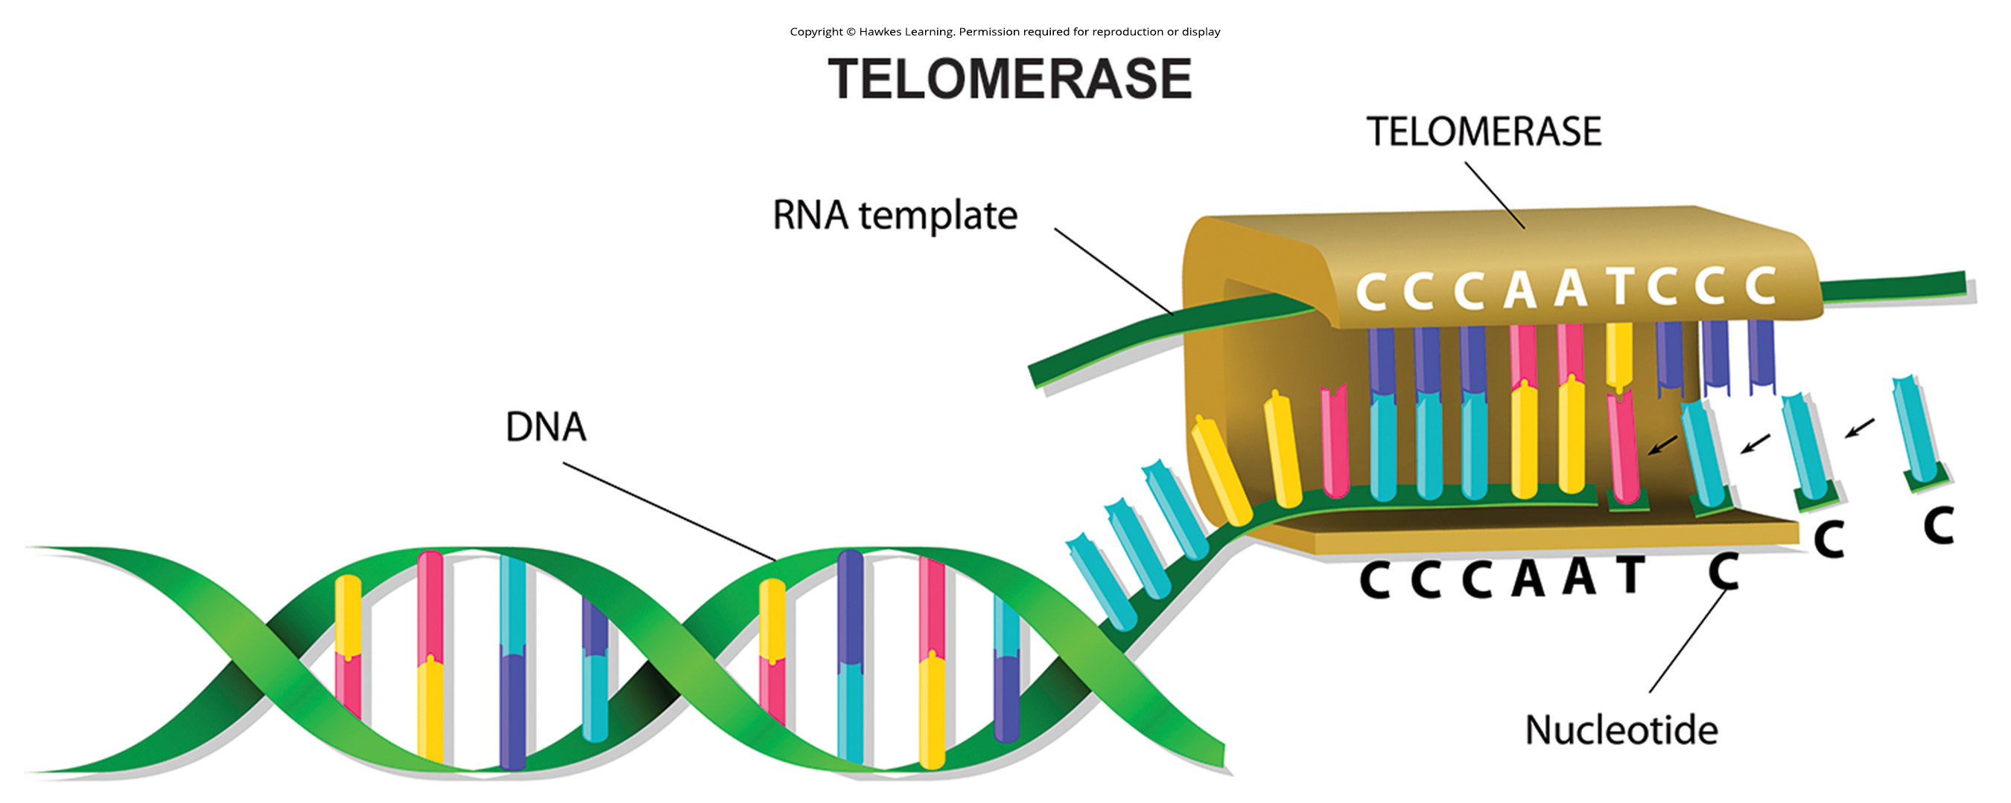
Lesson 14.4 Figure 3

Slide 28
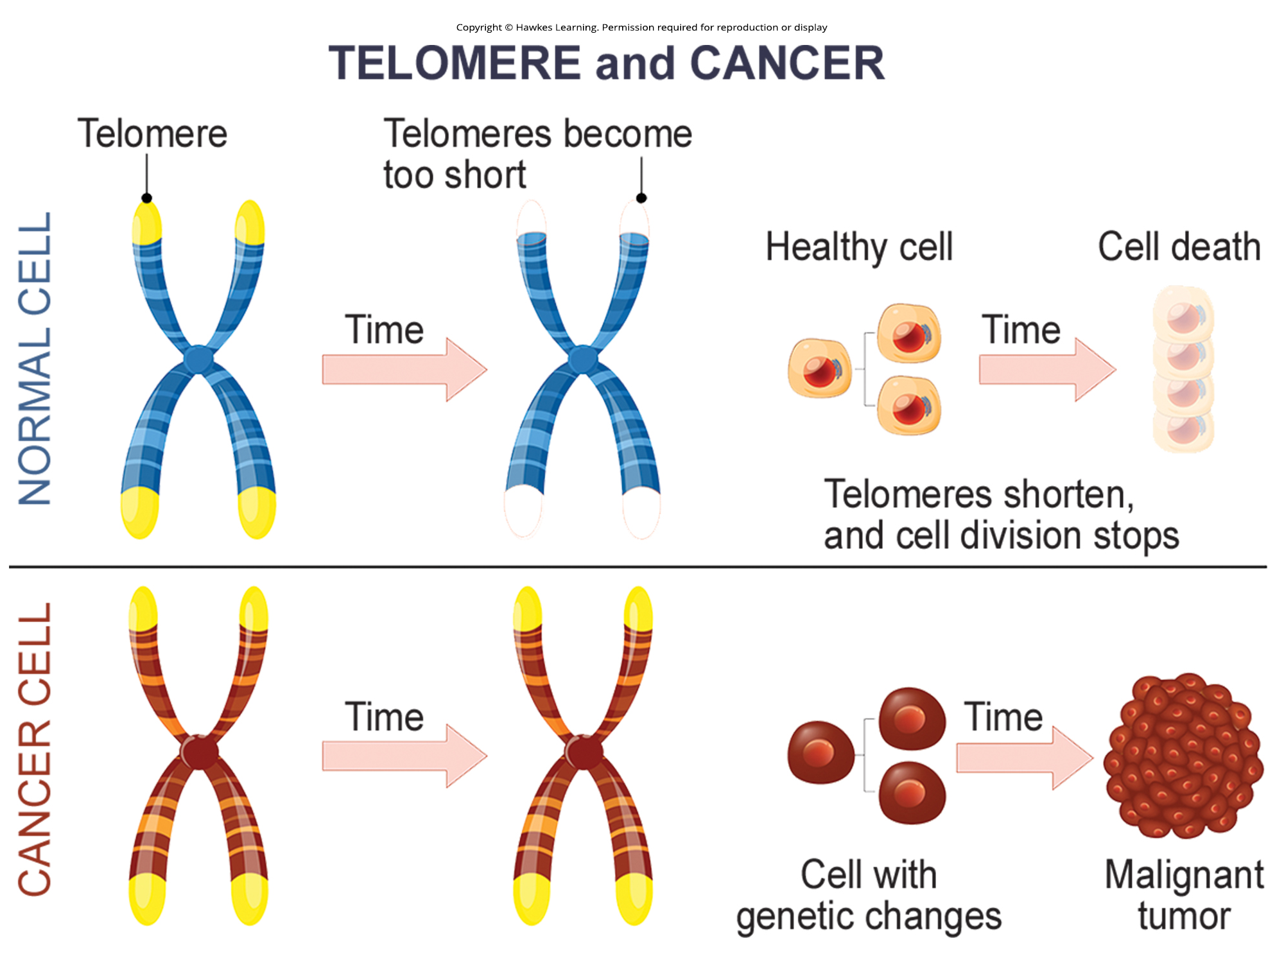
Lesson 14.4 Figure 4

Slide 29
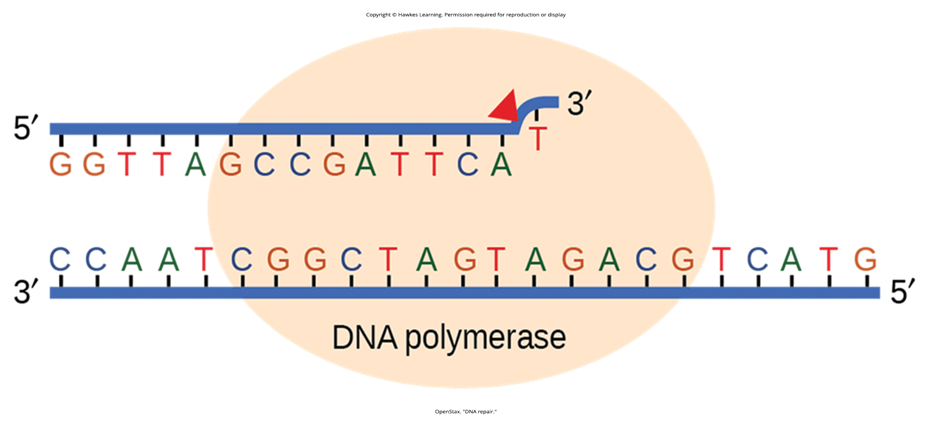
Lesson 14.5 Figure 1

Slide 30
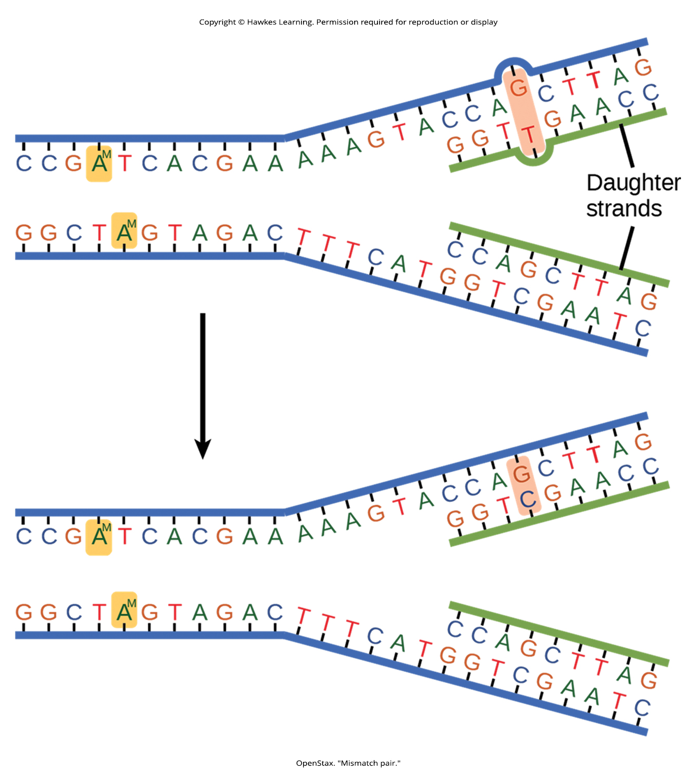
Lesson 14.5 Figure 2

Slide 31
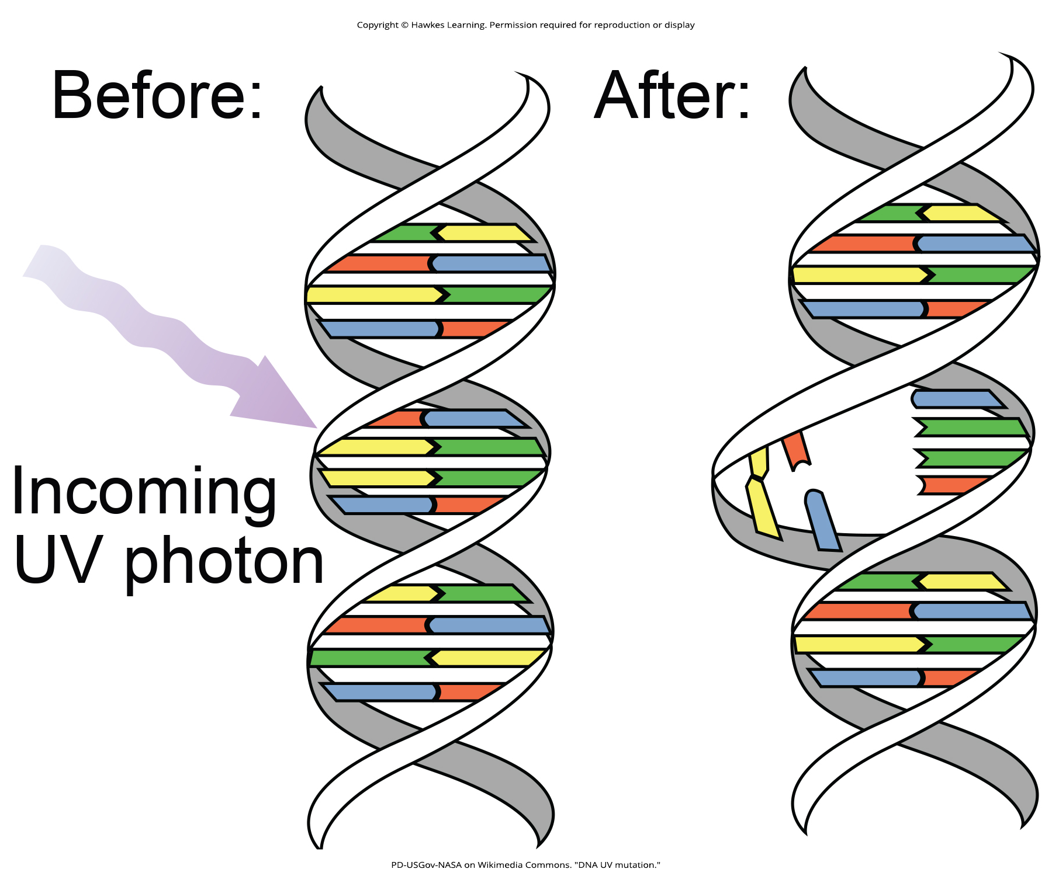
Lesson 14.5 Figure 3

Slide 32
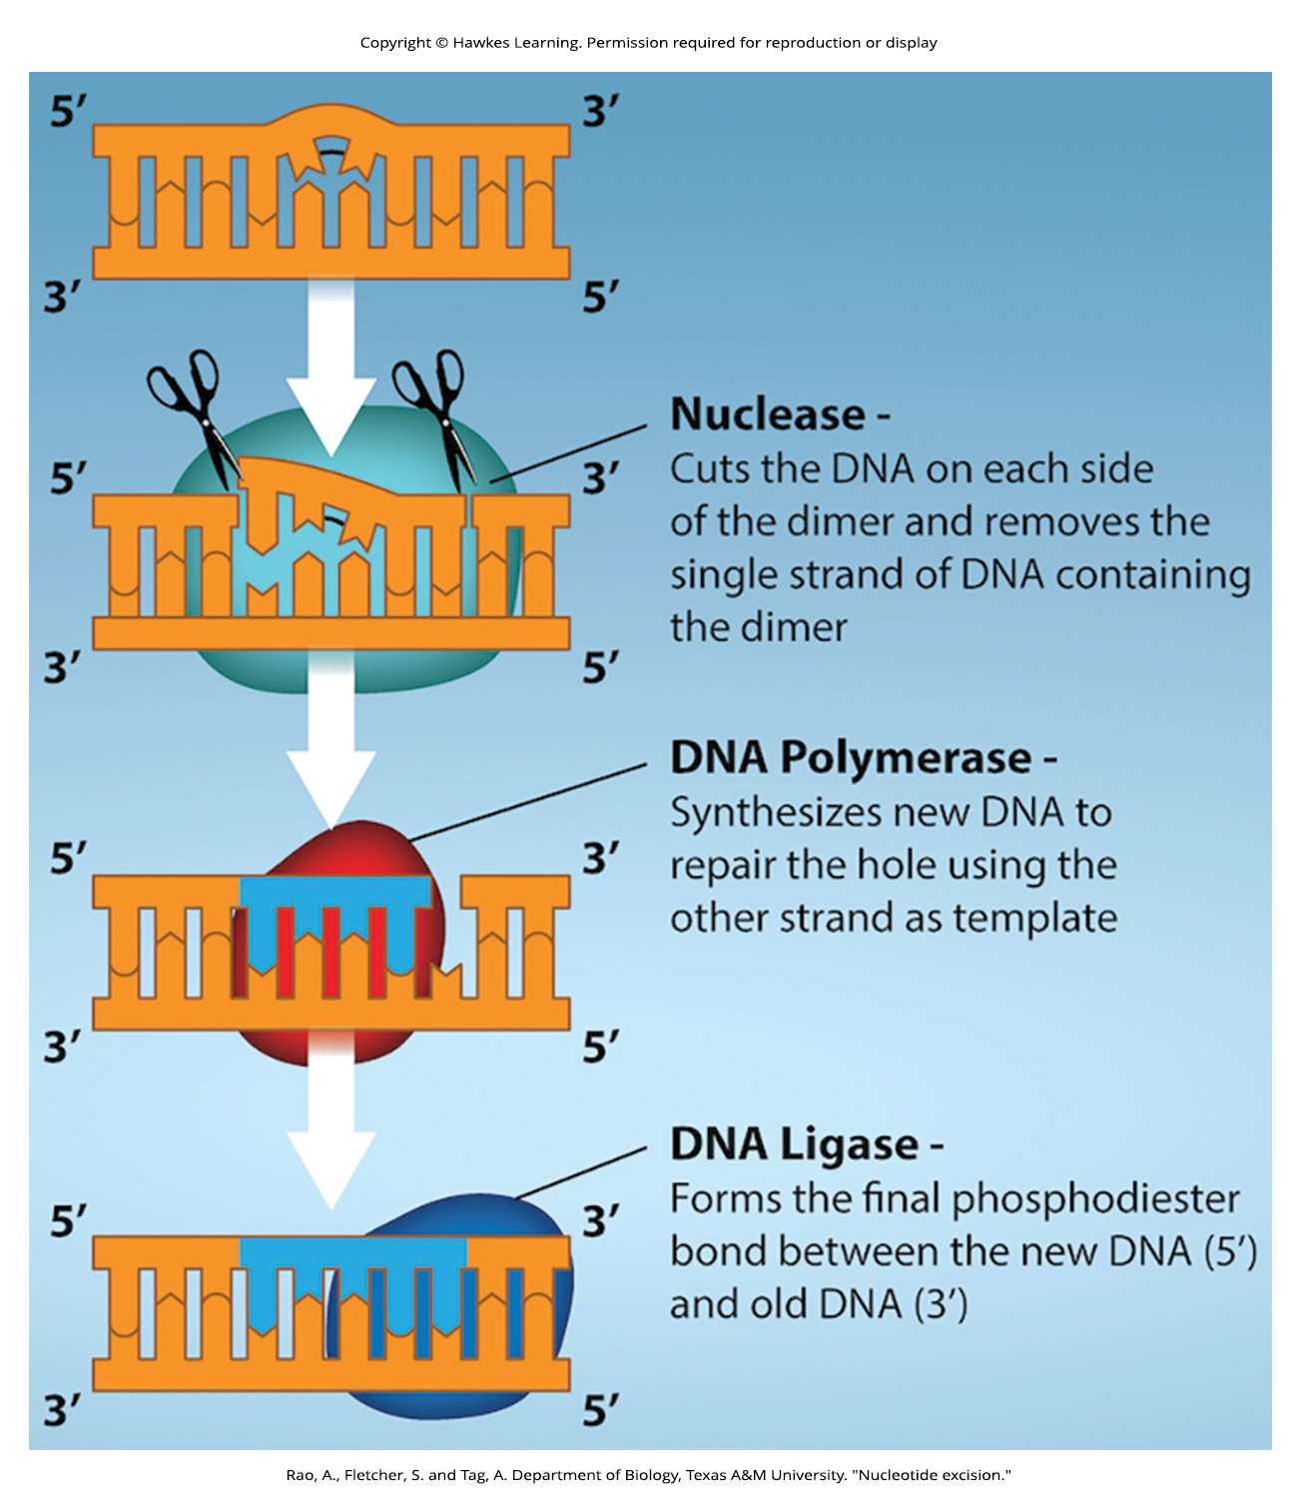
Lesson 14.5 Figure 4

Slide 33
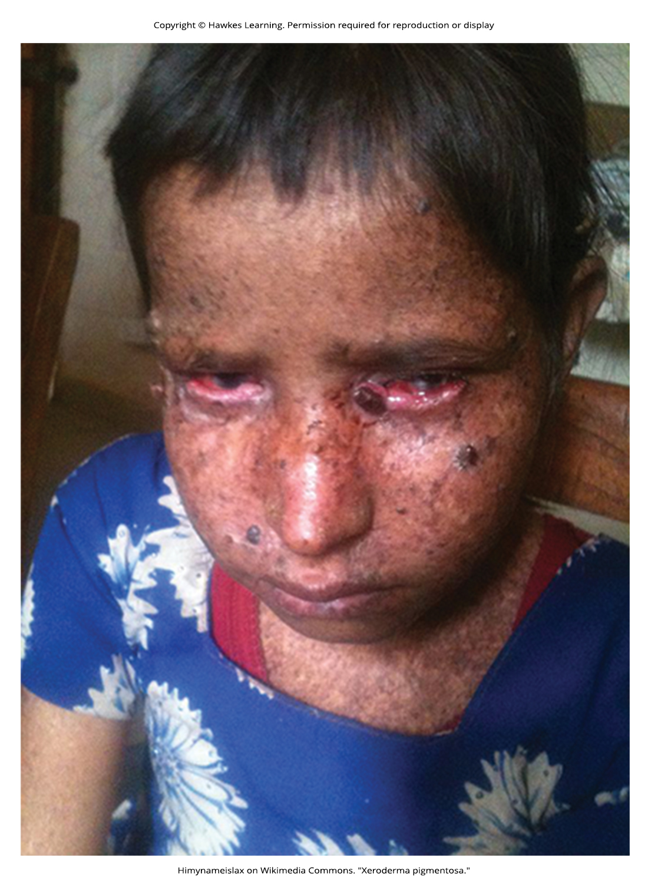
Lesson 14.5 Figure 5

Slide 34
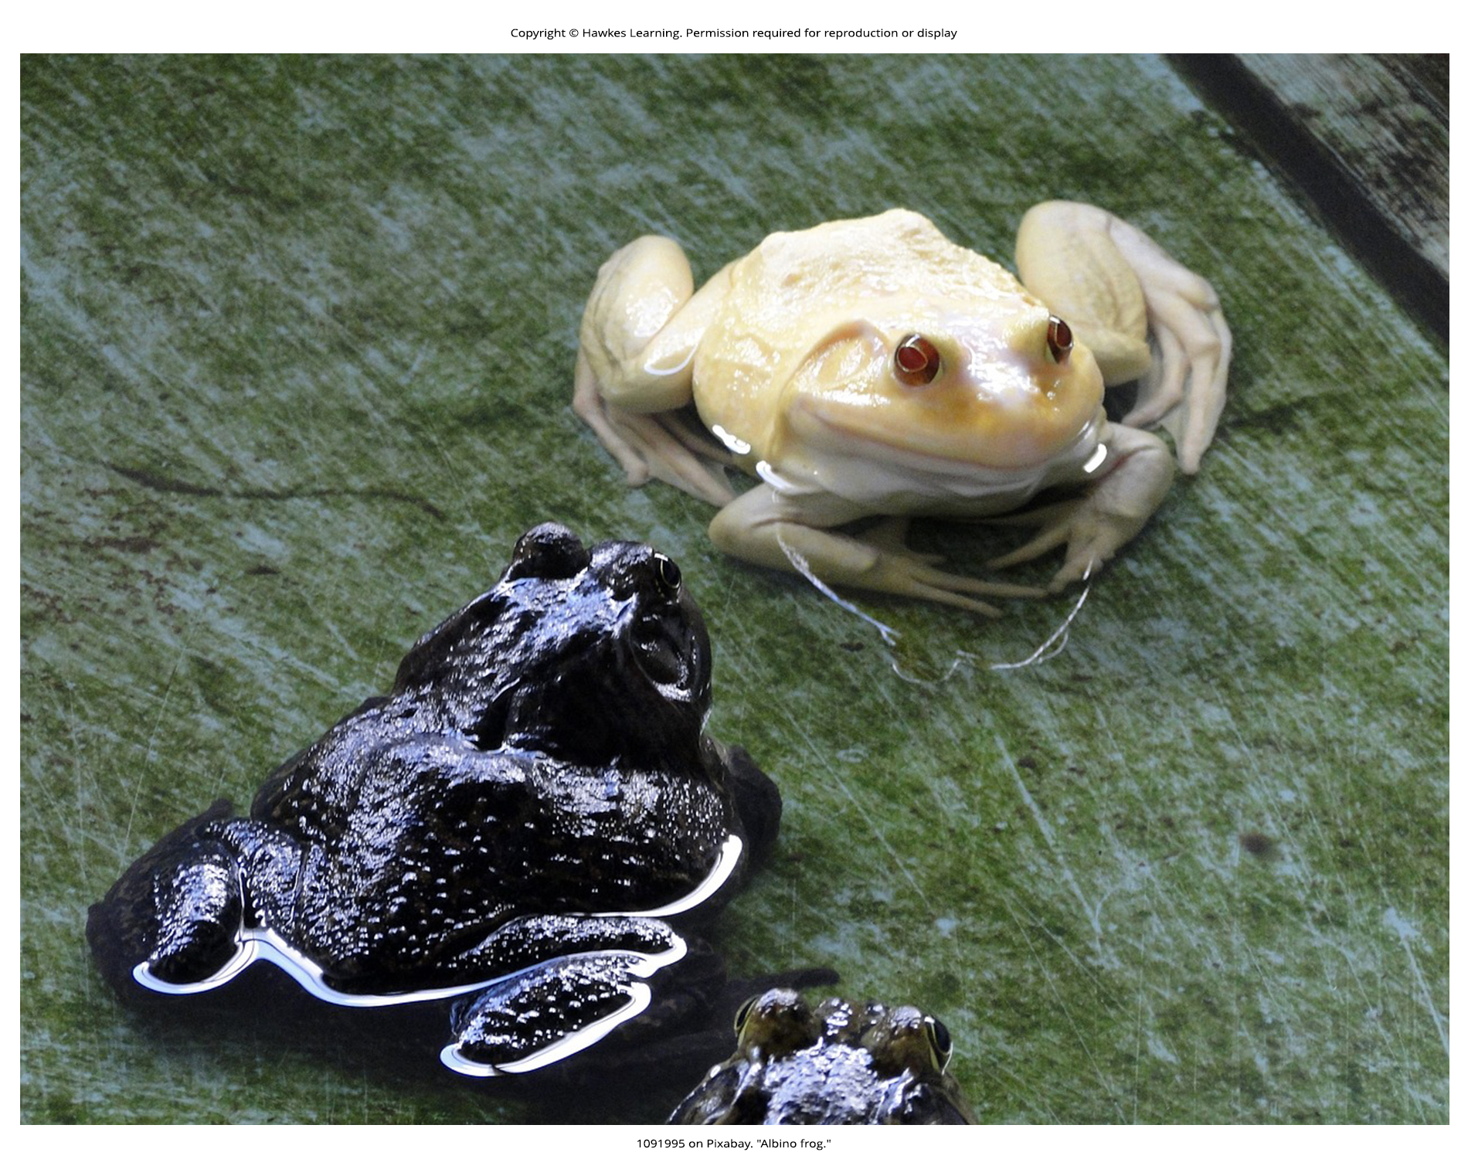
Lesson 14.5 Figure 6

Slide 35
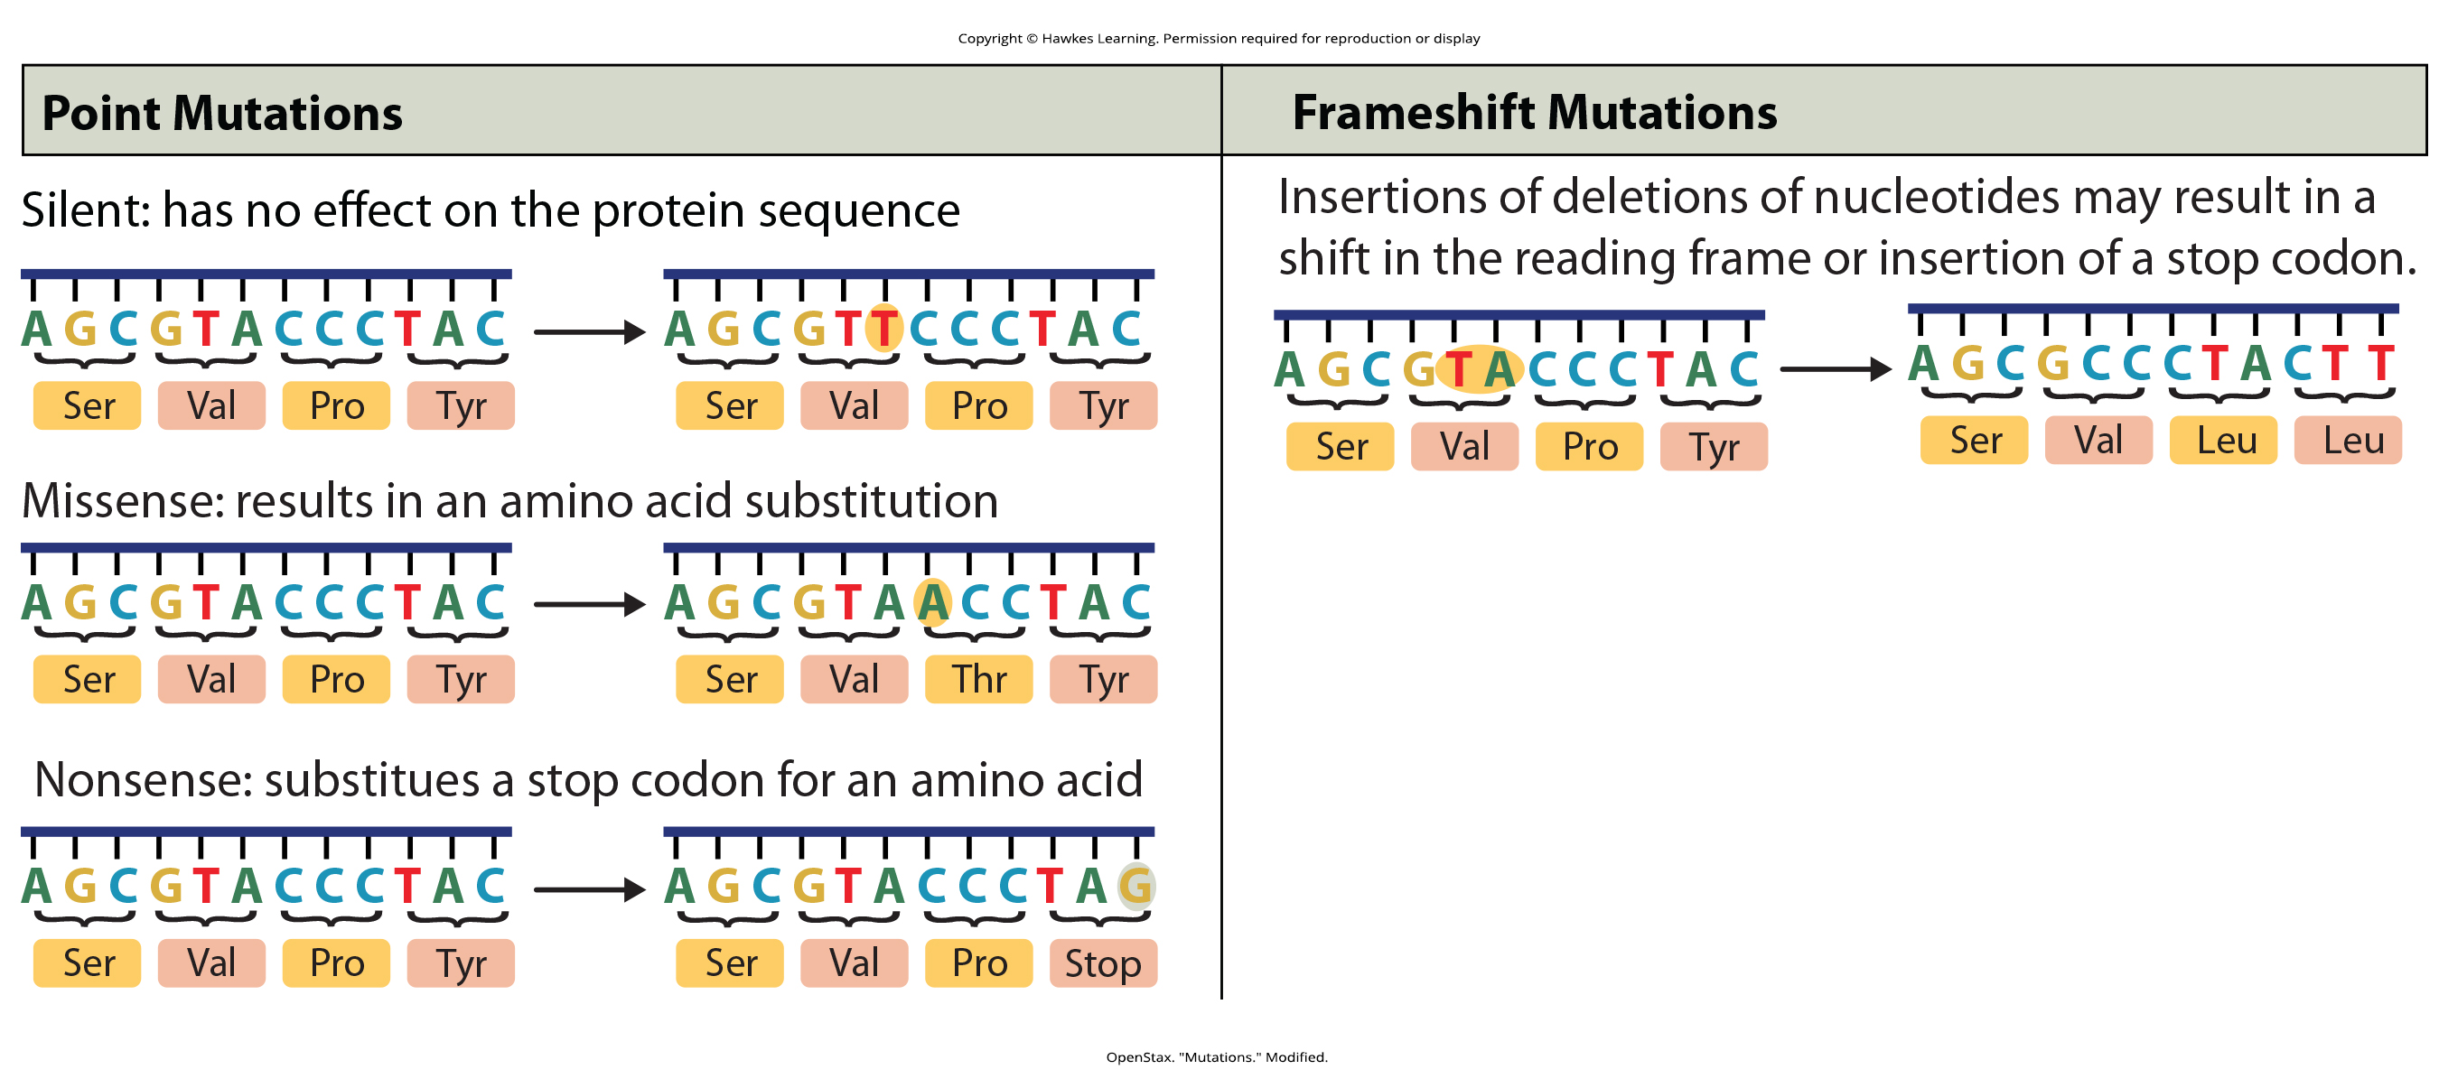
Lesson 14.5 Figure 7

Slide 36
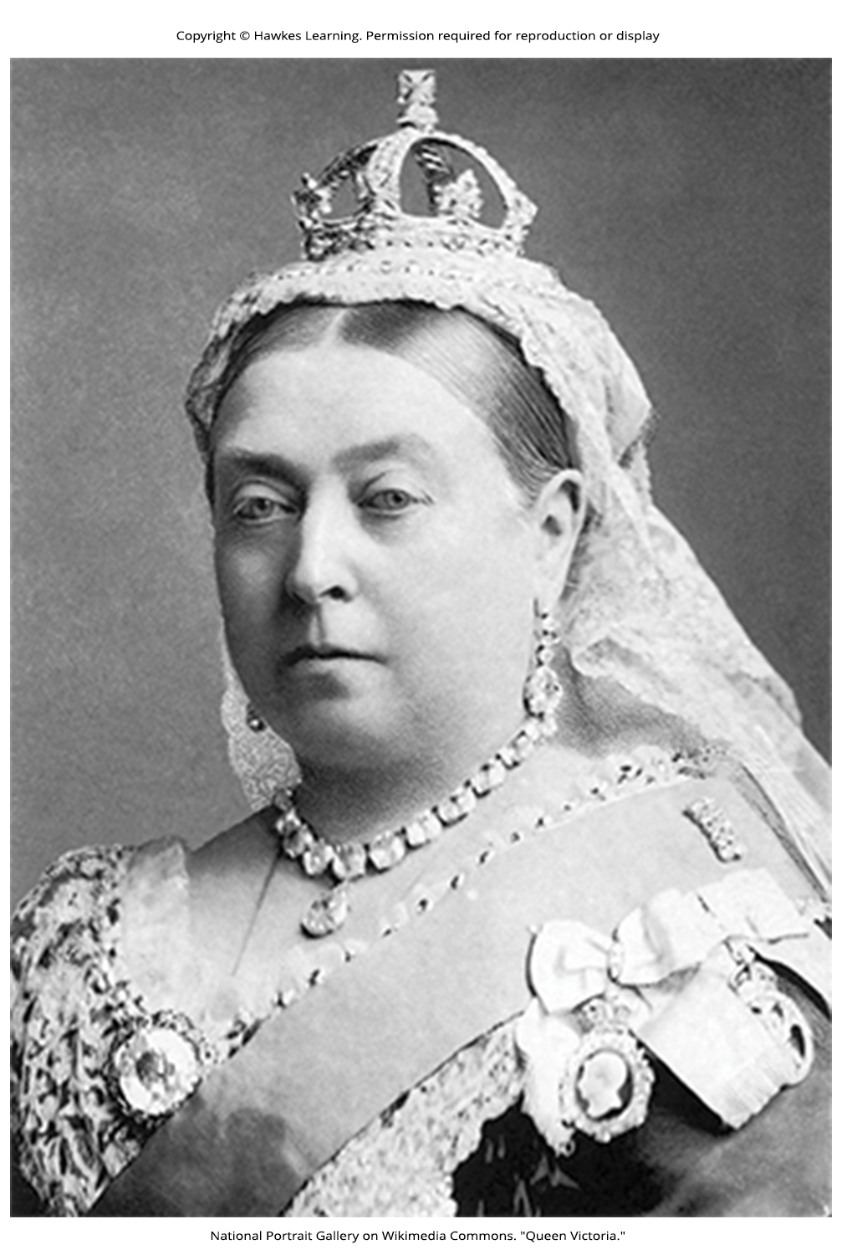
Lesson 14.5 Figure 8

Slide 37
Hawkes Learning – End of PowerPoint

