Slide 1
Chapter 10
Cell Reproduction

Slide 2
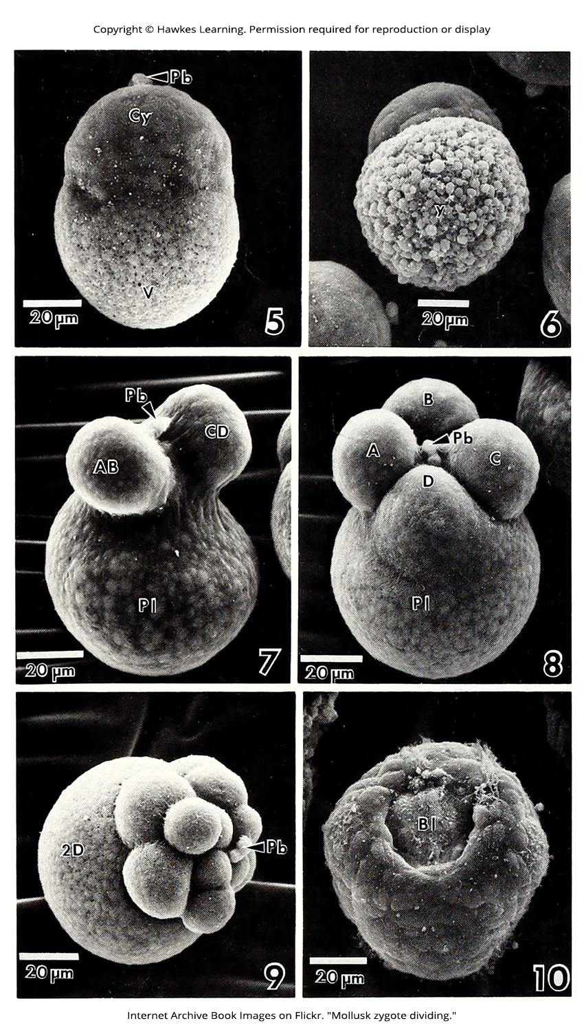
Lesson 10.1 Figure 1

Slide 3
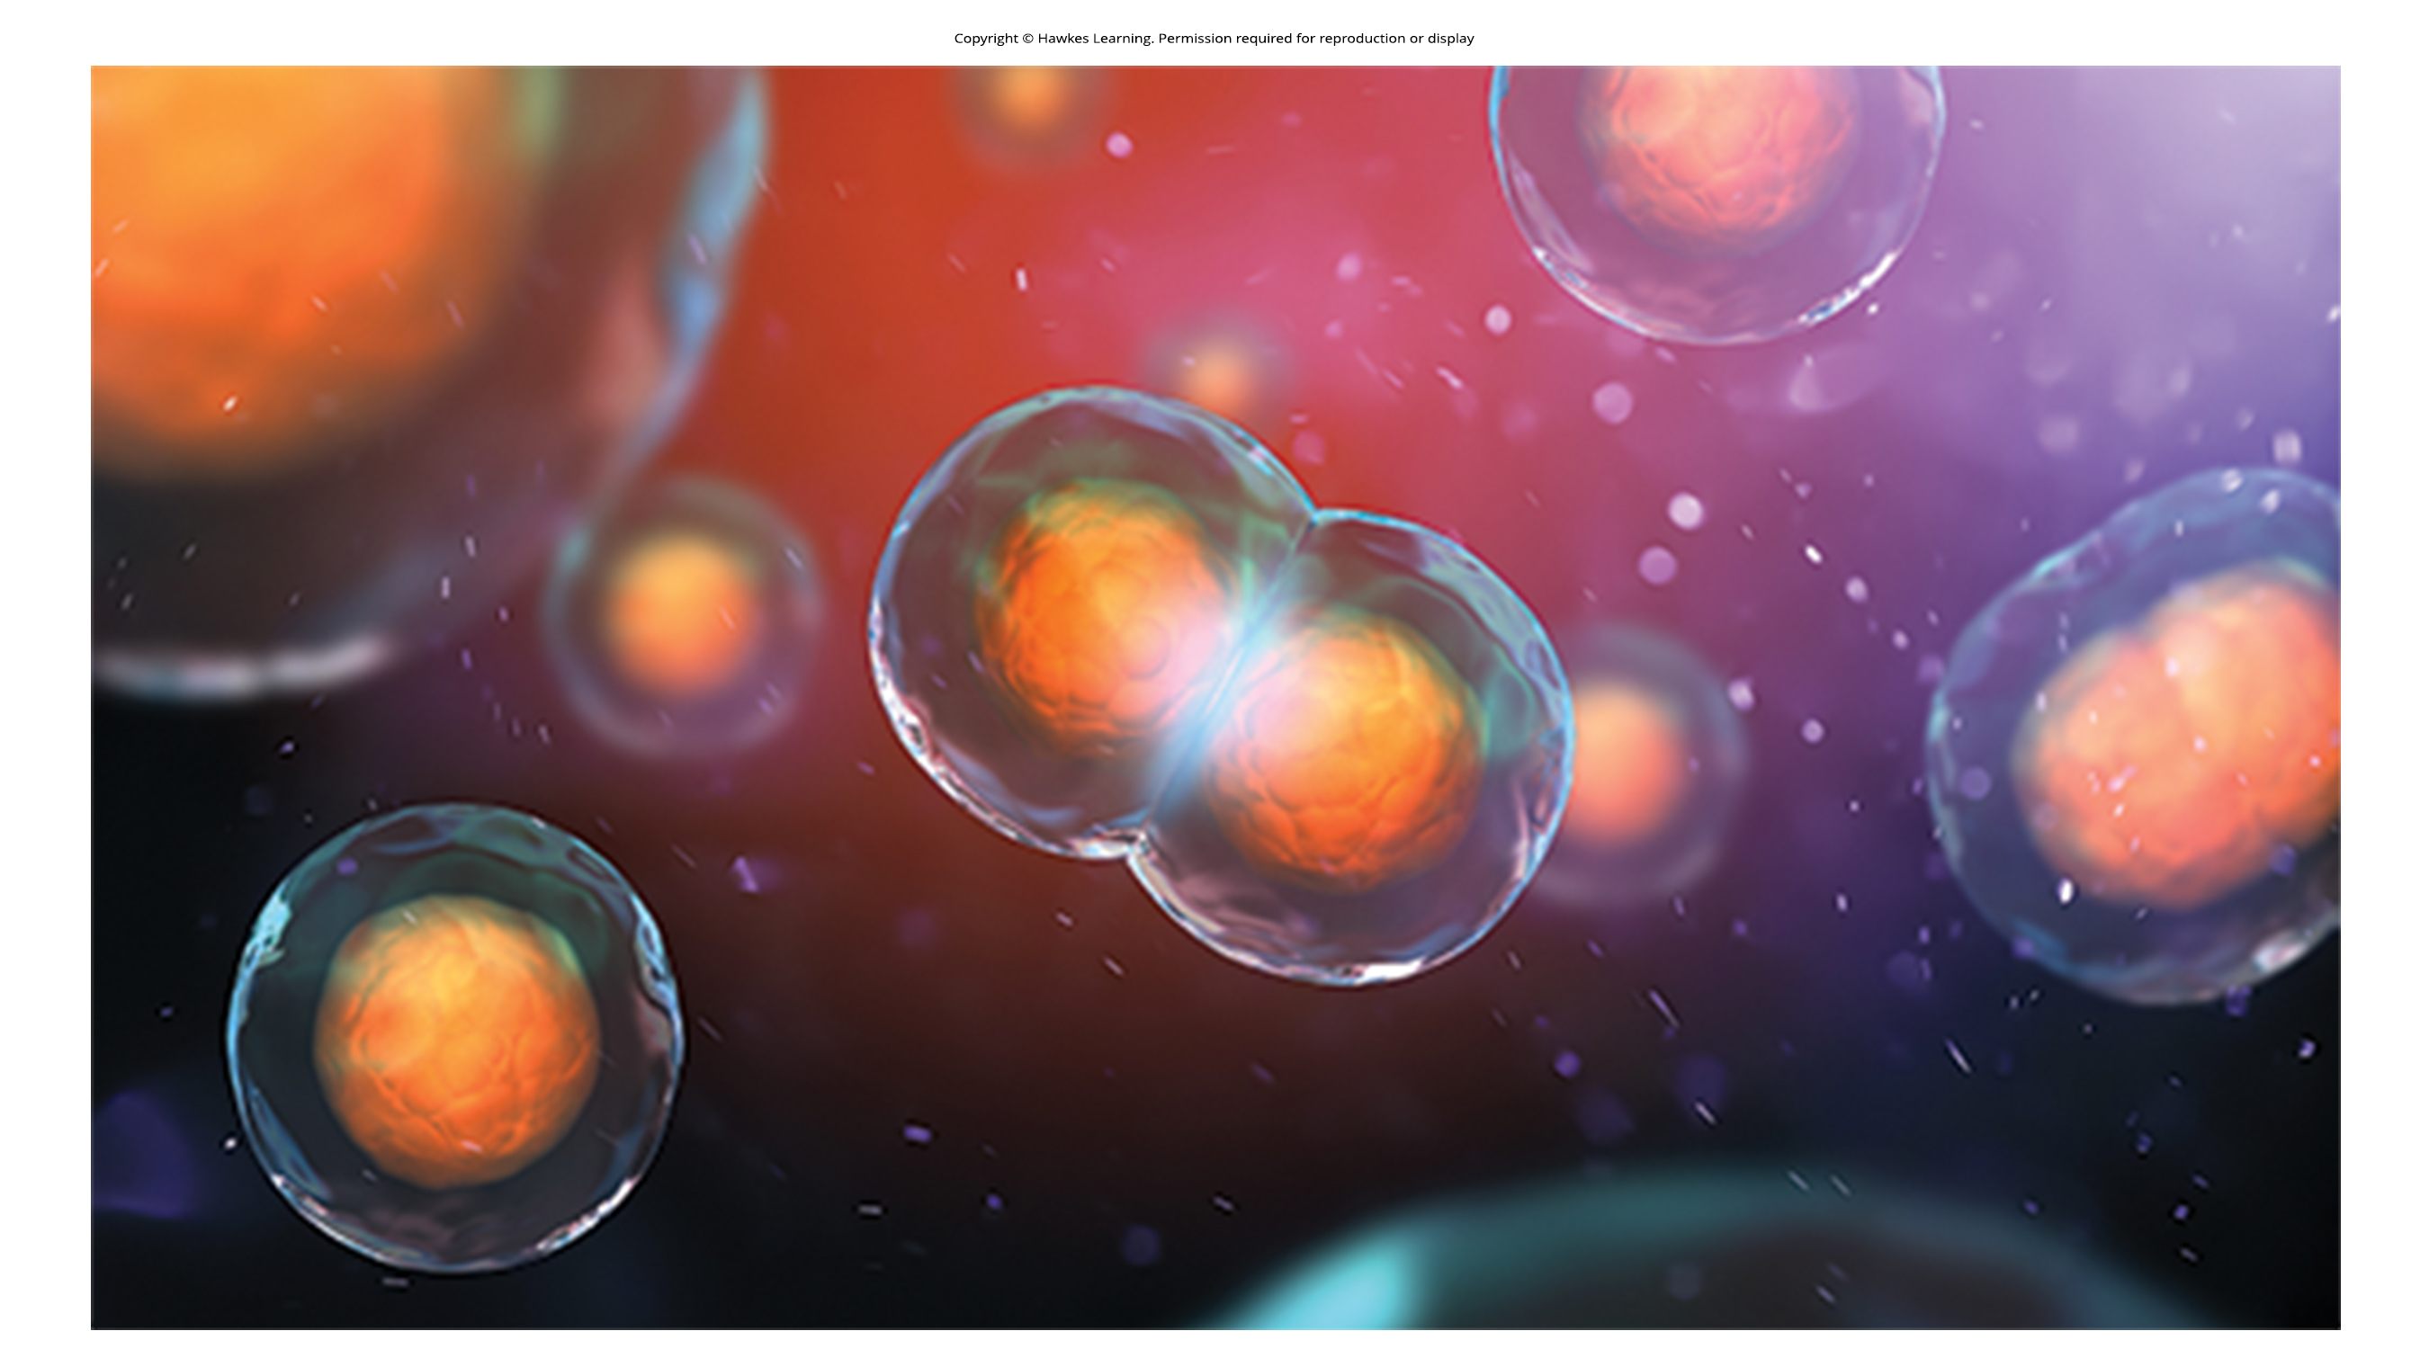
Lesson 10.1 Figure 2

Slide 4
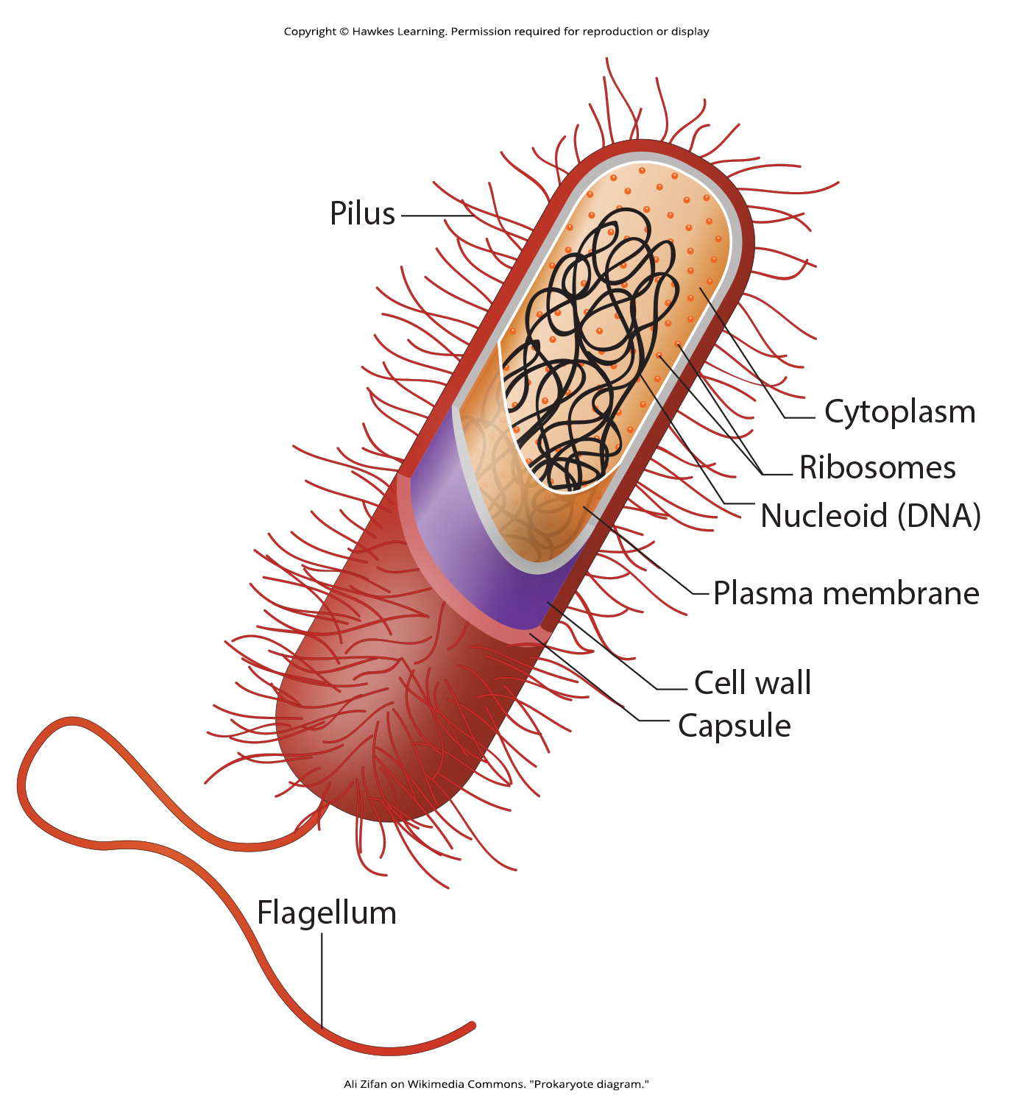
Lesson 10.1 Figure 3

Slide 5
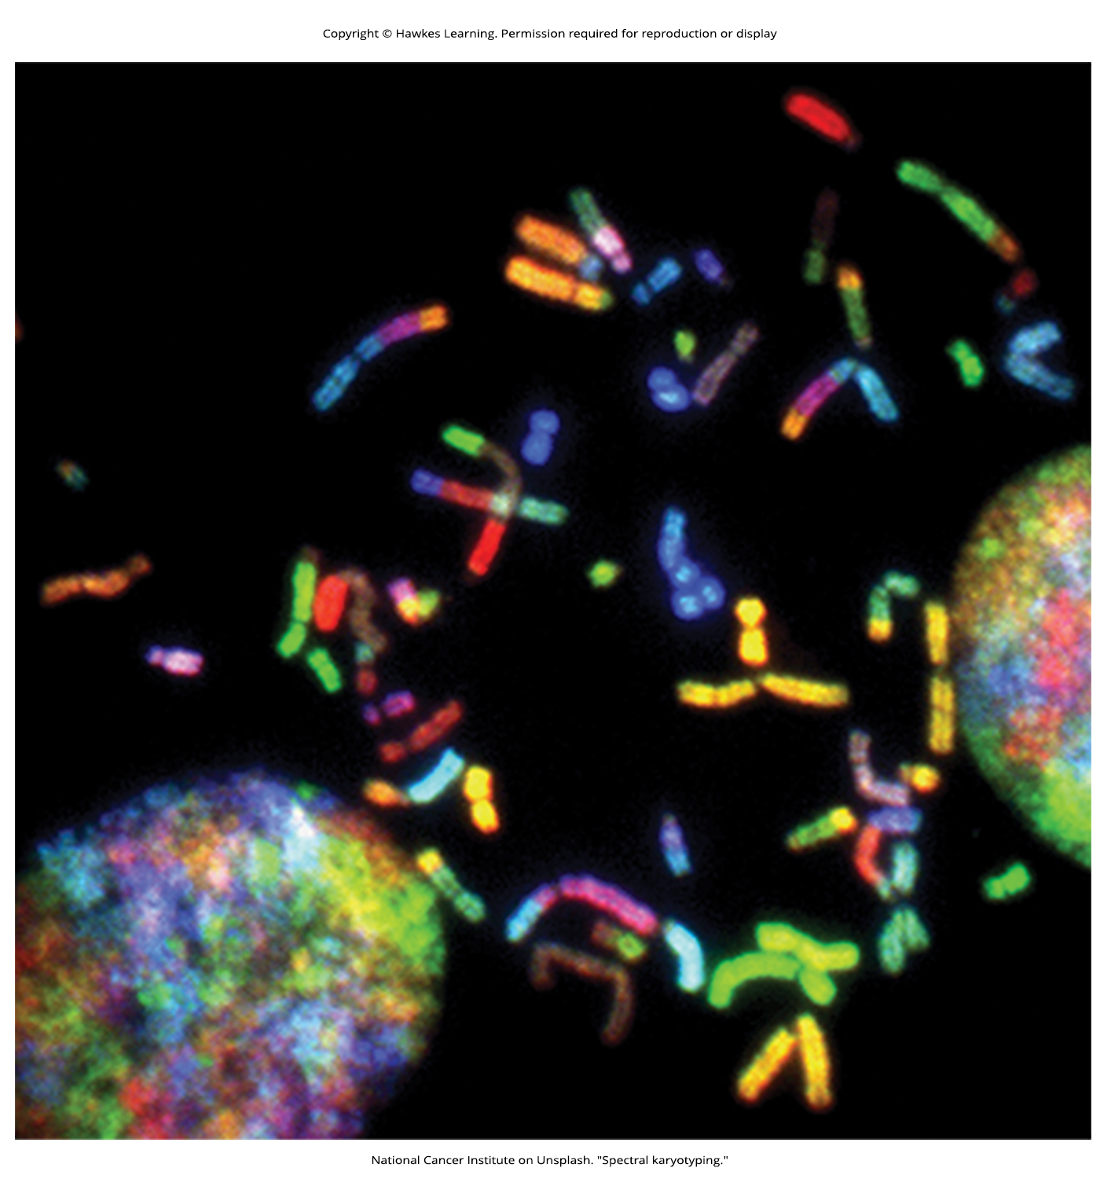
Lesson 10.1 Figure 4

Slide 6
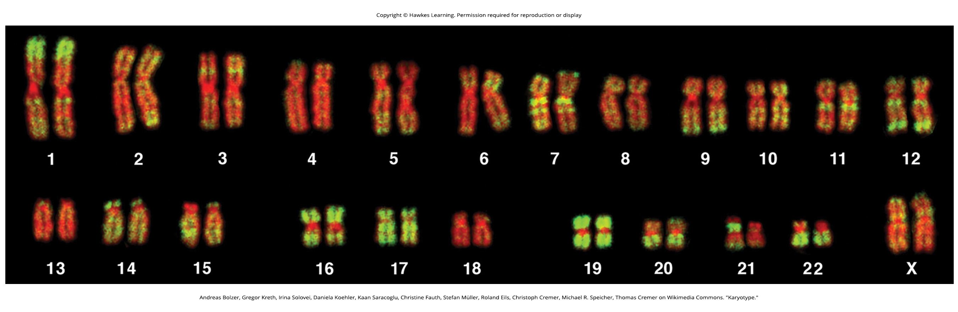
Lesson 10.1 Figure 5

Slide 7

Lesson 10.1 Figure 6

Slide 8
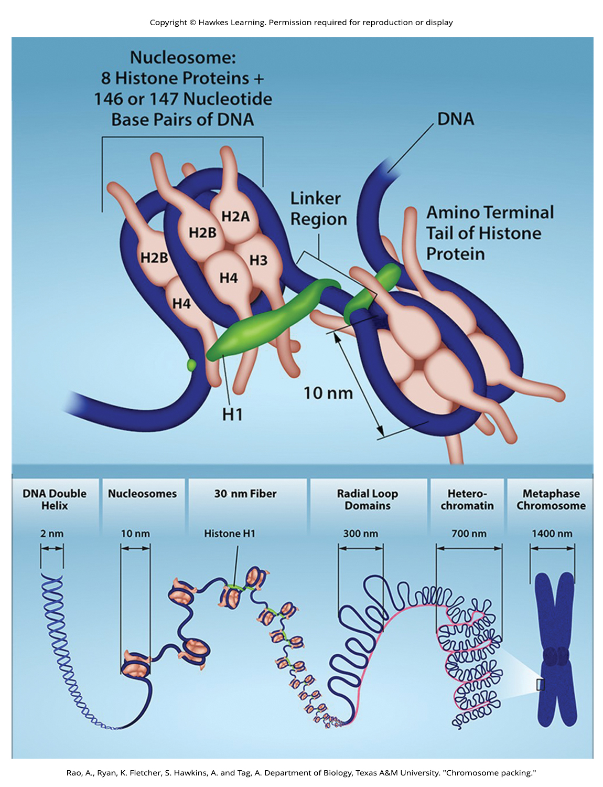
Lesson 10.1 Figure 7

Slide 9
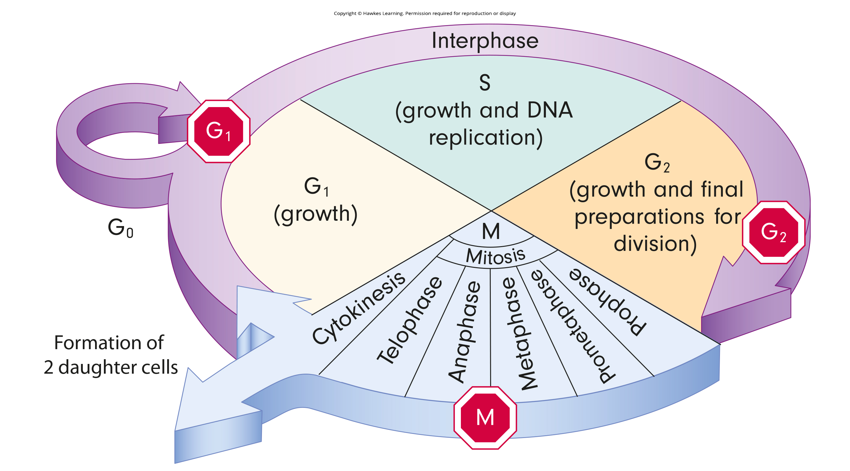
Lesson 10.2 Figure 1

Slide 10
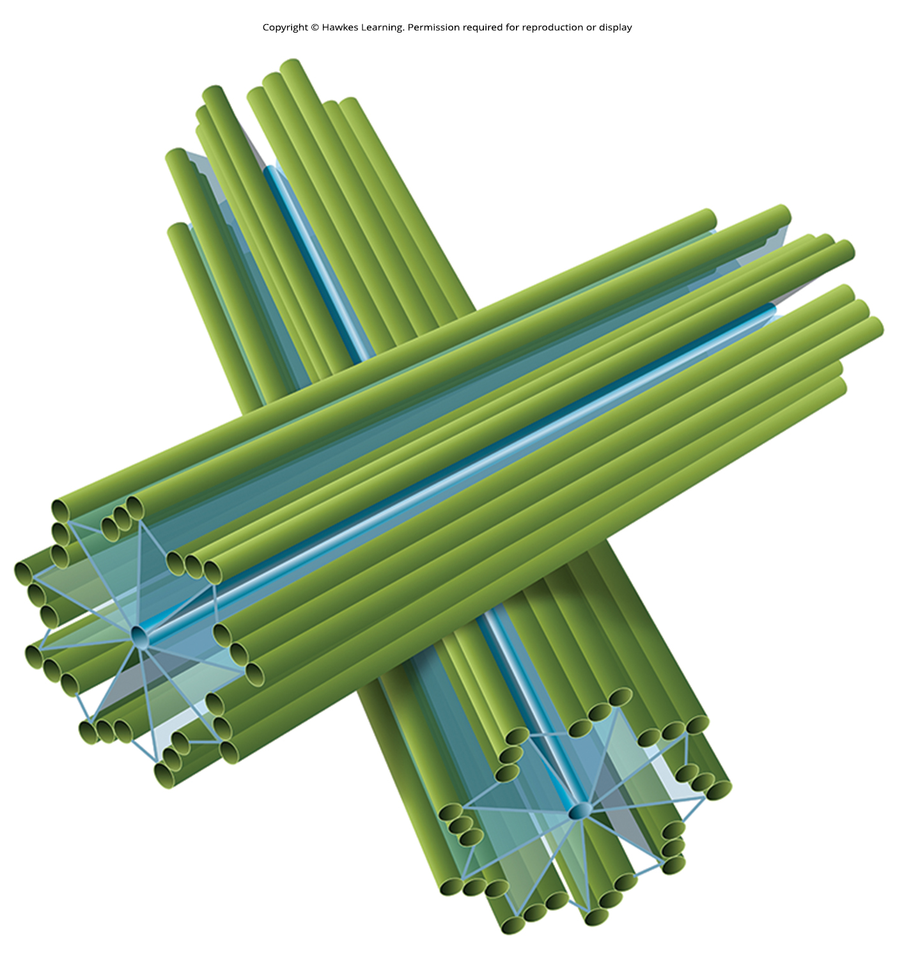
Lesson 10.2 Figure 2

Slide 11
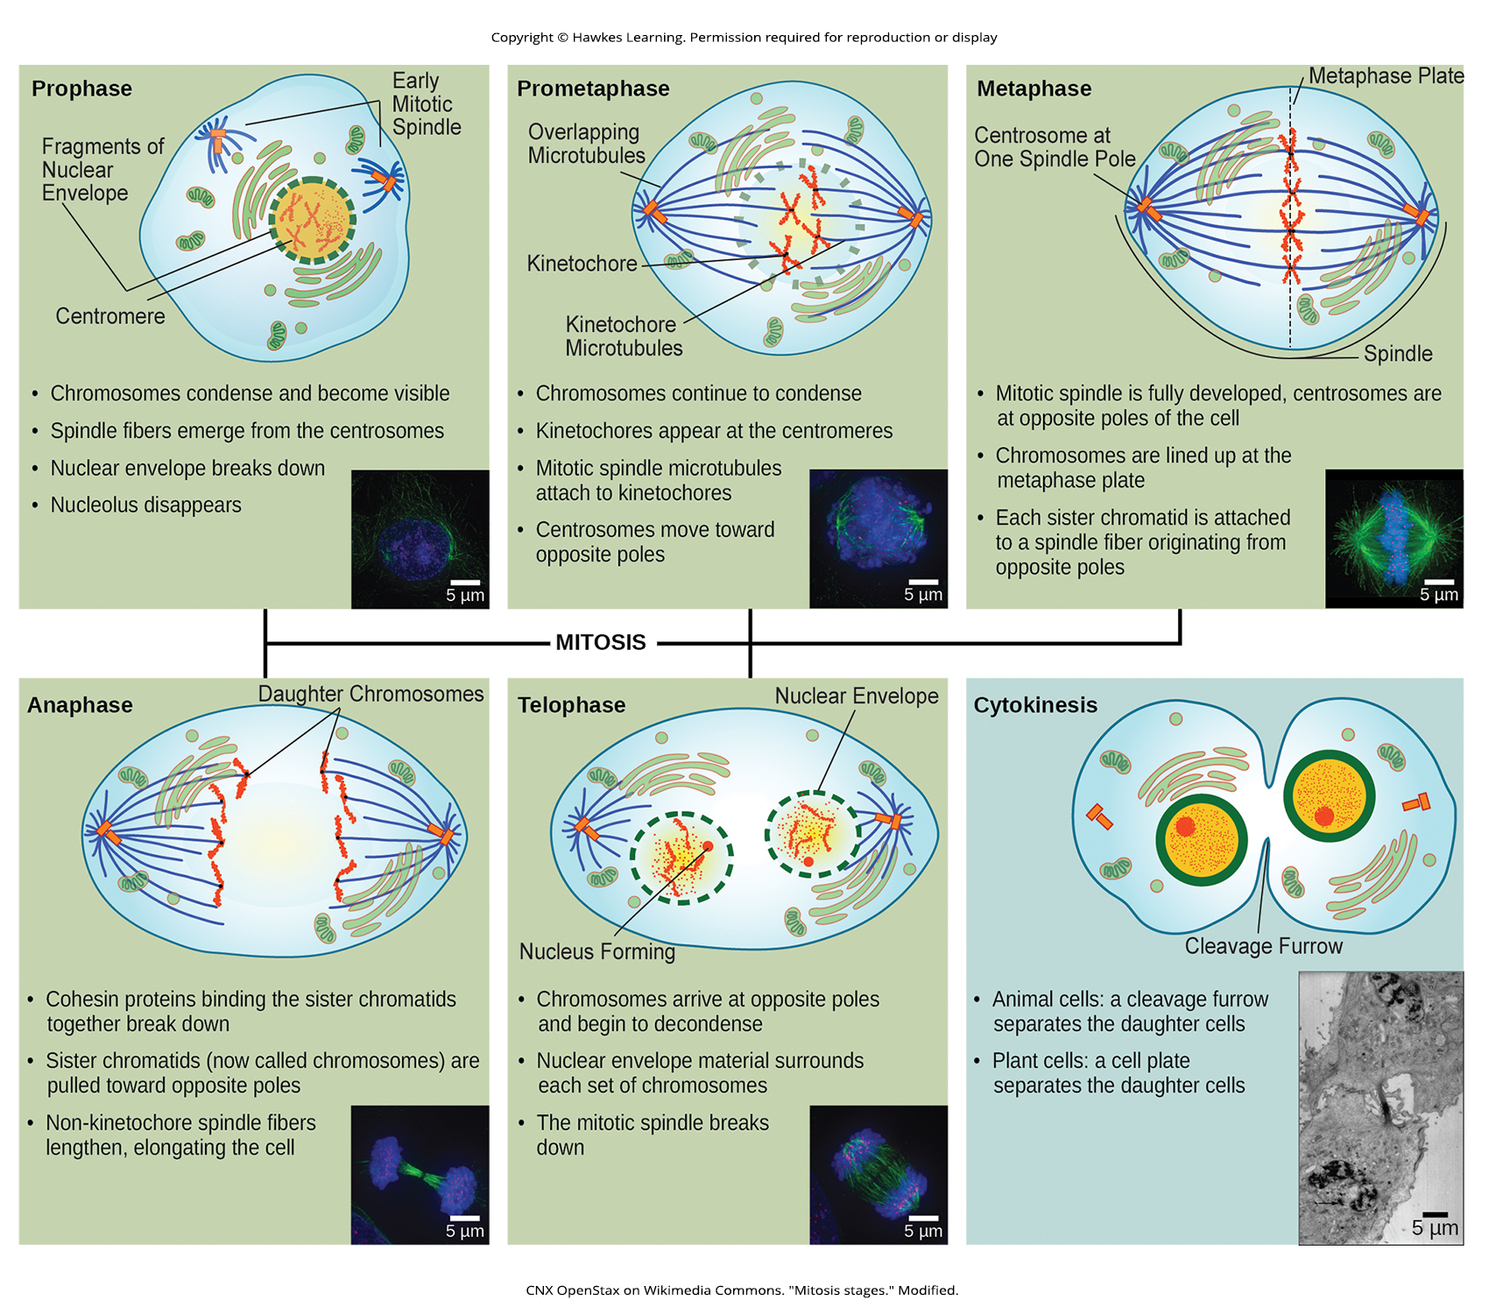
Lesson 10.2 Figure 3

Slide 12
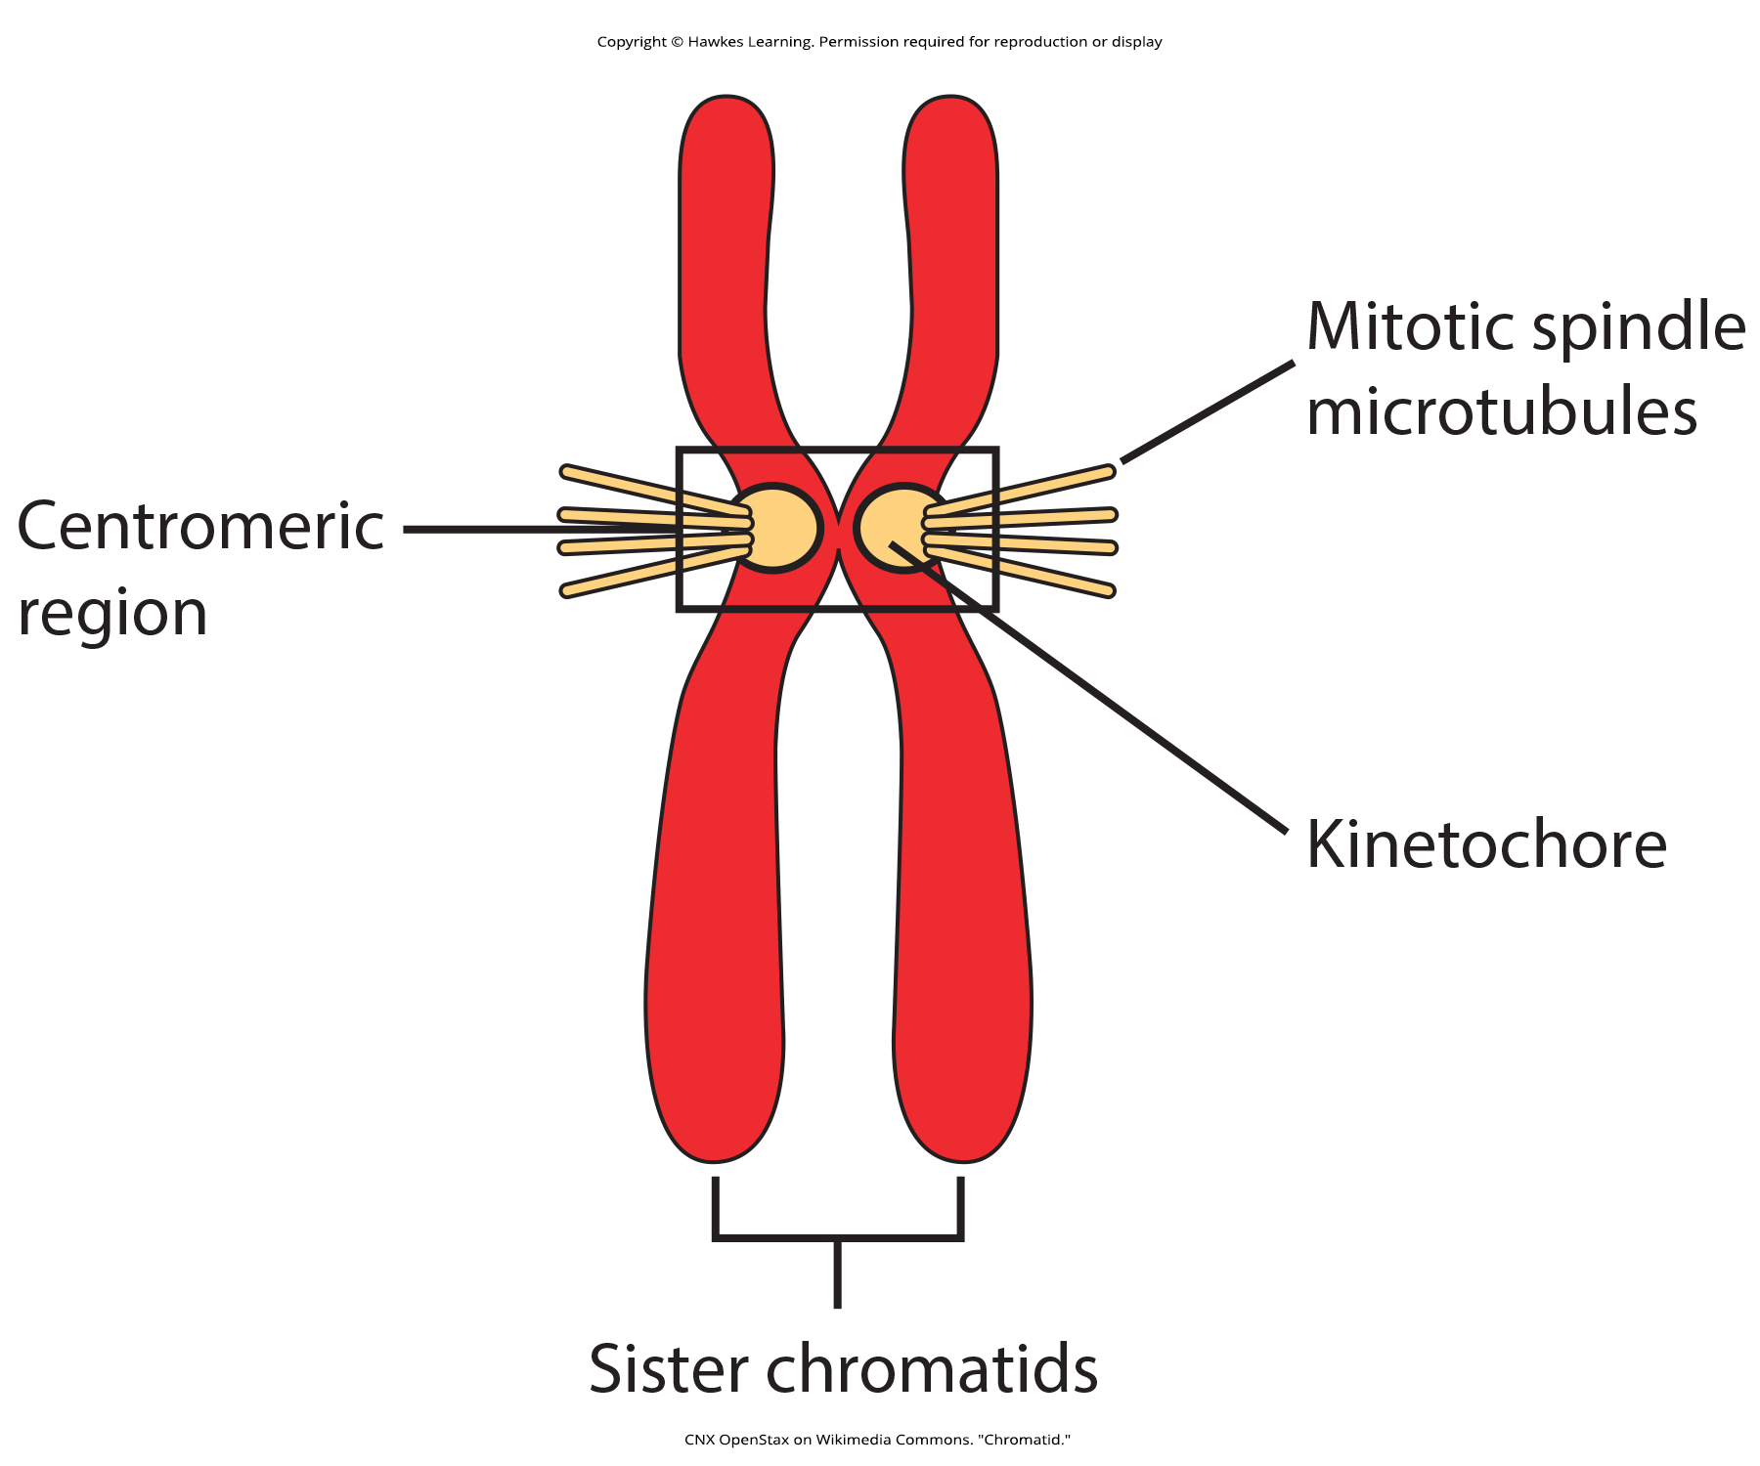
Lesson 10.2 Figure 4

Slide 13
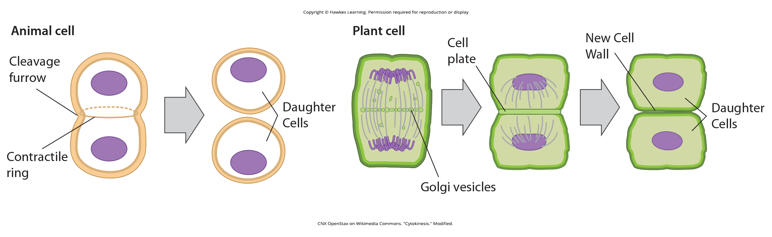
Lesson 10.2 Figure 5

Slide 14
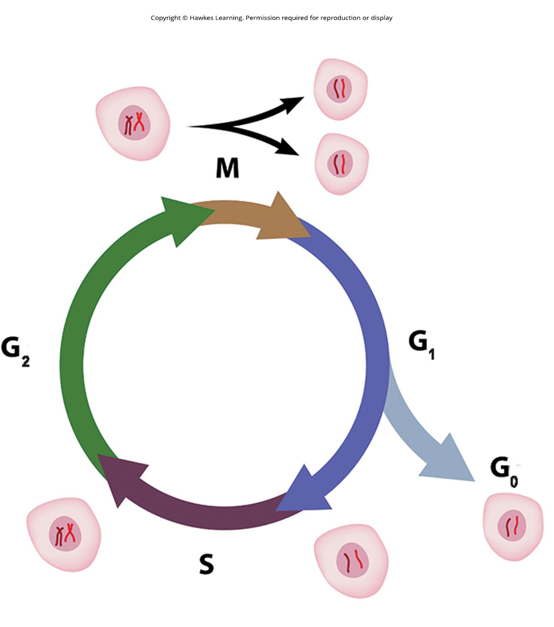
Lesson 10.2 Figure 6

Slide 15
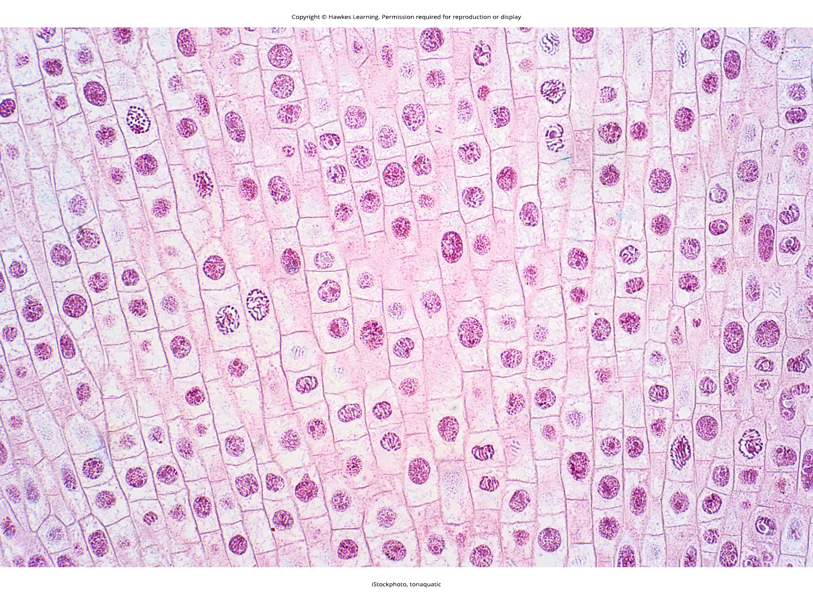
Lesson 10.2 Figure 7

Slide 16
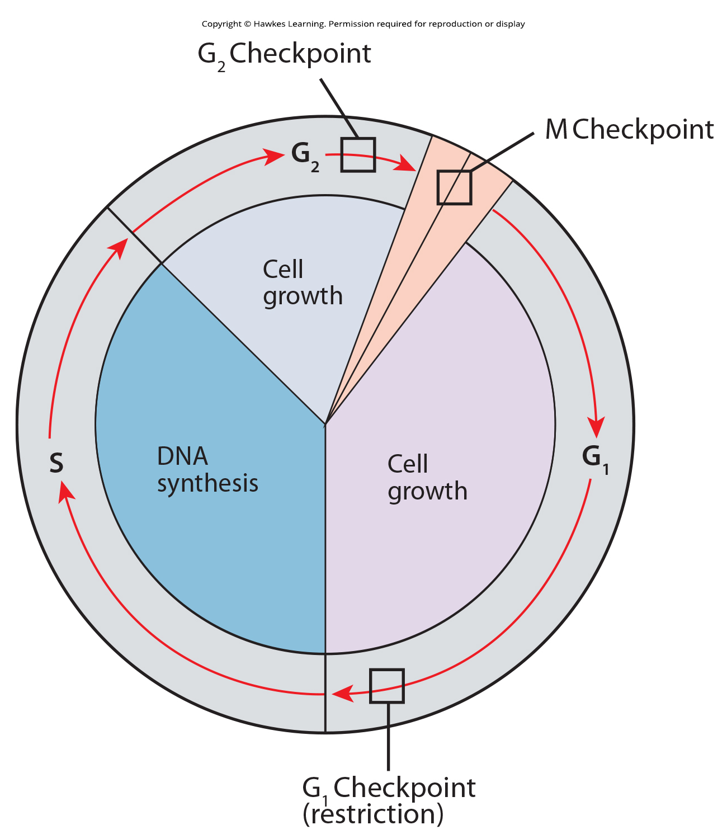
Lesson 10.3 Figure 1

Slide 17
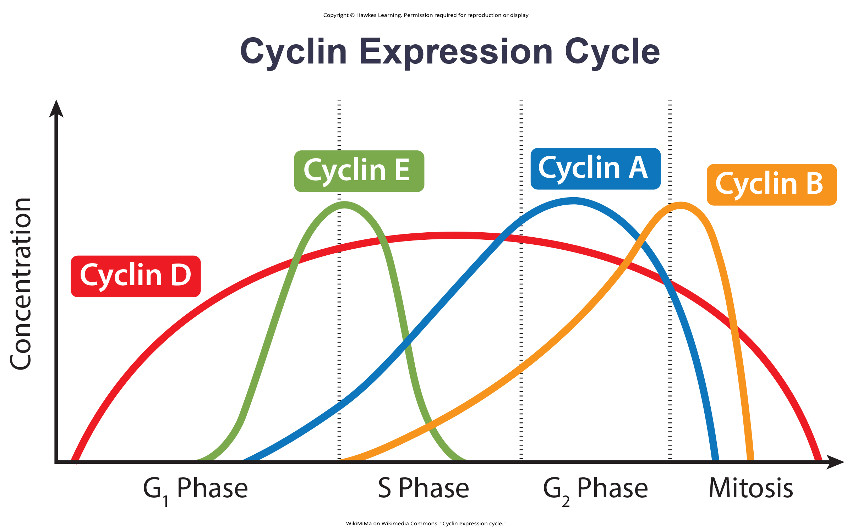
Lesson 10.3 Figure 2

Slide 18
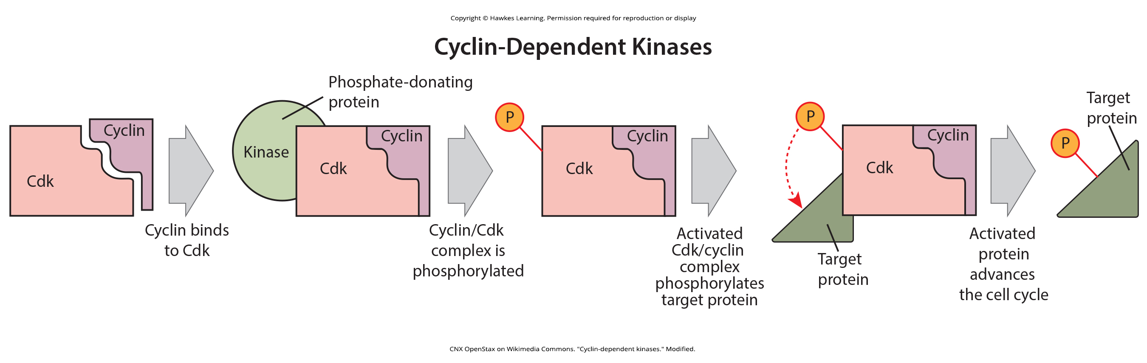
Lesson 10.3 Figure 3

Slide 19
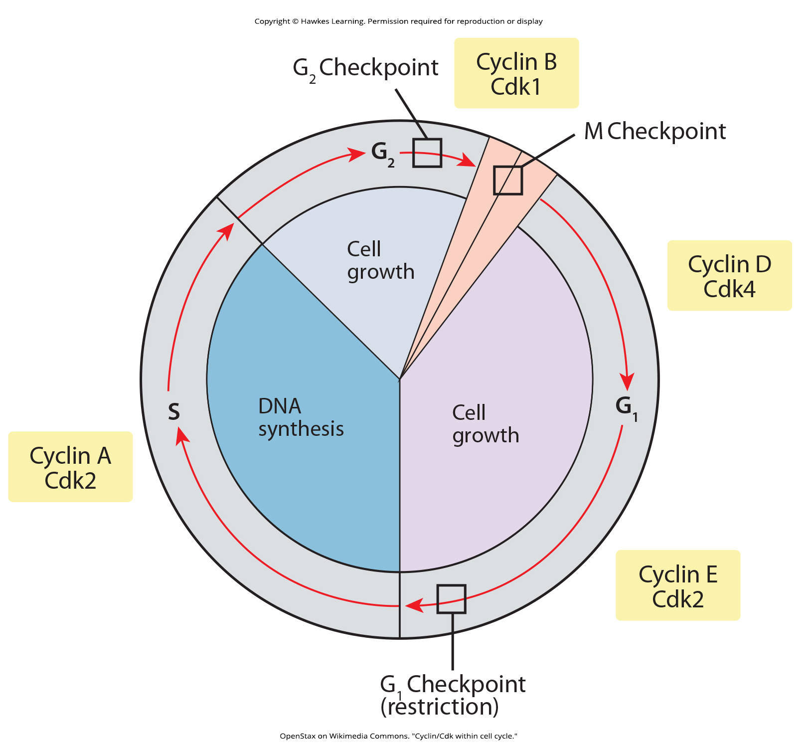
Lesson 10.3 Figure 4

Slide 20
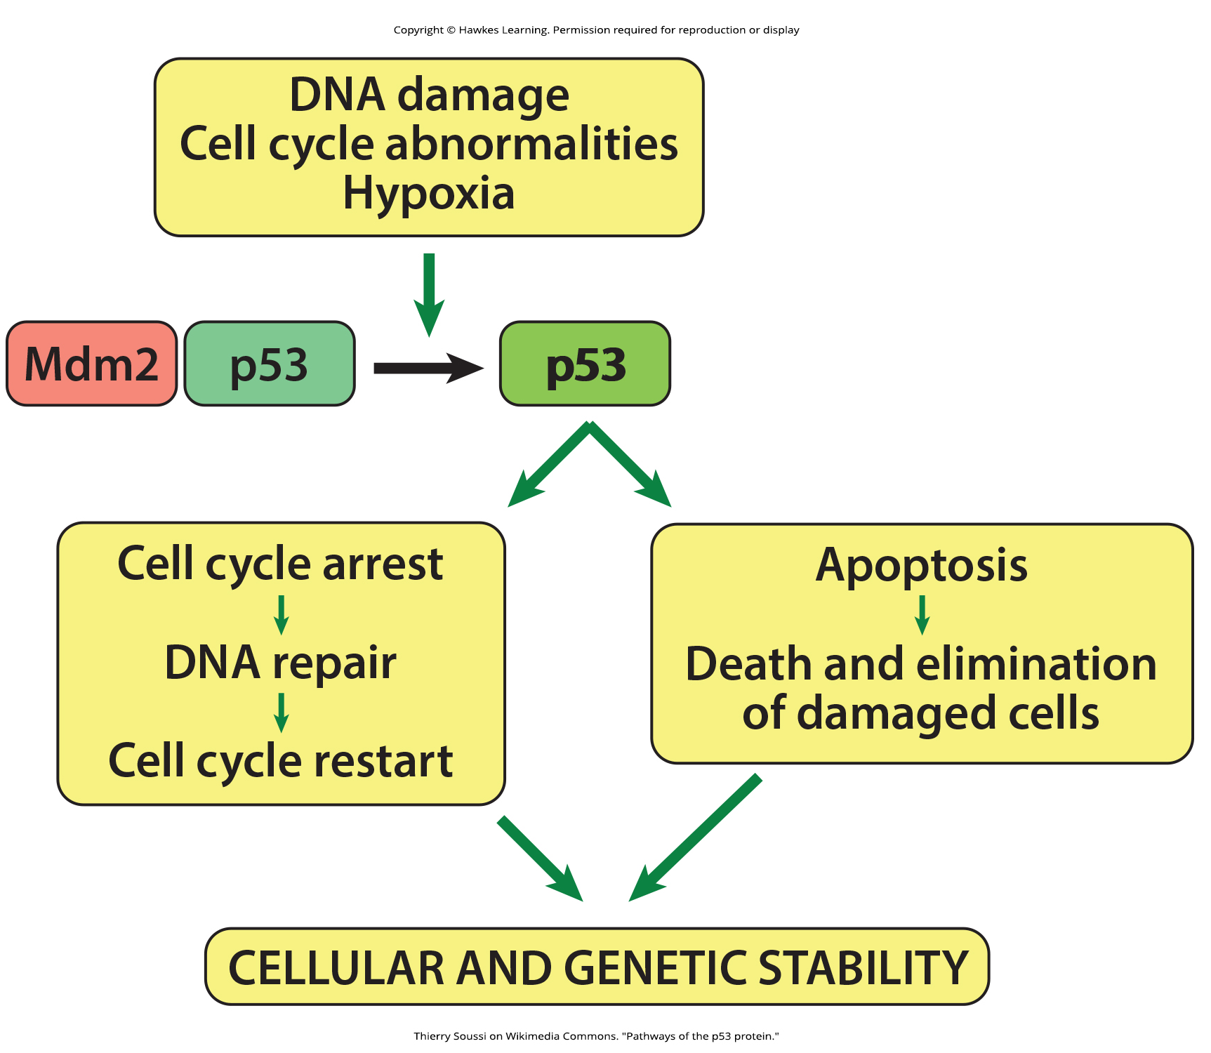
Lesson 10.3 Figure 5

Slide 21
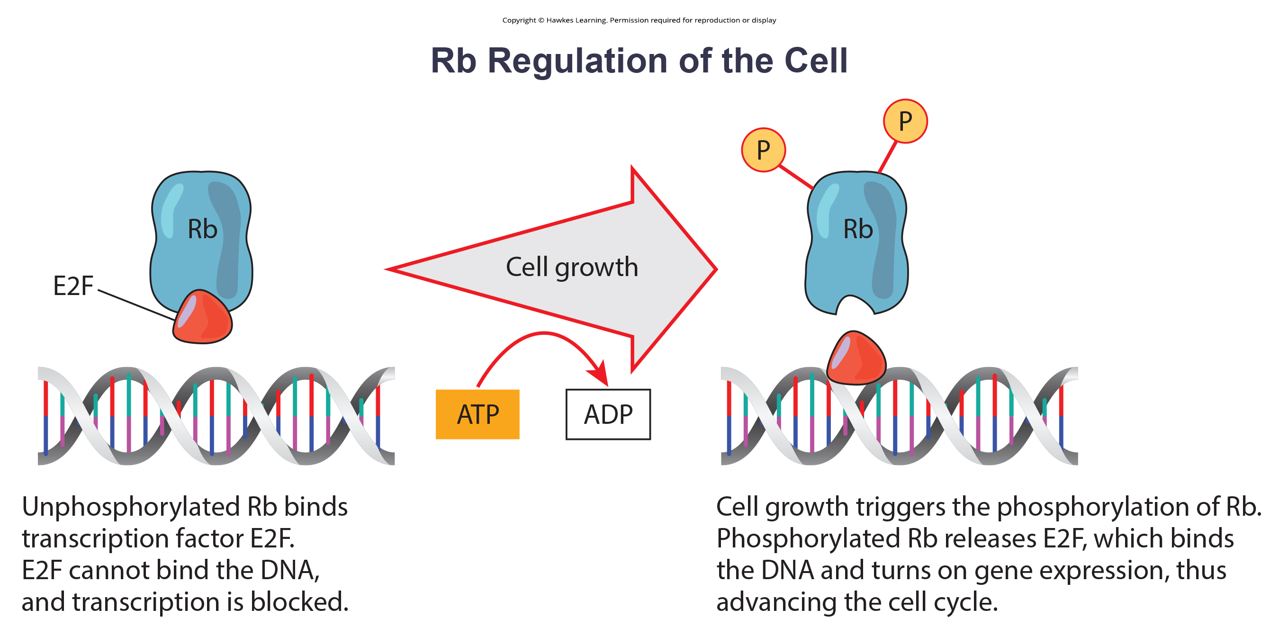
Lesson 10.3 Figure 6

Slide 22
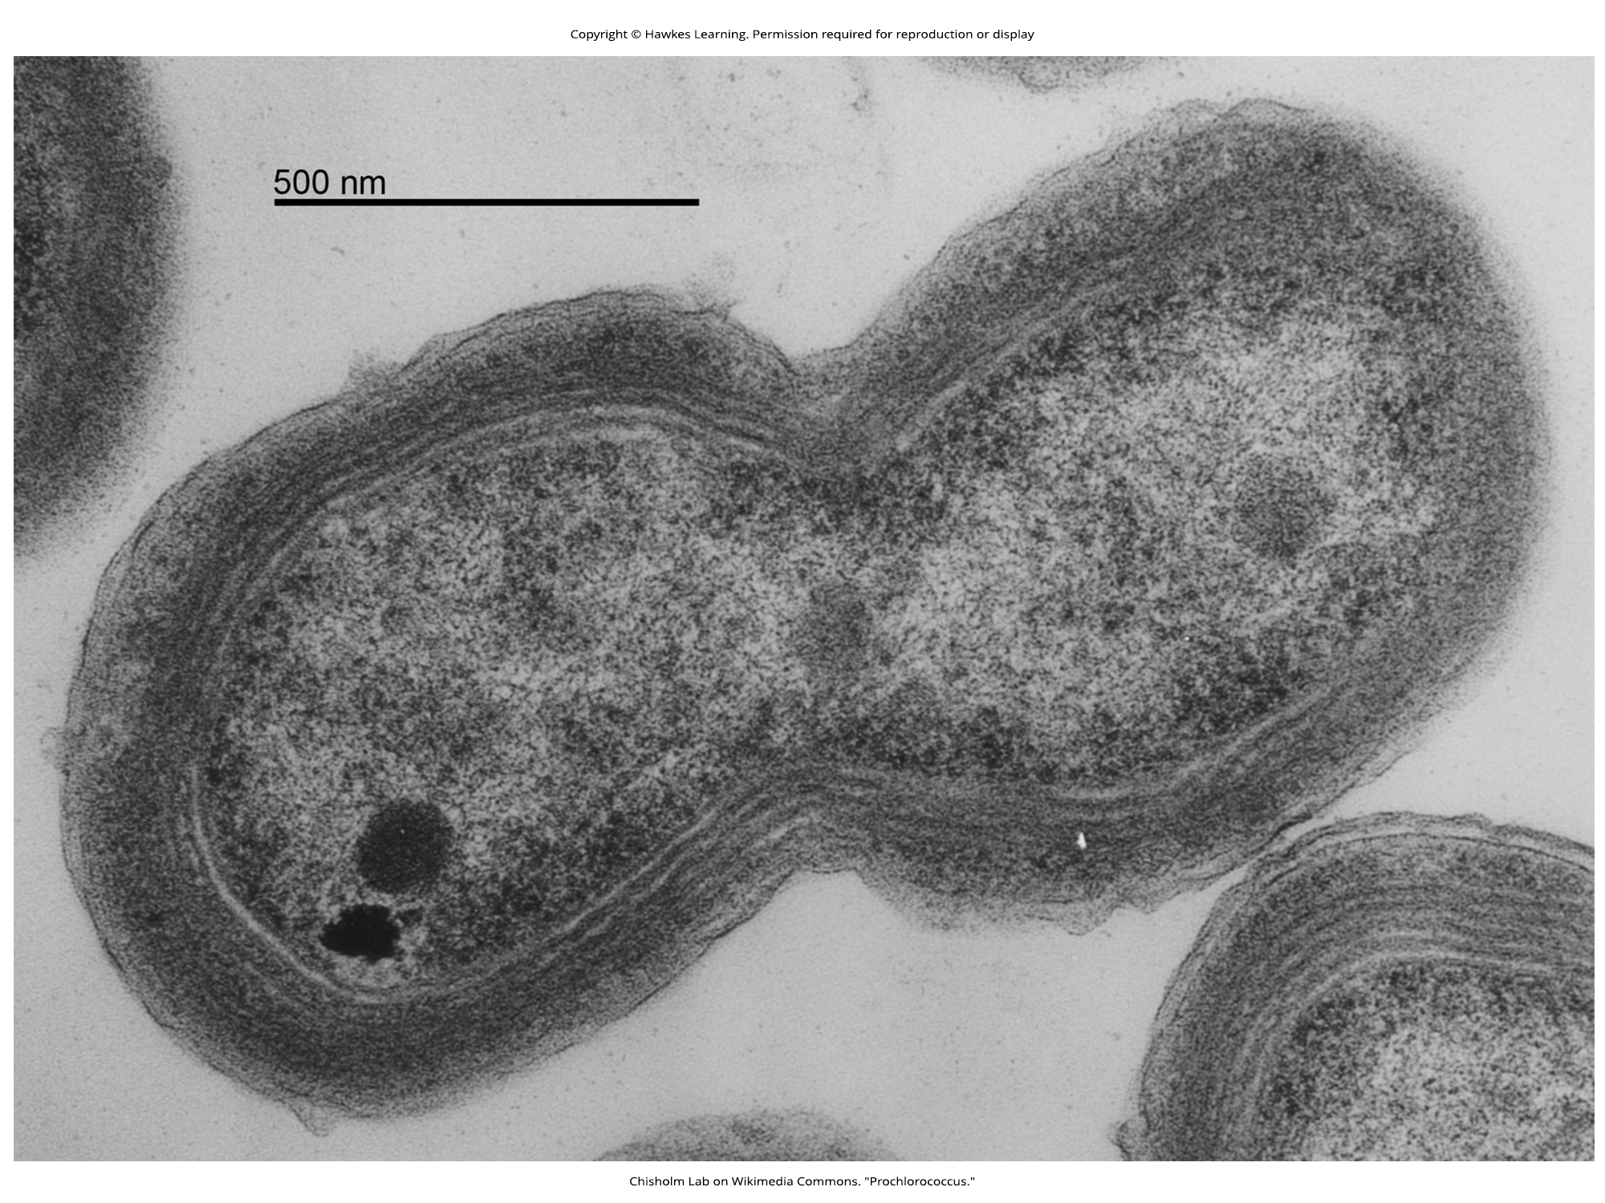
Lesson 10.4 Figure 1

Slide 23
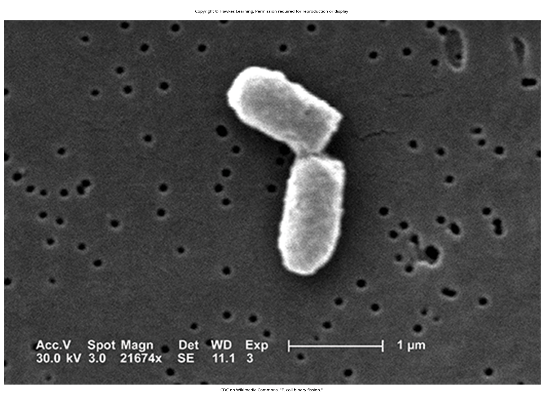
Lesson 10.4 Figure 2

Slide 24
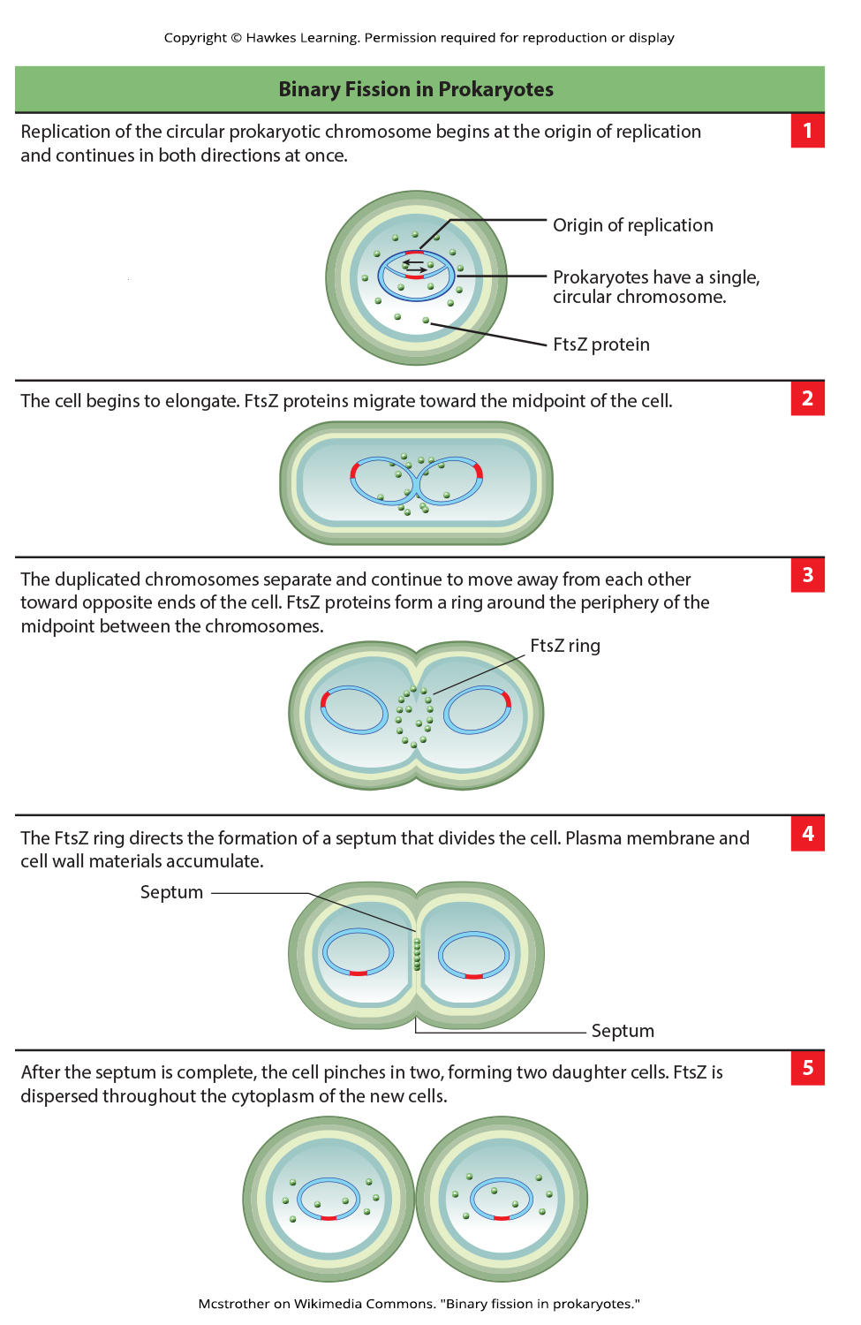
Lesson 10.4 Figure 3

Slide 25
Hawkes Learning – End of PowerPoint

