Slide 1
Section 8.1
Estimating Population Means (Sigma Known)

Slide 2
Point Estimate
Definition
A point estimate is a single-number estimate of a population parameter.

Slide 3
Unbiased Estimator
Definition
An unbiased estimator is a point estimate that does not consistently underestimate or overestimate the population parameter.

Slide 4
Example 8.1.1: Finding a Point Estimate for a Population Mean
Find the best point estimate for the population mean of test scores on a standardized biology final exam. The following is a simple random sample taken from the population of test scores.

Slide 5
Example 8.1.1: Finding a Point Estimate for a Population Mean (cont.)
45 | 68 | 72 | 91 | 100 | 71
69 | 83 | 86 | 55 | 89 | 97
76 | 68 | 92 | 75 | 84 | 70
81 | 90 | 85 | 74 | 88 | 99
76 | 91 | 93 | 85 | 96 | 100

Slide 6
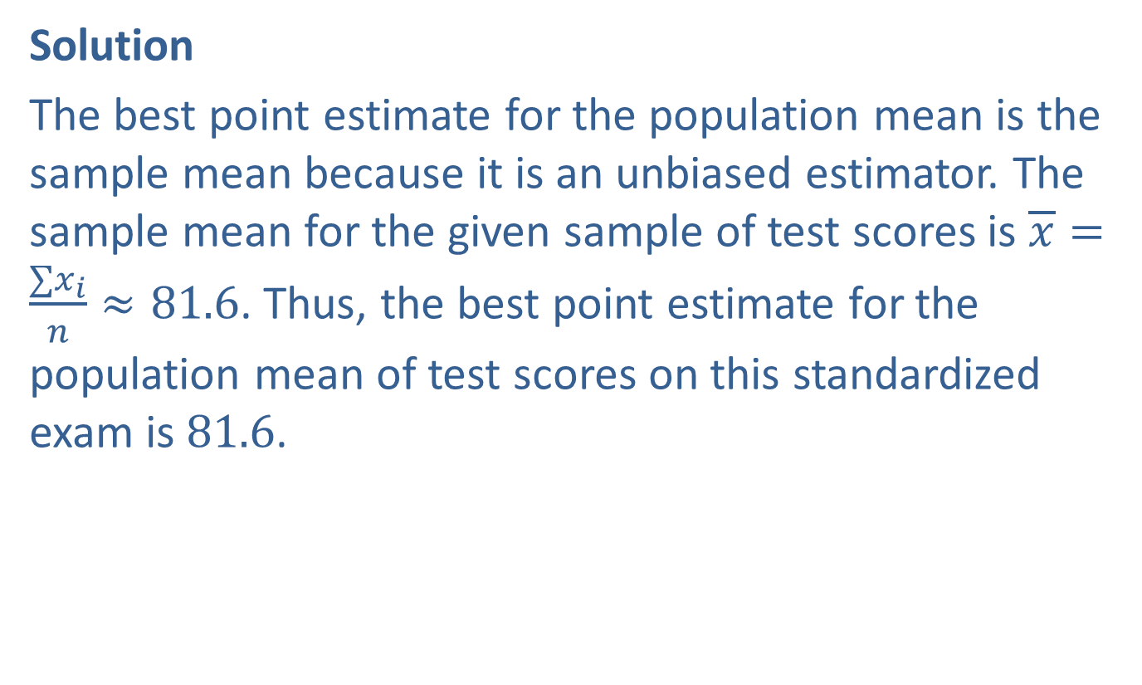
Example 8.1.1: Finding a Point Estimate for a Population Mean (cont.)
Solution
The best point estimate for the population mean is the sample mean because it is an unbiased estimator. The sample mean for the given sample of test scores is $\overline{x}=\frac{∑x_{i}}{n}≈81.6$. Thus, the best point estimate for the population mean of test scores on this standardized exam is 81.6.

Slide 7
The Father of Confidence Intervals: Jerzy Neyman (1894–1981)
Jerzy Neyman grew up in Poland. However, a significant part of Poland was under Russian control during his youth and Neyman received his training in mathematics in Russia.
In her book Neyman-from life, Constance Reid attributes the development of the confidence interval to Jerzy Neyman.
"During the years 1934–38 Neyman made four fundamental contributions to the science of Statistics. Each of them would have been sufficient to establish an international reputation, both for their immediate effect and for the impetus which the new ideas and methods had on the thinking of young and old alike. He put forward the theory of confidence intervals, the importance of which in statistical theory and analysis of data cannot be overemphasized. His contribution to the theory of contagious distributions is still of great utility in the interpretation of biological data. His paper on sampling stratified populations paved the way for a statistical theory which, among other things, gave us the Gallup poll. [His] work, and that of Fisher, each with a different model for randomized experiments, led to the whole new field of experimentation so much used in agriculture, biology, medicine, and physical sciences."

Slide 8
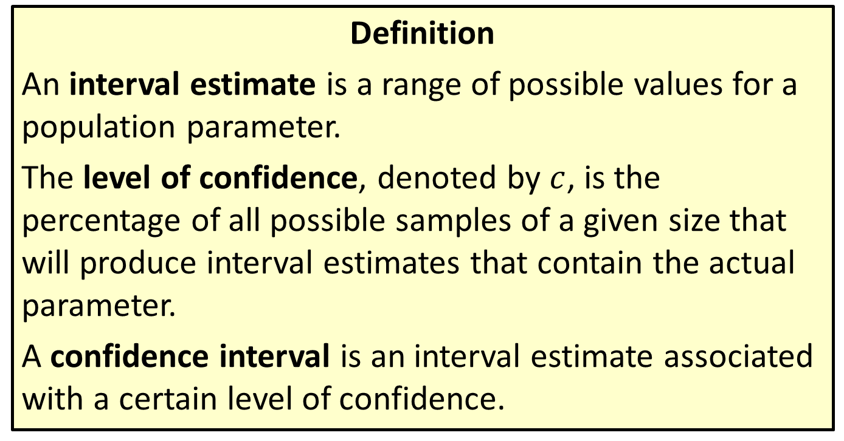
Interval Estimate, Level Of Confidence & Confidence Interval
Definition
An interval estimate is a range of possible values for a population parameter.
The level of confidence, denoted by $c$, is the percentage of all possible samples of a given size that will produce interval estimates that contain the actual parameter.
A confidence interval is an interval estimate associated with a certain level of confidence.

Slide 9
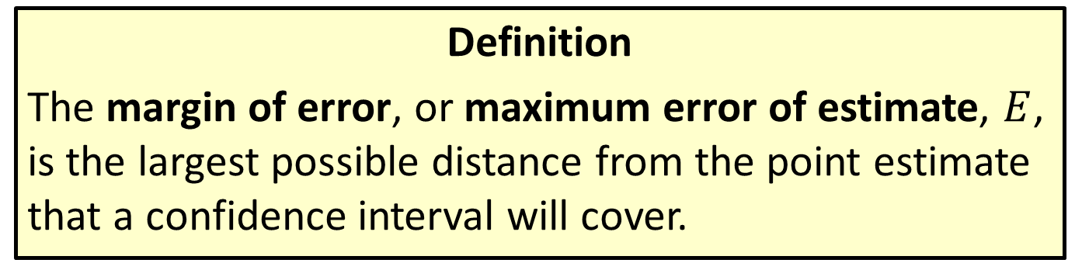
Margin Of Error
Definition
The margin of error, or maximum error of estimate, $E$, is the largest possible distance from the point estimate that a confidence interval will cover.

Slide 10
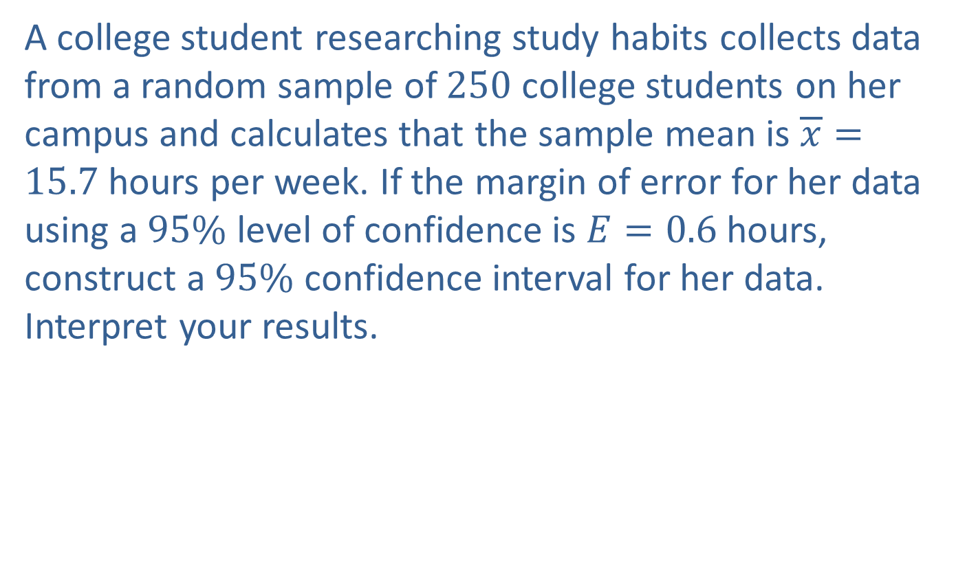
Example 8.1.2: Constructing a Confidence Interval with a Given Margin of Error
A college student researching study habits collects data from a random sample of 250 college students on her campus and calculates that the sample mean is $\overline{x}=15.7$ hours per week. If the margin of error for her data using a $95\%$ level of confidence is $E=0.6$ hours, construct a $95\%$ confidence interval for her data. Interpret your results.

Slide 11
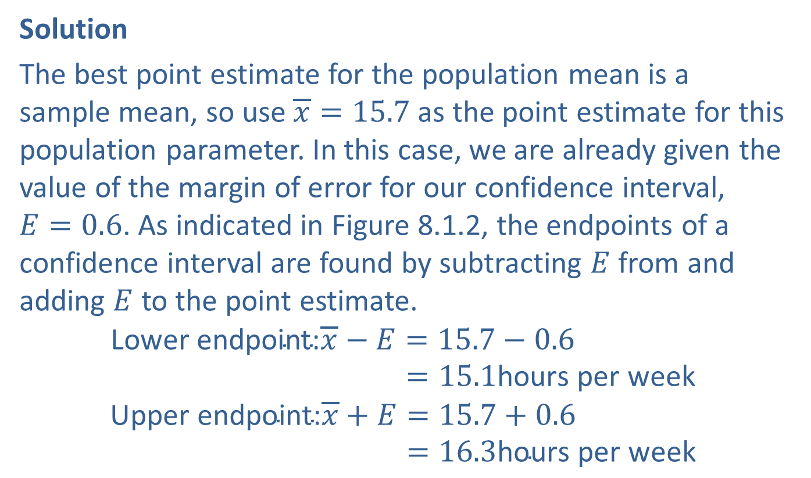
Example 8.1.2: Constructing a Confidence Interval with a Given Margin of Error (cont.)
Solution
The best point estimate for the population mean is a sample mean, so use $\overline{x}=15.7$ as the point estimate for this population parameter. In this case, we are already given the value of the margin of error for our confidence interval, $E=0.6$. As indicated in Figure 8.1.2, the endpoints of a confidence interval are found by subtracting $E$ from and adding $E$ to the point estimate.
Lower endpoint:𝑥−𝐸=15.7−0.6Lower endpoint:𝑥−𝐸=15.1hours per week
Upper endpoint:𝑥+𝐸=15.7+0.6Upper endpoint:𝑥+𝐸=16.3hours per week

Slide 12
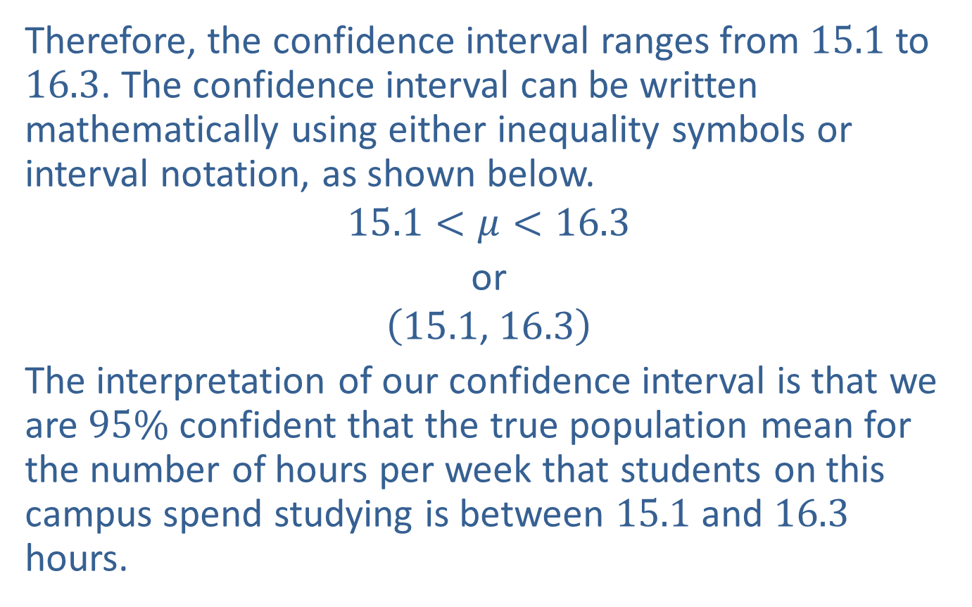
Example 8.1.2: Constructing a Confidence Interval with a Given Margin of Error (cont.)
Therefore, the confidence interval ranges from 15.1 to 16.3. The confidence interval can be written mathematically using either inequality symbols or interval notation, as shown below.
$$15.1<μ<16.3$$
or
$$\left(15.1\text{, }16.3\right)$$
The interpretation of our confidence interval is that we are $95\%$ confident that the true population mean for the number of hours per week that students on this campus spend studying is between 15.1 and 16.3 hours.

Slide 13
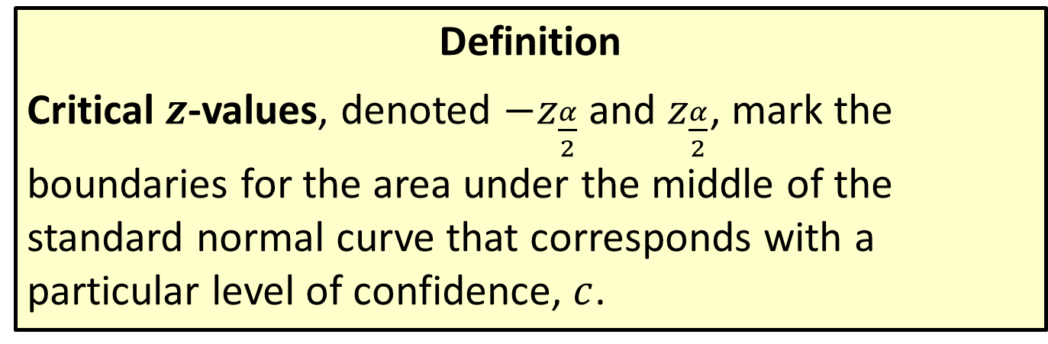
Critical z-Values
Definition
Critical $z$-values, denoted ${−z}_{\frac{α}{2}}$ and $z_{\frac{α}{2}}$, mark the boundaries for the area under the middle of the standard normal curve that corresponds with a particular level of confidence, $c$.

Slide 14
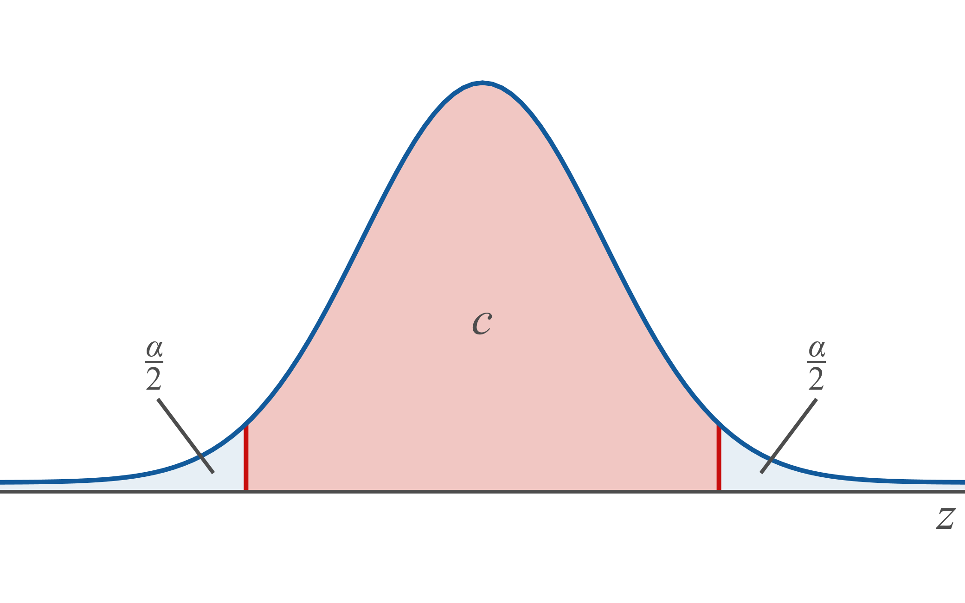

Memory Booster (cont.)
$c$ is the complement of $α$.

Slide 15
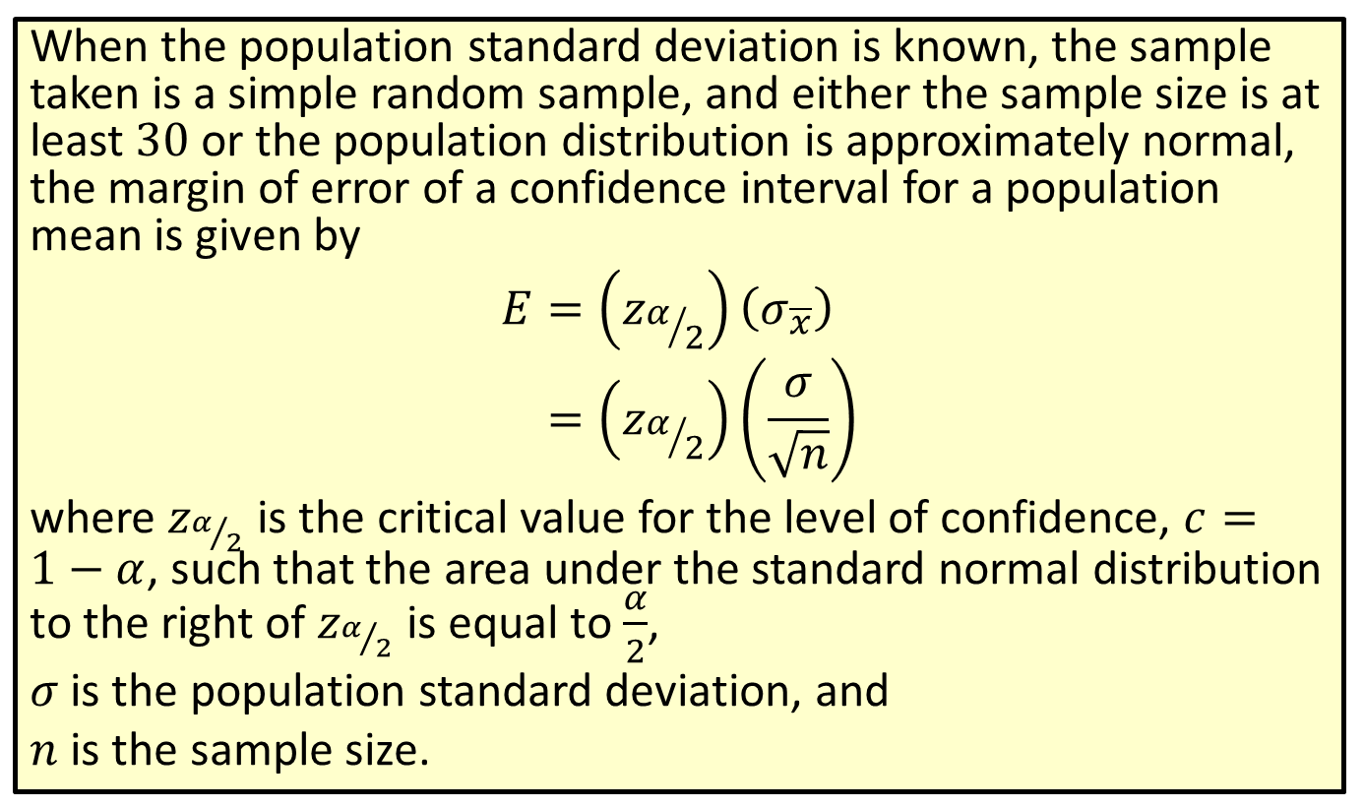

Formula: Margin of Error of a Confidence Interval for a Population Mean ($σ$ Known)
When the population standard deviation is known, the sample taken is a simple random sample, and either the sample size is at least 30 or the population distribution is approximately normal, the margin of error of a confidence interval for a population mean is given by
𝐸=𝑧𝛼2𝜎𝑥𝐸=𝑧𝛼2𝜎𝑛
where $z_{α/2}$ is the critical value for the level of confidence, $c=1−α$, such that the area under the standard normal distribution to the right of $z_{α/2}$ is equal to $\frac{α}{2}$,
$σ$ is the population standard deviation, and
$n$ is the sample size.

Slide 16
Rounding Rule
When calculating a margin of error for a confidence interval, round to at least six decimal places to avoid additional rounding errors in the subsequent calculations of the endpoints of the confidence interval.

Slide 17
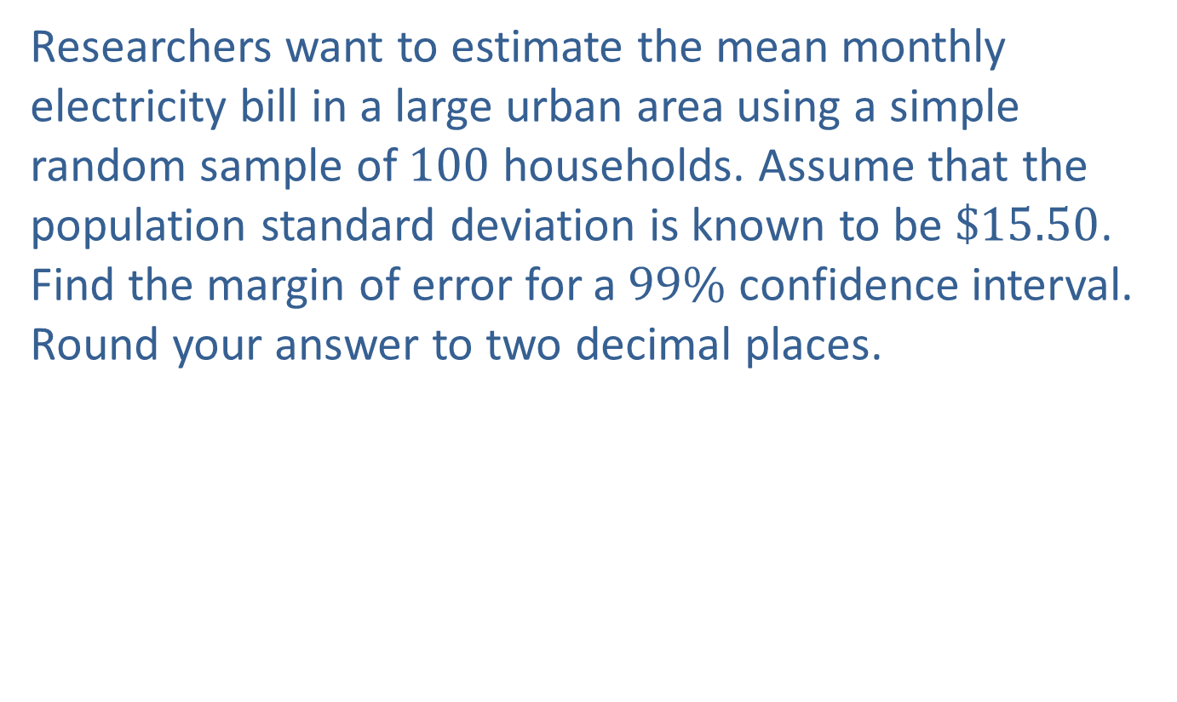
Example 8.1.3: Finding the Margin of Error of a Confidence Interval for a Population Mean (σ Known)
Researchers want to estimate the mean monthly electricity bill in a large urban area using a simple random sample of 100 households. Assume that the population standard deviation is known to be $\$15.50$. Find the margin of error for a $99\%$ confidence interval. Round your answer to two decimal places.

Slide 18
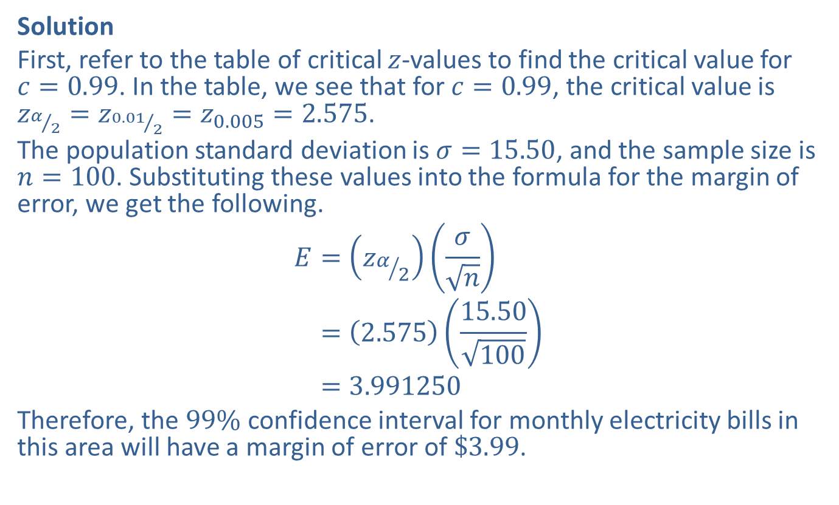
Example 8.1.3: Finding the Margin of Error of a Confidence Interval for a Population Mean (σ Known) (cont.)
Solution
First, refer to the table of critical $z$-values to find the critical value for $c=0.99$. In the table, we see that for $c=0.99$, the critical value is $z_{α/2}=z_{{0.01}/2}=z_{0.005}=2.575$.
The population standard deviation is $σ=15.50$, and the sample size is $n=100$. Substituting these values into the formula for the margin of error, we get the following.
𝐸=𝑧𝛼2𝜎𝑛𝐸=2.57515.50100𝐸=3.991250
Therefore, the $99\%$ confidence interval for monthly electricity bills in this area will have a margin of error of $\$3.99$.

Slide 19
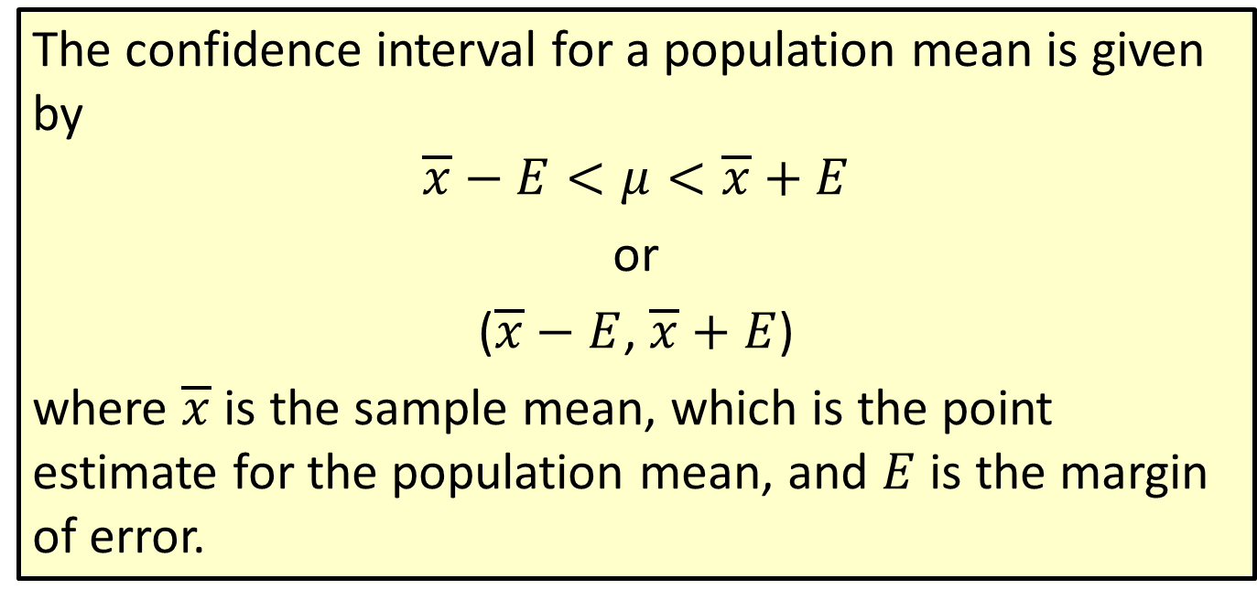
Formula: Confidence Interval for a Population Mean
The confidence interval for a population mean is given by
$$\overline{x}−E<μ<\overline{x}+E$$
or
($\overline{x}−E$, $\overline{x}+E$)
where $\overline{x}$ is the sample mean, which is the point estimate for the population mean, and $E$ is the margin of error.

Slide 20
Rounding Rule
Round the endpoints of a confidence interval for a population mean as follows:
​If sample data are given, round to one more decimal place than the largest number of decimal places in the given data.
​If statistics are given, round to the same number of decimal places as given in the standard deviation or variance.

Slide 21
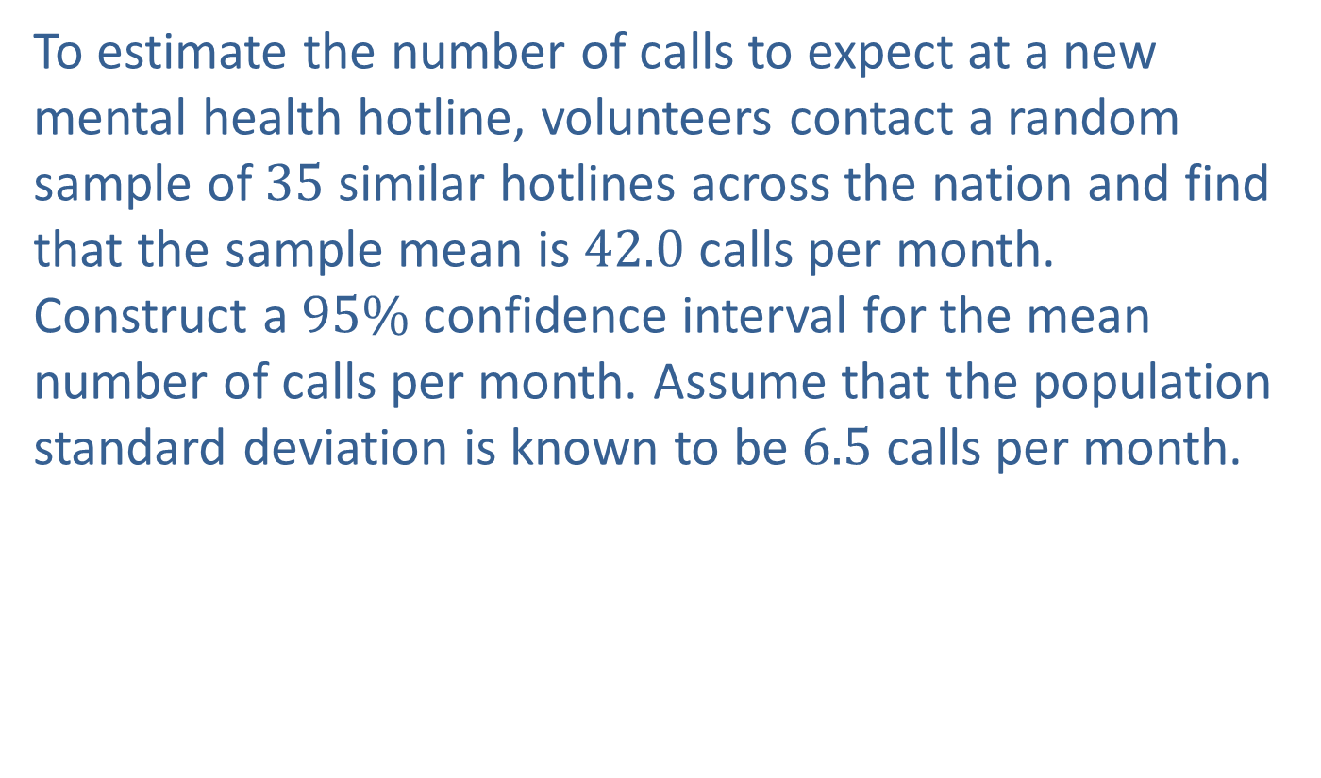
Example 8.1.4: Constructing a Confidence Interval for a Population Mean (σ Known)
To estimate the number of calls to expect at a new mental health hotline, volunteers contact a random sample of 35 similar hotlines across the nation and find that the sample mean is 42.0 calls per month. Construct a $95\%$ confidence interval for the mean number of calls per month. Assume that the population standard deviation is known to be 6.5 calls per month.

Slide 22
Example 8.1.4: Constructing a Confidence Interval for a Population Mean (σ Known) (cont.)
Solution
Step 1: Find the point estimate.
The point estimate for a population mean is the sample mean. In this example, the sample mean is given to us as 42.0 calls per month.

Slide 23
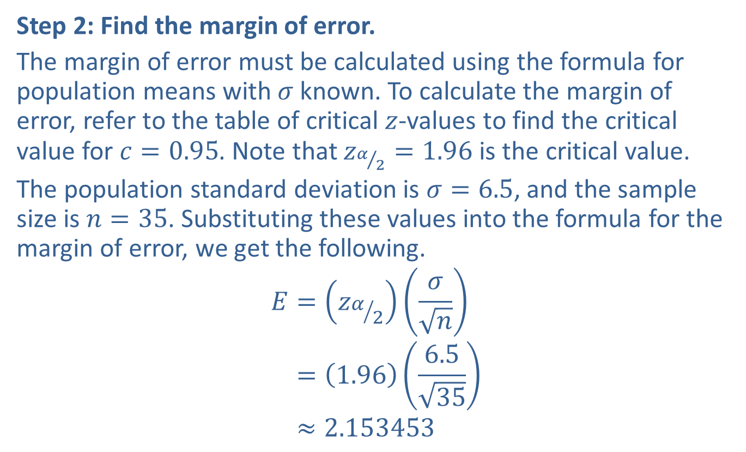
Example 8.1.4: Constructing a Confidence Interval for a Population Mean (σ Known) (cont.)
Step 2: Find the margin of error.
The margin of error must be calculated using the formula for population means with $σ$ known. To calculate the margin of error, refer to the table of critical $z$-values to find the critical value for $c=0.95$. Note that $z_{α/2}=1.96$ is the critical value.
The population standard deviation is $σ=6.5$, and the sample size is $n=35$. Substituting these values into the formula for the margin of error, we get the following.
𝐸=𝑧𝛼2𝜎𝑛𝐸=1.966.535𝐸≈2.153453

Slide 24
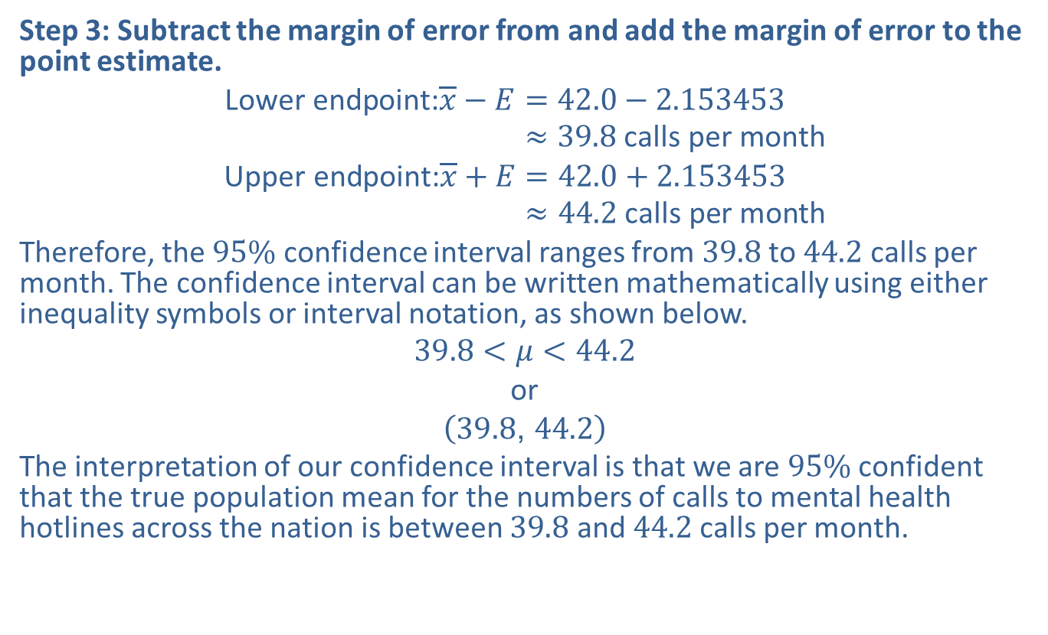
Example 8.1.4: Constructing a Confidence Interval for a Population Mean (σ Known) (cont.)
Step 3: Subtract the margin of error from and add the margin of error to the point estimate.
Lower endpoint:𝑥−𝐸=42.0−2.153453Lower endpoint:𝑥−𝐸≈39.8 calls per month
Upper endpoint:𝑥+𝐸=42.0+2.153453Upper endpoint:𝑥+𝐸≈44.2 calls per month
Therefore, the $95\%$ confidence interval ranges from 39.8 to 44.2 calls per month. The confidence interval can be written mathematically using either inequality symbols or interval notation, as shown below.
$$39.8<μ<44.2$$
or
$$\left(39.8\text{, }44.2\right)$$
The interpretation of our confidence interval is that we are $95\%$ confident that the true population mean for the numbers of calls to mental health hotlines across the nation is between 39.8 and 44.2 calls per month.

Slide 25
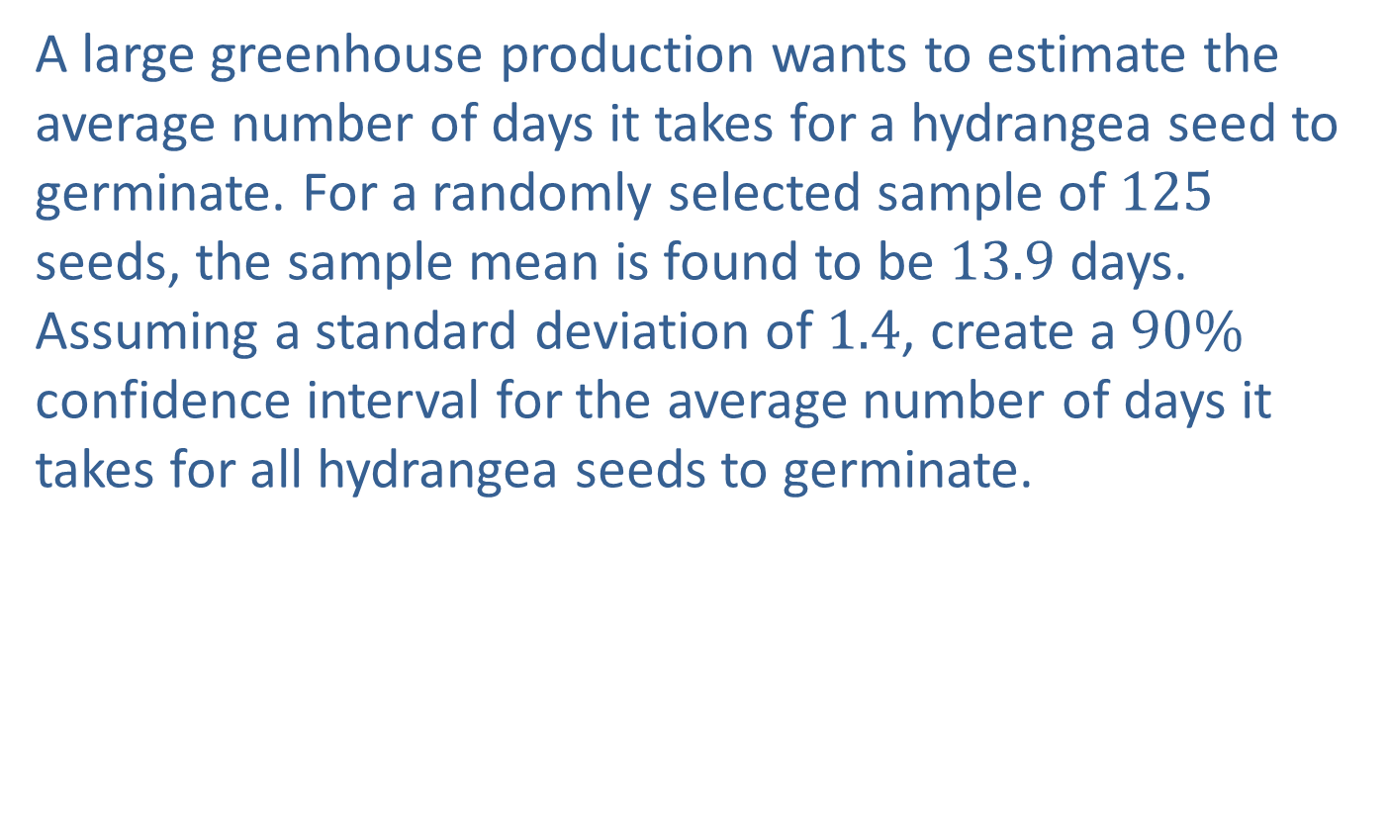
Example 8.1.5: Constructing a Confidence Interval for a Population Mean (σ Known)
A large greenhouse production wants to estimate the average number of days it takes for a hydrangea seed to germinate. For a randomly selected sample of 125 seeds, the sample mean is found to be 13.9 days. Assuming a standard deviation of 1.4, create a $90\%$ confidence interval for the average number of days it takes for all hydrangea seeds to germinate.

Slide 26
Example 8.1.5: Constructing a Confidence Interval for a Population Mean (σ Known) (cont.)
Solution
Step 1: Find the point estimate.
The point estimate for the population mean is the sample mean, which we are told is 13.4 days.

Slide 27
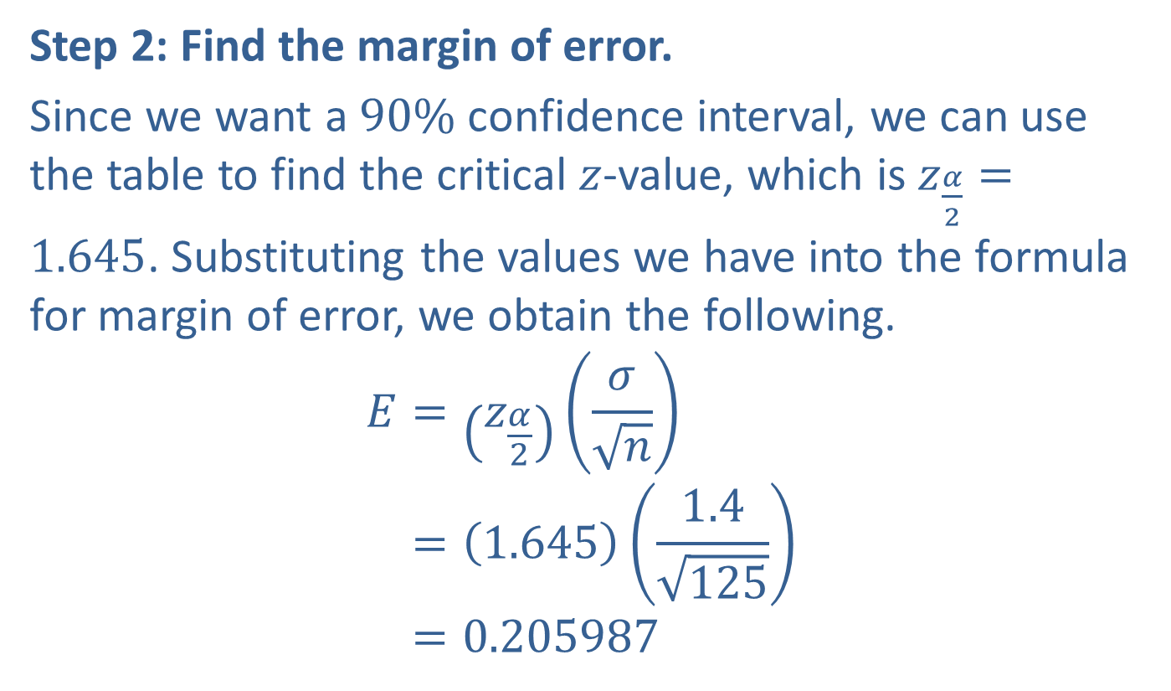
Example 8.1.5: Constructing a Confidence Interval for a Population Mean (σ Known) (cont.)
Step 2: Find the margin of error.
Since we want a $90\%$ confidence interval, we can use the table to find the critical $z$-value, which is $z_{\frac{α}{2}}=1.645$. Substituting the values we have into the formula for margin of error, we obtain the following.
𝐸=𝑧𝛼2𝜎𝑛𝐸=1.6451.4125𝐸=0.205987

Slide 28
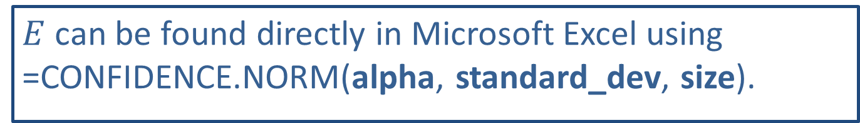
Technology Tip
$E$ can be found directly in Microsoft Excel using =CONFIDENCE.NORM(alpha, standard_dev, size).

Slide 29
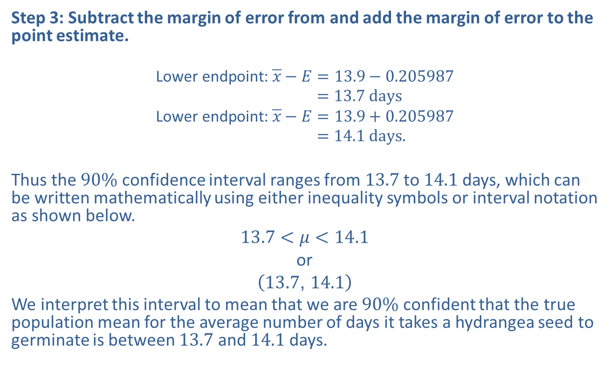
Example 8.1.5: Constructing a Confidence Interval for a Population Mean (σ Known) (cont.)
Step 3: Subtract the margin of error from and add the margin of error to the point estimate.
Lower endpoint: 𝑥−𝐸=13.9−0.205987Lower endpoint:𝑥−𝐸 =13.7 days
Lower endpoint: 𝑥−𝐸=13.9+0.205987Lower endpoint:𝑥−𝐸 =14.1 days.
Thus the $90\%$ confidence interval ranges from 13.7 to 14.1 days, which can be written mathematically using either inequality symbols or interval notation as shown below.
$$13.7<μ<14.1$$
or
$$\left(13.7\text{, }14.1\right)$$
We interpret this interval to mean that we are $90\%$ confident that the true population mean for the average number of days it takes a hydrangea seed to germinate is between 13.7 and 14.1 days.

Slide 30
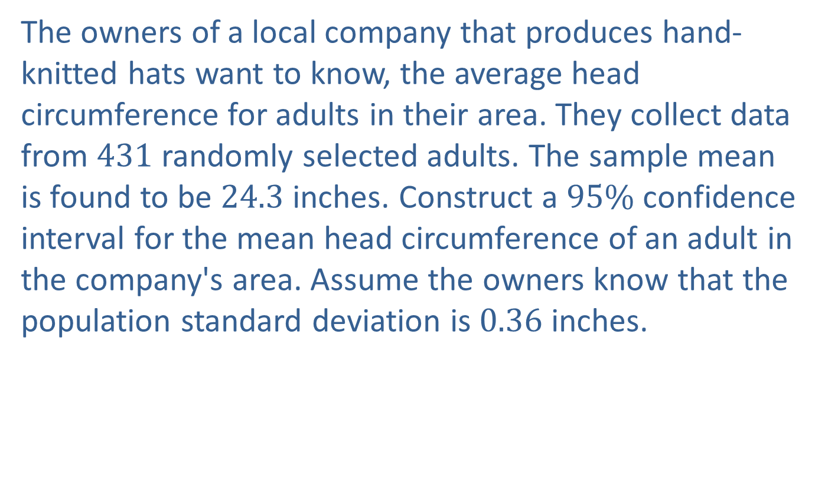
Example 8.1.6: Using a TI-83/84 Plus Calculator to Find a Confidence Interval for a Population Mean (σ Known)
The owners of a local company that produces hand-knitted hats want to know, the average head circumference for adults in their area. They collect data from 431 randomly selected adults. The sample mean is found to be 24.3 inches. Construct a $95\%$ confidence interval for the mean head circumference of an adult in the company's area. Assume the owners know that the population standard deviation is 0.36 inches.

Slide 31
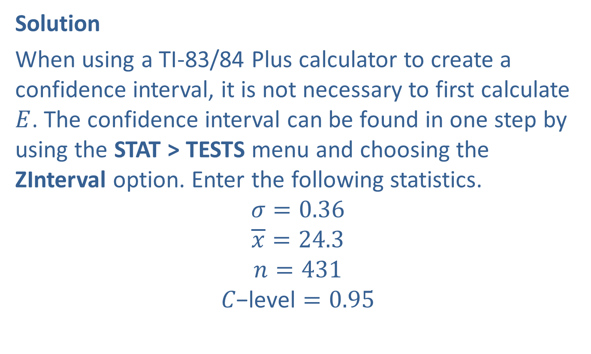
Example 8.1.6: Using a TI-83/84 Plus Calculator to Find a Confidence Interval for a Population Mean (σ Known) (cont.)
Solution
When using a TI-83/84 Plus calculator to create a confidence interval, it is not necessary to first calculate $E$. The confidence interval can be found in one step by using the STAT > TESTS menu and choosing the ZInterval option. Enter the following statistics.
$$σ=0.36$$
$$\overline{x}=24.3$$
$$n=431$$
$$C\text{−}\text{level}=0.95$$

Slide 32
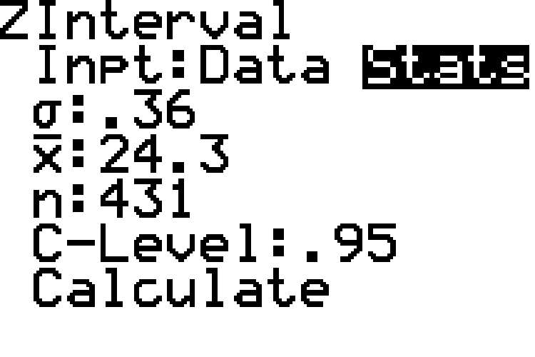
Example 8.1.6: Using a TI-83/84 Plus Calculator to Find a Confidence Interval for a Population Mean (σ Known) (cont.)

Slide 33
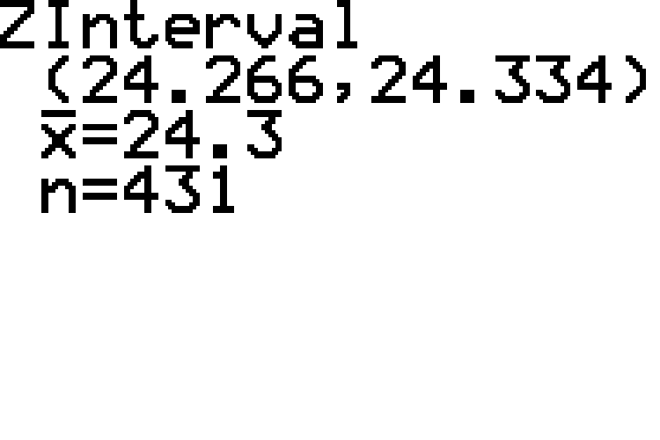
Example 8.1.6: Using a TI-83/84 Plus Calculator to Find a Confidence Interval for a Population Mean (σ Known) (cont.)

Slide 34
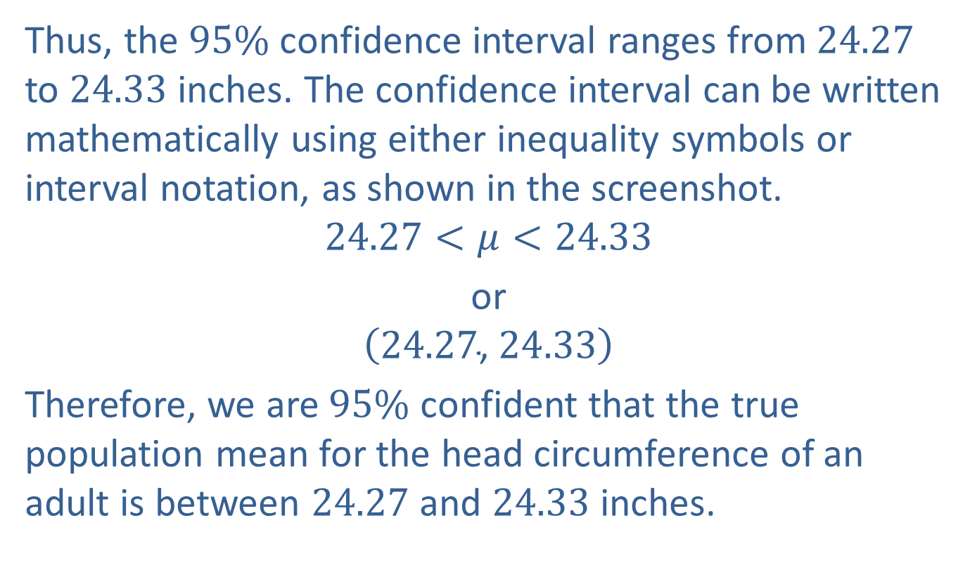
Example 8.1.6: Using a TI-83/84 Plus Calculator to Find a Confidence Interval for a Population Mean (σ Known) (cont.)
Thus, the $95\%$ confidence interval ranges from 24.27 to 24.33 inches. The confidence interval can be written mathematically using either inequality symbols or interval notation, as shown in the screenshot.
$$24.27<μ<24.33$$
or
$$\left(24.27\text{, }24.33\right)$$
Therefore, we are $95\%$ confident that the true population mean for the head circumference of an adult is between 24.27 and 24.33 inches.

Slide 35
Technology Tip
For further instructions on constructing the confidence interval using a TI-83/84 Plus calculator or other technology, please visit stat.hawkeslearning.com and navigate to Technology Instructions > Confidence Intervals > z-Interval.

Slide 36
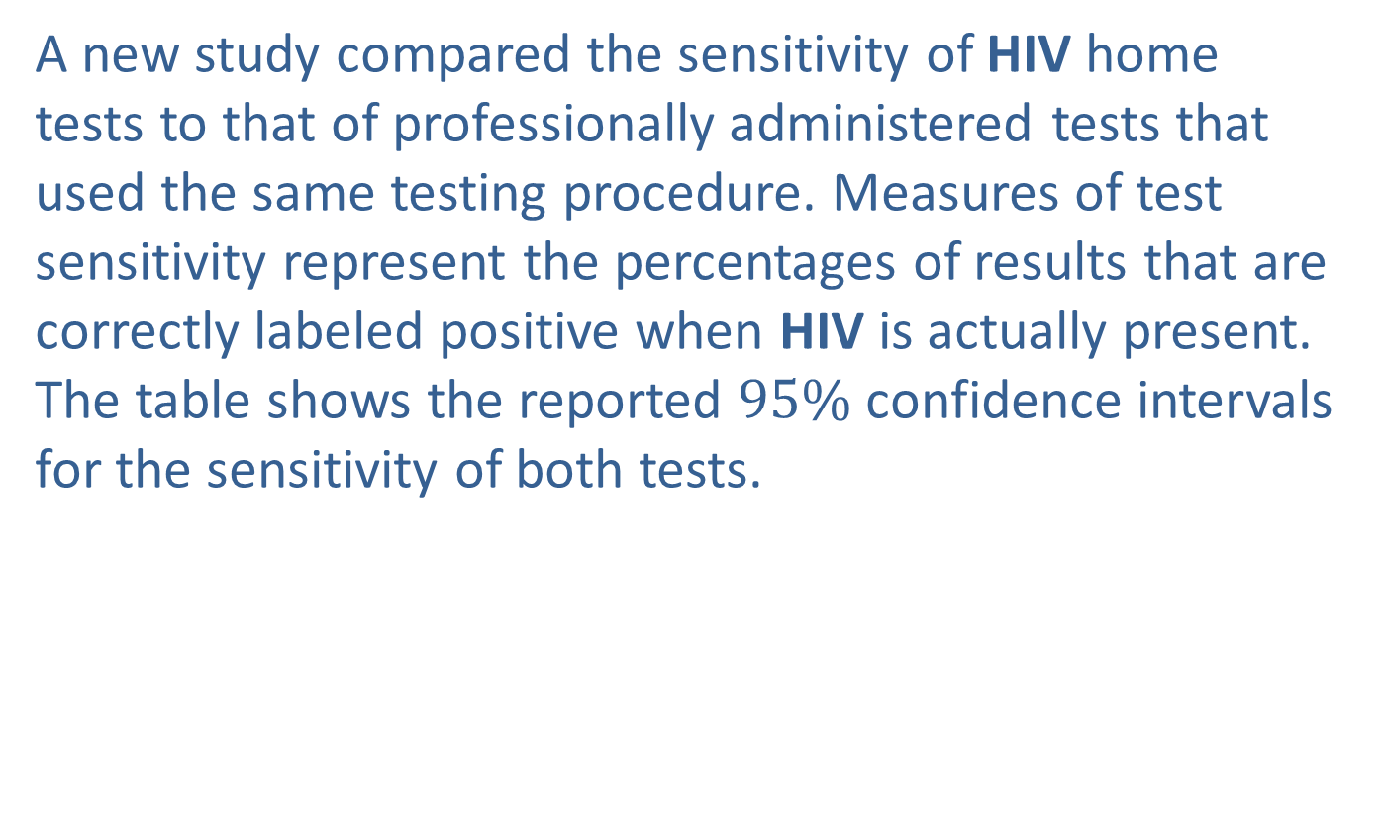
Example 8.1.7: Interpreting a Confidence Interval
A new study compared the sensitivity of HIV home tests to that of professionally administered tests that used the same testing procedure. Measures of test sensitivity represent the percentages of results that are correctly labeled positive when HIV is actually present. The table shows the reported $95\%$ confidence intervals for the sensitivity of both tests.

Slide 37
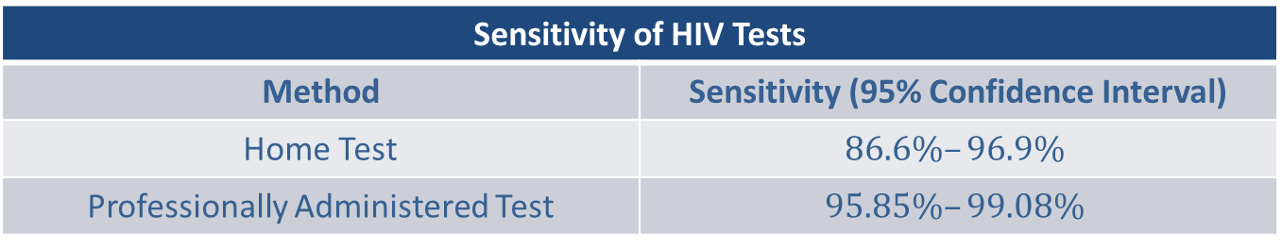
Example 8.1.7: Interpreting a Confidence Interval (cont.)
Sensitivity of HIV Tests
Method | Sensitivity (95% Confidence Interval)
Home Test | $$86.6\%–96.9\%$$
Professionally Administered Test | $$95.85\%–99.08\%$$

Slide 38
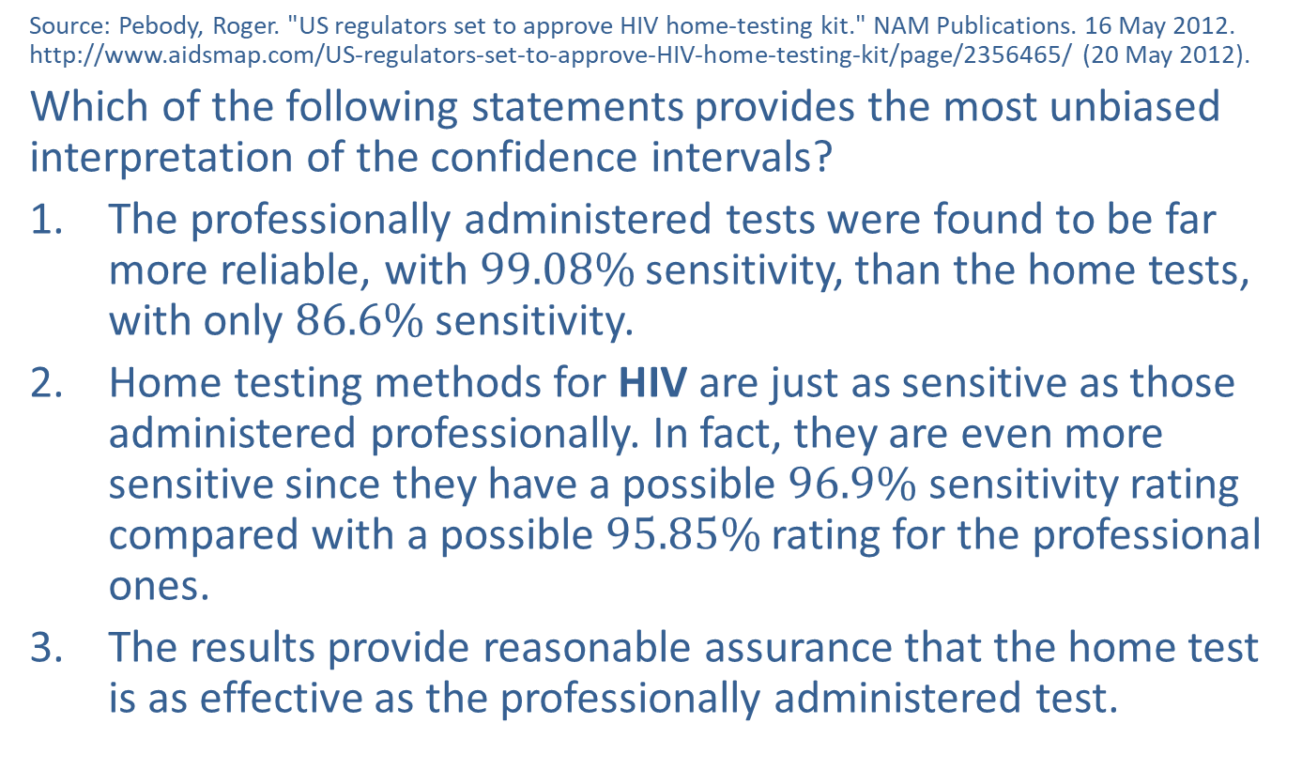
Example 8.1.7: Interpreting a Confidence Interval (cont.)
Source: Pebody, Roger. "US regulators set to approve HIV home-testing kit." NAM Publications. 16 May 2012. http://www.aidsmap.com/US-regulators-set-to-approve-HIV-home-testing-kit/page/2356465/ (20 May 2012).
Which of the following statements provides the most unbiased interpretation of the confidence intervals?
​The professionally administered tests were found to be far more reliable, with $99.08\%$ sensitivity, than the home tests, with only $86.6\%$ sensitivity.
​Home testing methods for HIV are just as sensitive as those administered professionally. In fact, they are even more sensitive since they have a possible $96.9\%$ sensitivity rating compared with a possible $95.85\%$ rating for the professional ones.
​The results provide reasonable assurance that the home test is as effective as the professionally administered test.

Slide 39
Example 8.1.7: Interpreting a Confidence Interval (cont.)
Solution
Option 3. gives the best interpretation of the confidence intervals given. Because the confidence intervals overlap, it is possible that both tests have the same sensitivity rating, and therefore can provide a reasonable assurance that they are similarly accurate. This was, in fact, a part of the findings that the expert panel reported to the Food and Drug Administration (FDA) in the United States.
Option 1. does not give a fair picture of the results by only providing the upper endpoint of the confidence interval for the professional tests compared to the lower endpoint of the interval for the home tests. This analysis might lead you to believe that there was definitely a large difference between the sensitivity ratings for the two tests. It does not reflect the possibility that the sensitivity ratings did not differ at all.
Option 2. is similar to option i. in that, by giving the upper endpoint of the home test interval compared to the lower endpoint of the professional test interval, one is led to believe that the home tests are out-performing the professional tests. It also does not account for the fact that it is possible for the professional tests to have a much higher sensitivity than the home tests.

Slide 40
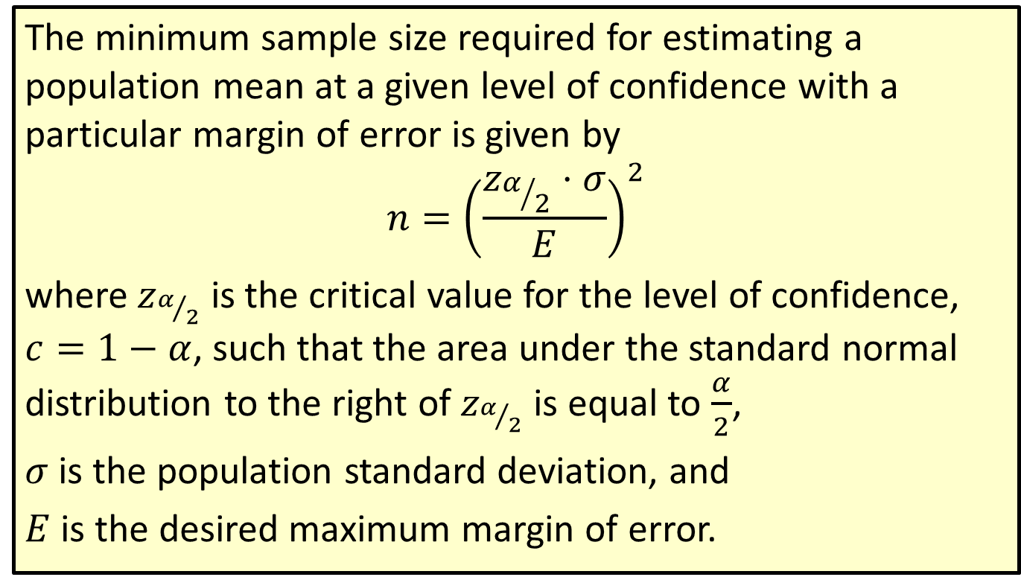
Formula: Minimum Sample Size for Estimating a Population Mean
The minimum sample size required for estimating a population mean at a given level of confidence with a particular margin of error is given by
$$n={\left(\frac{z_{α/2}⋅σ}{E}\right)}^{2}$$
where $z_{α/2}$ is the critical value for the level of confidence, $c=1−α$, such that the area under the standard normal distribution to the right of $z_{α/2}$ is equal to $\frac{α}{2}$,
$σ$ is the population standard deviation, and
$E$ is the desired maximum margin of error.

Slide 41
Rounding Rule
When calculating a minimum sample size, round up to the next larger whole number.

Slide 42
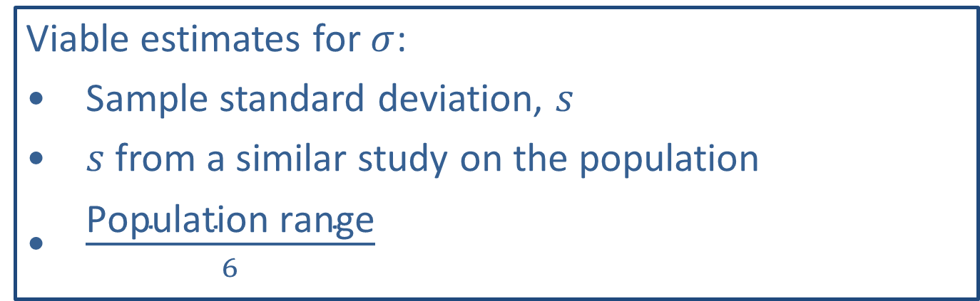
Memory Booster
Viable estimates for $σ$:
​Sample standard deviation, $s$
​$s$ from a similar study on the population
​$\frac{\text{Population} \text{range}}{6}$

Slide 43

Example 8.1.8: Finding the Minimum Sample Size Needed for a Confidence Interval for a Population Mean
Determine the minimum sample size needed if we wish to be $90\%$ confident that the sample mean is within two units of the population mean. An estimate for the population standard deviation of 8.4 is available from a previous study.

Slide 44
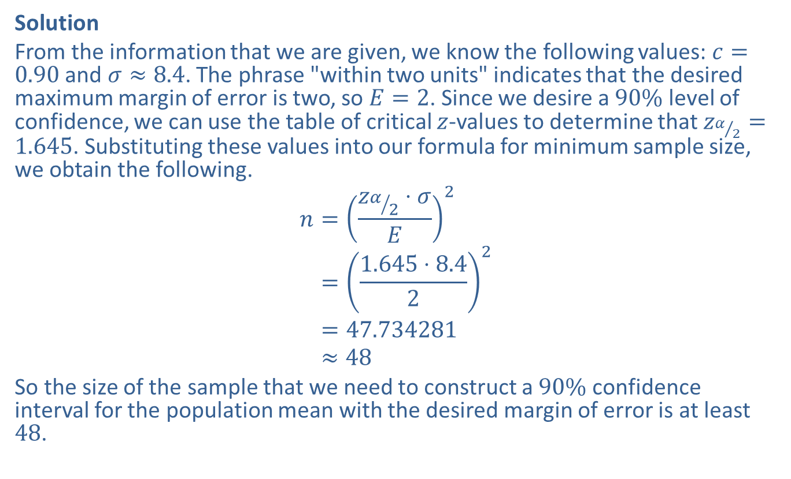
Example 8.1.8: Finding the Minimum Sample Size Needed for a Confidence Interval for a Population Mean (cont.)
Solution
From the information that we are given, we know the following values: $c=0.90$ and $σ≈8.4$. The phrase "within two units" indicates that the desired maximum margin of error is two, so $E=2$. Since we desire a $90\%$ level of confidence, we can use the table of critical $z$-values to determine that $z_{α/2}=1.645$. Substituting these values into our formula for minimum sample size, we obtain the following.
𝑛=𝑧𝛼2⋅𝜎𝐸2𝑛=1.645⋅8.422𝑛=47.734281𝑛≈48
So the size of the sample that we need to construct a $90\%$ confidence interval for the population mean with the desired margin of error is at least 48.

