Slide 1
Section 6.4
Finding Values of a Normally Distributed Random Variable

Slide 2
Memory Booster₁
Not sure about your answer? Draw a sketch to make sure your answer makes sense.

Slide 3
Caution
Careful! If the problem asks for a z-score, then the answer should come from the edges of the table, not the middle.

Slide 4
Example 6.4.1: Finding the z-value with a Given Area to Its Left₁
What z-value has an area of 0.7357 to its left? Round to 2 decimal places.

Slide 5
Example 6.4.1: Finding the z-value with a Given Area to Its Left₂
Solution
In order to sketch a graph of where the area under the curve lies, we need to shade under more than half of the curve because 0.7357 > 0.5. Therefore, we know that the z-value will be a positive number.

Slide 6
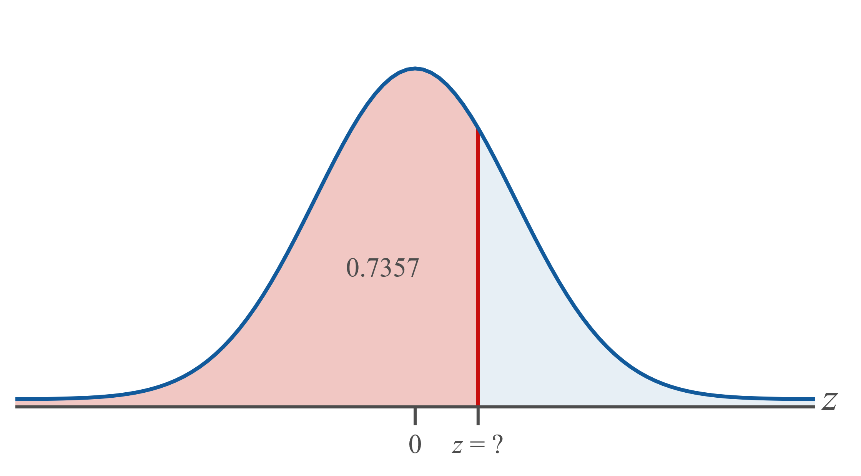
Example 6.4.1: Finding the z-value with a Given Area to Its Left₃

Slide 7
Example 6.4.1: Finding the z-value with a Given Area to Its Left₄
Tables:
Scan through the interior of the standard normal table for area −∞ to z for an area of 0.7357. Look to the left and up to find the corresponding z-value. Looking at the row and column titles, you will see that z = 0.63.

Slide 8
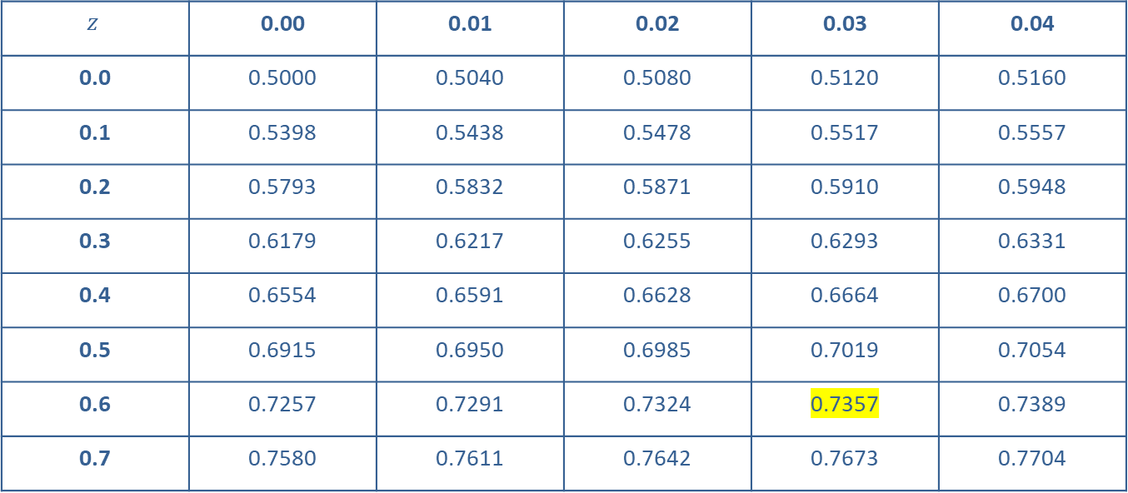
Example 6.4.1: Finding the z-value with a Given Area to Its Left₅
$$z$$ | 0.00 | 0.01 | 0.02 | 0.03 | 0.04
0.0 | 0.5000 | 0.5040 | 0.5080 | 0.5120 | 0.5160
0.1 | 0.5398 | 0.5438 | 0.5478 | 0.5517 | 0.5557
0.2 | 0.5793 | 0.5832 | 0.5871 | 0.5910 | 0.5948
0.3 | 0.6179 | 0.6217 | 0.6255 | 0.6293 | 0.6331
0.4 | 0.6554 | 0.6591 | 0.6628 | 0.6664 | 0.6700
0.5 | 0.6915 | 0.6950 | 0.6985 | 0.7019 | 0.7054
0.6 | 0.7257 | 0.7291 | 0.7324 | 0.7357 | 0.7389
0.7 | 0.7580 | 0.7611 | 0.7642 | 0.7673 | 0.7704

Slide 9
Technology Tip₁
When finding area under a normal curve, use
normal cdf.
When finding a z-score or raw score, use invNorm.

Slide 10
Example 6.4.1: Finding the z-value with a Given Area to Its Left₆
TI-83/84 Plus:
The calculator function invNorm (inverse normal probability distribution function) will calculate a specific cutoff point on any normal curve for a given area under the curve. The calculator asks for the area (probability), mean, and standard deviation of the distribution in the form invNorm(area to the left, μ, σ). Press 2ND and VARS to access the DISTR menu. Then, choose option invNorm(. The area to the left of the z-value we are interested in is 0.7357. The calculator's default mode is the standard normal curve where μ = 0 and σ = 1, so we do not need to enter μ or σ. Enter invNorm(0.7357) as shown in the following screenshot. This produces a z-value of 0.63 rounded to two decimal places.

Slide 11
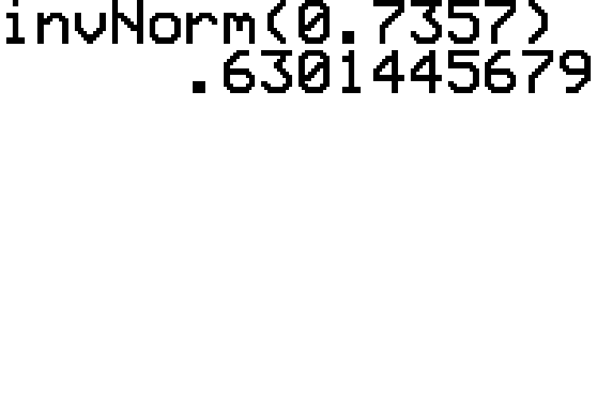
Example 6.4.1: Finding the z-value with a Given Area to Its Left₇

Slide 12
Example 6.4.1: Finding the z-value with a Given Area to Its Left₈
Therefore, an area of 0.7357 to the left corresponds to a z-value of approximately 0.63.

Slide 13
Technology Tip₂
For further instructions on finding values from a normal distribution with a TI-83/84 Plus calculator or other technology, please visit stat.hawkeslearning.com and see Technology Instructions → Normal Distribution → Inverse Normal.

Slide 14
Example 6.4.2: Finding the z-value That Represents a Given Percentile₁
What z-value represents the 90th percentile? Round to 2 decimal places.

Slide 15
Example 6.4.2: Finding the z-value That Represents a Given Percentile₂
Solution
In order to sketch the curve, we must first know the area in which we are interested. The 90th percentile corresponds to the z-value for which 90% of the area under the standard normal curve is to the left of z. So, we need to find the value of z that has an area of 0.9000 to its left.

Slide 16
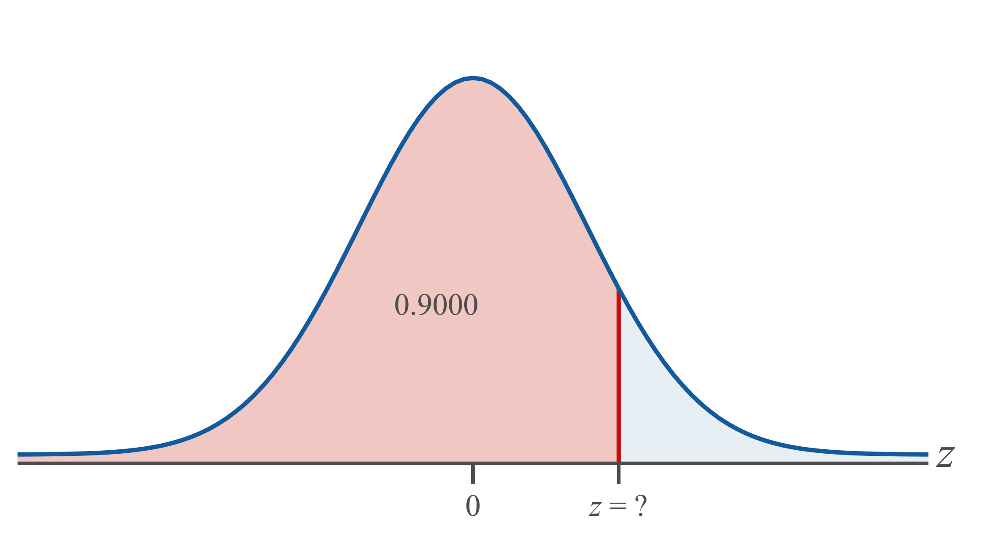
Example 6.4.2: Finding the z-value That Represents a Given Percentile₃

Slide 17
Side Note
If an exact area is not listed in the cumulative table, we will use the area closest in value.

Slide 18
Example 6.4.2: Finding the z-value That Represents a Given Percentile₄
Tables:
Looking for 0.9000 (or the closest area) in the interior of the cumulative normal tables, we find 0.8997, which corresponds to a z-value of 1.28. Thus we will use
z = 1.28 to represent the 90th percentile.

Slide 19
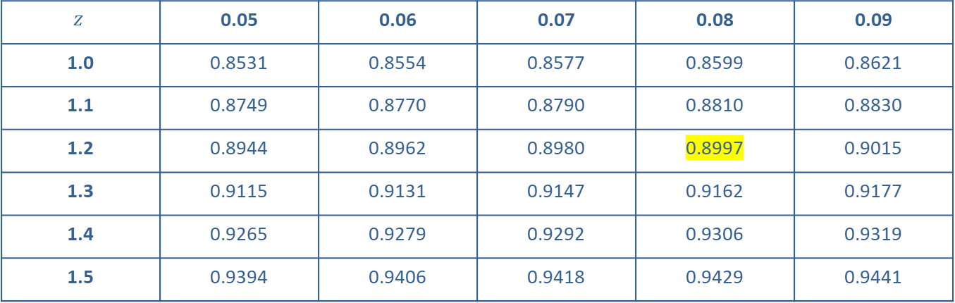
Example 6.4.2: Finding the z-value That Represents a Given Percentile₅
$$z$$ | 0.05 | 0.06 | 0.07 | 0.08 | 0.09
1.0 | 0.8531 | 0.8554 | 0.8577 | 0.8599 | 0.8621
1.1 | 0.8749 | 0.8770 | 0.8790 | 0.8810 | 0.8830
1.2 | 0.8944 | 0.8962 | 0.8980 | 0.8997 | 0.9015
1.3 | 0.9115 | 0.9131 | 0.9147 | 0.9162 | 0.9177
1.4 | 0.9265 | 0.9279 | 0.9292 | 0.9306 | 0.9319
1.5 | 0.9394 | 0.9406 | 0.9418 | 0.9429 | 0.9441

Slide 20
Example 6.4.2: Finding the z-value That Represents a Given Percentile₆
TI-83/84 Plus:
To find a value of z with a given area to its left, under the DISTR menu choose invNorm. As noted previously, the 90th percentile is the z-value that has an area of 0.9000 to its left. Since the standard normal is the default for the calculator, we only need to enter the area to the left. Enter invNorm(0.9000), as shown in the following screenshot. This produces a z-value of 1.28 rounded to two decimal places.

Slide 21
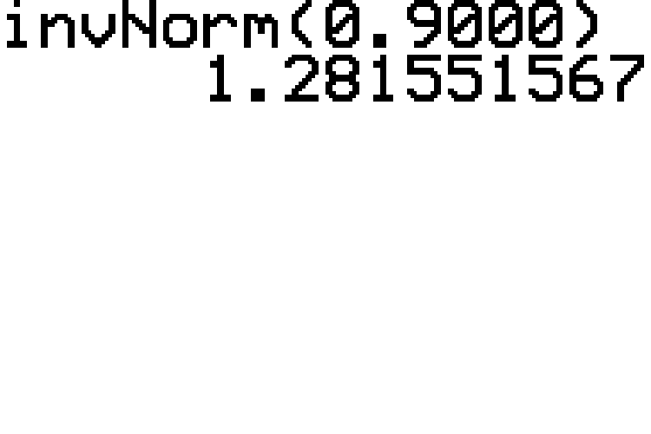
Example 6.4.2: Finding the z-value That Represents a Given Percentile₇

Slide 22
Example 6.4.2: Finding the z-value That Represents a Given Percentile₈
Thus, the z-value representing the 90th percentile is approximately 1.28.

Slide 23
Example 6.4.3: Finding the z-value with a Given Area to Its Right₁
What z-value has an area of 0.0096 to its right? Round to 2 decimal places.

Slide 24
Example 6.4.3: Finding the z-value with a Given Area to Its Right₂
Solution
First, sketch a graph of the curve. Because 0.0096 is such a small area on the right, we know we should sketch the z-score on the positive side of the graph. Since we need the area to the left in order to use the tables or calculators, subtract the area to the right of
z from 1. This gives us an area to the left of z equal to 0.9904.

Slide 25
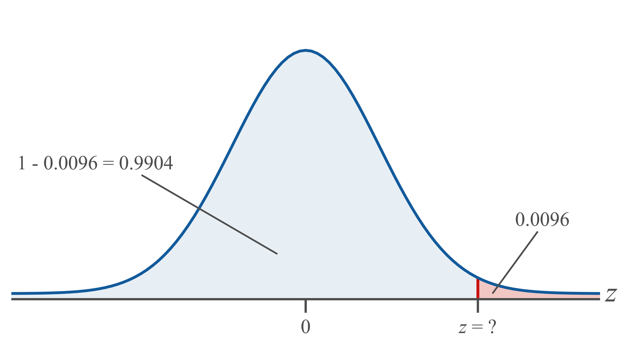
Example 6.4.3: Finding the z-value with a Given Area to Its Right₃

Slide 26
Example 6.4.3: Finding the z-value with a Given Area to Its Right₄
Tables:
Scan through the interior of the table for an area of 0.9904. Look to the left and above to find the corresponding z-value. What we find is that z = 2.34.

Slide 27
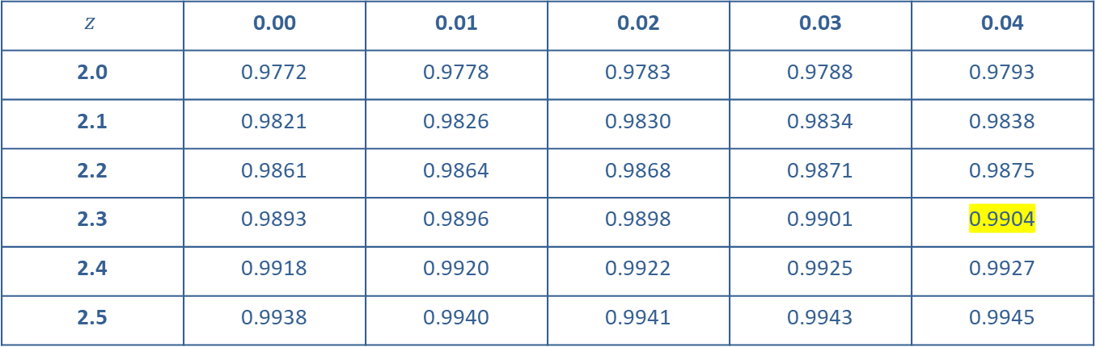
Example 6.4.3: Finding the z-value with a Given Area to Its Right₅
$$z$$ | 0.00 | 0.01 | 0.02 | 0.03 | 0.04
2.0 | 0.9772 | 0.9778 | 0.9783 | 0.9788 | 0.9793
2.1 | 0.9821 | 0.9826 | 0.9830 | 0.9834 | 0.9838
2.2 | 0.9861 | 0.9864 | 0.9868 | 0.9871 | 0.9875
2.3 | 0.9893 | 0.9896 | 0.9898 | 0.9901 | 0.9904
2.4 | 0.9918 | 0.9920 | 0.9922 | 0.9925 | 0.9927
2.5 | 0.9938 | 0.9940 | 0.9941 | 0.9943 | 0.9945

Slide 28
Technology Tip₃
The area entered must be to the left of the unknown
z-value when using invNorm.

Slide 29
Example 6.4.3: Finding the z-value with a Given Area to Its Right₆
TI-83/84 Plus:
Using a TI-83/84 Plus calculator we have two options. The first is to enter the area to the left of z which we have already calculated as 0.9904. The other option is to have the calculator do this subtraction for us at the same time that it finds the z-score. To use the second option enter invNorm(1−0.0096), as shown in the following screenshot, which produces a value of 2.34 rounded to two decimal places.

Slide 30
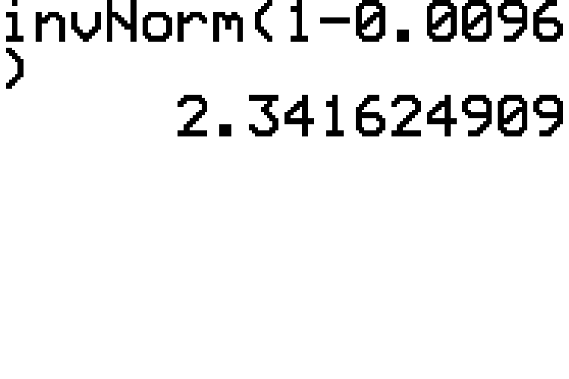
Example 6.4.3: Finding the z-value with a Given Area to Its Right₇

Slide 31
Example 6.4.3: Finding the z-value with a Given Area to Its Right₈
Therefore, the z-value which has an area of 0.0096 to its right is approximately 2.34.

Slide 32
Example 6.4.4: Finding the z-value with a Given Area between −z and z₁
Find the value of z such that the area between −z and z is 0.90. Round to 3 decimal places.

Slide 33
Example 6.4.4: Finding the z-value with a Given Area between −z and z₂
Solution
If the area between −z and z is 0.90, then the total area in the two tails must be 1 − 0.90 = 0.10. In our sketch, the shaded area will take up most of the area under the curve. Because the curve is symmetric, the area left after subtracting from 1 is divided equally between the two tails. So, half of that area, which is

Slide 34
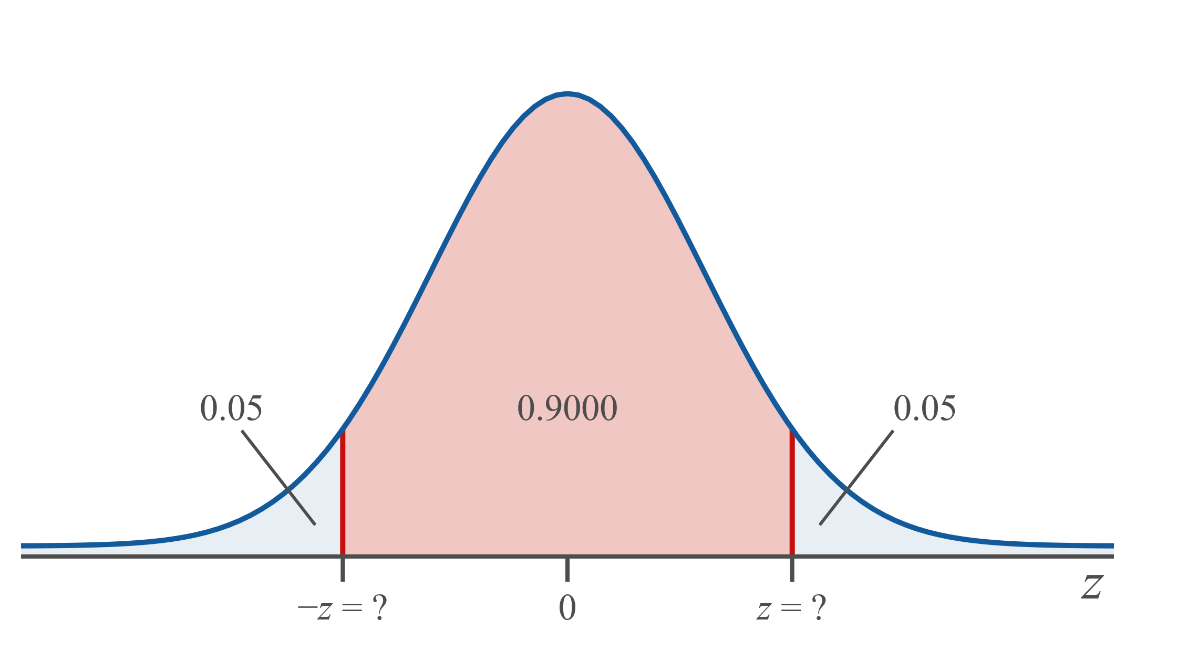
Example 6.4.4: Finding the z-value with a Given Area between −z and z₃

Slide 35
Example 6.4.4: Finding the z-value with a Given Area between −z and z₄
Tables:
Because the cumulative normal tables give the area to the left, we can look up the area in the left tail and find its corresponding z-value. Since the probabilities in the normal tables are given to four decimal places, we look for the probability that is closest to the left tail area of 0.0500.

Slide 36
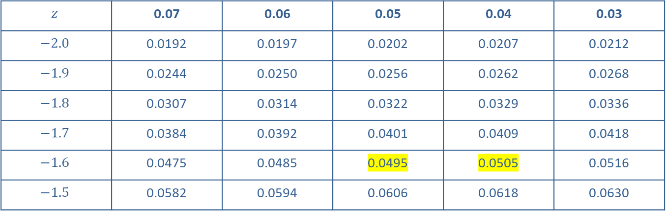
Example 6.4.4: Finding the z-value with a Given Area between −z and z₅
$$z$$ | 0.07 | 0.06 | 0.05 | 0.04 | 0.03
$$−2.0$$ | 0.0192 | 0.0197 | 0.0202 | 0.0207 | 0.0212
$$−1.9$$ | 0.0244 | 0.0250 | 0.0256 | 0.0262 | 0.0268
$$−1.8$$ | 0.0307 | 0.0314 | 0.0322 | 0.0329 | 0.0336
$$−1.7$$ | 0.0384 | 0.0392 | 0.0401 | 0.0409 | 0.0418
$$−1.6$$ | 0.0475 | 0.0485 | 0.0495 | 0.0505 | 0.0516
$$−1.5$$ | 0.0582 | 0.0594 | 0.0606 | 0.0618 | 0.0630

Slide 37
Example 6.4.4: Finding the z-value with a Given Area between −z and z₆
In the interior of the table, we find two areas that are equally close to 0.0500, so use the z-value exactly halfway between the z-scores corresponding to those two areas. The z-value halfway between z = −1.64 and
z = −1.65 is −1.645. Thus the positive z-value such that the area between −z and z is 0.90 is z = 1.645.

Slide 38
Example 6.4.4: Finding the z-value with a Given Area between −z and z₇
TI-83/84 Plus:
Using a TI-83/84 Plus calculator requires that we enter the area to the left of −z. Enter invNorm(0.05), as shown in the following screenshot. This gives a value of
−1.645 rounded to three decimal places.

Slide 39
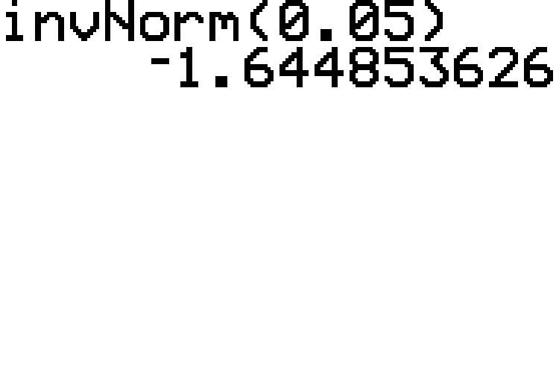
Example 6.4.4: Finding the z-value with a Given Area between −z and z₈

Slide 40
Example 6.4.4: Finding the z-value with a Given Area between −z and z₉
Therefore, the positive z-value such that the area between −z and z is 0.90 is approximately 1.645.

Slide 41
Example 6.4.5: Finding the z-value with a Given Area in the Tails to the Left of −z and to the Right of z₁
Find the value of z such that the area to the left of −z plus the area to the right of z is 0.1616. Round to 2 decimal places.

Slide 42
Example 6.4.5: Finding the z-value with a Given Area in the Tails to the Left of −z and to the Right of z₂
Solution
If the total area in both tails is 0.1616, then the area in
one of the tails must be half of that or

Slide 43
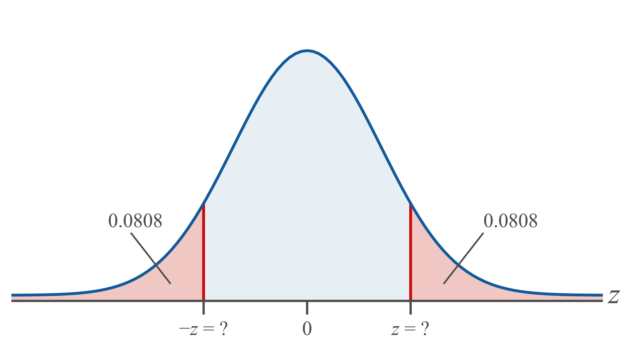
Example 6.4.5: Finding the z-value with a Given Area in the Tails to the Left of −z and to the Right of z₃

Slide 44
Example 6.4.5: Finding the z-value with a Given Area in the Tails to the Left of −z and to the Right of z₄
Tables:
Scan through the interior of the cumulative normal table for an area of 0.0808. The corresponding z-value is −z = −1.40.

Slide 45
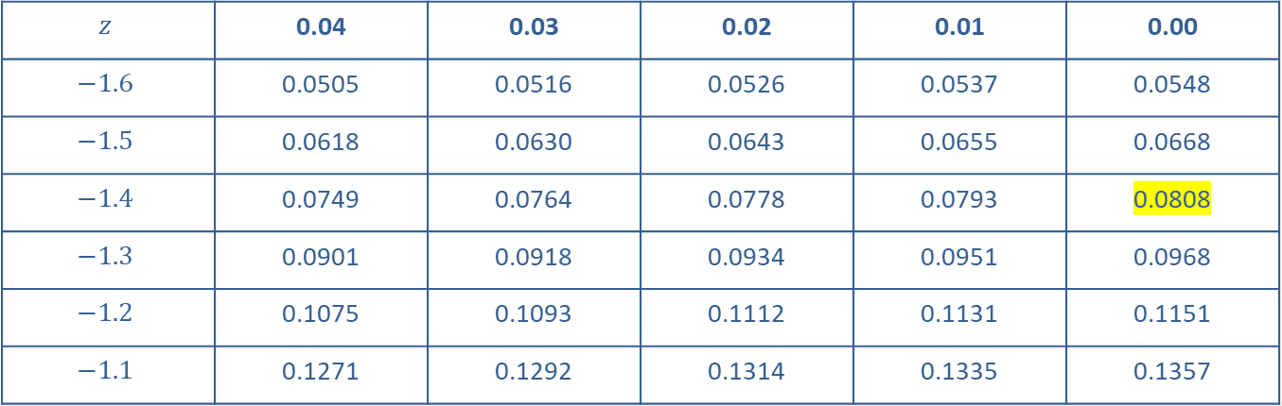
Example 6.4.5: Finding the z-value with a Given Area in the Tails to the Left of −z and to the Right of z₅
$$z$$ | 0.04 | 0.03 | 0.02 | 0.01 | 0.00
$$−1.6$$ | 0.0505 | 0.0516 | 0.0526 | 0.0537 | 0.0548
$$−1.5$$ | 0.0618 | 0.0630 | 0.0643 | 0.0655 | 0.0668
$$−1.4$$ | 0.0749 | 0.0764 | 0.0778 | 0.0793 | 0.0808
$$−1.3$$ | 0.0901 | 0.0918 | 0.0934 | 0.0951 | 0.0968
$$−1.2$$ | 0.1075 | 0.1093 | 0.1112 | 0.1131 | 0.1151
$$−1.1$$ | 0.1271 | 0.1292 | 0.1314 | 0.1335 | 0.1357

Slide 46
Example 6.4.5: Finding the z-value with a Given Area in the Tails to the Left of −z and to the Right of z₆
TI-83/84 Plus:
Again, we can either enter the area to the left, which we calculated as 0.0808, or we can have the calculator do the division for us by entering 0.1616/2. The following screenshot shows this second way and produces the more accurate value of −z ≈ −1.399711.

Slide 47
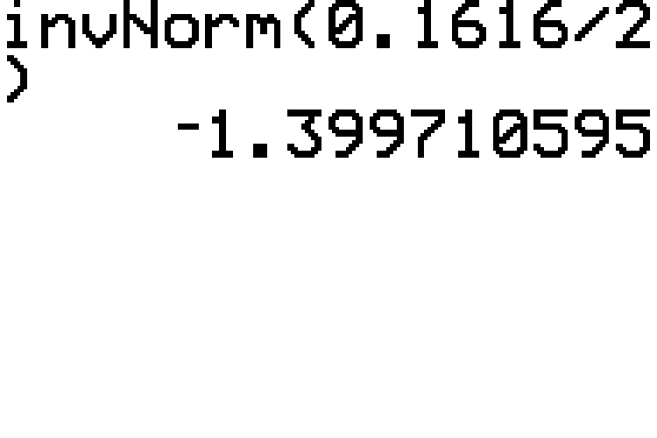
Example 6.4.5: Finding the z-value with a Given Area in the Tails to the Left of −z and to the Right of z₇

Slide 48
Example 6.4.5: Finding the z-value with a Given Area in the Tails to the Left of −z and to the Right of z₈
Thus, the z-value such that the area to the left of −z plus the area to the right of z amounts to 0.1616 is approximately 1.40.

Slide 49
Example 6.4.6: Finding the Value of a Normally Distributed Random Variable That Represents a Given Percentile₁
At his most recent well-being checkup, Ethan’s doctor told him that for his age, his cholesterol level was in a good range at the 60th percentile. Assume cholesterol levels are approximately normally distributed with a mean of 189.1 mg/dL and a standard deviation of
37.8 mg/dL for Ethan’s age group. What was Ethan’s cholesterol level at his last checkup? Round to two decimal places.

Slide 50
Example 6.4.6: Finding the Value of a Normally Distributed Random Variable That Represents a Given Percentile₂
Solution:
Begin by sketching the graph. The 60th percentile means that 0.6000 of the area under the curve will be to the left as shown in the following graph. Then use either the cumulative normal tables or technology to find the value of x.

Slide 51
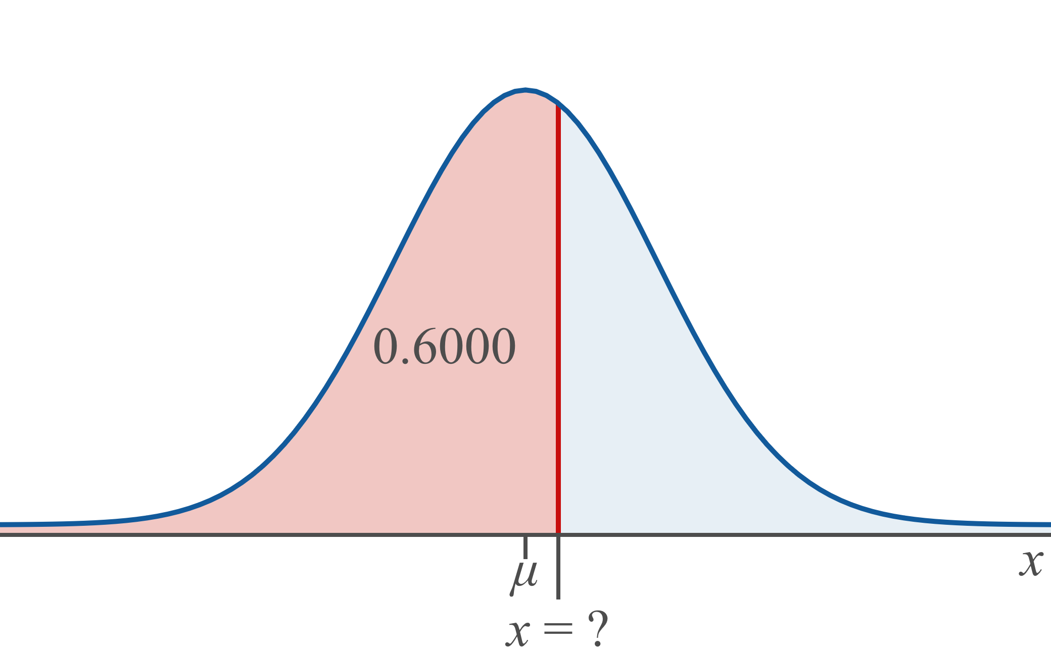
Example 6.4.6: Finding the Value of a Normally Distributed Random Variable That Represents a Given Percentile₃

Slide 52
Example 6.4.6: Finding the Value of a Normally Distributed Random Variable That Represents a Given Percentile₄
Tables:
To use the normal tables, we first need to find the
z-value that represents the 60th percentile. Looking for 0.6000 (or the closest area to it) in the interior of the tables we find 0.5987, which corresponds to a z-value of 0.25.

Slide 53
Example 6.4.6: Finding the Value of a Normally Distributed Random Variable That Represents a Given Percentile₅
z | 0.02 | 0.03 | 0.04 | 0.05 | 0.06
0.0 | 0.5080 | 0.5120 | 0.5160 | 0.5199 | 0.5239
0.1 | 0.5478 | 0.5517 | 0.5557 | 0.5596 | 0.5636
0.2 | 0.5871 | 0.5910 | 0.5948 | 0.5987 | 0.6026
0.3 | 0.6255 | 0.6293 | 0.6331 | 0.6368 | 0.6406
0.4 | 0.6628 | 0.6664 | 0.6700 | 0.6736 | 0.6772
0.5 | 0.6985 | 0.7019 | 0.7054 | 0.7088 | 0.7123

Slide 54
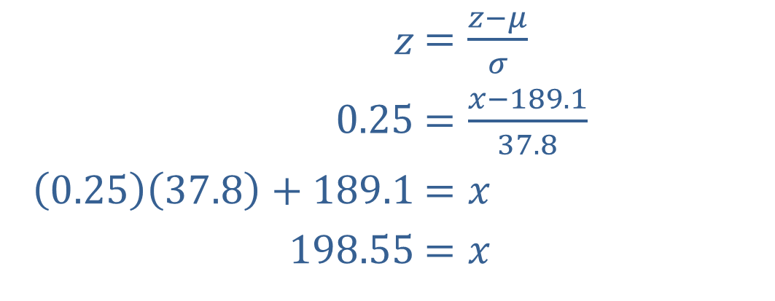
Example 6.4.6: Finding the Value of a Normally Distributed Random Variable That Represents a Given Percentile₆
We can now substitute this value, along with the mean and standard deviation, in the formula for standard scores and use algebra to find the x value.
​$z$ | ​$=\frac{z−μ}{σ}$
​$0.25$ | ​$=\frac{x−189.1}{37.8}$
​$\left(0.25\right)\left(37.8\right)+189.1$ | ​$=x$
​$198.55$ | ​$=x$

Slide 55

Memory Booster₂
The general form to find any value of x given a z-value, mean and standard deviation is

Slide 56
Example 6.4.6: Finding the Value of a Normally Distributed Random Variable That Represents a Given Percentile₇
Notice that by rearranging the z-score formula in general, we can use it to find any value of x, given the
z-value, mean, and standard deviation. The general form is then

Slide 57
Example 6.4.6: Finding the Value of a Normally Distributed Random Variable That Represents a Given Percentile₈
TI-83/84 Plus:
We can find the value of the normally distributed variable in one step using the calculator. The function syntax is invNorm(area, μ, σ), where area is the area to the left of x.
Here we have
area = 0.6000
μ = 189.1
σ = 37.8
Enter invNorm(0.6000, 189.1, 37.8), as shown in the following screenshot. The calculator gives the more accurate value of 198.67.

Slide 58
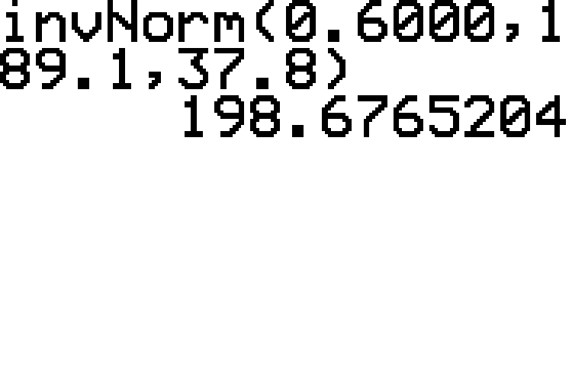
Example 6.4.6: Finding the Value of a Normally Distributed Random Variable That Represents a Given Percentile₉

Slide 59
Example 6.4.6: Finding the Value of a Normally Distributed Random Variable That Represents a Given Percentile₁₀
The answer would be reported as 198.55 if using the tables and 198.67 if using the calculator. Therefore,
Ethan had a cholesterol level of approximately

Slide 60
Example 6.4.7: Finding the Value of a Normally Distributed Random Variable That Represents a Given Quartile₁
Let's assume that the lengths of newborn full-term babies in the United States are normally distributed with a mean length of 20.0 inches and a standard deviation of 1.2 inches. What is the minimum length that a baby could be and still have a length that is amongst the top 25% of baby lengths? Round to one decimal place.

Slide 61
Example 6.4.7: Finding the Value of a Normally Distributed Random Variable That Represents a Given Quartile₂
Solution
If we want to find the minimum length for the top 25% of baby lengths, we can simply find the value of the 75th percentile, or Q ₃. A percentage of 75% is the same as an area of 0.75 under the normal distribution.

Slide 62
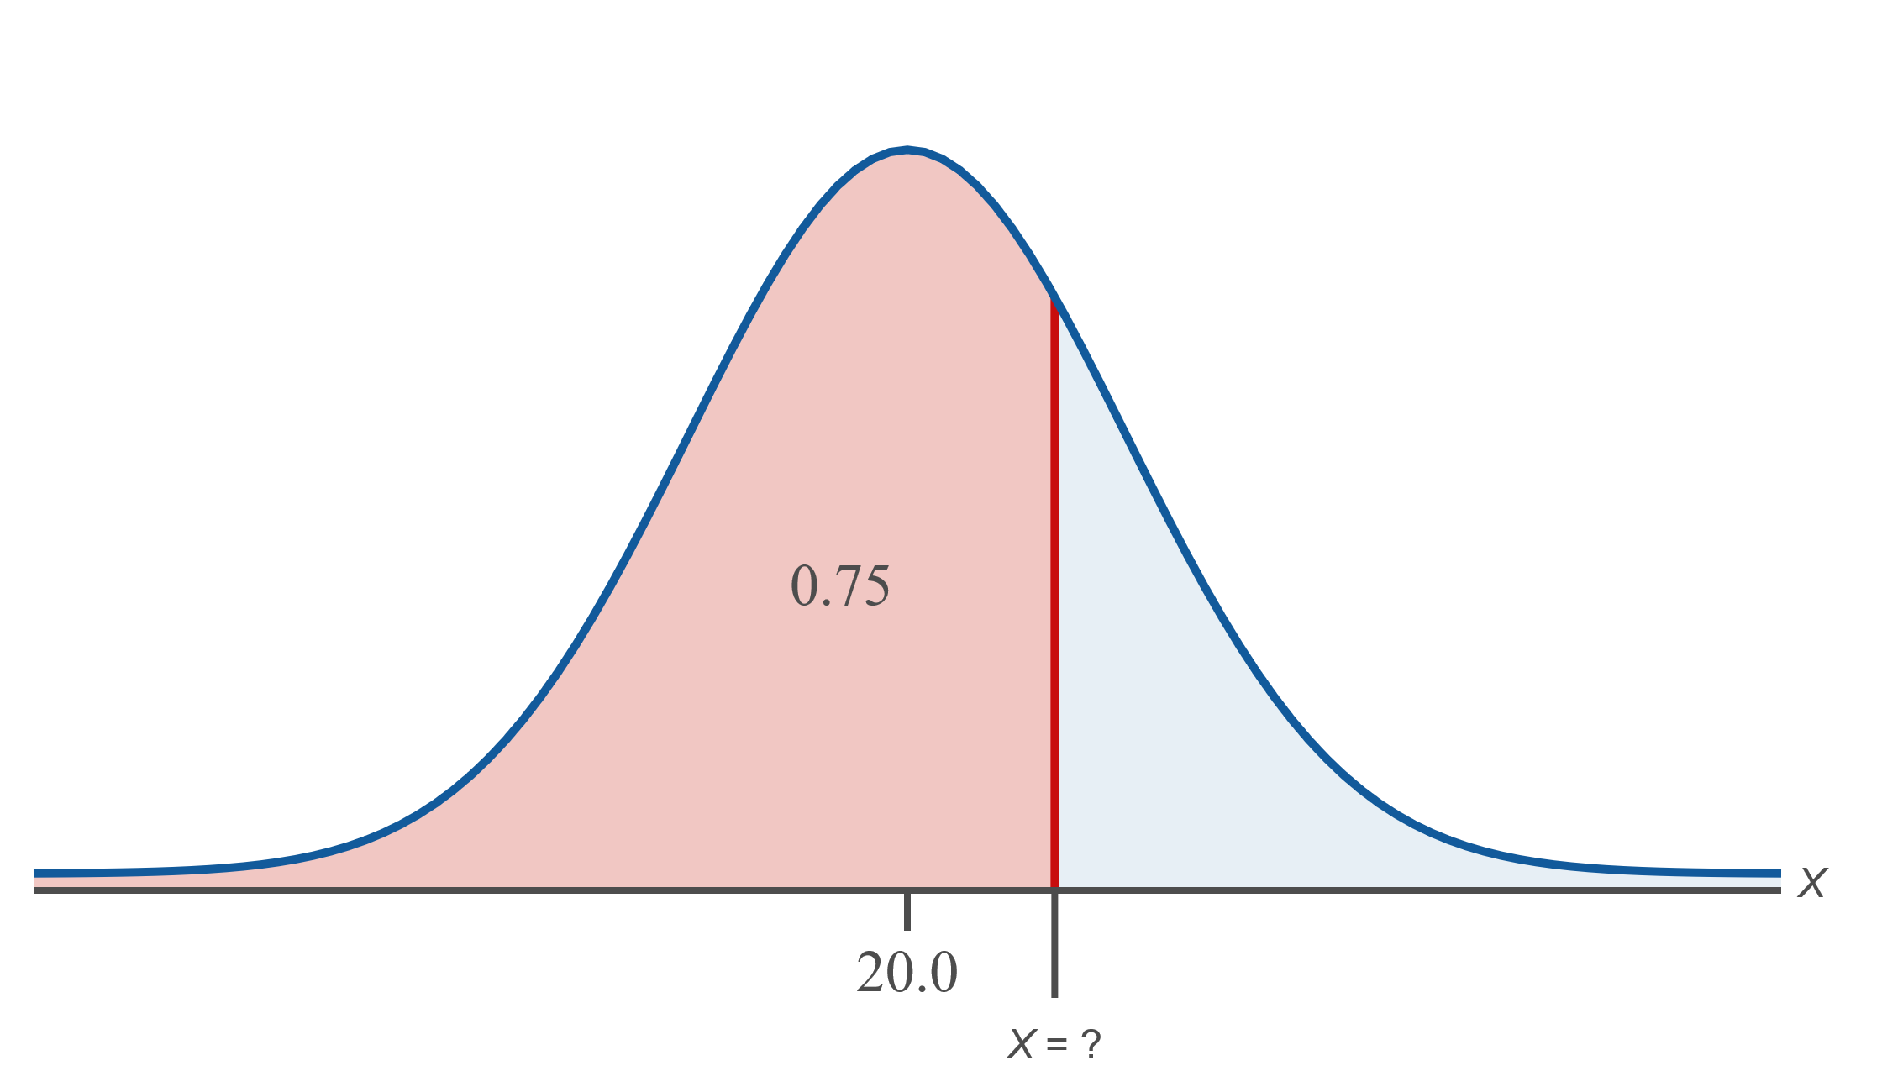
Example 6.4.7: Finding the Value of a Normally Distributed Random Variable That Represents a Given Quartile₃

Slide 63
Example 6.4.7: Finding the Value of a Normally Distributed Random Variable That Represents a Given Quartile₄
Tables:
We will begin by finding the z-score that has an area of 0.75 to its left. Scan through the interior of the cumulative normal table for an area of 0.7500. The closest corresponding z-value is z = 0.67.

Slide 64
Example 6.4.7: Finding the Value of a Normally Distributed Random Variable That Represents a Given Quartile₅
z | 0.05 | 0.06 | 0.07 | 0.08 | 0.09
0.4 | 0.6736 | 0.6722 | 0.6808 | 0.6844 | 0.6879
0.5 | 0.7088 | 0.7123 | 0.7157 | 0.7190 | 0.7224
0.6 | 0.7422 | 0.7454 | 0.7486 | 0.7517 | 0.7549
0.7 | 0.7734 | 0.7764 | 0.7794 | 0.7823 | 0.7852
0.8 | 0.8023 | 0.8051 | 0.8078 | 0.8106 | 0.8133
0.9 | 0.8289 | 0.8315 | 0.8340 | 0.8365 | 0.8389

Slide 65
Example 6.4.7: Finding the Value of a Normally Distributed Random Variable That Represents a Given Quartile₆
Now that we know the value of z, we will use it along with the mean and standard deviation to calculate the corresponding value of the random variable X that represents the length of the baby. We can use the formula for x that we saw previously.

Slide 66
Example 6.4.7: Finding the Value of a Normally Distributed Random Variable That Represents a Given Quartile₇
TI-83/84 Plus:
We can find the value of the normally distributed variable in one step using the function syntax invNorm(area, μ, σ), where area is the area to the left.
Here we have
area = 0.7500
μ = 20.0
σ = 1.2

Slide 67
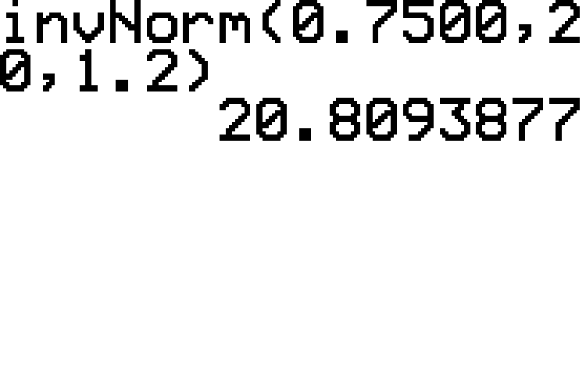
Example 6.4.7: Finding the Value of a Normally Distributed Random Variable That Represents a Given Quartile₈
Enter invNorm(0.7500, 20, 1.2), as shown in the following screenshot. This gives a value of 20.8 rounded to one decimal place.

Slide 68
Example 6.4.7: Finding the Value of a Normally Distributed Random Variable That Represents a Given Quartile₉
Therefore the minimum length a baby can be and still be in the top 25% of lengths of full-term newborn babies is approximately 20.8 inches.

