Slide 1
Section 6.2
The Standard Normal Distribution

Slide 2
Memory Booster₁
A standard score, or z-score, is a number which indicates how many standard deviations a data point is from the mean.

Slide 3
Definition: Distribution
The standard normal distribution is a normal distribution with a mean equal to 0 and standard deviation equal to 1, such that the following properties are true:
1. ​The standard normal distribution is bell-shaped and symmetric about its mean.
2. ​The standard normal distribution is completely defined by its mean, μ = 0, and standard deviation, σ = 1.
3. ​The total area under the standard normal distribution curve equals 1.
4. ​The x-axis is a horizontal asymptote for the standard normal distribution curve.

Slide 4
Side Note
A standard score may also be referred to as a z-score or a z-value. Statisticians use these three terms interchangeably.

Slide 5
Rounding Rule
When calculating a z-score, round to two decimal places.

Slide 6
Example 6.2.1: Calculating and Graphing z-values₁
Consider a normal distribution with μ = 48 and σ = 5.
a. ​Convert an x-value of 45 to a z-value.
b. ​Draw two normal curves: one indicating the placement of the x-value in relation to the mean one standard deviation, and the other indicating the placement of the z-value on the standard normal distribution.

Slide 7
Example 6.2.1: Calculating and Graphing z-values₂
Solution
a. ​Find the z-score for x = 45 as follows.

Slide 8
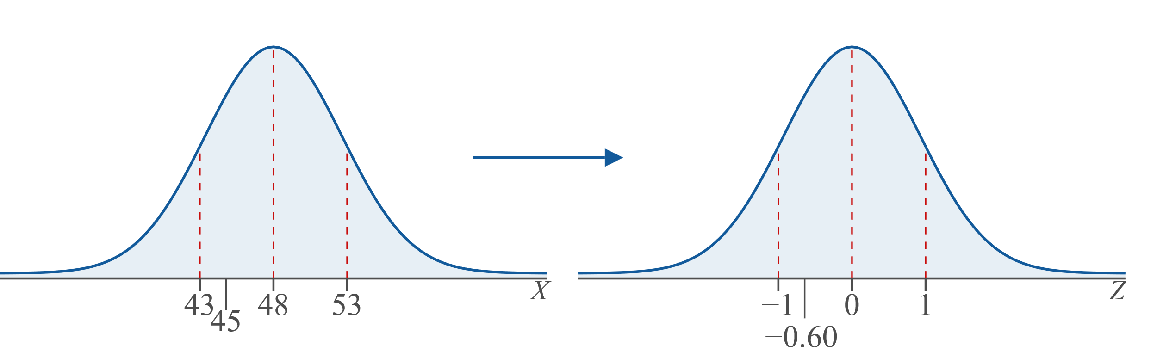
Example 6.2.1: Calculating and Graphing z-values₃
b. ​Draw each of the distributions, marking a standard score of z = −0.60 on the standard normal distribution. Remember that a negative z-score falls to the left of center on the curve.
​

Slide 9
Example 6.2.1: Calculating and Graphing z-values₄
​The distribution on the left is a normal distribution with a mean of 48 and a standard deviation of 5. The distribution on the right is a standard normal distribution with a standard score of z = −0.60 indicated.

Slide 10
Example 6.2.2: Finding Area to the Left of a Positive z-value Using a Cumulative Normal Table₁
Find the area under the standard normal curve to the left of z = 1.37.

Slide 11
Example 6.2.2: Finding Area to the Left of a Positive z-value Using a Cumulative Normal Table₂
Solution
Before we read the table, let's pause and consider what value we expect to get when we look up the z-score in the table. Sine the z-score is positive we know that it falls to the right of the mean. Therefore, we should expect that the area under the curve to the left of this value will be greater than half of the total area (0.5000) as shown in the following figure.

Slide 12
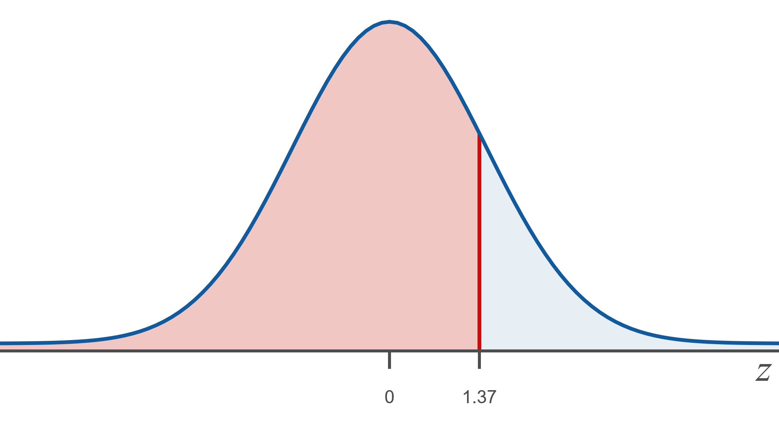
Example 6.2.2: Finding Area to the Left of a Positive z-value Using a Cumulative Normal Table₃

Slide 13
Example 6.2.2: Finding Area to the Left of a Positive z-value Using a Cumulative Normal Table₄
To read the table, we must break the given z-value (1.37) into two parts: one containing the first decimal place (1.3) and the other containing the second decimal place (0.07). Because the z-value is positive, we use the standard normal table for Area −∞ to z. Look across the row labeled 1.3 and down the column labeled 0.07. The row and column intersect at 0.9147. Notice that this value aligns with what we were expecting.

Slide 14
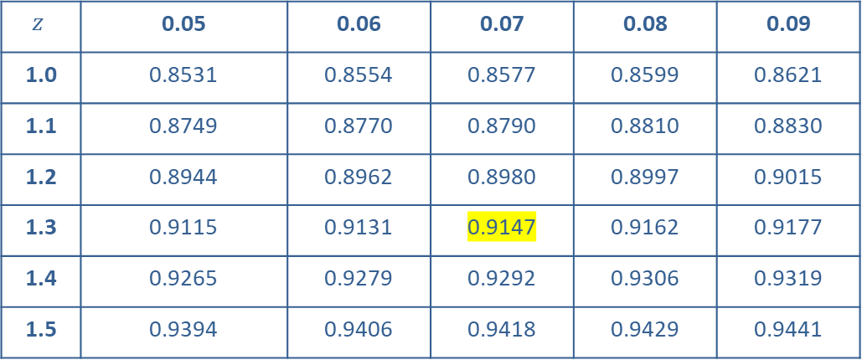
Example 6.2.2: Finding Area to the Left of a Positive z-value Using a Cumulative Normal Table₅
$$z$$ | 0.05 | 0.06 | 0.07 | 0.08 | 0.09
1.0 | 0.8531 | 0.8554 | 0.8577 | 0.8599 | 0.8621
1.1 | 0.8749 | 0.8770 | 0.8790 | 0.8810 | 0.8830
1.2 | 0.8944 | 0.8962 | 0.8980 | 0.8997 | 0.9015
1.3 | 0.9115 | 0.9131 | 0.9147 | 0.9162 | 0.9177
1.4 | 0.9265 | 0.9279 | 0.9292 | 0.9306 | 0.9319
1.5 | 0.9394 | 0.9406 | 0.9418 | 0.9429 | 0.9441

Slide 15

Example 6.2.2: Finding Area to the Left of a Positive z-value Using a Cumulative Normal Table₆
Thus, the area under the standard normal curve to the left of z = 1.37 is 0.9147.

Slide 16
Example 6.2.3: Finding Area to the Left of a Negative z-value Using a Table₁
Find the area under the standard normal curve to the left of z = −2.03.

Slide 17
Example 6.2.3: Finding Area to the Left of a Negative z-value Using a Table₂
Solution
Begin by noting that since we are asked to find an area to the left of a negative z-value, we should expect a value in the table which is less than 0.5000. Notice the first part of the z-value is −2.0 and the second part is 0.03. This time, use the standard normal table for Area −∞ to −z since the z-value is negative. On the chart, look across the row labeled −2.0 and down the column labeled 0.03. The row and column intersect at 0.0212.

Slide 18
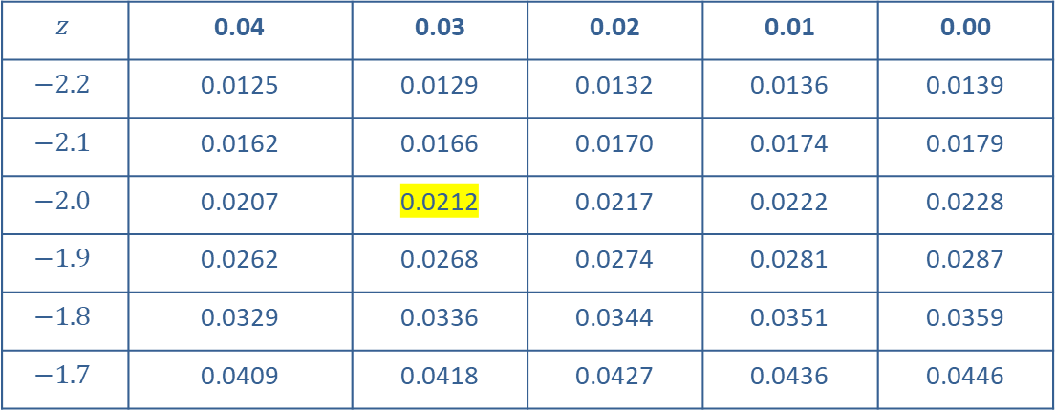
Example 6.2.3: Finding Area to the Left of a Negative z-value Using a Table₃
$$z$$ | 0.04 | 0.03 | 0.02 | 0.01 | 0.00
$$−2.2$$ | 0.0125 | 0.0129 | 0.0132 | 0.0136 | 0.0139
$$−2.1$$ | 0.0162 | 0.0166 | 0.0170 | 0.0174 | 0.0179
$$−2.0$$ | 0.0207 | 0.0212 | 0.0217 | 0.0222 | 0.0228
$$−1.9$$ | 0.0262 | 0.0268 | 0.0274 | 0.0281 | 0.0287
$$−1.8$$ | 0.0329 | 0.0336 | 0.0344 | 0.0351 | 0.0359
$$−1.7$$ | 0.0409 | 0.0418 | 0.0427 | 0.0436 | 0.0446

Slide 19
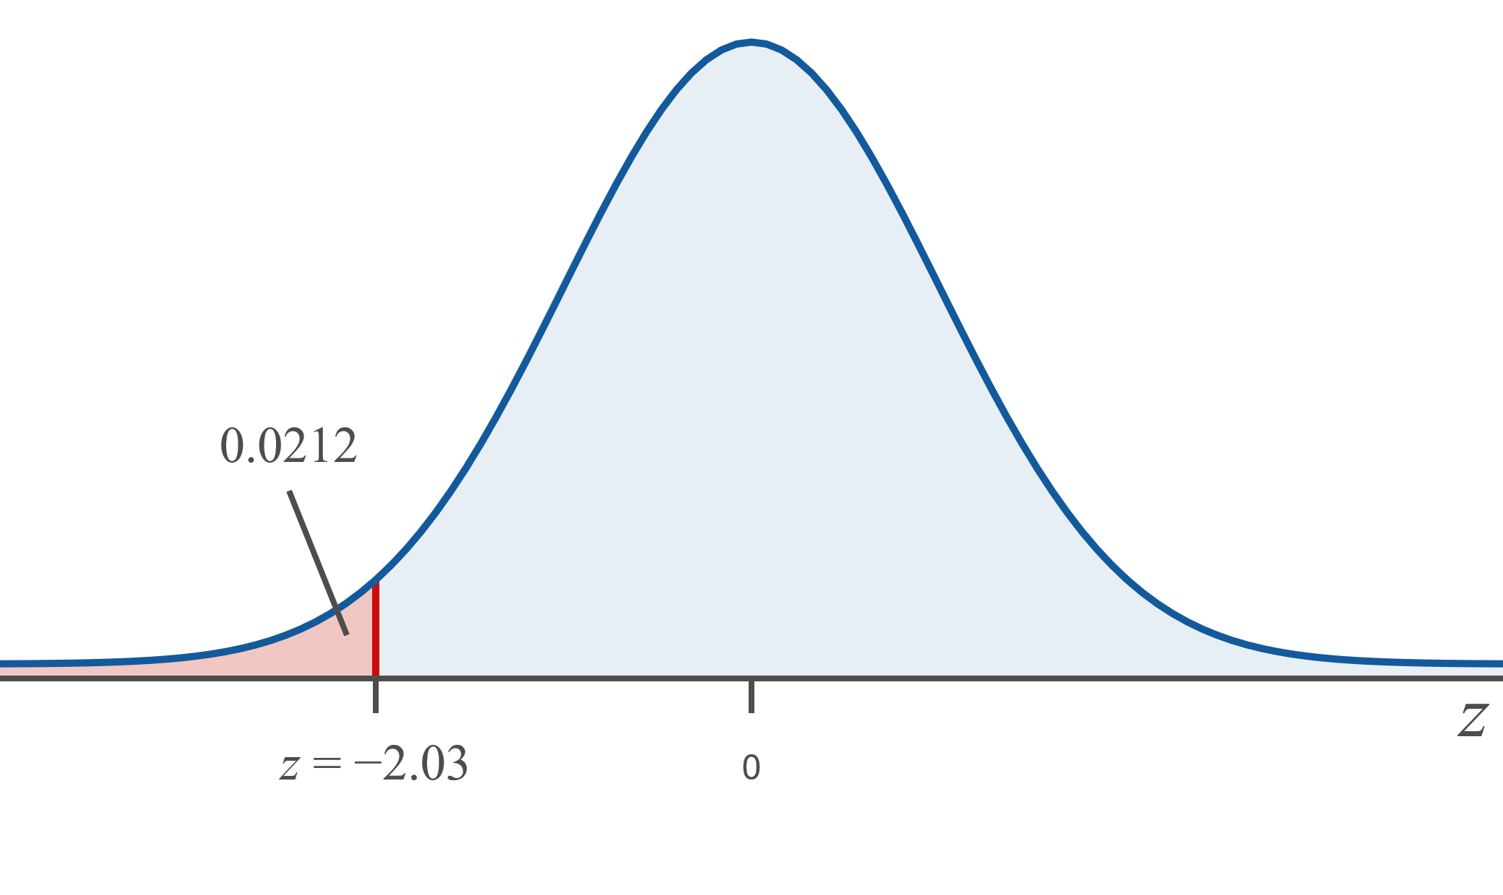
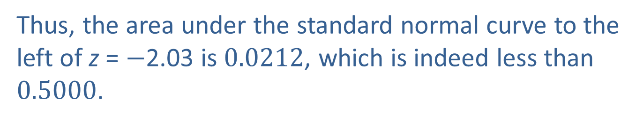
Example 6.2.3: Finding Area to the Left of a Negative z-value Using a Table₄
Thus, the area under the standard normal curve to the left of z = $−$2.03 is 0.0212, which is indeed less than 0.5000.

Slide 20
Memory Booster:₂
The total area under a normal curve = 1.

Slide 21
Example 6.2.4: Finding Area to the Right of a Positive z-value Using a Cumulative Normal Table₁
Find the area under the standard normal curve to the right of z = 1.37 using both methods described.

Slide 22
Example 6.2.4: Finding Area to the Right of a Positive z-value Using a Cumulative Normal Table₂
Solution
Take a moment to consider how large the value should be regardless of the method we use. Since we are looking for the area to the right of a positive z-value, our answer should be a value less than 0.5000.
​Method 1: From Example 6.2.2, we know that the area under the standard normal curve to the left of z = 1.37 is 0.9147. So, the area under the standard normal curve to the right of z = 1.37 is 1 − 0.9147 = 0.0853.
​

Slide 23
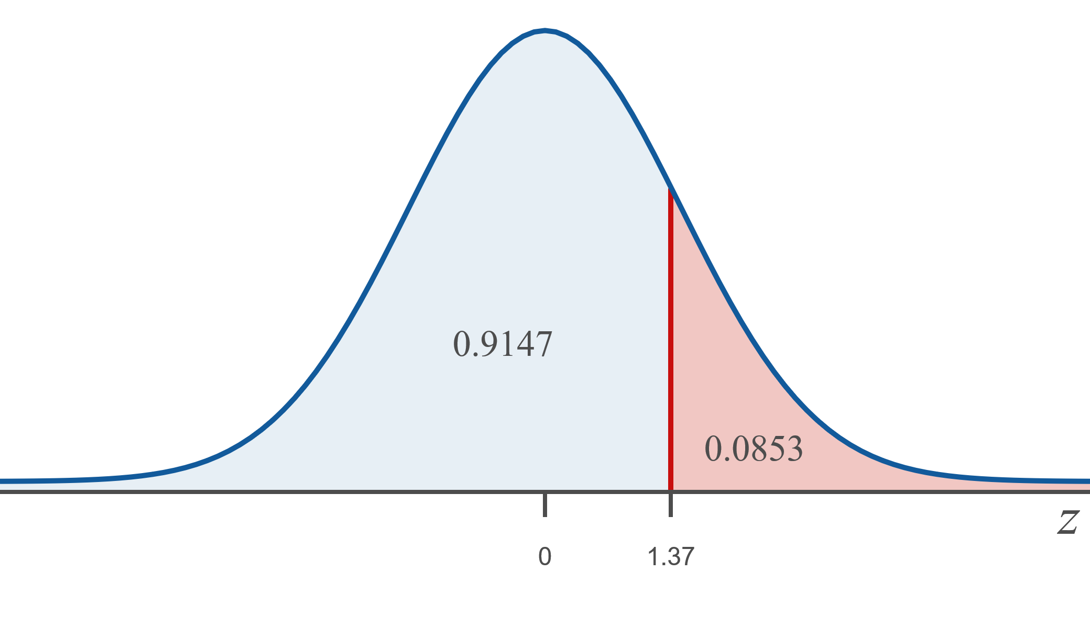
Example 6.2.4: Finding Area to the Right of a Positive z-value Using a Cumulative Normal Table₃

Slide 24
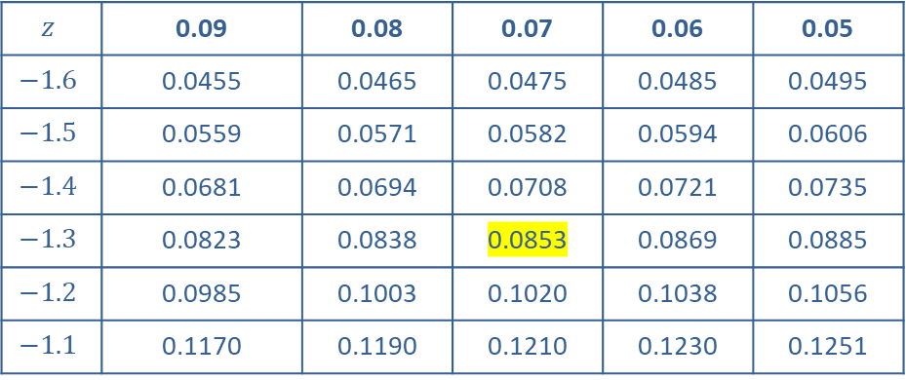
Example 6.2.4: Finding Area to the Right of a Positive z-value Using a Cumulative Normal Table₄
​Method 2: We obtain the same solution by looking up the negative of the z-value, z = −1.37, in the standard normal distribution table for Area −∞ to z. This also gives us an area of 0.0853.
$$z$$ | 0.09 | 0.08 | 0.07 | 0.06 | 0.05
$$−1.6$$ | 0.0455 | 0.0465 | 0.0475 | 0.0485 | 0.0495
$$−1.5$$ | 0.0559 | 0.0571 | 0.0582 | 0.0594 | 0.0606
$$−1.4$$ | 0.0681 | 0.0694 | 0.0708 | 0.0721 | 0.0735
$$−1.3$$ | 0.0823 | 0.0838 | 0.0853 | 0.0869 | 0.0885
$$−1.2$$ | 0.0985 | 0.1003 | 0.1020 | 0.1038 | 0.1056
$$−1.1$$ | 0.1170 | 0.1190 | 0.1210 | 0.1230 | 0.1251

Slide 25
Example 6.2.4: Finding Area to the Right of a Positive z-value Using a Cumulative Normal Table₅
Thus, the area under the standard normal curve to the right of z = 1.37 is 0.0853.

Slide 26
Example 6.2.5: Finding Area to the Right of a Negative z-value Using a Table₁
Find the area under the standard normal curve to the right of z = −0.90.

Slide 27
Example 6.2.5: Finding Area to the Right of a Negative z-value Using a Table₂
Solution
Begin by considering how much area is to the right of a negative z-value. The following figure illustrates that the area we are looking for will be larger than 0.5000.

Slide 28
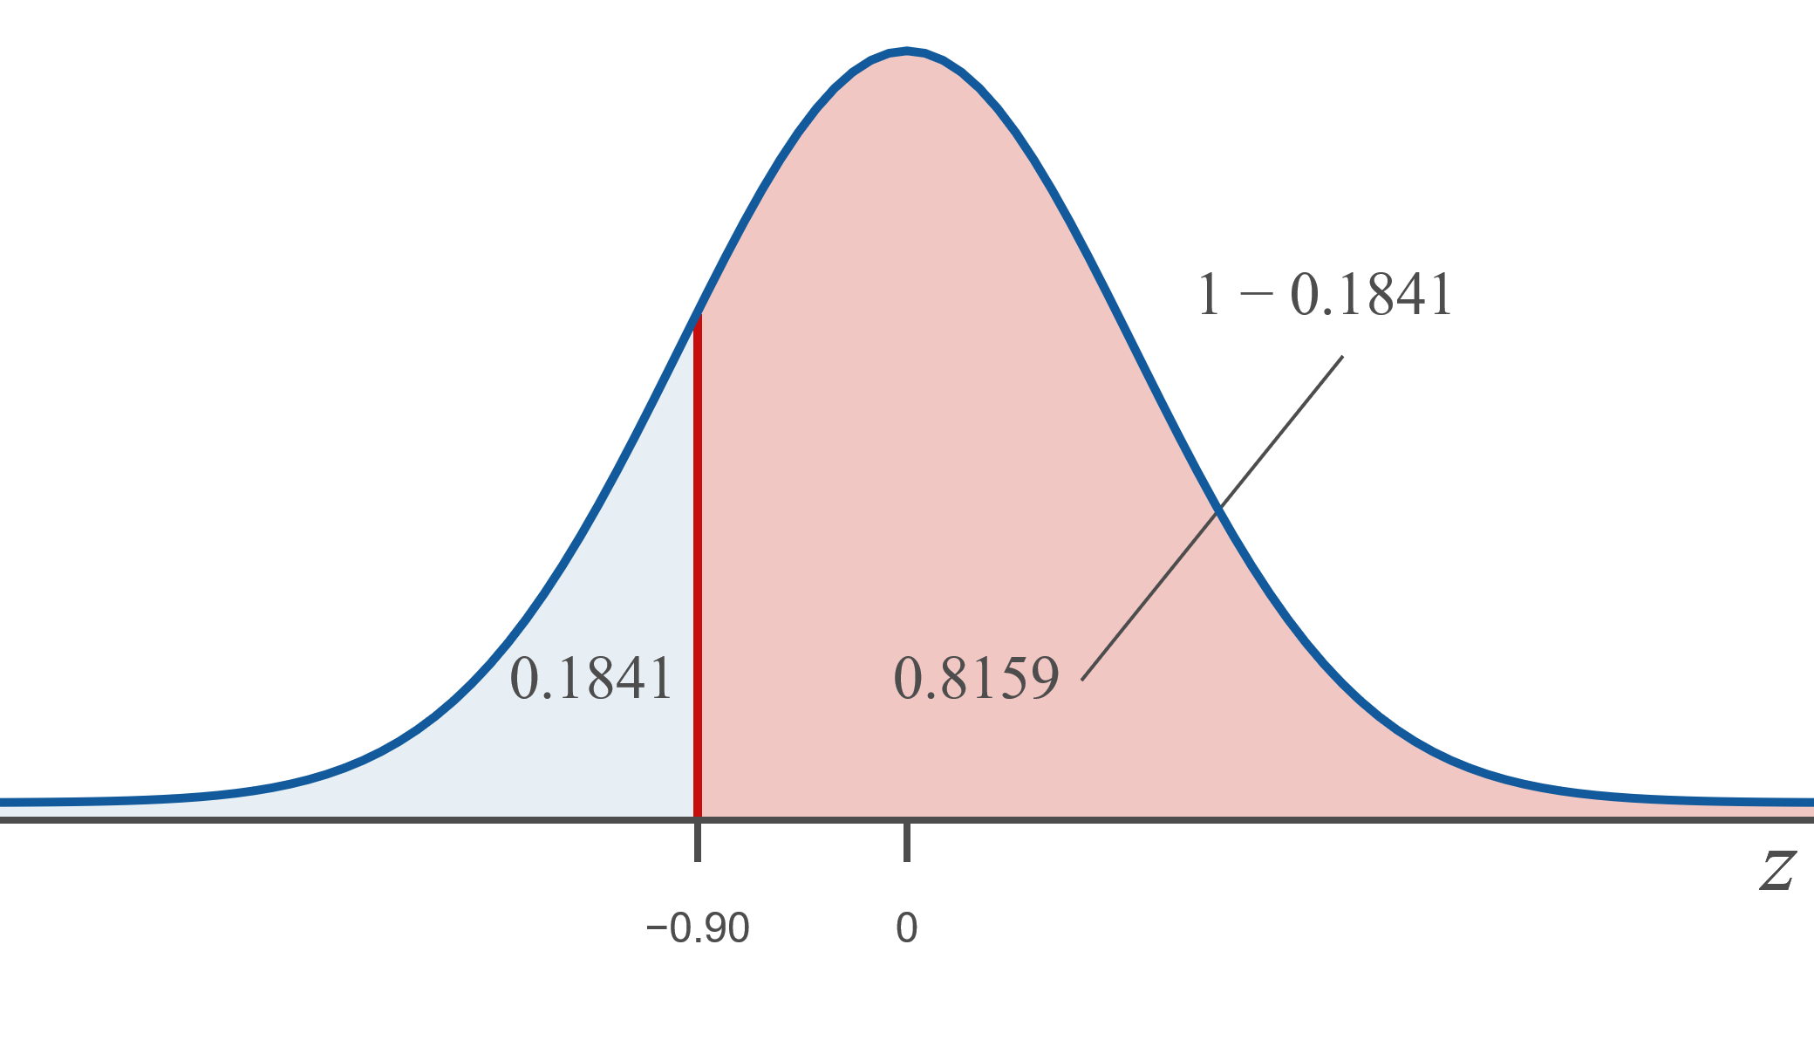
Example 6.2.5: Finding Area to the Right of a Negative z-value Using a Table₃

Slide 29
Example 6.2.5: Finding Area to the Right of a Negative z-value Using a Table₄
Method 1: If we look up z = −0.90 in the standard normal distribution table for area −∞ to −z, we see that an area of 0.1841 lies to the left of z. Then, subtract this area from 1 to find the amount of area to the right of z. Hence, an area of 1 − 0.1841 = 0.8159 lies to the right of z.
Method 2: Look up the negative of the z-value, z = 0.90, in the standard normal distribution table for area −∞ to z which also gives a value of 0.8159.

Slide 30
Example 6.2.5: Finding Area to the Right of a Negative z-value Using a Table₅
z | 0.00 | 0.01 | 0.02 | 0.03 | 0.04
0.6 | 0.7257 | 0.7291 | 0.7234 | 0.7357 | 0.7389
0.7 | 0.7580 | 0.7611 | 0.7642 | 0.7673 | 0.7704
0.8 | 0.7881 | 0.7910 | 0.79369 | 0.7967 | 0.7995
0.9 | 0.8159 | 0.8186 | 0.8212 | 0.8238 | 0.8264
1.0 | 0.8413 | 0.8438 | 0.8461 | 0.8485 | 0.8508
1.1 | 0.8643 | 0.8665 | 0.8686 | 0.8708 | 0.8729
Thus, the area under the standard normal curve to the right of z = −0.90 is 0.8159.

Slide 31
Example 6.2.6: Finding Area between Two z-values Using Tables₁
Find the area under the standard normal curve between

Slide 32
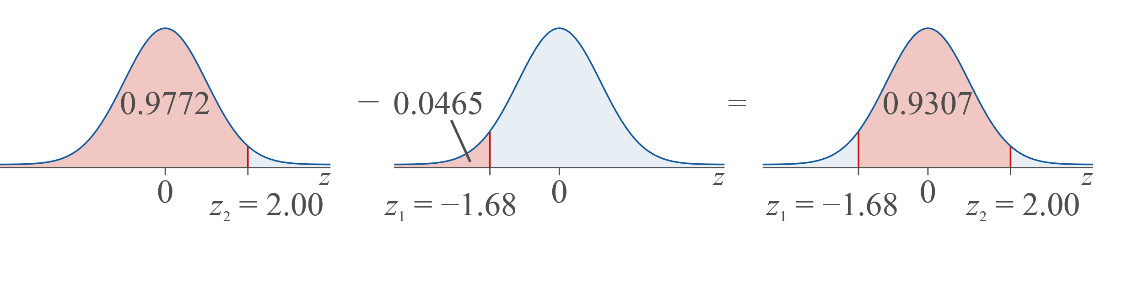
Example 6.2.6: Finding Area between Two z-values Using Tables₂
Solution
First look up the area to the left of
0.9772. Second, look up the area to the left of

Slide 33
Example 6.2.6: Finding Area between Two z-values Using Tables₃
Thus, the area between the two z-values is 0.9307.

Slide 34
Example 6.2.7: Finding Area in the Tails for Two z-values₁
Find the total of the areas under the standard normal curve to the left of

Slide 35
Example 6.2.7: Finding Area in the Tails for Two z-values₂
Solution
There are two areas that we must find. The total we are interested in is the sum of these two areas. Let's begin by finding the area to the left of
tell us this is 0.0062. Next, we need to find the area to
Of z, we know that the area to the right is equal to 0.0013.

Slide 36
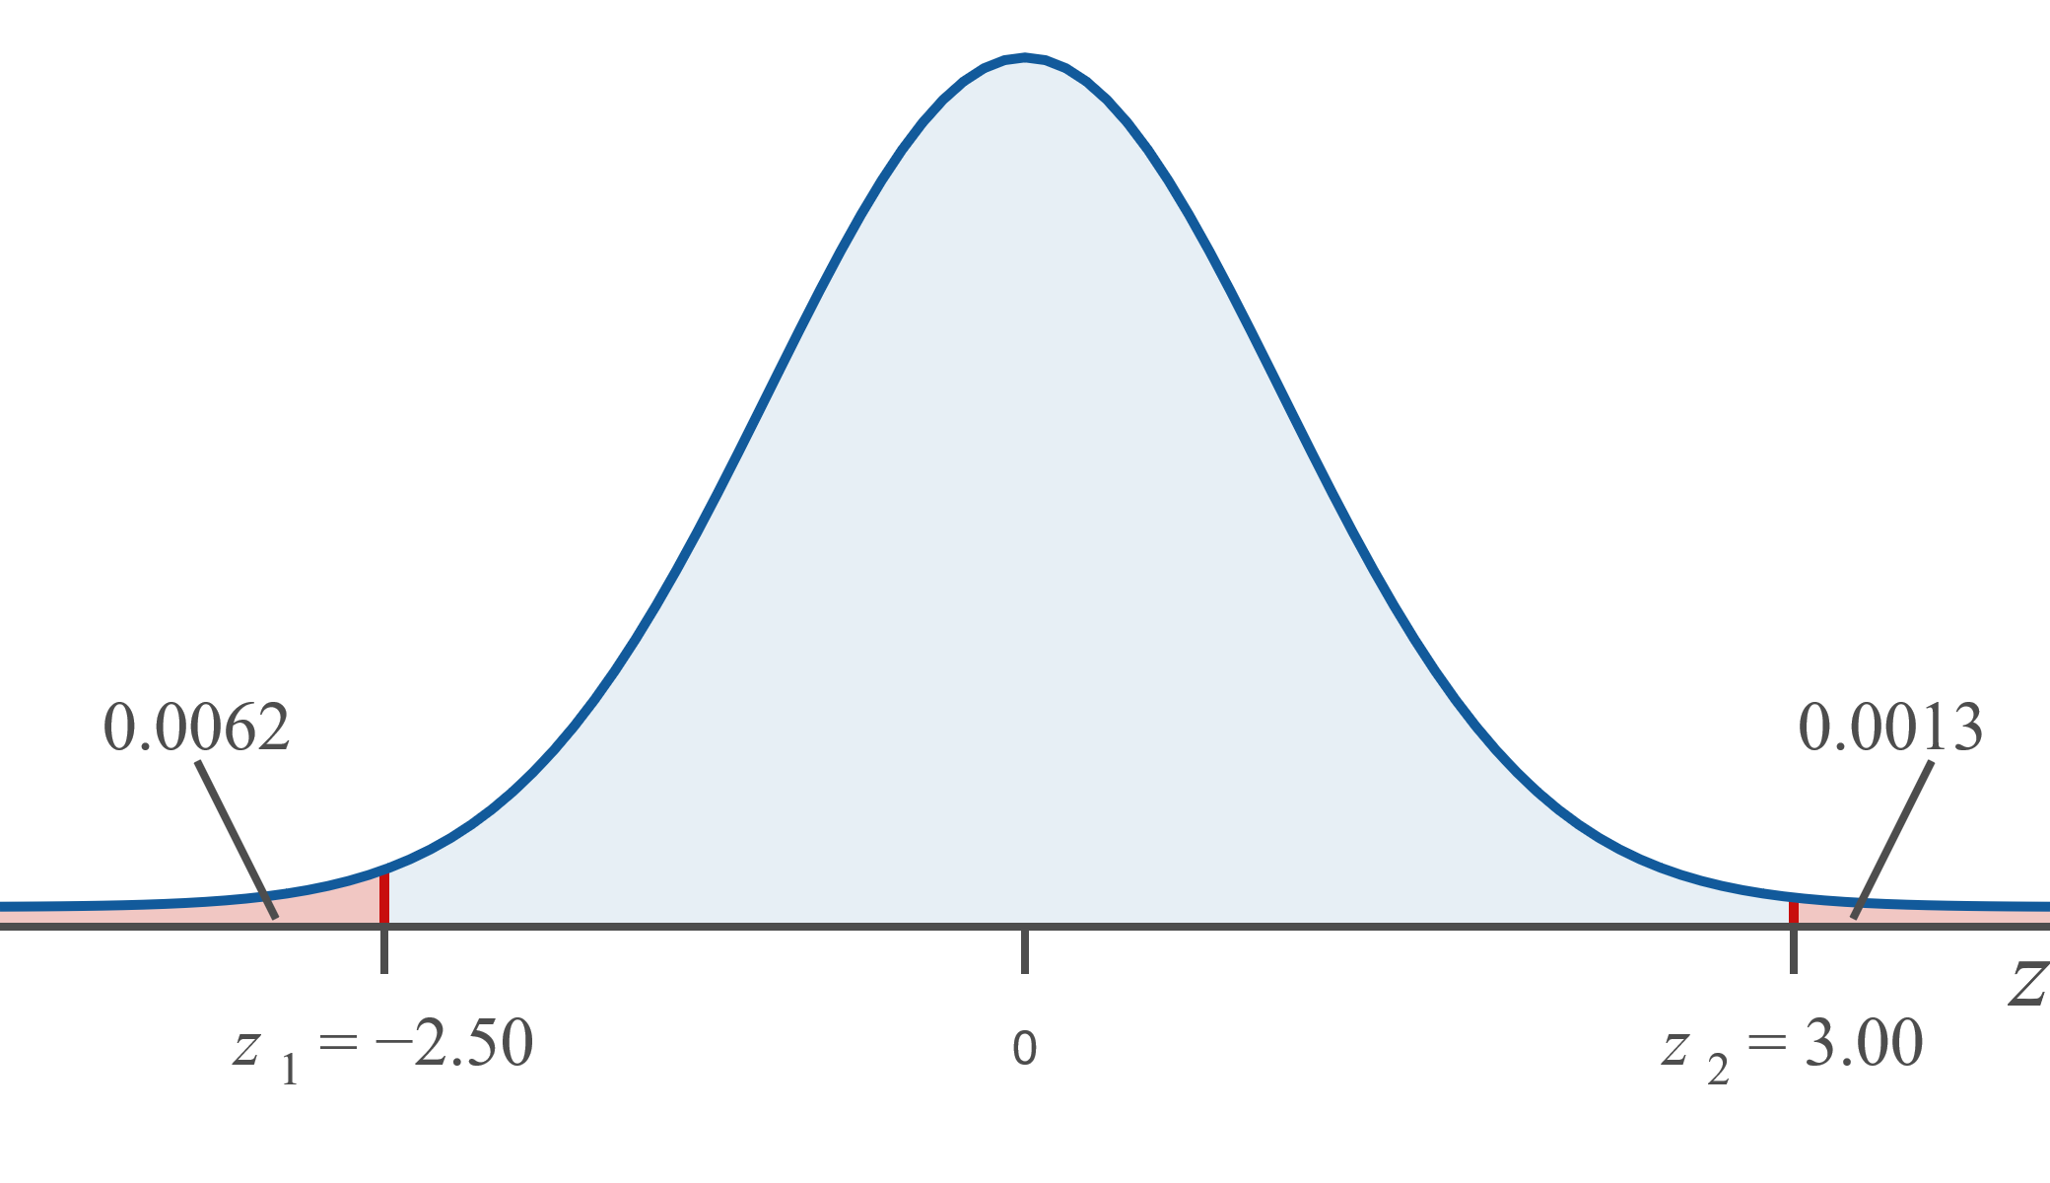
Example 6.2.7: Finding Area in the Tails for Two z-values₃

Slide 37
Example 6.2.7: Finding Area in the Tails for Two z-values₄
Thus, the total area in the tails is the sum of the two areas, 0.0062 + 0.0013 = 0.0075.

Slide 38
Example 6.2.8: Finding Area in the Tails for Two z-values₁
Find the total of the areas under the standard normal curve to the left of

Slide 39
Example 6.2.8: Finding Area in the Tails for Two z-values₂
Solution
Notice that the absolute values of
same. Thus, the areas in the two tails of the distribution will be the same because of the symmetric property of the standard normal curve. So, to find the total area in the two tails we only need to look up the area in the left tail and multiply that by 2.
We find that the area to the left of
0.1093. Multiply this area by 2 in order to obtain the combined area in the tails.

Slide 40
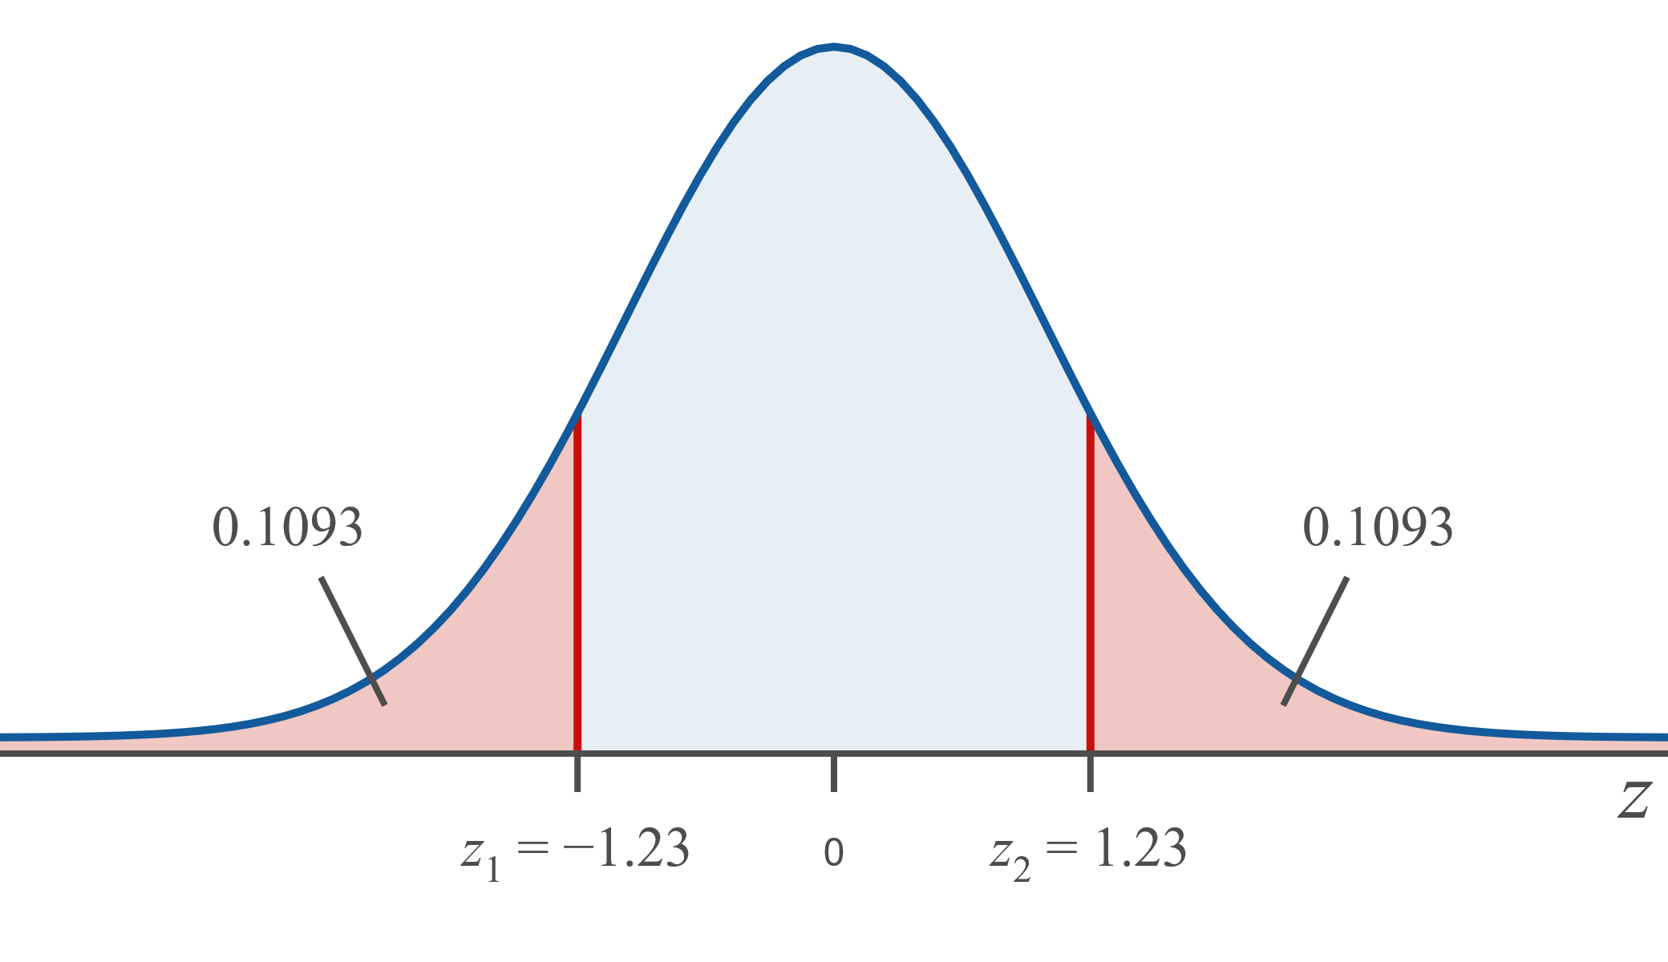
Example 6.2.8: Finding Area in the Tails for Two z-values₃
So, the total area in the two tails is approximately 0.2186.

Slide 41
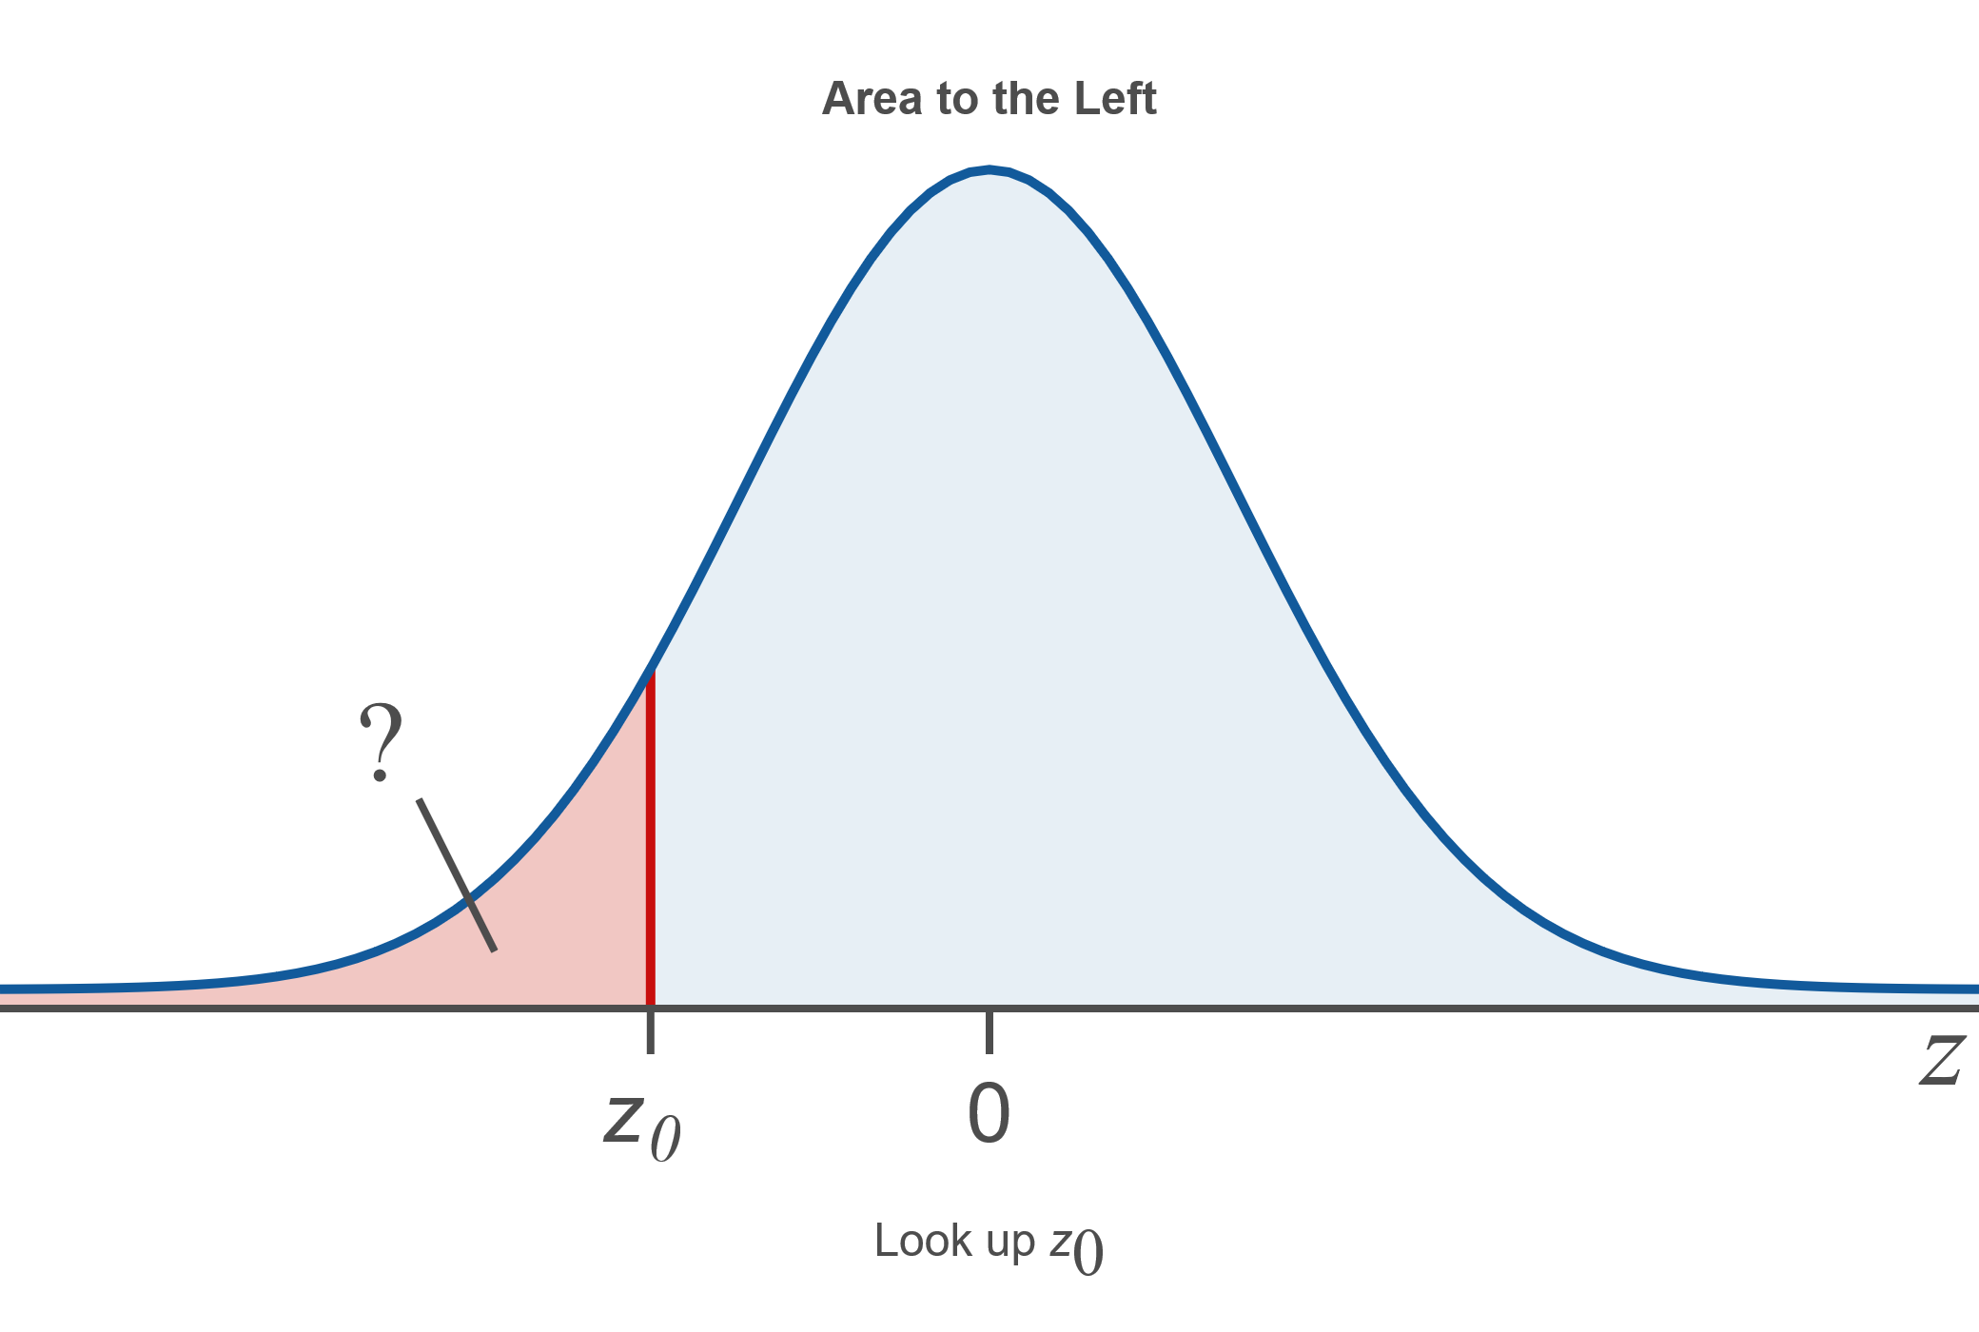
Procedure: Using the Cumulative Normal Distribution Tables to Find Areas under the Standard Normal Curve₁

Slide 42
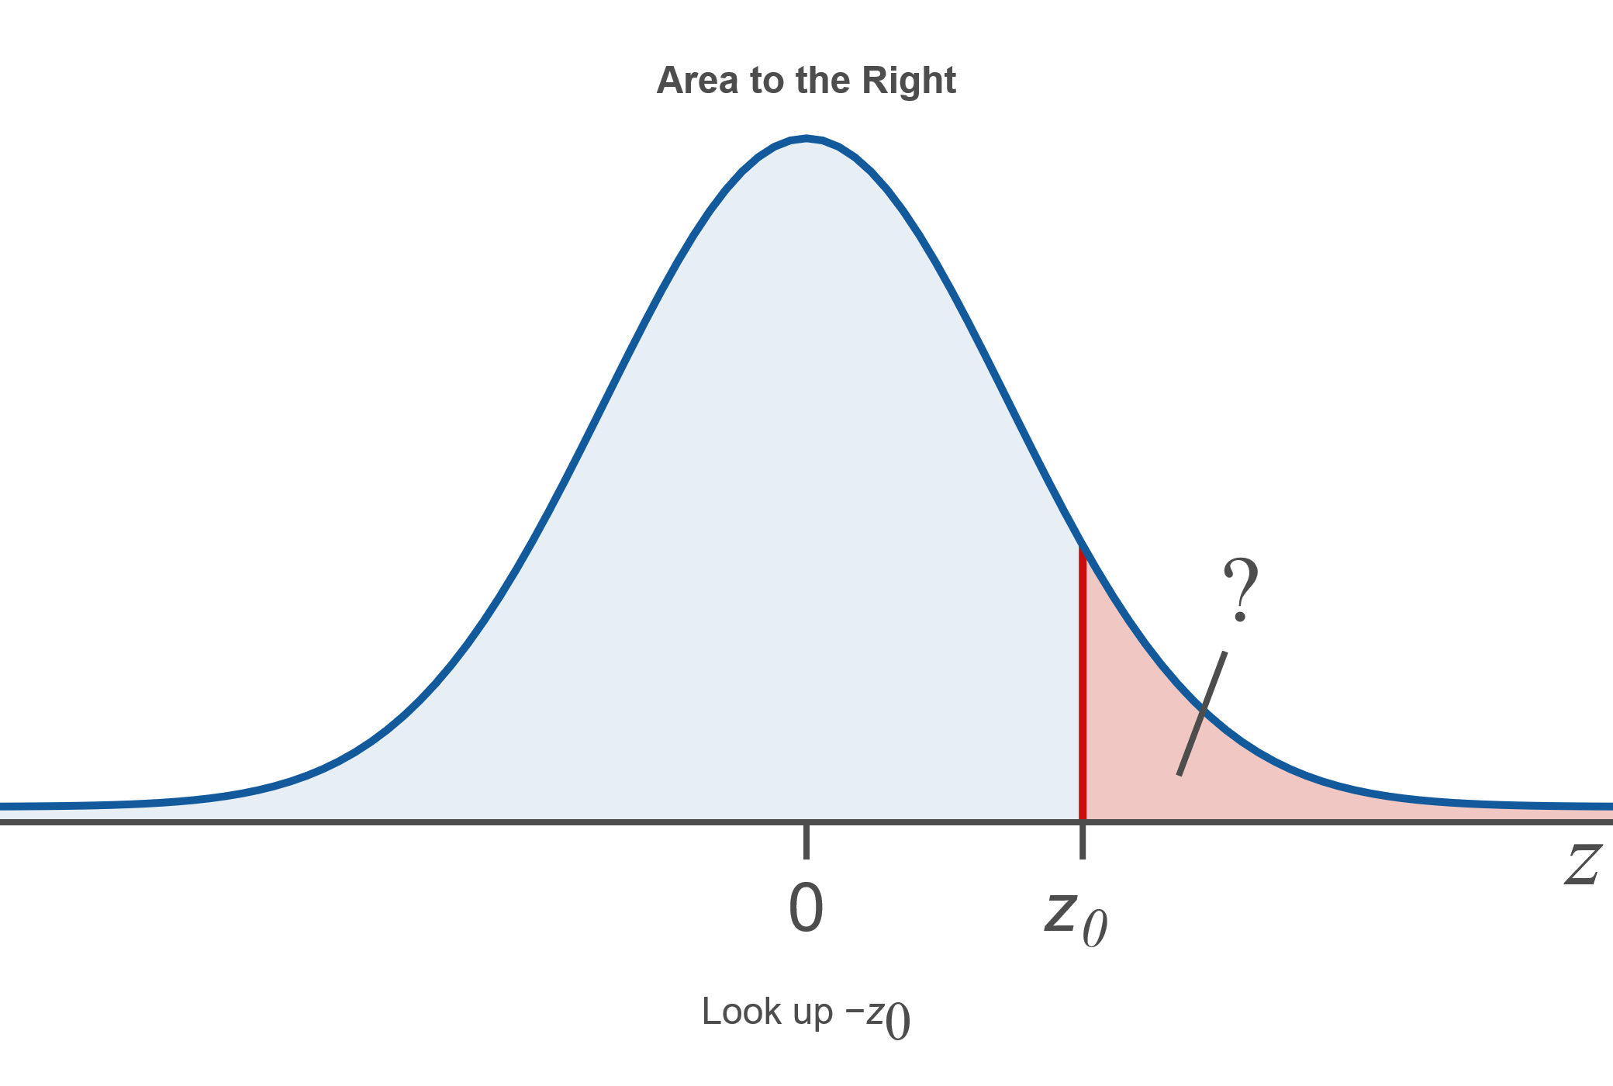
Procedure: Using the Cumulative Normal Distribution Tables to Find Areas under the Standard Normal Curve₂

Slide 43
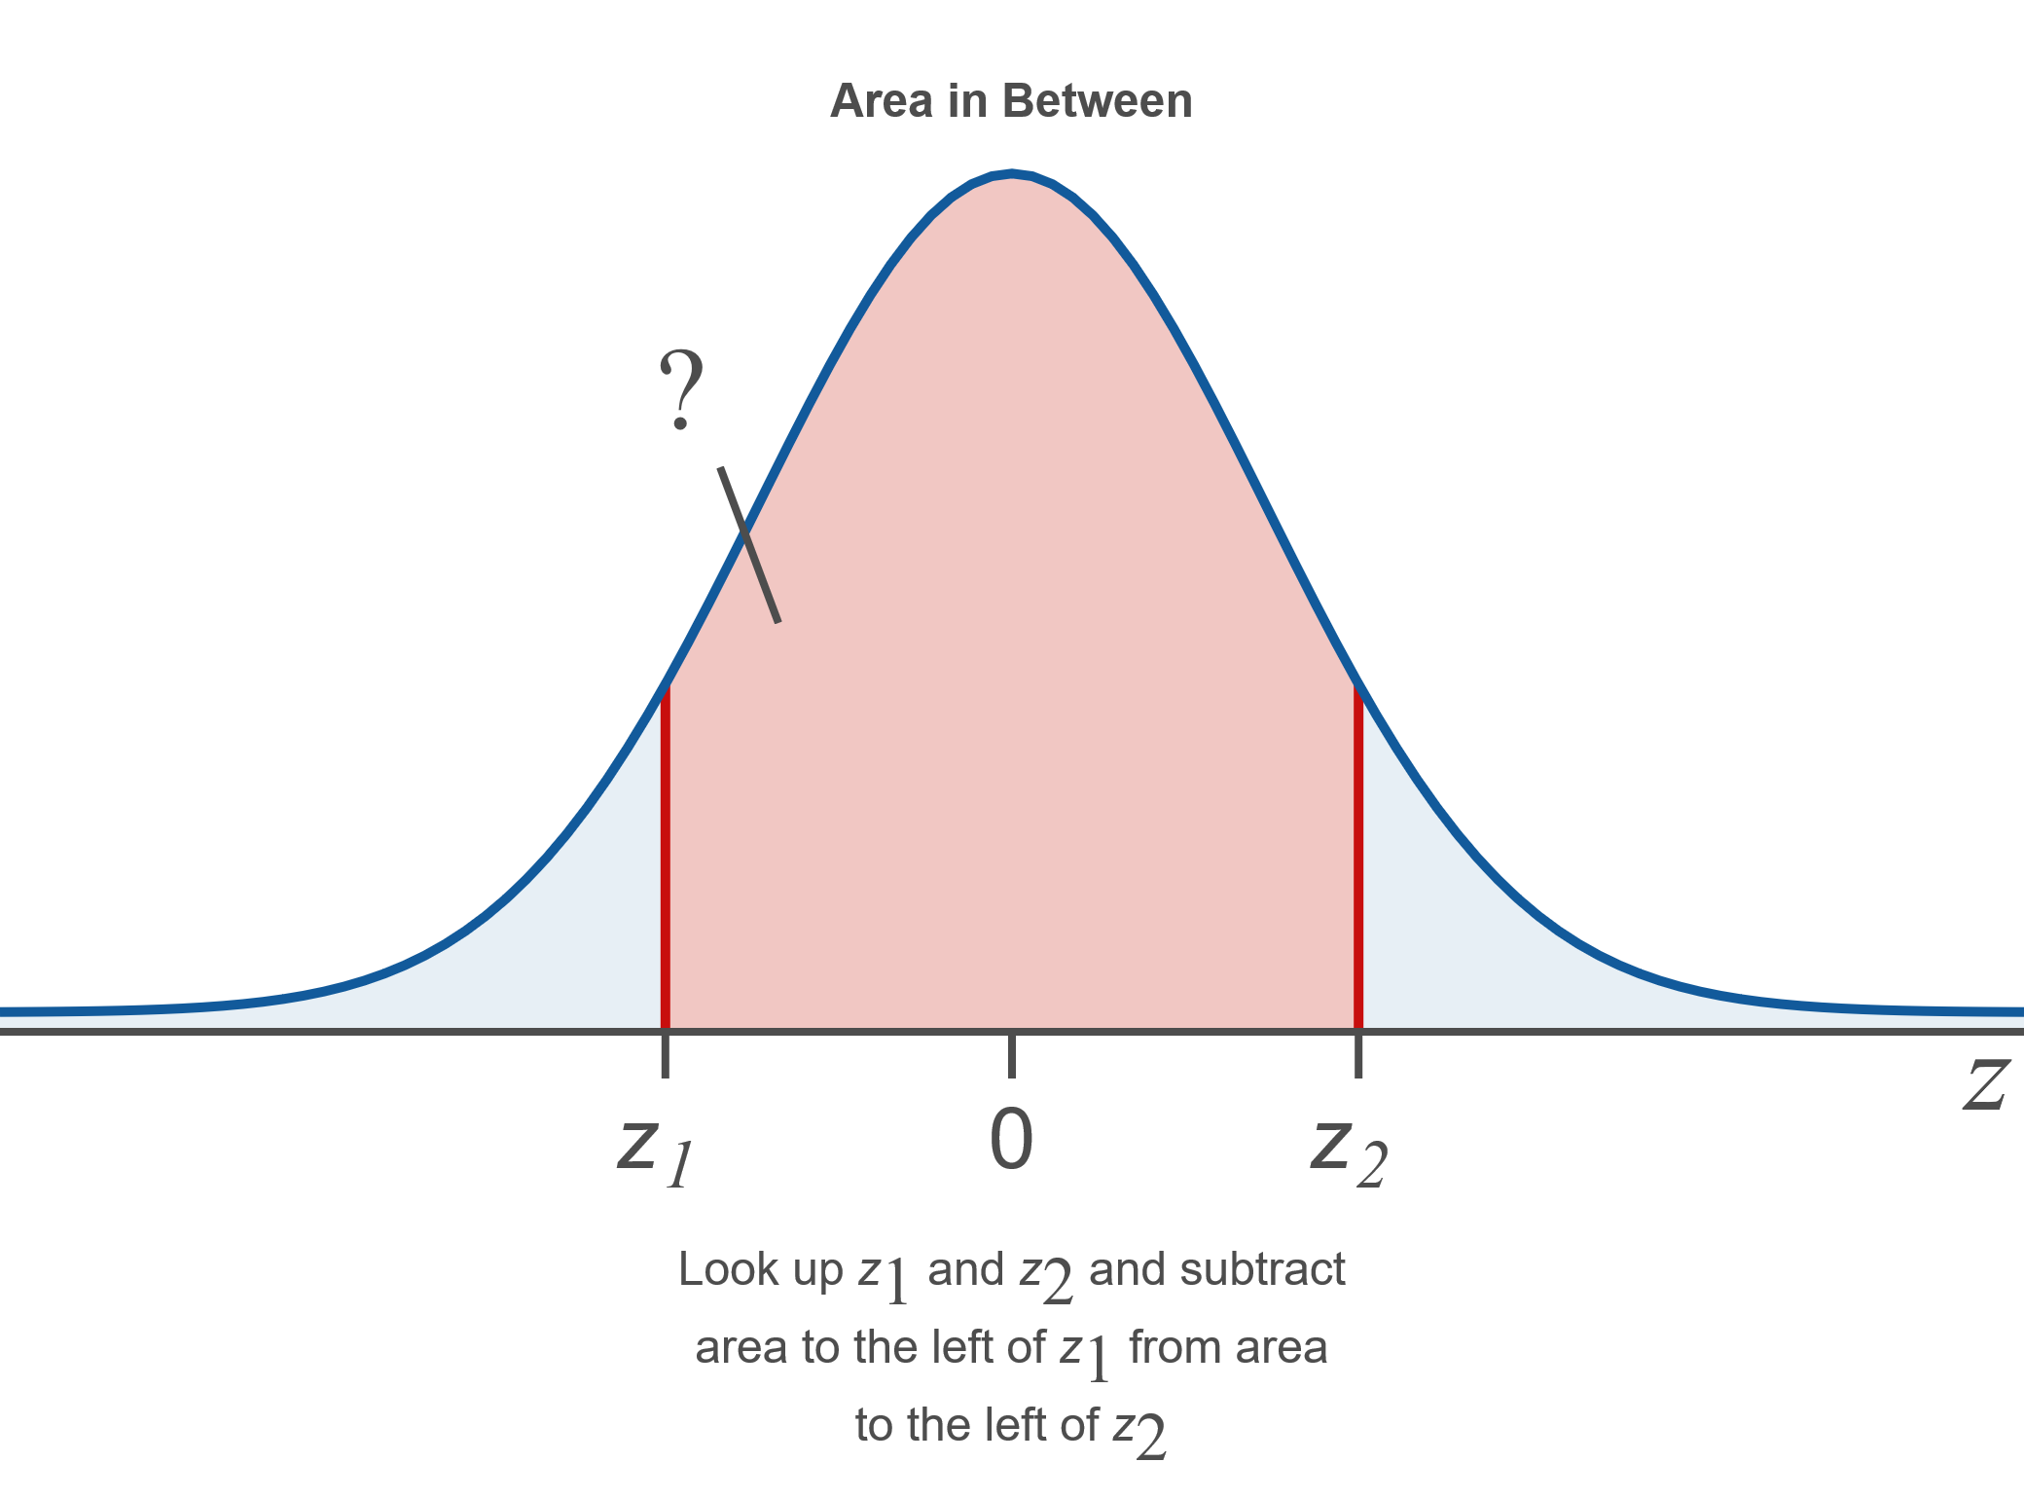
Procedure: Using the Cumulative Normal Distribution Tables to Find Areas under the Standard Normal Curve₃

Slide 44
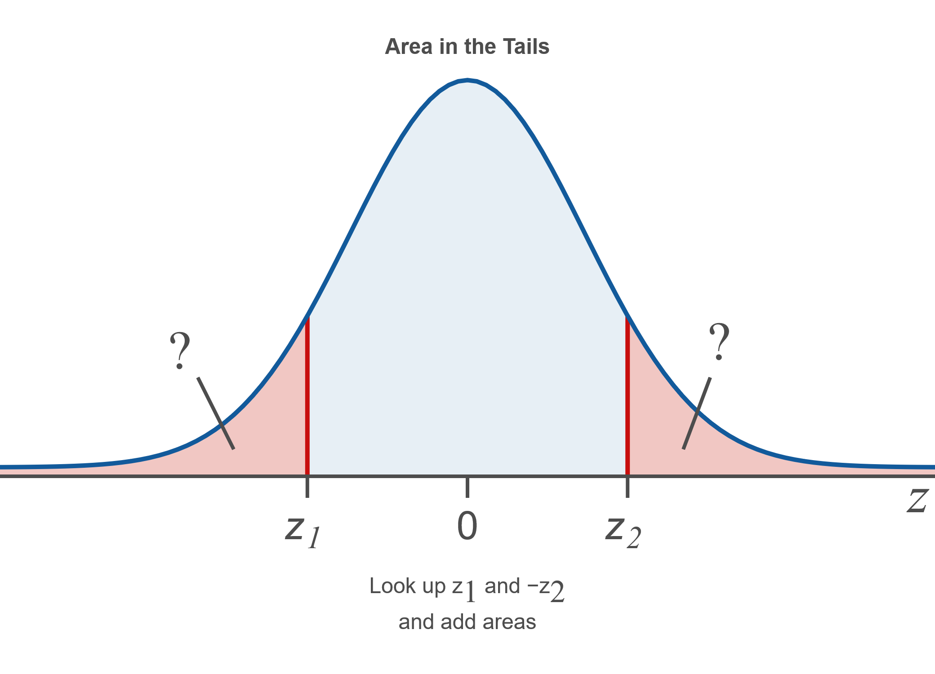
Procedure: Using the Cumulative Normal Distribution Tables to Find Areas under the Standard Normal Curve₄

Slide 45
Example 6.2.9: Interpreting Probability for the Standard Normal Distribution as an Area under the Curve₁
Interpret

Slide 46
Example 6.2.9: Interpreting Probability for the Standard Normal Distribution as an Area under the Curve₂
Solution
represents the probability that z is less
than or equal to −2.67. This is equal to the area under the standard normal curve to the left of z = −2.67, which is shaded in the following graph.

Slide 47
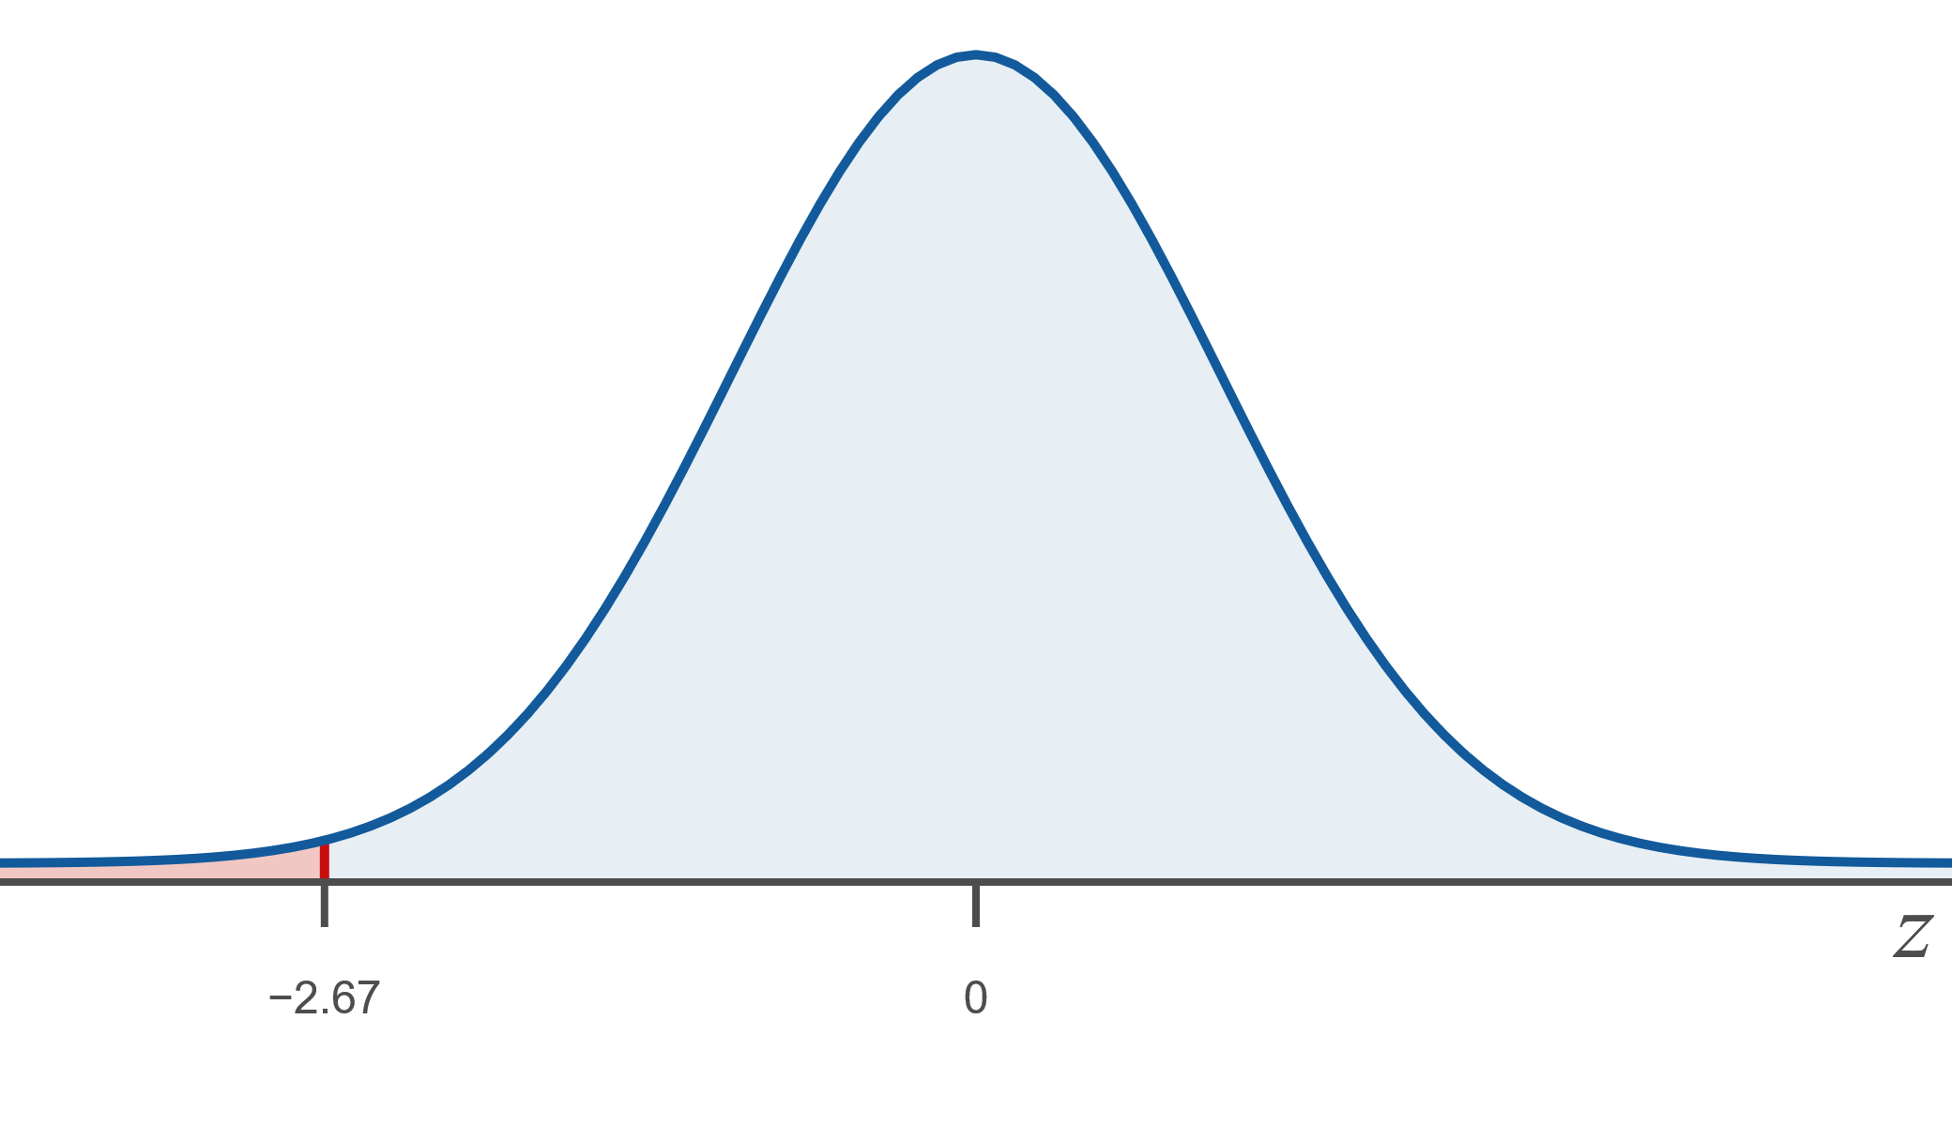
Example 6.2.9: Interpreting Probability for the Standard Normal Distribution as an Area under the Curve₃

Slide 48
Example 6.2.9: Interpreting Probability for the Standard Normal Distribution as an Area under the Curve₄
Note that the probability that z is less than a value is the same as the probability that z is less than or equal to that value, or symbolically,

Slide 49
Example 10: Finding Probabilities for the Standard Normal Distribution Using Tables or a TI-83/84 Plus Calculator₁
Find the following probabilities using the cumulative normal distribution tables or a TI-83/84 Plus calculator.

Slide 50
Example 10: Finding Probabilities for the Standard Normal Distribution Using Tables or a TI-83/84 Plus Calculator₂
Solution
For each part of this example, the solution first describes the method for finding the answer using the cumulative normal distribution tables and then explains how to find the answer using a TI-83/84 Plus calculator.
​​
is the area under the standard normal
curve to the left of z = 1.45.

Slide 51
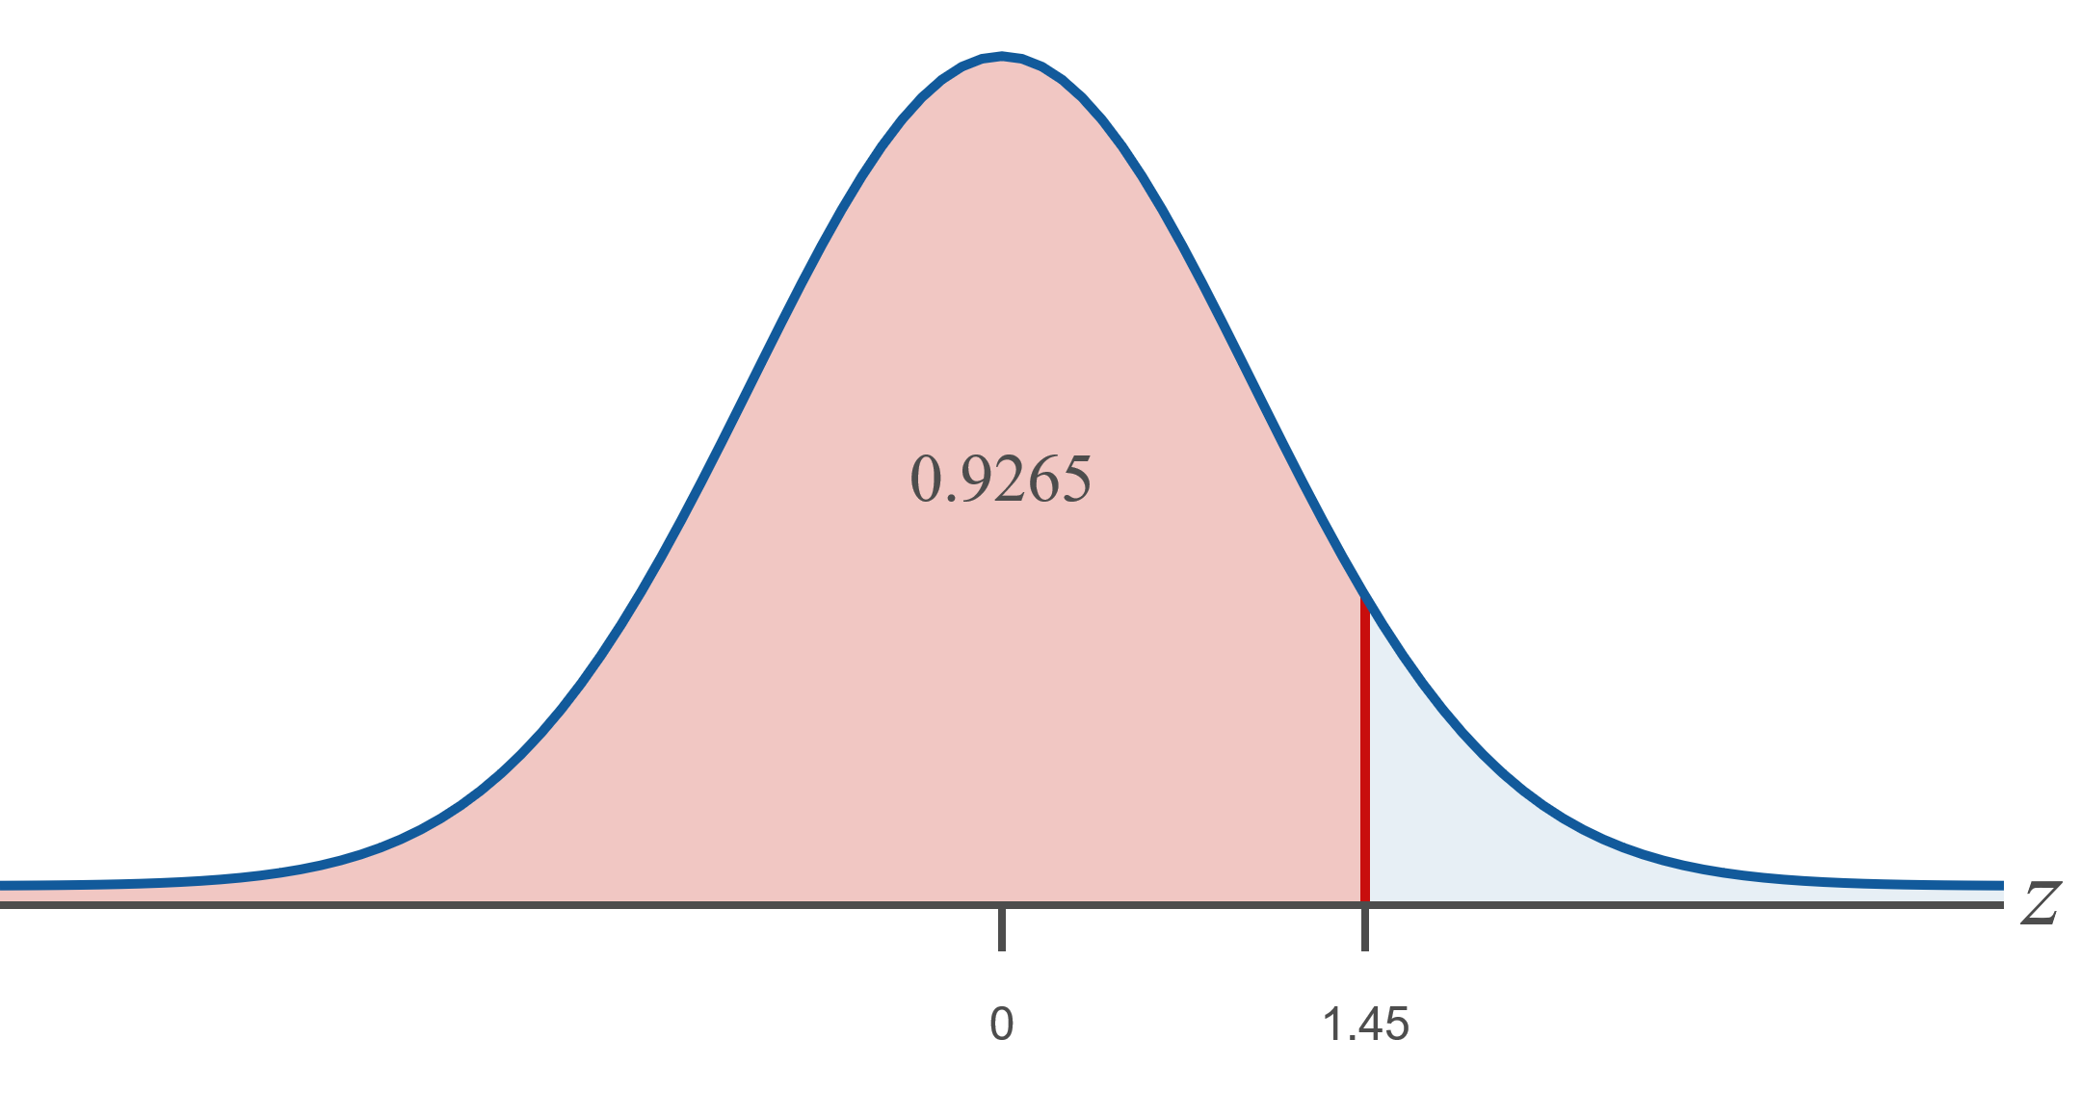
Example 10: Finding Probabilities for the Standard Normal Distribution Using Tables or a TI-83/84 Plus Calculator₃
​Tables:
​Look up z = 1.45 in the cumulative normal table for positive z-values. The area is 0.9265.

Slide 52
Example 10: Finding Probabilities for the Standard Normal Distribution Using Tables or a TI-83/84 Plus Calculator₄
​TI-83/84 Plus:
​The calculator function normal cdf (normal cumulative distribution function) will calculate a specific area under any normal curve. The calculator asks for both the lower and upper boundaries of the area we are interested in in the form normal cdf(lower bound, upper bound, μ, σ). This function can be accessed in the distribution menu, DISTR, by pressing 2ND VARS.

Slide 53
Example 10: Finding Probabilities for the Standard Normal Distribution Using Tables or a TI-83/84 Plus Calculator₅
​​Under the DISTR menu, choose option normal cdf.
​lower bound: Since we are asked to find the area to the left of z, the lower bound is −∞. We cannot enter −∞ into the calculator so we will enter a very small value for the endpoint, such as
This number appears as −1E99
when entered correctly into the calculator.
​upper bound: Our z-value is the upper bound here, z = 1.45.
The calculator’s default mode is the standard normal curve where μ = 0 and σ = 1, so we do not need to enter μ or σ.
​By entering normal cdf (−1E99, 1.45), we find the area to the left of z = 1.45 is approximately 0.9265, as shown in the screenshot.

Slide 54
Technology Tip
To enter −1E99 on a TI-83/84 Plus calculator, press (−) 1 2ND, 9 9.

Slide 55
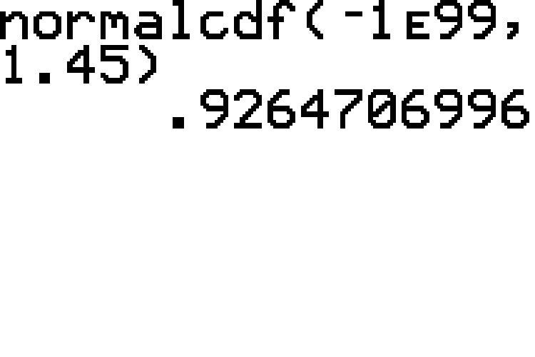
Example 10: Finding Probabilities for the Standard Normal Distribution Using Tables or a TI-83/84 Plus Calculator₆

Slide 56
Example 10: Finding Probabilities for the Standard Normal Distribution Using Tables or a TI-83/84 Plus Calculator₇
is the area under the standard normal
curve to the right of z = −1.37.

Slide 57
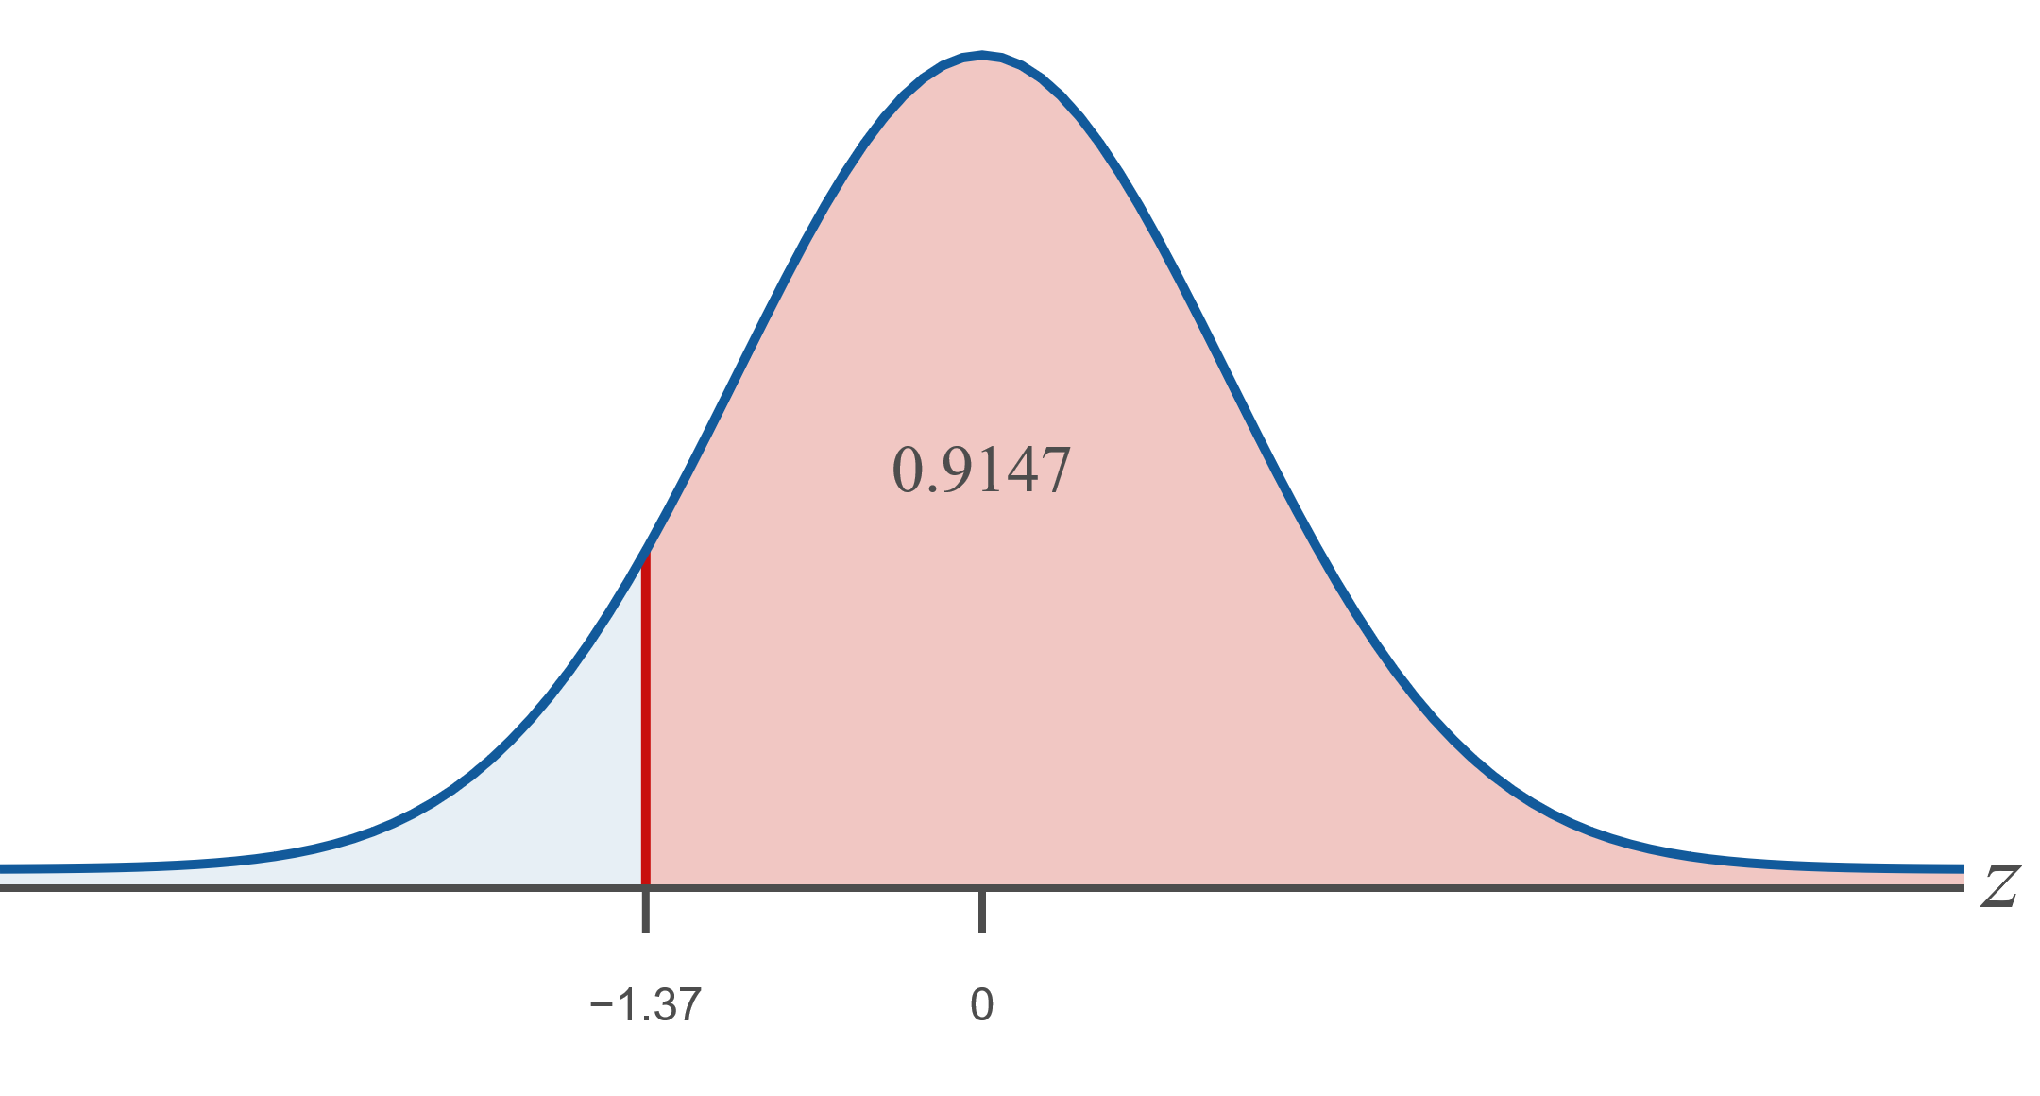
Example 10: Finding Probabilities for the Standard Normal Distribution Using Tables or a TI-83/84 Plus Calculator₈
​Tables:
​Use the symmetry property of the standard normal curve and find z = 1.37 in the cumulative normal table for positive z-values. The area to the right of z = −1.37 is 0.9147.
​

Slide 58
Example 10: Finding Probabilities for the Standard Normal Distribution Using Tables or a TI-83/84 Plus Calculator₉
​TI-83/84 Plus:
​Under the DISTR menu, choose option normal cdf(.
​lower bound: Because we want the area to the right of z, the z-value is the lower bound here, −1.37.
​upper bound: The upper bound is ∞. Because the calculator will not allow us to enter ∞ for the upper endpoint, we will choose a sufficiently large number, such as
​
​
This number appears as 1E99 on the calculator.
Once again, we are using the standard normal curve, which is the calculator's default, so we do not need to enter μ or σ.
​By entering normal cdf (−1.37, 1E99), we find the area to the right of z = −1.37 is approximately 0.9147, as shown in the screenshot.

Slide 59
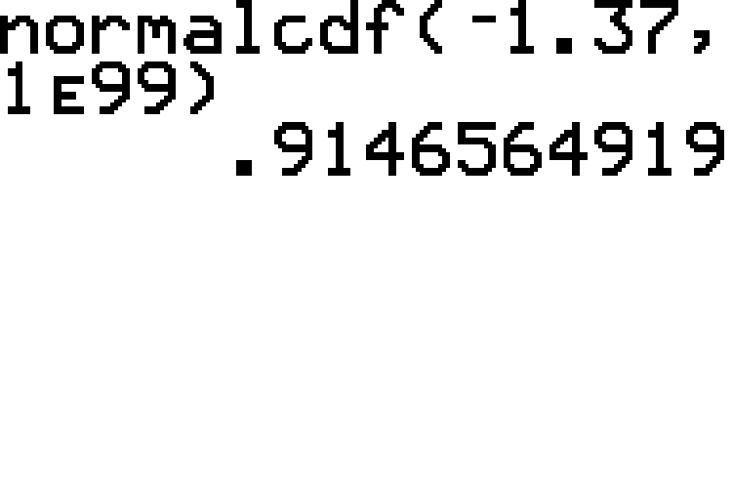
Example 10: Finding Probabilities for the Standard Normal Distribution Using Tables or a TI-83/84 Plus Calculator₁₀

Slide 60
Example 10: Finding Probabilities for the Standard Normal Distribution Using Tables or a TI-83/84 Plus Calculator₁₁
is the area under the standard
normal curve between
Tables:
​Look up each value in the cumulative normal table for positive z-values, Table B. The area to the left of
the difference between these two areas. Thus, the area is 0.9896 − 0.8944 = 0.0952.

Slide 61
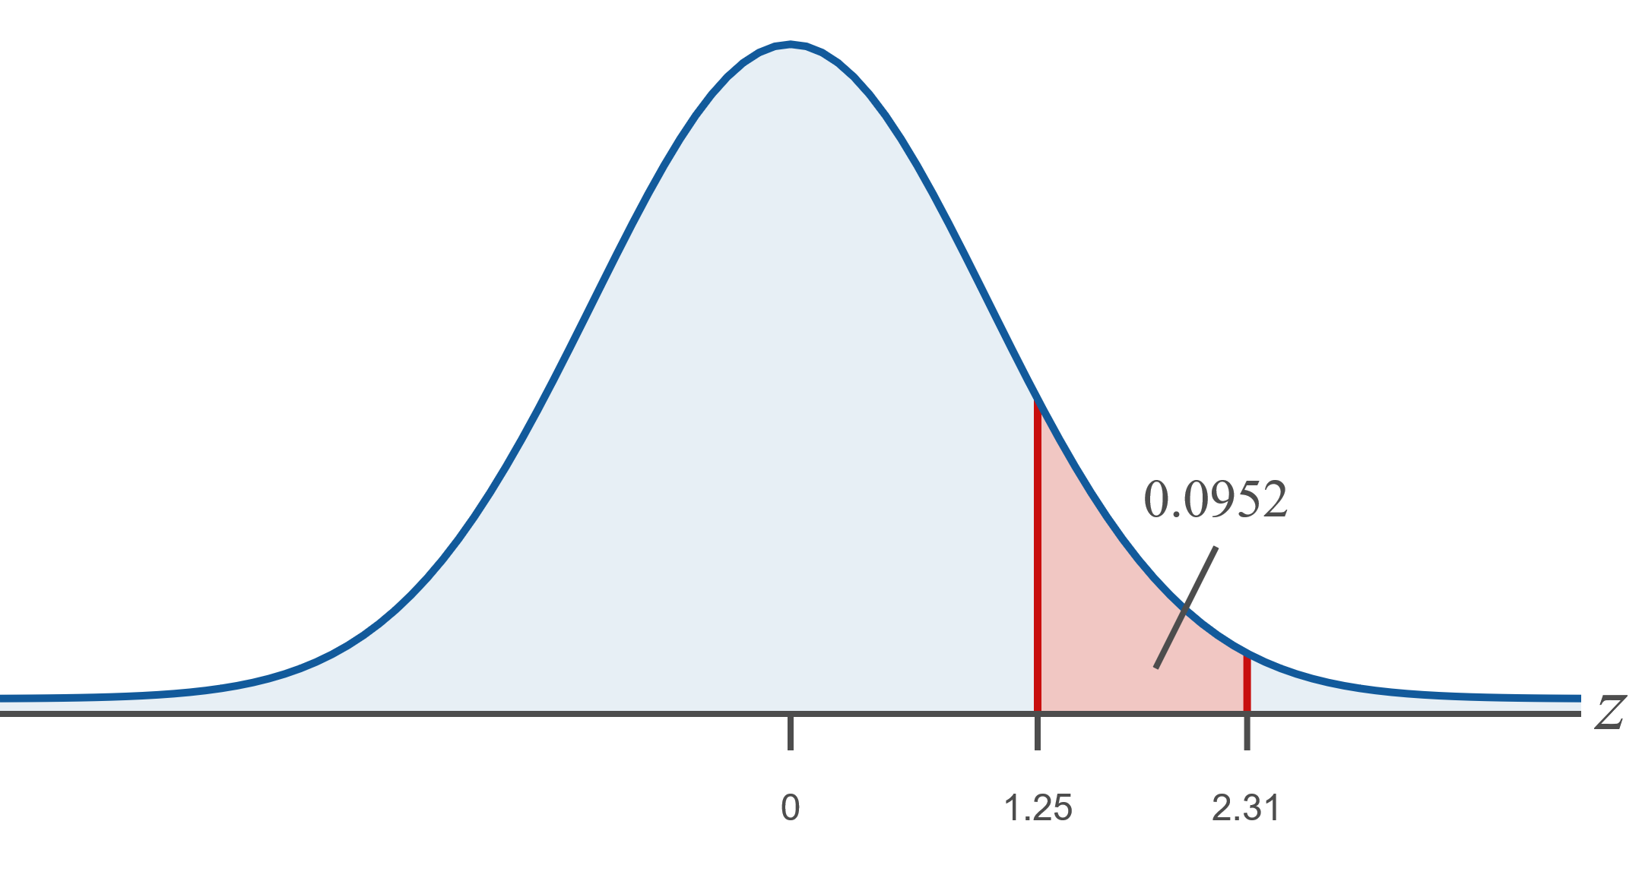
Example 10: Finding Probabilities for the Standard Normal Distribution Using Tables or a TI-83/84 Plus Calculator₁₂

Slide 62
Example 10: Finding Probabilities for the Standard Normal Distribution Using Tables or a TI-83/84 Plus Calculator₁₃
​TI-83/84 Plus:
​Under the DISTR menu, choose option normal cdf
​lower bound: The smaller z-value is the lower bound, 1.25.
​upper bound: The larger z-value is the upper bound, 2.31.
​By entering normal cdf(1.25, 2.31), we find that the area between z₁ = 1.25 and z₂ = 2.31 is approximately 0.0952, as shown in the following screenshot.

Slide 63
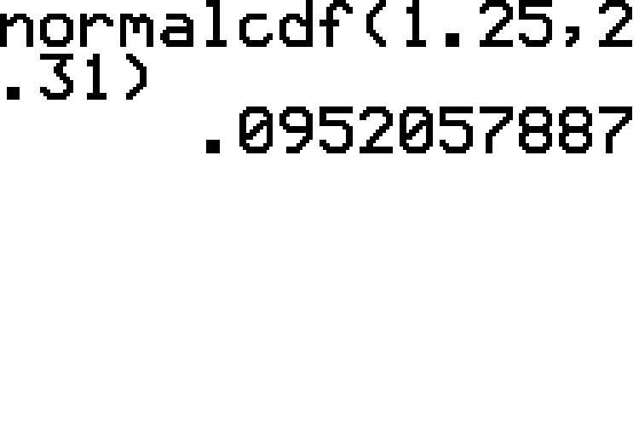
Example 10: Finding Probabilities for the Standard Normal Distribution Using Tables or a TI-83/84 Plus Calculator₁₄

Slide 64
Example 10: Finding Probabilities for the Standard Normal Distribution Using Tables or a TI-83/84 Plus Calculator₁₅
is the sum of the areas to the
Tables:
​Notice that the absolute values of
same. Since the normal curve is symmetric, these two areas are the same; therefore, look up the area to the left of z = −2.50 in the cumulative normal table for negative z-values, and multiply that area by 2. The area to the left of
are interested in is

Slide 65
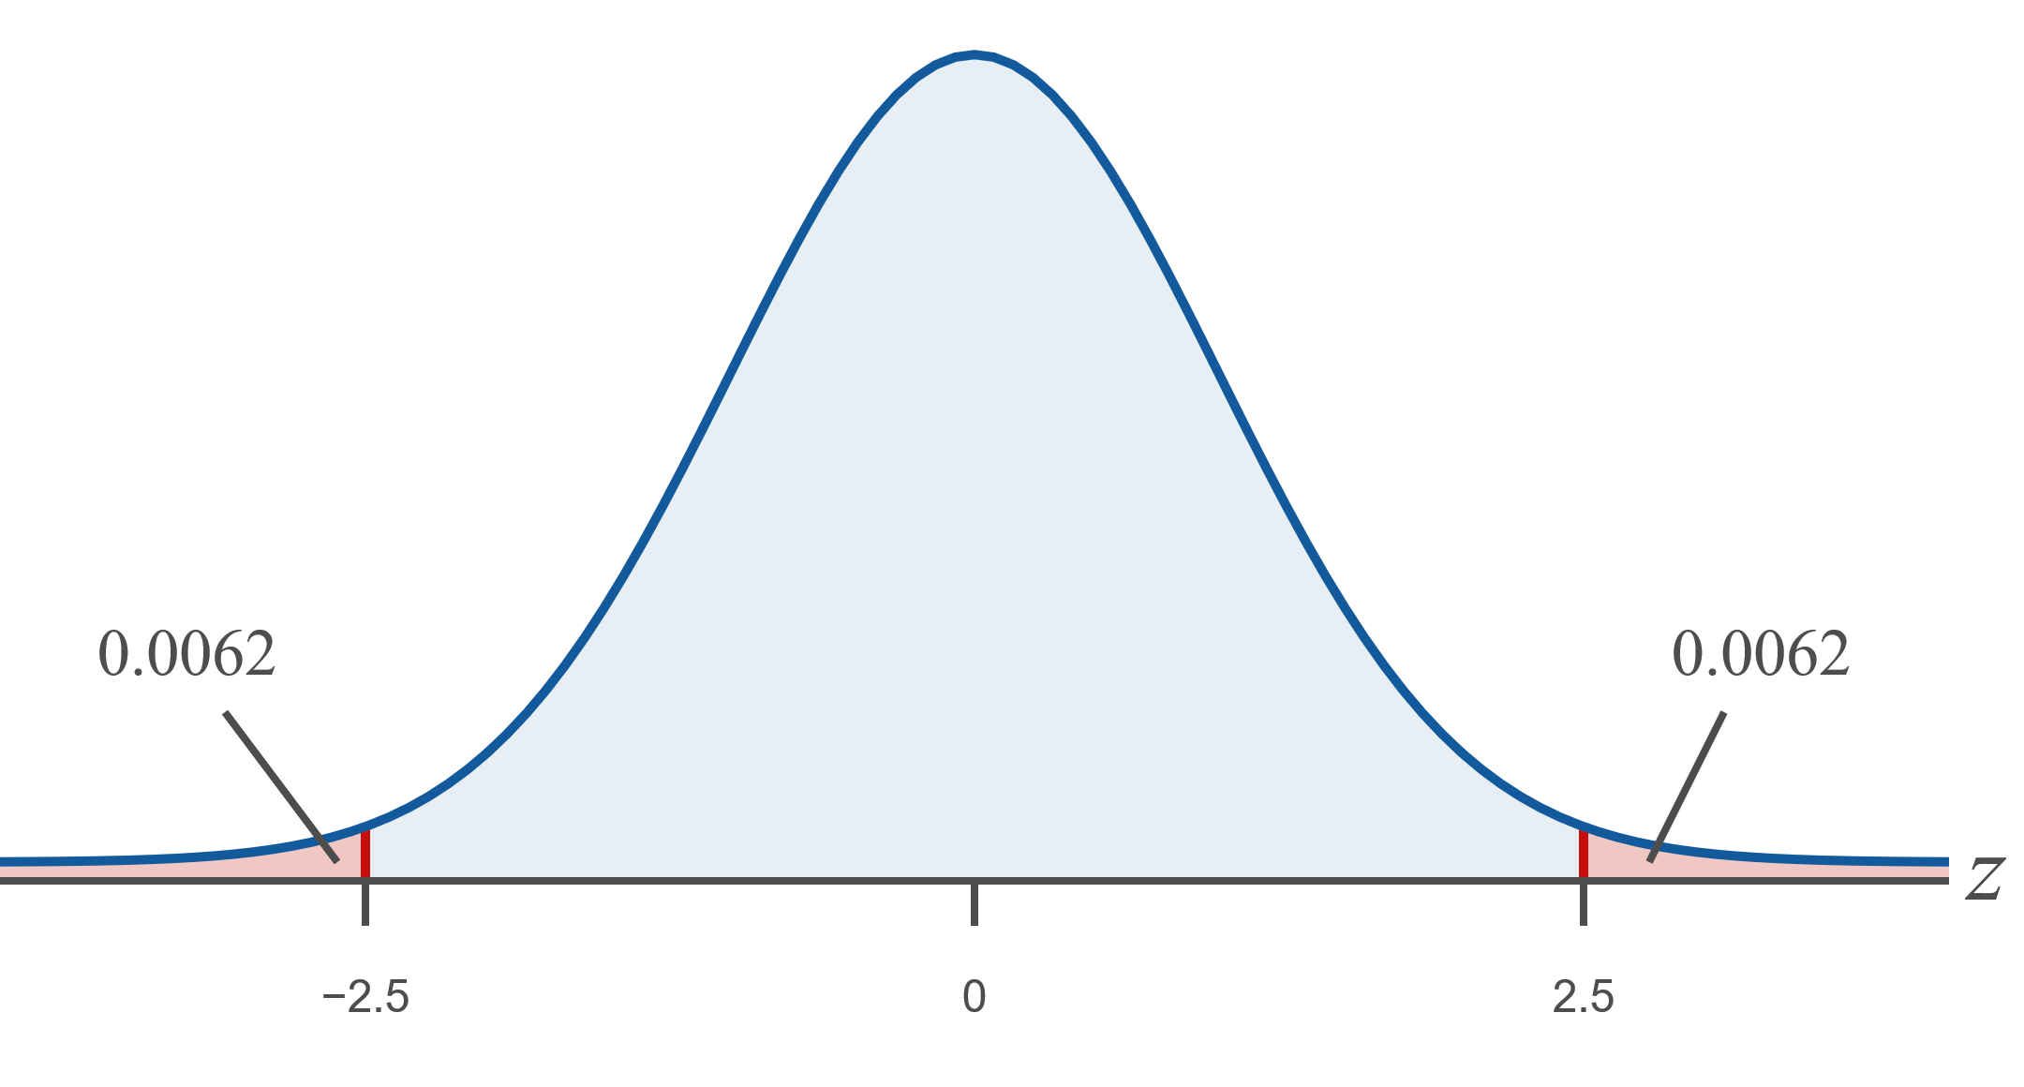
Example 10: Finding Probabilities for the Standard Normal Distribution Using Tables or a TI-83/84 Plus Calculator₁₆

Slide 66
Example 10: Finding Probabilities for the Standard Normal Distribution Using Tables or a TI-83/84 Plus Calculator₁₇
​TI-83/84 Plus:
​The area in the tails can be found in one step on the calculator. Notice that since the absolute values of
​​
to choose from. We can either double the area to the left of the negative z or we can find the area between the two z-values and subtract it from one. We will use the second method here. Remember that to find the area between two z-values, we need the upper and lower endpoints.

Slide 67
Example 10: Finding Probabilities for the Standard Normal Distribution Using Tables or a TI-83/84 Plus Calculator₁₈
​lower bound: The smaller z-value is the lower bound, −2.5.
​upper bound: The larger z-value is the upper bound, 2.5.
​Enter 1−normal cdf(−2.5,2.5) using option normal cdf(under the DIST menu. We find that the sum of the areas to the left of
​

Slide 68
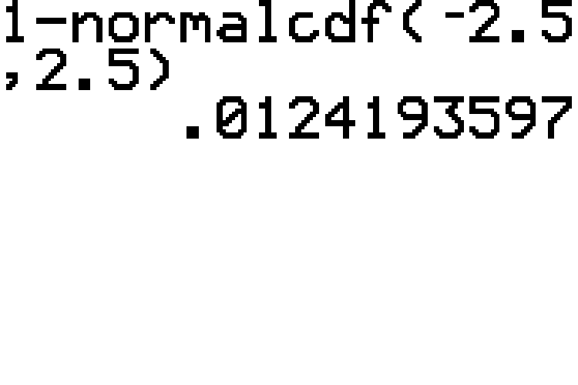
Example 10: Finding Probabilities for the Standard Normal Distribution Using Tables or a TI-83/84 Plus Calculator₁₉

Slide 69
Example 10: Finding Probabilities for the Standard Normal Distribution Using Tables or a TI-83/84 Plus Calculator₂₀
is the area under the standard normal
curve to the left of z = −4.01.
​Tables:
​Notice that z = −4.01 is not in the cumulative normal table for negative z-values. It is smaller than the z-values in the table, which means that it is further to the left. Thus, the area under the curve is smaller than all of the areas listed in the table. Therefore, P (z < −4.01) is approximately 0.0000.

Slide 70
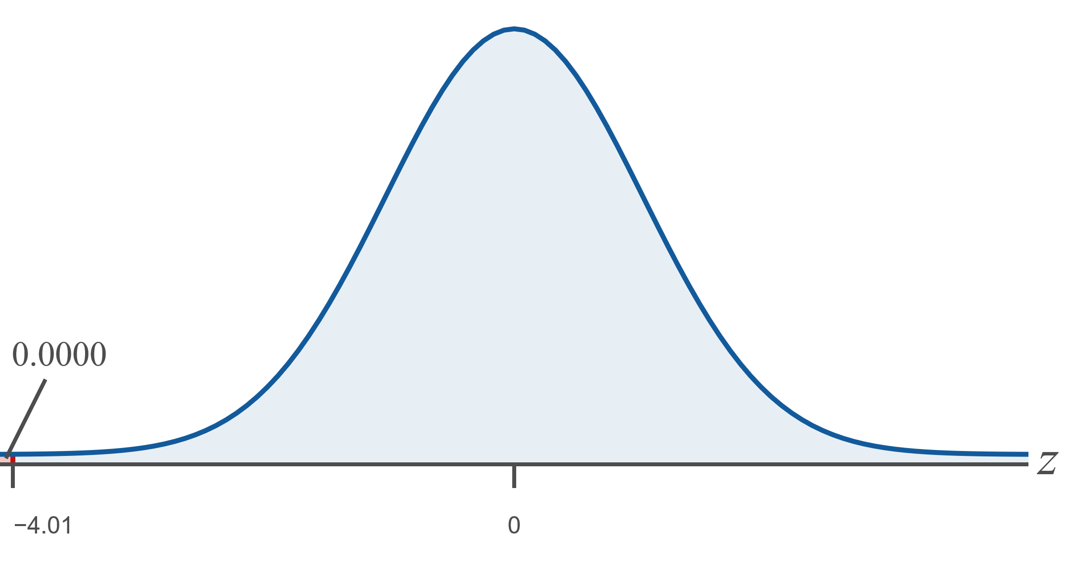
Example 10: Finding Probabilities for the Standard Normal Distribution Using Tables or a TI-83/84 Plus Calculator₂₁

Slide 71
Example 10: Finding Probabilities for the Standard Normal Distribution Using Tables or a TI-83/84 Plus Calculator₂₂
​TI-83/84 Plus:
​Under the DISTR menu, choose option normal cdf.
​lower bound: −∞, which we estimate on the calculator using −1E99.
​upper bound: z = −4.01.
​By entering normal cdf(−1E99,−4.01), the calculator displays an answer in scientific notation that is approximately equal to 0.00003 for the area to the left of z = −4.01, as shown in the screenshot. Notice that the calculator answer gives a finer precision than the tables allow.
​

Slide 72
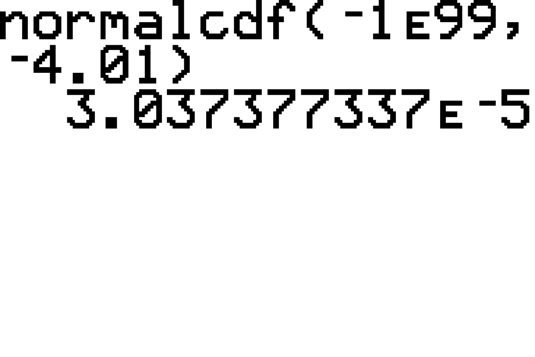
Example 10: Finding Probabilities for the Standard Normal Distribution Using Tables or a TI-83/84 Plus Calculator₂₃

Slide 73
Example 10: Finding Probabilities for the Standard Normal Distribution Using Tables or a TI-83/84 Plus Calculator₂₄
is the area under the standard normal
curve to the left of z = 3.98.
Tables:
​Notice that z = 3.98 is not in the cumulative normal table for positive z-values. It is larger than the z-values in the table, which means that it is further to the right. Thus, the area under the curve is larger than all of the areas listed in the table. Therefore,
approximately 1.0000.

Slide 74
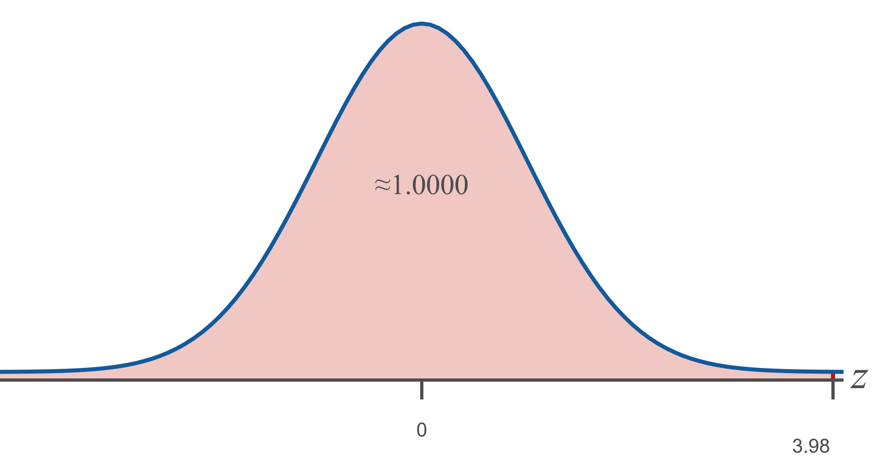
Example 10: Finding Probabilities for the Standard Normal Distribution Using Tables or a TI-83/84 Plus Calculator₂₅

Slide 75
Example 10: Finding Probabilities for the Standard Normal Distribution Using Tables or a TI-83/84 Plus Calculator₂₆
​TI-83/84 Plus:
​Under the DISTR menu, choose option normal cdf.
​lower bound: −∞. We cannot enter −∞ into the calculator so we will enter a very small value for the endpoint, such as
This number appears as
−1E99 on the calculator.
​upper bound: z = 3.98.
​By entering normal cdf(−1E99, 3.98), we find that the area to the left of z = 3.98 is approximately 1.0000, as shown in the screenshot.

Slide 76
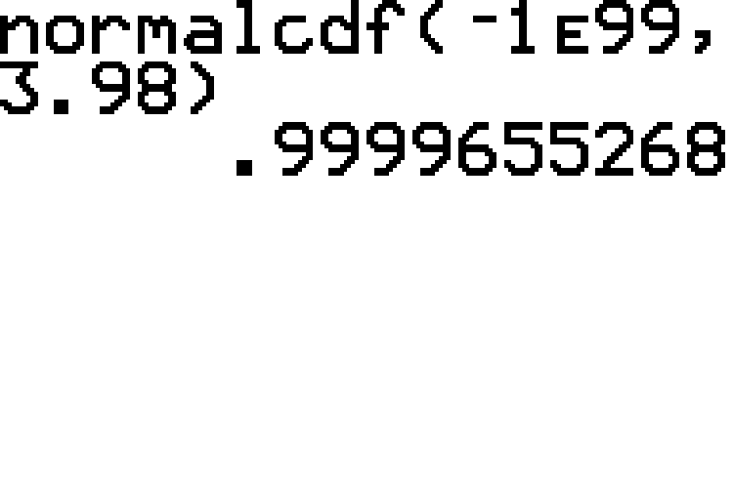
Example 10: Finding Probabilities for the Standard Normal Distribution Using Tables or a TI-83/84 Plus Calculator₂₇

Slide 77
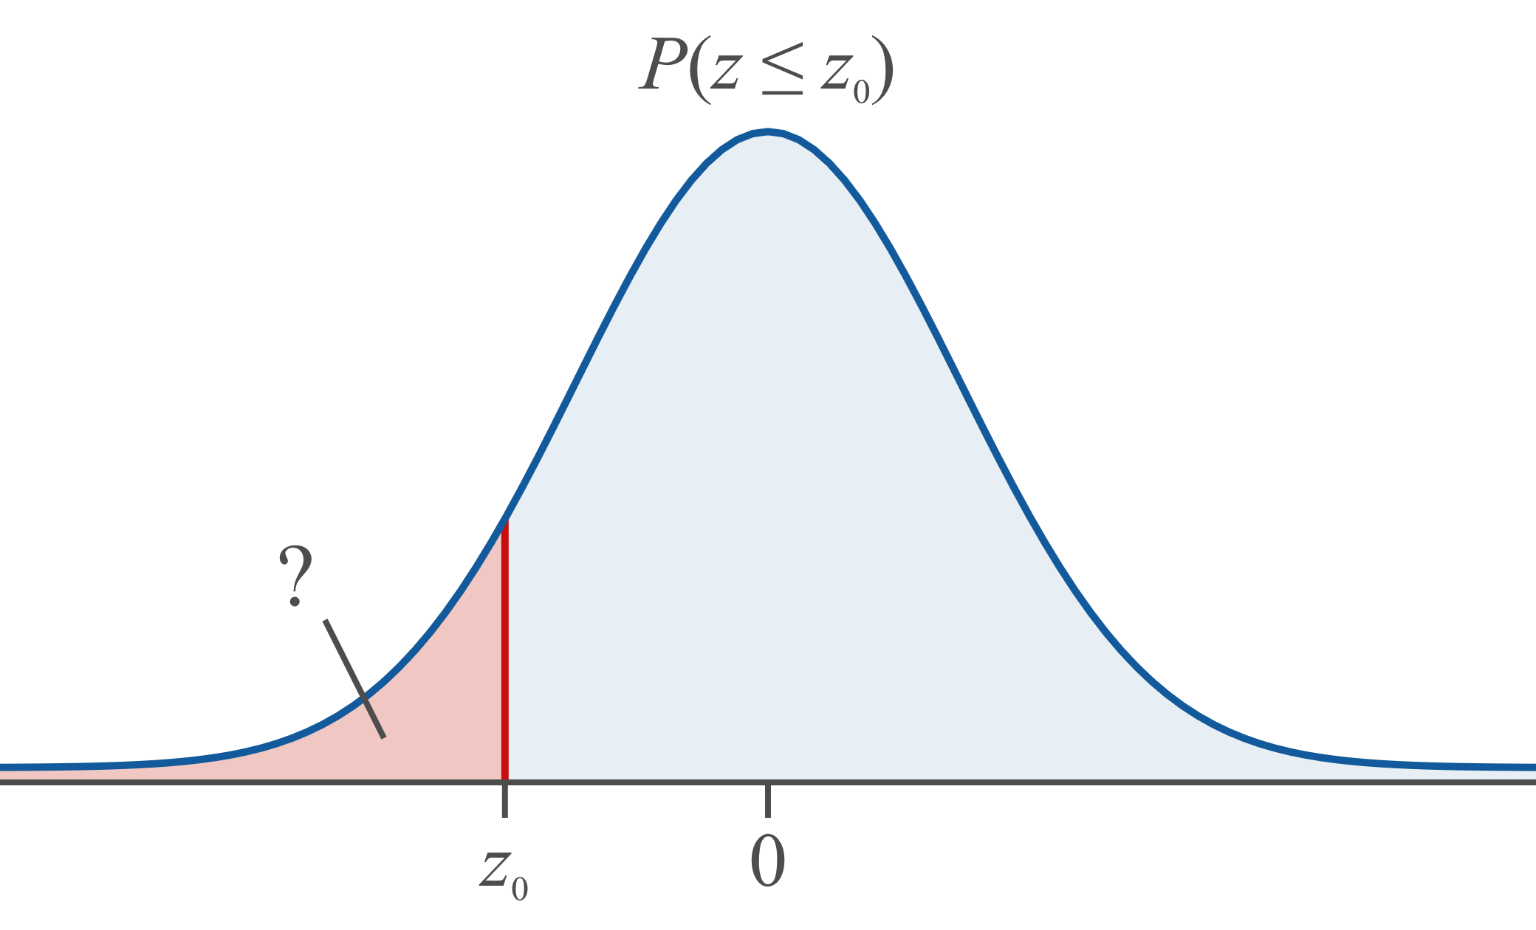
Procedure: Using a TI-83/84 Plus Calculator to Find Areas under the Standard Normal Curve₁

Slide 78
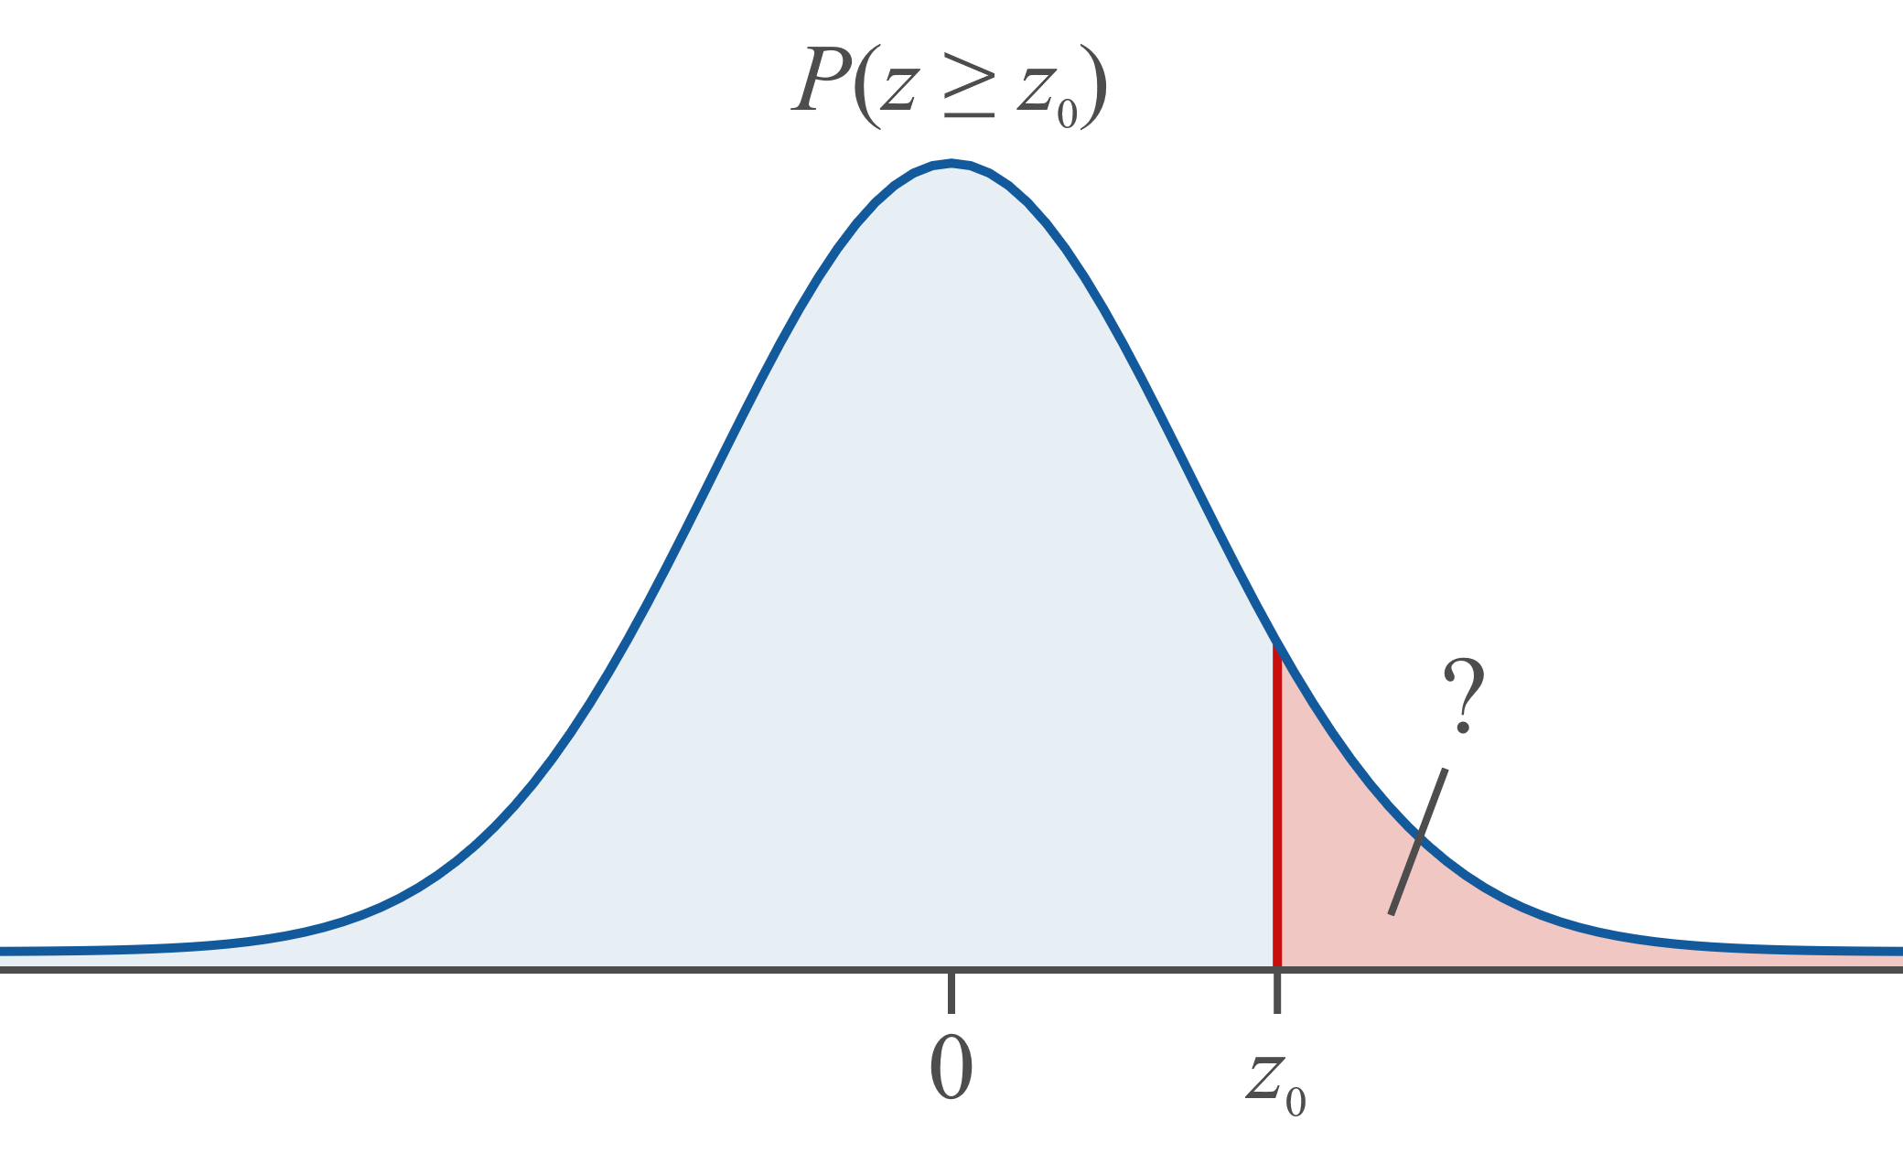
Procedure: Using a TI-83/84 Plus Calculator to Find Areas under the Standard Normal Curve₂

Slide 79
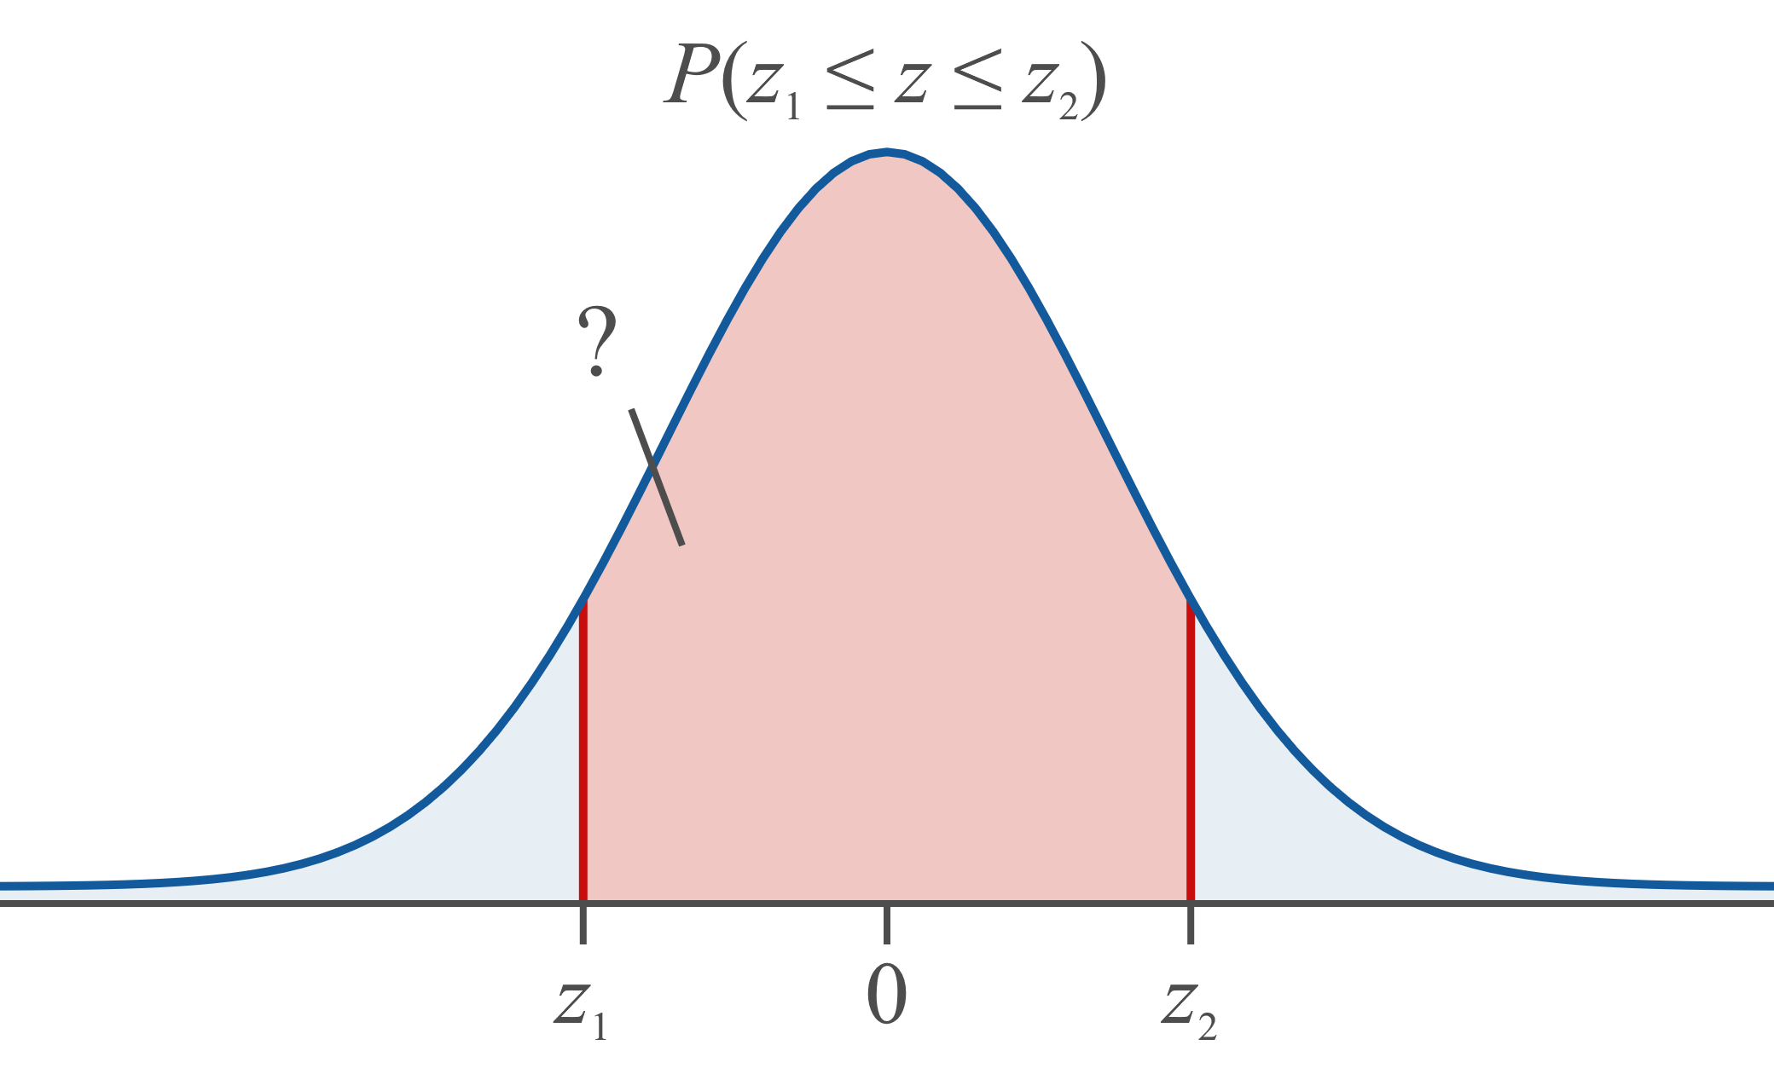
Procedure: Using a TI-83/84 Plus Calculator to Find Areas under the Standard Normal Curve₃

Slide 80
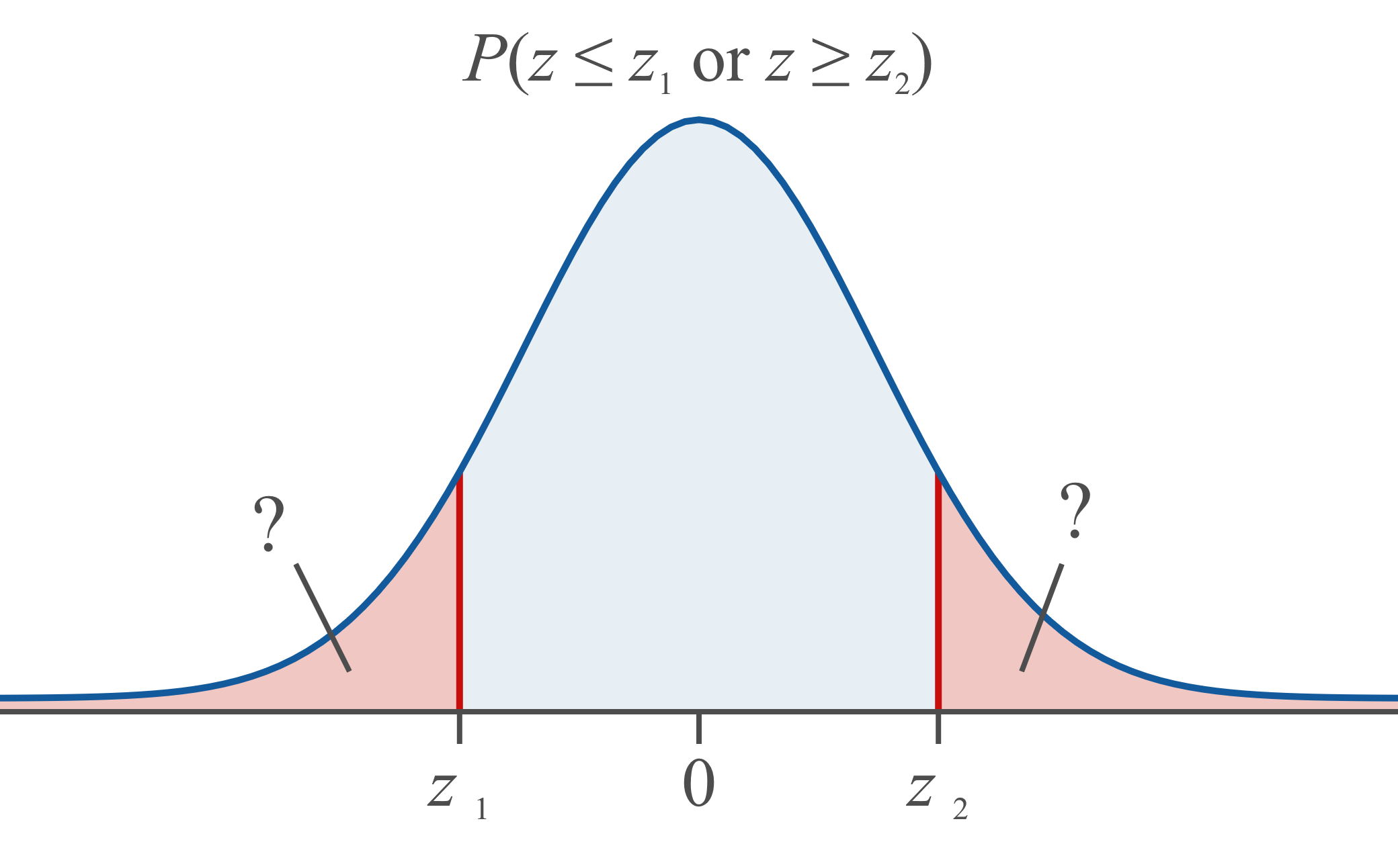
Procedure: Using a TI-83/84 Plus Calculator to Find Areas under the Standard Normal Curve₄

