Slide 1
Section 5.1
Discrete Random Variables

Slide 2
Definitions₁
A random variable is a variable whose numeric value is determined by the outcome of a probability experiment.

Slide 3
Memory Booster₁
Uppercase or lowercase?
X = random variable
x = specific value of the random variable

Slide 4
Definitions₂
A probability distribution is a table or formula that gives the probabilities for every value of the random variable X, where
such that the following properties are true:
1. All of the probabilities are between 0 and 1, inclusive. That is,
2. The sum of the probabilities is 1. That is,

Slide 5
Example 5.1.1: Creating a Discrete Probability Distribution₁
Create a discrete probability distribution for X, the sum of two rolled dice.

Slide 6
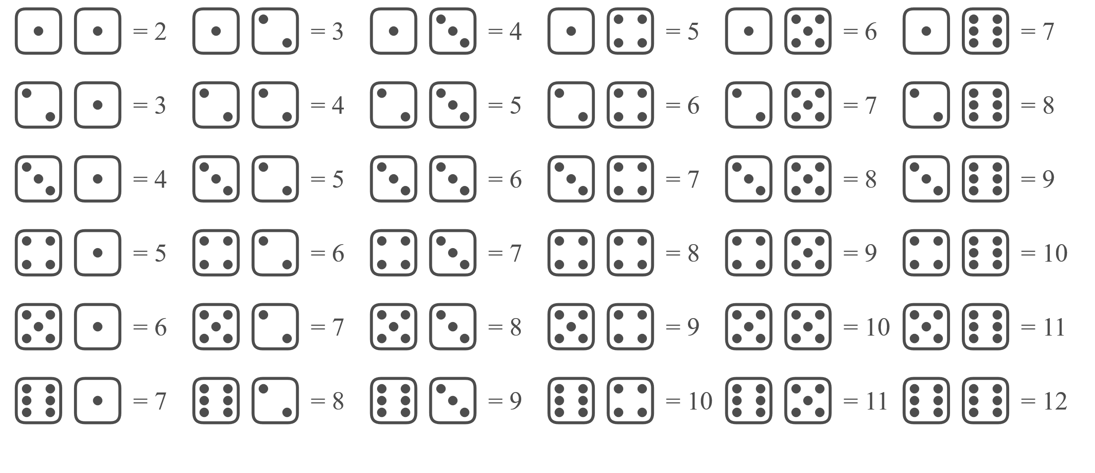
Example 5.1.1: Creating a Discrete Probability Distribution₂
Solution
To begin, let's list all of the possible values for X.

Slide 7

Example 5.1.1: Creating a Discrete Probability Distribution₃
When rolling two dice, there are 36 possible rolls, each giving a sum between 2 and 12, inclusive. To find the probability distribution, we need to calculate the probability for each value.
because there is only one way to get a sum of 2:

Slide 8

Example 5.1.1: Creating a Discrete Probability Distribution₄
because you may get the sum of 3 in two ways:
or

Slide 9
Example 5.1.1: Creating a Discrete Probability Distribution₅
Continuing this process will give us the following probability distribution.

Slide 10
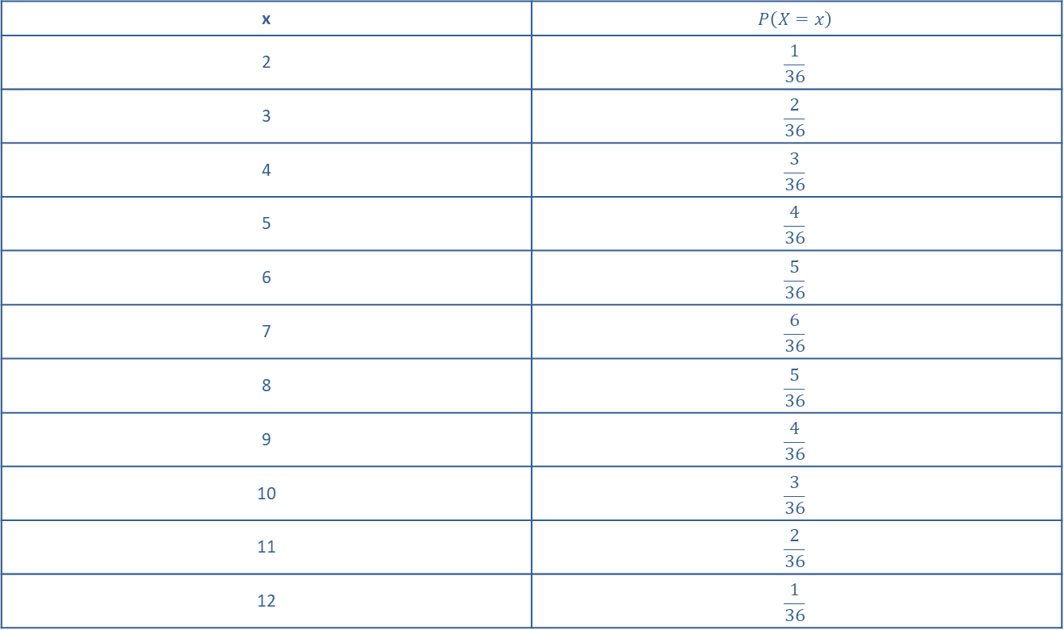
Example 5.1.1: Creating a Discrete Probability Distribution₆
Probability Distribution for the Sum of Two Rolled Dice.
x | $$P\left(X=x\right)$$
2 | $$\frac{1}{36}$$
3 | $$\frac{2}{36}$$
4 | $$\frac{3}{36}$$
5 | $$\frac{4}{36}$$
6 | $$\frac{5}{36}$$
7 | $$\frac{6}{36}$$
8 | $$\frac{5}{36}$$
9 | $$\frac{4}{36}$$
10 | $$\frac{3}{36}$$
11 | $$\frac{2}{36}$$
12 | $$\frac{1}{36}$$

Slide 11
Example 5.1.1: Creating a Discrete Probability Distribution₇
Check for yourself that the probabilities listed are the true values for the probability distribution of X, the sum of two rolled dice. Note that all of the probabilities are numbers between 0 and 1, inclusive, and that the sum of the probabilities is equal to 1, as you can verify for yourself.

Slide 12
Memory Booster₂
Properties of a Probability Distribution

Slide 13
Formula: Expected Value
The expected value for a discrete random variable X is equal to the mean of the probability distribution of X and is given by
where x _{i} is the i^{th} value of the random variable X.

Slide 14
Rounding Rule₁
When calculating the expected value, round to one more decimal place than the largest number of decimal places given in the values of the random variable. Occasional exceptions to this rule can be made when the type of data lends itself to a more natural rounding scheme, such as rounding values of currency to two decimal places.

Slide 15
Example 5.1.2: Calculating Expected Values₁
Let's return to that booth at the state fair that has rubber ducks floating in water. For a $1 ticket, you get two chances to win a small stuffed animal, worth $5, by choosing a duck that has a star drawn on the bottom of it. If you manage to choose 2 ducks which both have stars drawn on them, you win the extra-large stuffed animal, worth $15. After your first pick, the rubber duck is placed back in the water for your second pick. If there are 50 floating ducks and 3 which have stars drawn on them, what is the expected value of this carnival game?

Slide 16
Example 5.1.2: Calculating Expected Values₂
Solution
There are three possible outcomes for this state fair game: Winning the large extra-large stuffed animal, winning the small stuffed animal, and not winning either.
Winning the extra-large stuffed animal:
The probability of winning the extra-large stuffed animal is a probability of two independent events since the ducks are returned to the water after each pick. Therefore, we can use the multiplication rule to determine the probability.

Slide 17
Example 5.1.2: Calculating Expected Values₃
The probability of choosing a duck with a star on the bottom on the first pick is
The probability of choosing
a starred duck on the second pick is also
Thus, the
probability of both picks resulting in choosing a starred
duck is

Slide 18
Example 5.1.2: Calculating Expected Values₄
Since we paid $1 to play the game and the extra-large stuffed animal is worth $15, this outcome is worth $14.
Not winning either stuffed animal:
The probability of not winning either stuffed animal is calculated in a similar way to the one above, by determining the probability of not getting a starred duck for either pick, as shown below.

Slide 19
Example 5.1.2: Calculating Expected Values₅
Since we paid $1 to play the game and did not win either stuffed animal, this outcome is worth −$1.

Slide 20
Example 5.1.2: Calculating Expected Values₆
Winning the small stuffed animal:
This probability is slightly more complicated to calculate since you could choose the starred duck on the first draw or the second draw, and you need to consider each possibility. However, since we know that there are only three outcomes for this game, we can use the complement rule to determine the probability of this outcome.

Slide 21
Example 5.1.2: Calculating Expected Values₇
Since we paid $1 to play the game, and the small stuffed animal is worth $5, this outcome is worth $4.
Let's now organize our results in a table for this probability distribution, where W is the value of the game outcome, P(W = w) is the probability of obtaining that outcome, and the last column is the product of the value times its probability.

Slide 22
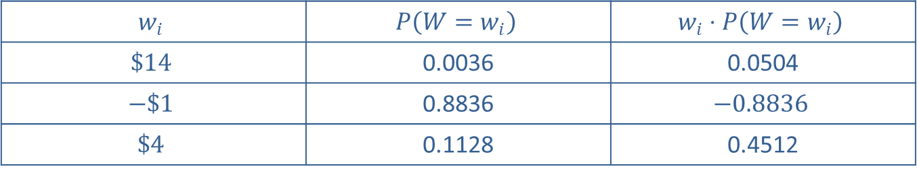
Example 5.1.2: Calculating Expected Values₈
Table 5.1.6: Rubber Duck Game Expected Value Calculation
$$w_{i}$$ | $$P\left(W=w_{i}\right)$$ | $$w_{i}⋅P\left(W=w_{i}\right)$$
$$\$14$$ | 0.0036 | 0.0504
$$−\$1$$ | 0.8836 | $$−0.8836$$
$$\$4$$ | 0.1128 | 0.4512

Slide 23
Example 5.1.2: Calculating Expected Values₉
Sum the values in the last column to get the expected value, E(W).
Thus, you can expect to lose on average $0.38 per
game if you play enough times.

Slide 24
Example 5.1.3: Calculating Expected Values₁
Peyton is trying to decide between two different investment opportunities. The two plans are summarized in the following table. The left column for each plan gives the potential earnings, and the right columns give their respective probabilities. Which plan should he choose?

Slide 25
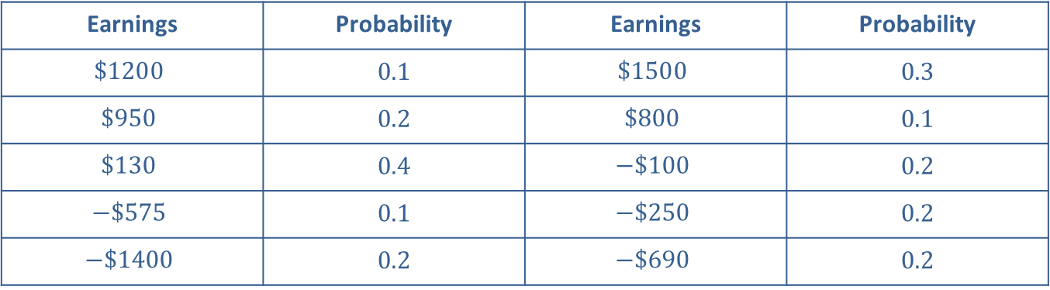
Example 5.1.3: Calculating Expected Values₂
Investment Plans
Plan A
Plan B
Earnings | Probability | Earnings | Probability
$$\$1200$$ | 0.1 | $$\$1500$$ | 0.3
$$\$950$$ | 0.2 | $$\$800$$ | 0.1
$$\$130$$ | 0.4 | $$−\$100$$ | 0.2
$$−\$575$$ | 0.1 | $$−\$250$$ | 0.2
$$−\$1400$$ | 0.2 | $$−\$690$$ | 0.2

Slide 26
Example 5.1.3: Calculating Expected Values₃
Solution
It is difficult to determine which plan will yield the higher return simply by looking at the probability distributions. Let's use the expected values to compare the plans. Let the random variable X _{A} be the earnings for Plan A, and let the random variable X_{B} be the earnings for Plan B. We will use a different method to calculate the expected value for each plan to demonstrate various methods.
For Investment Plan A:
By Hand:
Beginning with the probability distribution, multiply each value of the random variable,

Slide 27
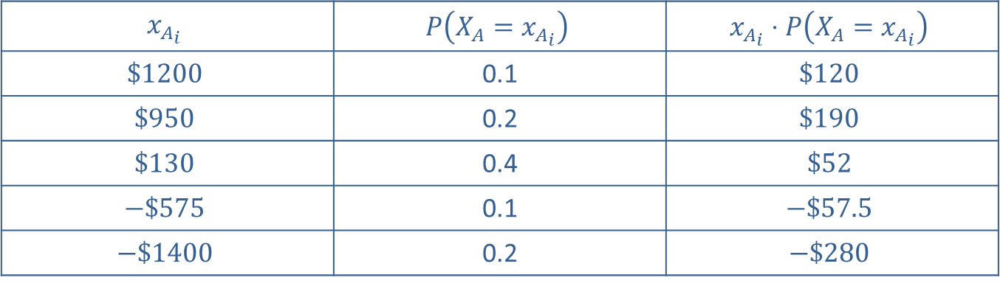
Example 5.1.3: Calculating Expected Values₄
Investment Plan A Expected Values
$$x_{A_{i}}$$ | $$P\left(X_{A}=x_{A_{i}}\right)$$ | $$x_{A_{i}}⋅P\left(X_{A}=x_{A_{i}}\right)$$
$$\$1200$$ | 0.1 | $$\$120$$
$$\$950$$ | 0.2 | $$\$190$$
$$\$130$$ | 0.4 | $$\$52$$
$$−\$575$$ | 0.1 | $$−\$57.5$$
$$−\$1400$$ | 0.2 | $$−\$280$$

Slide 28
Example 5.1.3: Calculating Expected Values₅
Sum the values in the last column to get the expected value, for Plan A.
E (X_{A}) = $120 + $190 + $52 − $57.50 − $280
= $24.50

Slide 29
Example 5.1.3: Calculating Expected Values₆
For Investment Plan B: TI-83/84 Plus:
Press STAT, and then EDIT to access the list function. Enter the earnings in L1 and the probabilities in L2. (Note the '$' is not entered here.) The calculator can perform the needed multiplication across each row for us. To do so, move the cursor so that it highlights L3. Enter " L1*L2 ", being sure to use the names of the lists. By entering " L1*L2 " in the heading of L3, the calculator fills in the column with the multiplication. Using the STAT → CALC menu and option 1-Var Stat, we will get the sum that we need. Enter L3 as the list for that function.

Slide 30
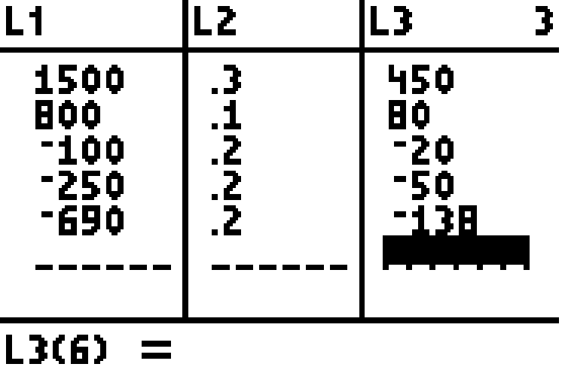
Example 5.1.3: Calculating Expected Values₇

Slide 31
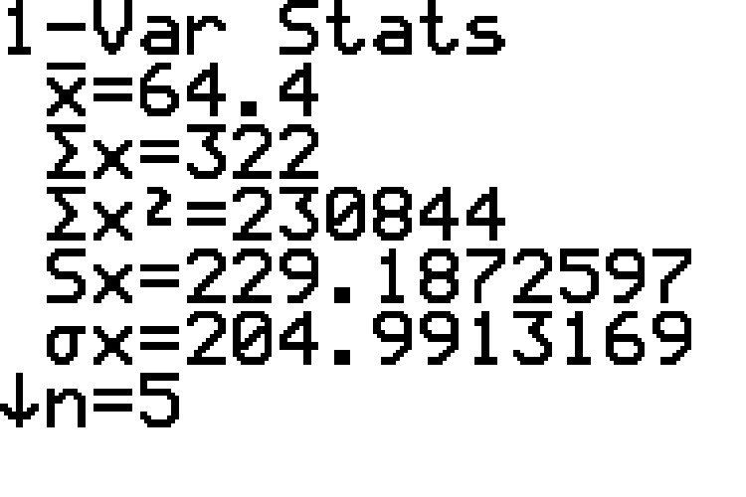
Example 5.1.3: Calculating Expected Values₈

Slide 32
Example 5.1.3: Calculating Expected Values₉
From these calculations, we see that the expected value of Plan A is $24.50, and the expected value of Plan B is $322.00. Therefore, Plan B appears to be the wiser investment option for Peyton.

Slide 33
Formula: Variance and Standard Deviation for a Discrete Probability Distribution
The variance for a discrete probability distribution of a random variable X is given by
where x _{i} is the i^{th} value of the random variable X and
µ is the mean of the probability distribution.
The standard deviation for a discrete probability distribution of a random variable X is the square root of the variance, given by the following formulas.

Slide 34
Rounding Rule₂
When calculating the variance or standard deviation for a discrete probability distribution, round to one more decimal place than the largest number of decimal places given in the values of the random variable. Occasional exceptions to this rule can be made when the type of data lends itself to a more natural rounding scheme, such as rounding values of currency to two decimal places.
When calculating the standard deviation, do not round the value of the variance before taking the square root.

Slide 35
Example 5.1.4: Calculating the Variances and Standard Deviations for Discrete Probability Distributions₁
Which of the investment plans in the previous example carries more risk, Plan A or Plan B?

Slide 36
Example 5.1.4: Calculating the Variances and Standard Deviations for Discrete Probability Distributions₂
Solution
To decide which plan carries more risk, we need to look at their standard deviations, which requires that we first calculate their variances. Let's calculate the variance separately for each investment plan. To do this, we will use a table to organize our calculations as we compute the variance. We will use the expected values that we calculated in the previous example as the means.
For Investment Plan A,
Begin by completing a table for the calculations needed to compute σ², as shown below.

Slide 37
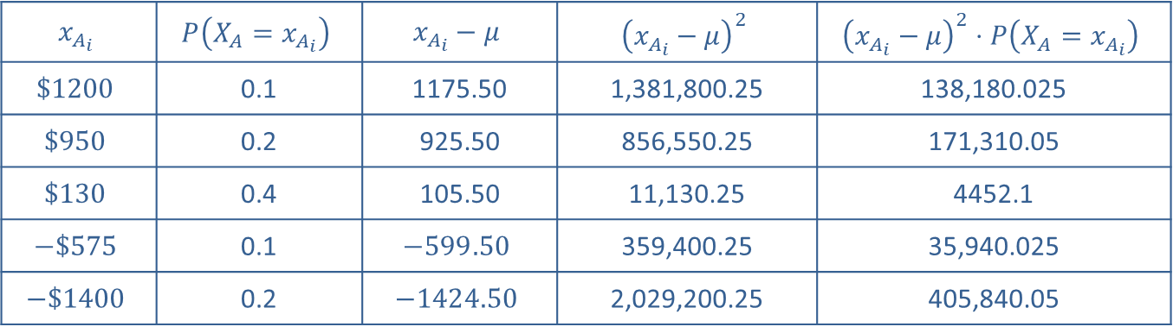
Example 5.1.4: Calculating the Variances and Standard Deviations for Discrete Probability Distributions₃
By Hand:
Investment Plan A
$$x_{A_{i}}$$ | $$P\left(X_{A}=x_{A_{i}}\right)$$ | $$x_{A_{i}}−μ$$ | $${\left(x_{A_{i}}−μ\right)}^{2}$$ | $${\left(x_{A_{i}}−μ\right)}^{2}⋅P\left(X_{A}=x_{A_{i}}\right)$$
$$\$1200$$ | 0.1 | 1175.50 | 1,381,800.25 | 138,180.025
$$\$950$$ | 0.2 | 925.50 | 856,550.25 | 171,310.05
$$\$130$$ | 0.4 | 105.50 | 11,130.25 | 4452.1
$$−\$575$$ | 0.1 | $$−599.50$$ | 359,400.25 | 35,940.025
$$−\$1400$$ | 0.2 | $$−1424.50$$ | 2,029,200.25 | 405,840.05

Slide 38
Example 5.1.4: Calculating the Variances and Standard Deviations for Discrete Probability Distributions₄
Now sum the final column to calculate the variance,
Finally, take the square root of
to find the standard deviation, σ, as shown.
Finally, take the square root of
to find the standard deviation, σ, as shown.
For Investment Plan B,

Slide 39
Example 5.1.4: Calculating the Variances and Standard Deviations for Discrete Probability Distributions₅
TI-83/84 Plus:
Begin by entering the earnings in L1 and the probabilities in L2. Highlight L3 and enter the formula for the variance, (L1−322)2*L2. This will fill in L3 with the same calculation for Plan B values that is in the last column of the table used for calculating Plan A. Using the STAT → CALC menu and option 1-Var stat, enter L3 as the list for that function. This will give the sum of the values in L3, ∑x, which in this case is the variance of the distribution,

Slide 40
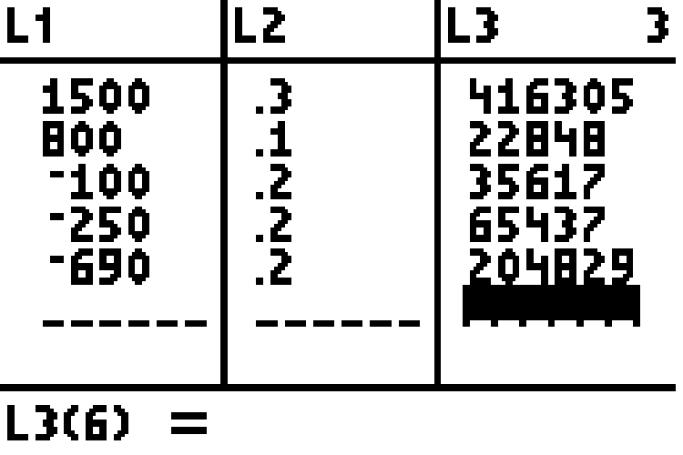
Example 5.1.4: Calculating the Variances and Standard Deviations for Discrete Probability Distributions₆

Slide 41
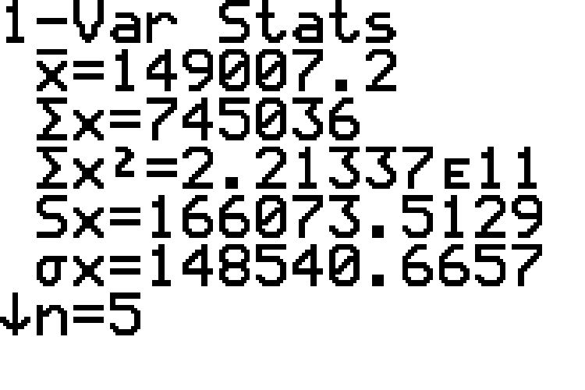
Example 5.1.4: Calculating the Variances and Standard Deviations for Discrete Probability Distributions₇

Slide 42
Example 5.1.4: Calculating the Variances and Standard Deviations for Discrete Probability Distributions₈
Taking the square root of the variance gives us the standard deviation,
Note that this is NOT the same value as shown in the screenshot for σx, since the value in the screenshot is the standard deviation of the values in L3, not the standard deviation of the probability distribution.
What do these results tell us? Comparing the standard deviations, we see that not only does Plan B have a higher expected value, but its profits vary slightly less than those of Plan A. We may conclude that Plan B carries a slightly lower amount of risk than Plan A.

