Slide 1
Section 4.4
Combinations and Permutations

Slide 2
Formula: Factorial
A factorial is the product of all positive integers less than or equal to a given positive integer, n, given by
where n is a positive integer.

Slide 3
Math Symbols₁

Slide 4
Example 4.4.1: Calculating Factorial Expressions₁
Calculate the following factorial expressions.
​
​
​
​

Slide 5
Example 4.4.1: Calculating Factorial Expressions₂
Solution
​
​
indicates that we need to multiply each positive
integer less than or equal to 7.
​By Hand:

Slide 6

Example 4.4.1: Calculating Factorial Expressions₃
​TI-83/84 Plus:
​To calculate a factorial of the form ​
enter the n-value in the calculator. Then press the MATH function button, and choose the probability menu, PRB. The factorial is option
The screenshot shows the appropriate input and output.

Slide 7
Example 4.4.1: Calculating Factorial Expressions₄
By Hand:
​Calculate each factorial and then divide. Remember that

Slide 8
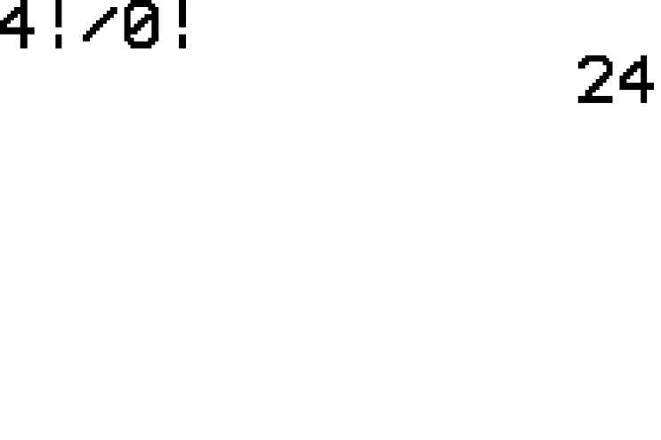
Example 4.4.1: Calculating Factorial Expressions₅
​TI-83/84:
​We can do the calculation in one step with the calculator by typing in ​
Note that we are not dividing by 0, but by
Thus, the solution is 24 as shown in the screenshot.

Slide 9
Example 4.4.1: Calculating Factorial Expressions₆
By Hand:
​It would be very cumbersome to multiply out
and then divide. Instead, we will cancel out some common factors that appear in both the numerator and denominator first.

Slide 10
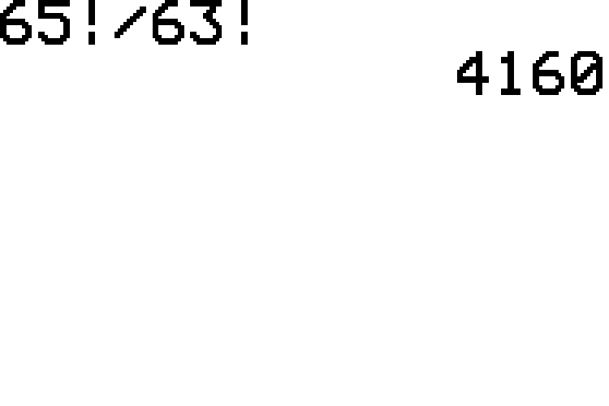
Example 4.4.1: Calculating Factorial Expressions₇
​TI-83/84 Plus:
​Notice that we do not need to simplify first when using the calculator. We simply enter
​
and obtain 4160 as shown in the screenshot.

Slide 11
Example 4.4.1: Calculating Factorial Expressions₈
By Hand:
​You must begin by evaluating the expression in parentheses. Next, cancel common factors in the numerator and denominator and then simplify.

Slide 12
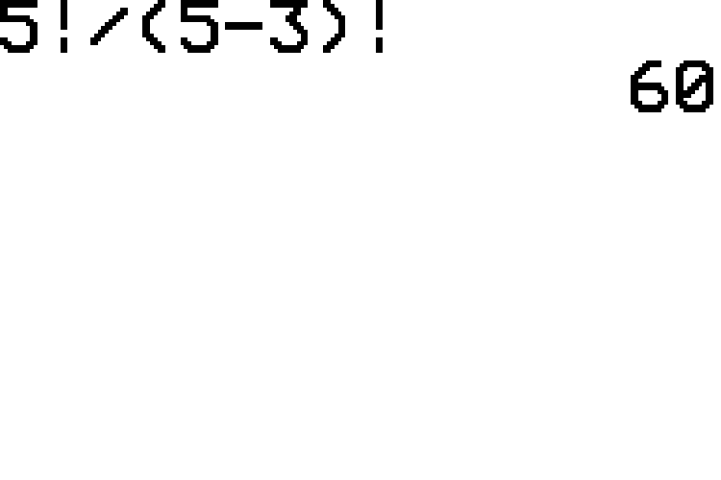
Example 4.4.1: Calculating Factorial Expressions₉
​TI-83/84 Plus:
​Notice that we can type the entire expression in without simplifying first. Be sure to place the parentheses in the denominator. The input and solution are shown in the screenshot.
​

Slide 13
Example 4.4.1: Calculating Factorial Expressions₁₀
By Hand:
​Make sure that you begin by subtracting to simplify the expression in parentheses.

Slide 14
Example 4.4.1: Calculating Factorial Expressions₁₁
​TI-83/84 Plus:
​Once again, we can enter the entire original expression in one line. However, we must place parentheses around the entire expression in the denominator, as shown in the screenshot, which produces the correct solution of 15. Since calculators follow the rules for order of operations, what answers are produced if you remove the parenthesis in the denominator? Try this for yourself.
​

Slide 15
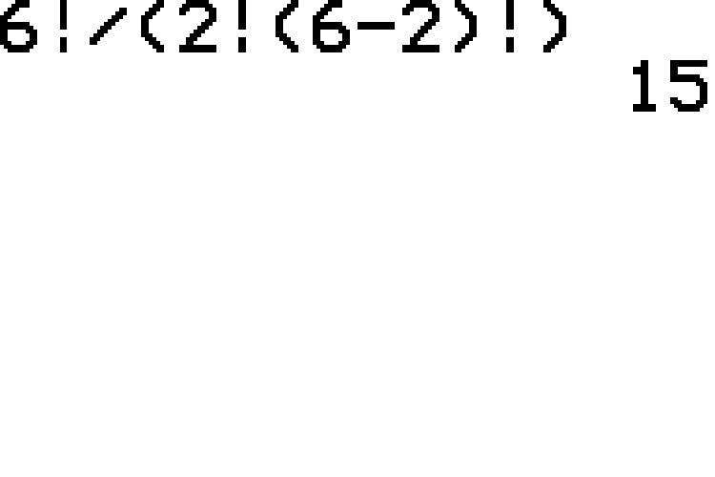
Example 4.4.1: Calculating Factorial Expressions₁₂

Slide 16
Definitions₁
A combination is a selection of objects from a group without regard to their arrangement.
A permutation is a selection of objects from a group where the arrangement is specific.

Slide 17
Memory Booster
Combinations
order does not matter
Permutations
order matters

Slide 18
Formula: Combinations and Permutations
When order is not important, the following formula is used to calculate the number of combinations.
When order is important, the following formula is used to calculate the number of permutations.
In both of these formulas, r objects are selected from a group of n distinct objects, so r and n are both positive integers with r ≤ n.

Slide 19
Math Symbols₂
Combinations
Permutations

Slide 20
Example 4.4.2: Calculating Numbers of Combinations and Permutations₁
Given a group of three friends, Emre, Heather, and Sheena:
a. ​How many ways can you arrange the way they stand in line for the movies?
b. ​How many ways can you choose two of them to ride in a car together?

Slide 21
Example 4.4.2: Calculating Numbers of Combinations and Permutations₂
Solution
a. ​First, notice that the arrangement of the three friends is important for counting purposes. To count how they can line up for a movie, the order in which they line up does make a difference, so this is a permutation. We are choosing to arrange three objects, so r = 3, from a group of three objects, so n also equals three, n = 3. Therefore, the number of permutations of 3 things permuted 3 at a time is calculated as follows.
​By Hand:

Slide 22
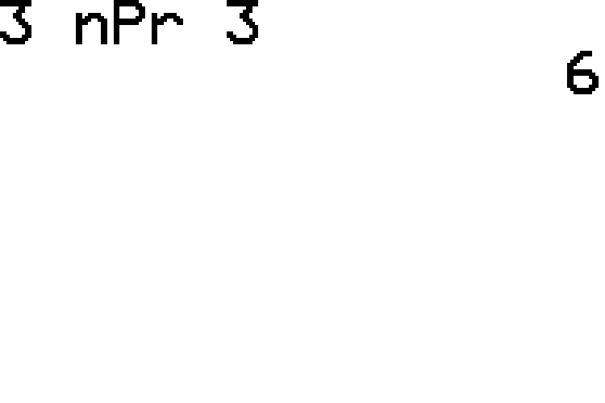
Example 4.4.2: Calculating Numbers of Combinations and Permutations₃
​TI-83/84 Plus:
​When calculating permutations using the TI-83/84 calculator, the computation will have the form
​
To accomplish this, we type the n value of 3 first, and then select PRB from the MATH menu and choose option n P r. Then we type in the r value of 3 as shown in the screenshot.

Slide 23
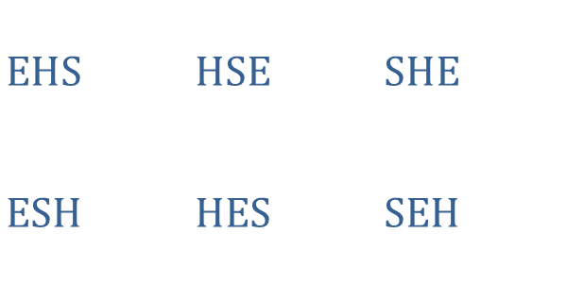
Example 4.4.2: Calculating Numbers of Combinations and Permutations₄
​So, there are six unique ways for the friends to line up for the movie. Let's check this by listing out all the possible arrangements. We'll use a pattern to help us.
​
​$\text{EHS}$ | ​$\text{HSE}$ | ​$\text{SHE}$
​$\text{ESH}$ | ​$\text{HES}$ | ​$\text{SEH}$

Slide 24
Example 4.4.2: Calculating Numbers of Combinations and Permutations₅
b. ​In the second part, we are interested in choosing two of the three friends to ride in a car together, where the arrangement is not specified to be important. Therefore, we'd like to count the number of combinations of two things from a group of three.
​By Hand:
​

Slide 25
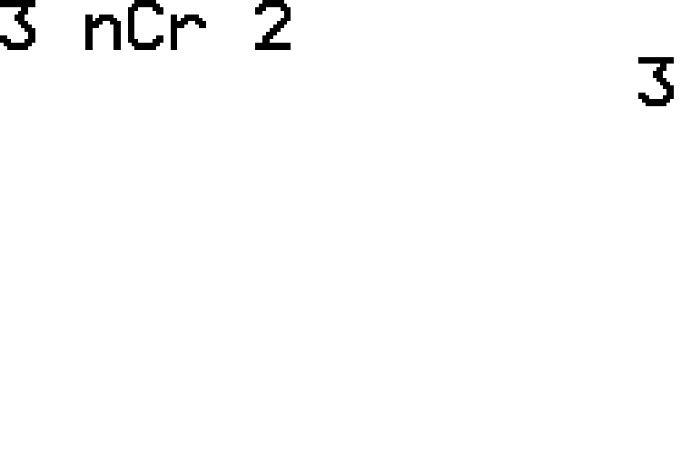
Example 4.4.2: Calculating Numbers of Combinations and Permutations₆
​TI-83/84 Plus:
​The computation will have the form ​
To accomplish this, we type the n value of 3 first, and then select PRB from the MATH menu and choose option n C r. Then we type in the r value of 2 as shown in the screenshot.

Slide 26

Example 4.4.2: Calculating Numbers of Combinations and Permutations₇
​From this, we know there are three distinct ways that we can choose two of the friends to ride in the car. Let's list out all of the possibilities.
​
​$\text{EH}$ | ​$\text{ES}$ | ​$\text{HS}$

Slide 27
Technology
For further instruction on calculating combinations and permutations using a TI-83/84 Plus calculator or other technology, navigate to stat.hawkeslearning.com and see Technology Instructions → Counting.

Slide 28
Side Note
Special Case
Note that
Thus,
gives the number of different sequences (or permutations) for a group of n distinct objects.

Slide 29
Example 4.4.3: Calculating the Number of Permutations₁
A class of 18 fifth graders is holding elections for class president, vice president, and secretary. In how many different ways can the officers be elected?

Slide 30
Example 4.4.3: Calculating the Number of Permutations₂
Solution
First, note that the order in which students are chosen is important; that is, it is different if someone is elected for president rather than vice president. Therefore, we are counting permutations. There are 18 students in the class, so n = 18. Because 3 students are to be elected, r = 3.
By Hand:

Slide 31
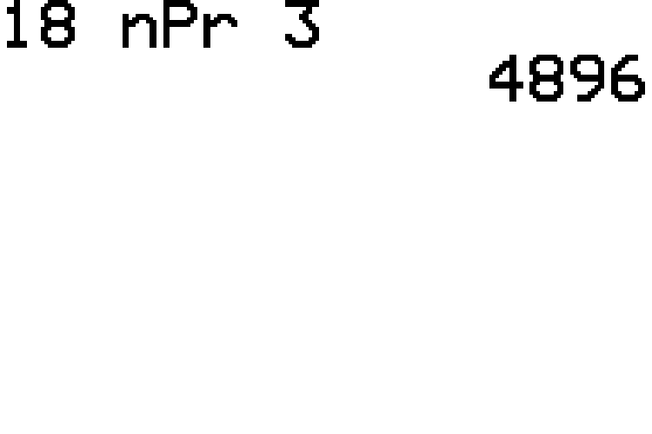
Example 4.4.3: Calculating the Number of Permutations₃
TI-83/84 Plus:
The computation will have the form
as shown in the screenshot.
So, there are 4896 ways the class officers can be elected.

Slide 32
Example 4.4.4: Calculating the Number of Combinations₁
Consider that a cafeteria is serving the following vegetables for lunch one weekday: carrots, green beans, lima beans, celery, corn, broccoli, and spinach. Suppose now that Bill wishes to order a vegetable plate with 3 different vegetables. How many ways can his plate be prepared?

Slide 33
Example 4.4.4: Calculating the Number of Combinations₂
Solution
For this problem, we are choosing 3 vegetables out of a list of 7. The order in which the vegetables are placed on Bill's plate makes no difference, so we are counting combinations. Fill in the combination formula using n = 7 and r = 3.
By Hand:

Slide 34
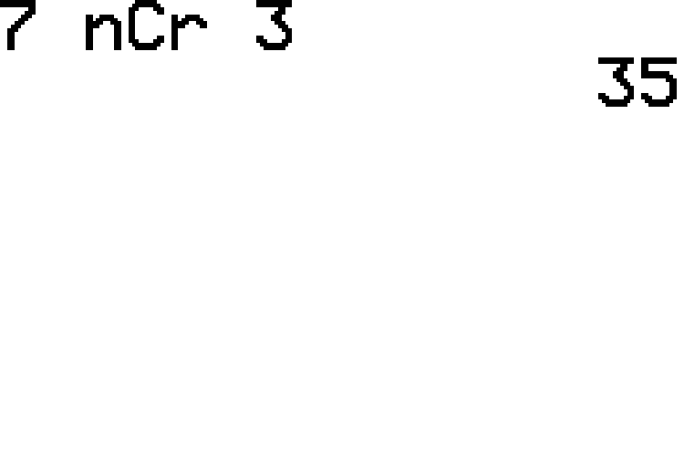
Example 4.4.4: Calculating the Number of Combinations₃
TI-83/84 Plus:
The computation will have the form
as shown in the screenshot.
Therefore, Bill has 35 different ways to order his vegetable plate. Let's hope he doesn't hold up the line making his choice!

Slide 35
Example 4.4.5: Calculating Probability Using Permutations₁
Suppose that a little league baseball coach is randomly listing the 9 starting baseball players in a batting order for their second game. At this level, the batting order is randomly chosen to give all players the opportunity to experience different batting positions. What is the probability that the order chosen for the second game is exactly the same as that of the first game?

Slide 36
Example 4.4.5: Calculating Probability Using Permutations₂
Solution
The answer to our probability question will be the following fraction.
Before we can calculate the probability, we must first know how many possible ways there are to make a batting order from the 9 players. In baseball, the batting order is important, so we know that we are counting permutations. Because there are 9 players, n = 9. However, for this problem, r is also 9, because all 9 players are to be chosen for the lineup.
By Hand:

Slide 37
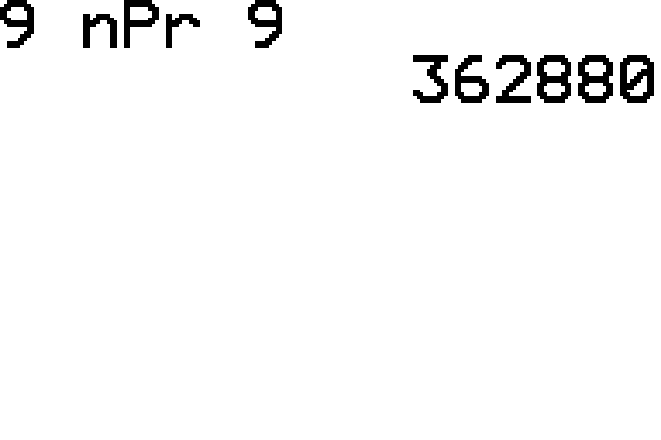
Example 4.4.5: Calculating Probability Using Permutations₃
TI-83/84 Plus:
The computation will have the form
as shown in the screenshot.

Slide 38
Example 4.4.5: Calculating Probability Using Permutations₄
There are 362,880 possible batting orders from which the coach can choose.
For the numerator of the fraction, we know that there is only 1 batting order that is exactly like the order used in the first game, so the probability of randomly choosing that same order is calculated as follows.
In other words, players can feel sure that there will be a difference of some sort in the lineup!

Slide 39
Example 4.4.6: Calculating Probability Using Combinations₁
Maya has a bag of 15 blocks, each of which is a different color including red, blue, and yellow. Maya reaches into the bag and pulls out 3 blocks. What is the probability that Maya has chosen one of each block color?

Slide 40
Example 4.4.6: Calculating Probability Using Combinations₂
Solution
Let's first determine the number of outcomes in the sample space. We want to count the number of ways that 3 blocks can be drawn. This is a combination because the order of the colors is not important. The number of ways to choose 3 blocks out of a group of 15 is calculated as follows.
By Hand:

Slide 41
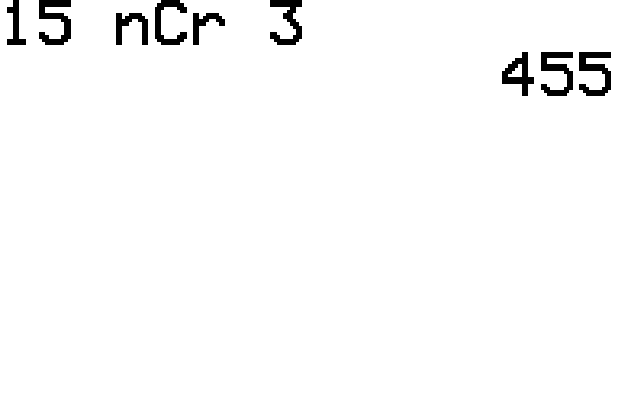
Example 4.4.6: Calculating Probability Using Combinations₃
TI-83/84 Plus:
The computation will have the form
as shown in the screenshot.

Slide 42
Example 4.4.6: Calculating Probability Using Combinations₄
How many combinations contain the red, blue, and yellow blocks? Order does not matter, so there is only one way to choose these colors. Thus, the probability that Maya chooses red, blue, and yellow is calculated as follows.

Slide 43
Formula: Special Permutations
Special permutations involve objects that are identical. The number of distinguishable permutations of n objects, of which
are all alike,
are all alike, and so forth, is given by
Where

Slide 44
Example 4.4.7: Calculating the Number of Special Permutations₁
How many different ways can you arrange the letters in the word TENNESSEE?

Slide 45
Example 4.4.7: Calculating the Number of Special Permutations₂
Solution
Because we can make no distinction between each E, N, or S in the word, we need to group the letters together. The letters in TENNESSEE are grouped as follows.
T: 1
E: 4
N: 2
S: 2
Since there are a total of 9 letters in TENNESSEE, substituting these values into the special permutation formula gives the following.

Slide 46
Example 4.4.7: Calculating the Number of Special Permutations₃
By Hand:

Slide 47
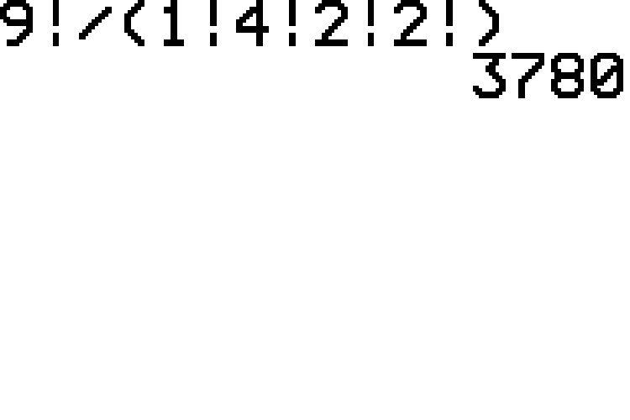
Example 4.4.7: Calculating the Number of Special Permutations₄
TI-83/84 Plus:
Using the calculator we obtain the same result shown in the screenshot. Remember that you need parentheses around the calculation in the denominator.
Thus, there are 3780 ways to arrange the letters in the word TENNESSEE.

