Slide 1
Section 3.2
Measures of Dispersion

Slide 2
Formula: Range
The range is a measure of dispersion that is the difference between the largest and smallest values in the data set.
Range = Maximum Data Value − Minimum Data Value

Slide 3
Example 3.2.1: Calculating the Range₁
The following data were collected from samples of call lengths (in minutes) observed for two different mobile phone users. Calculate the range of each data set.
a. ​2, 25, 31, 44, 29, 14, 22, 11, 40,
b. ​2, 2, 44, 2, 2, 2, 2, 2

Slide 4
Example 3.2.1: Calculating the Range₂
Solution
a. ​The maximum value is 44 minutes and the minimum value is 2 minutes, so the range is as follows.
Range = Maximum Data Value − Minimum Data Value
= 44 − 2
= 42 minutes.
b. ​The maximum value for the second data set is also 44 minutes and the minimum value is also 2 minutes, so the range is calculated in the same way.
Range = Maximum Data Value − Minimum Data Value
= 44 − 2
= 42 minutes.

Slide 5
Definitions: Variance₁
The variance is a measure of how far the data values are spread out from the mean. Variance is a squared measurement.
The population variance is given by
where x _{i} is the i^{th} value in the population,
μ is the population mean, and
N is the number of values in the population.

Slide 6
Definitions: Variance₂
The sample variance is given by
where x _{i} is the i^{th} data value,
is the sample mean, and
n is the number of data values in the sample.

Slide 7
Rounding Rule₁
When calculating the variance, round to one more decimal place than the largest number of decimal places given in the data. Occasional exceptions to this rule can be made when the type of data lends itself to a more natural rounding scheme, such as rounding values of currency to two decimal places.

Slide 8
Math Symbols₁
σ²: population variance; read as "sigma squared"
s²: sample variance

Slide 9
Example 3.2.2: Calculating Variance₁
Jesmyn has just started driving for Uber. The number of rides she has given each day for a sample of 5 consecutive days is listed below. Find the variance for the number of rides Jesmyn has given.
3, 2, 5, 6, 4

Slide 10
Technology Tip₁
The general formula for calculating sample variance in Excel is =VARS.S(range).
The general formula for calculating population variance in Excel is =VARS.P(range).

Slide 11
Example 3.2.2: Calculating Variance₂
Solution
As these data represent a sample, we need to calculate the sample variance.
By Hand:
The formula for the sample variance is given below.
To start, we need the mean and sample size of the data set. We calculate that
mean from each number in the sample, and then square each of
these differences. Let's use a chart to keep everything organized.

Slide 12
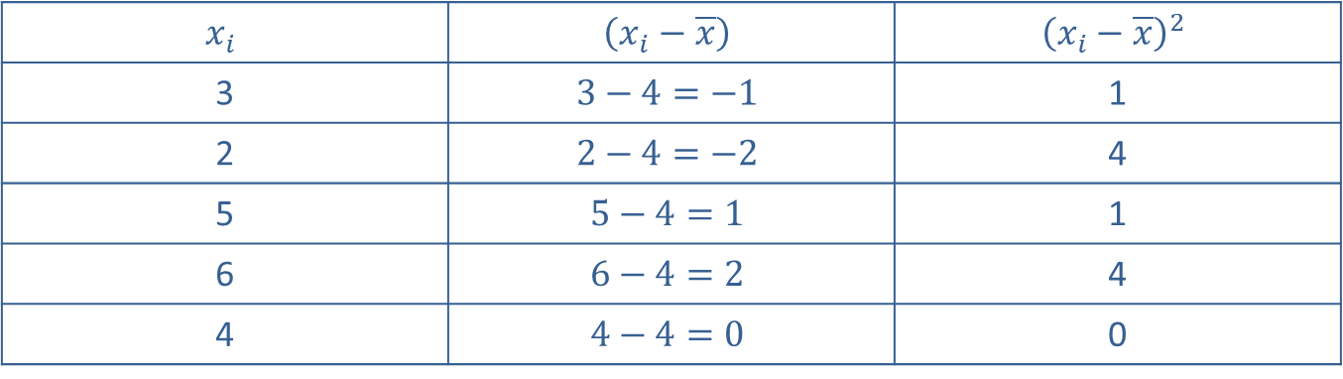
Example 3.2.2: Calculating Variance₃
Deviations and Squared Deviations of the Data
$$x_{i}$$ | $$\left(x_{i}−\overline{x}\right)$$ | $${\left(x_{i}−\overline{x}\right)}^{2}$$
3 | $$3−4=−1$$ | 1
2 | $$2−4=−2$$ | 4
5 | $$5−4=1$$ | 1
6 | $$6−4=2$$ | 4
4 | $$4−4=0$$ | 0

Slide 13
Example 3.2.2: Calculating Variance₄
Next, find the sum of the squared deviations by adding up the values in the last column.
Finally, substitute the appropriate values into the formula for sample variance as follows.
Microsoft Excel: You can easily calculate the sample variance in Excel by using the general formula =VAR.S(cell range). To do this, type the data into the first column of cells, A1 through A5. Then, in any available cell type =VARS.S(A1:A5) and press enter to obtain a sample variance of 2.5.

Slide 14
Technology Tip₂
The general formula for calculating the sample variance in Microsoft Excel is =VARS.S(cell range).
The general formula for calculating the population variance in Microsoft Excel is =VARS.P(cell range).
Therefore, the sample variance for Jesmyn's Uber rides is 2.5rides².
Therefore, the sample variance for Jesmyn’s Uber ride is 2.5rides².

Slide 15
Definitions: Standard Deviation₁
The standard deviation is a measure of how much we might expect a typical member of the data set to differ from the mean.
The population standard deviation is given by
where x _{i} is the i^{th} value in the population,
μ is the population mean, and
N is the number of values in the population.

Slide 16
Definitions: Standard Deviation₂
The sample standard deviation is given by
where x _{i} is the i^{th} data value,
is the sample mean, and
n is the number of data values in the sample.

Slide 17
Rounding Rule₂
When calculating the standard deviation, round to one more decimal place than the largest number of decimal places given in the data. Occasional exceptions to this rule can be made when the type of the data lends itself to a more natural rounding scheme, such as rounding values of currency to two decimal places.

Slide 18
Math Symbols₂
σ: population standard deviation; Greek letter, sigma.
s: sample standard deviation

Slide 19
Definitions₁
You can think of the standard deviation an estimated average distance that values in a set lie from the mean. While not the actual average, the standard deviation is usually very close to the average and, conceptually, that is a good way to think about standard deviation as we discuss how the formula is derived. To derive the formula for standard deviation, we will use a method similar to finding average distance, or deviation, from the mean. First, we must know the actual deviation from the mean for every data value in the set. The deviation is simply the difference between each value and the mean.

Slide 20
Definitions₂
Next, we need to find the sum of all the deviations. Here we run into a problem because the sum is zero. In fact, the sum of the deviations from the mean for any data set is always equal to zero because the positive deviations cancel out the negative deviations. To help eliminate the problem with the negative values canceling the positive values, we can make all the deviations positive by squaring each one.
Now, find the average by summing up all the squared deviations and dividing by the population size just as you would find a traditional mean. To find the standard deviation, we must take one additional step and "undo" the previous squaring by taking the square root. The completed population standard deviation formula is as follows.

Slide 21
Example 3.2.3: Calculating Standard Deviation₁
The following data set contains the ages (in years) of every patient seen by Dr. Dabbs at his urgent care clinic one afternoon. Calculate the standard deviation of the ages of his patients that afternoon.
11, 18, 25, 51, 44, 29, 30, 17, 29, 47, 52, 60

Slide 22
Example 3.2.3: Calculating Standard Deviation₂
Solution
First, notice that the data set we are given comprises all 12 patients seen by the doctor that afternoon. Therefore we will calculate the population standard deviation.
By Hand: Use the following formula for population standard deviation.
To start, we need the mean and population size of the data. We then calculate μ = 34.417 and N = 12. Next, we need to subtract the mean from each number in the population, and then square each of the differences. Let's use a chart to keep everything organized.

Slide 23
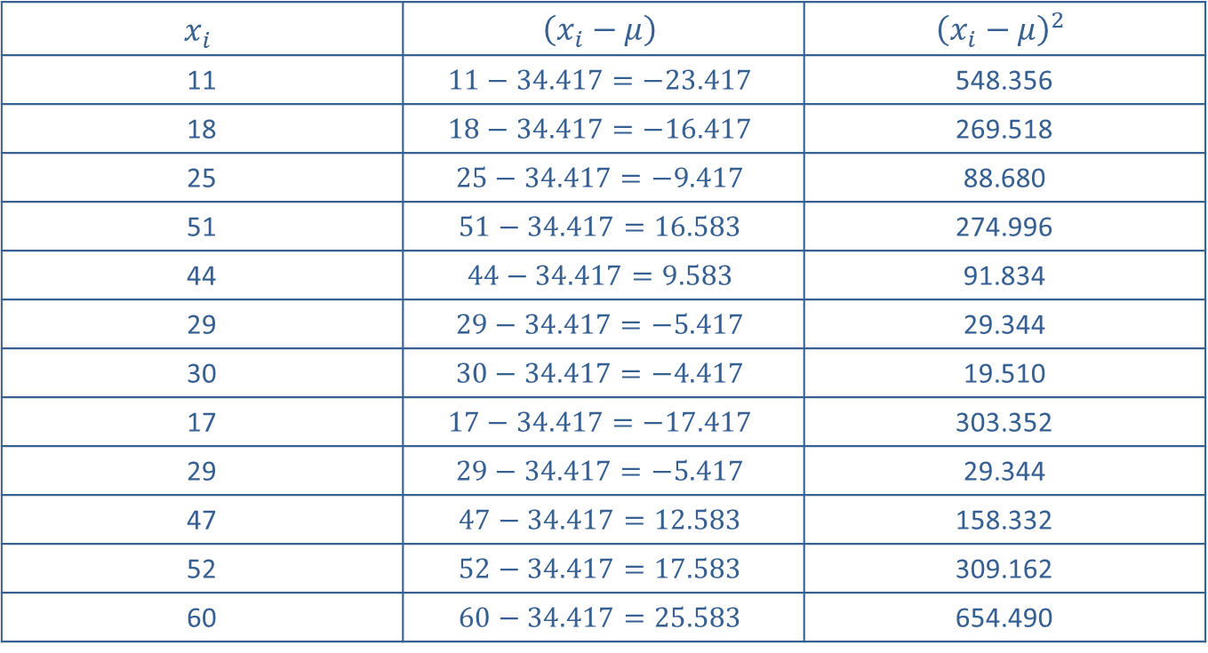
Example 3.2.3: Calculating Standard Deviation₃
Deviations and Squared Deviations
$$x_{i}$$ | $$\left(x_{i}−μ\right)$$ | $${\left(x_{i}−μ\right)}^{2}$$
11 | $$11−34.417=−23.417$$ | 548.356
18 | $$18−34.417=−16.417$$ | 269.518
25 | $$25−34.417=−9.417$$ | 88.680
51 | $$51−34.417=16.583$$ | 274.996
44 | $$44−34.417=9.583$$ | 91.834
29 | $$29−34.417=−5.417$$ | 29.344
30 | $$30−34.417=−4.417$$ | 19.510
17 | $$17−34.417=−17.417$$ | 303.352
29 | $$29−34.417=−5.417$$ | 29.344
47 | $$47−34.417=12.583$$ | 158.332
52 | $$52−34.417=17.583$$ | 309.162
60 | $$60−34.417=25.583$$ | 654.490

Slide 24
Example 3.2.3: Calculating Standard Deviation₄
Next, find the sum of the squared deviations by adding up the values in the last column.
Finally, substitute into the standard deviation formula to obtain the following.
TI-83/84 Plus: Begin by entering the data into List 1, which is found by pressing STAT → EDIT. Next, press STAT → CALC and choose 1-Var Stats. The population standard deviation, σx, is found within the list of descriptive statistics given, as shown in the screenshot below. Hence σ = 15.2.
Therefore, the population standard deviation for the ages of all of Dr. Dabb's patients one afternoon is 15.2 years.

Slide 25
Technology Tip₃
For a TI-83/84 Plus calculator, the sample standard deviation will be listed under 1-Var Stats as Sx. The population standard deviation will be listed as σx.

Slide 26
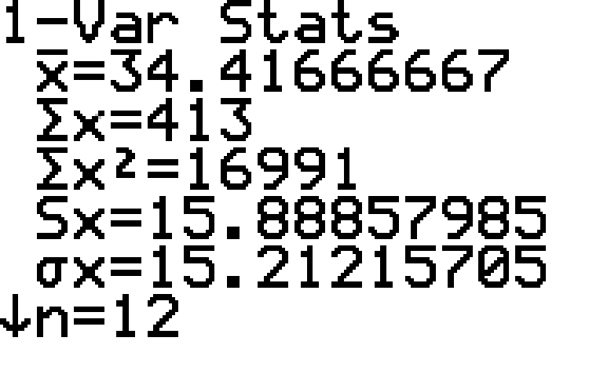
Example 3.2.3: Calculating Standard Deviation₅

Slide 27
Technology Tip₄
Many inexpensive calculators can easily compute standard deviation. For example, to calculate standard deviation on the TI-30XS, go to DATA and input the data values into L1. Next, go to STAT and choose 1-Var Stats. Using the settings Data:L1 and FRQ: ONE, scroll down to CALC and press Enter. You will then see a list of descriptive statistics, of which Sx is the sample standard deviation and σx is the population standard deviation.

Slide 28
Example 3.2.4: Interpreting Standard Deviations₁
Mark is looking into investing a portion of his recent bonus into the stock market. While researching different companies, he discovers the following standard deviations of one year of daily stock closing prices.
Profacto Corporation: Standard deviation of stock prices = $1.02.
Yardsmoth Company: Standard deviation of stock prices = $9.67.
What do these two standard deviations tell you about the stock prices of these companies?

Slide 29
Example 3.2.4: Interpreting Standard Deviations₂
Solution
A smaller standard deviation indicates that the data values are closer together, while a larger standard deviation indicates that the data values are more spread out. In this example, the standard deviation of stock prices for the Profacto Corporation is considerably smaller than that of the Yardsmoth Company. Hence, there is less variability in the daily closing prices of the Profacto stock than in the Yardsmoth stock prices. If Mark wants a stable long-term investment, then Profacto appears to be the better choice. If, however, Mark is looking to make a quick profit and is willing to take the risk, then the Yardsmoth stock would seem to better suit his purposes. Note that looking at the standard deviations is just one component of evaluating market prices.

Slide 30
Technology Tip₅
For further instructions on calculating standard deviation and variance using a TI-83/84 Plus calculator or other technology, please visit stat.hawkeslearning.com and see Technology Instructions → Descriptive Statistics → One Variable.

Slide 31
Formula: Coefficient of Variation
The coefficient of variation for a set of data is the ratio of the standard deviation to the mean as a percentage. For a population, it is given by
where σ is the population standard deviation and
μ is the population mean.
For a sample, it is given by
where $s$ is the sample standard deviation and
is the sample mean.

Slide 32
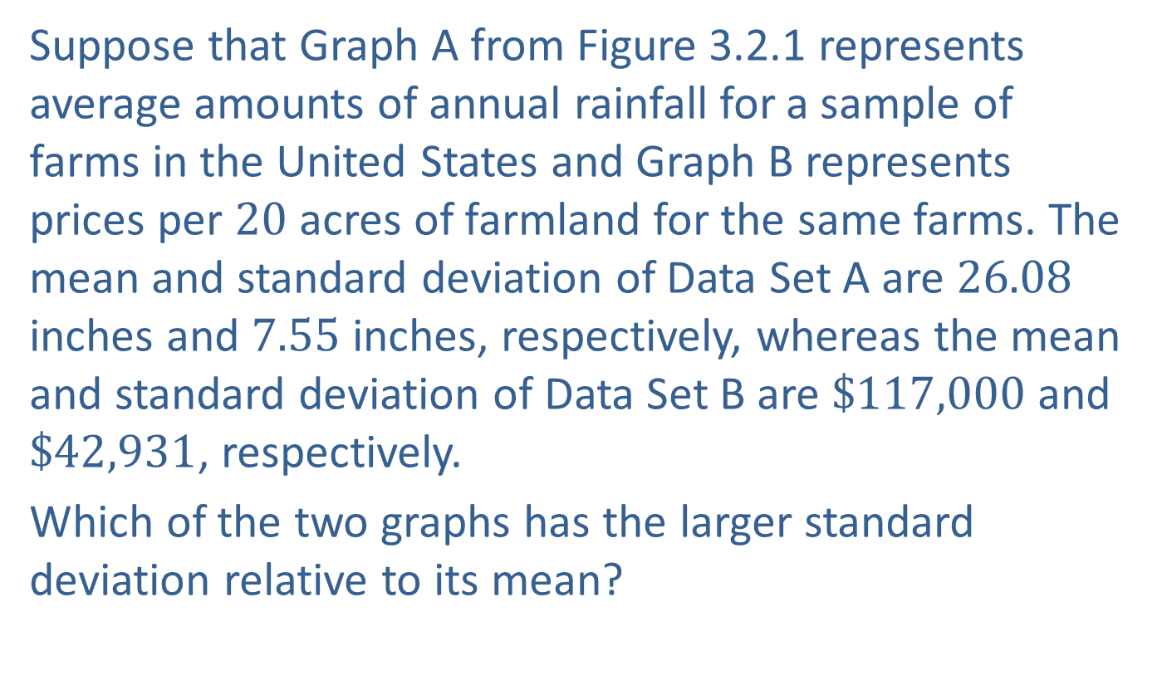
Example 3.2.5: Calculating and Interpreting Coefficient of Variation₁
Suppose that Graph A from Figure 3.2.1 represents average amounts of annual rainfall for a sample of farms in the United States and Graph B represents prices per 20 acres of farmland for the same farms. The mean and standard deviation of Data Set A are 26.08 inches and 7.55 inches, respectively, whereas the mean and standard deviation of Data Set B are $\$117,000$ and $\$42,931$, respectively.
Which of the two graphs has the larger standard deviation relative to its mean?

Slide 33
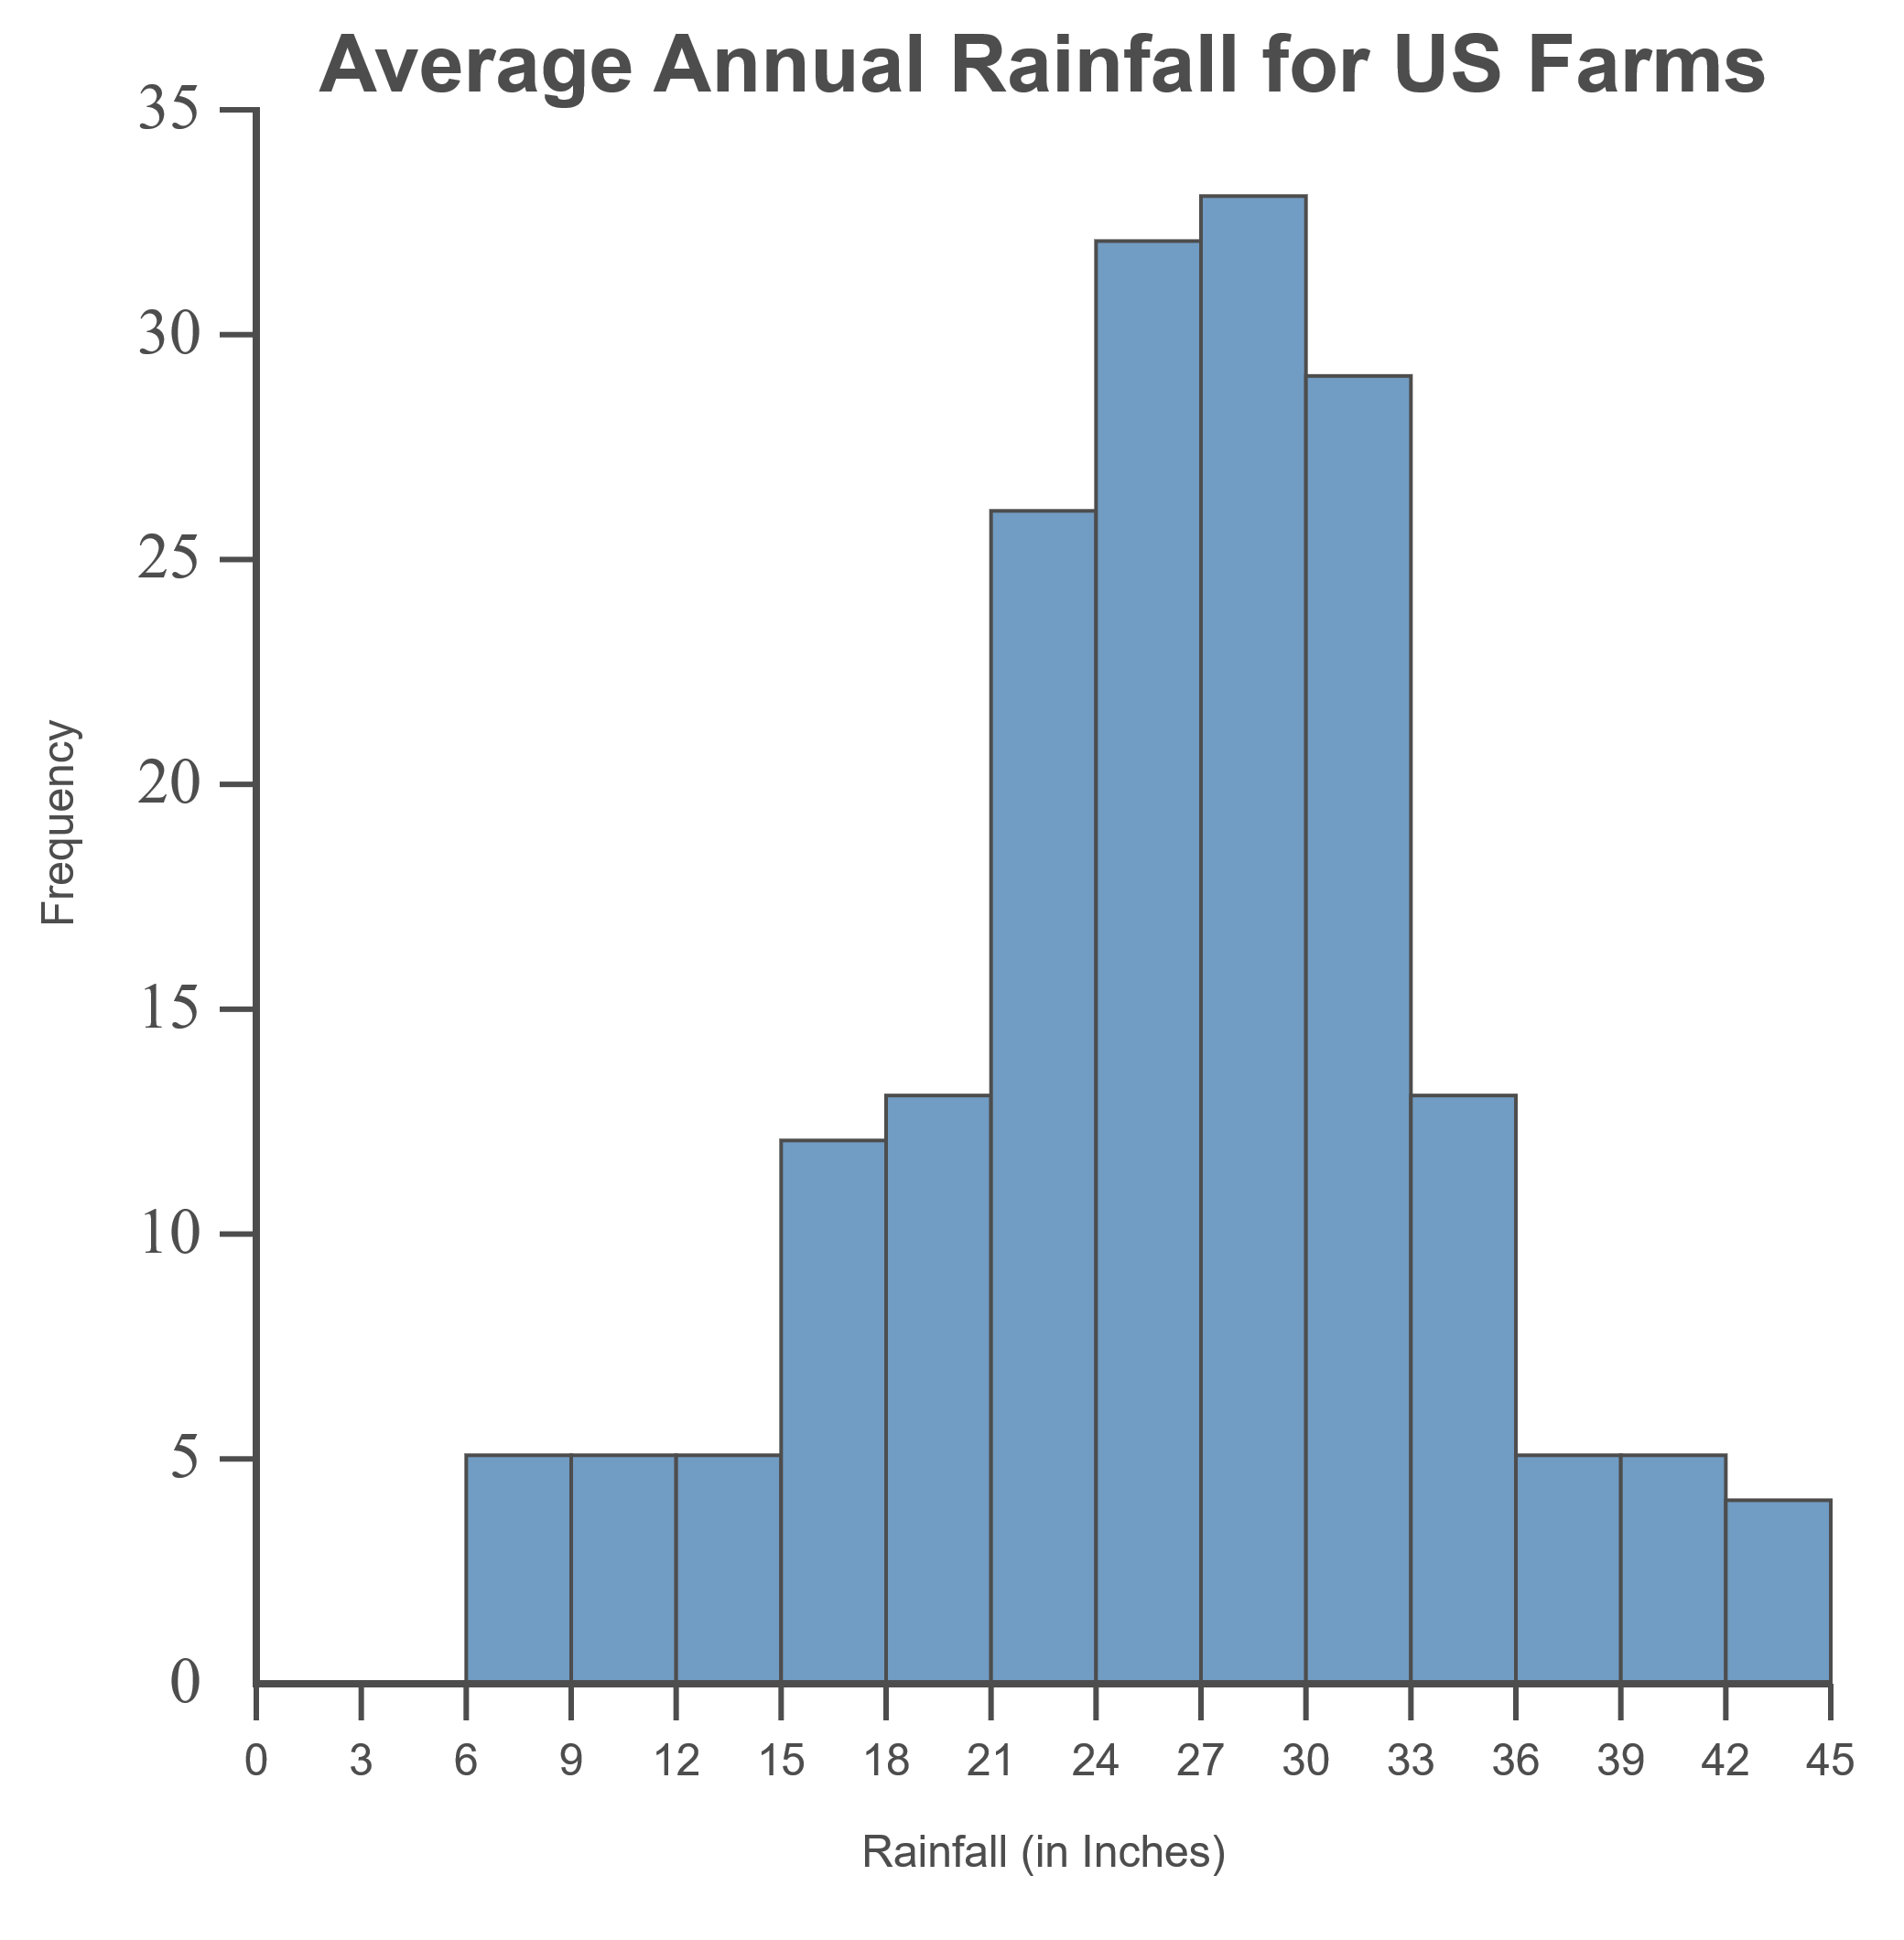
Example 3.2.5: Calculating and Interpreting Coefficient of Variation₂
A

Slide 34
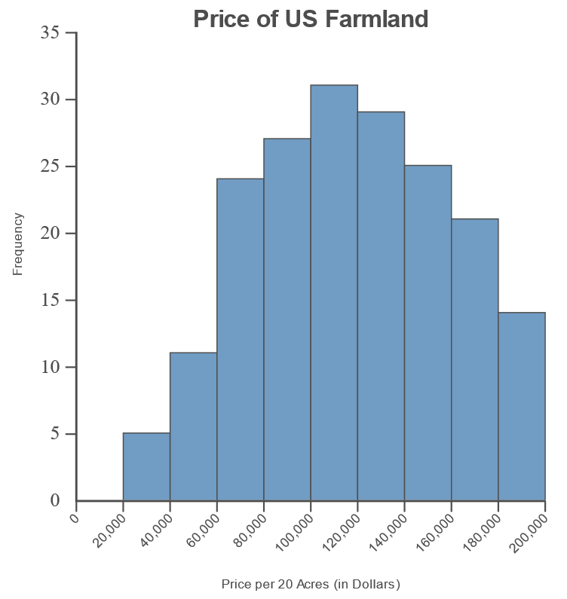
Example 3.2.5: Calculating and Interpreting Coefficient of Variation₃
B

Slide 35
Example 3.2.5: Calculating and Interpreting Coefficient of Variation₄
Solution
Calculate the coefficient of variation for each data set as follows.

Slide 36
Example 3.2.5: Calculating and Interpreting Coefficient of Variation₅
Notice that the CV for Data Set B is larger than the CV for Data Set A.
This indicates that Data Set B has the larger standard deviation relative
to its own mean.

Slide 37
Theorem: Empirical Rule for Bell-Shaped Distributions
​Approximately 68% of the data values lie within one standard deviation of the mean.
​Approximately 95% of the data values lie within two standard deviations of the mean.
​Approximately 99.7% of the data values lie within three standard deviations of the mean.

Slide 38
Who is King of the Hill?₁
In 1961, Wilt Chamberlain, won the National Basketball Association (NBA) rebounding title with 27 rebounds per game. In 1992, the colorful Dennis Rodman won the same title with 18.7 rebounds per game. Common sense suggests that professional basketball in the 1990’s is played at a much higher level than in the 1960’s. So why have the rebounding leader’s number fallen? Is it another case of “less is more”?

Slide 39
Who is King of the Hill?₂
Researchers investigating this interesting puzzle used two other variables: Number of rebounding opportunities available (this had gone down since the field goal percent has increased historically) and the average number of minutes played per game, which has also fallen. Thus, when we adjust the actual rebounds obtained by the rebounding leaders to the number of minutes played and the total number of rebounds available, we see a completely different picture.
The adjusted rebound numbers for Chamberlain and Rodman are 35.42 and 51.06, respectively.
Chatterjee, S., Brooks, G. and Yilmaz, M. R. (1997). Who is the Greatest Rebounder of All Time? Chance, 10, 1, 22-25.

Slide 40
Example 3.2.6: Applying the Empirical Rule for Bell-Shaped Distributions₁
The distribution of weights of newborn babies in one region is bell-shaped with a mean of 3000 grams and standard deviation of 500 grams.
​What percentage of newborn babies weigh between 2000 and 4000 grams?
​What percentage of newborn babies weigh less than 3500 grams?
​Calculate the range of birth weights that would contain the middle 68% of newborn babies' weights.

Slide 41
Example 3.2.6: Applying the Empirical Rule for Bell-Shaped Distributions₂
Solution
a. ​Since we know that the distribution of the data is bell-shaped, we can apply the Empirical Rule. We need to know how many standard deviations 2000 grams and 4000 grams are from the mean. By subtracting, we can find how far each of these figures is from the mean. Then, dividing by the standard deviation, we can convert these differences into numbers of standard deviations. Here are the calculations.

Slide 42
Example 3.2.6: Applying the Empirical Rule for Bell-Shaped Distributions₃
Weight = 2000 grams
Weight = 4000 grams

Slide 43
Example 3.2.6: Applying the Empirical Rule for Bell-Shaped Distributions₄
​Thus these weights lie two standard deviations above and below the mean. According to the Empirical Rule, approximately 95% of values lie within two standard deviations of the mean. Therefore, we can say that approximately 95% of newborn babies weigh between 2000 and 4000 grams. Note that this is important information for a doctor to know. A pediatrician may use different approaches to treat babies measuring either well above or well below the normal range, typically two standard deviations above or below the mean.

Slide 44
Example 3.2.6: Applying the Empirical Rule for Bell-Shaped Distributions₅
b. ​To begin, let's find out how many standard deviations a weight of 3500 grams lies from the mean by performing the same calculation as before.
​​
Weight = 3500 grams

Slide 45
Example 3.2.6: Applying the Empirical Rule for Bell-Shaped Distributions₆
​Thus this weight lies one standard deviation above the mean. The Empirical Rule says that 68% of data values lie within one standard deviation of the mean. Because of the symmetry of the distribution, half of this 68% is above the mean and half is below. Putting the upper 34% together with the 50% of data that is below the mean, we have that approximately
​50% + 34% = 84%
​of newborn babies weigh less than 3500 grams.
​

Slide 46
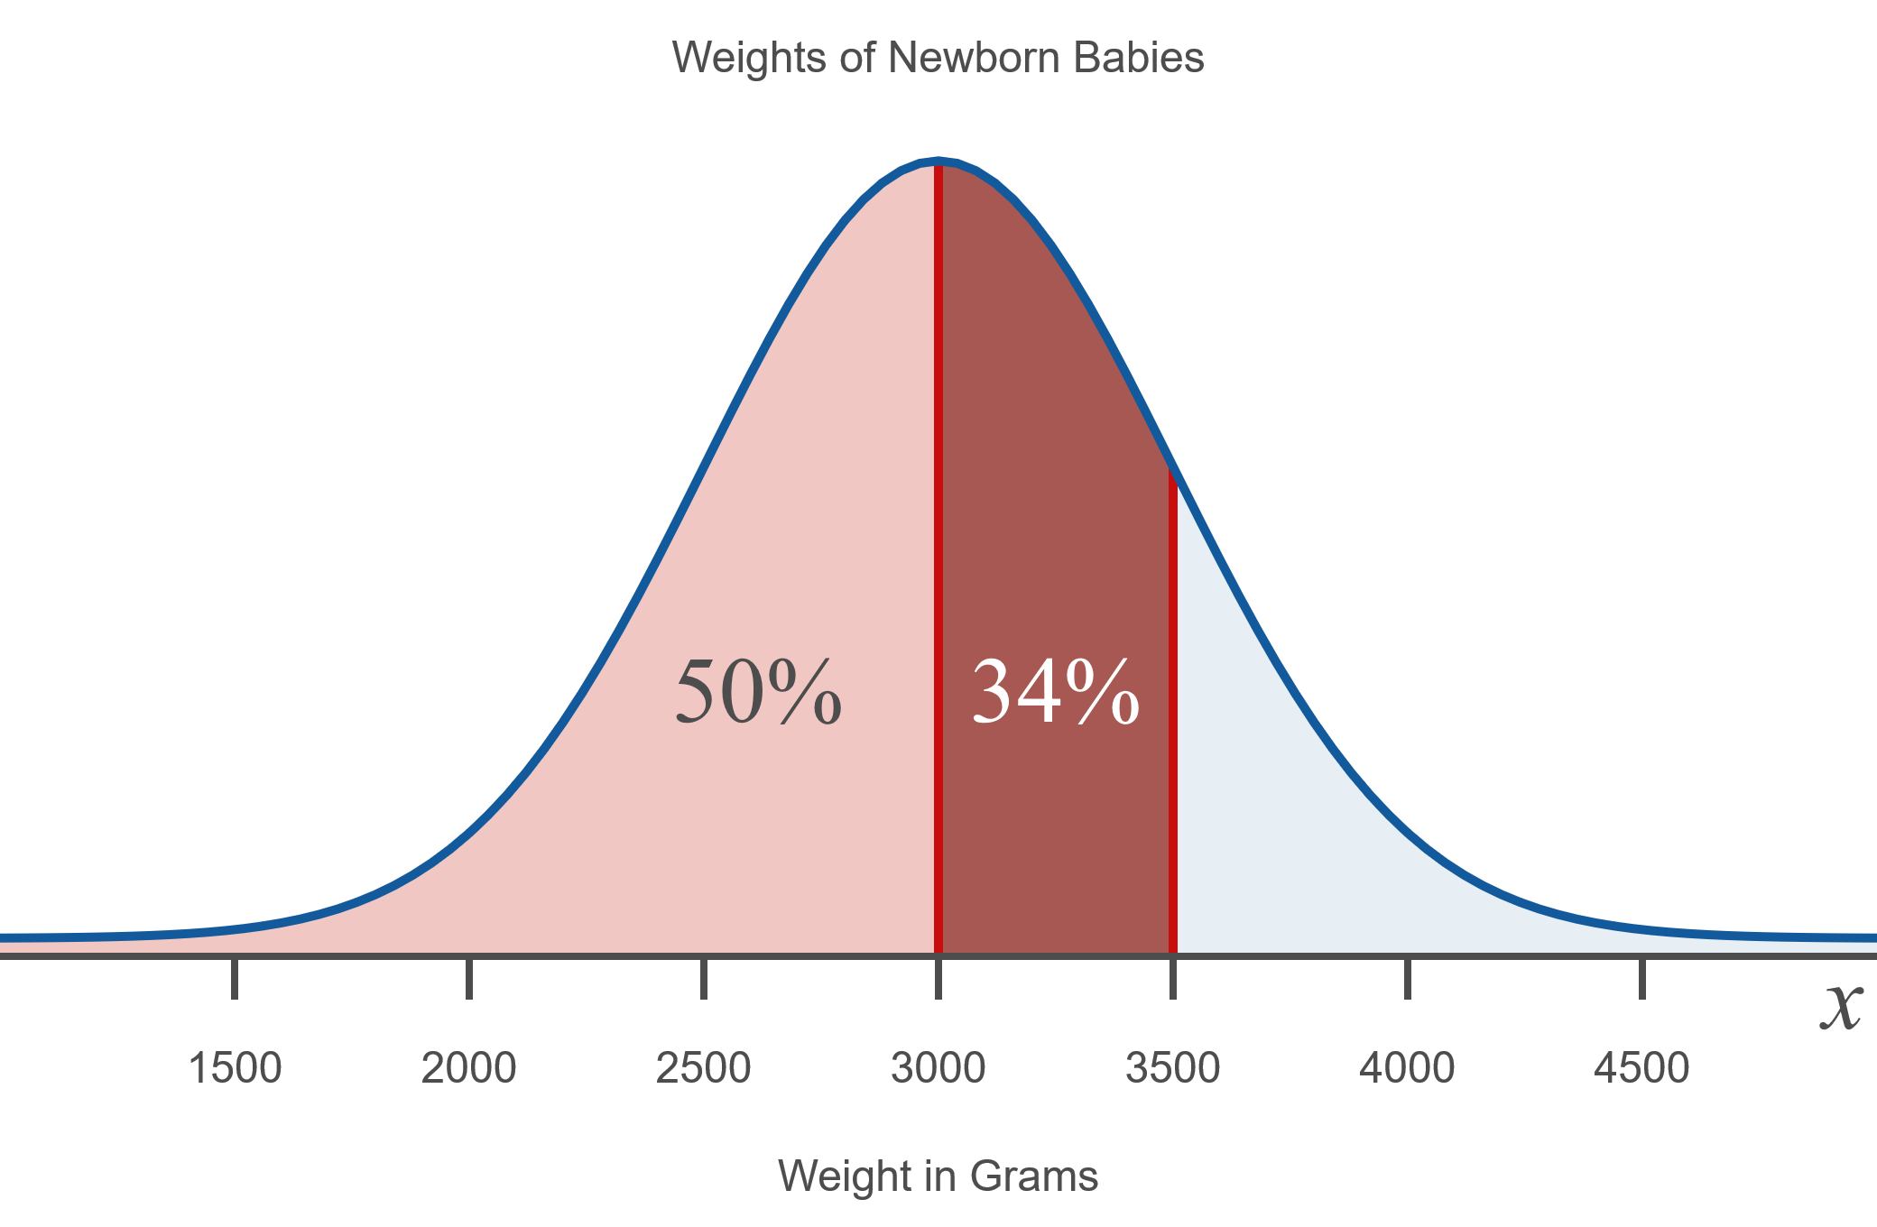
Example 3.2.6: Applying the Empirical Rule for Bell-Shaped Distributions₇

Slide 47
Example 3.2.6: Applying the Empirical Rule for Bell-Shaped Distributions₈
c. ​From the Empirical Rule, we know that 68% of the data values lie within one standard deviation of the mean for bell-shaped distributions. The standard deviation of this distribution is 500; thus, by adding 500 to and subtracting 500 from the mean of the distribution, we will get the range of birth weights that contain the middle 68% of newborn babies' weights.
Upper end point: 3000 + 500 = 3500
Lower end point: 3000 − 500 = 2500
​Thus, 68% of newborn babies weigh between 2500 and 3500 grams.

Slide 48
Theorem: Chebyshev's Theorem
The proportion of data that lie within K standard deviations of the mean is at least
When K = 2 and K = 3. Chebyshev's Theorem says the following.
K = 2: At least
within two standard deviations of the mean.
​K = 3: At least
within three standard deviations of the mean.

Slide 49
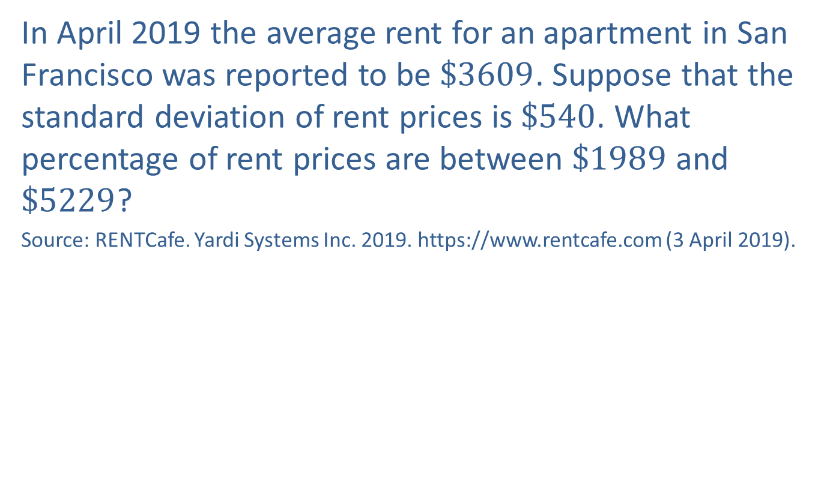
Example 3.2.7: Applying Chebyshev's Theorem₁
In April 2019 the average rent for an apartment in San Francisco was reported to be $\$3609$. Suppose that the standard deviation of rent prices is $\$540$. What percentage of rent prices are between $\$1989$ and $\$5229$?
Source: RENTCafe. Yardi Systems Inc. 2019. https://www.rentcafe.com (3 April 2019).

Slide 50
Example 3.2.7: Applying Chebyshev's Theorem₂
Solution
Since we are not told in the problem whether the distribution of the data is bell-shaped, we cannot apply the Empirical Rule here. However, we can apply Chebyshev's Theorem to find a minimum estimate. To do so, we need to know how many standard deviations $1989 and $5229 are from the mean. By subtracting, we can find how far each of these figures lie from the mean. Then, dividing by the standard deviation, we can convert these differences into numbers of standard deviations. Here are the calculations.

Slide 51
Example 3.2.7: Applying Chebyshev's Theorem₃
Rent = $1989
Rent = $5229

Slide 52
Example 3.2.7: Applying Chebyshev's Theorem₄
Thus these rent prices lie three standard deviations above and below the mean. Chebyshev's Theorem can then be applied for K = 3. Using the calculation previously shown in the box with the theorem, we can say that at least 88.9% of the rent prices lie within this range.

Slide 53
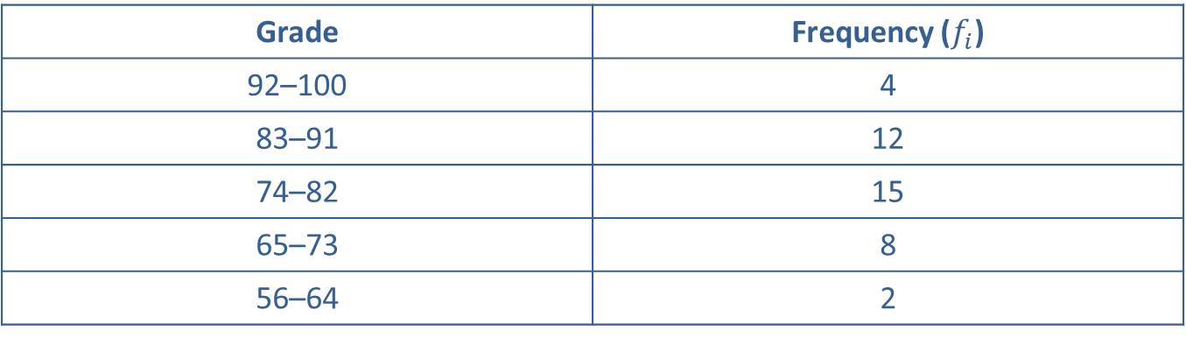

Example 3.2.8: Standard Deviation of Grouped Data₁
Calculate the standard deviation for the frequency distribution of final grades in the table below.
Grade
Frequency ($f_{i}$)
Final Grades
Grade | Frequency ($f_{i}\text{)}$
92–100 | 4
83–91 | 12
74–82 | 15
65–73 | 8
56–64 | 2

Slide 54
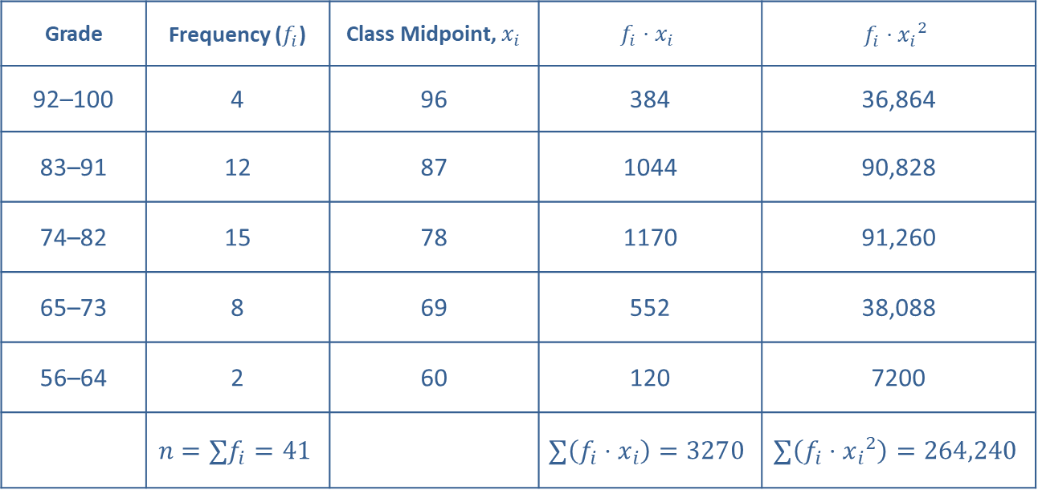
Example 3.2.8: Standard Deviation of Grouped Data₂
Solution
Final Grades
Grade | Frequency ($f_{i}\text{)}$ | Class Midpoint, $x_{i}$ | $$f_{i}⋅x_{i}$$ | $$f_{i}⋅{x_{i}}^{2}$$
92–100 | 4 | 96 | 384 | 36,864
83–91 | 12 | 87 | 1044 | 90,828
74–82 | 15 | 78 | 1170 | 91,260
65–73 | 8 | 69 | 552 | 38,088
56–64 | 2 | 60 | 120 | 7200
 | $$n=∑f_{i}=41$$ |  | $$∑\left(f_{i}⋅x_{i}\right)=3270$$ | $$∑\left(f_{i}⋅{x_{i}}^{2}\right)=264,240$$

Slide 55
Example 3.2.8: Standard Deviation of Grouped Data₃
Thus the standard deviation of the grades is approximately 9.3 points.

Slide 56
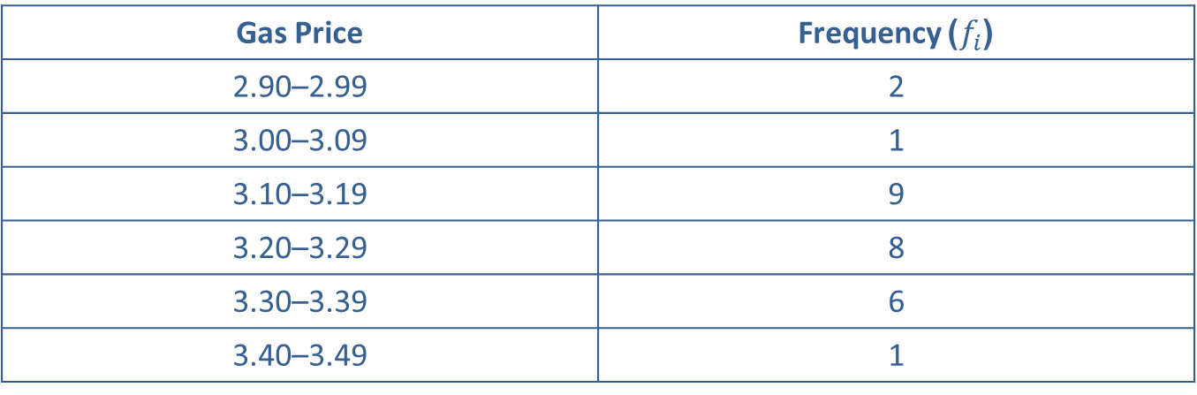
Example 3.2.9: Standard Deviation of Grouped Data₁
Calculate the sample standard deviation and variance for the following distribution of gas prices at the stations in a certain city.
Gas Prices
Gas Price | Frequency )$f_{i}$(
2.90–2.99 | 2
3.00–3.09 | 1
3.10–3.19 | 9
3.20–3.29 | 8
3.30–3.39 | 6
3.40–3.49 | 1

Slide 57
Example 3.2.9: Standard Deviation of Grouped Data₂
Solution
Begin by extending the frequency table to include columns for the midpoint, the frequency multiplied by the midpoint, and the frequency multiplied by the midpoint squared. Next calculate the values for each cell in the table and total the columns.

Slide 58
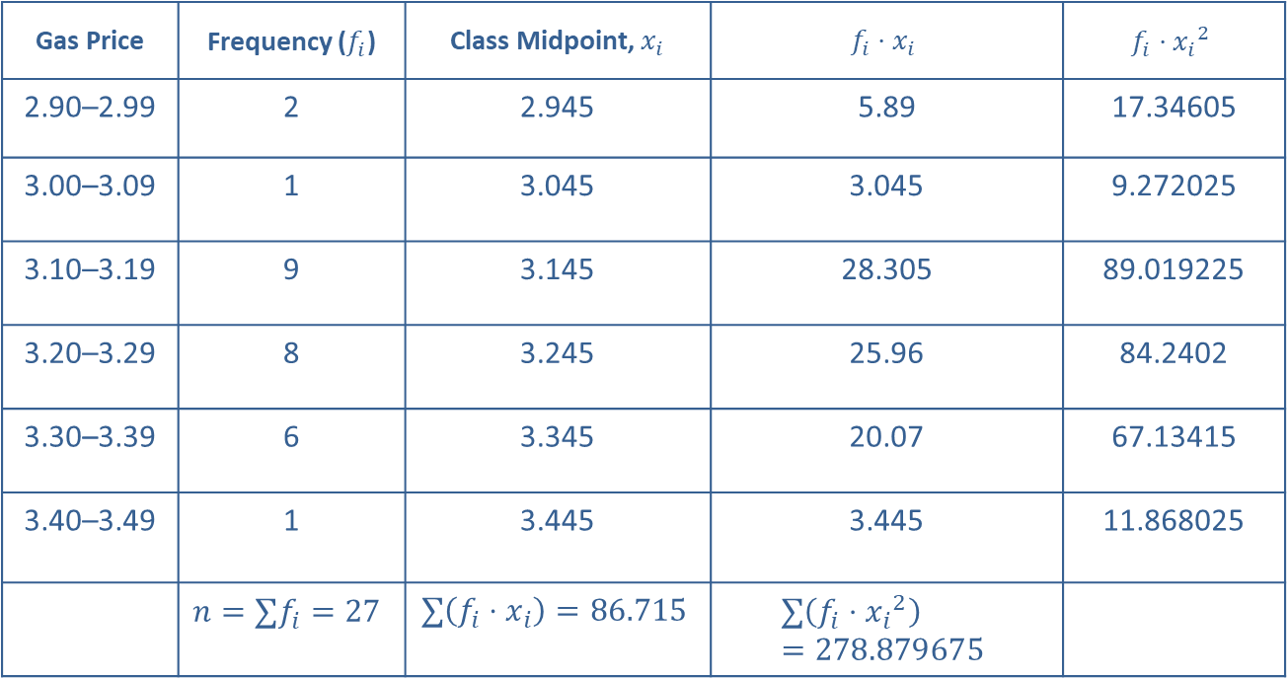
Example 3.2.9: Standard Deviation of Grouped Data₃
Gas Prices
Gas Price | Frequency ($f_{i}\text{)}$ | Class Midpoint, $x_{i}$ | $$f_{i}⋅x_{i}$$ | $$f_{i}⋅{x_{i}}^{2}$$
2.90–2.99 | 2 | 2.945 | 5.89 | 17.34605
3.00–3.09 | 1 | 3.045 | 3.045 | 9.272025
3.10–3.19 | 9 | 3.145 | 28.305 | 89.019225
3.20–3.29 | 8 | 3.245 | 25.96 | 84.2402
3.30–3.39 | 6 | 3.345 | 20.07 | 67.13415
3.40–3.49 | 1 | 3.445 | 3.445 | 11.868025
 | $$n=∑f_{i}=27$$ | $$∑\left(f_{i}⋅x_{i}\right)=86.715$$ | $$∑\left(f_{i}⋅{x_{i}}^{2}\right)=278.879675$$

Slide 59
Example 3.2.9: Standard Deviation of Grouped Data₄
Notice that no rounding occurred in the table. All resulting decimal places were recorded. Substituting these values into the formula for the standard deviation of grouped data yields the following:
Thus the standard deviation for gas prices in the city is approximately 0.121 dollars. Since the standard deviation is the square root of the variance, the variance is the value under the square root in the next to last expression above. Therefore,

