Slide 1
Section 12.4
Multiple Regression

Slide 2
Definition: Multiple Regression Model
A multiple regression model is a linear regression model using two or more explanatory variables to predict a response variable, given by
where
are the explanatory variables in the model
and
are the coefficients of the explanatory
variables. The coefficients,
of the explanatory
variables are the sample estimates of the corresponding
population parameters,
As before, the y-intercept
of the multiple regression equation is b₀, which is the sample
estimate of the population parameter,

Slide 3
Procedure: Null and Alternative Hypotheses for an ANOVA Test
The null and alternative hypotheses for an ANOVA test to analyze the statistical significance of the linear relationship between the variables in a multiple regression model are as follows.
are the coefficients of the explanatory
variables, and k is the number of explanatory variables in the model.

Slide 4
Memory Booster
Conclusions Using p-Values
If p-value ≤ α, then reject the null hypothesis.
If p-value > α, then fail to reject the null hypothesis.

Slide 5
Example 12.4.1: Constructing and Analyzing a Multiple Regression Model₁
Construct and analyze a multiple regression equation for predicting a child's reading level based on the following sample data, which omits the variable of teacher's experience from the multiple regression model that we have been discussing. Use this new model to predict the reading level for a child who is 10 years old and has parents with an average of 12.7 years of education. Which of the two multiple regression models we built is better at predicting a child's reading level?

Slide 6
Example 12.4.1: Constructing and Analyzing a Multiple Regression Model₂
 | A | B | C
1 | Child's Age | Parents' Education | Reading Level
2 | 6 | 13.1 | 1.3
3 | 7 | 14.5 | 2.2
4 | 8 | 16.1 | 3.7
5 | 9 | 12.5 | 4.1
6 | 10 | 11.8 | 4.9
7 | 11 | 11.1 | 5.2
8 | 12 | 10.2 | 6
9 | 13 | 12.6 | 7.1
10 | 14 | 12.1 | 8.5
11 | 15 | 14.3 | 9.7

Slide 7
Example 12.4.1: Constructing and Analyzing a Multiple Regression Model₃
Solution
We will use Microsoft Excel to construct and analyze a multiple regression model for these data. Begin by entering the data as they appear in columns A, B, and C. Next, under the Data tab, choose Data Analysis. Select Regression from the options listed. Enter the necessary information into the Regression menu. Then click OK.

Slide 8
Technology₁
If Data Analysis does not appear in your Excel menu under the Data tab, you can easily add this function. For instructions please visit stat.hawkeslearning.com and navigate to Technology Instructions → Getting Started.
The output is shown in the following figure.

Slide 9
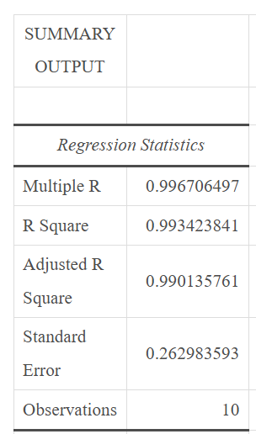
Example 12.4.1: Constructing and Analyzing a Multiple Regression Model₄

Slide 10
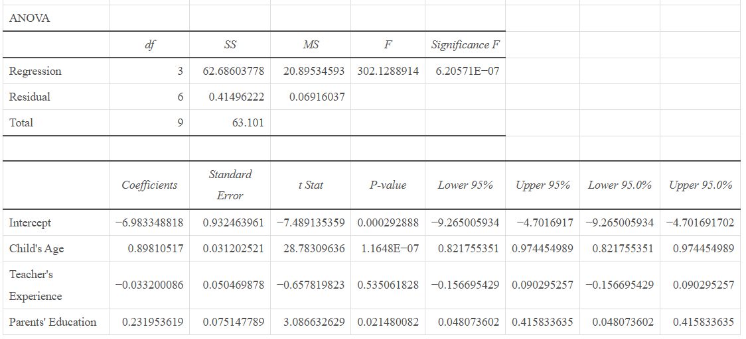
Example 12.4.1: Constructing and Analyzing a Multiple Regression Model₅

Slide 11
Example 12.4.1: Constructing and Analyzing a Multiple Regression Model₆
To begin, notice that the p-value for the regression equation is
p-value ≈ 2.94277E−08, or approximately 0.00000003, which is extremely small. Thus, this multiple regression equation fits the sample data extremely well. This can also be seen in the adjusted value of R² ≈ 0.991, which is close to 1. Notice that the p-values for the coefficients of the individual explanatory variables have changed. These p-values are both small, which indicates that both of these variables are useful in predicting the value of the response variable.
Using the coefficients listed in the table, the multiple regression equation for predicting a child's reading level based on the child's age, x₁, and the parents' education, x₂, is as follows.

Slide 12
Example 12.4.1: Constructing and Analyzing a Multiple Regression Model₇
We can now use this new equation to predict the reading level of a 10-year-old child with parents who have an average of 12.7 years of education. Note that
x₁ = 10 and x₂ = 12.7. Substituting these values into the regression equation yields the following.
Thus, we would again predict that this child would be reading at a fourth-grade reading level, and in fact would be slightly further along than the first prediction of 4.679.

Slide 13
Example 12.4.1: Constructing and Analyzing a Multiple Regression Model₈
This regression equation, and its predicted value of the response variable, is very similar to the one we calculated with three explanatory variables. So which regression equation does a better job of predicting the value of the response variable? Let's begin by looking at the overall picture. The first model includes three variables, but one was found to be not statistically significant. The second model only uses two variables, both of which were significant. Another consideration is to compare the adjusted R²-values for both models. For this new model, the adjusted R² ≈ 0.990935. For the first model with three explanatory variables, the adjusted R² ≈ 0.990136. The new model has the higher value. In either case, it appears as though the second model would do a better job of predicting the value of the response variable. There are certainly more robust techniques for determining which model is better, but we will leave those for a higher-level course.

Slide 14
Technology₂
For further instructions on finding a multiple regression equation using Excel, or other technology, please visit stat.hawkeslearning.com and see Technology Instructions → Regression → Multiple Regression.

