Slide 1
Section A.2
Games of Chance

Slide 2
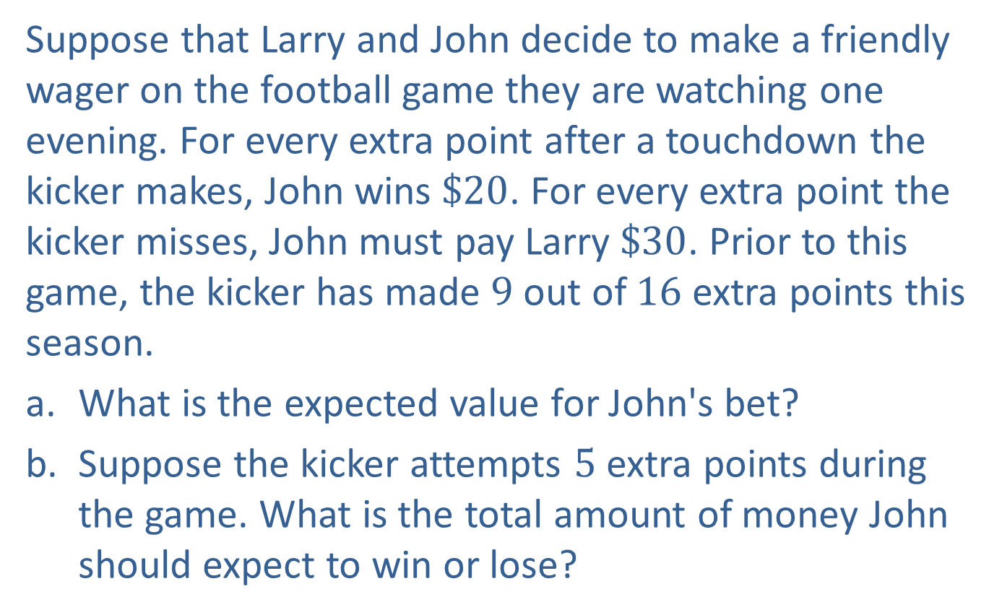
Example A2.1: Expected Value₁
Suppose that Larry and John decide to make a friendly wager on the football game they are watching one evening. For every extra point after a touchdown the kicker makes, John wins $\$20$. For every extra point the kicker misses, John must pay Larry $\$30$. Prior to this game, the kicker has made 9 out of 16 extra points this season.
a. ​What is the expected value for John's bet?
b. ​Suppose the kicker attempts 5 extra points during the game. What is the total amount of money John should expect to win or lose?

Slide 3
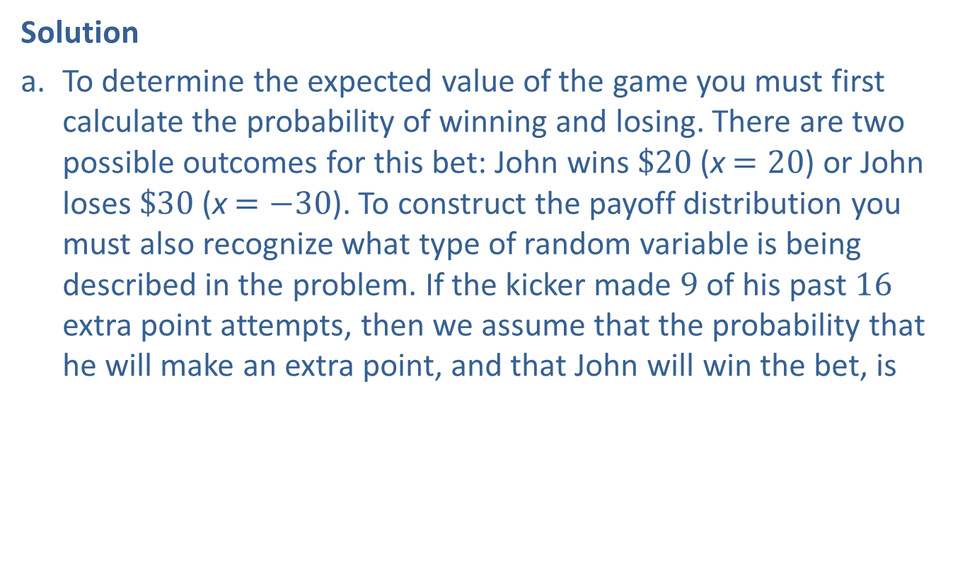
Example A2.1: Expected Value₂
Solution
a. ​To determine the expected value of the game you must first calculate the probability of winning and losing. There are two possible outcomes for this bet: John wins $\$20$ (x $=20$) or John loses $\$30$ (x $=−30$). To construct the payoff distribution you must also recognize what type of random variable is being described in the problem. If the kicker made 9 of his past 16 extra point attempts, then we assume that the probability that he will make an extra point, and that John will win the bet, is
By the complement rule, the probability that the kicker will miss, and John will lose the bet, is

Slide 4
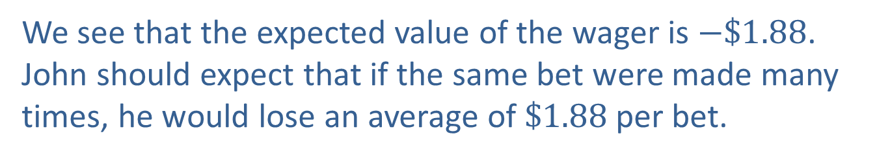
Example A2.1: Expected Value₃
​Then we calculate the expected value as follows:
​
We see that the expected value of the wager is $−\$1.88$. John should expect that if the same bet were made many times, he would lose an average of $\$1.88$ per bet.

Slide 5

Example A2.1: Expected Value₄
b. ​We know that over the long-term John would lose an average of $\$1.88$ per bet. If he and Larry place 5 bets, one for each extra point attempt the kicker makes, then the total winnings/losses for 5 bets would be:
​
Therefore, John could expect to lose approximately $\$9.40$.

Slide 6
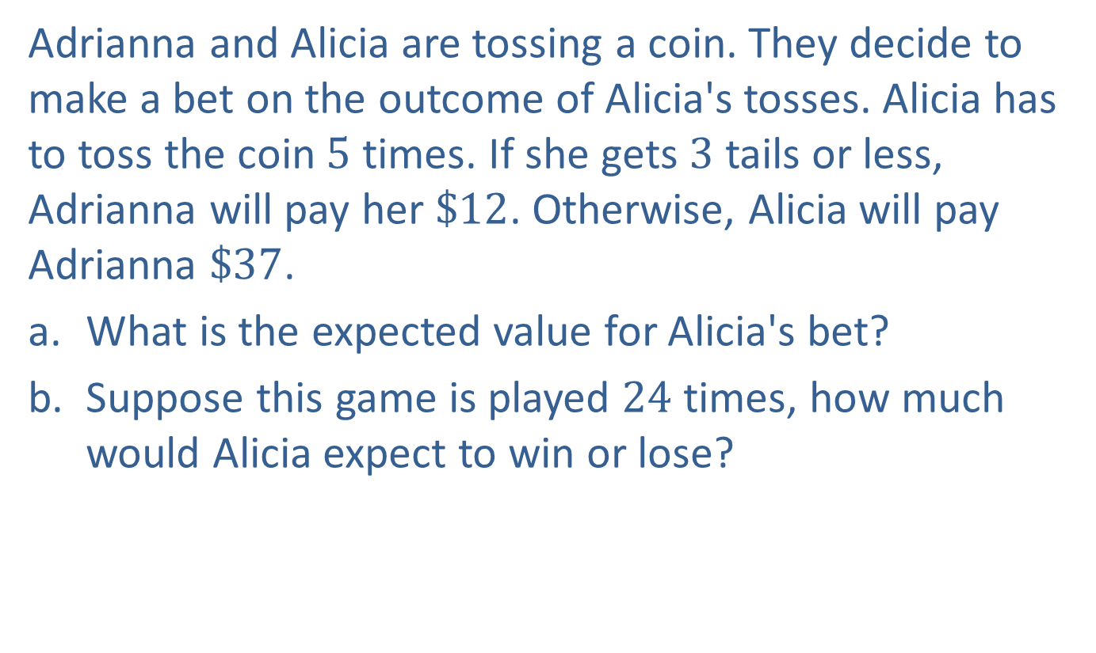
Example A2.2: Expected Value₁
Adrianna and Alicia are tossing a coin. They decide to make a bet on the outcome of Alicia's tosses. Alicia has to toss the coin 5 times. If she gets 3 tails or less, Adrianna will pay her $\$12$. Otherwise, Alicia will pay Adrianna $\$37$.
a. ​What is the expected value for Alicia's bet?
b. ​Suppose this game is played 24 times, how much would Alicia expect to win or lose?

Slide 7
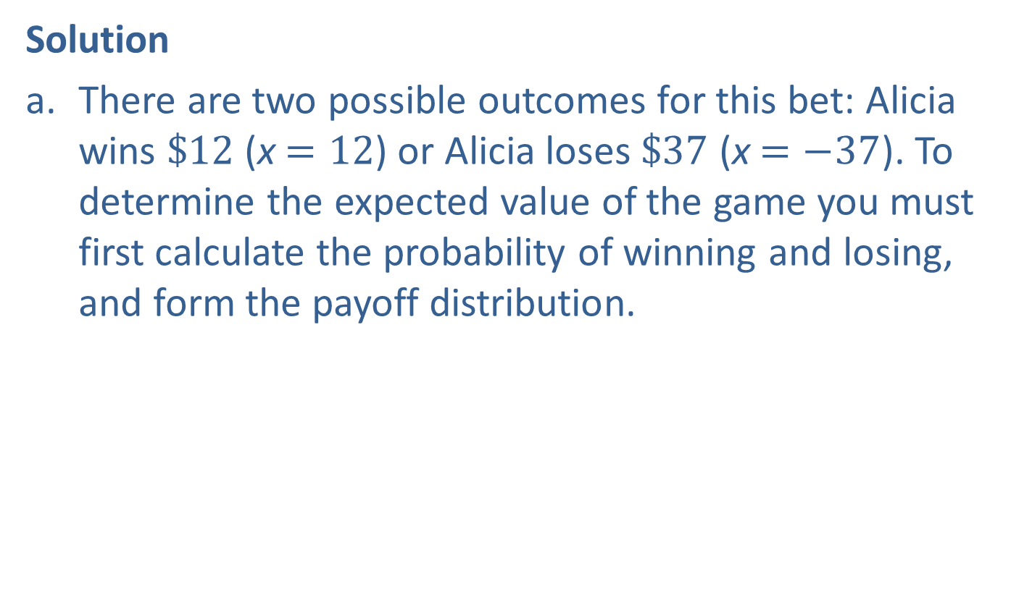
Example A2.2: Expected Value₂
Solution
a. ​There are two possible outcomes for this bet: Alicia wins $\$12$ (x $=12$) or Alicia loses $\$37$ (x $=−37$). To determine the expected value of the game you must first calculate the probability of winning and losing, and form the payoff distribution.
​
​

Slide 8
Example A2.2: Expected Value₃
​
​Since this is a binomial experiment, using the formula, ​​

Slide 9
Example A2.2: Expected Value₄
Then we calculate the expected value as follows:
​
We see that the expected value of the wager is $\$2.81$.

Slide 10
Example A2.2: Expected Value₅
b.
Therefore, Alicia could expect to win approximately $\$67.44$.

Slide 11
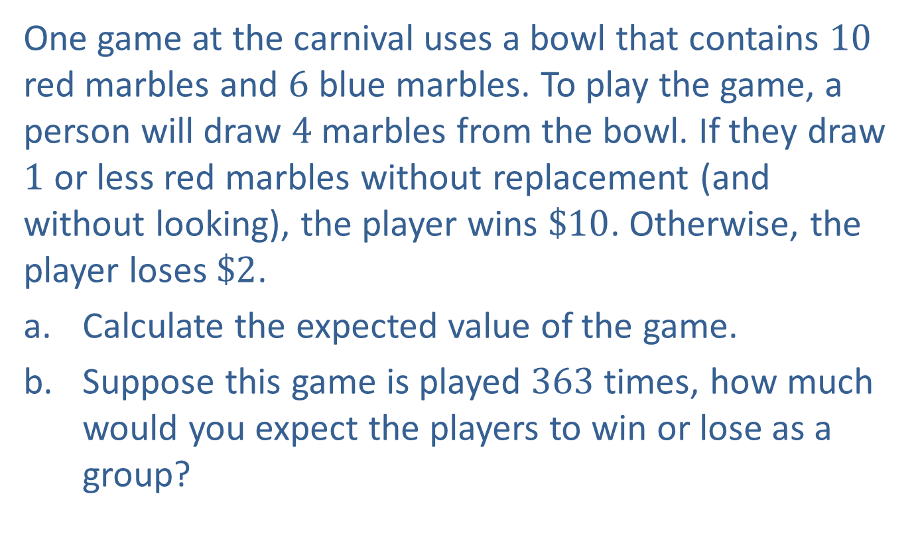
Example A2.3: Expected Value₁
One game at the carnival uses a bowl that contains 10 red marbles and 6 blue marbles. To play the game, a person will draw 4 marbles from the bowl. If they draw 1 or less red marbles without replacement (and without looking), the player wins $\$10$. Otherwise, the player loses $\$2$.
a. ​Calculate the expected value of the game.
b. ​Suppose this game is played 363 times, how much would you expect the players to win or lose as a group?

Slide 12
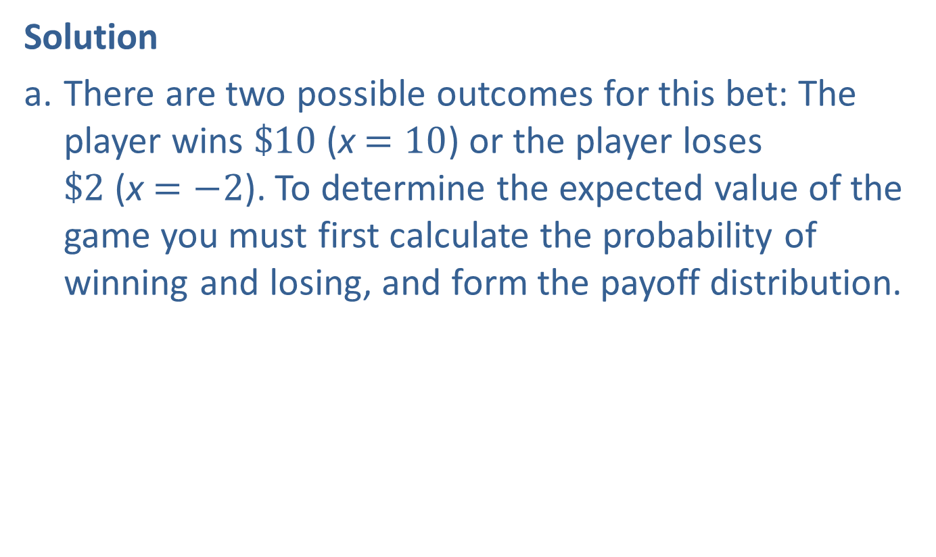
Example A2.3: Expected Value₂
Solution
a. ​There are two possible outcomes for this bet: The player wins $\$10$ (x $=10$) or the player loses $\$2$ (x $=−2$). To determine the expected value of the game you must first calculate the probability of winning and losing, and form the payoff distribution.
​

Slide 13
Example A2.3: Expected Value₃
​These probabilities have a hypergeometric distribution and can be calculated using the formula,
​​​

Slide 14
Example A2.3: Expected Value₄
Then we calculate the expected value as follows:
We see that the expected value of the wager is $−\$0.58$.

Slide 15
Example A2.3: Expected Value₅
b.
​
Therefore, the players could expect to lose approximately $\$210.54$.

